Slide 1
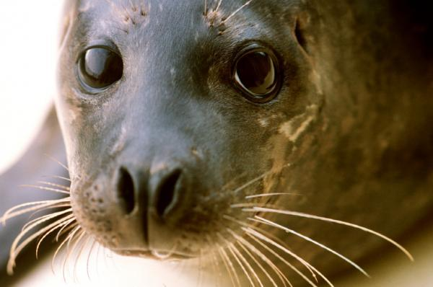
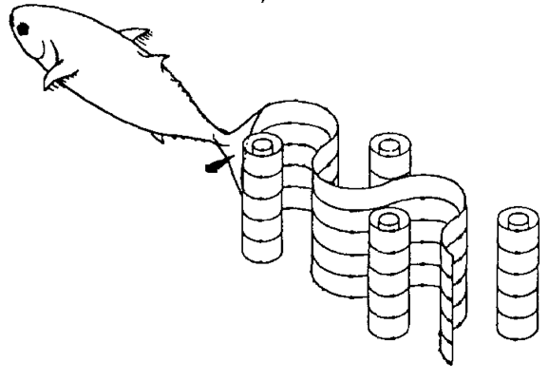

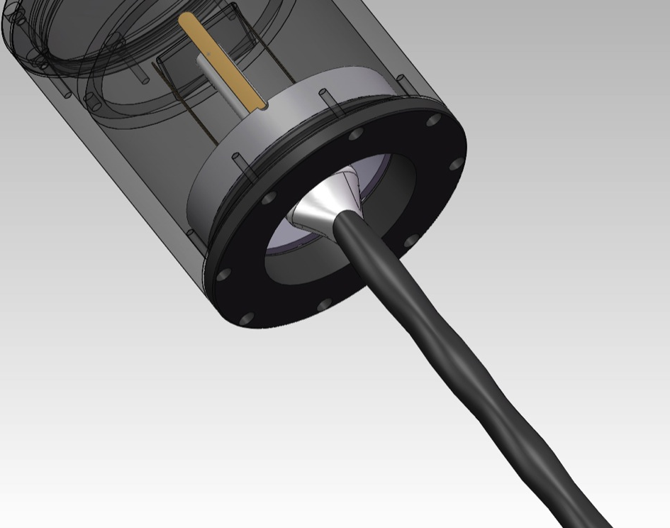
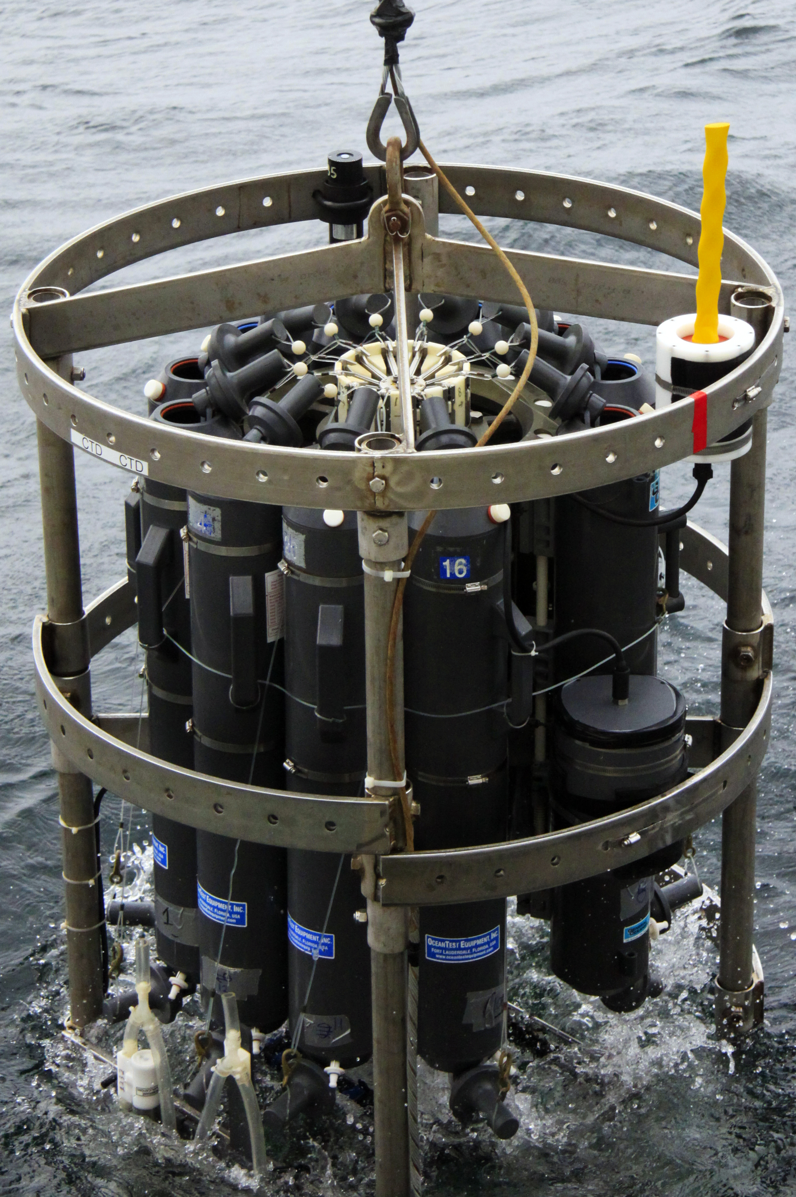
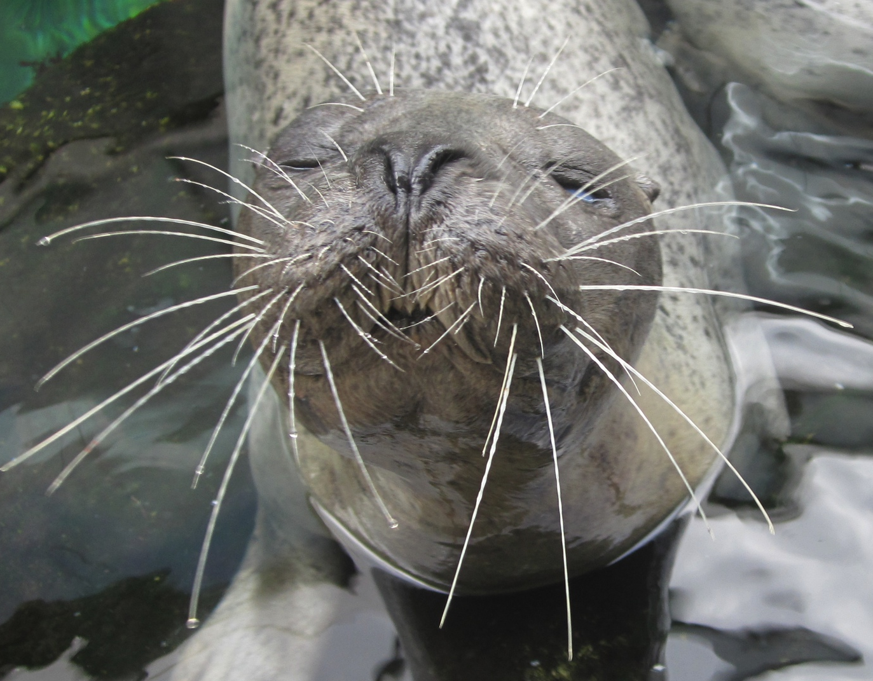
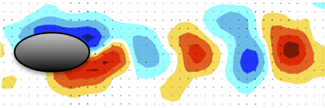
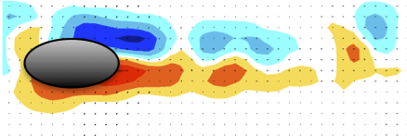
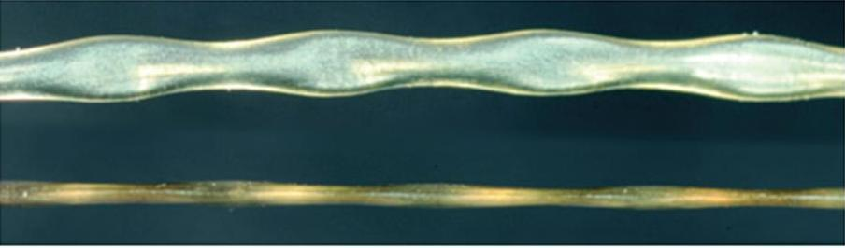
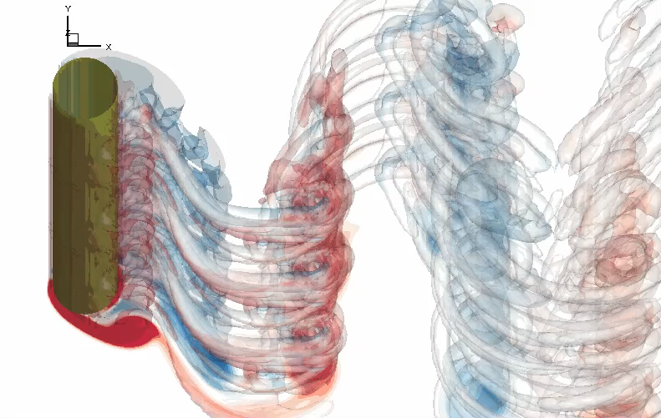
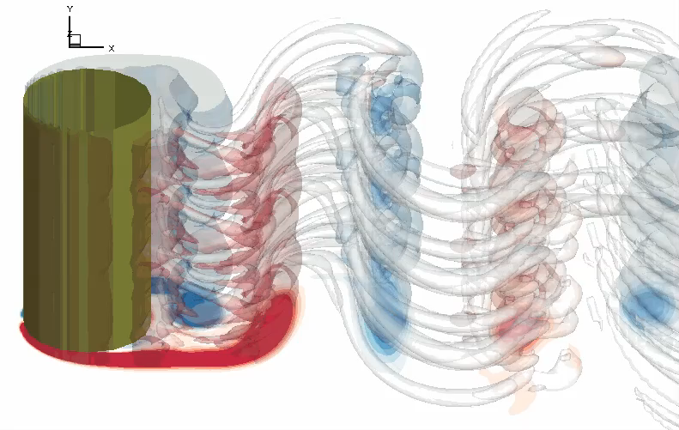
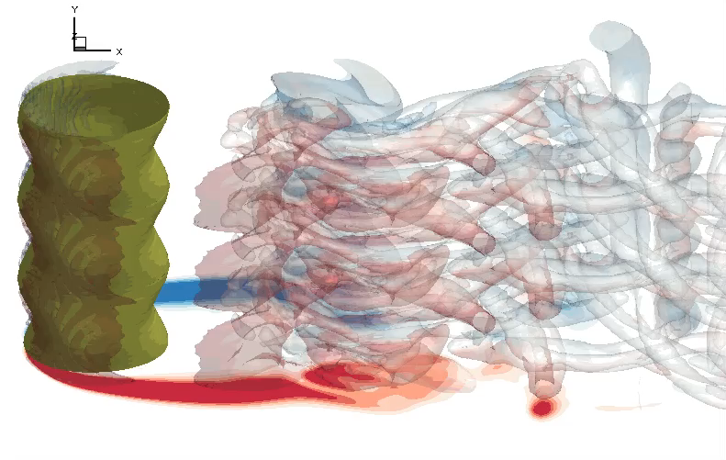
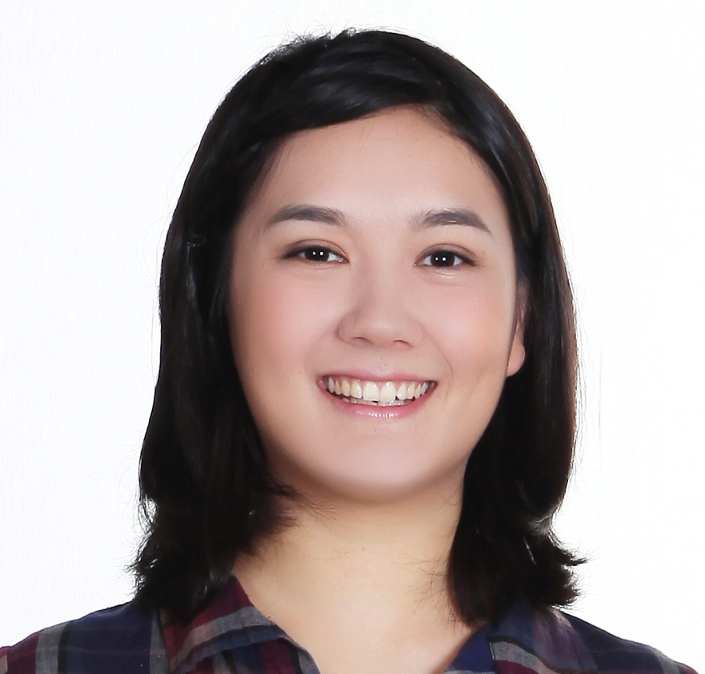
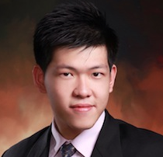
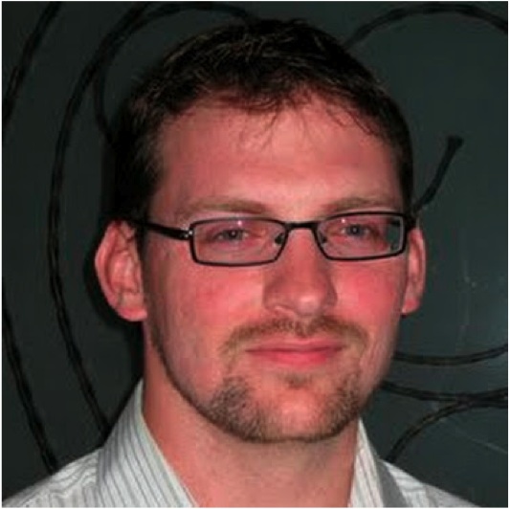
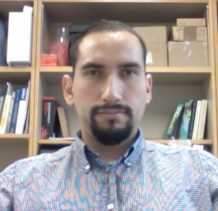

Seal Whiskers as Sensors
Heather Beem, Hendrik Hans, Dr. Gabriel Weymouth,
Dr. Pablo Valdivia y Alvarado, Prof. Michael Triantafyllou
MOTIVATION:
A major challenge for autonomous underwater vehicles (AUVs) is being able to intelligently assess their surroundings. Here we look to the harbor seal for inspiration, as they are able to use their whiskers to track prey via the hydrodynamic signature of the wake. A whisker-inspired sensor would enable underwater robots to “feel” the flow.
The harbor seal is unique in that its whisker morphology reduces flow-induced vibrations, suggesting that these seals are able to sense oncoming flow characteristics with reduced background noise.
I feel you!
Montgomery et al, 1995
ScienceDaily.com
INTRODUCTION:
Harbor seals can detect the wake of a fish up to 30 seconds after it has passed. Biological experiments show that they are able to do this using their whiskers, even when auditory and visual cues have been blocked [1]. This is unexpected, since a bluff body protruding into a flow experiences large vibrations from the oncoming flow, which would make it a noisy sensor.
Interestingly, the harbor seal whisker geometry is unique- it is undulatory and asymmetric.
It was conjectured [2] that this shape accomplishes a specific purpose: it suppresses vortex-induced vibrations (VIV). As the seal swims forward, the whiskers do not vibrate significantly, allowing the seal to pick up the signal of the upstream target with reduced background noise.
Our goal is to 1) study if and how this shape reduces VIV and 2) to develop a flow sensor capable of detecting hydrodynamic features, such as the vortex street left in a fish wake.
FLOW VISUALIZATION:
The flow around a model whisker being towed through a water tank was recorded using particle image velocimetry (PIV). The snapshot around a standard ellipse of the same size (left) shows what is expected- vortices are shed in a distinct pattern, resulting an oscillatory force on the model, which is the cause of the strong vibrations. The whisker (right), however, does not shed coherent vortices. This shows that the whisker feels reduced forces from the flow.
Also, numerical simulations were used to visualize the flow behind a whisker that is free to vibrate. Compared to a circular cylinder (top left) and an ellipse (top right), the whisker (bottom) produces an incoherent wake that forms farther downstream from the body, indicating reduced vibrations.
BIO-INSPIRED SENSOR:
The features we are discovering about how the whisker interacts with the flow are being engineered into a new sensor, which will enable underwater robots (AUVs) to intelligently assess their surroundings.
A first prototype sensor has been designed to work by the whisker pushing on “bend sensors” inside a waterproof housing. This instrument was tested on the R/V Wecoma during the NSF Chief Scientist Training Cruise where it was deployed on a CTD and used to measure local currents.
Our Research Group:
We study marine animal motion and sensing as inspiration for improving technologies on underwater robots, which are used to collect oceanographic data.
The underlying mechanisms, in which animals’ efficiencies lie, are largely governed by fluid mechanics, so this is where we focus our efforts.
These next-generation sensors will enable marine vehicles to “feel” features of the flow around them, allowing them to reduce drag by avoiding strong head-on currents, lock into and track the wake left behind schools of fish, and endless other opportunities.
[3]
Ellipse Whisker
[2]
Cylinder Ellipse
Whisker
References:
[1] G. Dehnhardt, et al., "Seal whiskers detect water movements [6]," Nature, vol. 394, pp. 235-236, 1998.
[2] W. Hanke, et al., "Harbor seal vibrissa morphology suppresses vortex-induced vibrations," Journal of Experimental Biology, vol. 213, pp. 2665-2672, 2010.
[3] H. Beem, et al. “Harbor Seal Vibrissa Morphology Reduces Vortex-Induced Vibrations”, American Physical Society Division of Fluid Dynamics Conference, 2011.
Acknowledgements:
The authors thank Kathy Streeter, the rest of the New England Aquarium staff, and NOAA for allowing us to interact with the live seals and acquire some of their shed whiskers.
NSF Grant OCE-1041068 sponsored the UNOLS Training Cruise.
The research described in this project was funded in part by the Singapore National Research Foundation (NRF) through the Singapore-MIT Alliance for Research and Technology (SMART) Center for Environmental Sensing and Modeling (CENSAM).
Notes:
http://www.sciencedaily.com/releases/2010/06/100610191044.htm

