Slide 1
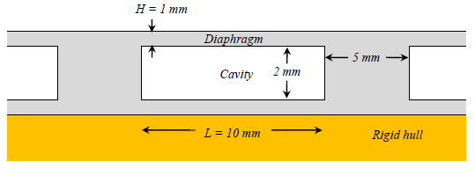
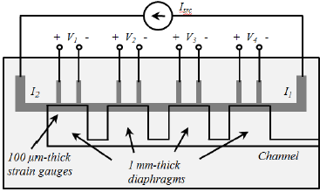
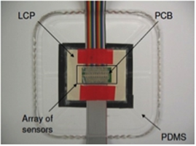
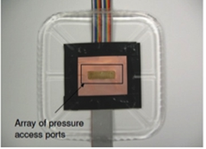
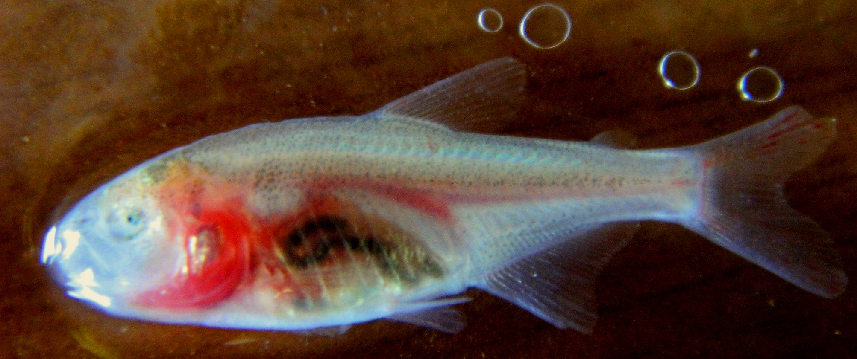
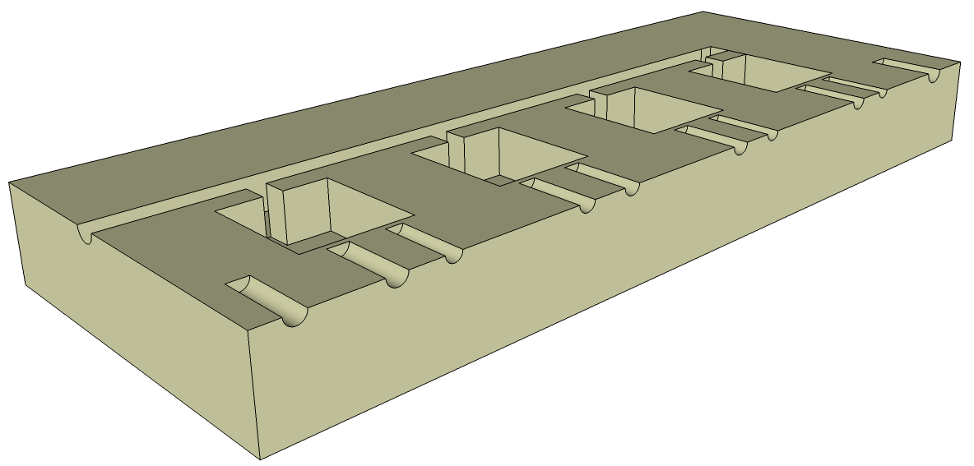
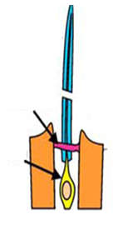
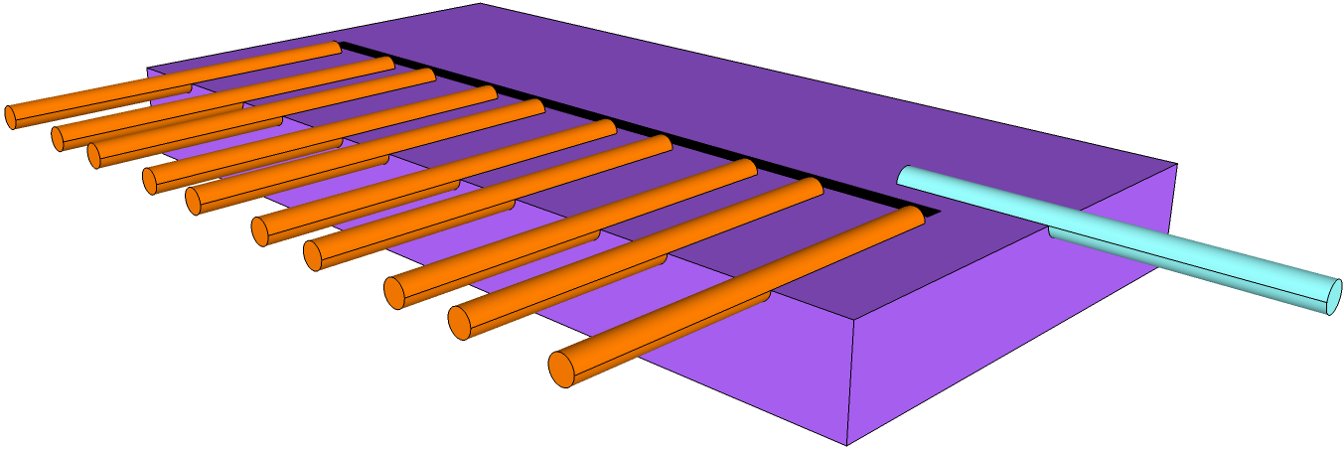
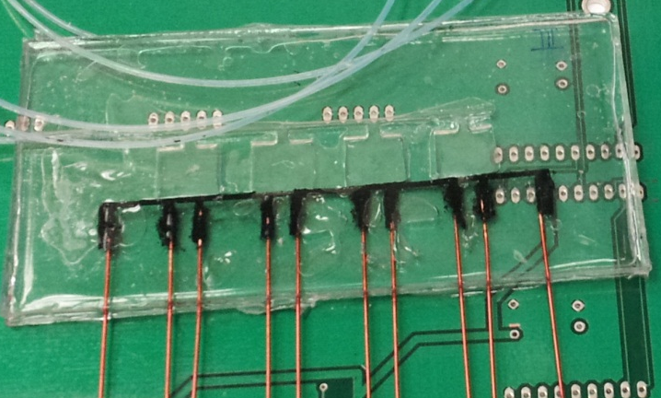
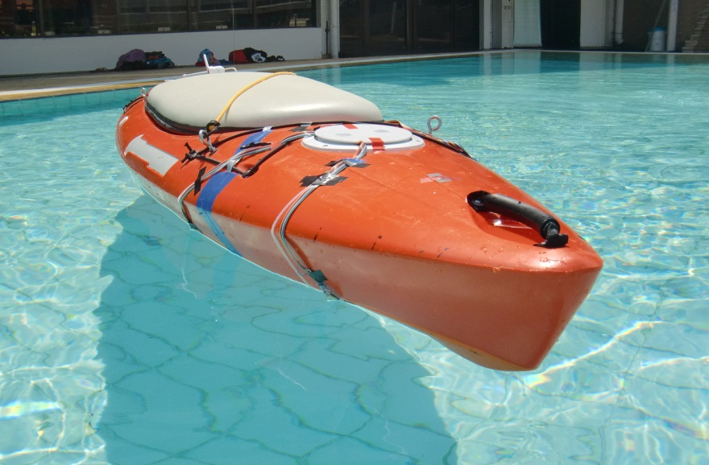
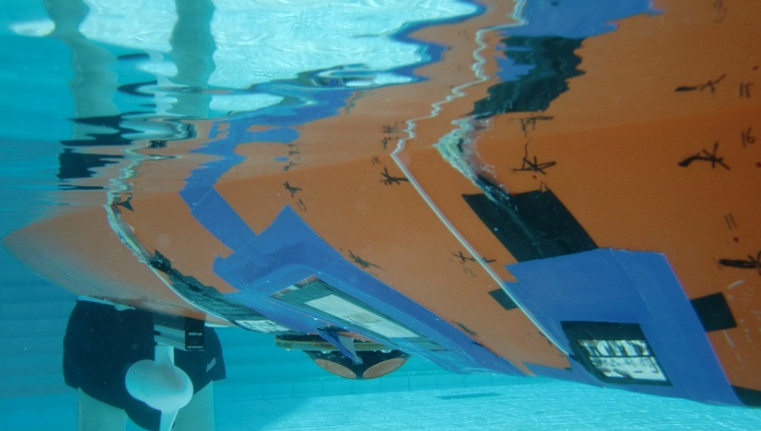
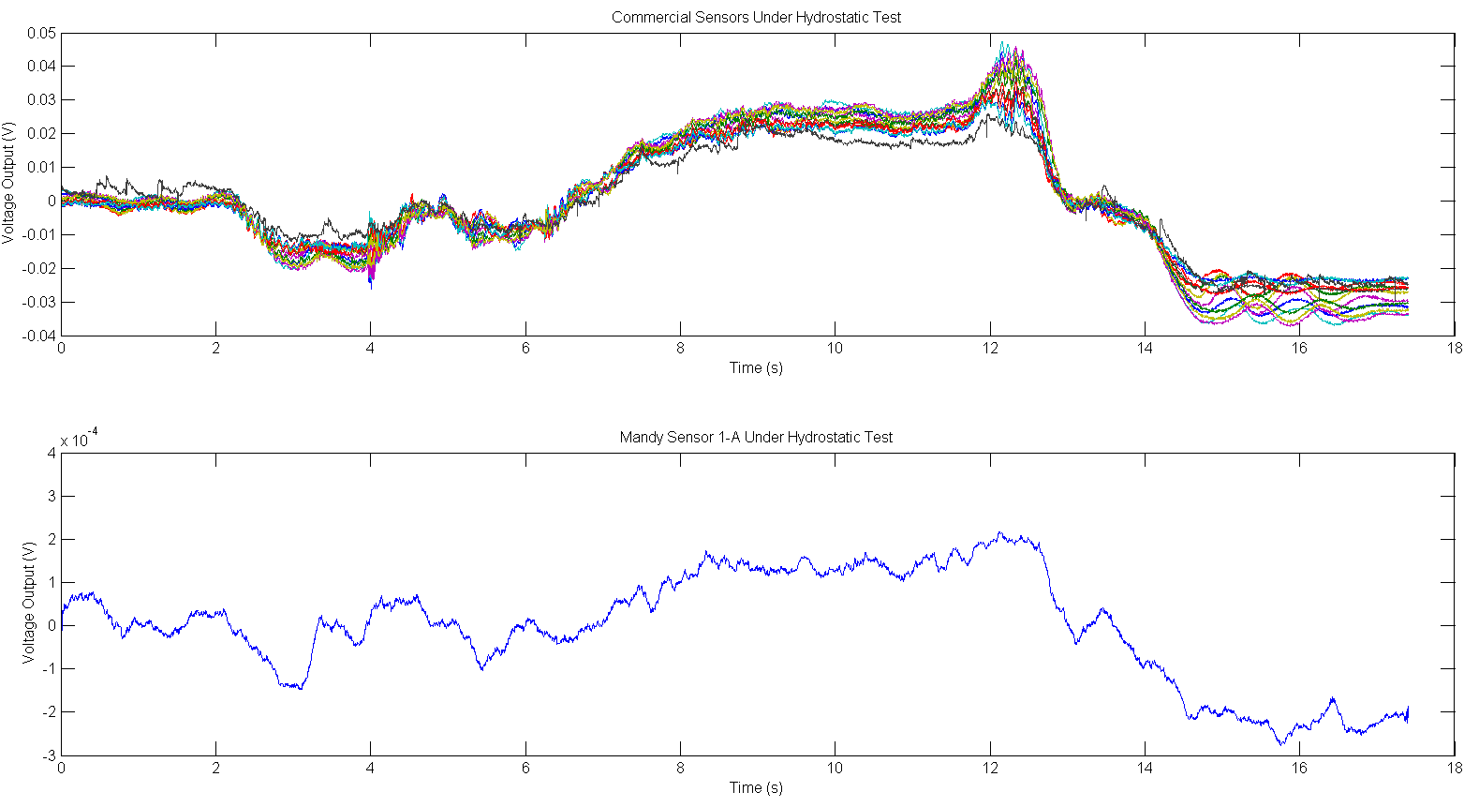
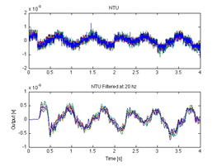
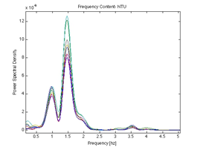
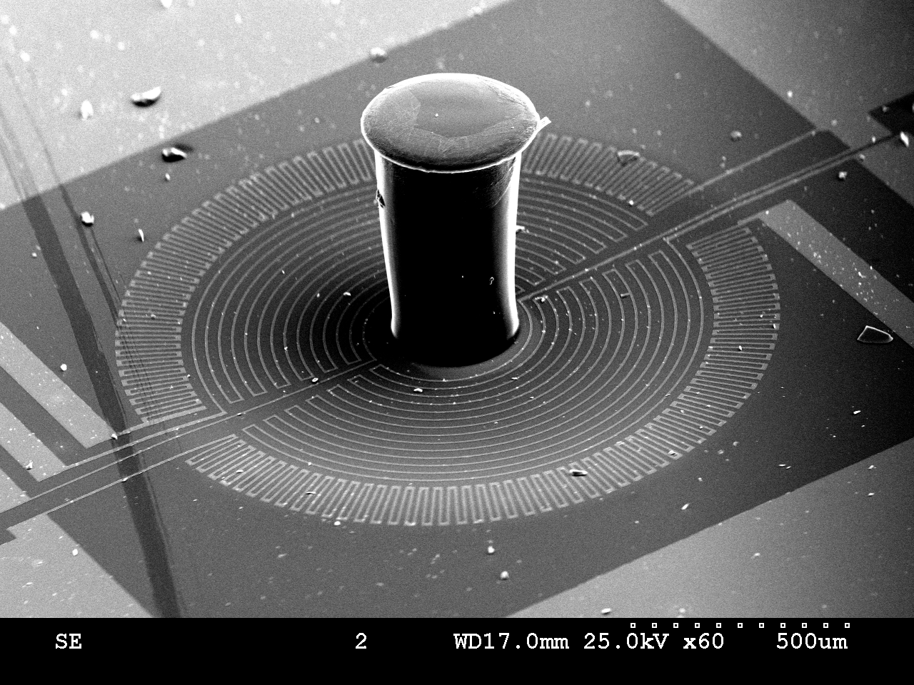
Bio-inspired MEMS Pressure and Flow Sensors for Underwater Navigation and Object Imaging
Mohsen Asadnia ‎(NTU), Ajay Kottapalli (NTU), Chee Wee Tan (NTU), Mun Ee (Mandy) Woo (MIT),
Prof. Jeffrey Lang (MIT), Prof. Jianmin Miao (NTU), Prof. Michael Triantafyllou (MIT)
Motivation: In an effort to improve the environmental awareness of maritime devices, MEMS (Microelectromechanical System) pressure sensor arrays based on flexible polydimethylsiloxane (PDMS), liquid crystal polymer (LCP) and LCP/PDMS substrates are being developed for use on autonomous underwater vehicles (AUVs). These sensors can guide an AUV to navigate in a dark, unsteady and cluttered environment where sonar and vision-based systems fail. Microfabricated pressure sensor arrays offer a unique advantage of low-power passive sensing while their low foot-print and flexible backing make them conveniently mounted on the streamlined bodies of underwater vehicles. These MEMS arrays have individual sensors that closely mimic the biological neuromasts on the body of many fish. For instance, the blind cave fish, Astyanax mexicanus fasciatus, swims adeptly by solely relying on lateral-line neuromasts to generate hydrodynamic images of its surroundings. Although the lateral-line sensory system has no equivalent in current underwater vehicle detection systems, the goal of this work focuses on developing an ideal artificial lateral-line system by employing an array of MEMS flow sensors.
MIT Pressure Sensor
Structure: Pressure-concentrating diaphragms support conductive elastomer strain gauges whose resistances are measured using a four-point probe array.
Materials: Substrates and diaphragms are PDMS; strain gauge is a piezoresistive carbon black (CB)-PDMS composite.
Singapore Pressure Sensor
An array of 2 × 10 silicon piezoresistive pressure sensors were fabricated on flexible LCP substrates and were encapsulated in PDMS before mounting on the kayak. The array of sensors were tested in a reservoir for various pressure signals.
Singapore Flow Sensor
This device consists of a LCP diaphragm and an SU-8 standing pillar resembling the cupula of the fish sensor. Hydrogel material (having same Young’s modulus as cupula and also photo-patternable) could be used to encapsulate the pillar. The sensors demonstrate a detection limit as low as 0.46 Pa – capability that matches with that of the fish in detecting the flow pressure.
Array Design
Side View
Top View
Fabrication
A photograph of blind cave fish - Astyanax mexicanus fasciatus. Due to survival in dark deep caves, this fish developed an atrophied eye and pale pink skin.
Fabrication
PDMS substrate with cavities
CB-PDMS strain gauge is screen patterned onto a PDMS substrate.
Substrates are bonded together for waterproofing.
Biomimetic Sensor Design
Backside of PCB sensor array
Front of PCB sensor array
Kayak Testing: Commercial vs. MEMS
Standing structure
Hydrogel cupula
CB-PDMS composite
Sensing membrane
SU-8 standing structure
25µm
Au strain gauge
PDMS substrate
Sensing element
LCP
Wires
Pressure compensating tube
300µm
Si
Si
Kayak Testing
Finished Device
An analogy between biological superficial neuromast and an artificial MEMS neuromast.
When mounted on the side of a kayak for open-water tests, the pressure response of the MEMS sensor is similar to that of a somewhat-nearby reference sensor.
Underwater Testing
Commercial Sensors (Reference)
MEMS Sensor
Pitching Test
Power Spectrum of
Pitching Test
SEM image of SU-8 pillar on Si membrane. A circuit is patterned on diaphragm using metal strain gauges.
Conclusions
Conclusions
Sensor is functional in an uncontrolled environment
Sensor can be mounted on a doubly-curved surface
Sensor resolution is ≈ 10 Pa
Array power dissipation is ≈ 2μW per sensor
During the pool test, results show that the MEMS sensors were able to generate the same output signals as the commercial sensors.
The sensors developed can measure air and water flow velocities with a good sensitivity of 64 (µV/V/Pa) and 12.6 (µV/V/Pa), respectively.
LCP has a very low moisture absorption coefficient and low chemical attack, and therefore offers high reliability.
References:
F. M. Yaul, “A flexible underwater pressure sensor array for artificial lateral line applications,” Master’s thesis, Massachusetts Institute of Technology, September 2011.
A. G. P. Kottapalli et. al., “Liquid crystal polymer membrane MEMS sensor for flow rate and flow direction sensing applications,” 2011, J. Micromech. Microeng. 21, 085006 (11pp)
Acknowledgements:
The authors gratefully thank Center for Environmental Sensing and Modeling (CENSAM) and NOAA National Sea Grant for supporting this work.

