Slide 1
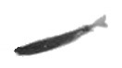
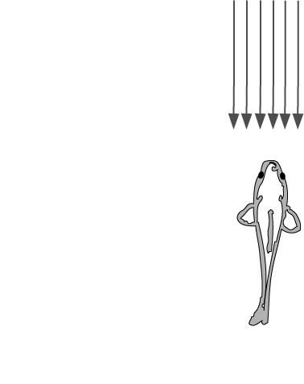
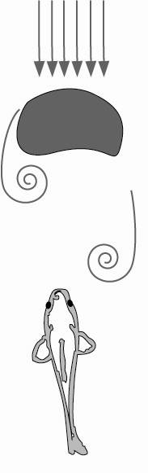
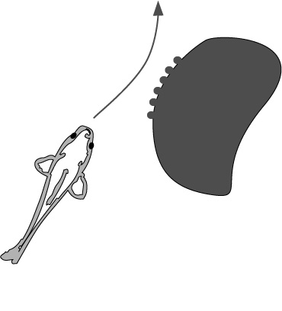
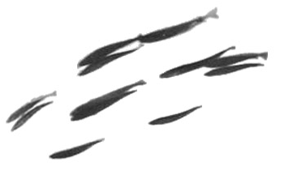
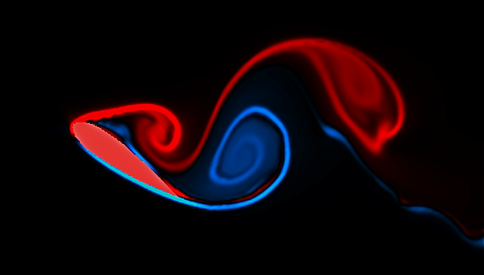
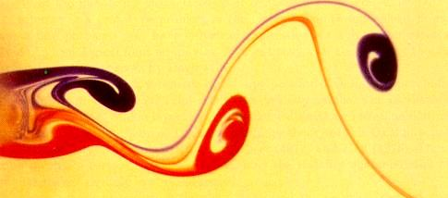
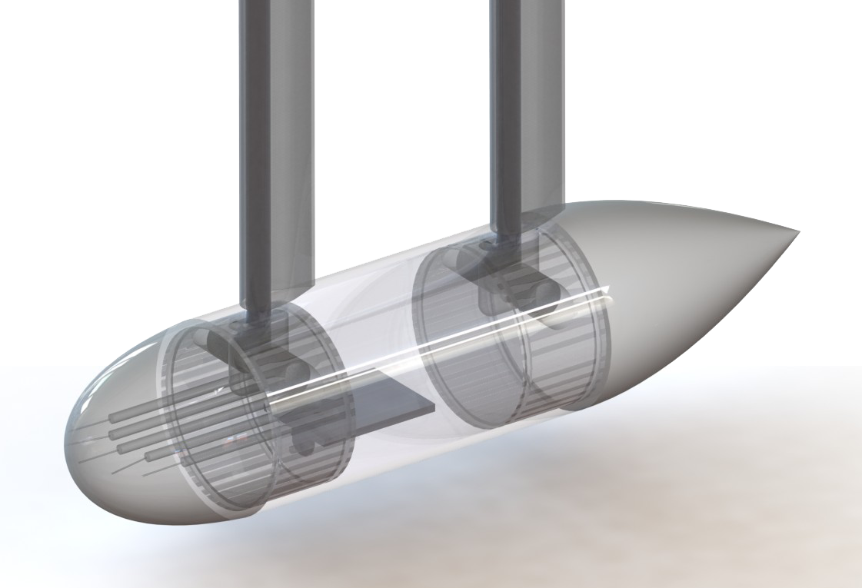
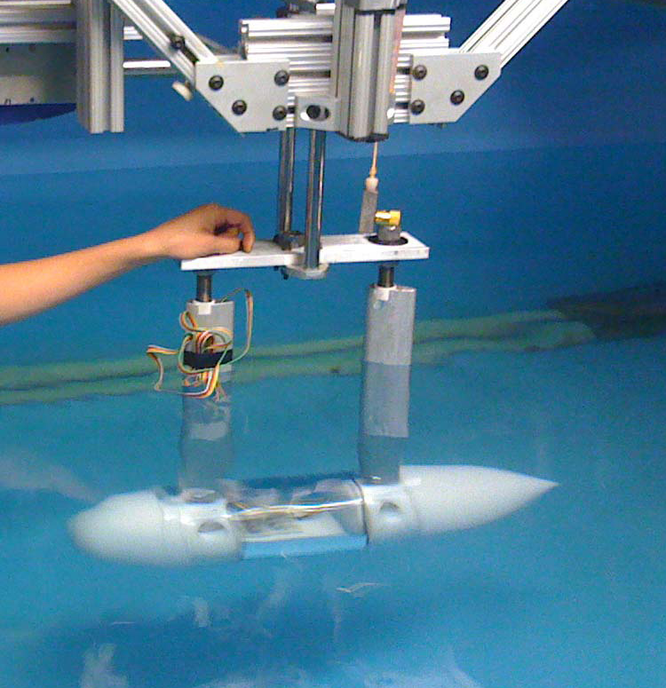
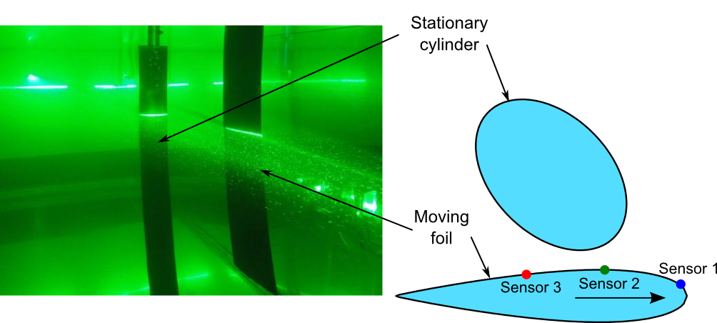
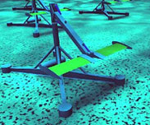
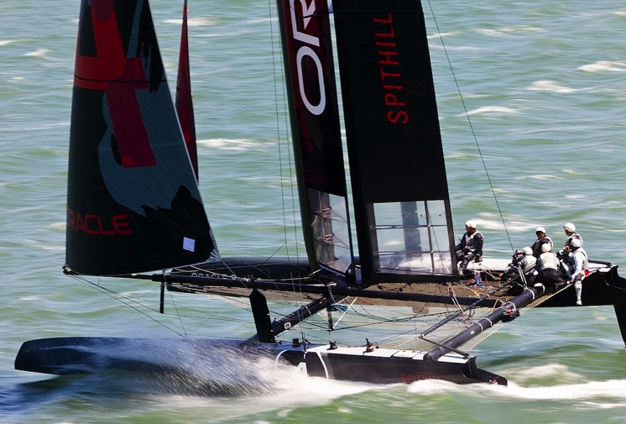
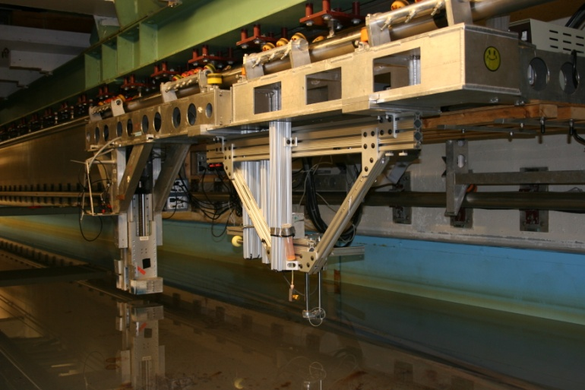
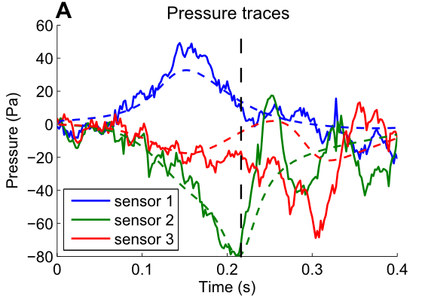
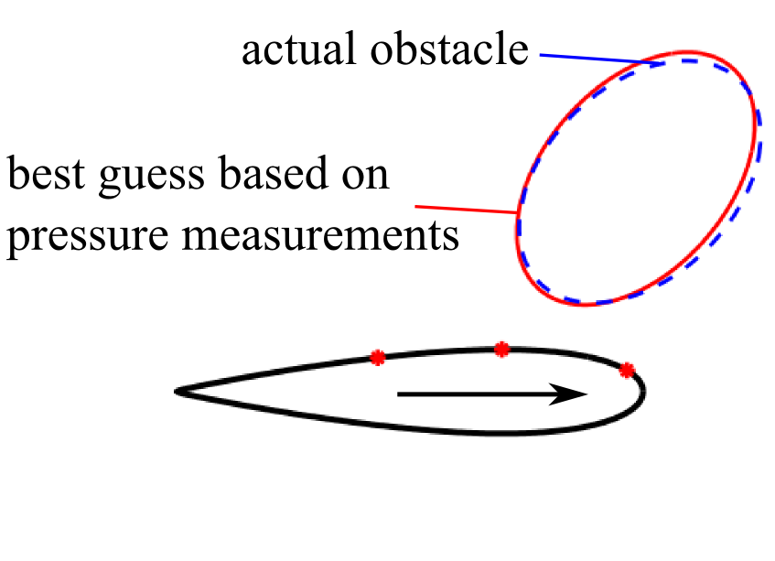
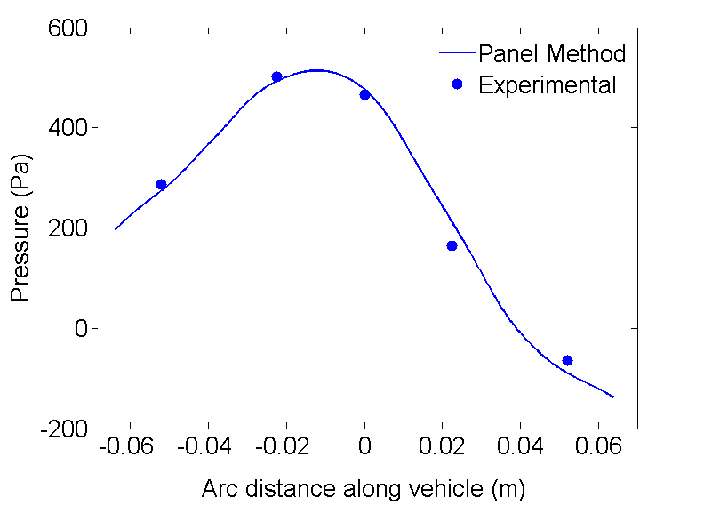
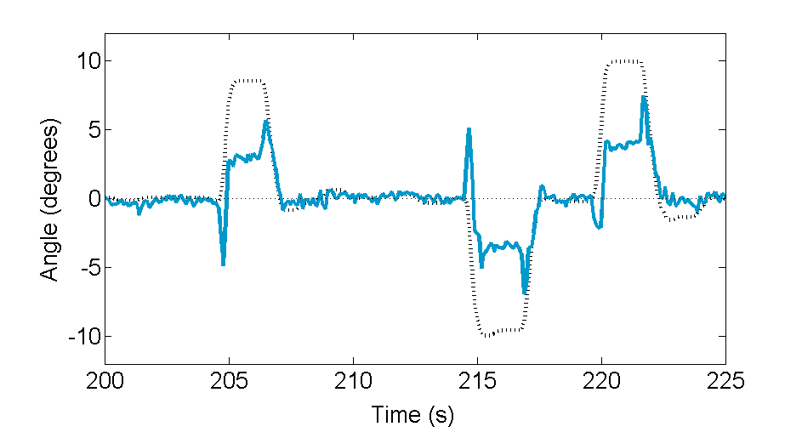
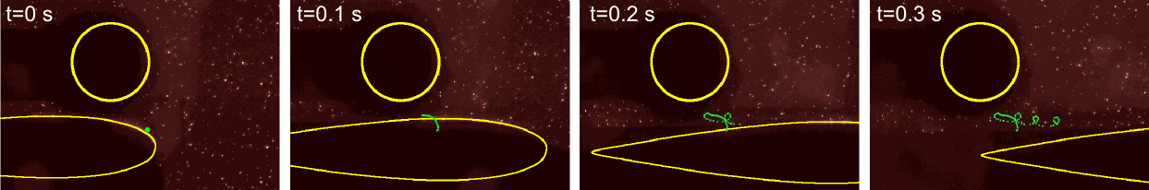
It’s dark and lonely down there…
Improving marine vehicle sensing, with a little help from biology
Jeff Dusek, Amy Gao, Audrey Maertens, Professor Michael Triantafyllou
Marine systems operate in some of the least forgiving environments an engineer is likely to face. Not only is a marine vehicle constantly assaulted by corrosive, highly dynamic, and inhospitable substance, but sensory feedback is severely limited in the marine environment. Unlike surface vehicles that benefit from visual, GPS, and radio systems, underwater operation limits the usefulness of traditional forms of sensor systems. Biology has overcome this deficit by equipping fish with a unique sensory organ known as the lateral line. Acting in a similar fashion to an array of pressure sensors on the fish’s body, the lateral line allows vehicles to detect vortical flows, identify and avoid obstacles, and maintain orientation within a school or ambient flow field. The work of the HELM (Hydrodynamic Engineering Laboratory and Modeling) group strives to extend the unique capabilities of biology to the grand problems of marine operations.
a)
b)
c)
d)
e)
a) Tracking prey b) Communication between individuals c) Recognizing physical features d) Exploiting energy in wakes e) Schooling
Vortex Shedding on Hydrofoils
Active Angle of Attack Control
  Anyone who has tried to steer a boat or swim in a crossflow knows how difficult it can be to maintain a bearing or maneuver when currents are acting in a different direction. By equipping an underwater vehicle with low-cost, low-bandwidth pressure sensors, we can measure the pressure of flows around the vehicle so that it can utilize rather than fight those flows, saving energy and improving maneuverability. Toward this, a towed vehicle with five pressure ports has been constructed and tested.
  Experiments have shown that angle of attack can be estimated quite well with just a combination of differential pressure measurements, and a simple proportional control system is sufficient to actively reorient the vehicle to the flow. With a potential flow model, the pressure at the front of the vehicle can be estimated with astounding accuracy.
  Furthermore, by building a control system based on some physical knowledge (the potential flow model), the dynamic pressure experienced during maneuvers can be estimated even faster, to yield a vehicle that is capable of fish-like, reflexive responses with minimal processing.
Obstacle detection and identification
When an underwater vehicle moves, it displaces water, generating a unique velocity and pressure field around it. The presence of an obstacle in the vicinity of a cruising vehicle forces the fluid to move around it, which results in a modified velocity and pressure field. A vehicle equipped with surface mounted pressure sensor arrays can measure the pressure signature of the object and infer the shape of the obstacle that is responsible for it.
A model based on potential flow theory provides a good approximation of the pressure signature until the viscous effects become dominant. Experimental pressure traces (solid lines) from the set-up shown above are compared to the model (dashed lines) in Figure A below.
The potential flow approximation has been used in a non linear Kalman filter to identify cylinders (Figure B). The pathline highlighted in green below shows one of the manifestations of the viscous effects.
During operation at large angles of attack, foils shed vortices from their leading and trailing edges in a similar fashion to the Karman vortex street in the wake of a circular cylinder. Because vortices represent a strong low pressure region, the presence of a shed vortex near the foil surface exerts forces on the body that can be harnessed to enhance foil performance.
From: TT Lim, NUS
Vortex Sensing and Control Applications
From: Z. Peng
From: Oracle Racing
Vortex detection and tracking has applications across a wide range of mechanical and biological systems. For flapping foil ocean energy systems, shed vortices could provide enhanced lift and reduce control force. On high speed sailing yachts, the ability to monitor flow separation could improve sail trim and increase performance. In biology, fish harness shed vortices to maintain position behind obstacles and reduce muscle usage.
B
Vortex Detection Using Pressure Sensing
Experiments using a pressure sensor instrumented hydrofoil have shown that leading edge vortex shedding produces a distinct and repeatable pressure signature. Force measurements also revealed a transient variation in lift force and torque consistent with the presence of a low pressure region near the foil surface. The ability to detect and track shed vortices could allow for active control of devices to ensure beneficial interactions with near-body vorticity.
Left: A potential flow model closely estimates the pressure at an angle of 10 degrees. Right: Closed-loop control maintains an angle of zero degrees when activated.
For additional information, please see the following publications
V Fernandez, J Dusek, J Schulmeister, A Maertens, S Hou, K Srivatsa, J Lang, and M S Triantafyllou. Pressure sensor arrays to optimize the high speed performance of ocean vehicles. 11th International Conference on Fast Sea Transportation, pages 1-8, Jul 2011.
V Fernandez, A Maertens, F Yaul, J Dahl, J Lang, and M S Triantafyllou. Lateral-line-inspired sensor arrays for navigation and object identification. Marine Technology Society Journal , Jul 2011.
A Maertens, J Dahl, and M S Triantafyllou. Distributed pressure sensing to locate and identify‬ obstacles. In Proceedings of the 17th International Symposium UUST11, Aug 2011.‬
Acknowledgements:
The authors gratefully acknowledge the support of the Singapore-MIT Alliance for Research and Technology (SMART) program’s Center for Environmental Sensing and Modeling (CENSAM) and that of the National Oceanic and Atmospheric Administration’s (NOAA) Sea Grant program.

