Slide 1

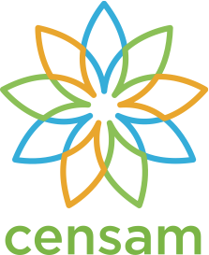
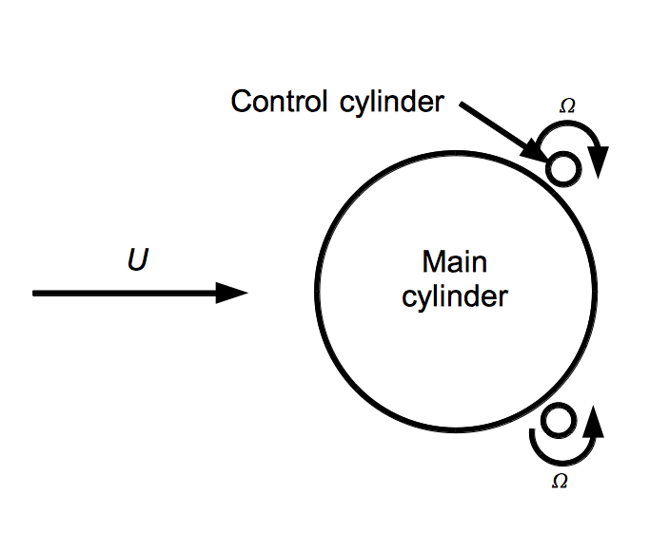
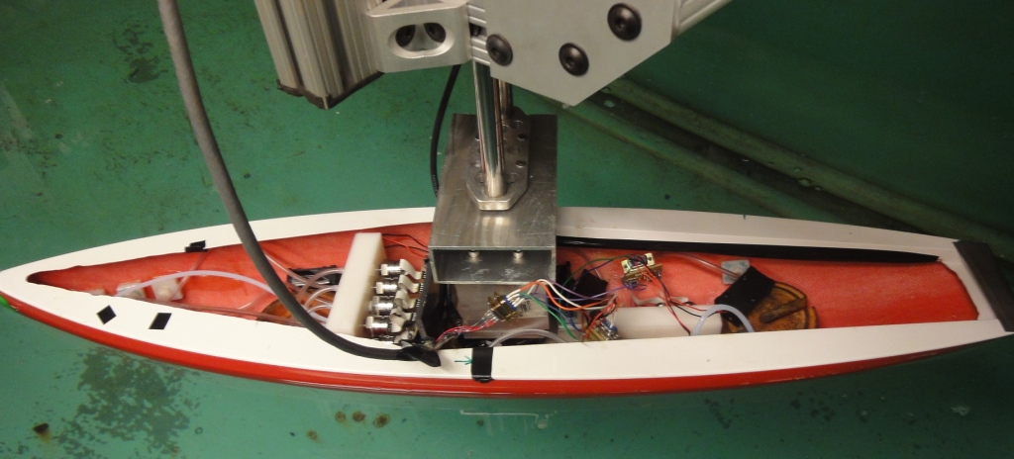
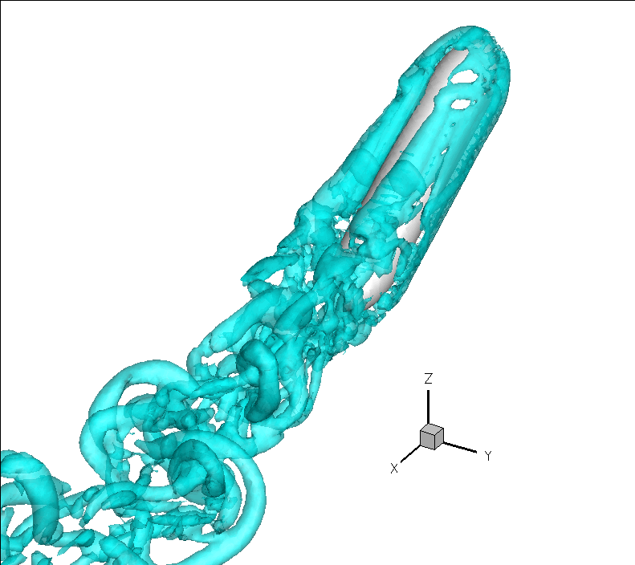
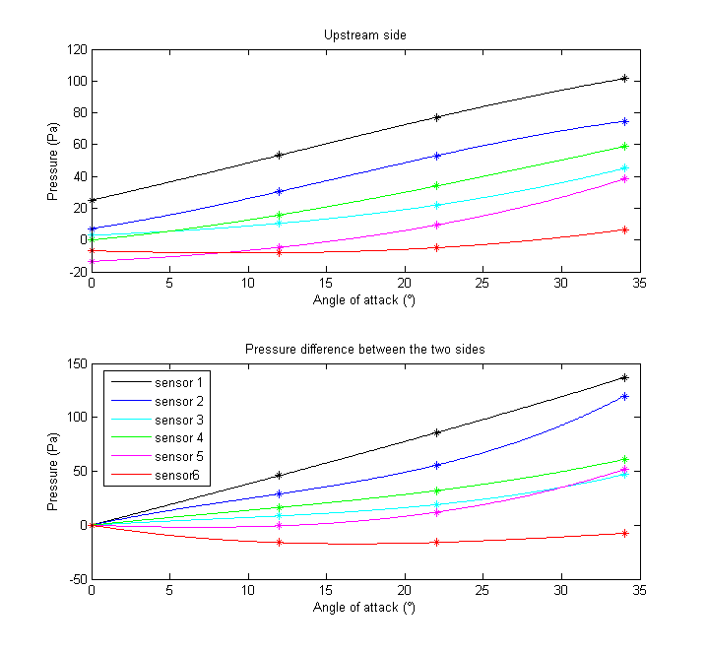
Installation of Biomimetic Pressure Sensors
On Ocean Vehicles to Improve Propulsion
MIT
Singapore
Audrey Maertens
Jeff Dusek
James C Schulmeister
Prof. Michael Triantafyllou
Vicente Fernandez
Dr. Jason Dahl
Dr. Gabriel Weymouth
Karthik Srivatsa
Goal: Develop techniques and algorithms to control underwater and surface vehicle maneuvering with pressure feedback.
Motivation:
When navigating in confined waters, ship maneuvers are often affected by unpredictable currents and forces that can lead to dangerous situations (Lee, 2008). Sensing these currents and forces could enable safer and more controlled maneuvering in such challenging environments.
Additionally, rapid maneuvers cause flow separation and result in large increases in drag. Active flow control mechanisms together with pressure sensors to detect and target separation can be used to decrease drag and improve maneuverability.
Real time flow sensing can revolutionize efficient propulsion and maneuvering of surface and underwater vehicles moving in turbulent ocean flows, a capability available to fish through their lateral line. With current advances in the fabrication of MEMs pressure arrays at CENSAM along with recent successes in vortex detection and object detection using pressure measurements, we look to apply this technology to maneuvering control of underwater and surface ocean vehicles.
Surface vehicle experimental setup
Flow Separation Control with Pressure Feedback
A fiberglass model sailboat hull of one meter length and 22 cm width has been instrumented with pressure sensors for closed-loop maneuver control.
The hull is equipped with twelve Honeywell 19 mm series pressure sensors connected to ports in the hull via plastic tubing. There are six ports on each side of the hull: four in the bow, spaced at 3.8 cm, one at the maximum width (50 cm from the bow), and one in the stern (76 cm from the bow). The dense cluster of pressure ports near the bow provides more information where the greatest spatial rate of change of pressure was expected. An ATI six-axis force transducer is additionally used to measure forces and moments on the hull.
The model also serves as a platform for testing new MEMS pressure sensors. New sensors can be compared directly to the existing sensors and also be immediately incorporated into maneuvering control experiments.
Initial experiments have been conducted in the large towing tank (30 m long) at MIT, where the model can be towed at up to 1.5 m/s and rotated in yaw. This accommodated two experiments: towing the model at constant angles of attack and towing it while dynamically changing the angle of attack.
Further experiments will be conducted in the CENSAM tow tank where flows can be visualized using particle image velocimetry (PIV).
Rotating Cylinder Control Method
The separation of fluid flow past a cylinder can be reduced or even eliminated by rotating strategically located control cylinders (figure 2) (Muddada, Patnaik, 2009). Previous experiments and simulations have been conducted for low Reynolds number flows (Re<500). This experiment pushes this active control mechanism to a flow regime more relevant to underwater vehicles (Re>10,000).
Figure 2: Diagram of cylinder in cross flow with rotating control cylinders. The control cylinders are positioned so that, when rotated, separation on the main cylinder will be reduced or eliminated.
Pressure ports
Pressure sensors
Force transducer
Experimental Method
Two experimental apparatus for implementing rotating cylinder control have been designed for use in the Marine Hydrodynamics Laboratory water tunnel at MIT. The first setup includes a main cylinder mounted on a force transducer and two control cylinders that are rotated independently with servo motors in the configuration shown in figure 2. The second apparatus includes a submersible model that will be mounted at a range of angles of attack to simulate rapid maneuvering (figure 3). In this implementation of rotating cylinder control, the control cylinders are inset into the model. The model is mounted on a force transducer at the end of a sting that extends from the stern.
Each apparatus will be subjected to a uniform flow of 0.5 to 1.5 m/s and the control cylinders will be rotated to delay separation and reduce drag. Drag will be measured with the force transducer and the wake flow velocity field will be visualized and calculated using particle image velocimetry (PIV).
Pressure port locations
Figure 3: Flow simulation of a submersible at a 30 degree angle of attack to a uniform stream models flow past a rapidly maneuvering vehicle (Top). The simulation predicts that high circulation vortex tubes separate from the body about mid-ship from bow to stern. This separation can be controlled with rotating cylinder control. A submersible model equipped with rotating cylinder control will be manufactured for testing in the MIT water tunnel. (Bottom Right). The end-view of the experimental model (Bottom Left) shows rotating cylinder control implemented with control cylinders partially inset into the model body. Servo motors inside of the model will drive the cylinder rotation.
Pressure characterization of a Model Ship for Maneuvering Control
Future work
Developing maneuvering control laws based on pressure sensing first requires characterizing the pressure response to parameters like the angle of attack. The pressure at each sensor location was characterized as a function of the angle of attack by towing the model at 0.5 m/s at a range of angles of attack (figure 1). On the upstream side of the model, this relationship is roughly linear.
Additionally, the difference in pressure between the upstream and downstream sides of the ship was also observed to be roughly linear with respect to angle of attack (figure 1).
Future work will include experimentally investigating the rotating cylinder separation control method in an open and then closed-loop configuration. Closed-loop control of the ship model yaw angle will be implemented in the CENSAM testing tank. Finally, new MEMS pressure sensor arrays will be incorporated into all experiments as they become available to provide greater spatial density of pressure sampling for more effective control.
Acknowledgements
The authors gratefully acknowledge the support of the Singapore-MIT Alliance for Research and Technology (SMART) program’s Center for Environmental Sensing and Modeling (CENSAM) and that of the National Oceanic and Atmospheric Administration’s (NOAA) Sea Grant program.
Figure 1: Both the pressure as a function of the angle of attack for each sensor location (numbered from bow to stern) and the difference in pressure at a given location between the upstream and downstream sides are roughly linear.
References
Chun-Ki Lee and Sam-Goo Lee (2008). Investigation of ship maneuvering with hydrodynamic effects between ship and bank. Journal of Mechanical Science and Technology 22:1230-1236
S. Muddada, B.S.V. Patnaik (2009). An active flow control strategy for the suppression of vortex structures behind a circular cylinder. European Journal of Mechanics B/Fluids. doi:10.1016/j.euromechflu.2009.11.002

