Slide 1
Covering the last mile
Developing e-science data services with liaison librarians
Tracy Gabridge (tag@mit.edu)
Co-Head, Engineering and Science Libraries, MIT Libraries
IATUL 2010 – Purdue

Slide 2

Network grid

Slide 3
If you build it…

Slide 4
they might not come!

Slide 5
Liaison strengths
Know user community needs and practices
Experienced coordinators of services between many parties
Collection curation expertise
Find difficult-to-locate materials
May also have domain expertise
Tracy Gabridge. “The Last Mile: Liaison Roles in Curating Science and Engineering Research Data.” Research Library Issues: A Bimonthly Report from ARL, CNI, and SPARC, no. 265 (August 2009): 15–21. http://www.arl.org/resources/pubs/rli/archive/rli265.shtml

Slide 6
Possible liaison roles
Analysis of data set deposit requirements
Data management planning
Teaching good data practices to students
Collecting and disseminating data sets
Creation of standards for data preservation
Promotion of services that support e-science data curation and dissemination
…
Tracy Gabridge. “The Last Mile: Liaison Roles in Curating Science and Engineering Research Data.” Research Library Issues: A Bimonthly Report from ARL, CNI, and SPARC, no. 265 (August 2009): 15–21. http://www.arl.org/resources/pubs/rli/archive/rli265.shtml

Slide 7

October 28th 2008 - Like a Deer in the Headlights by Stephen Poff, flickr

Slide 8
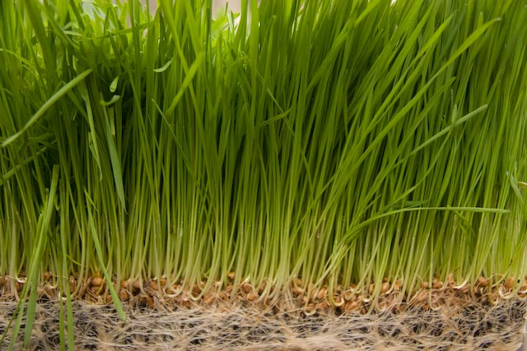

Slide 9
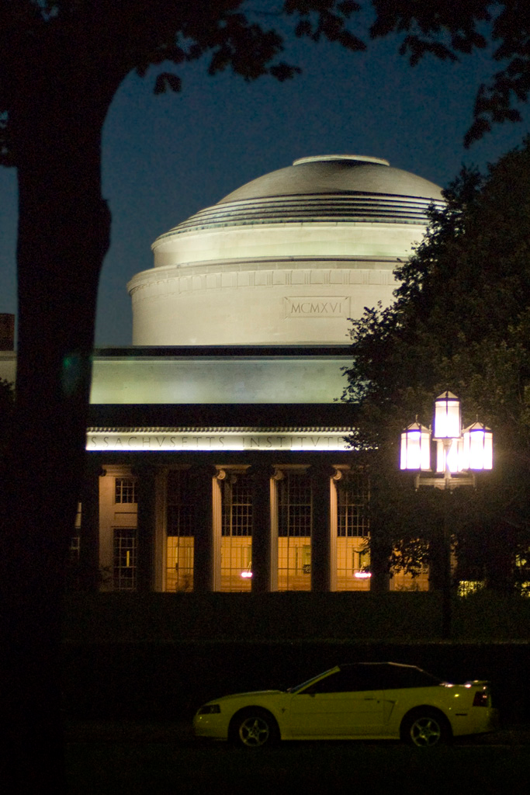

Slide 10
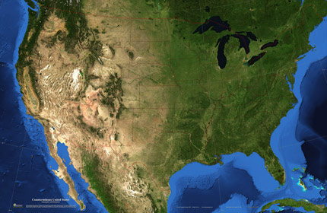

Slide 11
Grass roots by cpentecost, flickr

Slide 12
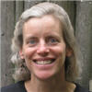




Slide 13
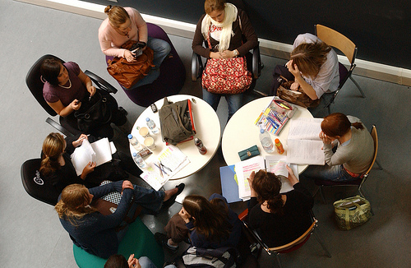
Grassroots activities
Brunel University study group by Brunel University, flickr

Slide 14

Experiments with water by Hpk, flickr

Slide 15
Plan
Do
Check
Act

Slide 16
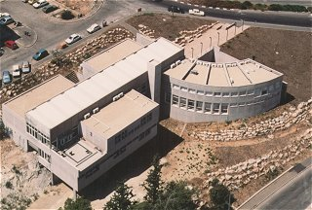
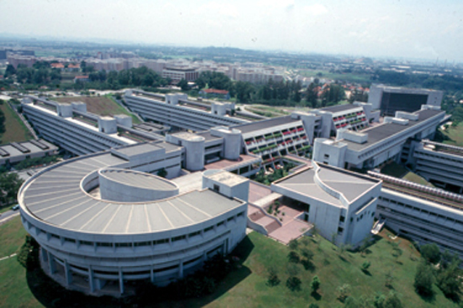

Slide 17










Slide 18



Slide 19
Your Library organization
Data services!

Slide 20
Data Study Group
Engineering and Science Data Strategy
Data working groups

Slide 21
JOBS

Slide 22
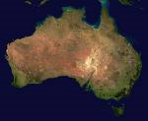
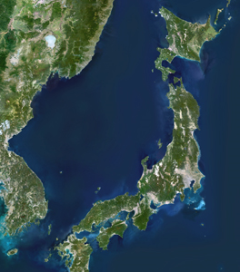
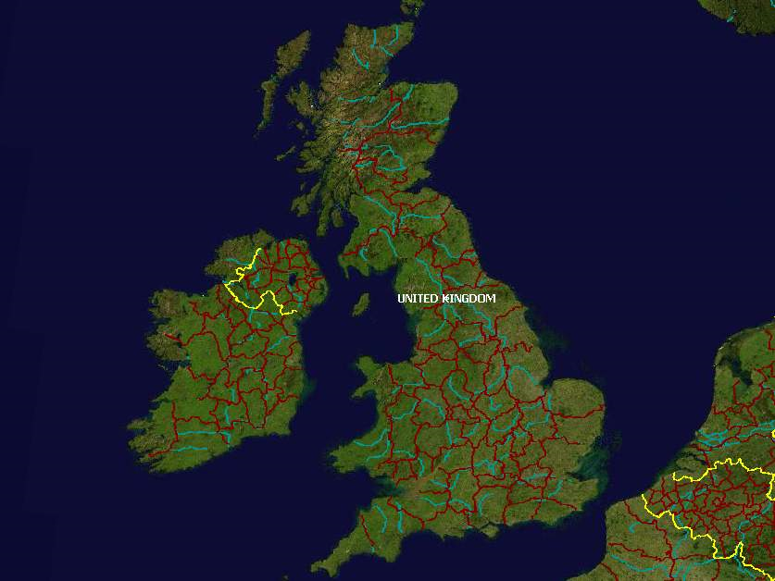

Slide 23
Activities that affect liaison activities at a national level
Guidelines that support service development
Curriculum development in information science programs
Conference development
Infrastructure development

Slide 24
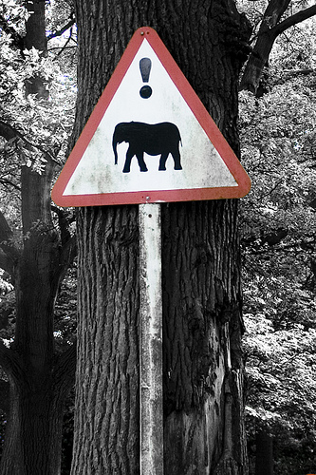
! danger elephants at Knowsley Safari Park? By Adam Foster, flickr

Slide 25
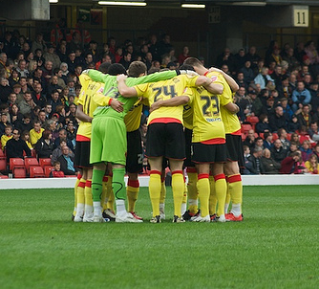
In the Huddle, by Paolo G, flickr

