Slide 1
CSS Billing Project
Interim Findings and Draft Recommendations
Winter, 2010

Slide 2
Understanding the Problem
Analysis of CSS billing transactions in SAP
    $ volume, transaction volume and types, lines of business.
Detailed Process Interviews with CSS teams involved
    DCAD, DDM, MDS, Athena HW/SW, PC Service, SW Repair, Software Distribution, Training, CSS Finance
Practices elsewhere in IS&T
    OIS’ TNIS, TSM, CableTV, Server Ops
Practices elsewhere at MIT
    Audio-Visual
Voice of the Client
    Interviews, emailed survey responses

Slide 3
From SAP DTR line items …
8 Lines of Business in FY09 did $2.8 million in revenue
By Method,
JVs, Uploads, or TechCASH accounted for 90% of $ and 75% of 3000 lines in 1400 SAP docs
Internal Provider JVs were 4% of $ and 13% of lines (includes PC Service’ PMATS)
Receipts for Cash Payments were 6% of $ and 12% of lines (PC Service, SW Repair)
Business | Revenue | DTR lines | % of $ | % of lines
Training | $ 98 k | 249 | 3% | 8%
DCAD | $ 483 k | 12 | 17% | 0%
DDM | $ 618 k | 299 | 21% | 10%
DS SLAs | $ 917 k | 303 | 32% | 10%
Athena | $ 121 k | 1093 | 4% | 37%
PC Service | $ 153 k | 608 | 5% | 20%
SW Repair | $ 45 k | 295 | 2% | 10%
VSLS | $ 419 k | 120 | 15% | 4%
Notes:
Not a “small business”; worthy of some process attention.
Very different ways of using payment tools to transfer revenue – could be more consistent

Slide 4
From Client Interviews …
More Industry-like Business Practices
  Provide electronic Statements / Packing Slips / Receipts for all transactions.
  Invoice right away, Net 30 days for transfer of payment.
More Transparency
    Monthly charges for year-long contracts are best for forecasting.
    Avoid end-of-year catch-up , no surprises.
    DTR Line Items need explicit reference numbers into transactional system (RT)
    Provide backup for charges without being asked.
More Consistency across IS&T Business Areas
    Some parts of IS&T do it “better” than others.
    Clients notice differences in how often billings occur, how promptly, whether they get a receipt, how the SAP line item text describes the charge.
Notes:
We talked to some clients about their preferences with regard to CSS Billing practices. Comments couldn’t be limited to CSS.

Slide 5
From Staff Interviews …
Monthly and Quarterly rush to get the JVs out in a process that isn’t always so easy.
No Integration between client lists, product catalogs, orders and invoices in most systems. Quickbooks would do it better.
Some SAP Line Items have no transactional identifier – impossible to prove that every billable ticket actually gets paid for.
RT is not a billing system (but still it is being used as one).
Can I please fill out a work order / invoice web form, press OK and have it email the receipt and transfer the funds all at once?

Slide 6
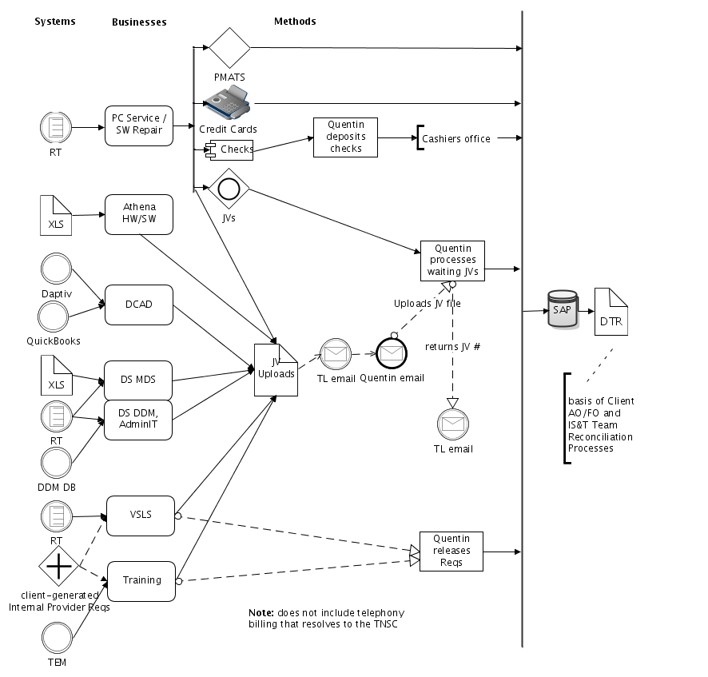
View from Above
Many client interaction tracking tools
- A challenge to improve consistency without more standardization, which may not be best for the business process.
Most payments transferred via JV, hand-built or file upload.
- Consistent with prevailing MIT practice.
- It all focuses on Quentin
- relies on being able to export JV files from the client interaction tools.
A few odd payment methods are inherited
Original reasons for using these are lost to time and staff turnover. Inertia keeps them active.
JV Uploads were not always available, and manual JVs were laborious, so these methods had advantages then, though not so much now.
SAP’s DTR line items are the de facto system of record.
DTRs need to be as complete and self-explanatory as possible.

Slide 7
Some Potential Targets
Exactly how and whether RT is used for billing …
Use of PMATS Process
Process Elimination
Exact layout of DTR line item text
Annual contract billing
One-time “work order” billing
Workflow of
JV Uploads
Use of Internal Provider Reqs
Notes:
These started as shapes with 90% transparency. Actually 90% didn’t show up on the Dell projector, so I changed it to 70% transparency. Should test it before using it.

Slide 8
Some Process Details, p1
Team / Client interaction tracking tools | Invoicing | Transferring Funds | Verifying SAP DTR line item text in Statements
PC Service (non-warranty) RT | If for a DLC, Staff creates a PMATS entry; print PMATS PDF & email to client; also RT ticket printed for pickup. | PMATS makes a JV in SAP; otherwise Credit cards and tech cash and checks. | DTR line item text examples: “PC Service Repair 0000016387” if PMATS, or “TechCASH 020209-030109 Sales or “8610000065688 2008-07-10” for credit cards.
PC Service (warranty) RT | Request for Warranty Reimbursement form to vendor | Wait for check from vendor, often lumping several together | “REC - APPLE CDF PAYMENT” or “REC-IBM REIMB/Check Warranty/1300760897”
Software Repair RT | Printout of the RT ticket handed to client at pickup. | Hand-built JV from Quentin if DLC, else credit card or check If both Software and Hardware (SW/HW) then 2 cost objects on IS&T side | JVs are like “Ticket#1065045/SW billing/P. Collymore” Credit card text is like “8610000065688 2009-08-04” Cash/Checks line item text is like “REC - TICKET 965547/HW AND SW REPAIR/ZHITNIKOV”
Software Distribution RT, SAP IP reqs | VSLS web order form makes a detailed email reply which acts as the invoice | monthly JV Uploads, Internal Provider Req; | “Dreamweaver-Billing-December2009” on IS&T DTRs, or Matlab-ConCurrentJulyBilling2009

Slide 9
Some Process Details, p2
Team / Client interaction tracking tools | Invoicing | Transferring Funds | Verifying SAP DTR line item text in Statements
DCAD Projects Quickbooks, Daptiv | Quickbooks generates invoices; PDF emailed to clients at key project stages | Quarterly JV Uploads | “Q1 DCAD Revenue “ on IS&T DTRs, quite different on DLC DTRs.
DS Short-term / SLAs RT | TL creates invoice in Word; PDF emailed to client | JV Upload file “when there are a few to do” | “Case #1009252 Office of Provost Network”
DS Long-term SLAs Excel, Word/PDF contracts | No invoice; contract on file is considered sufficient | Quarterly JV Uploads | “FY10-Q2DITR SLA for EAPS 8 hrs.”
DS DDM Deployments Filemaker | Deploy sheets from DB left with client (emailed too?) | DB generates JV Upload file per deployment. | “RT# 1006275”
Training TEM, SAP IP reqs, Excel | DLC clients create Internal Provider Reqs to Training; sometimes pay by check | Requisitions released by Quentin or checks cashed; skipped-class fees JV’d | “IS&T TRAINING COURSE - SEE LONG TEXT” – client creates the text

Slide 10
Improvement Themes
Processes can be optimized further
  Move away from older inconsistent processes (“I don’t know why but we’ve always done it this way”) to current prevailing practices.
  Change what we can (phrasing of text, say) to improve processes we don’t control. (Compensate for cashiers office / techcash / credit card shortcomings)
Existing Rules could be relaxed or changed
  Spread responsibility – maybe Quentin doesn’t have to do all the JV uploading.
  Reduce the problem – Set more products/services to pre-paid or not recovered.
Existing Tools that are underused by CSS could be used differently
    Imagine ensuring payment by filling out a short form and pressing OK, instead of exporting from RT to JV Upload and managing that whole process.
New Tools could be built or expanded on to ease process hiccups
    DDM Deploy Database’s design concepts could be generalized into a CSS Billing System, built in Filemaker by DCAD or their subcontractor.

Slide 11
Summary of Ideas, p1
Focus | Issue / Desirable Outcome | Possible Solution | Applies to
DTRs | Monthly charges for annual SLA contracts. Clients prefer this frequency to support their forecasting; if automated, it’s not economizing to do it only quarterly. | Use the TNSC Billing System for monthly recurring charges. Allows the TL to set and forget until it needs changing. Define an entry like “MDS weekly SLA hour” @ whatever rate per hour, and bill for N of hours per DLC. | MDS
 | More detail on IS&T side of the ledger. IS&T DTRs need to be more self-explanatory about the details of JVs, without having to resort to SAPweb for lookup; need the info in the warehouse for possible downstream analysis. | Modify the processes that result in JV upload files so that all the client-side line items are matched with IS&T line items. Athena HW/SW and other teams do this correctly. For DCAD and VSLS it’s probably just habitual not to. | DCAD, VSLS
 | Refine formatting of line item text. Unique line item text needs to go on the left RT ticket numbers need “RT#” preface. Spacing and delimiters need machine-like consistency. | Use JV upload files instead of relying on hand-crafting them. (SW Repair) Reword text to put units and other per-charge specifics on the left to avoid truncation (MDS, others) | MDS, SW Repair,
 | Train the client community on how to interpret the charges that do appear on their statements. | Create a handout on behalf of all IS&T to document our billing, that shows what we charge for, where it appears in SAP DTRs, what certain magic numbers mean, etc. Supply this handout to VPF classes geared to new AAs and FOs. | CSS, OIS
Notes:
Ideas emerged from lots of discussions during the meetings with staff about how things could go better, from their perspective.
Rob just generated some of them.
Socialized at the half-done stage with TLs of the processes.

Slide 12
Summary of Ideas, p2
Focus | Issue / Desirable Outcome | Possible Solution | Applies to
Invoices and Receipts | Issue PDF Receipts for all transactions. Clients need to receive documentation of the transaction for their own records and to perhaps pass on to their financial officers. | Ensure all business processes have a reliable method for generating emailable receipts. Unless there’s an SLA contract on file, which would be sufficient backup on its own. | All
 | Financial people don’t always get a copy of the receipt and have to call us to get backup for unexplained charges to their accounts. | Routinely email a copy of the receipt to the Addressee of the cost object. This would be easier if the addressees were queried ahead of time from the data warehouse. | PC Service, SW Repair, OnCall SLAs
Timely Billing | DLC Clients want their charges to hit SAP in the same month they happened. Reduce the practice of holding on to charges to process at the end of the month or quarter. Quentin’s preference is to space them out more across the month. | Reduce end-of-month bottlenecking. Create JV files as they happen and send to Quentin; or let TLs upload JV files on their own. Or create one-at-a-time charges through the TNSC Billing System where possible, to queue up and automate payment transfers. | MDS, SW Repair, VSLS
Unusual Billing Channels | PMATS is idiosyncratic to PC Service and generates poor DTR line item text. If we can’t change the PMATS output, we need to stop using it. | PC Service should use the same receipt and billing method as SW Repair. The PDF from the special RT print format is fine as a receipt. Improve the JV upload process for these queues to not require hand-built JVs. | PC Service
 | Internal Provider Requisitions are an awkward holdover from re-engineering. Most of MIT uses JVs for internal billing. They require Quentin to process payments and don’t fit into current email-driven workflows. | Replace Internal Provider transactions with JVs. Clients can send us email requests for training and for Abaqus software licenses, and we can initiate the transfer of funds as with all our other processes. No reason to keep this one around. | Training, VSLS

Slide 13
Summary of Ideas, p3
Focus | Issue / Desirable Outcome | Possible Solution | Applies to
Be More Collaborative | to:Quentin@mit.edu is a single point of failure in the JV Upload process. It’s not possible to share the load, and difficult to intervene if he becomes unavailable. | Apply a “site team” model to billing. Create a mailing list like “css-finance” in mailman with message archiving. Subscribe a small group to it and cross-train to handle all billing issues. | All, and CSS HQ
Using RT for billing | Billing via RT is handled inconsistently across teams. | CSS should have one common approach to using RT for billing. a.) unify billing-related custom fields and use them to power the process. Copy and use the VSLS’ “Billed Status” pulldown list; share the PC Service RT printable receipt layout. b.) create and staff a uniform CSS billing process to support multiple TLs, through a central business process managed out of HQ. “Submit completed work for billing, we’ll get it done.” The exact methods within the CSS Billing process could then be optimized centrally. (see more on that idea further down)
 | One-off bills for short-term projects are hard to create and process quickly. Hans Dietrich rhapsodized about having a more “one-button” solution for billing short-term SLAs rather than the RT ticket → Word invoice to email → JV Upload file at the end of the month process. | Separate work-related and billing-related transactions and optimize separately. a.) copy the SW Repair ticket-to-billing process; b.) create a web form to email pertinent details to the CSS::Billing queue who take it from there (see that idea further down). | MDS OnCall SLAs, SW Repair, others

Slide 14
Summary of Ideas, p4
Focus | Issue / Desirable Outcome | Possible Solution | Applies to
Using RT for billing, cont. | Problem-solving and billing are held in the same ticket. Measurements about the work are blurred by time spent waiting for payment. Work queues have to “rework” tickets when payment is collected to set a field as “paid” or the equivalent. Separating work from billing lets the teams get on to more work more quickly, and lets the billing process be as consistent and high-quality as possible. Also, can delegate if separate. | Create a CSS::Billing queue to operate that process. This queue is where all the accounts receivable work would go on. Use some method (perhaps a formatted email out of each CSS RT queue) to transfer the vital details to a related ticket in the CSS::Billing queue. The original ticket would be marked “Submitted for Payment” and resolved. That would be date-stamped and there would be a transaction entry in the original ticket. The CSS::Billing queue ticket would know what work-ticket created it, who the client was, etc., and payment transfers would resolve within that queue. | VSLS, SW Repair, PC Service, MDS OnCall SLAs, etc.
TNSC Billing System | OIS uses TNSC to bill and perhaps we can too. Jack Installs and ACD software licenses are just a couple items they bill this way. CSS Telephone CSRs use it for Circuits and other products. | Explore expanding TNSC’s use in CSS. With Jana’s help, we can create CSS-specific catalogs of billable entities, automate recurring billing, do reliable one-screen billing of DLC cost objects. Receipts would have to come from another source. | Depends
Build a system-in-the-middle to do billing right. | An Ideal system would combine knowledge of our clients and their cost objects (from data warehouse or a central repository) with knowledge of SAP-related payment processes (like uploads), with a catalog of products CSS charges for, to create, email and process bills at will. | Create a custom Filemaker app that expands on the best parts of the DS DDM Deployments database to create a general purpose CSS Billing System. | All

Slide 15
Possible Quick Wins
PMATS line item text changes to include tkt# and client’s name, replacing or placed in front of PMATS work order #
Use TNSC Billing System for automatic recurring monthly installments of MDS SLAS.
Internal Provider Requisitions change to JVs from tickets, removing an odd and distracting process
SW Repair changes to JV Uploads rather than hand-crafted JVs by Quentin from rt ticket printouts
Change to:quentin@mit for JV uploads to a Mailman list css-billing@mit with archiving of attachments and group management.
Use TNSC Billing System for OnCall SLAs and similar “one-off” work orders.
Better organize RT for billing, including billing-oriented custom fields consistently applied, perhaps a billing-specific queue.
Contribute time from CSS-HQ to work collaboratively with TLs and finance on facilitating issues in billing, reconciling warranty payments, tracking billing status of tickets, etc. Cross-train for backfill during outages.
Separate billing-for-work from doing-the-work within RT, creating a css accounts receivable process that operates independently of the TL do-the-work-and-authorize-billing process.
Notes:
Quick Wins concentrate on Process Changes and perhaps incorporating the existing TNSC Billing system, used by OIS for work orders and some incidental charges.
This is Rob’s list, built from interview-driven comments and subsequent conversations.

Slide 16
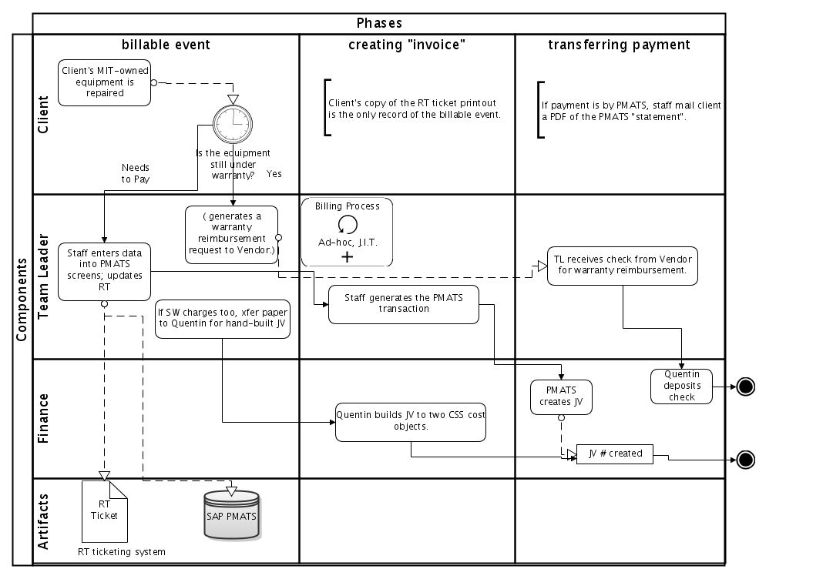
SD Hardware Repair
Highlights
Vendors “billed” differently for warranty work;
DLCs billed via PMATS; others pay with checks credit cards or Techcash
If DLC-billed work involves Software Repair too, total cost splits across two CSS cost objects and requires a hand-built JV
Only the JVs yield good SAP line item text.
PMATS generates nice PDF invoices that show time and materials detail.
Notes:
Image is 70%, 1” bottom cropping

Slide 17
Specific Ideas: Hardware Repair
PMATS has attractive qualities
Decent printable receipt detailing time and materials.
Direct unattended funds transfer in SAP.
But PMATS has Issues
1. DTR text is not self-documenting enough. The PMATS number cannot be linked to the RT ticket without a custom search in RT by a consultant. Major stumbling block for clients in the financial wing of DLCs.
2. PMATS hardwires the GL and Cost Object for its transfers, forcing mixed HW/SW cases into special handling, and preventing SW cases from using it either.
Possible Improvement Options
1. Switch tools to the TNSC Billing System for one-time charges.
New entries in the Predefined “equipment no.” catalog will direct hardware-only charges to the right cost object and g/l, and will bill automatically once submitted. The data entry screen is ugly but quick.
Emailable receipts with time and materials detail would have to be PDFs from the existing “PC Service Print” screen in RT.
Or,
2. Change PMATS’ SAP feed to improve the line item text in its Internal Provider JVs. I.e., include better fields from the PMATS screen, such as Case number and some client details like Email address at a minimum. This would require development in SAP. (This is being investigated now with Ken Le Vie of SAIS).
Or,
3. Use JV Uploads in a streamlined process that SW Repair could share.
Notes:
Image is 35%, there for continuity only. Should point at the part of the process diagram being changed.

Slide 18
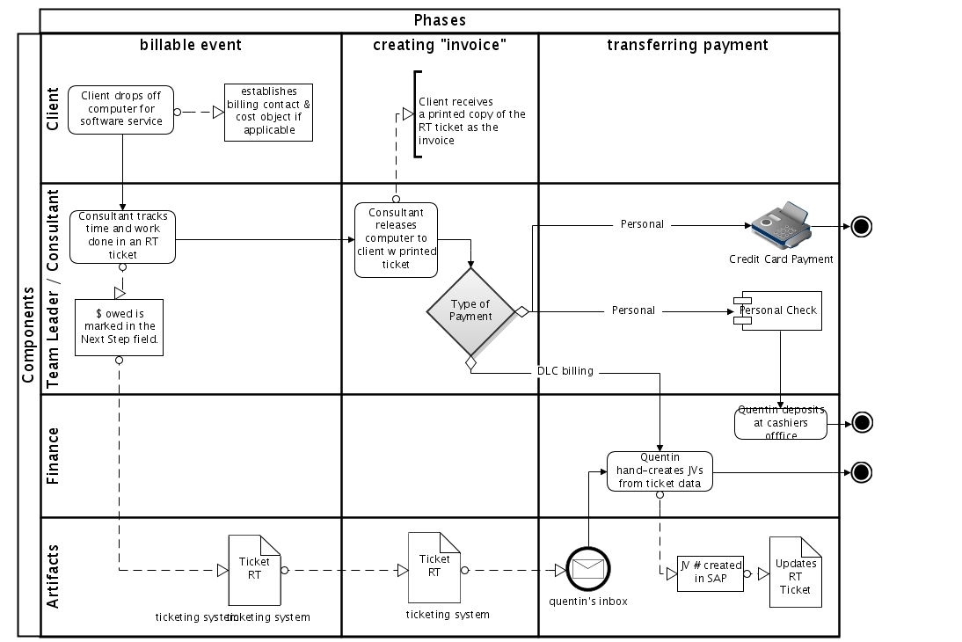
SD Software Repair
Highlights
Hardware tickets can have a software component, or Walkins at the front desk can be left for software work.
Printout of the RT ticket handed to client at pickup as their receipt.
If DLC client, team emails Quentin with request to bill; Quentin hand-builds a JV and submits it, then updates ticket with the JV#.
If check, cashiers office deposit slip created with ticket details.
If credit card/tech cash, payment commits automatically
Notes:
Image is 70%, 1” bottom cropping

Slide 19
Specific Ideas: Software Repair
Hand-Built Requisitions from Paper RT tickets ease one burden
The Service Center staff are relieved of the burden of generating billing files from RT transactions by handing a stack of paper RT printouts to Quentin to make into JVs.
It may take human intervention like Quentin’s to accurately create split JVs (two-cost-objects on the IS&T side) for HW and SW tickets.
But it creates other burdens
1. DTR text is not inconsistently formatted. This looks unprofessional and prevents the easy parsing of line item text by automated tools.
2. It’s more work for Quentin to build these.
Possible Improvement Options
1. Switch tools to exports of tickets from RT or data warehouse. Use the hardware and software charge fields as they were intended.
2. Reconsider the separation of PC Service revenue from SW Repair revenue.
3. Consider direct billing via TNSC Billng System for software-only tickets.
Notes:
Image is 70%, 1” bottom cropping

Slide 20
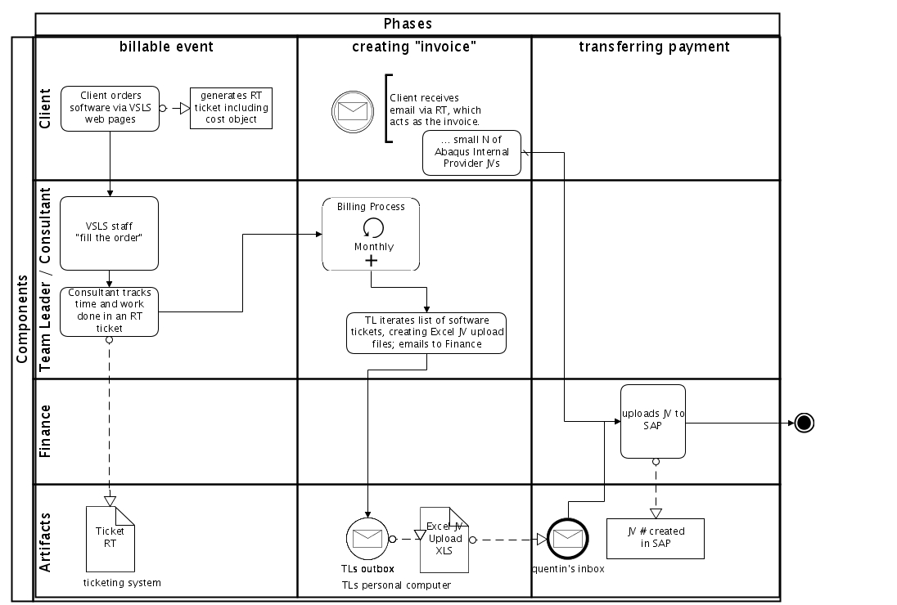
SD Software Distribution
Highlights
Web order forms create RT tickets.
RT email with license details amounts to the receipt.
A diminishing number of titles are billed for.
Establishing the Total price for Matlab is complicated.
RT extracts turn to JV uploads.
Tickets are updated with JV number as record of payment.
Internal Provider Reqs used for one product
Notes:
Image is 70%, 1” bottom cropping

Slide 21
Specific Ideas: Software Distribution
VSLS …
Benefits from certain software licenses moving to other payment arrangements (such as Filemaker) and more direct distribution.
Works hard at conforming to myriad license restrictions and “kits” at different prices when assembling orders. Changes to licensing terms and vendor product packaging are the only solution in this area.
VSLS web form and RT processes routinely generate emailed receipts.
Possible Improvement Options
1. Use the same line item text on the IS&T side of the JV upload file as on the client side. This makes the DTR line items as self-documenting as possible without having to open the JV separately in SAP or SAPweb to verify software charges having been made.
2. Could use the TNSC Billing System to bill immediately for licenses, rather than queue up tickets for JV upload. The usefulness of doing this would depend on volume and how standard a price might be.
Notes:
Image is 70%, 1” bottom cropping

Slide 22
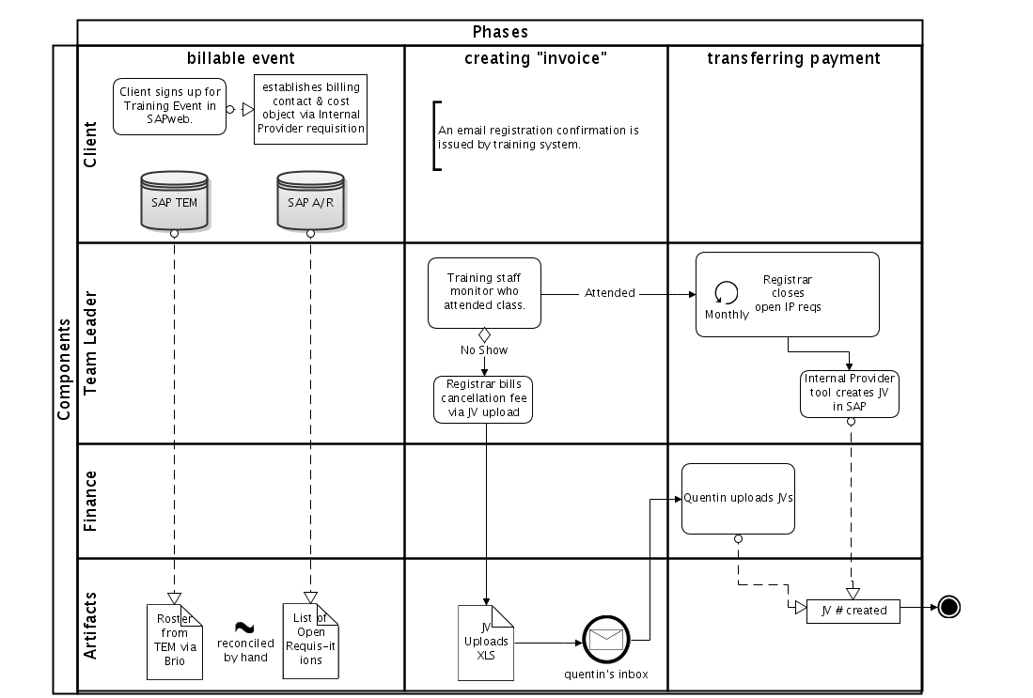
Training
Highlights
TEM lists who plans to take class.
Clients initiate payment with Internal Provider Requisitions.
Registrar manually tracks paid status; manually tracks who attended class.
“No show” fee billed by Registrar with JV Upload file. (Not often.)
Quentin releases open requisitions when class is over.
Notes:
Image is 70%, with .25” cropping left and right, .375” at top, 1” bottom

Slide 23
Specific Ideas: Training
Internal Provider Reqs have attractive qualities
Internal Provider Requisitions create a commitment in SAP that can be released by Quentin in a simple SAP screen.
The client does the work of creating the Requisition.
But they have drawbacks
Clients create them on their own schedule, and may not always do so. It would be better to transfer funds before the class occurs, as a commitment to attending.
The Requisition needs to be individually released for each attendee.
IP Reqs are an awkward business process to manage in parallel with more mainstream methods using JV uploads and TEM registrations.
Possible Improvement Options
1. Switch tools to JV Uploads, derived from a class attendance list maintained by the Registrar. Payments for an entire class can be processed in one JV file.
Notes:
Image is 35%. Red highlights the work that would be changed or eliminated.

Slide 24
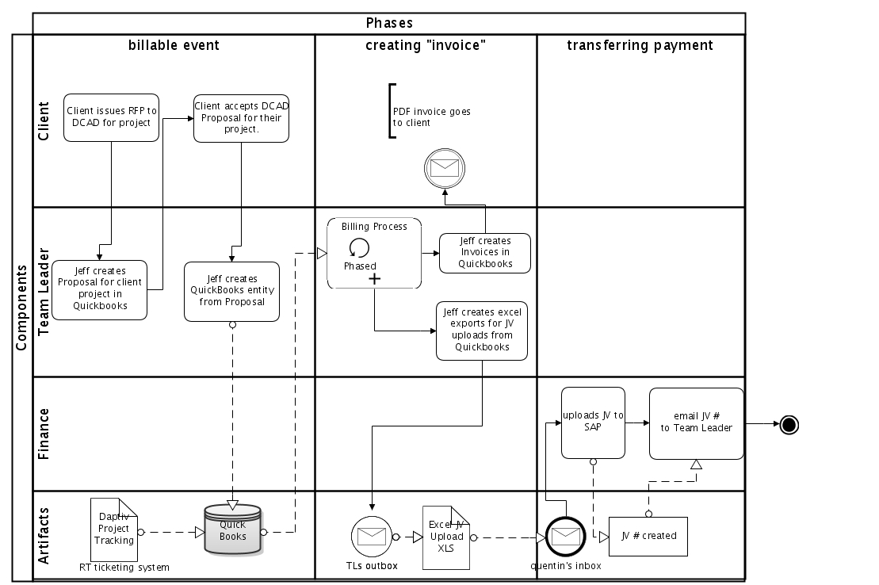
DS DCAD
Highlights
DCAD has a high-quality process for client tracking and billing that relies on Quickbooks for proposal generation, invoicing, and billing (Quickbooks exports the JV upload file).
Quickbooks is a single-user license on Jeff’s laptop.
The JV file has line item detail on the client side of the transaction, and just one line item on the CSS side, referring to “Revenue for the Quarter”.
Notes:
Image is 70%, 1” bottom cropping

Slide 25
Specific Ideas: DCAD
Quickbooks…
Is working fine for Jeff and there is no reason to change it now, especially if we have no other suitable client-tracking tool to switch to.
But…
The lone copy of the client data on Jeff’s Quickbooks represents a single point of failure in the event Jeff is incapacitated.
Line item details in the JV upload file should balance on the client and the IS&T sides.
Possible Improvement Options
1. Find a file-sharing location, perhaps a CSS or DS wiki page with permissions as private as necessary, to post the Quickbooks and related files on a regular basis. Or store the files on Sprockets, the DS file server, and document it all in the DCAD or DS wiki.
2. Use the same line item text on the IS&T side of the JV upload file as on the client side. This makes the DTR line items as self-documenting as possible without having to open the JV separately in SAP or SAPweb to see if a specific DLC was ever billed for a certain phase of work.
Notes:
Image is 70%, 1” bottom cropping

Slide 26
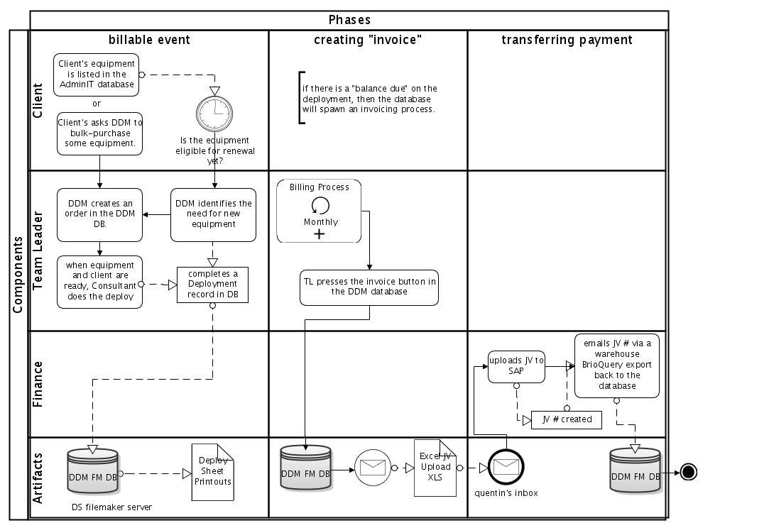
DS DDM
Highlights
DDM Deployments database designed to automate the bulk of this process.
“Deploy sheet” is the invoice, left by consultant during the deploy.
Database creates JV upload files for the amount owed.
Notes:
Image is 70%, 1” bottom cropping

Slide 27
Specific Ideas: DDM
DDM Deploy Database is an excellent solution
Nothing to do with the tool-mediated deploy process.
But it does generate an awful lot of JV files to upload, since the current MIT business requirement seems to be one upload file per deploy.
Possible Improvement Options
Reduce the load on Quentin by allowing Chuck to do his own uploads.
Would require well-constructed upload files and validated cost objects, which DDM DB generates, and Chuck to gain additional knowledge of SAP.
Notes:
Image is 35%, 1” bottom cropping

Slide 28
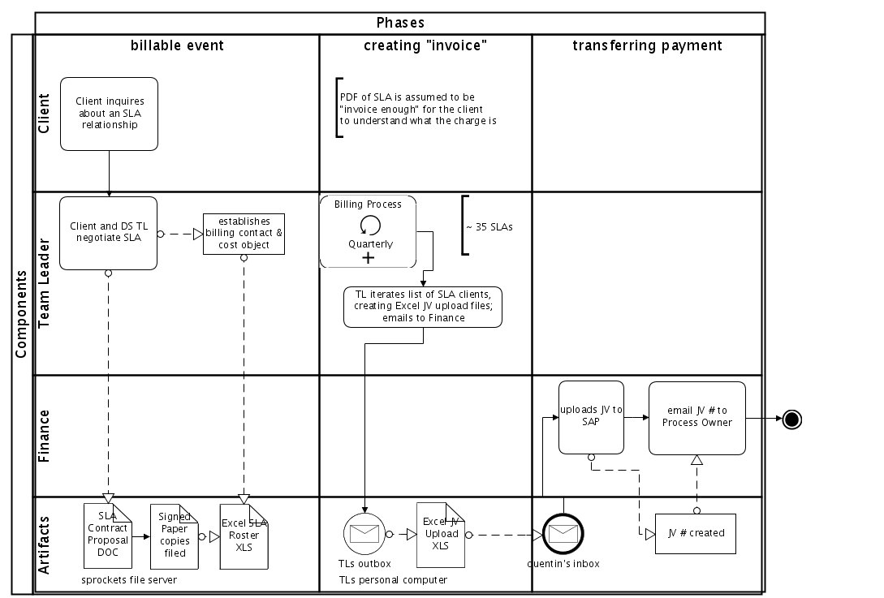
MDS Long-Term SLA
Highlights
Contract relationship involves a paper document signed by both sides and filed.
Each quarter, Manager bills with JV Upload.
Notes:
Image is 70%, 1” bottom cropping

Slide 29
Specific Ideas: MDS SLAs
Quarterly Billing of Annual Contracts has good points
It reminds clients more often than annually would that they have a contract relationship costing them a certain amount. With annual billing it’s a little “out of sight, out of mind” when it comes to forecasting.
Quarterly billing finds a balance between the needs of the DLC to remember about the contract, and the work involved in generating bills every so often by hand.
But it’s a false economy to go quarterly if the process is automatic.
Clients stated a preference for monthly billing, all else being equal. It eases forecasting since every month has a line item about the contract, It is consistent with other monthly charges, like TSM and TNSC Proxy.
Possible Improvement Options
1. Switch tools to the TNSC Billing System for recurring charges. Recurring charges are what TNSC does best.
New entries in the Predefined “equipment no.” catalog can bill a certain number of hours per week, customized per DLC, billed to the correct client and IS&T cost objects.
Once established, the bills occur monthly without fail until the entry is deleted or adjusted.
2. Change DTR line item text to have less redundant detail on the left side and avoid truncating important details on the right side. Should not say “FY10-Q2DITR SLA for EAPS 8 hrs” where the 8hrs would get clipped if the DLC name was long, but rather ”8 hr Dept Svcs SLA for EAPS” .
Notes:
Image is 35 %, 1” bottom cropping

Slide 30
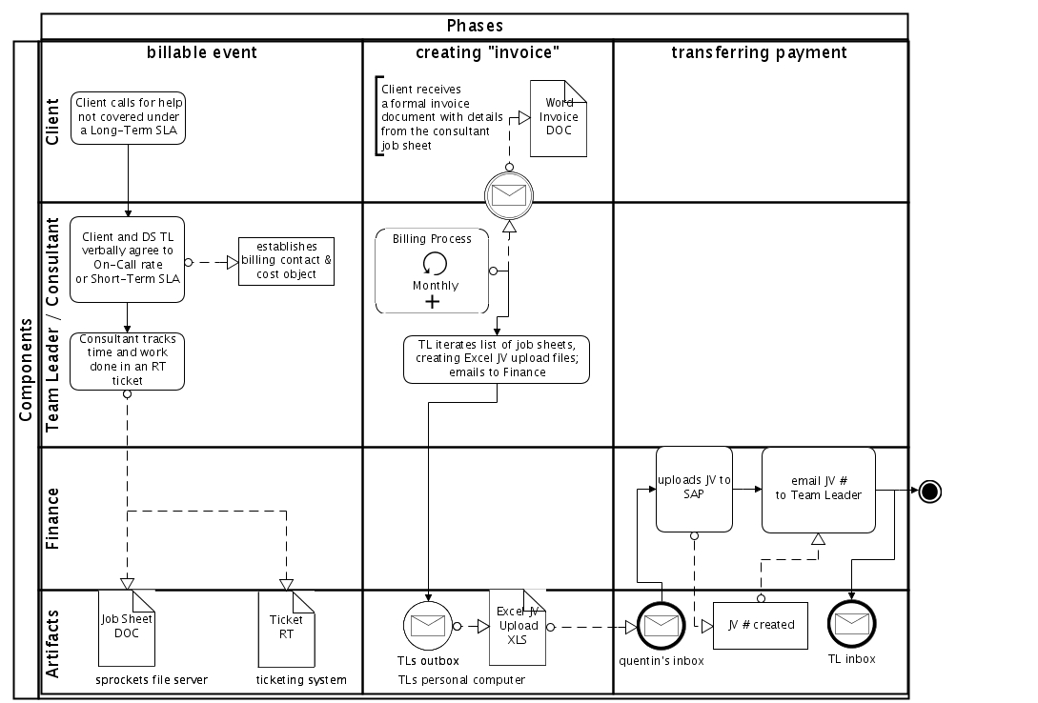
DS Short-Term SLA
Highlights
Client negotiates work to be done with the TL. Establishes cost object to bill.
Work is tracked in RT. Consultant updates ticket with total hours and notifies the TL that work is done.
For the list of resolved tickets that month,
TL prepares a Word invoice based on ticket., emails a PDF to client as receipt. Then exports into JV upload file which goes to Quentin.
Notes:
Image is 70%, 1” bottom cropping

Slide 31
Specific Ideas: Short-Term SLAs
Good Points…
But…
Possible Improvement Options
1. Switch tools to the TNSC Billing System for one-time charges.
Would save work in remembering to generate JV upload files by directly billing through that interface. Can retain the Word receipt or use the Service Center’s RT Print Receipt.
Or,
2. Switch tools to a customized web-form designed to feed the CSS::Billing queue and related processes.
Notes:
Image is 70%, 1” bottom cropping

Slide 32
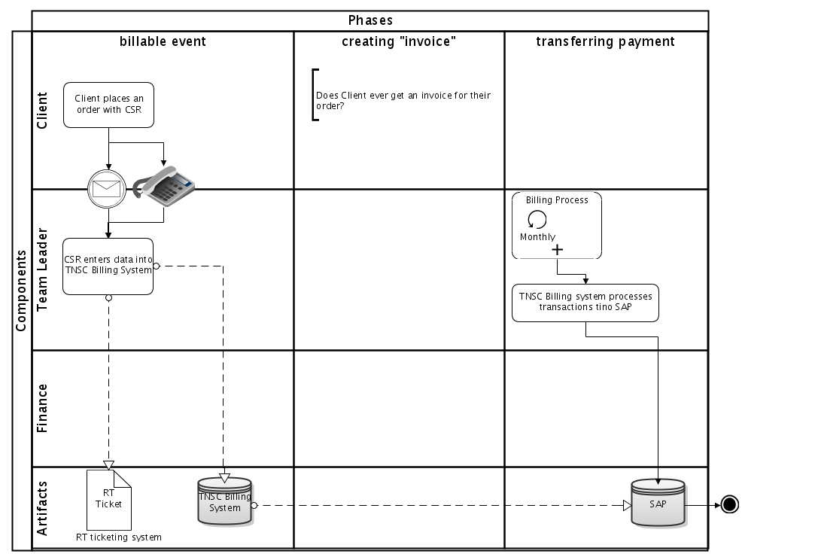
SD Telephony
Highlights
Telephone CSRs track order requests in RT
Service orders and billing are done in the TNSC Billing System, which enters SAP directly
NOTE: Studying Telephony billing was not in scope, but their use of TNSC Billing System resonated with OIS’ use of the same system as discovered in our interviews.
Notes:
Image is 70%, 1” bottom cropping

Slide 33
Next steps?
Temperature check with Finance
Identify Quick Wins in the current environment and kaizen them.
More research…
Pursue SAP-billing as Facilities does it.
Define some alternative solution spaces;
prototype proposable alternatives.
Notes:
Image is 70%, 1” bottom cropping

Slide 34
Appendix of Artifacts
On the slides that follow:
PMATS entry screen
PMATS receipt
TNSC Billing system screen shots
DCAD Project invoice
DS OnCall SLA invoice
DS OnCall SLA JV Upload file
Notes:
Image is 70%, 1” bottom cropping

Slide 35
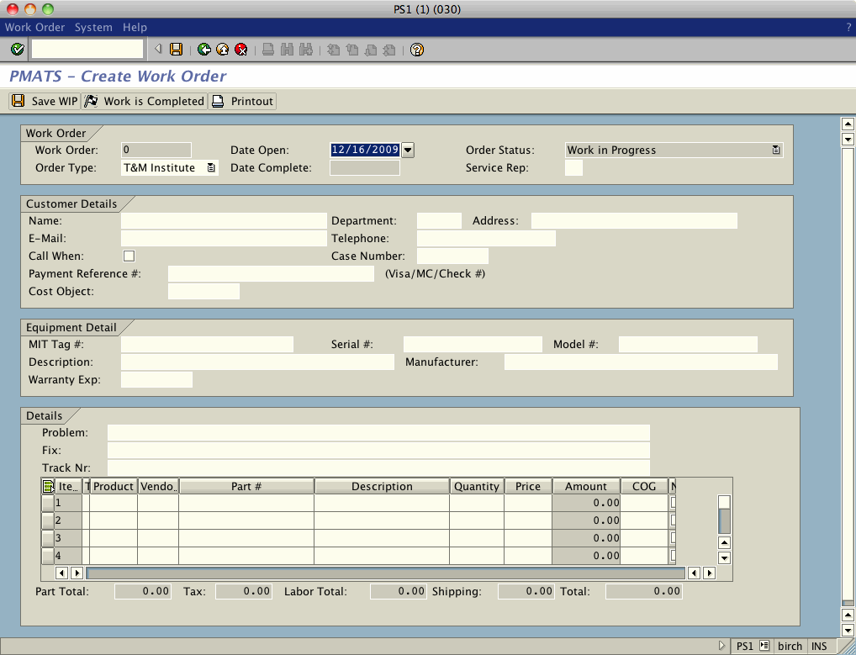
PMATS entry screen
Highlights
.
Notes:
Image is 70%, 1” bottom cropping

Slide 36
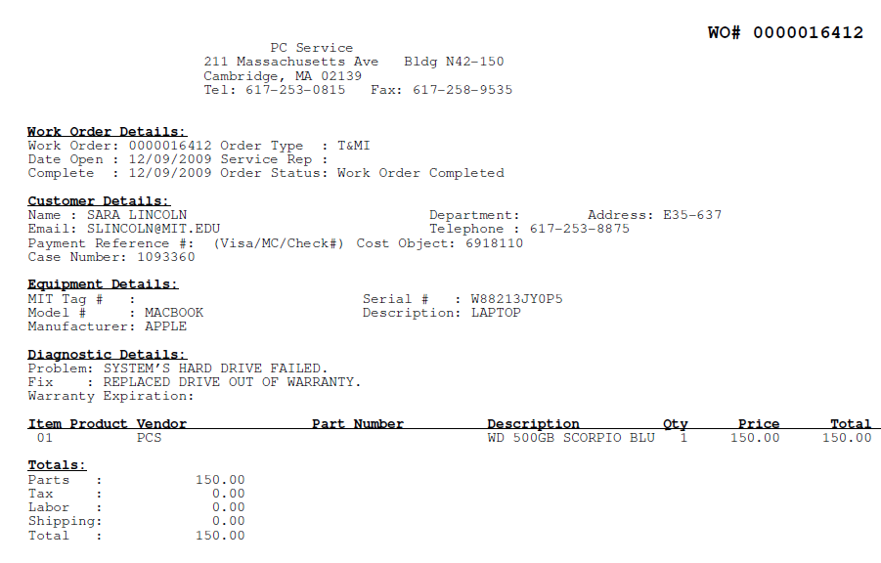
PMATS receipt
Highlights
Printed from PMATS to PDF format.
Attached to RT Ticket for future reference.
Emailed to client as part of invitation to claim their computer.
DLC financial people like to see the breakdown into parts, labor, and delivery to know exactly what they are paying for.
Notes:
Image is 70%, 1” bottom cropping

Slide 37
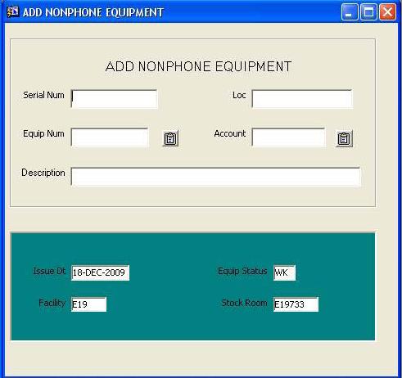
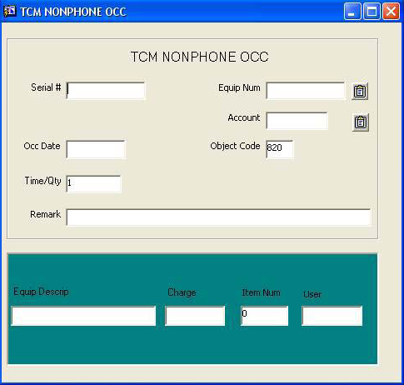
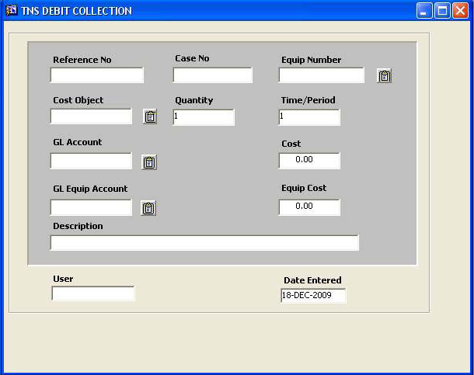
TNSC Billing System
Highlights
Very simple screens.
“Case No.” goes to DTR.
Charges are queued up until about the 25th of the month then they book automatically.
OIS uses TNSC BS for jack install projecs,
annual ACD licenses.
Jana can customize a CSS-specific version to show only our “equipment”
* NonPhone Equipment for Recurring Charges
* OCC for One-time Charges
* Debit Collection for entering a charge into a specific month in the past. (“back billing”)
Notes:
Image is 70%, 1” bottom cropping

Slide 38
DCAD Project Invoice
Highlights
Very simple screens.
“Case No.” goes to DTR.
Charges are queued up until about the 25th of the month then they book automatically.
OIS uses TNSC BS for jack install projecs,
annual ACD licenses.
Jana can customize a CSS-specific version to show only our “equipment”
* NonPhone Equipment for Recurring Charges
* OCC for One-time Charges
* Debit Collection for entering a charge into a specific month in the past. (“back billing”)

Slide 39
DS MDS On-Call SLA Invoice
Highlights
Hans Dietrich would get the hours consumed by the job from the RT ticket the consultant tracked it in,
Then open this attractive word file and fill in the details and mail the file to the client,
Then when he had accumulated a few to do, Hans would generate a JV upload file of the tickets that were waiting to be billed.
Hans’ desire was to get the client details from a central list, fill in the text to get the total, and press a button to email it and bill it, more or less all at once.

Slide 40
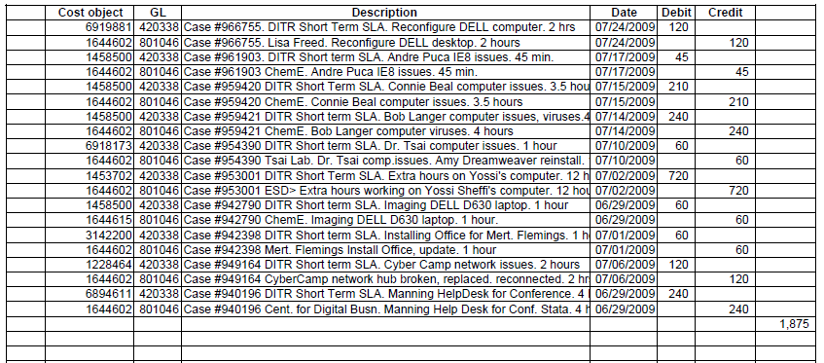
DS MDS On-Call SLA JV Upload
Highlights
The client and IS&T sides of the transaction use different text depending on the audience. Very thoughtful.
Hours and client could be on the left, “DITR Short-term SLA” could be shorter or right justified to optimize truncation.

Slide 41
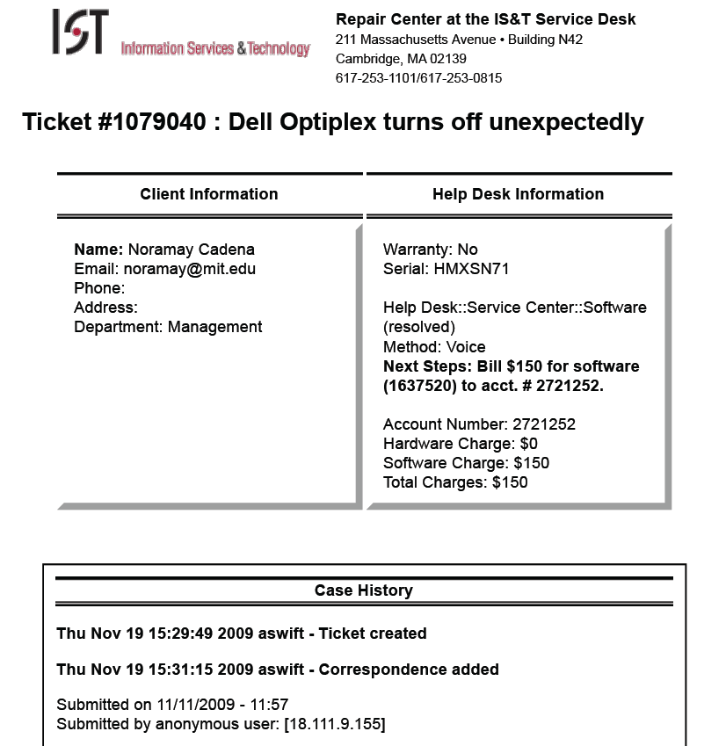
RT Ticket Receipt

Slide 42
</body>
Notes:
Image is 70%, 1” bottom cropping

