Slide 1
Project Development Approval Process
IST Finance
Feb. 2011
DRAFT

Slide 2
Project Approval Process
New Business Case Submission and
Additional SW Dev Funding Requests for Current Projects
to
Head of IS&T and External Sponsorship Committees (ASPCC, SSSC, ITGC, Etc.)
REQUIRES
a
Completed and Approved Project Cost Template
So what is a project cost template?

Slide 3
Project Cost Template
IS&T Project Cost Template must include:
  List of Resources (Internal & External)
  Estimated Hours on Project for each Resource
  Estimated Other Costs (Hardware, Software, Etc.)
  Estimated Ongoing Support

Slide 4
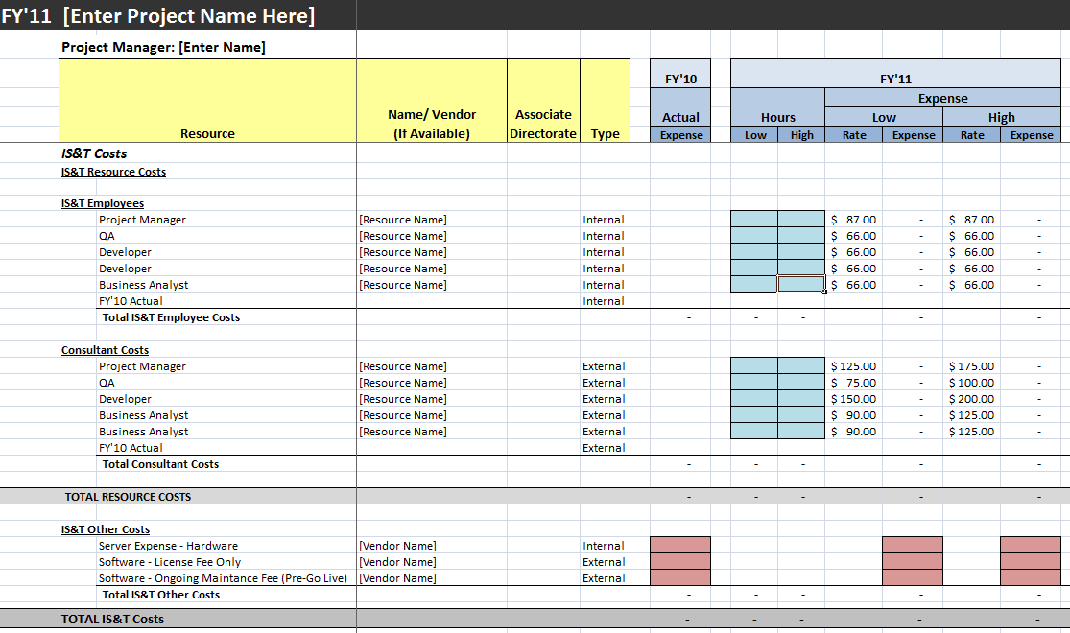
Project Cost Template
The objective of the project cost template is to capture resource needs, risks and assumptions and provide a high level cost range for a project over multiple fiscal years.

Slide 5
Project Cost Template
Resources: Project Managers should identify all resources that are needed on the project both by resource type (QA Analyst, Developer, Etc.) , name and type.
Who do you need?
Project Manager
Business Analysts
QA
Developers
Data Mgmt Analyst
Database Administrator
Interface Design
Training
Identify Resource Name (if possible)
Identify Resource Type

Slide 6
Project Cost Template
Current Project – Actuals: For Current Projects that require additional funding, make sure you add any Prior Year and Current Year Actual Expenses
Other Costs:
Hardware
Software
Software Maintenance Expense (Usually just one year)**

Slide 7
Project Cost Template
Current Project – Actuals: For Current Projects that require additional funding, make sure you add any Prior Year and Current Year Actual Expenses
For Current Projects that require more funding, make sure you add any Prior Year and Current Year Actual Expense

Slide 8
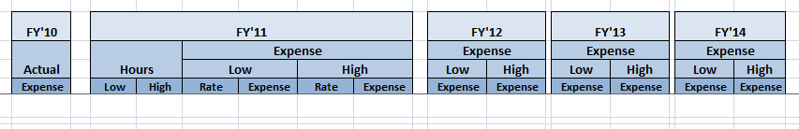
Project Cost Template
Current/ New Project – Plan: Project hour estimates for both new and current projects should include both the current and future year resource requirements.
Hours Estimates should take into consideration:
  Best-case estimates (low)
  Worst case contingency (based on risk, level of technical complexity, resource availability, etc.) (high)
The current project template provides for 4 additional years (FY’11-FY’14) if more years are needed, please contact finance.

Slide 9
Project Cost Template
Current/ New Project – Plan:
Hours Estimates should take into consideration:
Small Projects:
  Business Analysis
  Planning
  Scope and Requirements Sign-off
  Design
  Implementation
  Documentation
  Quality Assurance
  User Testing
  Usability
  User Training
Large Projects:
  Discovery Phases:
  Business Analysis
  Planning
  Scope and Requirements Sign-off
  Design Options (Standard, Moderate Customization, High Customization)
  Implementation Phases:
  Final Design
  Implementation
  Documentation
  Quality Assurance
  User Testing
  Usability
  User Training

Slide 10
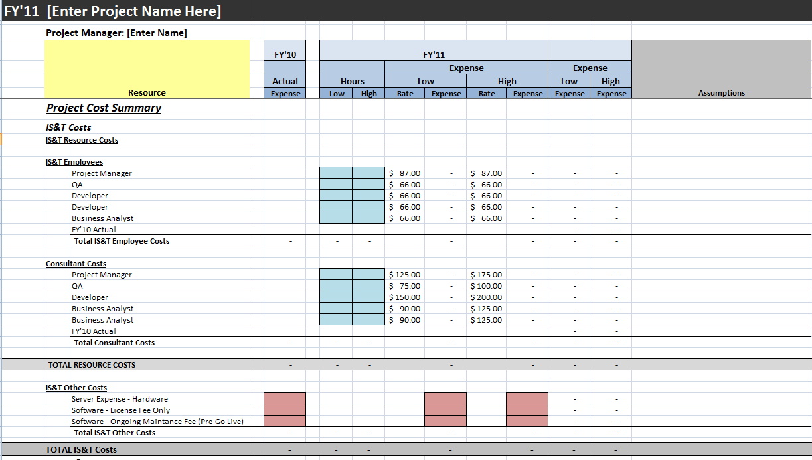
Project Cost Template
Project Assumptions:
All Assumptions should be documented in your project template

Slide 11
Project Cost Template
What Assumptions Should be Documented:
Scope, Requirements and Timeline:
What general assumptions have you incorporated into your estimate? (Sponsorship, Drivers, Resource Requirements (both business and IS&T), Etc.)
Do you have a clearly defined scope requirements?
Who approved them?
Are there any key dates or milestones that should be documented in assumptions (or can only go live in June, etc.)?
Are there multiple phases? Have those been vetted? Are they well defined?
Technical Requirements and Project Risks
What are some of the risks associated with this project? (scope creep, funding, key resource issues both on business and or IT side, internal vs. external, change management requirements, etc.)
What is the technology we will be using? Is it new or existing? Or will that be decided later?
Cost
What consultant rates did you use? (was there a specific agency or skill set they were based off of)
What contingency rate have you built in on the high side? Why?
Has ongoing maintenance expense been discussed? (for example if we buy external software will they pay the annual maintenance fee?

Slide 12
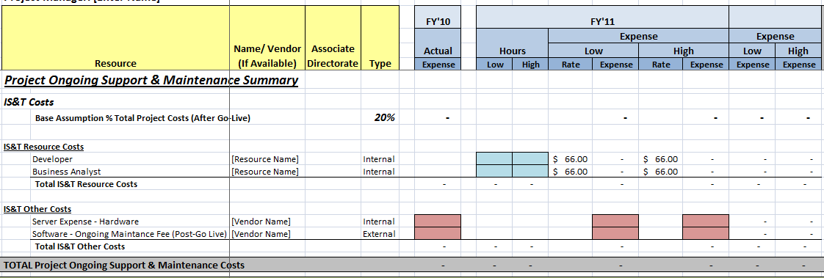
Project Cost Template
Estimated Support and Maintenance Costs : Ongoing support and maintenance costs should also be captured (if possible) otherwise a base assumption of 20% will be used in the model.
Estimated Support and Maintenance Costs should also be captured in the template (i.e. Annual Maintenance Expense)

Slide 13
Software Development Project Approval Process
Now I have a….
Completed and Approved Project Cost Template
So what is the approval process?

Slide 14
Software Development Project Approval Process
Project Manager Completes and Submits
Project Cost Template
To
FBC
Step 1: IS&T Project Cost Template must be completed and submitted to your Associate Directorate Financial Business Consultant. It is recommended that all Project Managers set up an in-person meeting with their FBC to discuss assumptions and issues. Guidance on filling out the IS&T Project Cost. Template can be provided by your Team Lead or your FBC.

Slide 15
Software Development Project Approval Process
Project Manager Completes and Submits
Project Cost Template
To
FBC
FBC Approval of
Project Cost Template
Step 2: Once the IS&T Project Cost Template is submitted all assumptions will be reviewed and approved by the area FBC.

Slide 16
Software Development Project Approval Process
Project Manager Completes and Submits
Project Cost Template
To
FBC
FBC Approval of
Project Cost Template
Associate Director Approval
of
Project Cost Template
Step 3: Once the Project Manager has received FBC's approval, the Project Manager can submit the template for Associate Director approval.

Slide 17
Software Development Project Approval Process
Project Manager Completes and Submits
Project Cost Template
To
FBC
FBC Approval of
Project Cost Template
Associate Director Approval
of
Project Cost Template
Head of IS&T and Sponsor
of
FINAL APPROVAL
of
Project Budget
Step 4: Once Associate Director approval is received, the project and the costs outlined in the IS&T Project Cost Template can be submitted to the Head of IS&T for approval and then to External Sponsorship Committees (ASPCC, SSSC, ITGC, Etc.) for FINAL APPROVAL.

