Slide 1


Implementing Remote Laboratories with the ILab Architecture: Three Case Studies from Obafemi Awolowo University, Nigeria
Prof. L.O. Kehinde
Prof. O. Osasona
K.P. Ayodele
Dept of Electronic and Electrical Eng.
Obafemi Awolowo University, Ile-Ife
Nigeria
Presented by
O.B. Akinwale
Dept of Electronic and Electrical Eng.
Obafemi Awolowo University, Ile-Ife
Nigeria

Slide 2
Outline
Introduction
iLab Architecture
Three Case Studies
The OAU Experience
Conclusion

Slide 3
Introduction
The Case for Remote Laboratories
Remote Laboratories

Slide 4
Experiment Architecture
Knowledge transfer via S&T Laboratories requires:
  The student
  The system-under-test (SUT)
  The laboratory: a location or means though which the student can access and manipulate the system-under-test (SUT)
  Lab instructor / manual?

Slide 5
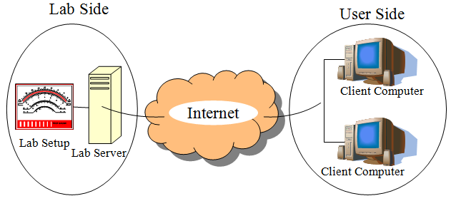
Remote Laboratories (Rlabs)
Online lab & virtual labs

Slide 6

Impetus for Rlabs
The availability and capability of communication facilities
Rapid advances in internet technologies.
Generalization of computer use for data acquisition and control of real processes

Slide 7
iLab Architecture
Batched iLab Architecture
Interactive iLab Architecture

Slide 8
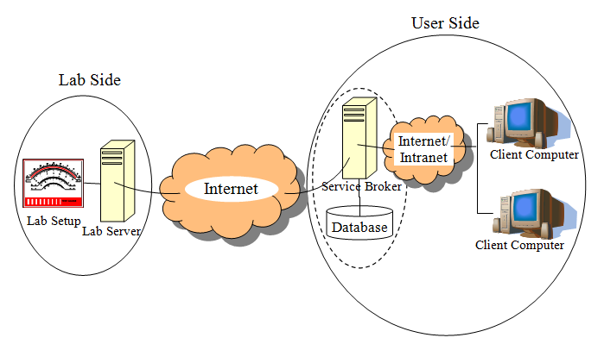
Batched iLab Architecture
3 tiers: Lab Server (LS), Service Broker (SB) & Client Application

Slide 9
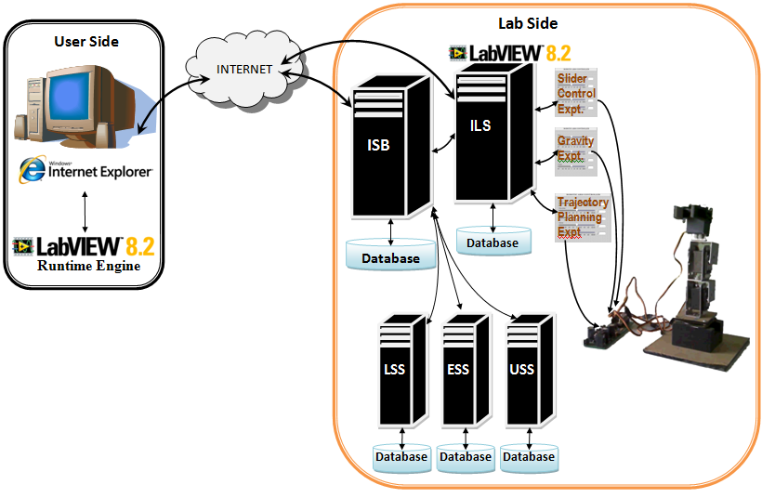
Interactive iLab Architecture

Slide 10
Three Case Studies
Op-Amp iLab – Batched iLab
Logic Design iLab – Batched iLab
Robotic Arm iLab – Interactive iLab

Slide 11
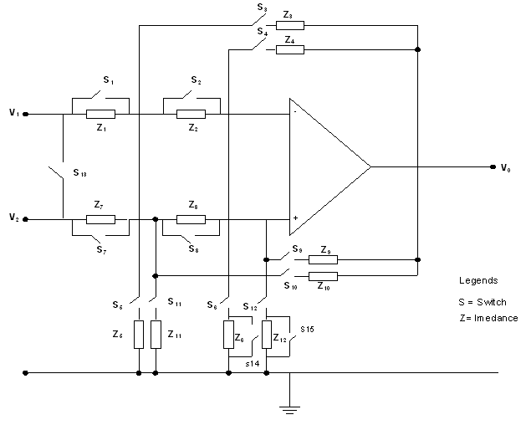
Op-Amp iLab (OpLab)
Based on the Dozen-Impedance operational amplifier configuration

Slide 12
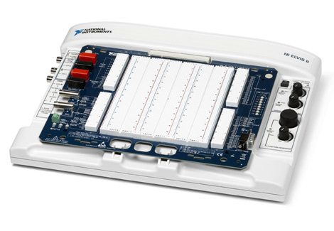
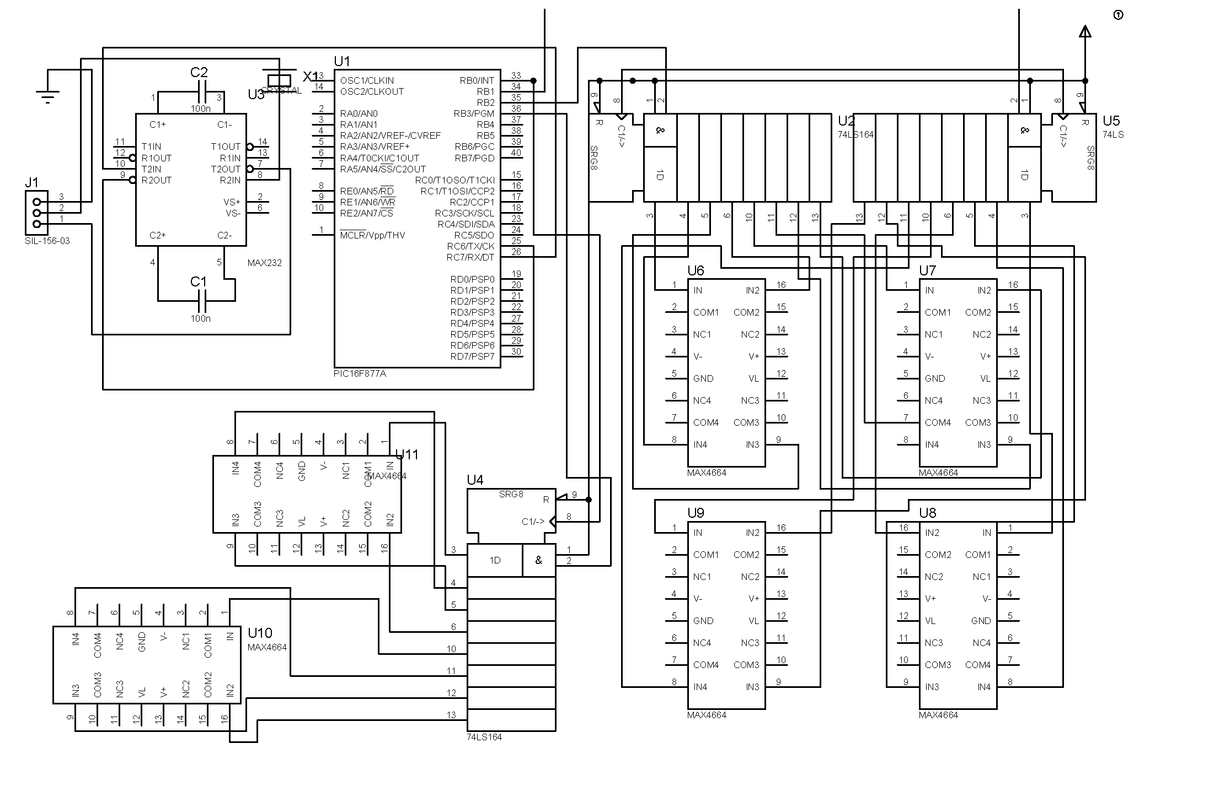
OpLab (cont’d)
Lab was set up using NI ELVIS (Educational laboratory Virtual Instruments Suite) + a switching matrix based on a PIC 18F452 microcontroller
+

Slide 13
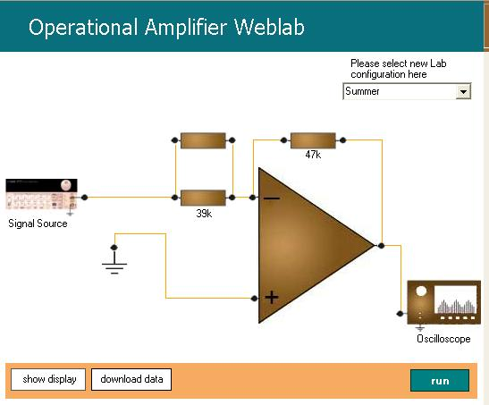
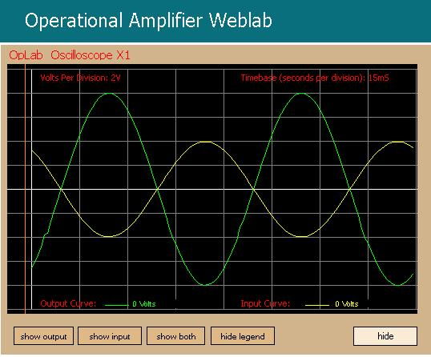
OpLab (cont’d)

Slide 14
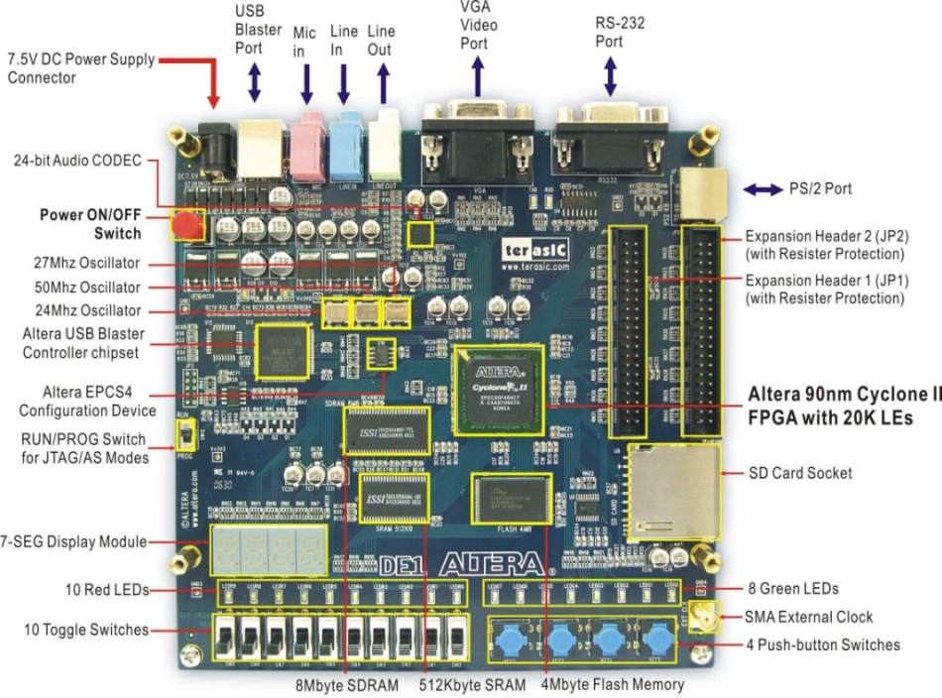
Logic Design iLab (ADLab)
Built around an Altera DE1 Development Board
Students programme the Cyclone II FPGA on board via VHDL
The only limit to the code which students can send is the capability of the Altera Development board!

Slide 15
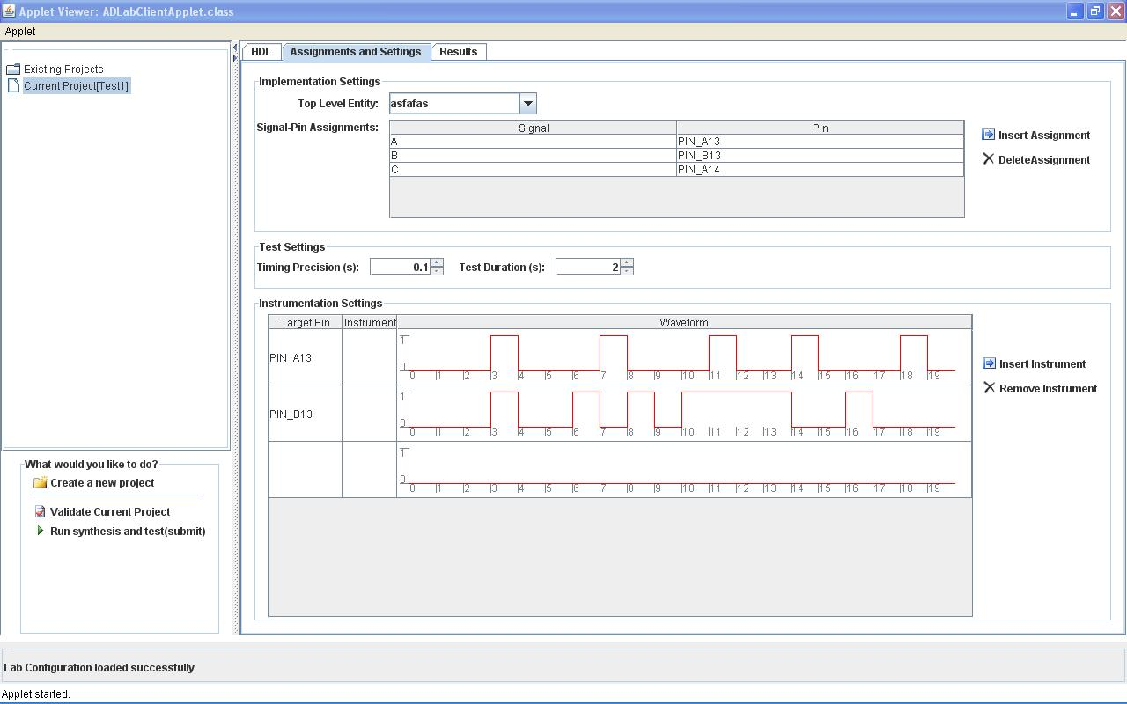
ADLab (cont’d)
Student submits VHDL code + test signals to use to test his synthesized system
ADLab parses code for error and then synthesizes system
ADLab tests system with test signals and returns results to student

Slide 16
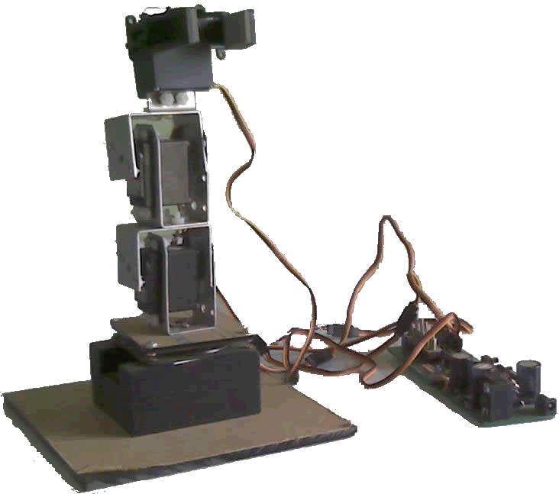
Robotic Arm iLab
Built around an Images SI Inc RA-01 robotic arm
Interactive lab: lab client developed using National Instruments LabVIEW
Three experiments:
  Position control experiment
  Effect of gravity experiment
  Trajectory planning experiment

Slide 17
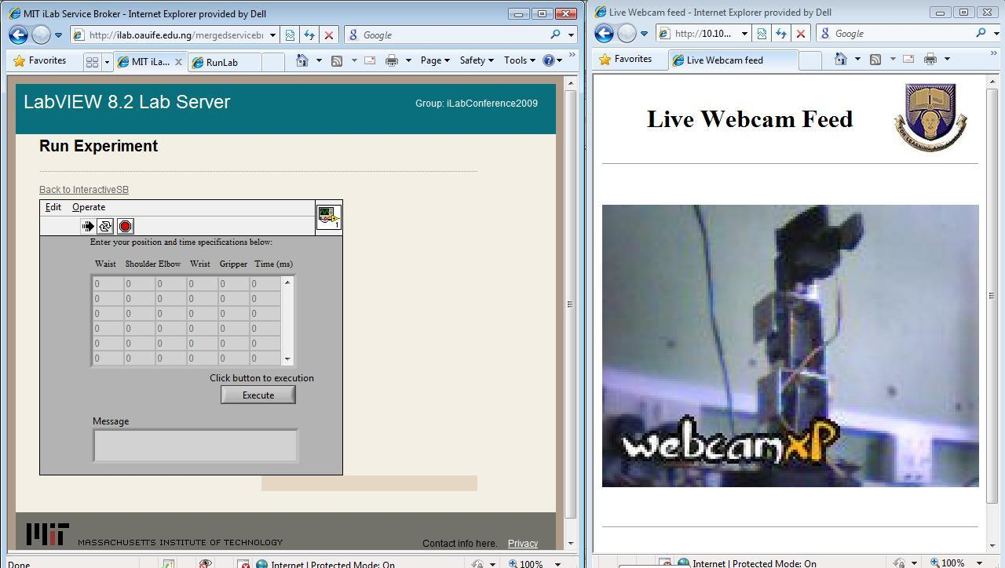
Robotic Arm iLab (cont’d)

Slide 18
The OAU Experience
Inter-University Collaboration
Enhanced Lab Experience
Curriculum Enhancement
Research in iLab Development
Student Intuition Encouragement

Slide 19
Inter-University Collaboration
MIT-OAU Collaboration for five years on the development of iLabs at OAU
  Funding obtained via MIT
  Staff of both universities exchange visits each year
OAU is fostering collaboration with other universities to use our iLabs and develop their own iLabs

Slide 20
Inter-University Collaboration (cont’d)
Reduction in lab equipment redundancy
With a common pool of equipment, relatively more funds are available to each university
Lab groups can be formed from students from different universities
Sharing of time on national and international experimental equipment such as space-based experiments – a university can perform experiments on equipment which it cannot afford

Slide 21
Enhanced Lab Experience
Each individual performs the lab for himself.
  Better individual understanding of concepts
  Instructor can check to make sure that each student actually performed the experiments
    Database of students who log on
    “Forensics” of e-lab reports
Problem: Lab interface
  Student compliant about OpLab
  The use of a webcam

Slide 22
Curriculum Enhancement
Curriculum delivery enhancement
  Experiments are performed as and when desired by the course lecturer.
  Experiments can be performed during lecture delivery.
Curriculum expansion
  VHDL and FPGA
  Robotics – kinematics and machine learning

Slide 23
iLabs as a Research Area
Curriculum delivery methods:
  Interface – client applications
  Feedback to the student
    Haptic
    Olfactory – e.g. for chemistry experiments
Technology of placing a lab online
  What is the best experiment setup to deliver the desired lab deliverables

Slide 24
Student Intuition
Safety is incorporated into iLabs, hence, students can feel free to experiment on the system-under-test without “playing by the book”.
Two of OAU’s labs particularly allow for student intuition:
  ADLab – “no limit” to possible student design
  Robotics iLab – can I get the robotic arm to write my name via trajectory planning?

Slide 25
Shortcoming of remote labs
Remote labs have the major short-coming of not providing the students with physical hands-on experience.
Half bread is better than none.

Slide 26
Conclusion

Slide 27
Conclusion
The development of iLabs are a viable research area in itself
iLabs present students with possibility of having hands-on experience with equipment which they would otherwise have had no access to.
iLabs present the possibility of having lab groups with students from different universities, communicating electronically.
iLabs enhances curricula as well as curriculum delivery.

Slide 28
Conclusion (cont’d) iLabs
Present users with the opportunity of performing experiments with laboratory apparatus which are not readily available in such users’ reachable environment.
create and foster the possibility of collaboration between educational institutions, thereby enabling a more comprehensive learning experience for students.
create the possibility of having students from different institutions at different locations operating in distributed teams, fostering inter-institutional student collaboration.
present the unique advantage of being able to run an experiment for demonstration during a lecture.
present great savings by reducing laboratory equipment redundancy in the learning environment.
provide a wider range of students with access to the laboratory experiment.
increase the possibility of being able to perform experiments.

Slide 29
Weblinks
http://ilab.oauife.edu.ng/ServiceBroker
http://ilab.oauife.edu.ng/MergedServiceBroker
https://wikis.mit.edu/confluence/display/ILAB2/Obafemi+Awolowo+University,+Ile-Ife

Slide 30

Thank You!

