Slide 1






Challenges on ASTRO-H Calibration Plans
“Bish” K. Ishibashi (Nagoya U.)
R. Petre (NASA’s Goddard)
J.-W. den Herder (SRON)

Slide 2
ASTRO-H Calibration Advisory Board
Calibration Advisory Board is established for ASTRO-H in order to help facilitate complex calibration plans which are to be executed in proper and efficient manner by instrument teams.
Three of us are appointed to serve for the purpose.
Software / Calibration Team (SCT led by Terada and Angelini) is established for the same concept.
Unofficial Remark: We are here to make the lives of instrument teams easier by providing advices on calibration when and where needed (on occasion, provide hard, physical labor…[→ Bish]).

Slide 3
ASTRO-H Calibration Plans
Having four instruments covering the energy range from 0.3 ~ 600keV, it is imperative for ASTRO-H to have good cross-calibration plans among instruments, as well as good calibration goals for each instrument.
We are here at this IACHEC to “give” you excellent opportunities to provide us insights on what you might do (differently) if you are to plan calibration activities for ASTRO-H.

Slide 4
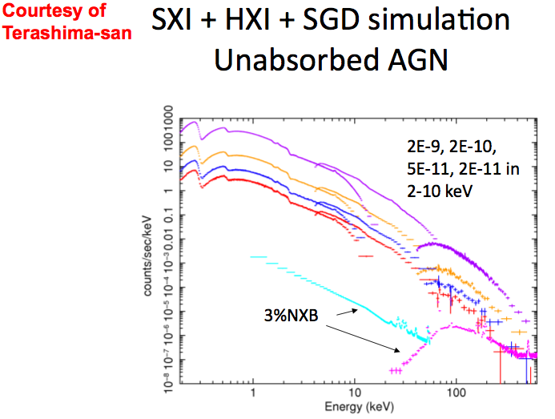
ASTRO-H Calibration Plans
How accurately can we
cross-calibrate between
SXI-SXS-HXI-SGD?
What actions are needed on
ground and in flight to ensure
high accuracies of calibration
in the overlap region?

Slide 5
ASTRO-H Calibration Plan
Graphic Representation
of
ASTRO-H Calibration Plans

Slide 6
ASTRO-H: SXT – SXS Calibration Items
SXT-SXS
To list a few examples
of cal items..
On-Axis EA
Effective Area
Off-Axis EA
PSF core (r < 20”)
On-Axis PSF
PSF
PSF wing (r > 20”)
Off-Axis PSF
Vignette
Transmission
Thermal Shields
QE/QEU
Filters
Detector Response
Energy Resolution
Contamination
Line Profile
Instrumental noise
Background
Gain Stability /
Thermal Variations
Stray Light
NXB

Slide 7
ASTRO-H: SXT – SXS Calibration Items
SXT-SXS
On-Axis EA
For Effective Area & PSF Cal…
Effective Area
Off-Axis EA
PSF core (r < 20”)
On-Axis PSF
PSF
PSF wing (r > 20”)
Off-Axis PSF
Vignette
Transmission
NASA/GSFC 100m diverging beam facility used
Measurement at E = 1.5, 4.5, 8.0, and 9.4 keV (proposed based on the Suzaku lessons)
1G-effect, imperfection in geometry/alignment examined (incl. the effect of vibration test)
EM test planned in April / June 2011
Expected accuracies in 5 – 10 %
Science requirement ~ 3 % (the goal not met)
Detector Response
Background

Slide 8
ASTRO-H: SXT – SXS Calibration Items
SXT-SXS
On-Axis EA
For Effective Area & PSF Cal…
Effective Area
Off-Axis EA
PSF core (r < 20”)
On-Axis PSF
PSF
PSF wing (r > 20”)
Off-Axis PSF
Vignette
Transmission
NASA/GSFC 100m diverging beam facility used
for the PSF core
ISAS/JAXA 30m pencil beam facility used
for the PSF tail/wing
Measurement at E = 1.5, 4.5, 8.0, and 9.4 keV (proposed based on the Suzaku lessons)
Vignetting – planned w/o specifics
FM test planned in Feb. / Sept. 2012
Expected accuracies in a few %?
Science requirement ~ 3 % (the goal not met)
Detector Response
Background

Slide 9
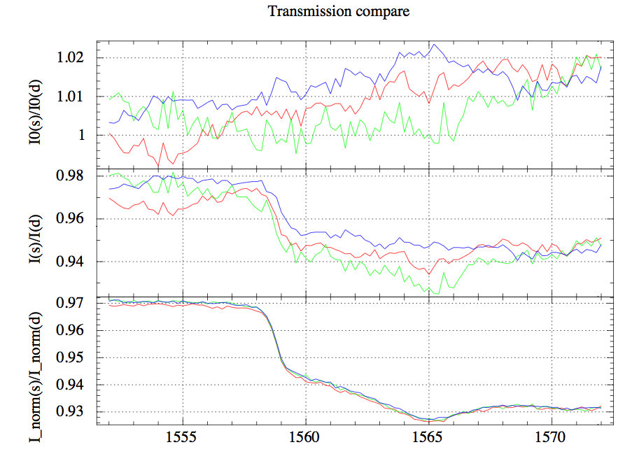
ASTRO-H: SXT – SXS Calibration Items
SXT-SXS
SPring-8 BL25SU measurement conducted
C-K, N-K, O-K, Al-K edges sampled at 0.2eV
(see example at Al-K below); in 0.8 – 1.8keV
at 10eV; otherwise (in 0.12 – 1.8keV) at 5 eV
Measured accuracies: better than 1% in general
Effective Area
PSF
Thermal Shields
Transmission
Filters
Contamination
Detector Response
Brookhaven/NSLS facility & LLNL/EBIT used
  for filter transmission
Thickness verification & edge structure examined
EM test in Apr 2011; FM test in Nov 2011
Expected accuracies: < 5%
Uncertainty in transmission would affect that of EA.
Background

Slide 10
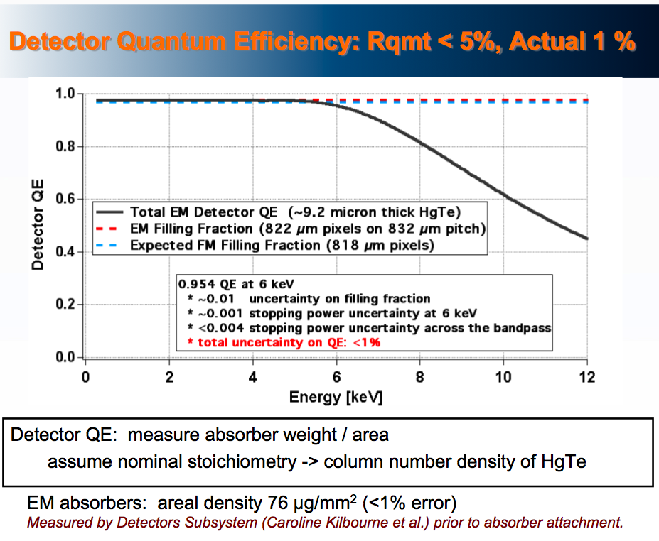
ASTRO-H: SXT – SXS Calibration Items
SXT-SXS
Effective Area
Eckart et al. 2011
PSF
Transmission
QE/QEU
NASA/GSFC facility used
QE = Absorber weight / area
Uncertainty in QE < 1 %
Mission Requirement: < 5 %
Detector Response
Energy Resolution
Line Profile
Background
Gain Stability /
Thermal Variations

Slide 11
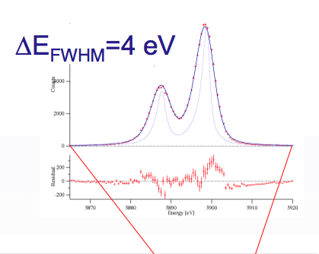
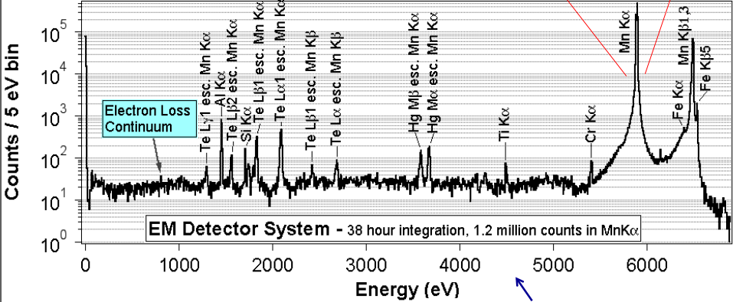
ASTRO-H: SXT – SXS Calibration Items
SXT-SXS
Eckart et al. 2011
Effective Area
PSF
Transmission
QE/QEU
NASA/GSFC facility used
σFWHM ~ +/-1eV (Goal 0.2eV)
Gaussianity of profile expected
Spectral redistribution
Measure several energies in
EM integration in May 2011
Science Requirement: < 1.6eV
Detector Response
Energy Resolution
Line Profile
Background
Gain Stability /
Thermal Variations

Slide 12
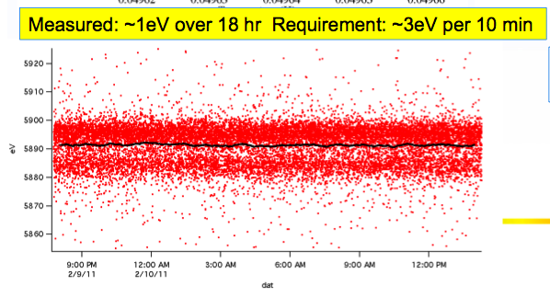
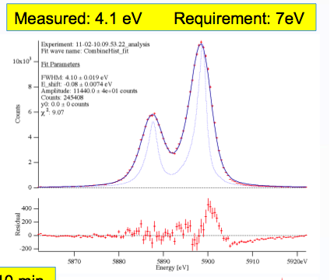
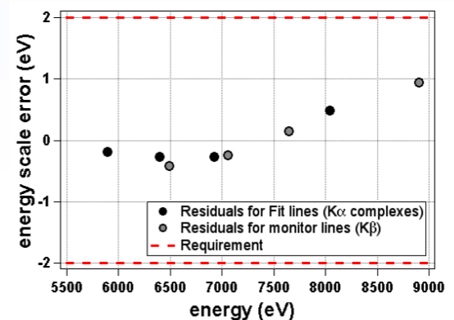
ASTRO-H: SXT – SXS Calibration Items
SXT-SXS
Effective Area
PSF
Kelley et al. 2011
Transmission
QE/QEU
Detector Response
Energy Resolution
Line Profile
Background
Gain Stability /
Thermal Variations

Slide 13
ASTRO-H: SXT – SXS Calibration Items
SXT-SXS
NASA/GSFC facility used (ISAS in later EM test)
ΔE ~ +/-2eV (Goal 0.5 – 1 eV)
Measure several energies in EM integration test in May / June 2011
FM test planned in the same manner; more extensive in large matrix of operating conditions
Use of Modulated X-ray Sources (MXS) in flight
Science Requirement: 0.5 – 1 eV (marginally OK)
Effective Area
PSF
Transmission
QE/QEU
Detector Response
Energy Resolution
Line Profile
Background
Gain Stability /
Thermal Variations

Slide 14
ASTRO-H: SXT – SXS Calibration Items
SXT-SXS
Effective Area
To be furnished later.
PSF
Transmission
Detector Response
Instrumental noise
Background
Stray Light
NXB

Slide 15
ASTRO-H: HXT – HXI Calibration Items
HXT-HXI
To list a few examples
of cal items..
On-Axis EA
Effective Area
Off-Axis EA
On-Axis PSF
PSF
Off-Axis PSF
Vignette
Transmission
Thermal Shields
QE/QEU
Entrance Window
Detector Response
Energy Resolution
Contamination
Energy Response
Instrumental noise
Background
Gain Stability
Stray Light
PC
Pb sheet
NXB
Veto: BGO/APD

Slide 16
ASTRO-H: HXT – HXI Calibration Items
HXT-HXI
On-Axis EA
For Effective Area & PSF Cal…
Effective Area
Off-Axis EA
On-Axis PSF
PSF
Off-Axis PSF
Vignette
SPring-8 BL20B2 facility used for calibration
Without Pre-Collimator
  EA Measurement at E = 8(?), 30, 70 keV (TBD)
  Vignetting – 8 offset + nominal
With PC (prior to vibration test)
  EA Measurement at E = 30keV only (TBD)
  No vignetting
With PC (after vibration test)
  EA Measurement at E = 30keV only (TBD)
  Vignetting – 8 offset + nominal
1kev Step beam data needed (EPR rec.) but feasible?
Expected accuracies in 5 – 10 % (TBD in flight)
Science requirement ~ 5 % (marginal)
Transmission
Detector Response
Background

Slide 17
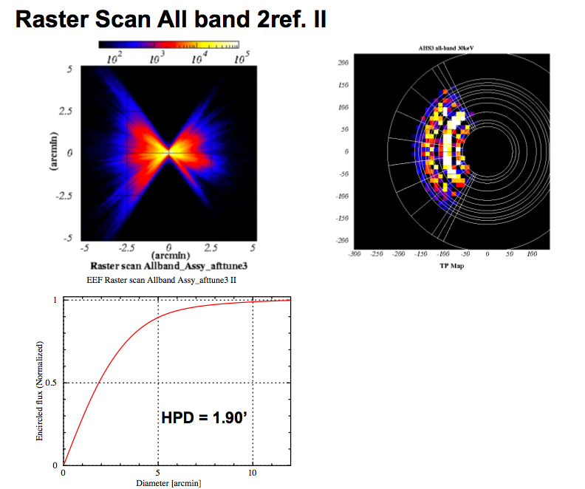
ASTRO-H: HXT – HXI Calibration Items
HXT-HXI
On-Axis EA
For Effective Area & PSF Cal…
Effective Area
Off-Axis EA
On-Axis PSF
PSF
Off-Axis PSF
Vignette
Transmission
Detector Response
Preliminary Result
From SPring-8:
Partial Raster Scan
at 30 keV.
Background

Slide 18
ASTRO-H: HXT – HXI Calibration Items
HXT-HXI
On-Axis EA
For Effective Area & PSF Cal…
Effective Area
Off-Axis EA
On-Axis PSF
PSF
Off-Axis PSF
Vignette
Transmission
Question to everyone:
At what high/low energies should we calibrate
the HXT’s effective area? What factor should
determine our choices? Science-based ideas (use
of a continuous spectrum)? Or crucial calibration
band that we need to have a well refined EA cal?
Detector Response
Background

Slide 19
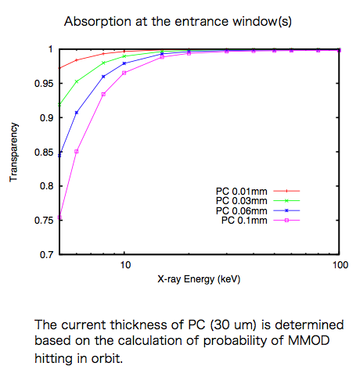
ASTRO-H: HXT – HXI Calibration Items
HXT-HXI
For thermal shield (by Toh-Ray):
Proposals in for utilizing SPring-8 BL25SU and/or KEK/PF
Possibly done in post-flight with the same sample?
For entrance window:
  TBD (polycarbonate used in EM; evapolated Al in FM)
Uncertainties here need to be accounted in EA
Effective Area
PSF
Thermal Shields
Transmission
Entrance Window
Contamination
Detector Response
Optical Constant for Pt edges needed
GEANT4 data needed as well
Background

Slide 20
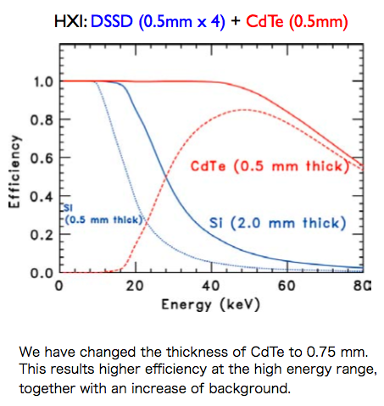
ASTRO-H: HXT – HXI Calibration Items
HXT-HXI
Effective Area
ISAS/JAXA facility used
Uncertainty in QE: TBD
Science Requirement in EA: 5 %
PSF
Transmission
QE/QEU
Detector Response
Energy Resolution
Energy Response
Background
Gain Stability

Slide 21
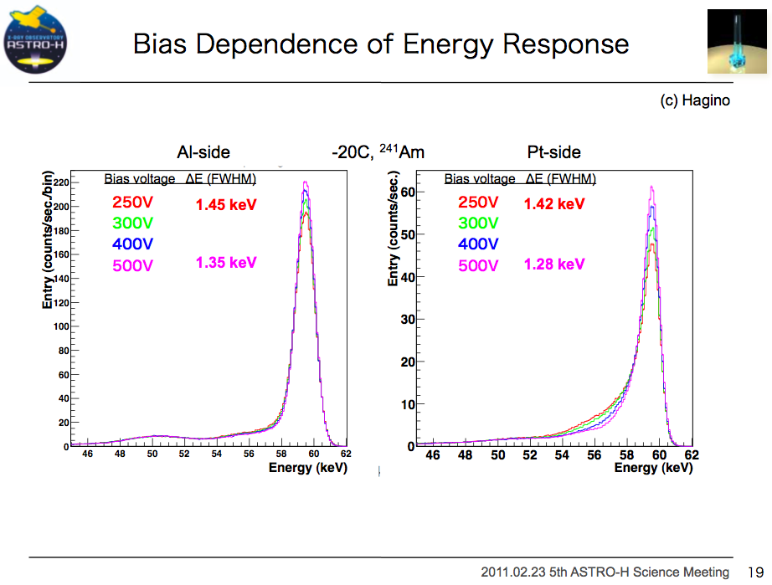
ASTRO-H: HXT – HXI Calibration Items
HXT-HXI
Effective Area
PSF
Transmission
Kokubun et al. 2011
QE/QEU
ISAS/JAXA facility used
EFWHM at 60keV:
  Si ~ 1.1 keV
  CdTe ~ 1.4 (Al) & 1.3 (Pt) keV
Science Requirement: ~ 1keV?
Detector Response
Energy Resolution
Energy Response
Background
Gain Stability

Slide 22
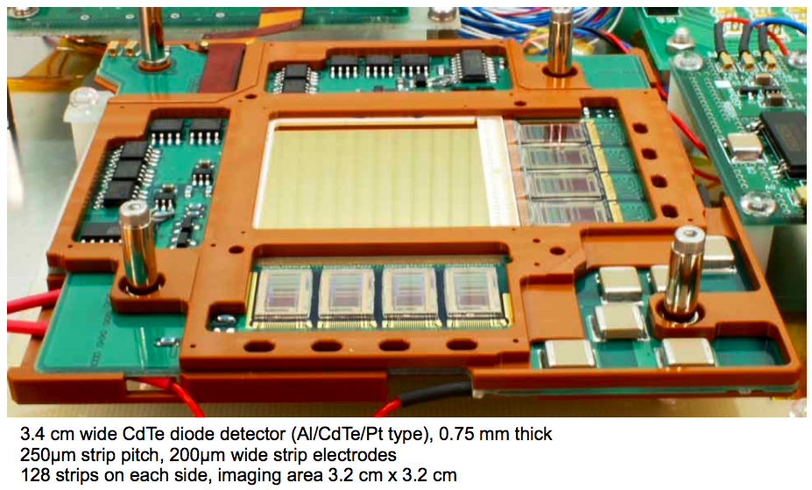
ASTRO-H: HXT – HXI Calibration Items
HXT-HXI
Effective Area
ISAS/JAXA facility used
Test Pulse Injector in ASIC to monitor gain variations in the HXI-DE
Uncertainty in gain: TBD
Science Requirement: 3 %? (seems poor)
PSF
Transmission
QE/QEU
Detector Response
Energy Resolution
Energy Response
Background
Gain Stability

Slide 23
ASTRO-H: Calibration Items
HXT-HXI
Effective Area
To be furnished later.
PSF
Transmission
Detector Response
Background

Slide 24
ASTRO-H: Calibration Items
SGD
Effective Area
On-Axis EA
Vignette
Off-Axis PSF
Transmission
Entrance Window
QE/QEU
Contamination
Detector Response
Energy Response
Gain Stability
Instrumental noise
Background
Modes
Stray Light
NXB
Veto: BGO/APD

Slide 25
ASTRO-H: Calibration Items
SGD
36864 channels to be calibrated
  Each detector pad to be calibrated separately with radioactive sources (²⁴¹Am,⁵⁷Co, ²²Na, ¹³⁷Cs).
  line channel checked for each pixel to correct for gain
  line strength checked for effective EA (+ QE).
  Can be done at any site with radioactive sources, clean room, etc.
The whole 36864 channels after integration
  Ditto as above, but with difficulties in reduction of flux by fine-collimator…
Test pulse injection in ASIC used for gain correction in electronics.
Effective Area
On-Axis EA
Vignette
Entrance Window
Transmission
Contamination
QE/QEU
Detector Response
Energy Response
Gain Stability
Background
Modes

Slide 26
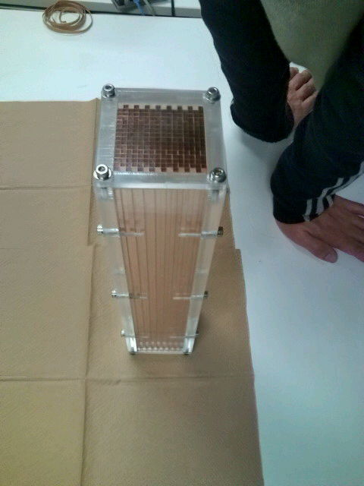
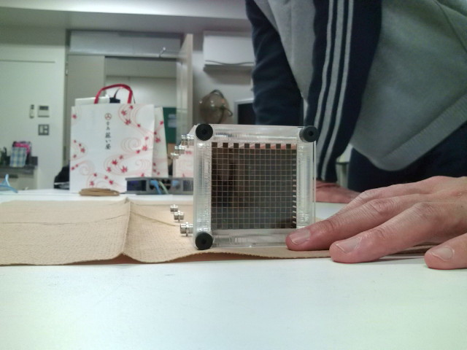
ASTRO-H: Calibration Items
SGD
Fine Collimator
  Structural measurements (distortion, gap / shift in welding points, etc)
  Precise 3-D info to be fed into GEANT4 model
Effective Area
Vignette
Off-Axis PSF
Transmission
Detector Response
Background
Fine Collimator (BBM)

Slide 27
ASTRO-H: Calibration Items
SXT-SXI
On-Axis EA
Effective Area
Off-Axis EA
PSF core (r < 20”)
On-Axis PSF
PSF
PSF wing (r > 20”)
Off-Axis PSF
Vignette
Transmission
Thermal Shields
QE/QEU
Blocking Filters
Detector Response
Energy Response
Contamination
Operation Modes
Instrumental noise
Background
Stray Light
NXB

Slide 28
ASTRO-H: Calibration Items
SXT-SXI
What modes can be made available and how well will they be calibrated prior to or in flight.
Can we selectively turn off CCD chips not needed?
Effective Area
PSF
Transmission
QE/QEU
Detector Response
Energy Response
Operation Modes
Background

Slide 29
ASTRO-H Calibration Plan
This page is left unintentionally blank. Oops.

