Slide 1

5th iLabs Africa Steering Committee Meeting at
Obafemi Awolowo University
University of Dar es Salaam (UDSM)
By
Dr. Alfred Mwambela

Slide 2
New Organizational Structure - 2009
University of Dar es Salaam
College of Engineering and Technology (CoET)
School of Informatics & Communication Technologies (SICT)
Department of Electrical and Computer System Eng (ECSE)
Power Engineering
Electronics & Comm. Technologies
Computer Systems Eng.
Computer Science
Telecommunication Eng.
Center for Virtual Learning

Slide 3
Goals
  Integrate iLabs experiments in teaching and learning process.
  Contributes to the development of iLabs experiments
  Convert existing traditional experiments at UDSM into iLabs Shared Architecture (ISA) for dual-mode teaching and learning
  Disseminate and share information about iLabs experiments
  Encourage fruitful staff/student exchange

Slide 4

1. Integrating iLabs experiments in teaching and learning process
Traditional Approach
Recommended Approach
Theory
Theory
Experiments
Experiments

Slide 5
1. Integrating iLabs experiments in teaching and learning process
ANALOGUE ELECTRONICS (2008/2009)
CODE | STUDENTS | UNIVERSITY
ES 110 | 39 | University of Dar es Salaam (UDSM)
OPH 207 | 10 | Open University of Tanzania (OUT)
PH 326 | 26 | Dar es Salaam University College of Education (DUCE)
 | 20 | Mkwawa University College of Education (MUCE)
 | 95
  Diode Characteristics.
  BJT Output Characteristics
  FET Output Characteristics

Slide 6
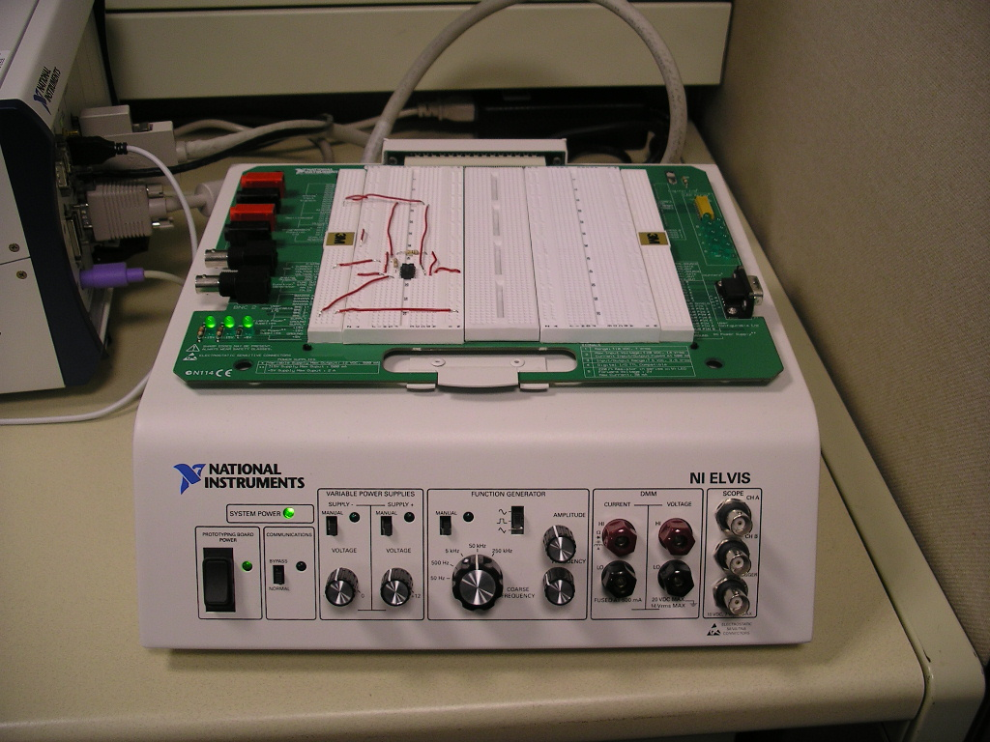
2. Contribute to development of iLabs experiment
2. 1 The NI ELVIS route
2. 1.1 The Common Emitter (CE) Amplifier Experiment
Vcc
Rb
Rc
C2
C1

Slide 7
2. Contribute to development of iLabs experiment
2. 1 The NI ELVIS route
2. 1.1 The Common Emitter (CE) Amplifier Experiment
Main Components of the Experiment | NI ELVIS ISA Requirements
Time domain response | Function generator
 | Scope
Frequency domain response | Bode analyzer
DC analysis | Variable power supply

Slide 8
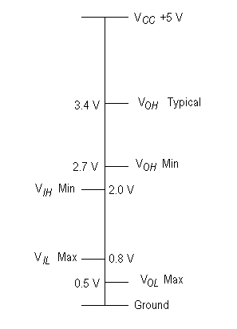
2. Contribute to development of iLabs experiment
2. 1 The NI ELVIS route
2. 1.2 The Transistor-Transistor Logic (TTL) Device Characteristics
  Desirable voltage levels for logic High (1) and logic Low (0).
Main Component | NI ELVIS ISA Requirements
DC analysis | Variable power supply

Slide 9
2. Contribute to development of iLabs experiment
2. 1 The NI ELVIS route
2. 1.2 The Transistor-Transistor Logic (TTL) Device Characteristics
  Excel graph of output voltage for increasing and decreasing input voltages for the NOT (Inverter) gate 74LS14.

Slide 10
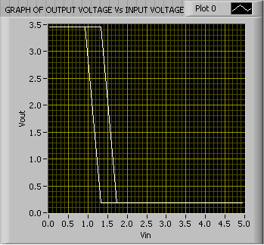
2. Contribute to development of iLabs experiment
2. 1 The NI ELVIS route
2. 1.2 The Transistor-Transistor Logic (TTL) Device Characteristics
  LABVIEW graph of output voltage for increasing and decreasing input voltages for the NOT (Inverter) gate 74LS14.

Slide 11
2. Contribute to development of iLabs experiment
2. 1 The NI ELVIS route
2. 1.3 The I-V Diode Characteristics
R
  This experiment is similar to the MIT microelectronics web lab
I
Vd
Main Component | NI ELVIS ISA Requirements
DC analysis | Variable power supply
 | 2-Wire I-V analyzer

Slide 12
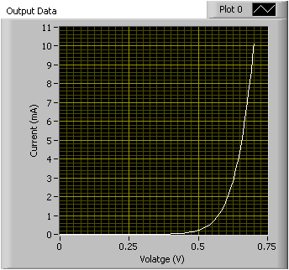
2. Contribute to development of iLabs experiment
2. 1 The NI ELVIS route
2. 1.3 The I-V Diode Characteristics
  LABVIEW graph showing I-V diode characteristics

Slide 13
2. Contribute to development of iLabs experiment
2. 1 The NI ELVIS route
2. 1.4 The Transistor Output Characteristics
  This experiment is similar to the Transistor Characteristics in MIT microelectronics web lab
Main Component | NI ELVIS ISA Requirements
DC analysis | Variable power supply
 | 3-Wire I-V analyzer

Slide 14
2. Contribute to development of iLabs experiment
2. 1 The NI ELVIS route
2. 1.5 The high voltage experiments using the TERCO DAQ system
  This was basically the second iLabs experiments at UDSM, which was discontinued due to malfunctioning of the system

Slide 15
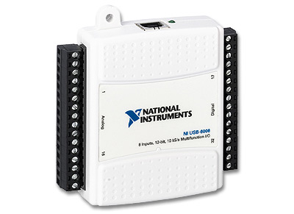
2. Contribute to development of iLabs experiment
2. 2 The NI USB 6009 DAQ route
2. 2.1 The I-V Diode Characteristics

Slide 16
2. Contribute to development of iLabs experiment
2. 3 Integration of NI ELVIS instruments in ISA
NI ELVIS INSTRUMENTS
INSTRUMENT | STATUS
Function generator
Oscilloscope
Bode analyzer
Variable power supply
2-wire current-voltage analyzer
3-wire current-voltage analyzer
Arbitrary waveform generator
Digital reader
Digital writer
Dynamic signal analyzer
Impedance analyzer
Digital multi-meter

Slide 17
3. Converting existing traditional experiments at UDSM into ISA for dual-mode teaching and learning
  This remains to be our area of focus
  Integration of all NI ELVIS instruments in ISA is important if this goal has to be realized

Slide 18
4. Students-Staff Exchange
  UDSM-MAK
  MAK – UDSM
  UDSM-OUT (Dr N Jiwaji)

