Slide 1
National Instruments iLabs Update
AcademiAndrew Watchorn/Lesley Yu
July, 2009

Slide 2
Outline
I. Additions to the Hardware Platform
  ELVIS II+ / Multisim integration with ELVIS
  Digital Electronics Board
  Emona DATEx
  SCXI Power Monitoring
  Controls, Quanser
II. Additions to the Software
  LabVIEW 8.6 Improvements
  Signal Processing
  Controls Software

Slide 3
NI ELVIS II+ Comparison Chart
 | NI ELVIS I | NI ELVIS II | NI ELVIS II+ (Q4’08)
12 Integrated instr. | YES | YES | YES
PCI/PCMCIA | YES | NO | NO
Integrated Usb | NO | YES | YES
Isolated DMM | NO | YES | YES
DAQmx Based S/w | NO | YES | YES
True MS Integration | NO | YES | YES
5 Mhz Source | NO | NO | YES
50 Mhz Scope | NO | NO | YES

Slide 4
What’s New in Multisim Alberta
Two main additions:
NI ELVIS II 3D representation in breadboard view
NI ELVIS 4.0 Soft Front Panels interoperability with Multisim
Goal:
NI ELVIS Simulation and NI ELVIS Measurement should share the same software experience.
Benefits:
The complete package - users use the same system for both simulation and for measurement, with seamless comparison between the two.
Notes:
NI Multisim:
Parser re-design for extensibility in supporting other SPICE variants
Investigate possibility of replacing Multisim grapher and post-processor with a SignalExpress based data view.
NI ELVIS II 3D representation in breadboard view
NI ELVIS 4.0 Soft Front Panels interoperability with Multisim
Additions to Multisim API (for example to replace components, change component values, manipulate interactive components, etc.)
Support for reading TDMS data through USI
Remove user fields from master database
Create mechanism to track testing and fixing of database components (models, symbols, and landpatterns)
Add links to Analog Devices website in Multisim menus and database.
[ from NI CDS Alberta Software Project Plan – Rev 3.3]

Slide 5
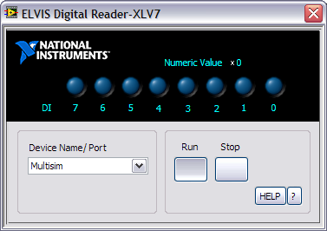
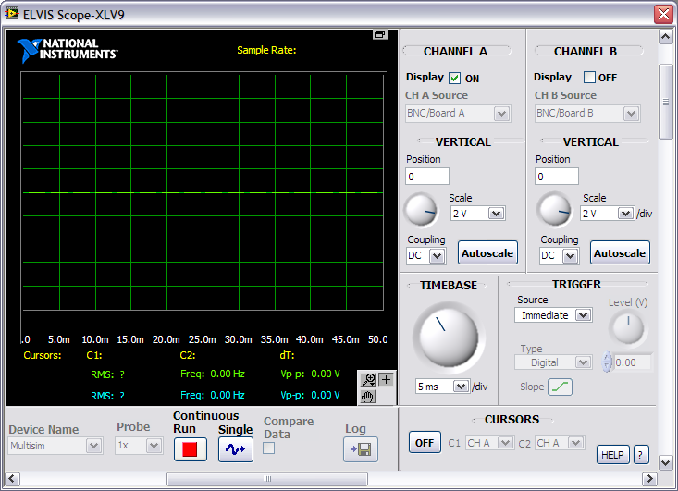
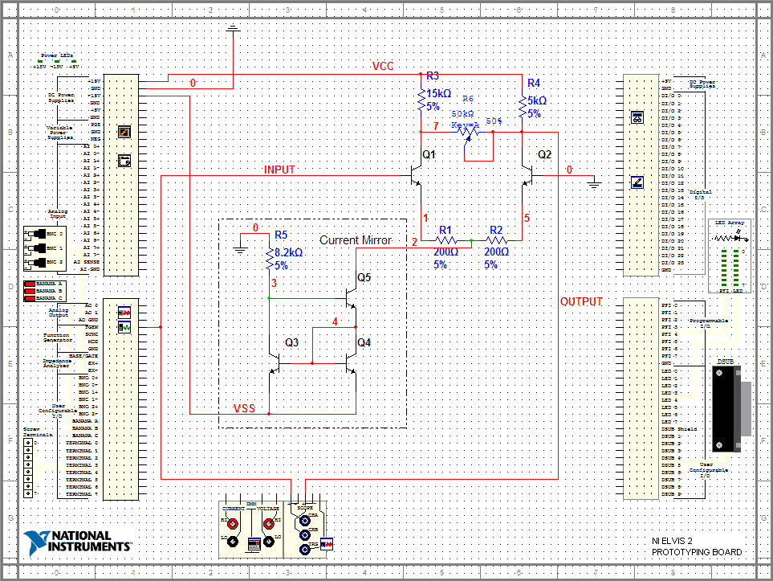
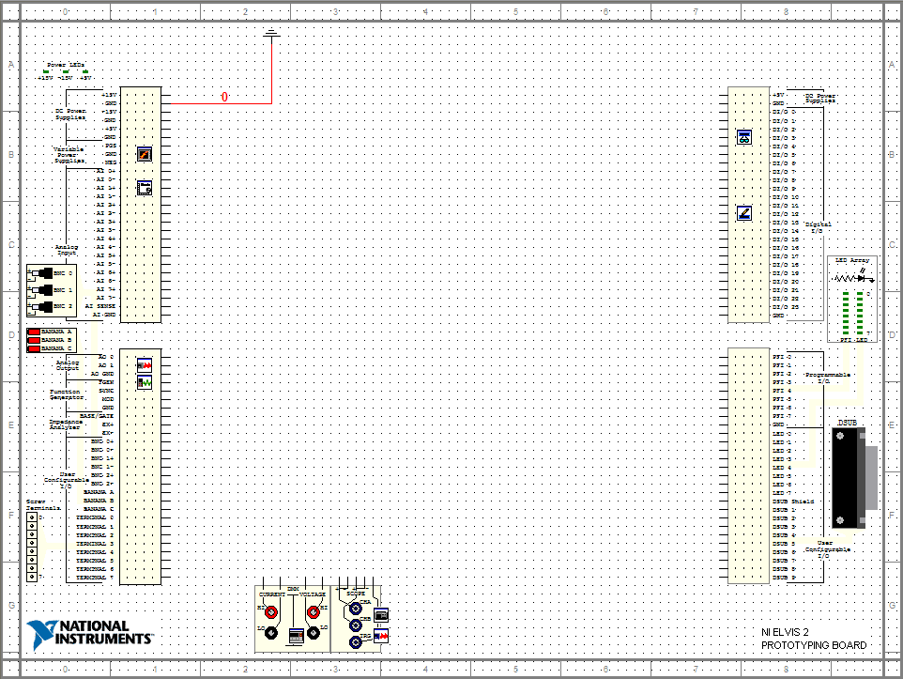
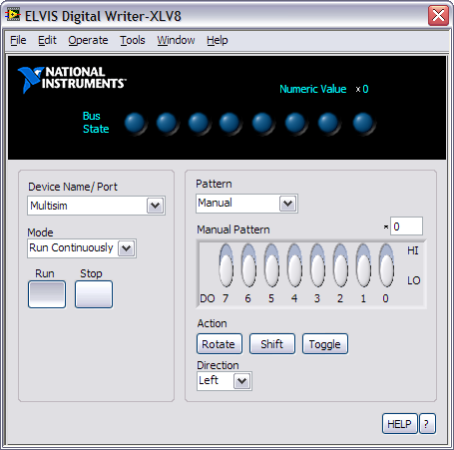
NI ELVIS II Schematic – Multisim Alberta
ELVIS Digital
Reader
ELVIS Power Supply
ELVIS Bode
Analyzer
ELVIS Digital
Writer
ELVIS Arbitrary
Generator
ELVIS LED
Array
ELVIS Function
Generator
ELVIS DMM
ELVIS Scope
ELVIS DSA

Slide 6





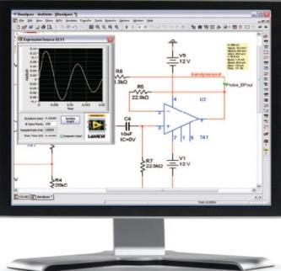
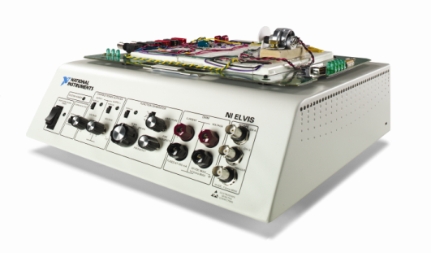
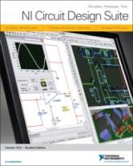
NI Electronics Education Platform
Multisim, LabVIEW and NI ELVIS
Theory
Design & Simulation
Prototype & Compare
NI Multisim Education Edition
ASL Circuits Option
(Department, College and Campus)
NI Multisim Student Edition
NI ELVIS
NI LabVIEW & NI LabVIEW SignalExpress
Measurement and analysis
Microelectronic Circuits
Sedra & Smith
Principles of Electric Circuits
Thomas Floyd
Stanford / MIT Circuits Series
Roger T. Howe, Charles G. Sodini, Boris Murmann
Multisim displaced PSpice in the #1 textbook in China
Notes:
The Electronics Education Platform
The Electronics Education Platform includes NI Multisim circuit simulation software, industry-standard NI LabVIEW measurement software, and the NI ELVIS prototyping workstation. This integrated hardware and software platform provides a hands-on method for students to gain in-depth knowledge of electronics design theory and practice. Based on professional PCB design tools, the Electronics Education Platform was designed with the needs of educators in mind, and aids student understanding through features such as integrated quizzes, virtual and rated components, 3D virtual breadboarding, easy measurements, and more.
The combination of Multisim, the NI ELVIS prototyping platform, and NI LabVIEW gives your students a comprehensive, hands-on experience throughout the entire product design cycle.
Integrated schematic capture and interactive SPICE simulation
Microcontroller co-simulation
Combined hands-on and simulation environments that reinforce circuit theory
Equivalent functionality of stand-alone instrumentation at a fraction of the cost
Built-in hardware and software instruments: oscilloscope, digital multimeter, function generator, and more
Easy comparison and analysis of simulated and real-world data

Slide 7
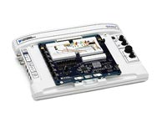
Digital Electronics
No VDHL/Verilog Necessary
Digital Electronics Board for ELVIS (Full Function)
  New with ELVIS II+
  Xillinx FPGA Based ELVIS Plug in
Spartan 3E (Low Cost)
  Xillinx Spartan FPGA
  Google:
    “LabVIEW Spartan 3E”

Slide 8

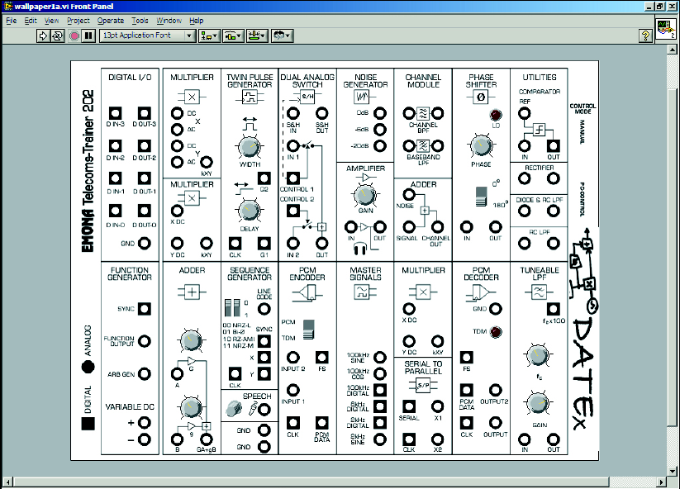
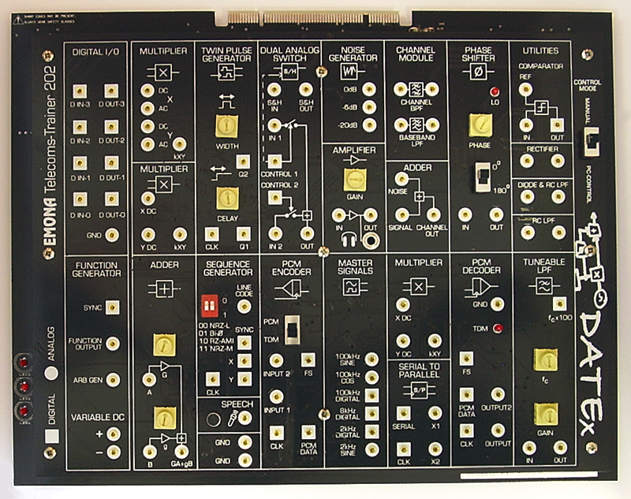
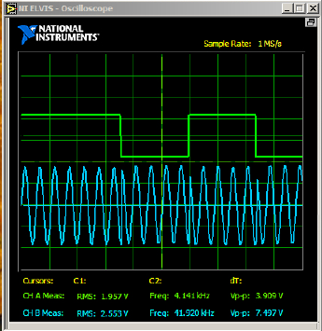
DATEx From Emona
Communications Trainer Board
LabVIEW Soft Front Panels
Courseware Included (29 Expts)
Shipping Q4’07
Example Labs:
  AM, DSB & FM
  BPSK, QPSK, QAM
  FSK, ASK, Sampling
  PCM & Line Codes
  Intro:Software Defined Radio

Slide 9
Emona Labs
Introduction ........................................................................................................ i - iv
1 - An introduction to the NI ELVIS test equipment ................................... Expt 1 - 1
2 - An introduction to the DATEx experimental add-in module................ Expt 2 - 1
3 - An introduction to soft front panel control .............................................. Expt 3 - 1
4 - Using the Emona DATEx to model equations............................................. Expt 4 - 1
5 - Amplitude modulation (AM)............................................................................. Expt 5 - 1
6 - Double Sideband (DSBSC) modulation......................................................... Expt 6 - 1
7 - Observations of AM and DSBSC signals in the frequency domain..... Expt 7 - 1
8 - AM demodulation................................................................................................ Expt 8 - 1
9 - Double Sideband DSBSC demodulation....................................................... Expt 9 - 1
10 - Single Sideband (SSB) modulation & demodulation............................... Expt 10 - 1
11 - Frequency Modulation (FM) ........................................................................... Expt 11 - 1
12 - FM demodulation............................................................................................... Expt 12 - 1
13 - Sampling & reconstruction ............................................................................ Expt 13 - 1
14 - PCM encoding ..................................................................................................... Expt 14 - 1
15 - PCM decoding..................................................................................................... Expt 15 - 1
16 - Bandwidth limiting and restoring digital signals..................................... Expt 16 - 1
17 - Amplitude Shift Keying (ASK) ..................................................................... Expt 17 - 1
18 - Frequency Shift Keying (FSK)...................................................................... Expt 18 - 1
19 - Binary Phase Shift Keying (BPSK)............................................................... Expt 19 - 1
20 - Quadrature Phase Shift Keying (QPSK) .................................................. Expt 20 - 1
21 - Spread Spectrum - DSSS modulation & demodulation ........................ Expt 21 - 1
22 - Undersampling in Software Defined Radio.............................................. Expt 22 - 1

Slide 10
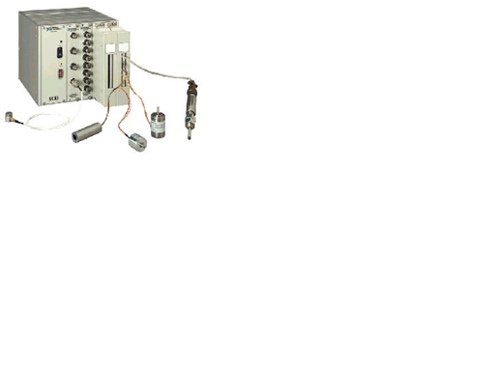
Power Monitoring
University of Virginia
  DAQ and SCXI
    1000 V DC of Isolation
    Graphical User interface to understand Power concepts
    Programmed as with regular DAQ
  “A combination of in-class demonstrations, simulations and computerized data acquisition for laboratory use has proven to be an effective route for conveying power systems concepts. We have observed that students who have a genuine interest in the course have taken extra time on occasion to extend the experiments on their own, and the user-friendly data-gathering environment has facilitated this.”
--Harry Powell, UVA Electrical Engineering Lab Manager

Slide 11

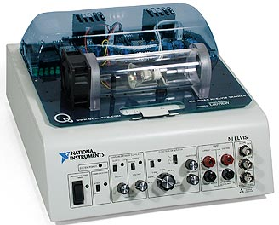
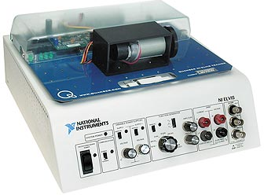
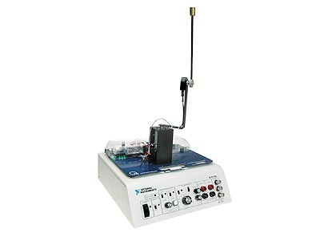
Controls – Quanser QNET Boards
Three plants
  QNET-010 DC Motor
  QNET-011 Rotary Pendulum
  QNET-012 HVAC Trainer
Includes
  VIs specific to these plans
  Courseware for plants
Future
  Full compatibility with NI ELVIS II
  Discussion for more boards

Slide 12
LabVIEW 8.6
Programming interaction through type to find
Programming readability with “Clean up All”
Load time

Slide 13
LabVIEW for Signal Processing concepts
Simulation of simple Filtering, AM, FM, etc
Advances Filters, IIR, FIR, etc
Making FPGA implementation of Algorithms
Mark Yoder, DSP First, Simulations

Slide 14
LabVIEW ARM
Luminary Micro ARM 7 Board
  AI/AO/DIO
  LCD
  Ethernet, Serial, Protocal Busses
  USB Programmed
LabVIEW + Keil Tool Chain
Elemental I/O in LabVIEW for Teir I

Slide 15
LabVIEW for control and simulation
Control Design Toolkit
  Transfer functions
  Time based analysis
  Frequency analysis
Simulation Module
  Controls Diagrams vs. Functional Programs
  Why use a solver
  Motor control demonstration
mechatronics.marquette.edu/
cRIO implementation of controllers

Slide 16
Duct-Tape Marketing – Guy Kawasaki
Simple, Effective, Affordable
1. Narrow the market focus.
2. Differentiate.
3. Think about strategy first.
4. Create information that educates.
5. Package the experience.
6. Generate leads from many points.
7. Nurture leads along the logical buying path.
8. Measure everything that matters.
9. Automate for leverage.
10. Commit.
Notes:
1. Narrow the market focus. Create a picture of the ideal client: what they look like, how they think, what they value, and where you can find them. Start saying no to non-ideal clients.
2. Differentiate. Strip everything you know about your product or service down to the simplest core idea. Make sure that the core idea allows you stand out.
3. Think about strategy first. Take everything you’ve done in steps one and two and create a strategy to own a word or two in the mind of your ideal client and prospect.
4. Create information that educates. You are in the information business, so think of your marketing materials, web sites, white papers, marketing kits as information products, not "sales" propoganda.
5. Package the experience. Put visual elements around every aspect of the marketing strategy that you adopt. Use design to evoke the appropriate emotional response from your ideal prospect.
6. Generate leads from many points. People learn in different ways. Your lead generation efforts must allow your prospects to experience your firm from many different angles and views.
7. Nurture leads along the logical buying path. There’s a natural way for your prospects to come to the conclusion that you have what they need. Build the lead conversion system for before, during, and after the sale.
8. Measure everything that matters. Certain things always matter. The secret sauce is in finding and measuring the intangibles – those things down on the shop floor that eventually add up to profit.
9. Automate for leverage. Embrace the Internet or else. Create access, stimulate community, capture innovation, and build knowledge to automate the basic delivery elements of your information business.
10. Commit. Resist the temptation of the marketing idea of the week. Create daily, weekly, monthly, and annual marketing calendars, make marketing your new habit, and find the money to stick with the plan.

Slide 17
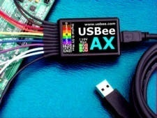
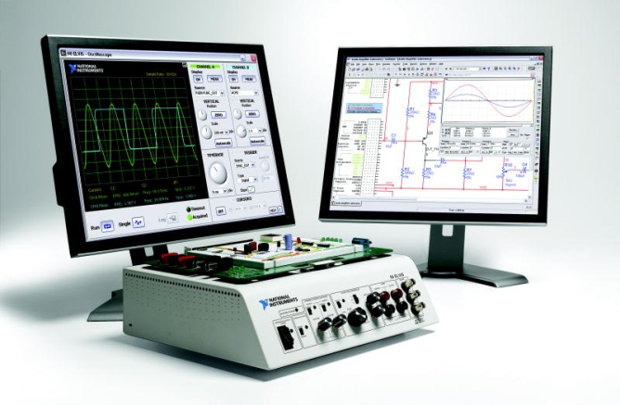
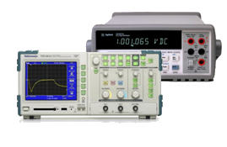
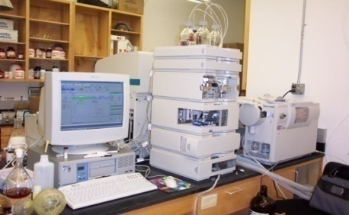
Gap in the Academic Market
Low
Price
High
Narrow
Application
Broad
Notes:
Define market space – teachers were looking for academic solution etc.
axis
Talk about possible solutions in the market
- How NI ELVIS fits into the picture
--------------
In the academic test and measurement market there is a range of applications from circuits labs to research. These products also go across a wide range of prices, seen on the left. You will notice a gap in the broad application …
Do we have reference about these?
Names
Manufacture
Price

Slide 18
NI ELVIS Performance as a Product
History:
Total Revenue: $16.6M
Total Units: 12,275
33% CAGR (2003-2007)
Notes:
Axis
Trends (going up /growing)
What is the graph of?
Totals – revenue/units
NI ELVIS is effective based on continuing growth, 36% YOY
-----------------------------------
ELVIS came out in 2003. Describe axes.
Where did we get these numbers? PowerPlay
This proves that there was a hole that NI ELVIS filled, been successful

Slide 19
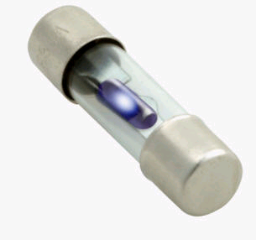
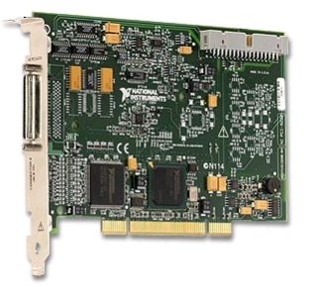
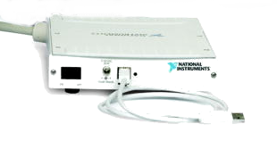
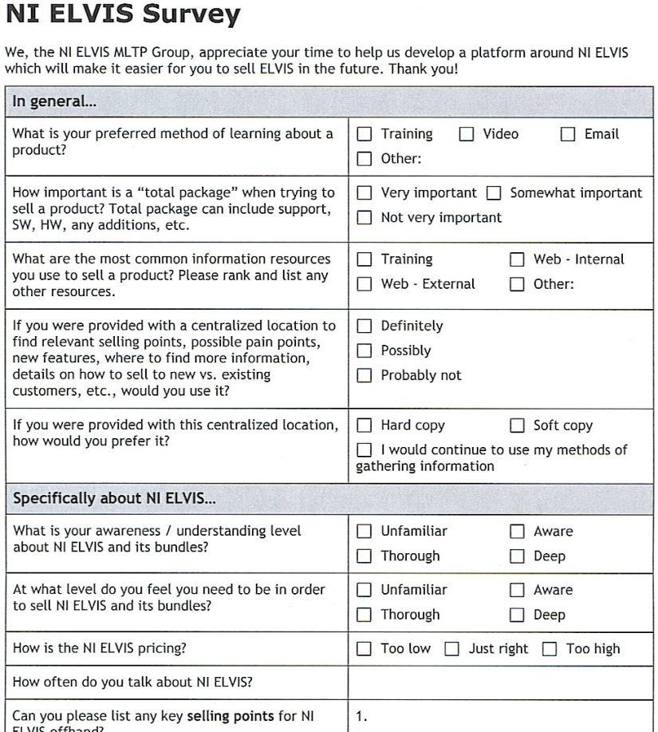
NI ELVIS Issues
Notes:
NOTE: talk about why sales force would want to sell ELVIS
need for ISR surveys/why we did it
explain that we wanted to know more. (Not particularly using the survey for R&D suggestions.)
what were the results
focus on ISRs about customers, not data from customers, filtered but condensed
customer pain points, so know what we need to do to improve
find out what feature to market
------------------------
Yeah it’s been helping students, but we needed to make it better. We’ve seen that it is effective and we wanted to improve upon it.
What can we do to make it easier to sell; for our sales force to sell -> fix painpoints for selling ; sales force is directly connected to customers. (make sure to message that these came from the sales force, and not customers)
** Have surveys in hand … emphasis!
ISR Survey – supporting data, show survey, why did we do this survey
- Here we are showing the pain points of ELVIS 1. We are correcting these and increasing functionality in ELVIS II. This should help it sell better.

Slide 20
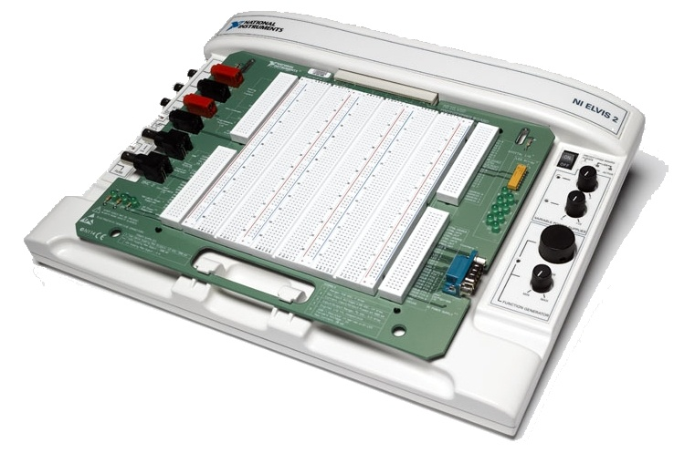
Introducing: NI ELVIS II
Automatically Resetting Fuses
Isolated DMM
Smaller Form Factor
Integrated DAQ Device
Faster Oscilloscope
Notes:
Intro NI ELVIS
We did address the top pain points
Thnx R&D for making our jobs easier
- New features?
----------------------------------------------
Change pictures and structure!
New features as compared to 1
Zoom
-

Slide 21
An Important Point
NI ELVIS II software is not backwards
Compatible

Slide 22
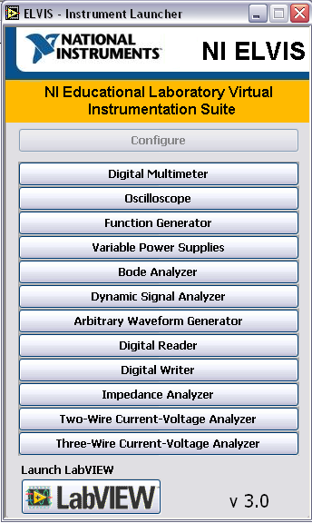

An Important Point
NI ELVISmx
Current Version

Slide 23
Curriculum Integration

Slide 24
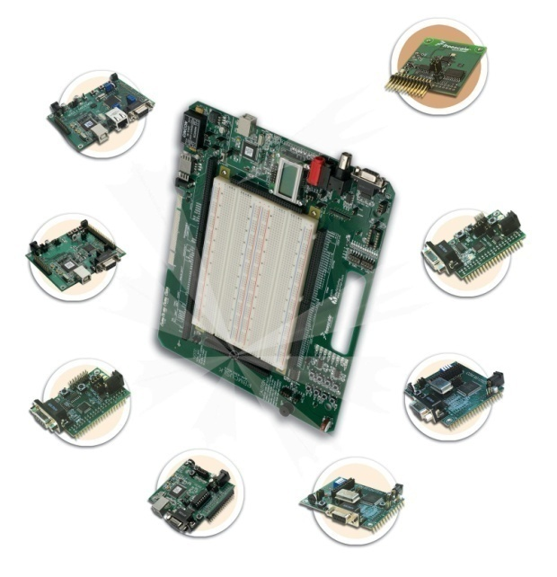
Freescale Board for NI ELVIS
Integrated HCS12(x)/HCS08 USB pod
Applicable Modules from
  HCS08 (1)
  HCS12/HCS12x/DSP (4)
  Coldfire processors (2)
  RF Transceiver (1)
Existing courseware
  Working to integrate NI ELVIS directly into courseware with FSL

Slide 25
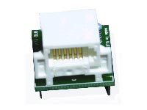
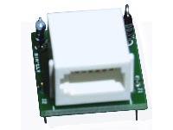
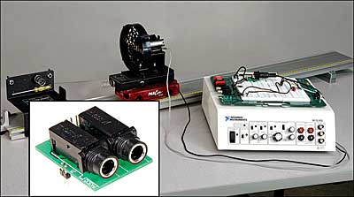
Vernier & Pasco Adapters
K-12 : A lucrative segment in the future
Current Opportunity
  Project Lead the Way
    Designing a Custom Protoboard for PLTW (in discussions)
NI ELVIS II opportunity
  Possible trade-in policy
  Donate NI ELVIS I to highschool near you and get X% discount on NI ELVIS II

Slide 26
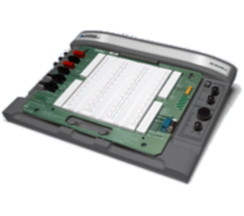

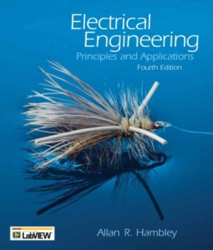

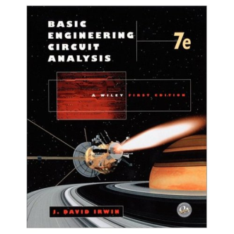

Platform for Teaching MCU Concepts
Software
Hardware
Curriculum
Multisim
Textbooks
  Electrical Engineering
  Microelectronic Circuits
  Basic Engineering Circuit Analysis

Slide 27
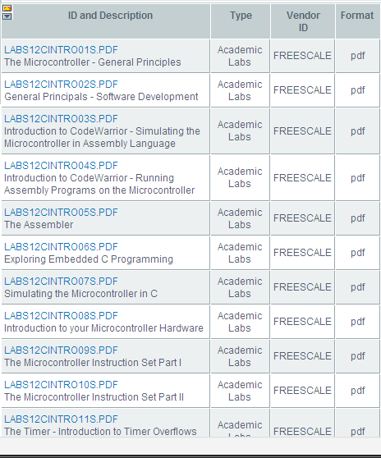

Platform for Teaching MCU Concepts
Software
Hardware
Curriculum
Coldwarrior

Slide 28
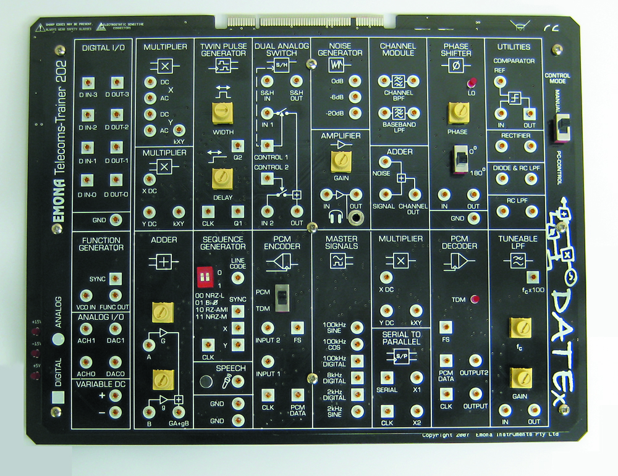
Platform for Teaching Telecom Concepts
Software
Hardware
Courseware
FPO

Slide 29


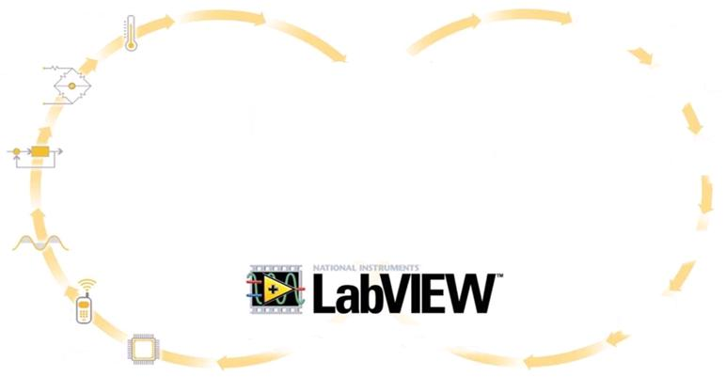
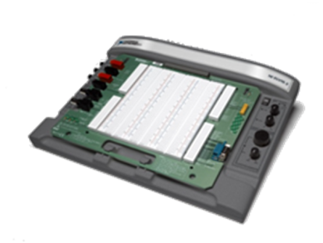


NI ELVIS II Teaching Platform
Measurement and Instrumentation
Circuit Design and Simulation
Multisim
Control, Simulation and Mechatronics
Signal and Image
Processing
RF and Wireless
Communications
Embedded Systems
Notes:
A look at ELVIS will reveal that it actually already has traits of a platform - It has 12 integrated instruments, allowing flexibility to be used with a variety of markets. (talk about application areas!) It is ‘bought-into’ by both partners and R&D. One example of a partner allowing penetration into a new market is Freescale, who makes a custom board and courseware for the embedded segment. Resarch and Development has a whole roadmap for the ELVIS family. ELVIS II continues to be integrated with the company core, as enables users to work with both LabVIEW and LabVIEW SignalExpress. Lastly, plans are in progress to increase the support qualtiy for ELVIS, along with better informing and enabling our sales force, but these will be discussed a bit later.
Together, all of the creates the foundation for the ELVIS II platform, which will help towards reaching the goals that Justin Talked about – helping to increase LabVIEW adoption along with increasing ELVIS II sales, therefore increasing NI revenue.
----------------------------------------------------------------------------------------------
This is a visualization of entire ELVIS as the academic platform story
----------------------------------------------
Figure 8 – further explaining the ‘platform’ idea and key points. (Flexibility, Buy-in, Tight Integration, & Support)
Partner Buy-in
Flexibility
Multidisciplinary
Integration
I- partner hardware
i- LabVIEW, LV SignalExpress, Multisim
supported

Slide 30
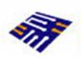


NI ELVIS II Platform
Controls
Communications
Multisim
Circuit Design & Instrumentation
Embedded
K-12
Notes:
A look at ELVIS will reveal that it actually already has traits of a platform - It has 12 integrated instruments, allowing flexibility to be used with a variety of markets. (talk about application areas!) It is ‘bought-into’ by both partners and R&D. One example of a partner allowing penetration into a new market is Freescale, who makes a custom board and courseware for the embedded segment. Resarch and Development has a whole roadmap for the ELVIS family. ELVIS II continues to be integrated with the company core, as enables users to work with both LabVIEW and LabVIEW SignalExpress. Lastly, plans are in progress to increase the support qualtiy for ELVIS, along with better informing and enabling our sales force, but these will be discussed a bit later.
Together, all of the creates the foundation for the ELVIS II platform, which will help towards reaching the goals that Justin Talked about – helping to increase LabVIEW adoption along with increasing ELVIS II sales, therefore increasing NI revenue.
----------------------------------------------------------------------------------------------
This is a visualization of entire ELVIS as the academic platform story
----------------------------------------------
Figure 8 – further explaining the ‘platform’ idea and key points. (Flexibility, Buy-in, Tight Integration, & Support)
Partner Buy-in
Flexibility
Multidisciplinary
Integration
I- partner hardware
i- LabVIEW, LV SignalExpress, Multisim
supported

Slide 31
Global Launch Objectives
Attract new customers to the LabVIEW, Multisim and NI ELVIS platform
Drive upgrades to existing NI ELVIS accounts
Convert existing EWB accounts to NI ELVIS customers
Expand NI ELVIS sales via existing academic site license accounts
Drive NI ELVIS sales in areas where it has been undersold (Eg: Germany)

Slide 32
Benchmarks for Success
50% growth in NI ELVIS revenue after launch
  X% new contacts at new locations in academic
30% Circuit Design Bundles growth
30% of account penetration of existing EWB accounts with NI ELVIS in 2008 (10% in 2007)
80% growth from new NI ELVIS sites
  20% revenue from upgrades

Slide 33
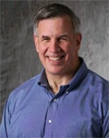
Who Are We Targeting?
Primary Audience
Teaching Professor
Key Needs
Easy implementation into existing courses with existing/supporting curriculum
Knowing who else is using it and how
Cost
Ease-of-use to the student, retention of the student’s interest

Slide 34
Primary NI ELVIS II Audience Segments
Circuit Design
  NI ELVIS II & EEP have the strongest integration possible
  Circuits: core course in every engineering program
  EWB existing accounts
Instrumentation
  Closely aligned with circuits
  Existing history behind NI ELVIS
  Widespread adoption = Upgrade revenue possibility

Slide 35
Secondary NI ELVIS II Audience Segments
Communications
  Emona has full integration with NI ELVIS and LabVIEW
  Solid curriculum = 28 experiments
Controls
  Quanser: Well known & acknowledged controls partner
  More NI ELVIS boards possible in future
Embedded
  Strong collaboration opportunities with Freescale
  Dedicated academic program with increased focus on Asia

Slide 36
Information Path
New Prospects
Existing Customers
Awareness | What is NI ELVIS II? What is LabVIEW? | What is new in NI ELVIS II?
Knowledge | NI ELVIS II value proposition Companion products Webcasts/Cool demos | NI ELVIS II value proposition Product specifications Companion products
Preference | Product specifications Product evaluation | How to use NI ELVIS II for X Why NI ELVIS II is right for you
Purchase | Buy Cross-sell site license, Multisim, companion products | “Upgrade” your lab Cross-sell site license, Multisim, companion products

Slide 37
NI ELVIS II Info Path
NI ELVIS II
What is NI ELVIS II
(Video)
Case Studies
Companion Products
Try
White Papers
Courseware
How-to
Webcasts/Videos
Product Bundles
Example Code and Experiments
Preconfigured
Carts
Site License
NI ELVIS Virtual Tour/Simulation

Slide 38
NI ELVIS II Landing Page
How-to Videos
Partners
White Papers
Case Studies
Try/Buy NI ELVIS II
Courseware
How-to Videos
Bundle
Bundle
Generate Lead
Buy NI ELVIS II
Try NI ELVIS II

Slide 39
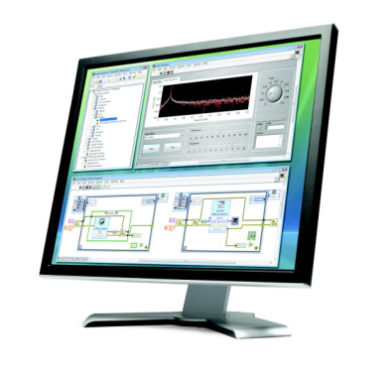
Key Themes
Validated
Open
Flexible
Low-cost
Hands-on

Slide 40
Key Themes
Validated
  Used by universities and professors in over 2000 schools worldwide; available with comprehensive curriculum resources
Open
  LabVIEW graphical system design software is an open environment designed to let you take advantage of other engineering tools to build the best system
Flexible
  Available with a suite of companion products to teach multidisciplinary concepts including controls, communications, and embedded design
Low-cost
  LabVIEW, USB plug-and-play, and 12 integrated instruments make this a low-cost, complete lab system
Hands-on
  Compare simulations to real-world signals, connecting theoretical concepts with the real-world

Slide 41
Key Message for NI ELVIS II Launch
What is NI ELVIS II?
Short Version: NI ELVIS II combined with LabVIEW is a fully integrated design and prototyping platform designed with the educational lab in mind.
Long Version: NI ELVIS II is a fully integrated design and prototyping platform designed with the educational lab in mind that includes a suite of accurate instrumentation based on LabVIEW graphical system design software, USB plug and play connectivity, and a comprehensive set of curriculum resources.

Slide 42
Elevator Pitch
Used by premier universities and technical schools worldwide, the powerful combination of LabVIEW with NI ELVIS II creates an open, flexible and low-cost platform to teach a variety of engineering and science concepts in a hands-on, experiential learning environment.

Slide 43

Partner/Distributor Marketing Toolbox
Product information/background
NI/Powered by LV logos
NI ELVIS photography
News release template
NI ELVIS e-newsletter blurbs

Slide 44
Supporting Curriculum
Semester worth of labs
  Circuits labs from PTI
  Basic measurement labs rewritten for NI ELVIS II
  Emona courseware (DONE)
  Freescale – 25 labs revved to use NI ELVIS
  Quanser courseware (Karl Astrom?)
  Dr. Kenneth Meissner (Bioinstrumentation labs)
  ADI partner board curriculum???
  Vernier courseware?

Slide 45
Key Media Ideas
Web: www.ni.com/ni_elvis
  Complete revamp of NI ELVIS web experience
  Streamline use experience through multimedia
  Curriculum delivery mechanism
Multimedia
  Flash/video tour of NI ELVIS II
  Video testimonials/lab demos
  Intro to teaching with NI ELVIS webcast series (topic-based?)

Slide 46
Key Media Ideas
PR
  Academic-focused press tour
  Partner press kit toolbox
  NI ELVIS INL dustcover mailing to academic INL subscribers
Advertising
  NEW NI ELVIS partner platform full page ad
  NEW NI ELVIS full page
  E-newsletter sponsorships

Slide 47
Key Media Ideas
Database Marketing
  Sneak peak e-mail
  “NI ELVIS II” mailer (ie. lift the breadboard to see new features inside)
  NI ELVIS II Academic e-newsletter edition
Events
  Re-launch at ASEE
  Featured product at branch Academic/Educator Days
Collateral
  NI ELVIS Platform Flyer

Slide 48
Media Team Specific Metrics
TBD

Slide 49
Launch Execution
Phase 1
Due March 20
Technical and multimedia content (webcasts, white papers, and app notes)
Phase 2
Due April 20
Direct Marketing content
Phase 3
Due May 20
Sales resources (demo scripts, presentations, and cheat sheets)
Key content that branches have requested
Developer Zone document stubs
Web page edits
NI ELVIS platform flyer
Out-of-the box experience
Launch date: May 20th 2008

Slide 50
Media Ownership
Media Area | Technical Lead | Media Lead
Advertising | Armando | Erin Hnath
Collateral | Sandra | Adam Hampshire
Database Marketing | Shekhar | Liz Pollard
Events | Sandra | Priscilla Brave
Global | Shekhar | Julie Schreier
Multimedia | Sandra | Julie Bach/Chris Roysden
PR/Corporate Comm | Shekhar | Trisha M. & Stephanie L.
Web | Shekhar | Erin Smith

Slide 51
Technical Leads
Application Area | PMM Lead
Overall | Shekhar/Jon (PMC)
Circuits | Sandra
Measurements | Shekhar/Armando
Control | Anu
Communications | Sam
Embedded | Shekhar
K-12 | Andy

Slide 52
Launch Team Logistics
Media strategy documents
Master spreadsheet with activity list
Bi-weekly core team meetings
Bi-weekly or weekly tactical meetings by media
Branch updates (single point of contact)

Slide 53
Next Steps
Individual media team planning sessions
  Strategy documents
  Activity plan
Branch communication/alignment (Mar/Apr)
Content development

Slide 54
Resources
NI ELVIS II Launch Wiki
http://nict.amer.corp.natinst.com/mediawiki/index.php/NI_ELVIS_II_Launch_Wiki
Server Location for Plans and Files
\\typhoon\MarketingII\Campaign Information\2008 Campaign Plans and Presentations\2008 Learning with LabVIEW\NI ELVIS II Launch

Slide 55
PR
NI news release
Partner news releases (Freescale, Quanser, Emona, ADI, Xilinx, Vernier, Pasco, Delmar)
Customer quotes/case studies
Video announcement (YouTube, Connexions)
Article abstracts (in collaboration with partners)
Blogs?

Slide 56
Newsletters
Q2 INL article
Q2 NI News articles
Q2 NI News Academic Edition
Partner newsletters

Slide 57
Advertising
NEW LabVIEW/NI ELVIS platform print ad
Update Electronics Education Platform ad
NEW LabVIEW/NI ELVIS partner print ad
Google keyword campaign
Online/banner ads (multiple sizes)
E-newsletter sponsorships

Slide 58
Web
ni.com feature graphic week of launch
ni.com/academic feature graphic
Revamp of NI ELVIS LTB
Model pages/datasheets for II/II+ and partners
Update to NI Academic Products/Services
Dev Zone updates/revamp
Updates to all portal pages
ni.com/nielvis redirect

Slide 59
Collateral
NI ELVIS/LabVIEW Platform Flyer
Academic Products Brochure update
NI New Products Brochure inclusion

Slide 60
Multimedia
Flash/video tour of NI ELVIS
Video testimonials/lab demos
Captivate software features
Intro to teaching with NI ELVIS webcast
Intro to teaching XXXXX with NI ELVIS (partners)
Podcasts
Topical webcasts (ie. Frequency Measurements with NI ELVIS, PID Control, Power Measurements, Circuit Design)

Slide 61
Events
NIWeek keynote presence
NIWeek show floor (NI ELVIS corner featuring partners)
NITS
Tradeshows/Conferences:
  ASEE “relaunch”
  SAME-TEC
  BMES
  ICASSP
  ACC

Slide 62
NI ELVIS Marketing Challenge Contest….

