Slide 1


iLabs@MAK
“Remote Engineering: Development and Deployment of iLabs Experiments on the NI ELVIS II Platform-
The Makerere University Experience”
Dr. Julius Butime

Slide 2
Outline
Introduction
Basic Telephony
Communication Theory
Digital Electronics
Conclusions
Notes:
Leaders in Measurement and Control
Direct Operations 40 Countries
1,353 engineers are employed
Headquartered in Austin, Texas, NI has more than 3,000 employees and direct operations in more than 40 countries. Along with the more than 1,000 measurement, control, and automation tools we offer, NI recognizes more than 500 members in our National Instruments Alliance Partner Program (a network of independent consultants and integrators) ready to assist you in assembling and implementing an NI measurement and automation solution. These Alliance Partners offer domain expertise from process control to discrete manufacturing for oil and gas, aerospace, automotive, electronics, communications, and semiconductor industries.

Slide 3
Introduction
iLabs@MAK is under the Electrical Engineering Department
Department Constrained by Resources: Experimentation Equipment and Space
iLabs Research targeted critical courses
Research based on the ISA model
Three Courses, Three Teams:
  Basic Telephony
  Communication Theory
  Digital Electronics
Notes:
Leaders in Measurement and Control
Direct Operations 40 Countries
1,353 engineers are employed
Headquartered in Austin, Texas, NI has more than 3,000 employees and direct operations in more than 40 countries. Along with the more than 1,000 measurement, control, and automation tools we offer, NI recognizes more than 500 members in our National Instruments Alliance Partner Program (a network of independent consultants and integrators) ready to assist you in assembling and implementing an NI measurement and automation solution. These Alliance Partners offer domain expertise from process control to discrete manufacturing for oil and gas, aerospace, automotive, electronics, communications, and semiconductor industries.

Slide 4
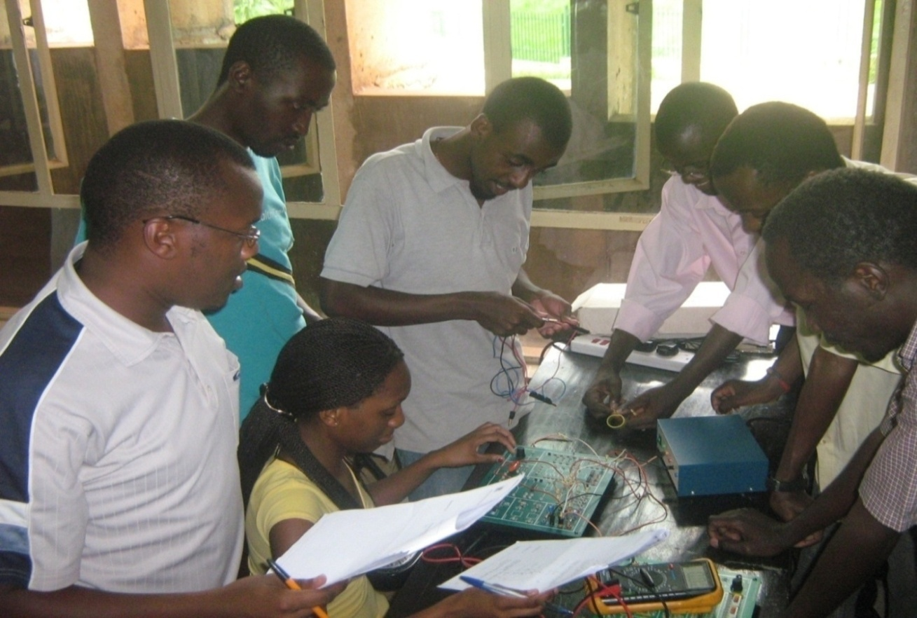
Students in a Digital Electronics Lab: 2008/2009
Notes:
Leaders in Measurement and Control
Direct Operations 40 Countries
1,353 engineers are employed
Headquartered in Austin, Texas, NI has more than 3,000 employees and direct operations in more than 40 countries. Along with the more than 1,000 measurement, control, and automation tools we offer, NI recognizes more than 500 members in our National Instruments Alliance Partner Program (a network of independent consultants and integrators) ready to assist you in assembling and implementing an NI measurement and automation solution. These Alliance Partners offer domain expertise from process control to discrete manufacturing for oil and gas, aerospace, automotive, electronics, communications, and semiconductor industries.

Slide 5
Basic Telephony Experiments
Nyquist Sampling Theorem: Identifying Sampling Scheme
Pulse Code Modulation: Steps involved
Line Coding: Identify Line coding Schemes
Notes:
Leaders in Measurement and Control
Direct Operations 40 Countries
1,353 engineers are employed
Headquartered in Austin, Texas, NI has more than 3,000 employees and direct operations in more than 40 countries. Along with the more than 1,000 measurement, control, and automation tools we offer, NI recognizes more than 500 members in our National Instruments Alliance Partner Program (a network of independent consultants and integrators) ready to assist you in assembling and implementing an NI measurement and automation solution. These Alliance Partners offer domain expertise from process control to discrete manufacturing for oil and gas, aerospace, automotive, electronics, communications, and semiconductor industries.

Slide 6
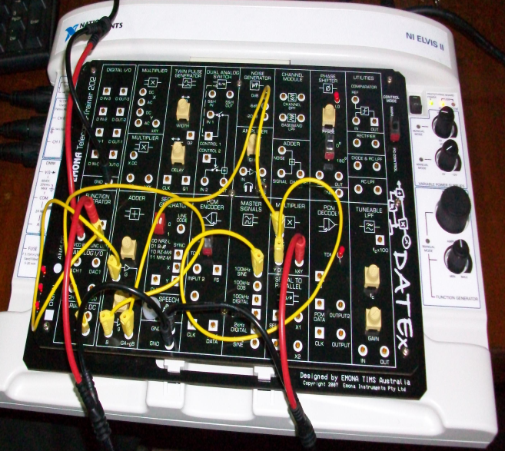
Experiment Design
Research concentrated on Digital Transmission Techniques: Nyquist Sampling Theorem, Pulse Code Modulation and Line Coding.
Designs were implemented on the Emona Datex Board
Changes made in Lab Server LabVIEW and Visual Basic to support FGEN and Scope Functionality on NI ELVIS II
The Emona Datex Board
Notes:
Leaders in Measurement and Control
Direct Operations 40 Countries
1,353 engineers are employed
Headquartered in Austin, Texas, NI has more than 3,000 employees and direct operations in more than 40 countries. Along with the more than 1,000 measurement, control, and automation tools we offer, NI recognizes more than 500 members in our National Instruments Alliance Partner Program (a network of independent consultants and integrators) ready to assist you in assembling and implementing an NI measurement and automation solution. These Alliance Partners offer domain expertise from process control to discrete manufacturing for oil and gas, aerospace, automotive, electronics, communications, and semiconductor industries.

Slide 7
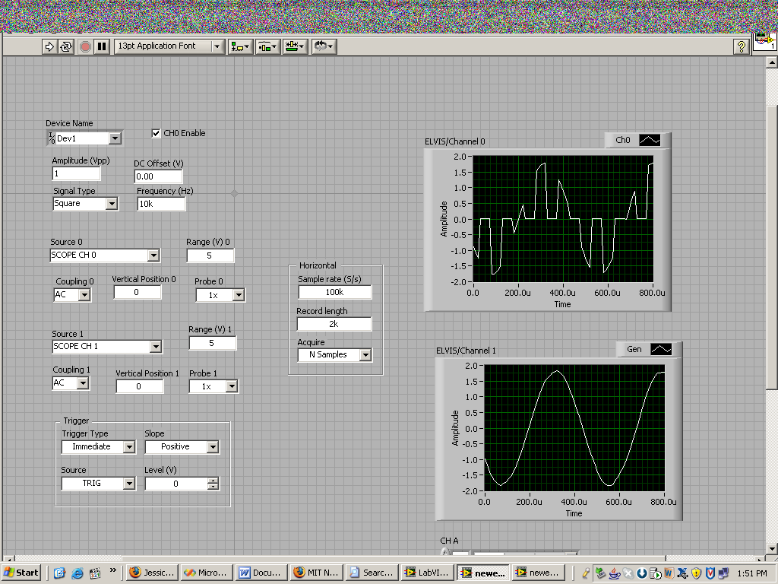
Nyquist Sampling Scheme-SFP Results
Notes:
Leaders in Measurement and Control
Direct Operations 40 Countries
1,353 engineers are employed
Headquartered in Austin, Texas, NI has more than 3,000 employees and direct operations in more than 40 countries. Along with the more than 1,000 measurement, control, and automation tools we offer, NI recognizes more than 500 members in our National Instruments Alliance Partner Program (a network of independent consultants and integrators) ready to assist you in assembling and implementing an NI measurement and automation solution. These Alliance Partners offer domain expertise from process control to discrete manufacturing for oil and gas, aerospace, automotive, electronics, communications, and semiconductor industries.

Slide 8
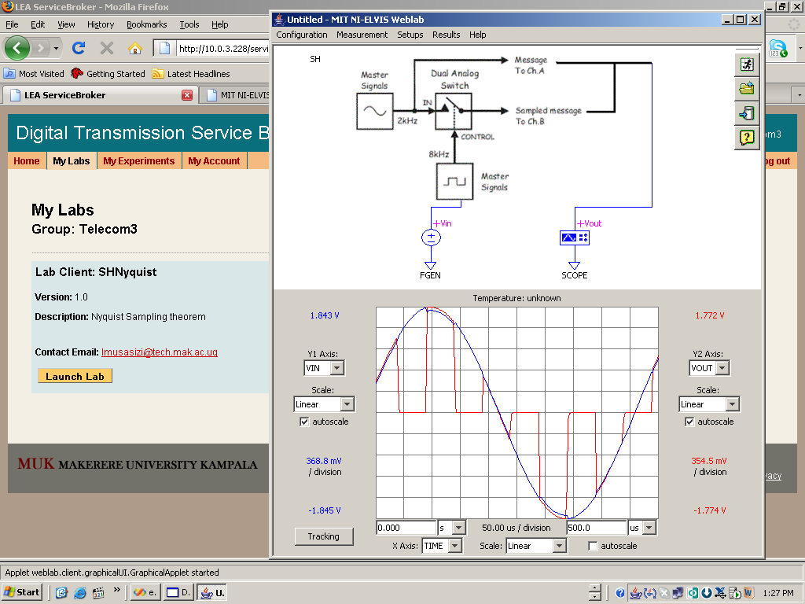
Nyquist Sampling Scheme-iLab
Notes:
Leaders in Measurement and Control
Direct Operations 40 Countries
1,353 engineers are employed
Headquartered in Austin, Texas, NI has more than 3,000 employees and direct operations in more than 40 countries. Along with the more than 1,000 measurement, control, and automation tools we offer, NI recognizes more than 500 members in our National Instruments Alliance Partner Program (a network of independent consultants and integrators) ready to assist you in assembling and implementing an NI measurement and automation solution. These Alliance Partners offer domain expertise from process control to discrete manufacturing for oil and gas, aerospace, automotive, electronics, communications, and semiconductor industries.

Slide 9
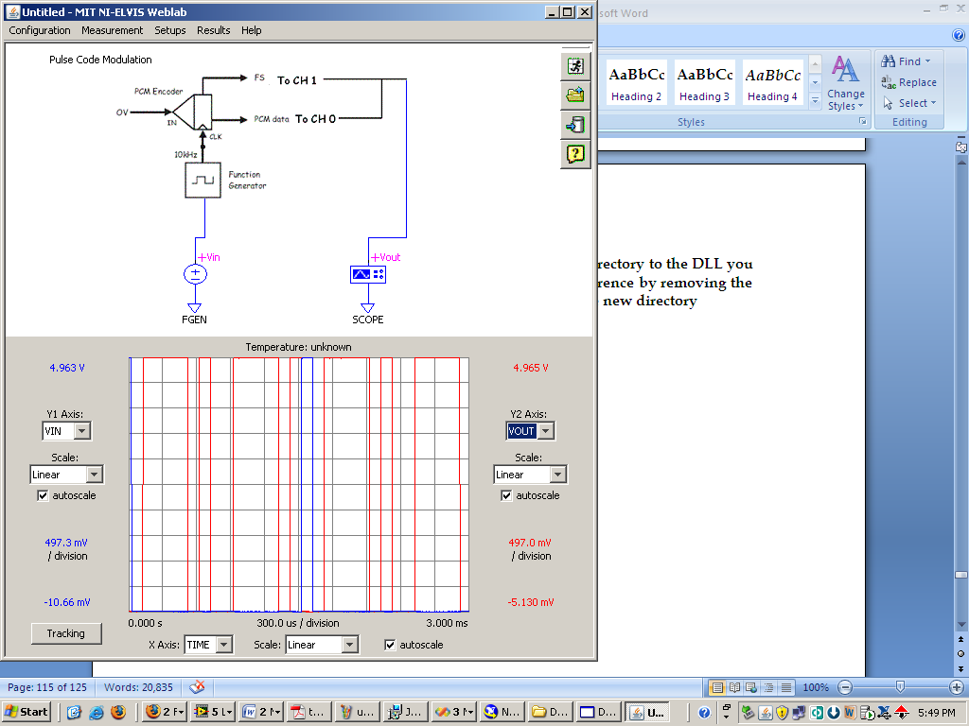
PCM Encoding of 0V DC
Notes:
Leaders in Measurement and Control
Direct Operations 40 Countries
1,353 engineers are employed
Headquartered in Austin, Texas, NI has more than 3,000 employees and direct operations in more than 40 countries. Along with the more than 1,000 measurement, control, and automation tools we offer, NI recognizes more than 500 members in our National Instruments Alliance Partner Program (a network of independent consultants and integrators) ready to assist you in assembling and implementing an NI measurement and automation solution. These Alliance Partners offer domain expertise from process control to discrete manufacturing for oil and gas, aerospace, automotive, electronics, communications, and semiconductor industries.

Slide 10
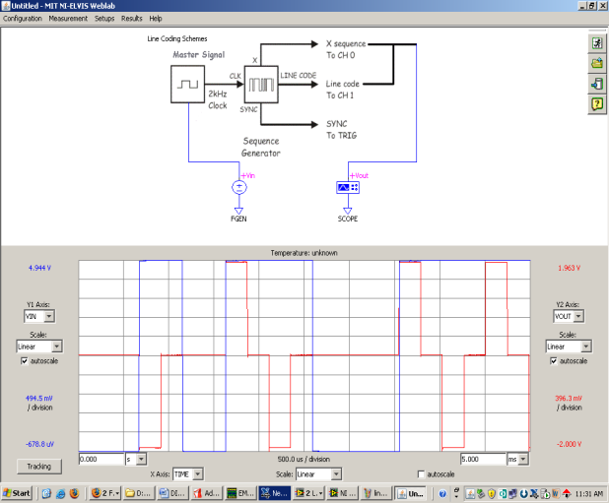
Line Coding: Return to Zero Alternate Mark Inversion
Notes:
Leaders in Measurement and Control
Direct Operations 40 Countries
1,353 engineers are employed
Headquartered in Austin, Texas, NI has more than 3,000 employees and direct operations in more than 40 countries. Along with the more than 1,000 measurement, control, and automation tools we offer, NI recognizes more than 500 members in our National Instruments Alliance Partner Program (a network of independent consultants and integrators) ready to assist you in assembling and implementing an NI measurement and automation solution. These Alliance Partners offer domain expertise from process control to discrete manufacturing for oil and gas, aerospace, automotive, electronics, communications, and semiconductor industries.

Slide 11
Communication Theory Experiments
Amplitude Modulation
Single Side Band Suppresses Carrier Modulation
Double Side Band Suppressed Carrier Modulation
Frequency Modulation
Notes:
Leaders in Measurement and Control
Direct Operations 40 Countries
1,353 engineers are employed
Headquartered in Austin, Texas, NI has more than 3,000 employees and direct operations in more than 40 countries. Along with the more than 1,000 measurement, control, and automation tools we offer, NI recognizes more than 500 members in our National Instruments Alliance Partner Program (a network of independent consultants and integrators) ready to assist you in assembling and implementing an NI measurement and automation solution. These Alliance Partners offer domain expertise from process control to discrete manufacturing for oil and gas, aerospace, automotive, electronics, communications, and semiconductor industries.

Slide 12
Experiment Design
Designs Based on Mathematical Models:
  AM = (DC + Message) × Carrier
  DSBSC = Message × Carrier
  SSBSC = (Message × Carrier)+(Message with 90º Shift× Carrier with 90º Shift)
  FM using the Voltage Controlled Oscillator
Designs implemented on the Emona Datex Board
LabVIEW VI involved FGEN, SCOPE, and the Variable Power Supply.
Notes:
Leaders in Measurement and Control
Direct Operations 40 Countries
1,353 engineers are employed
Headquartered in Austin, Texas, NI has more than 3,000 employees and direct operations in more than 40 countries. Along with the more than 1,000 measurement, control, and automation tools we offer, NI recognizes more than 500 members in our National Instruments Alliance Partner Program (a network of independent consultants and integrators) ready to assist you in assembling and implementing an NI measurement and automation solution. These Alliance Partners offer domain expertise from process control to discrete manufacturing for oil and gas, aerospace, automotive, electronics, communications, and semiconductor industries.

Slide 13
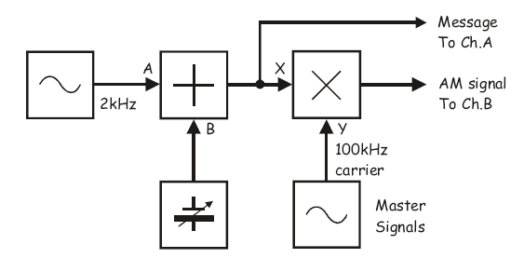
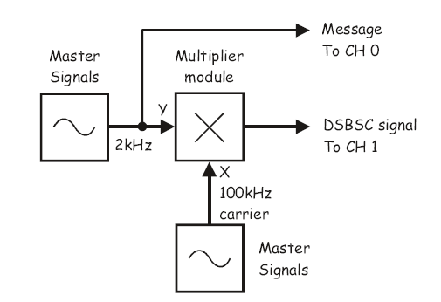
AM
FM
Notes:
Leaders in Measurement and Control
Direct Operations 40 Countries
1,353 engineers are employed
Headquartered in Austin, Texas, NI has more than 3,000 employees and direct operations in more than 40 countries. Along with the more than 1,000 measurement, control, and automation tools we offer, NI recognizes more than 500 members in our National Instruments Alliance Partner Program (a network of independent consultants and integrators) ready to assist you in assembling and implementing an NI measurement and automation solution. These Alliance Partners offer domain expertise from process control to discrete manufacturing for oil and gas, aerospace, automotive, electronics, communications, and semiconductor industries.

Slide 14
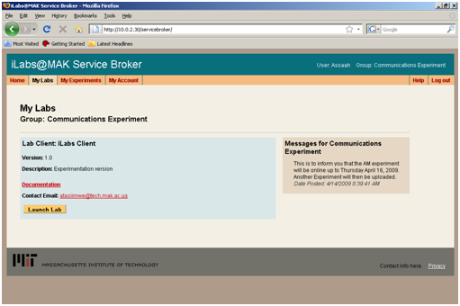
Accessing the Communication Theory Experiments
Notes:
Leaders in Measurement and Control
Direct Operations 40 Countries
1,353 engineers are employed
Headquartered in Austin, Texas, NI has more than 3,000 employees and direct operations in more than 40 countries. Along with the more than 1,000 measurement, control, and automation tools we offer, NI recognizes more than 500 members in our National Instruments Alliance Partner Program (a network of independent consultants and integrators) ready to assist you in assembling and implementing an NI measurement and automation solution. These Alliance Partners offer domain expertise from process control to discrete manufacturing for oil and gas, aerospace, automotive, electronics, communications, and semiconductor industries.

Slide 15
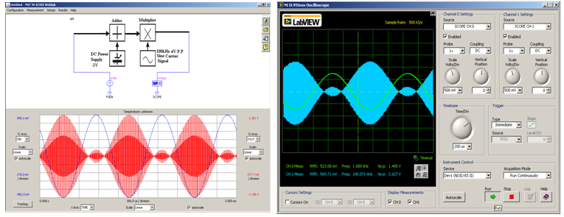
Amplitude Modulation Results
iLab
SFP SCOPE
Notes:
Leaders in Measurement and Control
Direct Operations 40 Countries
1,353 engineers are employed
Headquartered in Austin, Texas, NI has more than 3,000 employees and direct operations in more than 40 countries. Along with the more than 1,000 measurement, control, and automation tools we offer, NI recognizes more than 500 members in our National Instruments Alliance Partner Program (a network of independent consultants and integrators) ready to assist you in assembling and implementing an NI measurement and automation solution. These Alliance Partners offer domain expertise from process control to discrete manufacturing for oil and gas, aerospace, automotive, electronics, communications, and semiconductor industries.

Slide 16
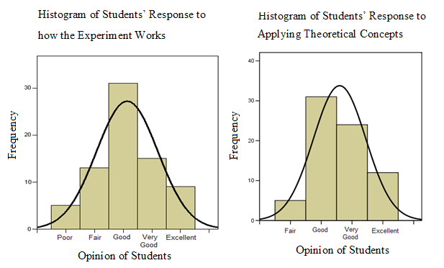
Student Reaction
Notes:
Leaders in Measurement and Control
Direct Operations 40 Countries
1,353 engineers are employed
Headquartered in Austin, Texas, NI has more than 3,000 employees and direct operations in more than 40 countries. Along with the more than 1,000 measurement, control, and automation tools we offer, NI recognizes more than 500 members in our National Instruments Alliance Partner Program (a network of independent consultants and integrators) ready to assist you in assembling and implementing an NI measurement and automation solution. These Alliance Partners offer domain expertise from process control to discrete manufacturing for oil and gas, aerospace, automotive, electronics, communications, and semiconductor industries.

Slide 17
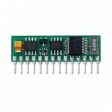
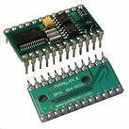
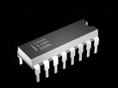

Digital Electronics Experiments
Logic Gate Characterization
Application of NAND Gates
Memory Elements
Notes:
Leaders in Measurement and Control
Direct Operations 40 Countries
1,353 engineers are employed
Headquartered in Austin, Texas, NI has more than 3,000 employees and direct operations in more than 40 countries. Along with the more than 1,000 measurement, control, and automation tools we offer, NI recognizes more than 500 members in our National Instruments Alliance Partner Program (a network of independent consultants and integrators) ready to assist you in assembling and implementing an NI measurement and automation solution. These Alliance Partners offer domain expertise from process control to discrete manufacturing for oil and gas, aerospace, automotive, electronics, communications, and semiconductor industries.

Slide 18
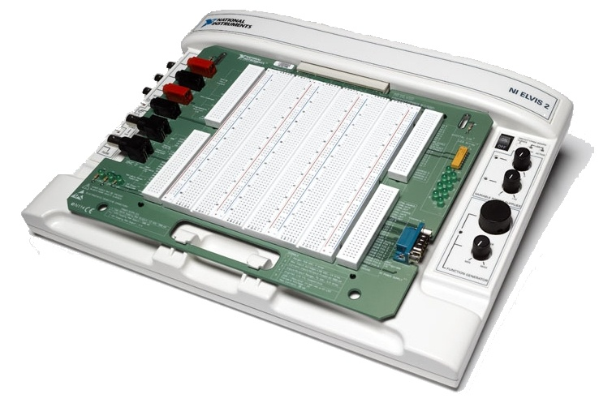
Experiment Design
Used the NI ELVIS II Free Scale Board
Experiments used Digital Reader and Writer: Combinational Circuit Logic
New VI created
Lab Server code Modified in line with lower level parameters.
Client-Digital Client developed by Hamidou Soumare
The NI ELVIS II with a Free Scale Board
Notes:
Leaders in Measurement and Control
Direct Operations 40 Countries
1,353 engineers are employed
Headquartered in Austin, Texas, NI has more than 3,000 employees and direct operations in more than 40 countries. Along with the more than 1,000 measurement, control, and automation tools we offer, NI recognizes more than 500 members in our National Instruments Alliance Partner Program (a network of independent consultants and integrators) ready to assist you in assembling and implementing an NI measurement and automation solution. These Alliance Partners offer domain expertise from process control to discrete manufacturing for oil and gas, aerospace, automotive, electronics, communications, and semiconductor industries.

Slide 19
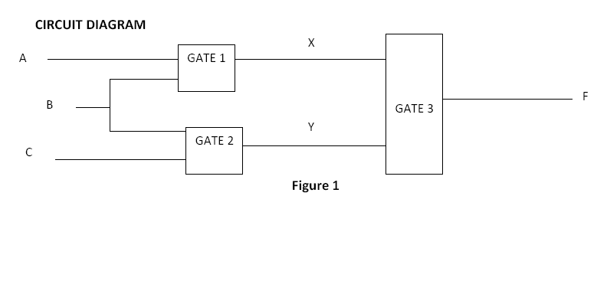
Experiment Deployed: Logic Gate Characterisation
Notes:
Leaders in Measurement and Control
Direct Operations 40 Countries
1,353 engineers are employed
Headquartered in Austin, Texas, NI has more than 3,000 employees and direct operations in more than 40 countries. Along with the more than 1,000 measurement, control, and automation tools we offer, NI recognizes more than 500 members in our National Instruments Alliance Partner Program (a network of independent consultants and integrators) ready to assist you in assembling and implementing an NI measurement and automation solution. These Alliance Partners offer domain expertise from process control to discrete manufacturing for oil and gas, aerospace, automotive, electronics, communications, and semiconductor industries.

Slide 20
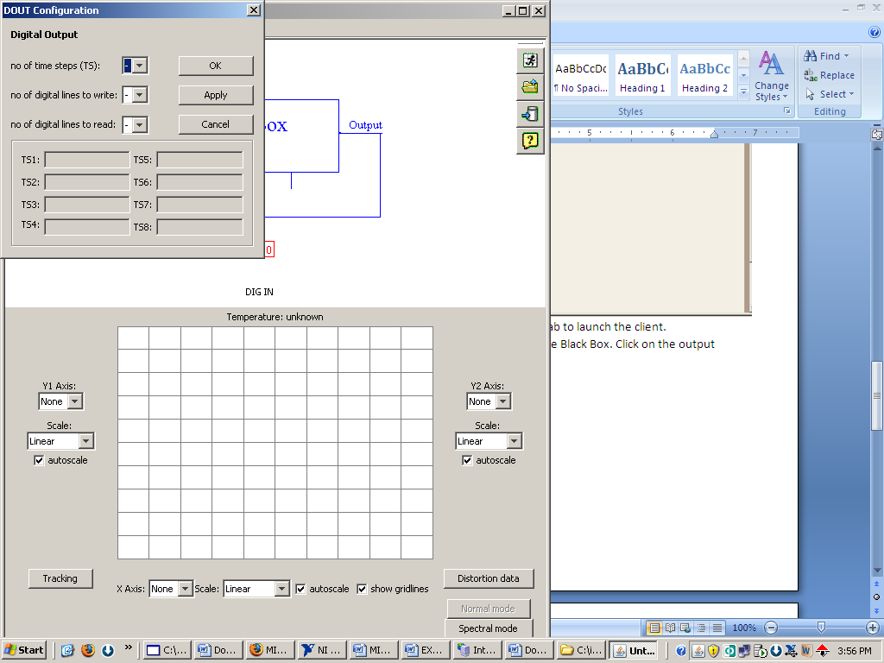
Parameterizing the Digital Input Instrument
Notes:
Leaders in Measurement and Control
Direct Operations 40 Countries
1,353 engineers are employed
Headquartered in Austin, Texas, NI has more than 3,000 employees and direct operations in more than 40 countries. Along with the more than 1,000 measurement, control, and automation tools we offer, NI recognizes more than 500 members in our National Instruments Alliance Partner Program (a network of independent consultants and integrators) ready to assist you in assembling and implementing an NI measurement and automation solution. These Alliance Partners offer domain expertise from process control to discrete manufacturing for oil and gas, aerospace, automotive, electronics, communications, and semiconductor industries.

Slide 21
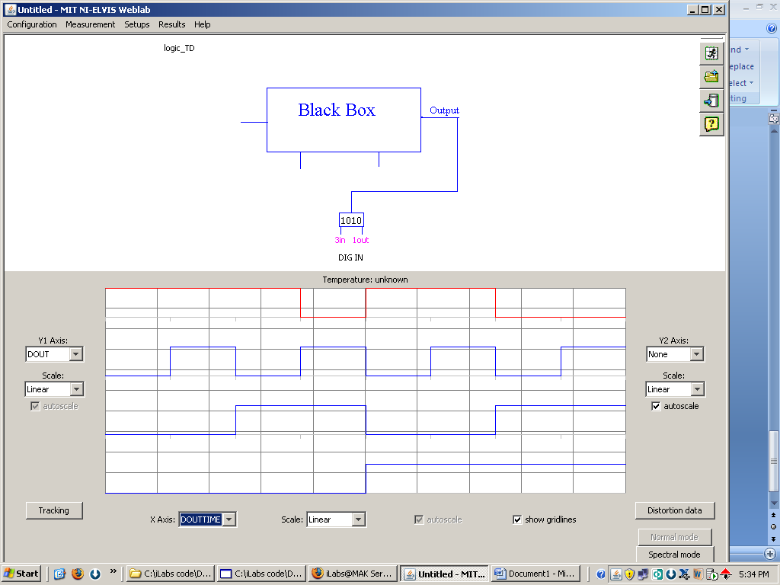
Experiment Results
Notes:
Leaders in Measurement and Control
Direct Operations 40 Countries
1,353 engineers are employed
Headquartered in Austin, Texas, NI has more than 3,000 employees and direct operations in more than 40 countries. Along with the more than 1,000 measurement, control, and automation tools we offer, NI recognizes more than 500 members in our National Instruments Alliance Partner Program (a network of independent consultants and integrators) ready to assist you in assembling and implementing an NI measurement and automation solution. These Alliance Partners offer domain expertise from process control to discrete manufacturing for oil and gas, aerospace, automotive, electronics, communications, and semiconductor industries.

Slide 22
Student Challenges
Experiments Deployed for a Short time
Public IP issues: Experiments only accessible on Faculty of Technology intranet
Alien experimentation Concept: Doing iLabs for the first time
Way Forward:
More developed experiments to be deployed
More Sensitisation of Students and Staff
Public IP to avail experiments more efficiently.
University Databases
Notes:
Leaders in Measurement and Control
Direct Operations 40 Countries
1,353 engineers are employed
Headquartered in Austin, Texas, NI has more than 3,000 employees and direct operations in more than 40 countries. Along with the more than 1,000 measurement, control, and automation tools we offer, NI recognizes more than 500 members in our National Instruments Alliance Partner Program (a network of independent consultants and integrators) ready to assist you in assembling and implementing an NI measurement and automation solution. These Alliance Partners offer domain expertise from process control to discrete manufacturing for oil and gas, aerospace, automotive, electronics, communications, and semiconductor industries.

Slide 23
Conclusion
Pioneer iLab Research on NI ELVIS II and Emona Datex board successful
Labs developed already incorporated in curricula
Theoretical and Practical Skills better demonstrated in the flexible and convenient iLabs.
More developed experiments to be deployed
Impetus for the next Generation Research
University Databases
Notes:
Leaders in Measurement and Control
Direct Operations 40 Countries
1,353 engineers are employed
Headquartered in Austin, Texas, NI has more than 3,000 employees and direct operations in more than 40 countries. Along with the more than 1,000 measurement, control, and automation tools we offer, NI recognizes more than 500 members in our National Instruments Alliance Partner Program (a network of independent consultants and integrators) ready to assist you in assembling and implementing an NI measurement and automation solution. These Alliance Partners offer domain expertise from process control to discrete manufacturing for oil and gas, aerospace, automotive, electronics, communications, and semiconductor industries.

Slide 24
THANK YOU

