Slide 1






































Maps on a Spreadsheet and Other Google Collaboration Tools
Mark Frydenberg
Computer Information Systems Department
Bentley University, Waltham, MA
Student Assistant: Brandon Schug

Slide 2
Ten things Google has found to be true
Focus on the user and all else will follow.
It's best to do one thing really, really well.
Fast is better than slow.
Democracy on the web works.
You don't need to be at your desk to need an answer.
You can make money without doing evil.
There's always more information out there.
The need for information crosses all borders.
You can be serious without a suit.
Great just isn't good enough.

Slide 3
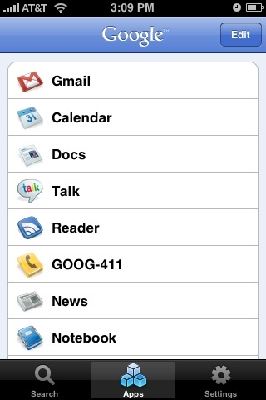
iPhone App

Slide 4
Google Docs and Spreadsheets
Create a Doc or Presentation (or upload a document from your computer)
Share it with a partner.
Edit at the same time.
Add as a post to your blog or on a Google site page.

Slide 5
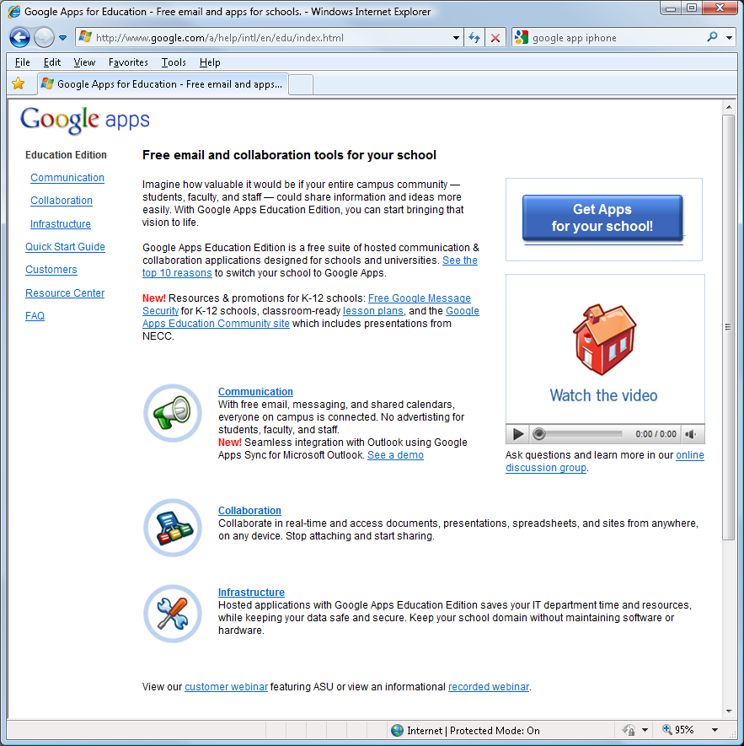
Google Apps for Schools (and NPOs)

Slide 6
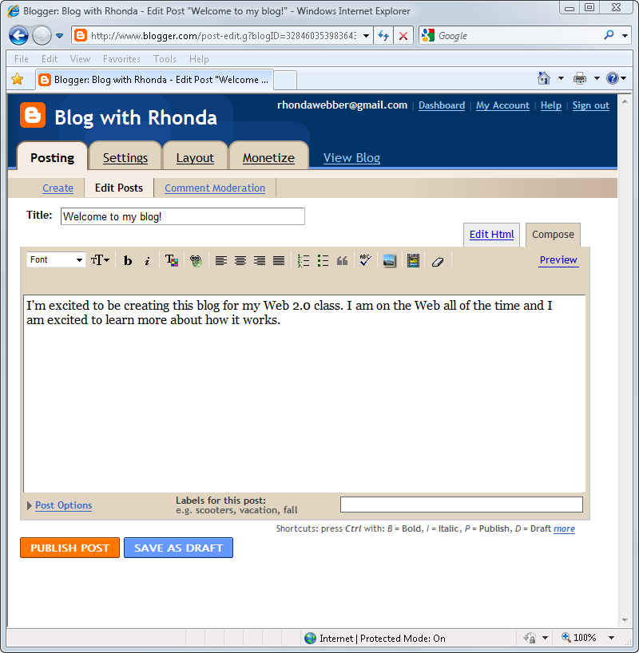
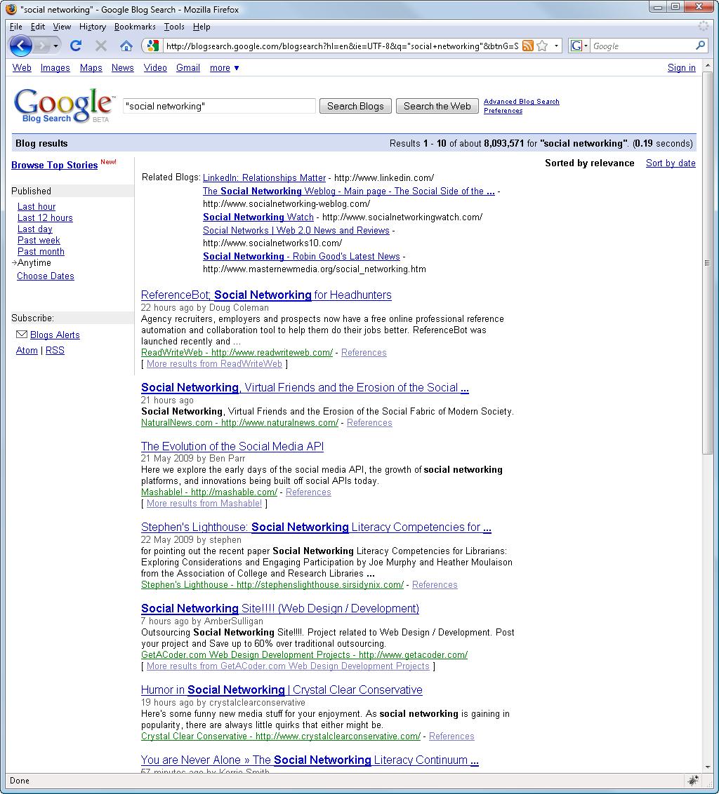
Blogger
Blog settings

Slide 7
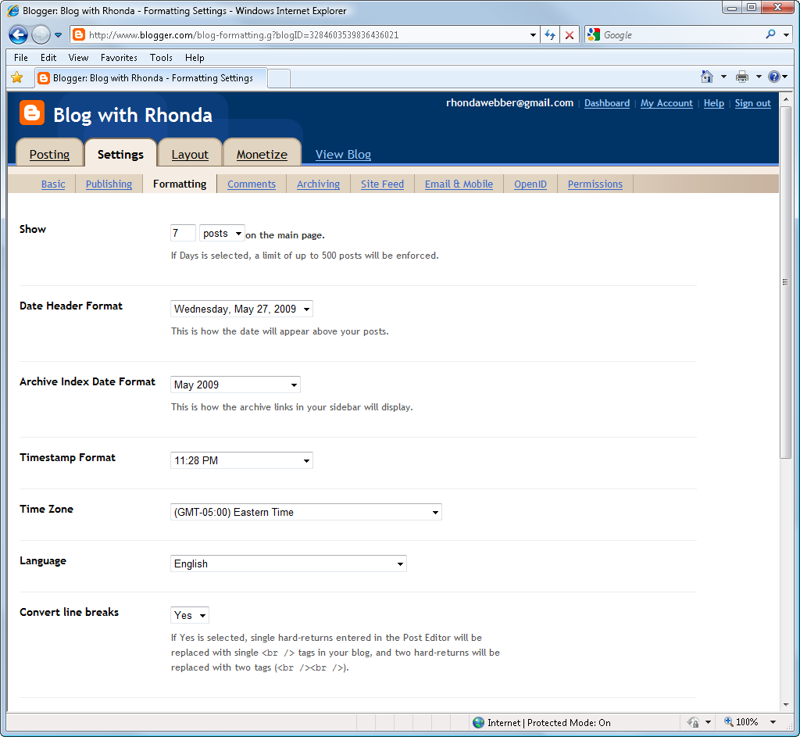
Blog Settings
Searchable? (Basic Tab)
Time Zone (Formatting Tab)
Fonts and Colors/ Template
Contributors and Roles (Permissions Tab)

Slide 8





More Blog
Platforms
Provider | Logo | Features
Blogger (blogger.com) |  | Provides an easy to use blogging platform with many customizable themes. Integrated with Google applications.
LiveJournal (livejournal.com) |  | Provides blogging for private journals, online discussion, and social networking.
Windows Live Spaces (spaces.live.com) |  | Provides free blogging integrated with your MSN or Windows Live account.
Wordpress (wordpress.com) |  | Provides a customizable, open source blogging platform and content management tool with many plug ins and themes. You can also host the software on your own ISP for full control.
Yahoo 360 (yahoo360.com) |  | Provides a blogging platform and photo sharing to connect with other Yahoo users.

Slide 9
Blogs in Education
Class blogs to promote discussion
Individual student blogs for writing, e-portfolio, or as a web site alternative
Department blogs to promote transparency and visibility

Slide 10

Blogger Checklist
Create a blog
Add and edit a post
Add a Sidebar gadget
Add users and roles
Embed a YouTube Video in a post
Add Subscription Links Gadget, add your blog’s feed to Google Reader
Add a Feed Gadget to the sidebar, importing any feed’s content

Slide 11
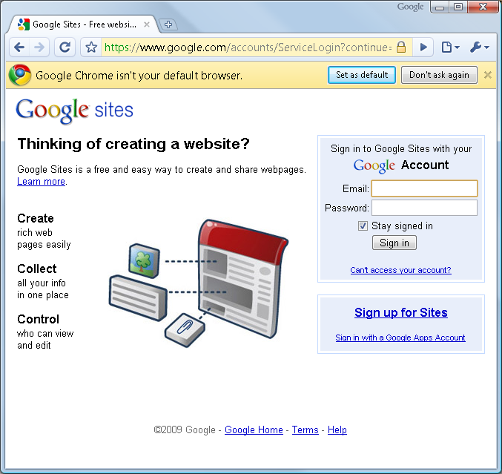
Google Sites
Wiki-like capabilities
Collaborative web site creation
Store and maintain organizational knowledge
Great classroom tool
Included in Google Apps for Edu, Non-Profits

Slide 12
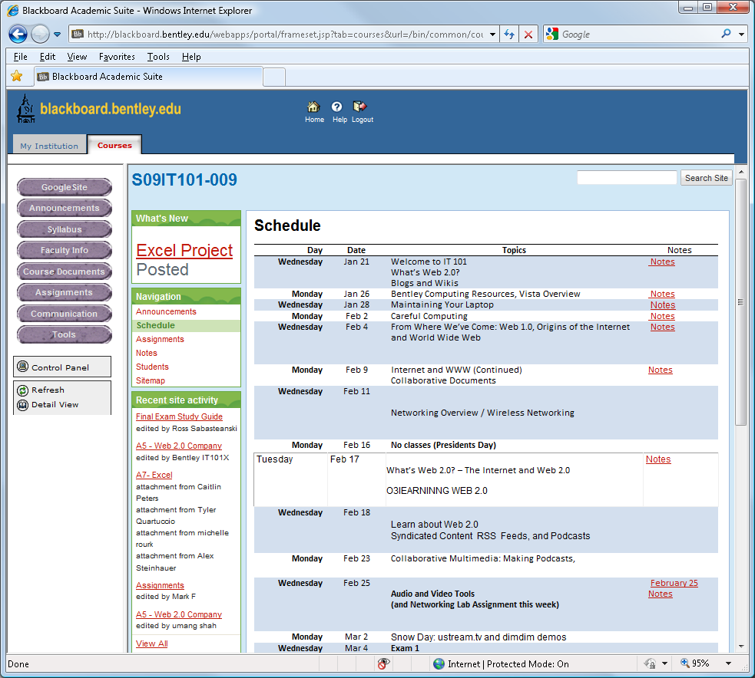
Hint: Use Your Google Site as a Course Entry Point in Blackboard
To change your landing page in Blackboard, go to Control Panel →
Course Options → Manage Course Menu → External Link. Create an external link to your Google site.
Then go to Control Panel → Settings -> Course Entry Point and select the Google site as the entry point.

Slide 13






Wiki Platforms
Provider | Logo | Features
Google Sites (sites.google.com) |  | Provides an easy to use set of tools for creating and sharing web pages. Integrated with Google applications.
Media Wiki (mediawiki.org) |  | Provides open source wiki software, originally created to support Wikipedia. You must install and configure the Media Wiki application on your web server in order to use it.
PBWorks (pbworks.com) |  | Provides hosted software for creating collaborative work spaces used across several industries. PBWorks is popular among educators because of its simplicity and security.
TiddlyWiki (tiddlywiki.org) |  | Provides personal wiki notebook capabilities in a single HTML file without the need of a web server or an internet connection.
Wet Paint (wetpaint.com) |  | Provides an easy to use hosted wiki tool which also includes features of blogs, forums, and social networks. Educational wikis are advertisement-free.
WikiSpaces (wikispaces.com) |  | Provides a user-friendly and intuitive hosted wiki platform used by business, non-profit , and educational customers.

Slide 14
Google Sites Checklist
Create a Google Site
Share it with people
Add a page
Add a page under a page
Add a file cabinet page and upload a file
Add a table page
Edit the sidebar for navigation
Contribute to the Google Site for this Workshop
Edit a page while someone else also editing, to experience lock out

Slide 15
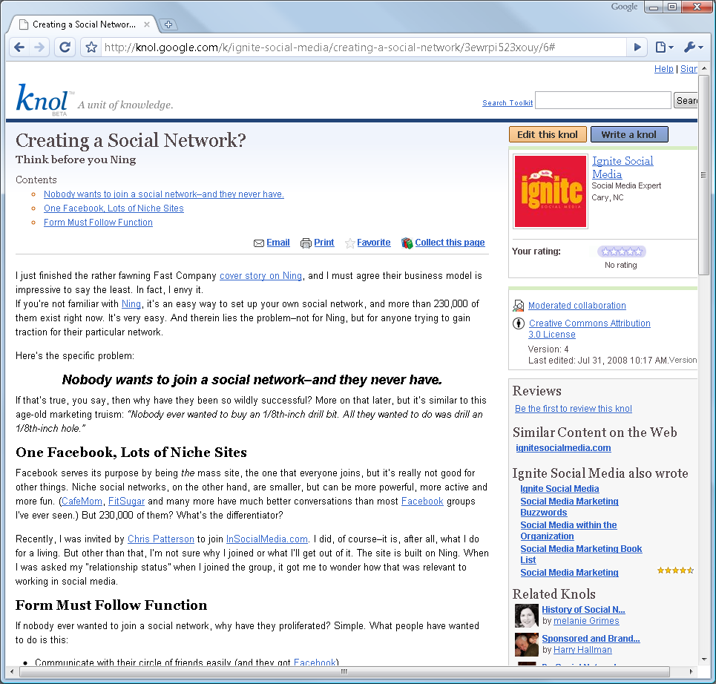
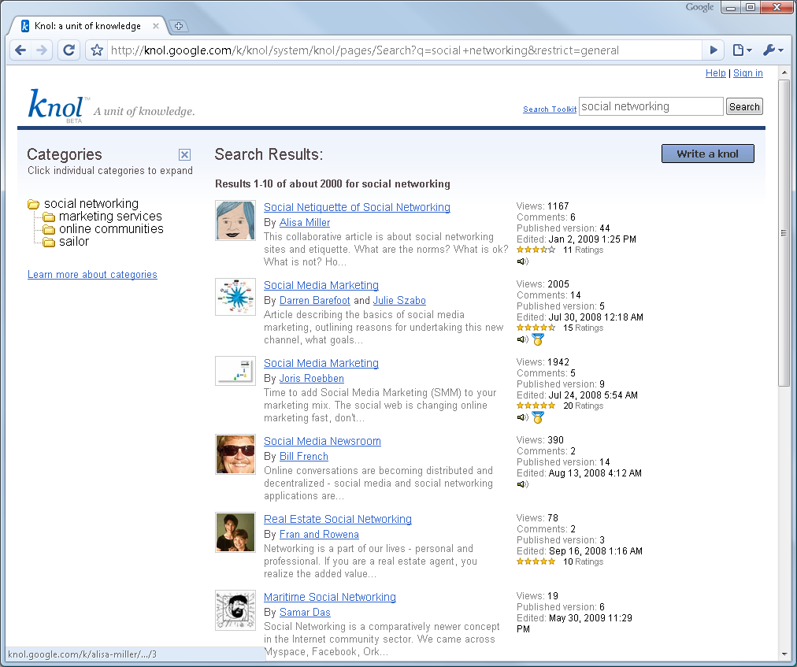
Knol

Slide 16
Knol Checklist
Compare with Wikipedia. Will Knol catch on?
Find, edit, or create a knol
Good for external use

Slide 17
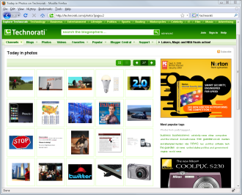


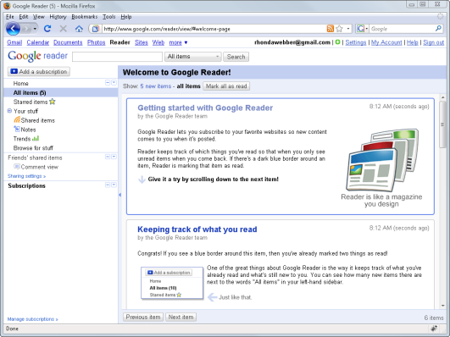
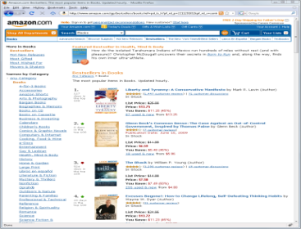
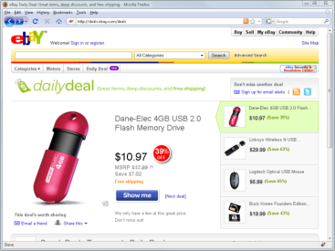
Web (RSS) Feeds
Favorite Sites with Feeds
2
Feed Reader
1

Slide 18
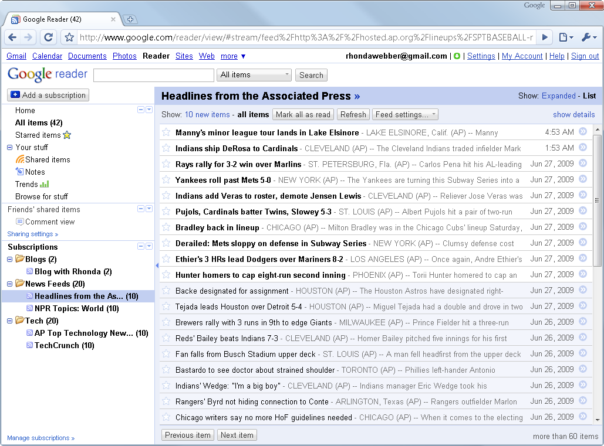
Google Reader
Downloads subscribed items to your computer for offline browsing.
New, unread items appear in bold.
Displays a text box to enter a feed’s URL or search terms to find feeds.
Number of unread items in this feed.
Subscribed feeds organized in folders.
The currently displayed feed.

Slide 19
Google Reader Checklist
Subscribe to a feed whose URL you know.
Use Google Reader to find and subscribe to feeds on topics of interest.
Organize your feeds into different folders.
Add a Subscription Links gadget to your blog.
Subscribe to your blog’s feed in Google Reader using the gadget on your blog’s sidebar.

Slide 20
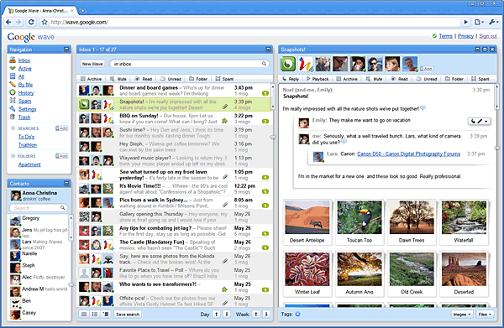
Google Wave (Coming!)
What is a wave?
A wave is equal parts conversation and document. People can communicate and work together with richly formatted text, photos, videos, maps, and more.
A wave is shared. Any participant can reply anywhere in the message, edit the content and add participants at any point in the process. Then playback lets anyone rewind the wave to see who said what and when.
A wave is live. With live transmission as you type, participants on a wave can have faster conversations, see edits and interact with extensions in real-time.

Slide 21
Google Spreadsheets
Checklist
Create a spreadsheet (or import an existing one).
Try some familiar spreadsheet tasks.
Share the spreadsheet with a partner.
Chat while simultaneously editing.
Embed the spreadsheet on your blog or Google site.

Slide 22
Google Docs, Spreadsheets, and Presentations
Apps run within the browser
Have students share assignments with you – makes for easy grading and return
Collaborative writing and reports

Slide 23
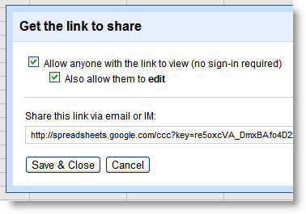
Google Docs / Presentations
Checklist
Import a PPTX or DOCX into Google Presentations / Docs or create a new one.
Share and edit it with other collaborators.
Embed it on a page in your Google site or on your blog.

Slide 24
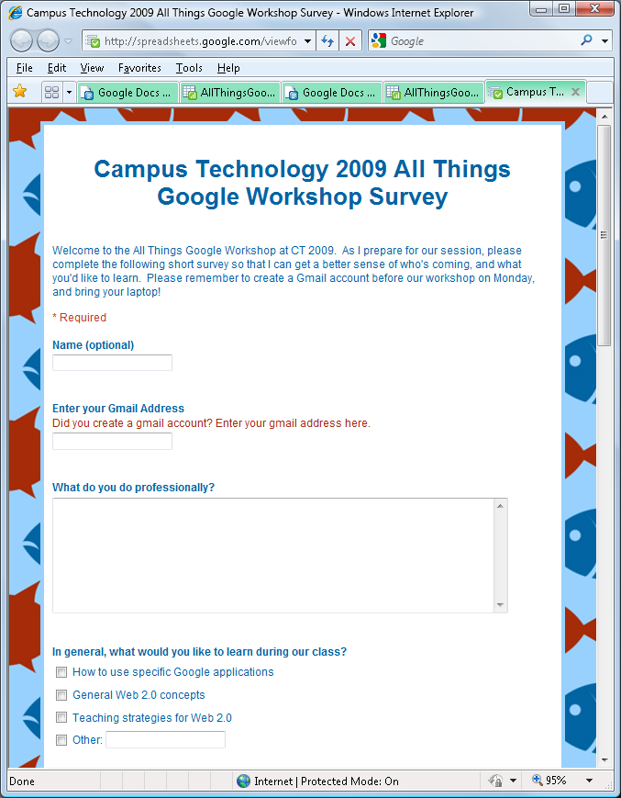
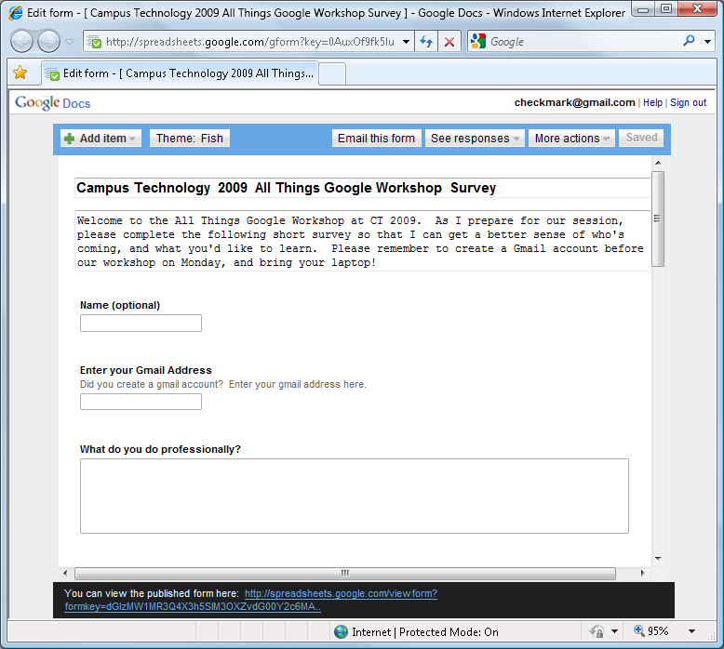
Google Forms

Slide 25
Google Forms Checklist
Create a Google Form with two questions.
Select Let Everyone see response summary.
Save and share it with a few people nearby.
Embed the form on your blog or Google site.
Email the URL to the form (Hint: use TinyURL to make it shorter.)
Embed the spreadsheet on your Google site as well to see the results below the form.
Ask two partners to take your survey.
View the results in Google spreadsheet.

Slide 26
Live Data with Google Spreadsheets
Google Sets (ctrl and drag)
=GoogleFinance(“symbol”, “attribute”)
=GoogleLookup(“entity”, “value”)
=ImportFeed(“url”, paramters)
=ImportXML(url, Xpath expression)
=ImportHTML(“url”)
=ImportData(“url”)
http://googlesystem.blogspot.com/2007/09/google-spreadsheets-lets-you-import.html

Slide 27
=GoogleLookup(entity, value)
Countries and Territories (like "Burkina Faso"): population, capital, largest city, gdp
U.S. States (like "Tennessee"): area, governor, nickname, flower
Rivers (like "Amazon River"): origin, length
Cities and Towns (like "Chicago"): state, mayor, elevation
Musicians (like "John Lennon"): date of birth, place of birth, nationality
Actors (like "Audrey Hepburn"): date of birth, place of birth, nationality
Politicians (like "Anwar Al-Sadat"): date of birth, place of birth, nationality
U.S. Presidents (like "Zachary Taylor"): date of birth, place of birth, political party
Baseball Players (like "Wade Boggs"): games, at bats, earned run average, position
Chemical Elements (like "Helium"): atomic number, discovered by, atomic weight
Chemical Compounds (like "Isopropyl Alcohol"): chemical formula, melting point, boiling point, density
Stars (like "Betelgeuse"): constellation, distance, mass, temperature
Planets (like "Saturn"): number of moons, length of day, distance from sun, atmosphere
Dinosaurs (like "Velociraptor"): height, weight, when it lived
Ships (like "USS Chesapeake"): length, displacement, complement, commissioned
Companies (like "Hewlett-Packard"): employees, ceo, ticker

Slide 28
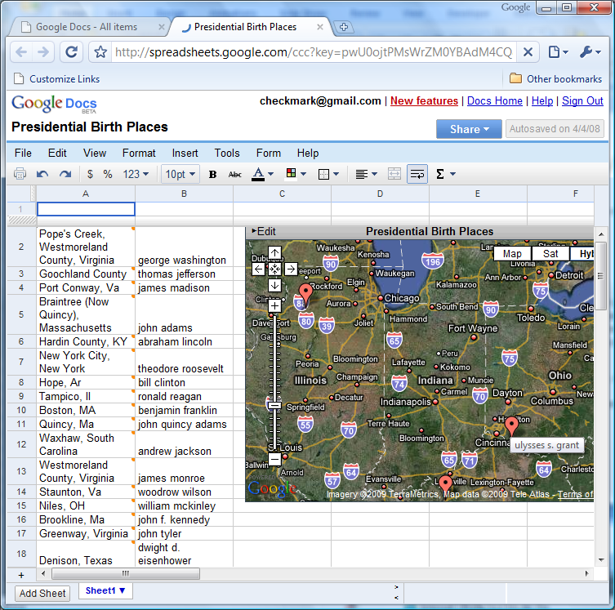
Maps on a Spreadsheet

Slide 29
Tech Companies Info Mashup
=hyperlink(ImportFeed("http://news.google.com/news?hl=en&ned=us&q=" & A2 & "&ie=UTF-8&output=rss", "items url", "false", 1),ImportFeed("http://news.google.com/news?hl=en&ned=us&q=" & A2 & "&ie=UTF-8&output=rss", "items title", "false", 1))

Slide 30
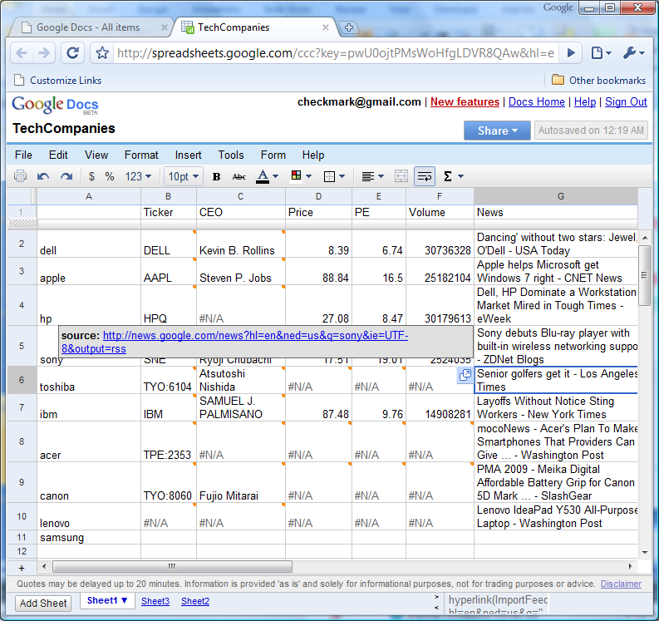

Slide 31
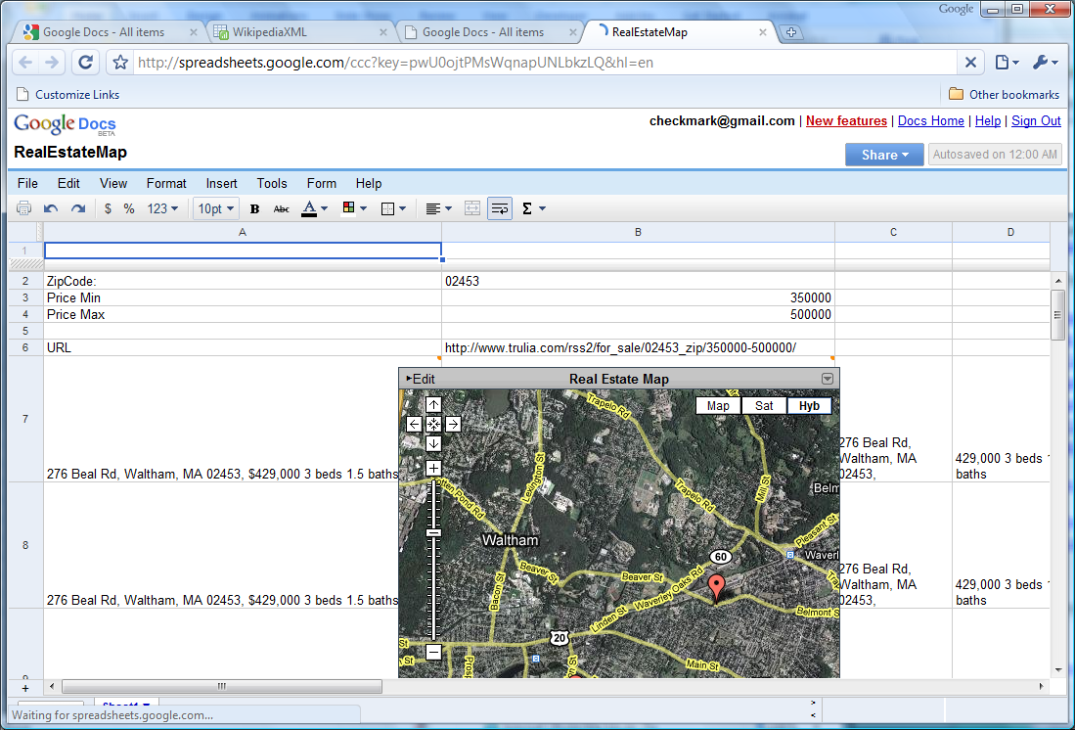

Slide 32
Live Data Checklist
Import an RSS Feed into Google Spreadsheets
Import XML from your twitter friends and the number of followers each has. See the API for suggestions of how to do it.

Slide 33

Questions?

