Slide 1
Center of Competence in
Online Labs and Open Learning
Michael E. Auer

Slide 2

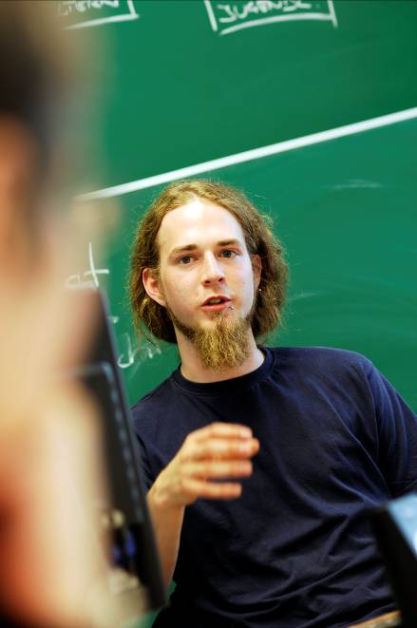
Carinthia University of Applied Sciences
Founded in 1995
Private University
1510 students
(770 beginners in the winter semester 2008/09)
Staff:
  422 employees
  72 professors & 64 full-time lecturers
  218 adjunct faculty
  19 study administration & 38 central services
34 Bachelor & Master Degree Programs in 8 areas
11 part-time study programs
Notes:
Stufe: Bachelorstudium
berufsfeldorientiert mit verpflichtendem Berufspraktikum
Abschluss
Bachelor of Science in Engineering (technische Studiengänge)
Bachelor of Arts in Business (Wirtschaftswissenschaftliche Studiengänge)
Bachelor of Arts in Social Sciences (Sozialwissenschaftliche Studiengänge)
Der Studienabschluss ermöglicht einerseits den direkten Einstieg ins Berufsleben und berechtigt andererseits zu einem weiterführenden Magister- bzw. Masterstudium an Universitäten und Fachhochschulen im In- und Ausland.
Studiendauer
6 Semester
2. Stufe: Masterstudium
weiterführendes, vertiefendes Fachstudium
Abschluss
Diplom-Ingenieur/Diplom-Ingenieurin oder Master of Science in Engineering (technische Studiengänge)
Master of Arts in Business (Wirtschaftswissenschaftliche Studiengänge)
Master of Arts in Social Sciences (Sozialwissenschaftliche Studiengänge)
Studiendauer
4 Semester
Das Masterstudium baut auf einem fachlich nahe stehenden Bachelorstudium auf und berechtigt nach Abschluss zu einem weiterführenden Doktoratsstudium an einer in- oder ausländischen Universität.

Slide 3

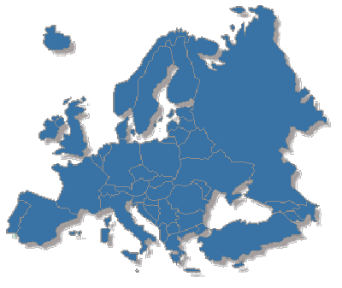
Where we are
Italy
Slovenia
Europe

Slide 4
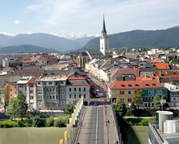

Campus Villach (1)
School of Systems Engineering
Bachelor
Systems Engineering
Systems Engineering (part-time)
Mechanical Engineering
Mechanical Engineering (part-time)
Master
Systems Design
Systems Design (part-time)
Integrated Systems and Circuits Design
Bionic Systems
School of Geoinformation
School of Management

Slide 5
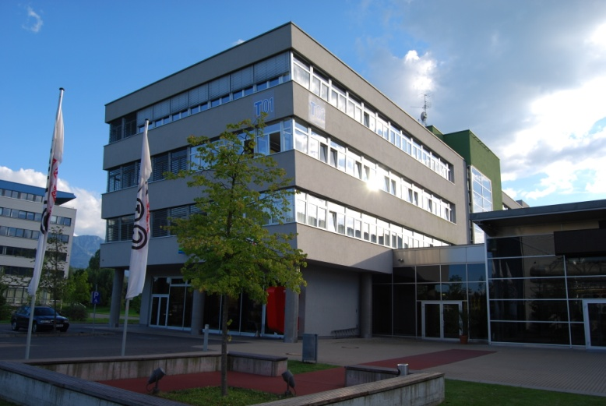

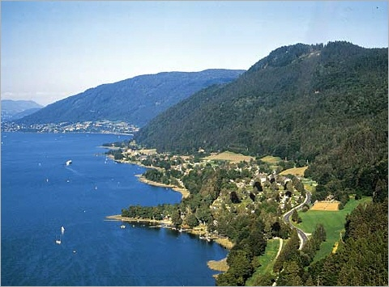

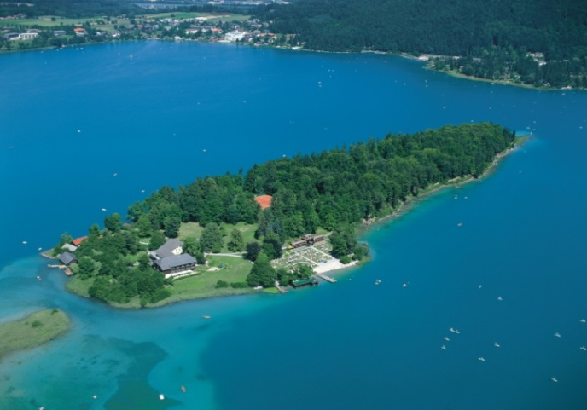
Campus Villach & Environment

Slide 6
Applied Research & Development
SYSTEMS ENGINEERING DEPT.:
Signal Processing for Wireless- and Multimedia Applications
Mobile Communications – Software Defined Radio IP-Cores
Online Laboratories (Center of Competence)
FIT Fault Injection for TTA
TTCar next (Time-triggered-architecture Car demonstrator)
System-on-Chip for Mobile Internet

Slide 7
CCOL² Resources
2 Profs
4 Researchers
Lab Engineer
E-Learning manager
Software assistant
7 PhD and Master student
OCW Mirror Server
MIT iLab Broker Server
Several Lab Server
MATLAB Web Server
CITRIX Application Server
CLIX E-Learning Platform
Zope with EduCommons

Slide 8
Our Philosophy
Clear separation of the technical environment and the experiment itself
Use of commercial tools (if possible)
Minimal effort on the client side (only a Web Browser)
Effective reuse possible !
Implementations can also be used in other contexts

Slide 9
Standard Lab Solutions of CCOL²
Remote Electronic Lab (REL)
Virtual Electronic Lab (VELO)
ASIC Design Lab (READ) Hybrid Lab
Micro Web Server (Embedded Web Server)
Lab Portal (OntoWiki Project)
XML Data Exchange Tools
XML Environment for interactive documents

Slide 10
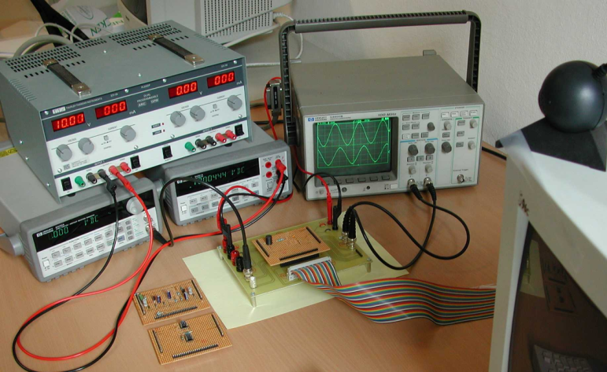
REL – Remote Electronic Lab (1)
Synchronous Remote Lab with real instruments

Slide 11
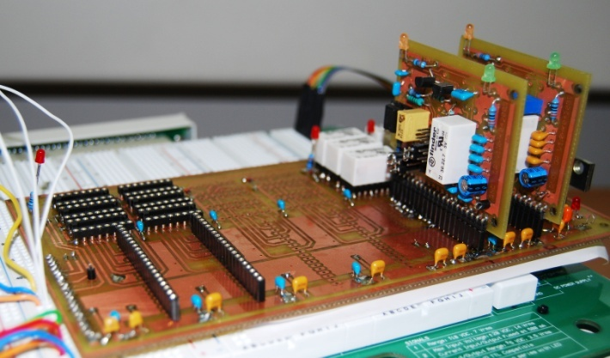
REL – Remote Electronic Lab (2)
Based on the MIT ELVIS iLab v1.0
We developed a set of Modules addressed by a bunch of switches
Synchronous Remote Lab with virtual instruments

Slide 12
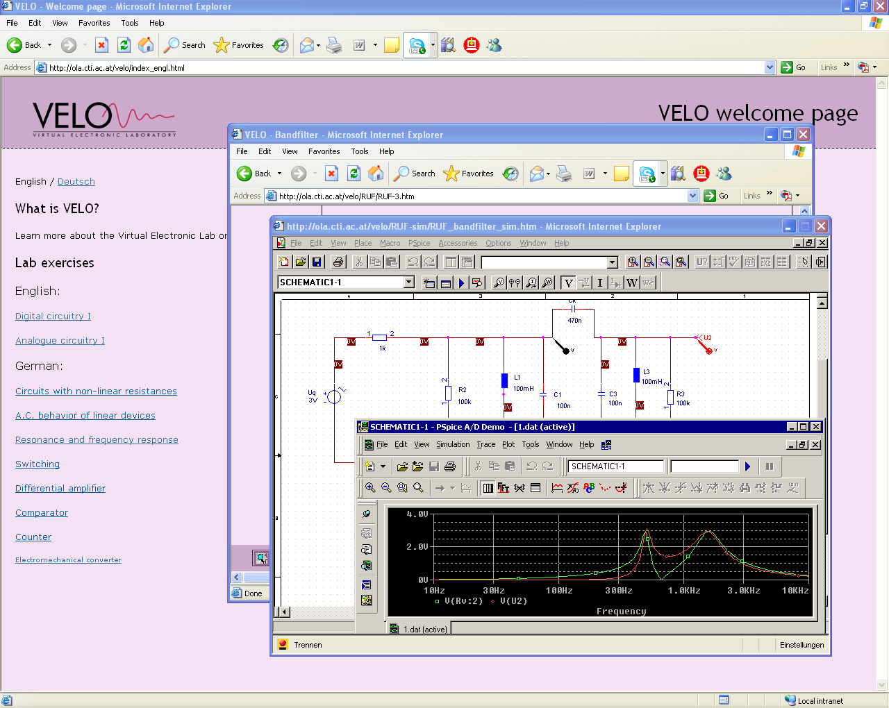
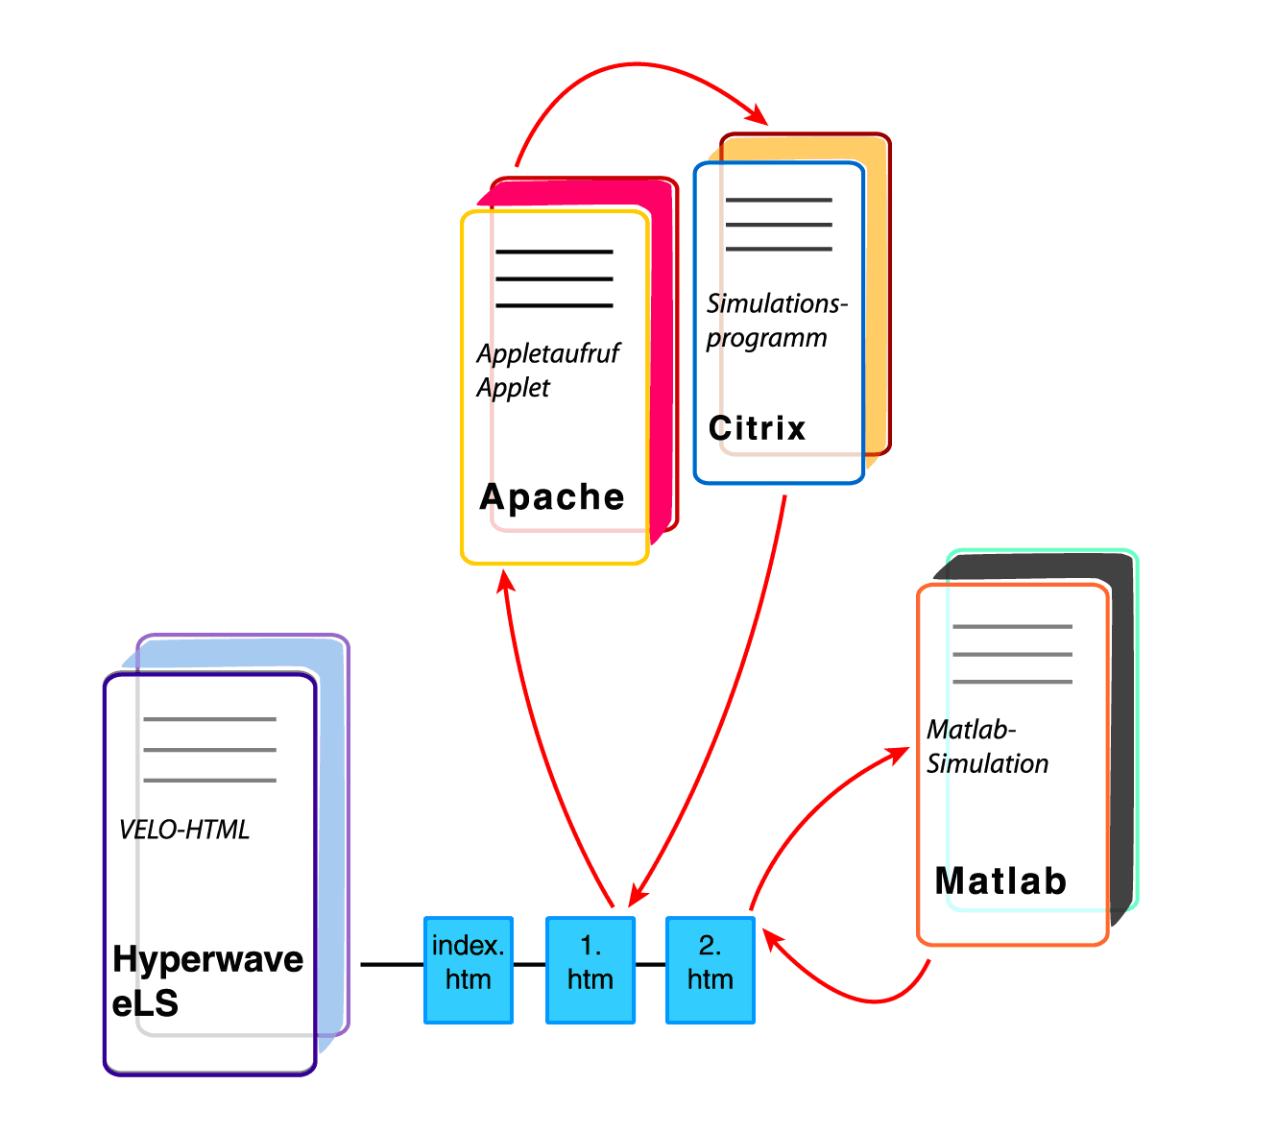
VELO – Virtual Electronic Lab
Developed at CUAS and
Part of
Online Lab Austria (OLA)
Virtual Lab
ORCAD, MATLAB/Simulink

Slide 13
Online ASIC Design Lab
Very complex solution
  combination of a virtual lab and a remote lab
    Mixed Reality Lab / Hybrid Lab
  online development of
    digital (Xilinx) and
    analog (Lattice) ASIC‘s
The following steps are implemented
  ASIC (digital/analog) design system running on a lab server
  simulation of the design on the lab server
  download of the design to the connected hardware (evaluation boards)
  test and measurements with real or virtual instruments via the Internet
New: fully integrated in iLab architecture
Notes:
13

Slide 14
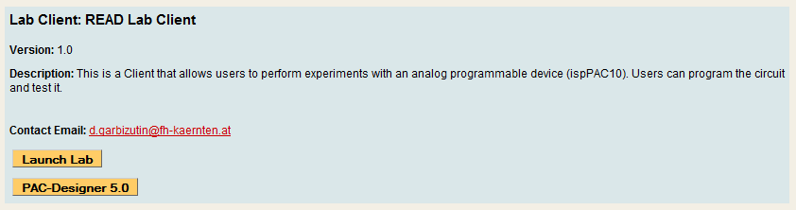
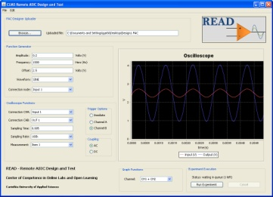
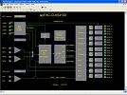

The READ System
The READ System
User logs in the service broker and chooses the READ Lab
Citrix Metaframe and READ Lab clients are delivered as Java Applets
Design.PAC
Application Delivery Client
(PAC-Designer)
Internet
(Web Services SOAP calls)
Internet

Slide 15


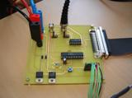
The READ Lab Server
READ Lab Server
PAC-Designer
API
ASP.NET Web Application
Experiment
Engine
Database
Internet
Web Services API
Process Manager
Circuit
under Test
User
LabView VI
Application Delivery Server
Internet
Design and Simulation
The READ Lab Server

Slide 16
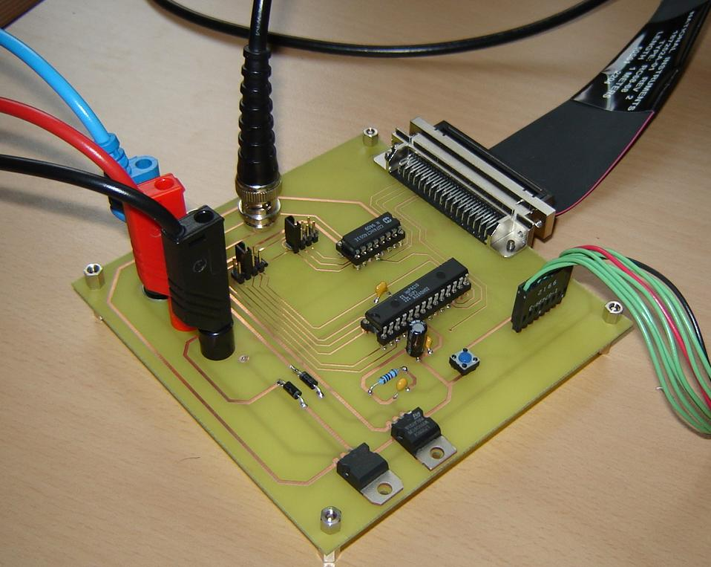
The READ Hardware
READ – Remote ASIC Design and Test
Allows for the realization of Electronics Experiments with an analogue programmable device .
A hybrid laboratory, allowing the design, simulation and test of real devices.
Completely integrated with the iLabs Shared Architecture (batched experiment)

Slide 17
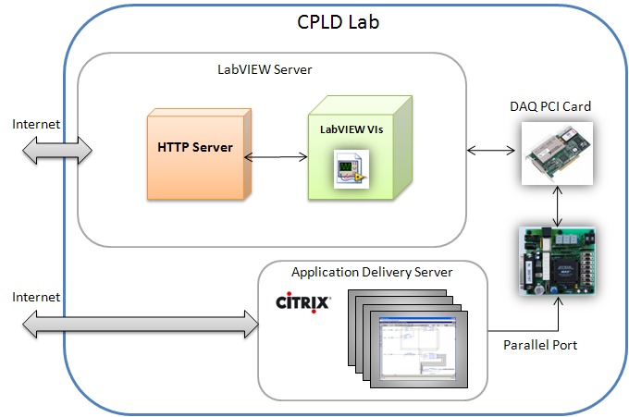
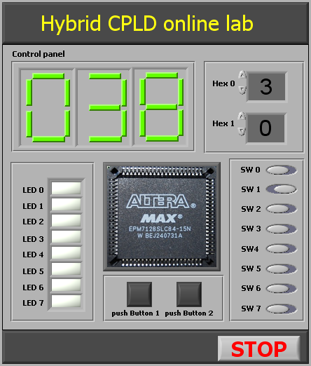
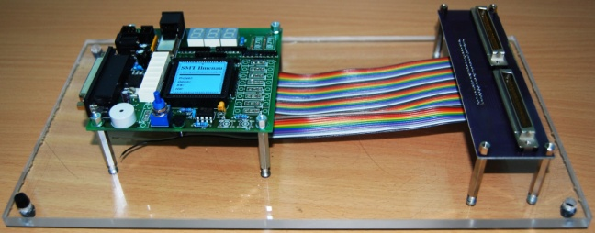
Altera MAX CPLD Remote Lab
UTBv Brasov, Romania
CUAS Villach, Austria
Hybrid Lab

Slide 18
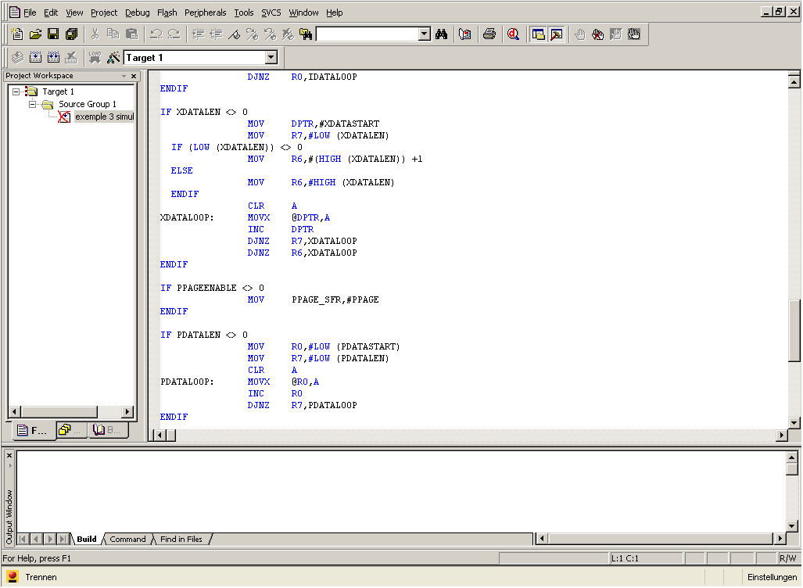
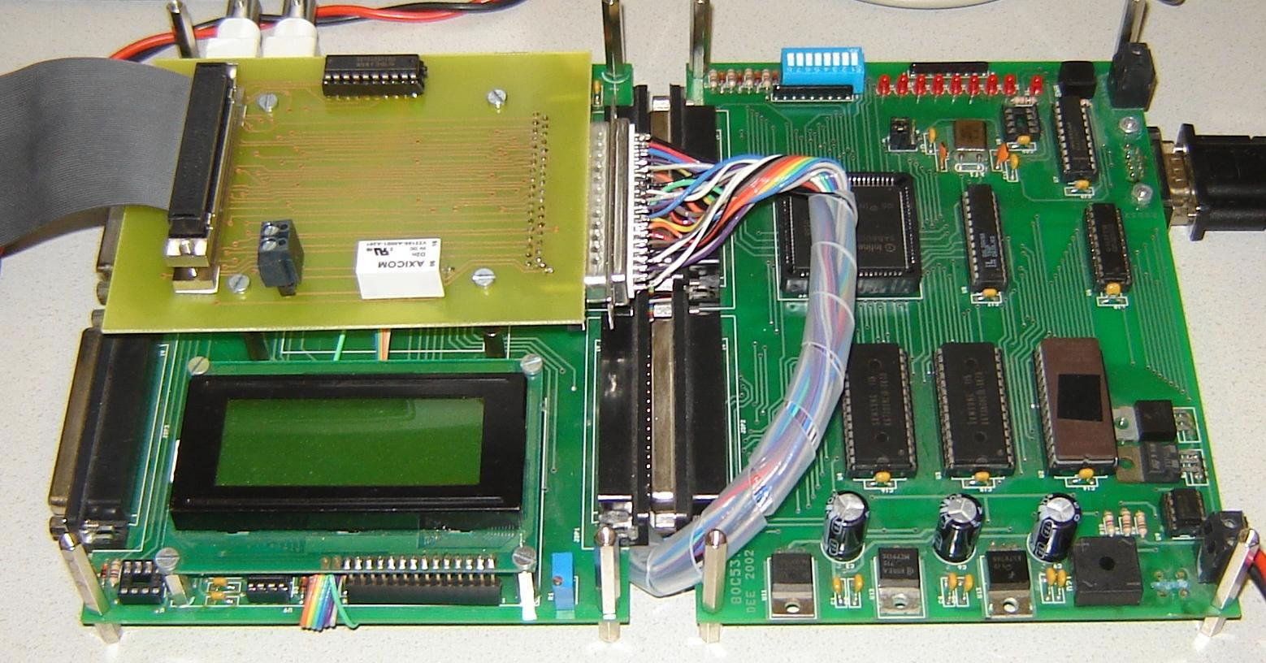
MP Remote Lab
UOC Barcelona, Spain
CUAS Villach, Austria
Hybrid Lab

Slide 19
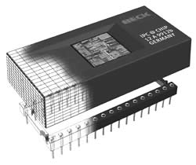
Embedded Web Server (EWS)
less than 100 EUR
full functional web server
http, ftp, telnet, RS232, USB
hardware
device
USB, RS232
Internet
micro web
server
3 cm
Ethernet
Micro Web Server
web enabled device
Notes:
19
A fully functional web server with communication and ethernet port with dimensions of some cm.
This technology will be the future!
any device / any hardware can be made to web-enabled one.

Slide 20
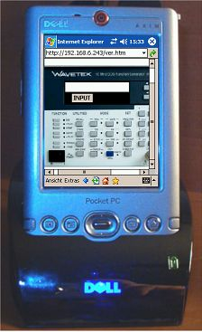
EWS User Interface Examples

Slide 21
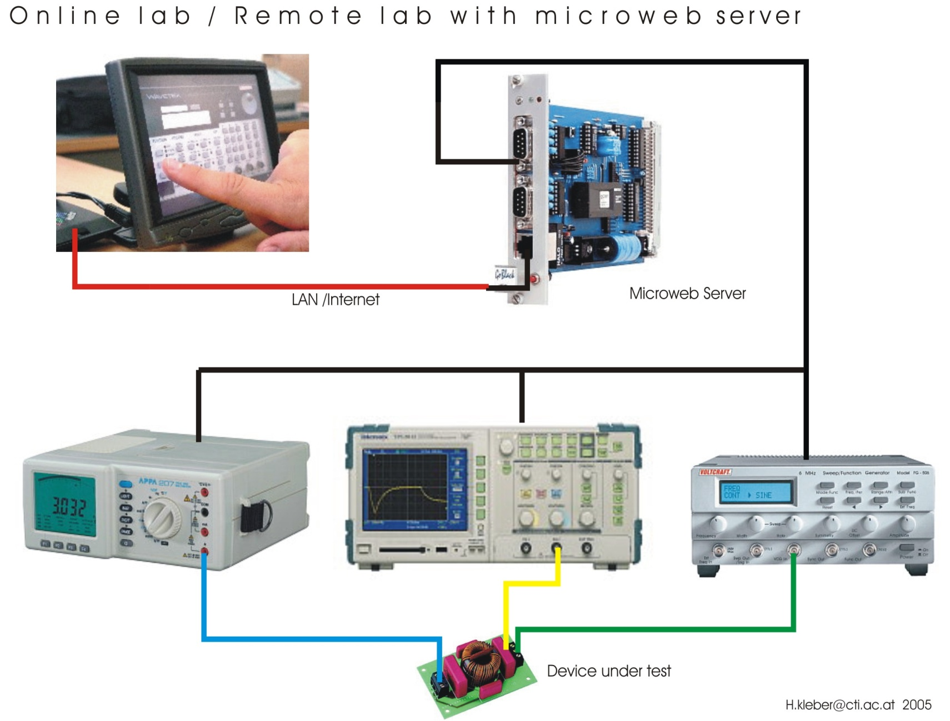
Remote Lab with EWS
Notes:
21

Slide 22
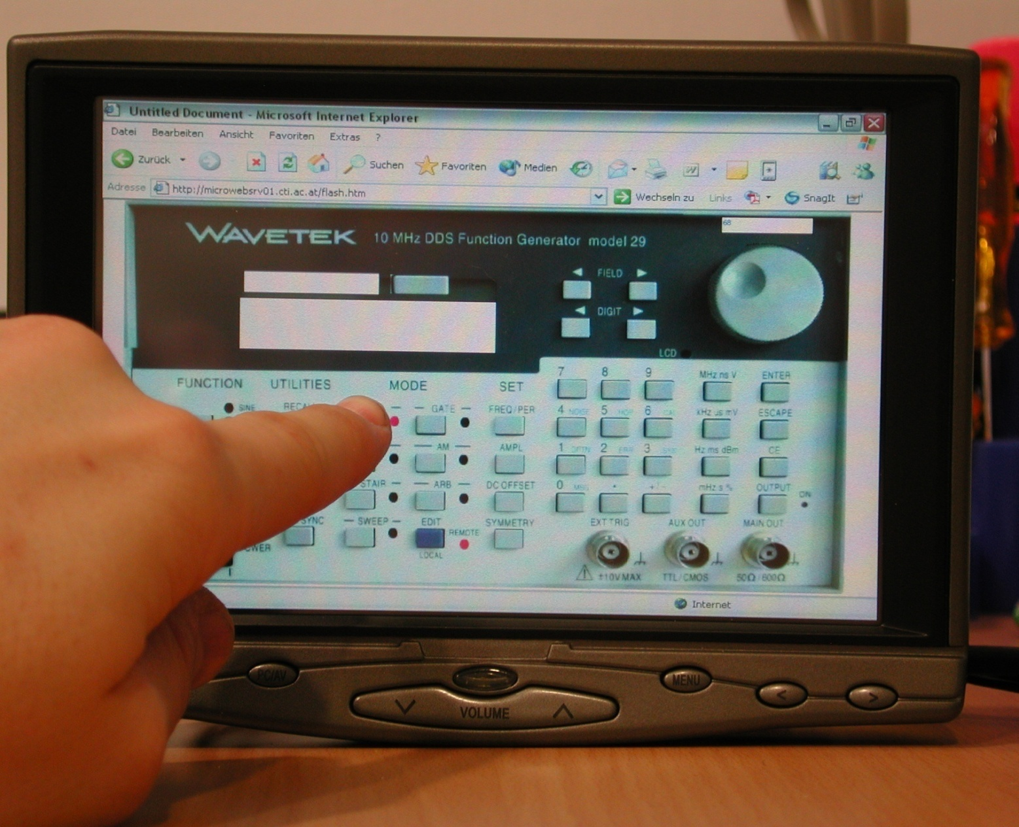
EWS Front End
Use of
touch
screen

Slide 23
Projects (Coordinating)
REL (Remote Electronic Lab) 
    funded by National Instruments
VELO (Virtual Electronic Laboratory) 
    funded by Austrian Ministry of Education and Research
OLA (Online Lab Austria) 
  funded by Austrian Ministry of Education and Research
MARE (Joint European Master Degree Program Remote Engineering) 
    funded by EU/SOCRATES
BIT2010 (Joint European Bachelor Degree in Information Technology)
funded by EU/SOCRATES

Slide 24
Projects (Partner)
PROLEARN (Network of Excellence) 
    funded by EU/FP6
LEAL (Interactive Programs in Industrial Automation) 
    funded by EU/ALPHA
REAL (Remote Engineering and Application Laboratory) 
    funded by EU/ENABLE
OntoWiki (Semantic Collaboration for Enterprise Knowledge Management, E-Learning and E-Tourism)
funded by EU/FP6

Slide 25
Main Partners in Projects
KTH Stockholm, Sweden
FH Düsseldorf, Germany
Technische Universität Ilmenau, Germany
Princess Sumaya University Amman, Jordan
UNESP Sao Paulo Region, Brazil
University of Patras, Greece
University of Limerick, Ireland
University of Porto, Portugal
University Transylvania Brasov, Romania
University of Maribor, Slovenia
University of Barcelona, Spain
Technical University of Kiev, Ukraine
UNED Madrid, Spain
University of Bucharest, Romania
University of St. Etienne, France
...

Slide 26
Bilateral Cooperations
Stanford University, USA
TU Berlin, Germany
University of Bridgeport CT, USA
Open University UK
University of Technology Sydney, Australia
Concordia University Montreal, Canada
University of Ulm, Germany
University of Bechar, Algeria
University of Deusto, Spain
University of Zagreb, Croatia
University of Genua, Italy
University of Colimna, Mexico
University of Technology Bucharest
State University Moscow (MADI), Russia
Blekinge Institute of Technology, Sweden
University of Ljubljana, Slovenia
University of Reading, UK
University of Pretoria, South Africa
...
(with universities)

Slide 27
Conferences
(organized by CCOL2with partners)
ICL (International Conference on Interactive Computer aided Learning)
    Since 1998 in Villach
    ICL2008: 340 participants from 61 countries
REV (International Conference on Remote Engineering and Virtual Instrumentation)
    Since 2004, REV2007 Porto, REV2008 Duesseldorf, REV2009 Bridgeport CT
IMCL (International Conference on Interactive Computer aided Mobile Learning)
    Since 2006 in Amman, Jordan
ICBL (International Conference on Interactive Computer aided Blended Learning)
    Since 2007 in Florianopolis, Brazil
ICELW (International Conference on E-Learning on the Working Place)
    Since 2008 in New York
IEEE EDUCON International Engineering Education Conference
    Start 2010 in Madrid
new

Slide 28
Summer Schools
(organized by CCOL² with partners)
Summer Schools for PhD and Master Students with industrial partners (NI, Agilent, Emona, …)
February 2007, Villach, Austria: “Remote Control”
July 2008, Ilmenau, Germany: “Wireless Communications”
July 2009, Maribor-Villach: "Applications of Remote and Virtual Technologies"
July 2010, Blekkinge, Sweden: “Signal Processing“
Summer 2011, Deusto, Spain
Summer 2012, Vienna, Austria

Slide 29
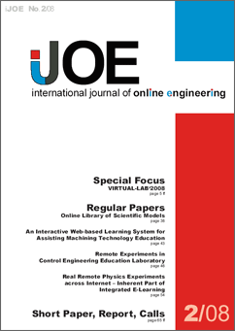
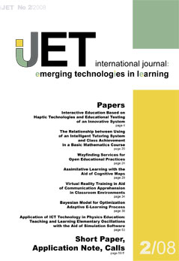
Publications
iJOE - International Journal of Online Engineering
since 2005 www.i-joe.org
iJET - International Journal of Emerging Technologies in Learning
since 2006 www.i-jet.org
iJIM - International Journal of Interactive Mobile Technologies
since 2007 www.i-jim.org
iJAC - International Journal of Advanced Corporate Learning
since 2008 www.i-jac.org

Slide 30


MARE Project
“Joint European Master Program Remote Engineering”
Partners:
CUAS Villach (AT) (Coordinator)
University of Ilmenau (DE)
University of Limerick (IR)
University of Maribor (SI)
University of Brasov (RO)
Associated partners:
Blekkinge Inst.of Technology (SE)
PSUT Amman (JO)
TU Bucharest (RO)
TU Kharkiv (UA)
Notes:
30

Slide 31
Results and Experience
We have now:
  Joint and agreed curriculum
  Content of the modules in English
  Didactic guidelines
  Running e-learning environment (Moodle, EduCommons)
  Accreditation of the study degree program in Austria, Slovenia, Romania, Germany
  Running Master Course in Villach, Austria
Notes:
31

Slide 32
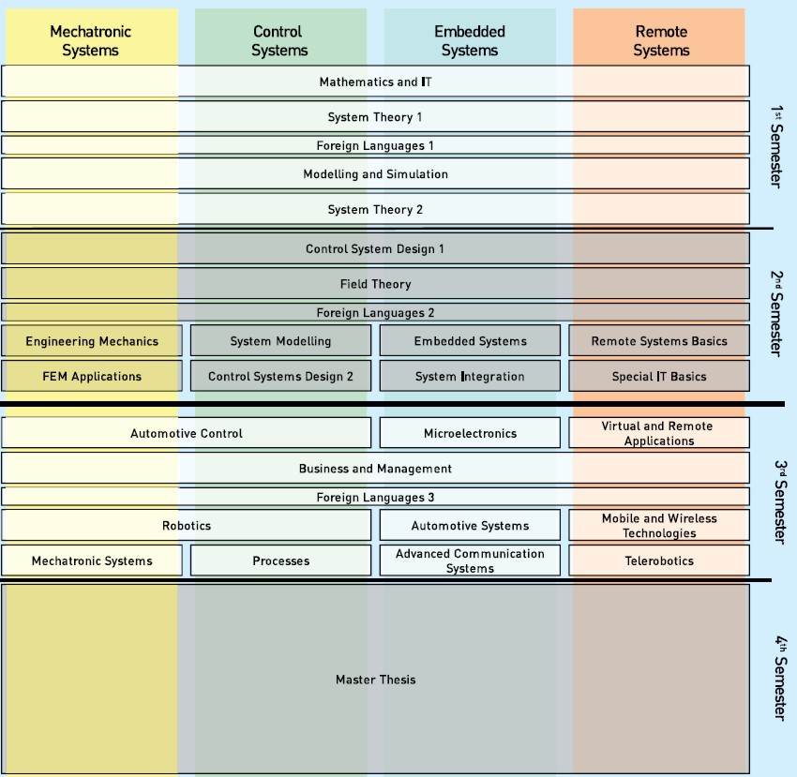
Master Study
Program
Remote Systems at CUAS within the
Systems Design
Program
Remote Systems Master (1)
Module Structure

Slide 33
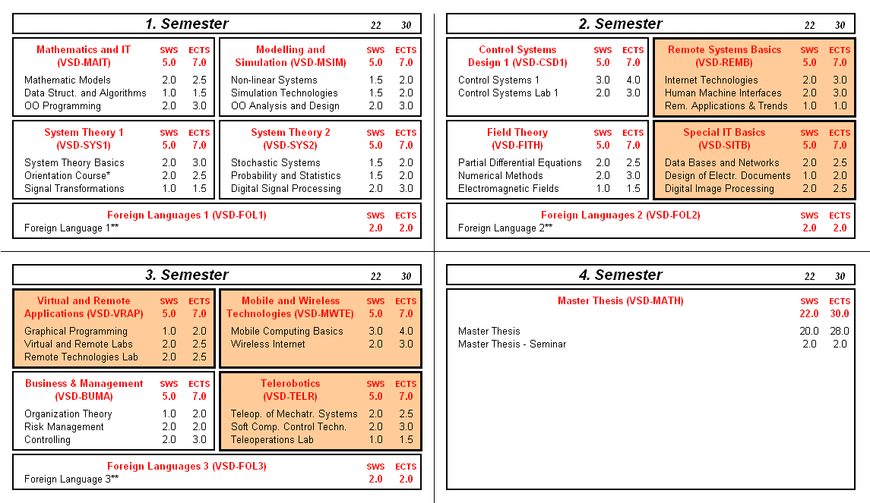
Remote Systems Master (2)
Notes:
33

Slide 34

International Association of Online Engineering
Michael E. Auer, Founder, President and CEO
Andreas Pester, Secretary General
A.Y. Al-Zoubi, Vice-President International Affairs
J.M. Martins Ferreira, Vice-President Membership Affairs
Christophe Gravier, Vice-President Academic Relations
Karsten Henke, Vice-President Educational Affairs
Doru Ursutiu, Vice-President Industrial Relations
Arthur Edwards, Latin America Liaison
David Lowe, Australian Liaison
Andreja Rojko
Kirchengasse 10/200
A-1070 WIEN
Austria
Phone: +43 664 73621196
Fax: +49 12120 294752
info@online-engineering.org
www.online-engineering.org
www.online-engineering.org

Slide 35

Contact
Prof. Dr.-Ing. Dr.sc. Michael E. Auer
Carinthia University of Applied Sciences
Europastrasse 4
9524 Villach, Austria
www.cti.ac.at/auer
m.auer@ieee.org

