Slide 1


MIT Presentation
“Development of Digital Electronics Experiments for Deployment on the iLabs Platform”
Cosmas Mwikirize
Victoria Florence Namuswa
Victoria Nakanwagi
March 2009

Slide 2
Research Objectives
Specific Objectives
To identify the digital electronics experiments that can be implemented based on the ISA model
To derive specifications for the experiments and develop iLabs for them
To test and deploy the developed experiments on the ISA
To document the research outputs
Notes:
Leaders in Measurement and Control
Direct Operations 40 Countries
1,353 engineers are employed
Headquartered in Austin, Texas, NI has more than 3,000 employees and direct operations in more than 40 countries. Along with the more than 1,000 measurement, control, and automation tools we offer, NI recognizes more than 500 members in our National Instruments Alliance Partner Program (a network of independent consultants and integrators) ready to assist you in assembling and implementing an NI measurement and automation solution. These Alliance Partners offer domain expertise from process control to discrete manufacturing for oil and gas, aerospace, automotive, electronics, communications, and semiconductor industries.

Slide 3
Conceptual Framework
Identify an experiment and specify its requirements
Physical Set-up of the
experiment
Modify the user interface
Create Virtual
Instruments
Integrate the virtual instruments
in the LabServer
Test and deploy
Notes:
Leaders in Measurement and Control
Direct Operations 40 Countries
1,353 engineers are employed
Headquartered in Austin, Texas, NI has more than 3,000 employees and direct operations in more than 40 countries. Along with the more than 1,000 measurement, control, and automation tools we offer, NI recognizes more than 500 members in our National Instruments Alliance Partner Program (a network of independent consultants and integrators) ready to assist you in assembling and implementing an NI measurement and automation solution. These Alliance Partners offer domain expertise from process control to discrete manufacturing for oil and gas, aerospace, automotive, electronics, communications, and semiconductor industries.

Slide 4
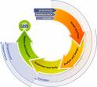
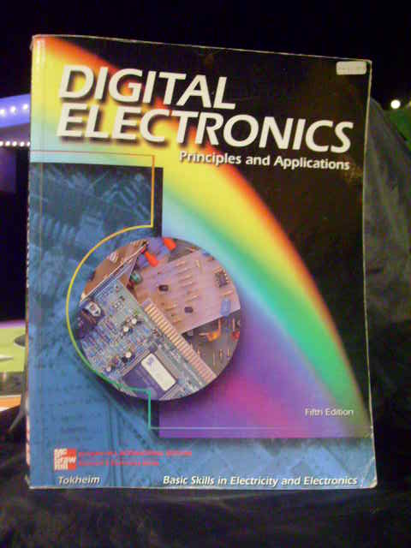

Work Done
Domain Analysis and Literature Review
  Understanding the ISA and review of documentation
  Identify possible experiments
  Requirement analysis
  Review of standards
  Tools: Text Books, journals, documentation
Notes:
Leaders in Measurement and Control
Direct Operations 40 Countries
1,353 engineers are employed
Headquartered in Austin, Texas, NI has more than 3,000 employees and direct operations in more than 40 countries. Along with the more than 1,000 measurement, control, and automation tools we offer, NI recognizes more than 500 members in our National Instruments Alliance Partner Program (a network of independent consultants and integrators) ready to assist you in assembling and implementing an NI measurement and automation solution. These Alliance Partners offer domain expertise from process control to discrete manufacturing for oil and gas, aerospace, automotive, electronics, communications, and semiconductor industries.

Slide 5
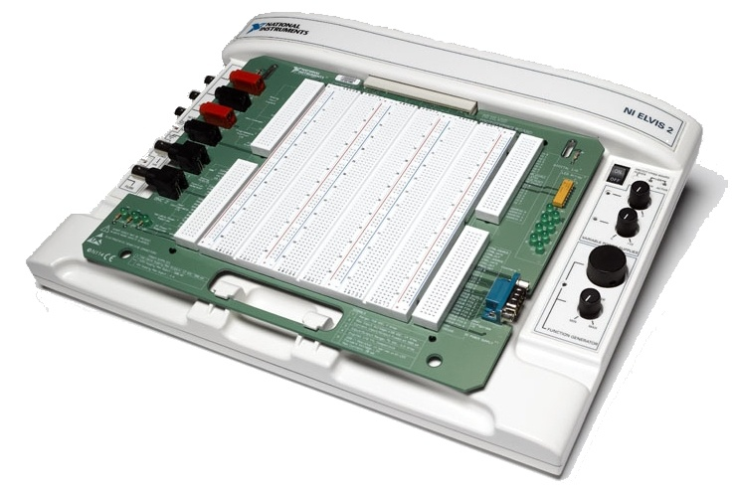
Work Done
Experiment Specification and Design
  Description of design criteria in line
  with curriculum
  Physical set-up of the experiments
  Creation of Virtual Instruments
  Tools: Text Books, NI ELVIS II, LabVIEW
University Databases
Notes:
Leaders in Measurement and Control
Direct Operations 40 Countries
1,353 engineers are employed
Headquartered in Austin, Texas, NI has more than 3,000 employees and direct operations in more than 40 countries. Along with the more than 1,000 measurement, control, and automation tools we offer, NI recognizes more than 500 members in our National Instruments Alliance Partner Program (a network of independent consultants and integrators) ready to assist you in assembling and implementing an NI measurement and automation solution. These Alliance Partners offer domain expertise from process control to discrete manufacturing for oil and gas, aerospace, automotive, electronics, communications, and semiconductor industries.

Slide 6
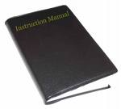
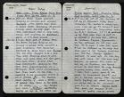

Work Left
  .NET of the Lab Server
  Client
  Testing and implementation
  Documentation
University Databases
Notes:
Leaders in Measurement and Control
Direct Operations 40 Countries
1,353 engineers are employed
Headquartered in Austin, Texas, NI has more than 3,000 employees and direct operations in more than 40 countries. Along with the more than 1,000 measurement, control, and automation tools we offer, NI recognizes more than 500 members in our National Instruments Alliance Partner Program (a network of independent consultants and integrators) ready to assist you in assembling and implementing an NI measurement and automation solution. These Alliance Partners offer domain expertise from process control to discrete manufacturing for oil and gas, aerospace, automotive, electronics, communications, and semiconductor industries.

Slide 7

Work Schedule
 | 2008 |  |  |  | 2009
Activity | SEP | OCT | NOV | DEC | JAN | FEB | MAR | APRIL | MAY
Domain Analysis/ Literature Review
Training
Midterm presentation
Specification/ Design
Implementation, Testing and Deployment
Documentation
University Databases
Notes:
Leaders in Measurement and Control
Direct Operations 40 Countries
1,353 engineers are employed
Headquartered in Austin, Texas, NI has more than 3,000 employees and direct operations in more than 40 countries. Along with the more than 1,000 measurement, control, and automation tools we offer, NI recognizes more than 500 members in our National Instruments Alliance Partner Program (a network of independent consultants and integrators) ready to assist you in assembling and implementing an NI measurement and automation solution. These Alliance Partners offer domain expertise from process control to discrete manufacturing for oil and gas, aerospace, automotive, electronics, communications, and semiconductor industries.

