Slide 1
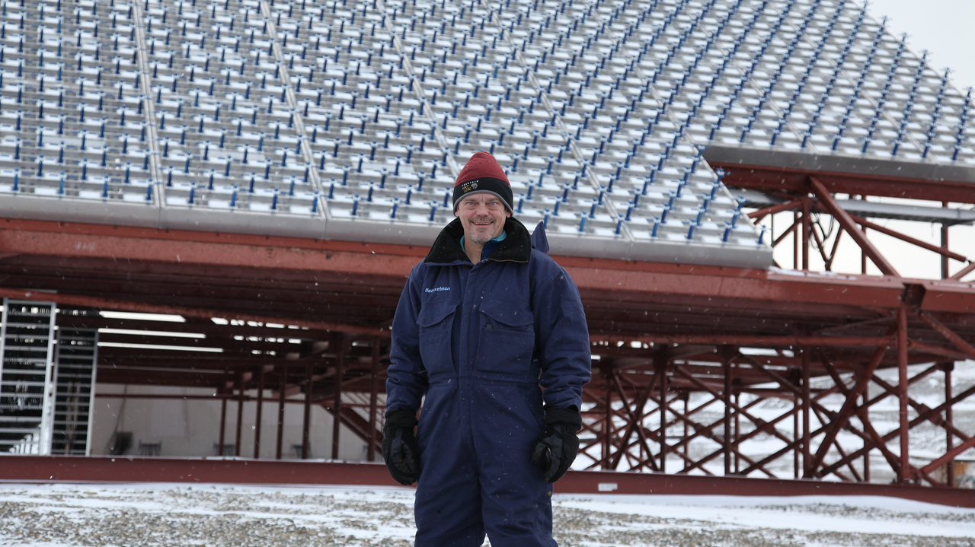
The Effects of ISR Beam-look Direction on Derived TID Characteristics
Björn Bergsson, Charmi Patel, Lara Kamal, Aidan Thayer, Madeline Evans
ISR Summer School 2024 – Boston, Massachusetts
Photo credit: Craig Heinselman

Slide 2
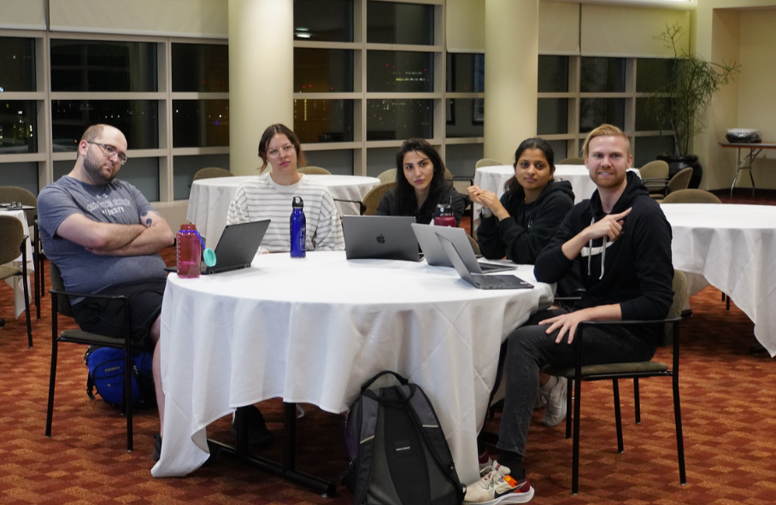
Outline
Scientific Motivation
Data analysis methods
Results
Conclusions
Photo credit: Craig Heinselman
Scientifically motivated students at 4:00 AM.

Slide 3
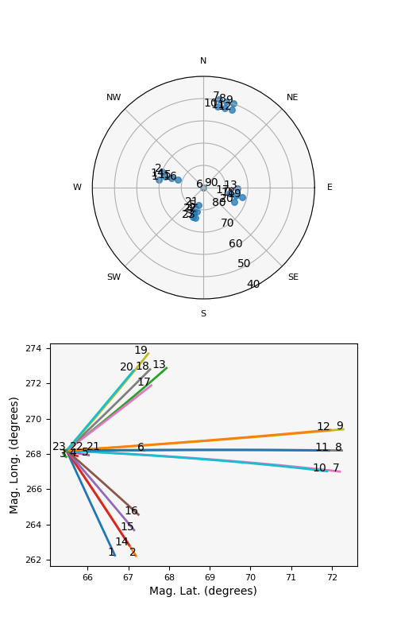
Scientific Motivation
Investigate F-region ionosphere during a geomagnetic storm
  High SWPC Kp index prediction (5.67) for 24th July from 6-9 AM UT
  (10 PM - 1 AM local time Alaska)
  High geomagnetic activity could potentially cause equatorward TIDs
Observe TIDs using different beam look directions
  Experiment time: 24th July 12 -2 AM local time Alaska
  Mode: long pulse (F-region)
  23 beams, 1 zenith looking and 4 groups of beams looking in different directions (perpendicular and parallel to the magnetic field).
Derive TID characteristics (vertical wavelength, period), and compare the derived characteristics between the different beam-look directions
  Quantify the effects of different beam-look directions when observing TIDs
  Essential for accurate interpretation of TIDs using ISR observations
Perpendicular
Parallel
Beam configuration for the experiment.

Slide 4
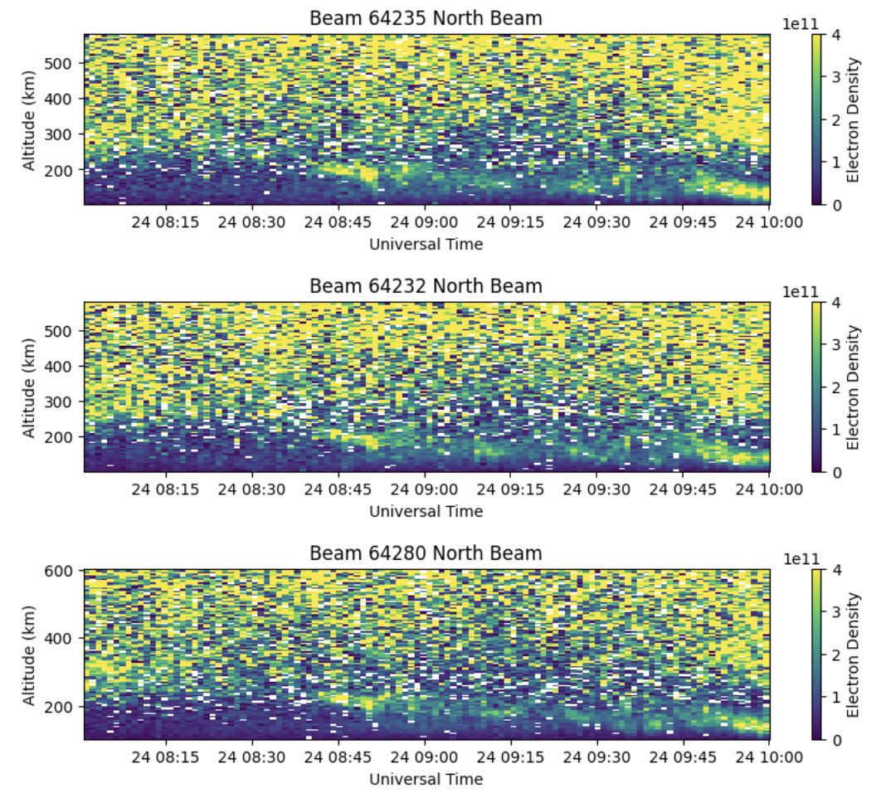
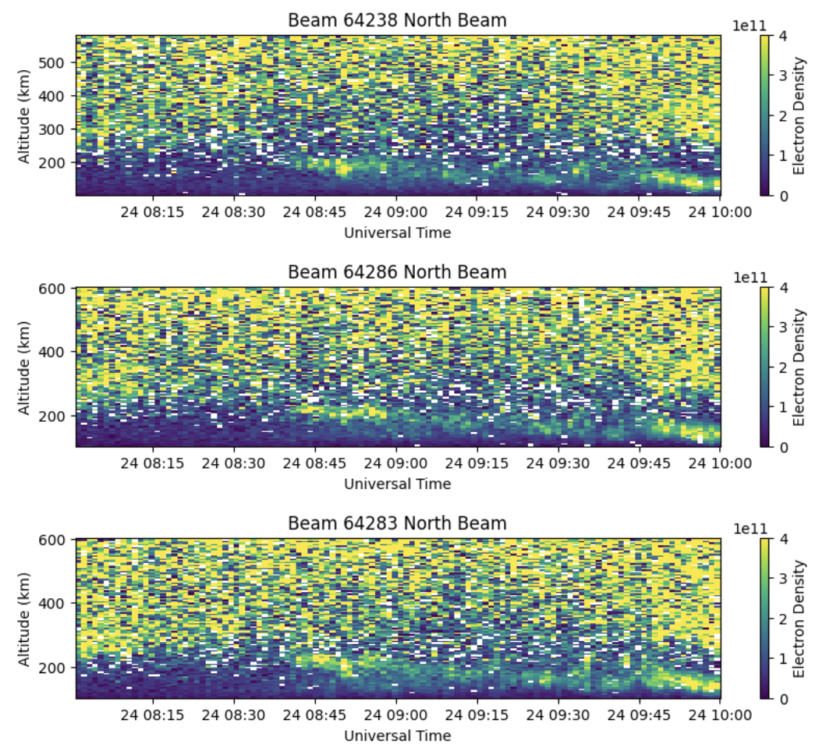
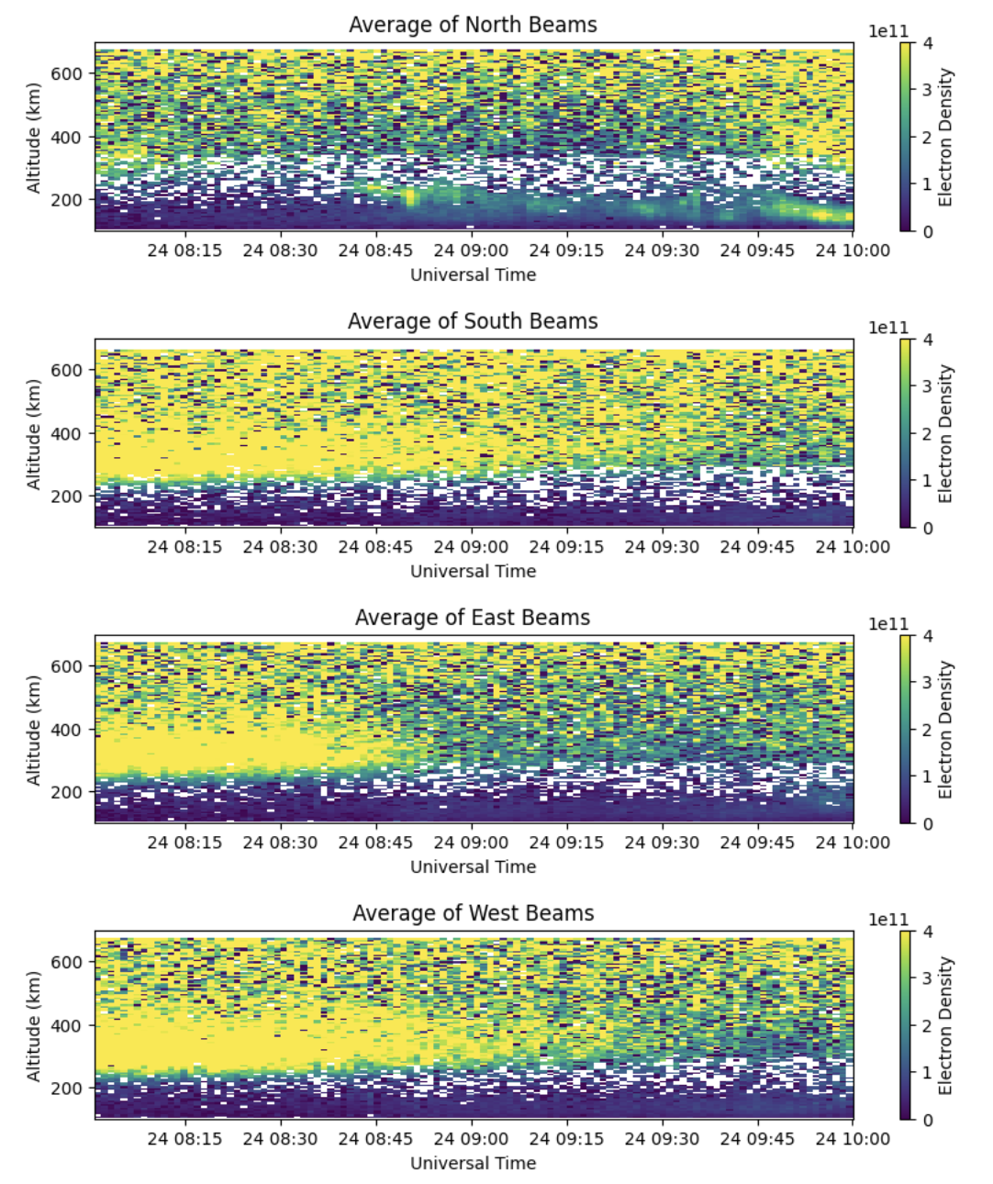
Methods – Northward perpendicular beams
Electron densities show same signatures, expected as the beams are looking in almost the same direction.
We use an error-weighted average of the beams to represent the electron densities in the northward direction.
Average of all 6 beams above

Slide 5
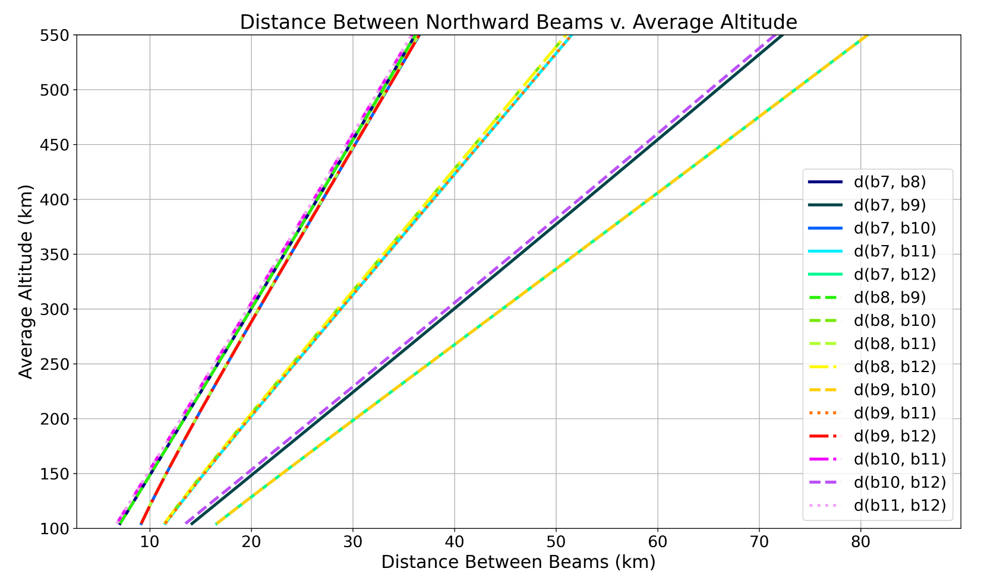
Methods – Beam Averaging Justification
To ensure that beams are looking at a similar ionospheric region, we calculated the euclidian distance between the beams at common sample indices.
Maximum distance between beams at 200 km is 30 km, so averaging the beams allows for resolution of large-scale phenomena.
30 km
Average of all 6 beams above

Slide 6
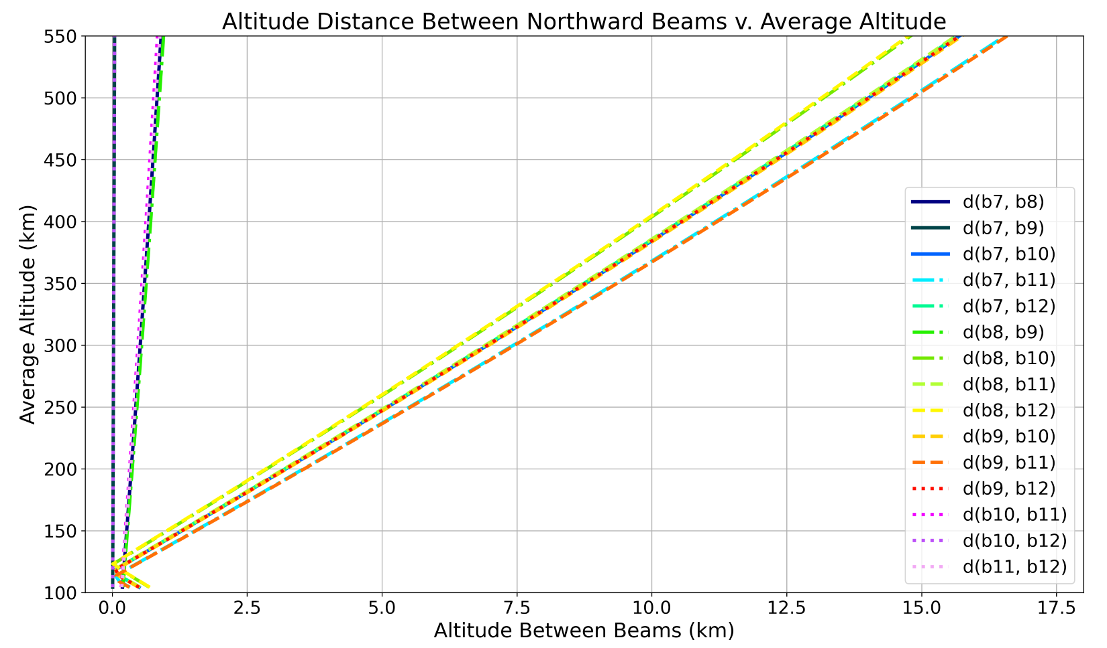
Methods – Beam Averaging Justification
To ensure that our altitude estimation is valid, we calculated the altitude distance between the beams at common sample indices.
The maximum altitude difference between beams at 200 km is ~3.5 km.
3.5 km
Average of all 6 beams above

Slide 7
Results – Electron densities from different beam directions
  Generally we see the electron densities decrease as night arrives.
  No TIDs were observed, but density structures present in the north beams, let’s analyse further.
Average of westward parallel
Average of eastward parallel
Notes:
West-east difference, nighttime arrives first in the east because they are at lower latitudes and sun sets in the west).
Density of south beams falls off at a time between west and east beams as expected, although a bit harder to see due to higher errors in those beams, as they are closer to the beam edges.

Slide 8
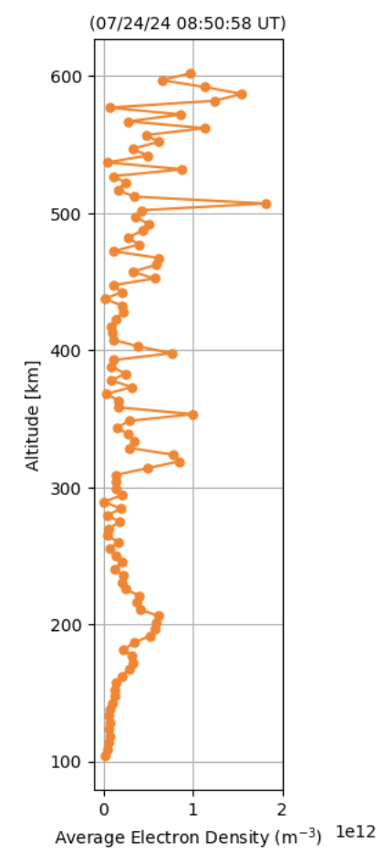
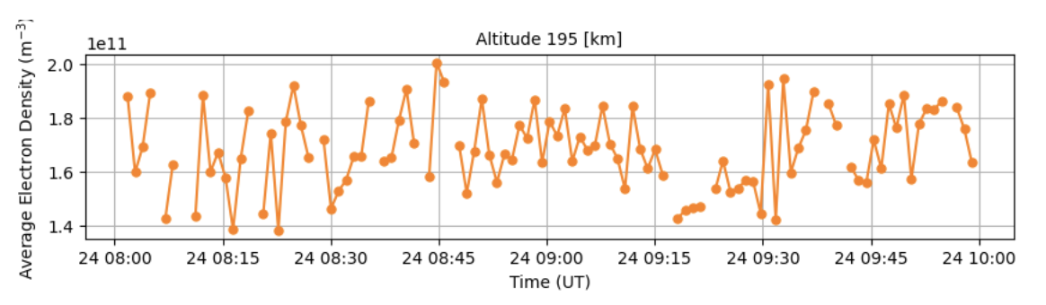
Results – First Look

Slide 9
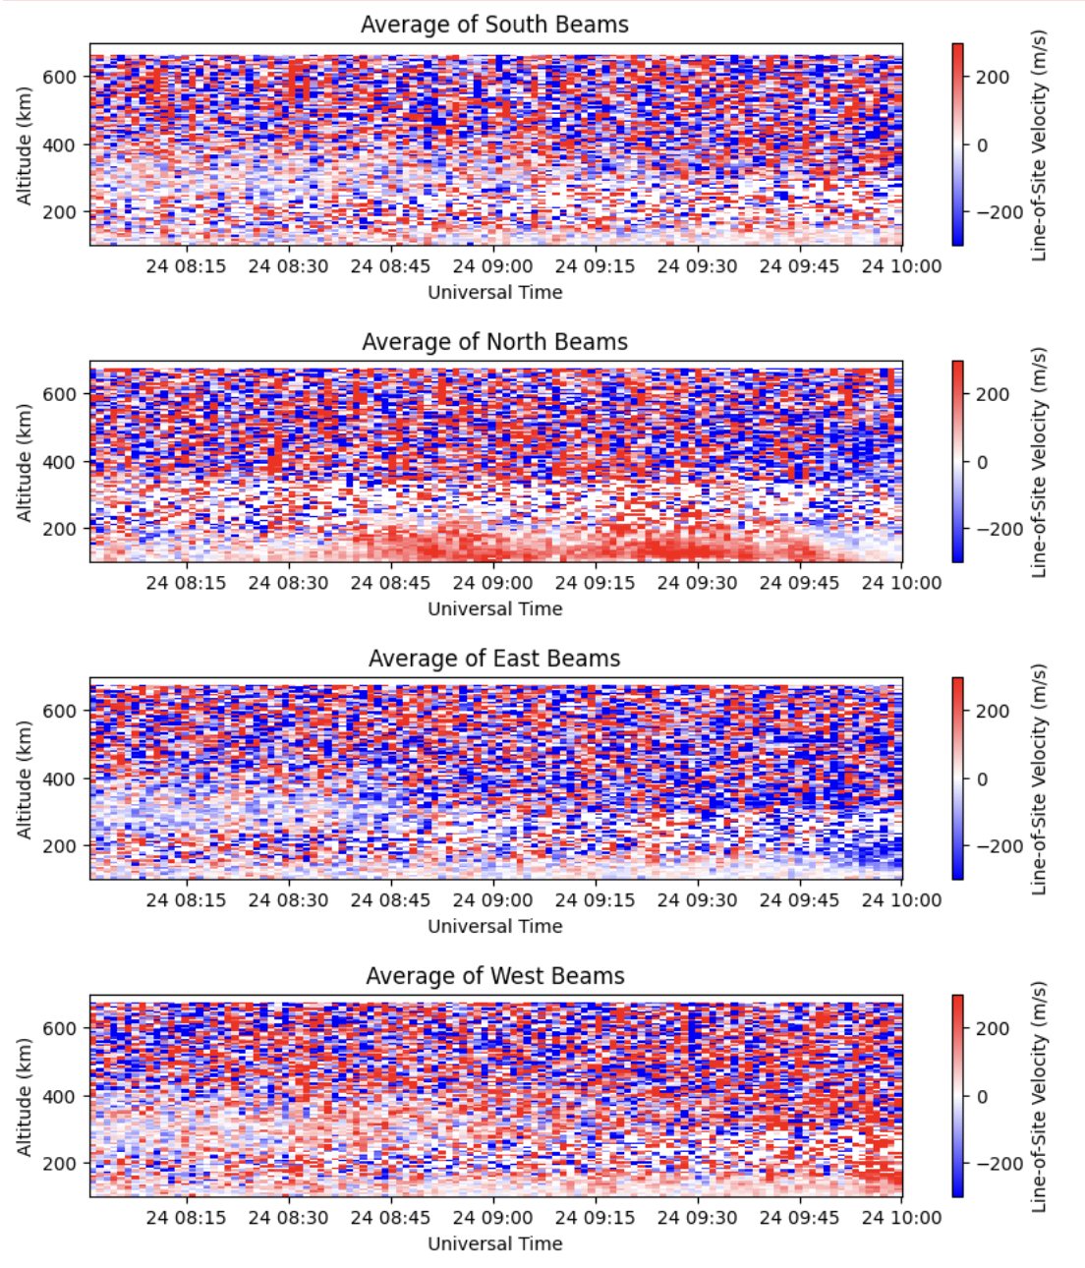
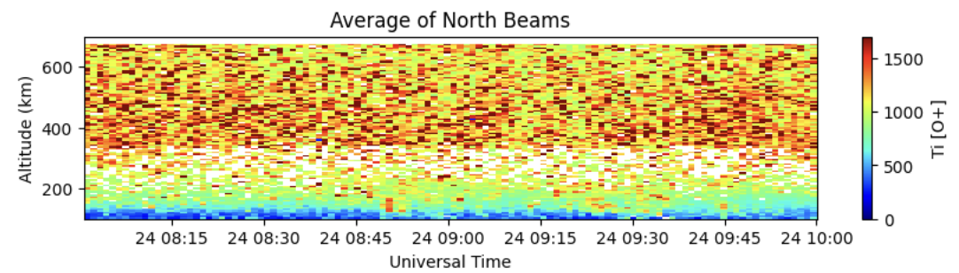
Results – Particle precipitation?
Investigated LOS velocities and ion temperature data
LOS velocities indicate plasma movement away from the radar.

Slide 10
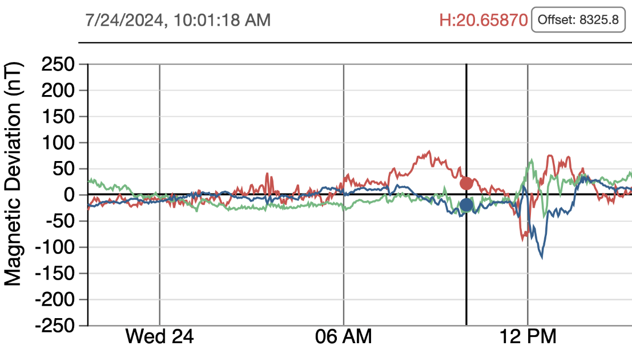
Results – Particle precipitation?
Electron density enhancements, could be a result due to particle precipitation (consistent with magnetometer data).
> 80 nT
Average of westward parallel
Experiment time
UAF magnetometer data at Toolik Lake (north of PFISR)

Slide 11
Results – Particle precipitation?
Seems to be a downward trend in the altitude.
Could be electron density enchancements due to particle precipitation, which is transported away from the LOS with the mean background flow.
Downward trend
Average of westward parallel

Slide 12
Results – LOS velocities from different beam directions
LOS velocities for average of each direction show no major features.

Slide 13
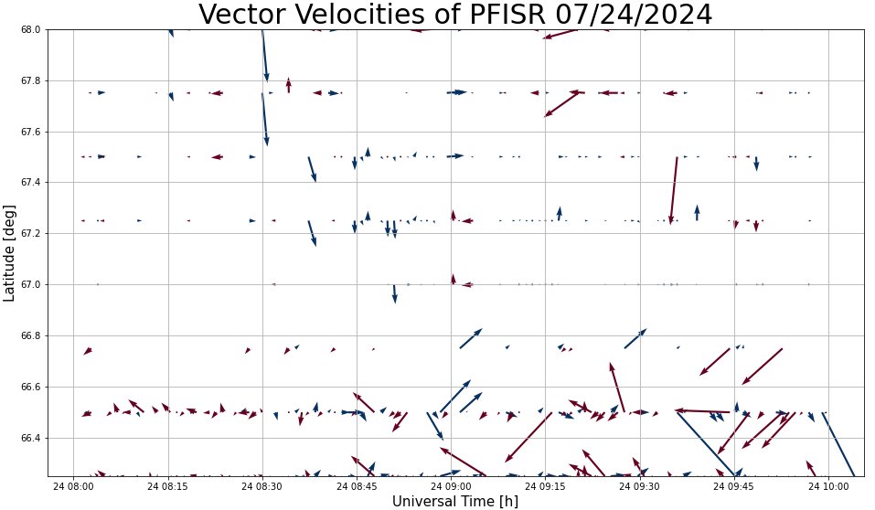
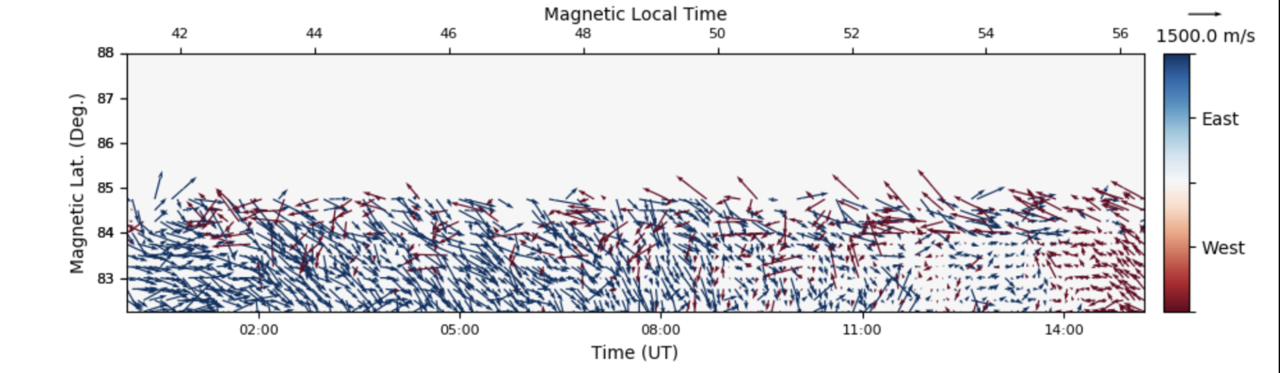
Results – Vector Velocities
Average of all 6 beams above

Slide 14
Conclusions
TIDs were not observed during the experimental time.
Density structures observed north from PFISR, possibly due to particle precipitation.
Nothing unusual observed in other beam directions.
Future work:
Process SuperDARN convection patterns (currently not yet available)
Gather suite of ionosonde and magnetometer data to support precipitation theory
Access GNSS network for TEC data
Plan more scans to detect TIDs and other events
Investigate RISR-N data
Properly average beams
Deal with potential beam bias
Average of eastward parallel

