Slide 1
ISACC:
ISR and SWARM-A Cross-Comparison
Presented by
Isaac, Nina, Anh, Aliaa, Adrienne

Slide 2
To do
Fix font/format
Background

Slide 3
Science questions
How do simultaneous topside in-situ measurements compare with ISR observations?
Previous experiments suggest that SWARM satellites tend to systematically underestimate electron density ranging by 10% up to ~30% (REF1, REF2)
How can in-situ and ISR observations be combined to better image the topside?
ISRs typically do not resolve topside ionospheric parameters well

Slide 4
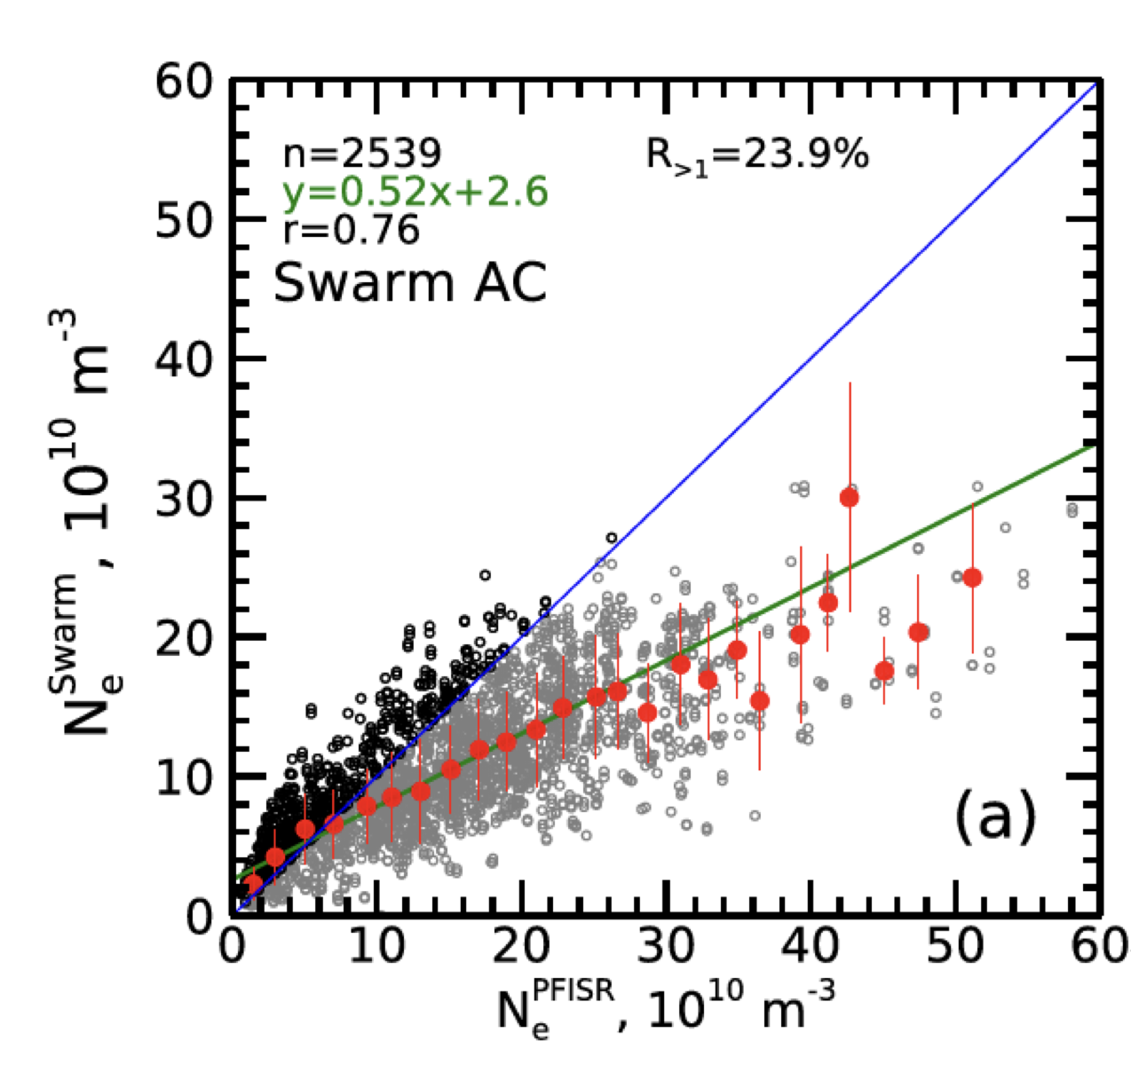
Comparing ISR and satellite data
Comparing different sources of data can help understand the limitations of each.
Satellites (e.g. SWARM) offer in-situ measurements of the topside ionosphere.
Statistical studies show that SWARM-A/C underestimate the ISR electron density by ~30% (Larson et al., 2021; Fast et al., 2023).

Slide 5
Background
In-Situ Measurements (Satellites, Rockets, etc) :
Direct, high-accuracy data at specific locations, ideal for localized and controlled experiments.
Limited spatial coverage
Incoherent Scatter Radar (ISR) Measurements:
Offer wide-area, monitoring of ionosphere, capturing large volumes of data simultaneously.
Indirect measurements

Slide 6
Questions
Does SWARM-A underestimate the ISR electron density, i.e., do we validate previous results?
If yes, what makes this underestimation occur?
How can we still use the SWARM data to help improve the topside ISR data?

Slide 7
What is our methodology?

Slide 8
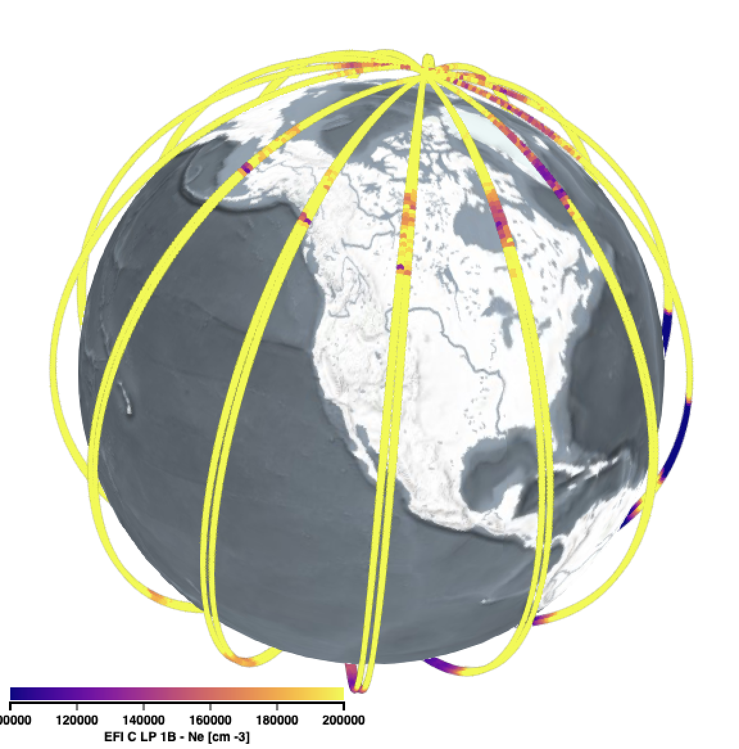
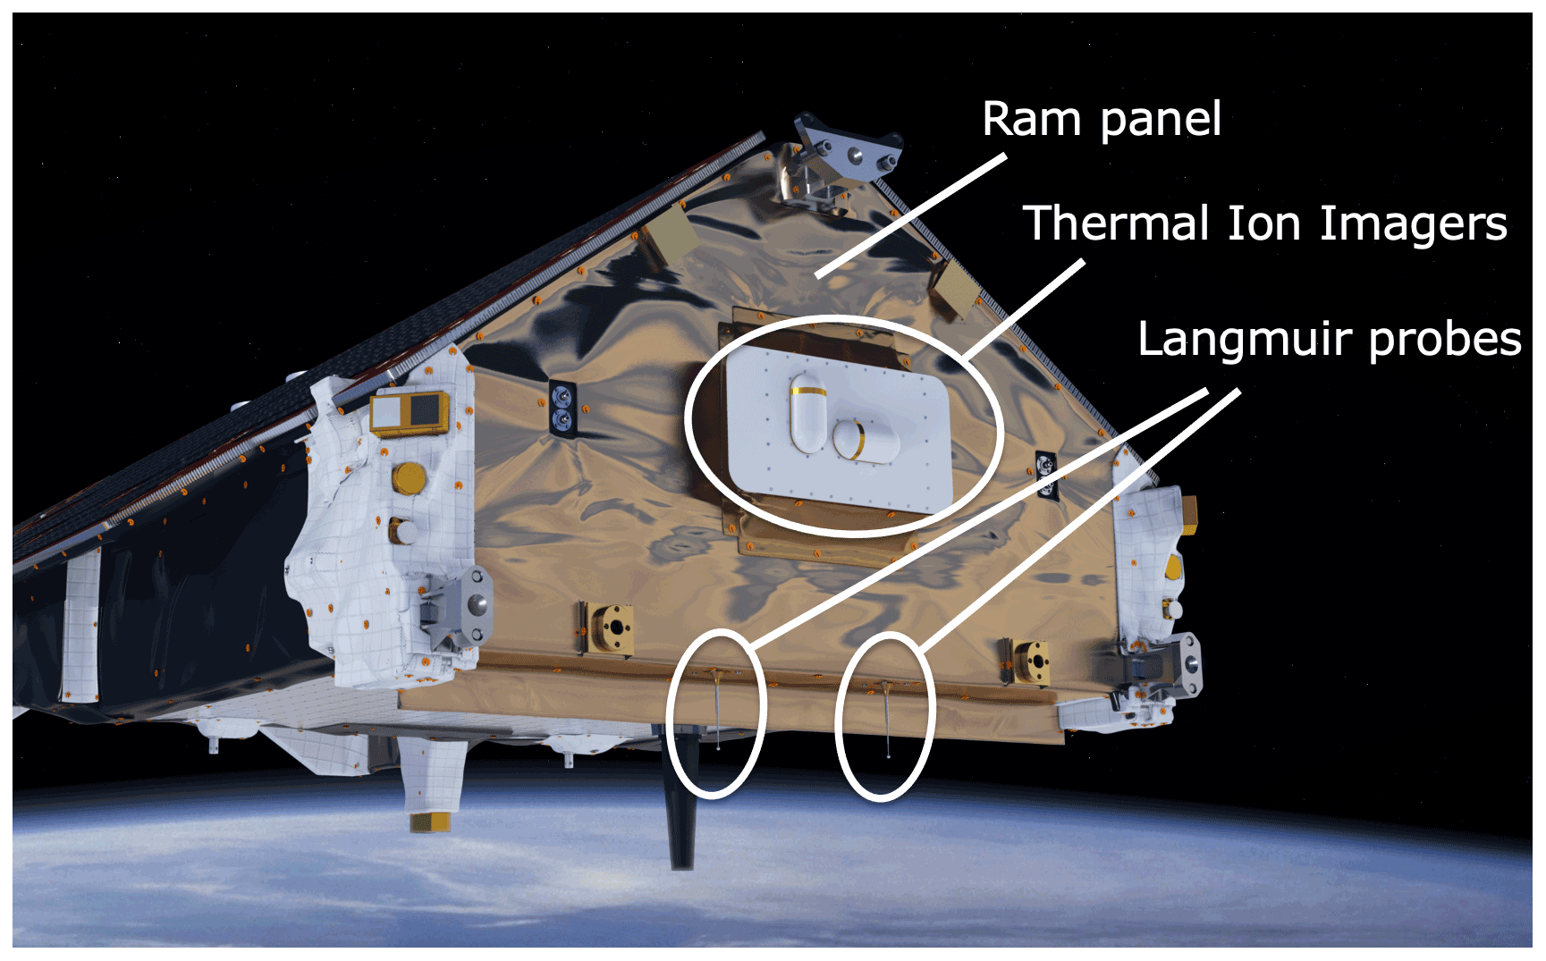
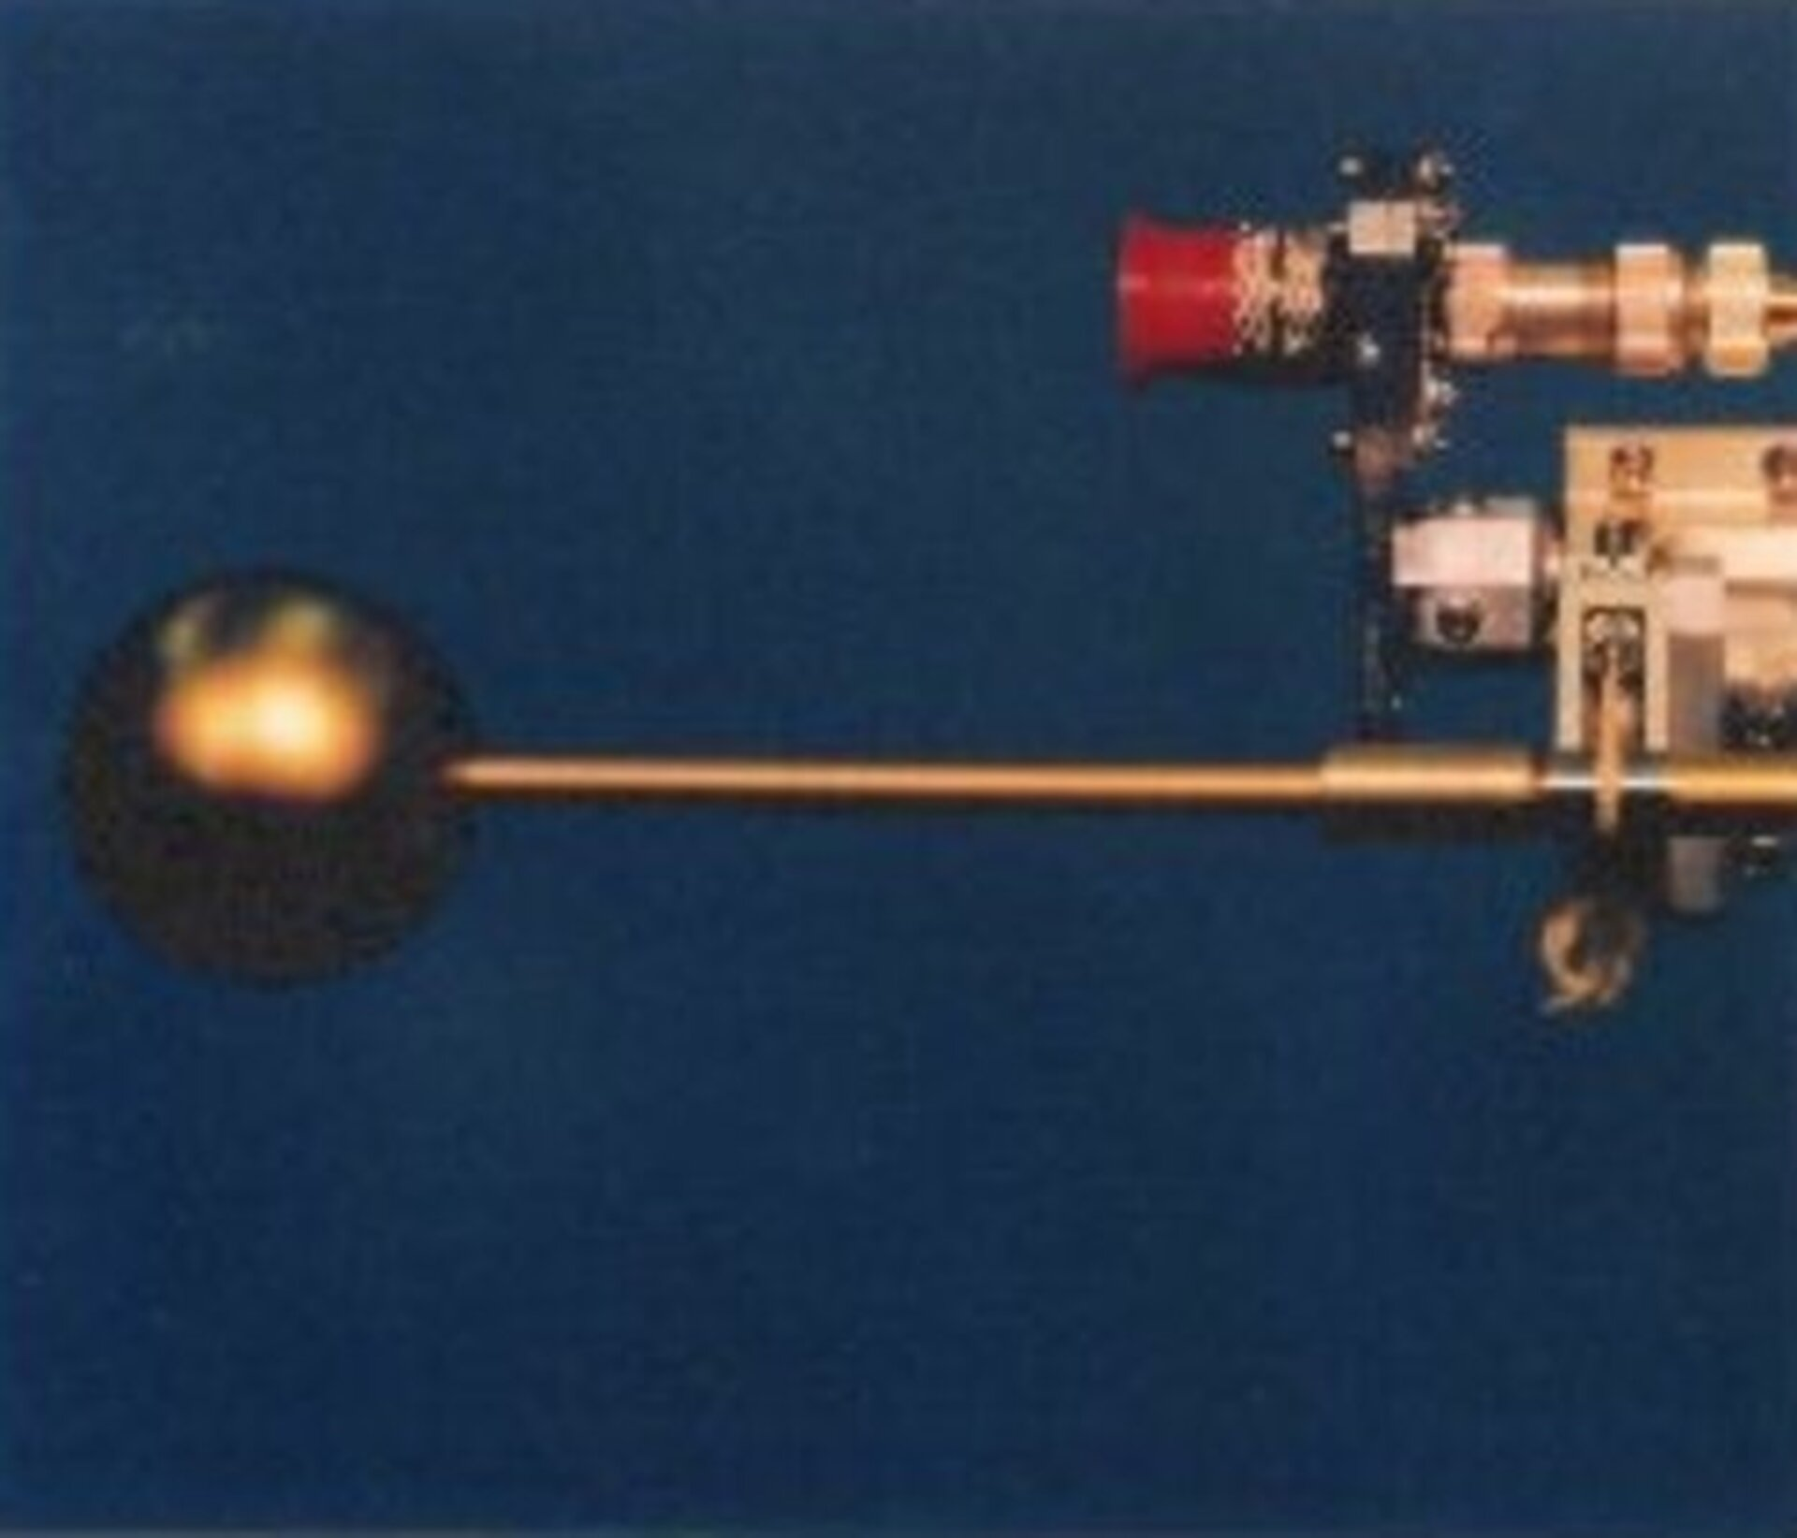
SWARM
three Swarm satellites have been in operation since 2013 (Buchert et al., 2015; FriisChristensen et al., 2008; Knudsen et al., 2017). The Swarm satellites fly at altitudes of 400 to 500 km, and measure the electron density with a temporal resolution of one second or better (Buchert et al., 2015), i.e. with a spatial resolution of less than 10 km. Langmuir probes are one of many instruments on these satellite. The electron density can also be inferred from the Thermal Ion Imager (TII) instrument (Knudsen et al., 2017). Data from the TII have only just started to be explored (Xiong et al., 2022)
Inclination: 87.4° (polar orbit)
Altitude: ~470 km
Langmuir Probe: Electron density & temperature
Three satellites: A, B, C. AC orbit together spaced 155km
Generated courtesy of https://vires.services/
Images courtesy of Canadian Space Agency and ESA

Slide 9
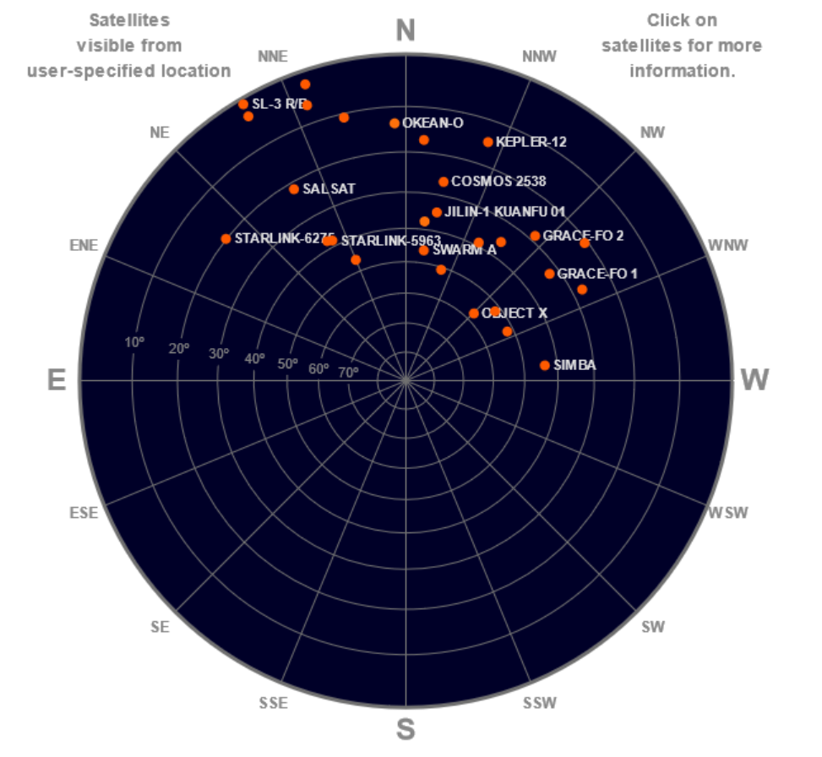
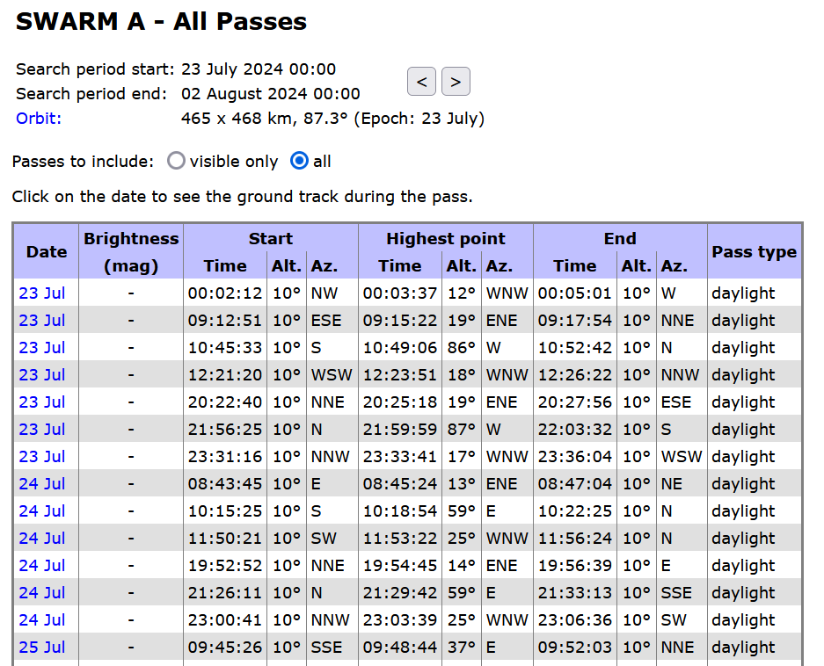
SWARM-A Observation Schedule
heavens-above.com
in-the-sky.org

Slide 10
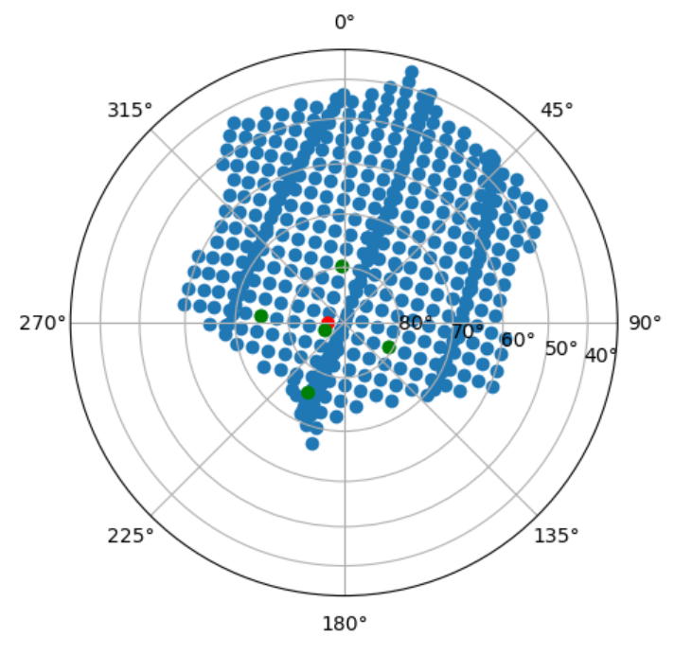
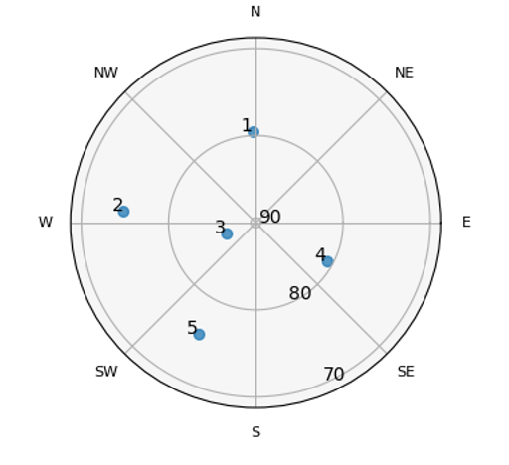
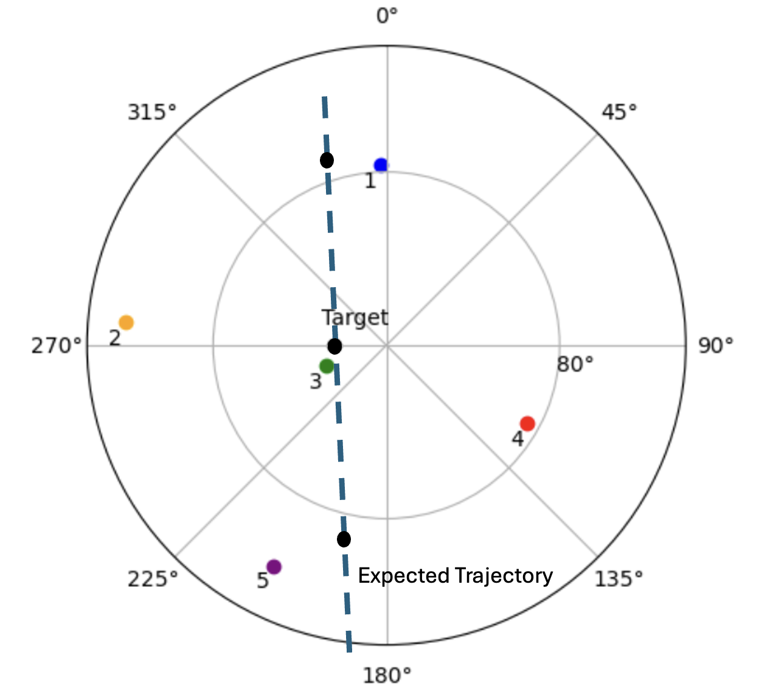
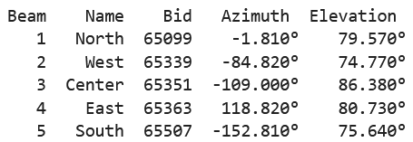
PFISR Setup - Long pulse
South beam least reliable
Notes:
PFISR1. Long Pulse
• 330 us long pulse with multiple frequencies to improve statistics
• Good mode for F-region studies needing high time resolution (e.g. TID studies)

Slide 11
What do the ISR data look like?

Slide 12
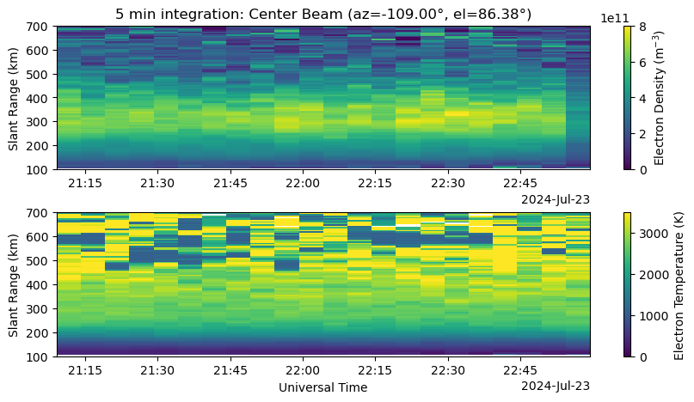
PFISR Electron Density & Temperature
Notes:
Middle of the day, great F region at about 300 km, it’s a stable ionosphere, we don’t see anything strange going on.
Point out 22:00 is the point where the satellite cross.

Slide 13
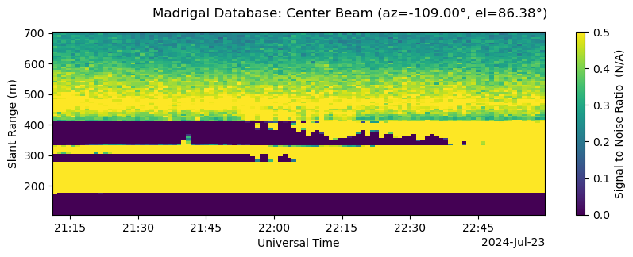
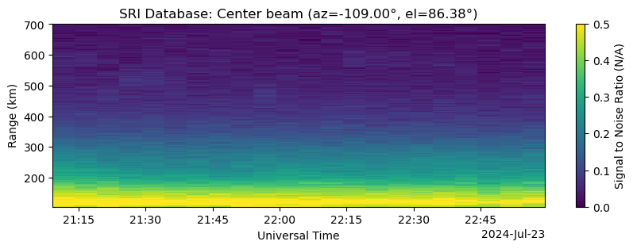
SNR Considerations
Ground clutter at 200-400 km??
No ground clutter above 100 km altitude
Notes:
We want to take the

Slide 14
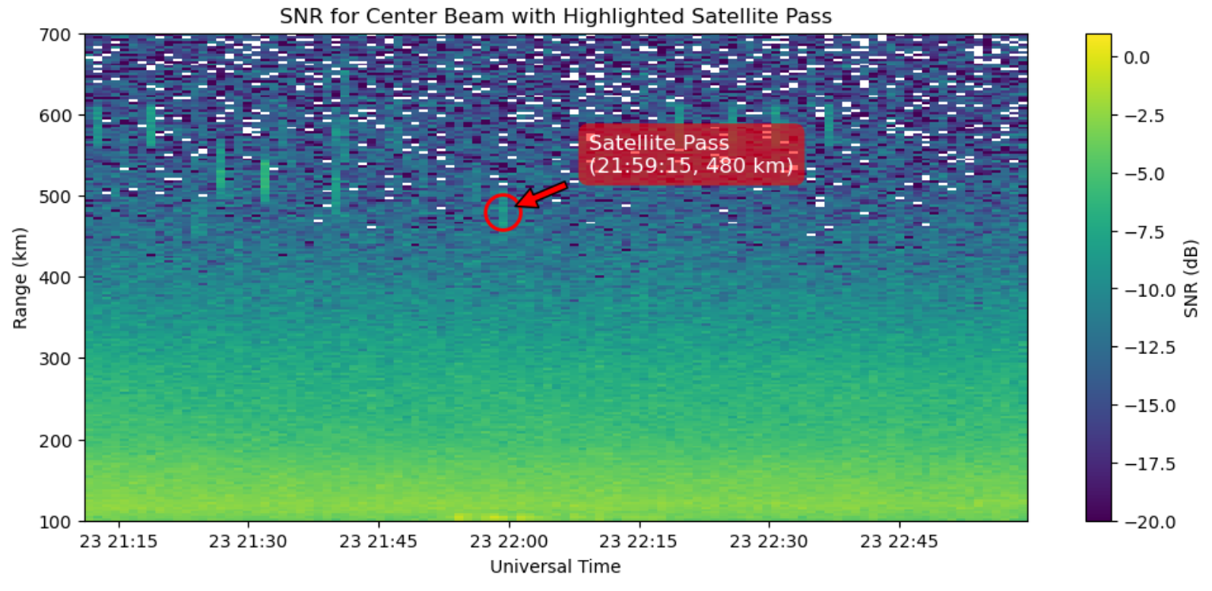
SWARM as seen in SNR

Slide 15
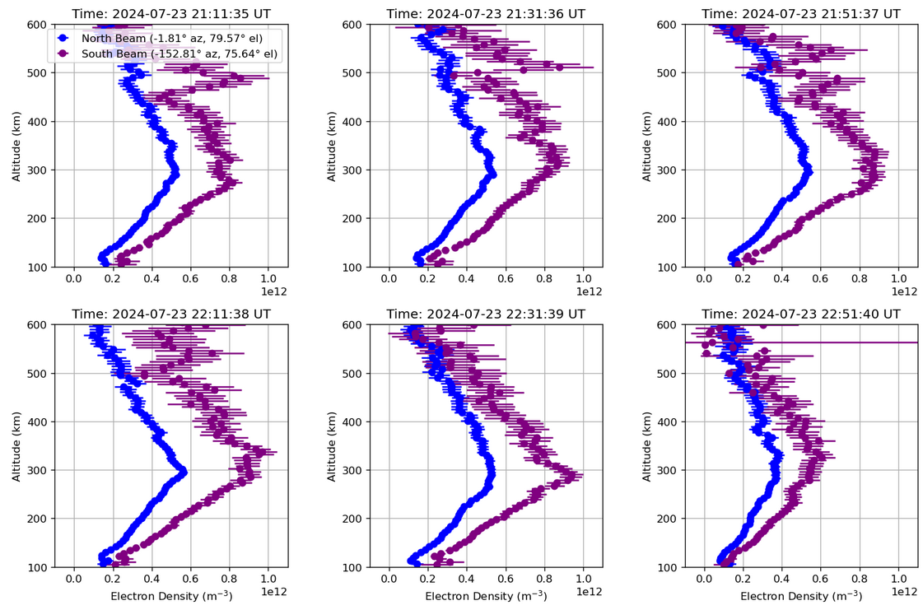
At the peaks:
electron density decreased by 20 - 30%

Slide 16
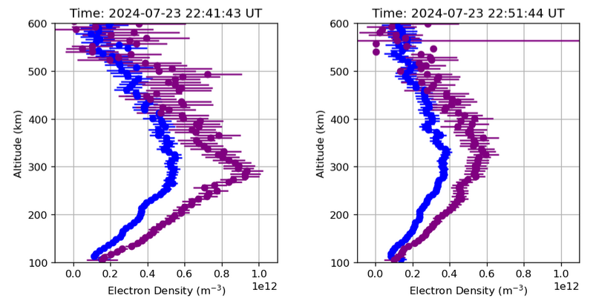

Slide 17
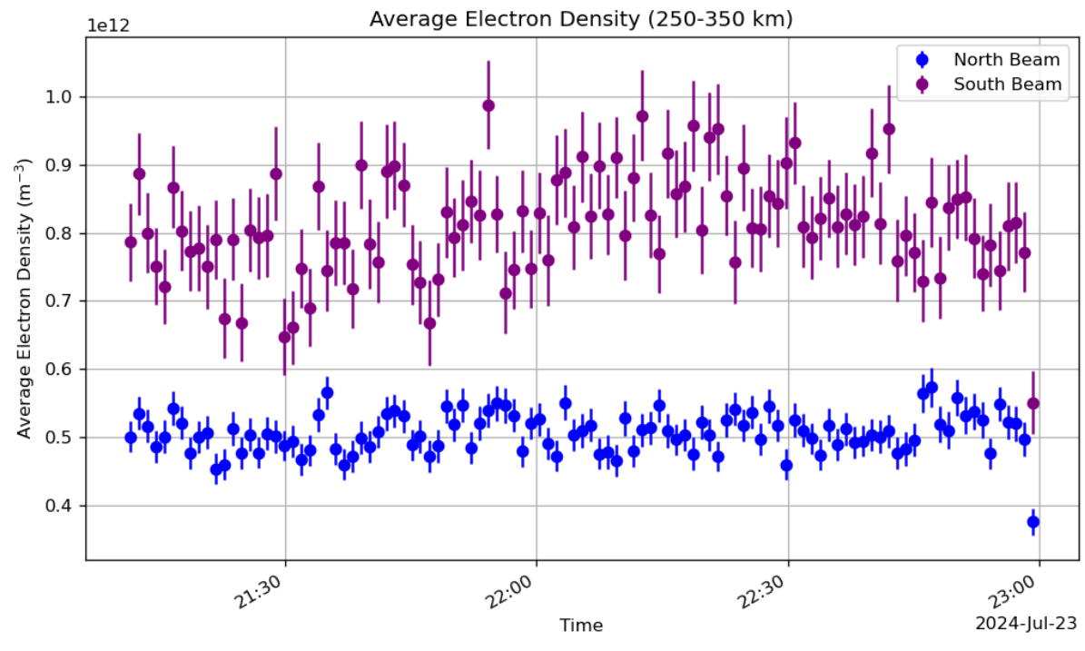
Notes:
Ask the students, is this physical?
Also point out the difference (40-60%) in electron density. Transition to Nina.

Slide 18
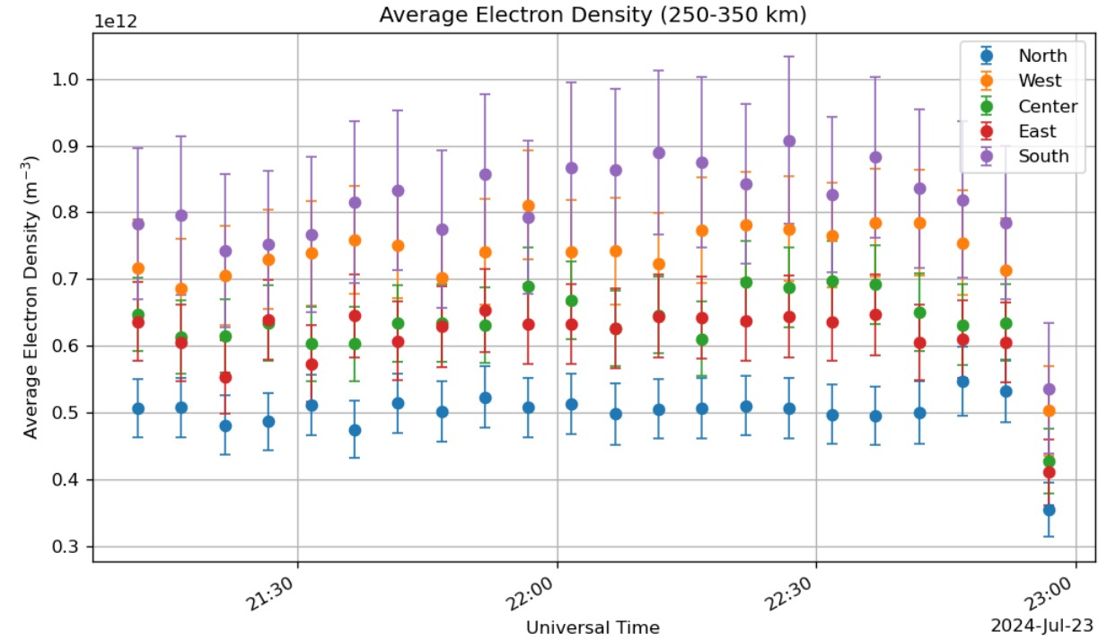
Ionosphere gradients or calibration issues?
South-North difference
=
3x10¹¹ el/m³
=
huge!

Slide 19
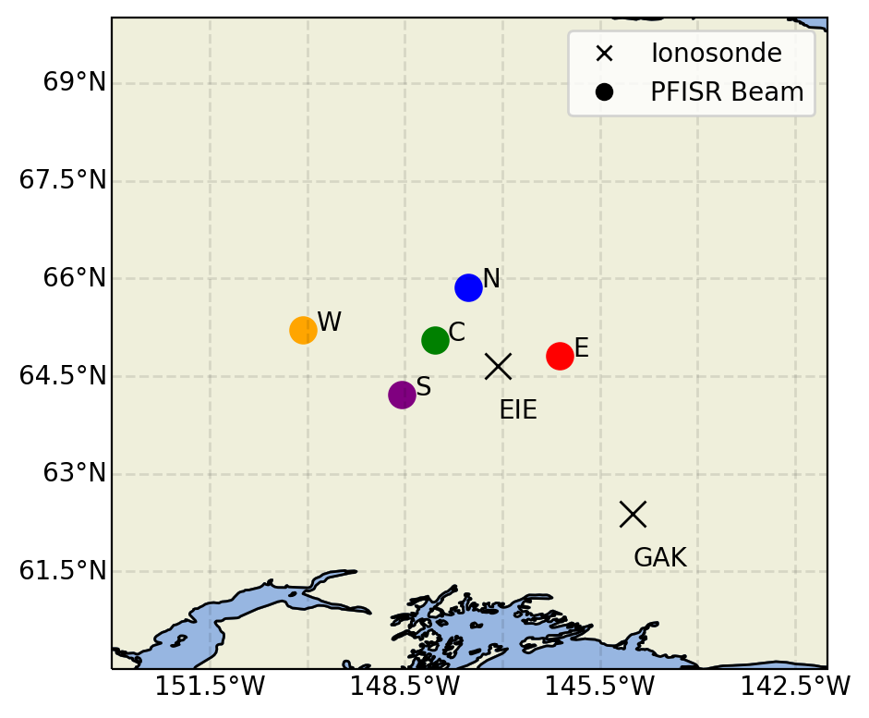
Ionosphere gradients or calibration issues?
Δlatitude = 2°
Solar Zenith Angle: North = 46°
South = 44°
latitudinal density gradient?

Slide 20
Ionosphere gradients or calibration issues?
Δlatitude = 2°
Δlatitude = 2°
Solar Zenith Angle: North = 46° EIE = 45°
South = 44° GAK = 43°
ionosonde data?

Slide 21
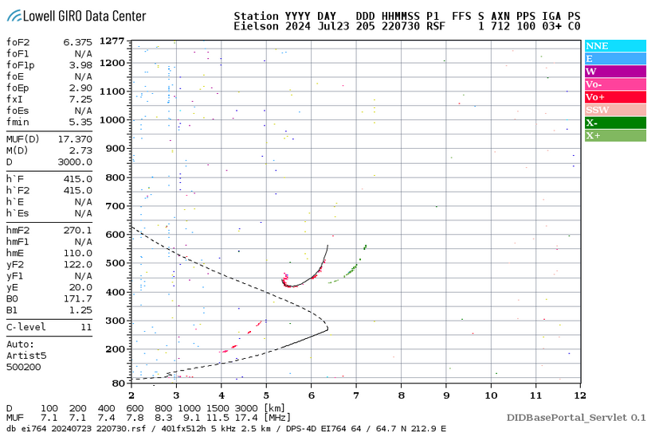
Ionosphere gradients or calibration issues?
Δlatitude = 2°
Δlatitude = 2°
Peak plasma frequency ~ 6.5 MHz → 5x10¹¹ el/m³
same value for both ionosondes!

Slide 22
How do the ISR data compare to the SWARM data?

Slide 23
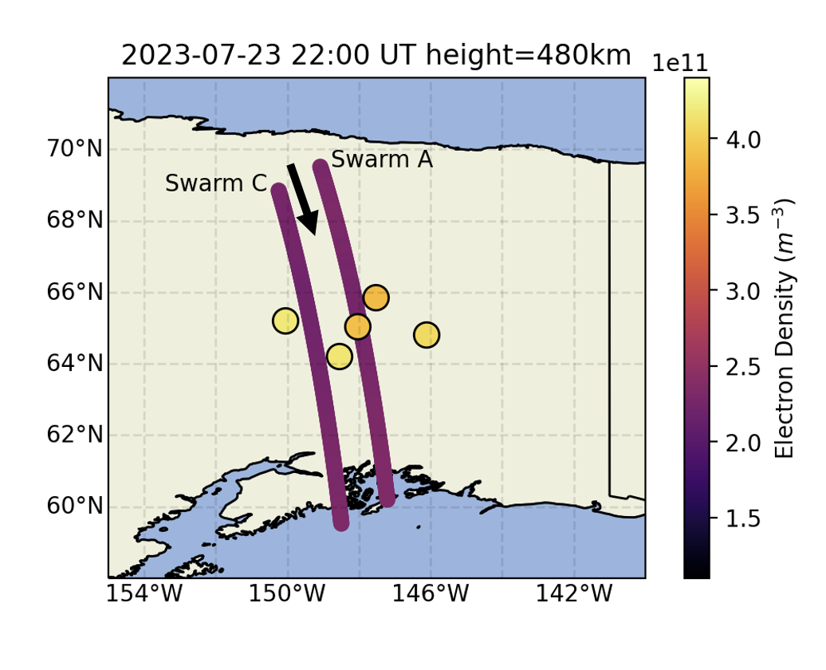
SWARM vs PFISR Ne
SWARM A and C briefly intersected PFISR FOV at 22 UT (~5° lat/min)
480 km altitude pass
Swarm in-situ densities lower than PFISR densities
  SWARM A/C: 2.2 ± 0.5 x10¹¹ el/m³
  PFISR: ~3.9 ± .8 x10¹¹ el/m³

Slide 24
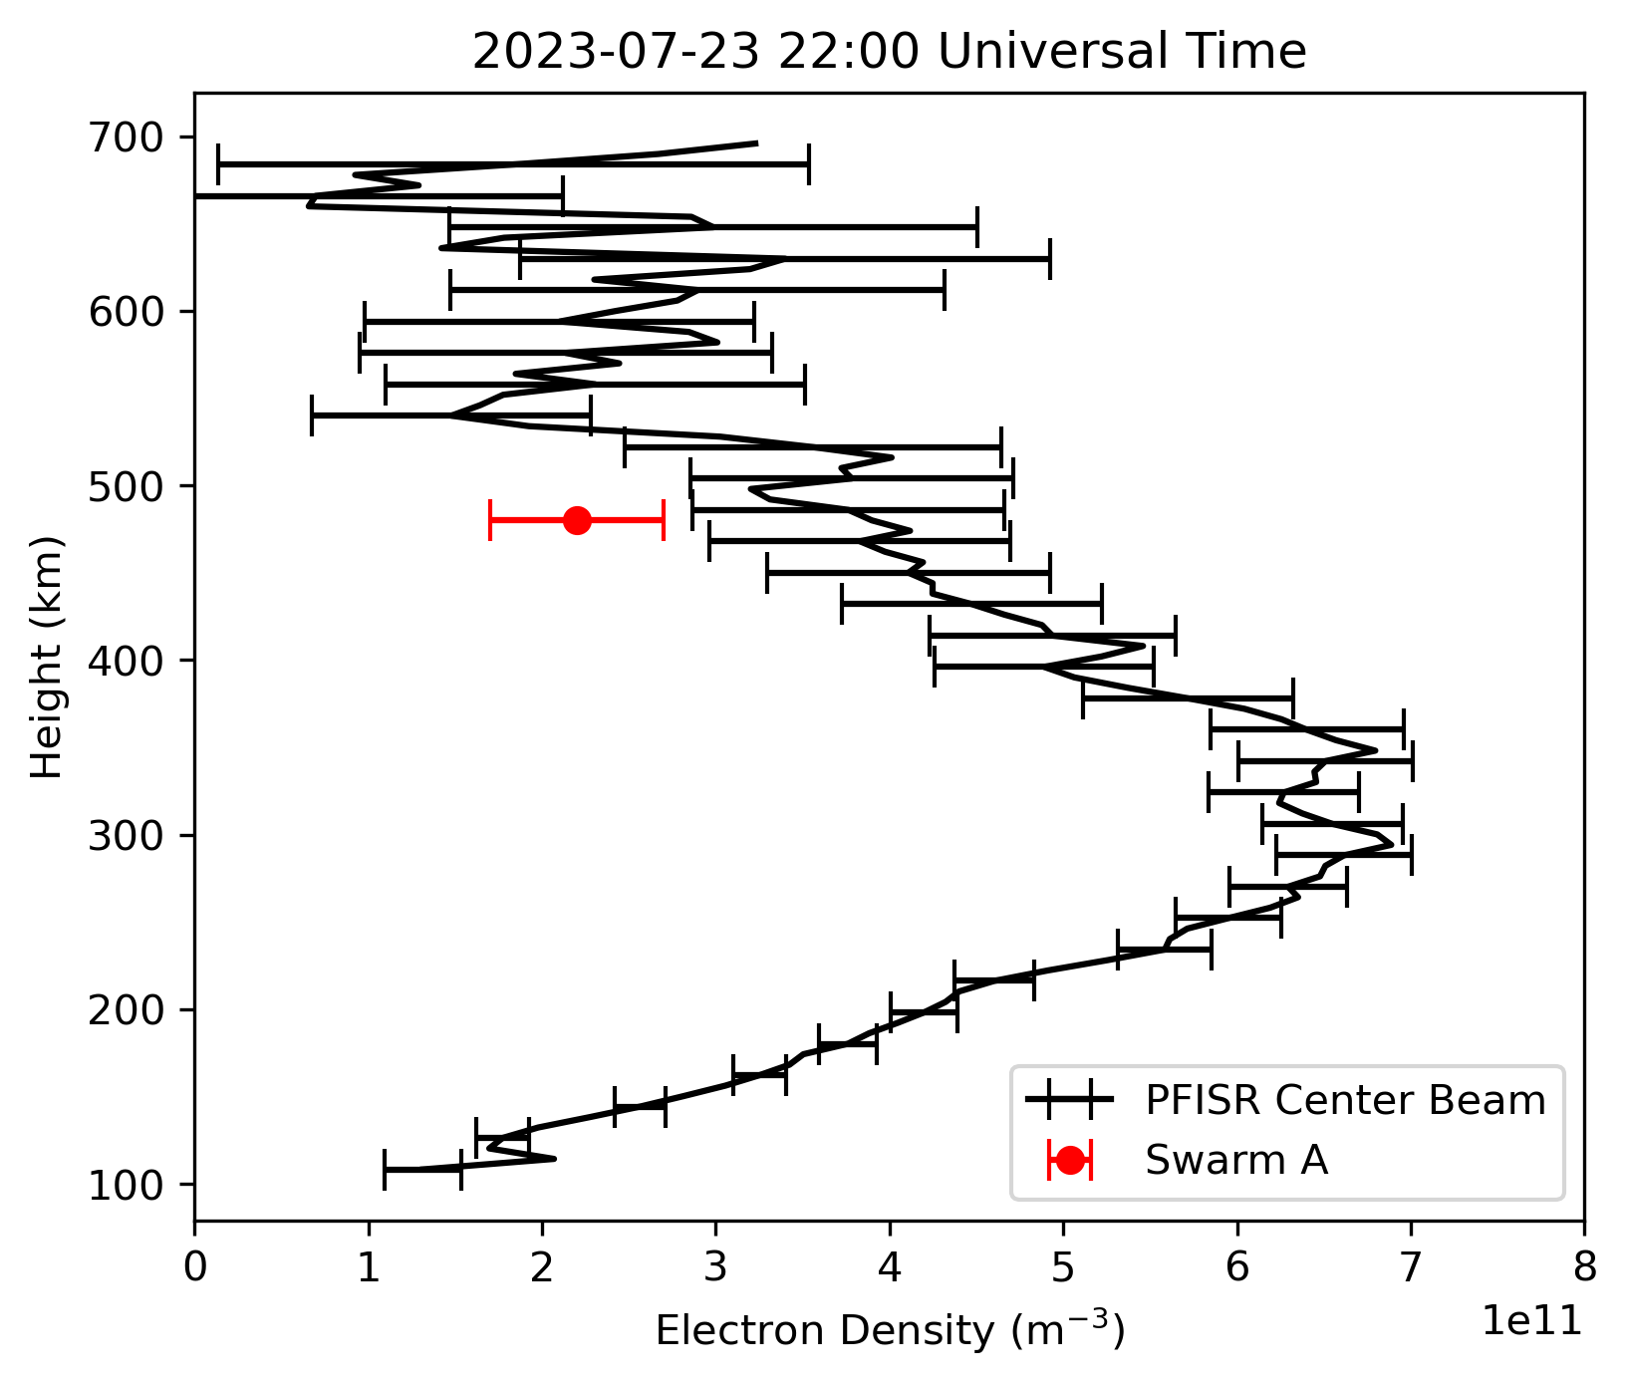
SWARM vs PFISR Ne
10 minute integration
SWARM A and C briefly intersected PFISR FOV at 22 UT (~5° lat/min)
480 km altitude pass
Swarm in-situ densities lower than PFISR densities
  SWARM A/C: 2.2 ± 0.5 x10¹¹ el/m³
  PFISR: ~3.9 ± .8 x10¹¹ el/m³
Notes:
Time slice

Slide 25
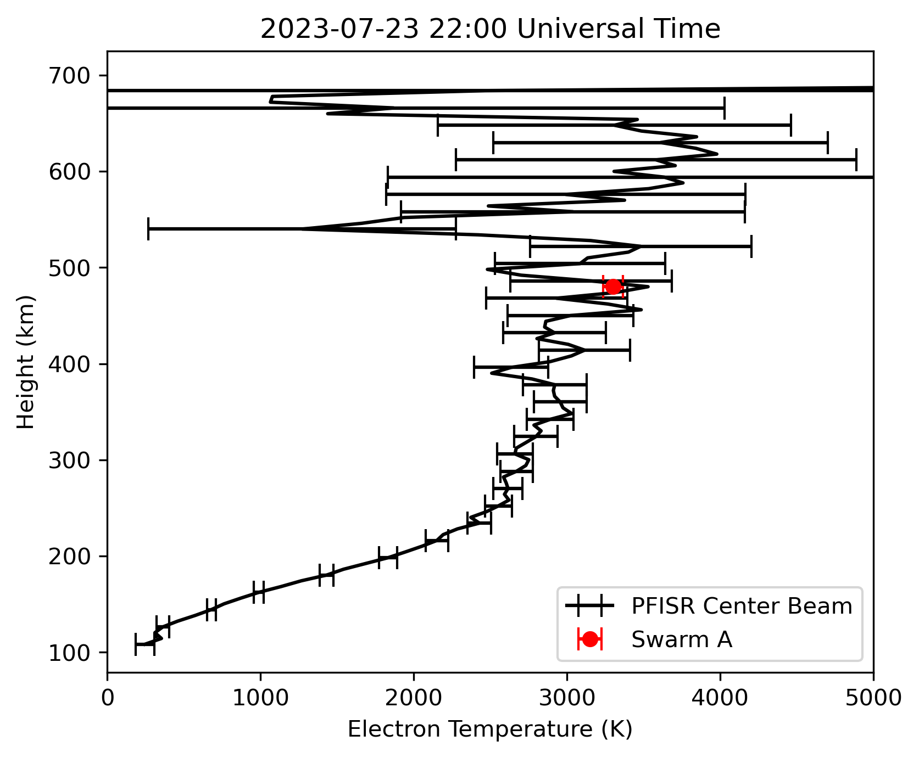
SWARM vs PFISR Te
Swarm A/C temperatures consistent with PFISR center beam
  ~2850 ± 500 K

Slide 26
How can we improve the comparison?

Slide 27
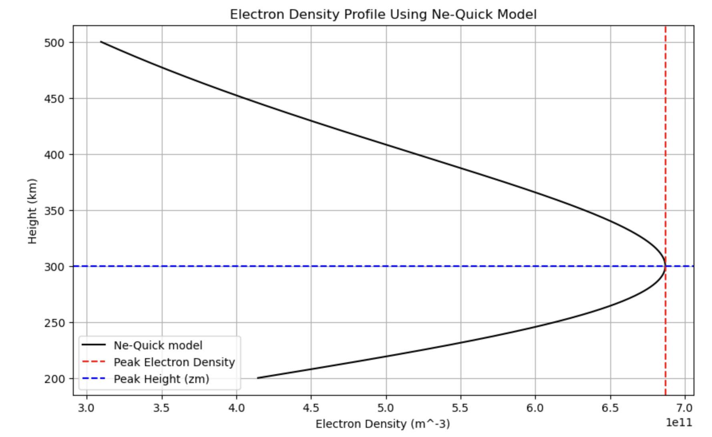
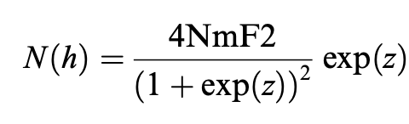
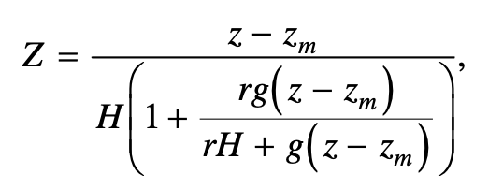

The NeQuick Model
Coïsson et al., 2006
Scale Height!

Slide 28
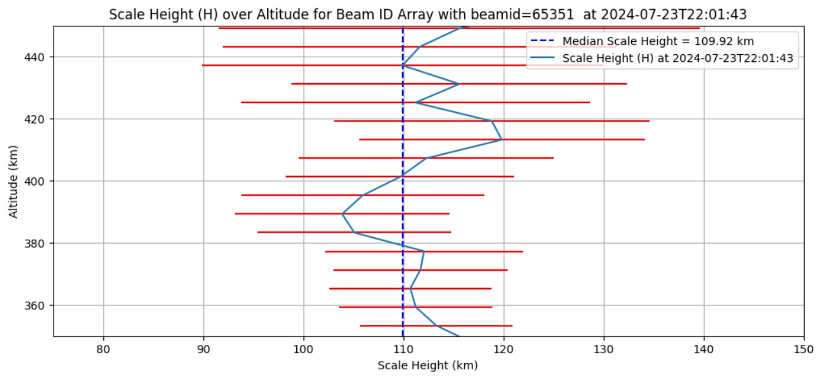
Scale height vs altitude

Slide 29
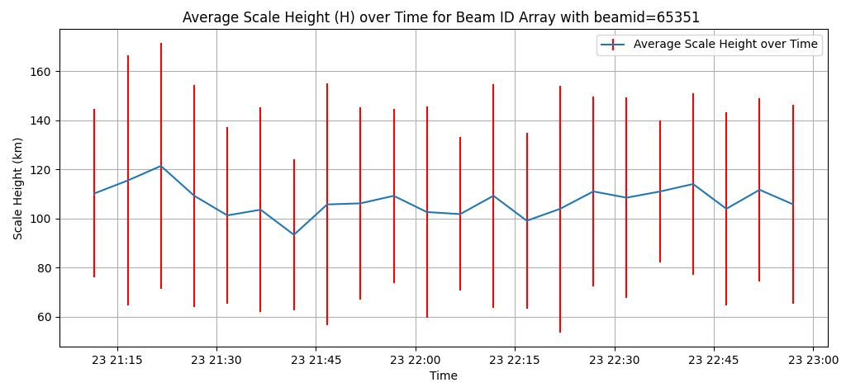
Scale height over time
SWARM-A PASS

Slide 30
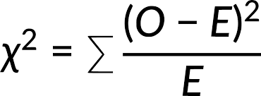
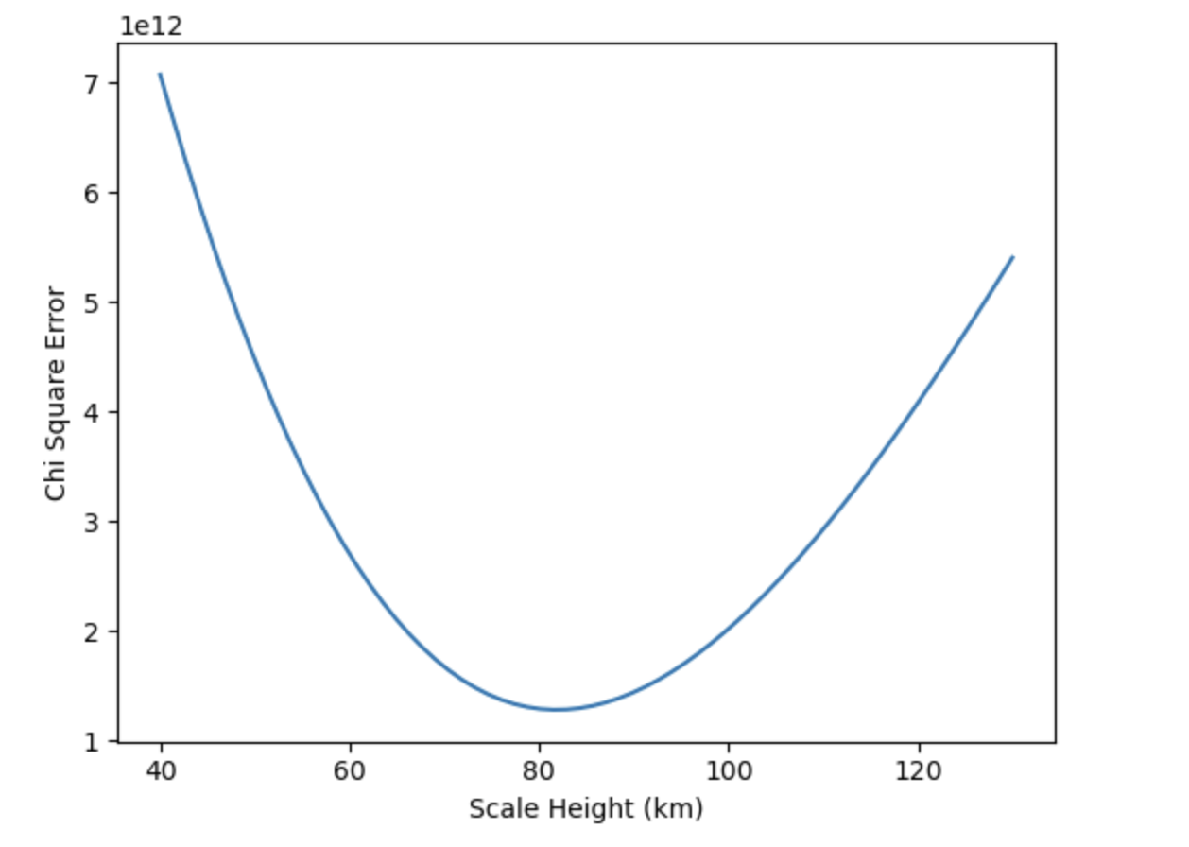
Fitting to ISR data: optimizing H
Optimized H = 80 km
< observed H = 110 km!
Possible explanations:
Measured Te is too high (unlikely because SWARM and ISR Te are in agreement!)
NeQuick model constants r and g are not optimized (likely)
NeQuick model isn’t a good representation of the topside (possible)

Slide 31
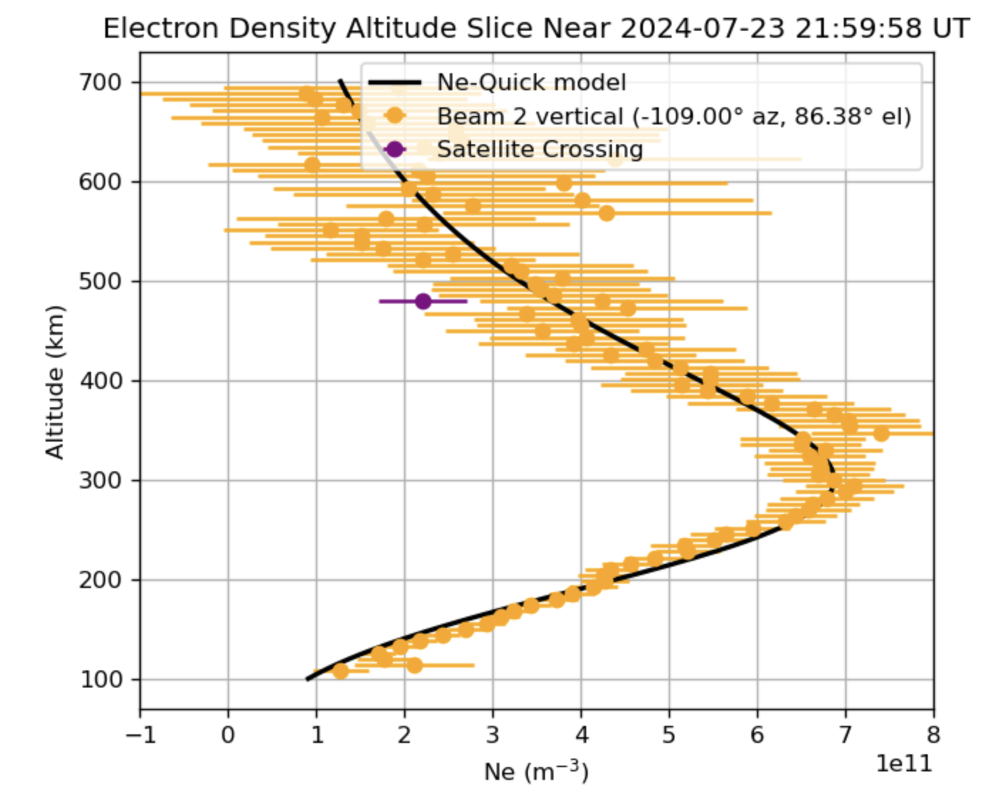
Fitted data comparison
Difference in Ne between Satellite Crossing and NeQuick model at 480 km = 1.24x10¹¹ m⁻³
~ 35% underestimation!

Slide 32
How can we interpret our results?

Slide 33
SWARM densities – to be trusted?
Statistical comparisons with PSISR/RISR show SWARM underestimates the ISR electron density by 10-35% (Larson et al., 2021; Lomidze et al. 2018, Fast et al., 2023).
  Methods include other calibration techniques (ionosondes, radio occlusion)
  Swarm underestimation is stronger at large densities
Interestingly, CHAMP LP also was found to underestimate densities over Jicamarca digisonde (McNamara et al. 2007)
Fast, 2023

Slide 34
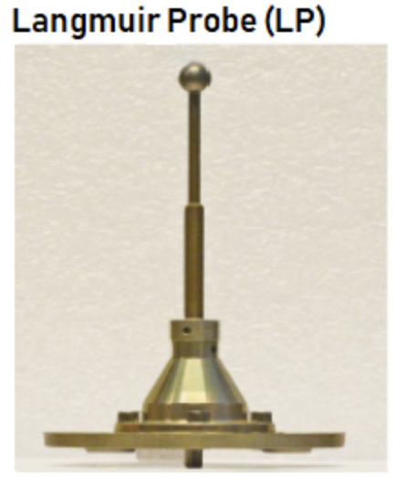
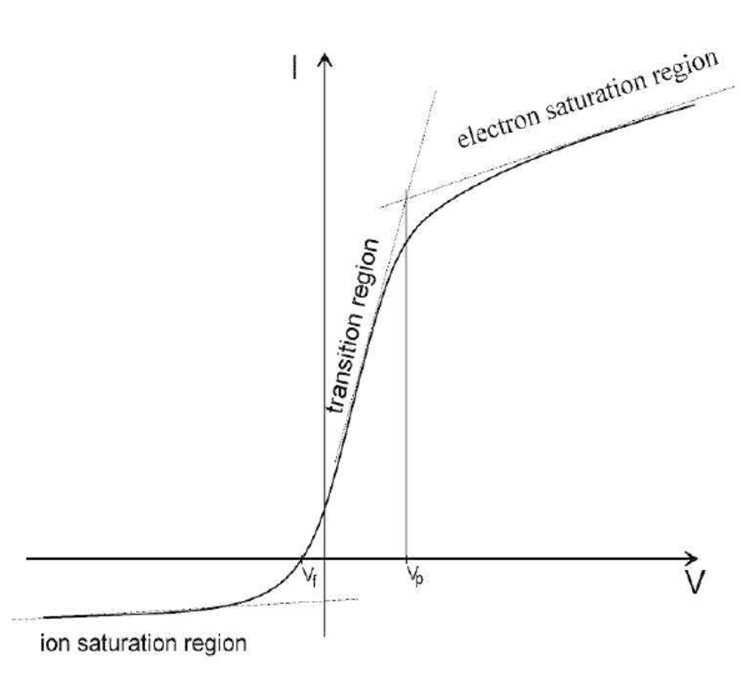
Possible reasons for SWARM underestimation
Langmuir Probe Surface Contamination
O+ assumption
Uncertainty of topside ISR measurements
Merikallion 2007
Notes:
‘Dirty’ langmuir probe would have higher than expected resistance => lower measured Ne
Error would be largest toward end of mission is at end.
Why would electron densities from both SWARM A and C be so similarly biased

Slide 35
Main takeaways
No data source is 100% accurate. Both ISR and in-situ data require careful interpretation (ideally cross-validated with other data sources)
SWARM-A/C show significant underestimation of electron density with respect to Poker Flat ISR despite lower uncertainty.
In situ measurements can be fused with ISR to provide an estimated topside profile–but only if the in-situ data is accurate.

Slide 36
Main takeaways
ISR data require careful interpretation (ideally cross-validated with other data sources)
No data source is 100% accurate (ISR, ionosonde, satellite in-situ measurements…)
SWARM-A/C data have lower uncertainty than ISR data in the topside ionosphere
But SWARM-A/C show consistent underestimation of electron density; perfect fitting to SWARM-A/C is not a solution

Slide 37

Notes:
I was skeptical. This was my face when we were spending hours looking for a satellite passing.
We had great lectures and learned a lot, but we still didn't know much. On the second day of the summer class, we were grouped with students we hadn't worked with before and assigned to design an experiment. What? How?
We had our disagreements. This is a shot of us "working" together. Just kidding. We actually collaborated really well. Each of us brought different skills to the table, and we learned a lot from each other.
Despite my initial skepticism, I supported the group. As we worked together, I saw their capability and dedication. I came to trust them.
Larisa said you need a "novel idea" to change a research paradigm. While what we are doing is just a small experiment, I believe our group's idea is both unique and novel (new, original, innovative).
In the end, I think we achieved a lot in a short period of time. Trust your friends. Remember, always question the validity of the data. Doubt the data instead. I'll be presenting on the importance of common sense in interpreting data.

Slide 38


Slide 39
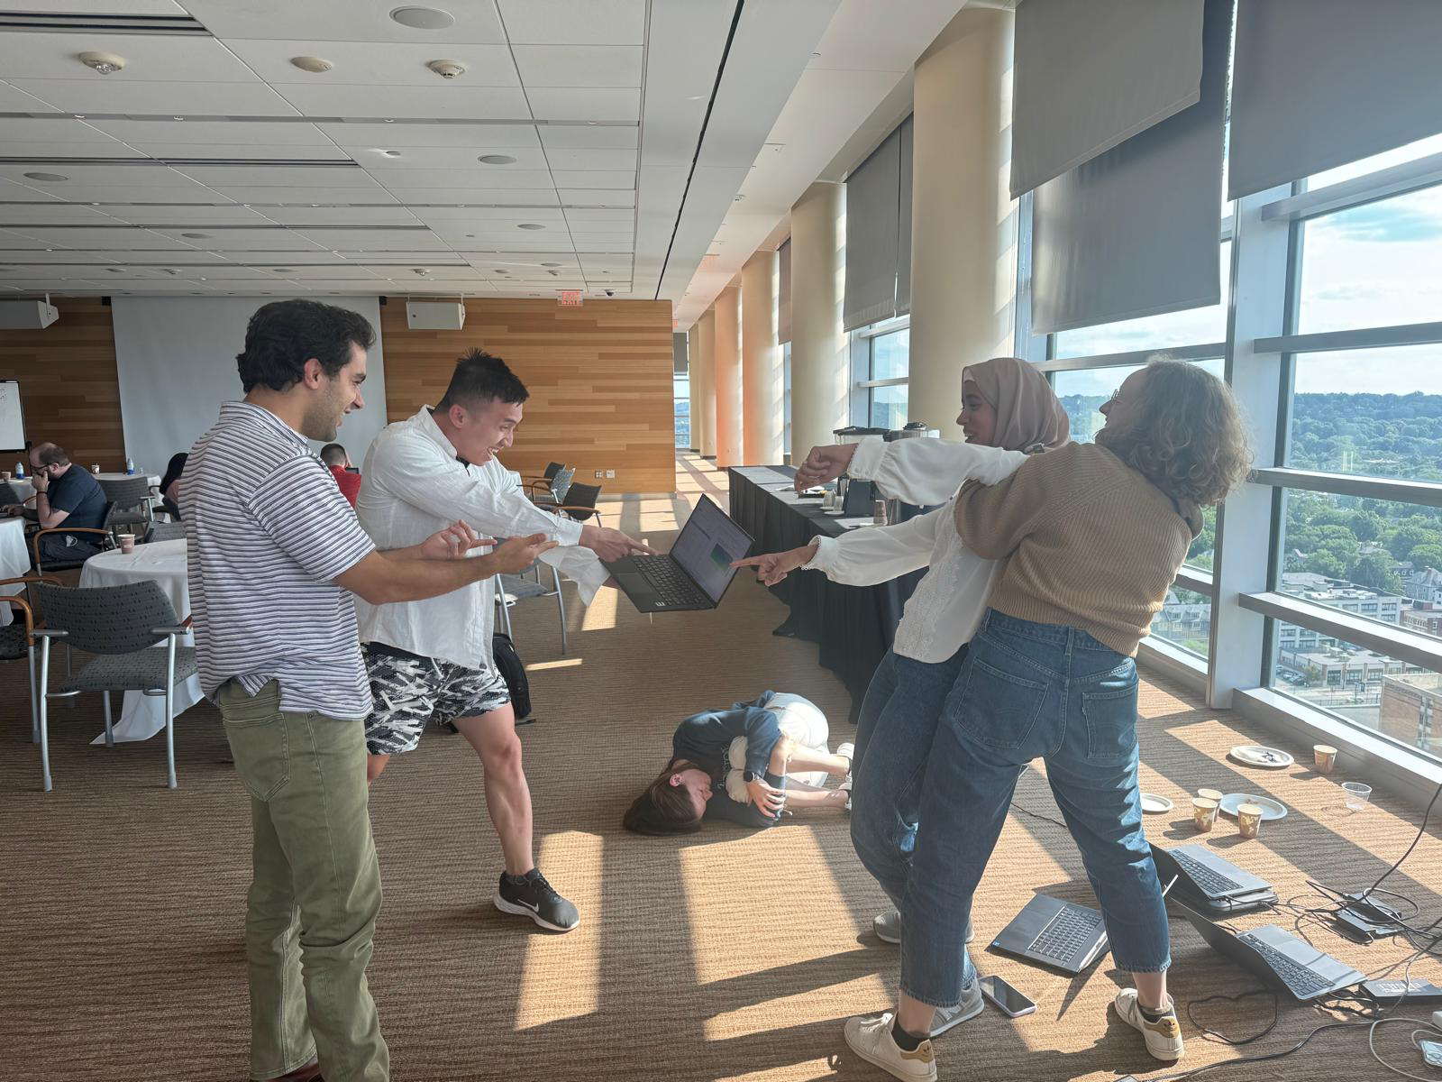

Slide 40
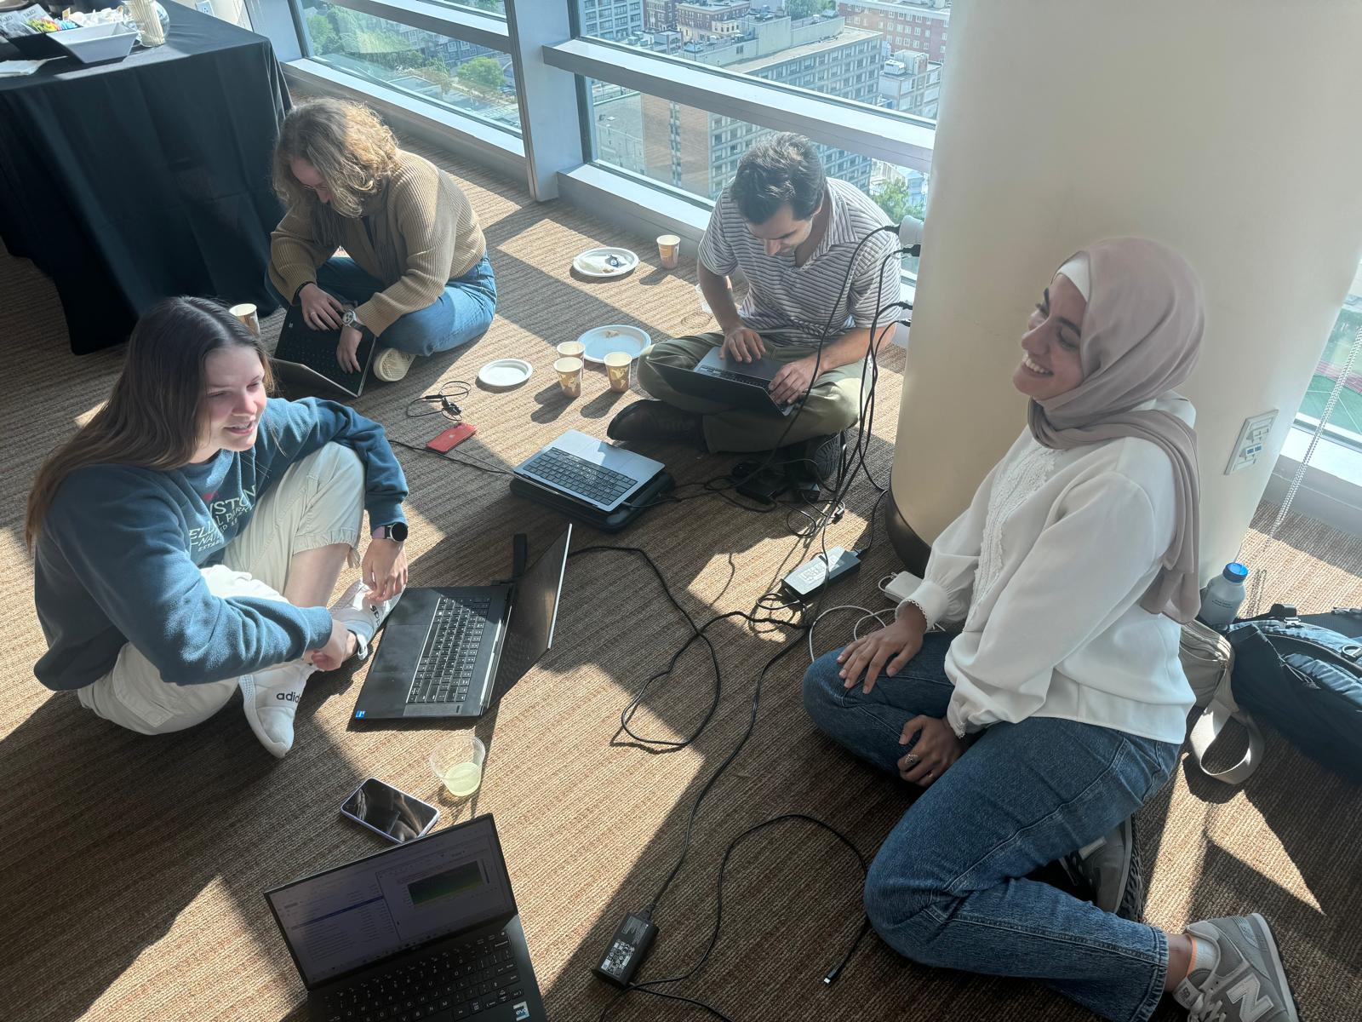
Thank you ISR Summer School 2024!
Great lectures…
…great tutorials…
…great opportunities…
…great collaboration(?)...
…and still lots to learn!

Slide 41
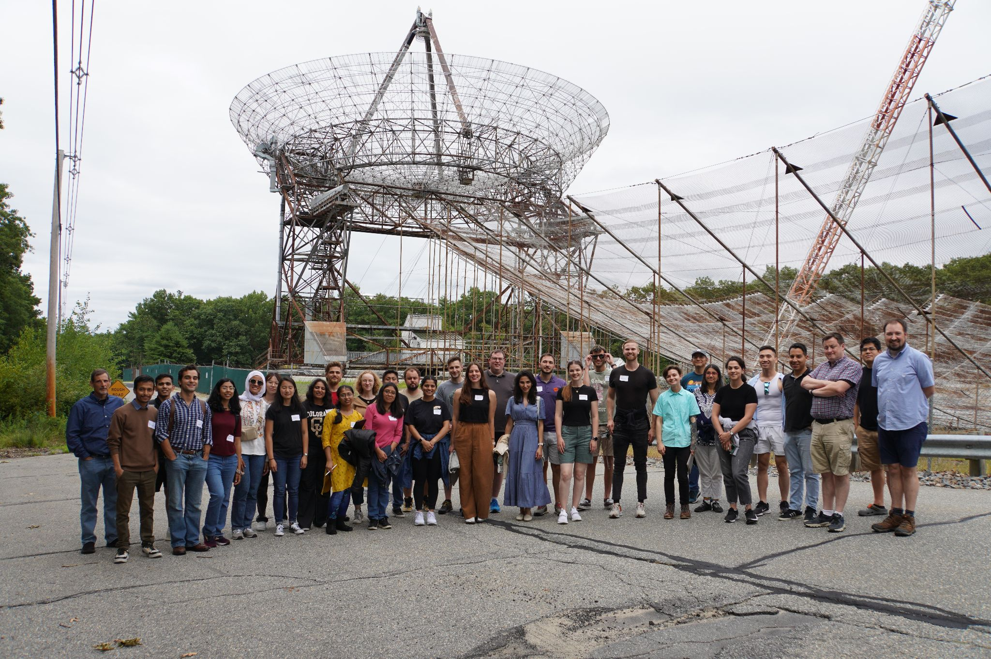
Thank you ISR Summer School 2024!
Great lectures…
…great tutorials…
…great opportunities…
…great collaboration(?)...
…and still lots to learn!

