Slide 1
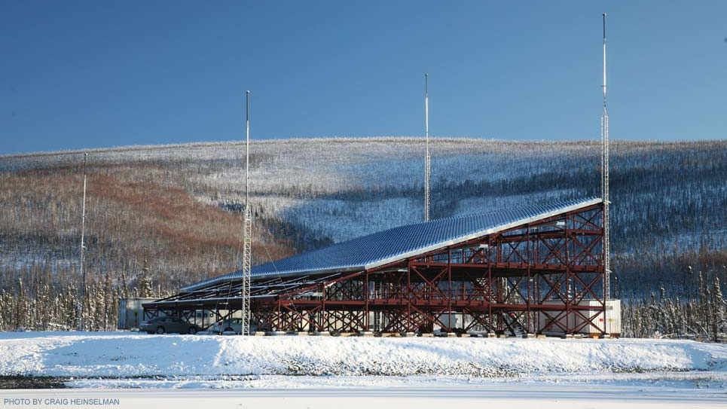
Original:
Investigating Ionospheric E-F Region Anomalies at High Latitudes
Group 1
Susan Palacios
Arunima Prakash
Bimal Dahal
Brian Pitzel
Teddy Surco

Slide 2
Refined:
What do you do when you see nothing in your data?
Group 1
Susan Palacios
Arunima Prakash
Bimal Dahal
Brian Pitzel
Teddy Surco

Slide 3
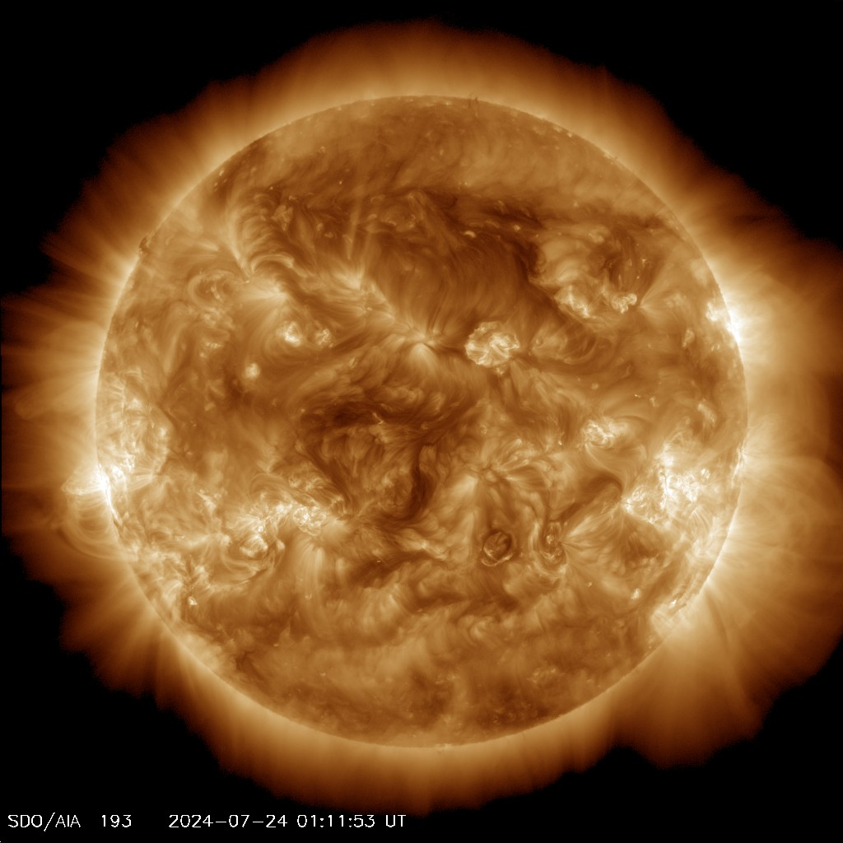
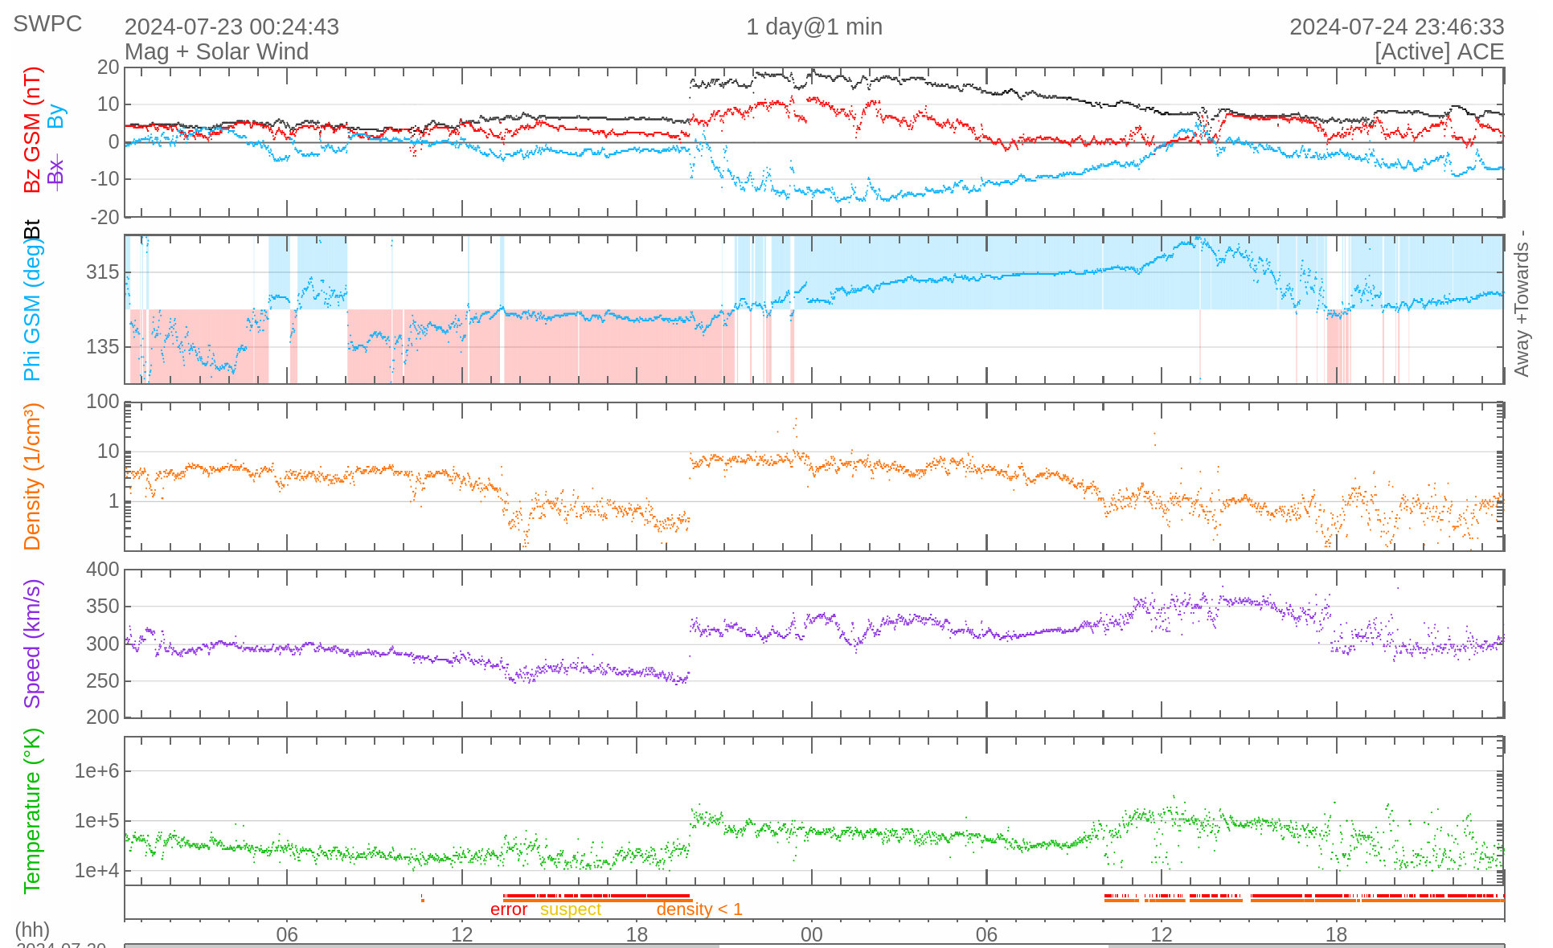
Space Weather During Experiment
Dst = 29.3.9 nT
Kp = 1
Bz = 8.55 nT
Solar Wind = 312.3 km/s
F10.7 = 179.8 sfu
Background: Sun on 24th July, at 1 UT taken from SDO Atmospheric Imaging Assembly instrument at 171 Å

Slide 4
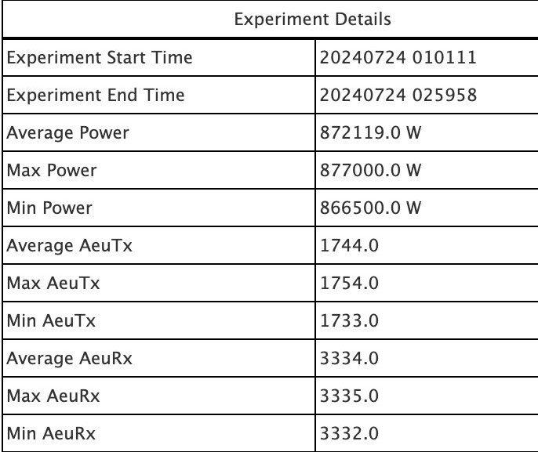
Description of the experiment
Instruments:
  Poker Flat Incoherent Scatter Radar (PFISR)
  GPS Receivers
Models:
  International Reference Ionosphere (IRI)
Time of investigation: 24th July, 2024 1-3 UT

Slide 5
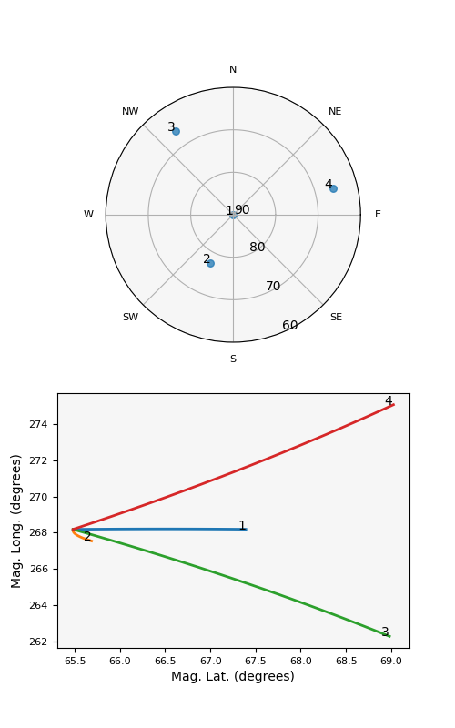
PFISR - Geometry and Details
SN | Beam ID | Az (deg) | El (deg)
1 | 64016 | 14.04 | 90
2 | 64157 | -154.30 | 77.50
3 | 64964 | -34.69 | 66.09
4 | 65066 | 75.03 | 65.56
ISR mode: Long pulse and alternating code

Slide 6
Science Goals
Original:
Investigate irregularities in Ne, Te, Ti in the E and F-region under active geomagnetic conditions, and examine drift velocities at the same time
Read: Find some cool anomalies and see some drifts
Refined:
Establish baseline ionosphere conditions to enable detection of something irregular
Read: What does nothing look like?

Slide 7
What does nothing look like?
Define "nothing" - using our PFISR experiment
  Nothing (data)
Define "nothing" - using the International Reference Ionosphere (IRI)
  Nothing (model)
Compare the "nothings" (data vs model)
Motivation: Establish a quiet baseline "nothing" so we know when we see an anomaly "something".

Slide 8
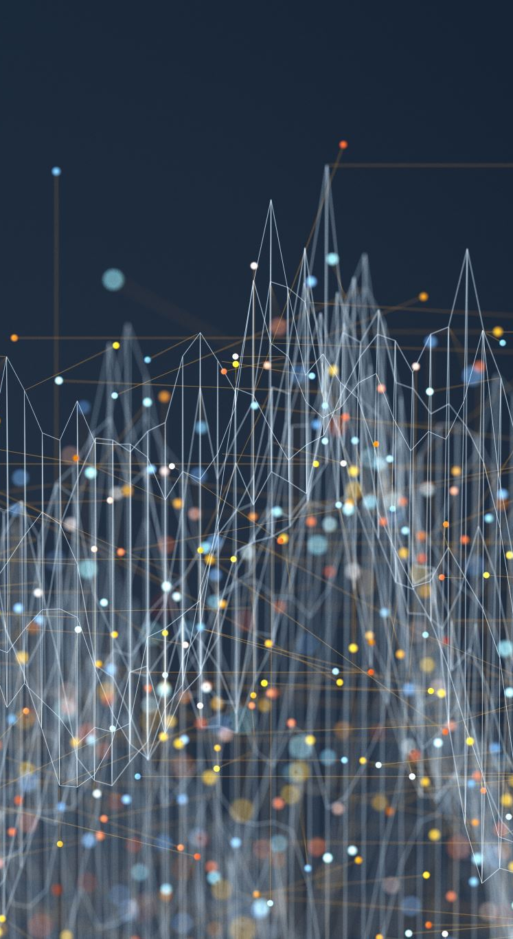
"Nothing" Data Analysis Overview
Integration time of PFISR data
  All integration times examined: 1 min, 3min, 5 min, 10 min, 15 min, 20 min
  Two modes combined: Long pulse and Alternating codes
  Longer integrations => lower errors
Data filtering
  Chi-squared
  Magnitude of error vs. Measurement
  Obvious outlier points (common sense)
Comparison with IRI Model
  International Reference Ionosphere (IRI) model is a standard empirical model that uses data from various ground based instruments (ISR, ionosondes) and various satellites (COSMIC, GNSS). (Bilitza et al., 2022 and Forsythe et al., 2024)
  Inputs for the IRI model include PFISR lat and lon, F10.7 during 1-3 UT, run with same integration times as PFISR data.

Slide 9
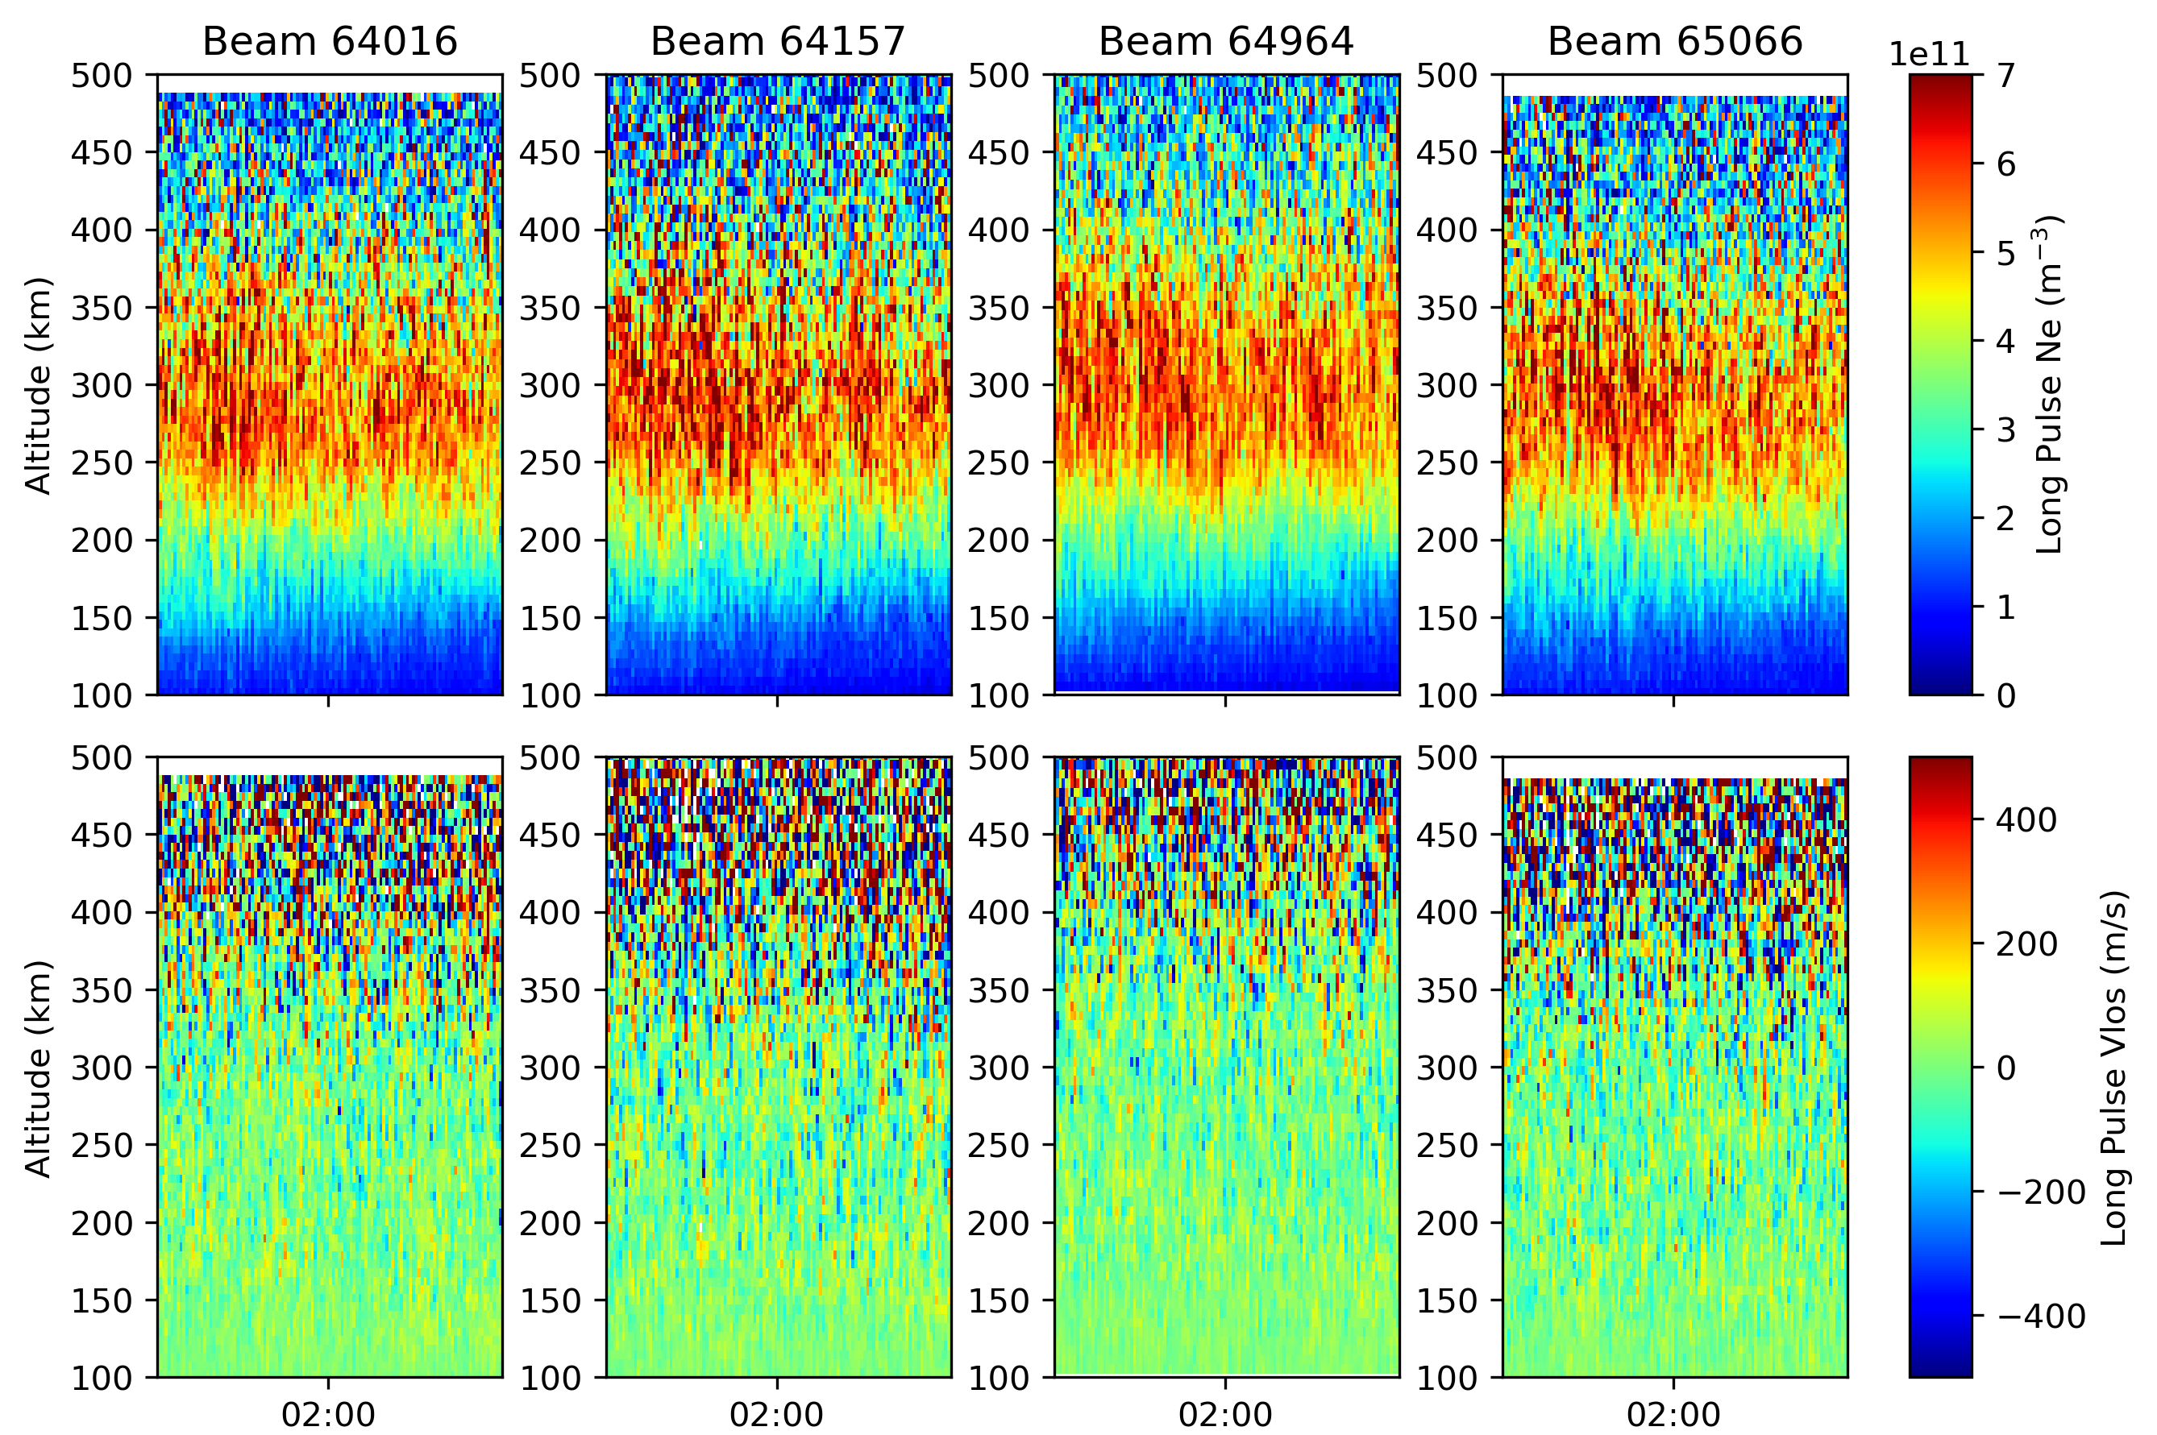
RAW unfiltered data from all 4 beams of PFISR
(F region) using long pulse

Slide 10
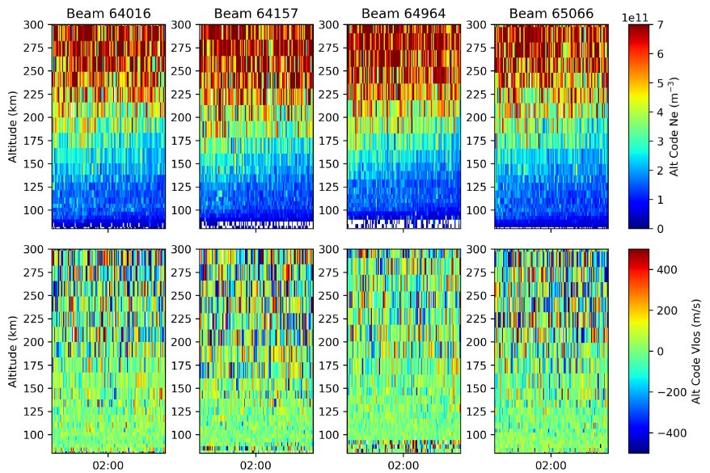
RAW unfiltered data from all 4 beams of PFISR (E Region) using alternate code

Slide 11
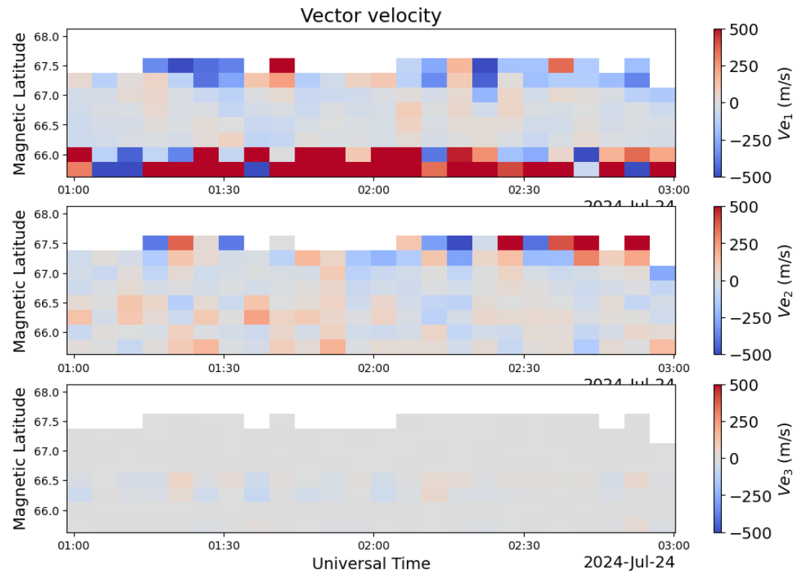
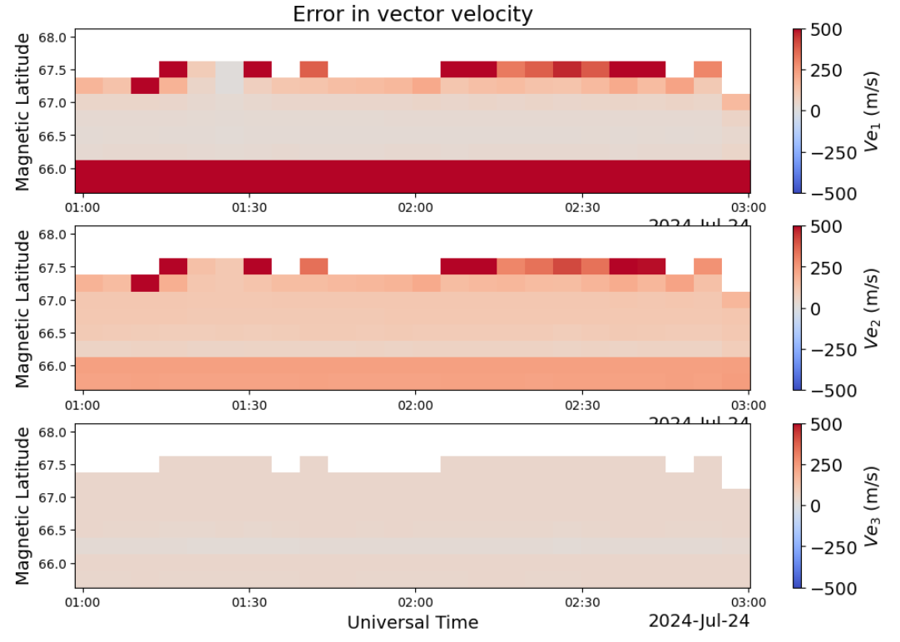
RAW unfiltered data from all 4 beams of PFISR
Errors were generally very large in LOS and vector velocities!

Slide 12
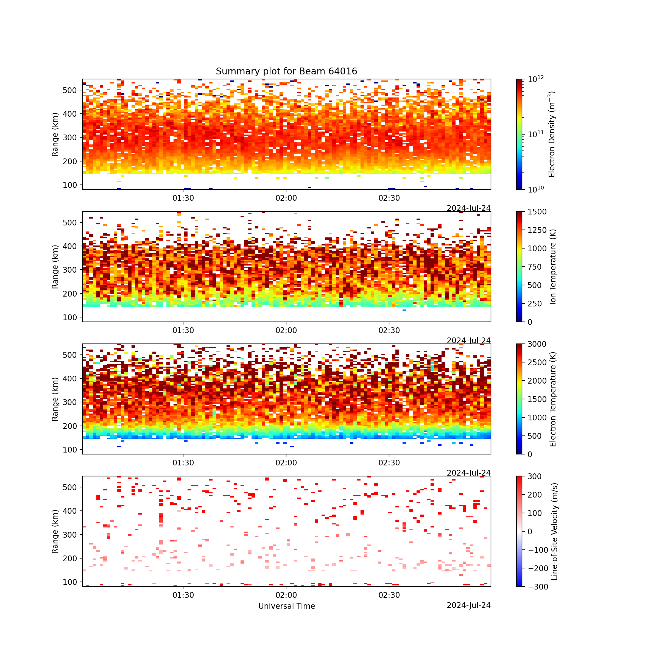
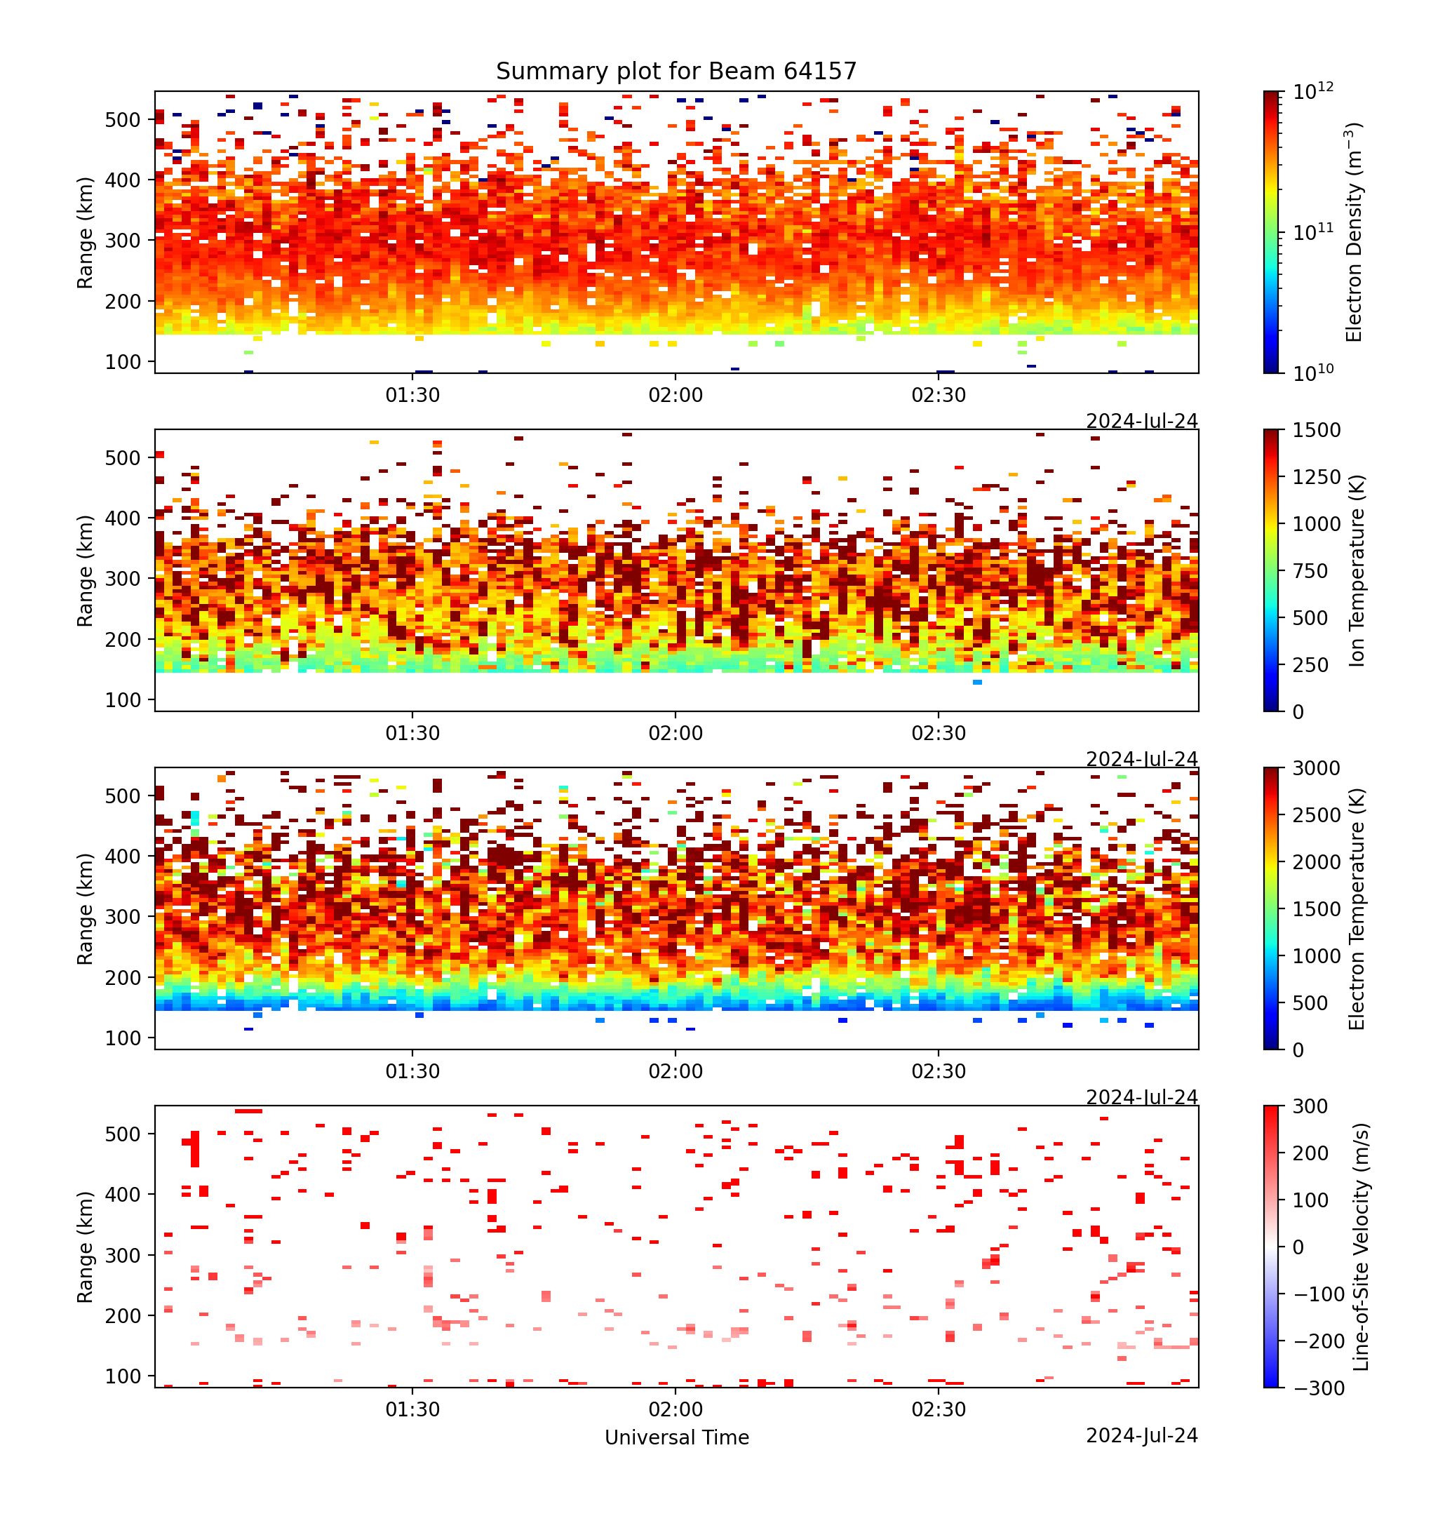
Filtered data from all 4 beams of PFISR (F region) combining both long pulse and alternate code

Slide 13
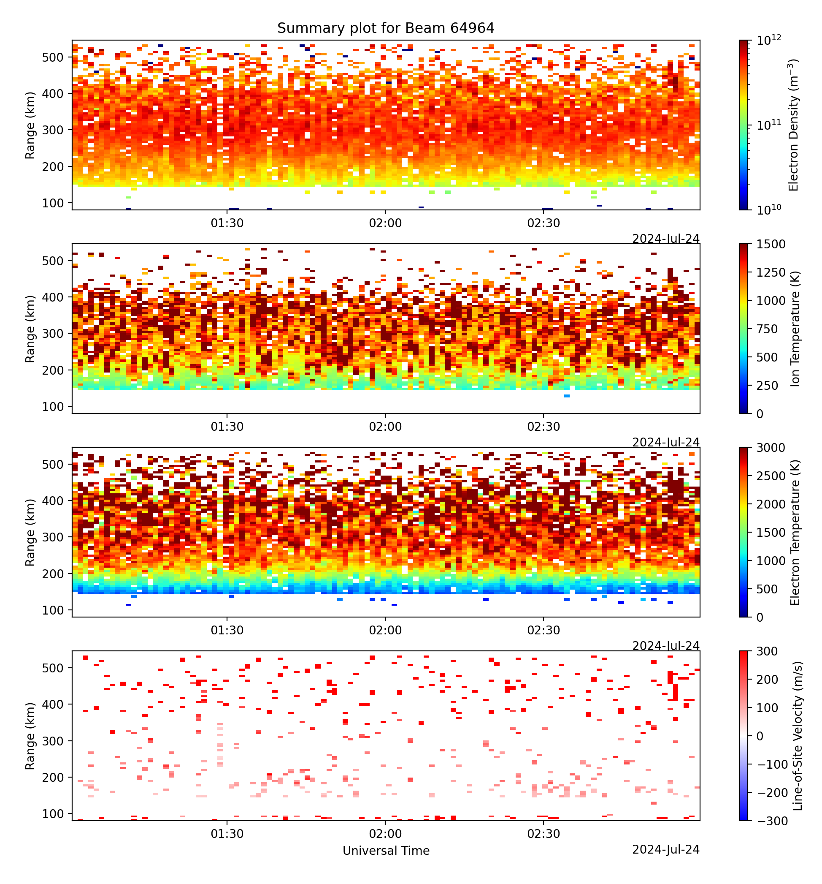
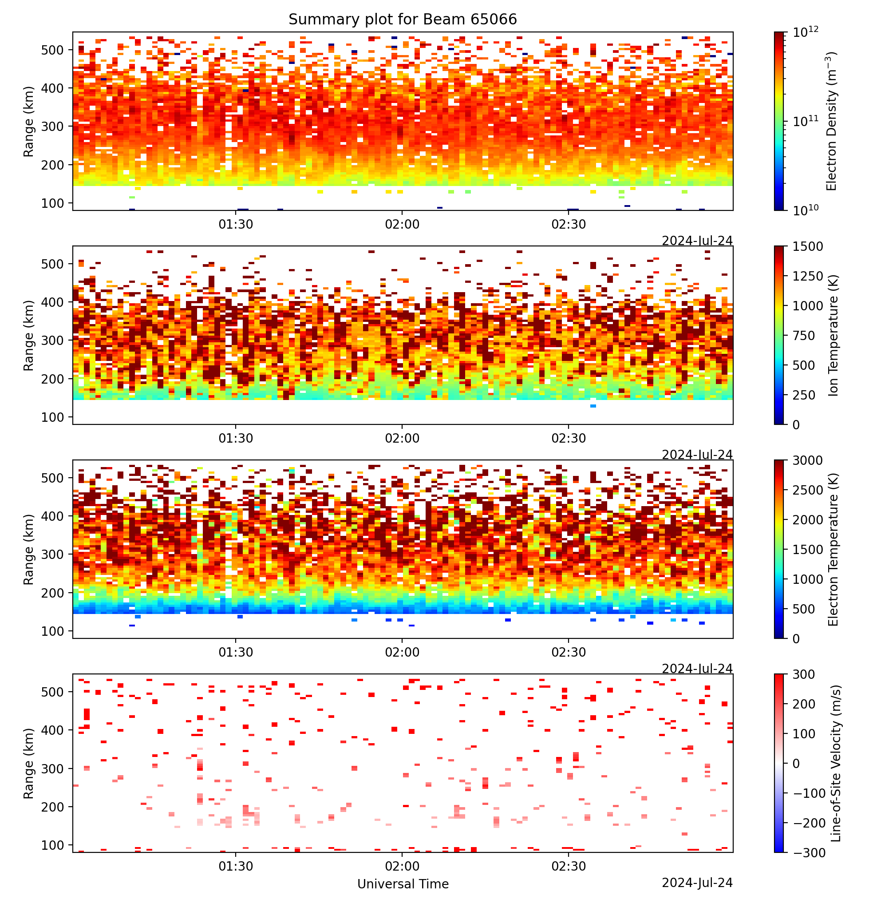
Filtered data from all 4 beams of PFISR (F region) combining both long pulse and alternate code

Slide 14
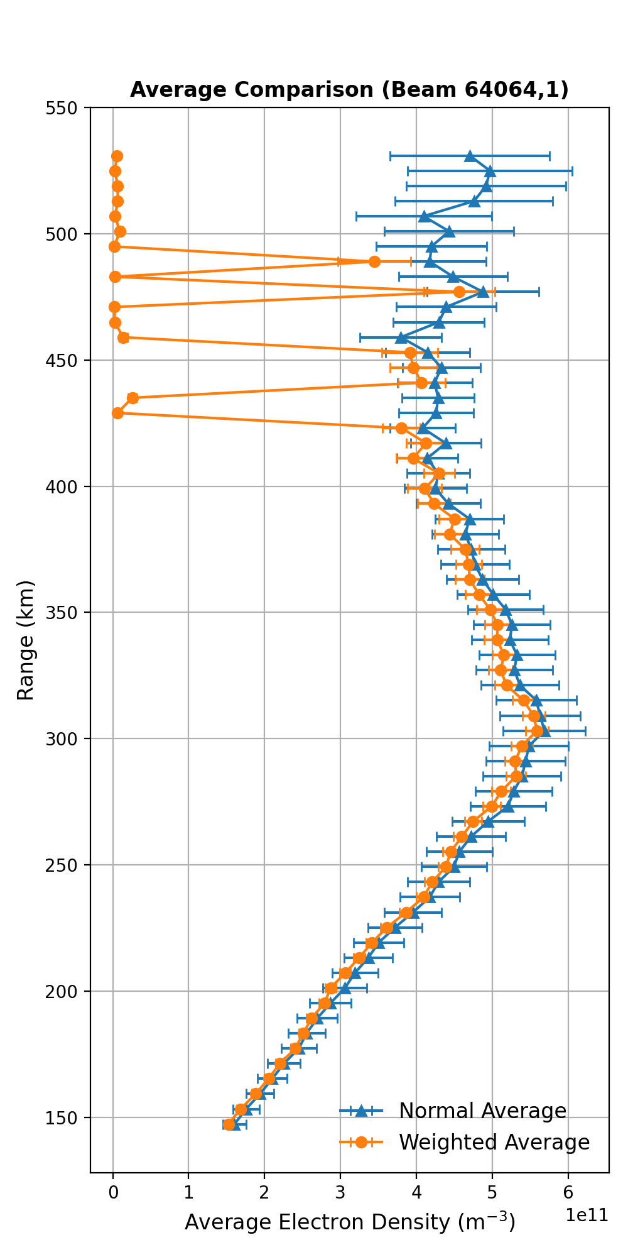
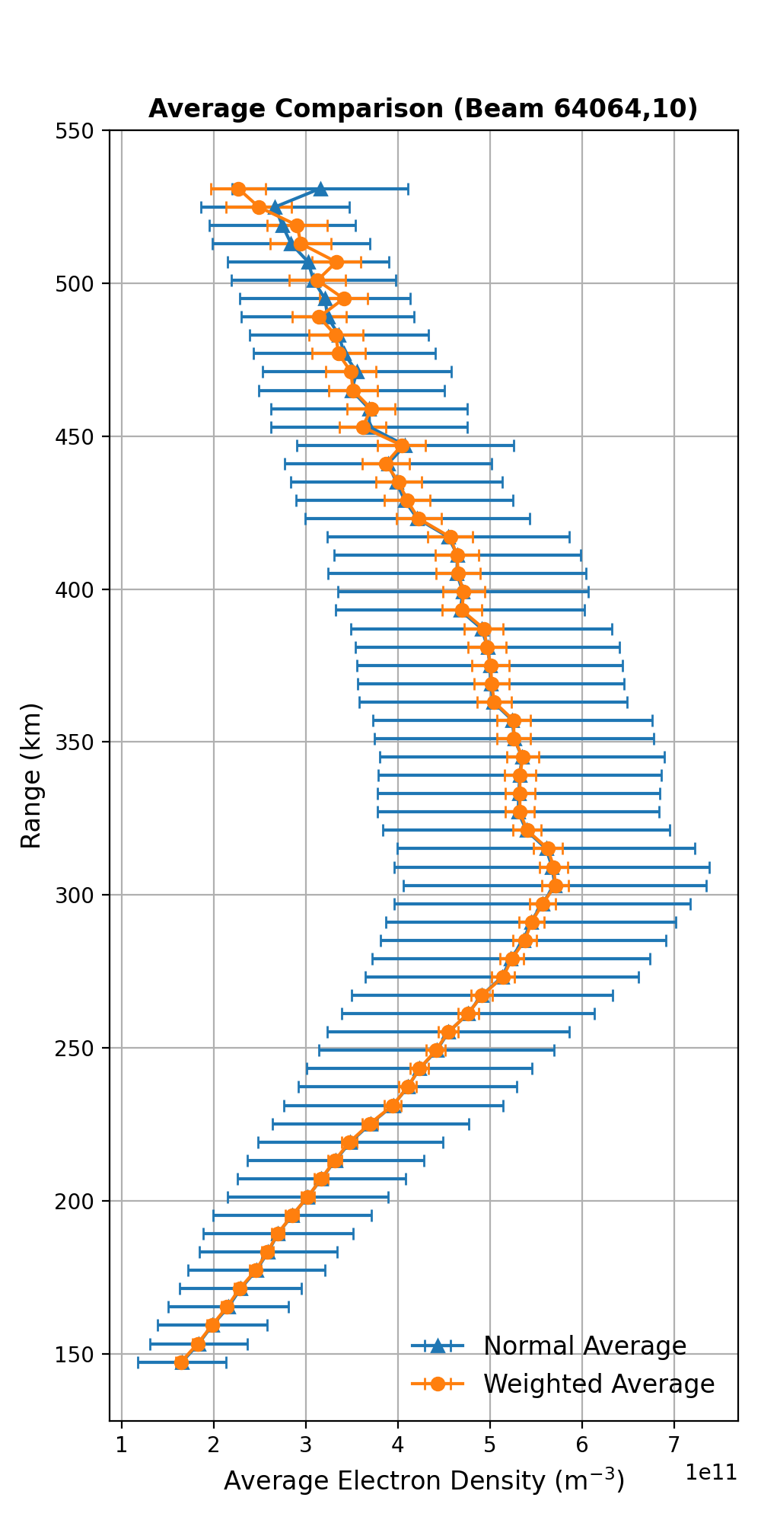
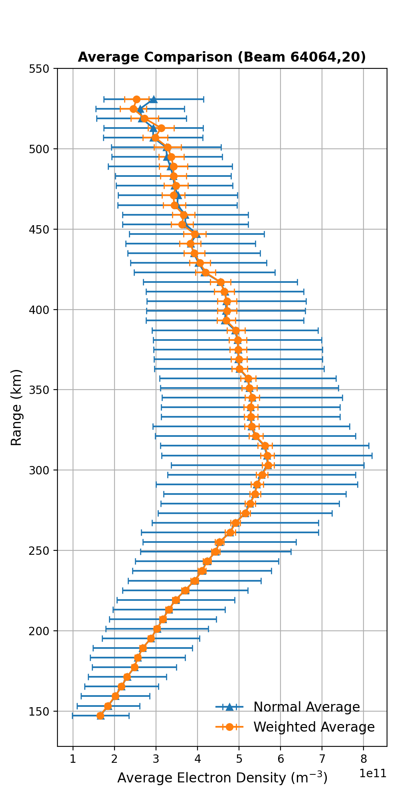
Electron Density Profiles for different integration times for 1 beam
1 min
10 min
20 min
Weighted average based on uncertainties
General mean
Weighted averages do a lot better than the general means!

Slide 15
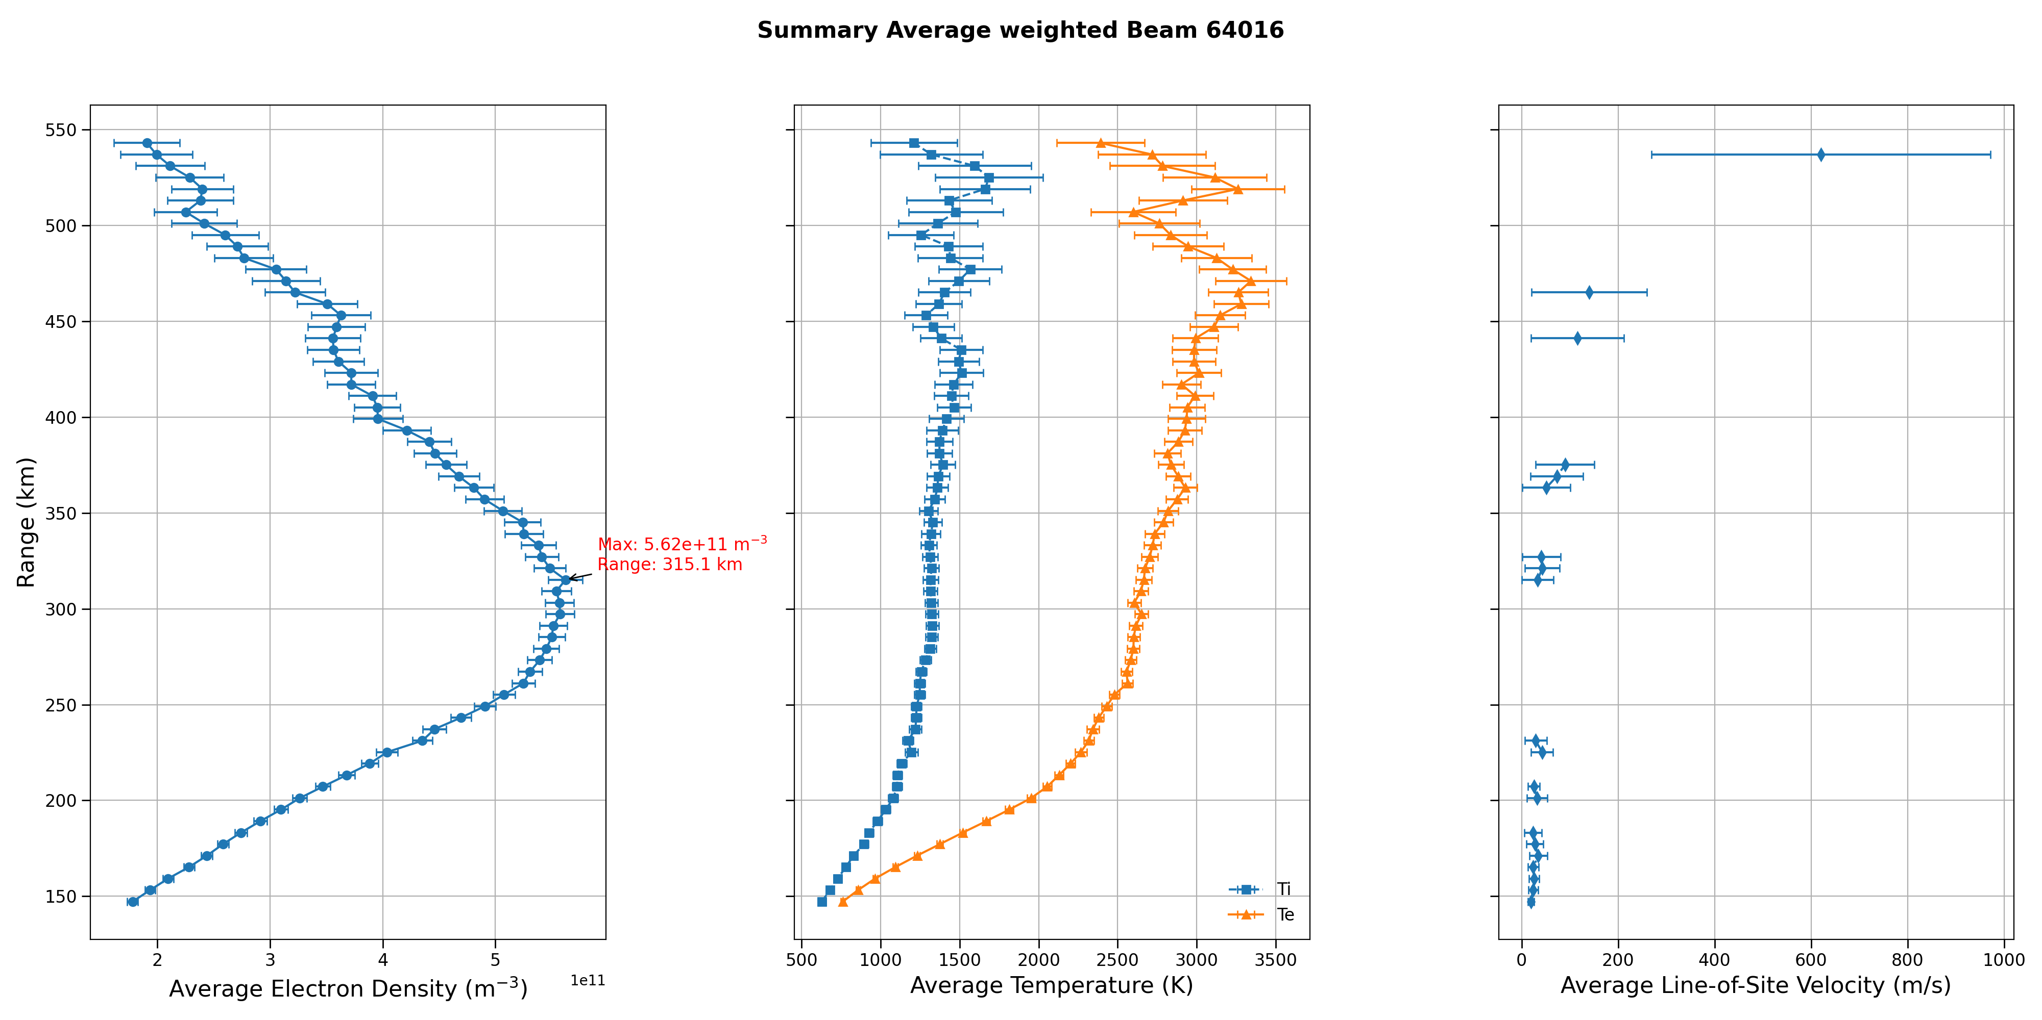
BEAM 1: Finalized Electron Density Profiles with integration time of 20 mins
Peak Electron Density of 5.62e11 /m³ at 315. 5 km

Slide 16
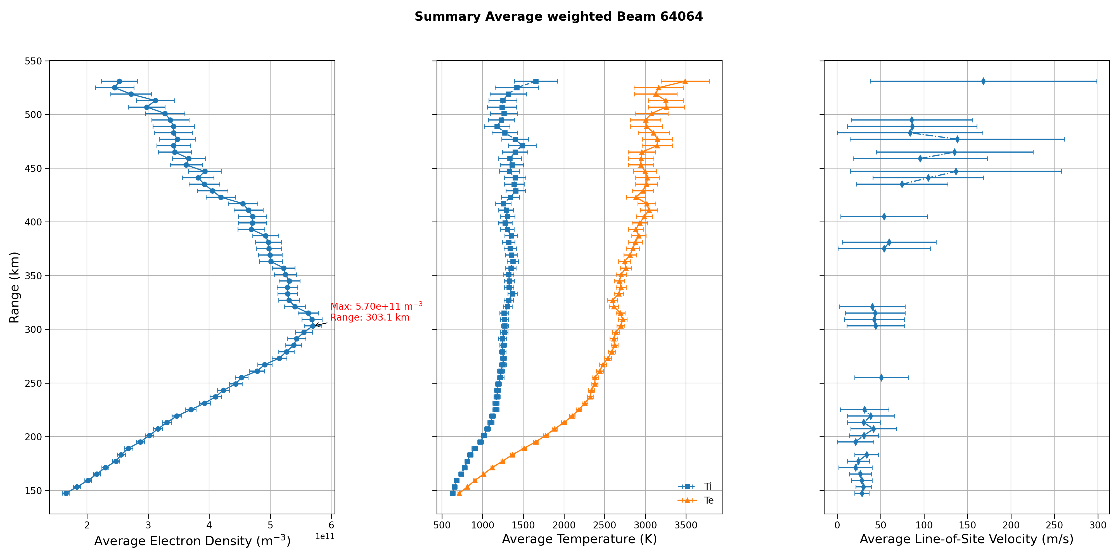
BEAM 2: Finalized Electron Density Profiles with integration time of 20 mins
Peak Electron Density of 5.70e11 /m³ at 303. 1 km

Slide 17
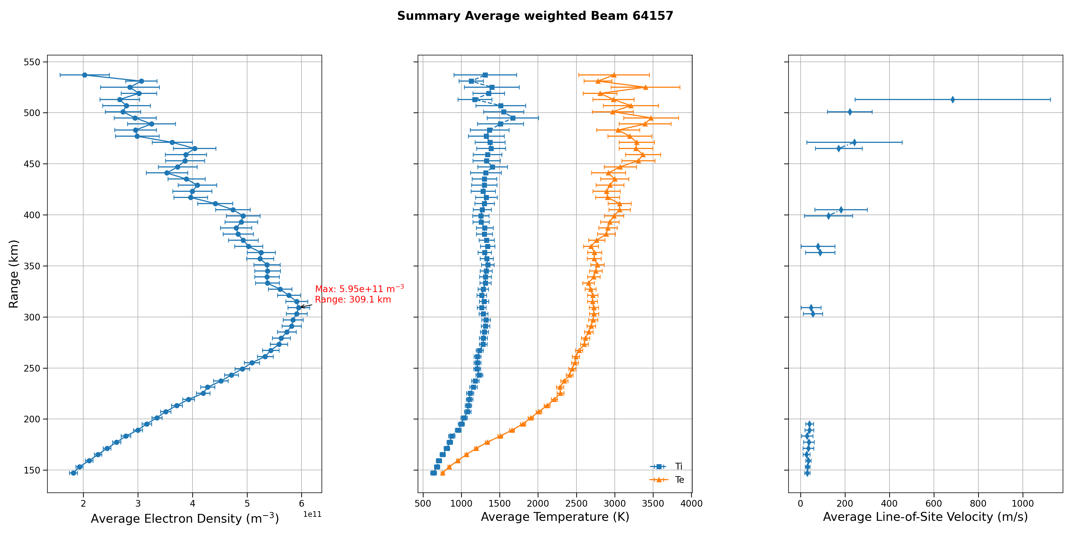
BEAM 3: Finalized Electron Density Profiles with integration time of 20 mins
Peak Electron Density of 5.95e11 /m³ at 309. 1 km

Slide 18
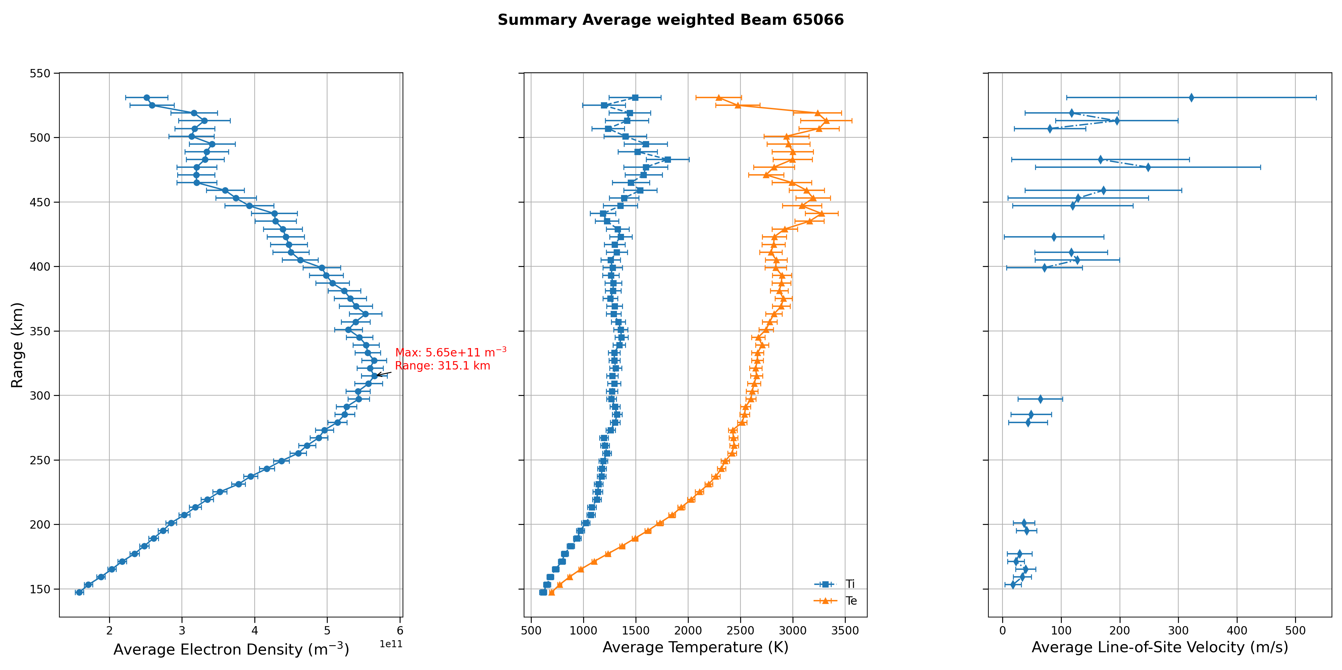
BEAM 4: Finalized Electron Density Profiles with integration time of 20 mins
Peak Electron Density of 5.65e11 /m³ at 315. 5 km

Slide 19
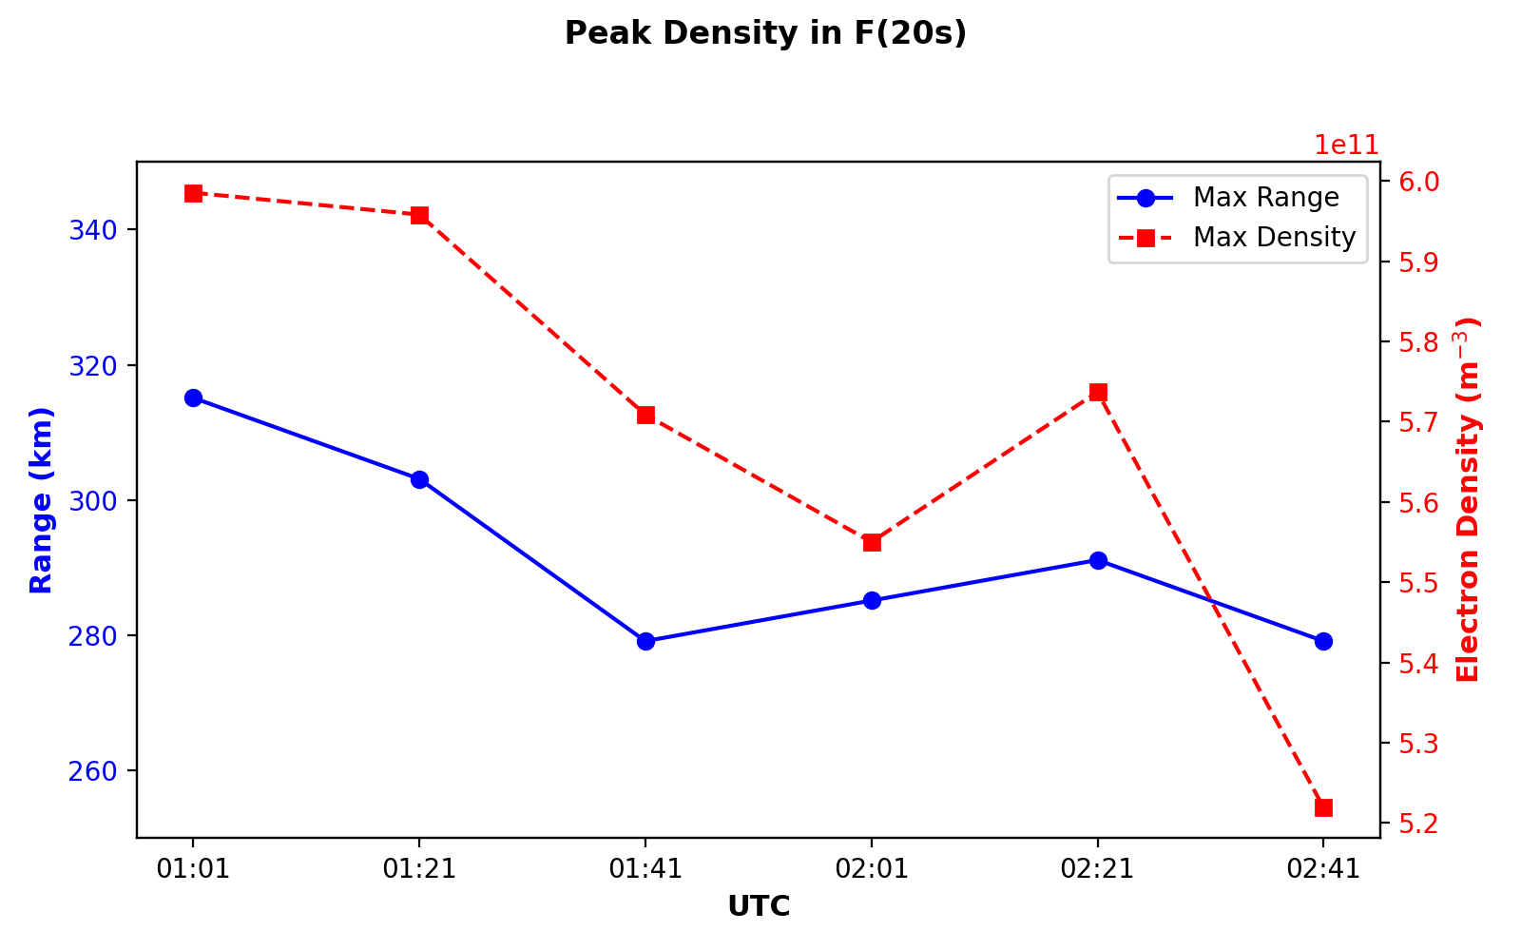
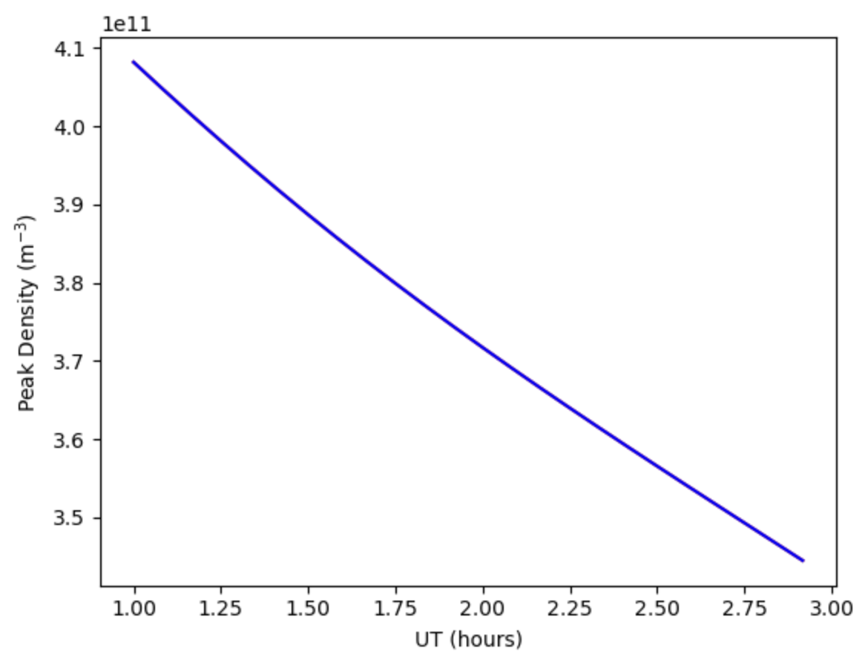
Change in Peak Densities and it’s altitude over the 2 hours
PFISR
IRI
Even in two hours of "nothing", we saw the ionosphere move, literally!

Slide 20
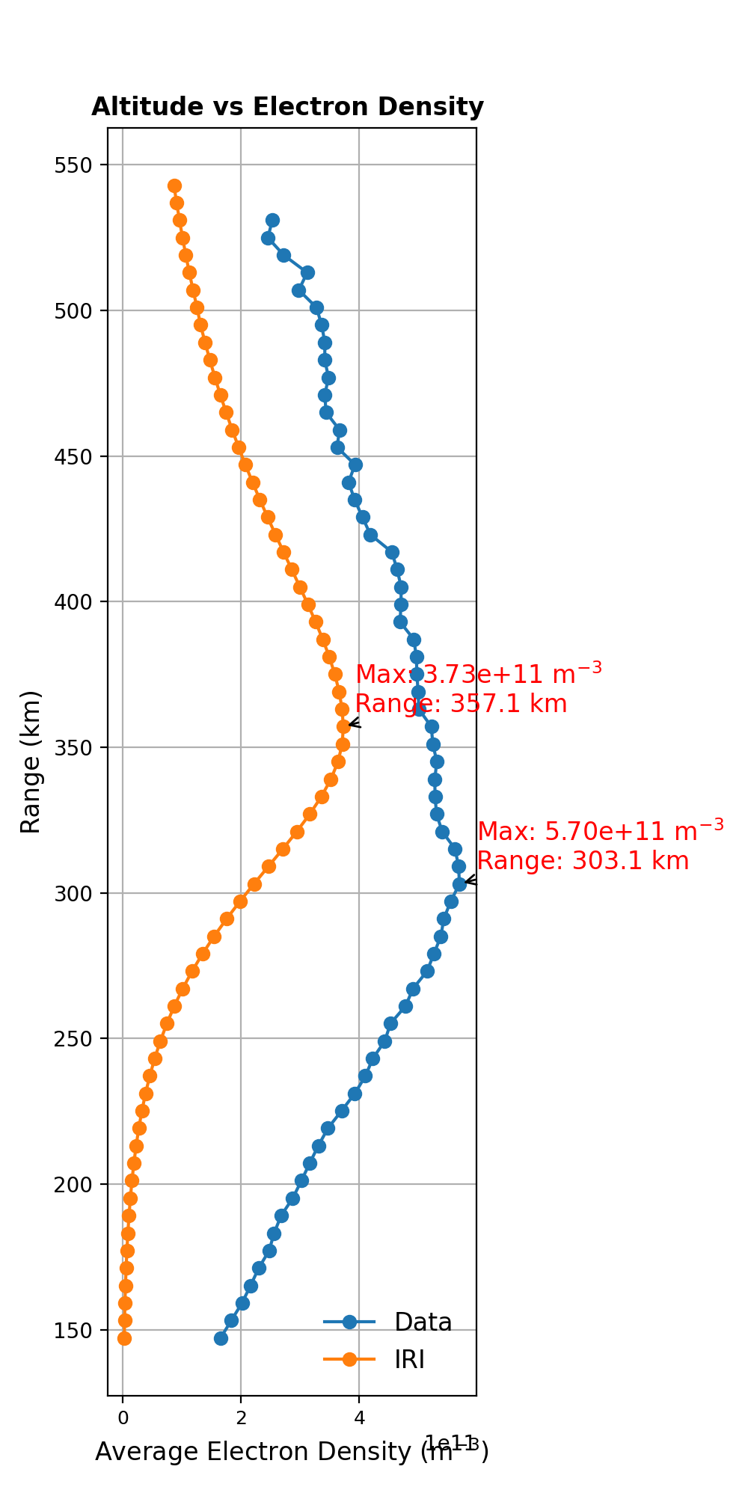
Comparison of Electron Density Profiles: PFISR vs IRI
PFISR
IRI

Slide 21
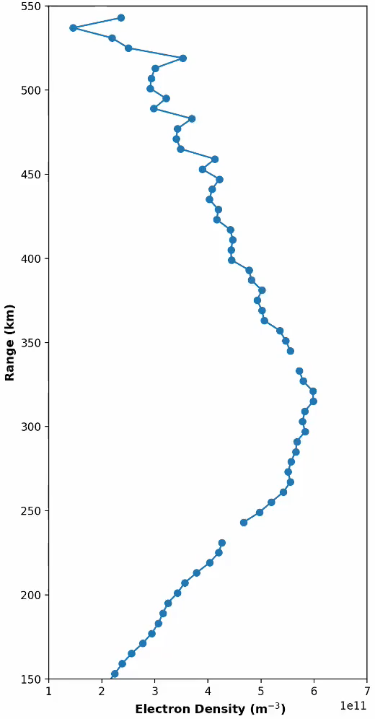
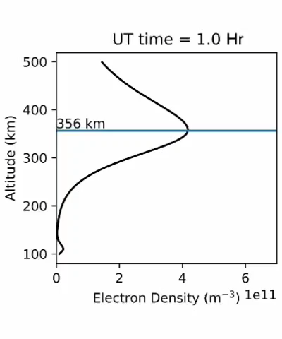
Comparison of Electron Density Profiles: PFISR vs IRI
PFISR
IRI

Slide 22
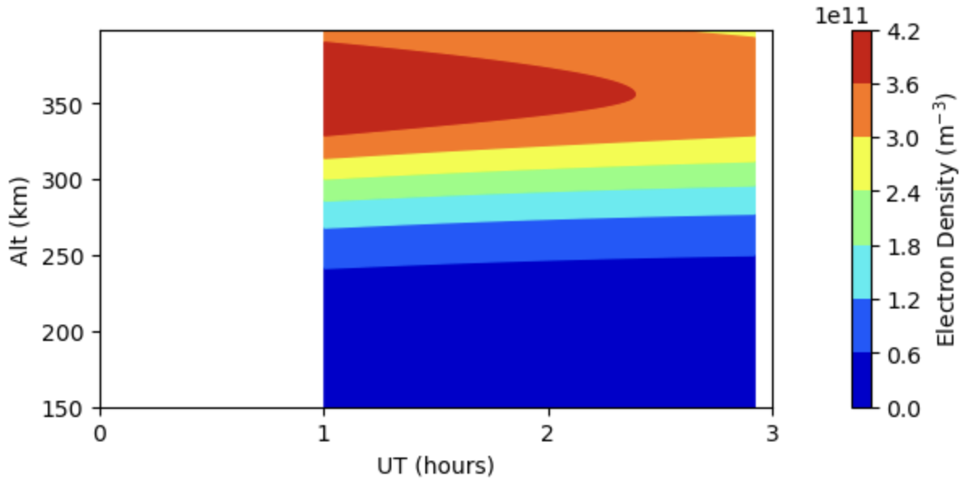
Comparison of Electron Density Contours: PFISR vs IRI
PFISR
IRI

Slide 23
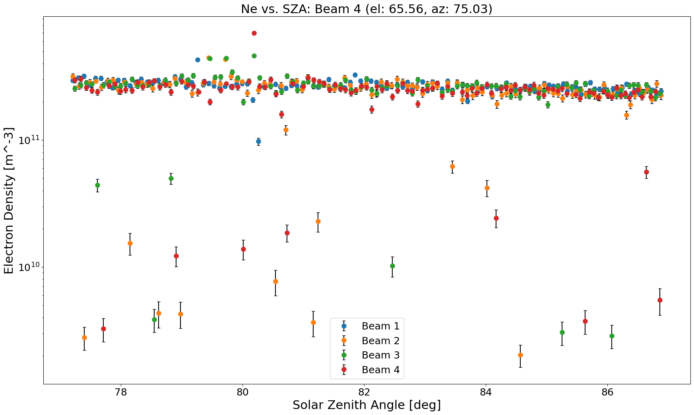
Change in the electron density over the solar zenith angle during 2 hours using ALL data

Slide 24
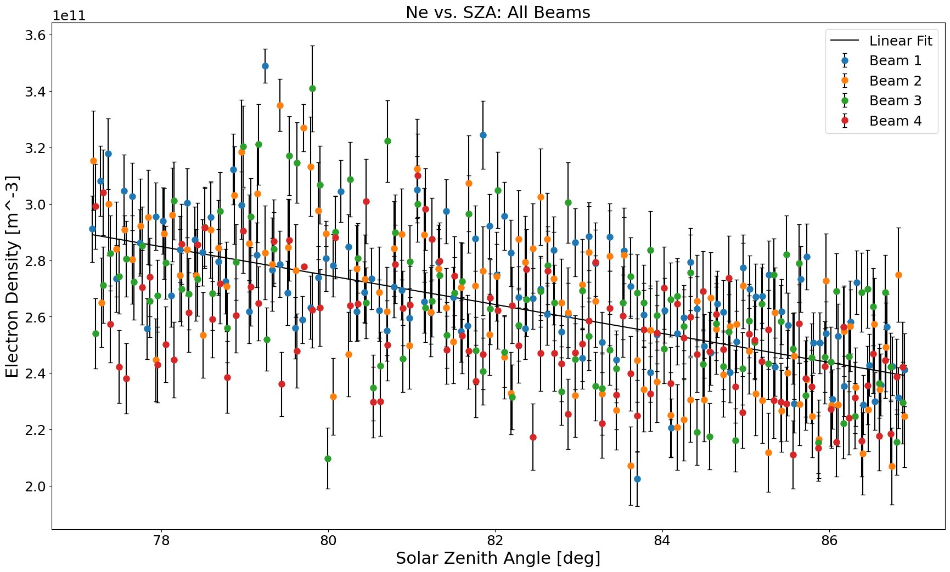
Change in the electron density over the solar zenith angle during 2 hours using FILTERED data
Filtered = major outliers removed
From IRI

Slide 25
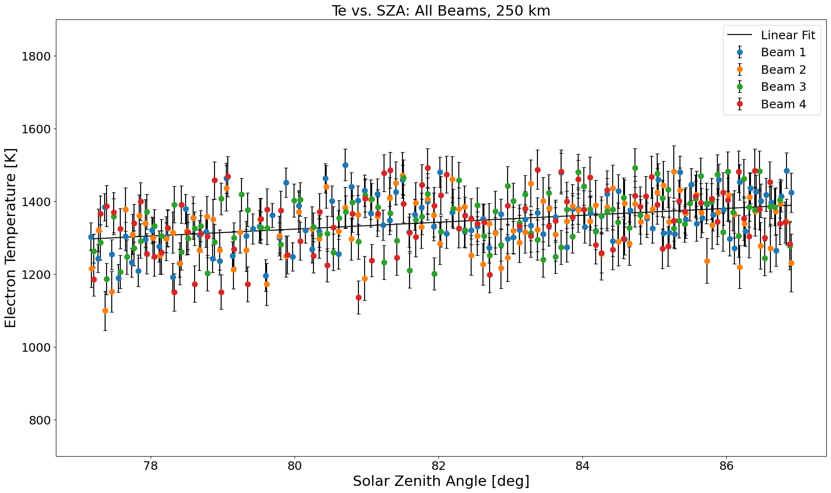
Change in the electron temperatures over the solar zenith angle during 2 hours using FILTERED data
Filtered = major outliers removed

Slide 26
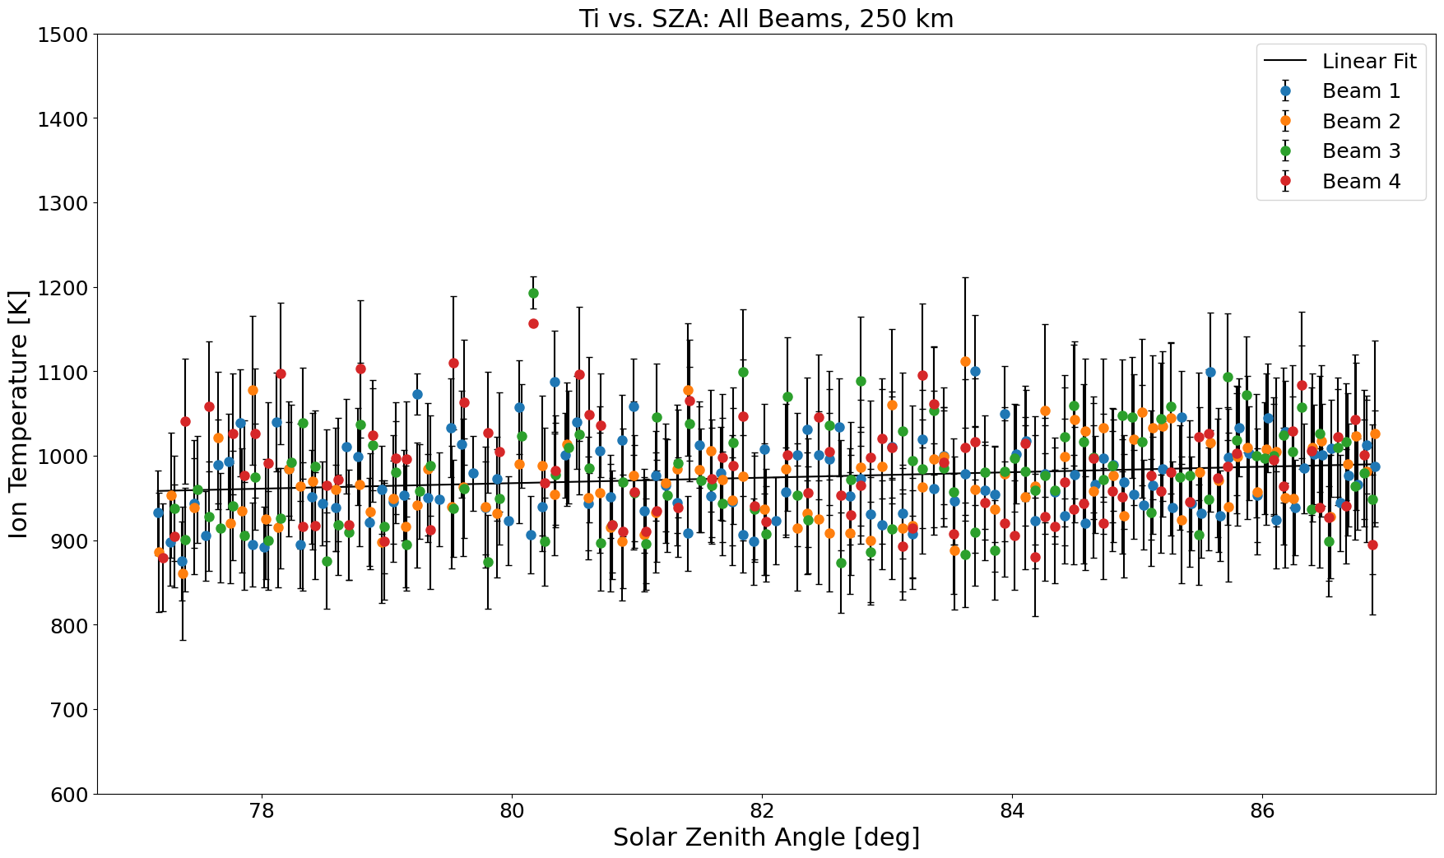
Change in the ion temperature over the solar zenith angle during 2 hours using FILTERED data
Filtered = major outliers removed

Slide 27
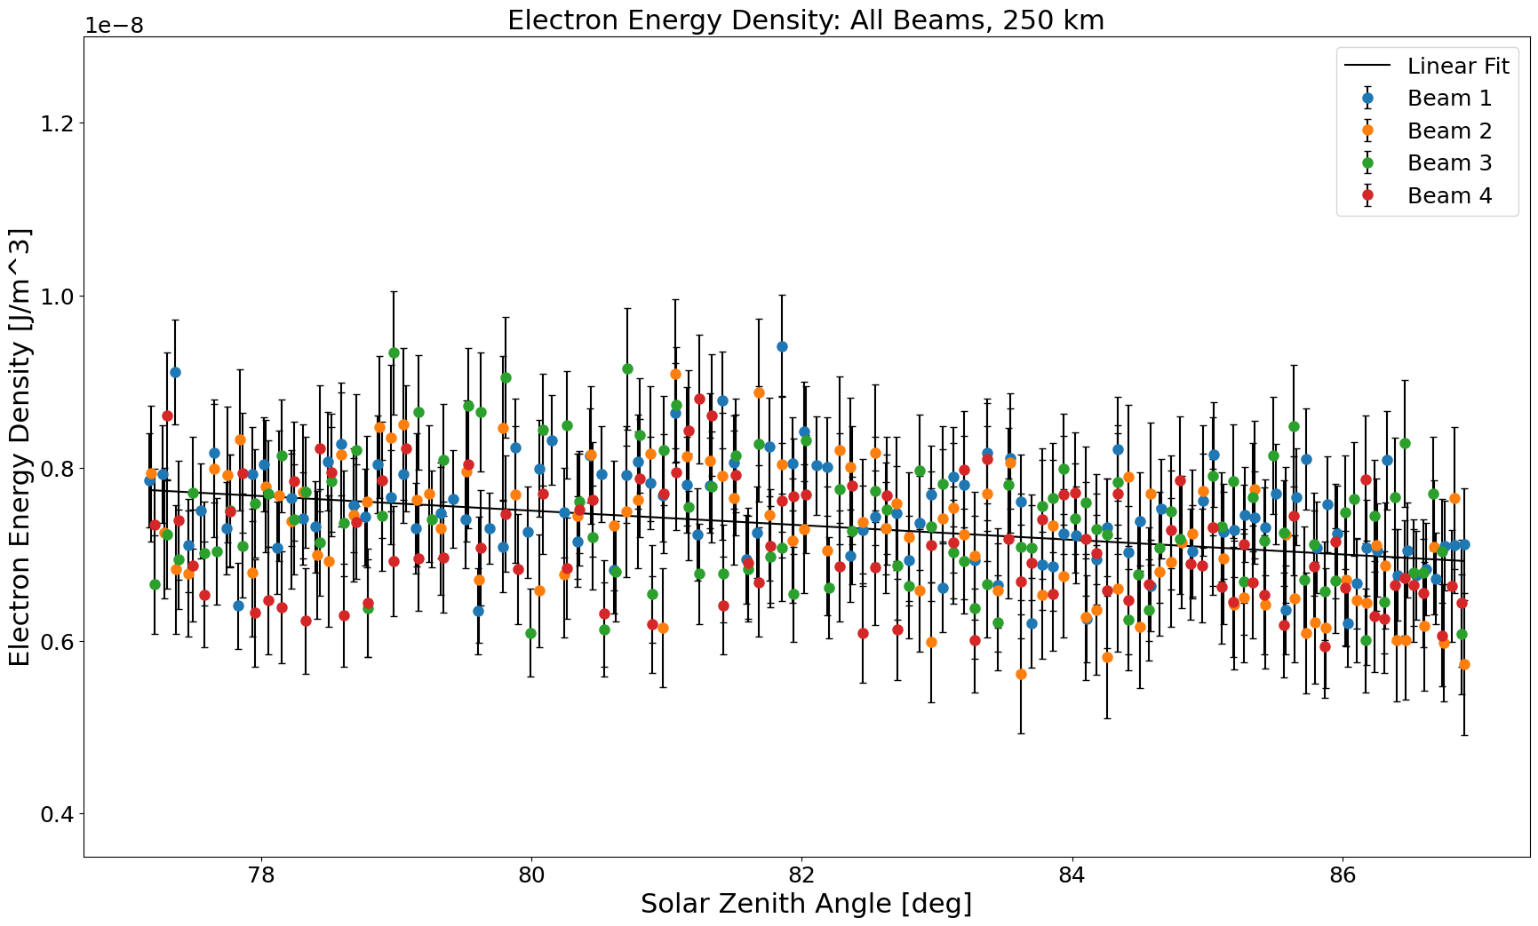
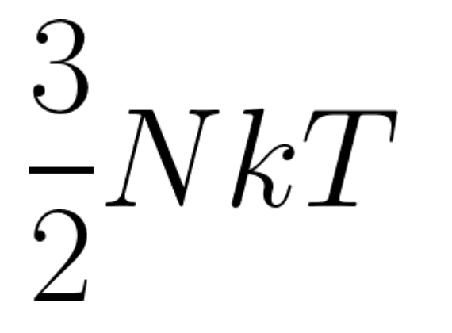
Change in the electron energy density over the solar zenith angle during 2 hours using FILTERED data
Filtered = major outliers removed
Electron energy density =

Slide 28
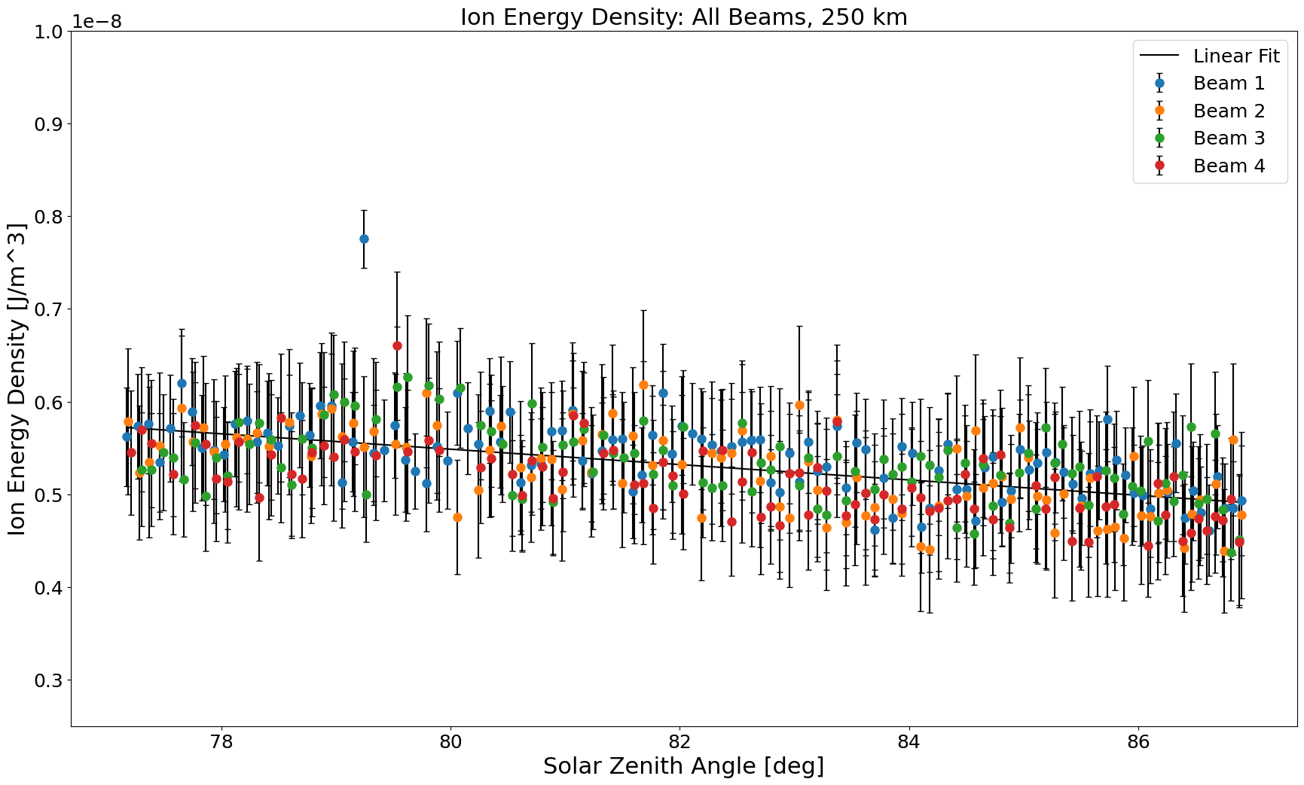
Change in the ion energy density over the solar zenith angle during 2 hours using FILTERED data
Filtered = major outliers removed
Ion
energy density =

Slide 29
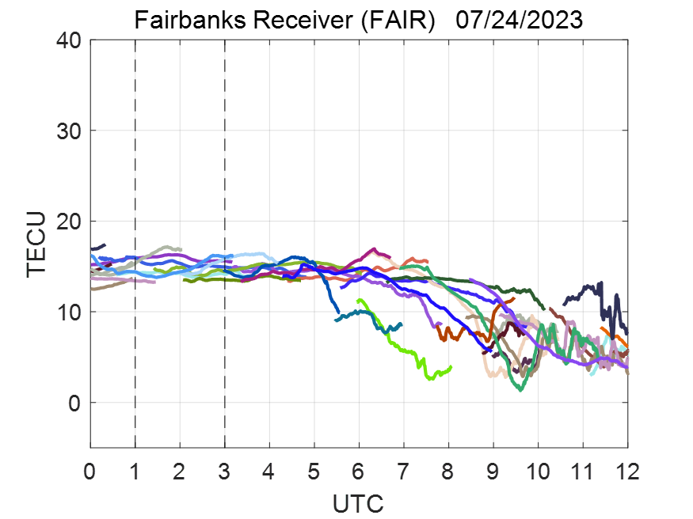
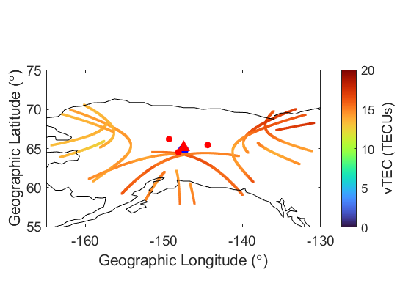


Comparison of TEC - PFISR vs GPS
Vertical TEC (IPP=350 km) based on GNSS receiver
Elevation mask> 20°
Satellite IPPs
Beam IPPs
PFISR

Slide 30
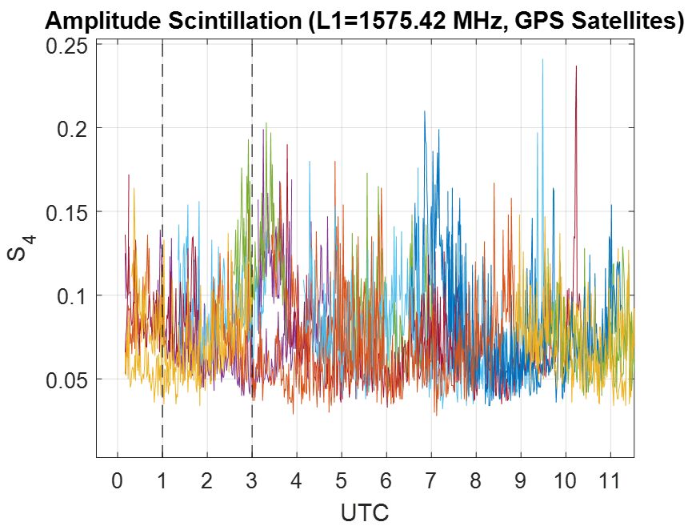
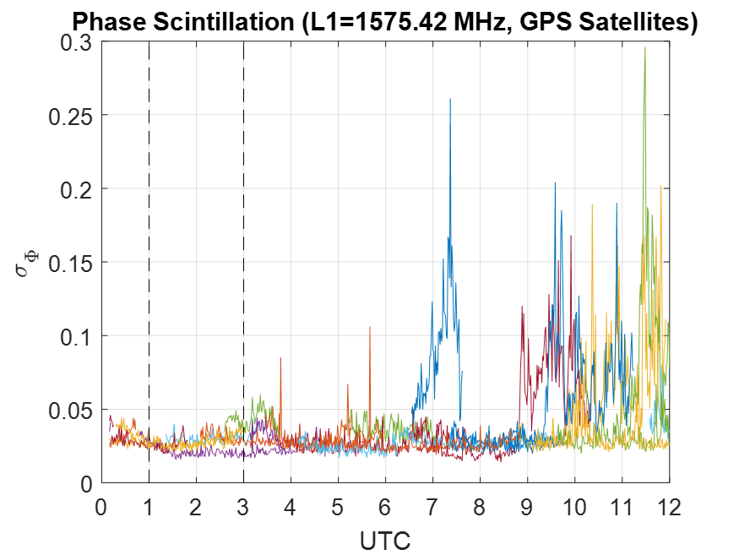
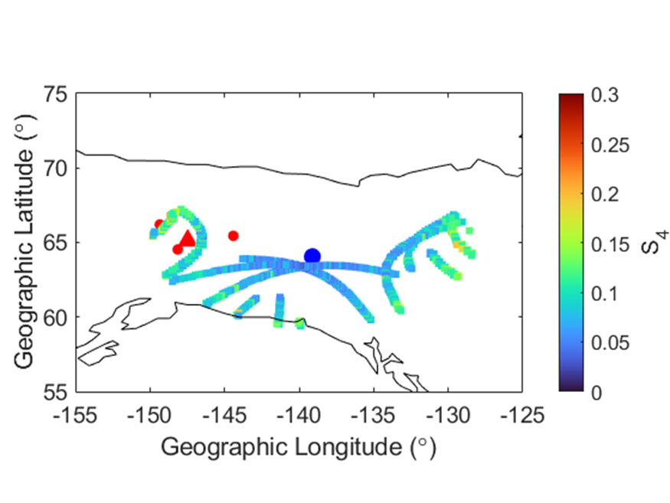
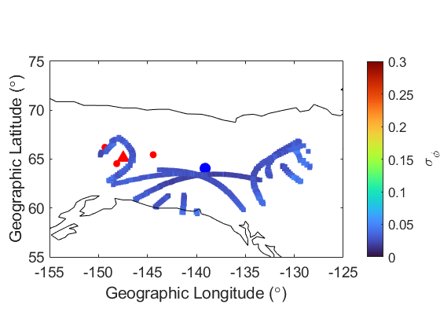
Ionospheric Scintillation (GPS)
Dawson Receiver
Dawson Receiver
Dawson Receiver
PFISR

Slide 31
Conclusions
Having a well-established baseline is vital to see any anomalies in the ionosphere! So all data is important data!
So what does nothing look like?
  PFISR
    Somewhat matches IRI!
    Ne peaks at 5e11, peak around 300 km
    Temperature: Te > Ti, Te/Ti increases with altitude as expected
    Ne, Te, Ti, and their products vary gently with SZA as expected
    Relatively poor quality of LOS velocity data
  GPS
    Low scintillation parameter values

Slide 32
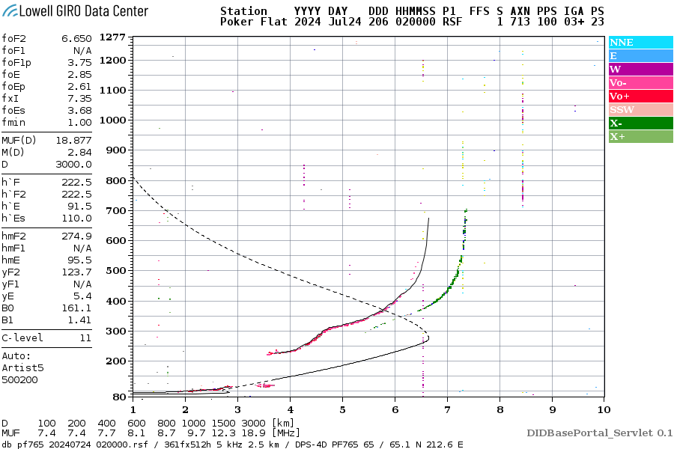
Future Work
After Dr.Goncharenko's talk yesterday we learned there is an ongoing SSW in Antarctica - so the data we have may not be nothing! It could have Inter-hemispheric coupling (IHC) signatures!
  Investigate teleconnection signatures in the PFISR and RISR data using a longer (10 days?) dataset
Compare PFISR data with neutral temperatures from MSIS
Compare PFISR data with PF ionosonde data

Slide 33
Lessons Learned!
Nothing could always be something!
  SSW in the SH could be affecting ionosphere in the NH!
Use more beams
  Higher spatial coverage will help find more irregularities
Madrigal parameter calculator
  Pretty seamless
Thank you for organizing this summer school and for all the amazing sessions!

Slide 34
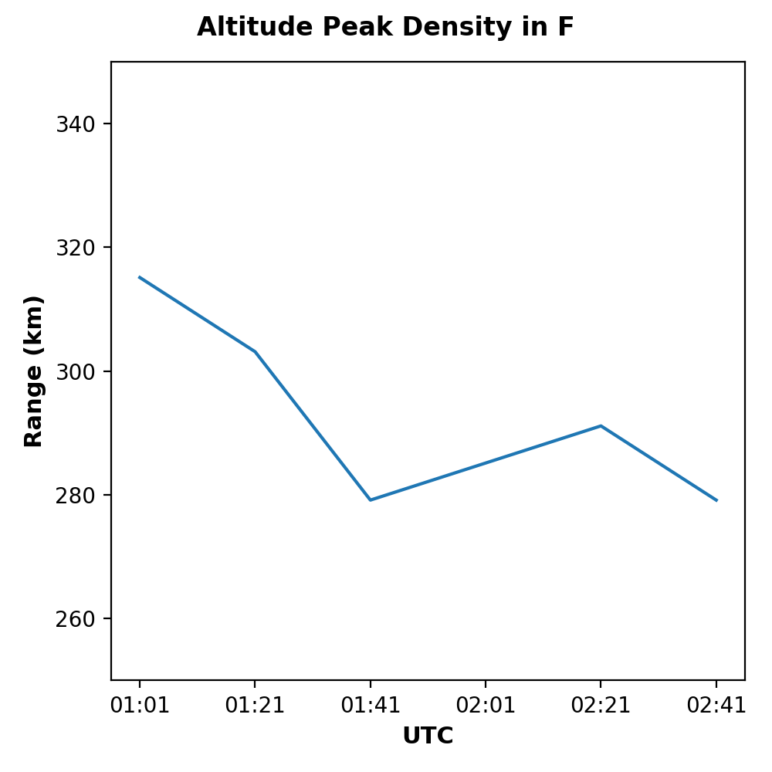
Change in Peak Densities over the 2 hours

Slide 35
