Slide 1




ISR School 2024
Characterizing Ionospheric Responses to Quiet Geomagnetic Conditions: PFISR and RISER Radar Observations
Homa Yazdi Karimi, Tapendra Sodari, Grace Kwon, Purbita Chatterjee, Gytis Blinstrubas

Slide 2
Scientific Objectives
Observe the onset of the solar wind to the Earth
Observe density enhancements and gradients correlated with the storm
Demonstrate that ISR can sense two cell convection
Predict which layer scintillation will occur due to density gradients

Slide 3
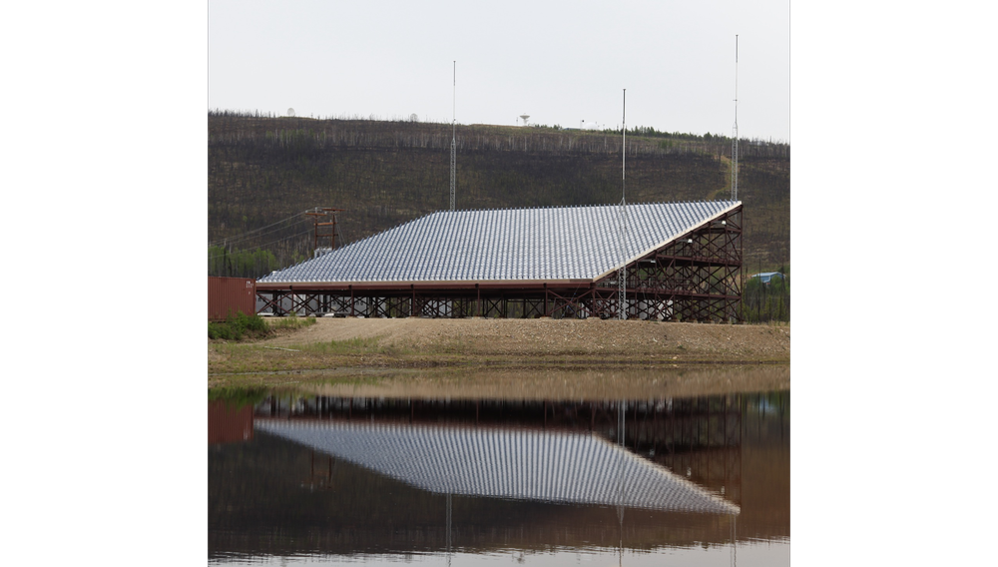
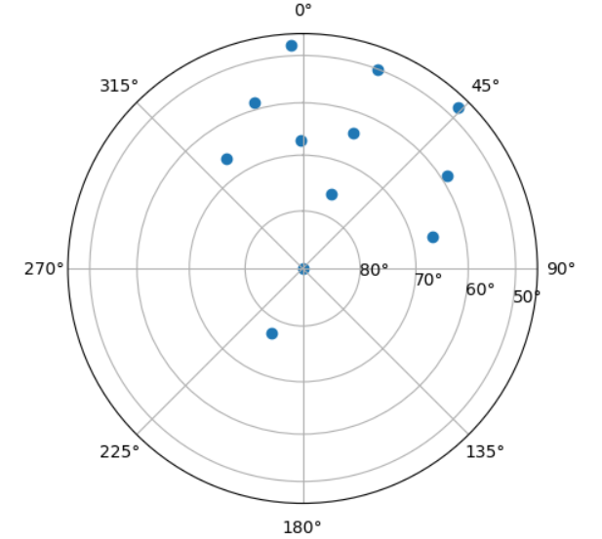
Experimental Setup
PFISR (Poker Flat Incoherent Scatter Radar)
Experiment Run 23:00-01:00 UT (19:00-21:00 EST) 07/23/2024
12 Beam Setup (Similar to World Day Setup)
Requested Alternating Code (AC) and Long Pulse (LP)
PFISR data also used from
  18:00-21:00 UT
  03:00-08:00 UT
RISR-N (Resolute Incoherent Scatter Radar)
  18:00-21:00 UT
  23:00-01:00 UT
  03:00-08:00 UT

Slide 4
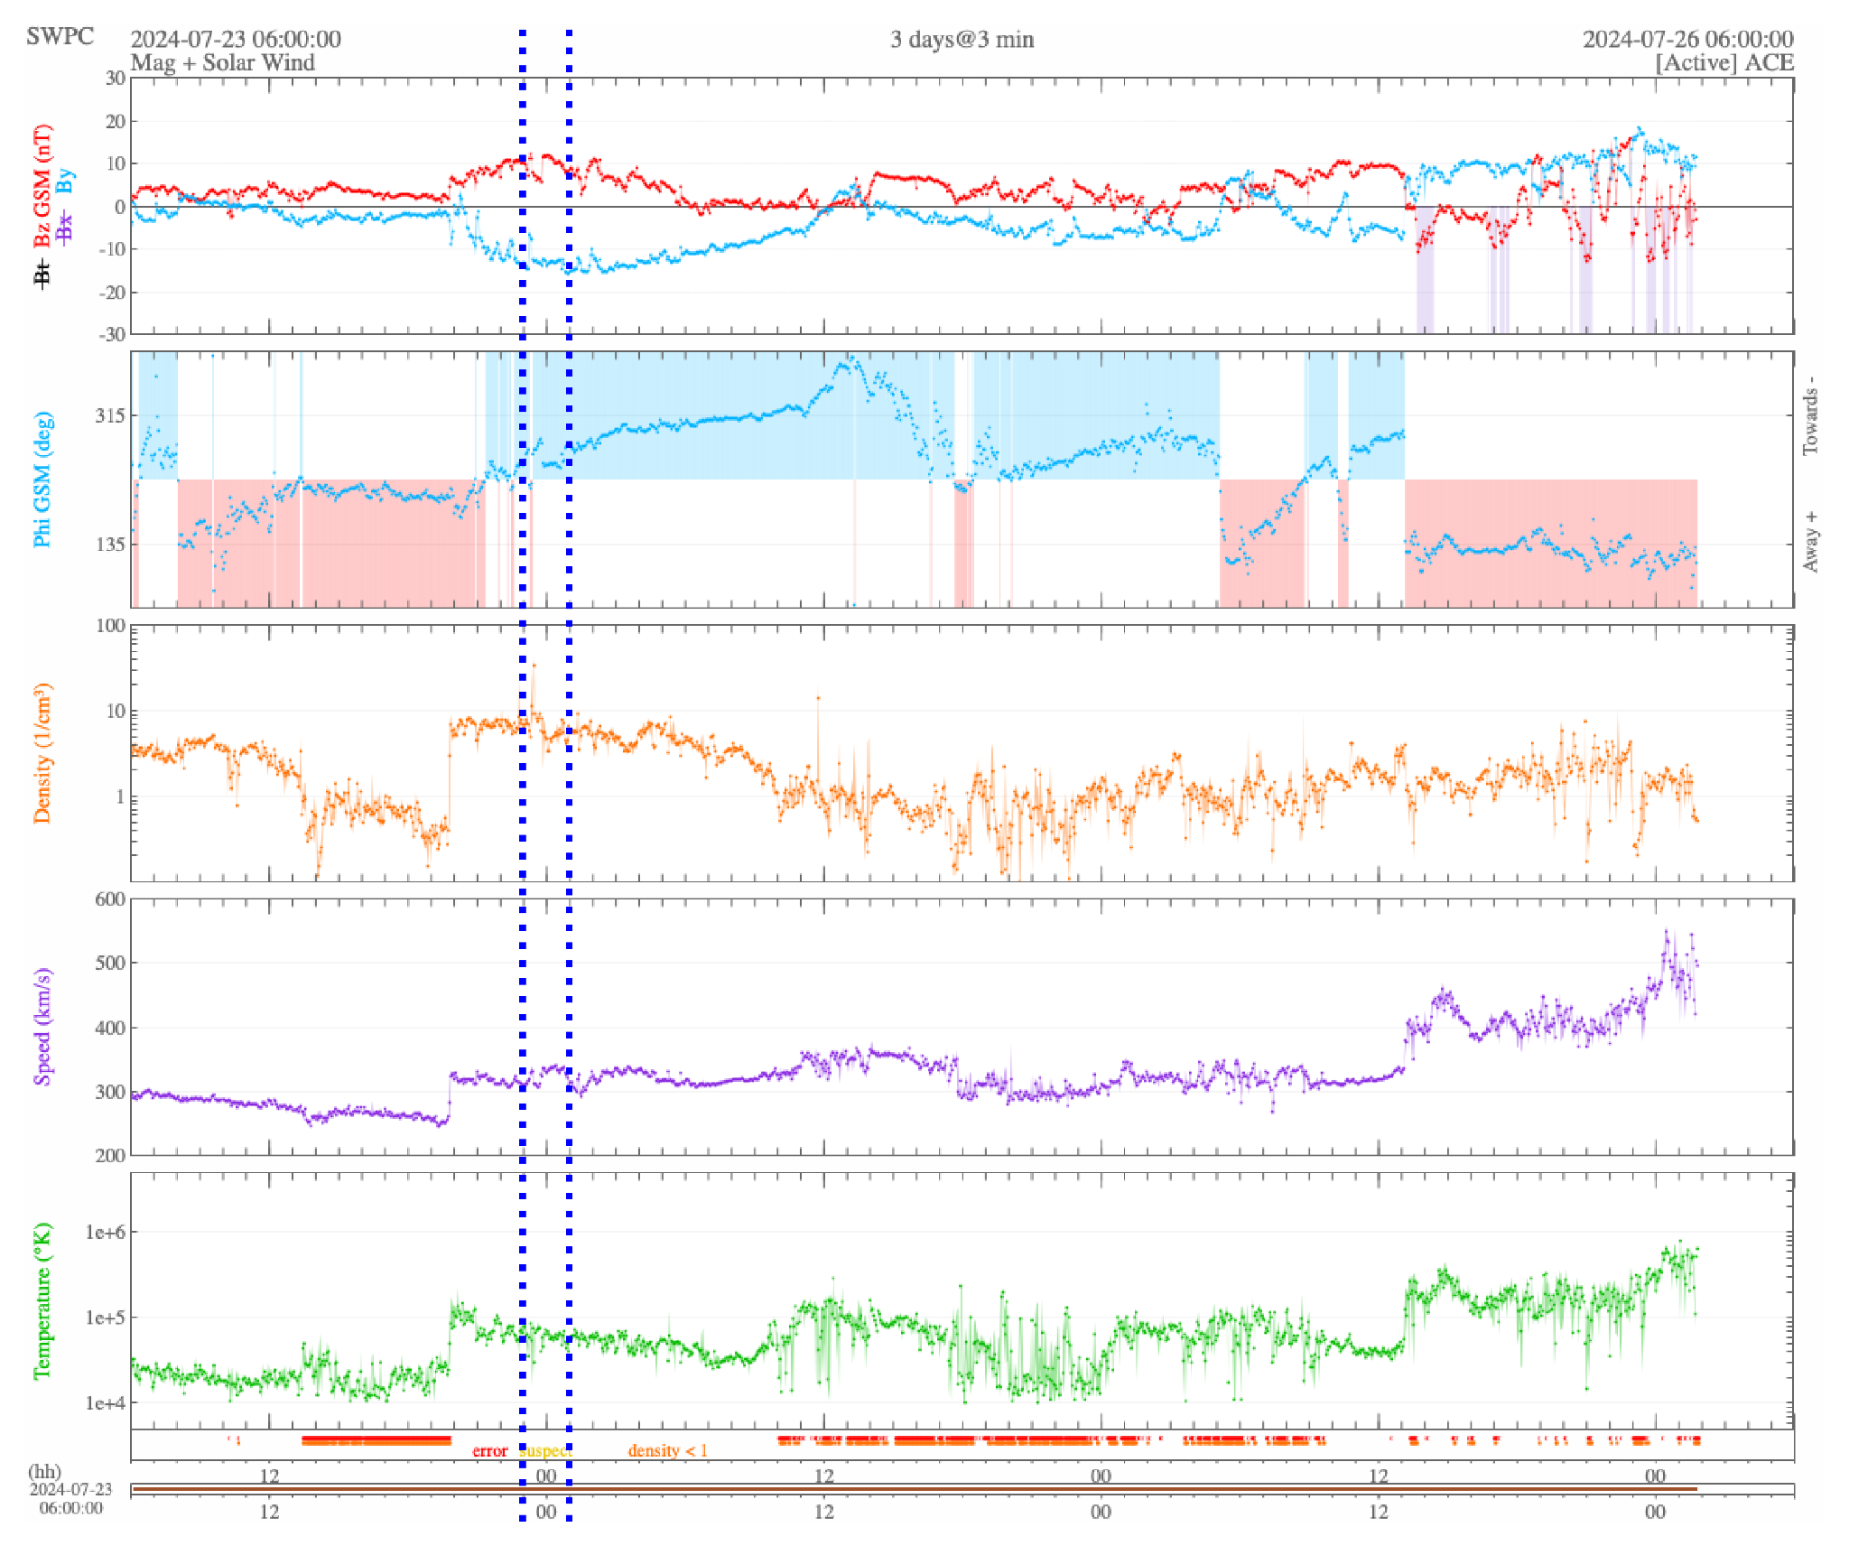
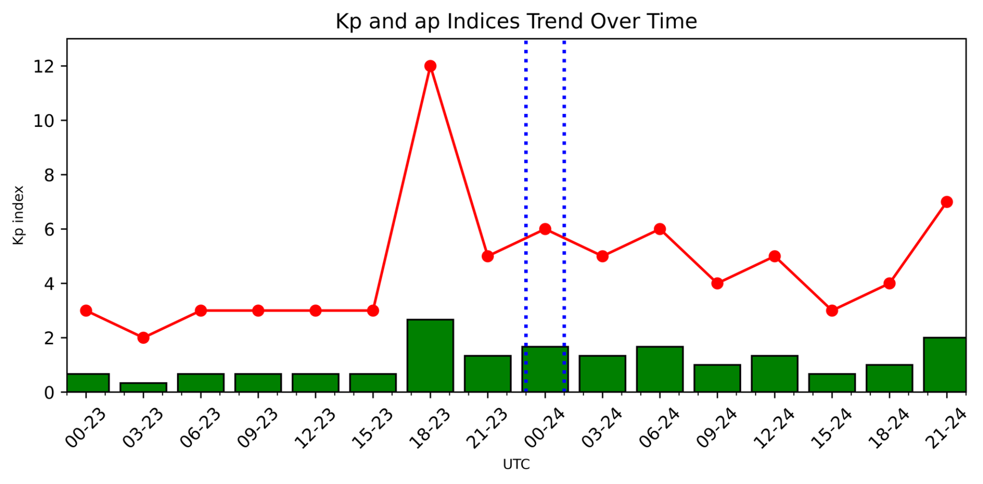
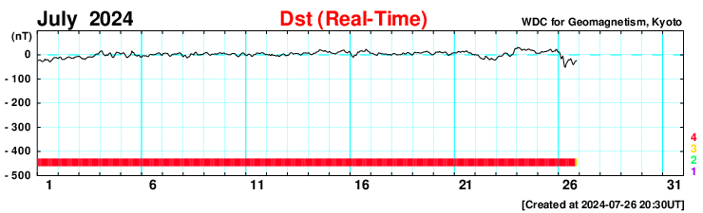
Real Time Solar Wind

Slide 5
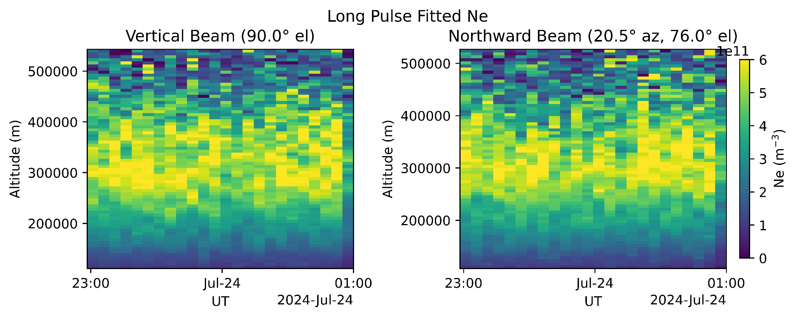
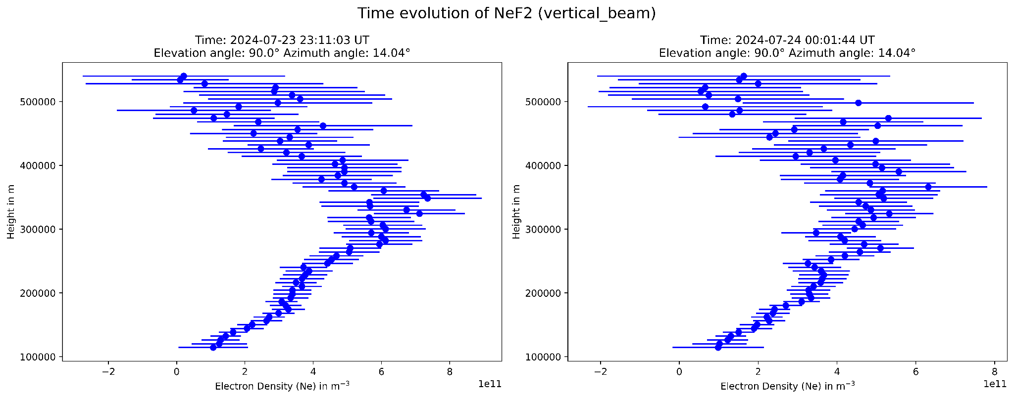
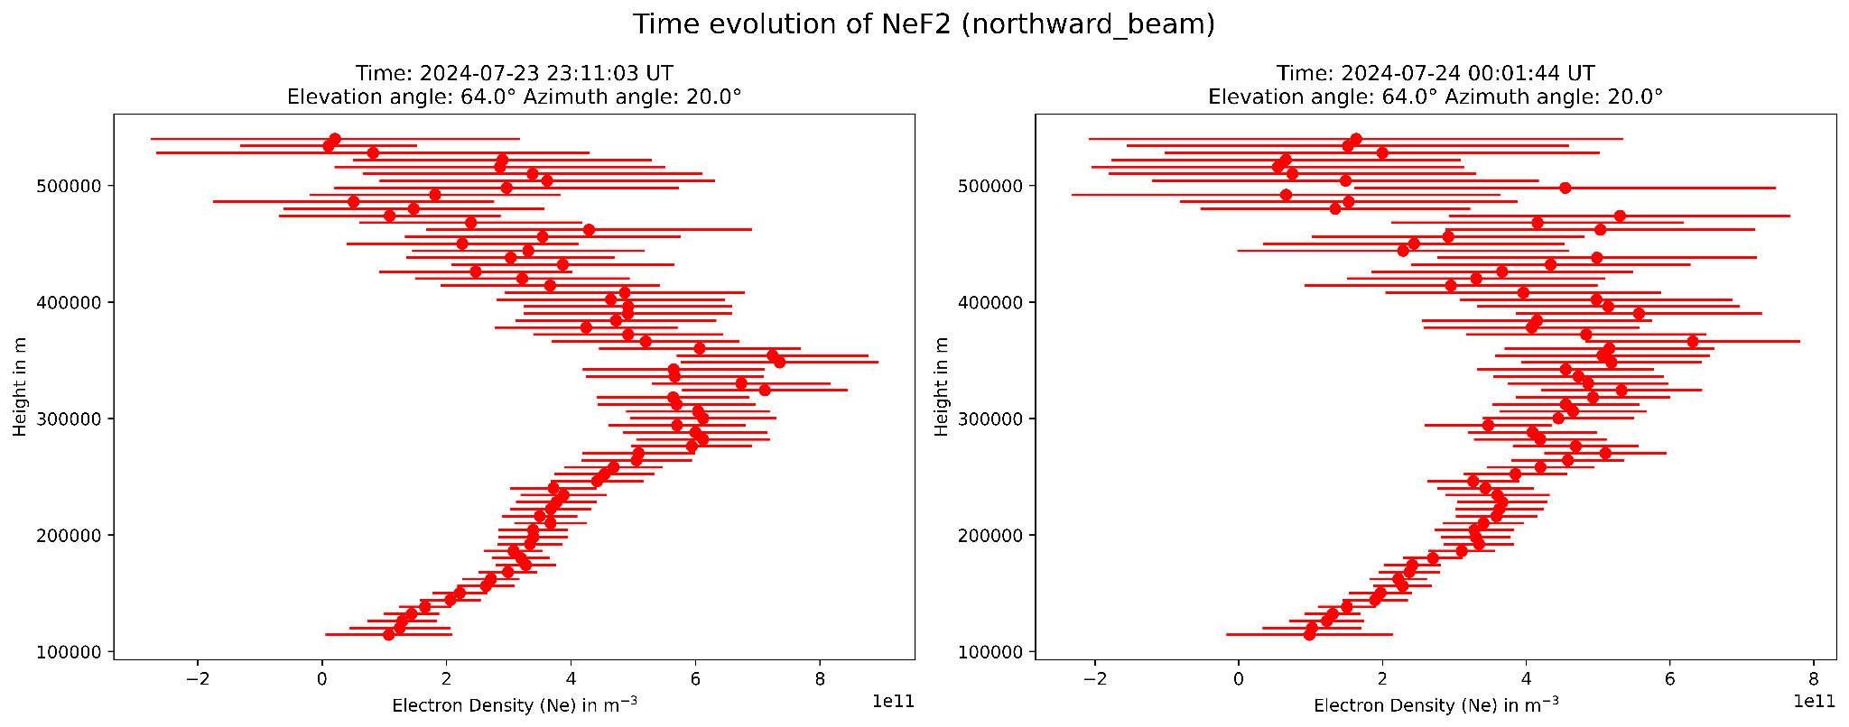
peaks in electron density, though these peaks shift and reduce in magnitude as time progresses
a clear overall decrease in electron density is evident across all altitudes

Slide 6
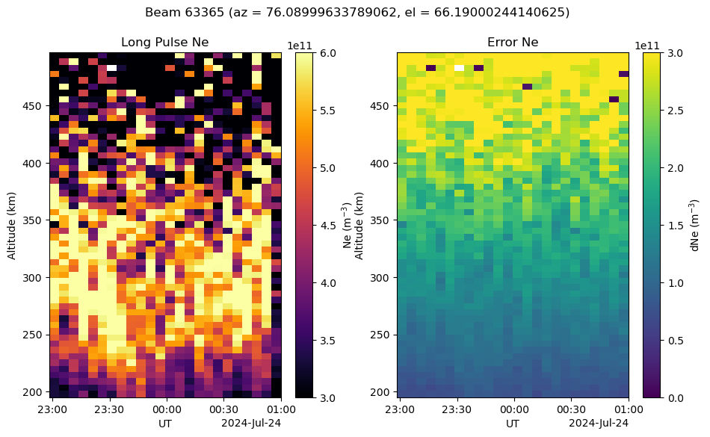
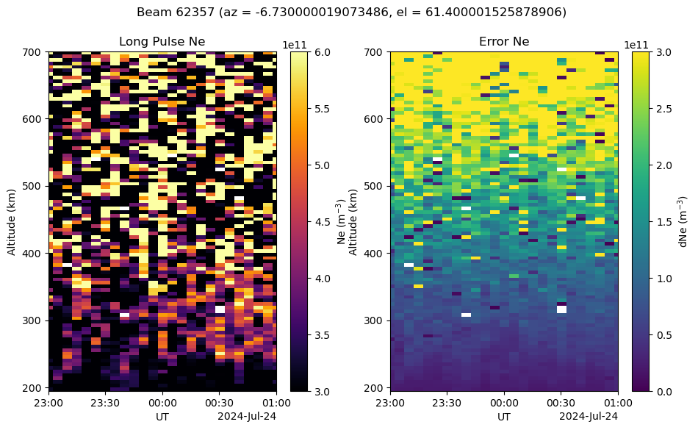
Electron Density
Left = PFISR, right = RISR-N

Slide 7
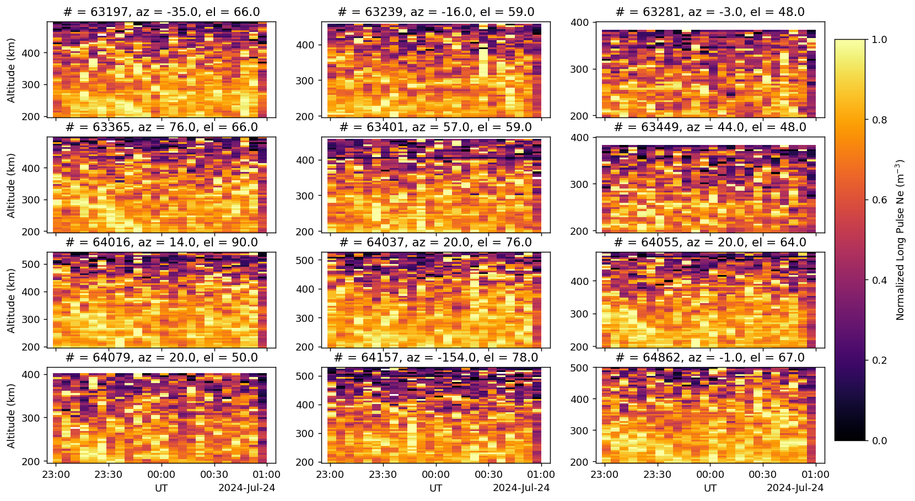
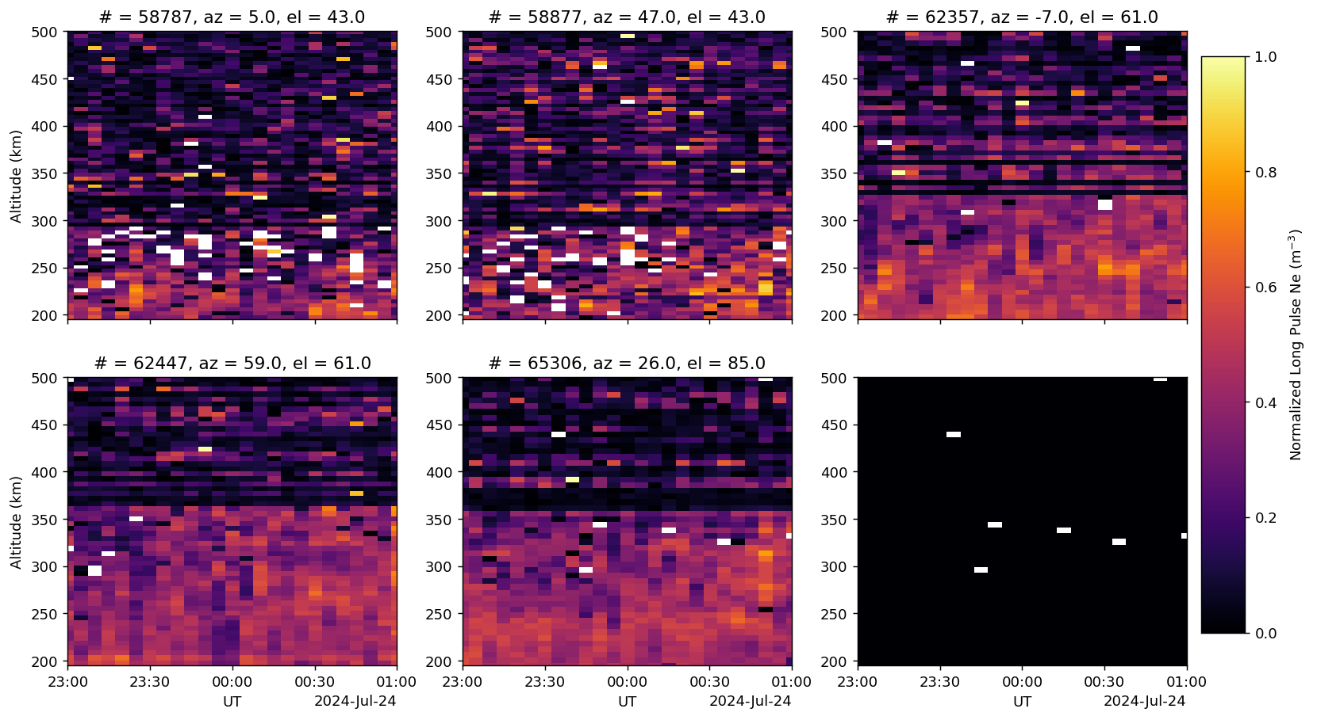
Normalized density (all beams)
Left = PFISR, right = RISR-N

Slide 8
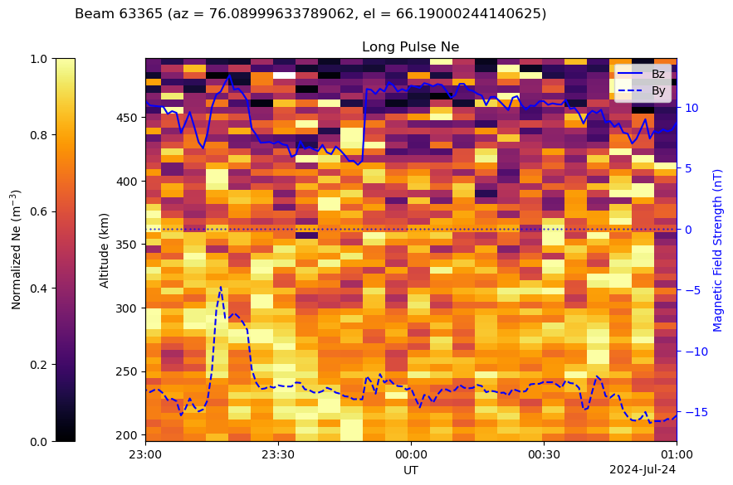
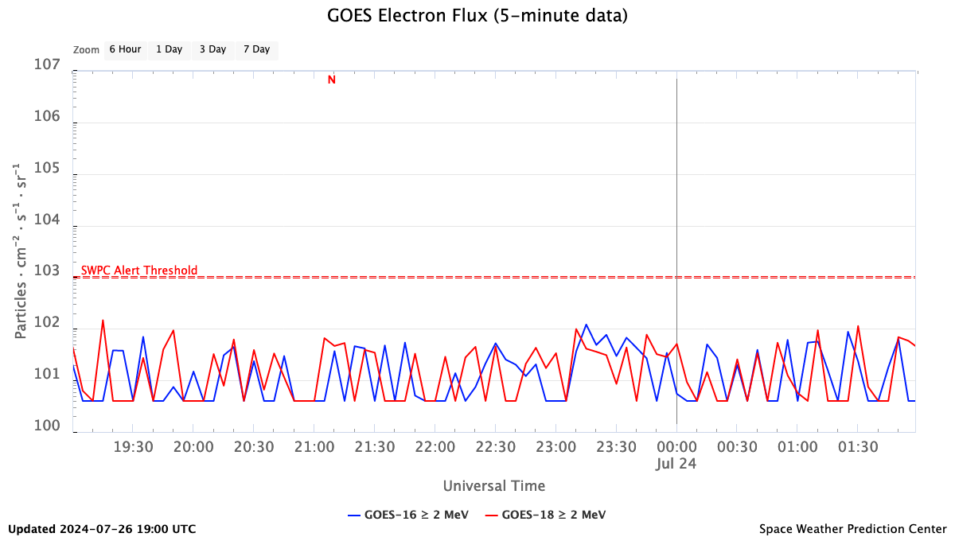
Possible drivers of Ne enhancement

Slide 9
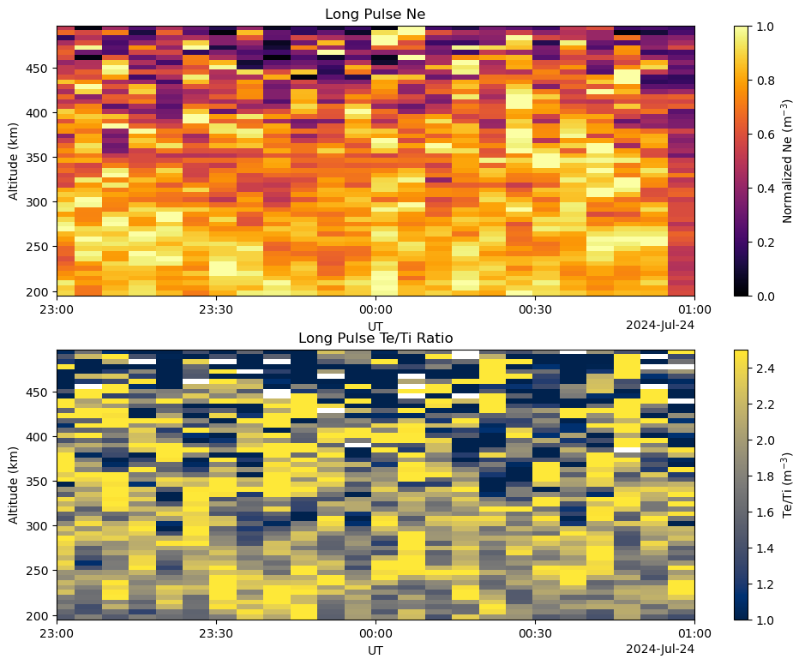
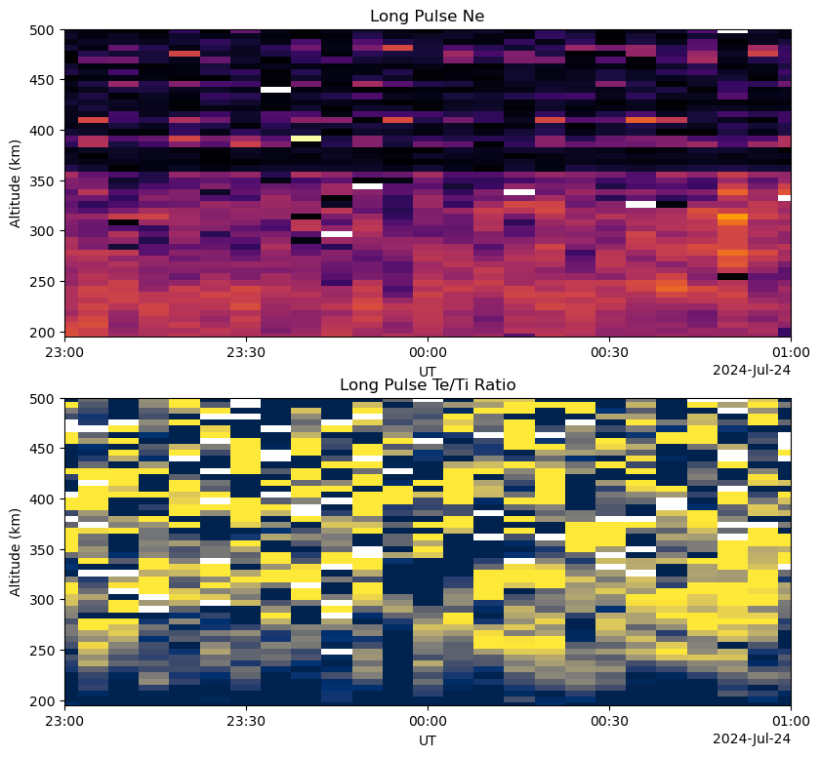
Te/Ti ratio
63365, 76.1, 66.2 PFISR (left)
65306, 26.0, 85.0 RISR-N (right)

Slide 10
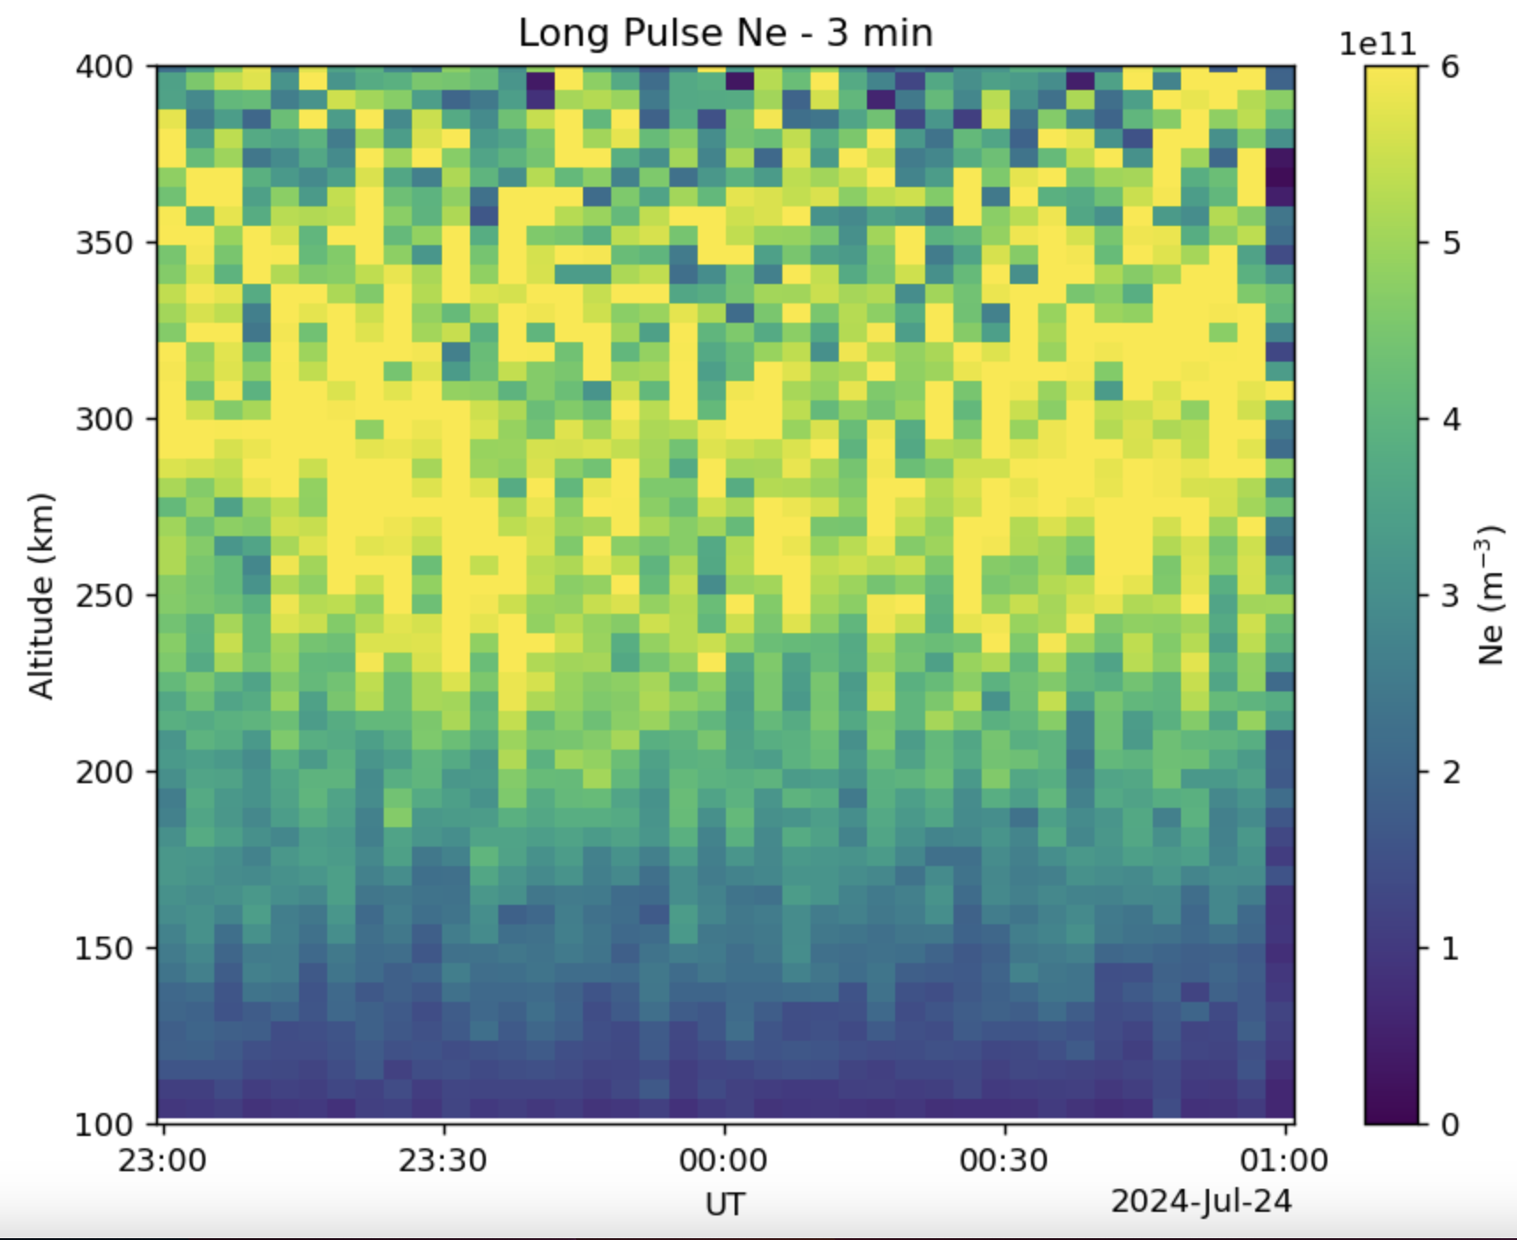
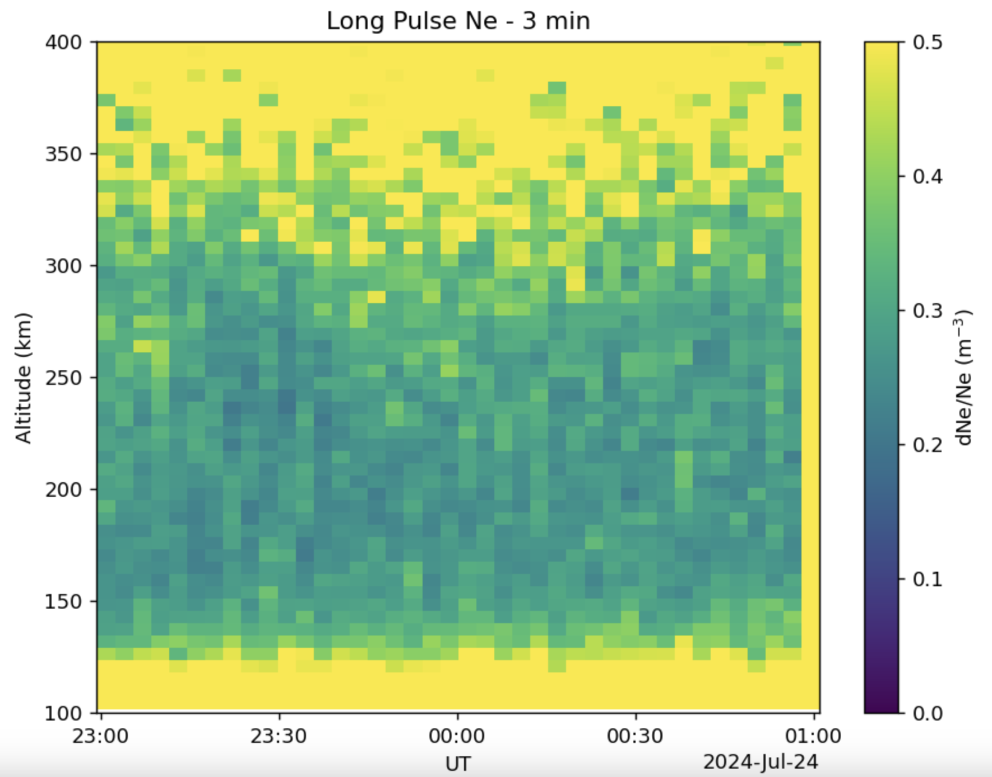
Moving Trail in Electron Density Observed: Can it be a TID ??

Slide 11
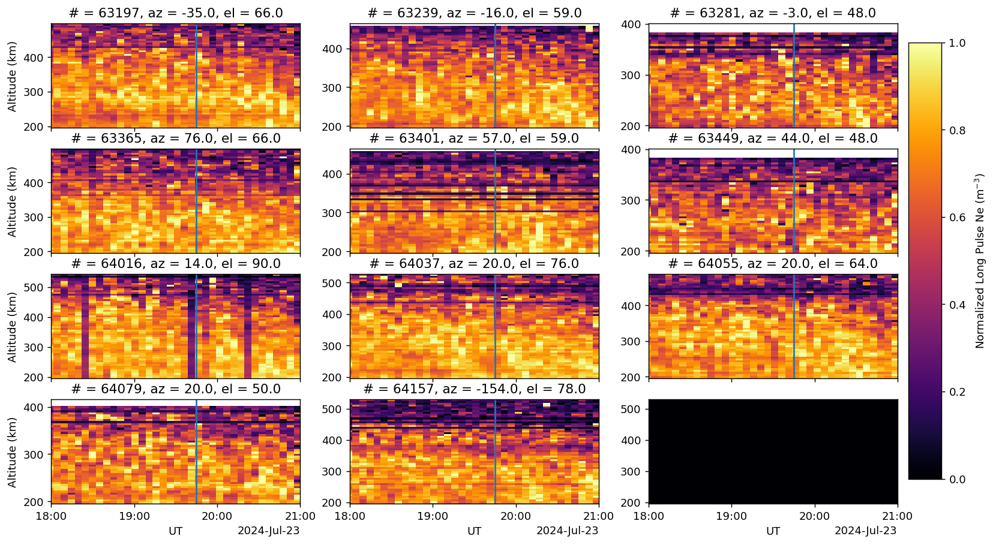
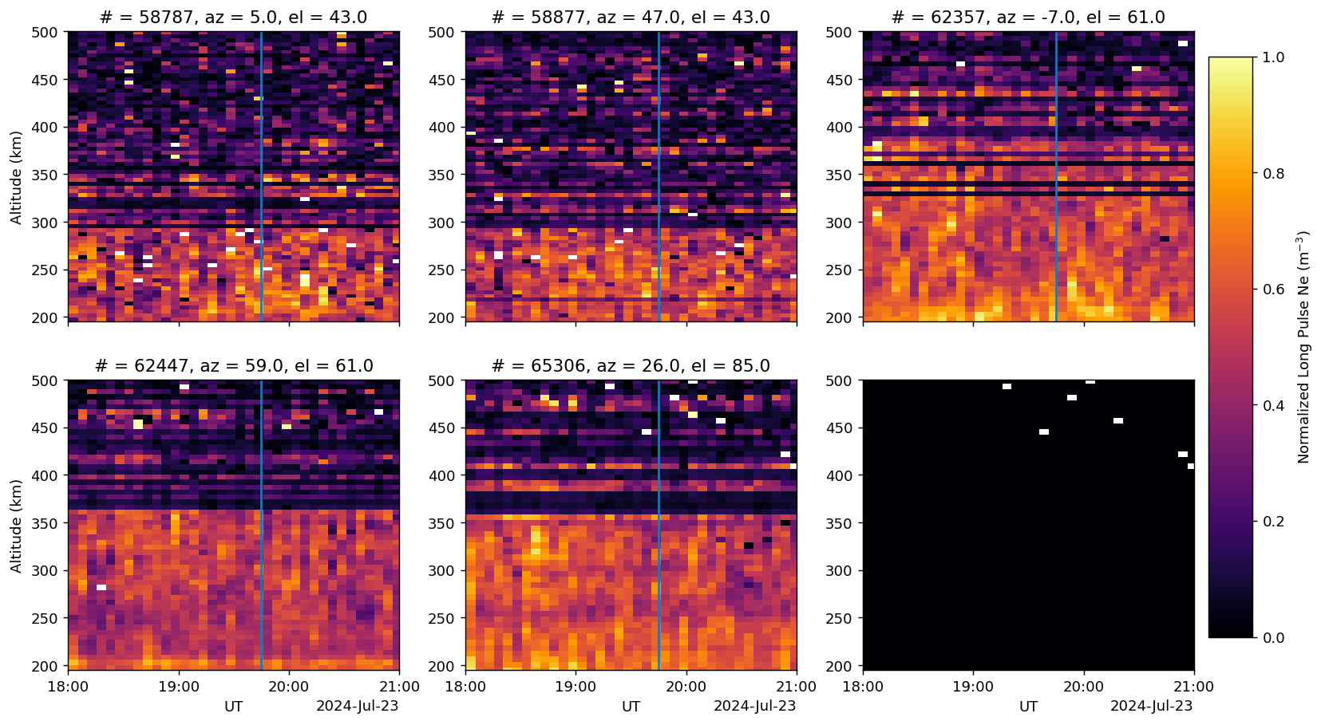
Storm onset
Left = PFISR, right = RISR-N

Slide 12
Moving Trail in Electron Density Observed: Can it be a TID ??

Slide 13
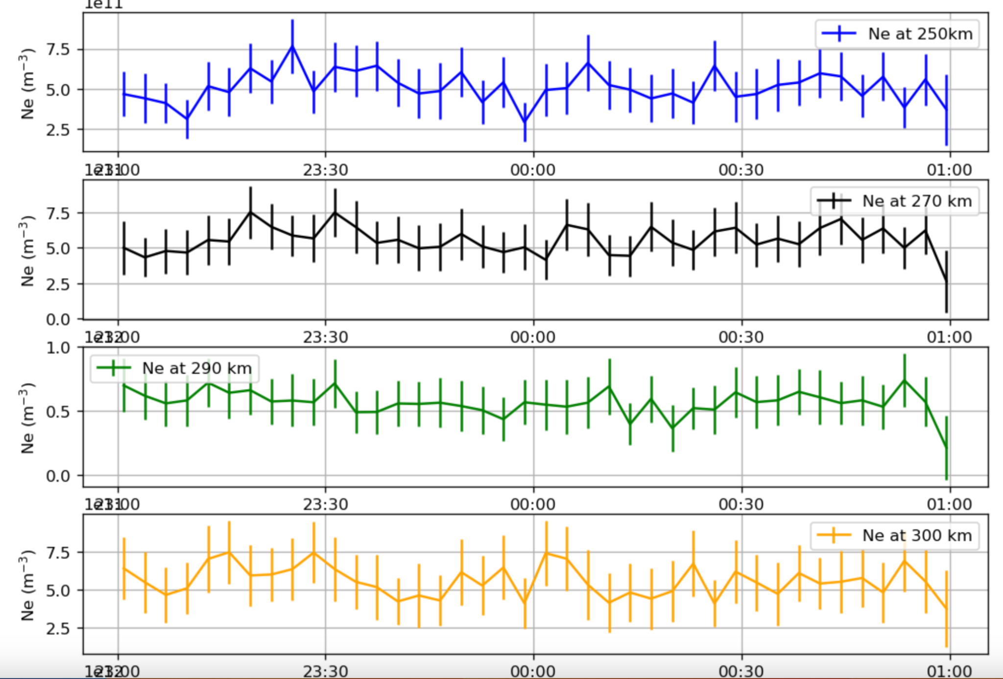
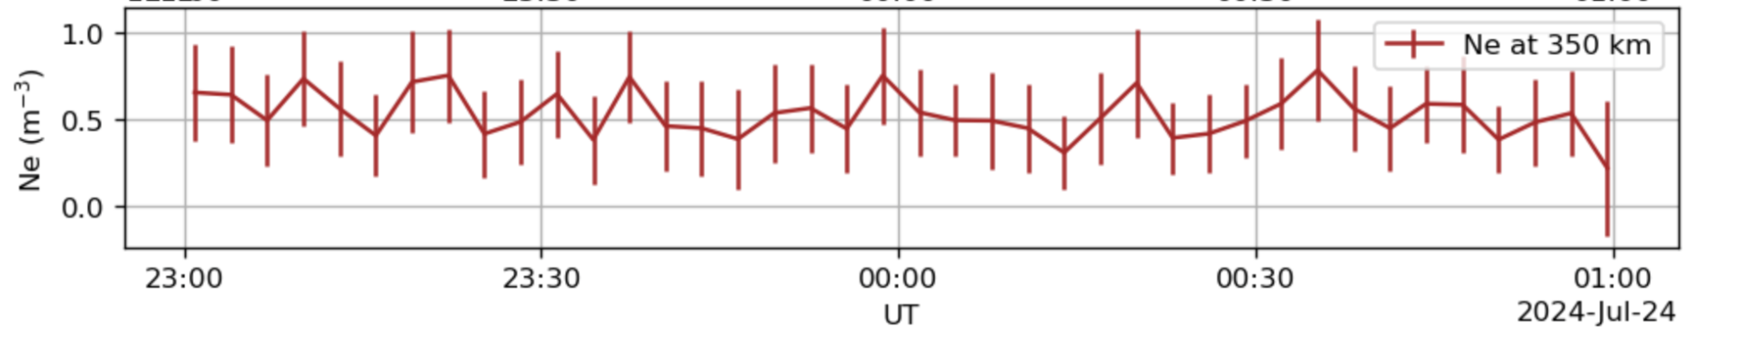
Electron Density variations at different heights

Slide 14
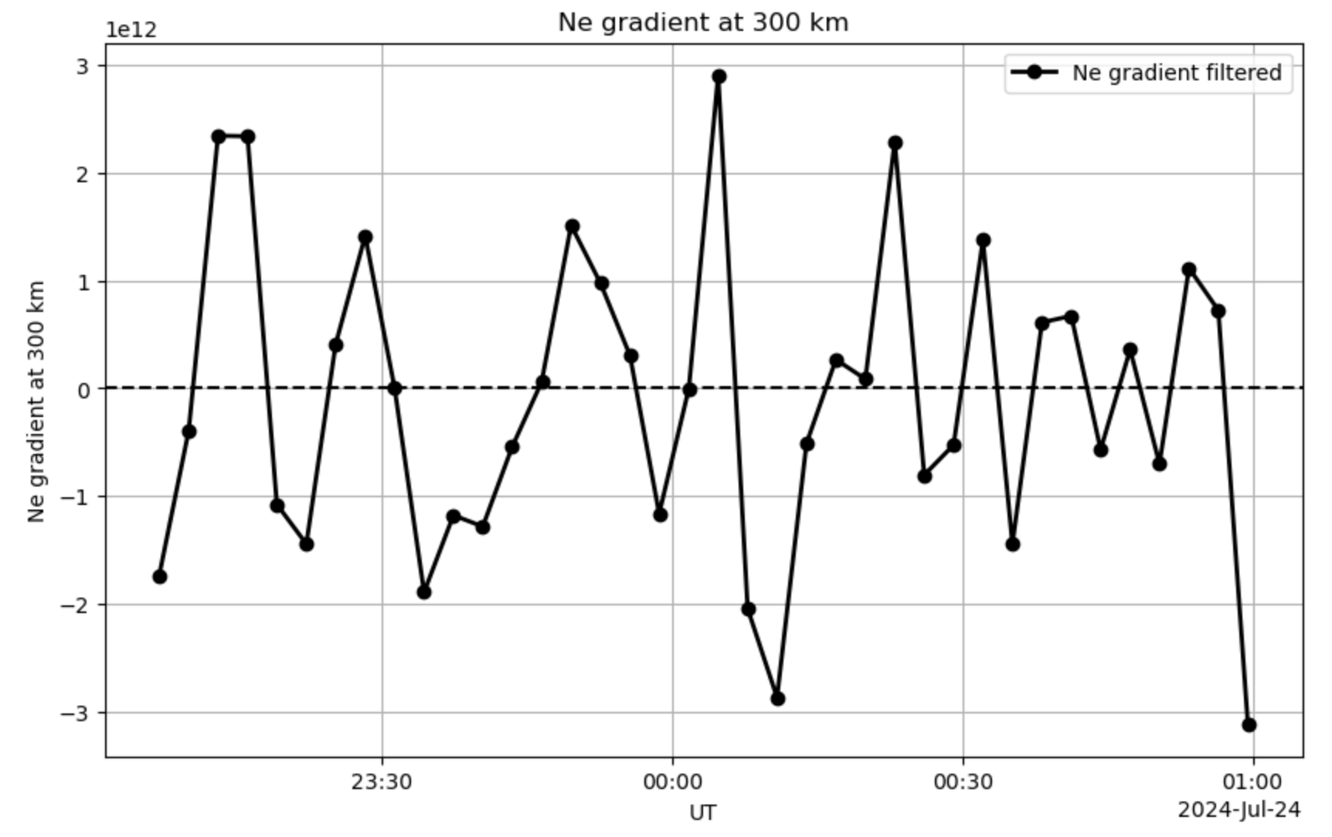
Ne gradient at 350 km altitude
Why ??
That is the region around which F2 peak density exists.
Sharp changes in Ne gradient observed at 350 km throughout the time of observation

Slide 15
What concerns us about Ne gradient fluctuations at 350 km altitude ??
– Electron density gradient at a selected height essentially describes the rate of change of electron density with time in that region.
– If we can notice sharp changes/rapid fluctuations in plasma density gradient, it implies, there may be some irregularities/instabilities associated in that region.
– Can also provide a qualitative measurement of the amount of scintillation associated with a signal as it passes through that region.
– Can serve to help remove scintillation effects in navigation signals.

Slide 16
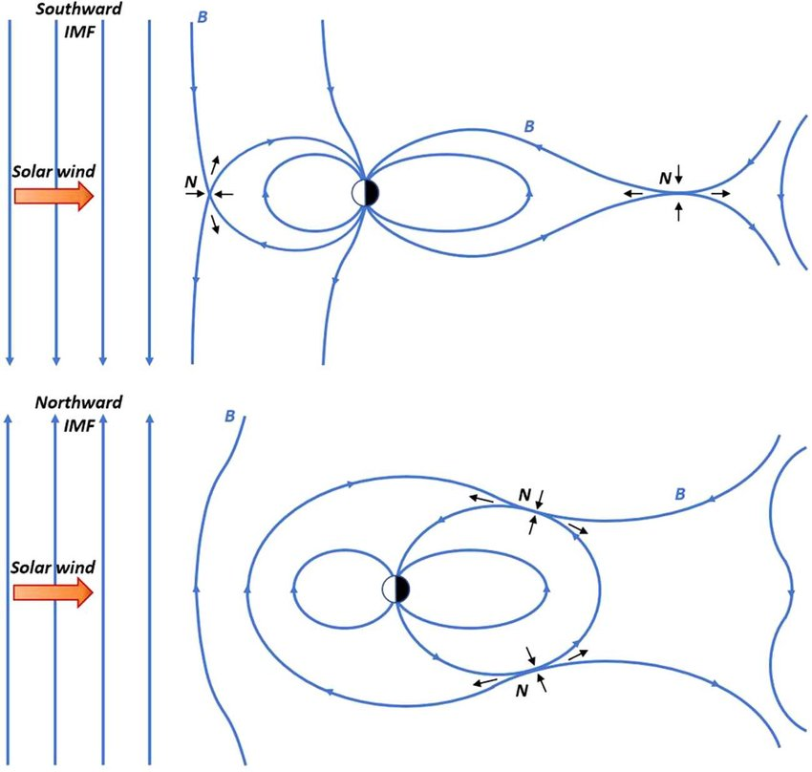
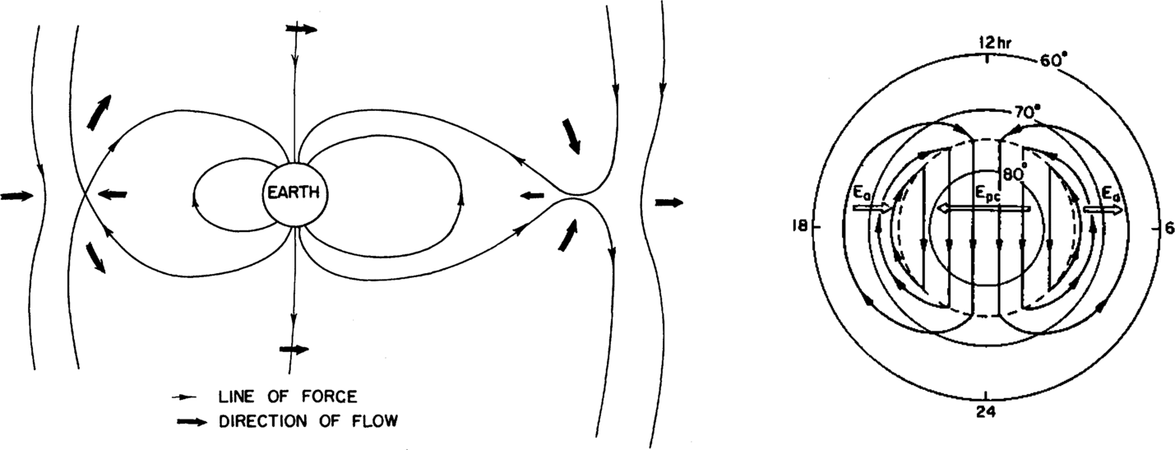
Convection pattern:
Bz>0 and Bz<0

Slide 17
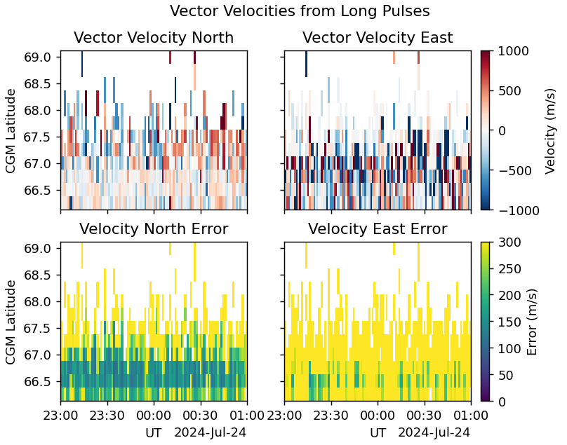
PFISR Velocities
Daytime 23:00-01:00 Ut (15:00-17:00 AKDT)
Notes:
Latitude of PFISR ~65º
Latitude of RISR ~75º North

Slide 18
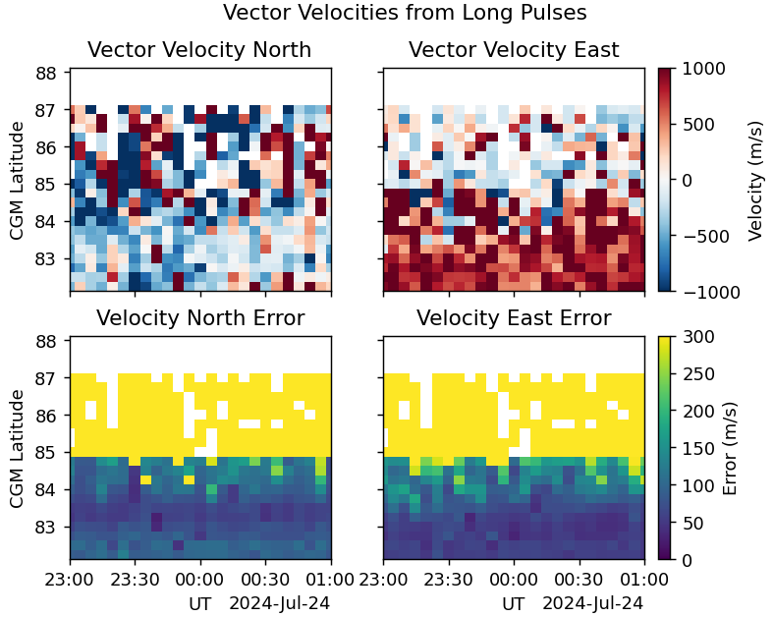
RISR-N Velocities
Daytime 23:00-01:00 Ut (18:00-20:00 CDT)

Slide 19
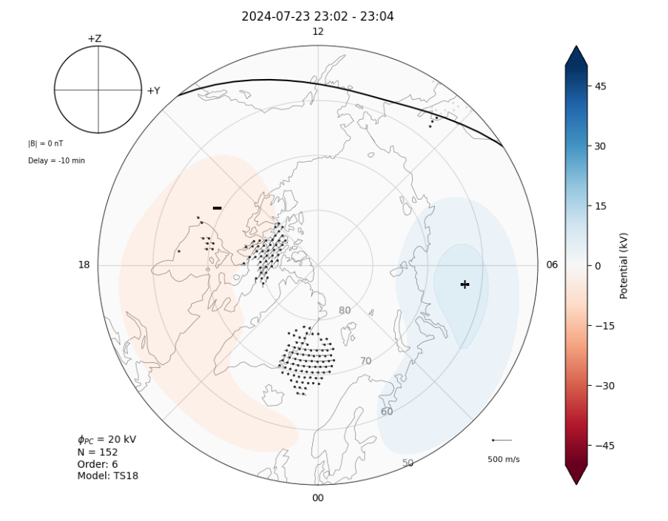
SuperDARN Convection Map

Slide 20
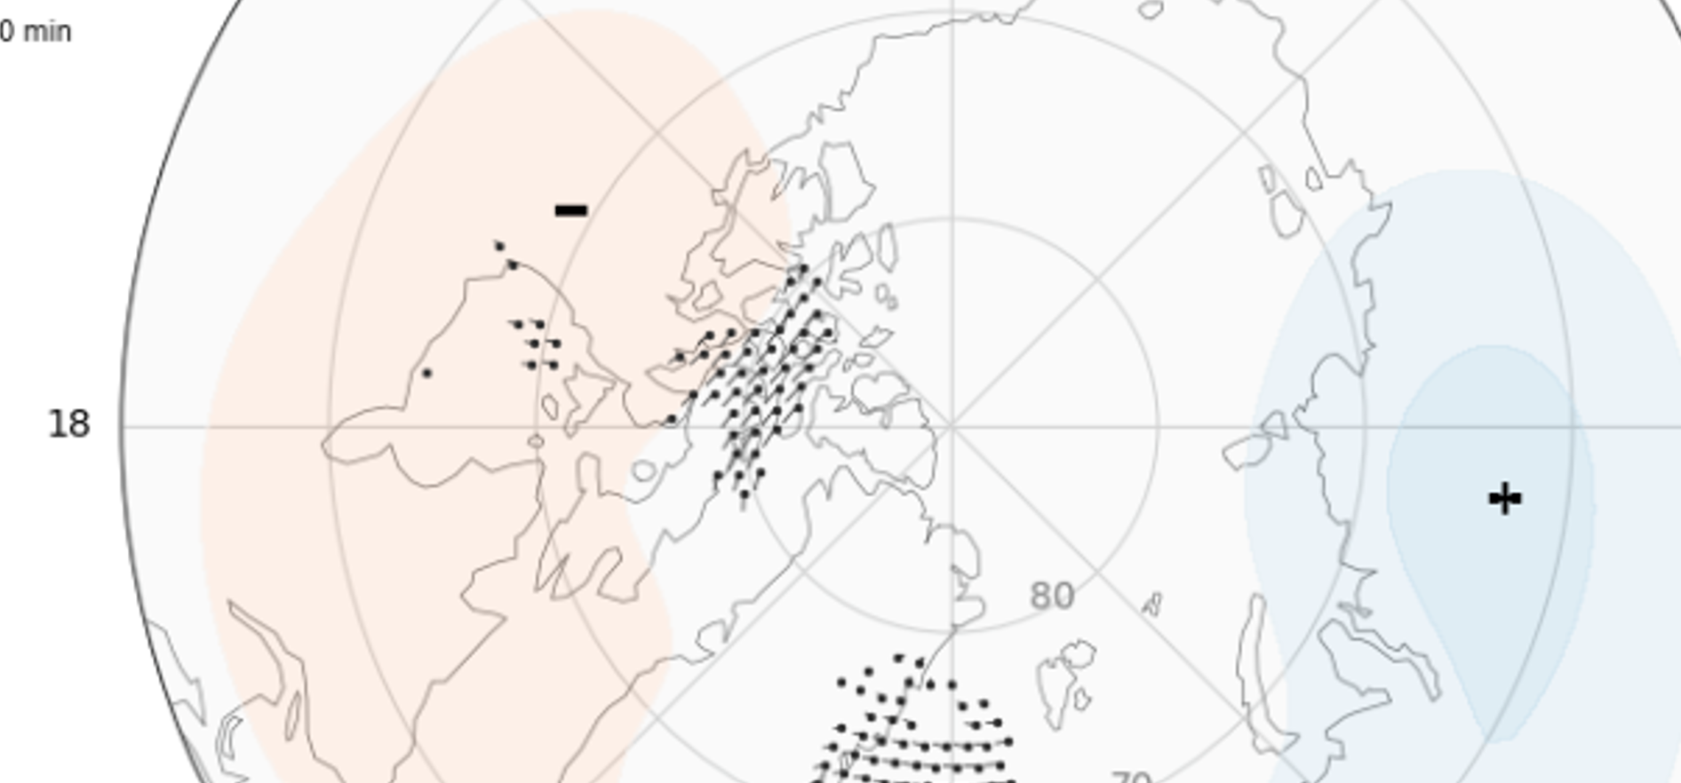
SuperDARN Convection Map

Slide 21
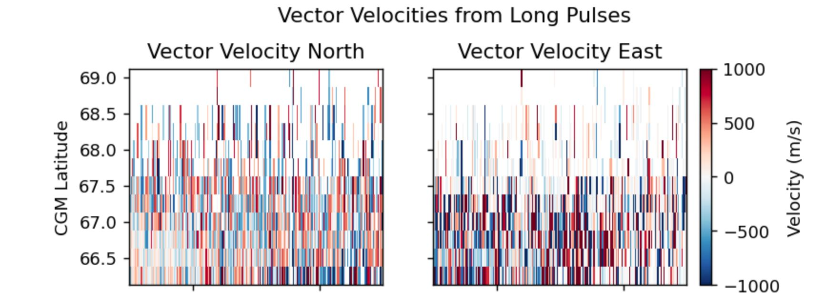
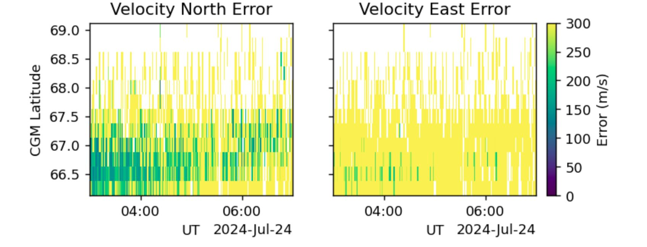
During the night time
PFISR
2024-07-24

Slide 22
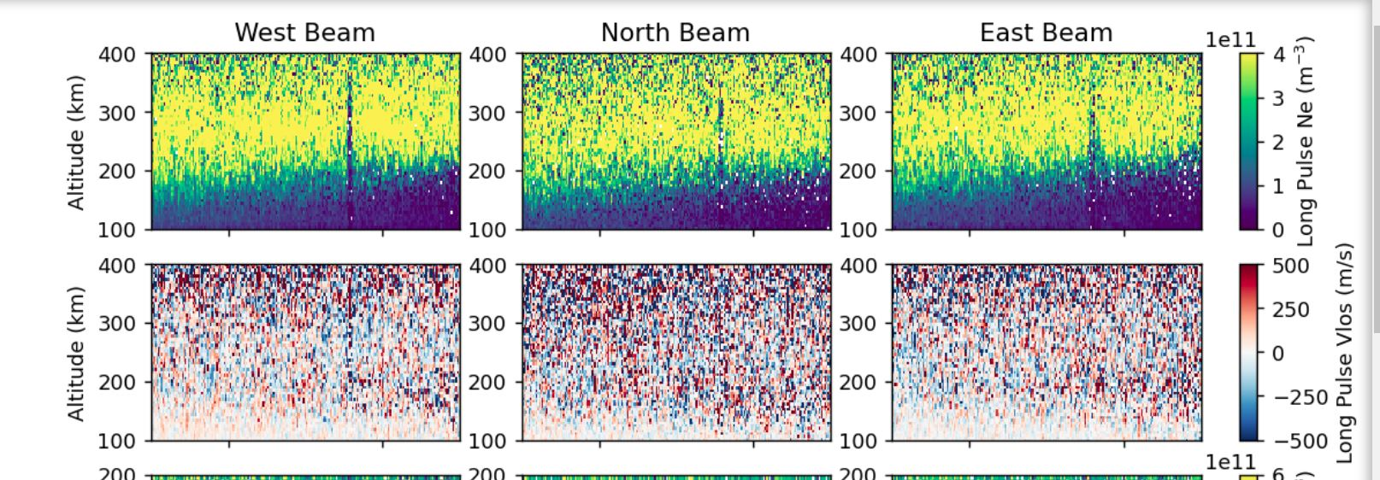
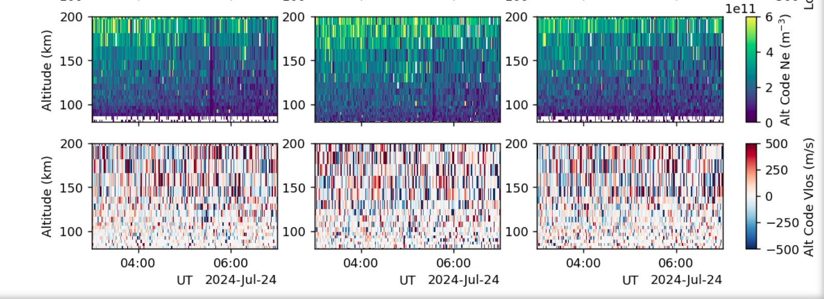

Slide 23
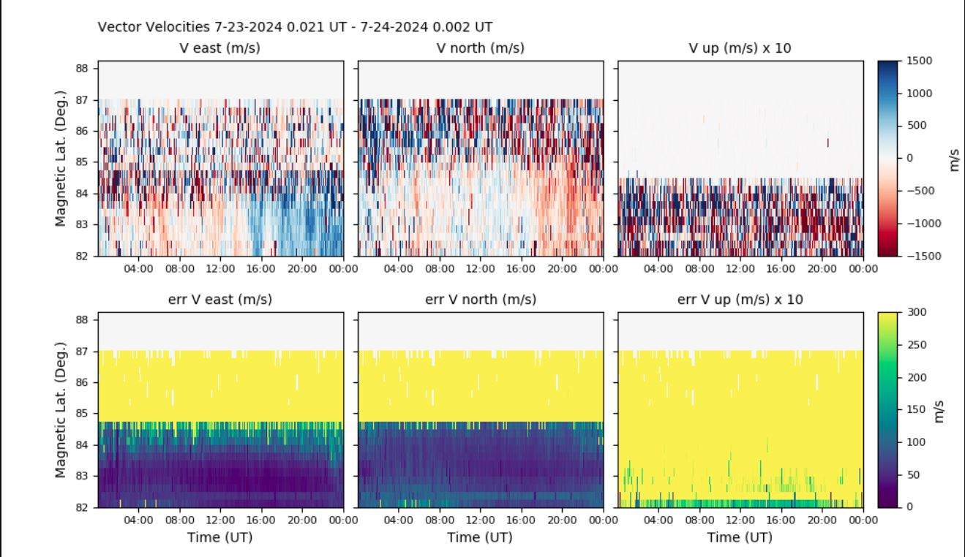
RISR

Slide 24
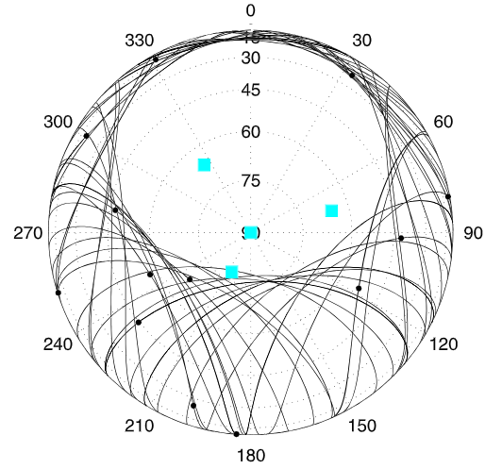
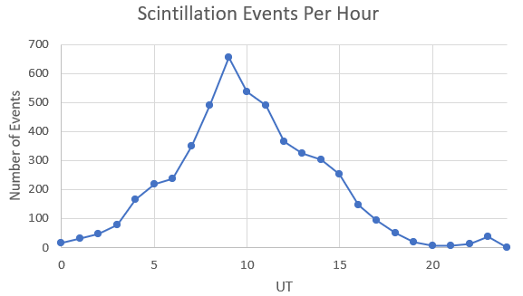
Scintillation Prediction
90
Image modified from Sreenivash et al. 2020
Sreenivash, V., Su, Y., & Datta-Barua, S. (2020). Automated ionospheric scattering layer hypothesis generation for detected and classified auroral GPS scintillation events. Radio Science, 55, e2018RS006779. https://doi.org/10.1029/2018RS006779
Notes:
1.1% chance of scintillation happening from 23-01 ut

Slide 25
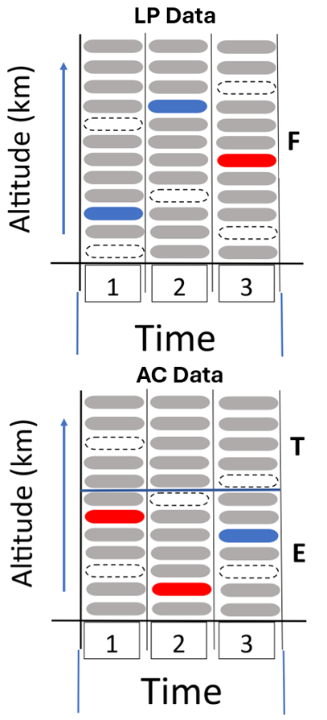
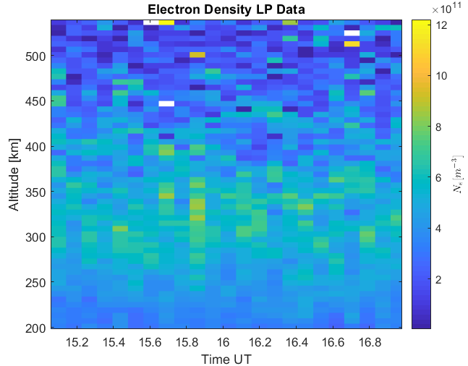
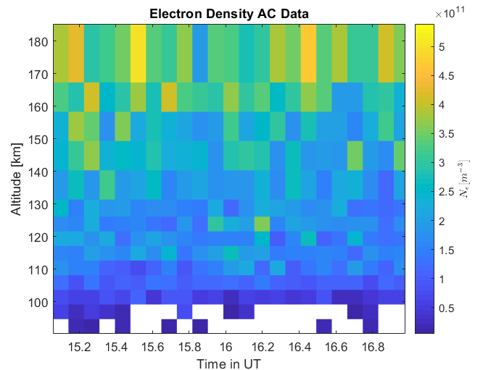
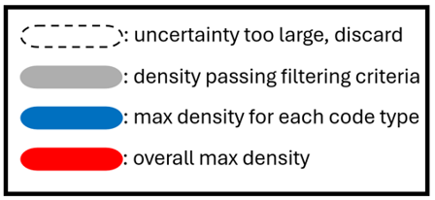
Scintillation Prediction
Altitude [km]
23
23.5
0
0.5
01
Time UT
Altitude [km]
23
23.5
0
0.5
01
Time UT
Notes:
-154.3 az and 77.5 elevation

Slide 26
Conclusion
The solar wind arrived early
Observed density enhancements and gradients correlated with the storm
Showed the correlation of ISR and SuperDARN velocity measurements
Predicted the layer scintillation most likely would occur

