Slide 1
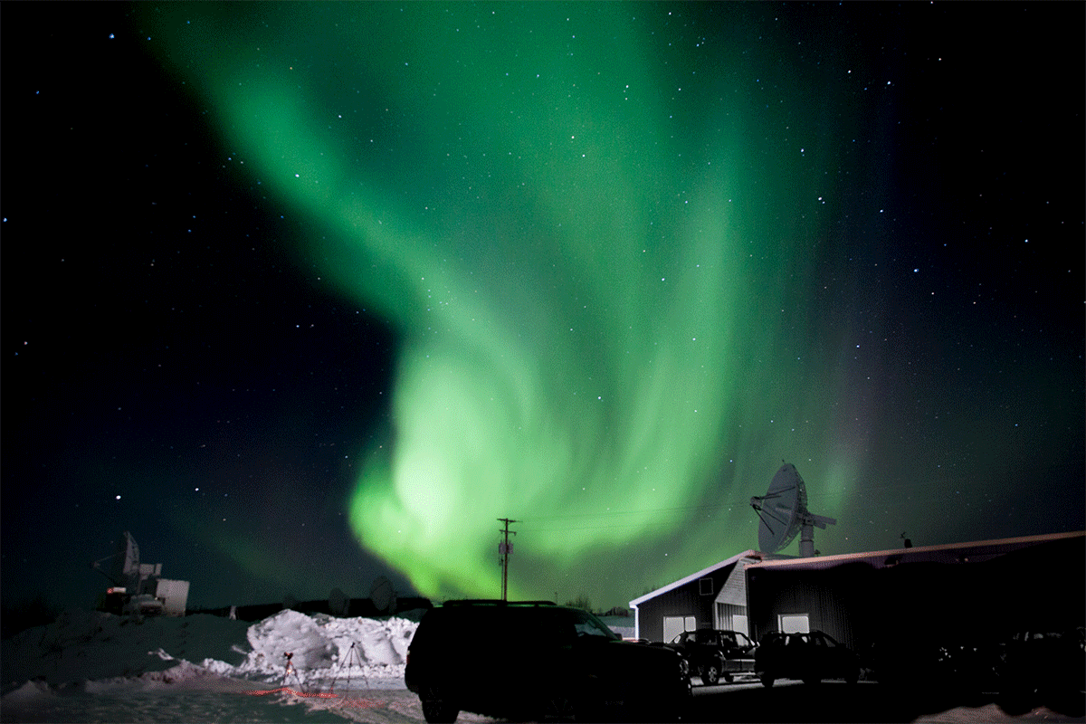
DaMP
D-region resolution and Magnetic Perturbation
L. Coleman, A. Pedgaonkar, Y. Peng, A. Pop Stefanija, B. Powers

Slide 2
Science Questions
We hoped to observe possible D and E region Ionospheric enhancements and enhancements of other night side phenomena due to the forecasted magnetic storm impact as
  Existence of some nightside D or low E region (asymmetry)
  Potential for sporadic E’s in summer conditions
  Ion and electron temperature variations induced by field-aligned currents (FAC)
  Particle precipitation

Slide 3
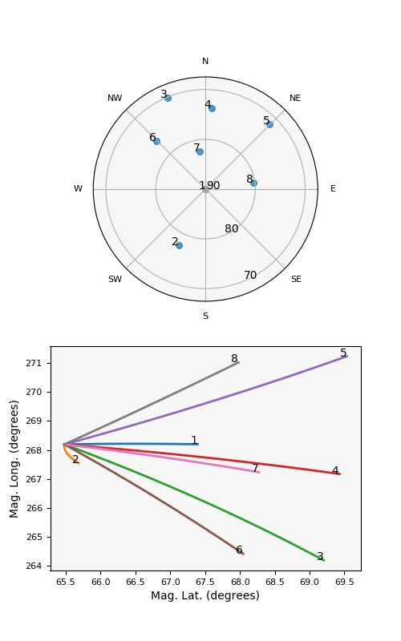
Experimental Design
Our observation time was 10:00-12:00 UTC on 7/24/2024
  06:00-08:00 EST, 02:00-04:00 AKDT
Poker Flat Phased Array Incoherent Scatter Radar
Beams: 2x3 grid, zenith, along B
Mode: PFISR3
  Barker Code (D region)
  Alternating Code (E region)
  Long Pulse (F Region)

Slide 4
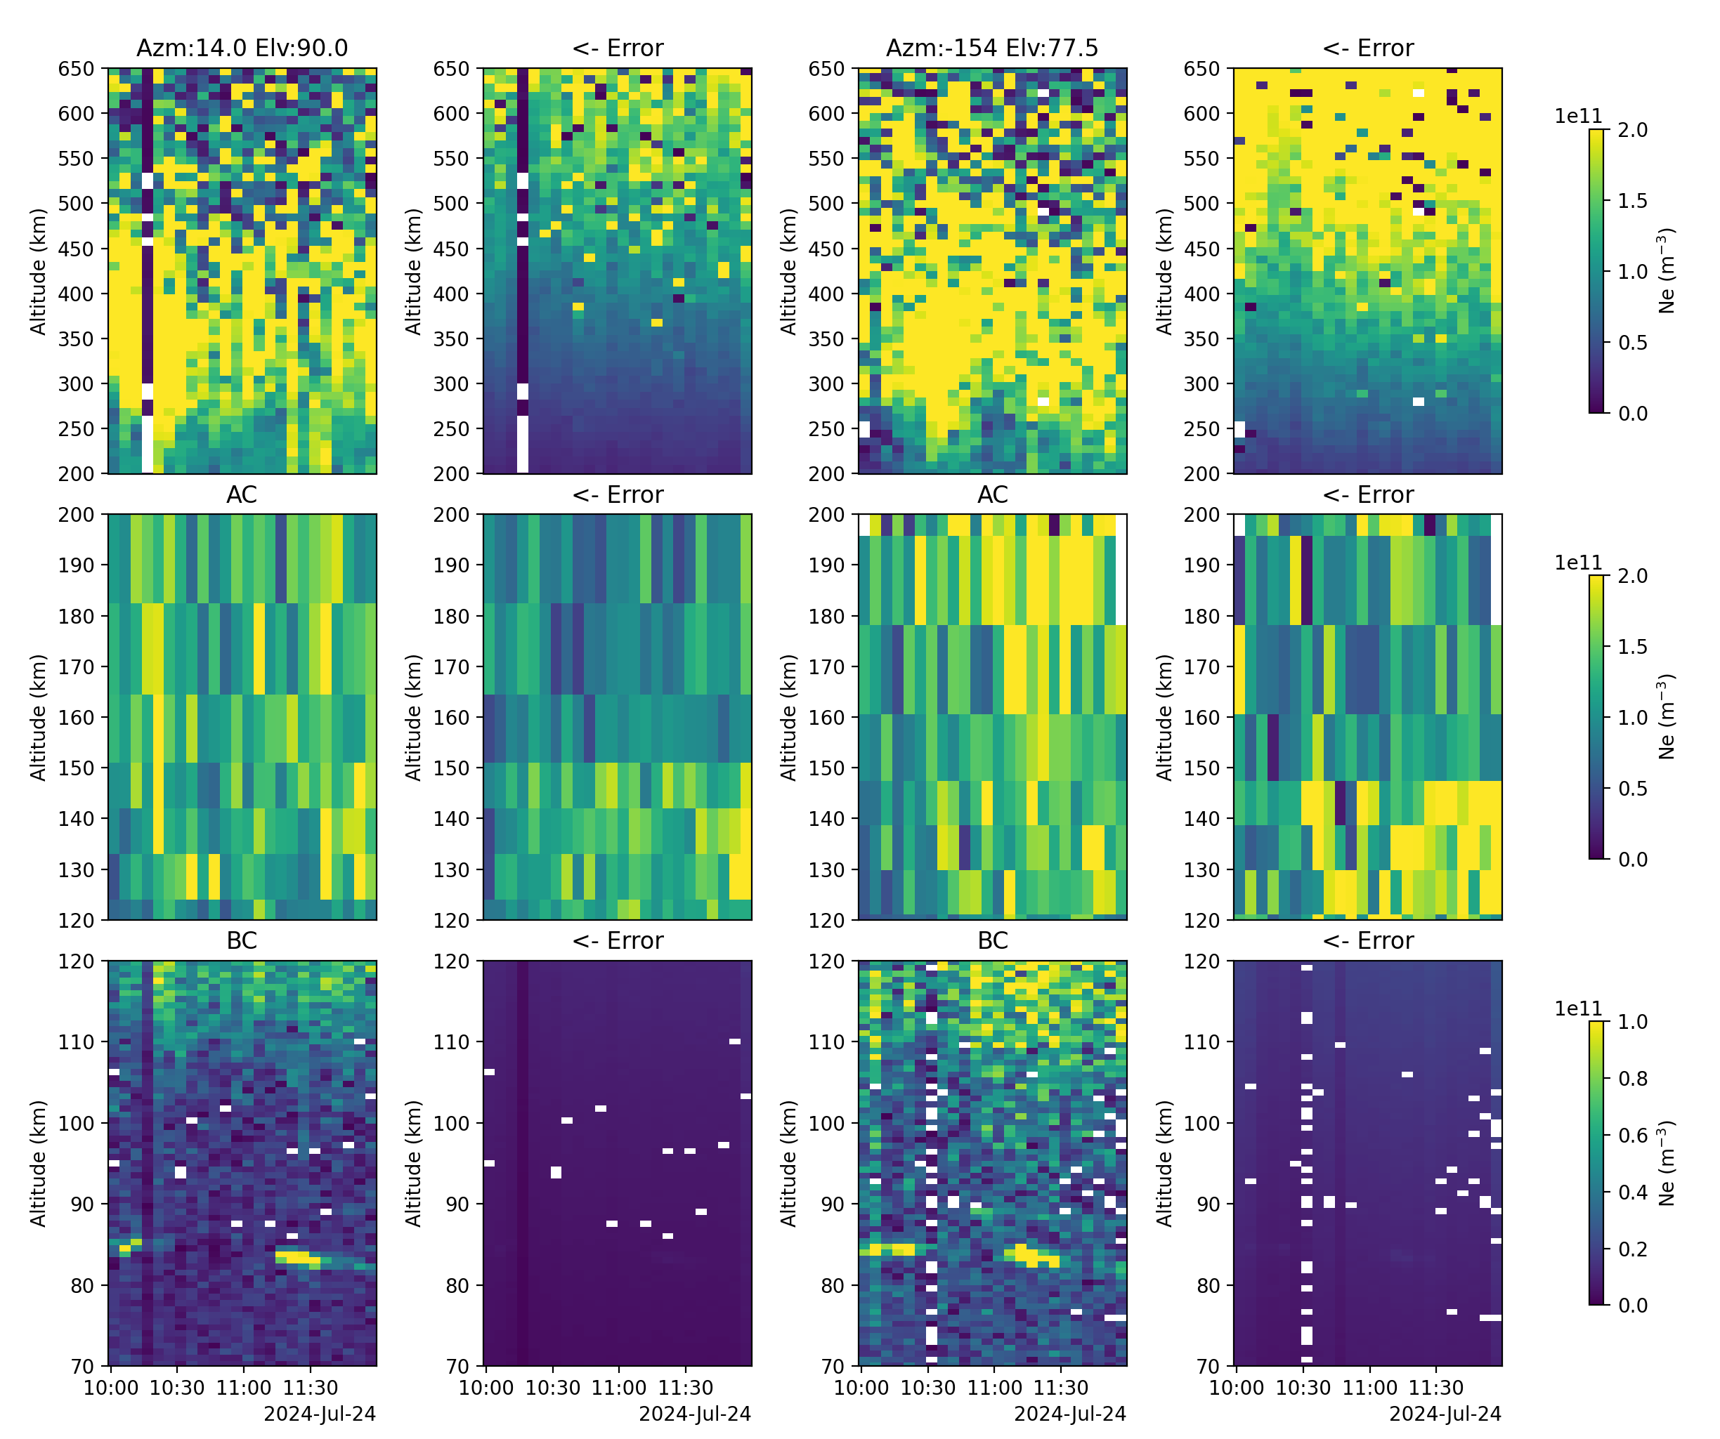
Data Quality
Although we did not see the effects of the CME some interesting features still appeared
Our data quality was good enough to trust to between 70-400 km

Slide 5
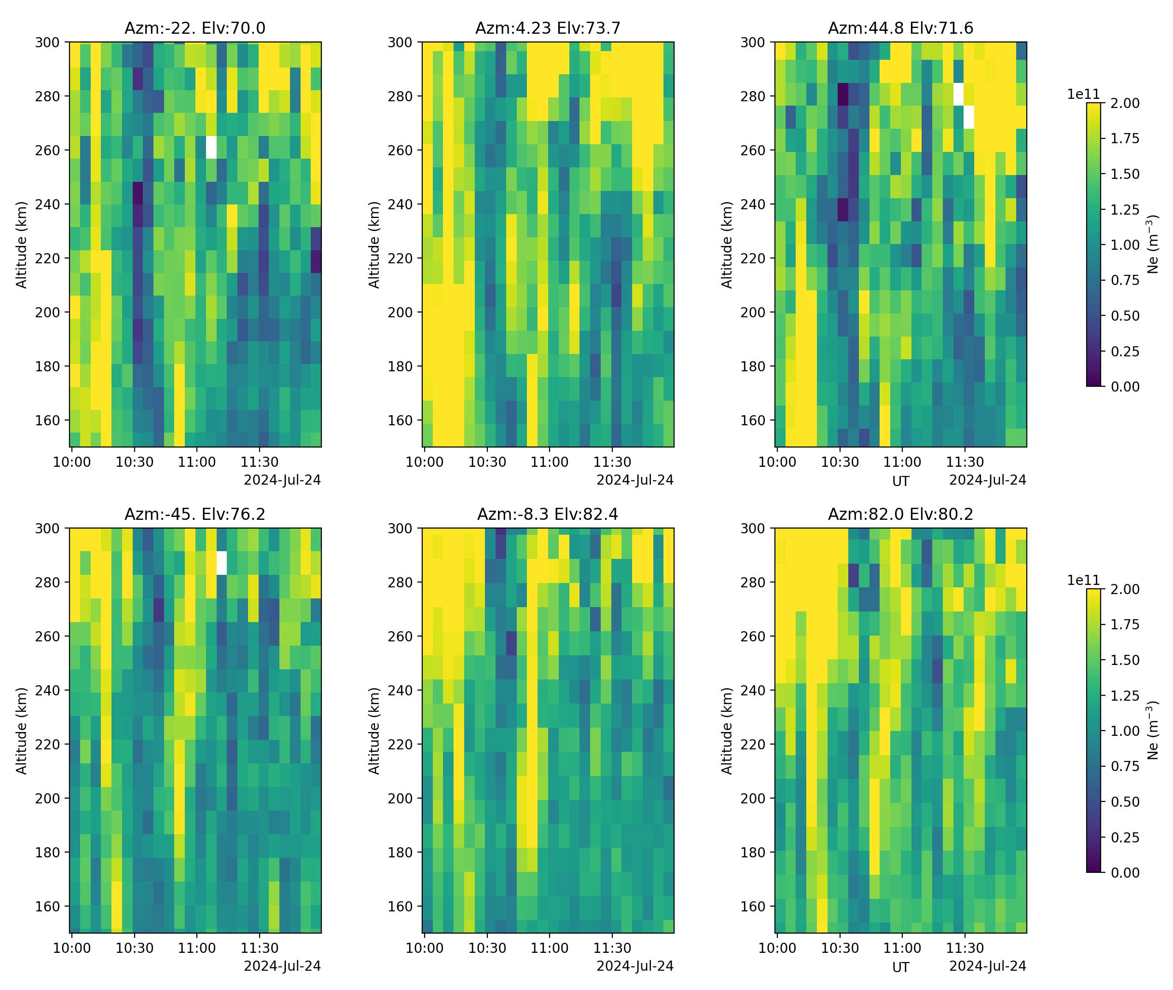
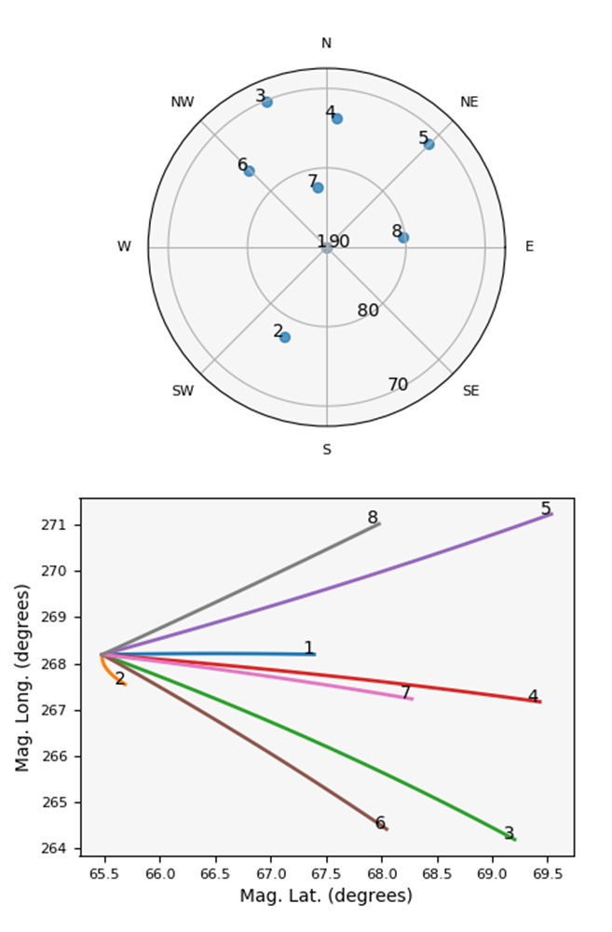
F-region Electron Density

Slide 6
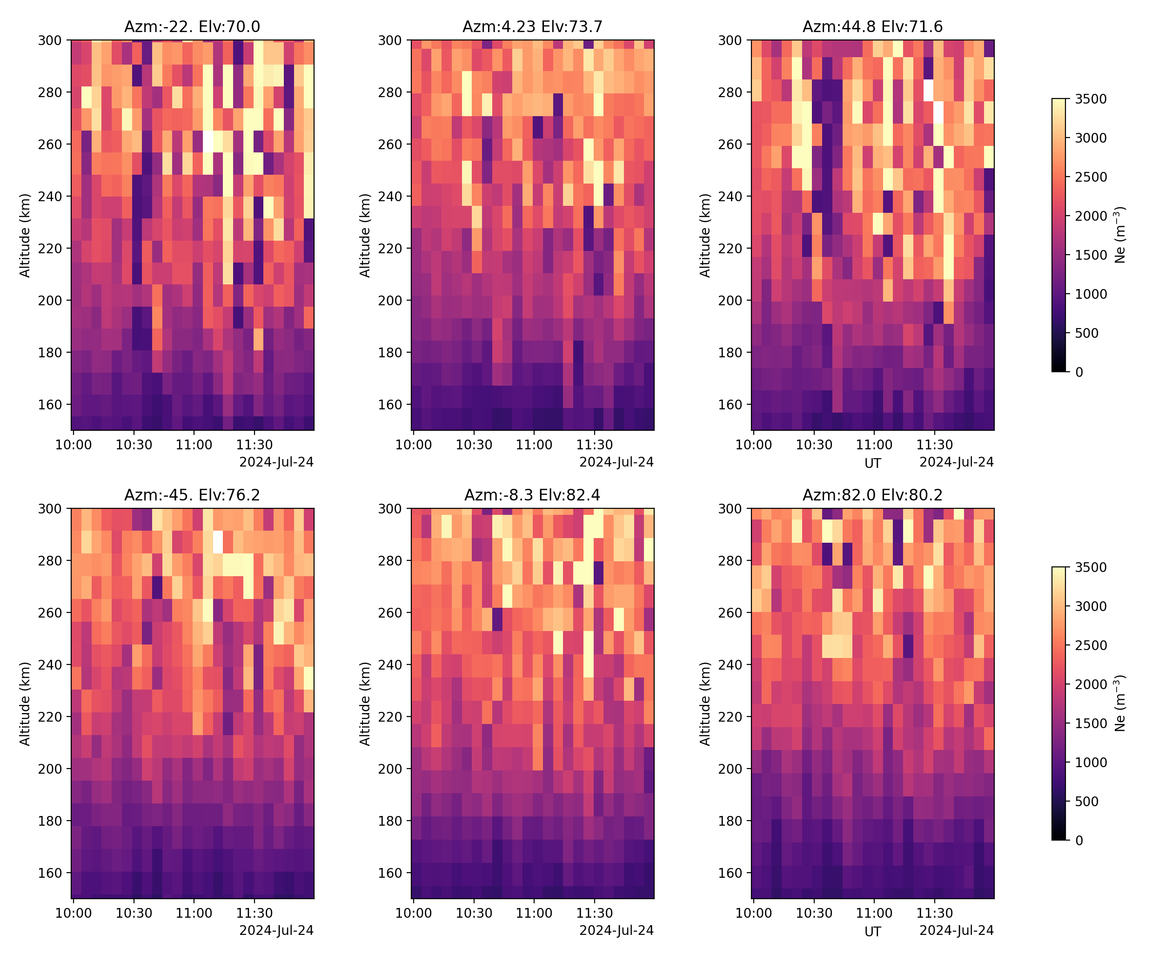
F-region Electron Temperature

Slide 7
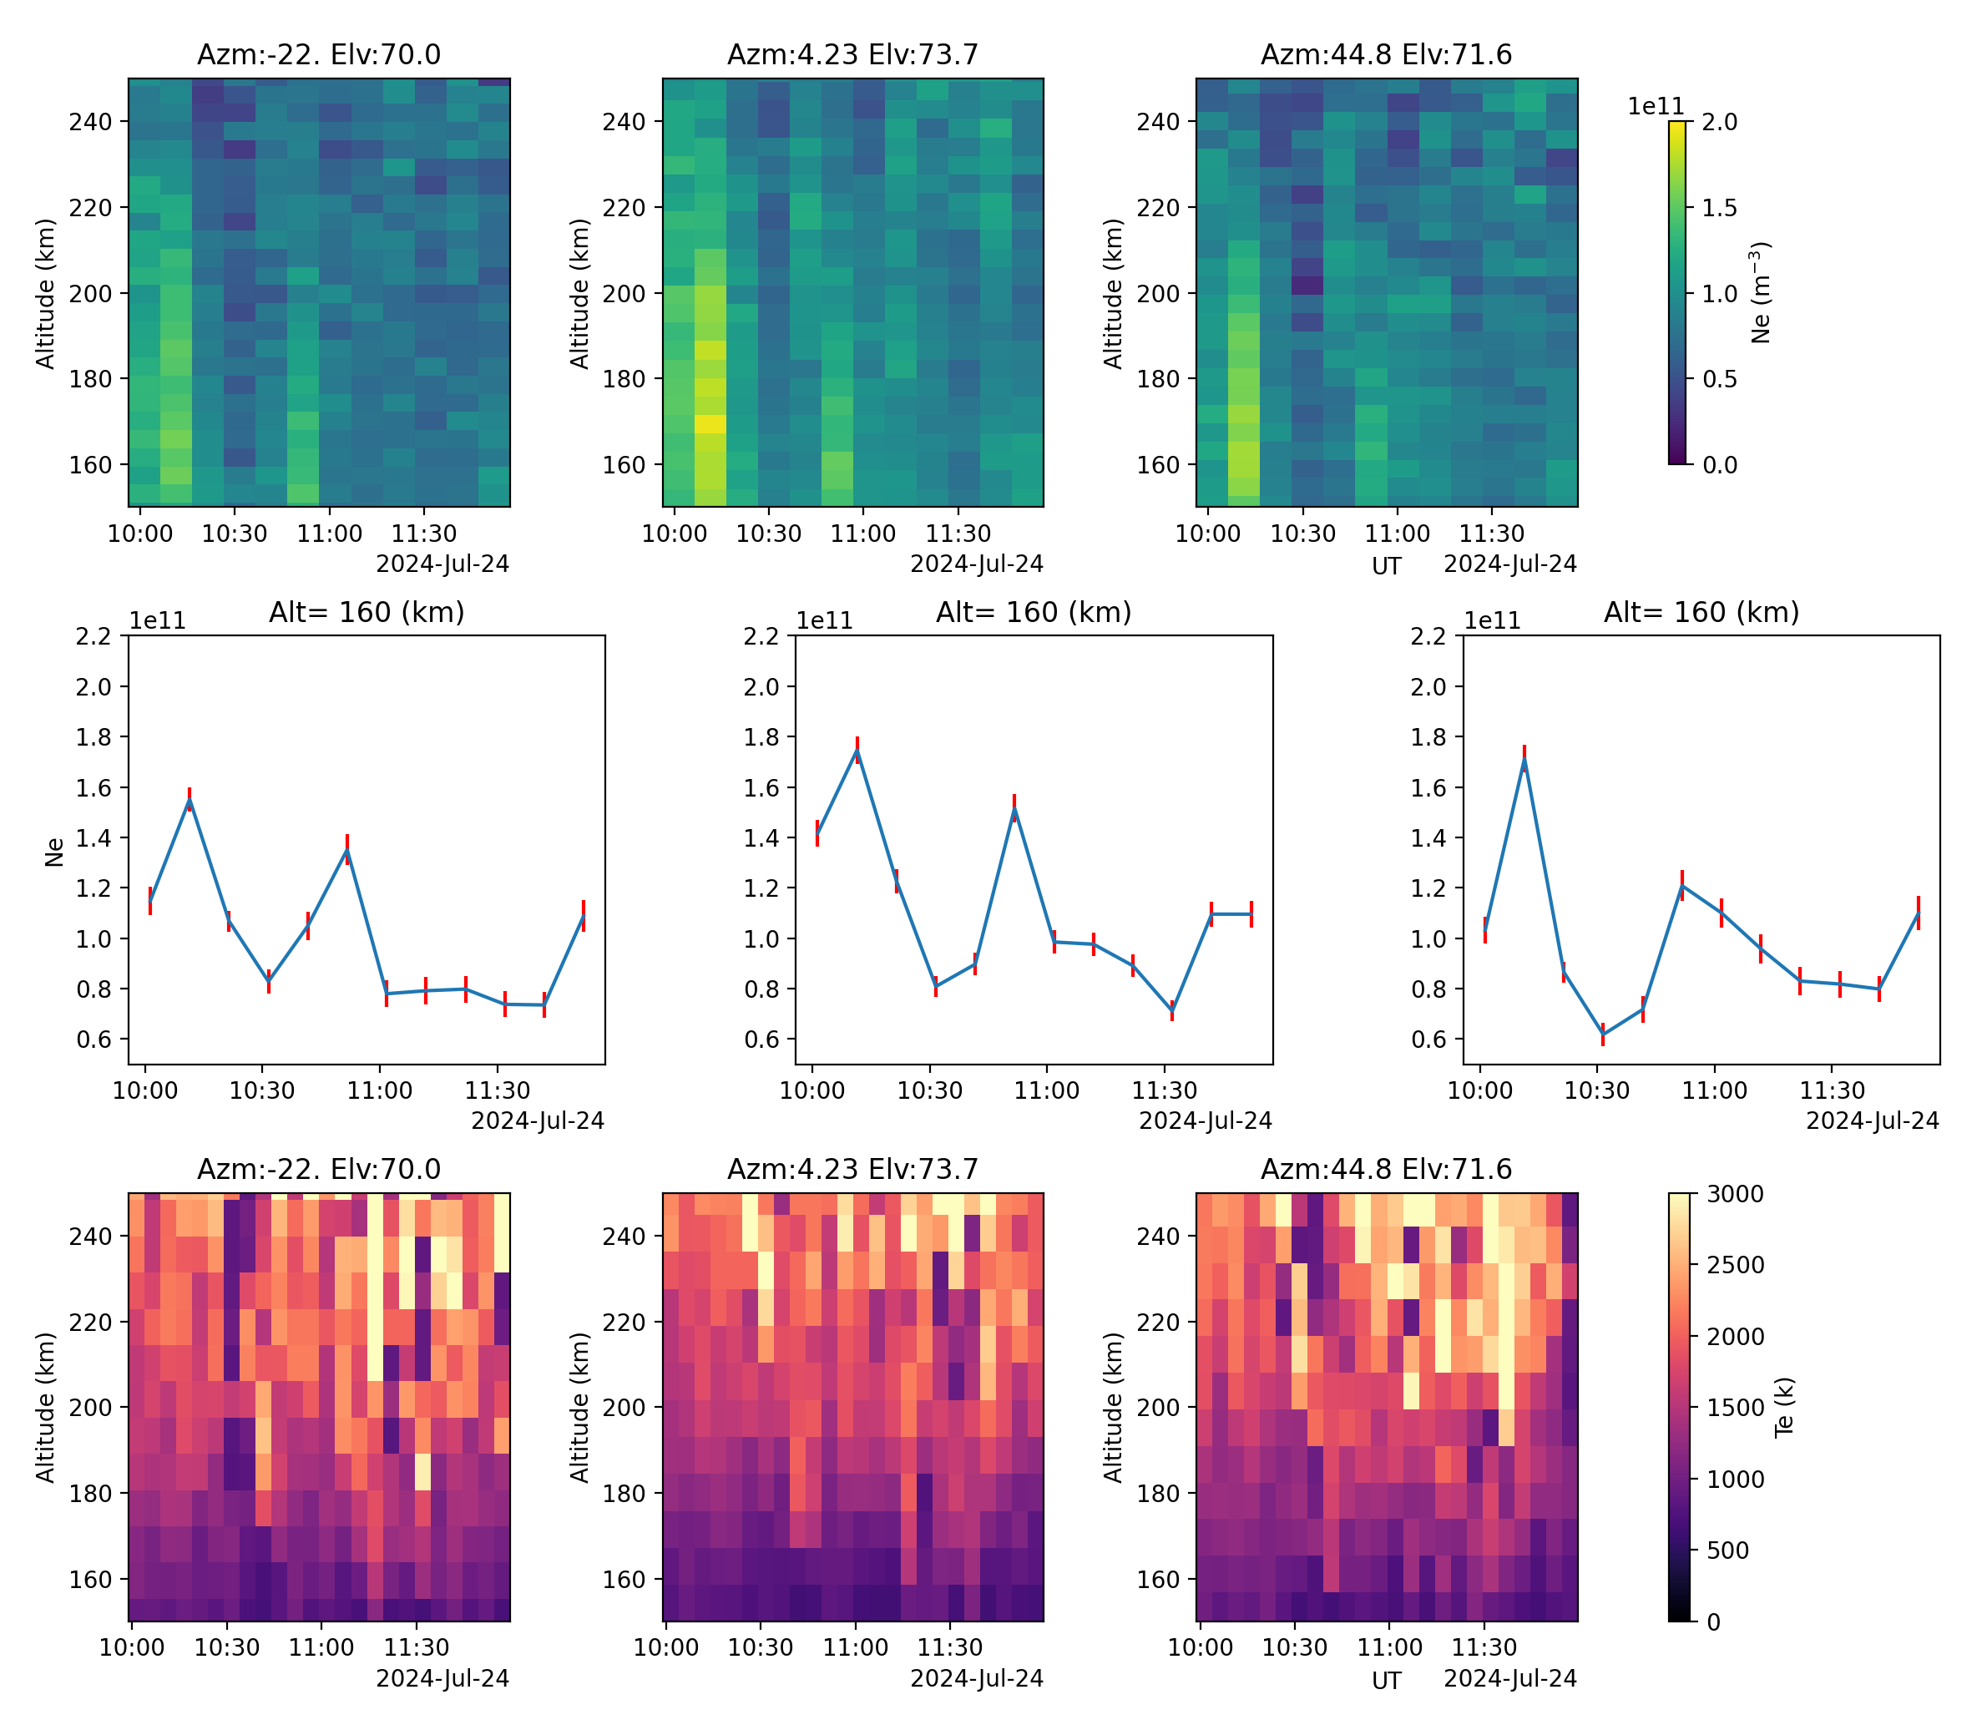
F-region Electron Density

Slide 8
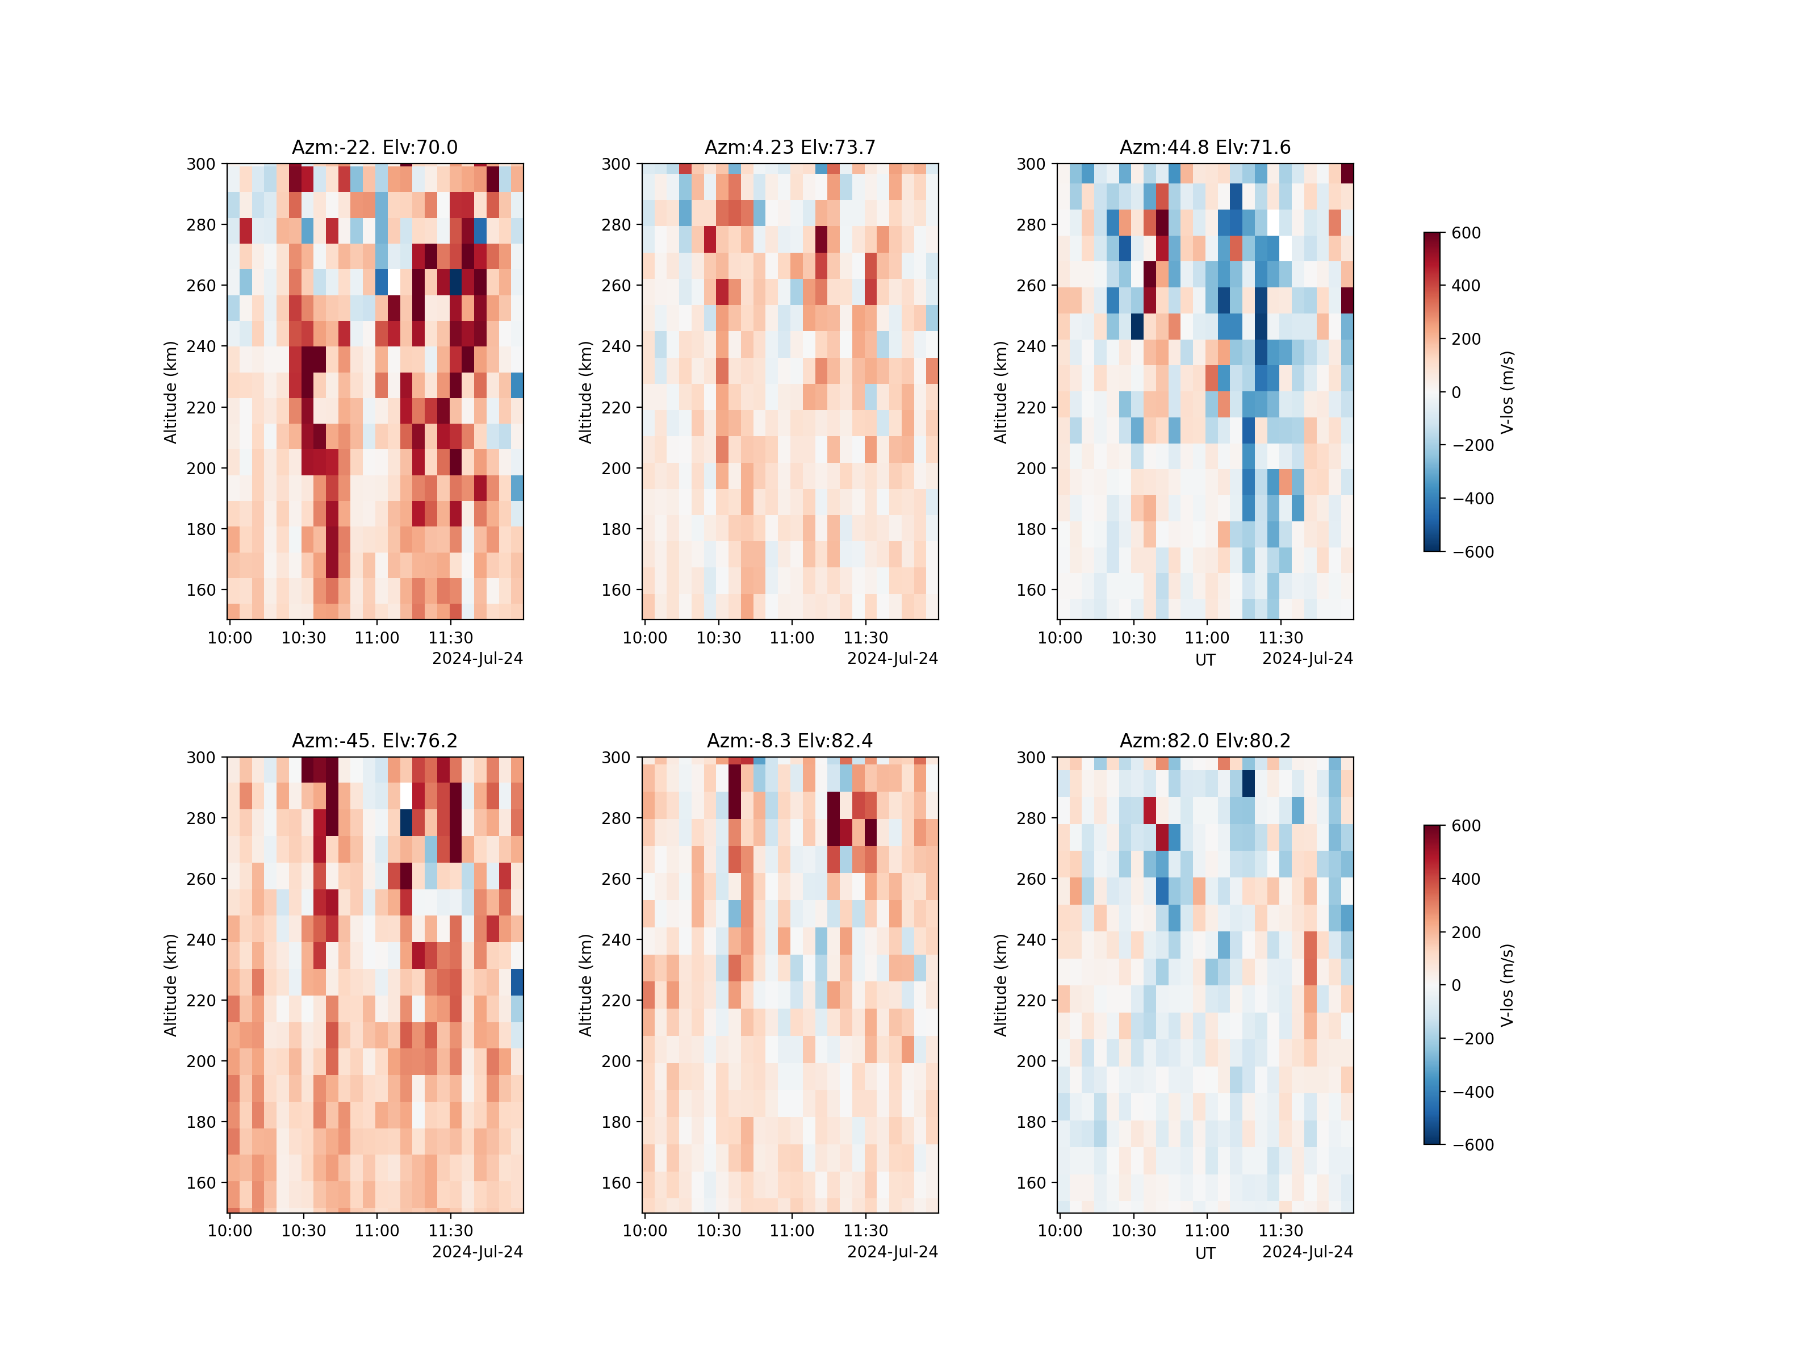
Line of SIght Velocities

Slide 9
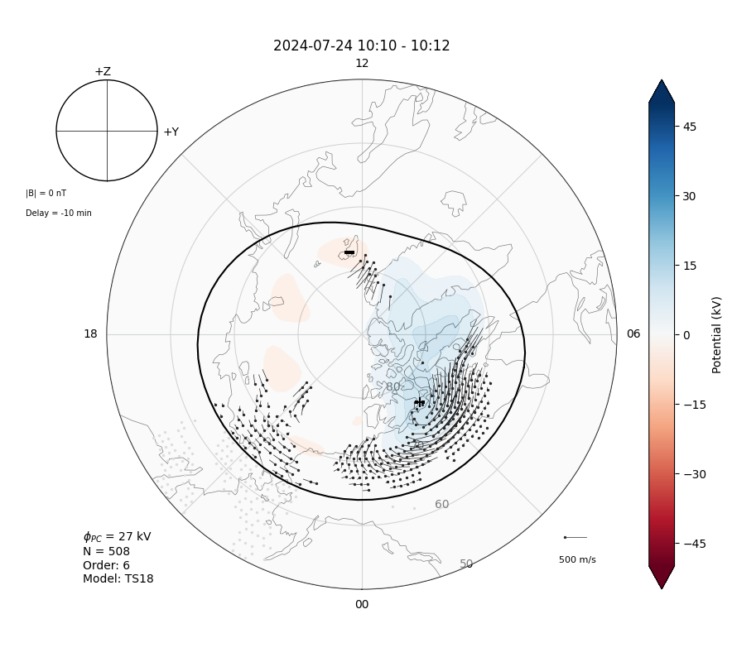
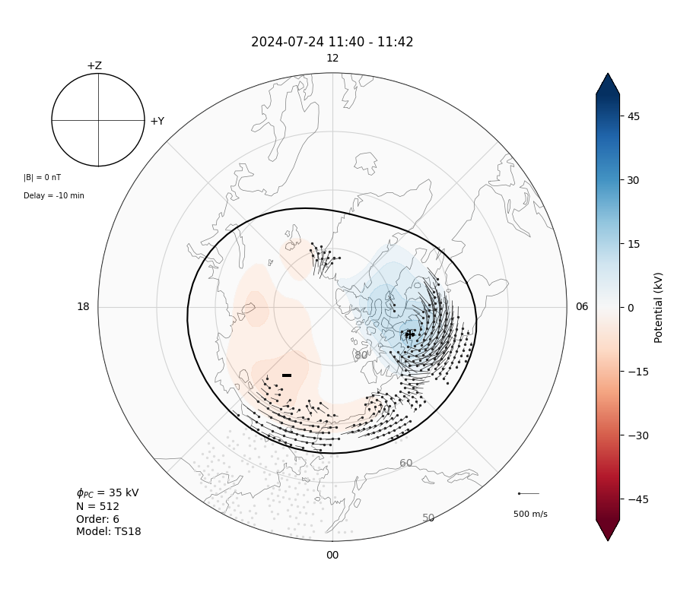

Slide 10
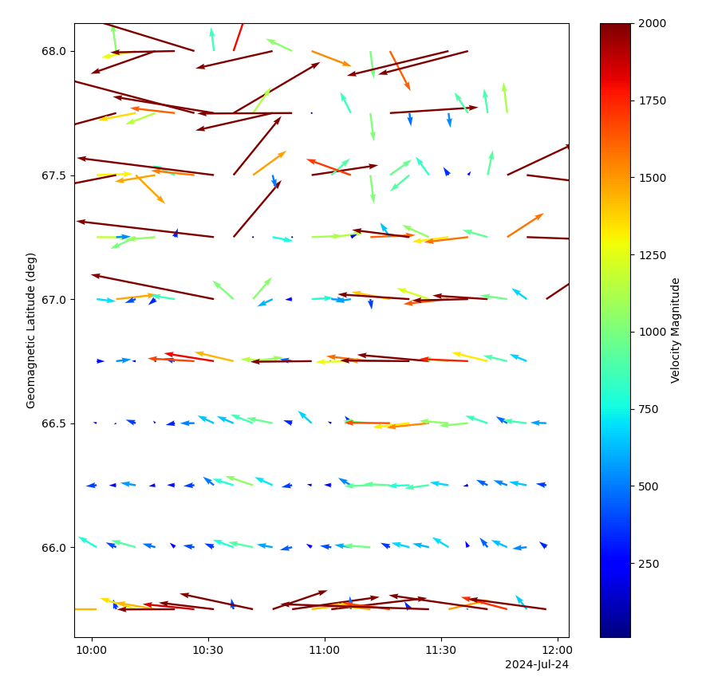
Resolved Velocities

Slide 11
F-region Electron Density - Long Pulse

Slide 12
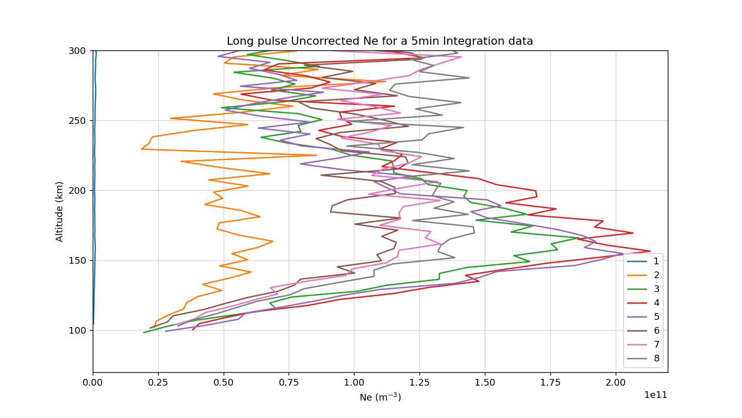
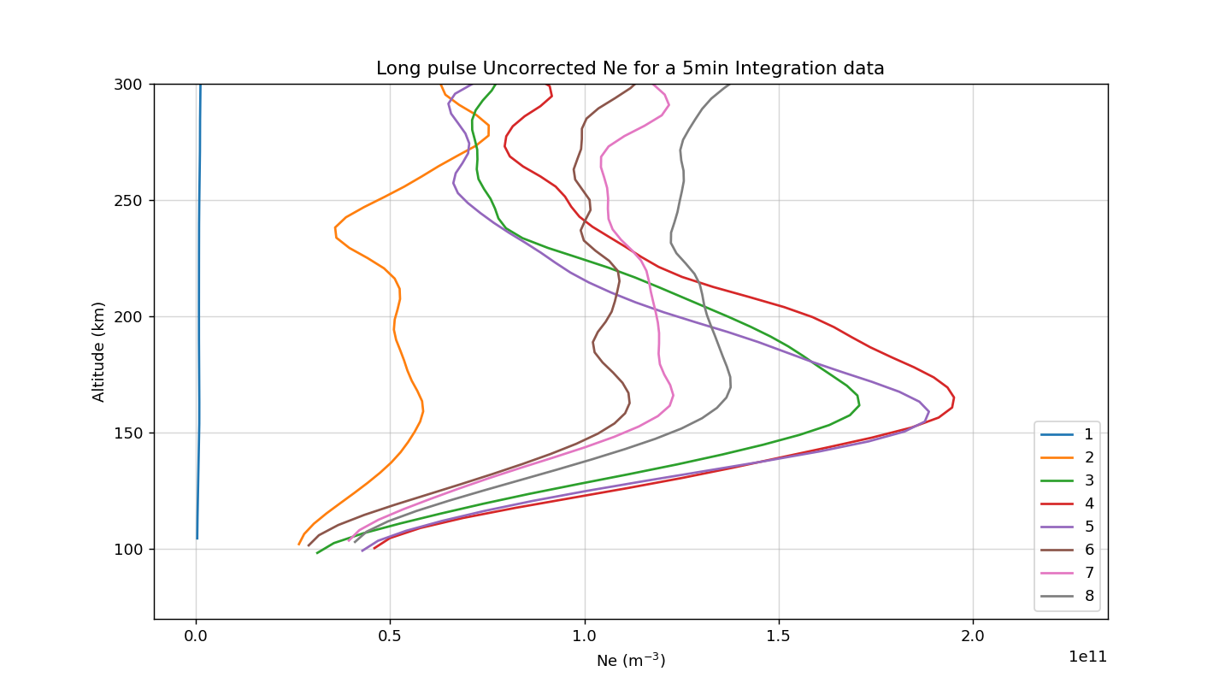
F-region Electron Density Line Plot
10:15 UT

Slide 13
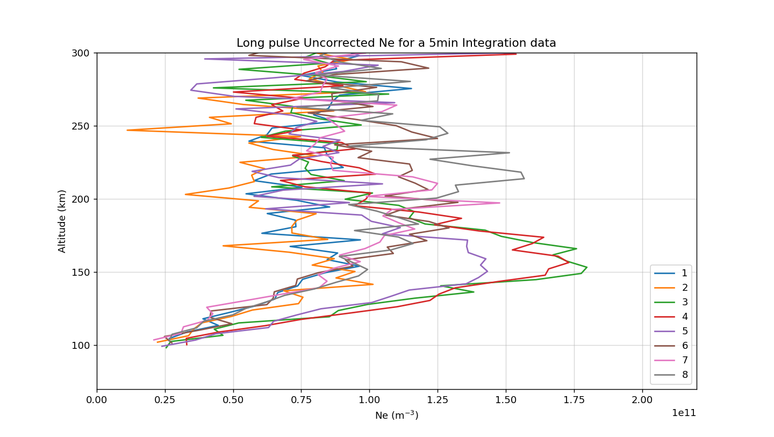
F-region Electron Density Line Plot
10:50 UT

Slide 14
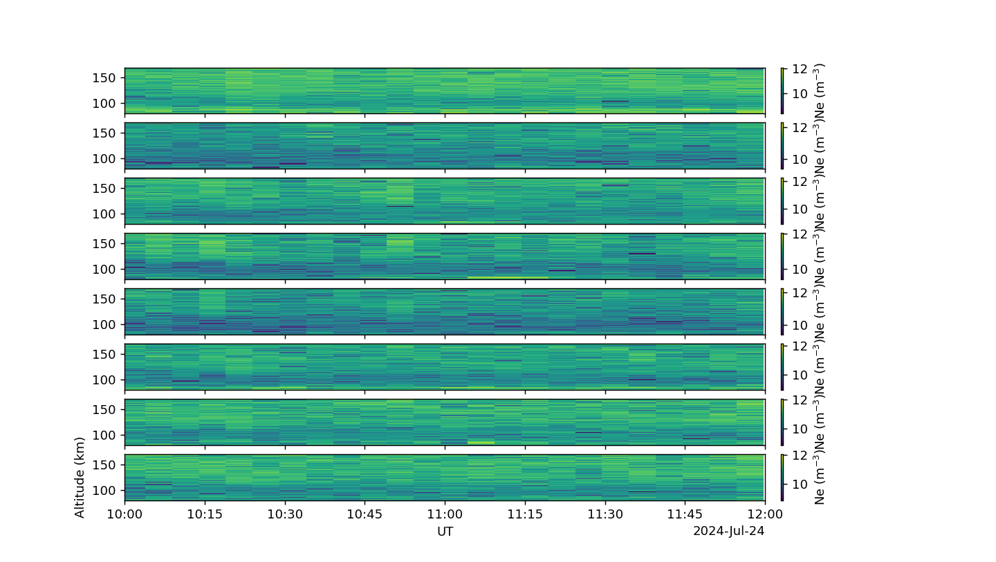
E-region Electron Density - AC pulse

Slide 15
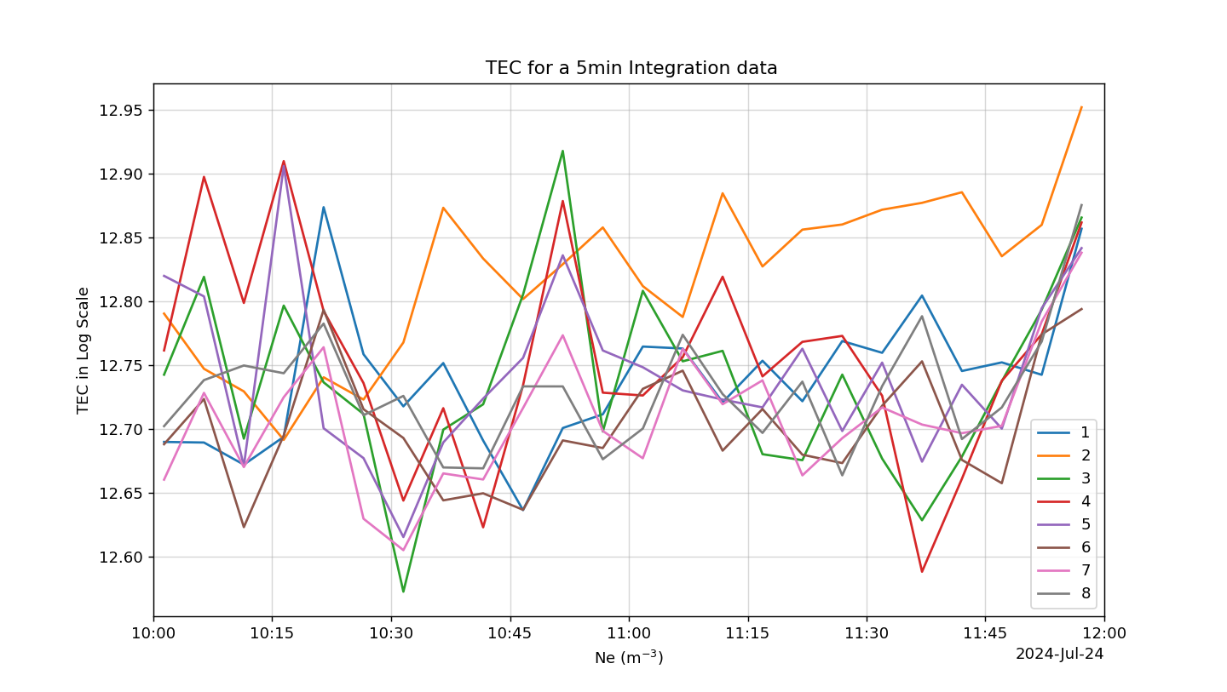
E-region TEC

Slide 16
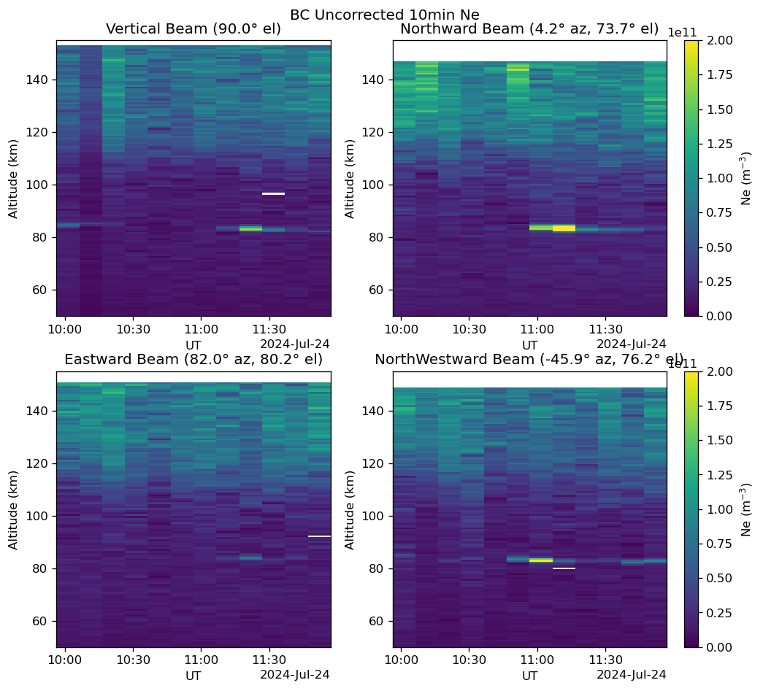

Slide 17
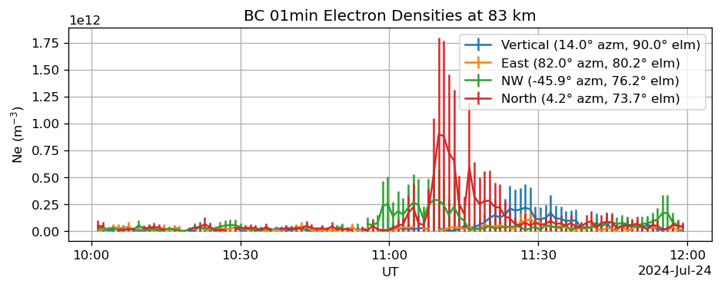
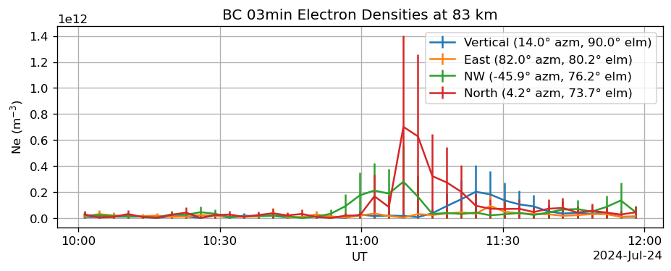
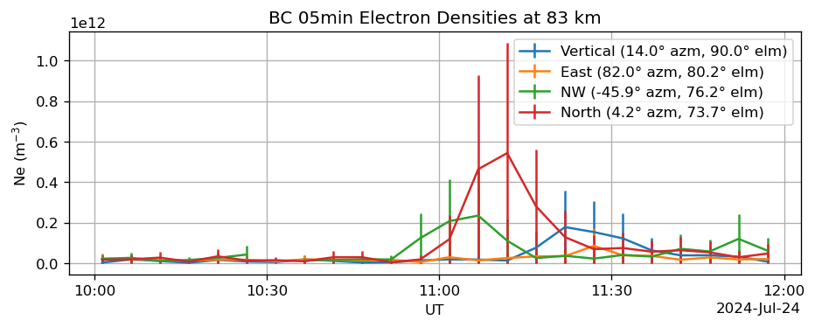
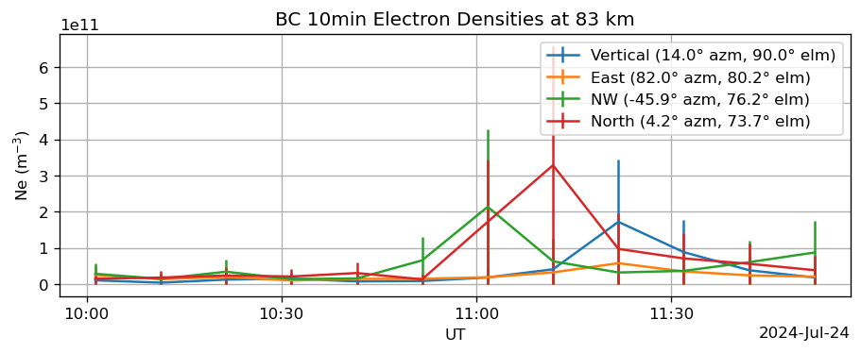
83km altitude false density enhancement

Slide 18
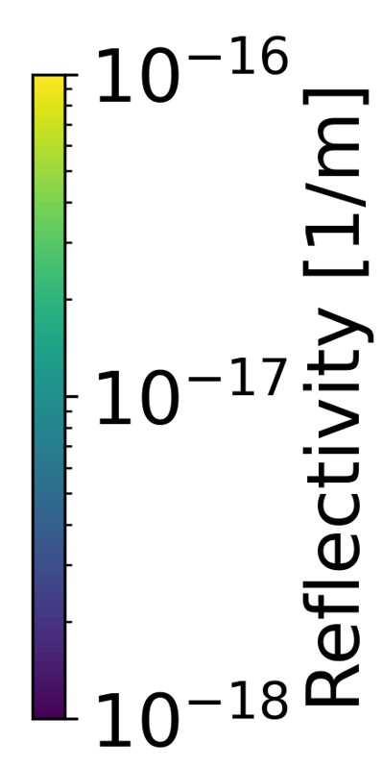
Polar Mesospheric Summer Echo
Motion from west to east
Altitude ~ 83km
Possibly two clouds

Slide 19
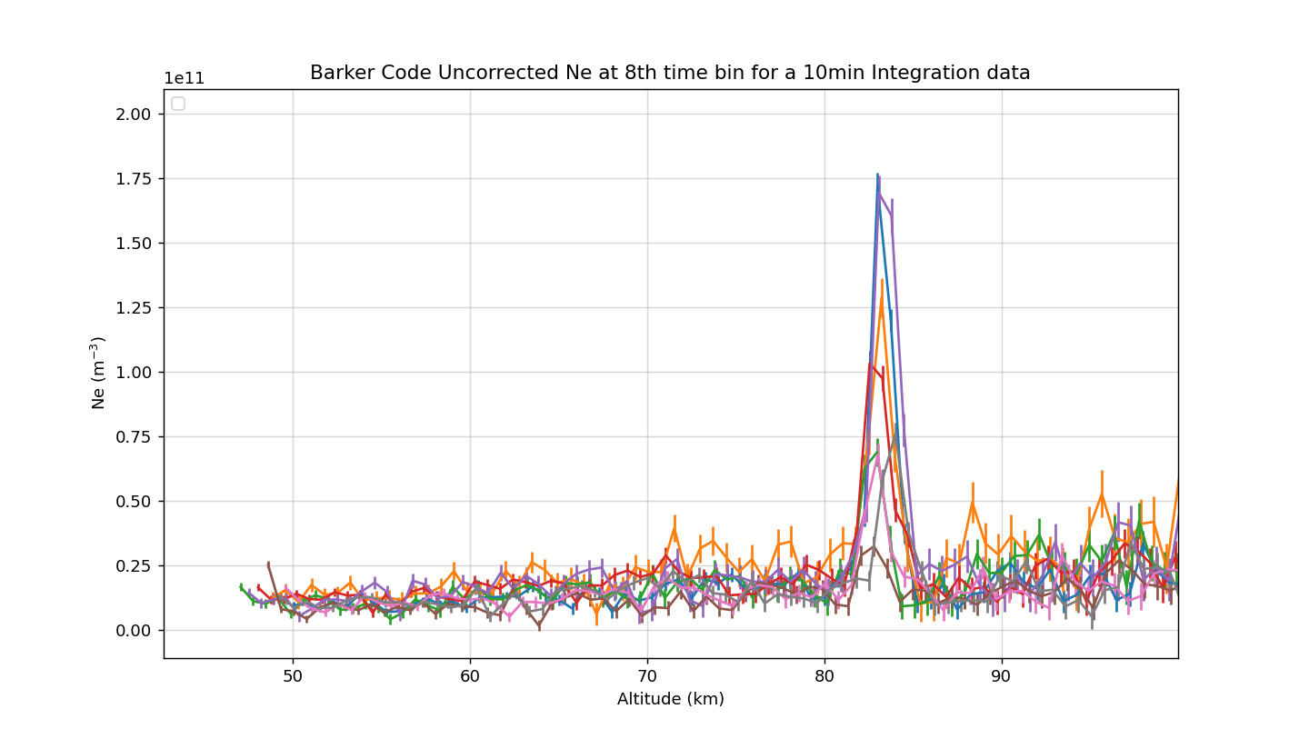
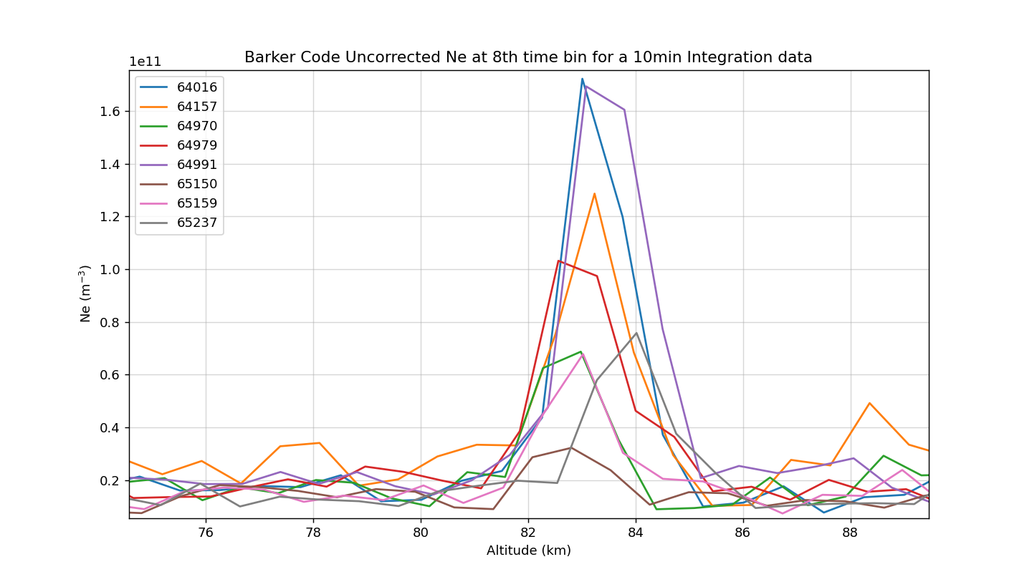
Altitude Estimation of the PMSE across all beams
Plot with Error bar
Zoomed plot
The 10min integration time data has been extracted at a specific time bin to get an estimate of the start and start altitude of PMSE
Start altitude ~ 81.5 km
Stop altitude ~ 85 km

Slide 20
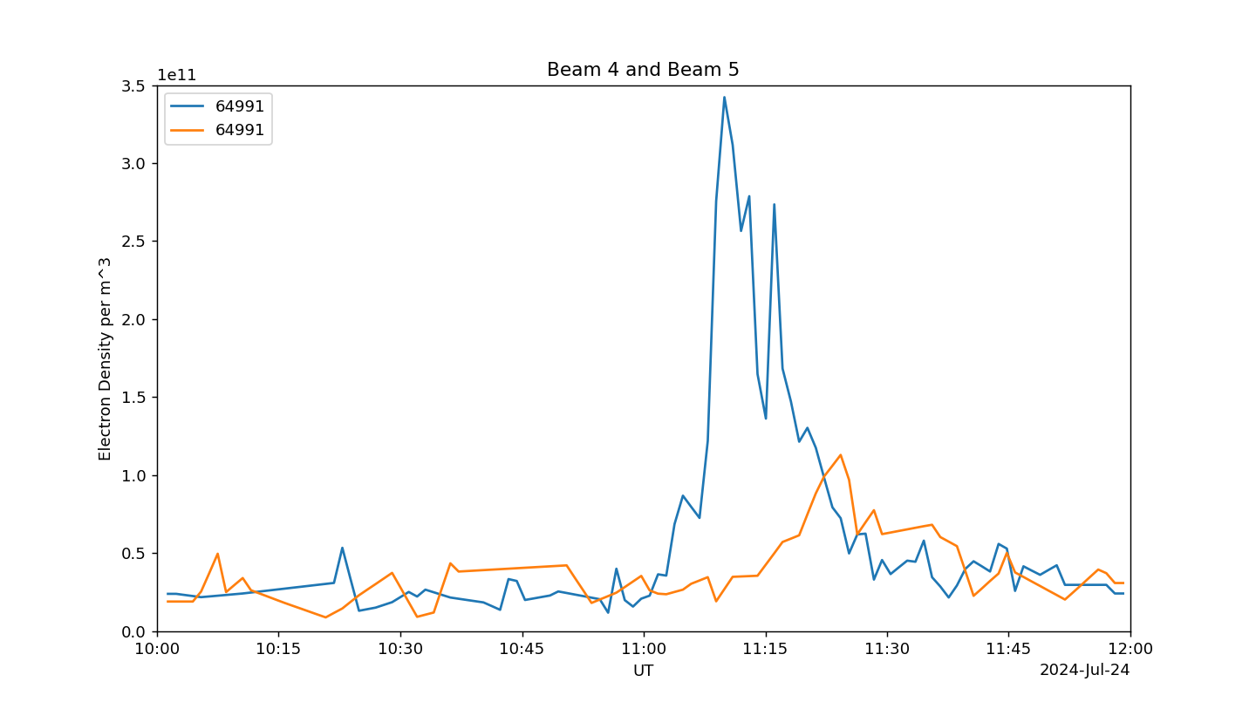
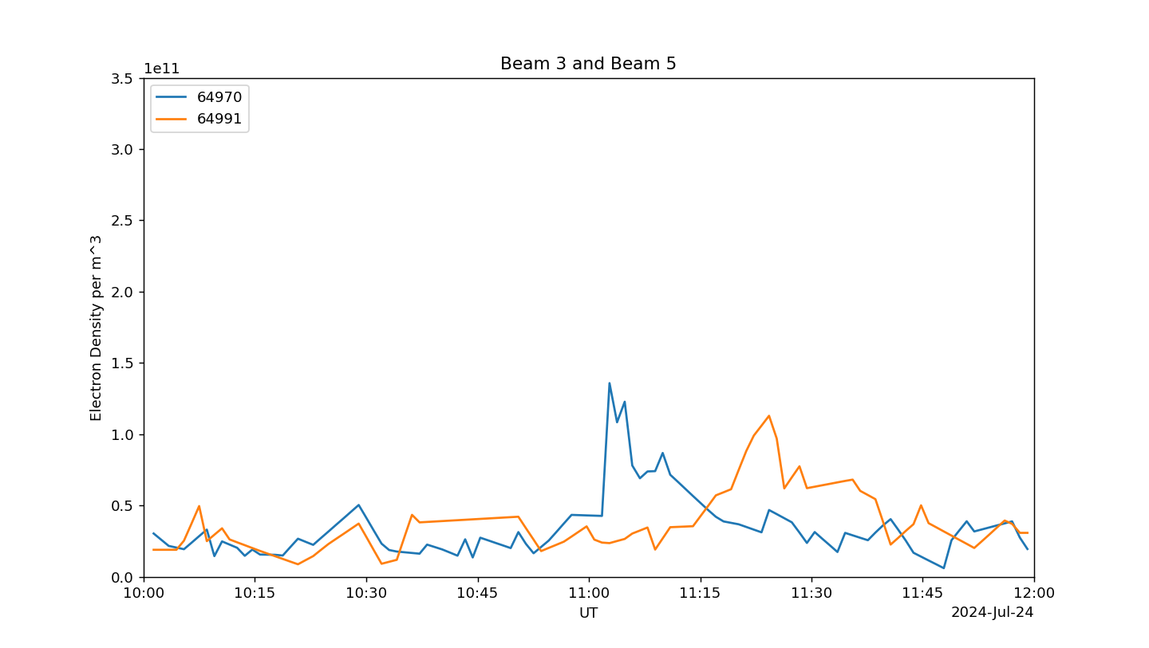
Tracking Motion of PMSE
The altitude was averaged for the size of the PMSE
Beam 4
Beam 3
Beam 5
Beam 5

Slide 21
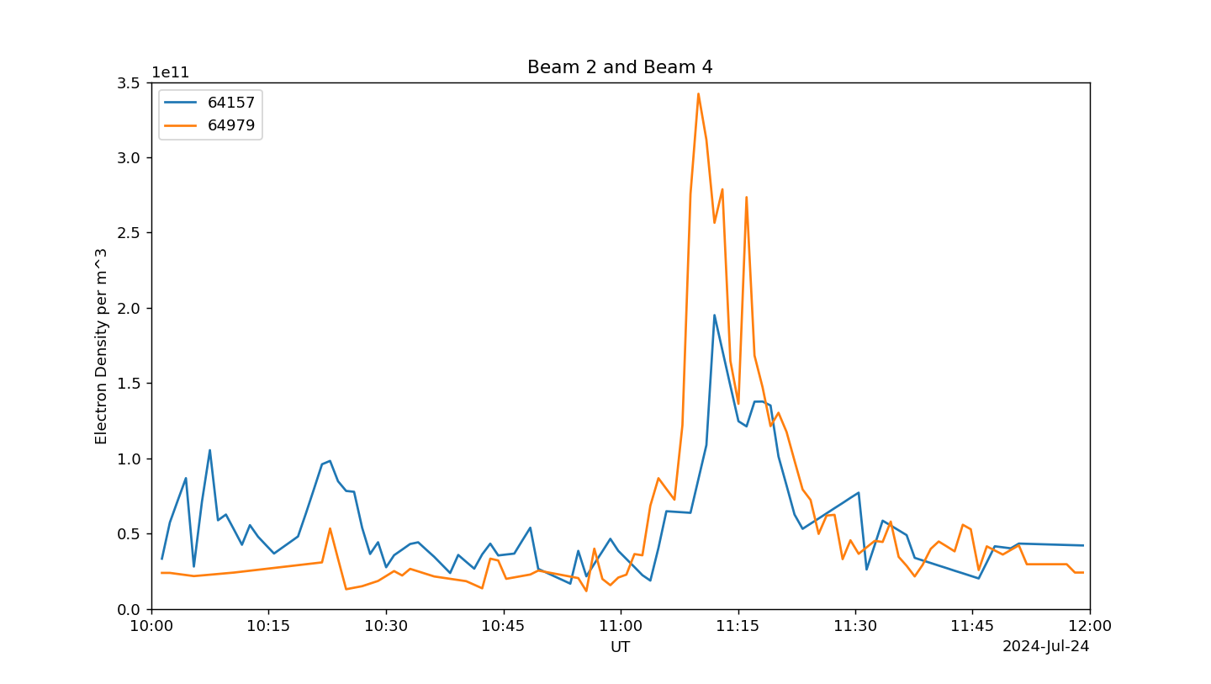
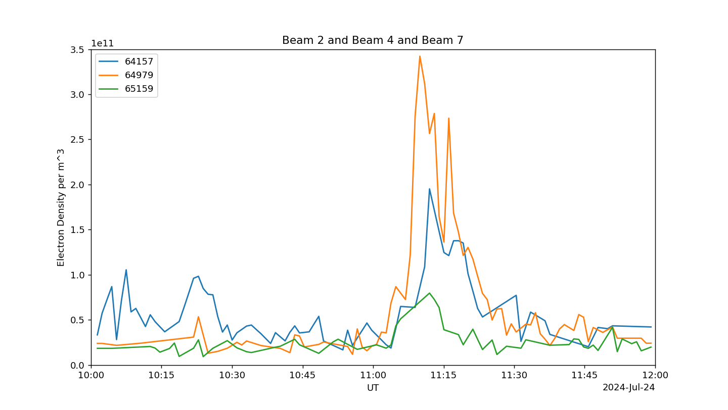
Tracking Motion of PMSE
The altitude was averaged for the size of the PMSE
Beam 4
Beam 4
Beam 2
Beam 2
Beam 7

Slide 22
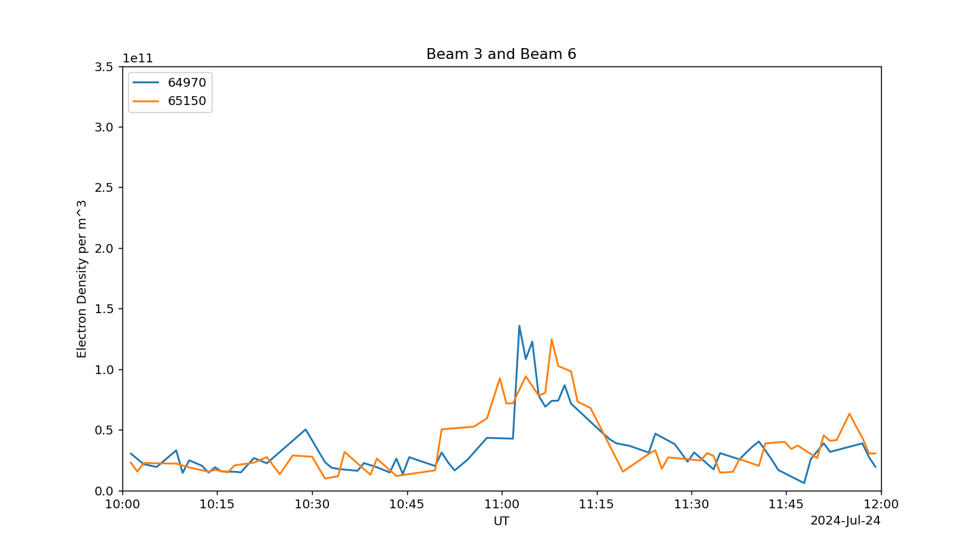
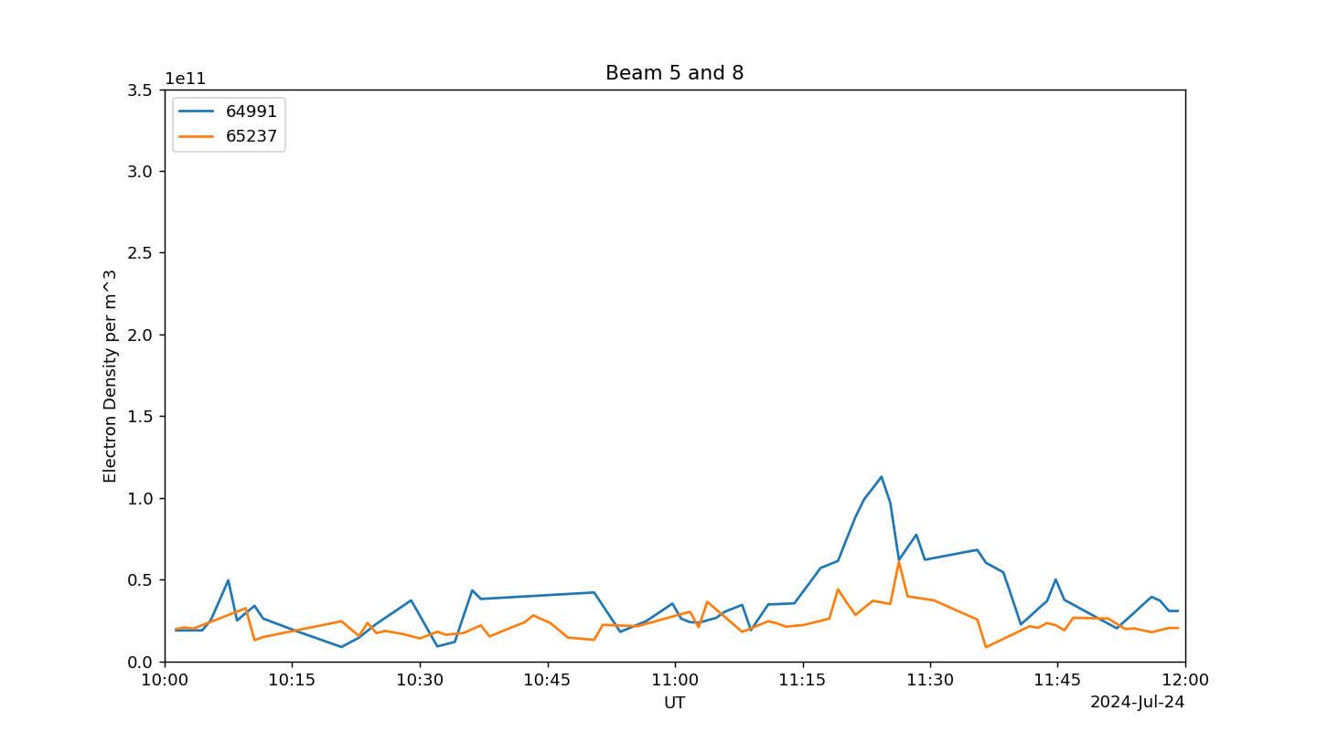
Tracking Motion of PMSE
The altitude was averaged for the size of the PMSE
Beam 6
Beam 8
Beam 3
Beam 5

Slide 23
Tracking Velocity of PMSE
Beam Pair | Distance [km] +/- 1 | Time [min] +/- 2 | Velocity [m/s] +/- 1
3 and 5 | 30.3 | 22 | 23
6 and 8 | 30.5 | 19 | 27
2 and 4 | 40.5 | 1.5 | ---
5 and 8 | 17.8 | 1.0 | ---
23 m/s
27 m/s
Approximate front velocity of 25 m/s at azimuth 105°
Front is nearly parallel to beam structure as orthogonal beam crossings are indistinguishable
The PSME velocity is a good proxy for the neutral wind (Un) at 82-86km

Slide 24
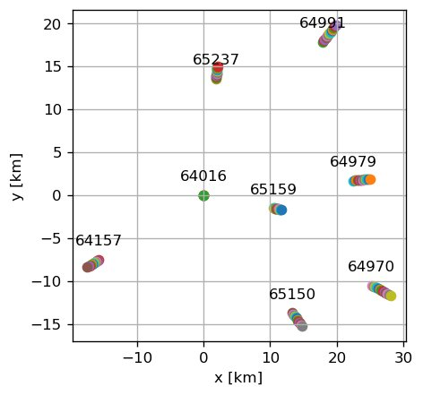
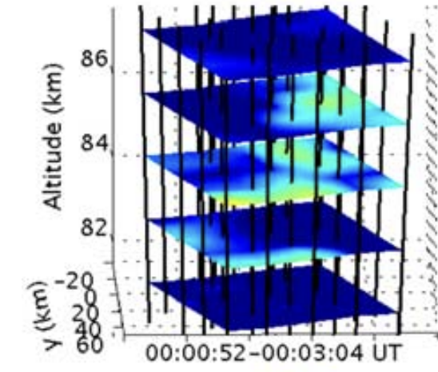
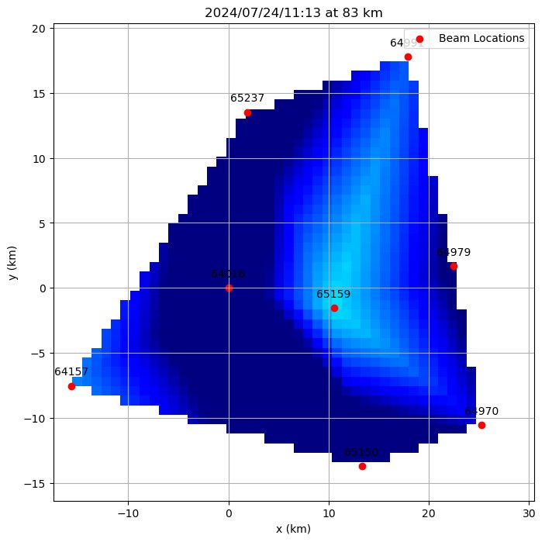
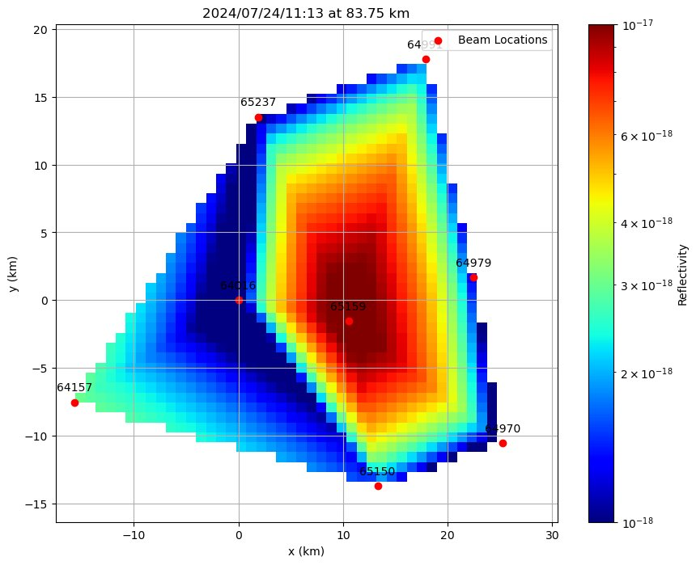
PMSE 3D Movies
Height resolution: 0.75 km​
Linear interpolated at each height and plot in 3D time series
Inspired by [M. J. Nicolls et al., 2007]

Slide 25
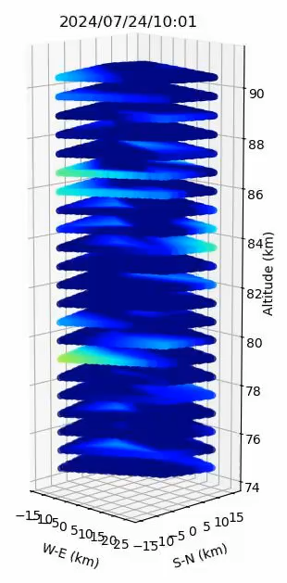
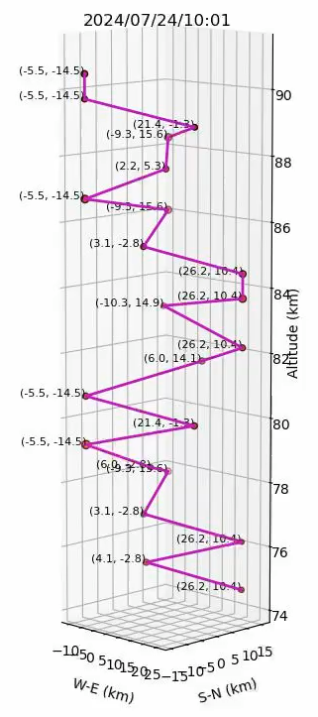
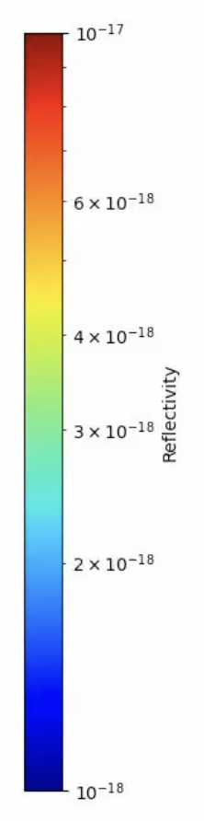
1st PMSE: 10:00 — 10:40 UT
one major slice of PMSE at the beginning of 10 UT
  ~87 km near west-south
  ~83 km near center

Slide 26
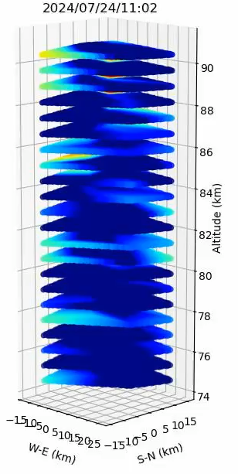
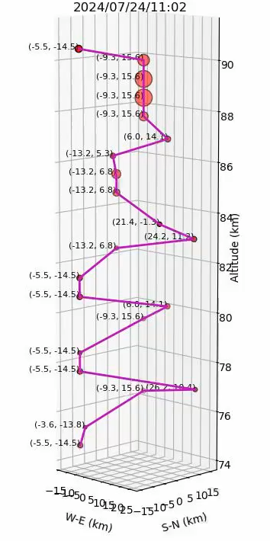
2nd PMSE: 11:00 — 12:0 UT
11:02-04 UT
  PMSE crosses 88-90 km at west-north
11:07-08 UT
  PMSE developed into two layers
    87 km at east-north
    83-84 km near center
after 11:10 UT
  PMSE developed another patch at ~86 km west-south
11:16-21 UT
  Bottom layer of PMSE at 83 km disappeared
11:30-50 UT
  Two layers of PMSE persist

Slide 27
Summary
We did not observe a CME-induced geomagnetic storm of expected high intensity
However, the F-region shows potential signs of particle precipitation and convective flow
We detected a PMSE propagating ESE at ~83km altitude using a Barker code
We tracked front velocity of the PMSE to estimate neutral wind speeds in the D-region at ~25 m/s
Thanks to all staff and students for making this summer school a great experience

