Slide 1
How to Build an MTG Pippin Box
Kirsten (Olson) Pappas, Class of 2014

Slide 2
Notes before we start
Pippin Boxes are 1 foot x 1 foot x 1 ½ foot and have handles in both of the end caps for easy carrying.
Properly built Pippin Boxes are a theater person’s best friend. They can be used in sets, to hold up wood while cutting it, as a step stool for us short people, you name it.
Because of this, you should be very careful/precise in your creation. Stuff should be as flush as possible. If you ever create a Pippin Box that seems “wonky,” take it apart and do it again. These need to be structural for years after you leave. Don’t skimp or people might get hurt.
On a similar note, if you ever find a Pippin Box that is structurally unstable/falling apart, pull it apart. It is better to have no Pippin Box than to have a crappy Pippin Box. Safety first!
In this document, colors are added for the easy of telling things apart.

Slide 3
Cut Short Edges (x2)
The short edges are 1 foot x 1 foot squares made of ¾ inch plywood.
Each Pippin box has 2 of them

Slide 4
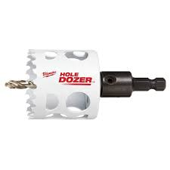
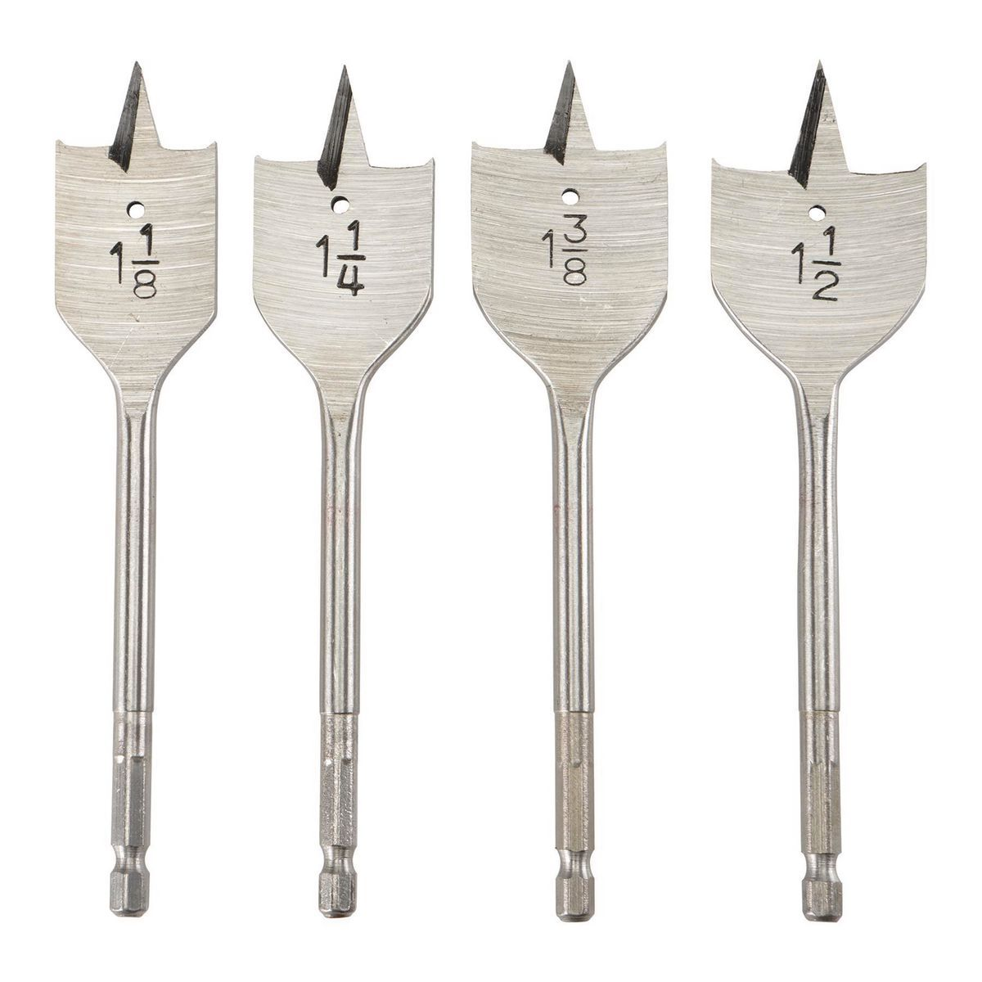
2. Put handles in the short edges
Cut two circular holes in the center of the piece, using a hole saw drill bit.
Connect the two holes using a jigsaw or other appropriate saw.

Slide 5
3. Cut Long Edges A (x2)
The first set of long edges is the wider set. They are also made of ¾ inch plywood. There are two of them.
They should be 1 foot wide and 16 ½ inches tall. This is so, when the short edges are put on either end, the box itself ends up being exactly 18 inches tall.

Slide 6
4. Cut Long Edges B (x2)
The first set of long edges is the narrower set. They are also made of ¾ inch plywood. There are two of them.
They should be 10 ½ inches wide and 16 ½ inches tall.

Slide 7
5. Cut 2x4 supports (x4)
2x4s are added to the inside to help the box stay structural.
There are a total of 4 of them and they are 16 ½ inches long, like the long edges of the Pippin Box.

Slide 8
6. Attach 2x4s to Long Edges B
Using 1 ½ inch screws or similar, attach the thinner edge of a 2x4 to the longer edge of a Long Edge B. (Green for screw location)
Repeat until both Long Edge Bs have two 2x4s attached to them. (See picture)
Back in the day, I believe we used to use a nail gun to REALLY make sure these things stayed together, but I don’t think we currently have a functional one.
Note: screw locations are approximate. Screws should always go from the Plywood into the 2x4, not the other way around

Slide 9
7. Attach Long Edge As to Long Edge Bs
Using the same screws from the previous step, attach the long end of Long Edge A to the long end of Long Edge B using the 2x4s.
Repeat until you have a box shape. (These edges should also be as flush as possible.
Once again, screw placement is approximate.

Slide 10
8. Attach Short Edges
Add the short edges to the ends using the same screws into the 2x4s.
If you have either a nail gun or a staple gun with really long staples (pink, also approximate), go around the outer edge to connect the shorter edge directly to the longer edges. Do not do this with screws, as it will most likely split the wood.
Cut out view:

Slide 11
9. Sand Everything
No splinters allowed on the Pippin Boxes!
Sand down all of the edges
Sand down the inside of the handles so that people don’t get splinters when they pick up the boxes

Slide 12
10. Test
Take a good, hard look at your finished project. Does this feel like something you would feel confident standing on, jumping on, using as stairs?
If yes, do that. If you survive, congratulations! You have built a good Pippin Box.
If not, fix it. Can it be salvaged? Anything you can do to reinforce it more? If not, pull it apart.

Slide 13
11. Probably paint them
In general, it is a good idea to have a coat of paint on most of the set components we have. This is because the paint is where we add our fireproofing. Also, a coat of paint can make things a bit smoother.

