Slide 1
Project Prometheus
Critical Design Review
10 December 2023

Slide 2
Agenda
Overview
Structures/Aerodynamics
Intermission
Avionics
Propulsion
*internal deadline

Slide 3
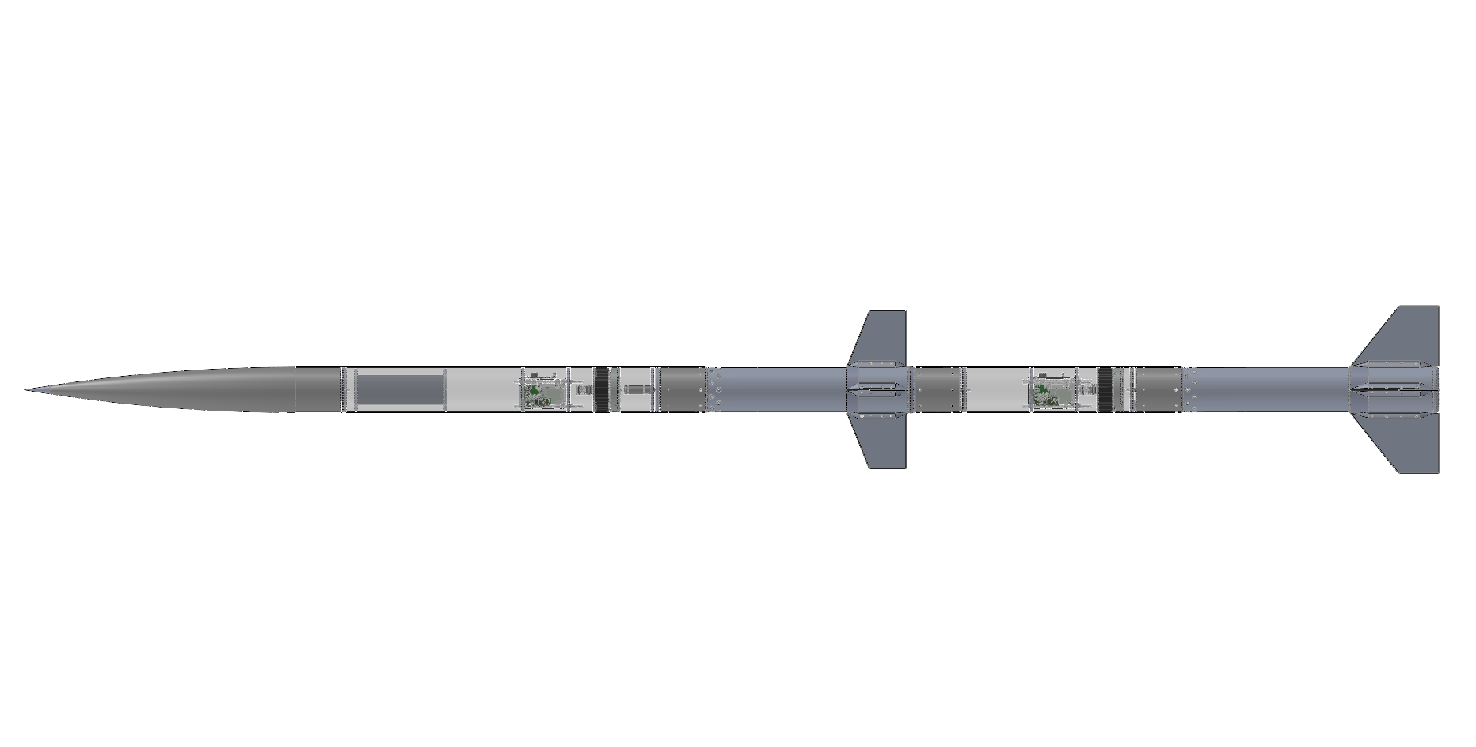
Vehicle Overview
Two-stage rocket
15 ft, 11 in long, 6 in nominal diameter
  Sustainer: 10 ft
  Booster: 5 ft, 11 in
148 lb loaded mass
  Sustainer: 67.1 lb
  Booster: 80.6 lb
N-class sustainer on O-class booster
Predicted apogee: 32,984 ft AGL
  Ground level: 4600 ft MSL

Slide 4
Flight Event Timeline
T+00:00.00 | Booster Ignition
T+00:03.81 | Booster Burnout
T+00:04.00 | Booster Airbrakes Deployment
T+00:05.87 | Sustainer Ignition
T+00:10.12 | Sustainer Burnout
T+00:18.00 | Booster Apogee, Drogue Deployment
T+00:44.00 | Sustainer Apogee, Drogue Deployment
T+01:34.00 | Booster Main Deployment
T+02:08.00 | Booster Touchdown
T+05:34.00 | Sustainer Main Deployment
T+06:08.00 | Sustainer Touchdown

Slide 5
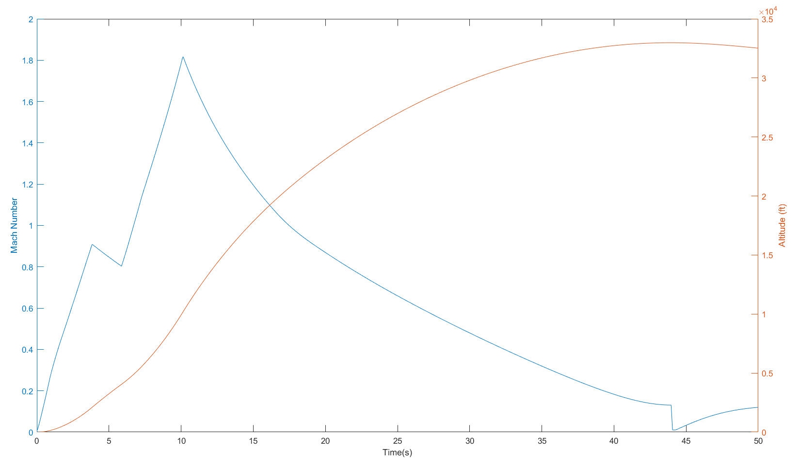
Flight Profile

Slide 6
Spring Schedule
1st Interim Progress Report: 15 December 2023
2nd Interim Progress Report: 16 February 2024
Test Launch Manufacturing Deadline: 7 April 2024*
3rd Interim Progress Report: 19 April 2024
Test Launch: 20-21 April 2024*
Project Technical Report, Poster/Podium Session Materials: 10 May 2024
Spaceport America Cup: 17-21 June 2023
*internal deadline

Slide 7
Structures & AeroD
Project Prometheus Critical Design Review

Slide 8
Agenda
Structures Overview
Recovery Overview
Aerodynamics Overview
Air Brakes Overview
Payload Overview
Aeroshells Overview
Mass & Cost Breakdowns

Slide 9
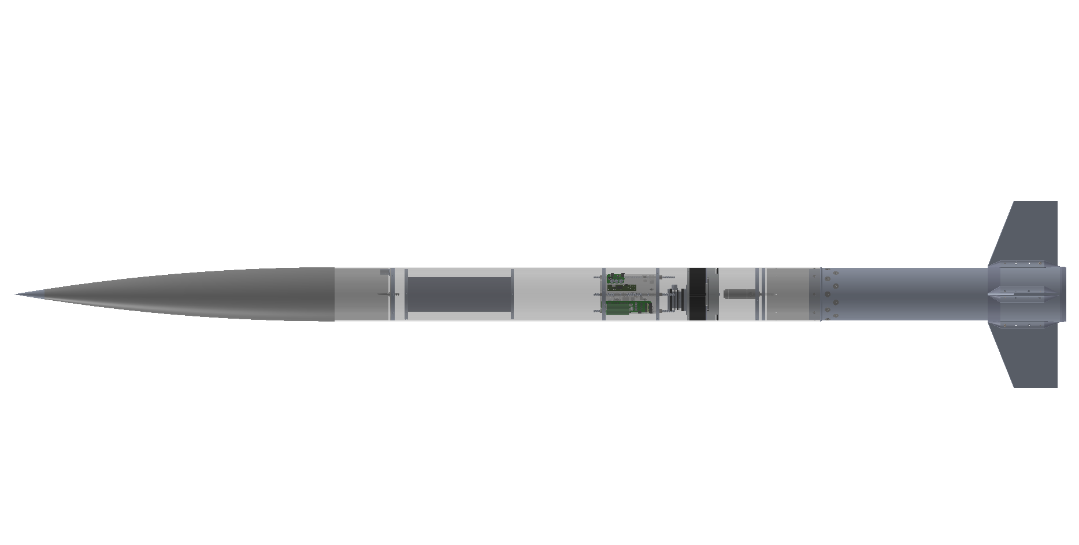
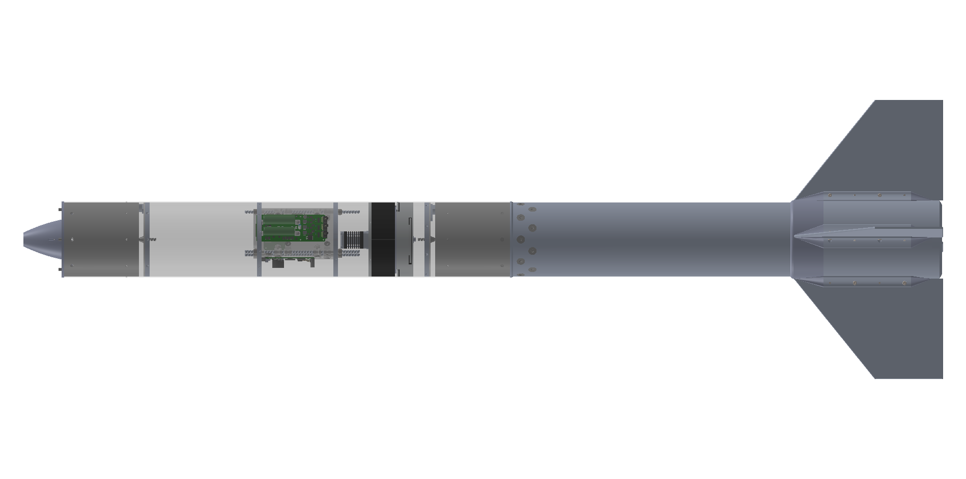
Structures Overview
Motor
Mission Package Tube
Booster
Fins
Recovery
Avionics Bay
Recovery
Sustainer
Air Brakes
Payload
Nose Cone
Recovery
Avionics Bay
Staging Cone
Booster
Fins
Air Brakes
Recovery
Sustainer
avionics bay
parachute
parachute
Motor
payload
Nose Cone
Fins + Fin Can
air brakes

Slide 10
Recovery System

Slide 11
Functional Requirements
Drogue and Main Parachutes: A vehicle with apogee > 1500 ft must have two parachutes (drogue and main)*
Main Parachute Deployment Altitude < 1500 ft
  Goal: 1400 ft
Descent Velocities
  65 ft/s < Drogue descent velocity < 165 ft/s
    Goal: 70 ft/s
  Main Descent Velocity < 36 ft/s
    Goal: 25 ft/s
Redundancy in parachute deployment triggers

Slide 12
Flight + Recovery Trajectories
Sustainer Drogue Deployment (30,000 ft)
Sustainer: Drogue & Main Parachutes
  Dual separation, dual deployment
Booster: Drogue & Main Parachutes
  Dual separation, dual deployment
Deployment Mechanism
  Sustainer Drogue: Piston
  Others: Black Powder Charge
Booster Drogue Deployment (6,000ft)
Separation (4,000ft)
Booster Main Deployment (1,400ft)
Sustainer Main Deployment (1,400ft)

Slide 13
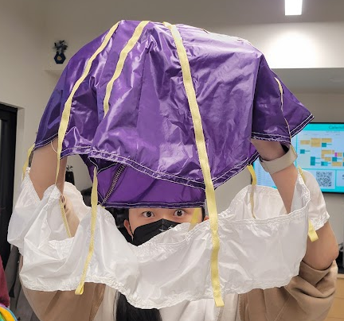
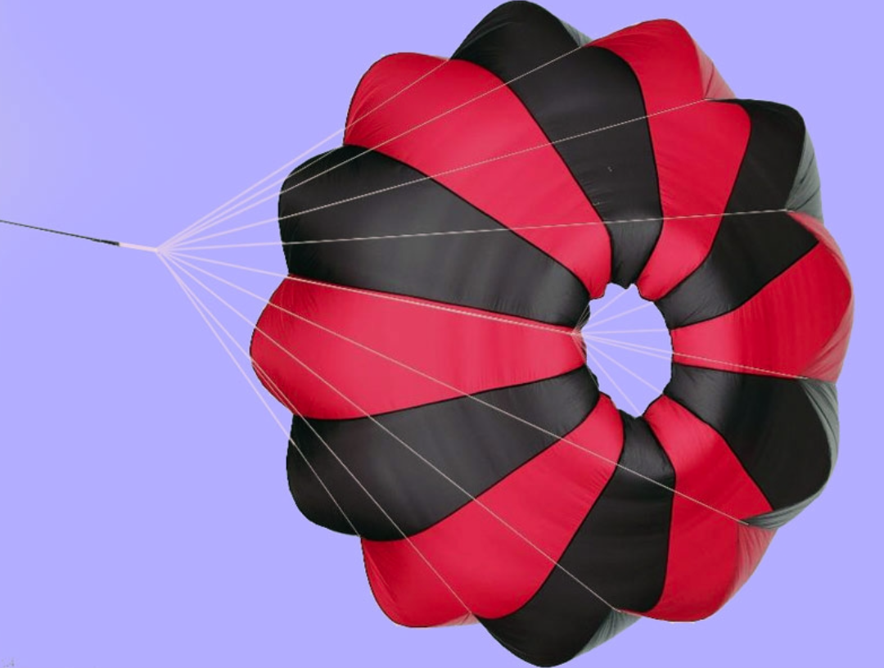
Parachutes
Drogue Parachutes (SRAD):
Type: Disk-Band Gap
Material: Ripstop Nylon, braided kevlar shroud lines
Deployed at Apogee
Descent velocity: 70 ft/s
Prevent excessive drifting, stabilize rocket for mains to open cleanly
Main Parachutes (COTS):
Type: Eye
Material: Ripstop Nylon
Deployed at 1400 ft
Descent velocity: 25 ft/s

Slide 14
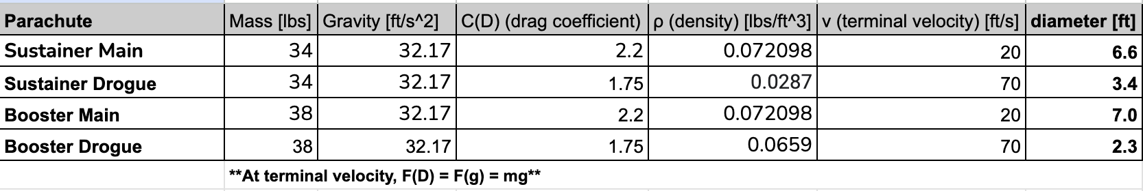
Parachute Sizing
F_{D} = Drag Force
Design Constraints
Descent Velocity (terminal velocity)
  Drogue Parachutes: 70 ft/s
  Main Parachutes: 25 ft/s
Want to find
Diameter of parachute
Other Variables
Coefficient of Drag (2.2 for COTS, 1.5 SRAD)
Air density at altitude of deployment
Mass of Sustainer and Booster
  Sustainer: 61.1 lbs
  Booster: 53.15 lbs
Guiding Equation:
m × g = (½) × C_{D} × A_{P} × ⍴ × V²
F_{g} = Force of gravity on object
Results (diameters):
Sustainer Drogue: 5 ft
Sustainer Main: 7 ft
Booster Drogue: 3 ft
Booster Main: 7 ft
F_{D} = (½) × C_{D} × A_{P} × ⍴ × v² at terminal velocity to obtain desired circle area → diameter

Slide 15
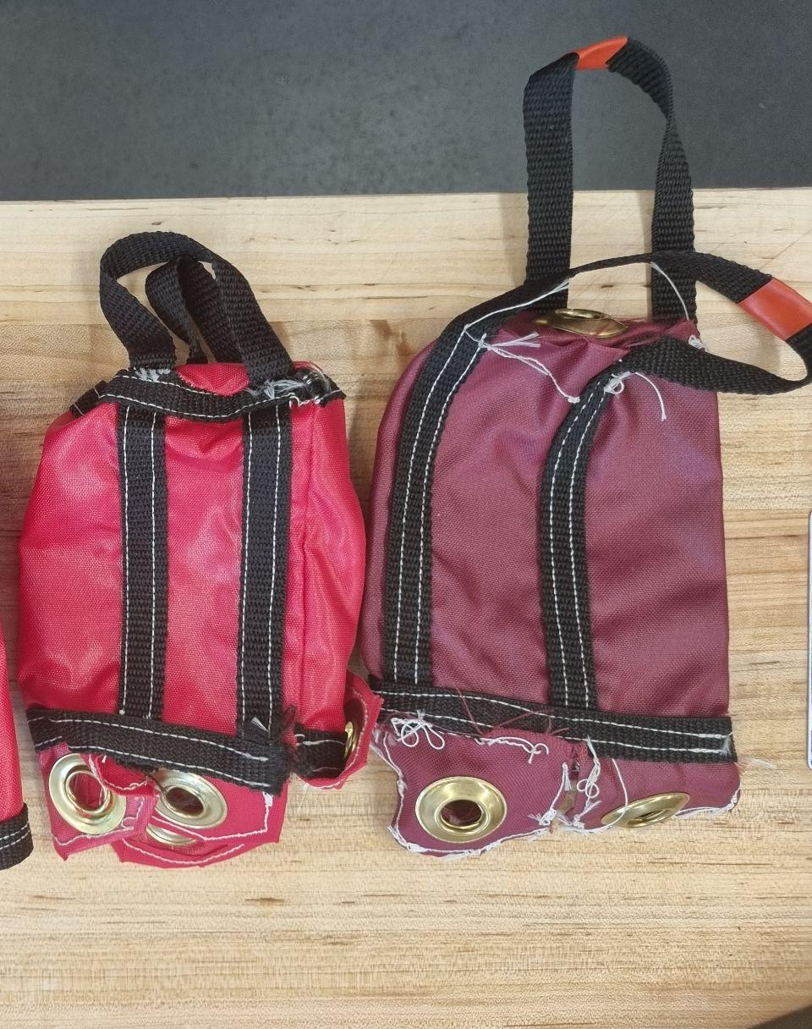
Parachute Bags
Purpose: must fully protect parachute from black powder charge
  Fully enclosed design
Material: flame resistant nylon fabric

Slide 16
Parachute Packing Volume
Packing Density: Parachute, Bags, Lines, Swivels, and Quicklinks for each parachute assembly
Parachute | Total Packed Volume (in^3) | Minimum Height in MPT (in)
Sustainer Main | 82.2 | 3.1
Sustainer Drogue | 56.2 | 2.1
Booster Main | 81.9 | 3.1
Booster Drogue | 29.3 | 1.1

Slide 17
Parachute Shock Forces
Used OSCALC software to calculate shock forces on parachutes when they are deployed
Required inputs:
  Air Density at Deployment
  Dry Vehicle Mass
    Sustainer: 61 lbs
    Booster: 51 lbs
  Descent Rate
    Drogue: 70 ft/s
    Main: 25 ft/s
  Coeff. Drag
    Drogue: 1.5
    Main: 2.2
  Nominal Parachute Area
Parachute | Shock Force (N)
Sustainer Drogue | 531
Sustainer Main | 812
Booster Drogue | 17
Booster Main | 812

Slide 18
Lines Diagram
Drogue Deployment:
Main Deployment:
Quicklink
Nose Cone /
Staging Cone
Swivel
Cone Riser
Main
Parachute + Bag
Main MPT Riser
Main Bag Riser
Mission Package Tube
Drogue Bag Riser
Drogue
Parachute + Bag
Drogue MPT Riser
Motor Riser
Motor

Slide 19
Lines Sizing
Line: | Length (Sustainer): | Length (Booster): | Calculations:
Cone Riser | 3 ft | 1 ft | > cone length
Main MPT Riser | 16 ft | 10 ft | 4 x MPT length AND > cone riser + cone
Main Bag Riser | 1.5 ft | 1.5 ft
Drogue MPT Riser | 19 ft | 12 ft | 4 x MPT length
Drogue Motor Riser | 24 ft | 16 ft | 4 x motor length AND > mpt riser + mpt
Drogue Bag Riser | 1.5 ft | 1.5 ft
Dangling sections of the rocket should not collide with each other
Prevent wake effects from the rocket body on parachute inflation

Slide 20
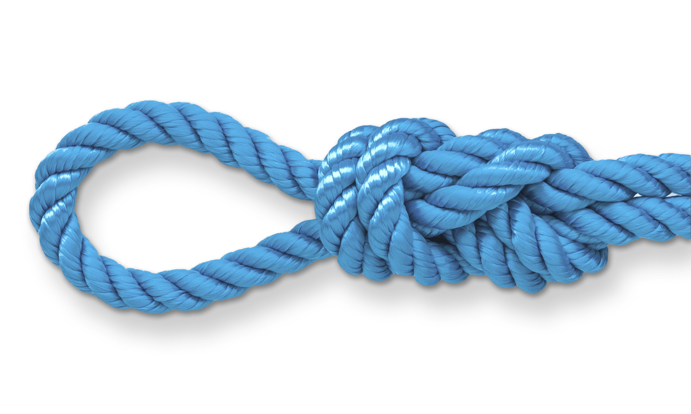
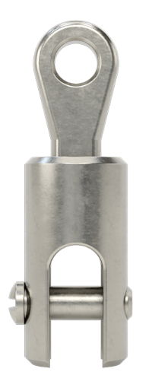
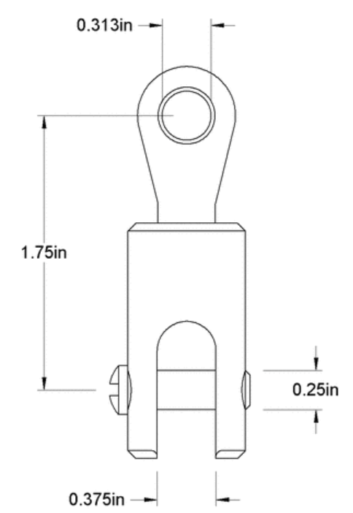
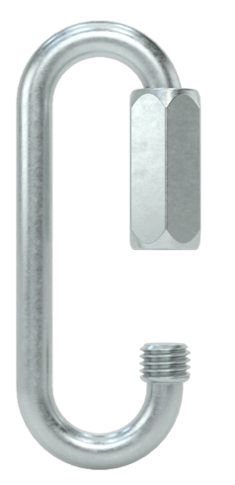
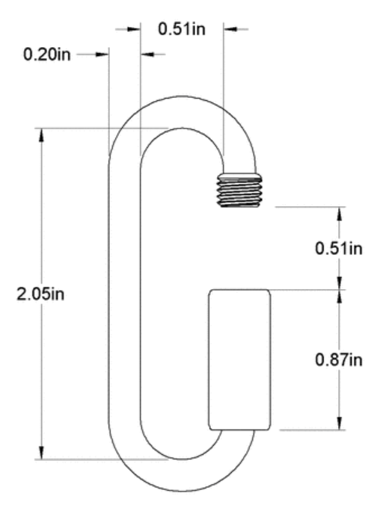
Lines and Attachments
Lines
  Capacity: 600lb
  Material: Braided Kevlar
Shroud Lines
  Capacity: 200lb
  Material: Braided Kevlar
Figure 8 knots
  Attaches lines to hardware
  Tensile Testing: stronger than Bowline knots
Quicklinks
  Capacity: 500lb
  Material: Zinc coated Steel
Swivels
  Capacity: 1,800lb
  Material: 316 Stainless Steel

Slide 21
Deployment Mechanisms Overview
Piston
  Used for: Sustainer Drogue
  Effective even at high altitudes (piston = pressurized volume)
  Uses black powder to pressurize/actuate piston, piston bulkhead breaks shear pins
Black Powder Expansion
  Use for: all other parachutes (lower altitudes)
  Less mass and more compact than a piston
  Uses well of black powder, ignited by e-match, pressurizes contained volume to break shear pins

Slide 22
Deployment Components Overview
Drogue Parachute Assembly
Main Parachute Assembly
Sustainer
FRR Bulkhead
Piston Assembly
Black Powder Assembly
Nose cone Bulkhead
Drogue Parachute
Main Parachute Assembly
Booster
FRR Bulkhead
Black Powder Assembly
Black Powder Assembly
Staging Cone
avionics bay
parachute
parachute
Motor
payload
Nose Cone
Fins + Fin Can
air brakes

Slide 23
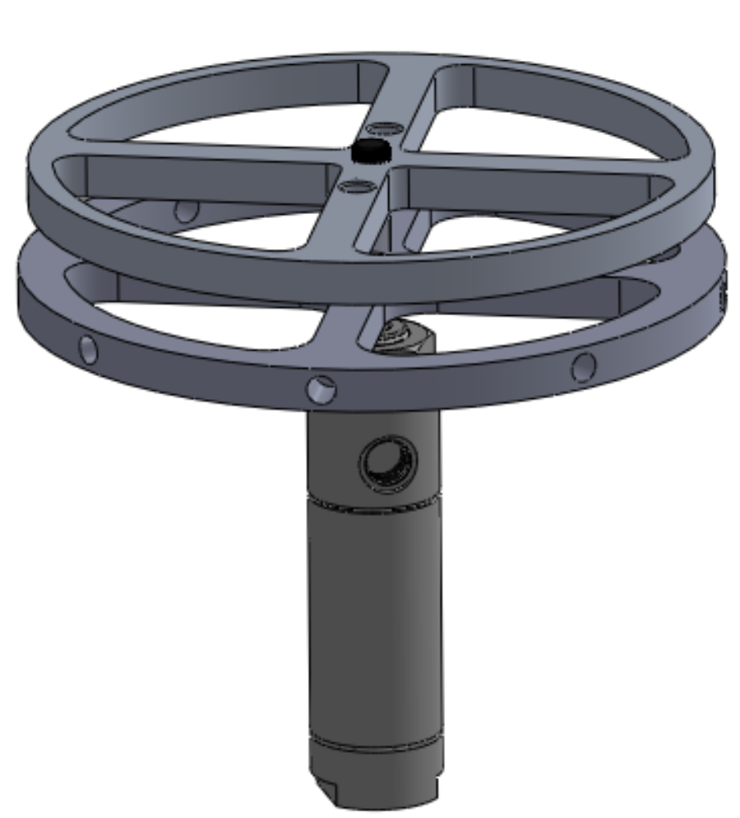
Piston Deployment Assembly
Holes for U-Bolt (Recovery Attachment)
Bulkhead
Mount
Piston

Slide 24
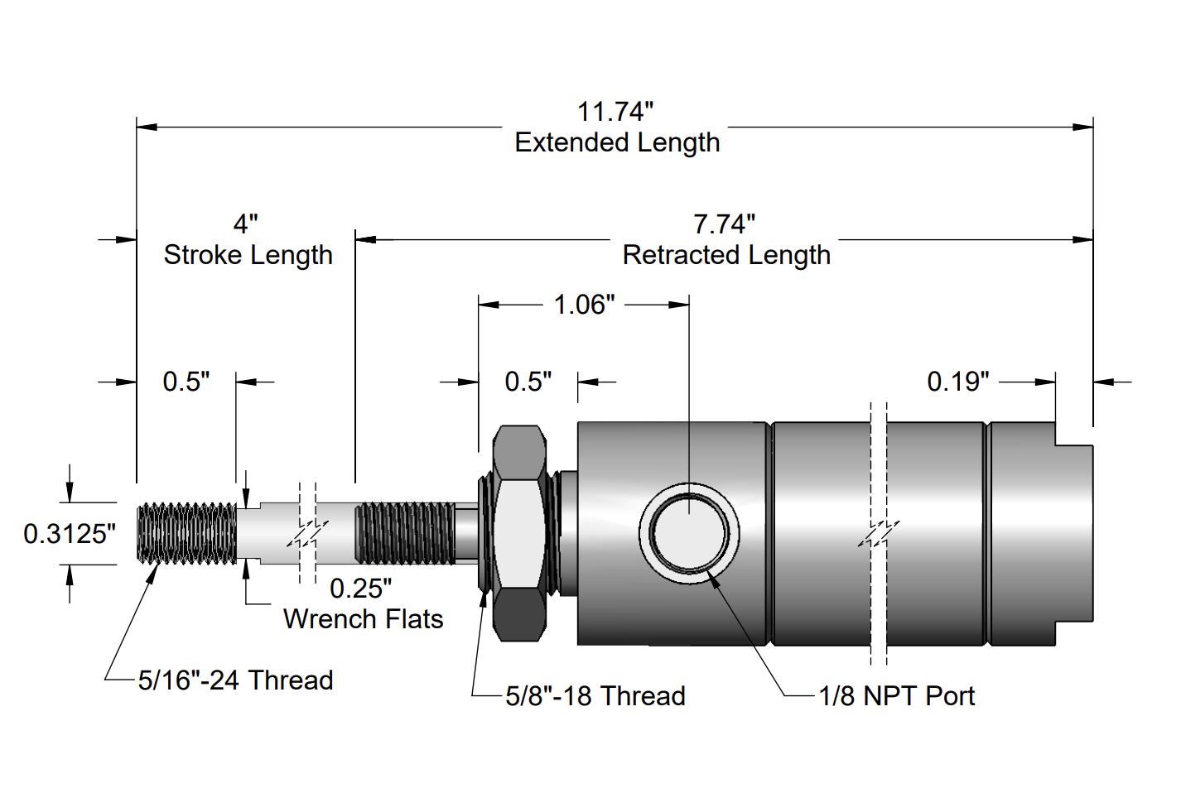
Piston Deployment: Piston
Shear Pins (nylon screws): ~46lb x 4
Piston force: 1000 N (225 lbf) at 250 psi
Extension Length: 4 in

Slide 25
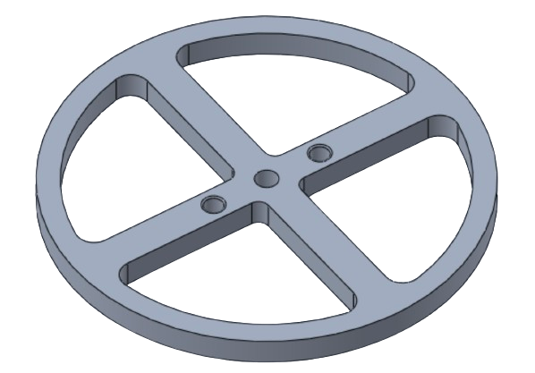
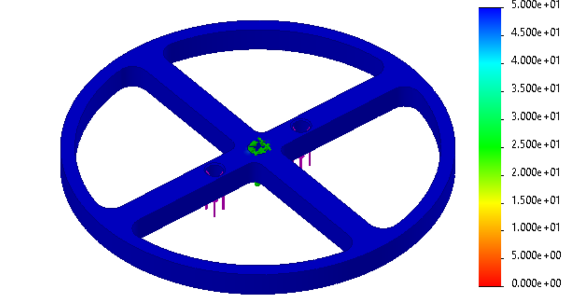
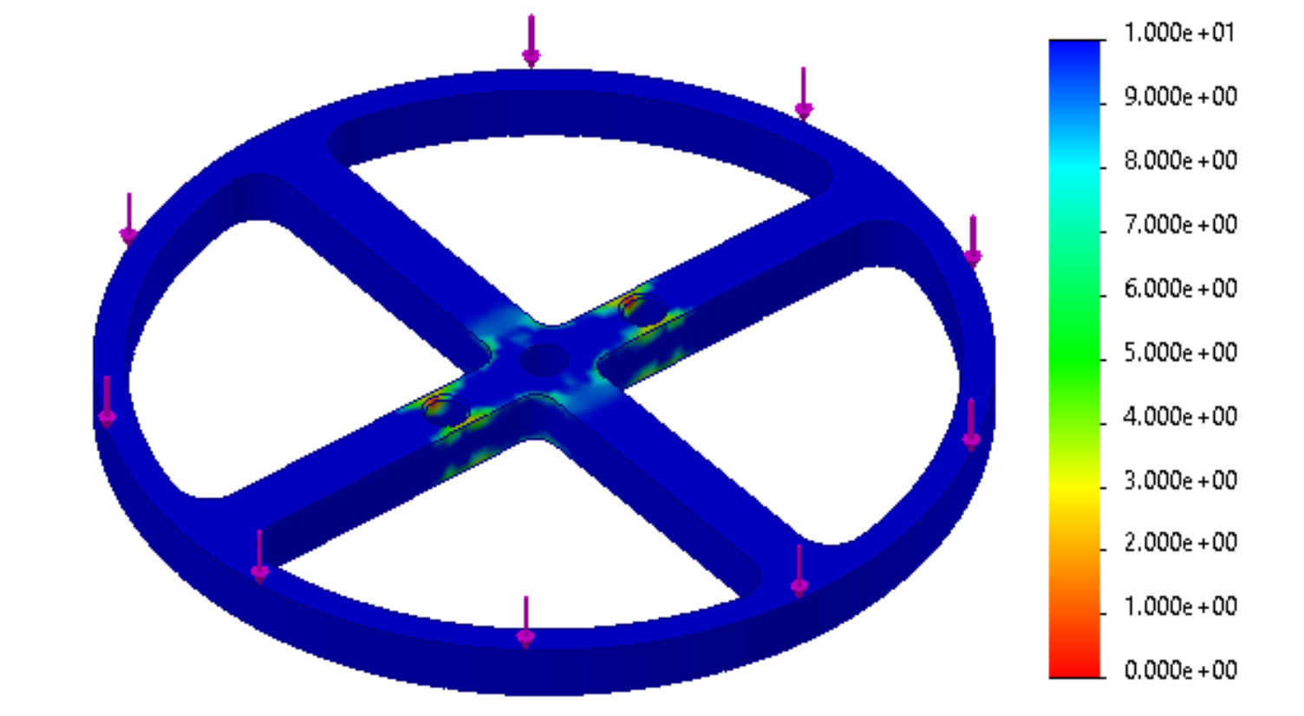
Piston Deployment: Diaphragm
Purpose: takes the bulk of forces during flight and piston deployment
Aluminum Alloy: 6061- T6 (SS)
0.37 lbs
Piston Connection
U bolt Connection
Forces:
Shock Force (530 N)
Piston Force (1000 N)
Min. Factor of Safety: 1.9
Shockforces
Piston Force

Slide 26
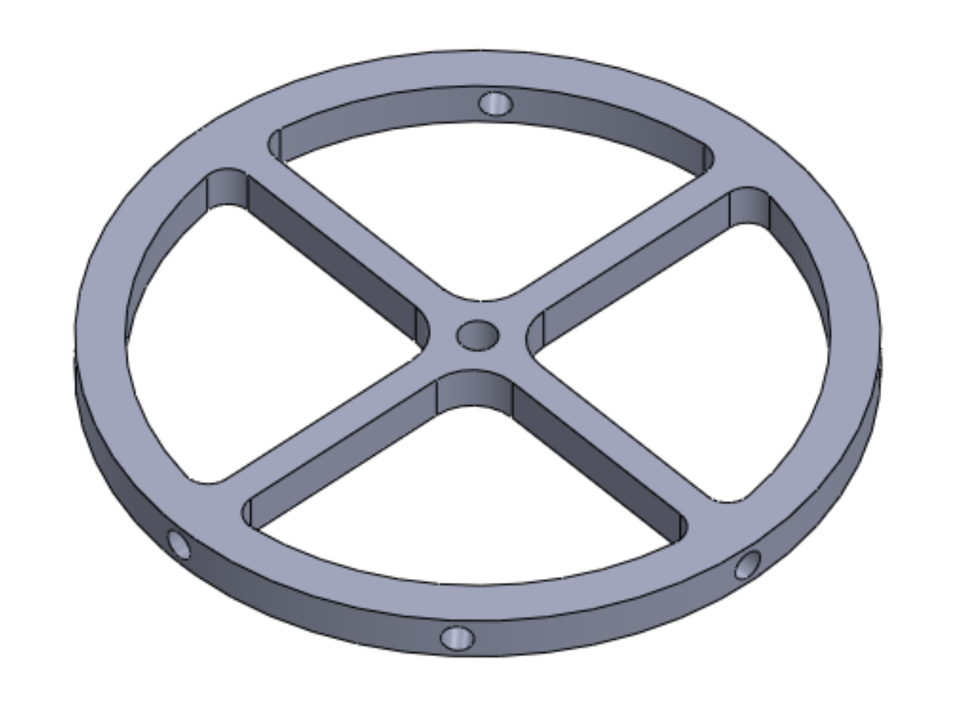
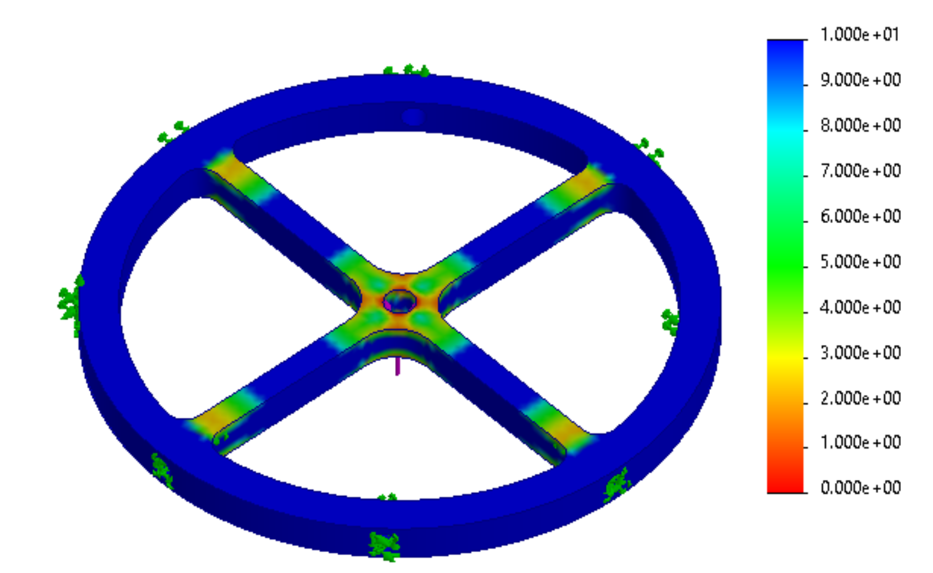
Piston Deployment: Piston Mount
Purpose: Attaches the piston to the Mission Package Tube
Aluminum Alloy: 6061- T6 (SS)
0.12 lbs
Forces:
  Piston Force (1000 N)
  Min. Safety Factor: 3
Piston Connection
MPT Connection

Slide 27
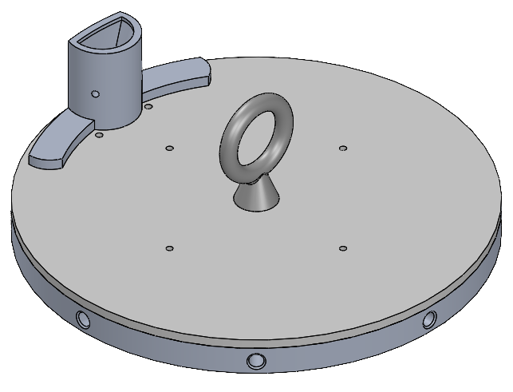
Black Powder Deployment Assembly
Bulkhead supports black powder well and Eye Bolt (recovery attachment)
Acrylic plate to maintain pressure while minimizing mass
Aluminum Alloy: 6061- T6 (SS)
Mass : 0.70 lbs
Black Powder Well
Eye Bolt
(Recovery Attachment)
Acrylic Plate
Bulkhead
MPT Connection

Slide 28
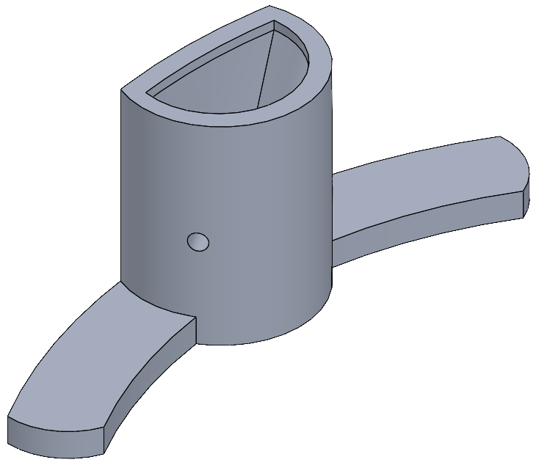
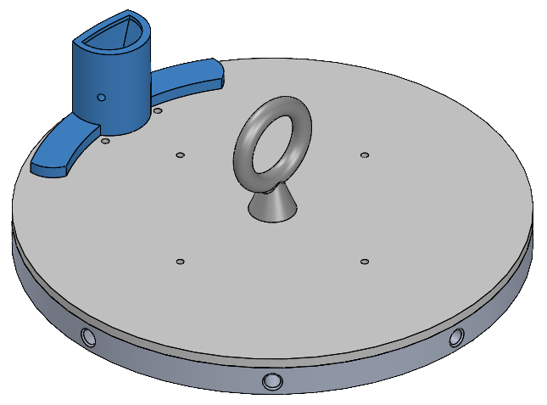
Black Powder Deployment: Well
Well placed on edge to maximize usable space for parachute
3D printed in resin

Slide 29
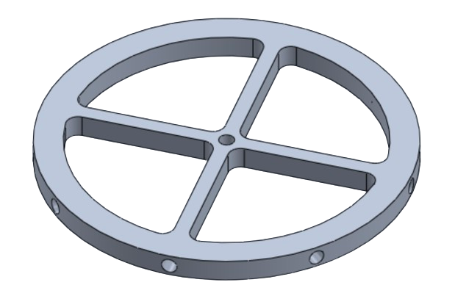
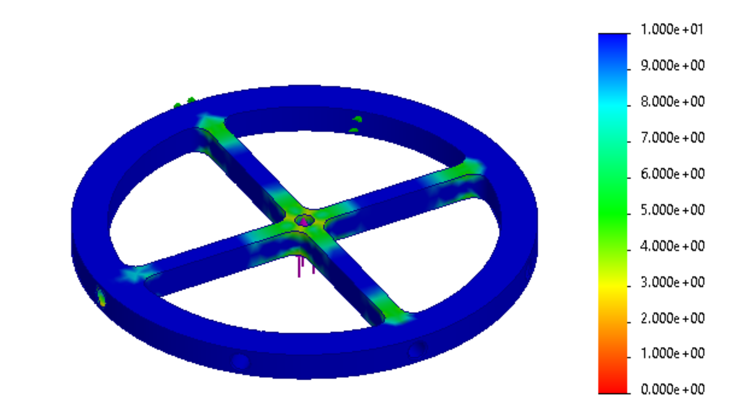
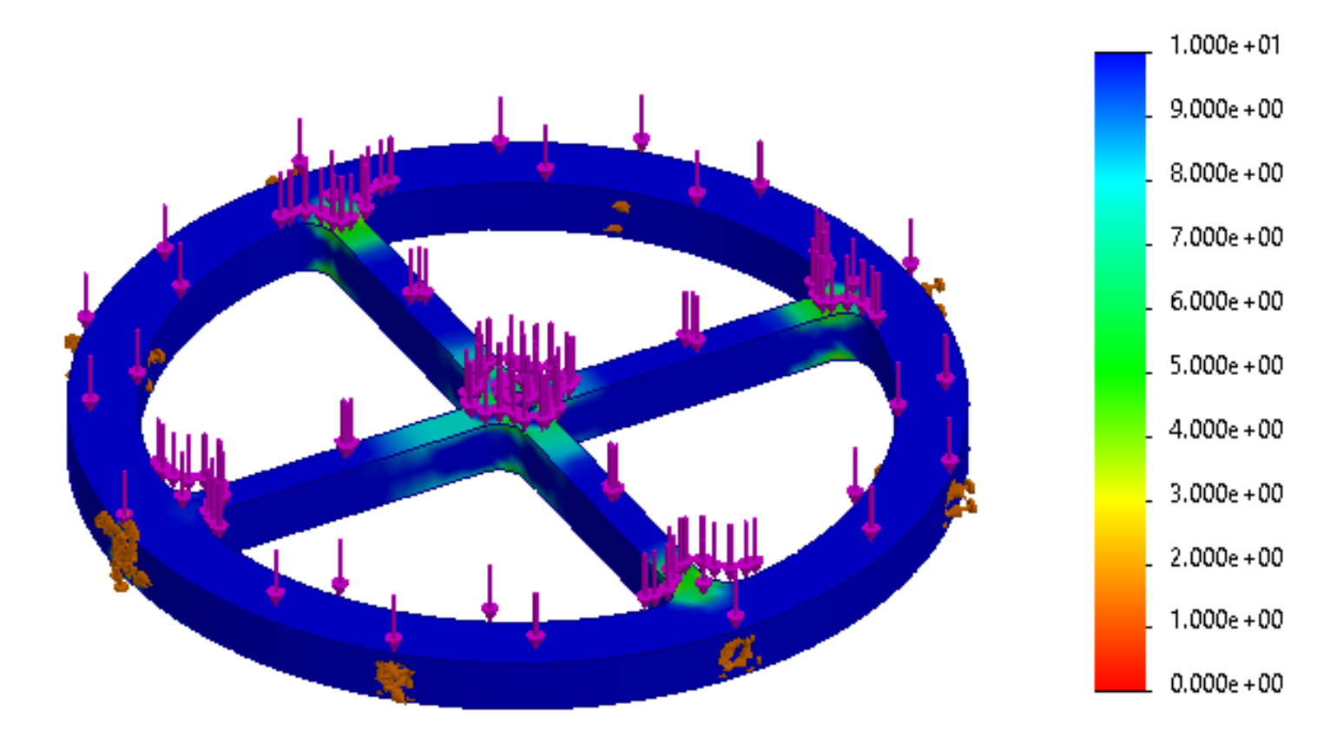
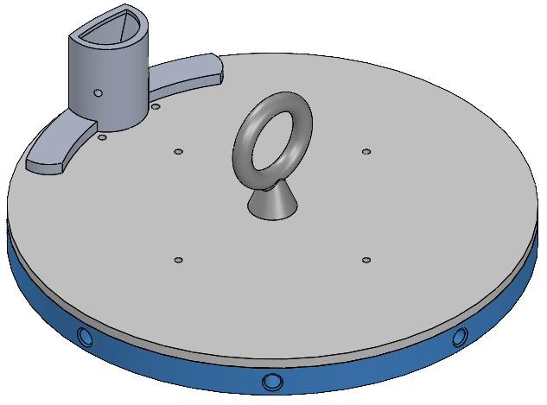
Black Powder Well: Bulkhead
Eyebolt Connection
Purpose: attaches to MPT, withstands launch, deployment and shock forces
Aluminum Alloy: 6061- T6 (SS)
Mass: 0.37 lbs
Forces:
G-Forces w/ Parachute (83 N) (Not Pictured)
Max. Black Powder Force (5410 N)
Max. Shock Force (810 N)
Min. Factor of Safety: 2.0
MPT Connection
Shockforces
Black Powder Forces

Slide 30
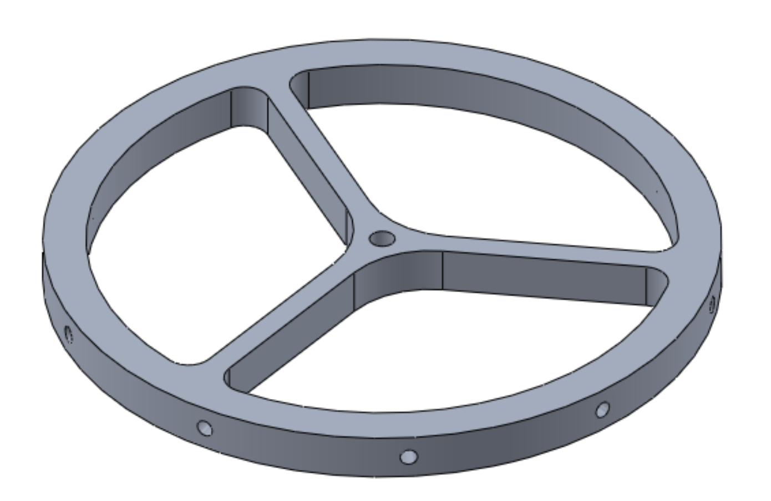
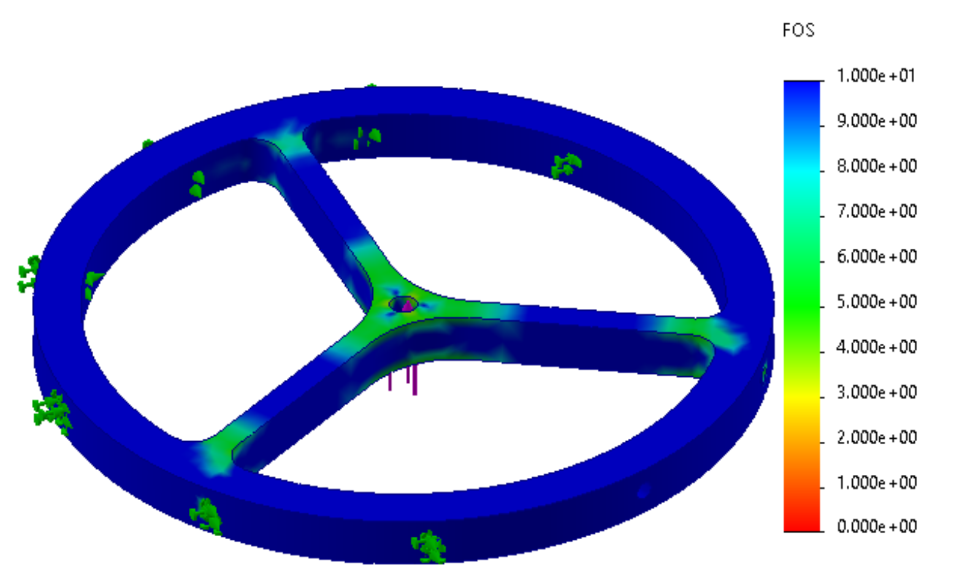
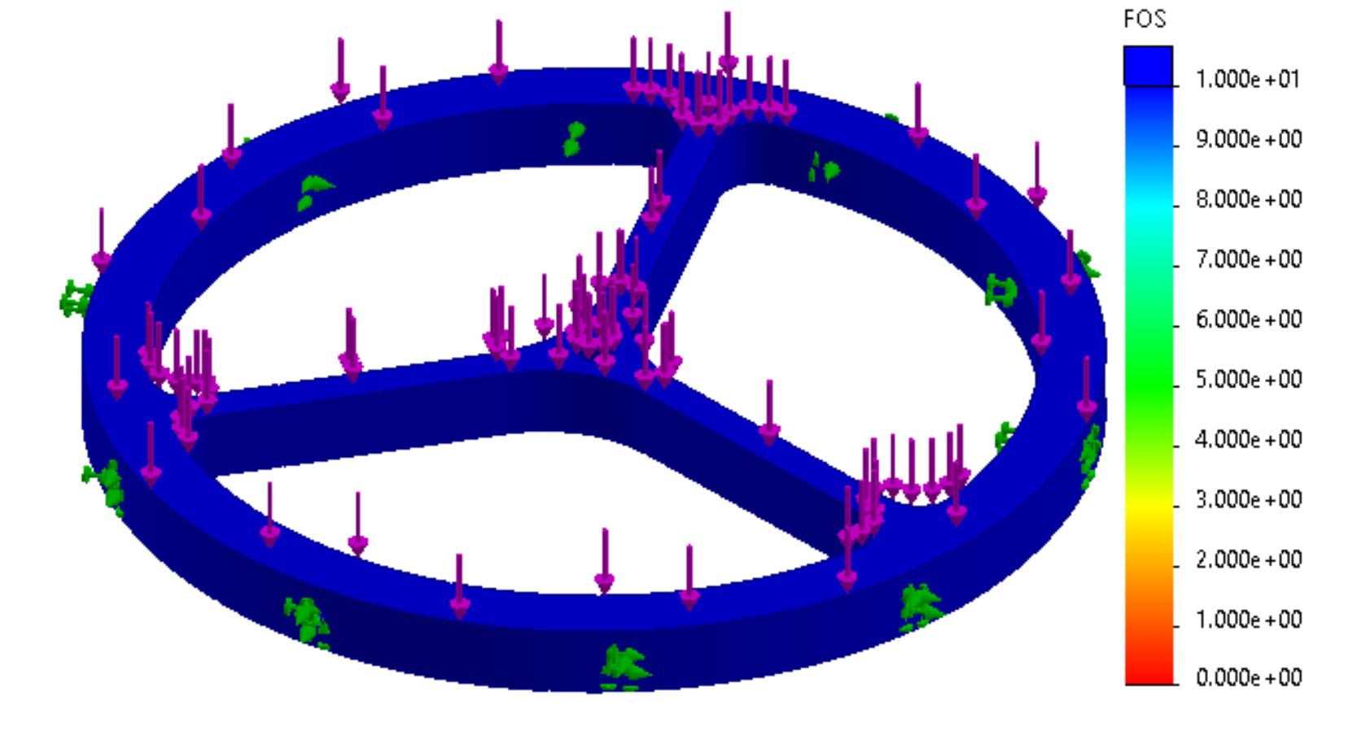
FRR Bulkhead
Eyebolt Connection
Purpose: Withstands forces, minimizes volume, & separates motor from parachute
Aluminum Alloy: 6061- T6 (SS)
Mass: 0.24 lbs
FRR Connection
Forces:
Max. Shock Force (530 N) (Left)
Max. Black Powder Force (1640 N) (Right)
Max G-Forces w/ Parachute (50 N) (Not Pictured)
Min. Factor of Safety: 2.7
Shockforces
Black Powder Forces

Slide 31
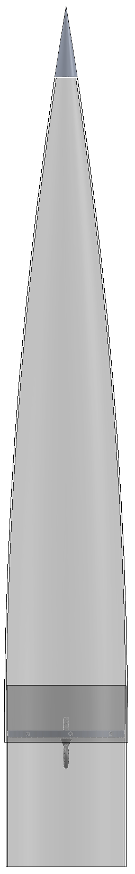
Nose Cone
Tip: Aluminum 6061
Body and Coupler: fiberglass
Recovery attachment point:
Eye Bolt screwed into bulkhead
  Capacity: 475 lbf
  Material: 304 Stainless Steel
33 in
Bulkhead
Eye Bolt
6.17 in
6 in

Slide 32
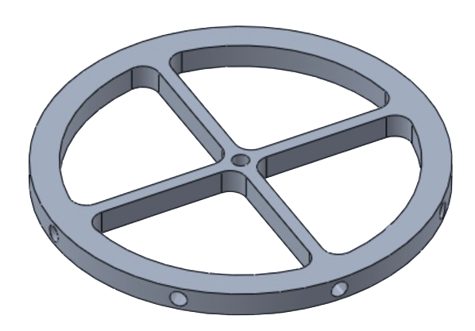
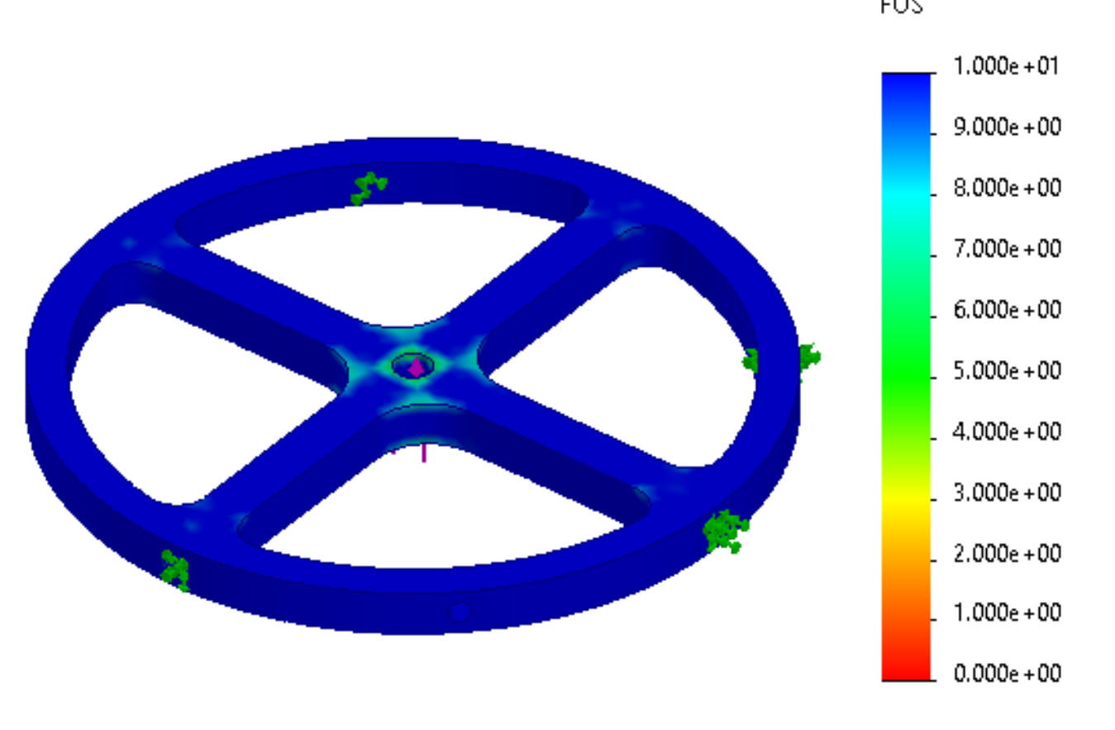
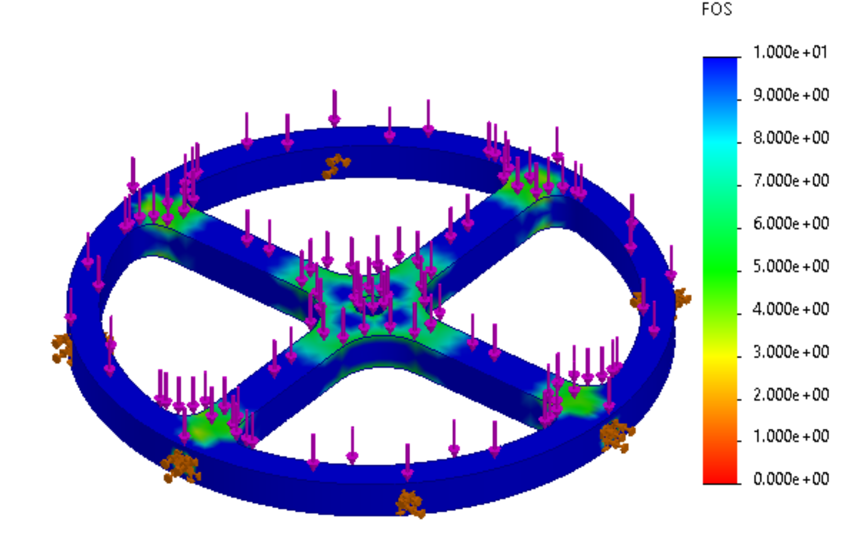
Nose Cone Bulkhead
Eyebolt Connection
Purpose: Withstands forces & minimizes volume
Aluminum Alloy: 6061- T6 (SS)
Mass: 0.33 lbs
Nose Cone Connections
Forces:
Shock Force (810 N) (Left)
Black Powder Force (5410 N) (Right)
Min. Factor of Safety: 1.8
Shockforces
Black Powder Forces

Slide 33
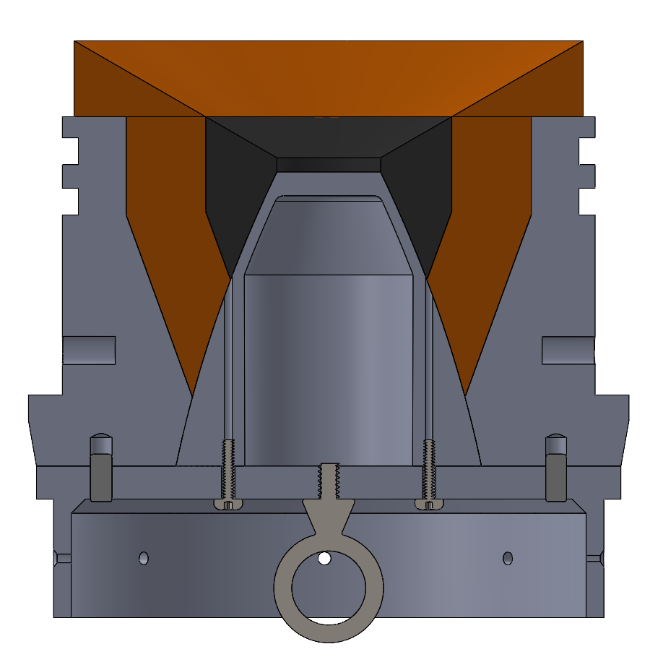
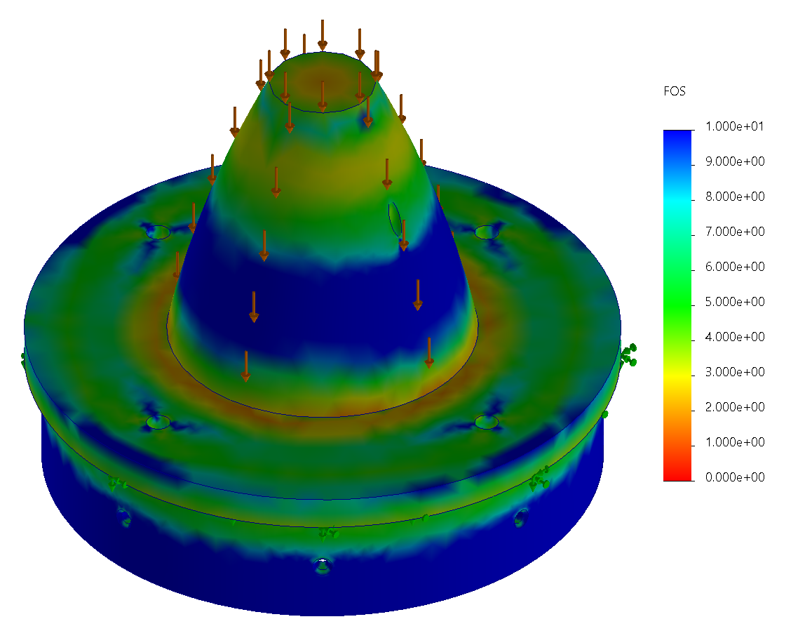
Staging Cone
sustainer nozzle
Purpose: Transitions from booster to sustainer
Aluminum Alloy: 6061- T6 (SS)
Mass: 2.2 lbs
staging cone
Forces:
Sustainer Mass x Max gs + Drag (4600 N)
Min. Factor of Safety: 2
eye bolt (recovery attachment)
Sustainer Mass * Max gs + Drag

Slide 34
Possible Failure Modes
Failure Mode | Probability | Severity | Mitigation
E-matches fail to ignite | Medium | High | Two e-matches per system, black powder integrated day of launch, wires have protective coating
Black Powder well spills | Medium | High | Duct tape cover for well
Shear pins fail to break (black powder or piston) | Low | High | Black powder: more black powder Piston: higher expected force and more black powder
Parachutes tear | Low | Medium | Bags to protect

Slide 35
Possible Failure Modes
Failure Mode | Probability | Severity | Mitigation
Line tangling | High | Low | Swivels, appropriate line sizing
Shock Force breaks connection points | Medium | High | x2 safety factors
Shear pins (main) break due to drogue deployment shock force | Medium | Medium | Calcs, safety factors
Parachute sticks inside bag | Low | High | Tow testing

Slide 36
Testing Timeline
Hydrostatic Piston Test
Drop Testing
Test Launch
February
April
June
January
March
May
Piston Testing
Black Powder Testing
Tow Testing
Spaceport America

Slide 37
Questions?

Slide 38
Aerodynamics

Slide 39
Functional Requirements
Dynamic Stability: Fins must give the rocket a dynamic stability margin between 1.5 and 6 calibers*
Flutter Stability: Fins must have a predicted flutter speed 50% greater than the max speed during flight*
Fins must withstand lift forces
Fillets must secure fins to fin can throughout flight
  Epoxy cannot burn
  Screws must withstand shear force exerted by the fins
Transitions must not deform due to temperature
*Spaceport America Requirement

Slide 40
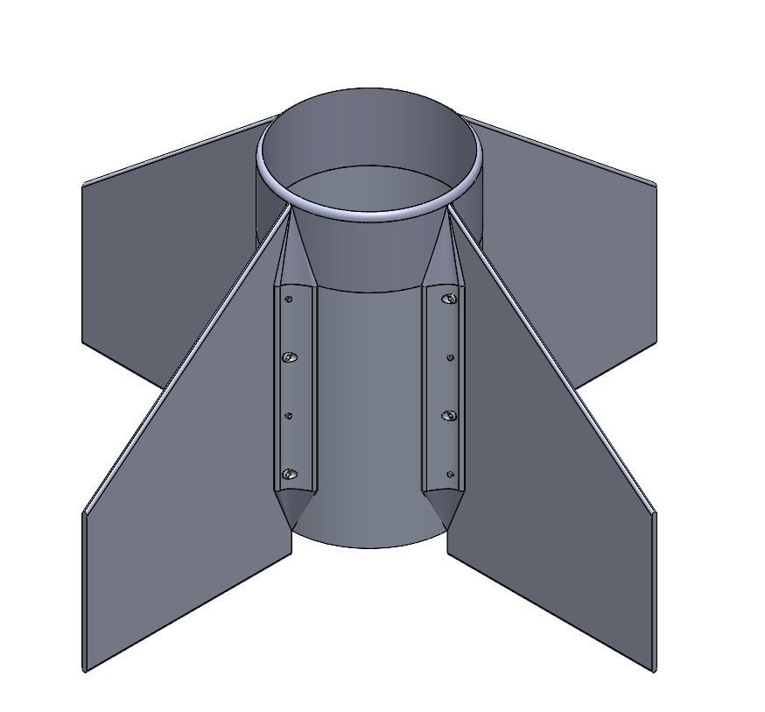
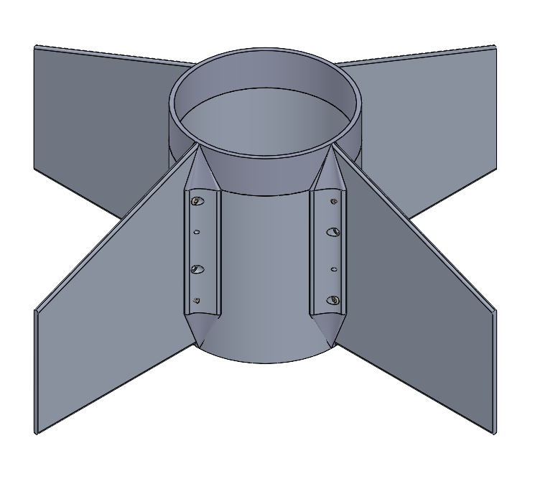
Fin Can Assembly Overview
Material: Aluminum 6061-T6
Two fillets attached to each fin using #8-32 x ⅝” screws
Each fin and fillet is secured to fin can with epoxy resin
Fin leading and trailing edges: sanded to be round
Sustainer
Booster

Slide 41
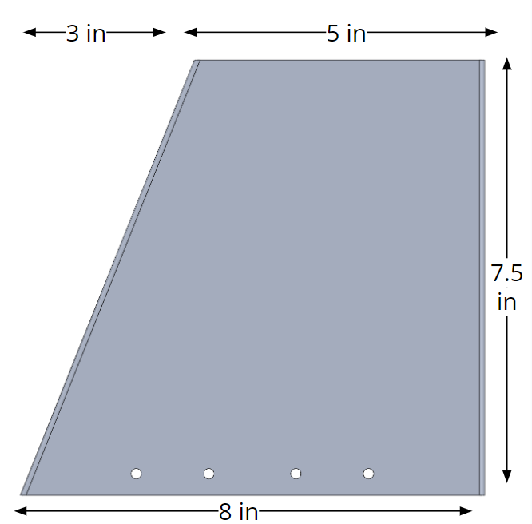
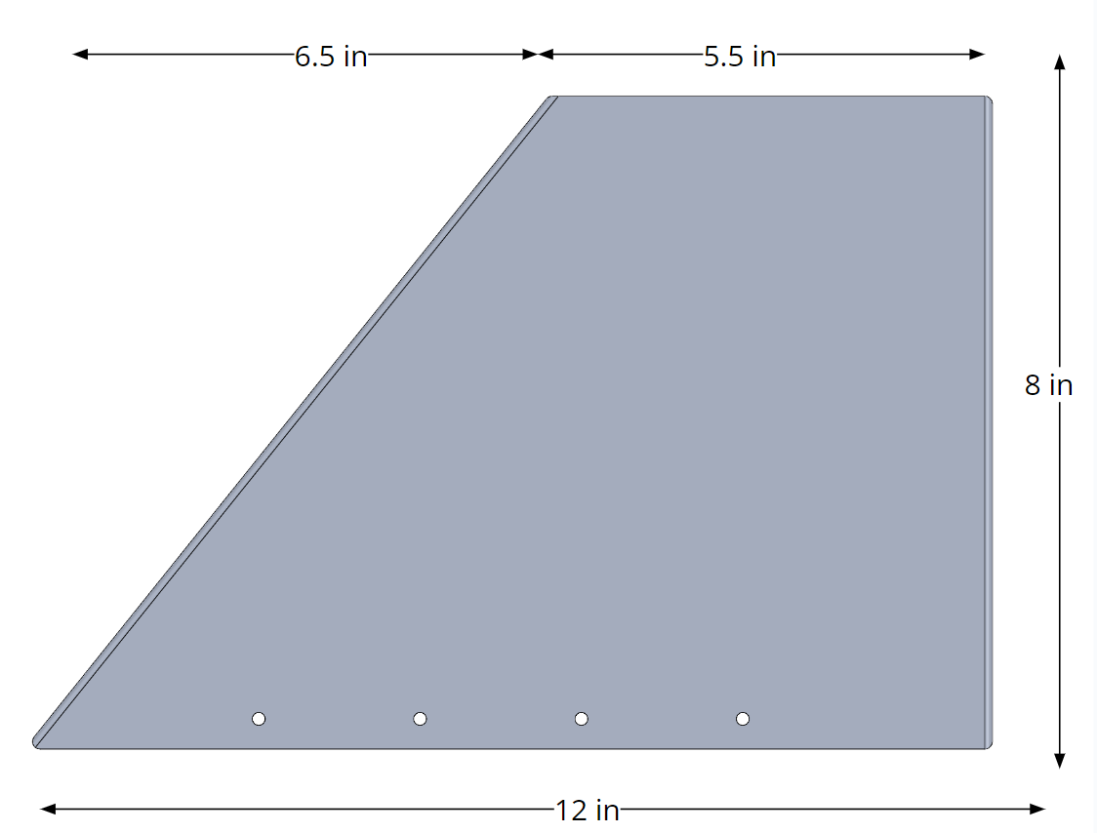
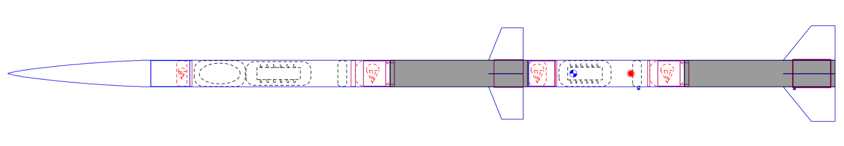
Fin Shape & Design
Sustainer Fin
Booster Fin
Booster Fin

Slide 42
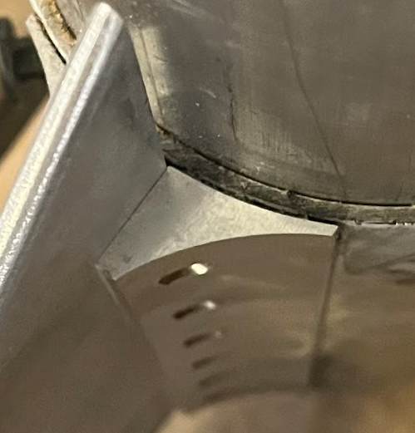
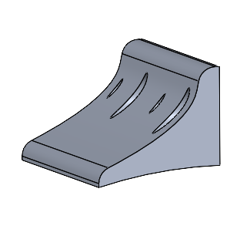
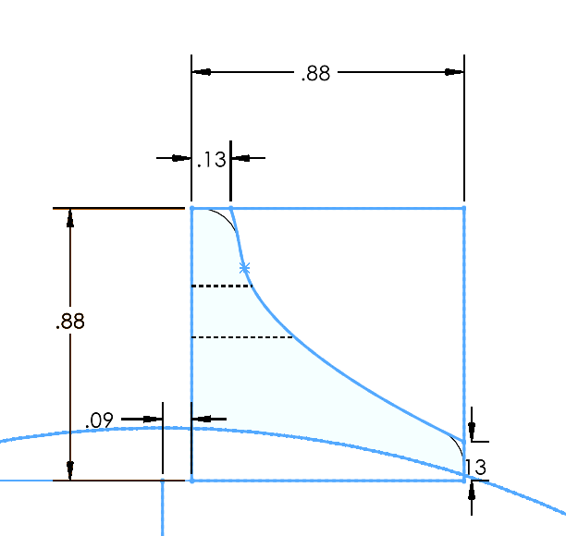
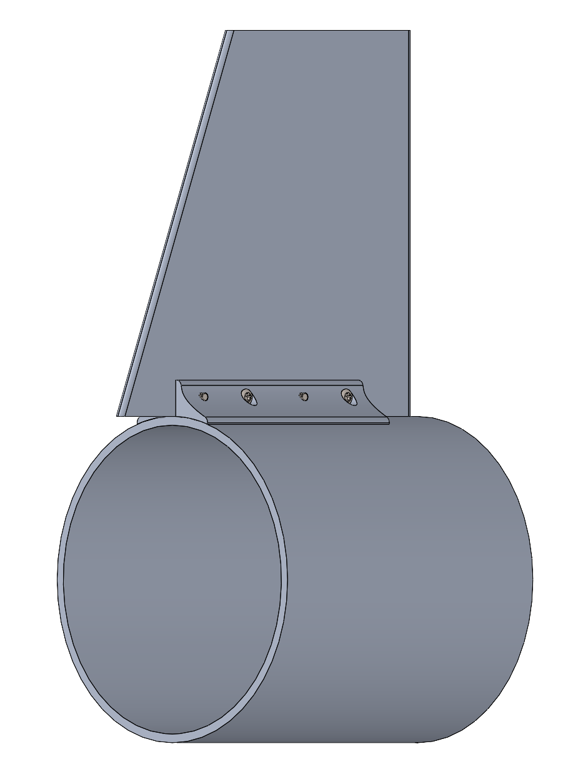
Fin Attachment
Phoenix fillet
Prometheus fillet
Fins are attached to fin can with fillets
Aluminum fillets allow for easy attachment and removal of fins via screws
Fillets attached to fin can with epoxy
Fillet Material: Aluminum 6061-T6
New design includes rounded edges and slightly thinner profile
Fin can, fillet,
sustainer fin:
Fillet profile

Slide 43
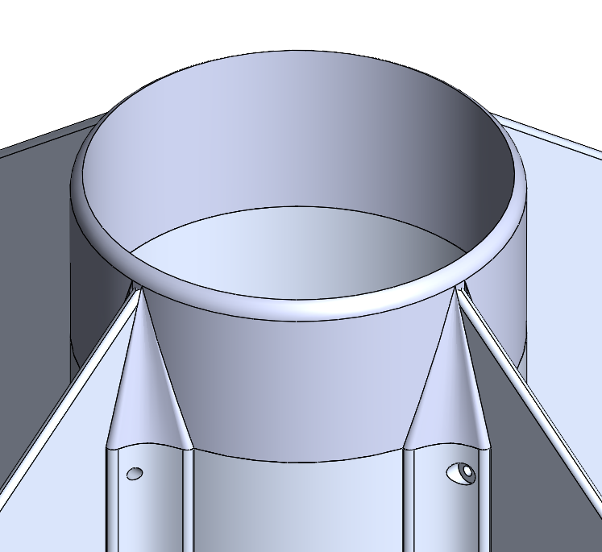
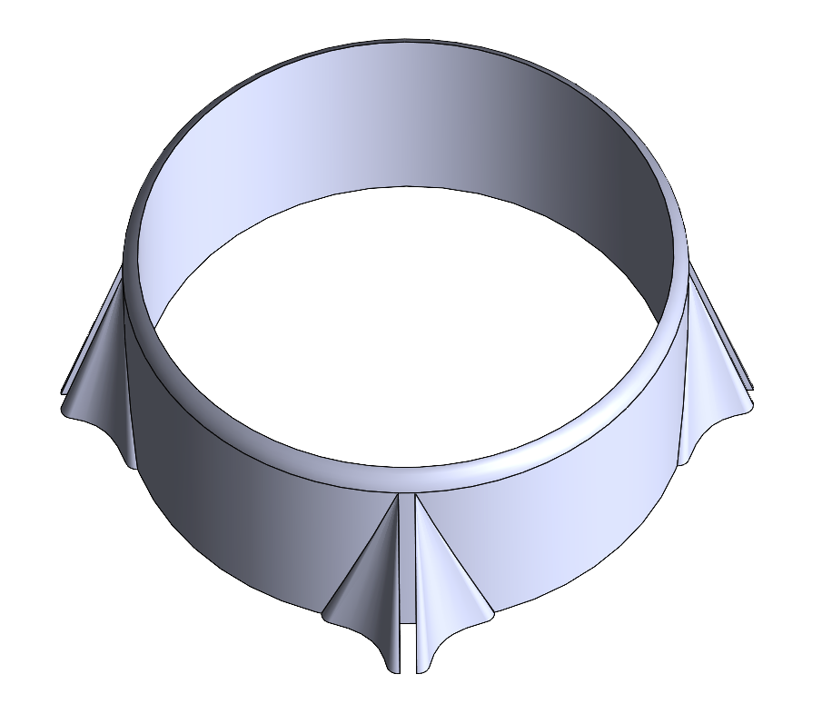
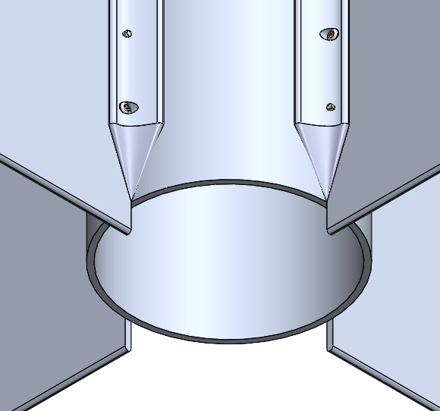
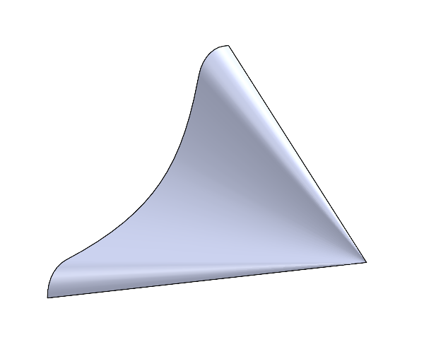
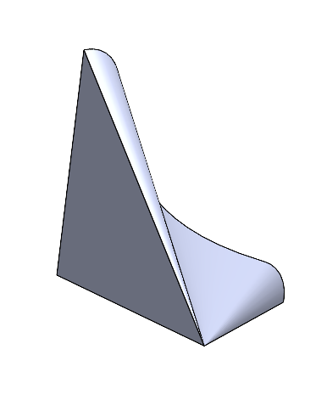
Transitions
Purpose: Aerodynamically transition from motor case to fillets (forward transition) and from fillets to fin can (rear transition)
Material: 3D printed PETG (500F melting temperature) and coated with heat-resistant paint (ablative)
Forward Transition
Rear Transition

Slide 44

Air Stagnation Temperature Calculations
 | Altitude (ft) | Temperature at altitude (K) | Ratio of specific heats | Mach number | Temperature at stagnation (K) | Temperature at Stagnation (°F)
Booster | 2323 | 284 | 1.4 | 1.7 | 447 | 346
Sustainer | 14292 | 260 | 1.4 | 1.7 | 410 | 278
Led to the choice of PETG for transitions
Melting point of PETG: 500°F

Slide 45


Shear Force on Fillet Screws Calcs
 | Fin Mass (lbs) | Velocity (ft/s) | Altitude (ft) | Drag Coefficient | Fin cross sectional area (in²) | Drag Force (N) | Normal Force (N) | Total Force (N)
Booster | 1.29 | 1010 | 2323 | 0.9 | 1.94 | 75 | 80 | 310
Sustainer | 0.89 | 1800 | 14292 | 0.9 | 1.60 | 124 | 55 | 359
Screw Diameter | Shear Strength (psi) | Force at Failure (N)
5/32” | 20000 | 1706
based on McMaster stainless steel pan head screws

Slide 46


Lift Force Calcs
 |  | Altitude (ft) | Speed (ft/s) | Angle of Attack (°) | Mach Number | Lift Coefficient | Fin area (in²) | Lift (N)
Booster | Flat Plate Theory | 77 | 228 | 2.6 | - | 0.28 | 70 | 38
 | Supersonic Thin Airfoil Theory | 77 | 228 | 2.6 | 1.7 | 0.13 | 70 | 18
Sustainer | Flat Plate Theory | 77 | 228 | 2.6 | - | 0.28 | 49 | 26
 | Supersonic Thin Airfoil Theory | 77 | 228 | 2.6 | 1.7 | 0.13 | 49 | 12
Lift forces act on fins, checking to see if fins will be knocked off rocket
Lift force based on two different calculation methods: Flat-Plate Theory and Supersonic Thin Airfoil Theory

Slide 47


Fin FEA
Lift
38 N
Lift
26 N
Drag
124 N
Drag
75 N
Bolt connections
Bolt connections
Fin can fixtures
Fin can fixtures
Sustainer
Min Factor of Safety: 44
Booster
Min Factor of Safety: 41

Slide 48
Flutter Stability
 |  | Velocity @ max dynamic pressure (ft/s) | Flutter Speed (ft/s) | % of Spaceport America Requirement
Booster | Before Separation | 1010 | 2334 | 154
Sustainer | Before Separation | 1010 | 2854 | 188
 | After Separation | 1800 | 3322 | 123

Slide 49
Possible Failure Modes
Failure Mode | Probability | Severity | Mitigation
Structural failure of fasteners | Low | High | Choosing correct screw and hole size to prevent screws being too small
Plastic deformation of fin due to lift force | Medium | High | Making fins thick enough to withstand lift force
Heat induced epoxy failure | Medium | High | Choosing thickness of fin can to prevent epoxy from burning from heat of motor
Forward transition melting | High | Low | Make out of PETG and coat with heat resistant paint

Slide 50
Testing Timeline
Instron Fin Can Testing
Test Launch
February
April
June
January
March
May
Thermal FEA on Fin Can
Spaceport America

Slide 51
Questions?

Slide 52
Air Brakes

Slide 53



What are Air Brakes?
A mechanism that upon actuation, creates a large amount of drag to slow down the rocket by suddenly creating a large amount of area outside the rocket.
Purpose on Booster: Cause drag separation
Purpose on Sustainer: Reach target altitude with accuracy (prevent overshooting)

Slide 54
Functional Requirements
Actuation Time: Transition from fully retracted to fully extended within 0.5 seconds
Predictability: Produce a predictable amount of drag when fully extended
  Cd: 1.9

Slide 55



CAD
Servo mount
Connector
Reinforcement Plate
Leaf
Leaf trays

Slide 56



Torque Calcs
Plate experiences resistance to moving outward (deployment) due to friction with airbrake internals (drag force = normal force)
Inputs
Mass of plate
Distance extended
Time to extend
Coefficient of friction
Air density
Coefficient of drag
Velocity at deployment
Area of plate
Length of servo arms
Distance airbrake is extended
( )
4a⁴(4a²d⁻²-1)^{1/2}
T =
(2mΔx Δt⁻² + 2 μ_{k} ⍴C_{D}V²A)
2a²d-d³+2a²

Slide 57


Servos by Stage
Finding the Torque required to deploy the plates under different conditions
 | Booster | Sustainer
Rockets Speed (ft/s) | 450 | 1000
Altitude of Deployment (ft) | 10,000 | 35,000
Air Density at Altitude (lb/ft^3) | 0.0237 | 0.0565
Drag Force Produced (ft*lb/s^2) | 249.34 | 2,935.35
Torque Required (ft-lb) | 0.564 | 6.59

Slide 58
Servos by Stage Continued
Choosing servos that have enough torque to move the plates
 | Booster | Sustainer
Servo Chosen | D950TW | HS-1005SGT
Torque Capable (ft-lb) | 2.53 | 7.96

Slide 59

Material Selection: Bending Stress
Finding the Bending Stress in the plate due to Drag Force when plate is fully extended
F_{D}
Inputs:
Coefficient of Drag (plate): 1.9
Air Density: 0.0565 lb/ft^3 (at altitude)
Velocity at Deployment: 1000 ft/s
Length of Plate: 2.25in
Thickness of Plate: 0.125in
3.5in
2.25in
3⍴C_{D}V²L²
(2h²)
σ_{B} =
.125in

Slide 60
Bending Breakdown by Stage
Finding the Bending Stress in the plates and the Torque required to move them
 | Booster | Sustainer
Rockets Speed (ft/s) | 450 | 1000
Altitude of Deployment (ft) | 10,000 | 35,000
Air Density at Altitude (lb/ft^3) | 0.0237 | 0.0565
Drag Force Produced (ft*lb/s^2) | 249.34 | 2,935.35
All plate dimensions remain the same for both stages
Bending Stress (MPa) | 6.59 | 77.63
Failure Stress of 6061 T6 Aluminum (MPa) | 241

Slide 61
Possible Failure Modes
Failure Mode | Probability | Severity | Mitigation
Air brakes fail to deploy (sustainer) | Low | Medium | Choose servo with sufficient torque
Air brakes fail to deploy (booster) | Low | Medium | Choose servo with sufficient torque
Deformation or structural failure of plates | Low | Medium | Choose material and thickness to withstand sufficient bending stress
Structural failure of mission package tube at air brakes | Medium | High | Choose sufficient thickness of material within mission package tube and size of screws

Slide 62
Testing Timeline
Prototyping (3D printed mock up)
Test Launch
February
April
June
January
March
May
Wind Tunnel Testing (Determine Cd)
Spaceport America

Slide 63
Questions?

Slide 64
Payload
“In reality there’s no reason to launch a rocket unless there’s a payload”
Space Dynamics Laboratory

Slide 65
Functional Requirements
Independent Function: not required for trajectory/recovery
Mass: No less than 8.8 (-0.4) lbs
  Up to 2.25 lbs. “boiler-plate” mass
Form Factor: Fit completely in a 3U Cubesat dispenser (10cm x 10cm x ≥ 30cm)
Interface: Minimal interference with launch operations
  Modular design (independent weigh-in)
  Remain stable after hours of launch prep, rail time, heat, waiting for other launches
Restricted Materials: no lead, radioactives, “hazardous materials”, live vertebrates
Rapid Results Turnaround: Delivered by noon Saturday
Relevant and well-designed scientific or technical objective
Bonus Technology Relevance Award: Robotics, AI, Infrared

Slide 66


Payload Overview: Cyclops
Goal: Investigate biomechanical effects of hypergravity on the SANS symptom of hyperopic globe flattening of an in-vitro B. taurus ocular specimen
Figure 1. Schematic of hyperopic globe flattening to be measured with Cyclops. Adapted from Velez et al., 2017.

Slide 67
Payload Overview: Cyclops
Goal: Investigate biomechanical effects of hypergravity on the SANS symptom of hyperopic globe flattening of an in-vitro B. taurus ocular specimen
Scientific Motivation:
  Studying launch conditions is difficult (invasive, inconvenient)
  SANS affects up to 75% of astronauts (long-term post-flight)
  NASA science priority for future spaceflight
  Hypothesis in literature that elastic properties of eye contribute to SANS (would be affected significantly by launch)
Data: axial length (flight imaging) as a function of (gravitational) acceleration

Slide 68


Payload Assembly (outer view)
3.937 in
Lid Height: 0.0625 in
11.811 in
Figure 2. Isometric view of payload assembly featuring bulkheads on top and bottom and outer 3U holder in between
Figure 3. Side view of payload assembly featuring bulkheads on top and bottom and outer 3U holder in between

Slide 69


Payload Assembly (inner view)
Eyeball Holder (down)
Camera
Camera
Eyeball Holder (up)
Eyeball Holder
(down)
Camera
Camera
Eyeball Holder (up)
Figure 4. Cross-sectional Isometric of payload assembly featuring outer 3U box, inner cylindrical pressure vessel, and eyeball holders with camera mounts
Figure 5. Cross-sectional side view of payload assembly demonstrating eyeball holder and camera mount relative orientations

Slide 70

Outer Box Manufacturing
COTS 3U dispensers around $3,000
Alternative manufacturing plan: use 1/16” thick sheet of steel and bend into rectangular prism
Figure 6. Rectangular prism net diagram with tabs and screw hole for outer box

Slide 71



Payload Design - Holder V.3
Figure 7. Isometric view of holder
Figure 8. Side view of holder
Figure 9. Top view of holder

Slide 72



Payload Design - Holder V.3
Figure 10. Holder Base
Figure 11. Holder Claw
Figure 12. Holder with eye (left) and diagram of optical muscles (right)
Two Parts, Resin 3D-Printed; Secured by 4, #4-40 screws for rapid experimenting with eyeball
Bounding Volume: 1.92” x 1.68” x 3.17” - Mass: 0.2 lbs
FOS: 360
Biology-inspired Design

Slide 73



Payload Design - Holder V.3
Figure 13. Holder Stress -
Experiencing 14g, fixed at base
Figure 14. Holder Displacement -
Experiencing 14g, fixed at base
Figure 15. Holder Strain -
Experiencing 14g, fixed at base

Slide 74


Pressurized Inner Lid
O-Ring Size Parker No. 2-043
O-Ring
0.049 in
3.623 in
0.093 in
3.525 in
Figure 16: Pressurized inner lid and o-ring groove isometric view (top), dimensioned side view (bottom left), zoomed in and dimensioned side view (bottom right)

Slide 75
Raspberry Pi Camera FOV Diagrams
3.6 in
3.6 in
102°
67°
11.69 in
7.686 in
3.6 in
4.120 in
1.181 in
3.009 in
3.009 in
Figure 17. Field of View diagram side view (left), top view (right)
*Minimum separation between eyeball and camera: 1.070 inches

Slide 76




Raspberry Pi Camera Mount
Curvature of camera base matches that of the cylinder → will be attached on the side of the cylinder by epoxy
Threaded inserts will be placed inside the cylindrical extruded cuts (the screws mounting the camera will be inserted into these threaded inserts)
Four camera mounts in total (one per eyeball)
Figure 18. Camera Mount top view (left), side view (middle), isometric view (right)

Slide 77


Bulkhead FEA
Figure 19. Von Mises stress of bulkhead - 14g applied force, fixed at screw holes; Factor of Safety: 138.565
Figure 20. Resultant displacement of bulkhead - 14g applied force, fixed at screw holes

Slide 78


Electrical Design
Battery: 3.7V Lithium Rechargeable Battery (2.6 x 1.42 x 0.39 in)
Charge Controller: 5V Lithium Battery Charging Board (1.02 x 0.67 x 0.04 in)
Circuit Board: Raspberry Pi 5 (3.35 x 2.2 in)
LED Lights
Cameras: Raspberry Pi 3 Wide

Slide 79

Vibration Damping and Insulation
Overview
  Reduces inner container vibrations to minimize unwanted eyeball displacement
  Insulate eyeball pre-launch (empirical testing needed for acceptable temps.)
Material
  Silicone Gel Pads
    Thermal conductivity: 0.2 W/mK
Gap between inner and outer boxes containing insulation
Figure 22. Cross-sectional view of payload showing area for insulation placement

Slide 80
Possible Failure Modes Analysis
Failure Mode | Probability | Severity | Mitigation
Payload Module Leak | Medium | Low | 2 independent sealed layers of containment (follows NASA ISS standards for biological hazards) PPE when handling rocket and payload pre/post-flight
Pressure Vessel Failure | Low | Medium | Materials and thickness selection (calculated – minimum 0.001 inches for 6061) Impact avoidance with vibration damping materials Visual inspection prior to flight

Slide 81
Possible Failure Modes Analysis (Loss of Science)
Failure Mode | Probability | Severity (Rocket) | Severity (Science) | Mitigation
Eyeball Holder Failure | Medium | Low | High | Vibration testing in flight- simulated environments Selection of eyeball within specified allowable diameter
Camera Failure | Low | Low | Medium | Testing of camera operations prior to flight Secondary Camera(s) in parallel
SD Card Recovery Failure | Medium | Low | High | Alternative science plan of comparing before and after flight axial lengths
LED Light Failure | Low | Low | Medium | Multiple circuits of LED lights in parallel
Electronics Integration Failure | Low | Low | High | Soldered wiring inside of insulating cover Testing of basic electronics function prior to launch

Slide 82
Testing Timeline
Bio Makerspace access and training
Bio Makerspace specimen characterization
Test Launch
February
April
June
January
March
May
Pressure vessel testing
Spaceport America

Slide 83
Questions?

Slide 84
Aeroshells

Slide 85
Aeroshell Requirements
Keeps external cameras below their maximum operating temperature of 50°C
Shape creates minimal drag
Mounts securely to airframe

Slide 86




Overview
2 ply carbon fiber layup over 3D printed nylon 66 frame
½”x ½” cross section
Heat resistant paint applied over surface
Screw holes countersunk into the body

Slide 87
Simulation and Testing
Aerodynamics of shape will be evaluated through CFD
Thermal testing in progress
  Mimic pad time: set camera and aeroshell in sun for an hour to ensure the heat emitted from the camera dissipates to avoid camera overheating
  Mimic flight conditions: set aeroshell in front of heat gun (400°-500°C) for 30 seconds, while measuring the internal temperature with thermocouple.

Slide 88
Questions?

Slide 89
Recovery Mass Breakdown |  |  | AeroD Mass Breakdown
Part | Sustainer Mass (lbs) | Booster Mass (lbs) | Part | Sustainer Mass [lbs] | Bposter Mass (lbs)
Parachutes (x2) | 0.63, 0.96 (1.59) | 0.63, 0.96 (1.59) | Fin Can | 2.17 | 2.81
Quicklinks (x4) | 0.01 (0.04) | 0.01 (0.04) | Fillet (x8) | 0.12 (0.96) | 0.21 (1.68)
Swivels (x4) | 0.01 (0.04) | 0.01 (0.04) | Fin (x4) | 0.89 (3.56) | 1.29 (5.16)
Piston Assembly | 0.70 | N/A | Forward Transition | 0.24 | 0.36
Black powder assembly | 0.57 | 0.70 (1.40) | Rear Transitions (x8) | 0.005 (0.040) | 0.002 (0.016)
FRR Bulkhead | 0.33 | 0.22 | Total: | 6.97 | 9.706
Staging Cone | 4.98 | 1.30 | Share of Stage Mass | 9% | 12%
Total: | 8.25 | 4.59
% of Stage Mass
Total Mass: 12.8 % of Rocket Mass: |  |  | Total Mass: 16.68 % of Rocket Mass: 11%

Slide 90
Payload Mass Breakdown |  | Air Brakes Mass Breakdown
Part | Sustainer Mass (lb) | Part | Sustainer Mass (lbs) | Booster Mass (lbs)
Bulkhead | 0.52 | Servo Bulkhead | 0.230 | 0.230
3U Box + Cylinder | 6.70 | Frames | 0.870 | 0.870
Lids | 0.45 | Leaf tray (x2) | 0.06 (0.12) | 0.06 (0.12)
Raspberry Pi Cameras (4) | 0.04 | Leaves (x4) | 0.140 (0.56) | 0.140 (0.56)
Eyeball | 0.264 | Servo | 0.149 | 0.683
Eyeball Holder | 0.80 | Hardware | 0.23 | 0.23
Electronics | 0.242 | Total: | 2.16 lbs | 2.7 lb
Mass w/o Bulkheads | 8.53 | % of Stage | 3% | 3%
% of Sustainer: | 13.5%
Total Mass: 9.05 lb Percent of Rocket: 6% |  | Total Mass: 4.86% Percent of Rocket: 3%

Slide 91
Cost Breakdown: Recovery and Aerodynamics
Recovery |  | Aerodynamics
Item | Total Cost | Item | Total Cost
Main Parachutes | $550 | Fin Stock | $475.66
Lines | $71.2 | Fillet Stock | $110.25
Lines Hardware | $713.07 | Fin Can Stock | $520.79
Piston | $43.20 | Screws | $12.62
Bulkhead Stock | $267.91 | Epoxy | $19.98
Acrylic Stock | $38.42 | Total | $1,139.3
Shear Pins | $286.32
Total | $1,970.12
Total: 12.8 lbs
Notes:
BH Masses have changed + there are new additions:
BOOSTER: x2 Black Powder assembly(0.70 - 1.40), , ( 1x FRR Bulkhead (0.22 lbs), x1 staging cone (1.3 lbs) , Parachute masses total - 5ft + 7ft (10.1 oz + 15.3 oz, 1.59 lbs). Quicklinks x4 (.008 x 4 (.032)), swivels x4 (.01 x 4 (.04))
SUSTAINER: x1 Black Powder assembly (0.70), , x1 Piston assembly (0.57 lbs), x1 nose cone (4.98), x1 nose cone BH (0.33 lbs), and Parachute mass total (1.59 lbs), quicklinks x4 (.008 x 4 (.032)), swivels x4 (.01 x 4 (.04)

Slide 92
Cost Breakdown: Payload and Air Brakes
Payload |  | Air Brakes
Item | Total Cost | Item | Total Cost
Outer 3U Box Stock + Bulkhead Stock | $237.22 | Frame + Bulkhead Stock | $286.20
Pressurized Cylinder Stock | $206.89 | Plates Stock | $54.34
Biomed Resin | $249.00 | Arm Connector Stock | $40.79
Cow Eyeballs | $155.00 | Servo (Booster) | 479.99
Raspberry Pi 5 | $145.95 | Servo (Sustainer) | $149.99
RP Camera Module 3 (x4) + Adaptor | $189.99 | Servo Hardware | $49.18
Lithium Ion Battery + Charger | $69.22 | Total | $910.5
Gel Sheets | $221.47
Accelerometer + LEDs | $11.94
Total | 1,486.59 | Structures Total | $5,506.51
Total: 12.8 lbs

Slide 93
Intermission

Slide 94
Avionics
Project Prometheus Critical Design Review

Slide 95
Agenda
Avionics Overview
Avionics Bay
Testing Plans

Slide 96
Avionics Overview

Slide 97
COTS = commercial off the shelf
SRAD = student researched and developed
Avionics Overview
Board | Source | Purpose
DENNIS | SRAD | Transmitter/receiver, logging, recovery, air brakes
TeleMega | COTS | Transmitter/receiver, logging, ignite motor, recovery backup
Blue Raven Altimeter | COTS | Logging, ignite motor, recovery backup
Power Amplifier | SRAD | Increase DENNIS transmitting range
Power Board | SRAD | Powers DENNIS, Raven, and camera board
Camera Board | SRAD | Launch footage
Foxeer Cameras | COTS | Launch footage

Slide 98
Avionics Overview- Connections
DENNIS
Power
Amplifier
Powerboard
Camera Board
Blue Raven Altimeter
COTS LiPo
Battery
TeleMega

Slide 99
Questions?

Slide 100
Avionics Bay

Slide 101

Avionics Bay- Layout (Front)
Panel Dimensions:
  4.10 x 5.75 in
Two antennas: Transmitting at different frequencies, lower risk of interference
Total length: 12.5 in

Slide 102


Avionics Bay- Layout (Back)
Sustainer only: Batteries necessary for air brake servo
  LiFePO4, approx 9.6 V with three batteries

Slide 103

Avionics Bay- CAD
3 Boards: Allows placement of more components on the outside of AV Bay for easy access and integration
Panels extend slightly past bulkhead at bottom to ensure no metal surrounding antennas
Total length: 13.5 in
  Includes 0.5 in clearance for antennas

Slide 104
Avionics Bay- Board Mass Breakdown
Component | Quantity | Mass [lb]
LiFePO4 Battery | 6 | 0.180
LiPo Battery | 2 | 0.053
Raven | 2 | 0.055
SRAD Boards | 4 | 0.065
Antenna | 4 | 0.025
Total |  | 0.936 lb

Slide 105
Avionics Bay- Structure Mass Breakdown
Component | Quantity | Mass [lb]
Lower Bulkhead | 1 | 0.330
Upper Bulkhead | 1 | 0.420
Panel | 3 | 0.101
Aluminum Threaded Rod | 3 | 0.024
Miscellaneous | N/A | 0.04
Boards | 1 | 0.846
Total |  | 2.101 lb

Slide 106
Questions?

Slide 107
Testing Plans

Slide 108
Power Amplifier
Power output
  RF power meter
  Goal: >12 dBm
Interference
  Construct AV bay, place and turn on both DENNIS and Telemega, move to different positions around AV Bay
  Goal: Consistent signal received from both flight computers
Distance Confirmation
  Separate laptop from DENNIS PA in open field by as large a distance possible
  Goal: Packets received consistently

Slide 109
Pyros
Ematch Ignition
  Check to see if switch to ignite matches functions; flip transistor with basic program
  Goal: Ematches ignite
State Machine Functionality
  Simulate stages of launch and different lockout conditions
  Goal: Proper functioning of state machine

Slide 110
Cameras
Aeroshell temperature control
  Allow cameras to sit outside in sunlight while on for 30 minutes
  Goal: Cameras record continuously, don’t overheat

Slide 111
Air Brakes
Ground Test
  From horizontal position, deploy recovery and air brakes
  Goal: Ignition of recovery system and deployment of air brakes
Test Launch
  Deploy air brakes at calculated altitude to reach goal apogee
  Goal: Successful deployment, goal altitude reached within 1% accuracy

Slide 112
Questions?

Slide 113
Propulsion
Project Prometheus Critical Design Review

Slide 114
Agenda
Requirements
Propellant Overview
System Overview
Booster Motor
Sustainer Motor

Slide 115
Requirements Summary
Motors
  Deliver enough thrust to carry a 6” diameter sustainer to 30k feet*
  Thrust to weight ratio of at least 8 for the booster and 3 for the sustainer*
  Exit the launch rail with a minimum velocity of 50 FPS* (100 FPS to avoid waiver)
  Bursting pressure of no less than twice maximum expected operating pressure*
  Sustainer ignition at ambient pressure of 11 PSI (.75 atm)
Tests
  All flight hardware hydrostatic tested at a minimum of 1.5 × max operating pressure for at least twice the operating duration*
  All flight hardware static fired yielding a thrust and pressure curve*
  Measured curves must closely match the simulations when accounting for pressure differences
  All flight hardware will be flown once prior to the competition*
*Spaceport America requirement

Slide 116
Propellant Selection
Angry Goat:
  Reactants*
    10% aluminum
    2% magnesium
    28% 90μm AP
    42% 400μm AP
  a = 0.013971 in/(s*psi^n)†
  n = 0.453300†
  Outclasses Deimos in virtually every respect
Deimos:
  Reactants*
    9% aluminum
    24% 90μm AP
    48% 200μm AP
  a = 0.02055 in/(s*psi^n)†
  n = 0.37614†
*percent of total propellant mass
† burn rate = a × pressure^{n}

Slide 117
System Overview
N3261: Angry Goat
11.4 kNs Impulse
38.2 lbs Wet
22 lbs Dry
4.3 s Burn Time
Two stage propulsion will carry the payload to 30k ft AGL in 45 seconds
O5443: Deimos
21 kNs Impulse
54 lbs Wet
26.4 lbs Dry
3.8 s Burn Time

Slide 118
Questions?

Slide 119
Booster

Slide 120
Requirements
Propulsion
  Push the sustainer to Mach 0.8 in 4 seconds
  Deliver enough initial thrust to accelerate the rocket to at least 100 FPS before leaving the rail
  Thrust to weight ratio of at least 8*
  High acceleration (>10G) & quick burn time (<4s) to drop mass
  Mass flux below 1.5 lb/in²s for the duration of the burn to mitigate erosive burning
Hardware
  Yield at no less than twice max operating pressure*
  Wide tolerances to minimize machining on the motor case
*Spaceport America requirement

Slide 121


Overview
Motor Classification | O5443
Total Impulse | 21 kNs
Specific Impulse | 171 s
Propellant Mass | 27.6 lbs
Peak Mass Flux | 0.99 lbs/in²s
Average Pressure | 600 psi
Peak Pressure | 780 psi

Slide 122




Grain Geometry

Slide 123

Bell Nozzle
Requirements
  Withstand 2*max operating pressure of the chamber
  Attach securely to booster case
  Support the fin can under high acceleration
  Optimized for 1385 ft above ground level level (2/3 of burnout altitude 2078 ft)
Materials
  Aluminum 6061-T6
  Canvas phenolic
  Graphite

Slide 124

Specifications
Mass | 7.13 lbs
Throat Diameter | 1.500”
Throat Length | 0.150”
Convergent Geometry | 60° half angle
Linearized Divergence | 25° half angle
Throat to Expansion Area Ratio | 6.15
Exit Velocity at Optimized Height | Mach 2.97
Ø 1.500”
4.769”
25°
Ø 3.838”

Slide 125





Specification Derivations
Barometric Formula
Isentropic Gas Flow Equations:
P_{r}: 101325 Pa ; T: 288.16 K ; g : 9.81 m/s²; M: 0.0289 kg/mol ; R: 8.3145 J/(Mol*K) ;
h: height above sea level;
M_{e}: exit mach number; 𝜸: specific heat of propellant; p_{c}: chamber pressure; p_{a}: ambient pressure

Slide 126

FOS (Pressure from Chamber)
Min. FoS: 6.245

Slide 127
Risk Assessment and Mitigation - Nozzle
Failure Mode | Probability | Severity | Mitigation
O-rings fail | Low | High | Use three hundred series for the most lenient tolerances and double seal against the case wall
Slag buildup in throat area | Low | Medium | Choose a wider throat for the slag to eject more easily
Gas leak between graphite, phenolic, and carrier interface | Medium | Medium | Score surfaces that RTV needs to seal, utilize a pure taper design that seals better with pressure
Structural failure of graphite throat | Low | High | Choose sufficient thickness of graphite and utilize an FoS of 2

Slide 128


Case
Material | Al 6061-T6
Mass | 11.25 lbs
Length | 34”
Outer Diameter | 6”
Case Thickness | 0.1875”
Liner Thickness | 0.125”
Anticipated stress | 12480 psi
Actual FoS | 2.8
Requirements
  Withstand 780 PSI internal
  Utilize a FoS of 2*
Hoop Stress Approximation
  Used linearized formula
*Spaceport America requirement

Slide 129


Forward Closure
Material | Al 6061-T6
Mass | 1.94 lbs
Bottom Thickness | 0.400”
Bottom FoS | 2.00
Wall Thickness | 0.218”
Wall FoS | 2.00
Case O-Ring | 2-355
Liner O-Ring | 2-353
Requirements
  Prevent exhaust escape
  Seat pressure tap for inflight data collection
  Utilize a FoS of 2*
Forward Closure
*Spaceport America requirement

Slide 130

Factor of Safety
Forward Closure
Min. FoS: 1.00

Slide 131


Forward Retention Ring
Requirements
  Connect the booster to the MPT
  Hold the forward closure in place
  Withstand 88.96 kN upward force (on bottom face)
  Withstand 20.90 kN downward force (on lip)
  FoS above 2*
.298”
Material | Al 6061-T6
Mass | 1.51 lbs
Lower Thickness | 0.200”
Upper Thickness | 0.298”
Minimum FoS | 2.78
5.750”
1.250”
.250”
2.188”
*Spaceport America requirement
5.625”
.200”

Slide 132
Anticipated Maximum Forces
Upward Forces
  86.2 kN
  Derived from anticipated maximum internal pressure and surface area of the FC
Downward Forces
  20.9 kN
  Derived from summing g-force and drag maximums
  183.854 kg (Mass above FRR) * 122.03 m/s² (max acceleration) = 20.67 kN
  Drag: 0.184 kN
Forward Closure

Slide 133

FoS (upward forces)
Forward Closure
Min. FoS: 2.77

Slide 134

FoS (downward forces)
Forward Closure
Min. FoS: 12.0

Slide 135

FEA (max displacement)
Max Displacement: .0001 in

Slide 136

Bolt Selection
Considerations
  Coarse threads to limit seizing and stripping
  Torx head to limit stripping
Threads | 5/16-18
Length | 3/4”
Countersink Angle | 82º
Material | Black-Oxide Alloy Steel
Tensile Strength | 140,000 psi

Slide 137

Bolt Pattern Design
Pattern | 2 rows of 10 bolts
Bolts/Motor | 40
Mass/Motor | 0.75 lbs
Minimum FoS* | 2.06 (Compressive)
Edge Distance | 1.5×D_{Bolt} = 0.470”
Row to Row Distance | 3×D_{Bolt} = 0.940”
Engagement Length (minimum) | 1.5×D_{Bolt} = 0.470”
0.940”
0.470”
*Spaceport America requirement

Slide 138
Bolt Specs
Analysis Assumptions
  Bolt tensile strength: 140,000 psi
  Hole Yield Stress: 35,000 psi
  Factor of Safety: 1.25
  Lubrication torque reduction factor (graphite): 0.5
Maximum Load Before Failure
  Bolt shaft: 7.877 kN
  Bolt threads: 2.643 kN
  Hole threads: 2.237 kN
Torque Specs
  Lubricated Torque: 6.1 Nm
  Preload: 2.237 kN
  Failure Mode: In hole threads
*Max load is calculated from the applicable area and material yield strength

Slide 139
Safety Margins
Part | Lowest Margin of Safety
Case | 1.8
Forward Retention Ring | 1.8
Forward Closure | 4.5
Nozzle Assembly | 1.3
Bolts | 1.06

Slide 140
Risk Assessment and Mitigation - Motors
Failure Mode | Probability | Severity | Mitigation
Bolts torqued incorrectly | Medium | Low | Use a torque wrench and an FoS of 1.25 in torque calcs
Bolts Shear | Low | High | Choose thick enough bolts
Voids in propellant | Medium | Medium | Use density of the propellant to see if there are large voids
O-ring seals leak | Low | High | Choose material and thickness to withstand sufficient bending stress
Ablative liner fails | Low | High | Sufficient thickness, look for defects
Forward Closure Deforms | Low | High | Use an FoS of 2, conduct light test after hydrostatic test

Slide 141
Mass Breakdown
Part | Mass (lbs) | % Booster Mass
Reusable Hardware | 21.2 | 21.9
Consumable Hardware | 5.2 | 5.4
Propellant | 27.60 | 28.5
Total | 54 | 55.8

Slide 142
Questions?

Slide 143
Sustainer

Slide 144
Sustainer Requirements
Propulsion
  Push the sustainer to an apogee at 30000 feet*
  Thrust to weight ratio of at least 3*
  Moderate constant acceleration (around 5G)
  Mass flux below 1.5 lb/in²s for the duration of the burn to mitigate erosive burning
  Have a similar internal pressure as the booster to reduce design complexity
Hardware
  Yield at no less than twice max operating pressure*
  Ignition system must be primed on the pad*
  Wide tolerances to minimize machining on the motor case
  Utilize the same bolts, o-rings, case stock, and retention rings as the booster
*Spaceport America requirement

Slide 145


Sustainer Overview
Motor Classification | N2641
Total Impulse | 11.4 kNs
Prop Mass | 16.16 lbs
Hardware Mass | 22 lbs
Peak Mass Flux | 0.81 lbs/in^2*s
Average Pressure | 554.95 psi
Peak Pressure | 604.77 psi

Slide 146



Grain Geometry

Slide 147

Bell Nozzle
Requirements
  Withstand 2*max operating pressure of the chamber
  Attach securely to booster case
  Support the fin can under high acceleration
  Optimized for 12822 ft above ground level (sum of 2/3 of height difference from ignition to burnout and ignition)
Materials
  Aluminum 6061-T6
  Canvas phenolic
  Graphite

Slide 148

Specifications
Mass | 7.45 lbs
Throat Diameter | 1.100”
Throat Length | 0.150’’
Convergence Geometry | 60° half angle
Linearized Divergence | 26° half angle
Throat to Expansion Area Ratio | 7.62
Exit Velocity at Optimized Height | Mach 3.09
1.100”
4.484”
26°
3.226”

Slide 149


Specification Derivations
Barometric Formula
Isentropic Gas Flow Equations:
P_{r}: 101325 Pa ; T: 288.16 K ; g : 9.81 m/s²; M: 0.0289 kg/mol ; R: 8.3145 J/(Mol*K) ;
h: height above sea level;
M_{e}: exit mach number; 𝜸: specific heat of propellant; p_{c}: chamber pressure; p_{a}: ambient pressure

Slide 150

FOS (Pressure from Chamber)
Min. FoS: 6.276

Slide 151

Case
Material | Al 6061-T6
Mass | 10.2 lbs
Length | 31”
Outer Diameter | 6”
Case Thickness | 0.1825”
Liner Thickness | 0.125”
Anticipated Stress | 9000 psi
Actual FoS | 3.3
Requirements:
  Withstand 600 PSI during burn
  Withstand 900 PSI for twice the burn time during hydrostatic test*
  Utilize a FoS of 2*
Hoop Stress Approximation
  Used linearized formula
*denotes Spaceport America requirement

Slide 152


Forward Closure and IHEI
Purposes
  Ignite sustainer at 8100 feet AGL (~11 psi)
  Choke flow of e-match to provide sufficient pressure and heat to ignite inner grain geometry
  Seat pressure tap for data collection
  Prevent exhaust escape
  FoS above 2*
  Utilize the same retention ring as the booster
Materials
  Propellant: Angry Goat
  Canvas phenolic
  Aluminum 6061-T6
*Spaceport America requirement

Slide 153


IHEI Igniter Bolt

Slide 154


IHEI Igniter Bolt (Crisalli Igniter)

Slide 155

Specifications
Dry Mass | 2.297 lbs
Propellant Mass | 1.601 lbs
Forward Diameter | 3.00”
Throat Diameter | 0.25”

Slide 156

IHEI Testing
Goal
  Test the performance of the IHEI in a low pressure environment
  Prove the feasibility of the system
  Determine the risk of the erosive burning of the nozzle
Analysis Criteria
  Success
    Propellant lights and burns for more than 0.5s
    Pre-choke pressure remains above 250 psi for 0.5s
  Failure
    Propellant fails to light
    Propellant lights and is immediately extinguished

Slide 157
Risk Assessment and Mitigation - IHEI
Failure Mode | Probability | Severity | Mitigation
Igniters fail | Low | High | Use two completely separate igniters that can each light the grain alone
IHEI doesn’t light | Medium | High | Choose sufficient throat size to choke the igniter burst
Choke point fails structurally | Medium | High | Choose a throat length that can support itself, brace against grain wall
Igniter bolts leak through hole | Low | High | Utilize high temperature epoxy, verify with hydrostatic tests
Bolts and transducer leak around threads | Low | High | Utilize tapered threads and teflon tape, verify with hydrostatic tests

Slide 158
Mass Breakdown
Part | Mass (lbs) | % Sustainer Mass
Reusable Hardware | 17.7 | 19.1
Consumable Hardware | 4.3 | 4.6
Propellant | 16.2 | 17.5
Total | 38.2 | 41.2

Slide 159
Safety Margins
Part | Lowest Margin of Safety
Case | 1.5
Forward Retention Ring | 1.8
HEI | 4.5
Nozzle Assembly | 1.5
Bolts | 1.06

Slide 160
Questions?

Slide 161
Appendices and
Reference Slides

Slide 162
Project Prometheus: Structures & AeroD
Critical Design Review
10 December 2023

Slide 163

Payload Failure Modes Analysis
Failure Modes: | Payload Module Leak | Pressure Vessel Failure
Probability | Medium | Low
Severity | Low | Medium
Mitigation | 2 independent sealed layers of containment (follows NASA ISS standards for biological hazards) PPE when handling rocket and payload pre/post-flight | Materials and thickness selection (calculated – minimum 0.001 inches for 6061) Impact avoidance with vibration damping materials Visual inspection prior to flight
Table 3. Payload Failure Modes Analysis

Slide 164
Payload Failure Modes Analysis (Loss of Science)
Failure Modes: | Eyeball Holder Failure | Camera Failure | SD Card Recovery Failure | LED Light Failure | Electronics Integration Failure
Probability | Medium | Low | Medium | Low | Low
Severity | Low | Low | Low | Low | Low
Mitigation | Vibration testing in flight- simulated environments Selection of eyeball within specified allowable diameter | Testing of camera operations prior to flight Secondary Camera(s) in parallel | Alternative science plan of comparing before and after flight axial lengths | Multiple circuits of LED lights in parallel | Soldered wiring inside of insulating cover Testing of basic electronics function prior to launch
Table 4. Payload Failure Modes Analysis - Loss of Science Cases

Slide 165
Project Prometheus: Avionics
Critical Design Review
10 December 2023

Slide 166
Avionics Bay- Maximizing Antenna Spacing
Triangular design: maximizes the amount of space between antennas
Downlink transmitting frequencies: 70 cm band
  Best practices space antennas at ¼ wavelength
  This design allows for ⅛ wavelength; not possible to allow more without more vertical space
4.25 in
Antenna

Slide 167
Power Amplifier

Slide 168


Power Amplifier Board- Layout
FRONT
BACK
Antenna
Battery
connection
DENNIS
connection

Slide 169
Power Amplifier Board Redesign- High Level
5.0 V
7.4 V
Buck Converter
5.5 V
LDO Regulator
Power Amplifier
Amplified
RF Output
RF Input
915 MHz
PDR Problem: Too much power drawn from the power board previously
  Solution: use two LiPo batteries directly
  Note: for Spaceport must use LiFePO4 batteries (6.4V)
Decision to use buck converter over boost converter:
  More efficient → less heat generated
  Lower output ripple voltage

Slide 170
Power Amplifier Board Redesign- High Level
5.0 V
7.4 V
Buck Converter
5.5 V
LDO Regulator
Power Amplifier
Amplified
RF Output
RF Input
915 MHz
Typically 20dB gain from chosen PA
  P1dB = 33dBm at 940 MHz
Legal limit of 36dBm effective radiated power at 900MHz
  Concern for manufacturer, less so for us
Range and interference testing

Slide 171
Buck Converter- Component Selection
 | Needed | TPS62913RPUR
Vin (V) | 4.4 to 10 | 3 to 17
Vout (V) | 5.5 | 0.8 to 5.5
Iout (A) | 0.55 | 3
Voltage Ripple | – | < 10 µVRMS after ferrite bead (10 Hz, 100 kHz)
Package and Size (mm²) | – | QFN, 2.0 × 2.0

Slide 172

Buck Converter- Schematic

Slide 173
LDO- Component Selection
 | Needed | TPS7A47
Vin (V) | 5.5 | 3 to 36
Vout (V) | 5.0 | 1.4 to 20.5
Iout (A) | 0.55 | 1
Voltage Ripple | – | 4 µVRMS (10 Hz, 100 kHz)
Package and Size (mm²) | – | VQFN, 5 x 5

Slide 174

LDO- Schematic

Slide 175

Power Amplifier IC- Schematic (Inherited)

Slide 176

Battery Connection- Schematic
JST connector- commonly used, easy to switch out battery
Rated for 3A current → we only need 0.6

Slide 177


Power Amplifier Board- Layout
FRONT
BACK

Slide 178

Four Plane Layout
Goal:
  Minimize loss and interference
  Improve heat dissipation

Slide 179

Grounded Coplanar Waveguide
Method of routing high frequency waves that involves two layers of the PCB
  Ground vias on either side of signal act as “fencing” against interference
  Ground plane helps to isolate the signal

Slide 180
Via Stitching
Uneven spread of vias consequence of automatic avoidance of parts on back side
Via stitching:
  Allow energy to dissipate quickly
  Ensures ground stays relatively consistent voltage

Slide 181


Grounded Coplanar Waveguide
Effective dielectric constant impacted by geometry of transmission line
Higher dielectric constants result in more loss

Slide 182



Grounded Coplanar Waveguide
Balance: Conductor loss higher at lower frequencies
  Skin effect (tendency to distribute on surface of conductor) increases
A bit of a wash in terms of loss at 915MHz

Slide 183

Power Amplifier BOM- Components

Slide 184
Pyros- Overview
Goal:
  DENNIS triggers recovery for rocket rocket
  Ability to ignite 3 ematches per DENNIS
    Sustainer: drogue, main parachute, miscellaneous
Basic concept:
  Send a current through an electronic match to ignite it
  Sense continuity to have confidence circuit working

Slide 185
Pyros- Safety
Decision not to fire first or second stages with DENNIS:
  Site/competition restrictions
  Little additional proof of concept/challenge for firmware or hardware
  Consequence of error high
Testing:
  Circuit and code functionality check
  Ground test
  Flight test on an L2

Slide 186

Pyros- Design
MOSFET transistor switched on by MCU by raising voltage at GATE
MCU pin sense voltage over R₁ to check continuity
Ematch:
  1A to ignite
  40mA max to test

Slide 187
Pyros- Design
MOSFET transistor switched on by MCU by raising voltage at GATE
MCU pin sense voltage over R₁ to check continuity
Ematch:
  1A to ignite
  40mA max to test

Slide 188

Transistor Selection
 | SI2312BDS-T1-E3
V_{DS} | 20V
V_{GS} | 8V
I_{D} (5 seconds) | 5.0A
I_{D} (Steady State) | 3.9A
P_{D} (5 seconds) | 1.25W
P_{D} (Steady State) | 0.75W
Type | N-Channel, Enhancement

Slide 189

Check Transistor Works
Below the maximum current/power of the transistor and above the current needed to ignite the ematch

Slide 190

Resistor Calculations
When gate closed, can approximate current through ematch as current through resistors

Slide 191
Resistor Calculations
Ensure not too much voltage over sensing pin (< 3.3V)

Slide 192

Pyro Schematic

Slide 193

Pyros- Layout

Slide 194
Questions?

Slide 195

Avionics Bay

Slide 196
Project Prometheus: Propulsion
Critical Design Review
10 December 2023

Slide 197
Objectives
Communicate proposed overall motor performance
Get feedback on grain geometry and thrust curves
Share upcoming nozzle and head end ignition changes
Get feedback on individual parts, especially on changes from past projects
Share planned timeline and cost

Slide 198
Motor-MPT Interface

Slide 199



Stress Areas
Bolt cross section area
Bolt thread shear area
Hole thread shear area

Slide 200



Mandril Design

Slide 201

Concave-Convex Nozzle (Secondary COA)
Requirements
  Convert mass flow to thrust with 98% efficiency
  Interface with sustainer case
  Support the fin can
  Optimized for 5666 ft (2/3 of burnout altitude of 8500 ft AGL)
Materials
  Aluminum 6061-T6
  canvas phenolic
  graphite

Slide 202

Specifications
Mass | 8.98 lbs
Throat Diameter | 1.100”
Throat Length | 0.150’’
Convergent Geometry | 60° half angle
Divergent Geometry | 15° half angle
Throat to Expansion Area Ratio | 8.372
Exit Velocity | Mach 3.13 at 5666 ft
1.100”
5.345”
15°
Ø 3.224”

Slide 203

FoS (downward forces)
Forward Closure
Min. FoS: 7.23

Slide 204

FEA (max displacement)
Max Displacement: .0005 in

Slide 205
Specifications Comparison
 | Bell Nozzle | Concave Convex | Δ
Mass | 7.43 lbs | 8.98 lbs | -17.2%
Throat Diameter | 1.100” | 1.100”
Linearized Divergence | 26° Half angle | 15° half angle
Throat to Expansion Area Ratio | 8.372 | 8.372
Length | 4.592’’ | 3.971’’ | -19.4%
Exit Velocity at optimized height | Mach 3.53 | Mach 3.53

Slide 206

Size Comparison

Slide 207
Bolt Max Loads
Max Loads*
Bolt shaft: 7.877 kN
Bolt threads: 2.643 kN
Hole threads: 2.237 kN

Slide 208
IHEI Testing Safety
All team members must wear protective equipment and be in proper clothing at test site
Ensure end cap is properly sealed and attached to the ground so there are no loose parts.
Have the pump operator give readings of the chamber pressure to ensure the whole team is aware
Ensure there is a safe distance from the IHEI before ignition and testing

Slide 209

Forward Closure and HEI (Secondary COA)
Requirements
  Ignite at sustainer at 5500 feet AGL (~0.75 atm)
  Interface with sustainer case and forward retention ring
  Withstand 700 PSI
  FoS above 2*
Materials
  Propellant: Blue Thunder
  Canvas phenolic
  Aluminum 6061-T6
Mass | 1.72 lbs
Wall thickness | 0.125”
Bottom Thickness | 0.51”
*denotes Spaceport America requirement

Slide 210


HEI Calculations and Bolts
Bolts | 4-40
Length | ⅝”
Material | Alloy Steel
Yield Strength | 170,000 psi
Engagement Length | 0.725”
Percentage of total mass | 3.8%

Slide 211
Risk Assessment and Mitigation - Motors
Failure Mode | Probability | Severity | Mitigation
Forward Closure improper seal and leak | Low | High | Reduce the tolerances and test Forward Closure for leaks with air leak testing.
Propellant incorrectly mixed | Low | High | Proper and continuous shifts of mixing, ensure right instruments are employed during the mixing.
Nozzle sealing impacts thrust | Medium | Medium | Pressure test the nozzle sealing in the context of motor
Pressure build up from nozzle | Low | High | Choose a sufficiently wide nozzle to maintain adequate pressure in motor

Slide 212


Forward Retention Ring
Requirements
  Connect the booster to the MPT
  Taper connection between motor and MPT
  Hold the forward closure in place
  Withstand 20,000 lbf upward force
  Withstand 4,700 lbf downward force
  FoS above 2*
.250”
Material | Al 6061-T6
Mass | 1.41 lbs
Lower Thickness | 0.200”
Upper Thickness | 0.250”
Minimum FoS | 2.78
5.750”
1.250”
.250”
2.188”
.488”
5.625”
*Spaceport America requirement

Slide 213
Bolts, O-Rings, and Tolerancing Review
Bolts
Internal pressures are almost identical to the booster, so same bolts and patterns can be used
  5/16-18 3/4” length
O-Rings
ID is the same as the booster, so same O-rings and tolerancing can be used.
  O-Ring 355 sealing the motor case
  O-Ring 353 sealing the ablative liner
  Groove diameter +0.000/-0.005, width +0.000/-0.002

Slide 214
Motor-MPT Interface

Slide 215
Risk Assessment and Mitigation - Nozzle
Severity
 | 1-Insignificant | 2-Minor | 3-Significant | 4-Major | 5-Severe
5 - Almost Certain
4 - Likely
3 - Moderate
2 - Unlikely |  |  | O-ring failure
1 - Rare |  | Improper gluing of nozzle case, phenolic, and graphite | Insulation failure: heat escapes from graphite through phenolic to aluminum. | Slag build up in throat
Low Risk
Moderate Risk
Probability
High Risk
Critical Risk

Slide 216
Risk Assessment and Mitigation - HEI
Severity
 | 1-Insignificant | 2-Minor | 3-Significant | 4-Major | 5-Severe
5 - Almost Certain
4 - Likely
3 - Moderate
2 - Unlikely
1 - Rare |  |  |  | Igniter bolts fail; Low pressure and nozzle geometry impede choking | O-ring leak in the HEI
Low Risk
Moderate Risk
Probability
High Risk
Critical Risk

Slide 217
Risk Assessment and Mitigation - Booster and Sustainer Motors
Severity
 | 1-Insignificant | 2-Minor | 3-Significant | 4-Major | 5-Severe
5 - Almost Certain
4 - Likely
3 - Moderate
2 - Unlikely |  |  | Bolts torqued too loose | Bolts torqued too tight | Propellant mixed wrong
1 - Rare |  |  | Sealing around nozzle leaks; Bolt breaking | FRR lip shears from downward forces | Forward closure not sealed properly
Low Risk
Moderate Risk
Probability
High Risk
Critical Risk

Slide 218
Risk Assessment and Mitigation - Nozzle
Failure Mode | Probability | Severity | Mitigation
Improper gluing of nozzle case, phenolic, and graphite | Low | High | Careful and slow adhesion process. Perform air leak testing.
Improper bell-shaped geometry | Low | Medium | Precise machining or outsource part, especially for graphite treatment.
Nozzle deformations and unexpected geometry | Medium | High | Choose resilient and robust materials that will withstand the high forces and possible erosion.

Slide 219
Tolerancing For Sealing Surfaces*
Inner Diameters: +0.000/-0.004”
Outer Diameters: +0.000/-0.001”
O-ring Groove Diameters: +0.000/-0.005”
O-ring Groove Widths: +0.000/-0.002”
All other non critical dimensions: +0.010/-0.010”
*2-355 o-rings seal the case, and 2-353 o-rings seal the liner

Slide 220

O-Ring Selection
 | 2-355 (9396K317) | 2-353 (9396K315)
Gland Depth (L) | 0.170” | 0.170”
Groove Width (G) | 0.281” | 0.281”
Groove Diameter (B-1) | 5.285” | 5.035”
Plug Diameter (C) | 5.622” | 5.372”
SEALS CASE
0.281”
0.170”
5.285”
5.622”
0.170”
5.035”
5.372”
0.281”
SEALS ABLATIVE LINER

Slide 221
IHEI Testing Procedure
Insert NPT igniter bolts to prime IHEI
Set up IHEI in vacuum test stand, ensuring end cap is securely attached to the ground.
Decrease pressure slowly in increments of 5 psi. Pause for 1 min every increment to investigate leaks. Repeat until near-vacuum conditions reached.
Ignite IHEI

Slide 222


Mandril
Inner mold for the propellant grain
*Spaceport America requirement

