Slide 1
Project Prometheus
Design Review 3
21 January 2024

Slide 2
Agenda
Overview
Propulsion
AeroD
Avionics
*internal deadline

Slide 3
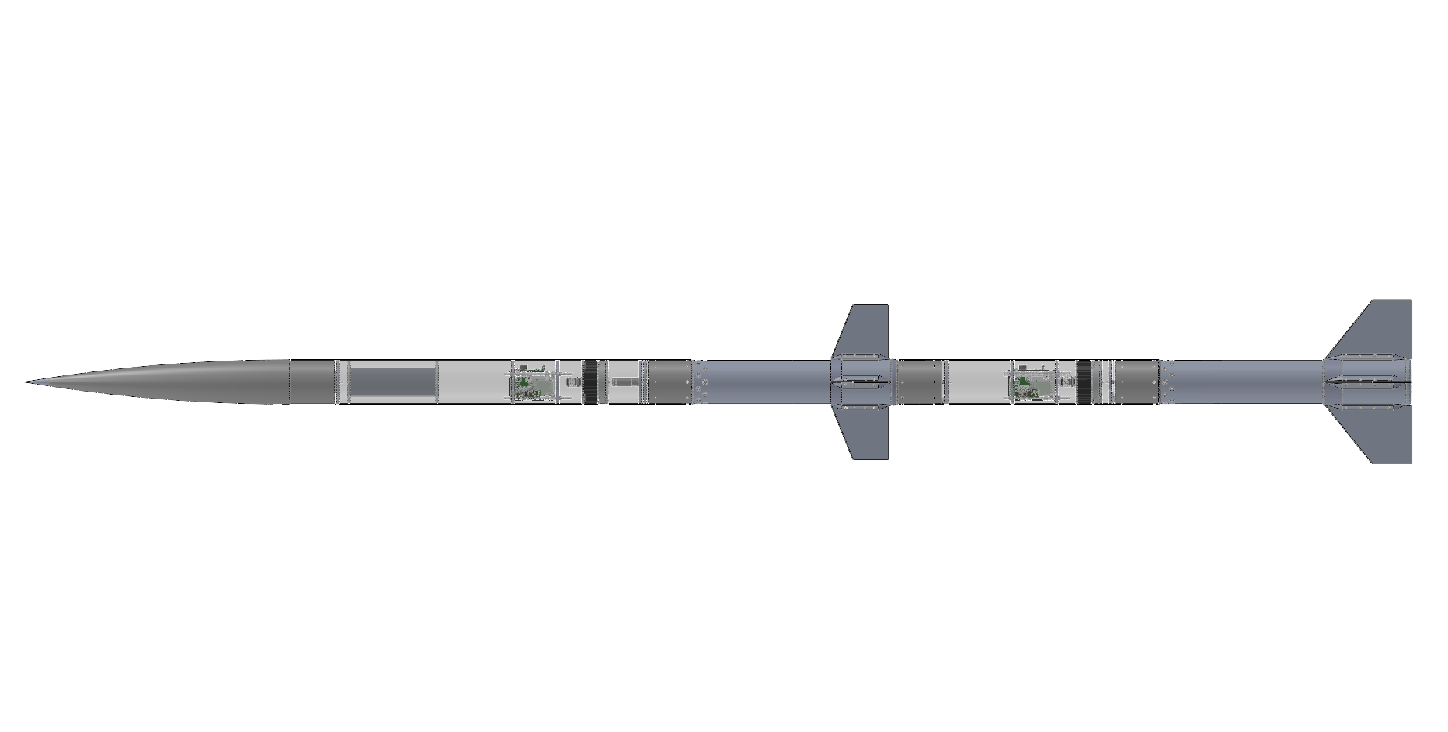
Vehicle Overview
Two-stage rocket
15 ft, 3 in long, 6 in nominal diameter
  Sustainer: 9 ft, 4 in
  Booster: 5 ft, 11 in
146.3 lb loaded mass
  Sustainer: 69.5 lb
  Booster: 76.8 lb
N-class sustainer on O-class booster
Predicted apogee: 32,474 ft AGL
  Ground level: 4600 ft MSL

Slide 4
Flight Event Timeline
T+00:00.00 | Booster Ignition
T+00:05.30 | Booster Burnout
T+00:11.25 | Sustainer Ignition
T+00:15.80 | Sustainer Burnout
T+00:21.00 | Booster Apogee, Drogue Deployment
T+00:43.60 | Sustainer Apogee, Drogue Deployment
T+04:00.00 | Booster Main Deployment
T+04:40.00 | Booster Touchdown
T+05:54.00 | Sustainer Main Deployment
T+06:42.00 | Sustainer Touchdown

Slide 5
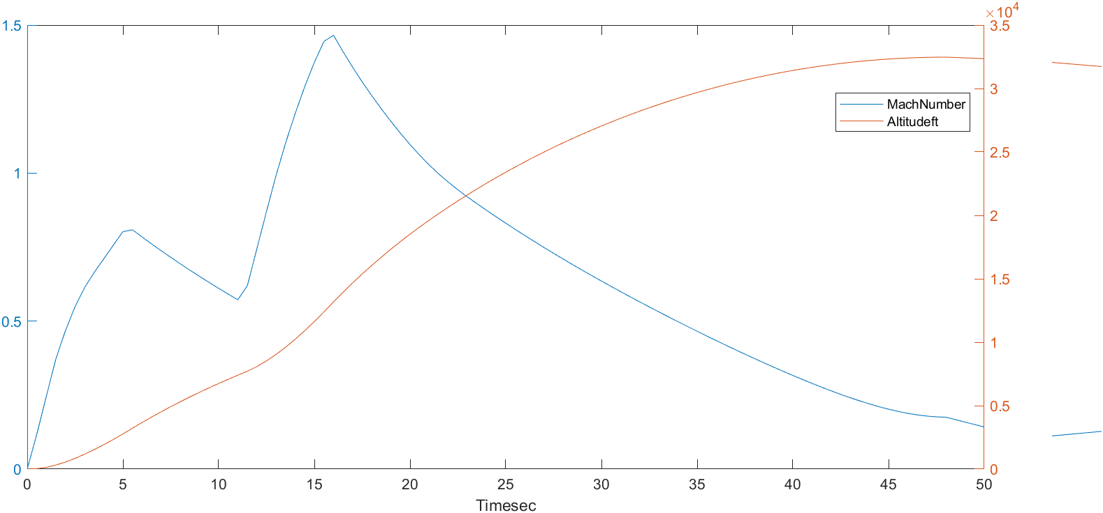
Flight Profile

Slide 6
Spring Schedule
Design Review 4: 11 February 2024*
2nd Interim Progress Report: 16 February 2024
Test Launch Manufacturing Deadline: 7 April 2024*
3rd Interim Progress Report: 19 April 2024
Test Launch: 18-21 April 2024*
Project Technical Report, Poster/Podium Session Materials: 10 May 2024
Spaceport America Cup: 17-21 June 2023
*internal deadline

Slide 7
Solid Propulsion
Notes:
Derek

Slide 8
Agenda
Requirements
Propellant Overview
System Overview
Booster Motor
Sustainer Motor
Notes:
Derek

Slide 9
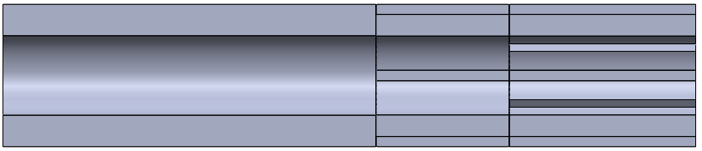
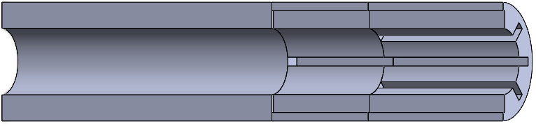
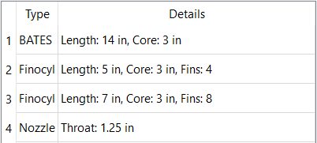
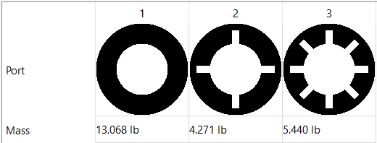
Grain Geometry
Notes:
Derek
ACKNOWLEDGE: the grain didn’t change, still doing BATES, FINOCYL, FINOCYL design

Slide 10
Requirements Summary
Motors
  Deliver enough thrust to carry a 6” diameter sustainer to 30k feet*
  Thrust to weight ratio of at least 8 for the booster and 3 for the sustainer*
  Exit the launch rail with a minimum velocity of 50 FPS* (100 FPS to avoid waiver)
  Bursting pressure of no less than twice maximum expected operating pressure*
  Sustainer ignition at ambient pressure of 11 PSI (.75 atm)
Tests
  All flight hardware hydrostatic tested at a minimum of 1.5 × max operating pressure for at least twice the operating duration*
  All flight hardware static fired yielding a thrust and pressure curve*
  Measured curves must closely match the simulations when accounting for pressure differences
  All flight hardware will be flown once prior to the competition*
*Spaceport America requirement
Notes:
Derek
CLARIFY: bursting pressure of 2x max expected pressure is a design req and does not need to be tested
READ: SPACEPORT REQUIREMENTS
BRIEFLY MENTION: test req
Designed to be two times the expected operating pressure (doesn’t need to be tested… 1.5 times for testing)

Slide 11
Propellant Selection
Deimos:
  Reactants*
    9% aluminum
    24% 90μm AP
    48% 200μm AP
  a = 0.02055 in/(s*psi^n)†
  n = 0.37614†
*percent of total propellant mass
† burn rate = a × pressure^{n}
Notes:
Derek
Over IAP, we decided that we trusted the data of Deimos more and decided to use Deimos for both stages instead.
Explain : a ≡ burn rate coefficient; n ≡ burn rate exponent
r = a×P^{n} r ≡ burn rate; P ≡ pressure;

Slide 12
System Overview
N2865: Deimos
11 kNs Impulse
34 lbs Wet
23 lbs Dry
4.6 s Burn Time
Two stage propulsion will carry the payload to 30k ft AGL in 45 seconds
O3919: Deimos
21 kNs Impulse
50 lbs Wet
28 lbs Dry
5.3 s Burn Time
Notes:
Derek
EXPLAIN: lower end is BOOSTER with DEIMOS, read IMPULSE and WET WEIGHT
EXPLAIN: upper end is SUSTAINER with DEIMOS, read IMPULSE and WET WEIGHT
Our specifications has been updated as we redesigned our propellant grain, more details in each section
21 kNs impulse for the booster, 11.4 for the sustainer
O & N class respectively
~50 lbs and 40 lbs respectively
Assemblies not updated yet 11/5

Slide 13
Questions?
Notes:
Derek

Slide 14
Booster
Notes:
Derek

Slide 15
Requirements
Propulsion
  Push the sustainer to Mach 0.8 in 4 seconds
  Deliver enough initial thrust to accelerate the rocket to at least 100 FPS before leaving the rail
  Thrust to weight ratio of at least 8*
  High acceleration (>10G)
  Mass flux below 1.5 lb/in²s for the duration of the burn to mitigate erosive burning
Hardware
  Yield at no less than twice max operating pressure*
  Wide tolerances to minimize machining on the motor case
*Spaceport America requirement
Notes:
Derek
READ

Slide 16
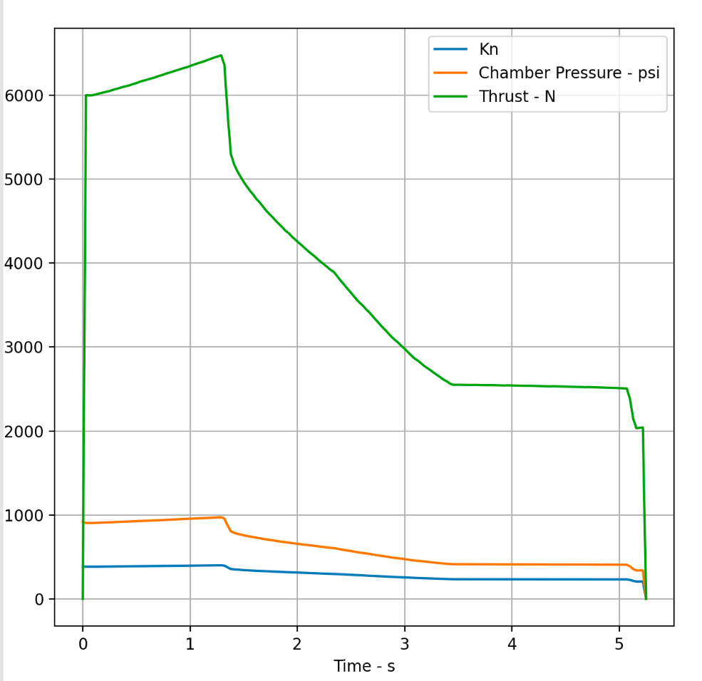
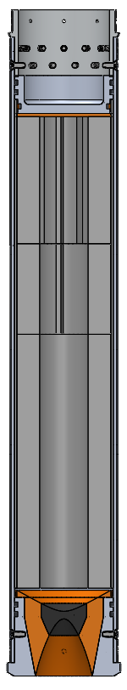
Overview
Motor Classification | O3919
Total Impulse | 20.7 kNs
Specific Impulse | 204.3 s
Propellant Mass | 22.8 lbs
Peak Mass Flux | 0.61 lbs/in²s
Average Pressure | 613 psi
Peak Pressure | 972 psi
Notes:
Derek
ACKNOWLEDGE: We have updated our stats. Our peak pressure and specific impulse is now higher as we lowered the throat size. The total impulse is relatively the same as the last DR.
READ: max pressure | Propellant mass | Peak max flux, which is within our goal of < 1.5

Slide 17
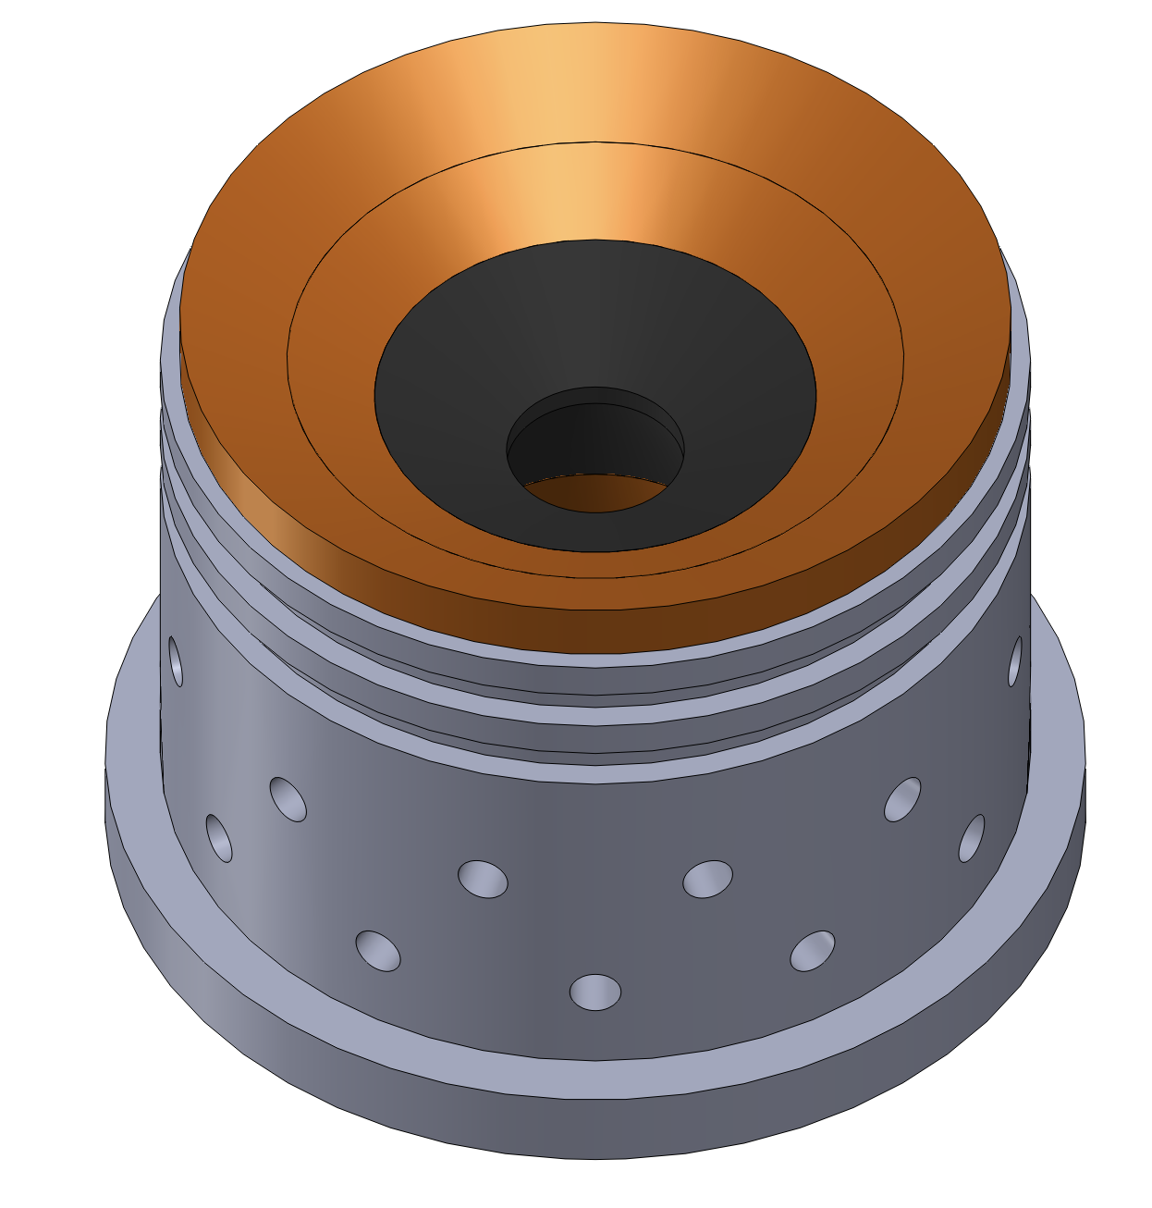
Bell Nozzle
Requirements
  Withstand 2*max operating pressure of the chamber
  Attach securely to booster case
  Support the fin can under high acceleration
  Optimized for ground level (4600 MSL)
Materials
  Aluminum 6061-T6
  Canvas phenolic
  Graphite
Notes:
DEREK
We are still going with a bell nozzle design, made with the same materials.
We have optimized our nozzle for ground level, 4600ft MSL, to simplify our design with a stable variable.

Slide 18
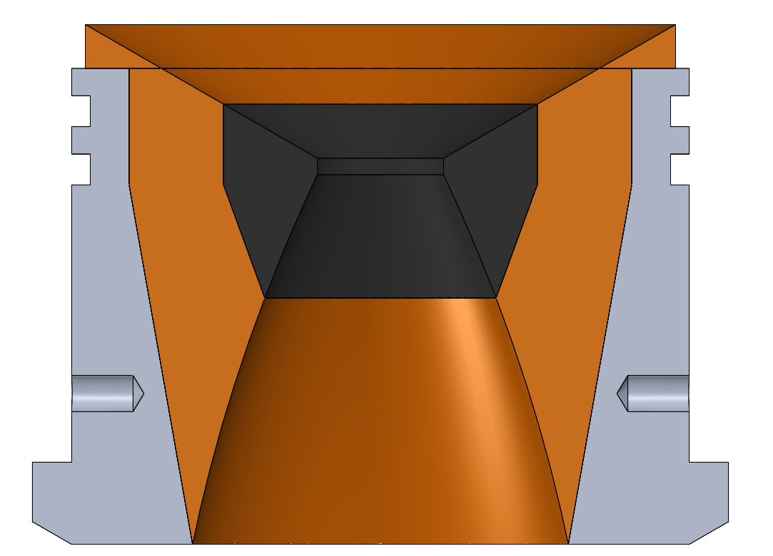
Specifications
Mass | 7.59 lbs
Throat Diameter | 1.150”
Throat Length | 0.150”
Convergent Geometry | 60° half angle
Linearized Divergence | 22° half angle
Throat to Expansion Area Ratio | 7.40
Exit Velocity at Optimized Height | Mach 2.97
Ø 1.150”
4.740”
22°
Ø 3.416”
Notes:
DEREK
Here are the updated stats for the reoptimization
NOTE: mass, throat, expansion ratio

Slide 19
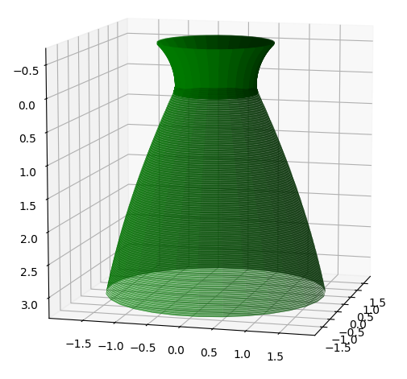
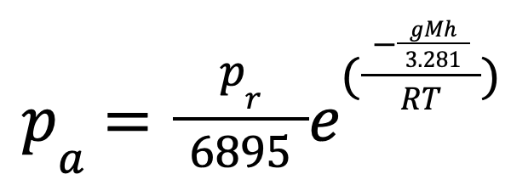
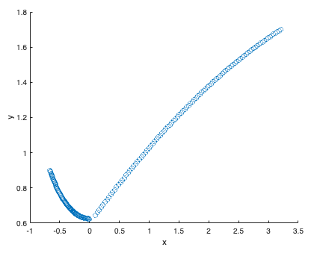
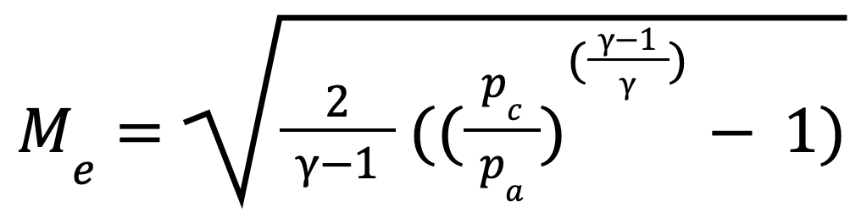
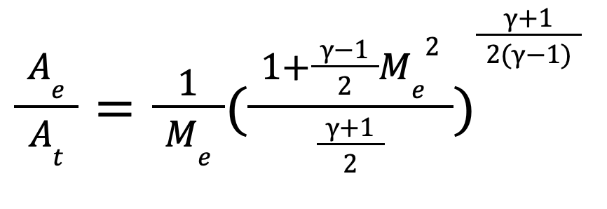
Specification Derivations
Barometric Formula
Isentropic Gas Flow Equations:
P_{r}: 101325 Pa ; T: 288.16 K ; g : 9.81 m/s²; M: 0.0289 kg/mol ; R: 8.3145 J/(Mol*K) ;
h: height above sea level;
M_{e}: exit mach number; 𝜸: specific heat of propellant; p_{c}: chamber pressure; p_{a}: ambient pressure
Notes:
DEREK
STATE: ASSUME gas flow out of nozzle is IDEAL and ISENTROPIC (no heat is added to the gas and no energy is lost due to friction)
EXPLAIN: first find the AMBIENT pressure at our OPTIMIZED HEIGHT | RELATE the AMBIENT pressure to the CHAMBER pressure to find EXIT MACH NUMBER | THEN ABLE to RELATE EXIT MACH NUMBER to EXPANSION RATIO
POINT GRAPH: GRAPHED a BEZIER curve with the RATIO to be DRAWN in SOLIDWORKS

Slide 20
Risk Assessment and Mitigation - Nozzle
Failure Mode | Probability | Severity | Mitigation
O-rings fail | Low | High | Use three hundred series for the most lenient tolerances and double seal against the case wall
Slag buildup in throat area | Low | Medium | Choose a smaller throat for increased pressure
Gas leak between graphite, phenolic, and carrier interface | Medium | Medium | Score surfaces that RTV needs to seal, utilize a pure taper design that seals better with pressure
Structural failure of graphite throat | Low | High | Choose sufficient thickness of graphite and utilize an FoS of 2
Notes:
DEREK
Highlight third point as justification for taper (and its sharp and hard to machine edge) as opposed to the more traditional design with a flat edge (note we might revert to said design if its too hard to machine)
Slag buildup = increase pressure = pipe bomb

Slide 21

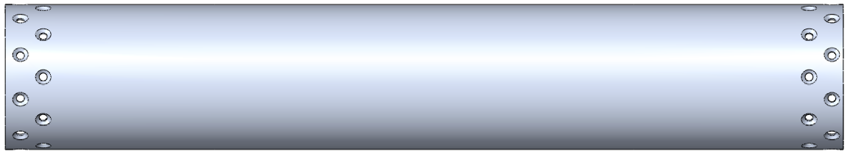
Case
Material | Al 6061-T6
Mass | 11.33 lbs
Length | 34.49”
Outer Diameter | 6”
Case Thickness | 0.1875”
Liner Thickness | 0.125”
Anticipated stress | 12480 psi
Actual FoS | 2.8
Requirements
  Withstand 980 PSI internal
  Utilize a FoS of 2*
Hoop Stress Approximation
  Used linearized formula
*Spaceport America requirement
Notes:
CRIS
Design requirements were to withstand ~800 PSI internal with a FoS of 2.
Mention mass, outer diameter, and the thicknesses
For FoS, a hoop stress approximation was used.
The case has a higher than necessary Factor of Safety because the case at this thickness is more easily sourced, and we are using stock from the scrapped Project Medusa (liners in particular)
Our case is 3/16” thick, and we are using a liner that is ⅛” thick

Slide 22
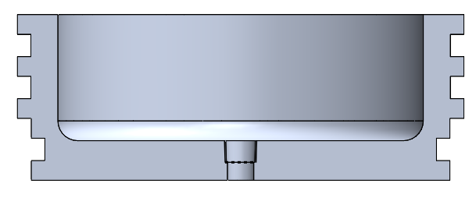
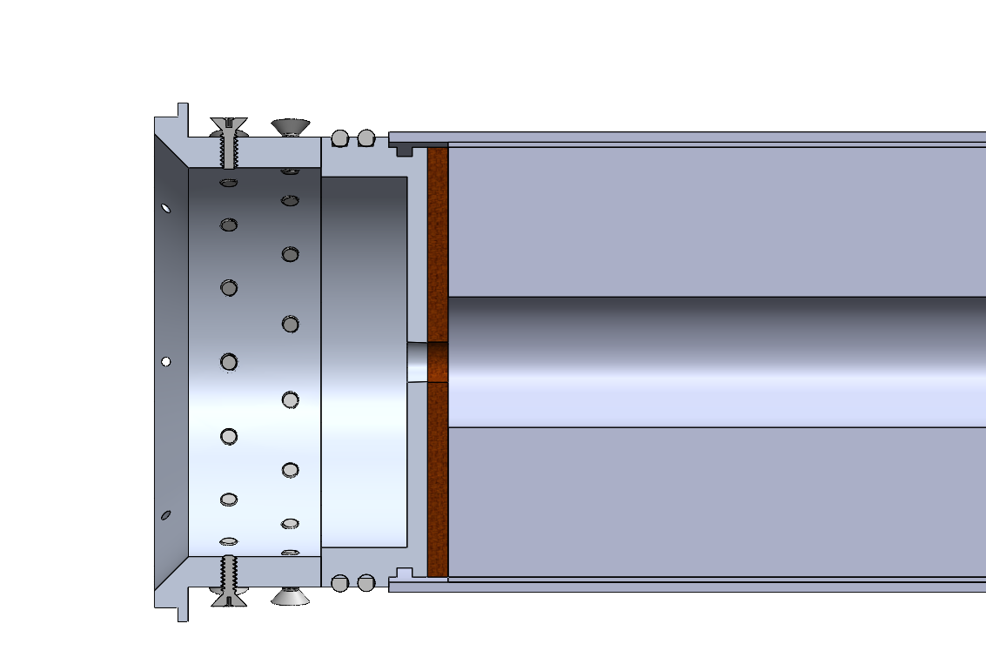
Forward Closure
Material | Al 6061-T6
Mass | 2.04 lbs
Bottom Thickness | 0.500”
Bottom FoS | 2.00
Wall Thickness | 0.170”
Wall FoS | 2.00
Case O-Ring | 2-355
Liner O-Ring | 2-353
Requirements
  Prevent exhaust escape
  Seat pressure tap for inflight data collection
  Utilize a FoS of 2*
Forward Closure
*Spaceport America requirement
Notes:
CRIS
The design requirements for the forward closure were to prevent gas from escaping through the top end (we would like for all of the gas to exit through the nozzle), and seat a pressure transducer to collect pressure data during static fires (this would screw into the hole on the bottom of the forward closure).
Utilized fine element analysis to minimize the thickness of the wall and bottom. The minimum thickness (near the bottom o-ring groove) is 0.218”, and the thickness at the bottom is 0.400”. Collectively these figures allow the part to have an overall FoS of 2 based on the 800 psi max internal pressure.
O-rings to seal the case (top of part) are 2-355, ablative liner (bottom) is sealed by 2-353 series o-rings.
The part has an overall mass of 1.94 lbs.

Slide 23
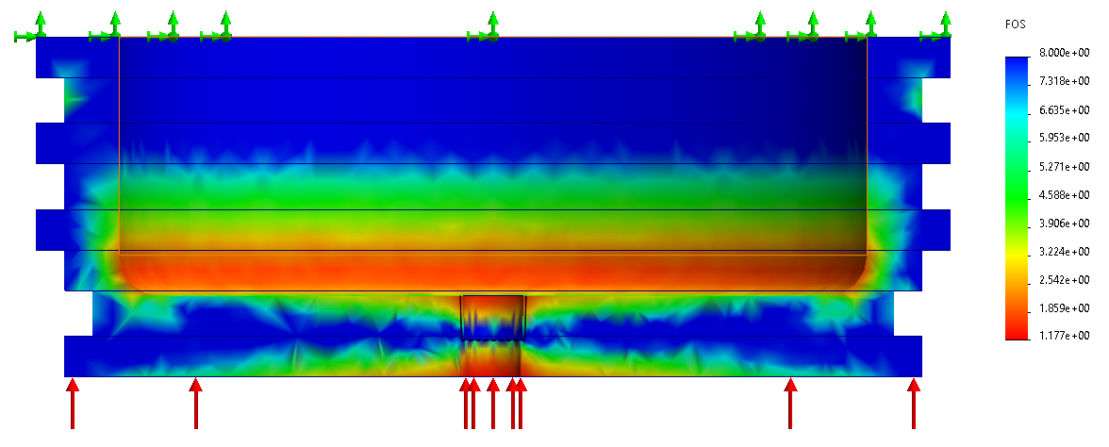
Factor of Safety
Forward Closure
Min. FoS: 1.18
Notes:
CRIS
The FEA here shows a minimum Factor of Safety for each individual components is above 1. Since there is a “band” of the component at or above the necessary safety factor of 2, the factor of safety of 1 on some edges is still enough to ensure there would be no deformation and give the part an FoS of 2.
Despite this, since we are required by SpacePort to use the part we have tested for launch, we would need to see if the part yielded. In particular, if there is any deformity on the bottom face of the FC, we would need to adjust the thickness of the wall or bottom to make the part reusable.

Slide 24
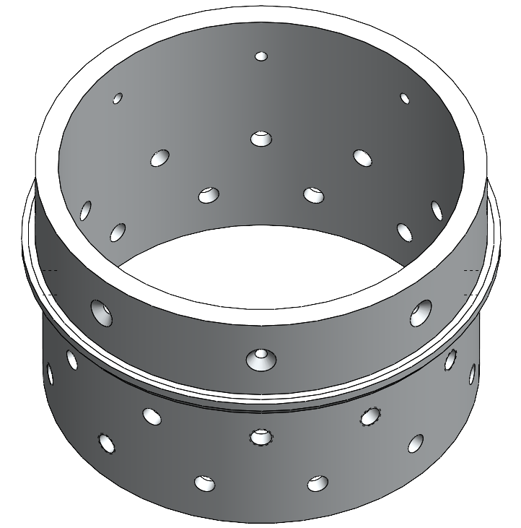
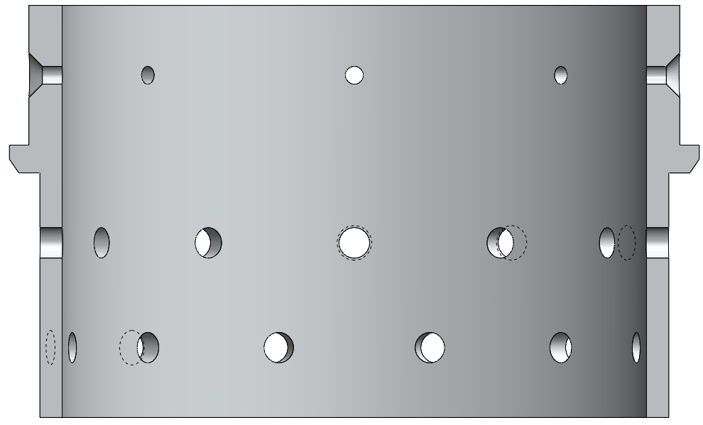
Forward Retention Ring
Requirements
  Connect the booster to the MPT
  Hold the forward closure in place
  Withstand 99.2 kN upward force (on bottom face)
  Withstand 11.4 kN downward force (on lip)
  FoS above 2*
.298”
Material | Al 6061-T6
Mass | 1.51 lbs
Lower Thickness | 0.200”
Upper Thickness | 0.298”
Minimum FoS | 2.43
5.750”
1.250”
.250”
2.188”
*Spaceport America requirement
5.625”
.200”
Notes:
CRIS
The requirements for the FRR are to connect the booster to the mission package tube. In this case the interface was designed to have a taper, which is the angled bit of the lip.
The FRR was also required to withstand around 90 kN of upward force from the maximum pressure. This maximum pressure was applied on the bottom face of the FRR, and an FEA shown later demonstrates the requirement for a FoS above 2 is still met.
Additionally, the FRR has to withstand the maximum downward force of around 21 kN, which is a combination of gravitational acceleration and drag.
Currently, the minimum FoS is 2.78 from the upward forces on the bottom face.
The thickness of the top component is .2975”, and the thickness of the bottom component is .200”. There is no longer a taper on the interior face of the part for ease of machining.

Slide 25
Anticipated Maximum Forces
Upward Forces
  99.2 kN
  Derived from anticipated maximum internal pressure and surface area of the FC
Downward Forces
  11.4 kN
  Derived from summing g-force and drag maximums
  31.2 kg (Mass above FRR) * 360 m/s² (max acceleration) = 11.22 kN
  Drag: 0.184 kN
Forward Closure
Notes:
CRIS
The maximum forces are extracted using Matlab to combine the pressure, gravitational, and drag force data from Open Motor at each time. The max upward force of around 89 kN indicates the maximum force experienced at any one time throughout the duration of the flight of the rocket.
The upward force acts on the bottom face of the FRR.
The maximum downward force occurs at a different time than the maximum upward forces, which will be reflected in the FEA.
The maximum downward force is calculated by multiplying the maximum acceleration of the rocket, around 112 m/s^2 by the mass above the sustainer nozzle, around 184 kgs. This yields a max gravitational acceleration of around 20.67 kN.
The drag force extracted from Ras Aero is about .184 kN, which means the total downward force has a maximum of 21 kN.
Talk about why we are evaluating them separately (ie something could go wrong and downward forces don’t exist, rocket pressurizes before any sort of acceleration and movement, this is a way to ensure we have the right numbers)

Slide 26
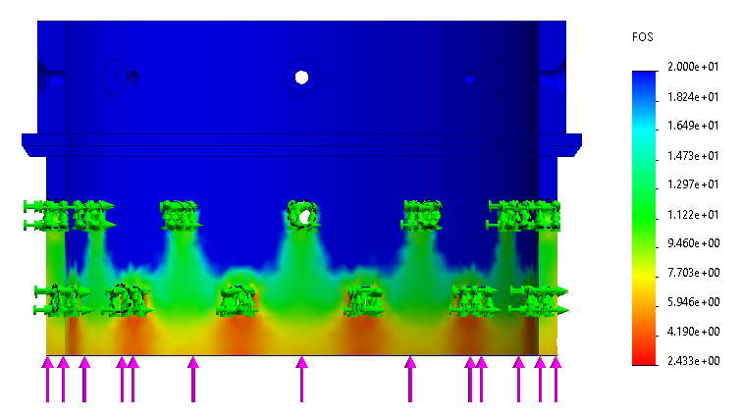
FoS (upward forces)
Forward Closure
Min. FoS: 2.43
Notes:
CRIS
The FEA illustrates the 88.96 kN of force from pressure acting on the bottom face of the FRR. The minimum safety factor here is 2.77, which is significantly smaller than what he had previously when the thicknesses were based on the length of engagement.
Although this is quite a bit higher than the FoS of 2 necessary for spaceport, we did not want to take any risk by going any thinner on the bottom even if the FEA allowed.

Slide 27
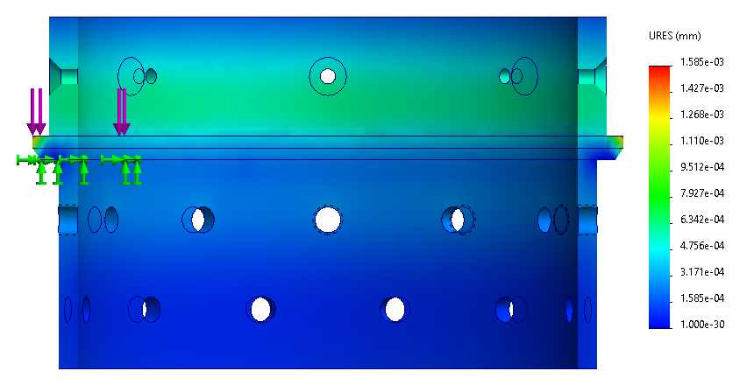
FEA (max displacement)
Max Displacement: .0000624 in
Notes:
CRIS
As a sanity check, we also performed FEA for the maximum displacement with the 21 kN.
This diagram shows displacement in the places we would expect, with the maximum displacement being .0005 inches, which should be fine for our purposes.

Slide 28
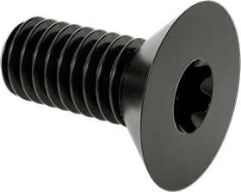
Bolt Selection
Considerations
  Coarse threads to limit seizing and stripping
  Torx head to limit stripping
Threads | 5/16-18
Length | 3/4”
Countersink Angle | 82º
Material | Black-Oxide Alloy Steel
Tensile Strength | 140,000 psi
Notes:
CRIS
When deciding on bolts to use for both motors, the primary considerations we had in mind were to
Use coarse threads to limit stripping aluminum threading
Use torx heads to mitigate stripping of the head
Our final bolt choice are 5/16” diameter, 18 threads per inch, ¾” long countersunk bolts with a countersink angle of 82º made of black-oxide alloy steel which has a tensile strength of 150,000 psi
Acknowledge that the FRR will bolts with the same thread size, just of a different length

Slide 29
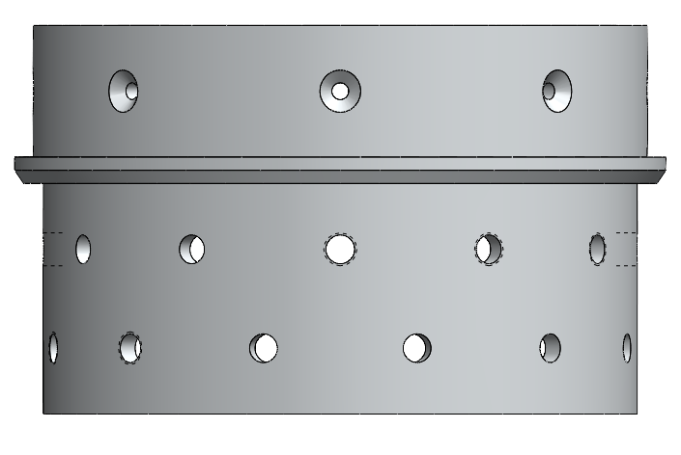
Bolt Pattern Design
Pattern | 2 rows of 12 bolts
Bolts/Motor | 48
Mass/Motor | 0.90 lbs
Minimum FoS* | 2.02 (Compressive)
Edge Distance | 1.5×D_{Bolt} = 0.470”
Row to Row Distance | 3×D_{Bolt} = 0.940”
Engagement Length (minimum) | 1.5×D_{Bolt} = 0.470”
0.940”
0.470”
*Spaceport America requirement
Notes:
CRIS
** Removed design assumptions but should still mention them
Our final bolt pattern for each end of each motor is 2 rows of 10 bolts each giving us a total of 40 bolts per motor.
The minimum factor of safety of this arrangement is 2.06 which is for its compressive strength, and is above the Spaceport America requirement of an FoS > 2
Our design assumptions for this arrangement’s FoSs were an edge distance of 1.5 times the bolt diameter (measured from edge of case to edge of bolt), a row to row distance of 3 times the bolt diameter (measured from center to center), an engagement length of at least 1.5 times the bolt diameter.

Slide 30
Bolt Specs
Analysis Assumptions
  Bolt tensile strength: 140,000 psi
  Hole Yield Stress: 35,000 psi
  Factor of Safety: 1.25
  Lubrication torque reduction factor (graphite): 0.5
Maximum Load Before Failure
  Bolt shaft: 18.095 kN
  Bolt threads: 38.014 kN
  Hole threads: 19.902 kN
Torque Specs
  Lubricated Torque: 28.0 Nm
  Preload: 9.048 kN
  Failure Mode: In bolt shaft
*Max load is calculated from the applicable area and material yield strength
Notes:
CRIS
Analyzed failure modes to determine first mode of failure and calculated torque spec accordingly.
To determine the appropriate torque for our bolts, we used the following assumptions, which are:
[the assumptions]
These assumptions gave us a lubricated torque of 6.1Nm, preload of 2.237 kN, and failure mode in the shaft
Explain what failure mode in shaft means (when the bolt fails, it will break away at the head, allowing us to know that something went wrong)
Our torque analysis also gave the following values for the maximum load that the bolt and hole can withstand (and maintain our factor of safety of 2)
Comment on how failure in threads is undesirable
We also need to do these calcs for the FRR (bolts and length of engagement will be shorter)

Slide 31
Safety Margins
Part | Lowest Factor of Safety
Case | 2.8
Forward Retention Ring | 2.4
Forward Closure | 2.0
Nozzle Assembly (Throat) | 4.1
Bolts | 2.06
Notes:
Cris

Slide 32
Risk Assessment and Mitigation - Motors
Failure Mode | Probability | Severity | Mitigation
Bolts torqued incorrectly | Low | Medium | Use a torque wrench and an FoS of 1.25 in torque calcs
Voids in propellant | Medium | Medium | Use density of the propellant to see if there are large voids
O-ring seals leak | Low | High | Choose material and thickness to withstand sufficient bending stress
Ablative liner fails | Low | High | Sufficient thickness, look for defects
Forward Closure Deforms | Low | High | Use an FoS of 2, conduct light test after hydrostatic test
Notes:
Cris
If the bolts are torqued too loosely, the possibility exists that vibrations during launch or during flight could loosen the bolts and compromise the structural integrity of the rocket. If the bolts are over torqued, they may strip the aluminum threads.
To mitigate this, we will tighten the bolts using a torque wrench to tighten to the correct torque.
If the bolts shear, the structural integrity of the rocket is compromised and components are not held securely in place.
To mitigate this, we are using a high amount of bolts, and they are pretty thick, which gave us a pretty good safety cushion.
If there are voids in the propellant, this leads to unaccounted for surface area in the propellant that could increase the chamber pressure. Since our components are designed for a certain max pressure without these imperfections, this could damage some of the parts.
As mitigation for this, we check the propellant and using its density, determine whether any voids are present.
If the o-rings do not

Slide 33
Mass Breakdown
Part | Mass (lbs) | % Booster Mass
Reusable Hardware | 20.3 | 43.36
Consumable Hardware | 6.77 | 10.54
Propellant | 22.78 | 46.10
Total | 49.85 | 100
Notes:
Cris

Slide 34
Questions?
Notes:
Cris

Slide 35
Sustainer
Notes:
Cris

Slide 36
Sustainer Requirements
Propulsion
  Push the sustainer to an apogee at 30000 feet*
  Thrust to weight ratio of at least 3*
  Moderate constant acceleration (around 5G)
  Mass flux below 1.5 lb/in²s for the duration of the burn to mitigate erosive burning
  Have a similar internal pressure as the booster to reduce design complexity
Hardware
  Yield at no less than twice max operating pressure*
  Ignition system must be primed on the pad*
  Wide tolerances to minimize machining on the motor case
  Utilize the same bolts, o-rings, case stock, and retention rings as the booster
*Spaceport America requirement
Notes:
Cris
Emphasize that most of these requirements we’ve seen
Emphasize last requirement in each section (they’re sustainer specific, so is min TWR of 3)

Slide 37
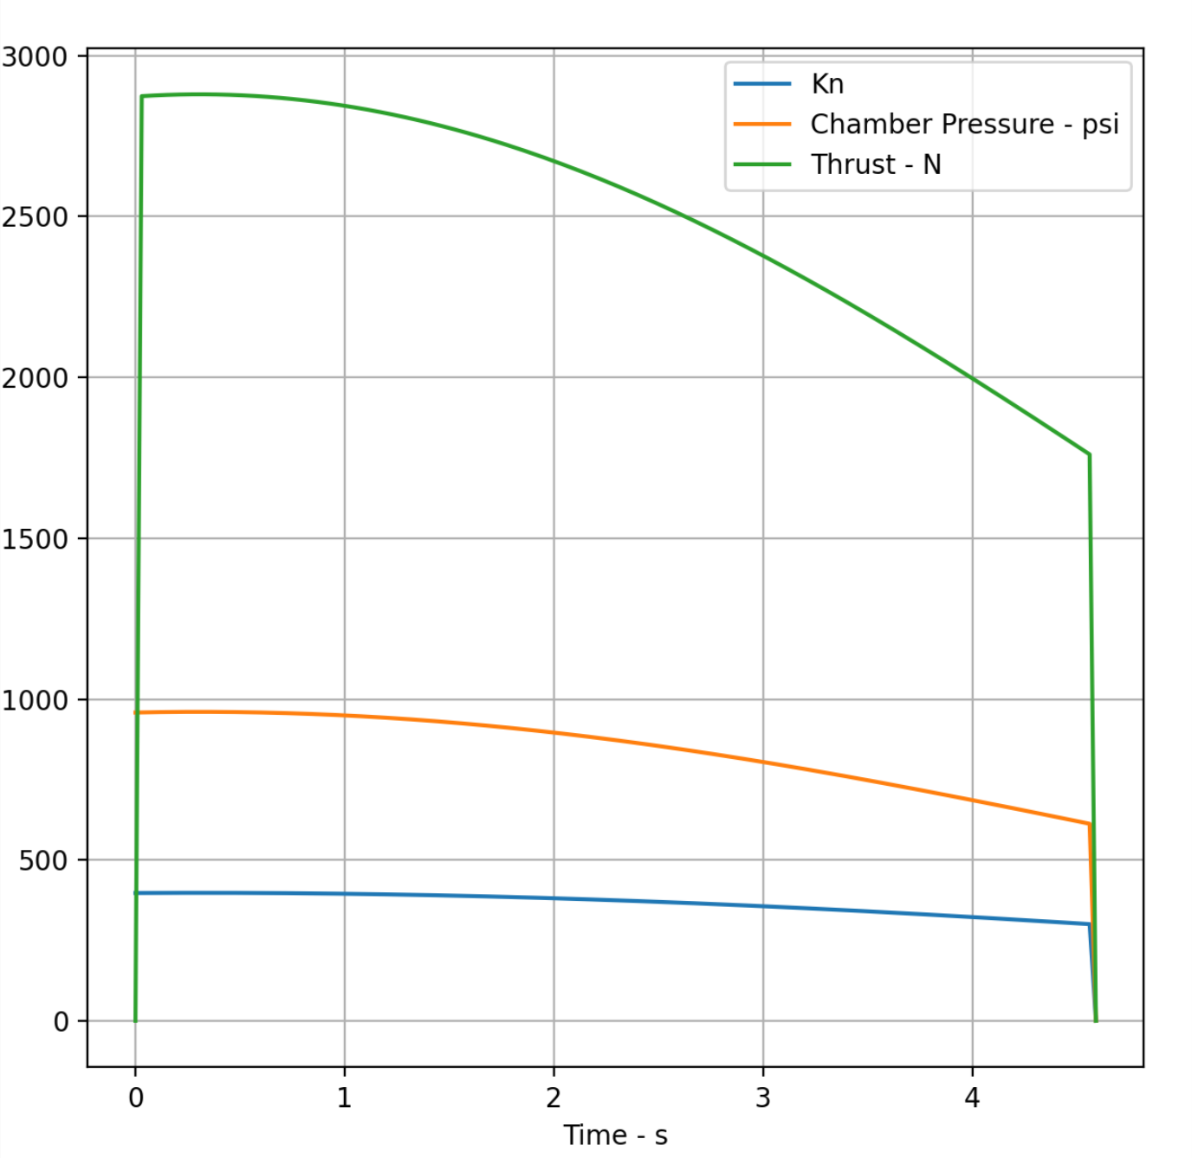
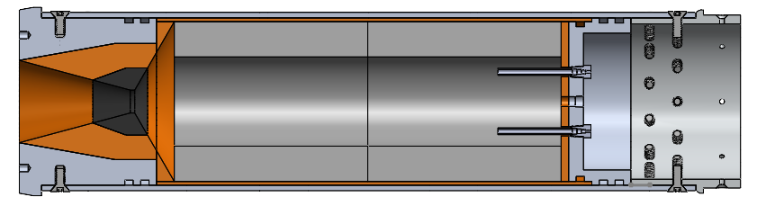
Sustainer Overview
Motor Classification | N2468
Total Impulse | 11.4 kNs
Prop Mass | 12.13 lbs
Hardware Mass | 22.80 lbs
Peak Mass Flux | 0.38 lbs/in^2*s
Average Pressure | 837 psi
Peak Pressure | 960 psi
Notes:
Cris
Acknowledge
While this was done in open motor, we will also simulate in burn sim over IAP (post recharacterization)
Design will change slightly post characterization
Angry Goat is getting recharacterized, but we predict it not to be drastically different
Highlight
max pressure
Propellant mass
Peak max flux (we chose to shoot for this to be less than 1.5, ask me if you don’t know what it is)

Slide 38
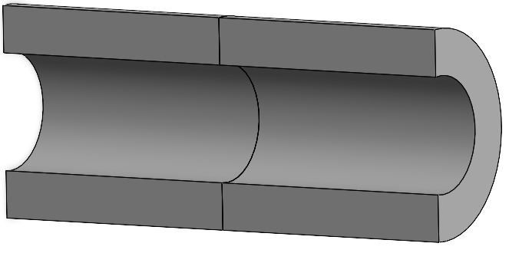
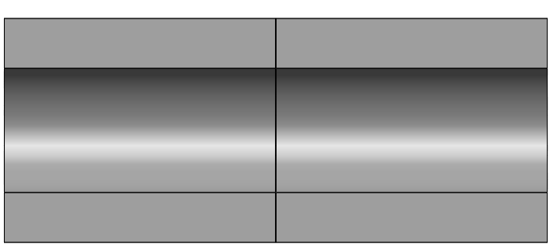
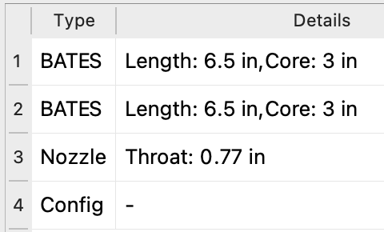
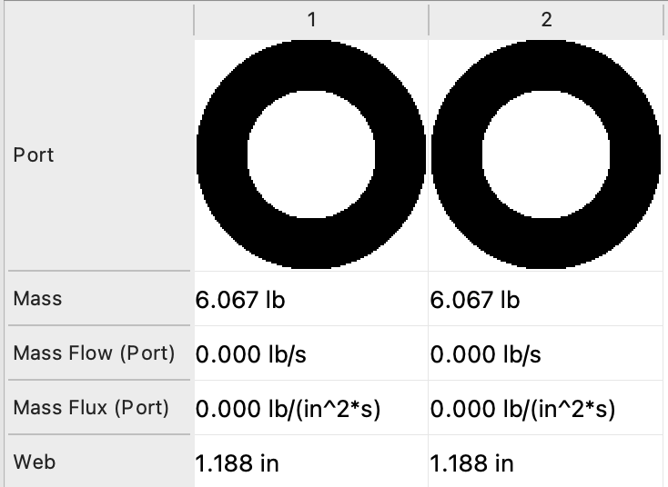
Grain Geometry
Notes:
Cris
Acknowledge
Grain is unorthodox
Mass loading is awful (lots of empty space)
Both of these factors will change post recharacterization
Motor will get shorter and have better mass loading and density
Left most grain is one idea for a Head end ignition
It will be tested on a small scale over IAP provide the timeline allows
If we move forward with it, it will have better support in the bates grain directly preceding it (resembling a nozzle)

Slide 39
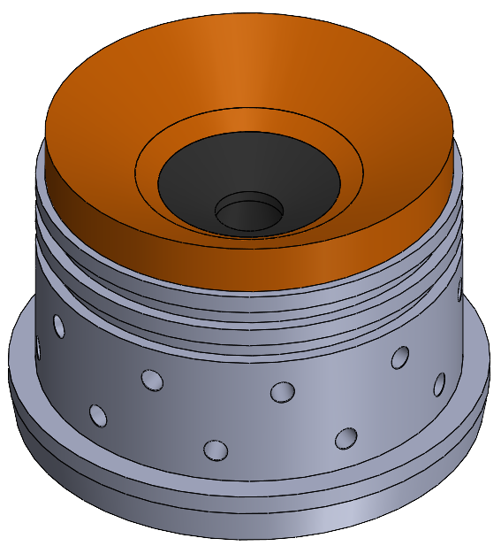
Concave Convex Nozzle
Requirements
  Withstand 2*max operating pressure of the chamber
  Attach securely to booster case
  Support the fin can under high acceleration
  Optimized for 14350 ft above ground level (sum of 2/3 of height difference from ignition to burnout and ignition)
Materials
  Aluminum 6061-T6
  Canvas phenolic
  Graphite
Notes:
DEREK
We have decided to revert to a concave convex nozzle design to simplify our machining process as we found out that our timeline for the spring was too ambitious
Incorporate 4 dowel pins to mitigate sustainer rotation

Slide 40
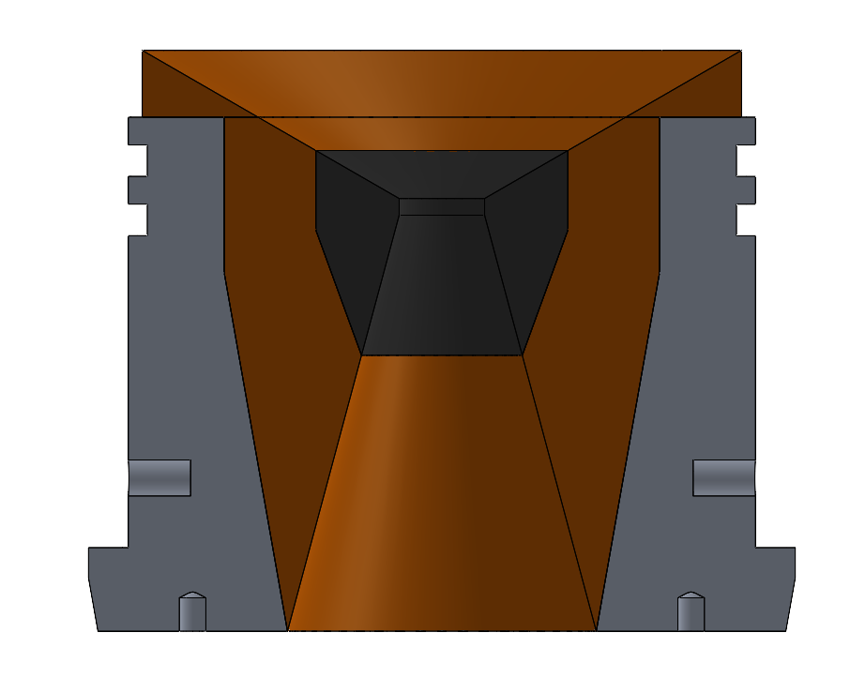
Specifications
Mass | 9.43 lbs
Throat Diameter | 0.770”
Throat Length | 0.150’’
Convergence Geometry | 60° half angle
Divergence Geometry | 15° half angle
Throat to Expansion Area Ratio | 10.3
Exit Velocity at Optimized Height | Mach 3.52
0.770”
5.214”
15°
2.770”
Notes:
DEREK
Here are the specifications, they have not changed since last time except for the removal of the bell curve. Again, there are 4 dowel pins at the bottom to attach to the staging cone.

Slide 41
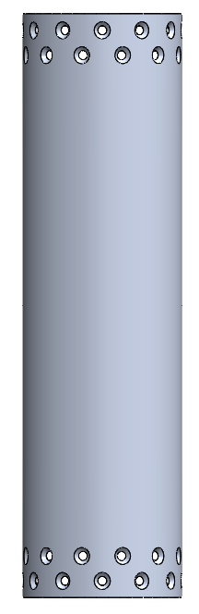
Case
Material | Al 6061-T6
Mass | 10.2 lbs
Length | 22”
Outer Diameter | 6”
Case Thickness | 0.1825”
Liner Thickness | 0.125”
Anticipated Stress | 9000 psi
Actual FoS | 3.3
Requirements:
  Withstand 960 PSI during burn
  Withstand 1440 PSI for twice the burn time during hydrostatic test*
  Utilize a FoS of 2*
Hoop Stress Approximation
  Used linearized formula
*denotes Spaceport America requirement
Notes:
Corinne:
Case is 3/16” thick, and we are using a liner that is ⅛” thick (same as booster)
Higher FoS than necessary bc
Case of this thickness is more easily sourced (and subsequently cheaper)
We are using stock from medusa (liners in particular)
Want consistency with the booster to minimize design changes

Slide 42
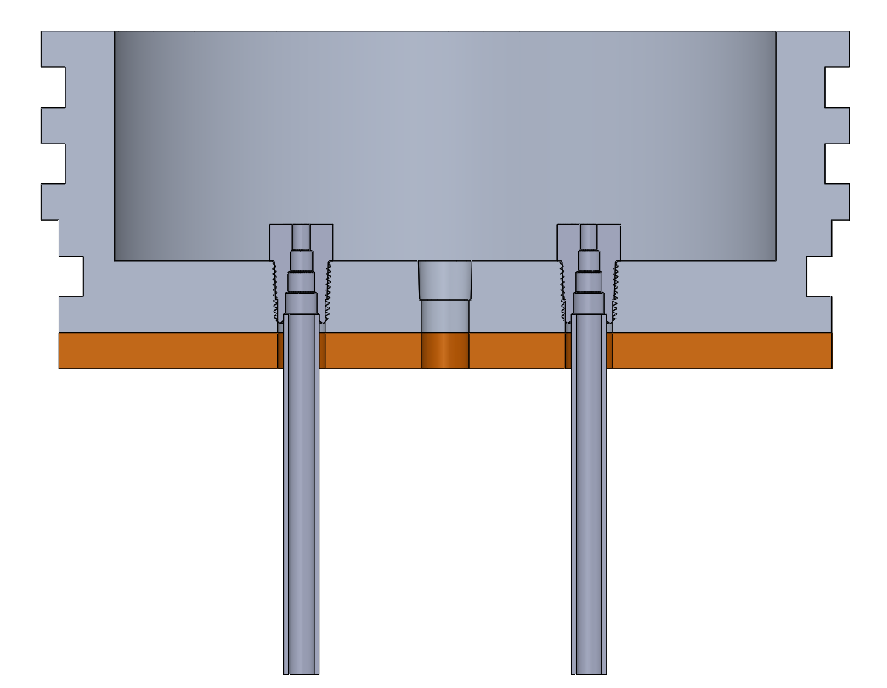
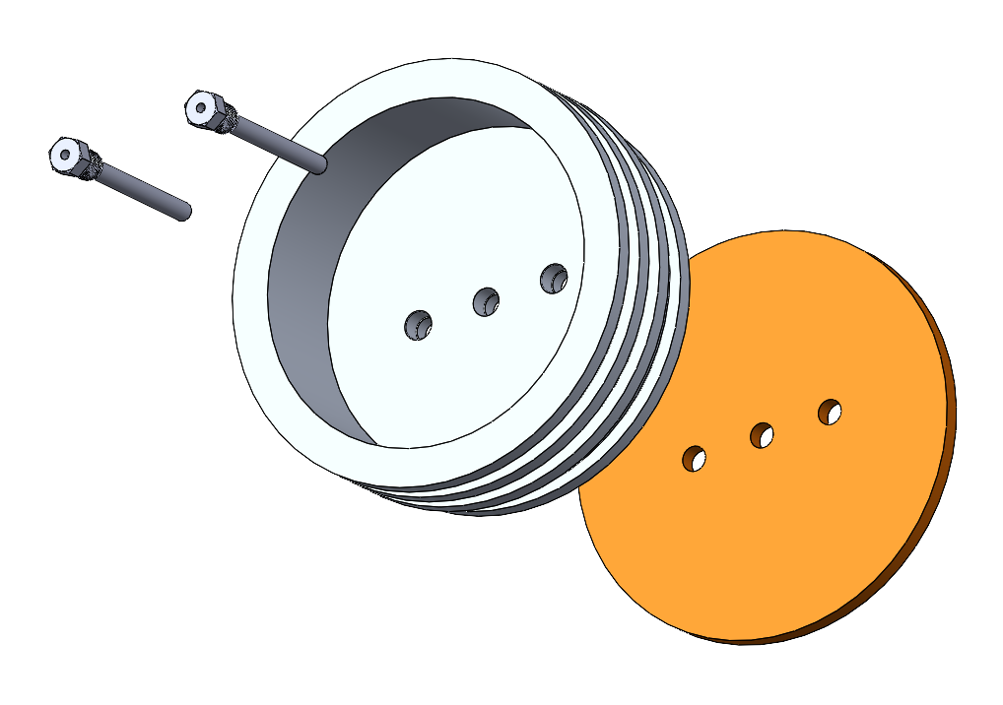
Forward Closure and HEI
Purposes
  Ignite sustainer at 3300 feet AGL (~11 psi)
  Seat pressure tap for data collection
  Prevent exhaust escape
  FoS above 2*
  Utilize the same retention ring as the booster
Materials
  Canvas phenolic
  Aluminum 6061-T6
*Spaceport America requirement
Notes:
Corinne
List purposes
To ignite the sustainer at 8100 feet
Talk about propellant grain being shaped almost like a cone… to choke the flow of the ematch and provide sufficient pressure/temp to light the rest of the sus grain
There is a seat for a pressure transducer to collect pressure data for the sustainer… this was not in our past designs btu we wanted to
Say that igniter bolts will be integrated at launch site
This design is very similar to the forward closure, plus two additional holes for those igniter bolts so it will use same forward retention ring as the booster
Describe how it works:
Igniter bolts will be integrated at the launch site
Serves as the forward closure for the sustainer to keep the hot gases and propellant from shooting into the body of the rocket, frying the other components
(it has the same orings as the forward closure that cris talked about or will talk about)
Igniters are fed through bolts which can be attached at launch site (we do not want these to accidentally ignite before launch)
E-match coated in propellant (igniter) (maybe want to include how much propellant and why we are doing this)
Grain of propellant will have a section that chokes the flow so we can provide a pressure and heat for the rest of the grain to light) (give dimensions of the choke maybe?)
Choke point quickly burns away so there is not too much pressure build up
Also maybe include how we figured out that the pressure would be choked which helped us determine geometry of grain here?
include how we are going to test to see if this works
(hole for vacuum pump to test if it ignites in low pressure environment… closure with L-gasket sealing the test hei on the opposite end to keep vacuum contained, but connected to a chain so when we static fire to test, the seal pops off but does not go flying)
Idk if this is what we should have… but in my head we should have a slide talking about the choke calculations (along with propellant mass on e-match) in more depth… dont know what this includes though
Rapidly erode choke point to prevent buildup of pressure after ignition
U also wanna make sure u have a high enough pressure at the beginning where the igniters r so that the grain can ignite properly

Slide 43
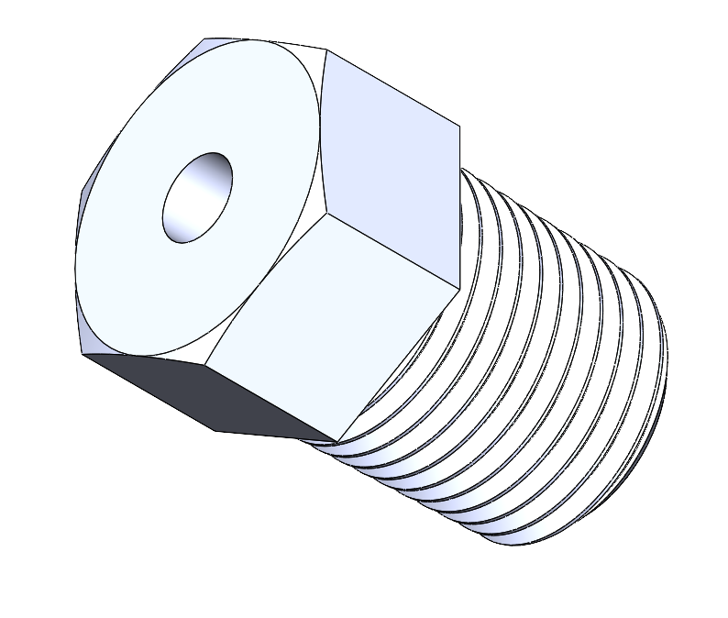
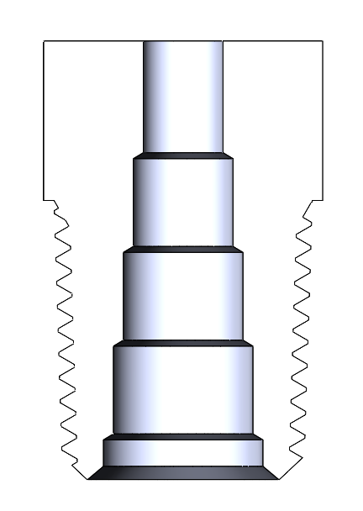
HEI Igniter Bolt
Notes:
Corinne
To seal it, this will use an oring (point out where this is), teflon tape, and lots of high temperature epoxy to lock the igniter in the center and prevent leaks out the top. (same as the other igniter bolts)
Steps in the bolt for a better epoxy seal so more resistant to pressure… it will have to push outward too rather than just ejecting it out
First hydrostatic test was straight hole so we switched to this design so epoxy could get caught on edge for better support

Slide 44
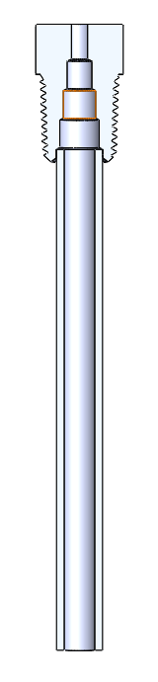
HEI Igniter Bolt (Crisalli Igniter)
Aluminum pipe filled with propellant scraps
Supportive Edges for better epoxy seal
Notes:
Corinne
How this seals…
Tight fit and epoxy for tube… cover threads before so epoxy doesnt damage threads (so still fits in closure)
This is an alternative design that we would integrate into our motor in a very similar way, just without the cone shaped propellant. This uses an npt tapped bolt connected to an aluminum tube filled with propellant scraps. This will be integrated into the same hei forward closure, but will instead ignite the sustainer grain directly.
To seal it, this will use an oring (point out where this is), teflon tape, and lots of high temperature epoxy to lock the igniter in the center and prevent leaks out the top.
Bottom side is taped so prop scraps don’t fall out
Tube will be threaded into bolt

Slide 45
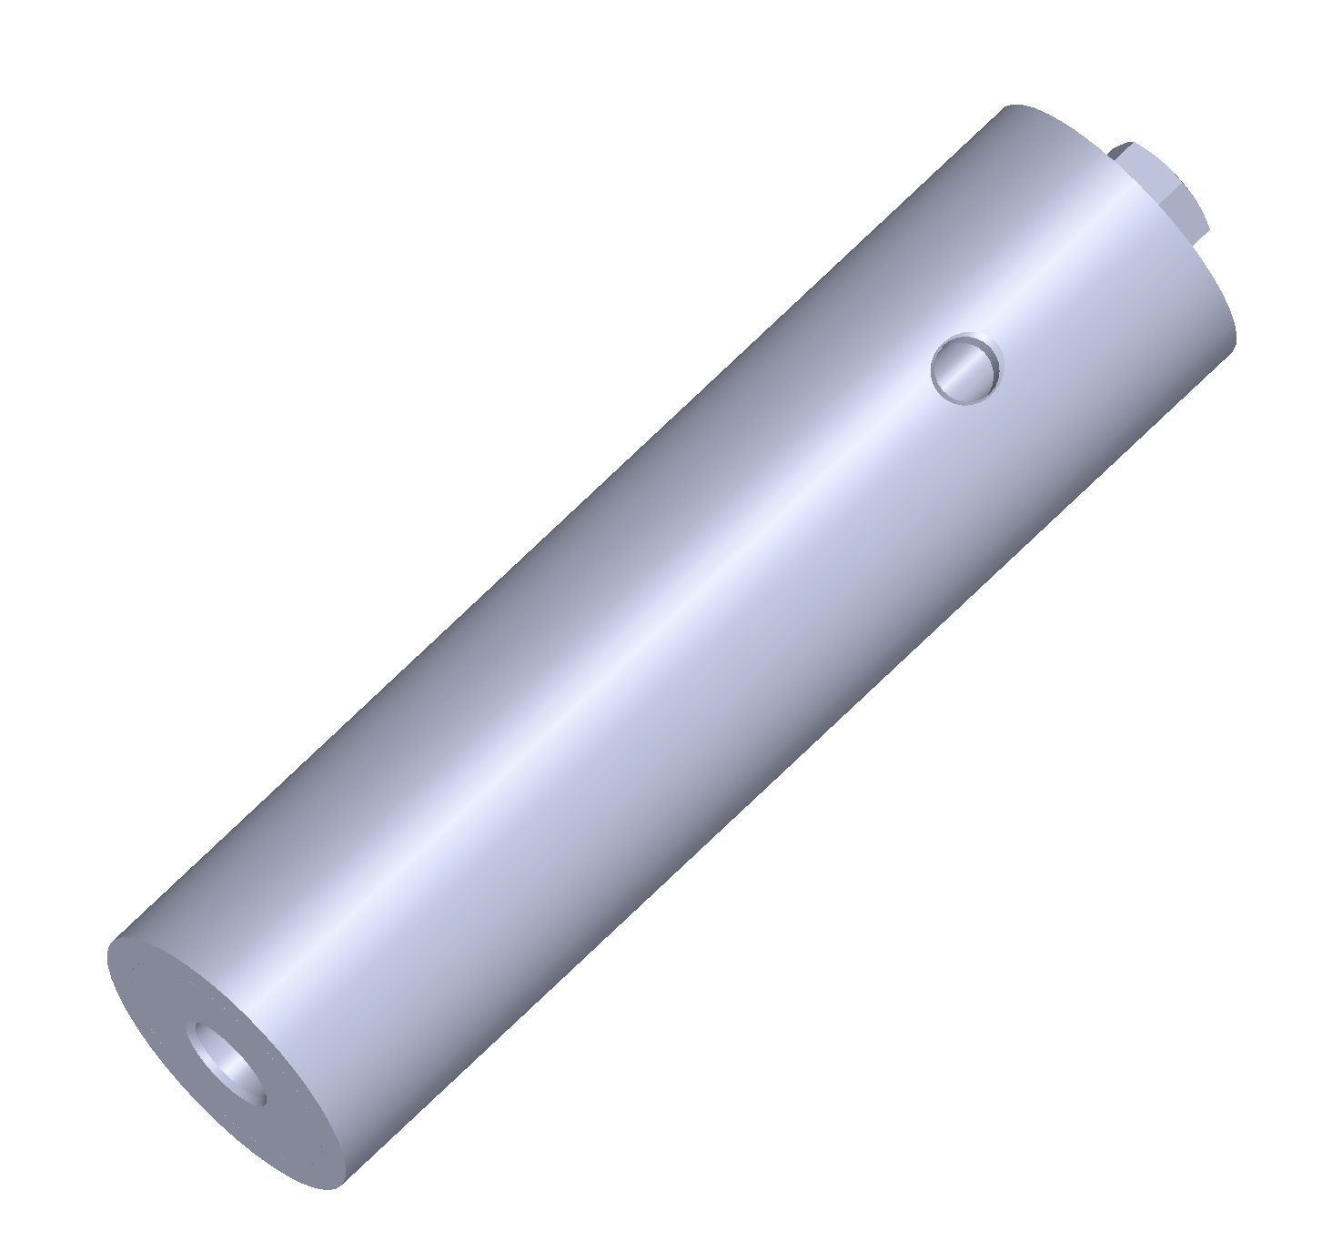
HEI Testing
Vacuum Gauge
Goal
  Test the performance of the HEI in a low pressure environment
  Prove the feasibility of the system
Analysis Criteria
  Success
    Propellant lights and burns
  Failure
    Propellant fails to light
    Only a small portion of propellant successfully ignites
Valve
Notes:
Corinne
Goal of the test…
Pump vacuum
Face seal with the end cap
Vacuum gauge to hold pressure inside at testing environment we want
Cushioned the valve ejection site (shot it into the floor) (4in above ground only ) cushioned so it doesn't rebound
What is the goal of the testing
Describe the set up.
The test set up is essentially the same set up as the top section of our sustainer motor with our forward retention ring and forward closure/hei. The propellant had a ring that is bolted into the test case so that the propellant doesn’t get ejected during testing.
(((The inner diameter of this ring supports more the throat in this model, but we will test it with varying diameters to see how that impacts out results)))
The end cap has a hole for a vacuum valve connection. This is where we will attach a vacuum pump and bring the test case to near vacuum conditions. With the valve, we will be able to remove this pump while keeping the vacuum in our set up. There will be face seal surrounding this end cap so the cap is secure and the vacuum doesnt escape.)
The eye bolt is there to attach the end cap to the ground so it does not go flying when the propellant is lit.
Procedures:
Insert NPT igniter bolts to prime IHEI
Set up IHEI in vacuum test stand, ensuring end cap is securely attached to the ground.
Decrease pressure slowly in increments of 5 psi. Pause for 1 min every increment to investigate leaks. Repeat until near-vacuum conditions reached.
Ignite IHEI
To analyze how the test went, we will use the data from the pressure transducer and video to see if it is a success or a failure:
A success would be the propellant lights and burns for more than 0.5s (this is from past rt observations)
And the pre-choke pressure remains above 250 psi for that time (this number was generated through our simulations… we expect it to be this value, or zero (didnt light))
A failure would be if the propellant failed to light or immediately goes out after lighting

Slide 46
Risk Assessment and Mitigation - HEI
Failure Mode | Probability | Severity | Mitigation
Igniters fail | Low | High | Use two completely separate igniters that can each light the grain alone
Igniter bolts leak through hole | Low | High | Utilize high temperature epoxy, verify with hydrostatic tests
Bolts and transducer leak around threads | Low | High | Utilize tapered threads and teflon tape, verify with hydrostatic tests
Notes:
Corinne
Erosive burning (dont want chunks flying out to clog nozzle
Also if the pressure in the hei and regular chamber equalizes, then ur propellant is less likely to tear out I think

Slide 47
Mass Breakdown
Part | Mass (lbs) | % Sustainer Mass
Reusable Hardware | 18.63 | 58.16
Consumable Hardware | 4.83 | 10.52
Propellant | 12.13 | 31.32
Total | 35.59 | 100
Notes:
Corinne

Slide 48
Safety Margins
Part | Lowest Factor of Safety
Case | 2.5
Forward Retention Ring | 2.4
HEI | 2
Nozzle Assembly | 4.6
Bolts | 2.1
Notes:
Corinne

Slide 49
Questions?
Notes:
corinne

Slide 50
Aerodynamics

Slide 51
Functional Requirements
Dynamic Stability: Fins must give the rocket a dynamic stability margin between 1.5 and 6 calibers*
Flutter Stability: Fins must have a predicted flutter speed 50% greater than the max speed during flight*
Fins must withstand lift forces
Fillets must secure fins to fin can throughout flight
  Epoxy cannot burn
  Screws must withstand shear force exerted by the fins
Transitions must not deform due to temperature
*Spaceport America Requirement

Slide 52
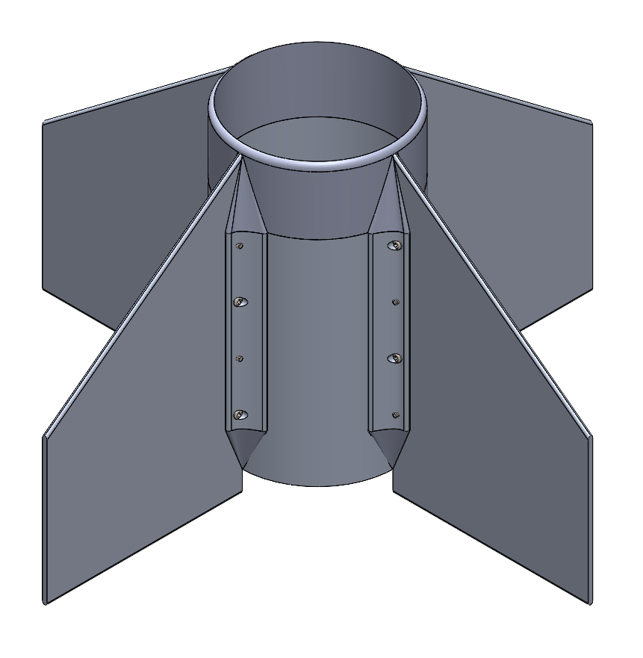
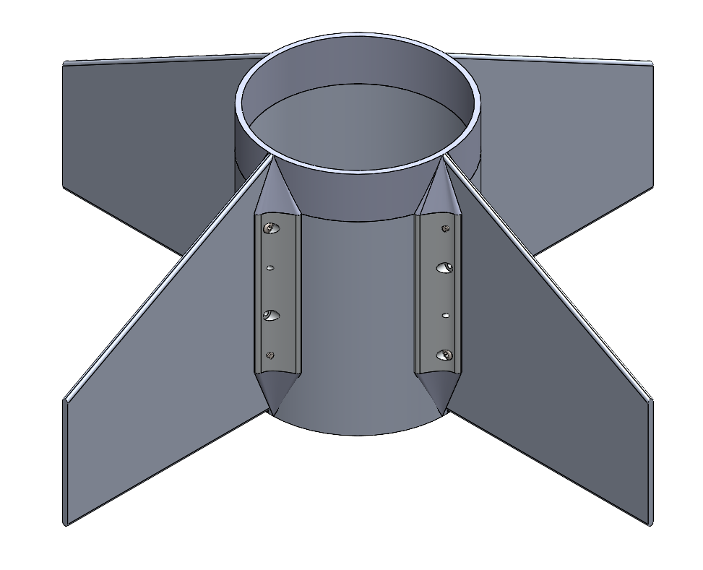
Fin Can Assembly Overview
Material: Aluminum 6061-T6
Two fillets attached to each fin using #8-32 x ⅝” screws
Each fin and fillet is secured to fin can with epoxy resin
Fin leading and trailing edges: sanded to be round
Sustainer
Booster

Slide 53
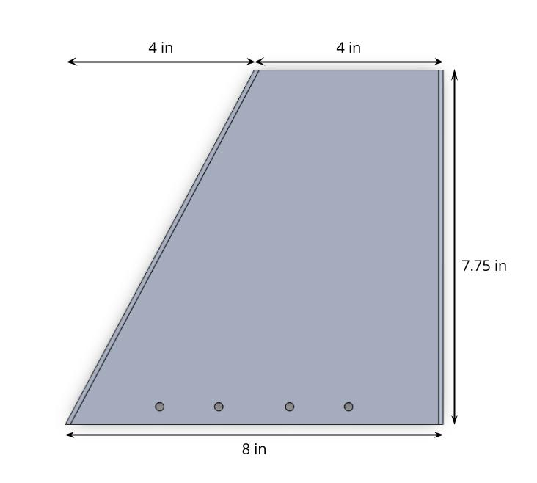
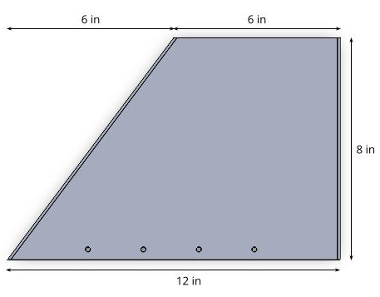
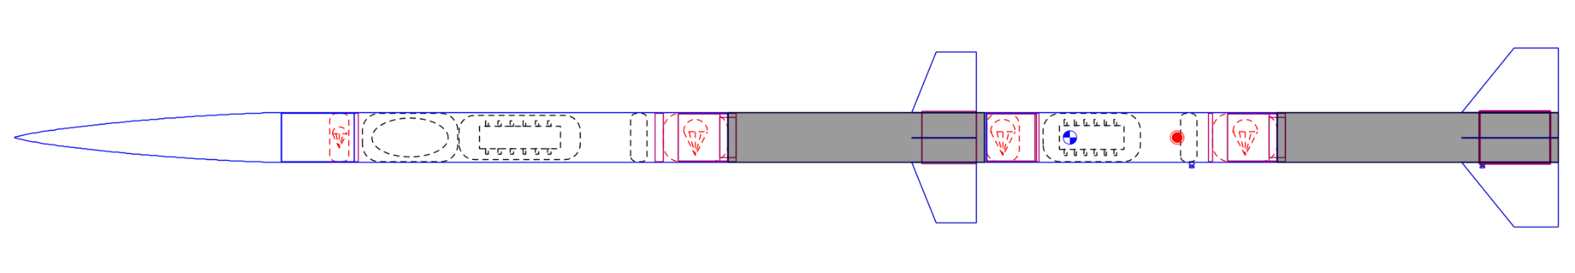
Fin Shape & Design
Sustainer Fin
Booster Fin
Booster Fin

Slide 54
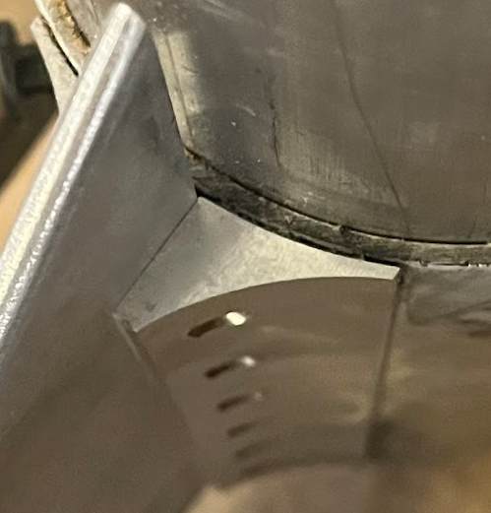
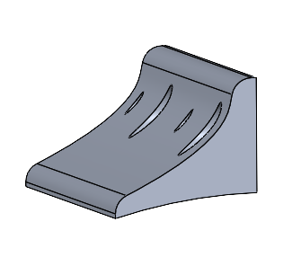
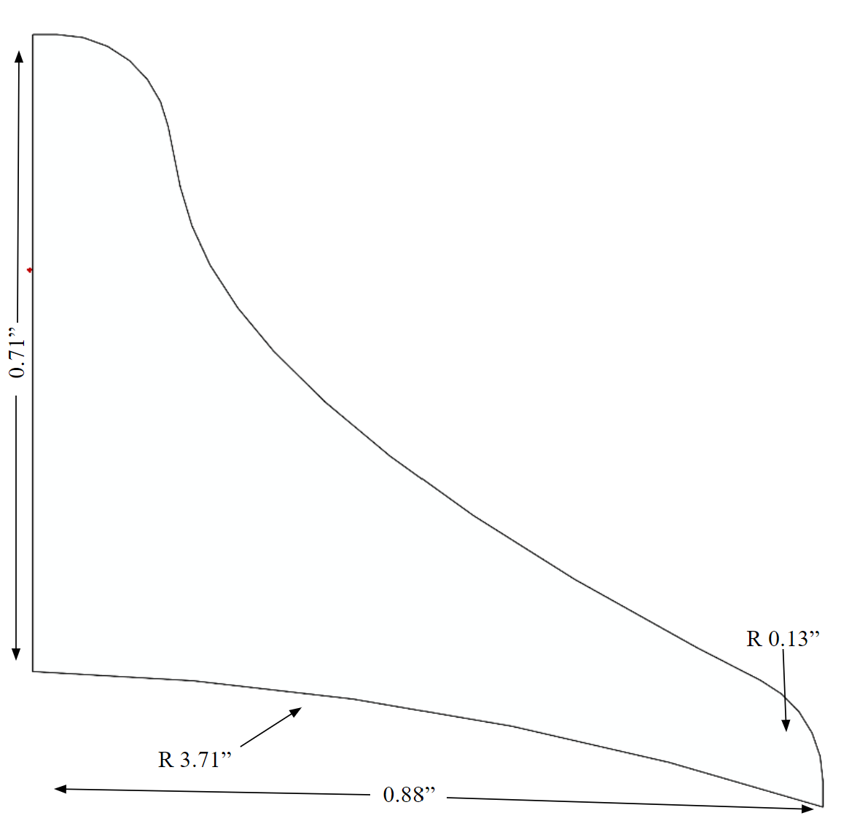
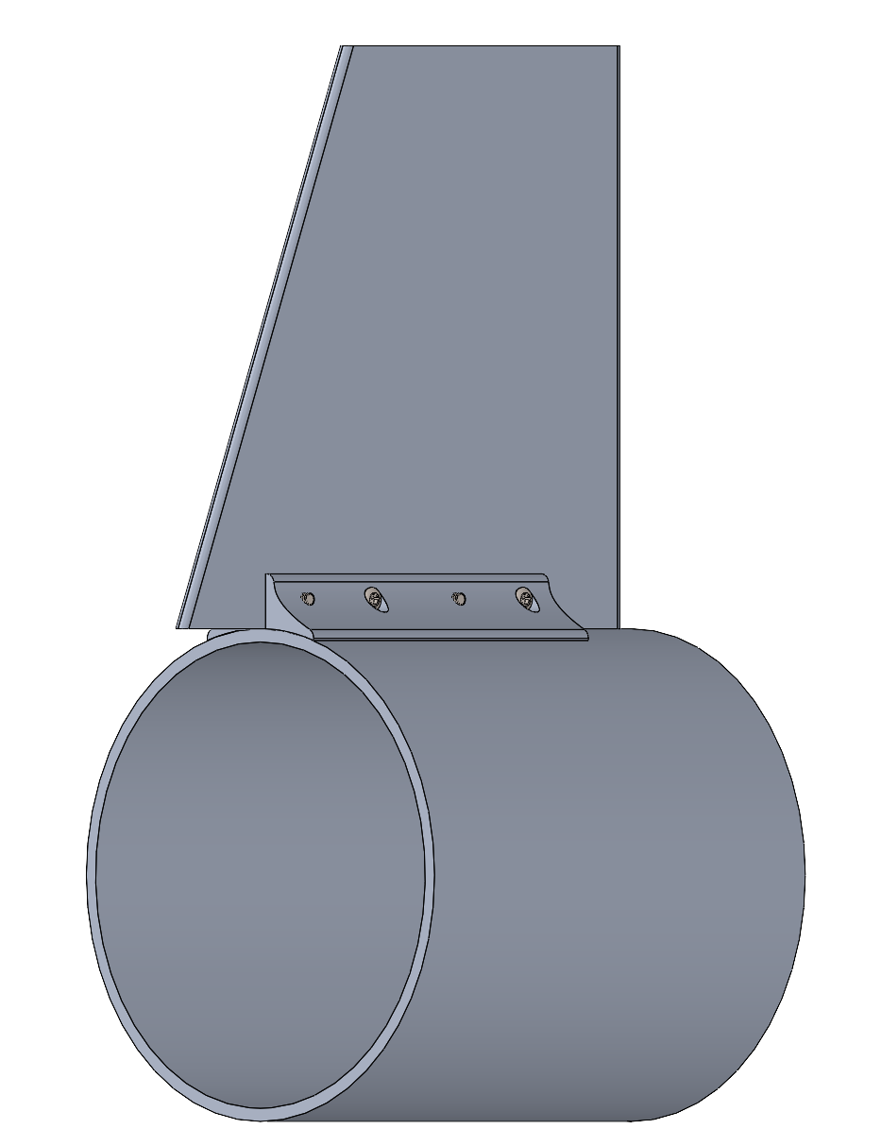
Fin Attachment
Phoenix fillet
Prometheus fillet
Fins are attached to fin can with fillets
Aluminum fillets allow for easy attachment and removal of fins via screws
Fillets attached to fin can with epoxy
Fillet Material: Aluminum 6061-T6
New design includes rounded edges and slightly thinner profile
Fin can, fillet,
sustainer fin:
Fillet profile

Slide 55
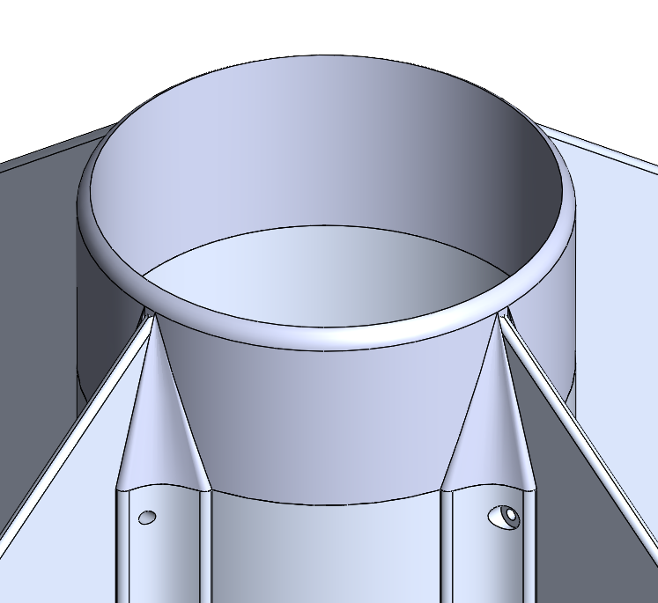




Transitions
Purpose: Aerodynamically transition from motor case to fillets (forward transition) and from fillets to fin can (rear transition)
Material: 3D printed PETG (500F melting temperature) and coated with heat-resistant paint (ablative)
Forward Transition
Rear Transition

Slide 56

Air Stagnation Temperature Calculations
 | Altitude (ft) | Temperature at altitude (K) | Ratio of specific heats | Mach number | Temperature at stagnation (K) | Temperature at Stagnation (°F)
Booster | 2984 | 282 | 1.4 | 1.6 | 418 | 292
Sustainer | 10069 | 268 | 1.4 | 1.6 | 406 | 270
Led to the choice of PETG for transitions
Melting point of PETG: 500°F

Slide 57


Shear Force on Fillet Screws Calcs
 | Fin Mass (lbs) | Velocity (ft/s) | Altitude (ft) | Drag Coefficient | Fin cross sectional area (in²) | Drag Force (N) | Normal Force (N) | Total Force (N)
Booster | 1.31 | 925.4 | 3984 | 1.1 | 1.88 | 59 | 82 | 282
Sustainer | 0.85 | 1728 | 10069 | 1.1 | 1.66 | 145 | 53 | 396
Screw Diameter | Shear Strength (psi) | Force at Failure (N)
5/32” | 20000 | 1706
based on McMaster stainless steel pan head screws

Slide 58



Lift Force Calcs
 | Max Lift (N)
Booster | 42
Sustainer | 27

Slide 59


Fin FEA
Lift
42 N
Lift
27 N
Drag
145 N
Drag
59 N
Bolt connections
Bolt connections
Fin can fixtures
Fin can fixtures
Sustainer
Min Factor of Safety: 43
Booster
Min Factor of Safety: 40

Slide 60
Flutter Stability
 |  | Velocity @ max dynamic pressure (ft/s) | Flutter Speed (ft/s) | % of Spaceport America Requirement
Booster | Before Separation | 925.4 | 2414 | 174
Sustainer | Before Separation | 925.4 | 2703 | 195
 | After Separation | 1728 | 3024 | 117

Slide 61


Staging Cone
sustainer nozzle
Purpose: Transitions from booster to sustainer
Aluminum Alloy: 6061- T6 (SS)
Mass: 2.35 lbs
staging cone
Forces:
Sustainer Mass x Max gs + Drag (3145 N)
Min. Factor of Safety: 3
eye bolt (recovery attachment)
Sustainer Mass * Max gs + Drag
Notes:
Screws into fiberglass plate, charge well, and mission package tube

Slide 62
Possible Failure Modes
Failure Mode | Probability | Severity | Mitigation
Structural failure of fasteners | Low | High | Choosing correct screw and hole size to prevent screws being too small
Plastic deformation of fin due to lift force | Medium | High | Making fins thick enough to withstand lift force
Heat induced epoxy failure | Medium | High | Choosing thickness of fin can to prevent epoxy from burning from heat of motor
Forward transition melting | High | Low | Make out of PETG and coat with heat resistant paint

Slide 63
Testing Timeline
Instron Fin Can Testing
Test Launch
February
April
June
January
March
May
Thermal FEA on Fin Can
Spaceport America

Slide 64
Mass Breakdown
Part | Sustainer Mass (lbs]) | Booster Mass (lbs)
Fin Can | 2.17 | 2.81
Fillet (x8) | 0.12 (0.96) | 0.21 (1.68)
Fin (x4) | 0.85 (3.4) | 1.31 (5.24)
Forward Transition | 0.24 | 0.36
Rear Transitions (x8) | 0.005 (0.040) | 0.002 (0.016)
Total: | 6.81 | 9.79
Share of Stage Mass | 9.80% | 12.80%
Total Mass: 16.60 Share of Rocket Mass: 11.37%

Slide 65
Cost Breakdown
Item | Total Cost
Fin Stock | $799.28
Fillet Stock | $110.25
Fin Can Stock | $520.79
Screws | $12.62
Epoxy | $19.98
Total | $1,462.92
Notes:
BH Masses have changed + there are new additions:
BOOSTER: x2 Black Powder assembly(0.70 - 1.40), , ( 1x FRR Bulkhead (0.22 lbs), x1 staging cone (1.3 lbs) , Parachute masses total - 5ft + 7ft (10.1 oz + 15.3 oz, 1.59 lbs). Quicklinks x4 (.008 x 4 (.032)), swivels x4 (.01 x 4 (.04))
SUSTAINER: x1 Black Powder assembly (0.70), , x1 Piston assembly (0.57 lbs), x1 nose cone (4.98), x1 nose cone BH (0.33 lbs), and Parachute mass total (1.59 lbs), quicklinks x4 (.008 x 4 (.032)), swivels x4 (.01 x 4 (.04)

Slide 66
Questions?

Slide 67
Avionics
Project Prometheus Design Review 3
21 January 2024

Slide 68
Agenda
Power Amplifier
DENNIS
Notes:
Updated

Slide 69
Power Amplifier

Slide 70


Layout
Dimensions:
  2 x 1.5 in
Four mounting holes
Battery source:
  2x LiFePO4 batteries
Via stitching and shielding as presented previously
FRONT
BACK

Slide 71
DENNIS

Slide 72
Circuit Design
Arming stage added
  Minimize risk of accidental fire
LED Indicators
  Arming- red
  Continuity- green

Slide 73
Component Selection
 | Constraint | Selected Part
Saturation Voltage | Between 2V and 3V | 2.5V
Max power | > 0.9W | 1.5W
Max drain current | > 9A | 10A
Max drain-source voltage | > 7V | 24V
Max gate-source voltage | > 5V | 12.5V

Slide 74

Schematic

Slide 75


Layout
Dimensions:
  4 x 2 in
Power:
  Primary: Power board
  Pyros: 1 separate LiFePO4 battery
Pyro circuitry updated
FRONT
BACK

Slide 76

Schematic

Slide 77

Avionics Bay- Layout (Front)
Panel Dimensions:
  4.10 x 5.75 in
Two antennas: Transmitting at different frequencies, lower risk of interference
Total length: 12.5 in

