Slide 1
Project Prometheus
Preliminary Design Review
12 November 2023

Slide 2
Agenda
Overview
Aerodynamics/Structures
Intermission
Avionics
Solid Propulsion

Slide 3
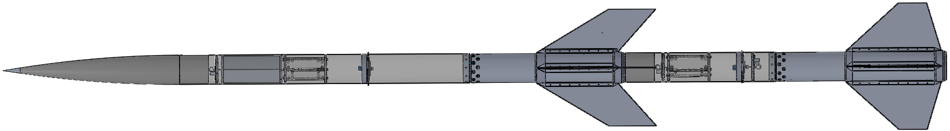
Vehicle Overview
Two-stage rocket
15.5 ft long, 6.17 in diameter
  Sustainer: 10 ft
  Booster: 5.5 ft
160 lb loaded mass
  Sustainer: 76 lb
  Booster: 84 lb
N-class sustainer on O-class booster
Predicted apogee: 30,721 ft AGL
  Ground level: 4600 ft MSL

Slide 4
Flight Event Timeline
T-00:00.00 | Booster Ignition
T-00:03.81 | Booster Burnout
T-00:04.00 | Booster Airbrakes Deployment
T-00:06.81 | Sustainer Ignition
T-00:09.94 | Sustainer Burnout
T-00:18.00 | Booster Apogee, Drogue Deployment
T-00:44.00 | Sustainer Apogee, Drogue Deployment
T-01:34.00 | Booster Main Deployment
T-02:08.00 | Booster Touchdown
T-05:34.00 | Sustainer Main Deployment
T-06:08.00 | Sustainer Touchdown

Slide 5
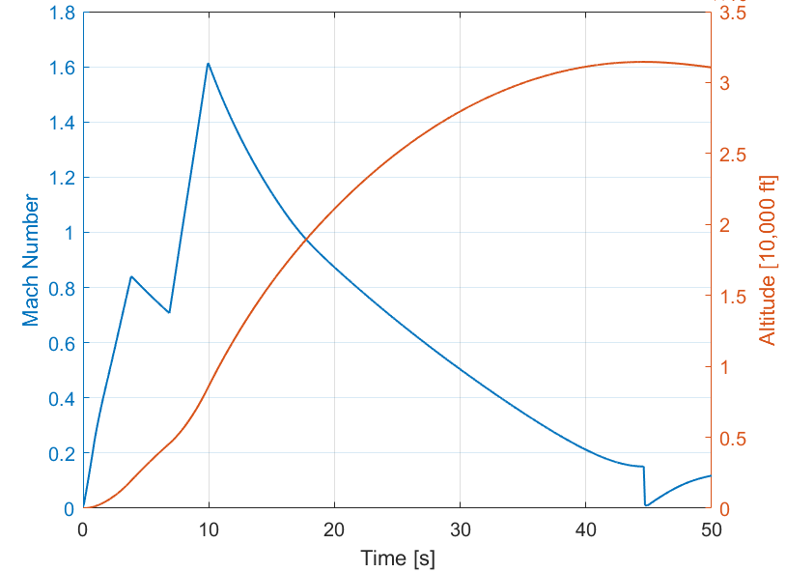
Flight Profile

Slide 6
Project Prometheus:
Structures & Aerodynamics

Slide 7
Agenda
Structures Overview
Recovery Overview
Aerodynamics Overview
Air Brakes Overview
Payload Overview
Aeroshells Overview
Notes:
Updated

Slide 8
Structures Overview
Motor
Mission Package Tube
Booster
Parachute
Avionics Bay
Parachute
Sustainer
Air Brakes
Payload
Nose Cone
Fins
Parachute
Avionics Bay
Staging Cone
Booster
Air Brakes
Parachute
Fins
Sustainer
avionics bay
parachute
parachute
Motor
payload
Nose Cone
Fins + Fin Can
air brakes

Slide 9
Recovery System

Slide 10
Functional Requirements
Drogue and Main Parachutes: A vehicle with apogee > 1500 ft must have two parachutes (drogue and main)*
Main Parachute Deployment Altitude < 1500 ft
  Goal: 1400 ft
Descent Velocities
  65 ft/s < Drogue descent velocity < 165 ft/s
    Goal: 70 ft/s
  Main Descent Velocity < 36 ft/s
    Goal: 25 ft/s
Redundancy in parachute deployment triggers
Notes:
Updated

Slide 11
Flight + Recovery Trajectories
Sustainer Drogue Deployment (30,000 ft)
Sustainer: Drogue & Main Parachutes
  Dual separation, dual deployment
Booster: Drogue & Main Parachutes
  Dual separation, dual deployment
Deployment Mechanism
  Sustainer Drogue: Piston
  Others: Black Powder Charge
Booster Drogue Deployment (6,000ft)
Separation (4,000ft)
Booster Main Deployment (1,400ft)
Sustainer Main Deployment (1,400ft)

Slide 12
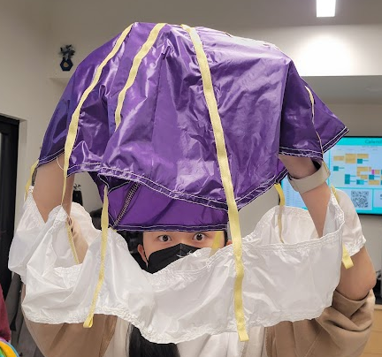
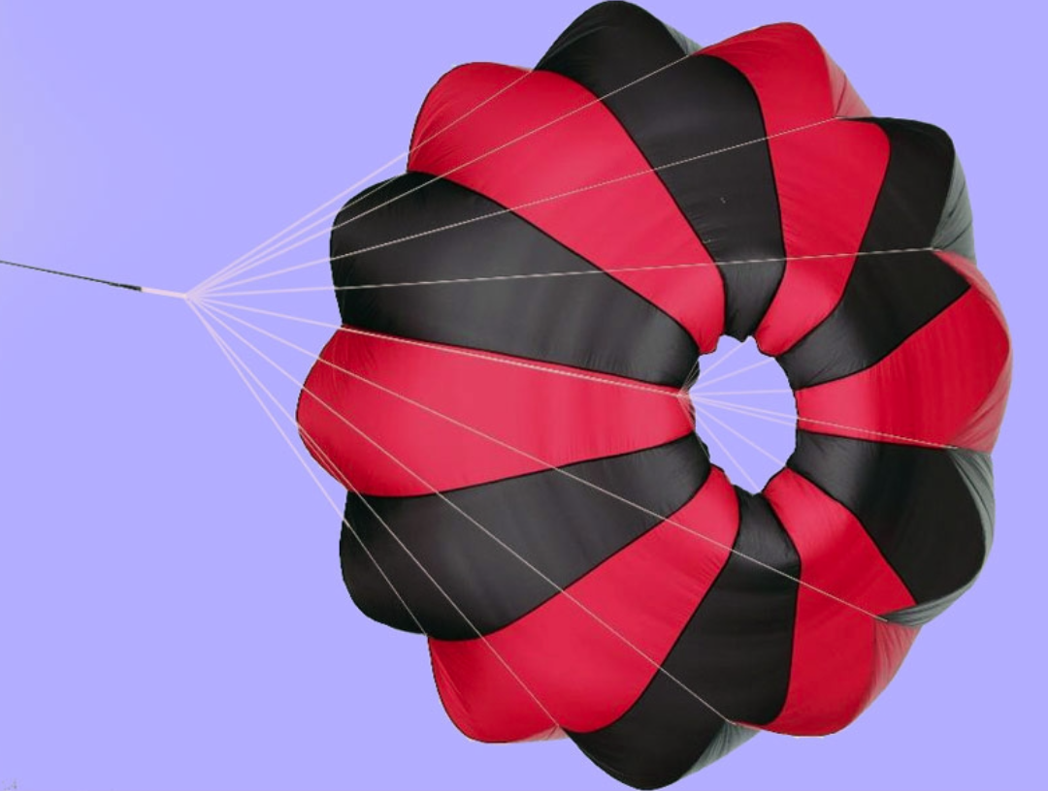
Parachutes
Drogue Parachutes (SRAD):
Type: Disk-Band Gap
Material: Ripstop Nylon, braided kevlar shroud lines
Deployed at Apogee
Descent velocity: 70 ft/s
Prevent excessive drifting, stabilize rocket for mains to open cleanly
Main Parachutes (COTS):
Type: Eye
Material: Ripstop Nylon
Deployed at 1400 ft
Descent velocity: 25 ft/s

Slide 13
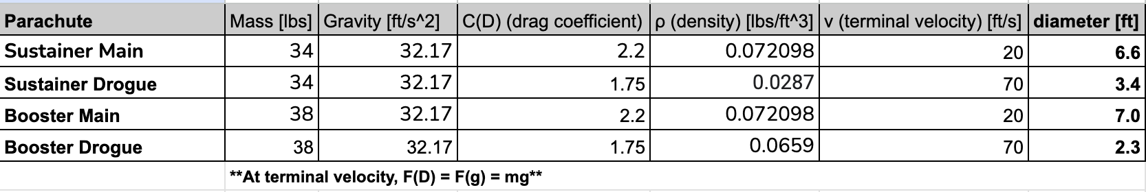
Parachute Sizing
F_{D} = Drag Force
Design Constraints
Descent Velocity (terminal velocity)
  Drogue Parachutes: 70 ft/s
  Main Parachutes: 25 ft/s
Want to find
Diameter of parachute
Other Variables
Coefficient of Drag (2.2 for COTS, 1.5 SRAD)
Air density at altitude of deployment
Mass of Sustainer and Booster
  Sustainer: 61.1 lbs
  Booster: 53.15 lbs
Guiding Equation:
m × g = (½) × C_{D} × A_{P} × ⍴ × V²
F_{g} = Force of gravity on object
Results (diameters):
Sustainer Drogue: 5 ft
Sustainer Main: 7 ft
Booster Drogue: 3 ft
Booster Main: 7 ft
F_{D} = (½) × C_{D} × A_{P} × ⍴ × v² at terminal velocity to obtain desired circle area → diameter
Notes:
Updated to account for Booster Drogue addition

Slide 14
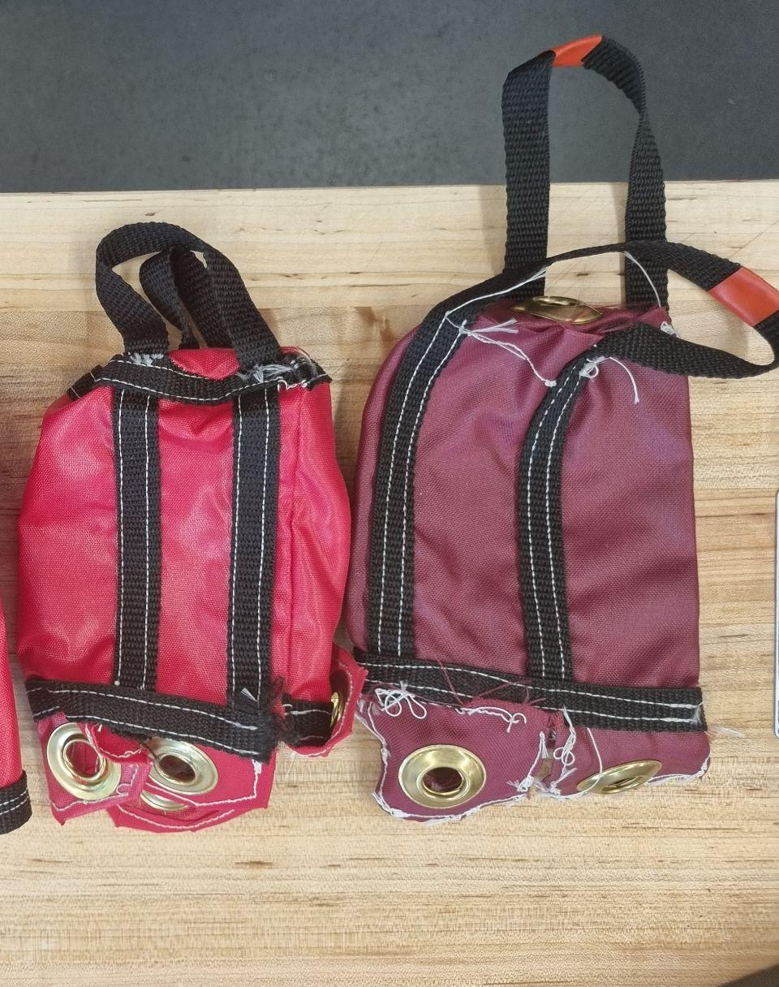
Parachute Bags
Purpose: must fully protect parachute from black powder charge
  Fully enclosed design
Material: flame resistant nylon fabric

Slide 15
Shock Force Calculations (All Values)
Parachute | Booster- Main | Booster- Drogue | Sustainer- Main | Sustainer- Drogue
Air Density [lbs/ft^3] | 0.072 | 0.065 | 0.072 | 0.029
Total Mass [lbs] | 53.15 | 53.15 | 61.1 | 61.1
Fall Rate [ft/s] | 70 | 30 | 70 | 150
Coeff. Drag | 2.2 | 1.5 | 2.2 | 1.5
Area [ft^2] | 38.5 | 7.1 | 38.5 | 19.6
Avg. Shock Force [N] | 812 | 16 | 530 | 812

Slide 16
Parachute Shock Forces
Used OSCALC software to calculate shock forces on parachutes when they are deployed
Required inputs:
  Air Density at Deployment
  Dry Vehicle Mass
    Sustainer: 61 lbs
    Booster: 51 lbs
  Descent Rate
    Drogue: 70 ft/s
    Main: 25 ft/s
  Coeff. Drag
    Drogue: 1.5
    Main: 2.2
  Nominal Parachute Area
Parachute | Shock Force (lbf)
Sustainer Drogue | 120
Sustainer Main | 183
Booster Drogue | 17
Booster Main | 183

Slide 17
Lines Diagram
Drogue Deployment:
Main Deployment:
Quicklink
Nose Cone /
Staging Cone
Swivel
Cone Riser
Main
Parachute + Bag
Main MPT Riser
Main Bag Riser
Mission Package Tube
Drogue Bag Riser
Drogue
Parachute + Bag
Drogue MPT Riser
Motor Riser
Motor

Slide 18
Lines Sizing
Line: | Length (Sustainer): | Length (Booster): | Calculations:
Cone Riser | 3 ft | 1 ft | > cone length
Main MPT Riser | 16 ft | 10 ft | 4 x MPT length AND > cone riser + cone
Main Bag Riser | 1.5 ft | 1.5 ft
Drogue MPT Riser | 18 ft | 15 ft | 4 x MPT length AND > motor riser + motor
Drogue Motor Riser | 13.3 ft | 11.6 ft | 4 x motor length
Drogue Bag Riser | 1.5 ft | 1.5 ft
Dangling sections of the rocket should not impact each other
Prevent wake effects from the rocket body on parachute inflation

Slide 19
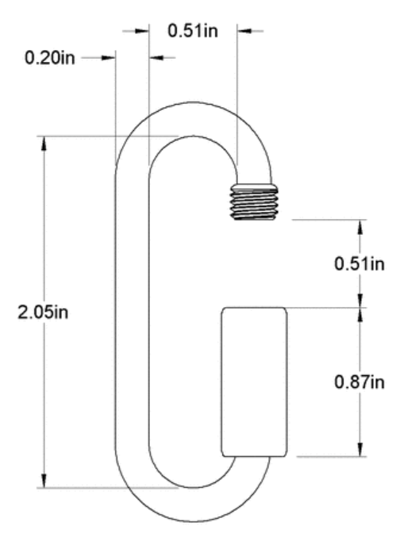
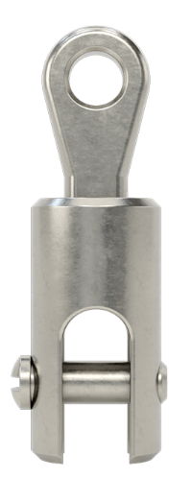
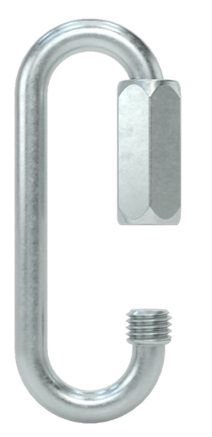
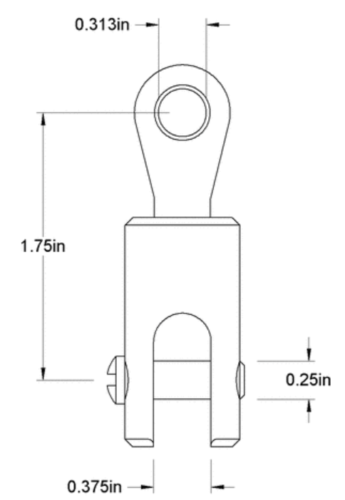
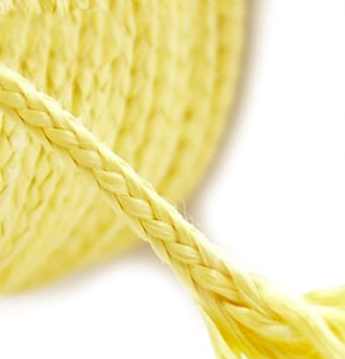
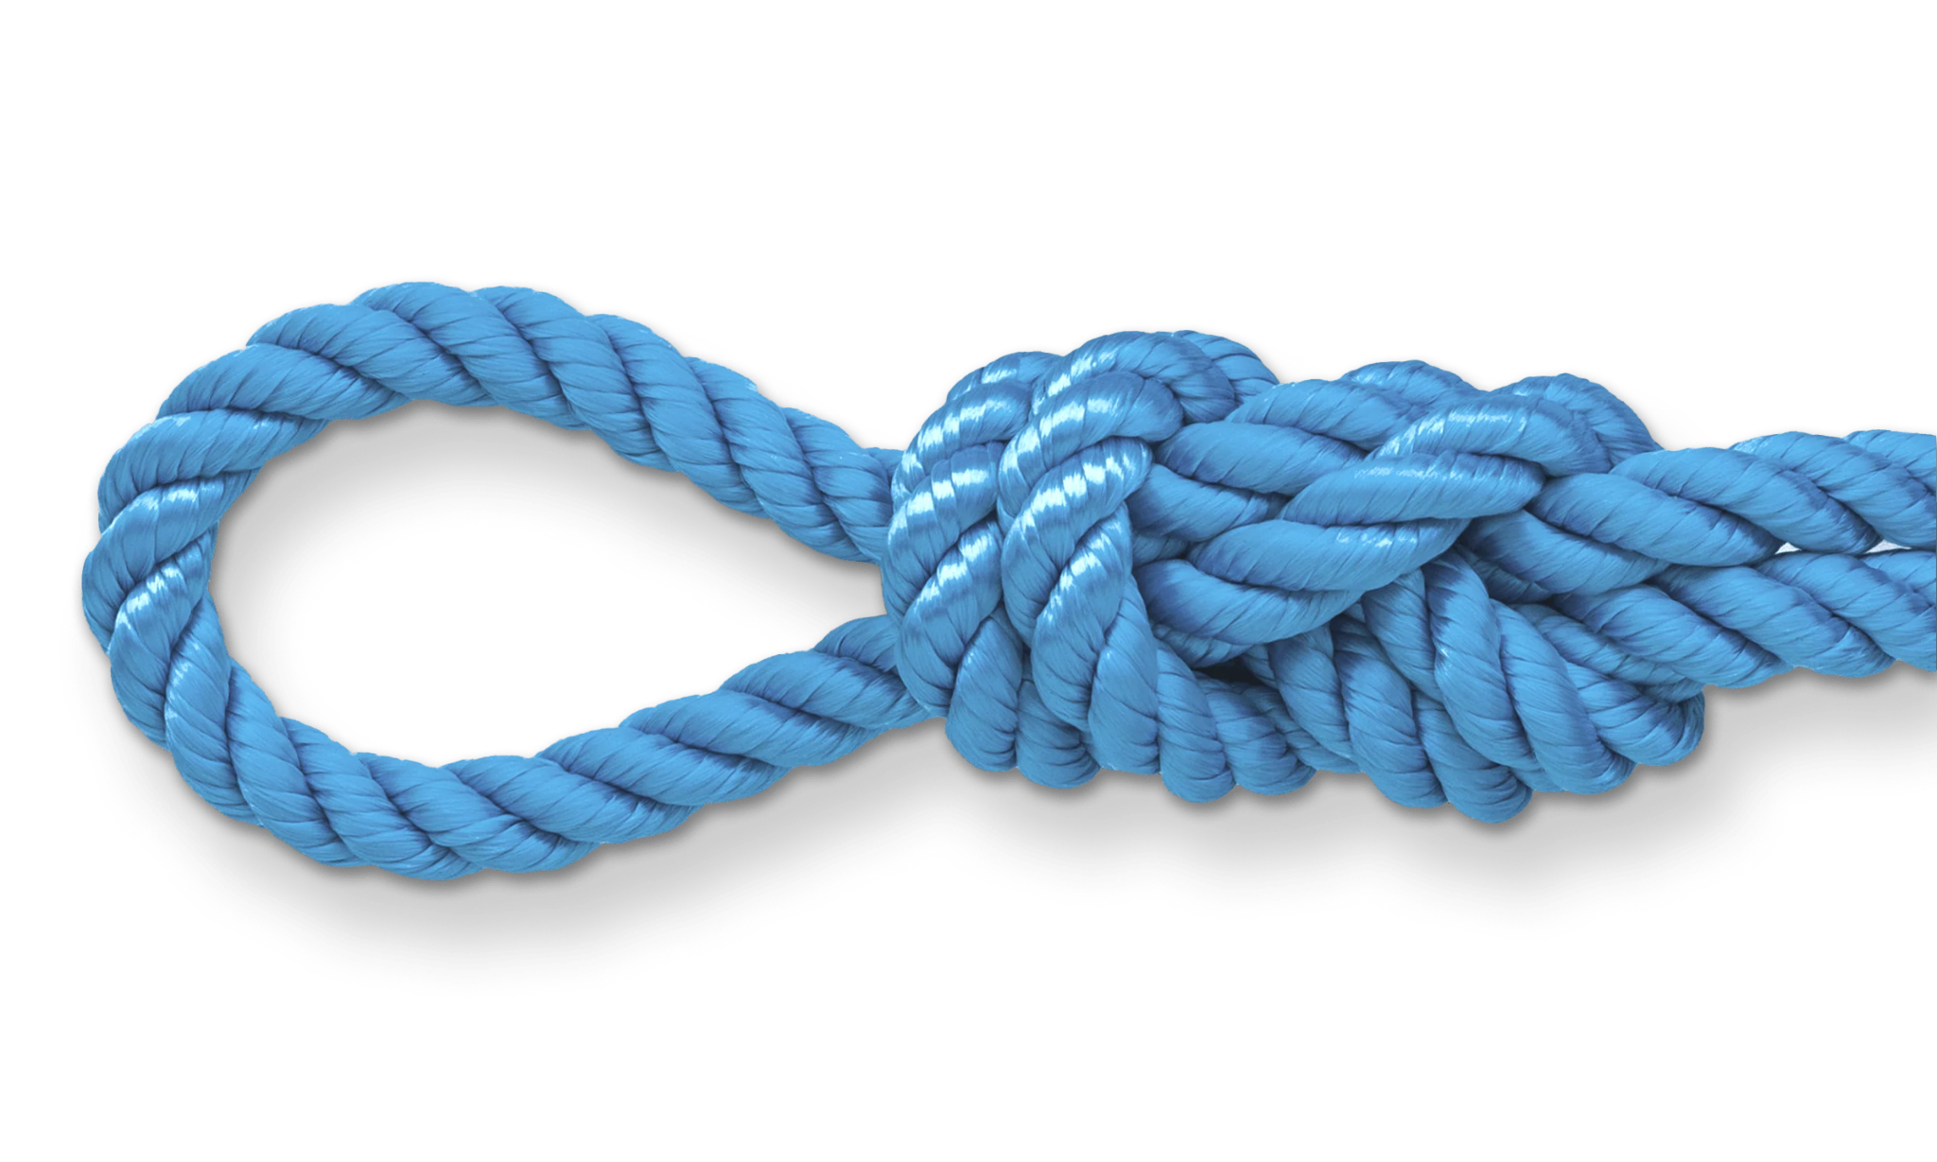
Lines and Attachments
Quicklinks
  Capacity: 500lb
  Material: Zinc coated Steel
Swivels
  Capacity: 1,800lb
  Material: 316 Stainless Steel
Lines
  Capacity: 500lb
  Material: Braided Kevlar
  Flame Resistant, Abrasion Resistant
  Diameter: 2mm
Shroud Lines
  Capacity: 150lb
  Material: Braided Kevlar
  Flame Resistant, Abrasion Resistant
  Diameter: 1mm
Figure 8 knots
  Attaches lines to hardware
  Tensile Testing: stronger than Bowline knots
Notes:
Quicklinks: https://www.mcmaster.com/3711T22/
Swivels: https://www.mcmaster.com/8928T33/
Lines: https://www.amazon.com/9KM-DWLIFE-70lb-2000lb-Braided-Survival/dp/B0BYYSD6W3/ref=sr_1_6?crid=1KGLWUHS9XJ0D&keywords=kevlar%2Brope%2B400lb&qid=1699489841&sprefix=kevlar%2Brope%2B400lb%2Caps%2C79&sr=8-6&th=1
Shroud Lines: https://www.amazon.com/9KM-DWLIFE-70lb-2000lb-Braided-Survival/dp/B0BYYRZ2SL/ref=sr_1_6?crid=30B30S9F77C92&keywords=braided%2Bkevlar%2B200lb&qid=1699490309&sprefix=braided%2Bkevlar%2B200lb%2Caps%2C106&sr=8-6&th=1

Slide 20
Deployment Mechanisms Summary
Piston
  Used for: Sustainer Drogue
  Effective even at high altitudes (piston = pressurized volume)
  Uses black powder to pressurize/actuate piston, piston cup breaks shear pins
Black Powder Expansion
  Use for: all other parachutes (lower altitudes)
  Less mass and more compact than a piston
  Uses well of black powder, ignited by e-match, pressurizes contained volume to break shear pins

Slide 21
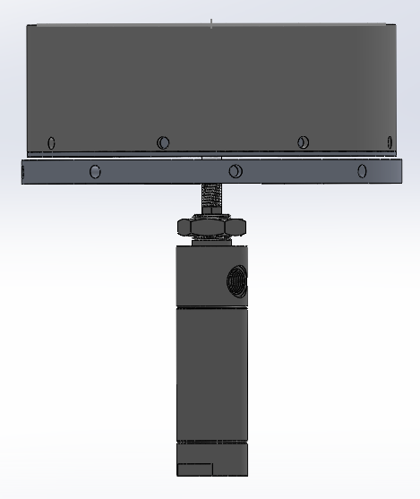
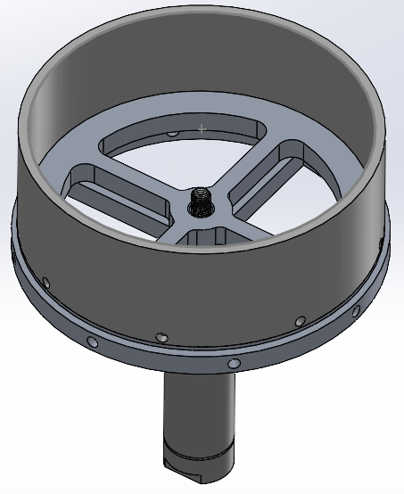
Piston Deployment Assembly
Diaphragm
Cup
Piston
Mount

Slide 22
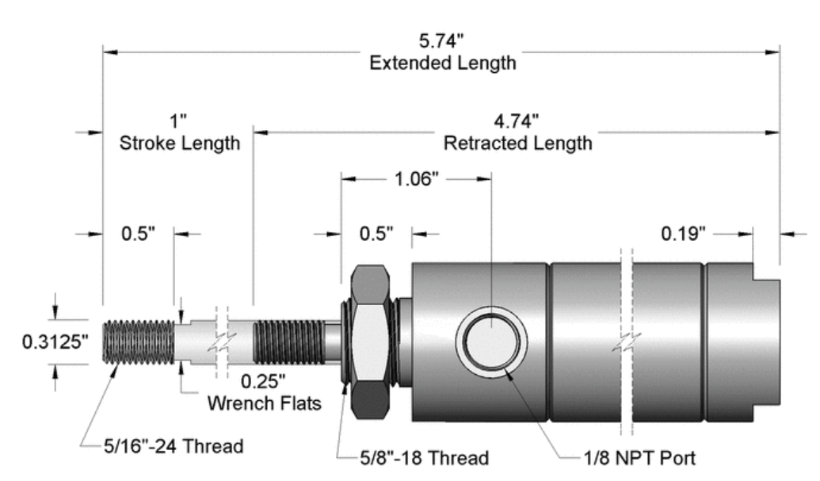
Piston Deployment: Piston
Shear Pins (nylon screws): ~40lb x 4
Piston force: 250 lb at 280 psi
Extension Length: 1in

Slide 23
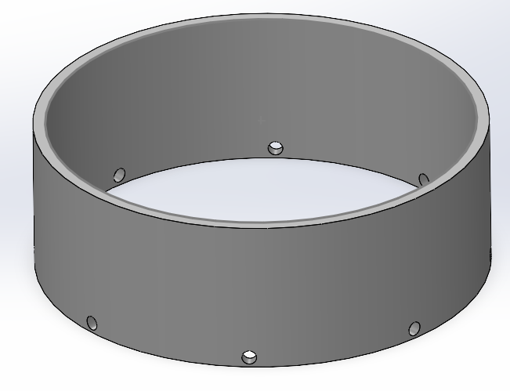
Piston Deployment:
Piston Cup
Purpose: holds parachute and will break shear pins at connection point
Screws into the piston bulkhead
COTS Fiberglass
Mass: 0.1 lbs

Slide 24
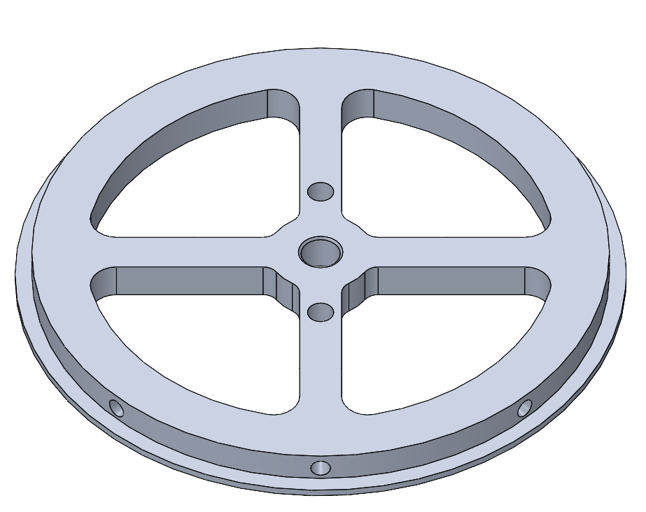
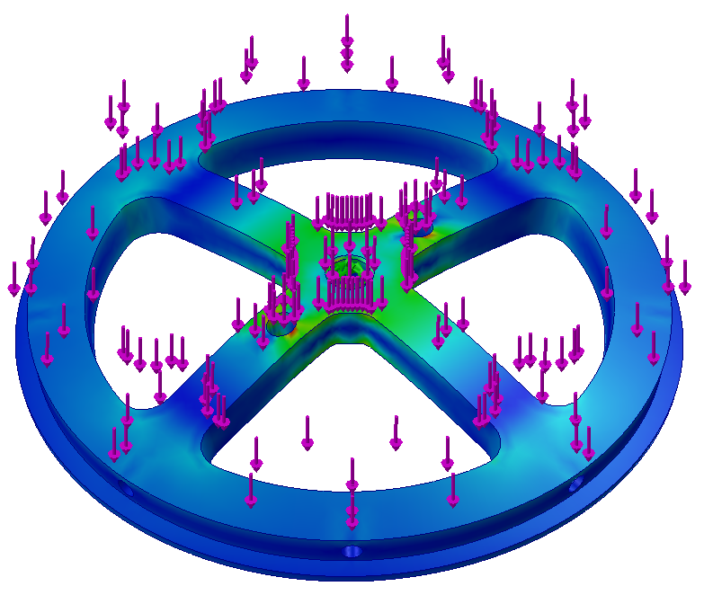
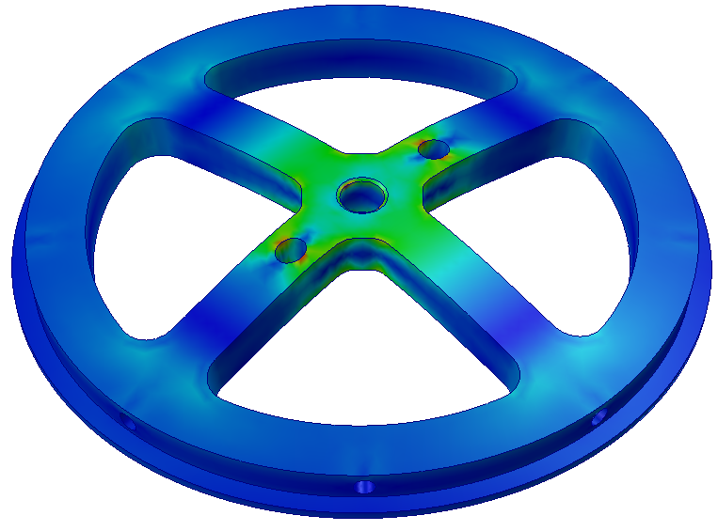
Piston Deployment:
Diaphragm
Piston Connection
U bolt Connection
Purpose: takes the bulk of forces during flight and piston deployment
Aluminum Alloy: 6061- T6 (SS)
0.41 lbs
Piston Cup Connection
G-forces: 448 lbf
(Left Picture)
  Min. Factor of Safety: 2
Piston Force (250 lbf) (Right picture)
  Min. Factor of Safety: 2.4

Slide 25
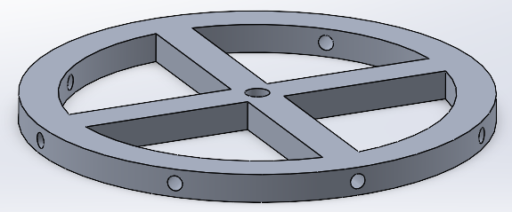
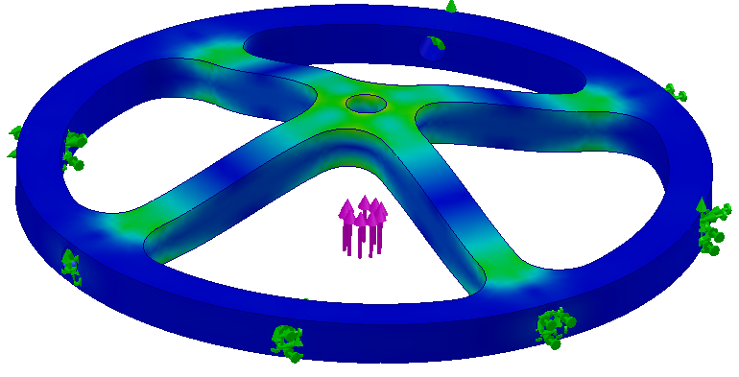
Piston Deployment: Piston Mount
Attaches Piston to MPT
Piston screws into center of mount
FEA
  Force: Piston actuation (250lb)
  Fixed at outer holes
  Safety Factor: 3

Slide 26
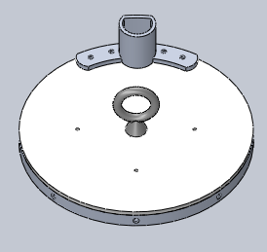
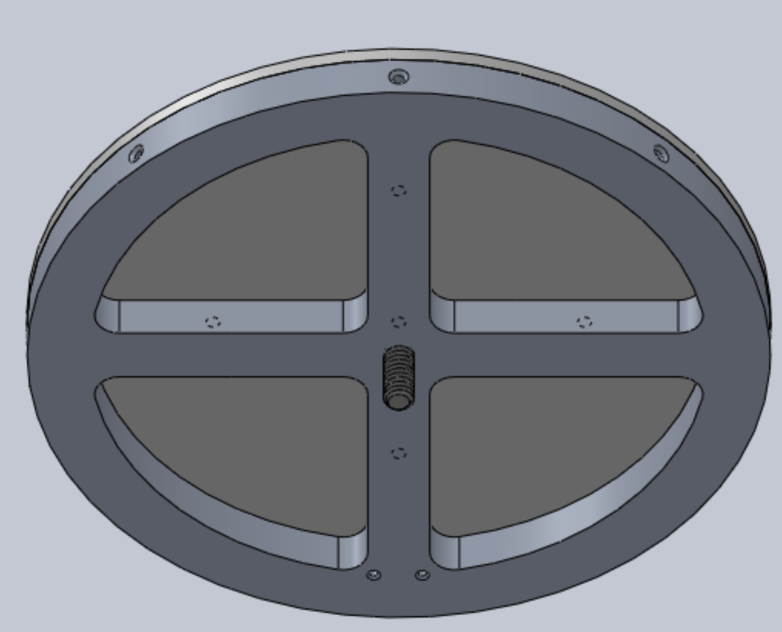
Black Powder Well: Well Design
On side to leave space for parachute and sit over strong part of bulkhead
G10 fiberglass plate to maintain pressure while minimizing mass
Aluminum Alloy: 6061- T6 (SS)
Mass : 0.69 lbs

Slide 27
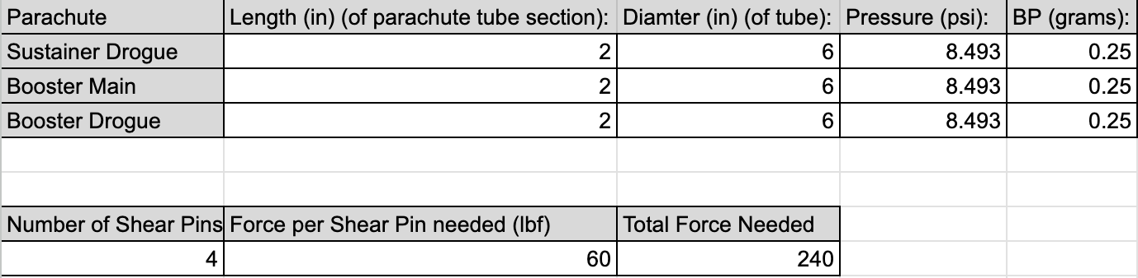
Black Powder Well: Black Powder Calculations
https://www.insanerocketry.com/blackpowder.html

Slide 28
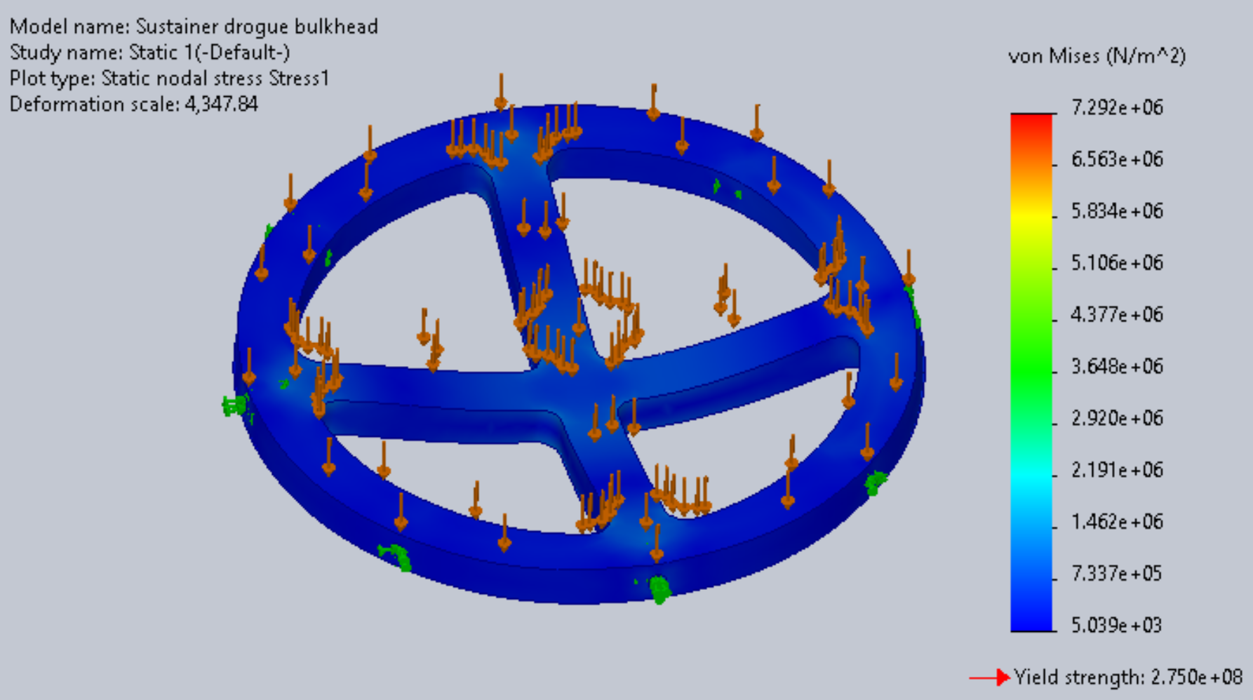
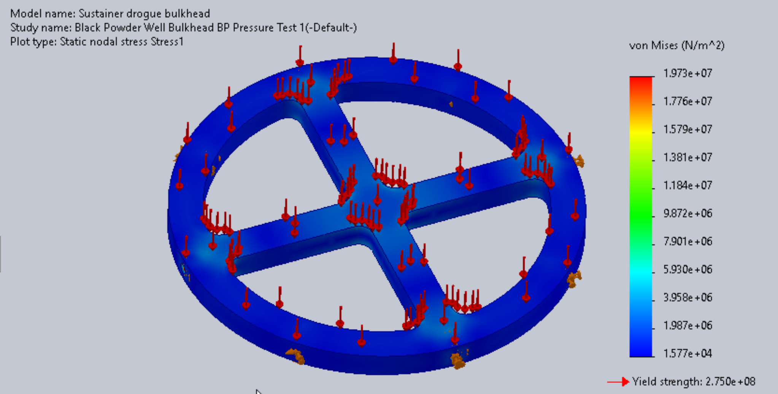
Black Powder Well: Bulkhead
Purpose: Withstands forces & keeps components in place
Screws into fiberglass plate, charge well, and mission package tube
Aluminum Alloy: 6061- T6 (SS)
Mass: 0.49 lbs
Conducted FEA for g-forces (top) and pressure of black powder combustion (bottom)
  Safety Factor: 16

Slide 29
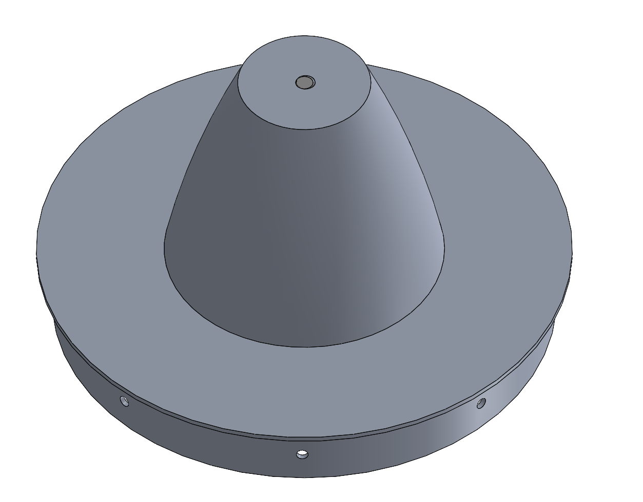
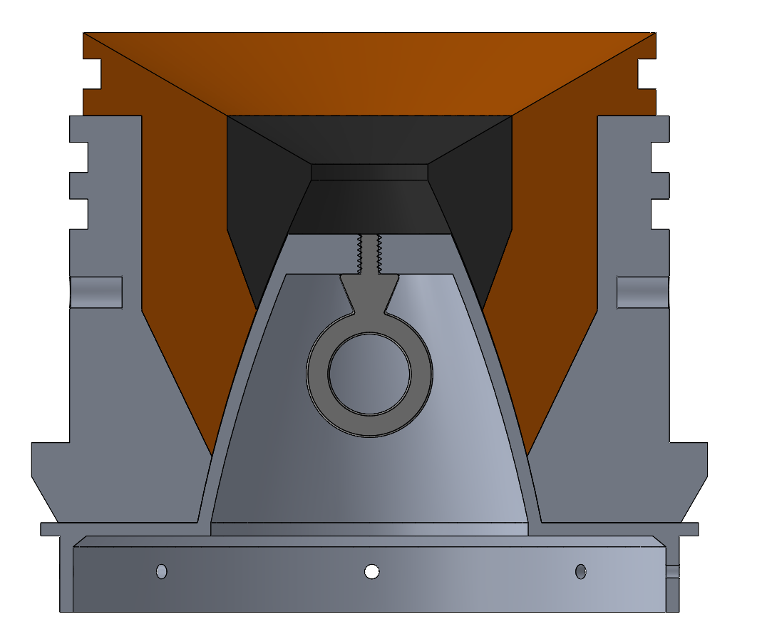
Staging Cone
Staging cone is the transition between booster and sustainer
The curve of the cone matches the inner bell shape of the sustainer nozzle
sustainer nozzle
eye bolt (recovery attachment)
staging cone

Slide 30
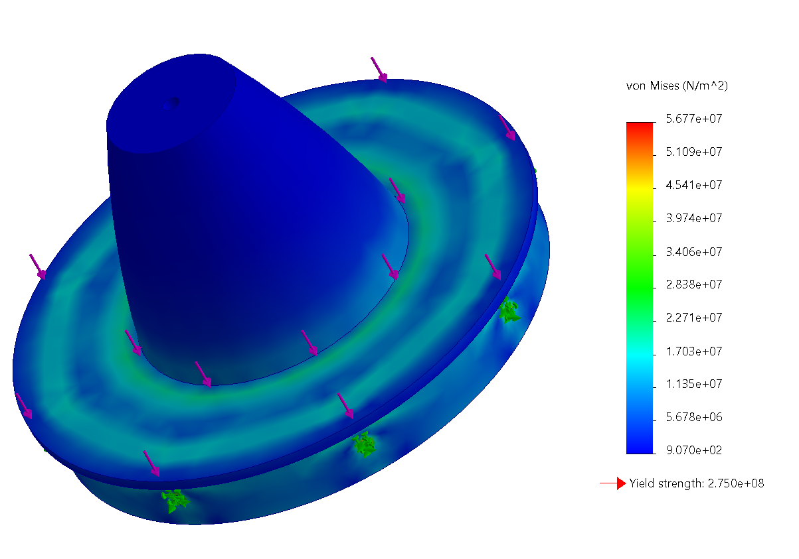
Staging Cone
Forces:
1090 lbf down on lip
0.761 lbf up on center
Fixtures:
Bolt holes on lower edge
Minimum Safety Factor: 4.8

Slide 31
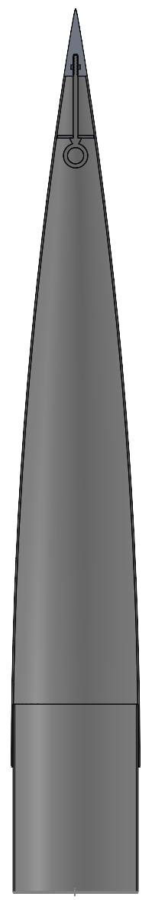
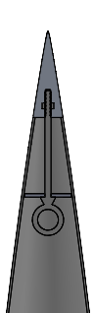
Nose Cone
Tip
Tip: Aluminum 6061
Body and Coupler: fiberglass
Recovery attachment point:
Eye Bolt screwed into tip
  Capacity: 475 lbf
  Material: 304 Stainless Steel
33 in
Eye Bolt
6 in
6 in

Slide 32
Recovery Mass Breakdown
Booster | Part | Mass (lbs) | Sustainer | Part | Mass (lbs)
 | Parachute and lines (x2) | 1 (2) |  | Parachute and lines (x2) | 1 (2)
 | Black powder assembly (x2) | 1.18 (2.36) |  | Black powder assembly | 1.18
 |  |  |  | Piston cup | 0.1
 |  |  |  | Piston diaphragm | 0.41
 |  |  |  | Piston | 1.15
 | Staging Cone | 0.44 |  | Nose cone | 5
 | Total: | 4.8 |  | Total: | 9.84
Total: |  |  | 14.64

Slide 33
Possible Failure Modes
Failure Mode | Probability | Severity | Mitigation
E-matches fail to ignite | Low | High | Two e-matches per system
Black Powder well spills | Medium | High | Duct tape cover for well
Shear pins fail to break (black powder or piston) | Low | High | Black powder: more black powder Piston: higher expected force and more black powder
Parachutes tear | Low | Medium | Bags to protect

Slide 34
Possible Failure Modes
Failure Mode | Probability | Severity | Mitigation
Line tangling | Medium | Low | swivels
Shock Force breaks connection points | Medium | High | x2 safety factors
Shear pins (main) break due to drogue deployment shock force | Medium | Medium | Calcs, safety factors

Slide 35
Questions?

Slide 36
Aerodynamics

Slide 37
Functional Requirements
Dynamic Stability: Fins must give the rocket a dynamic stability margin between 1.5 and 6 calibers
Flutter Stability: Fins must have a predicted flutter speed 50% greater than the max speed during flight
Fins must withstand lift forces
Fillets must secure fins to fin can throughout flight
  Epoxy cannot burn
  Screws must withstand shear force exerted by the fins
Transitions must not deform due to temperature

Slide 38
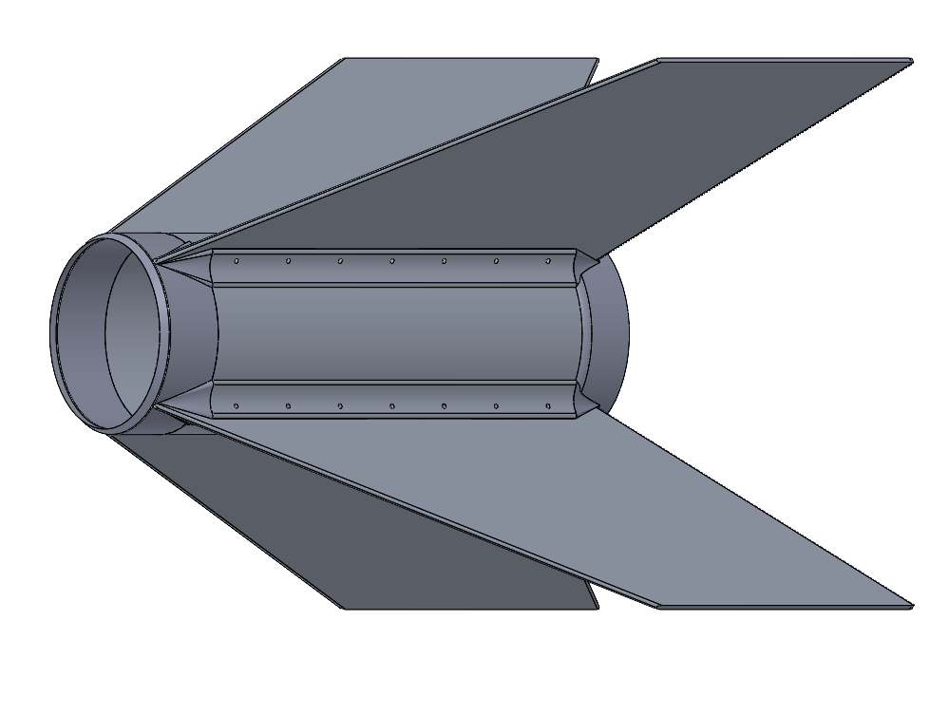
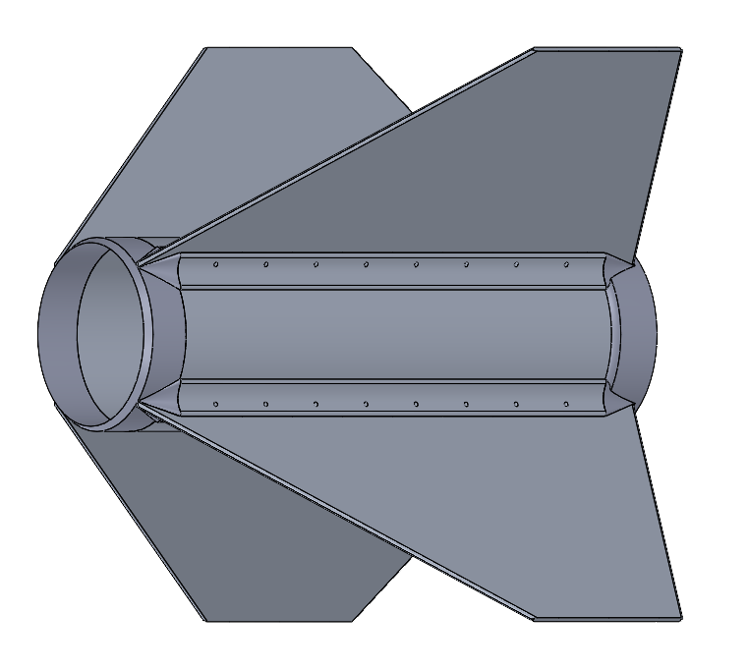
Fin Can Assembly Overview
Material: Aluminum 6061-T6
Two fillets attached to each fin using #10-32 screws
Each fin and fillet is secured to fin can with epoxy resin
Fin leading and trailing edges: sanded to be round
Screws on fillets: #10-32 Alloy Steel
Sustainer
Booster

Slide 39
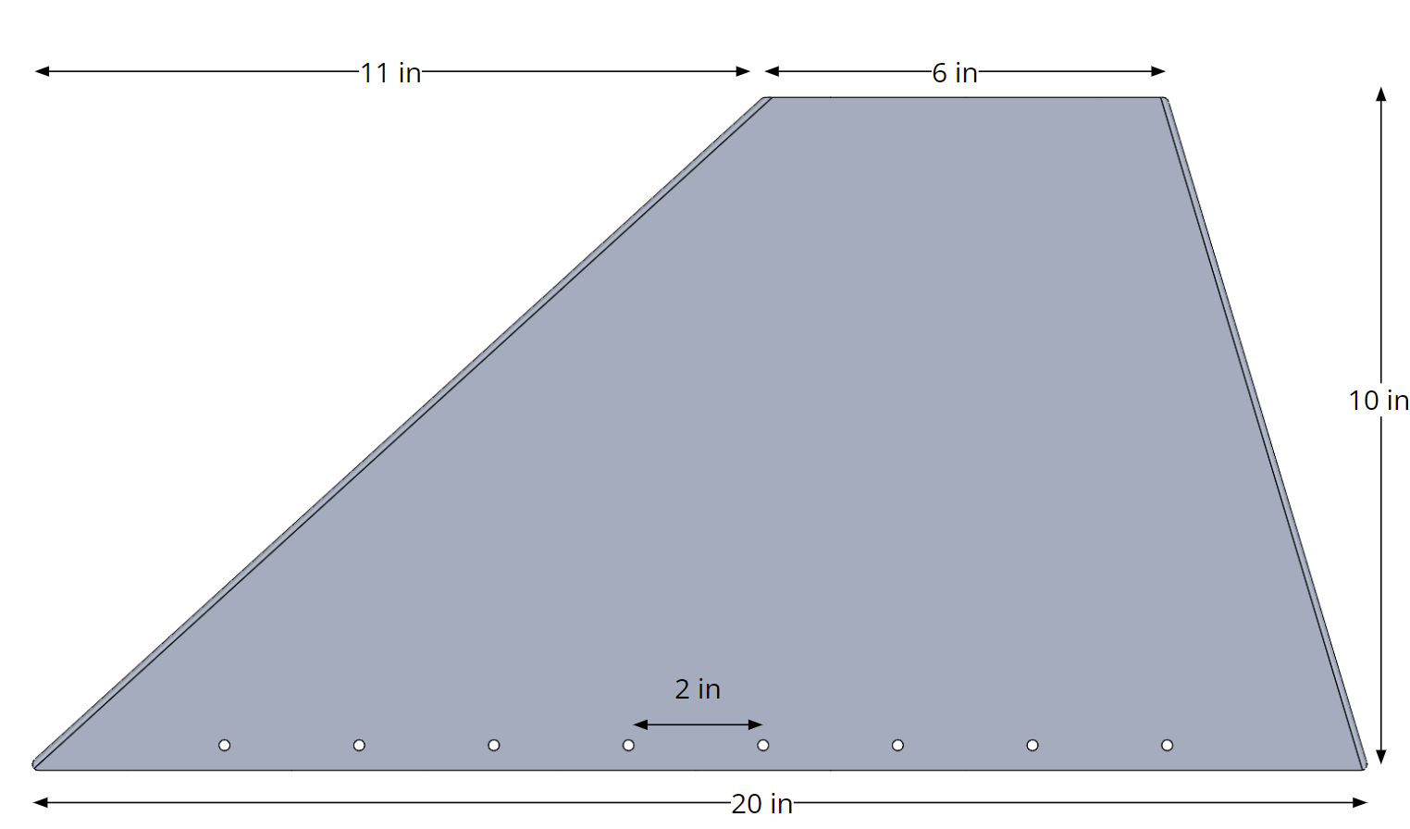
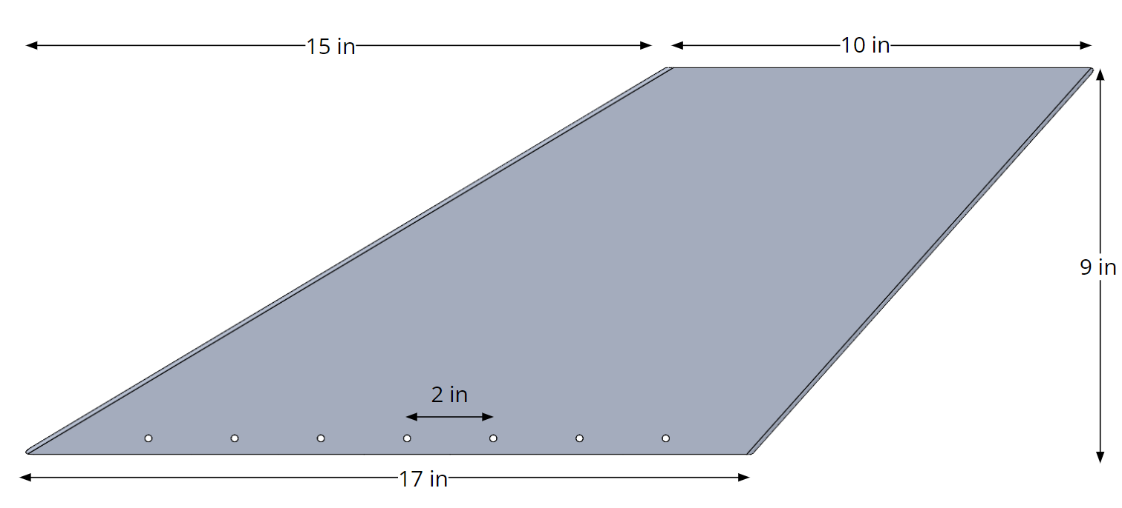
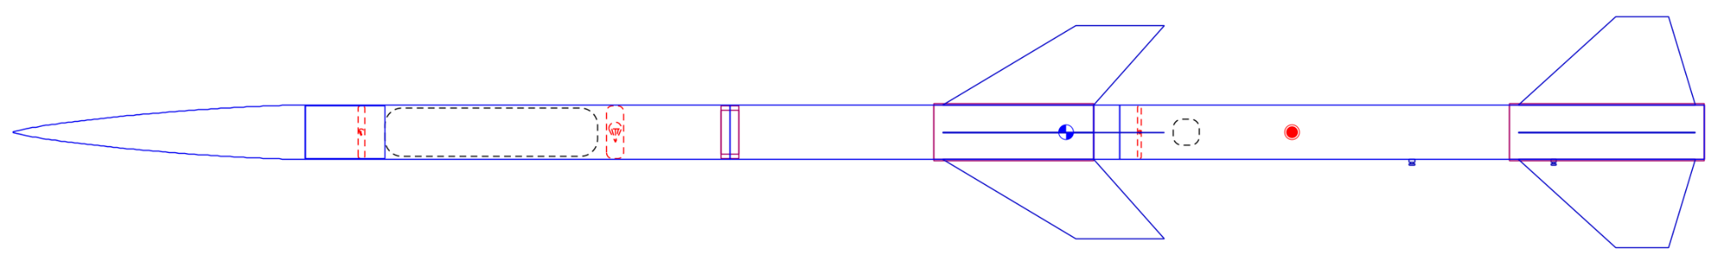
Fin Shape & Design
Sustainer Fin
Booster Fin
Booster Fin

Slide 40
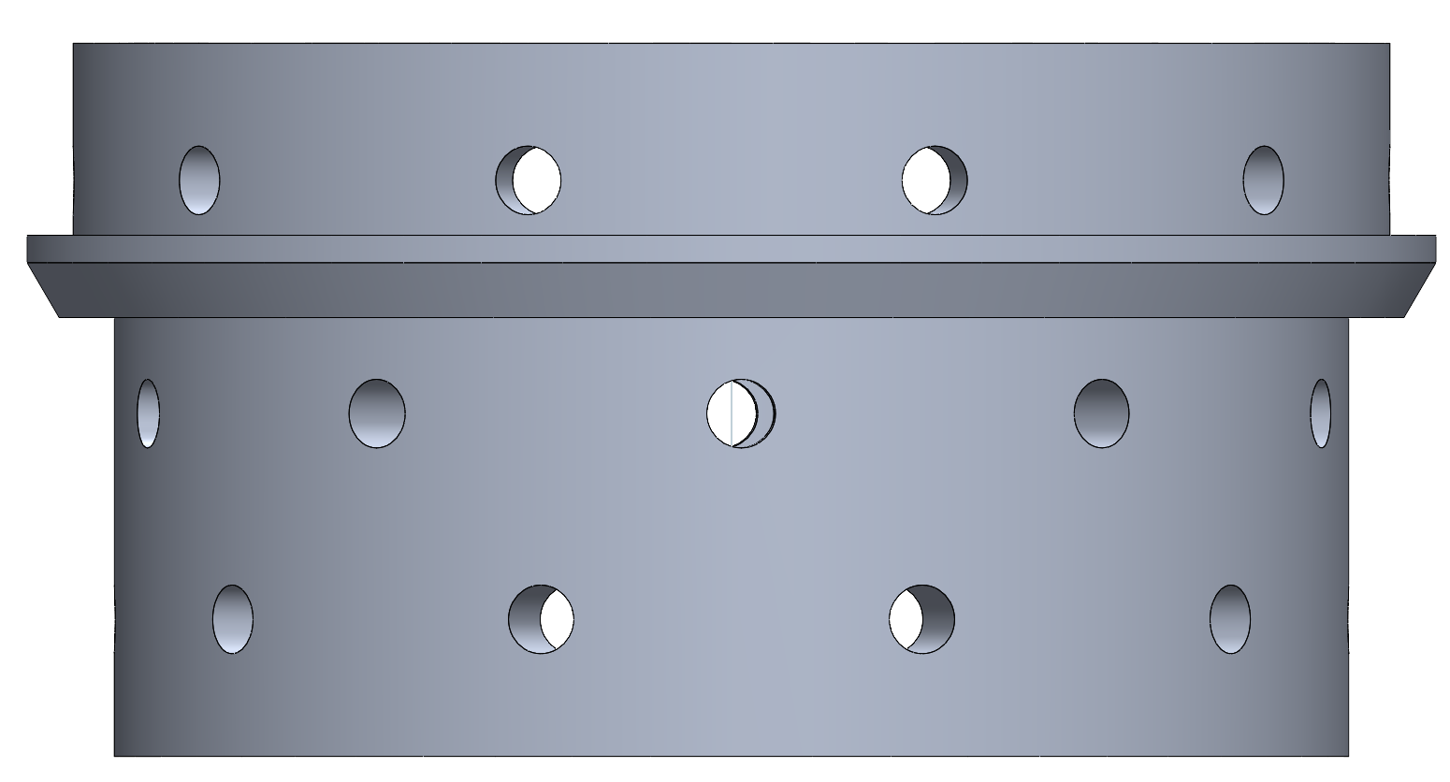
Forward Retention Ring (FRR)
Material: Aluminium 6061
Same FRR for Booster & Sustainer
Couples Motor to Mission Package Tube (motor slides over bottom, MPT slides over top)
Added a taper to protruding part to reduce separation between diameters
Added ⅛ in to the top of protruding edge to prevent injury while machining
Bottom radius: 2.8125 in | Height of the taper: .25 in
Top radius: 3 in | Height from bottom to the taper: 2 in
Bottom thickness: .4688 in | Height from taper to top: .8750 in
Top thickness: .25 in

Slide 41
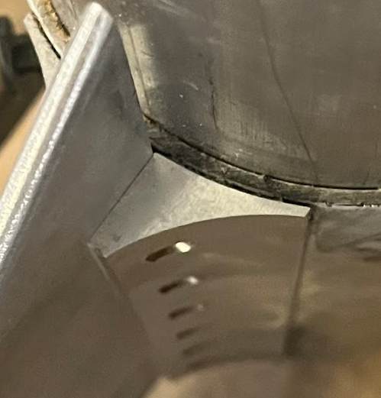
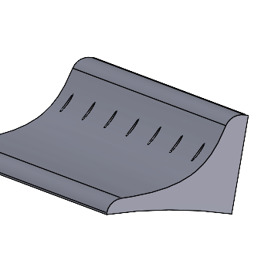
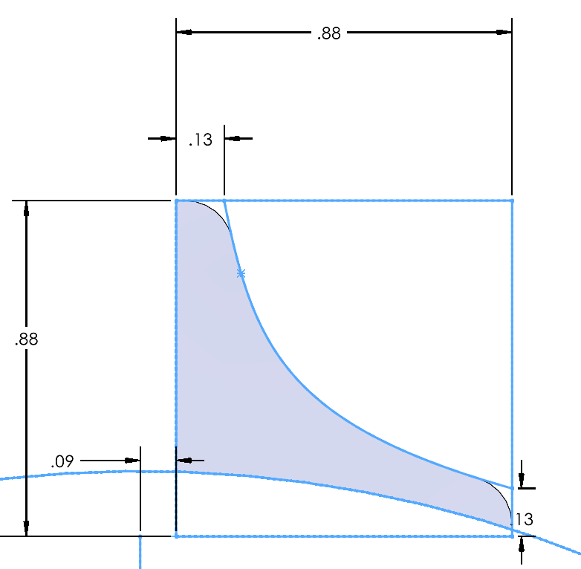
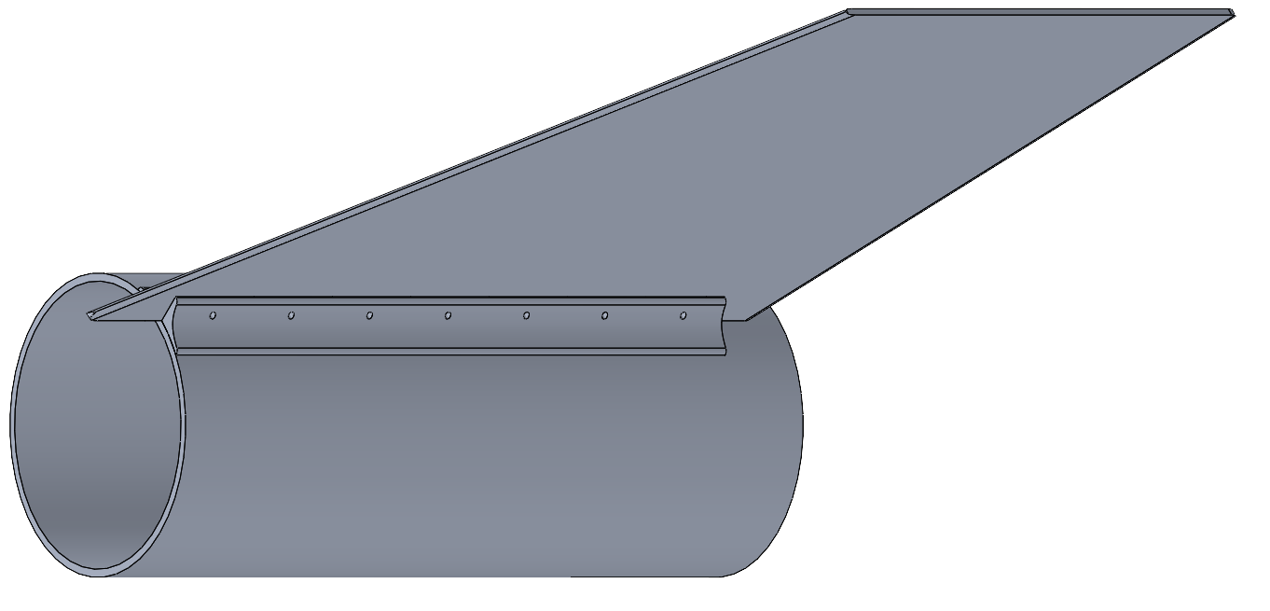
Fin Attachment
Phoenix fillet
Prometheus fillet
Fins are attached to fin can with fillets & screws
Aluminum fillets allow for easy attachment and removal of fins
Fillets attached to fin can with epoxy
Fillet Material: Aluminum 6061-T6
New design includes rounded edges and slightly thinner profile
Fin can, fillet, sustainer fin:
Fillet profile

Slide 42
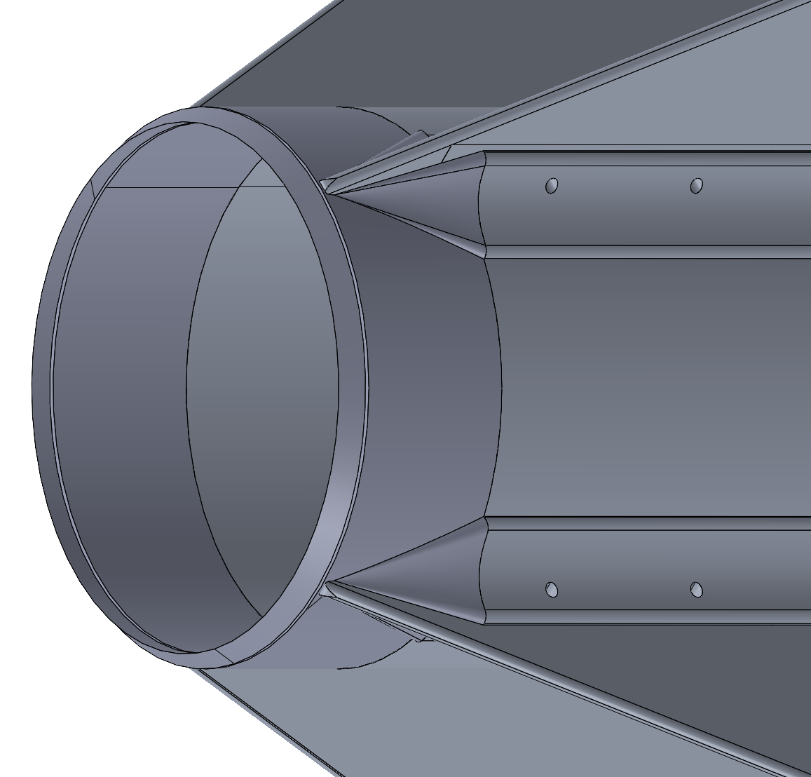
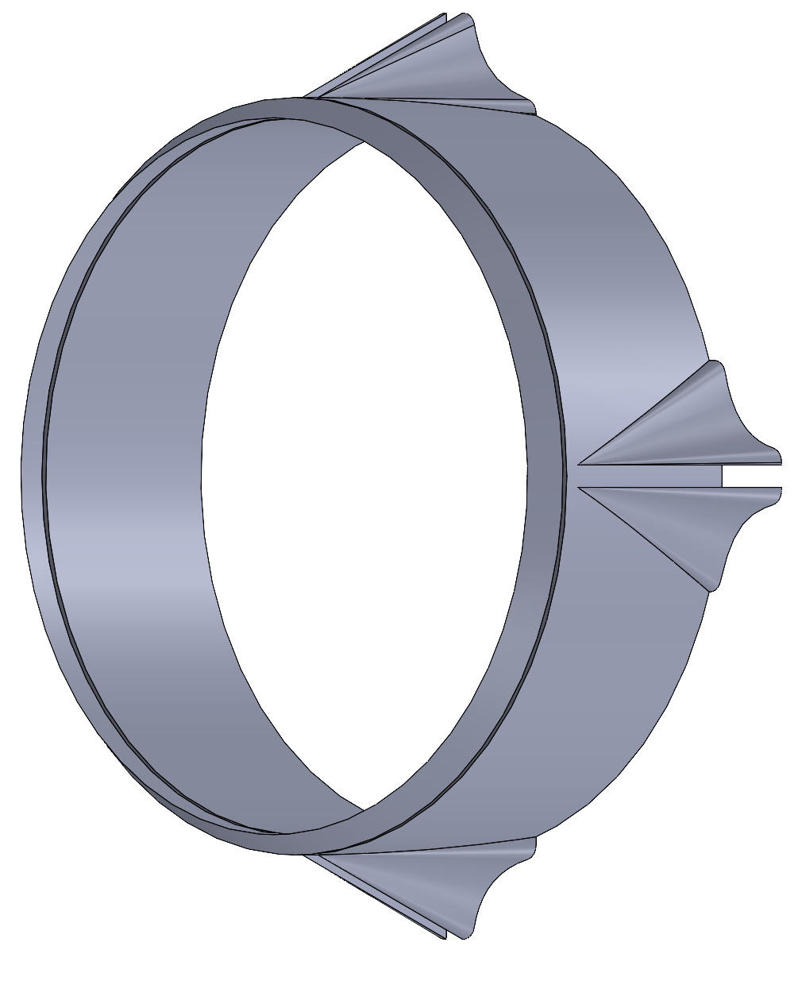
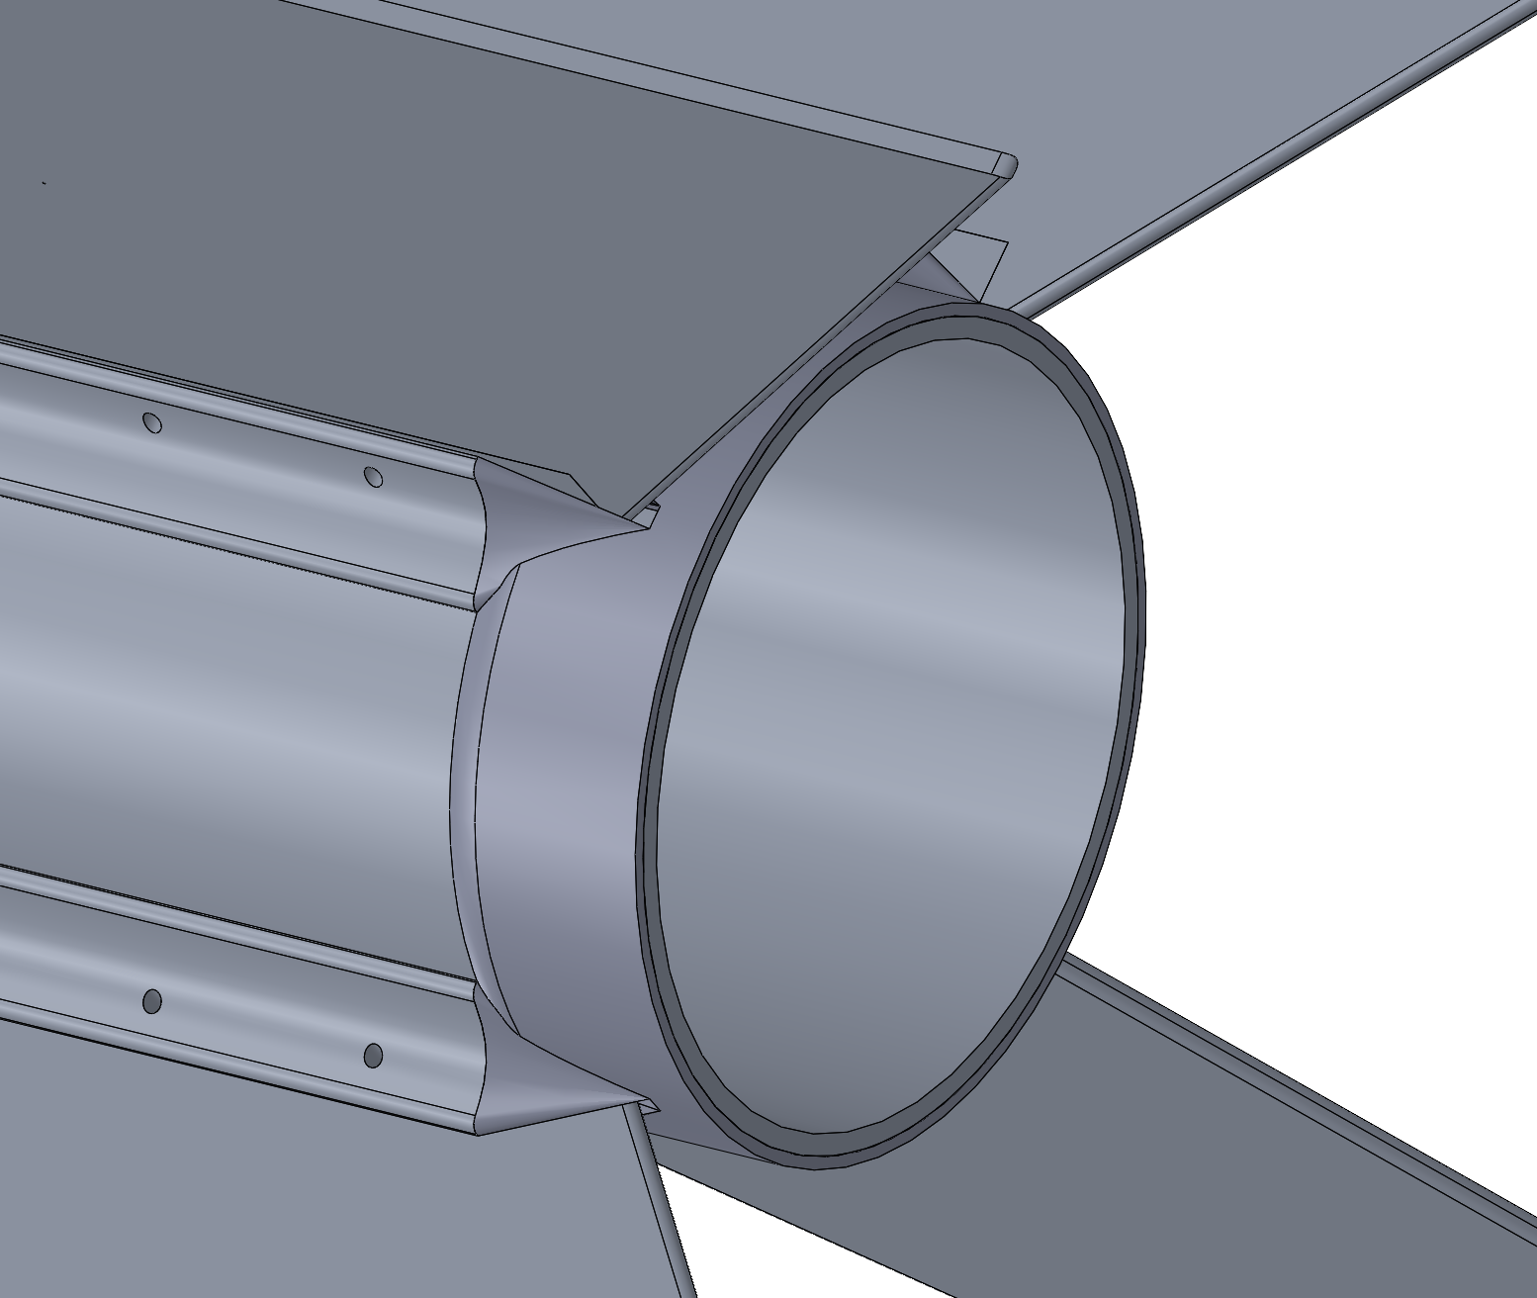
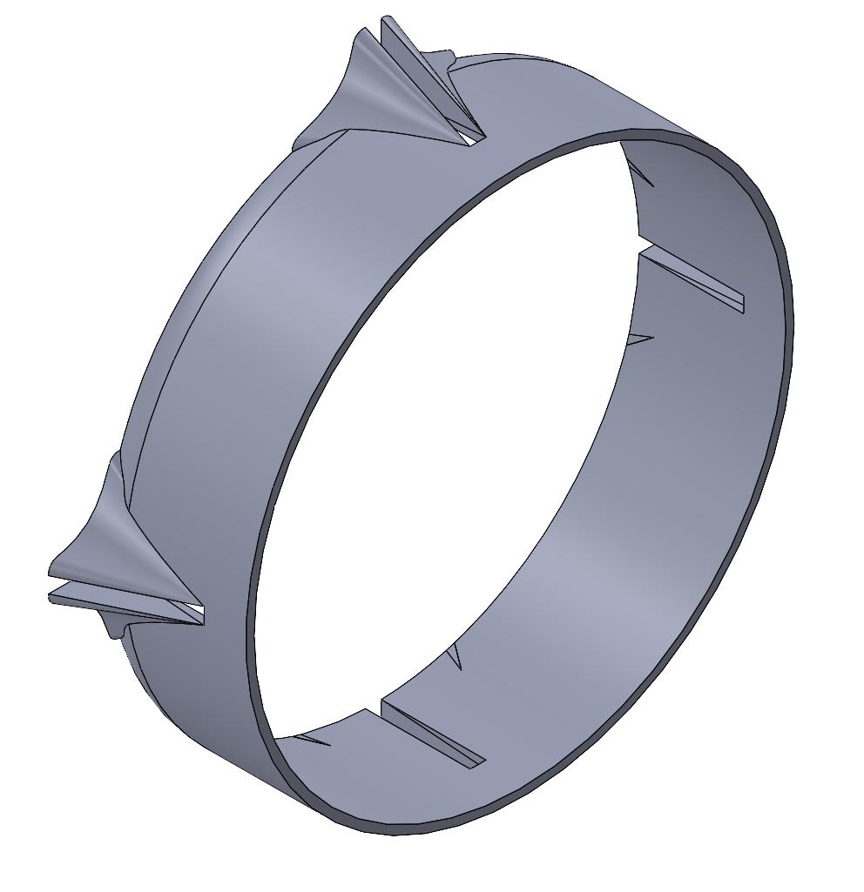
Transitions
Purpose: Aerodynamically transition from motor case to fillets (forward transition) and from fillets to fin can (backward transition)
Material: 3D printed PETG (500F melting temperature) and coated with heat-resistant paint (ablative)
Forward Transition
Backward Transition

Slide 43
Fin Assembly
Two fillets attached to each fin using #10-32 screws
Each fin and fillet is secured to fin can with epoxy resin
Sustainer
Booster

Slide 44
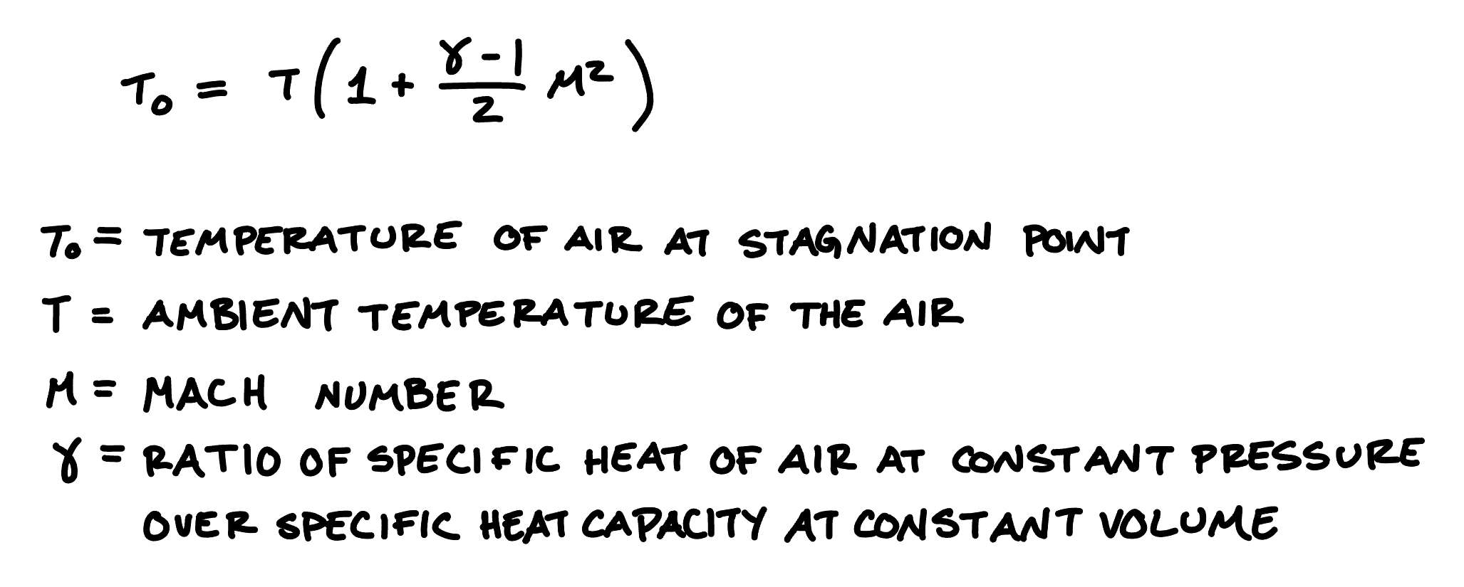
Air Stagnation Temperature Calculations
Altitude (ft) | Ambient temperature at altitude (°F) | Gamma | Mach number | Temperature at Stagnation (°F)
2326 | 284 | 1.4 | 1.5 | 312
9744 | 269 | 1.4 | 1.5 | 272
Led to the choice of PETG for transitions
Melting point of PETG: 500°F

Slide 45
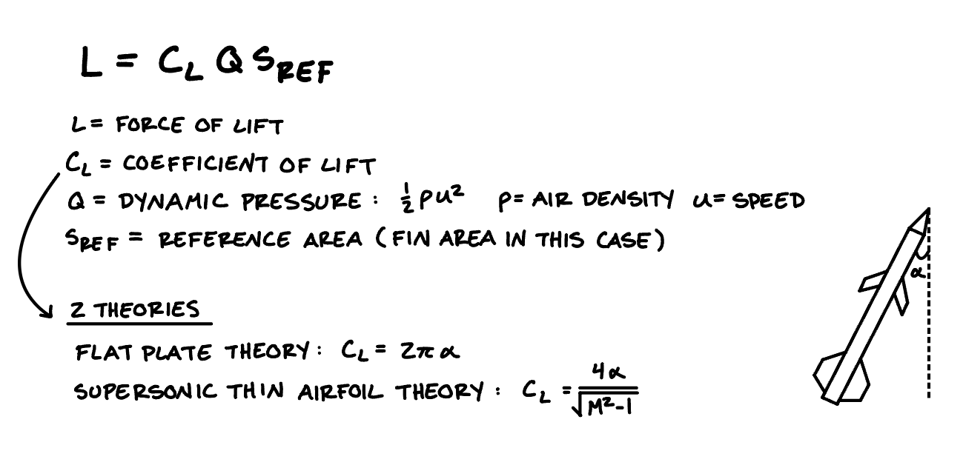
Lift Force Calcs
 | Altitude (ft) | Speed (ft/s) | Mach Number | Angle of Attack (°) | Lift Coefficient | Fin area (in²) | Lift (lbf)
Flat Plate Theory | 2326 | 1124 | 1.5 | 11 | 1.2 | 104 | 1215
Supersonic Thin Airfoil Theory | 2326 | 1124 | 1.5 | 11 | 0.69 | 104 | 692
Flat Plate Theory | 9744 | 1962 | 1.5 | 11 | 1.2 | 115 | 3240
Supersonic Thin Airfoil Theory | 9744 | 1962 | 1.5 | 11 | 0.69 | 115 | 1845
Booster
Sustainer
Lift forces act on fins, checking to see if fins will be knocked off rocket
Lift force based on two different calculation methods: Flat-Plate Theory and Supersonic Thin Airfoil Theory

Slide 46
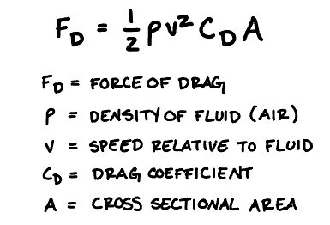
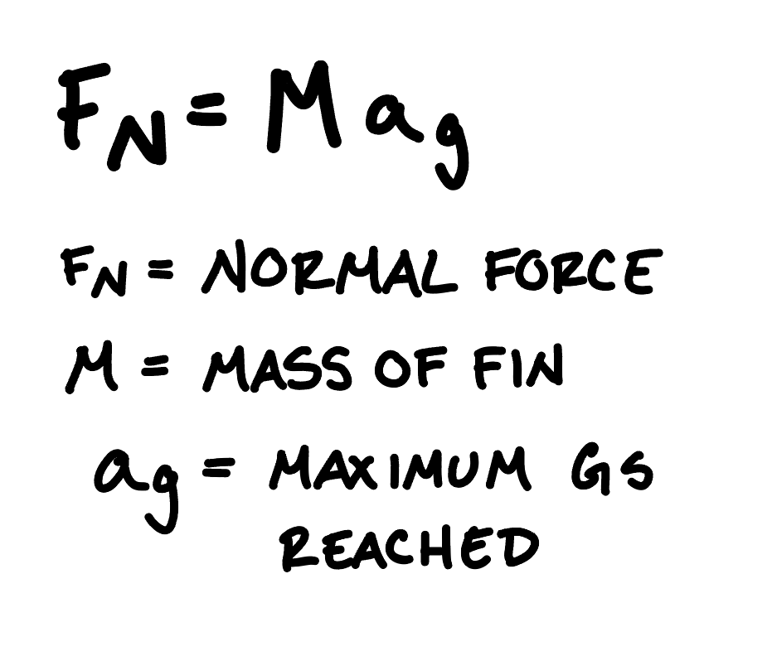
Shear Force on Fillet Screws Calcs
Fin Mass (lbs) | Velocity (ft/s) | Altitude (ft) | Drag Coefficient | Fin cross sectional area (in²) | Drag Force (lbf) | Normal Force (lbf) | Total Force (lbf)
11.6 | 1120 | 2330 | 0.9 | 2.80 | 24.5 | 163 | 187
8.75 | 1960 | 9740 | 0.9 | 3.29 | 69.2 | 122 | 192
Booster
Sustainer
Screw Diameter | Shear Strength (psi) | Force at Failure (lbf)
3/16” | 85000 | 2347
based on McMaster alloy steel socket head screws

Slide 47
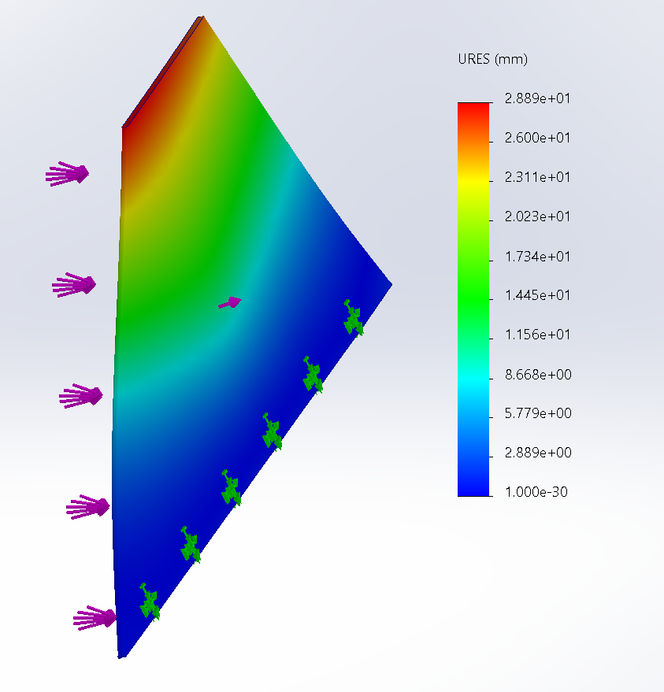
Fin FEA

Slide 48

FRR FEA
very conservative: assumes entire rocket’s weight is on FRR
used booster peak pressure (higher than the sustainer)
minimum safety factor: 18

Slide 49
Flutter Stability
Sustainer fin flutter speed: 2304 ft/s
  Velocity of sustainer at maximum dynamic pressure (max q): 1780 ft/s
  Does not meet Spaceport margin
Booster fin flutter speed: 1444 ft/s
  Velocity at max q: 950 ft/s
  Meets Spaceport margin

Slide 50
AeroD Mass Breakdown
Booster | Part | Mass (lbs) | Sustainer | Part | Mass (lbs)
 | Fin Can | 5.46 |  | Fin Can | 4.50
 | Fillet (x8) | 0.41 (3.27) |  | Fillet (x8) | 0.34 (2.69)
 | Fin (x4) | 2.37 (9.48) |  | Fin (x4) | 2.22 (8.88)
 | Forward Transition | 0.25 |  | Forward Transition | 0.28
 | Rear Transition | 0.28 |  | Rear Transition | 0.19
 | Total: | 18.74 |  | Total: | 16.54
Total: |  |  | 34.94

Slide 51
Possible Failure Modes
Failure Mode | Probability | Severity | Mitigation
Structural failure of fasteners | Low | Medium | Choosing correct screw and hole size to prevent screws being too small
Plastic deformation of fin due to lift force | Medium | High | Making fins thick enough to withstand lift force
Heat induced epoxy failure | Medium | Medium | Choosing thickness of fin can to prevent epoxy from burning from heat of motor
Forward transition melting | High | Low | Make out of PETG and coat with heat resistant paint

Slide 52
Questions?

Slide 53
Air Brakes

Slide 54



What are Air Brakes?
A mechanism that upon actuation, creates a large amount of drag to slow down the rocket
Suddenly creates a large amount of area outside the rocket which creates drag
Applications:
  Reaching target altitude with accuracy
  Drag separation

Slide 55
Functional Requirements
Actuation Time: Transition from fully retracted to fully extended within 0.5 seconds
Predictability: Produce a predictable amount of drag when fully extended
Purpose on Booster: Cause drag separation
Purpose on Sustainer: Reach target altitude with accuracy (prevent overshooting)
  Note: Avionics will be creating a feedback control loop to determine when to extend air brakes

Slide 56



CAD

Slide 57


CAD

Slide 58


Design

Slide 59


CAD Pt. 2

Slide 60




Torque Calcs
Plate experiences resistance to moving outward (deployment) due to friction with opening (drag force = normal force)
Inputs
Mass of plate
Distance extended
Time to extend
Coefficient of friction
Air density
Coefficient of drag
Velocity at deployment
Area of plate
Length of servo arms
Distance airbrake is extended
Results: 9.5 Nm = 1345 oz-in
Possible Servo:
Torque: 1435 oz-in (7.5 ft-lbs)
Size (LxW): 4.26 x 3.42 in
Notes:
https://teknic.com/products/brushless-servo-motors/hudson-motors-ready-ship/
https://teknic.com/hudson-model/M-3432S-LN-08D/?model_voltage=300
http://www.ee.ic.ac.uk/pcheung/teaching/DE1_EE/stores/sg90_datasheet.pdf

Slide 61

Material Selection
Finding the Bending Stress in the plate due to Drag Force when plate is fully extended
Inputs:
Coefficient of Drag (plate): 1.9
Air Density: 0.0765 lb/ft^3 (sea level)
Velocity at Deployment: 400 ft/s
Length of Plate: 3in
Thickness of Plate: 0.25in
Results
Bending Stress: 7.9 MPa
Yield Strength of Materials:
Aluminum 6061-T6: 241 MPa
PLA: 26 MPa (homogenous)

Slide 62
Air Brakes Mass Breakdown
Booster | Part | Mass (lbs) | Sustainer | Part | Mass (lbs)
 | Servo | 0.032 |  | Servo | 0.032
 | Leaf (x4) | 0.044 (0.176) |  | Leaf (x4) | 0.044 (0.176)
 | Base plate | 0.088 |  | Base plate | 0.088
 | Total: | 0.296 |  | Total: | 0.296
Total: |  |  | 0.592

Slide 63

Integration
8-32 screws

Slide 64
Manufacturing
Tests will be done to determine necessary materials and if all components can be 3D printed
If needed almost all components can be machined out of aluminum

Slide 65
Possible Failure Modes
Failure Mode | Probability | Severity | Mitigation
Air brakes fail to deploy (sustainer) | Low | Medium | Choose servo with sufficient torque
Air brakes fail to deploy (booster) | Low | Medium | Choose servo with sufficient torque
Deformation or structural failure of plates | Low | Medium | Choose material and thickness to withstand sufficient bending stress
Structural failure of mission package tube at air brakes | Medium | High | Choose sufficient thickness of material within mission package tube and size of screws

Slide 66
Questions?

Slide 67
Payload
“In reality there’s no reason to launch a rocket unless there’s a payload”
Space Dynamics Laboratory

Slide 68
Agenda
Requirements
Scientific Overview
Design Overview
  Assembly
  FEA
  Highlighted Components: Payload Holder, Pressure Vessel, Vibration Damping Materials
Materials and Mass
Field of View
Failure Modes Analysis

Slide 69
Functional Requirements
Independent Function: not required for trajectory/recovery
Mass: No less than 8.8 (-0.4) lbs
  Up to 2.25 lbs. “boiler-plate” mass
Form Factor: Fit completely in a 3U Cubesat dispenser (10cm x 10cm x ≥ 30cm)
Interface: Minimal interference with launch operations
  Modular design (independent weigh-in)
  Remain stable after hours of launch prep, rail time, heat, waiting for other launches
Restricted Materials: no lead, radioactives, “hazardous materials”, live vertebrates
Rapid Results Turnaround: Delivered by noon Saturday
Relevant and well-designed scientific or technical objective
Bonus Technology Relevance Award: Robotics, AI, Infrared

Slide 70


Payload Overview: Cyclops
Goal: Investigate biomechanical effects of hypergravity on the SANS symptom of hyperopic globe flattening of an in-vitro B. taurus ocular specimen
Figure 1. Schematic of hyperopic globe flattening to be measured with Cyclops. Adapted from Velez et al., 2017.

Slide 71
Payload Overview: Cyclops
Goal: Investigate biomechanical effects of hypergravity on the SANS symptom of hyperopic globe flattening of an in-vitro B. taurus ocular specimen
Scientific Motivation:
  Studying launch conditions is difficult (invasive, inconvenient)
  SANS affects up to 75% of astronauts (long-term post-flight)
  NASA science priority for future spaceflight
  Hypothesis in literature that elastic properties of eye contribute to SANS (would be affected significantly by launch)
Data: axial length (flight imaging) as a function of (gravitational) acceleration

Slide 72


Payload Assembly (outer view)
3.937 in
Lid Height: 0.0625 in
11.686 in
Figure 2. Isometric view of payload assembly featuring bulkheads on top and bottom and outer 3U holder in between
Figure 3. Side view of payload assembly featuring bulkheads on top and bottom and outer 3U holder in between

Slide 73



Payload Assembly (inner view)
Bulkhead
Gap between boxes for insulation
O-ring sealed inner lid
Inner cylindrical pressure vessel
Eyeball
Eyeball holder
Eyeball holder
Camera (side view)
Figure 4. Cross-sectional view of payload assembly featuring bulkheads on top and bottom with outer 3U box, inner cylindrical pressure vessel, and eyeball holder
Figure 5. Cross-sectional view of payload assembly demonstrating orientation of eyeball holder (left) and camera (right)
Figure 6. Cross-sectional view of payload assembly illustrating eyeball holder containing ocular specimen

Slide 74



Payload Design - Holder V.2
Figure 7. Isometric view of holder
Figure 8. Side view of holder
Figure 9. Top view of holder

Slide 75




Payload Design - Holder V.2
Figure 10. Holder Base
Figure 10. Holder Claw
Figure 11. Holder with eye (left) and diagram of optical muscles (right)
Two Parts, 3D-Printed & Machined; Secured by 4, #4-40 screws for rapid experimenting with eyeball
Bounding Volume: 1.68” x 1.68” x 6.42”
Biology-inspired Design

Slide 76



Payload Design - Holder V.2
Figure 12. Holder Stress -
Experiencing 14g, fixed at base
Figure 13. Holder Displacement -
Experiencing 14g, fixed at base
Figure 14. Holder Strain -
Experiencing 14g, fixed at base

Slide 77

Raspberry Pi Camera FOV Calculations

Slide 78

Raspberry Pi Camera FOV Diagrams

Slide 79



Pressurized Inner Lid
O-Ring Size Parker No. 2-043
O-Ring
0.098 in
3.623 in
0.1405 in
3.525 in
Figure 15: Pressurized inner lid and o-ring groove isometric view (top), dimensioned side view (bottom left), zoomed in and dimensioned side view (bottom right)
*Evaluating various lid attachment mechanisms including clamping and screwing options

Slide 80
Raspberry Pi Camera FOV Diagrams
3.6 in
3.6 in
102°
67°
11.69 in
7.686 in
3.6 in
4.120 in
1.181 in
3.009 in
3.009 in
Figure 16. Field of View diagram side view (left), top view (right)
*Minimum separation between eyeball and camera: 1.070 inches
Notes:
Green - safe range to place the eye within
Blue - eyeball/eyeball dimensions
Not drawn to scale
Shows inner dimensions of the cylindrical container

Slide 81


Bulkhead FEA
Figure 17. Von Mises stress of bulkhead - 14g applied force, fixed at screw holes
Figure 18. Resultant displacement of bulkhead - 14g applied force, fixed at screw holes
Factor of Safety: 138.565 → can introduce more aggressive mass-saving cuts

Slide 82
Payload Materials
Part | Material | Part | Material
Pressure Vessel | Aluminum 6061 (1/16”) | Insulation | Silicone or rubber options (discussed subsequently)
Eyeball Holder | BioMed Durable Resin + Aluminum 6061 Base | Camera | Raspberry pi v3 Wide
Outer 3U Box | Aluminum 6061 or COTS CubeSat frame | Accelerometer | Raspberry Pi ADXL345 Pre-Soldered 3-axis
Table 1. Payload Materials

Slide 83
Vibration Damping and Insulation
Overview
  Reduces inner container vibrations to minimize unwanted eyeball displacement
  Insulate eyeball pre-launch (empirical testing needed for acceptable temps.)
Potential Materials
  Silicone Foam Sheets
    Thermal conductivity: 0.163 W/mK
  Silicone Gel Pads
    Thermal conductivity: 0.2 W/mK
  Sorbothane Rubber
    Thermal conductivity: 0.29 W/mK
Gap between inner and outer boxes containing insulation
Notes:
R - value
conductivity

Slide 84
Payload Mass Breakdown
Part | Mass (lb) | Part | Mass (lb)
Bulkhead | 0.52 | Eyeball | 0.066
3U Box + Cylinder | 2.28 | Eyeball Holder | 0.58
Inner Lid | 0.31 | Camera | 0.0088
Outer Lid | 0.09 | Electronics | 0.25*
Total Mass: 4.1048 lbs (room for replicates and additional science )
*Circuit Board weighs 0.11 lb - estimated additional electronics total to approx. 0.25 lb

Slide 85

Payload Failure Modes Analysis
Failure Modes: | Payload Module Leak | Pressure Vessel Failure
Probobility | Medium | Low
Severity | Low | Medium
Mitigation | 2 independent sealed layers of containment (follows NASA ISS standards for biological hazards) PPE when handling rocket and payload pre/post-flight | Materials and thickness selection (calculated – minimum 0.001 inches for 6061) Impact avoidance with vibration damping materials Visual inspection prior to flight
Table 2. Payload Failure Modes Analysis

Slide 86
Payload Failure Modes Analysis (Loss of Science)
Failure Modes: | Eyeball Holder Failure | Camera Failure | SD Card Recovery Failure | LED Light Failure | Electronics Integration Failure
Probability | Medium | Low | Medium | Low | Low
Severity | Low | Low | Low | Low | Low
Mitigation | Vibration testing in flight- simulated environments Selection of eyeball within specified allowable diameter | Testing of camera operations prior to flight Secondary Camera(s) in parallel | Alternative science plan of comparing before and after flight axial lengths | Multiple circuits of LED lights in parallel | Soldered wiring inside of insulating cover Testing of basic electronics function prior to launch
Table 3. Payload Failure Modes Analysis - Loss of Science Cases

Slide 87
Payload Design Failure Modes Analysis
Failure Mode: Payload module leak
  Risk: 3 (Occasional)
  Severity: 2 (Minor)
  Mitigation:
    2 independent sealed layers of containment (follows NASA ISS standards for biological hazards)
    PPE when handling rocket and payload pre/post-flight
Failure Mode: Pressure Vessel Failure
  Risk: 1 (Improbable)
  Severity: 3 (Moderate)
  Mitigation:
    Selection of materials and thickness based on mechanical properties and pressure calculations – minimum 0.001 inches for 6061 aluminum
    Impact avoidance with surrounding vibration damping materials
    Visual inspection prior to flight

Slide 88
Payload Design Failure Modes Analysis (Loss of Science)
Failure Mode: Eyeball Holder Failure
  Risk: 3 (Occasional)
  Severity: 1 (Minimal - LOS ONLY)
  Mitigation:
    Vibration testing to ensure successful operation in flight-simulated environments
    Selection of eyeball within specified allowable diameter
Failure Mode: Camera Failure
  Risk: 2 (Remote)
  Severity: 1 (Minimal - LOS ONLY)
  Mitigation:
    Testing of camera operations prior to flight
    Secondary Camera

Slide 89
Payload Design Failure Modes Analysis (Loss of Science)
Failure Mode: SD Card Recovery Failure
  Risk: 3 (Occasional)
  Severity: 1 (Minimal - LOS ONLY)
  Mitigation:
    Alternative science plan of comparing before and after flight axial lengths
Failure Mode: LED Light Failure
  Risk: 2 (Remote)
  Severity: 1 (Minimal - LOS ONLY)
  Mitigation:
    Multiple circuits of LED lights in parallel
Failure Mode: Electronics Integration Failure
  Risk: 2 (Remote)
  Severity: 1 (Minimal - LOS ONLY)
  Mitigation:
    Soldered wiring inside of insulating cover
    Testing of basic electronics function prior to launch

Slide 90
Questions?

Slide 91
Aeroshells

Slide 92
Aeroshell Requirements
Keeps external cameras below their maximum operating temperature of 50°C
Shape creates minimal drag
Mounts securely to airframe

Slide 93




Overview
2 ply carbon fiber layup over 3D printed nylon 66 frame
½”x ½” cross section
Heat resistant paint applied over surface
Screw holes countersunk into the body

Slide 94
Simulation and Testing
Aerodynamics of shape will be evaluated through CFD
Thermal testing in progress
  Mimic pad time: set camera and aeroshell in sun for an hour to ensure the heat emitted from the camera dissipates to avoid camera overheating
  Mimic flight conditions: set aeroshell in front of heat gun (400°-500°C) for 30 seconds, while measuring the internal temperature with thermocouple.

Slide 95
Questions?

Slide 96
Intermission

Slide 97
Project Prometheus:
Avionics

Slide 98
Agenda
Avionics Overview
Avionics Bay
Notes:
Updated

Slide 99
Avionics Overview

Slide 100
COTS = commercial off the shelf
SRAD = student researched and developed
Avionics Overview
Board | Source | Purpose
DENNIS | SRAD | Transmitter/receiver, logging, recovery, air brakes
TeleMega | COTS | Transmitter/receiver, logging, ignite motor, recovery backup
TeleMega | COTS | Transmitter/receiver, logging, ignite motor, recovery backup
Power Amplifier | SRAD | Increase DENNIS transmitting range
Power Board | SRAD | Powers DENNIS, Raven, and camera board
Camera Board | SRAD | Launch footage
Foxeer Cameras | COTS | Launch footage
Notes:
Updated

Slide 101
Avionics Overview- Connections
Powerboard
DENNIS
Power
Amplifier
Camera Board
COTS LiPo
Battery
TeleMega
COTS LiPo
Battery
TeleMega

Slide 102
Questions?

Slide 103
Avionics Bay

Slide 104

Avionics Bay- Layout
Panel Dimensions:
  4.10 x 5.75 in
Antennas: All placed on the same side of the bay due to vertical space constraints
  Receiving (RX): 6.75 in
  Transmitting (TX): 5.125 in
Total length: 12.5 in

Slide 105
Avionics Bay- Maximizing Antenna Spacing
Triangular design: maximizes the amount of space between antennas
Downlink transmitting frequencies: 70 cm band
  Best practices space antennas at ¼ wavelength
  This design allows for ⅛ wavelength; not possible to allow more without more vertical space
4.25 in
Antenna

Slide 106

Avionics Bay- CAD
3 Boards: Allows placement of all components on the outside of AV Bay for easy access and integration
Panels extend slightly past bulkhead at bottom to ensure no metal surrounding antennas
  Based on earlier design for Medusa’s AV Bay
Total length: 13.5 in
  Includes 0.5 in clearance for antennas

Slide 107
Avionics Bay- Board Mass Breakdown
Component | Quantity | Mass [lb]
LiFePO4 Battery | 3 | 0.090
LiPo Battery | 2 | 0.053
TeleMega | 2 | 0.055
SRAD Boards | 4 | 0.065
Antenna | 4 | 0.025
Total |  | 0.846 lb

Slide 108
Avionics Bay- Structure Mass Breakdown
Component | Quantity | Mass [lb]
Lower Bulkhead | 1 | 0.330
Upper Bulkhead | 1 | 0.420
Panel | 3 | 0.101
Aluminum Threaded Rod | 3 | 0.024
Miscellaneous | N/A | 0.04
Boards | 1 | 0.846
Total |  | 2.011 lb

Slide 109
Questions?

Slide 110
Power Amplifier

Slide 111


Power Amplifier Board- Layout
FRONT
BACK
Antenna
Battery
connection
DENNIS
connection

Slide 112
Power Amplifier Board Redesign- High Level
5.0 V
7.4 V
Buck Converter
5.5 V
LDO Regulator
Power Amplifier
Amplified
RF Output
RF Input
915 MHz
PDR Problem: Too much power drawn from the power board previously
  Solution: use two LiPo batteries directly
  Note: for Spaceport must use LiFePO4 batteries (6.4V)
Decision to use buck converter over boost converter:
  More efficient → less heat generated
  Lower output ripple voltage
Notes:
Lithium iron phosphate

Slide 113
Power Amplifier Board Redesign- High Level
5.0 V
7.4 V
Buck Converter
5.5 V
LDO Regulator
Power Amplifier
Amplified
RF Output
RF Input
915 MHz
Typically 20dB gain from chosen PA
  P1dB = 33dBm at 940 MHz
Legal limit of 36dBm effective radiated power at 900MHz
  Concern for manufacturer, less so for us
Range and interference testing
Notes:
Lithium iron phosphate

Slide 114
Buck Converter- Component Selection
 | Needed | TPS62913RPUR
Vin (V) | 4.4 to 10 | 3 to 17
Vout (V) | 5.5 | 0.8 to 5.5
Iout (A) | 0.55 | 3
Voltage Ripple | – | < 10 µVRMS after ferrite bead (10 Hz, 100 kHz)
Package and Size (mm²) | – | QFN, 2.0 × 2.0

Slide 115

Buck Converter- Schematic

Slide 116
LDO- Component Selection
 | Needed | TPS7A47
Vin (V) | 5.5 | 3 to 36
Vout (V) | 5.0 | 1.4 to 20.5
Iout (A) | 0.55 | 1
Voltage Ripple | – | 4 µVRMS (10 Hz, 100 kHz)
Package and Size (mm²) | – | VQFN, 5 x 5

Slide 117

LDO- Schematic

Slide 118

Power Amplifier IC- Schematic (Inherited)

Slide 119

Battery Connection- Schematic
JST connector- commonly used, easy to switch out battery
Rated for 3A current → we only need 0.6

Slide 120


Power Amplifier Board- Layout
FRONT
BACK

Slide 121

Four Plane Layout
Goal:
  Minimize loss and interference
  Improve heat dissipation

Slide 122

Grounded Coplanar Waveguide
Method of routing high frequency waves that involves two layers of the PCB
  Ground vias on either side of signal act as “fencing” against interference
  Ground plane helps to isolate the signal

Slide 123
Via Stitching
Uneven spread of vias consequence of automatic avoidance of parts on back side
Via stitching:
  Allow energy to dissipate quickly
  Ensures ground stays relatively consistent voltage

Slide 124


Grounded Coplanar Waveguide
Effective dielectric constant impacted by geometry of transmission line
Higher dielectric constants result in more loss

Slide 125



Grounded Coplanar Waveguide
Balance: Conductor loss higher at lower frequencies
  Skin effect (tendency to distribute on surface of conductor) increases
A bit of a wash in terms of loss at 915MHz

Slide 126

Power Amplifier BOM- Components

Slide 127
Pyros- Overview
Goal:
  DENNIS triggers recovery for rocket rocket
  Ability to ignite 3 ematches per DENNIS
    Sustainer: drogue, main parachute, miscellaneous
Basic concept:
  Send a current through an electronic match to ignite it
  Sense continuity to have confidence circuit working

Slide 128
Pyros- Safety
Decision not to fire first or second stages with DENNIS:
  Site/competition restrictions
  Little additional proof of concept/challenge for firmware or hardware
  Consequence of error high
Testing:
  Circuit and code functionality check
  Ground test
  Flight test on an L2

Slide 129

Pyros- Design
MOSFET transistor switched on by MCU by raising voltage at GATE
MCU pin sense voltage over R₁ to check continuity
Ematch:
  1A to ignite
  40mA max to test

Slide 130
Pyros- Design
MOSFET transistor switched on by MCU by raising voltage at GATE
MCU pin sense voltage over R₁ to check continuity
Ematch:
  1A to ignite
  40mA max to test

Slide 131

Transistor Selection
 | SI2312BDS-T1-E3
V_{DS} | 20V
V_{GS} | 8V
I_{D} (5 seconds) | 5.0A
I_{D} (Steady State) | 3.9A
P_{D} (5 seconds) | 1.25W
P_{D} (Steady State) | 0.75W
Type | N-Channel, Enhancement

Slide 132

Check Transistor Works
Below the maximum current/power of the transistor and above the current needed to ignite the ematch

Slide 133

Resistor Calculations
When gate closed, can approximate current through ematch as current through resistors

Slide 134
Resistor Calculations
Ensure not too much voltage over sensing pin (< 3.3V)

Slide 135

Pyro Schematic

Slide 136

Pyros- Layout

Slide 137
Questions?

Slide 138

Avionics Bay

Slide 139
Project Prometheus:
Propulsion
Notes:
ALEX

Slide 140
Agenda
Objectives
Requirements
Propellant Overview
System Overview
Booster Motor
Sustainer Motor
Testing Plans
Next Steps
Schedule
Notes:
ALEX

Slide 141
Objectives
Communicate proposed overall motor performance
Get feedback on grain geometry and thrust curves
Share upcoming nozzle and head end ignition changes
Get feedback on individual parts, especially on changes from past projects
Share planned timeline and cost
Notes:
ALEX

Slide 142
Requirements Summary
Motors
  Deliver enough thrust to carry a 6” diameter sustainer to 30k feet*
  Thrust to weight ratio of at least 8 for the booster and 3 for the sustainer*
  Exit the launch rail with a minimum velocity of 50 FPS* (100 FPS to avoid waiver)
  Bursting pressure of no less than twice maximum expected operating pressure*
  Sustainer ignition at ambient pressure of 11 PSI (.75 atm)
Tests
  All flight hardware hydrostatic tested at a minimum of 1.5 × max operating pressure for at least twice the operating duration*
  All flight hardware static fired yielding a thrust and pressure curve*
  Measured curves must closely match the simulations when accounting for pressure differences
  All flight hardware will be flown once prior to the competition
*Spaceport America requirement
Notes:
ALEX

Slide 143
Propellant Selection
Angry Goat:
  Reactants*
    10% aluminum
    2% magnesium
    28% 90μm AP
    42% 400μm AP
  High burn rate exponent and low burn rate coefficient
  0.28 in/s burn rate at 800 PSI
  Higher impulse when optimized for longer burns
  Chosen for the sustainer
Deimos:
  Reactants*
    9% aluminum
    24% 90μm AP
    48% 200μm AP
  Low burn rate exponent and high burn rate coefficient
  0.45 in/s burn rate at 800 PSI
  Higher impulse when optimized for shorter burns
  High viscosity
  Chosen for the booster
*percent of total propellant mass
Notes:
ALEX
Analysis to be copied from SA application

Slide 144


Booster Comparison
Deimos w/ 21 kNs
Angry Goat w/ 14.5 kNs
Notes:
ALEX

Slide 145


Sustainer Comparison
Deimos w/ 10.5 kNs
Angry Goat w/ 11 kNs
Notes:
ALEX
Pressures are insane with Deimos, almost impossible to sustain
Effective thrust is much lower because of increase speed

Slide 146



System Overview
N3261: Angry Goat
10.5 kNs Impulse
43.2 lbs Wet
25.6 lbs Dry
3.2 s Burn Time
Two stage propulsion will carry the payload to 30k ft AGL in 40 seconds
MPT
MPT
O5443: Deimos
21 kNs Impulse
55.6 lbs Wet
28.0 lbs Dry
3.8 s Burn Time
Notes:
ALEX
Justification to be copied from SA application, note the math for how much propellant in each XX lbs for the booster XX lbs for the sustainer
Assemblies not updated yet 11/5

Slide 147
Questions?
Notes:
ALEX

Slide 148
Booster
Notes:
ALEX

Slide 149
Booster Requirements
Propulsion
  Push the sustainer to Mach 0.8 in 4 seconds
  Deliver enough initial thrust to accelerate the rocket to at least 100 FPS before leaving the rail
  Thrust to weight ratio of at least 8*
  High acceleration (>15G) & quick burn time (<4s) to drop mass
  Mass flux below 1.5 lb/in²s for the duration of the burn to mitigate erosive burning
Hardware
  Yield at no less than twice max operating pressure*
  Wide tolerances to minimize machining on the motor case
  No requirement to minimize mass
*Spaceport America requirement
Notes:
ALEX

Slide 150


Booster Overview
Motor Classification | O5443
Total Impulse | 21 kNs
Prop Mass | 27.6 lbs
Hardware Mass | 26.0 lbs
Peak Mass Flux | 0.99 lbs/in²s
Average Pressure | 600 psi
Peak Pressure | 780 psi
Notes:
ALEX

Slide 151




Grain Geometry
Notes:
ALEX

Slide 152
Mandril Design
Notes:
ALEX/Layna?

Slide 153

Bell Nozzle
Requirements
  Convert mass flow to thrust with 99% efficiency
  Interface with booster case
  Support the fin can
  Optimized for 1266 ft AGL (2/3 of burnout altitude 1900 ft AGL)
  Present a sizeable difference in weight compared to a concave-convex nozzle to justify moving forward with manufacturing
Materials
  Aluminum 6061-T6
  Canvas phenolic
  Graphite
Notes:
THOMAS

Slide 154

Specifications
Mass | 6.64 lbs
Throat Diameter | 1.500”
Throat Length | 0.150”
Convergent Geometry | 60° half angle
Linearized Divergence | 25° half angle
Throat to Expansion Area Ratio | 7.260
Exit Velocity | Mach 3.08 at 1266ft
Ø 1.500”
25°
5.269”
Ø 4.108”
Notes:
THOMAS

Slide 155




Specification Derivations
Barometric Formula
Isentropic Gas Flow Equations:
P_{r}: sea level pressure; T: sea level temperature; g : gravitational constant; h: height above sea level; M: molar mass of air; R: universal gas constant; M_{e}: exit mach number; 𝜸: specific heat of propellant; p_{c}: chamber pressure; p_{a}: static pressure
Notes:
DEREK
Assumed ideal gas flow out of nozzle: isentropic (no heat is added and no loss to friction)
Optimizing for 2/3 of max altitude, and calculate ambient air pressure at that point
Derek
Pb: reference pressure, at sea level
Tb: reference temperature, at sea level
H: height
M: molar mass
R: universal gas constant
G0 = grav constant
Using the isentropic gas flow equations, we found exit mach numbers of the gas
Then we found the ratio of the areas of the choke and the expanded using that mach number and the specific heat of our propellant
Plugged that ratio and our choke diameter of 1.5in into a program to plot a bezier curve for our nozzle geometry

Slide 156


Curve Generation and CAD
Python Program to plot Bezier Curve:
MATLAB Program to fit curve into a polynomial for SOLIDWORKS:
Notes:
DEREK
Using those points, we then regressed it into a polynomial curve for SOLIDWORKS to create our CAD model of the nozzle
Derek

Slide 157

Concave-Convex Nozzle (Secondary COA)
Requirements
  Convert mass flow to thrust with 98% efficiency
  Interface with booster case
  Support the fin can
  Optimized for 1266 ft (2/3 of burnout altitude of 1900 ft AGL)
Materials
  Aluminum 6061-T6
  Canvas phenolic
  Graphite
Notes:
STONE
Bolts - 5/16"-18 Thread Size, 7/8" Long,
Thread Diameter: 0.3125”
Hole length; length - casing = .6875”
O-Rings
2-355 and 2-353
Groove depth and diameter are same for both (.17 and .281 respectively)
Drop from aluminum to phenolic is .25 (diameter given to me)

Slide 158

Specifications
Ø 1.500”
Mass | 8.73 lbs
Throat Diameter | 1.500”
Throat Length | 0.150”
Convergent Geometry | 60° half angle
Divergent Geometry | 15° half angle
Throat to Expansion Area Ratio | 7.260
Exit Velocity | Mach 3.08 at 1266 ft
6.811”
15°
Ø 4.108”
Notes:
STONE
Mach number found using python formula with height and propellent as inputs
Same with exit diameter and nozzle length, both are calculated by the area ratio found from python formula
Bolts - 5/16"-18 Thread Size, 7/8" Long,
Thread Diameter: 0.3125”
Hole length; length - casing = .6875”
O-Rings
2-355 and 2-353
Groove depth and diameter are same for both (.17 and .281 respectively)
Drop from aluminum to phenolic is .25 (diameter given to me)

Slide 159
Comparison
Bell Design
  Advantages:
    2.09 lbs lighter and 1.542” shorter
    Proof of concept for future spaceshot rockets
    Potential presentable “bit” for the Spaceport America competition
  Disadvantages:
    Calculations are harder and have a higher risk of error
    Requires CAM to machine
Concave-Convex Design
  Advantages:
    Easier to machine
    Tried and tested, we know what we are doing with these
Notes:
DEREK
Lighter is important for future projects
Derek and Alex

Slide 160

Size Comparison
Notes:
DEREK
Lighter is important for future projects
Derek and Alex

Slide 161
Risk Assessment and Mitigation - Nozzle
Failure Mode | Probability | Severity | Mitigation
O-rings fail | Low | High | Use three hundred series for the most lenient tolerances and double seal against the case wall
Slag Builds up in throat | High | Low | Choose a wide throat
RTV between graphite, phenolic, and carrier fails | Medium | Medium | Score surfaces that RTV needs to seal, utilize a pure taper design that seals better with pressure (like a morse taper)
Structural failure of graphite throat | Low | High | Choose sufficient thickness of graphite and utilize an FoS of 2
Notes:
DEREK

Slide 162
Specifications Comparison
 | Mass | Length | Expansion Ratio | Throat Dimensions
Traditional | 9.2 lbs |  | 7.68 | Ø 1.500” × 0.150”
Bell | 6.96 lbs |  | 7.68 | Ø 1.500” × 0.150”
Δ | 2.24lbs |  | 0 | 0
Notes:
THOMAS/Derek?

Slide 163


Case
Material | Al 6061-T6
Mass | 11.41 lbs
Length | 34.5”
Outer Diameter | 6”
Case Thickness | 0.1875”
Liner Thickness | 0.125”
Anticipated stress | 12480 psi
Actual FoS | 2.8
Requirements
  Withstand 780 PSI internal
  Utilize a FoS of 2*
Hoop Stress Approximation
  Used linearized formula
*Spaceport America requirement
Notes:
LAYNA

Slide 164


Forward Closure
Material | Al 6061-T6
Mass | 1.94 lbs
Bottom Thickness | 0.400”
Bottom FoS | 2.00
Wall Thickness | 0.218”
Wall FoS | 2.00
Case O-Ring | 2-355
Liner O-Ring | 2-353
Requirements
  Prevent exhaust escape
  Seat pressure tap for inflight data collection
  Utilize a FoS of 2*
Forward Closure
*Spaceport America requirement
Notes:
CRIS
*Collects data for the pressure transducer during static fires.
*Used formula to approximate the hoop stress given the safety factor of 2. This calculation took in the minimum outer diameter and provided the maximum inner diameter that would still have the necessary factor of safety.
*Performed FEA to ensure the safety factor of 2 was met given the bottom thickness of .375”

Slide 165

FEA
Forward Closure
Notes:
CRIS
The FEA performed on SolidWorks shows the factor of safety fits what we are looking for, and for safety we would measure to see if the part yielded on the bottom.

Slide 166


Forward Retention Ring
Requirements
  Connect the booster to the MPT
  Taper connection between motor and MPT
  Hold the forward closure in place
  Withstand 20,000 lbf from case pressure
  FoS above 2*
.125”
5.750”
Material | Al 6061-T6
Mass | 2.18 lbs
Lower Thickness | 0.488”
Upper Thickness | 0.125”
Minimum FoS | Too High
1.250”
.250”
2.188”
*Spaceport America requirement
5.625”
.488”
Notes:
CRIS
Cross section with the case and mission package tube

Slide 167
Motor-MPT Interface
Notes:
CRIS
Cross section with the case and mission package tube

Slide 168

Bolt Selection
Considerations
  Coarse threads to limit seizing and stripping
  Torx head to limit stripping
Threads | 5/16-18
Length | 3/4”
Countersink Angle | 82º
Material | Black-Oxide Alloy Steel
Yield Strength | 105,000 psi
Notes:
EDWIN

Slide 169

Bolt Pattern Design
Bolts/Motor | 40
Mass/Motor | 0.75 lbs
Pattern | 2 rows of 10 bolts
Minimum FoS* | 2.06
Edge Distance | 1.5×D_{Bolt} = 0.470”
CS Edge Distance | 2×D_{Bolt} = 0.625”
Engagement Length | 1.5×D_{Bolt} = 0.470”
Row to Row Distance | 3×D_{Bolt} = 0.940”
0.940”
0.470”
0.470”
*Spaceport America requirement
Notes:
EDWIN
Removed design assumptions but should still mention them

Slide 170
Bolt Specs
Torque Specs
Dry Torque | 177.10 in-lb
Lubricated Torque (graphite) | 88.55 in-lb
Failure Mode in Shaft? | Yes
Max Loads*
Tensile | 2834 lbs
Bolt Thread Shear | 4229 lbs
Hole Thread Shear | 4091 lbs
Analysis Assumptions
Bolts Proof Strength | 60,000 PSI
Hole Yield Stress | 35,000 PSI
Fastener FoS | 1.25
Nut Factor (aluminum) | 0.2
Lubrication Factor (dry graphite) | 0.5
*Max load is calculated from the applicable area and material yield strength
Notes:
EDWIN
Analyzed failure modes to determine first mode of failure and calculated torque spec accordingly.
Minimum FoS is for compressive strength
Explain what failure mode in shaft means (when the bolt fails, it will break away at the head, allowing us to know that something went wrong)
If people ask, formulas are on the next slide

Slide 171



Stress Areas
Bolt cross section area
Bolt thread shear area
Hole thread shear area
Notes:
EDWIN

Slide 172
Tolerancing For Sealing Surfaces*
Inner Diameters: +0.000/-0.004”
Outer Diameters: +0.000/-0.001”
O-ring Groove Diameters: +0.000/-0.005”
O-ring Groove Widths: +0.000/-0.002”
All other non critical dimensions: +0.010/-0.010”
*2-355 o-rings seal the case, and 2-353 o-rings seal the liner
Notes:
CRIS
Using 300 series o-rings for laxer tolerances

Slide 173
Safety Margins
Part | Lowest Margin of Safety
Case | 1.8
Forward Retention Ring | Too High
Forward Closure | 1
Nozzle Assembly | TBD
Bolts | 1.06
Notes:
ALEX

Slide 174
Risk Assessment and Mitigation - Motors
Failure Mode | Probability | Severity | Mitigation
Bolts torqued incorrectly | Medium | Low | Use a torque wrench and an FoS of 1.25 in torque calcs
Bolts Shear | Low | High | Choose thick enough bolts
Propellant mixed incorrectly | Medium | Medium | Adhere to the mixing procedure, have and experienced person lead mix
O-ring seals leak | Low | High | Choose material and thickness to withstand sufficient bending stress
Ablative line fails | Low | High | Sufficient thickness, look for defects
FC Deforms | Low | High | Use an FoS of 2 and conduct FEA
Notes:
ALEX

Slide 175
Component Mass Breakdown
Part | Mass (lbs) | Percent Mass (%)
Case | 11.41 | 20.51
Liner & Casting Tube | 3.89 | 6.99
Forward Retention Ring | 2.18 | 3.92
Forward Closure | 1.94 | 3.42
Grain | 27.6 | 49.62
Nozzle Assembly | 7.98 | 14.35
Bolts | .75 | 1.35
Total | 55.62 | 100.00
Notes:
ALEX

Slide 176
Questions?
Notes:
ALEX

Slide 177
Sustainer
Notes:
ALEX

Slide 178
Sustainer Requirements
Propulsion
  Push the sustainer to an apogee at 30000 feet*
  Thrust to weight ratio of at least 3*
  Moderate constant acceleration (>5G)
  Mass flux below 1.5 lb/in²s for the duration of the burn to mitigate erosive burning
  Have a similar internal pressure as the booster to reduce design complexity
Hardware
  Yield at no less than twice max operating pressure*
  Ignition system must be primed on the pad*
  No requirement to minimise mass
  Wide tolerances to minimize machining on the motor case
*Spaceport America requirement
Notes:
ALEX

Slide 179


Sustainer Overview
Motor Classification | N3261
Total Impulse | 10.5 kNs
Prop Mass | 17.6 lbs
Hardware Mass | 29.00 lbs
Peak Mass Flux | 0.92 lbs/in^2*s
Average Pressure | 664 psi
Peak Pressure | 700 psi
Notes:
ALEX

Slide 180



Grain Geometry
Notes:
ALEX

Slide 181
Mandril Design
Notes:
ALEX/Jay?

Slide 182

Bell Nozzle
Requirements
  Convert mass flow to thrust with 99% efficiency
  Interface with sustainer case
  Support the fin can
  Optimized for 5666 ft AGL (2/3 of burnout altitude of 8500 ft AGL)
  Presents a sizeable difference in weight compared to a concave-convex nozzle to justify moving forward with manufacturing
Materials
  Aluminum 6061-T6
  Canvas phenolic
  Graphite
Notes:
THOMAS
Incorporate 4 dowel pins to mitigate sustainer rotation

Slide 183

Specifications
Mass | 7.43 lbs
Throat Diameter | 1.100”
Throat Length | 0.150’’
Linearized Divergence | 26° half angle
Throat to Expansion Area Ratio | 8.372
Exit Velocity | Mach 3.13 at 5666ft
1.100”
4.593”
26°
3.224”
Notes:
THOMAS

Slide 184

Specification Derivations
Barometric Formula
Isentropic Gas Flow Equations:
P_{r}: sea level pressure; T: sea level temperature; g : gravitational constant; h: height above sea level; M: molar mass of air; R: universal gas constant; M_{e}: exit mach number; 𝜸: specific heat of propellant; p_{c}: chamber pressure; p_{a}: static pressure
Notes:
DEREK
Assumed ideal gas flow out of nozzle: isentropic (no heat is added and no loss to friction)
Optimizing for 2/3 of max altitude, and calculate ambient air pressure at that point
Pb: reference pressure, at sea level
Tb: reference temperature, at sea level
H: height
M: molar mass
R: universal gas constant
G0 = grav constant
Using the isentropic gas flow equations, we found exit mach numbers of the gas
Then we found the ratio of the areas of the choke and the expanded using that mach number and the specific heat of our propellant
Plugged that ratio and our choke diameter of 1.5in into a program to plot a bezier curve for our nozzle geometry

Slide 185


Curve Generation and CAD
Python Program to plot Bezier Curve:
MATLAB Program to fit curve into a polynomial for SOLIDWORKS:
Notes:
DEREK
Using those points, we then regressed it into a polynomial curve for SOLIDWORKS to create our CAD model of the nozzle

Slide 186

Concave-Convex Nozzle (Secondary COA)
Requirements
  Convert mass flow to thrust with 98% efficiency
  Interface with sustainer case
  Support the fin can
  Optimized for 5666 ft (2/3 of burnout altitude of 8500 ft AGL)
Materials
  Aluminum 6061-T6
  canvas phenolic
  graphite
Notes:
DEREK

Slide 187

Specifications
Mass | 8.98 lbs
Throat Diameter | 1.100”
Throat Length | 0.150’’
Convergent Geometry | 60° half angle
Divergent Geometry | 15° half angle
Throat to Expansion Area Ratio | 8.372
Exit Velocity | Mach 3.13 at 5666 ft
1.100”
5.345”
15°
Ø 3.224”
Notes:
DEREK

Slide 188
Specifications Comparison
 | Bell Nozzle | Concave Convex | Δ
Mass | 7.43 lbs | 8.98 lbs | -17.2%
Throat Diameter | 1.100” | 1.100”
Linearized Divergence | 26° Half angle | 15° half angle
Throat to Expansion Area Ratio | 8.372 | 8.372
Length | 4.592’’ | 3.971’’ | -19.4%
Exit Velocity at optimized height | Mach 3.53 | Mach 3.53
Notes:
THOMAS/Derek?

Slide 189
Size Comparison
Notes:
DEREK

Slide 190

Case
Material | Al 6061-T6
Mass | 10.22 lbs
Length | 31”
Outer Diameter | 6”
Case Thickness | 0.1625”
Liner Thickness | 0.125”
Anticipated Stress | 14030 psi
Actual FoS | 2.5
Requirements:
  Withstand 700 PSI during burn
  Withstand 1050 PSI for twice the burn time during hydrostatic test*
  Utilize a FoS of 2*
Hoop Stress Approximation
  Used linearized formula
*denotes Spaceport America requirement
Notes:
JAY

Slide 191


Forward Closure and IHEI
Requirements
  Ignite at sustainer at 5500 feet AGL (~0.75 atm)
  Choke flow of e-match to provide sufficient pressure and heat to ignite inner grain geometry
  Rapidly erode choke point to prevent buildup of pressure after ignition
  Seat pressure tap for data collection
  Prevent exhaust escape
  FoS above 2*
Materials
  Propellant: Angry Goat
  Canvas phenolic
  Aluminum 6061-T6
*Spaceport America requirement
Notes:
CORINNE
Describe how it works:
Serves as the forward closure for the sustainer to keep the hot gases and propellant from shooting into the body of the rocket, frying the other components
(it has the same orings as the forward closure that cris talked about or will talk about)
Igniters are fed through bolts which can be attached at launch site (we do not want these to accidentally ignite before launch)
E-match coated in propellant (igniter) (maybe want to include how much propellant and why we are doing this)
Grain of propellant will have a section that chokes the flow so we can provide a pressure and heat for the rest of the grain to light) (give dimensions of the choke maybe?)
Choke point quickly burns away so there is not too much pressure build up
Also maybe include how we figured out that the pressure would be choked which helped us determine geometry of grain here?
include how we are going to test to see if this works
(hole for vacuum pump to test if it ignites in low pressure environment… closure with L-gasket sealing the test hei on the opposite end to keep vacuum contained, but connected to a chain so when we static fire to test, the seal pops off but does not go flying)
Idk if this is what we should have… but in my head we should have a slide talking about the choke calculations (along with propellant mass on e-match) in more depth… dont know what this includes though

Slide 192

Specifications
Dry Mass | 2.042 lbs
Propellant Mass | 1.601 lbs
Forward Diameter | 3.00”
Throat Diameter | 0.25”
Convergent Geometry | 54° half angle
Notes:
CORINNE

Slide 193

IHEI Testing
Goal
  Test the feasibility of the IHEI in a low pressure environment
Procedure
  Insert NPT igniter bolts to prime the IHEI
  Cap the test case with a one way seal
  Pull a vacuum and then close the vacuum valve
Results
  Success
    Propellant lights and burns for more than 0.5s
    Pre-choke pressure remains above 250 PSI for 0.5s
  Failure
    Propellant lights and immediately goes out
    Propellant fails to light
Notes:
CORINNE
hole for vacuum pump to test if it ignites in low pressure environment… closure with L-gasket sealing the test hei on the opposite end to keep vacuum contained, but connected to a chain so when we static fire to test, the seal pops off but does not go flying

Slide 194
Risk Assessment and Mitigation - IHEI
Failure Mode | Probability | Severity | Mitigation
Igniters fail | Low | High | Use two completely separate igniters that can each light the grain alone
IHEI doesn’t light | Low | High | Choose sufficient throat size to choke the igniter burst, choose sufficient throat length to keep internal pressure high for <0.5s
Choke point faces erosive burning | Medium | Low | Choose a throat length that can support itself before the rest of the motor comes up to pressure, have a high FoS in the case walls
Igniter bolts leak | Low | High | Utilize NPT taps, teflon tape, and high temp epoxy
Notes:
CORINNE

Slide 195

Forward Closure and HEI (Secondary COA)
Requirements
  Ignite at sustainer at 5500 feet AGL (~0.75 atm)
  Interface with sustainer case and forward retention ring
  Withstand 700 PSI
  FoS above 2*
Materials
  Propellant: Blue Thunder
  Canvas phenolic
  Aluminum 6061-T6
Mass | 1.51 lbs
Wall thickness | 0.125”
Bottom Thickness | 0.375”
*denotes Spaceport America requirement
Notes:
ARIANA

Slide 196


HEI Calculations and Bolts
Bolts | 4-40
Length | ⅝”
Material | Alloy Steel
Yield Strength | 170,000 psi
Engagement Length | 0.725”
Percentage of total mass | 3.8%
Notes:
ARIANA

Slide 197
Forward Retention Ring
Forward Retention Ring
Requirements
  Utilize the same design as the booster
  Connect the sustainer to the MPT
  Taper connection between motor and MPT
  Hold the HEI in place
  Withstand 20,000 lbf from case pressure
  FoS above 2*
.125”
5.750”
Material | Al 6061-T6
Mass | 2.18 lbs
Lower Thickness | 0.488”
Upper Thickness | 0.125”
Minimum FoS | Too High
1.250”
.250”
2.188”
*Spaceport America requirement
5.625”
.488”
Notes:
ALEX

Slide 198
Motor-MPT Interface
Notes:
CRIS
Cross section with the case and mission package tube

Slide 199
Bolts, O-Rings, and Tolerancing Review
Bolts
Internal pressures are almost identical to the booster, so same bolts and patterns can be used
  5/16-18 3/4” length
O-Rings
ID is the same as the booster, so same O-rings and tolerancing can be used.
  O-Ring 355 sealing the motor case
  O-Ring 353 sealing the ablative liner
  Groove diameter +0.000/-0.005, width +0.000/-0.002
Notes:
ALEX
Still missing bolt review

Slide 200
Component Mass Breakdown
Part | Mass (lbs) | Percent Mass
Case | 10.26 | 23.8
Liner+Casting Tube | 2.98 | 6.9
Forward Retention Ring | 2.18 | 5.0
HEI | 1.50 | 3.5
Grain | 16.40 | 38.0
Nozzle Assembly | 9.11 | 21.0
Bolts | 0.75 | 1.8
Total | 43.18 | 100.00
Notes:
ALEX

Slide 201
Safety Margins
Part | Lowest Margin of Safety
Case | 1.5
Forward Retention Ring | Too High
HEI | 1.0
Nozzle Assembly | TBD
Bolts | 1.06
Notes:
ALEX

Slide 202
Questions?
Notes:
ALEX

Slide 203
Testing Requirements
All flight hardware hydrostatic tested at a minimum of 1.5 × max operating pressure for at least twice the operating duration*
All flight hardware static fired yielding a thrust and pressure curve*
Measured curves must closely match the simulations when accounting for pressure differences
All flight hardware will be flown once prior to the competition
*Spaceport America requirement
Notes:
ALEX

Slide 204
Testing Plans
HEI Tests
  Hydrostatic test - checking seals around electrode bolts
  Ignition test - checking Angry Goat ignites and grain geometry chokes flow
Hydrostatic tests
  All flight hardware before test launch
  1.5x bursting pressure (~1200 psi) for twice the burn times (~8 sec)
Static fires
  All flight hardware before test launch
  Including HEI with sustainer
Test Launch
  Less propellant in the sustainer
  Test HEI ignition and separation
Notes:
ALEX

Slide 205
Risk Assessment and Mitigation - Nozzle
Severity
 | 1-Insignificant | 2-Minor | 3-Significant | 4-Major | 5-Severe
5 - Almost Certain
4 - Likely
3 - Moderate
2 - Unlikely |  |  | O-ring failure
1 - Rare |  | Improper gluing of nozzle case, phenolic, and graphite | Insulation failure: heat escapes from graphite through phenolic to aluminum. | Slag build up in throat
Low Risk
Moderate Risk
Probability
High Risk
Critical Risk
Notes:
O-ring failure: Thrust decreases
Improper gluing of nozzle case + phenolic + graphite: Nozzle falls apart; Thrust decreases
Graphite may not resist forces or heat: Graphite shoots out of the nozzle, potentially just leaving a cylinder as a nozzle
Insulations fails: Heat conducts through phenolic to aluminum
Slag build up in throat: Internal pressure builds, Thrust slows, Rocket explodes

Slide 206
Risk Assessment and Mitigation - HEI
Severity
 | 1-Insignificant | 2-Minor | 3-Significant | 4-Major | 5-Severe
5 - Almost Certain
4 - Likely
3 - Moderate
2 - Unlikely
1 - Rare |  |  |  | Igniter bolts fail; Low pressure and nozzle geometry impede choking | O-ring leak in the HEI
Low Risk
Moderate Risk
Probability
High Risk
Critical Risk
Notes:
-Igniter bolts fail: Sustainer does not ignite
-Low pressure and nozzle geometry impede choking: Sustainer does not ignite; Embarrassment
O-ring leak in the HEI: Avionics are fried, thrust exhausts from both sides of the rocket

Slide 207
Risk Assessment and Mitigation - Booster and Sustainer Motors
Severity
 | 1-Insignificant | 2-Minor | 3-Significant | 4-Major | 5-Severe
5 - Almost Certain
4 - Likely
3 - Moderate
2 - Unlikely |  |  | Bolts torqued too loose | Bolts torqued too tight | Propellant mixed wrong
1 - Rare |  |  | Sealing around nozzle leaks; Bolt breaking |  | Forward closure not sealed properly
Low Risk
Moderate Risk
Probability
High Risk
Critical Risk
Notes:
-Bolts torqued too loose: Bolt falls out
Other bolts could follow suit, resulting in part separation
-Bolts torqued too tight: Bolts experience higher than expected force; shearing
-Propellant mixed wrong:Burn area and pressure changes unexpectedly
-Sealing around nozzle leaks:Less thrust, Rapid depressurization, Rocket will spin or tilt
-Bolt breaking: Closure tilts, resulting in an unbalanced rocket
Forward closure not sealed properly:‎️‍Sustainer propellant ignited; trajectory tilted

Slide 208
Bill of Materials
Reusable Parts | Cost (approximate) | Consumable Parts | Cost (approximate)
Cases | $400 | Liners | $500
Forward Closures | $100 | 27.6 lbs Deimos | $350
Nozzle Carriers | $300 | 17.6 lbs Angry Goat | $250
Retention Rings | $100 | Graphite Rounds | $30
Bolts | $50 | Phenolic Rounds | $150
 |  | Phenolic Sheets | $800*
Total | $950 |  | $2080
Notes:
ALEX

Slide 209
Next Steps
Implement feedback from today’s design review
Conduct FEA on each component and the motor assemblies as a whole
Write manufacturing procedures for parts that do not need revision
Write detailed test procedures for IHEI and characterization testing
Test the IHEI
Notes:
ALEX

Slide 210
Schedule
IHEI Static Fire: 3 December 2023*
Critical Design Review: 10 December 2023
1st Interim Progress Report: 15 December 2023
Characterization Static Fires: IAP 2024*
Motor Static Fires: 27 January 2024*
2nd Interim Progress Report: 16 February 2024
3rd Interim Progress Report: 19 April 2024
Test Launch: 20 April 2024
Technical Report: 10 May 2024
Spaceport America Cup: 17-21 June 2023
*Dates subject to change
Notes:
ALEX

Slide 211
Questions?
Notes:
ALEX

Slide 212

Forward Retention Ring
Requirements
  Connect the booster to the MPT
  Taper connection between motor and MPT
  Hold the forward closure in place
  Withstand 20,000 lbf from case pressure
  FoS above 2*
Material | Al 6061-T6
Mass | 2.18 lbs
Lower Thickness | 0.470”
Upper Thickness | 0.250”
Minimum FoS | Too High
.125”
5.750”
1.250”
.210”
.250”
.250”
.170”
2.188”
*Spaceport America requirement
5.625”
.488”
Notes:
Alex
Cross section with the case and mission package tube

Slide 213

O-Ring Selection
 | 2-355 (9396K317) | 2-353 (9396K315)
Gland Depth (L) | 0.170” | 0.170”
Groove Width (G) | 0.281” | 0.281”
Groove Diameter (B-1) | 5.285” | 5.035”
Plug Diameter (C) | 5.622” | 5.372”
SEALS CASE
0.281”
0.170”
5.285”
5.622”
0.170”
5.035”
5.372”
0.281”
SEALS ABLATIVE LINER
Notes:
CRIS

