Slide 1
Project Prometheus: Air Brakes
Design Review 4
18 February 2024

Slide 2
Agenda
System Overview
Calculations
FEA
Failure Modes
Mass & Cost Breakdowns
Notes:
Updated

Slide 3
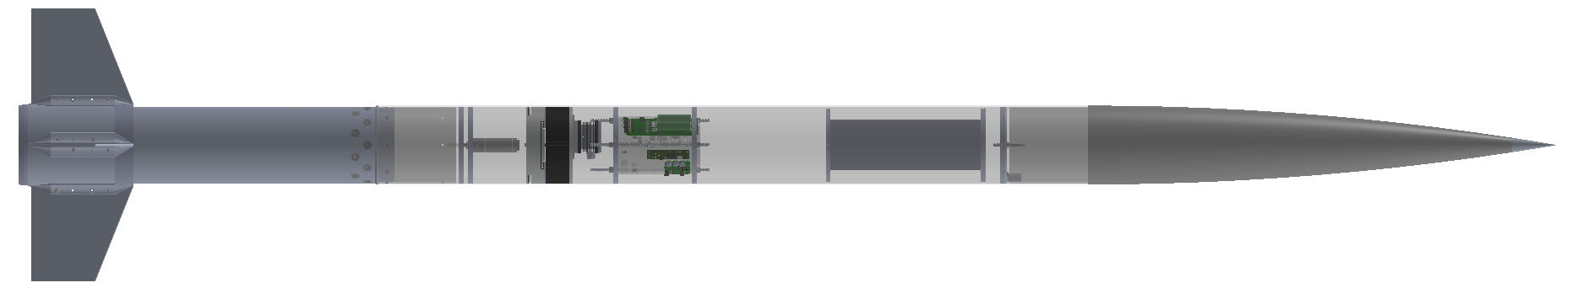
Structures Overview
Motor
Mission Package Tube
Booster
Fins
Recovery
Avionics Bay
Recovery
Sustainer
Air Brakes
Payload
Nose Cone
Sustainer
avionics bay
parachute
parachute
Motor
payload
Nose Cone
Fins + Fin Can
air brakes

Slide 4
Air Brakes

Slide 5
What are Air Brakes?
Functional Requirements
A mechanism that upon actuation, creates a large amount of drag to slow down the rocket by suddenly creating a large amount of area outside the rocket.
Purpose: Reach target altitude with accuracy (prevent overshooting)
Actuation Time: Transition from fully retracted to fully extended within 0.5 seconds
Predictability: Produce a predictable amount of drag when fully extended
  Cd: 1.9
Notes:
Kareena
Cd will likely be lower because of the wind tunnel testing

Slide 6
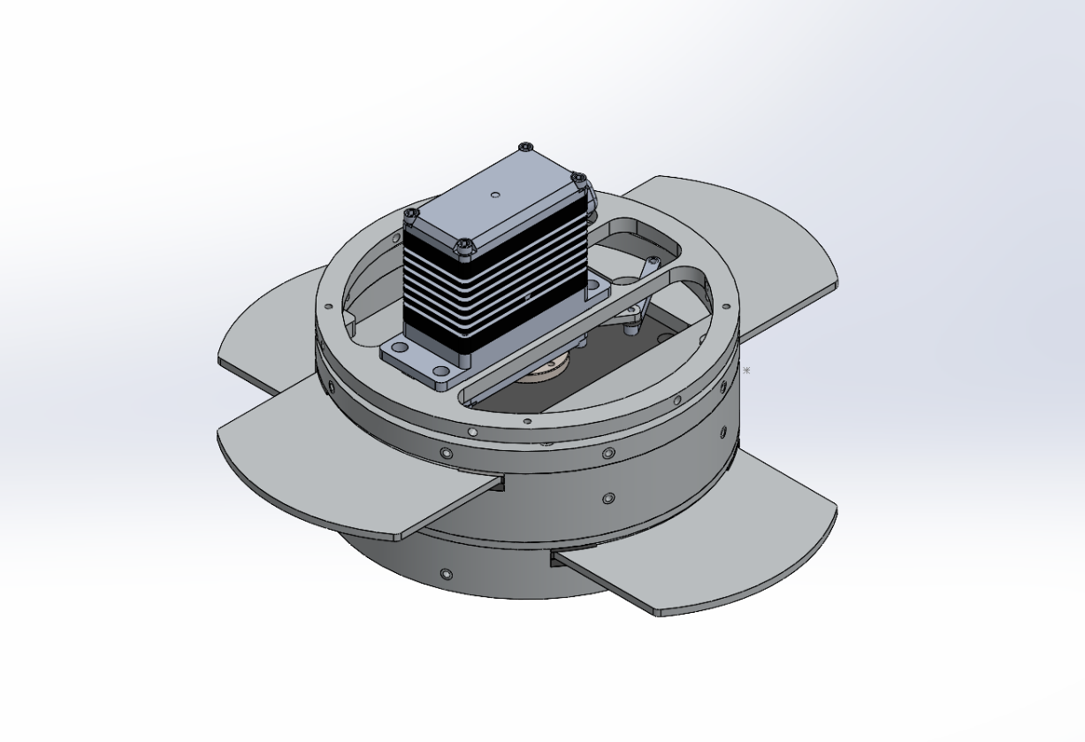
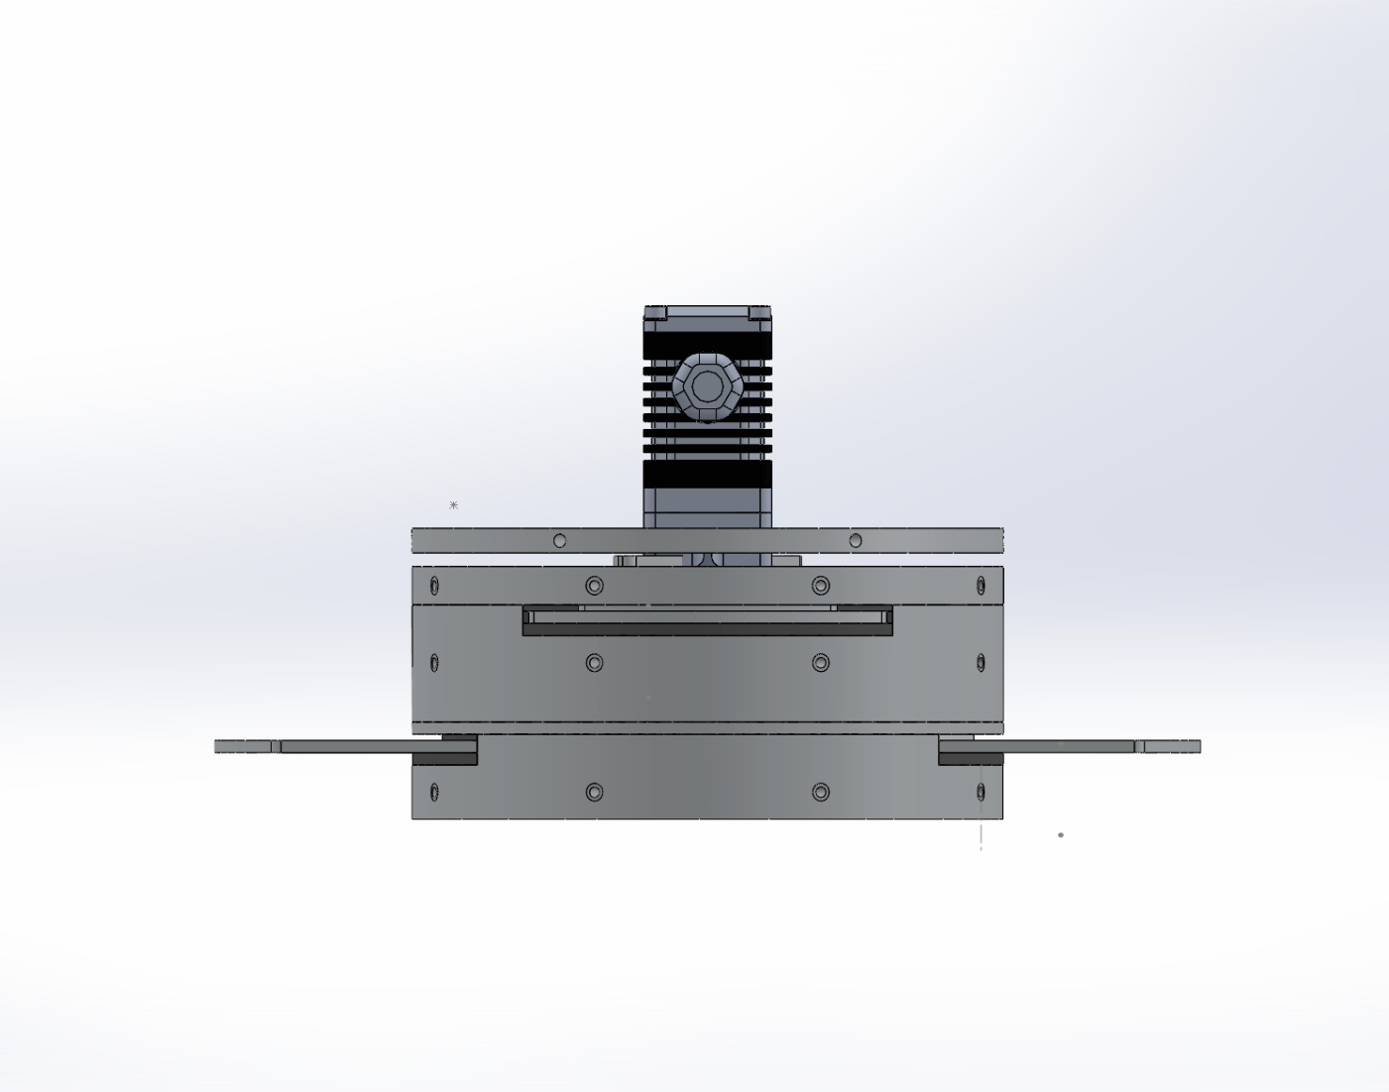
CAD Overview

Slide 7
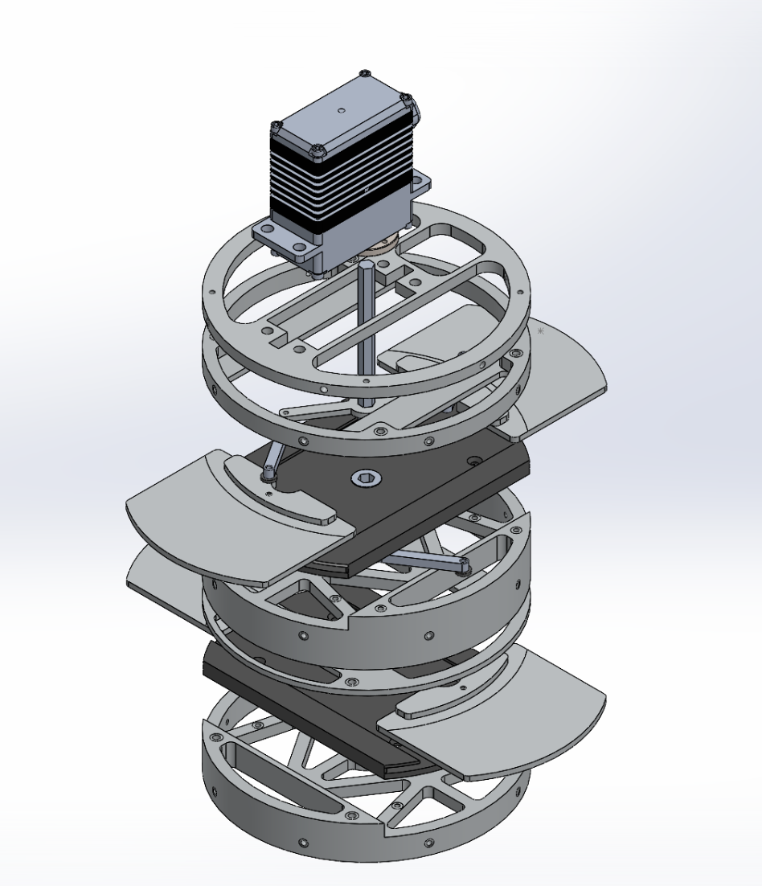
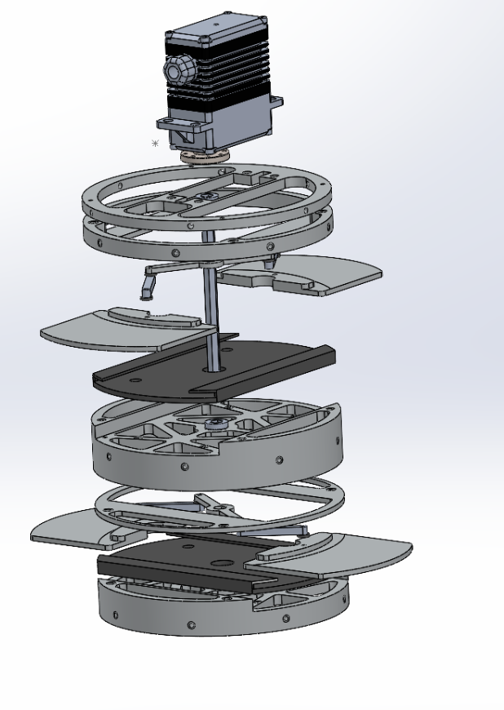
CAD Breakdown
Servo mount
Hex Shaft
Connector
Reinforcement Plate
Leaf trays
Leaf
Notes:
Kareena
- sla - too much friction
-durable resin
Reinforcement - prevents the air brakes from pushing up, holds plate down
Leaf trays - have lips that help keep plates in place
Exploded , isometric views

Slide 8
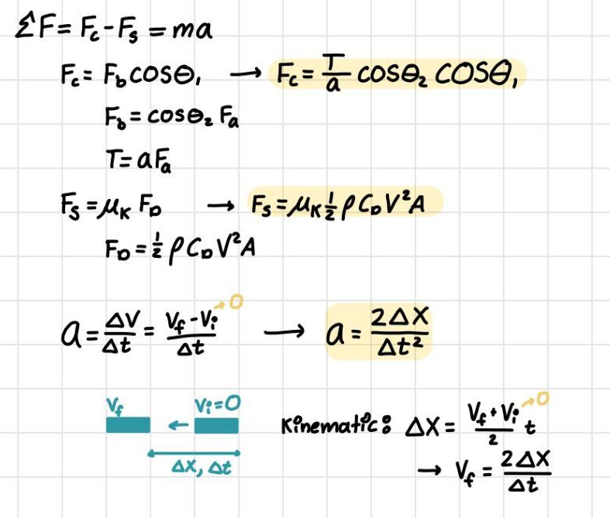
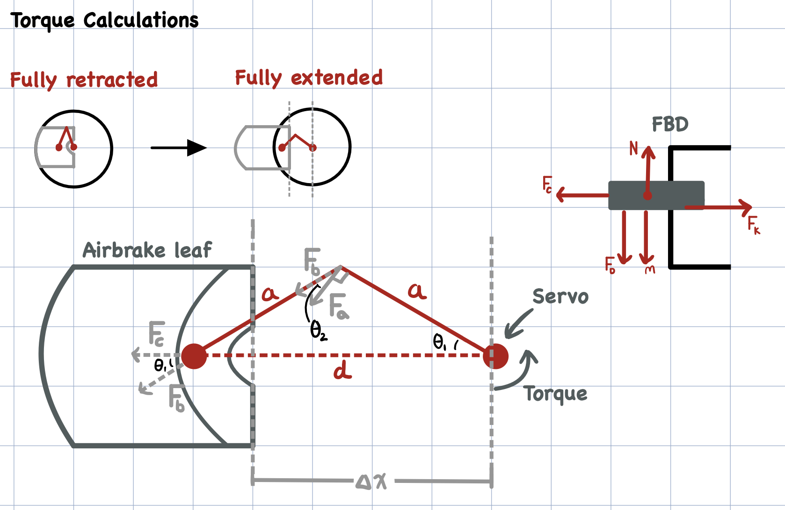
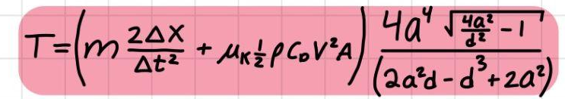
Torque Calcs: Setup
Plate experiences resistance to moving outward (deployment) due to friction with airbrake internals (drag force = normal force)
g
g
Notes:
https://teknic.com/products/brushless-servo-motors/hudson-motors-ready-ship/
https://teknic.com/hudson-model/M-3432S-LN-08D/?model_voltage=300
http://www.ee.ic.ac.uk/pcheung/teaching/DE1_EE/stores/sg90_datasheet.pdf
nicole

Slide 9
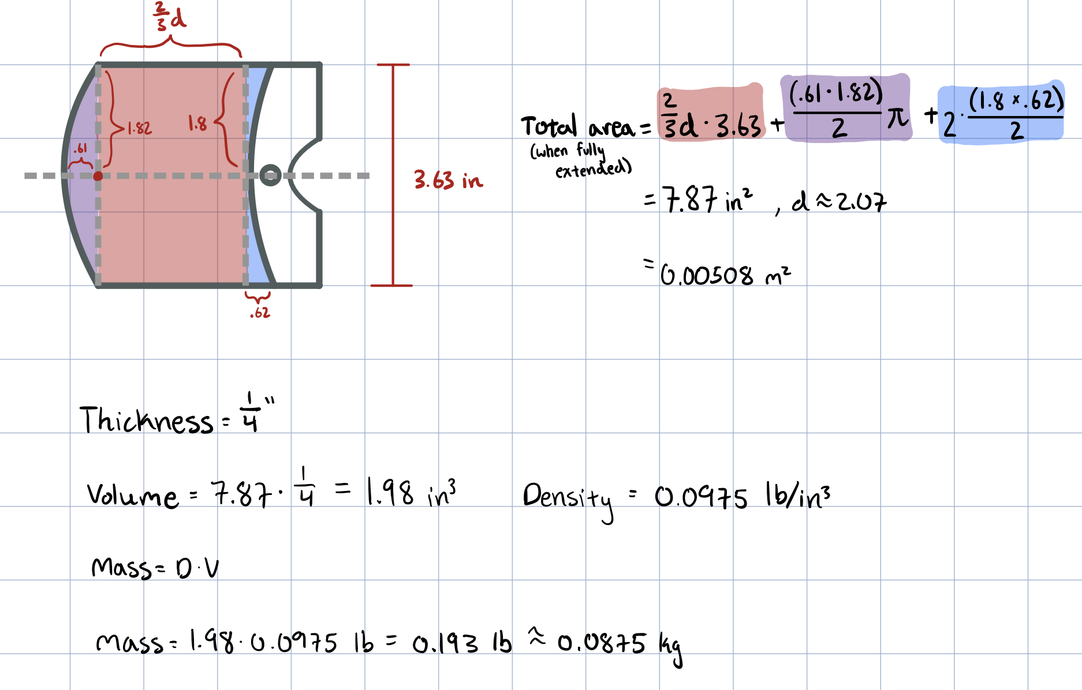
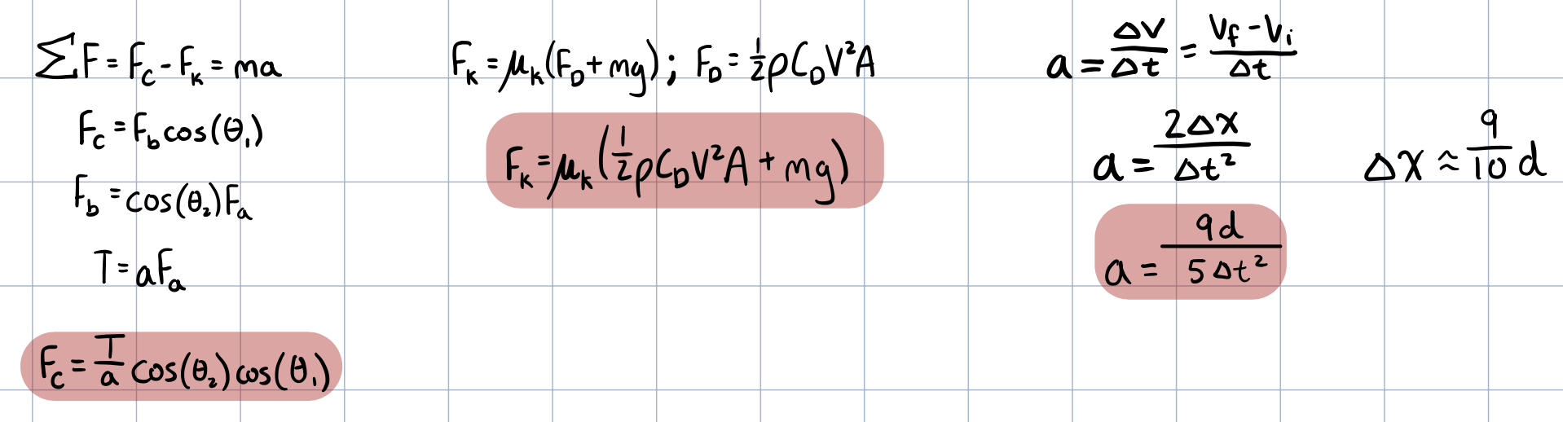
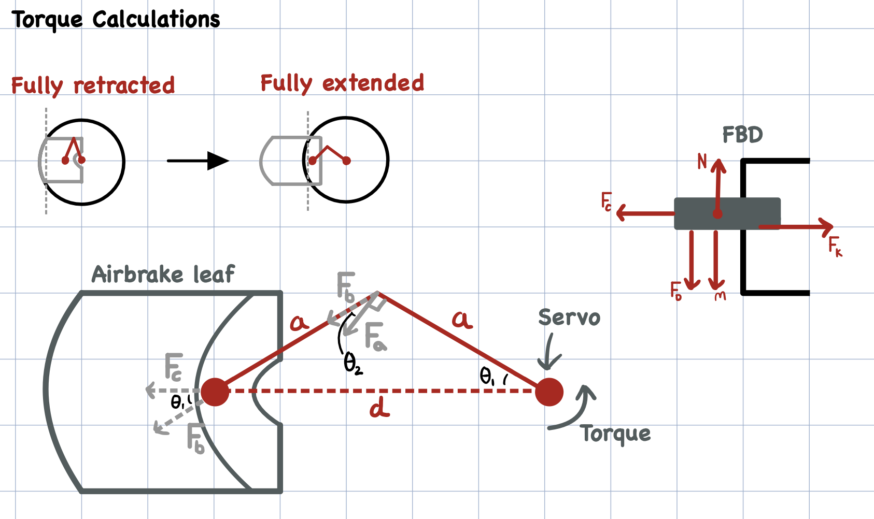
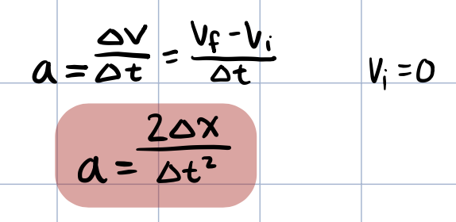
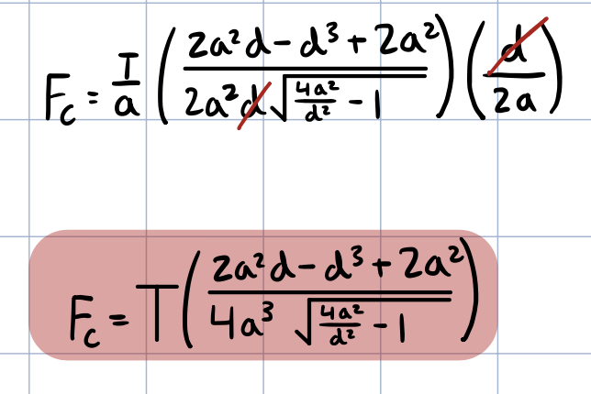
Torque Calcs: Force Equilibrium
Force Equilibrium
Inputs
Mass of plate (m)
Distance extended (d)
Time to extend (Δt)
Coefficient of friction (μ_{k})
Air density (⍴)
Coefficient of drag (C_{D})
Velocity at deployment (V)
Area of plate (A)
Length of servo arms (a)
Servo Force (F_{C})
Acceleration (a)
Friction Force (F_{k})
( )
9md
4a⁴(4a²d⁻²-1)^{1/2}
T =
( + 2 μ_{k} ⍴C_{D}V²A)
5Δt²
2a²d-d³+2a²
Notes:
https://teknic.com/products/brushless-servo-motors/hudson-motors-ready-ship/
https://teknic.com/hudson-model/M-3432S-LN-08D/?model_voltage=300
http://www.ee.ic.ac.uk/pcheung/teaching/DE1_EE/stores/sg90_datasheet.pdf
nicole

Slide 10
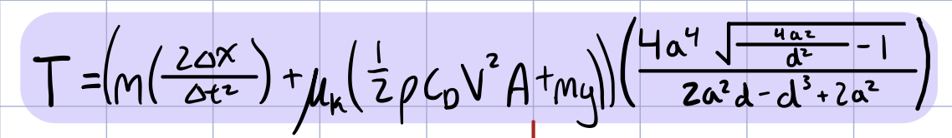
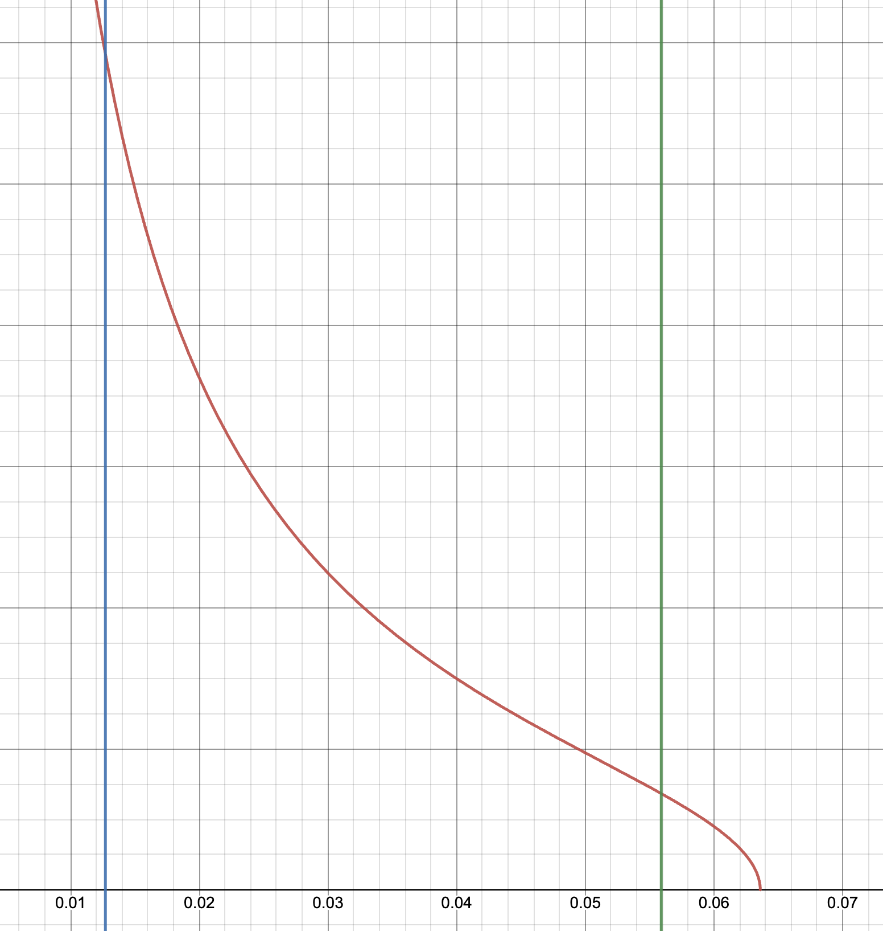
Torque Calcs: Final Equation and Results
Final Equation:
Variables
Mass of plate (m) = 0.14 [lb]
Distance extended (d): 0.5 < 2.2 [in]
Time to extend (Δt) = 0.5 [s]
Coefficient of friction (μ_{k}) = 0.7
Altitude of Deployment = 30,000 [ft] (ASL)
Air density (⍴) = 0.0287 [lb/ft³]
Coefficient of drag (C_{D}) = 1.9
Velocity at deployment (V) = 1000 [ft/s]
Width of plate (w) = 3.63 [in]
Length of servo arms (a) = 1.25 [in]
Torque (Nm)
Dist extended (m)
( )
9md
4a⁴(4a²d⁻²-1)^{1/2}
T =
( + 2 μ_{k} ⍴C_{D}V²A)
5Δt²
2a²d-d³+2a²
Notes:
https://teknic.com/products/brushless-servo-motors/hudson-motors-ready-ship/
https://teknic.com/hudson-model/M-3432S-LN-08D/?model_voltage=300
http://www.ee.ic.ac.uk/pcheung/teaching/DE1_EE/stores/sg90_datasheet.pdf
nicole

Slide 11
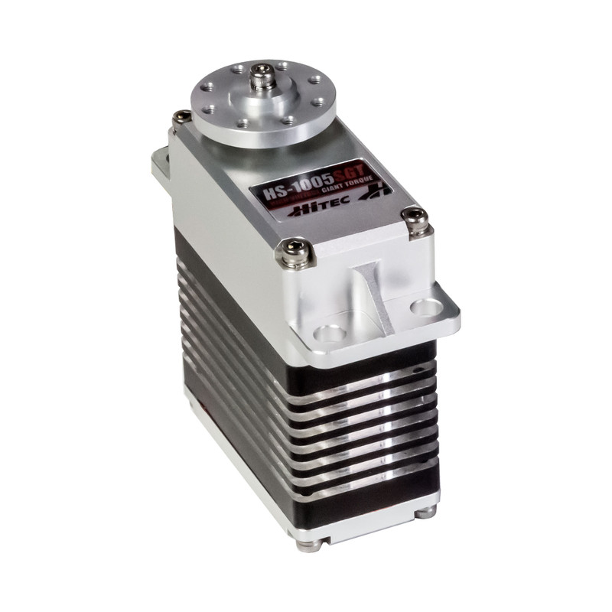
Servo for Sustainer
 | Sustainer
Servo Chosen | HS-1005SGT
Torque Capable (ft-lb) | 7.96
Torque Required (ft-lb) | 0.87
Notes:
Nicole
Engineering toolbox slay

Slide 12
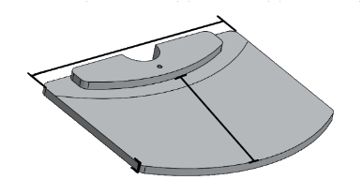
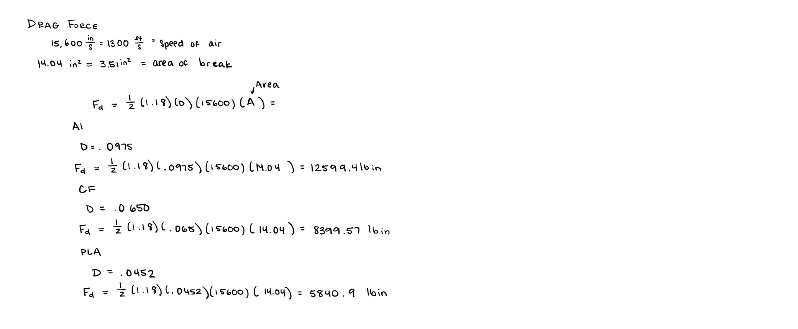
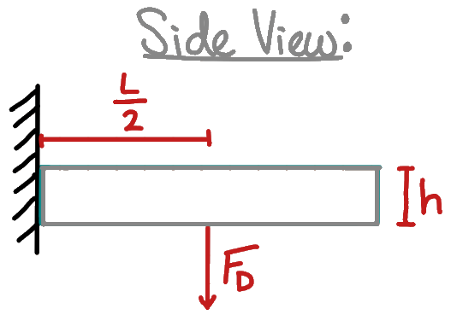
Material Selection: Bending Stress
Finding the Bending Stress in the plate due to Drag Force when plate is fully extended
F_{D}
3.6in
Inputs:
Coefficient of Drag (plate): 1.9
Air Density: 0.0565 lb/ft^3 (at altitude)
Velocity at Deployment: 1000 ft/s
Length of Plate: 2.25in
Thickness of Plate: 0.125in
2.25in
Mc
I
3⍴C_{D}V²L²
(2h²)
σ_{B} =
=
.125in
Altitude of Deployment: 30,000 ft ASL
Bending Stress: 77.63 MPa
Failure Stress of 6061 T6 Aluminum: 241 MPa
Notes:
Remove the grey 3 point background
Olivia
Beam bending
Side view

Slide 13
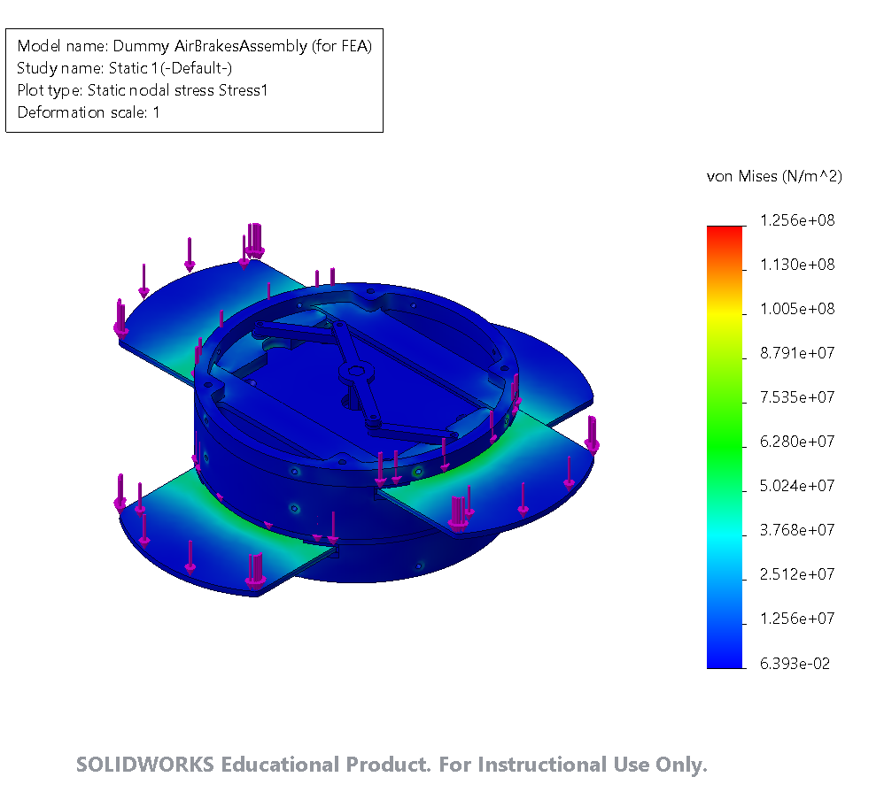
FEA
Fixtures
  Radial holes, bolted into Mission Package Tube
  Split surface circle surrounding bolt hole (0.05” radial difference)
Forces
  Drag forces on plates
  4000N on each plate
Connections
  Global Interactions: Contact
  Local Interactions: Bonded around bolt holes
Safety Factor 2.2
Notes:
ezra

Slide 14
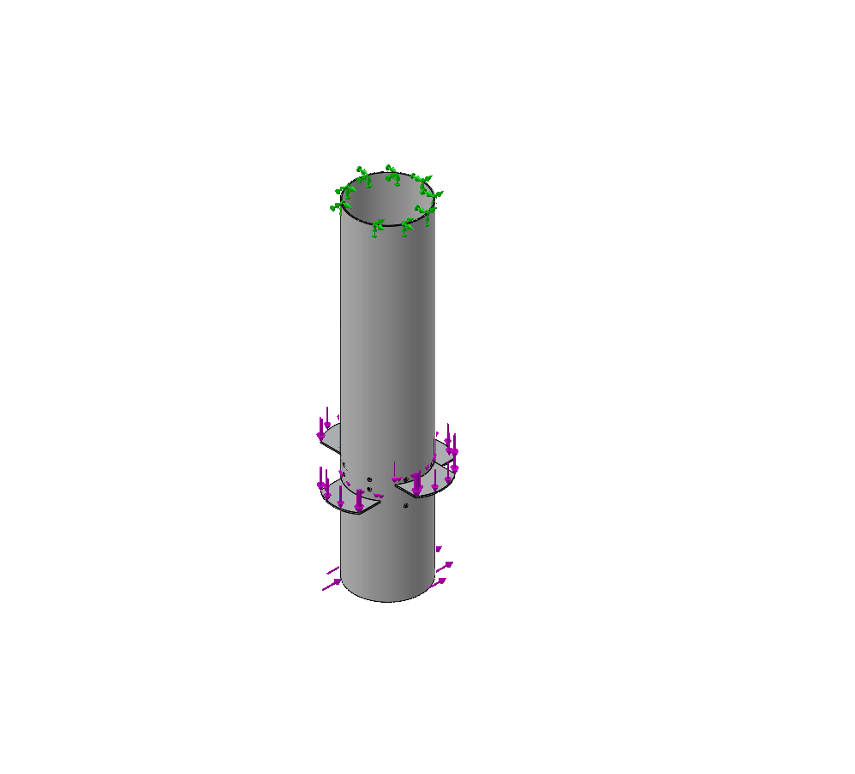
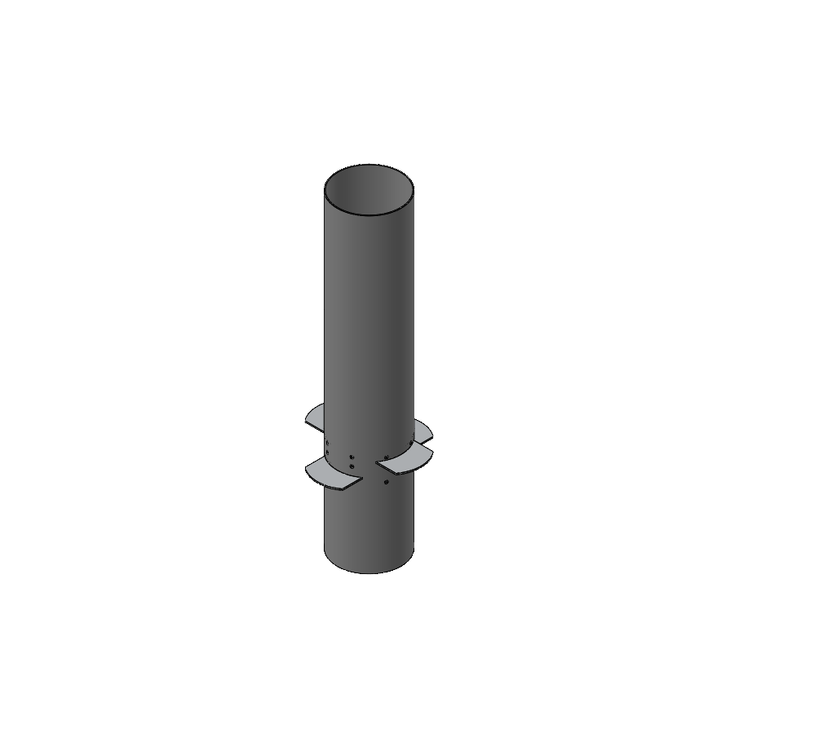
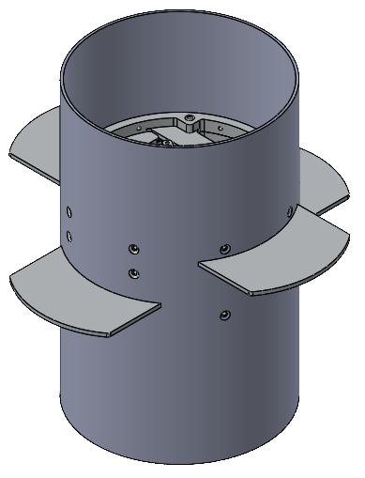
FEA with Mission Package Tube
Fixtures
  Top edge of mission package tube
Forces
  Lift Force acting on fins → creates moment→ modeled as force acting on end of mission package tube
Connections
  Global Interactions: Contact
  Local Interactions: Bonded around bolt holes
Mission Package Tube Material
  Tried modeling as composite (I think I did it incorrectly)
  Will try modeling as homogenous using the material properties in the weaker direction
Notes:
ezra

Slide 15
Possible Failure Modes
Failure Mode | Probability | Severity | Mitigation
Air brakes fail to deploy (sustainer) | Low | Medium | Choose servo with sufficient torque
Deformation or structural failure of plates | Low | Medium | Choose material and thickness to withstand sufficient bending stress
Structural failure of mission package tube at air brakes | Low | High | Choose sufficient thickness of material within mission package tube and size of screws
Notes:
olivia

Slide 16
Testing Timeline
Instron Test
Test Launch
February
April
June
January
March
May
Wind Tunnel Testing (Determine Cd)
Spaceport America
Notes:
Olivia
To test the force material withstand

Slide 17
Mass Breakdown
Part | Mass (lbs)
Servo Bulkhead | 0.230
Frames | 1.33
Leaf tray (x2) | 0.06 (0.12)
Leaves (x4) | 0.140 (0.56)
Servo | 0.683
Hardware | 0.23
Total: | 3.15 lbs
% of Stage | 3%
Notes:
Olivia
To test the force material withstand

Slide 18
Cost Breakdown
Item | Total Cost
Frame + Bulkhead Stock | $286.20
Plates Stock | $54.34
Arm Connector Stock | $40.79
Servo (Booster) | $479.99
Servo (Sustainer) | $149.99
Servo Hardware | $49.18
Total | $910.5
Notes:
Olivia
To test the force material withstand

Slide 19
Questions?

Slide 20
Bending Breakdown by Stage
Finding the Bending Stress in the plates and the Torque required to move them
 | Sustainer
Rockets Speed (ft/s) | 1000
Altitude of Deployment (ft) | 35,000
Air Density at Altitude (lb/ft^3) | 0.0565
Drag Force Produced (ft*lb/s^2) | 2,935.35
Bending Stress (MPa) | 77.63
Failure Stress of 6061 T6 Aluminum (MPa) | 241
Notes:
olivia

