Slide 1
MIT Tableau User Group
(MIT TUG)
+
IT Partners
October 11, 2023
Join the conversation on Slack
mit-tableau.slack.com and mit-itpartners.slack.com
Yes, we are recording the session
The recording will be sent out and posted on Slack

Slide 2
Agenda
What are the MIT TUG and IT Partners
Licensing Changes
- Roshni Gohil (for Bryan Murray, IS&T)
Tableau Prep Builder: An Intro
- Terry McNatt (MIT Medical)
What’s new in Tableau Server and Desktop
- MIT TUG Leads
RAFFLE!

Slide 3
What is the MIT TUG?
A community of Tableau users, and those who want to use or are thinking about using Tableau, across MIT
Open to anyone
Any MIT department
All skills levels: none to novice to Jedi
Those who use Tableau only, and those who use Tableau with other data tools
Users of any Tableau product (Desktop, Prep, Server, Online, DataDev)

Slide 4
How It Works
Virtual (sometimes hybrid) meetings
Community-informed topics
Presentations (informal or formal) specific to Tableau at MIT
Opportunities to meet other Tableau users at MIT
MIT Tableau Slack: mit-tableau.slack.com
Join the email list: mailman.mit.edu/mailman/listinfo/mit_tableau_user_group
Happy hour: next Wednesday (10/18; more on this later)

Slide 5
Participate How You Like
Be active
present, share, ask and/or answer questions
Lurk
watch, listen, learn
Anything in between
If you want to present and/or have a topic you want to see, contact the leads
#ask-mit-tug-leads on Slack
mit-tableau-user-group-admin@mit.edu

Slide 6
What is IT Partners?
IT Partners are MIT community members who share a commitment to support:
  the goals of the Institute
  the technology needs of some subset of the MIT community, small or large (coworkers in an office, a course, a whole department, etc.)
  the mission of the IT Partners program

Slide 7
How It Works
IT Partners provides programming throughout the year, including:
Hosting lunch-time events and an annual conference to share information and network with fellow IT support providers across campus
Providing opportunities to share projects and initiatives in DLCs with a wider audience so we can learn from each other
Facilitating collaborative problem-solving, training, and information-sharing among DLCs and with IS&T
If you want to present and/or have a topic you want to see, contact the leads
#ask-it-partners-planning-team on Slack
itpartners-plan@mit.edu

Slide 8
Licensing Changes
On behalf of Bryan Murray
IS&T Software Asset Management team
software-distribution@mit.edu
Notes:
Bryan Murray has been at IS&T for 18 years, and has spent the past six on the Software Asset Management Team, which is responsible for the compliance, purchase, renewal and distribution of the software licenses available to all of MIT. Bryan’s would have been here to talk about some of the recent Tableau licensing changes, but he’s under the weather, and what it means for you as an MIT Tableau user.
We were in the process of renewing when Tableau changed their licensing.
We had to start over (which is why it took so long to renew).
It was a slog, but we're good for 3 years. Thanks, software asset management team!
If you have questions, contact software-distribution@mit.edu!
So what does this really mean?
Desktop licenses are out!
Creator licenses are in!
There’s a new way to activate your Tableau license: DEMO
And also deactivate your desktop license
What’s in the Creator license? All the cool things you previously did in Desktop + TABLEAU PREP! What is Tableau Prep?

Slide 9
Tableau Prep: An Intro
Terry McNatt
Senior Programmer/Analyst
MIT Medical, Healthcare Informatics
Notes:
Terry McNatt has been at MIT Medical for 20 plus years first consulting and now 13 years as an employee. He is currently a Senior Programmer/Analyst on the MIT Medical Healthcare Informatics team, which handles reporting, dashboards and 3rd party software integration. MIT Medical has been using Tableau Prep for around 3 years, which means they’re the resident experts here at MIT. Terry’s here to show us a little of what Tableau Prep can do, so that you can mentally start prepping how to tackle your own data cleaning projects.

Slide 10
Tableau Upgrade to v2022.3
We’re moving from v2021.4 to v2022.3
We recommend keeping your Tableau Desktop version in line with the MIT Tableau Server to prevent compatibility issues

Slide 11
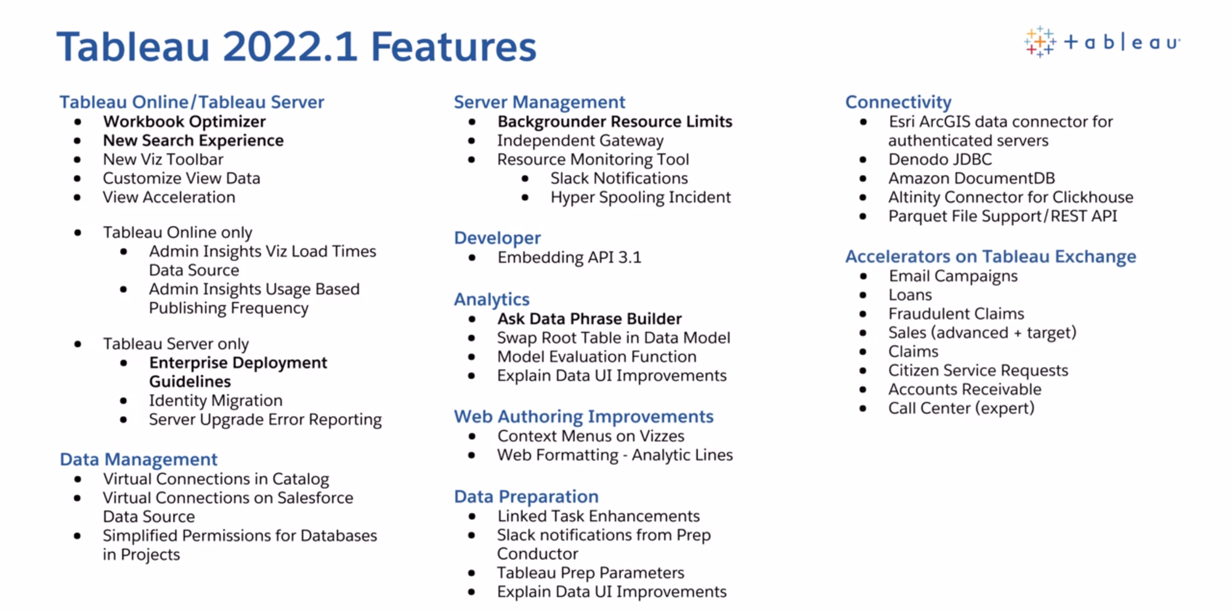
tableau.com/2022-1-features
Notes:
https://tableau.com/2022-1-features

Slide 12
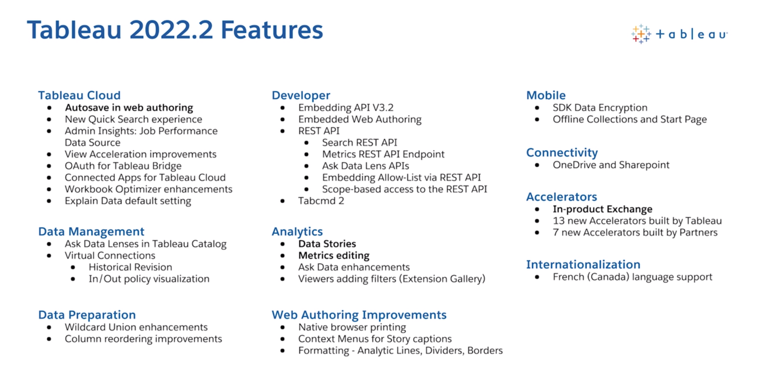
tableau.com/2022-2-features
Notes:
https://tableau.com/2022-2-features

Slide 13
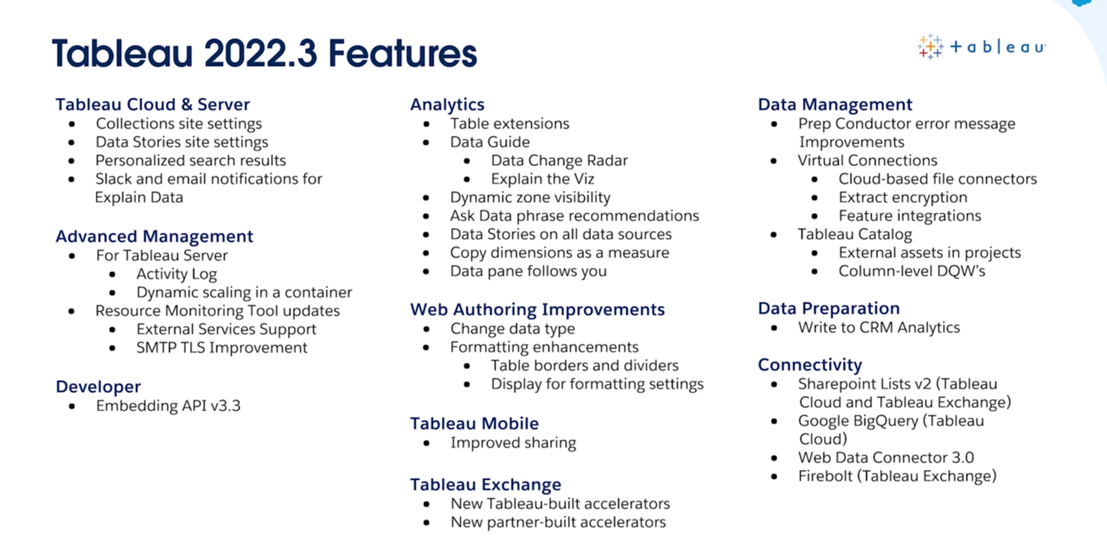
tableau.com/2022-3-features
Notes:
https://tableau.com/2022-3-features

Slide 14
New Desktop Features

Slide 15
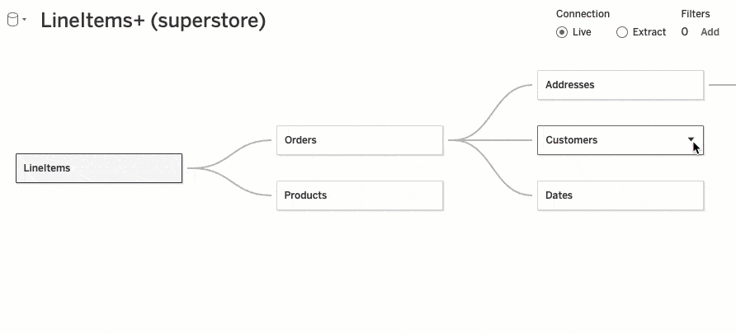
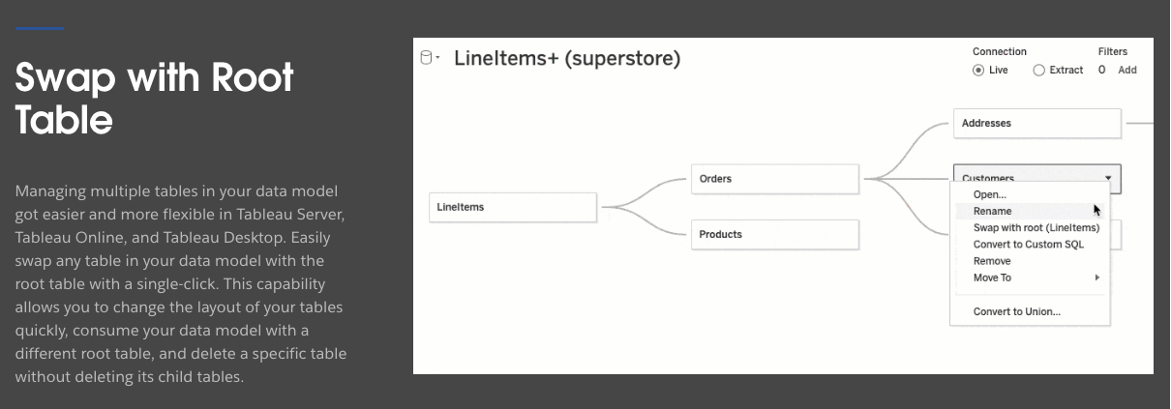
Swap Root Table in Data Model
tableau.com/2022-1-features#item-89146
Notes:
Swap Root Table in Data Model
https://www.tableau.com/2022-1-features#item-89146

Slide 16
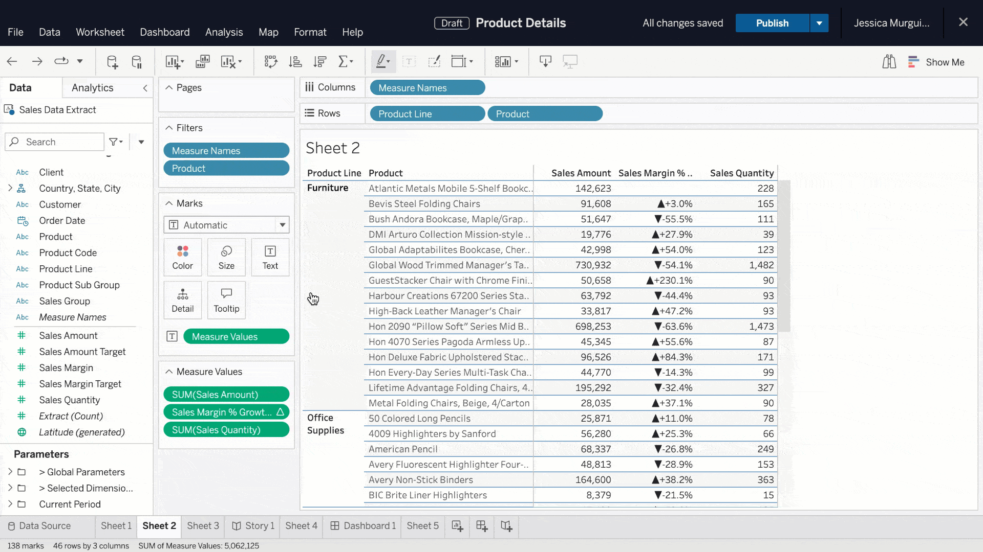
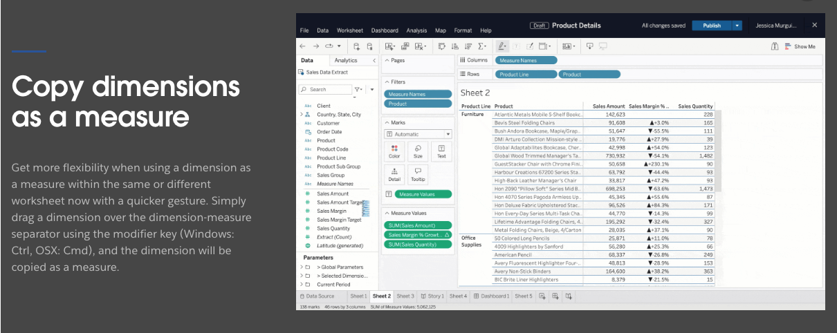
Copy dimensions as a measure
tableau.com/2022-3-features#item-94156
Notes:
Copy dimensions as a measure
https://www.tableau.com/2022-3-features#item-94156

Slide 17
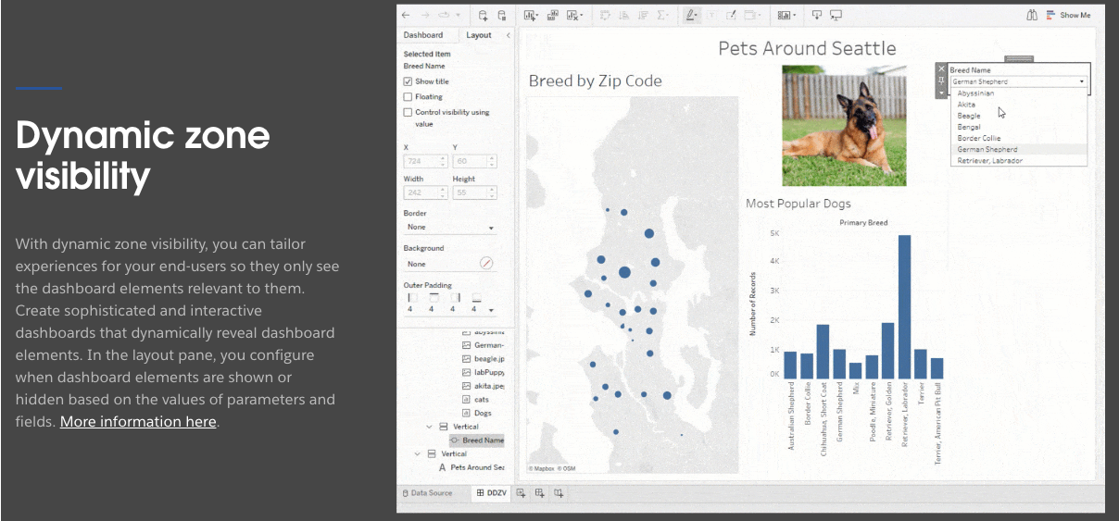
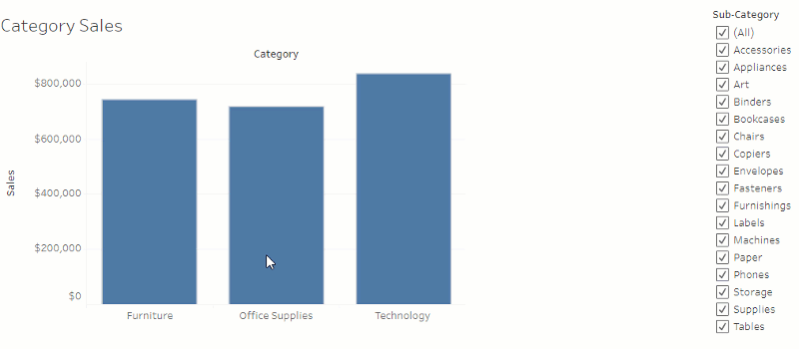
Dynamic zone visibility
tableau.com/2022-3-features#item-94161
Notes:
Dynamic zone visibility
https://www.tableau.com/2022-3-features#item-94161
https://help.tableau.com/current/pro/desktop/en-us/dynamic_zone_visibility.htm

Slide 18
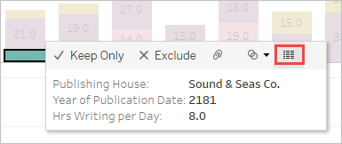
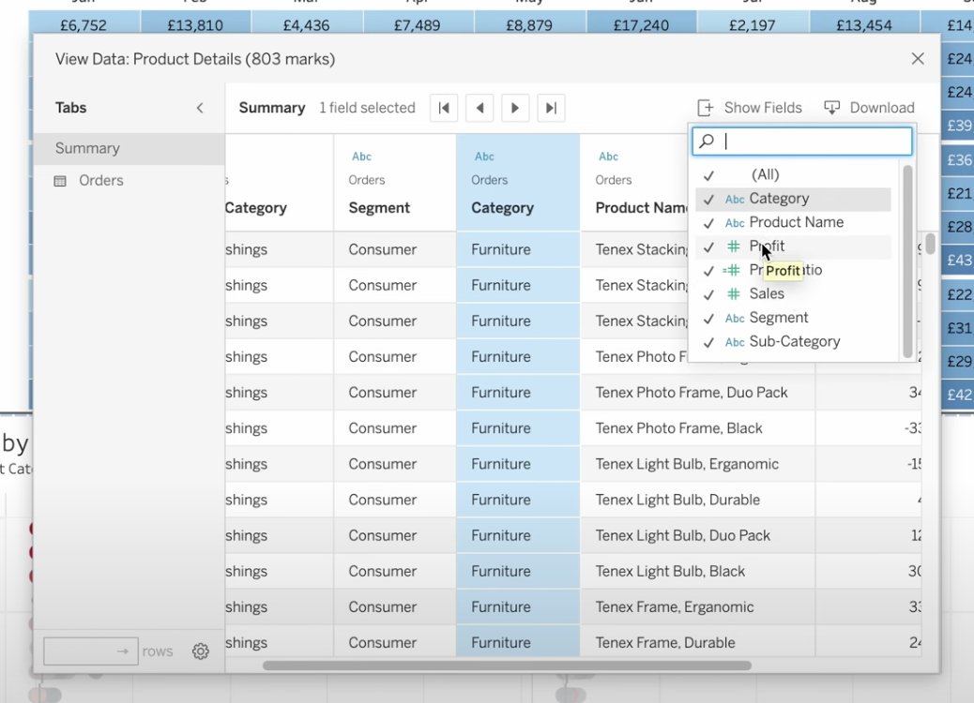
The view data pane has always been a pain
Used to show all underlying data as it appears in the dash
  Gross formatting and all
Now able to customize
  Can reorder columns
  Choose what columns to show
  Sort by columns
Both users and developers can customize!
Opens differently for users
  It’s own window
  Better for screen readers
Customize View Data
From Tableau Tim
youtube.com/watch?v=IJAFTp0GoD4
tableau.com/2022-1-features#item-89137
Notes:
Customize View Data
https://www.tableau.com/2022-1-features#item-89137
Tableau Tim video: https://www.youtube.com/watch?v=IJAFTp0GoD4

Slide 19
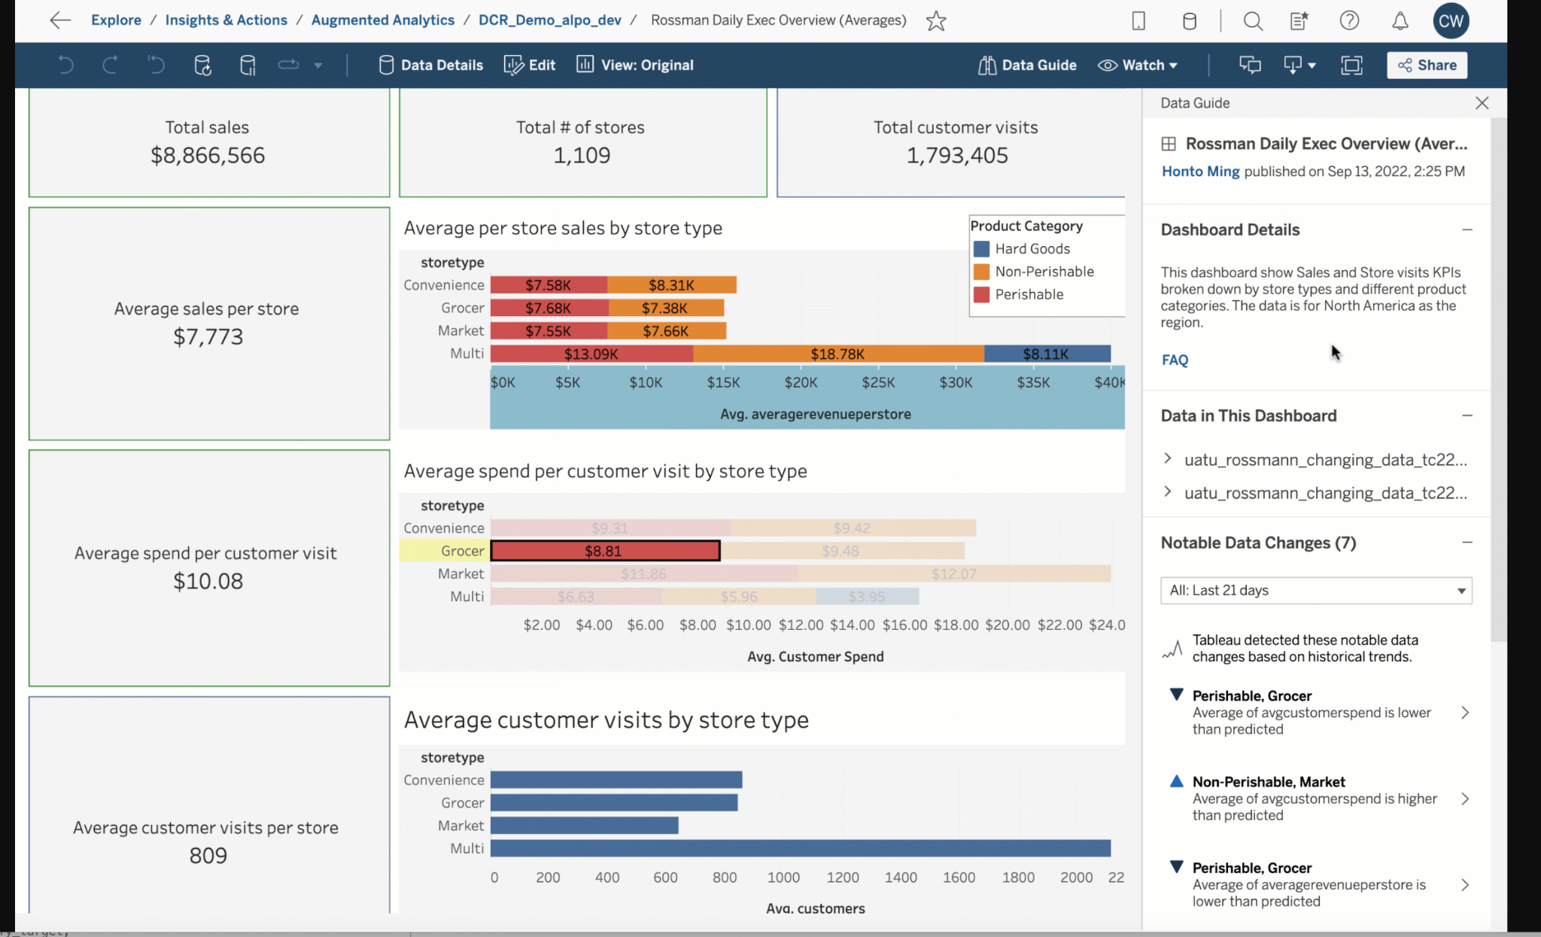
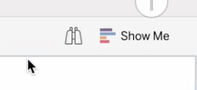
Data Guide
tableau.com/2022-3-features#item-94168 and tableau.com/sites/default/files/2022-09/Data%20Guide_0.gif
Notes:
Data Guide
https://www.tableau.com/2022-3-features#item-94168
https://www.tableau.com/sites/default/files/2022-09/Data%20Guide_0.gif
Works at both dashboard and view level
Dashboard view:
Who published, Description
Data - dropdown showing you all fields in dashboard
Outliers - Using their explain data tool to find outliers in your data
Links
By clicking on a view goes to view level
Data in view
View specific links
APPLIED FILTERS!!! (just lists them)
The Good & The Bad & The Ugly
Good: Hopefully helps users understand their data
Good: Can help with education (links, description)
Good: Filter holes!
Bad: Filters names, Column Names, Filters we apply beforehand,
Ugly: outliers??? How will this work?

Slide 20
Performance Improvements

Slide 21

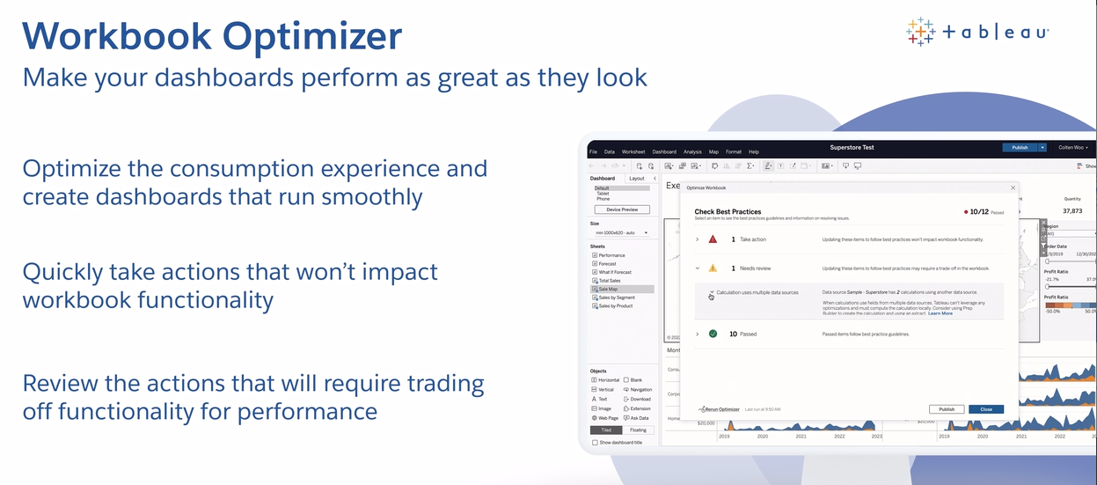
80+ PAGES
demo
Workbook Optimizer
tableau.com/2022-1-features#item-89136 and help.tableau.com/current/pro/desktop/en-us/wbo_overview.htm
Notes:
Workbook Optimizer
https://www.tableau.com/2022-1-features#item-89136
https://help.tableau.com/current/pro/desktop/en-us/wbo_overview.htm
Designing Efficient Workbooks whitepaper: https://www.tableau.com/learn/whitepapers/designing-efficient-workbooks
Tableau performance is complicated. There are lots of small and big changes you can make to make your dashboards load faster, make interactions work better, and even have extracts refresh more quickly. Unfortunately, there are a lot of factors. Last Fall, Tableau and InterWorks published an 80+ page revision of their Efficient Dashboards whitepaper. Yeah, 80+ pages. Raise your hand if you’ve read it.
How the heck are you supposed to keep all 80 pages of tips, tricks, and other random details in mind every time you build or publish a dashboard? Well, the Workbook Optimizer actually does it for you. It analyzes your workbook and identifies changes you can make to improve the performance of your dashboard. You can scroll through the recommendations, and decide what to change and what to ignore, and after making changes, re-run it to see if your changes introduced new or different issues.

Slide 22
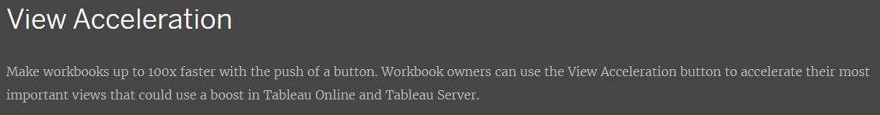
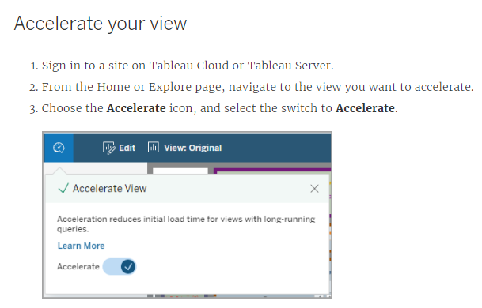
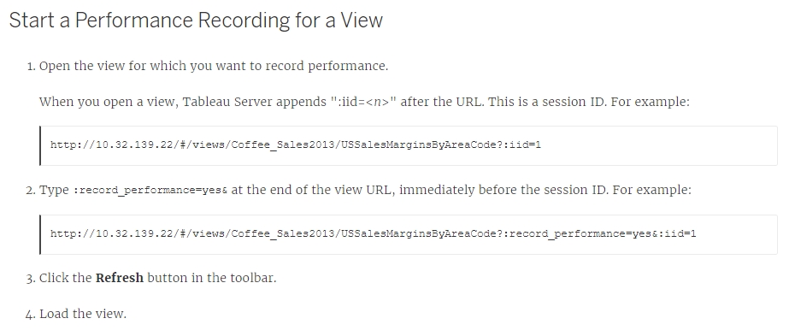
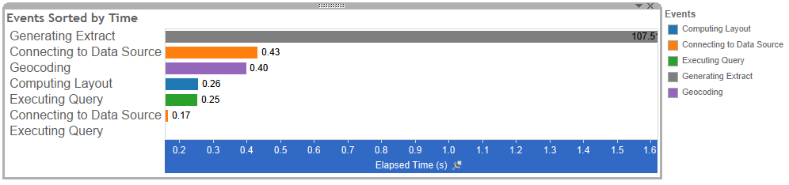
View Acceleration
help.tableau.com/current/server-linux/en-us/data_acceleration.htm and help.tableau.com/current/server-linux/en-us/perf_troubleshooting.htm
Notes:
View Acceleration
https://www.tableau.com/2022-1-features#item-89158
https://help.tableau.com/current/server-linux/en-us/data_acceleration.htm
https://help.tableau.com/current/server-linux/en-us/perf_troubleshooting.htm
Simply put, some views are slow. In reality, you ought to use the workbook optimizer and do some performance checks before you publish something that’s slow as molasses. But if you don’t, or even if you do and a high priority workbook is still slow as molasses, you can accelerate the view so that it loads more quickly.
There are a whole slew of caveats:
View Acceleration reduces the time it takes to execute queries of a view. If executing queries isn’t the bottleneck, something you can check with performance recordings, then accelerating the views isn’t going to have much of an impact.
It will impact other things on the server because it uses server resources.
You can only accelerate a fixed number of views on your site. This limit can be adjusted by asking IS&T, but if you accelerate everything, you’ve accelerated nothing, so keep that in mind.
if you’re not a workbook owner or site admin, you can only recommend a view be accelerated. From what I’ve read, workbook owners/site admins only get notified when they open the view or for site admins, if they go to a specific spot on the server, so the recommendation process appears to leave something to desire.
It only works with embedded credentials.
It doesn’t work with user filter, so if you’re applying row-level security, forget about it.
Probably more that I’m forgetting.
The real answer is work with your local database folks to build better queries; use the Workbook Optimizer to fix your workbooks; review what you really need on your dashboard; and if all that fails, then view acceleration may be an option.

Slide 23
Server User Experience

Slide 24
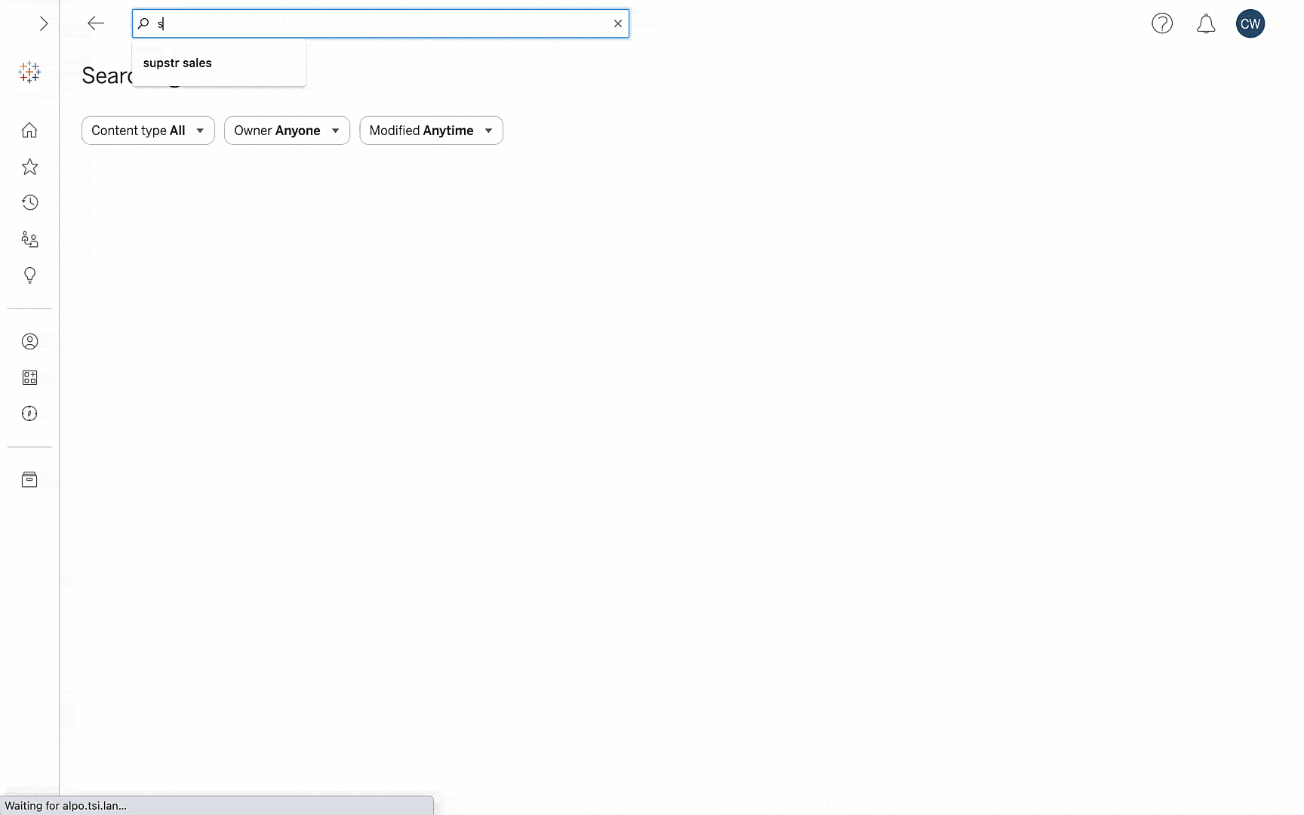
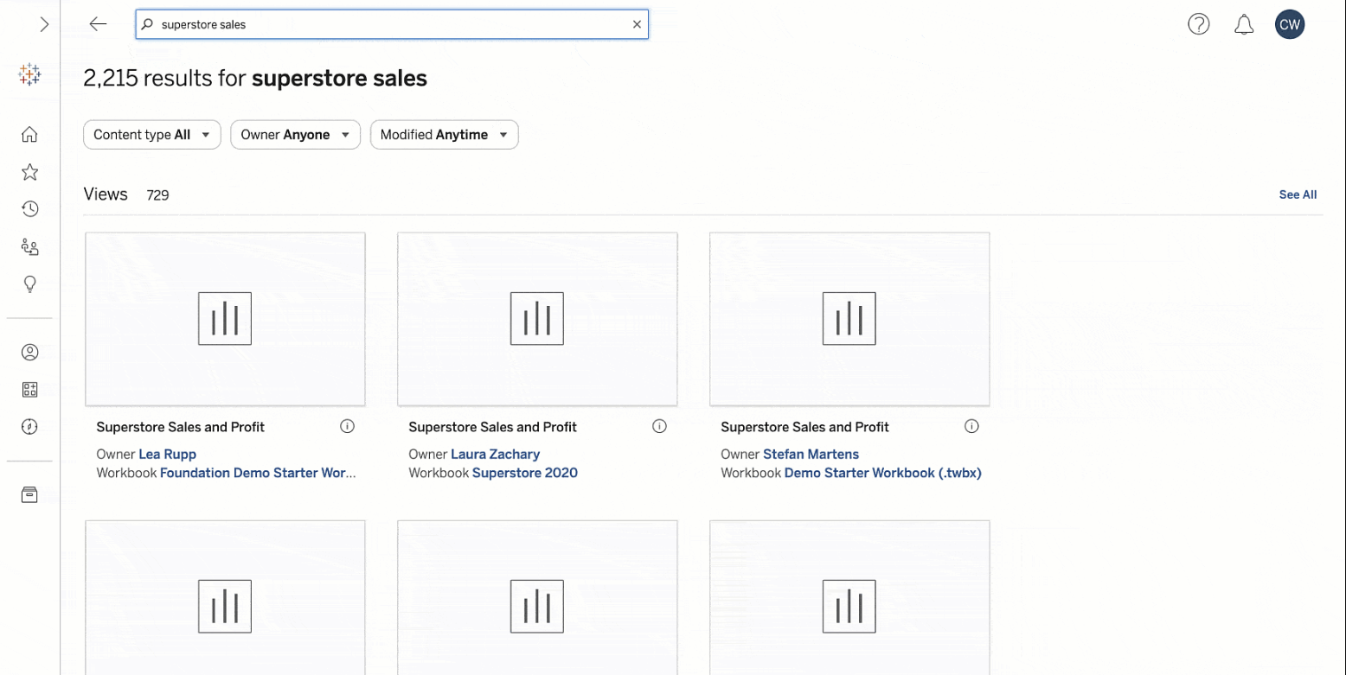
New Search Experience
tableau.com/2022-1-features#item-89157
Notes:
New Search Experience
https://www.tableau.com/2022-1-features#item-89157
The new search factors in text relevance, popularity, and recency into results rankings; corrects for typos; all content types (views, workbooks, metrics, lenses, data sources) on single landing page - scroll instead of tabs

Slide 25
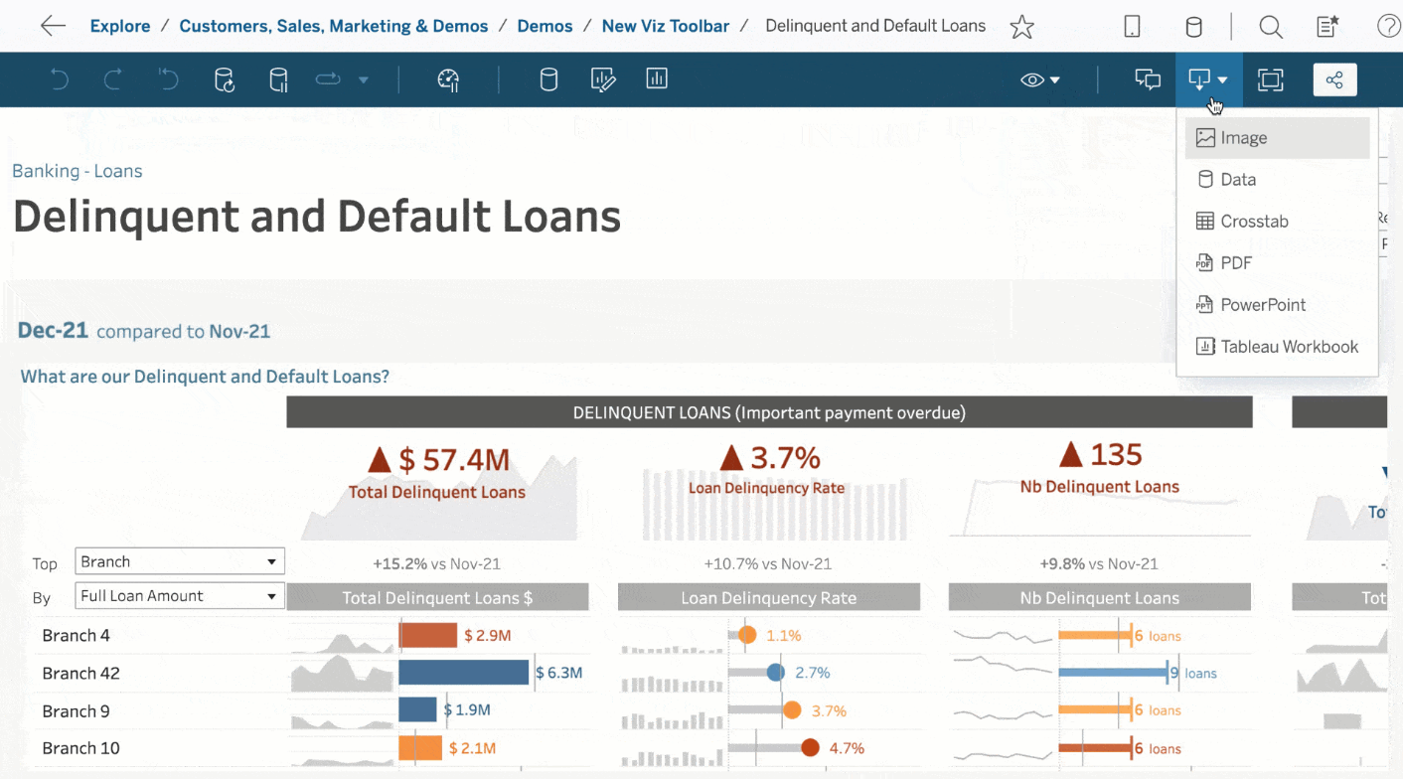
New Viz Toolbar
tableau.com/2022-1-features#item-89154
Notes:
New Viz Toolbar
https://www.tableau.com/2022-1-features#item-89154
Tableau reworked the toolbars to be a little less crowded; grouped icons by function, e.g., modifying content on the left, collaboration tools on the right, hoping this will be scalable going forward. In interim, probably a minor pain point for users as is usually the case for any nav change. What’s available to you will vary with access level/where you are (e.g., no Share options if you’re in your personal space).

Slide 26
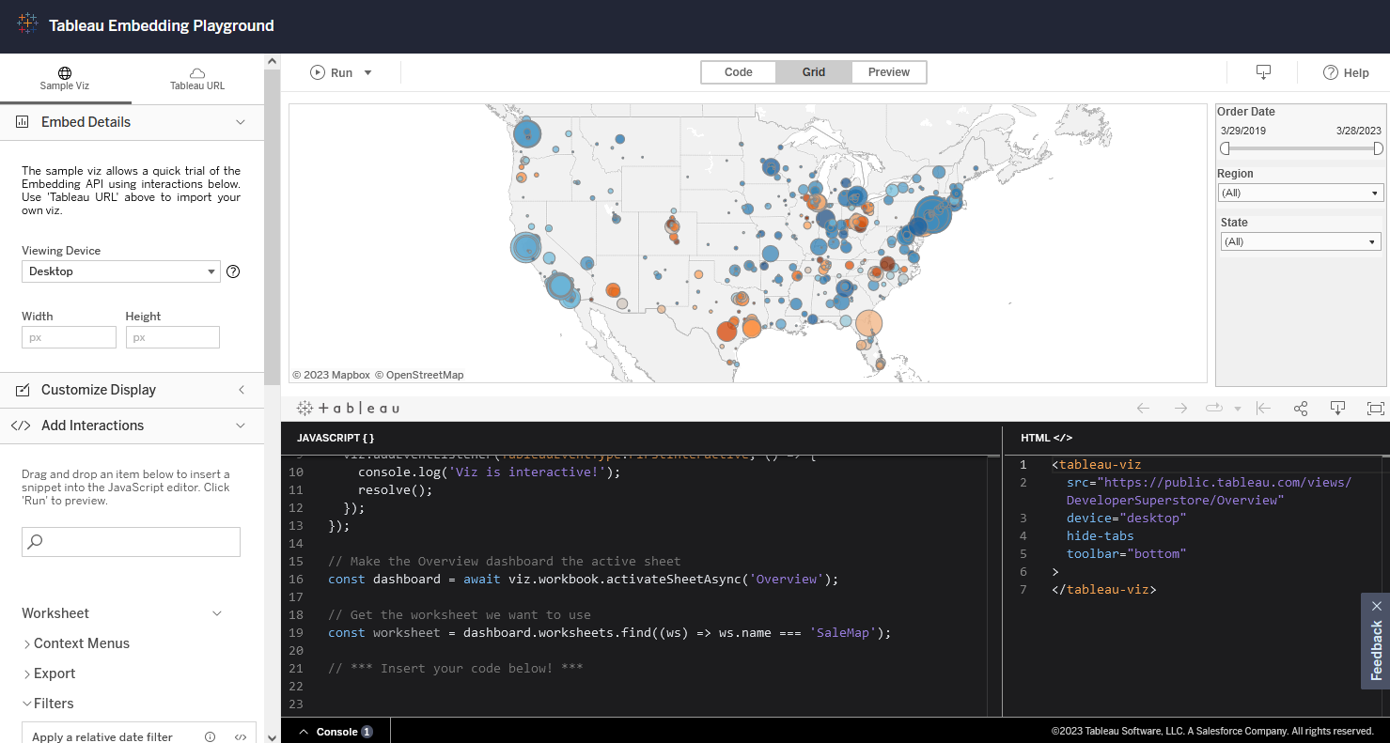
Embedding Playground
developer.salesforce.com/tools/tableau/embedding-playground
Notes:
Embedding Playground
https://developer.salesforce.com/tools/tableau/embedding-playground
This feature helps create exportable code to embed interactive vizzes into your website/application - key for non-developers, can add prepackaged modules (including interactive filters, context menus, etc), more of a drag & drop approach. For those already comfortable, can also test custom code.

Slide 27
What are you most excited about?
Talk about it or post it in the chat!

Slide 28
Tableau Upgrades v2023.4 and beyond
Tableau is changing its release cadence
  3x/year: Desktop, Prep Builder, and Cloud
  1 or 2x/year: Server in every other release
  tableau.com/blog/tableau-updates-product-release-cadence
MIT will likely continue to upgrade annually
  Timing depends on IS&T priorities and community interest
  What’s available? Check out tableau.com/products/all-features
  Want something? Say something reporting-help@mit.edu
Notes:
Updates to release cadence: https://www.tableau.com/blog/tableau-updates-product-release-cadence
New features/all versions: https://www.tableau.com/products/all-features
Want something? Say something: reporting-help@mit.edu
Before we leave the topic of the upgrade, we want to talk about what’s NOT in the upgrade. We’re upgrading to v2022.3, but v2023.3 is coming out soon. As we mentioned before, MIT will always be at least a major version behind. That’s nothing new.
What’s changing in the future (and again), though, is Tableau’s release timing. They’re switching from updating from 4 releases a year to 3. This is in part to stay in line with Salesforce’s release cycle since Salesforce is the parent company of Tableau (and Slack, and Mulesoft, and probably a few others applications we use here at MIT).
Last time they changed release cadence, they started only updating Server twice a year. Now they’re going to move to server upgrades every other release. That’s because most organizations with Server only upgrade once a year. Those server upgrades are going to be once or twice a year. That means our upgrades at MIT may be less frequent or to less recent versions.
IS&T will likely continue to upgrade annually, depending on their priorities and what MIT’s Tableau community needs. One key factor is that community need. There’s lots of cool features in the newest version of Tableau that we won’t be getting until next summer, or even later, if IS&T doesn’t know we’d like the features.
To take a line from the MBTA, want something? Say something. If there are features that you see in new releases, let IS&T know by contacting reporting-help@mit.edu. Let them know what the feature is, what version it’s in, and how it’ll help you do your job better. That’s the best way for us as a community to advocate for more frequent Tableau Server (and therefore Desktop) upgrades.

Slide 29
What’s next?
HETUG on Oct. 17
  usergroups.tableau.com/e/mz8kqk/
MIT TUG meetup on Oct. 18
  mit-tableau.slack.com/archives/CK66N4U1Z/p1697031852332309
MIT/Mass Higher Ed TUG (MUG) @ MIT
  Date TBD: mid-Nov or early Dec
  Join the MUG list: usergroups.tableau.com/massachusetts-higher-ed-tableau-user-group/
IT Partners IAP Jan. 11
  Microsoft will presenting on new and upcoming features
  Registration and request for topics coming soon

Slide 30
Want to present?
Want to see something?
MIT TUG Leads
#ask-mit-tug-leads
mit-tableau-user-group-admin@mit.edu
IT Partners Planning Team
#ask-it-partners-planning-team
itpartners-plan@mit.edu

Slide 31

RAFFLE
Notes:
Roshni
Thanks to our Tableau Account Executive, Denise Youngberg for putting together this swag bag for us!
So here are the rules:
you have to be an MIT employee, student, or temp/contractor (not sure if we'll get any randos)
mit tug leads aren't eligible
you have to here when we draw to get a prize
If we pick your name and you’re not here, we’ll draw again until we get someone who IS in the room

