Slide 1
Data Warehouse
What is it - Who uses it – Why?
IT Partners – 06/20/2023

Slide 2
Data Warehouse - Agenda
Data Warehouse Team
Data Warehouse Overview
What’s in the Warehouse?
How does it get there?
Who uses it? Why?
Data Security
Who supports it?
How do I get started?
FAQs
Q&A

Slide 3

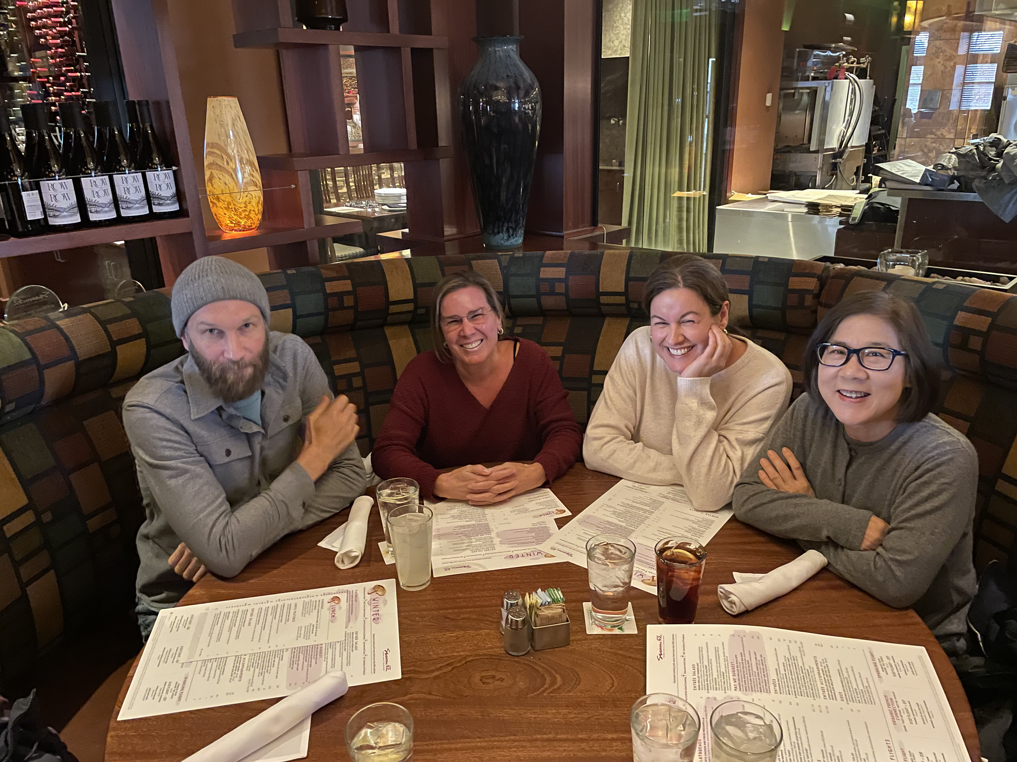
Data Warehouse Team Speakers
Faith Hill
Sr. Manager
IS&T, Data Warehouse Team
Started at MIT in 2015
Brandin Tumeinski
Hima, Brandin, Faith, Raisa, Nancy
BI Engineer IV
IS&T Data Warehouse Team
Started at MIT in 2010

Slide 4
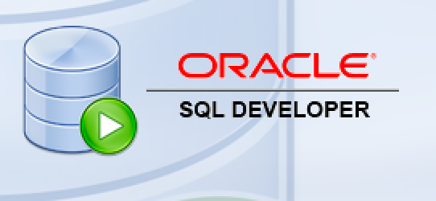






Data Warehouse Overview
a read-only database that combines information from separate systems into one easy-to-access location
Reporting and Analytical Tools (Access Layer)
Open
Interface
Data Warehouse
Data Sources / ETL (Extract, Transform, Load)
MITSIS
Batch Feeds
Other MIT data sources (Advance, Coeus, KC, Powerfaids, Roles, Nimbus, etc.)
Notes:
MIT’s Data Warehouse developed ca. 1995

Slide 5

What’s in the Warehouse?
Biographical information (E&S)
Graduate Admissions
Lots more!!
Student Applicant information
Payroll (E&S)
Student Enrollment/Courses
1
2
3
4
5
6

Slide 6







How does it get there?
ETL
Views
MITSIS
Data Warehouse
Oracle Sources
SDA
SAP MIT
Open Interface
Any DB connection
Feeds via System Accounts
Flat File
Data Warehouse 2.0
Notes:
Oracle Sources include COEUS/KC, FRC, Powerfaids, Roles, NIMBUS, Advance
Synthesizes data across disparate systems of record

Slide 7
Who Uses It? Why?
HR, IR, Card Office, Finance, Alumni/R&D, OSP, Lots of DLCs (CSAIL, Chemical Engineering, EHS ), IS&T
Individuals: Who can get an account?
  All Employees have an account - can see “public” data and their own
  Username is the same as your Kerberos account – different password
  Affiliates with Kerberos accounts can request an account
  Should *not* be shared
Departments: What is a “System account” and why would I want one
  Used for automation of department reports
  Should *not* be used by individuals
  Minimizes disruption when employees change positions or leave
How do I get access to data I can’t see?
  Send requests to warehouse@mit.ed and we will route it to App Support
  Access must be approved by data owners – not us

Slide 8
Data Security
Data is an Asset…Data Must be Shared…BUT…Data Must be Secured
Access control can be set up in the Warehouse at the following levels:
  Object Level: People who can “see” an object can see all of the data in it – example, MIT Holidays
  Row Level: People who can “see” an object can only see certain rows in it – example, HR data can be secured by department, so if you are in “Department A” you will NOT see data in “Department B”
  Column Level: People who can “see” an object can only see only see certain columns in it – others may be “blanked out” – so maybe you have access to HR data, but you cannot see salaries
Data access is specified by data owners during implementation – owners approve data – not IS&T
Note:
Once data is extracted from the warehouse, the extractor is responsible for keeping it secure!!!

Slide 9
Who Supports It?
Source System Developers
Warehouse Team
Reporting Team
ETLs
Views
Package Layer
MITSIS
Data Warehouse
Data Loads
and Presentation
Oracle Sources
Users, DBAs, Warehouse Team
SDA
SAP MIT
Open Interface
Any DB connection
Feeds via System Accounts
Flat File
Data Warehouse 2.0
App Support & Data Owners

Slide 10
How do I get started?
Request an account – personal or System
Log in and see what you have access to
Talk to other people who are using the Warehouse
  We’re happy to do 1:1 sessions for you or your team
Check out the standard reports - Cognos
Try creating your own
If you have a “data” question you need answered, but don’t know where to start you can always email warehouse@mit.edu or reporting-help@mit.edu

Slide 11
How do I get help?
Help with data in the warehouse – warehouse@mit.edu
Looking for specific data but don’t know where it is
Data you’re looking at looks odd
One-on-One session with team member (or Group sessions)
Access to data – warehouse@mit.edu
Need access to objects you can’t see
Help connecting to the warehouse – warehouse@mit.edu
Help with ODBC or similar connections
Help setting up a system account
Help with a report (Cognos / Tableau) – reporting-help@mit.edu
Existing reports or help creating new
One-on-One session with team member (or Group sessions)
User Group sessions will be starting up again this summer

Slide 12
FAQs
Data Questions:
  Where is this field coming from?
  How is this calculated?
  This morning _____ field shows 0’s or blanks – why?
  What does table or view does not exist mean?
  Can you let me know when something fails?
Account Questions:
  What do I do if my account is locked?
  We just unlocked it - Why does it keep getting locked?
  How do I change my Password?
  What can I see when I log in?
  http://ist.mit.edu/warehouse

Slide 13
Subject Areas
Education: Admissions/Graduate Admissions Enrollment Financial Aid Curriculum Academic Record Graduate Awards Classification of Instructional Programs (CIP) Course Listing Online Subject Evaluation | HR & Payroll: Employees, Positions &Appointments Benefits Training Payroll (Distributions, Deductions, Certifications) Academic Chairs Pension Vacation/Absences/Leaves | Facilities & Resources: Library (Financial, Orders, Circulations, Collection Mgmt, Serials Control Processing) Property Space Plant Maintenance Orders Keys Coop Textbook Cybersource MIT Storefront
Aumni and R&D: Alumni Bio, Occupation, Degree Resource Development Fund Data | Other: IAP Credit/Non-Credit Activities Moira Lists Publication Data (Journal Articles/Books from Academic Analytics) Request Tracker TLO Patents Zip Codes Who’s Teaching What | Student: Bio Degree Pre-registration Grades, Academic Training & Events
Finance: Budget General Ledger Procurement (Purchasing, Requisition & Credit Card) Vendor Travel | Master Data/Shared: Mit IDs, Kerberos Ids MIT ID Card Data/Pictures Orcid Organizations Time Roles & Authorizations | Research: Proposals Awards OSP Proposals, Awards, Cost Sharing

Slide 14
Sources
ADONIS (Development Research and Systems) ADVANCE (Alumni Office) ALEPH (Libraries) AVID (Parking Office) Academic Analytics (Academic Analytics) COEUS / Kuali Coeus (MIT Office of Sponsored Programs) COOP (B&NTextbook Data) CSGold (MIT Card Office) CYBORG (Human Resources) CyberSource (MIT storefront transactions) FORRESTER (Technology Licensing Office) Grade20 (Graduate Admissions) INSIGHT (Physical Plant) MDS - Managed Data Services: AFFILIATION (Schema created for IR in MDS) FRC (Financial Review and Control) IR (Institutional Research) SPACE_ECON (Space Management) SPONSOR_BILL(Sponsored Billing) FPR (Faculty Professional Record) MITID (MIT ID Database) | MITSIS MITSIS (MIT Student Information System) OSEUSER (Online Subject Evaluation) EMMGR (Enrollment Manager) MOIRA (Moira Accounts) NIMBUS (Budget, Finance and Treasury) ORCID (Connecting Research/Researchers orcid.org) ROLES (Roles Authorization System) RT (Request Tracker) SAP Comptrollers Accounting Office Environment, Health, and Safety Office SAP HR Payroll Human Resources, SAP SAP Financial Training & Events Management, SAP Facilities TELECOM (Telecommunications) WAREHOUSE (Data Warehouse) ZIPCodeDownload (Zip Code) DAPERUSER-(Dpt of Athletics, Physical Education and Recreation) DIRUSER (Student Directory) MEDUSER (MIT Medical) MITAC (MIT Activities Committee) SMART(Singapore - MIT Alliance for Research and Technology)

Slide 15
Questions?

