Slide 1
MSEE Salesforce Ecosystem
Presented by Jake Berry
June 20, 2023

Slide 2
Project Background
Launched January 2021
4 Months of Preplanning
4 Weeks of Discovery
1 Year of Development
  Team of 10 developers and 2 project manager
  Development was outsourced to Cloud for Good
1 Year of Post Launch Development
  Team of 2 developers and 1 project manager
  Development was outsourced to Cloud for Good

Slide 3

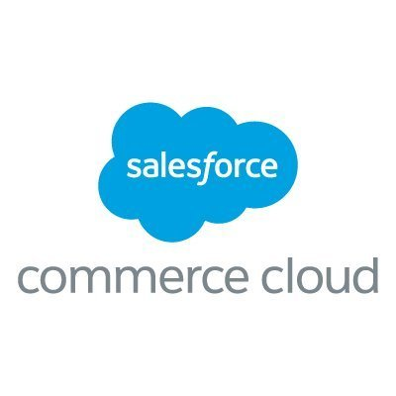
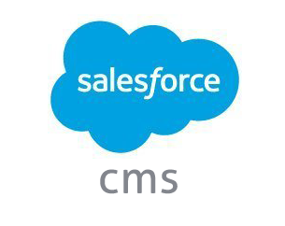

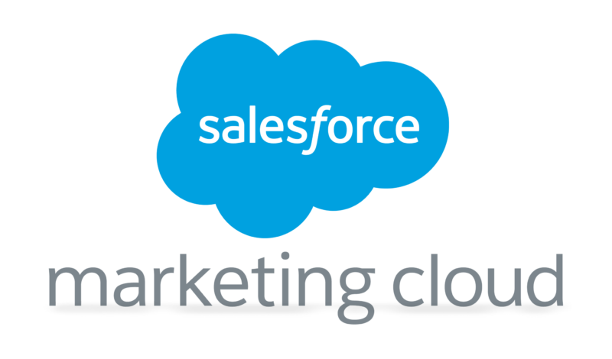




















Integrated Salesforce Ecosystem
Website CMS Systems
APIs
Connected Apps

Slide 4
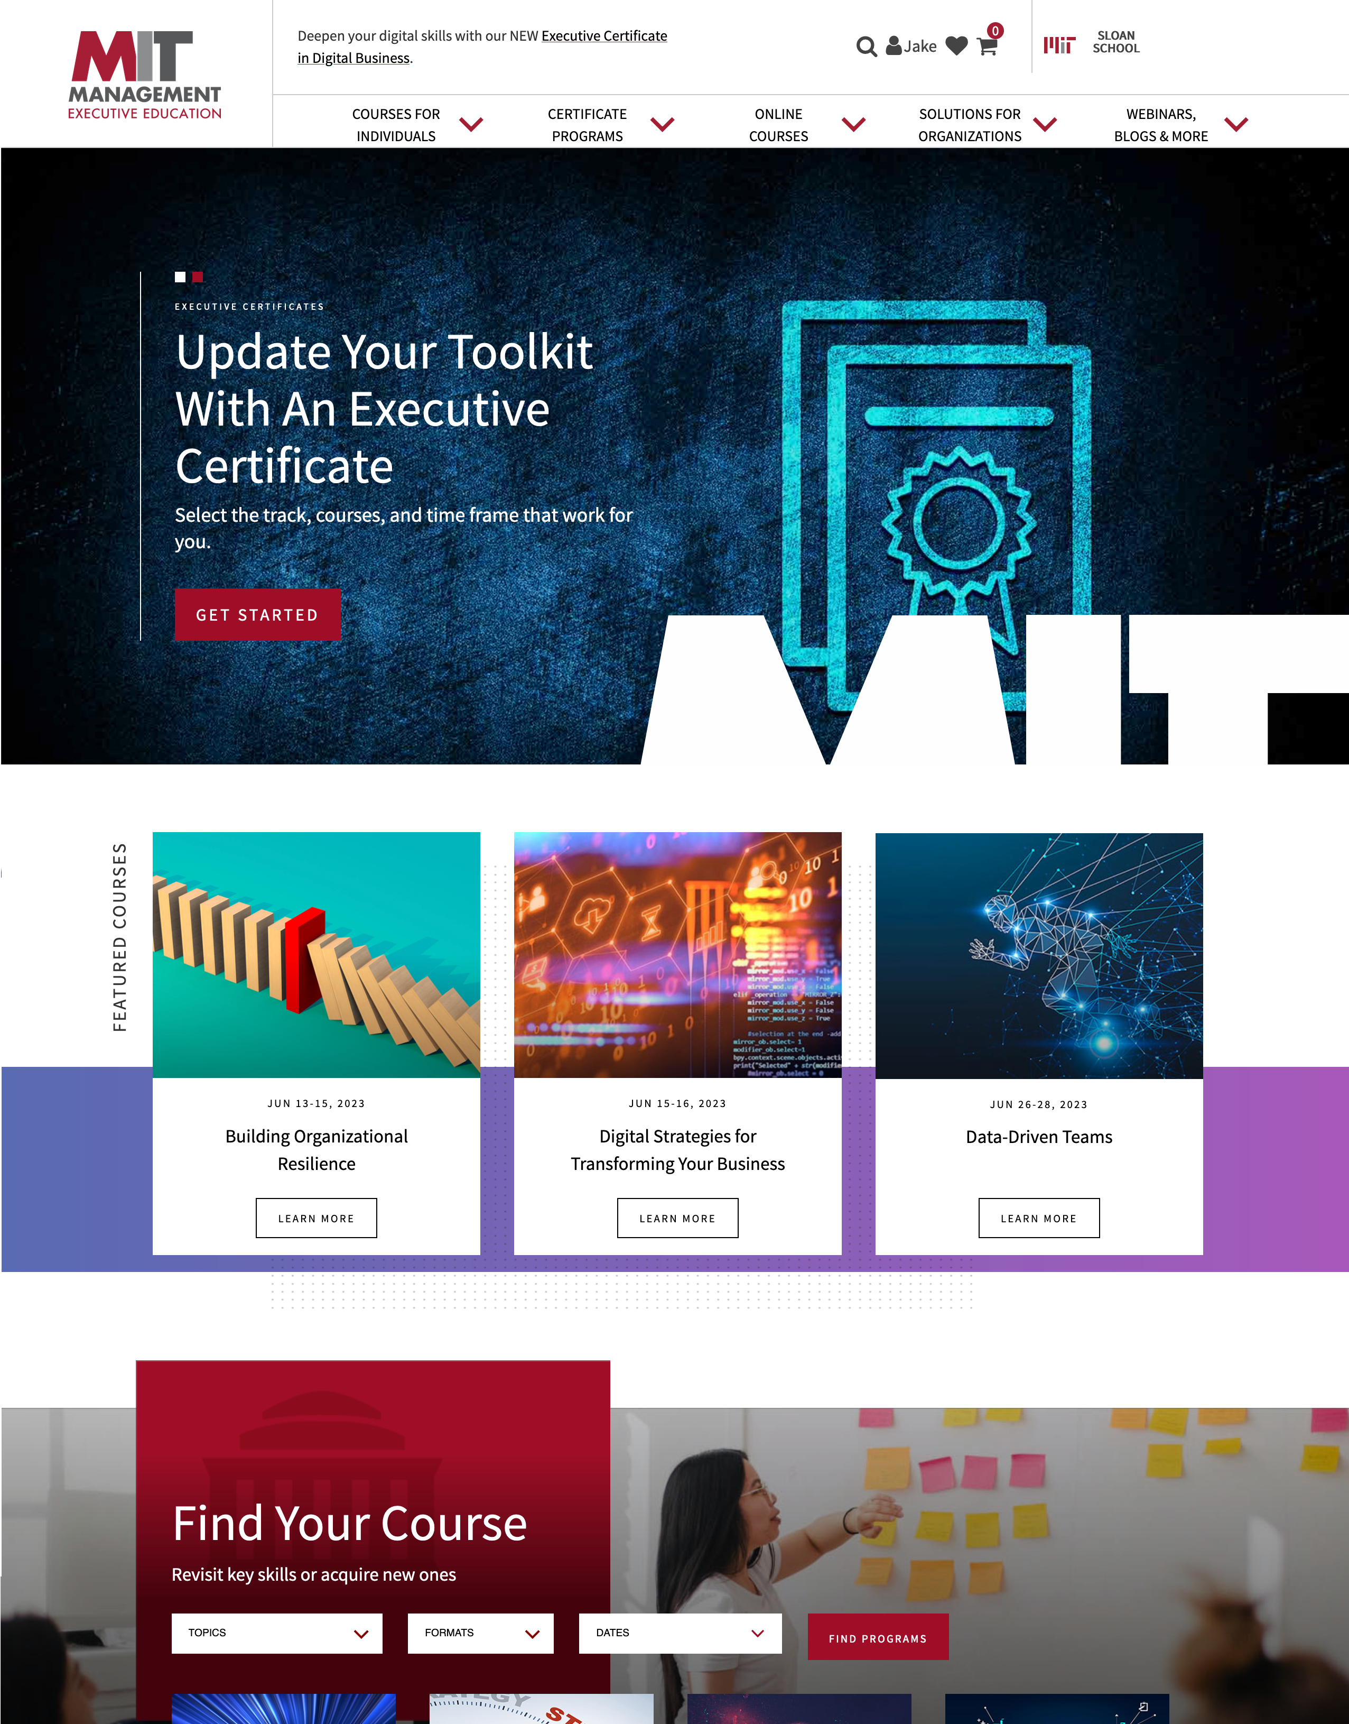
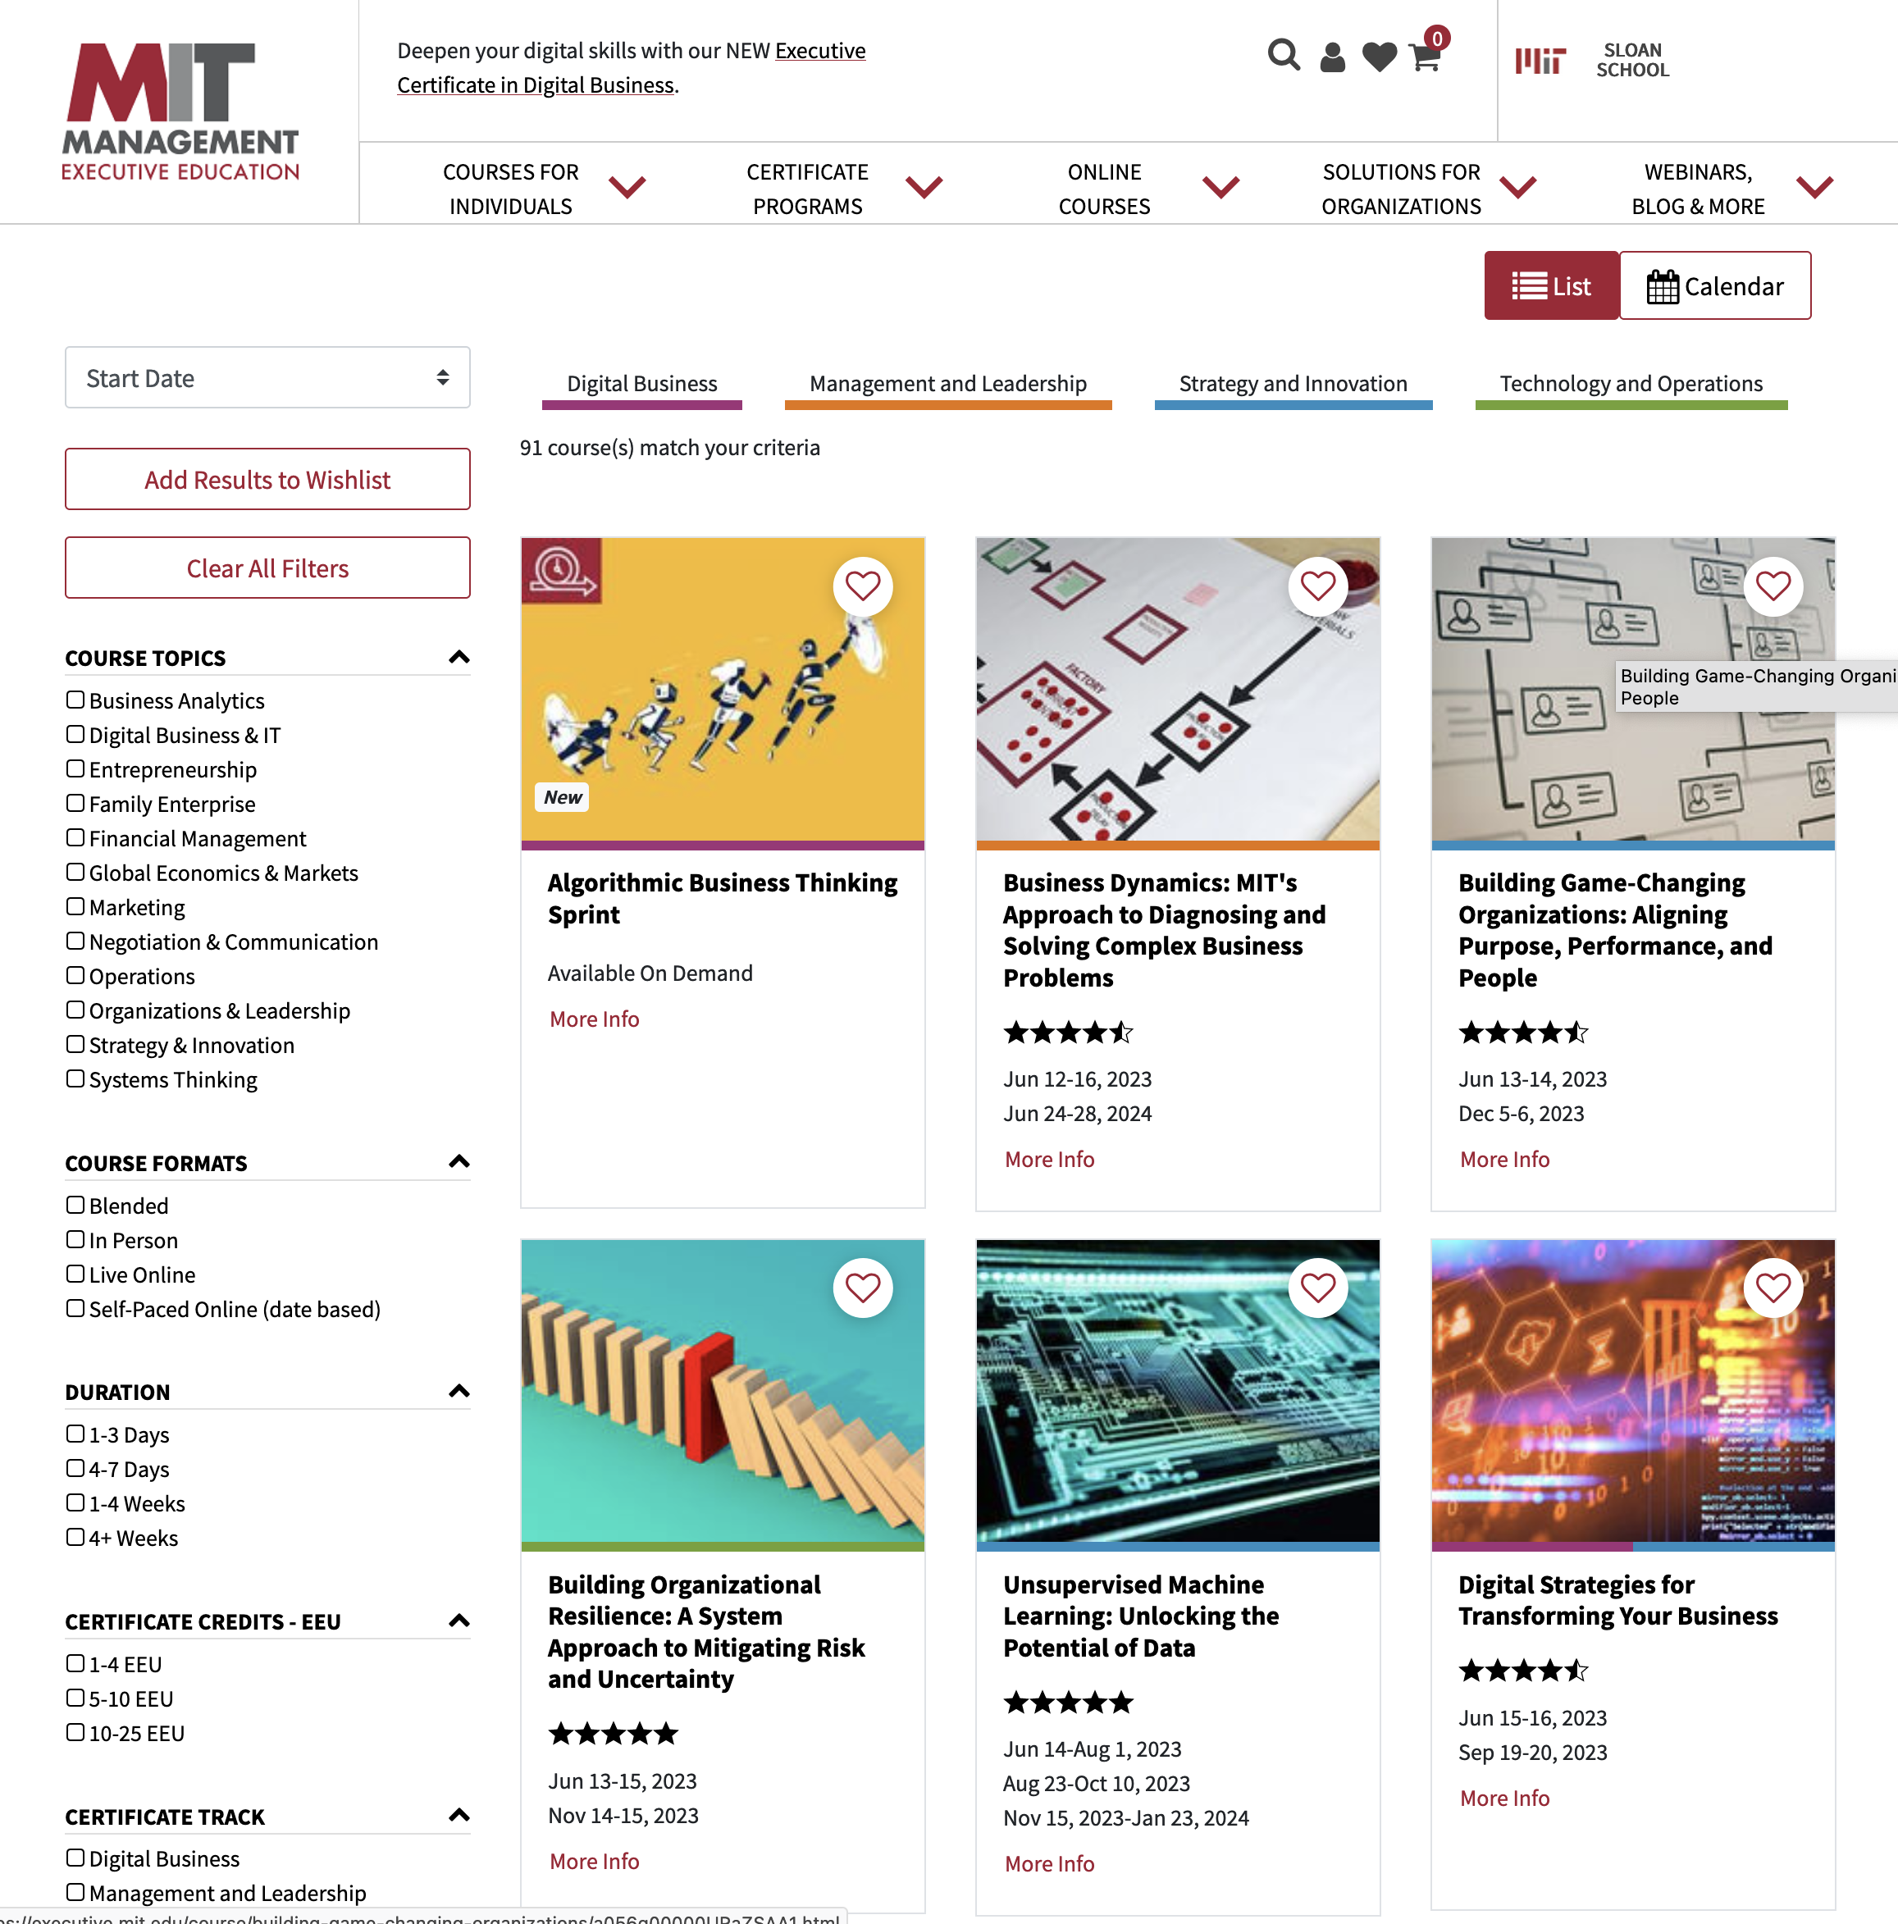
Notes:
A new front end website is being built on the Salesforce CMS platform. The website is designed with the goal to make it much easier for a participant to find and purchase a course. Course data and faculty data will be pulled directly from Salesforce into the site. This allows us to make changes to a course in Salesforce and for the data to automatically update on the website. Faculty images and bios will be pulled from the Sloan Person Database into Salesforce and the website. This will allow faculty to update the information that displays on the website using SPD.

Slide 5
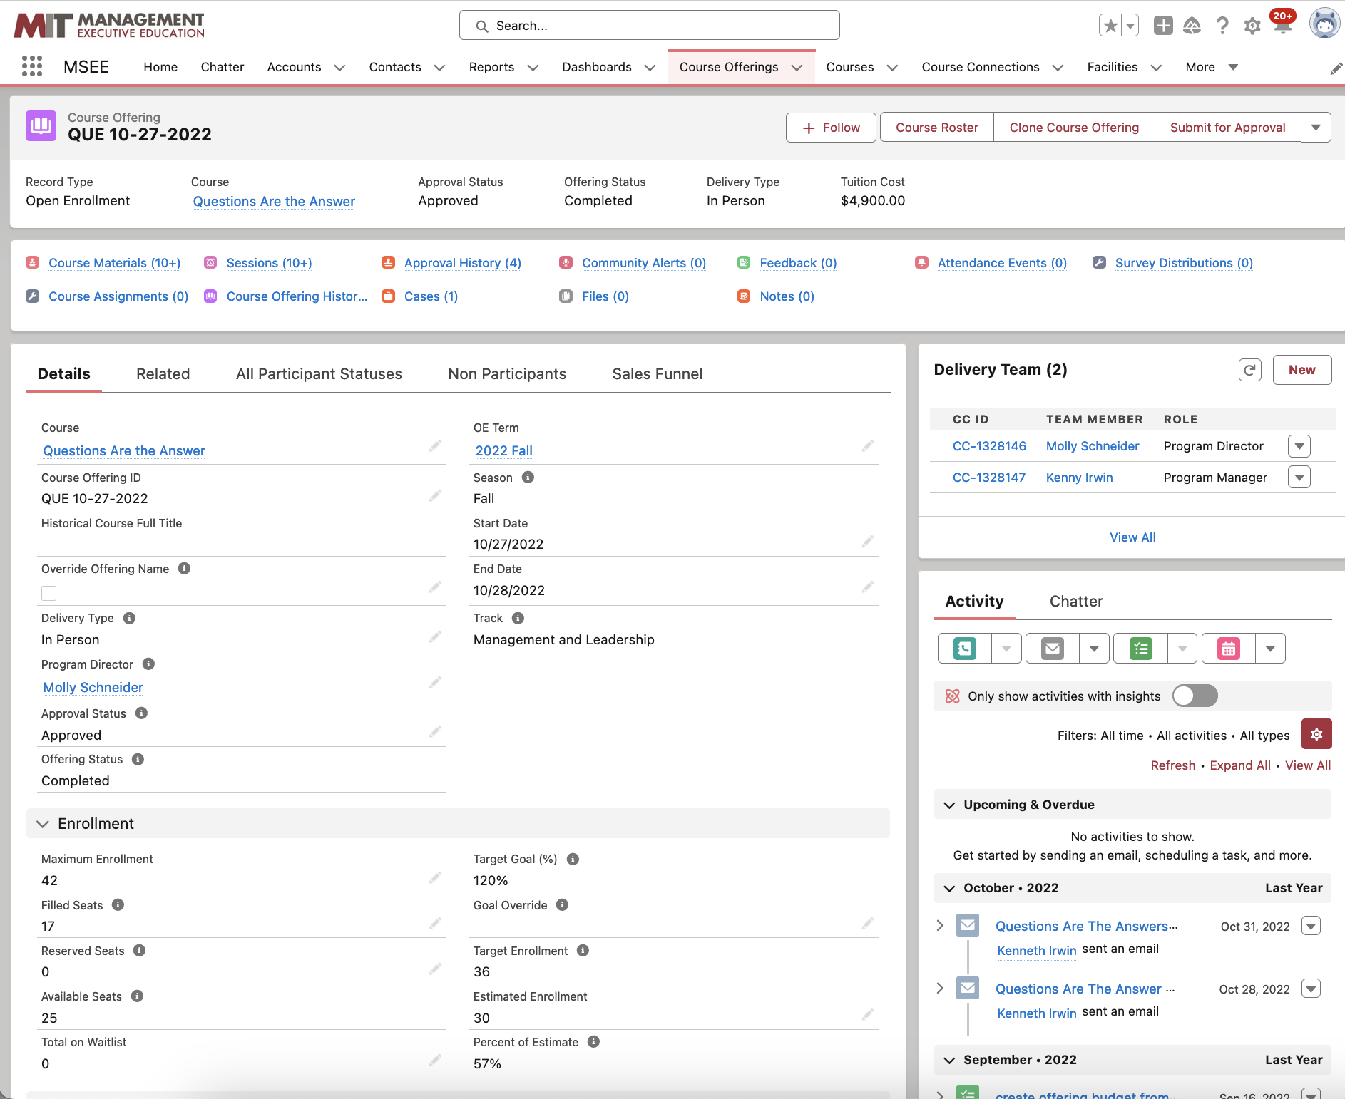
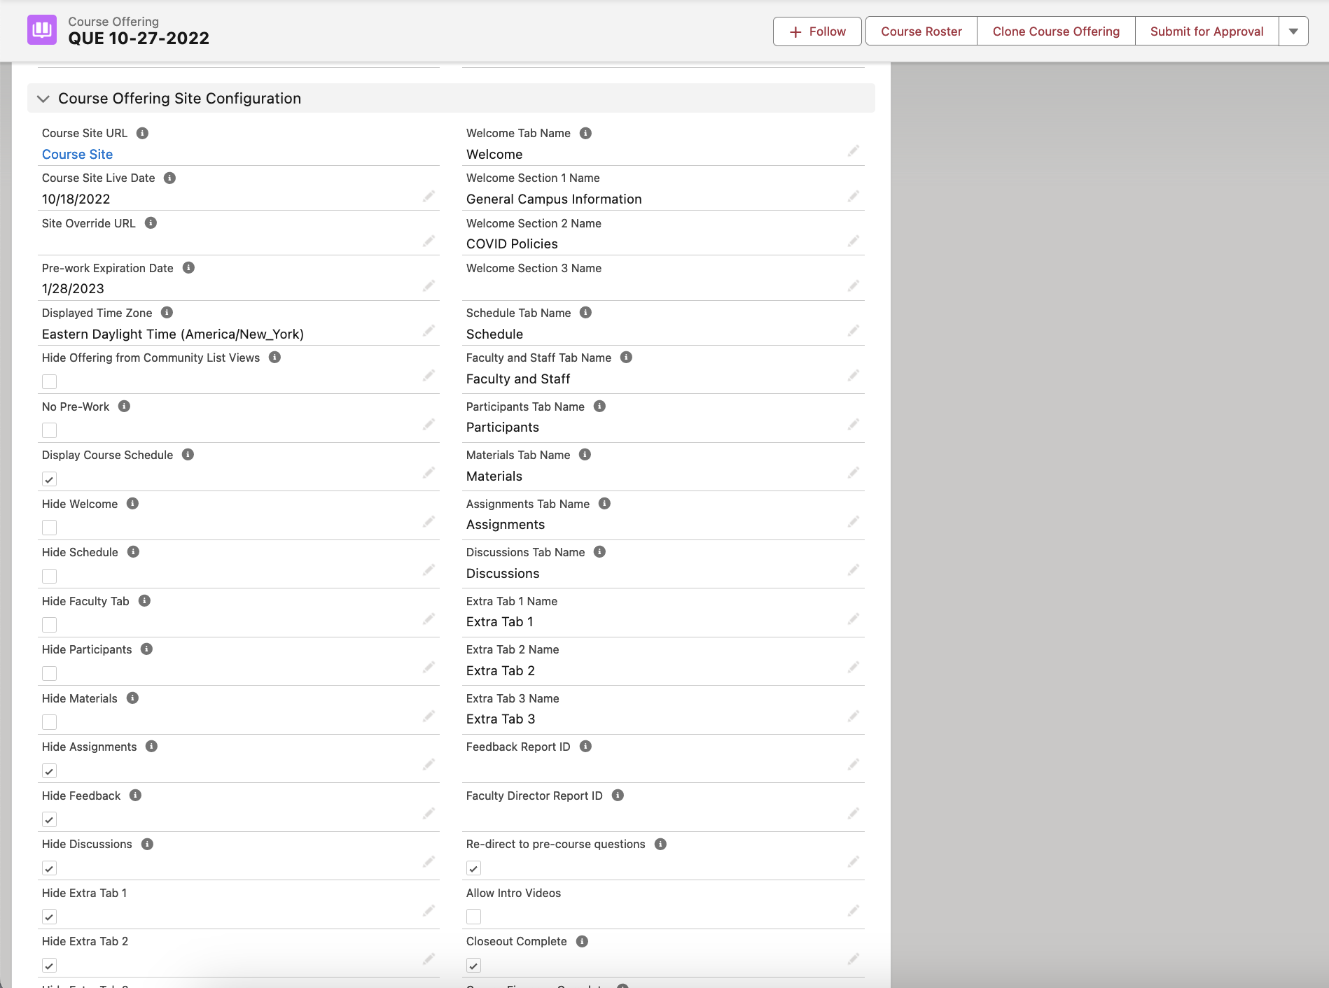
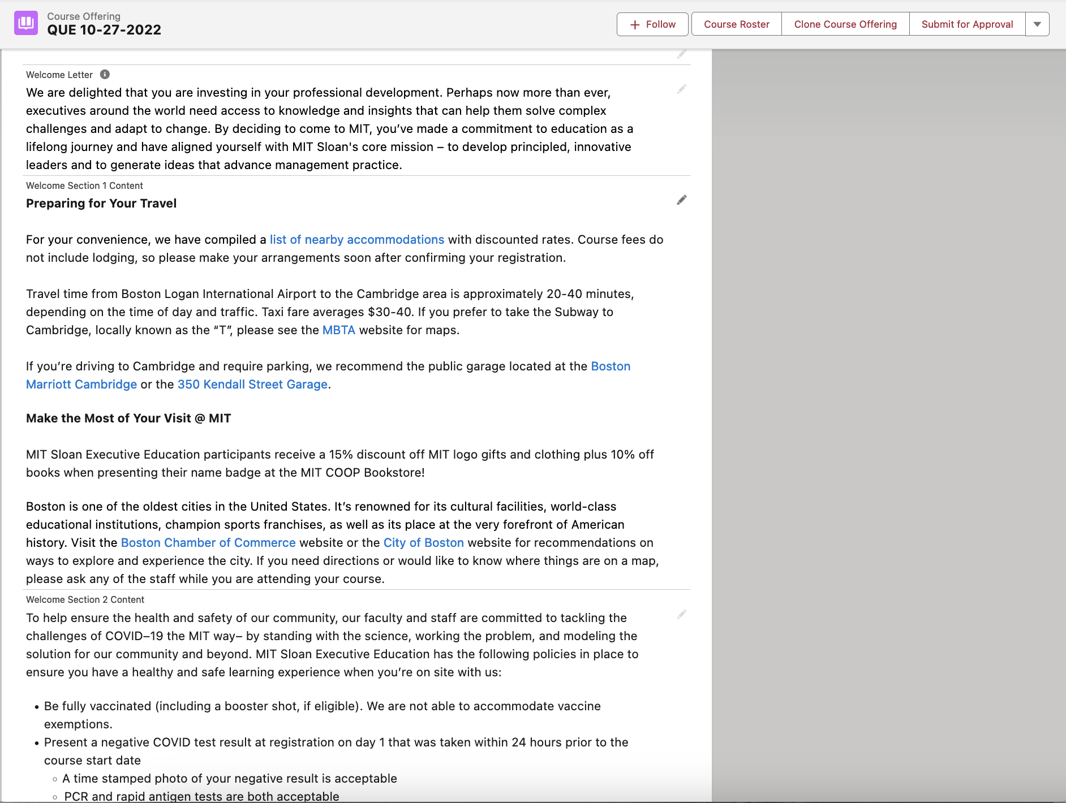
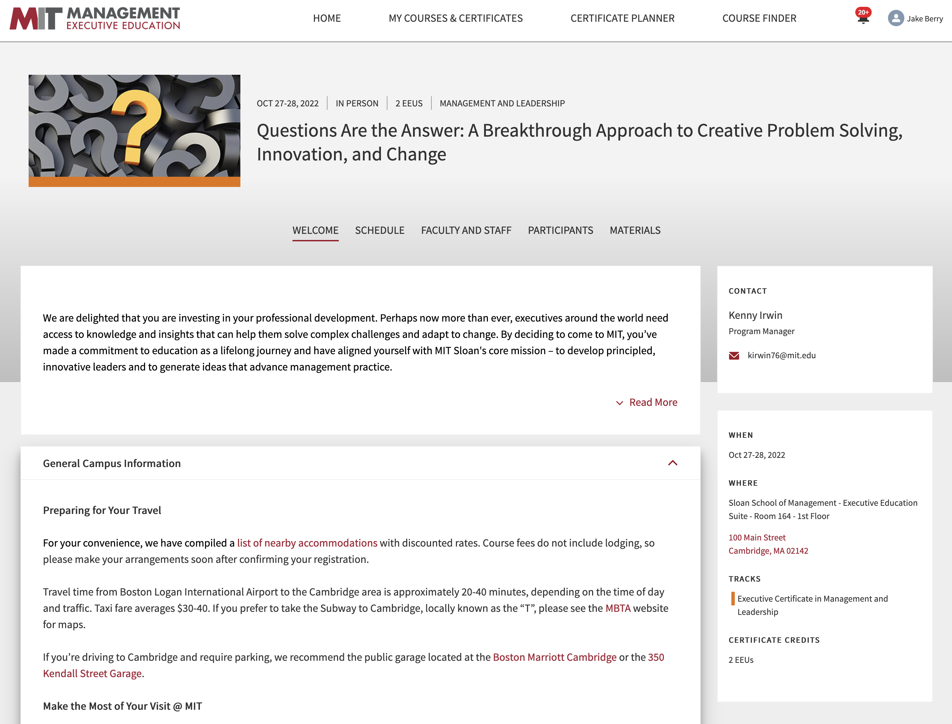

Slide 6
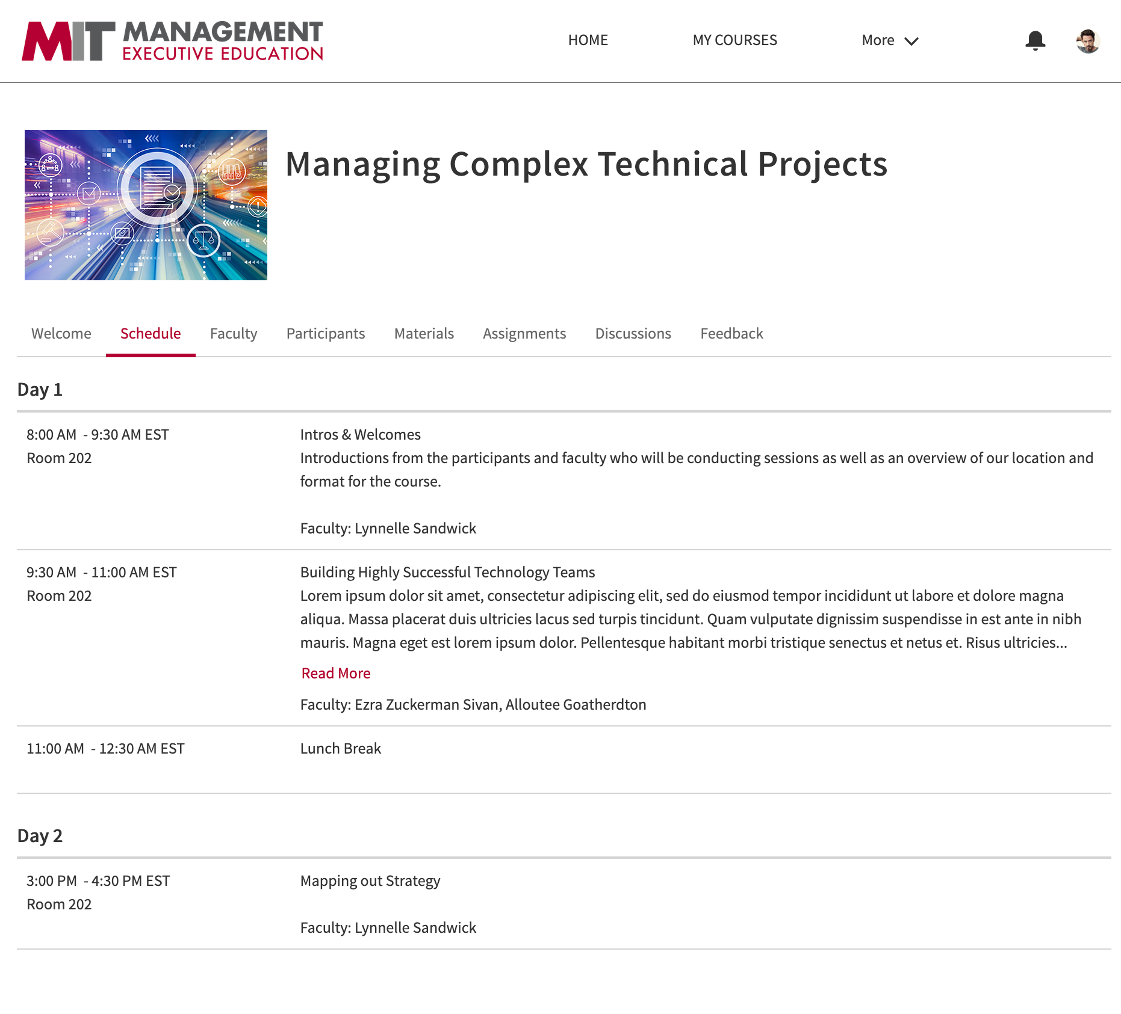
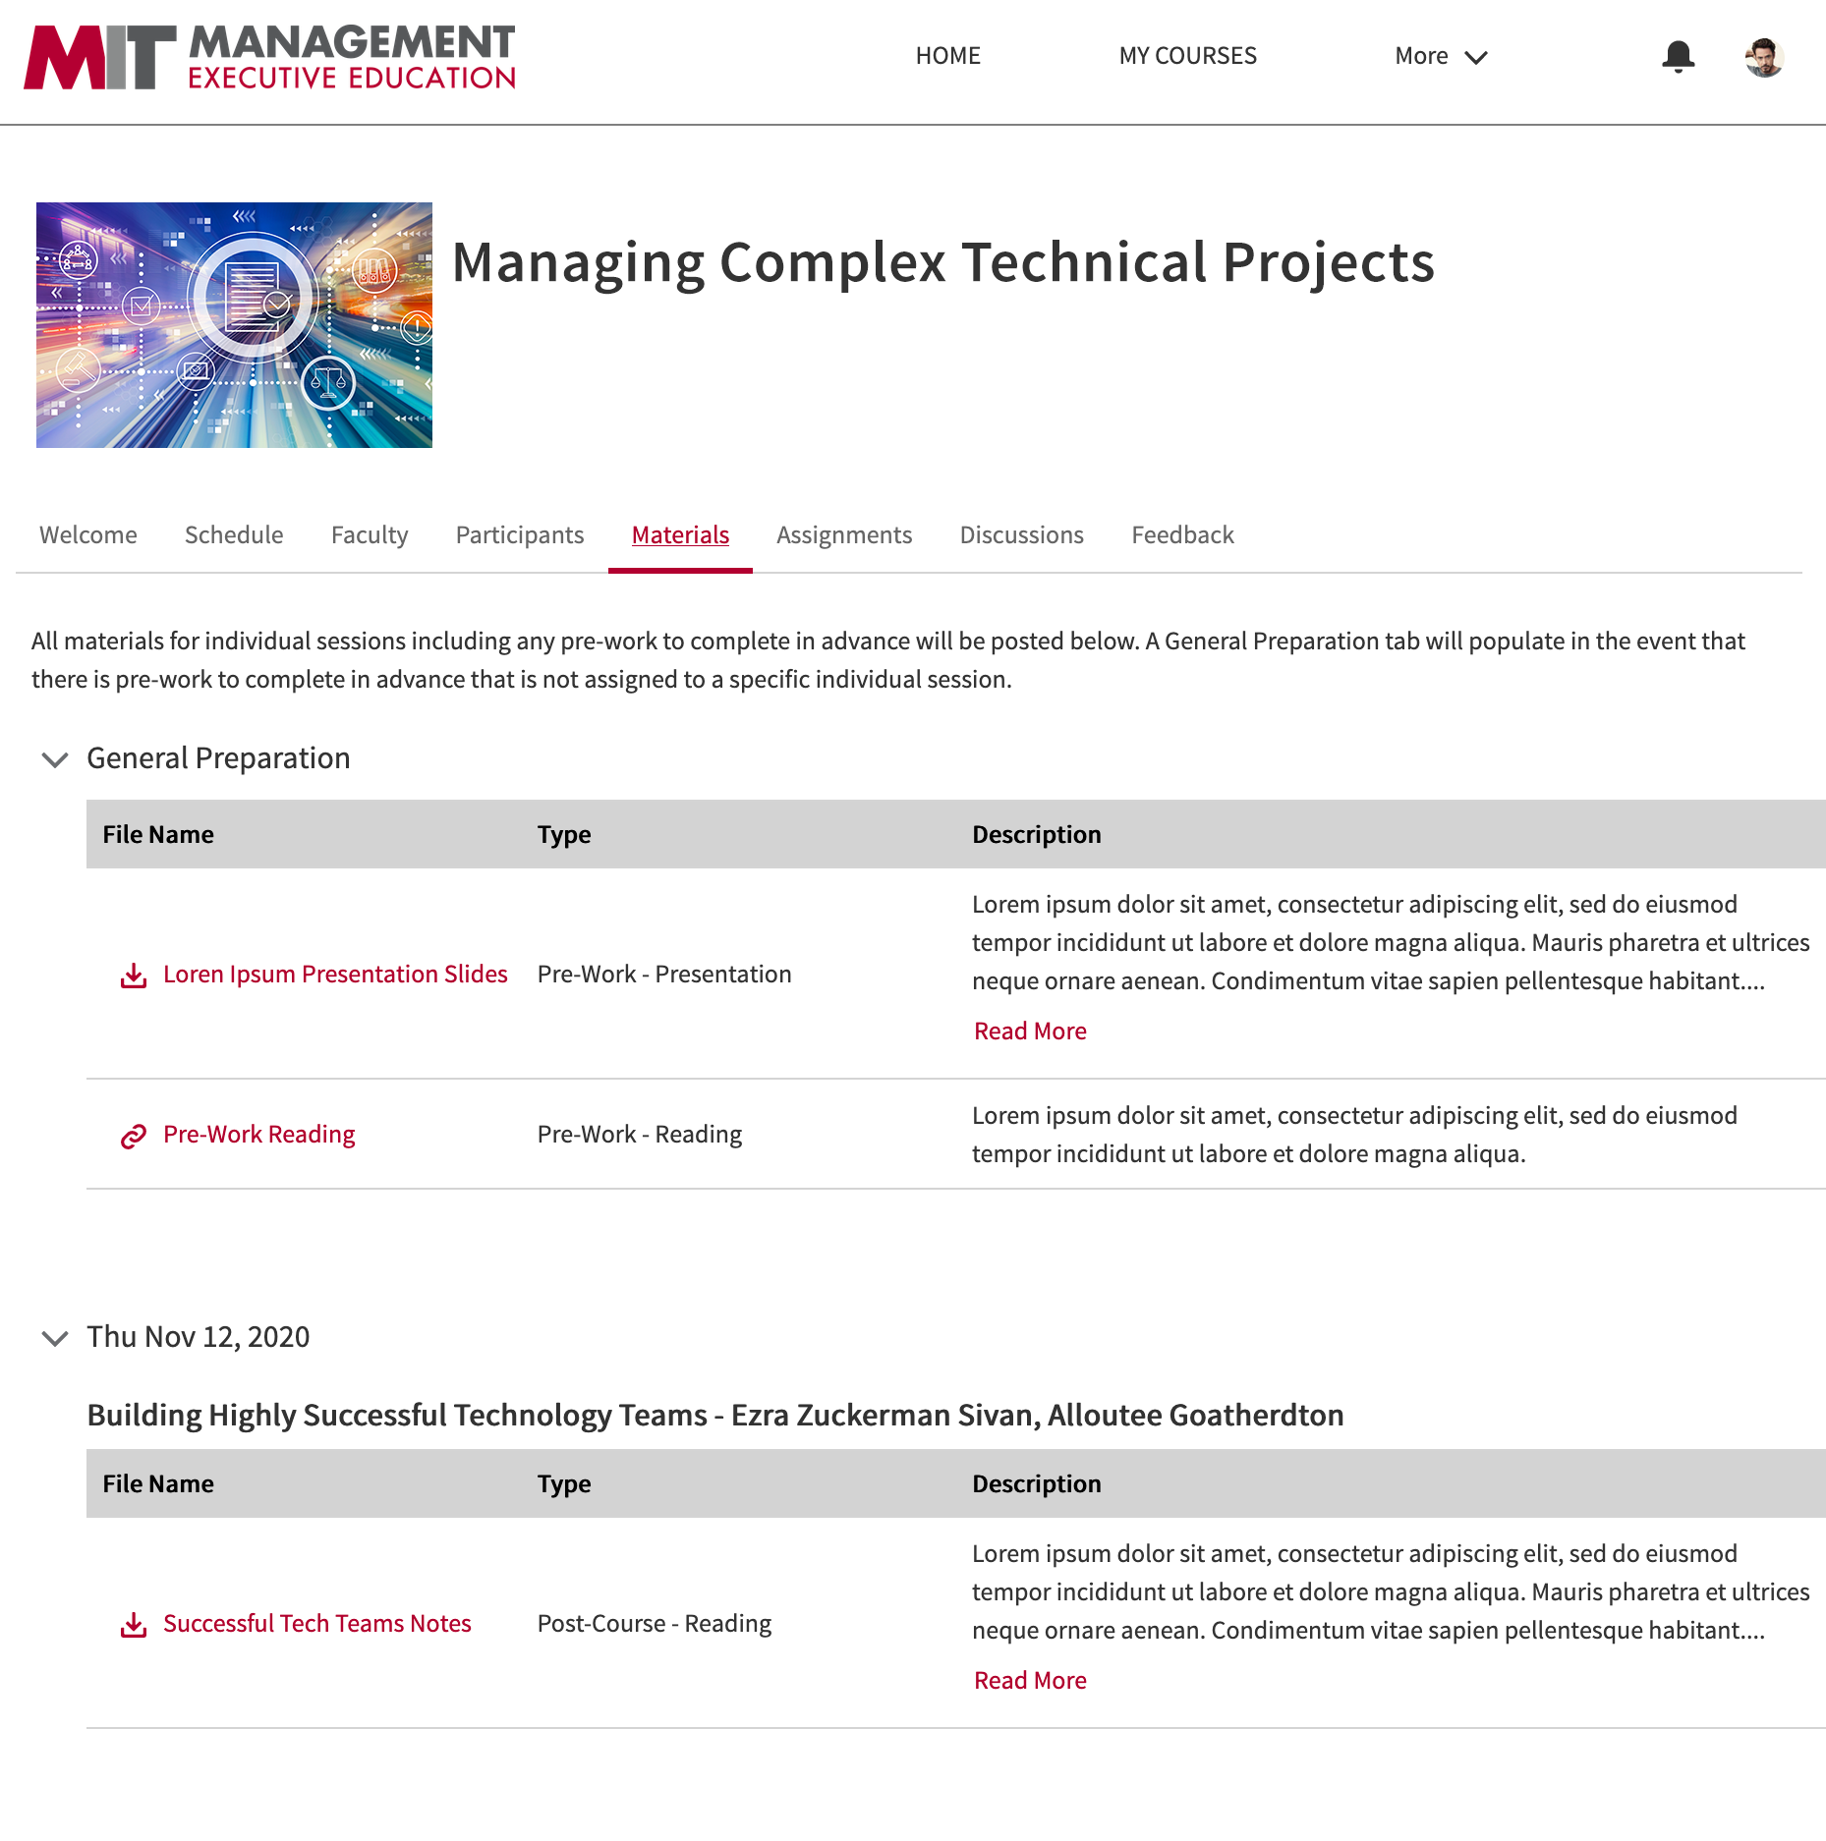
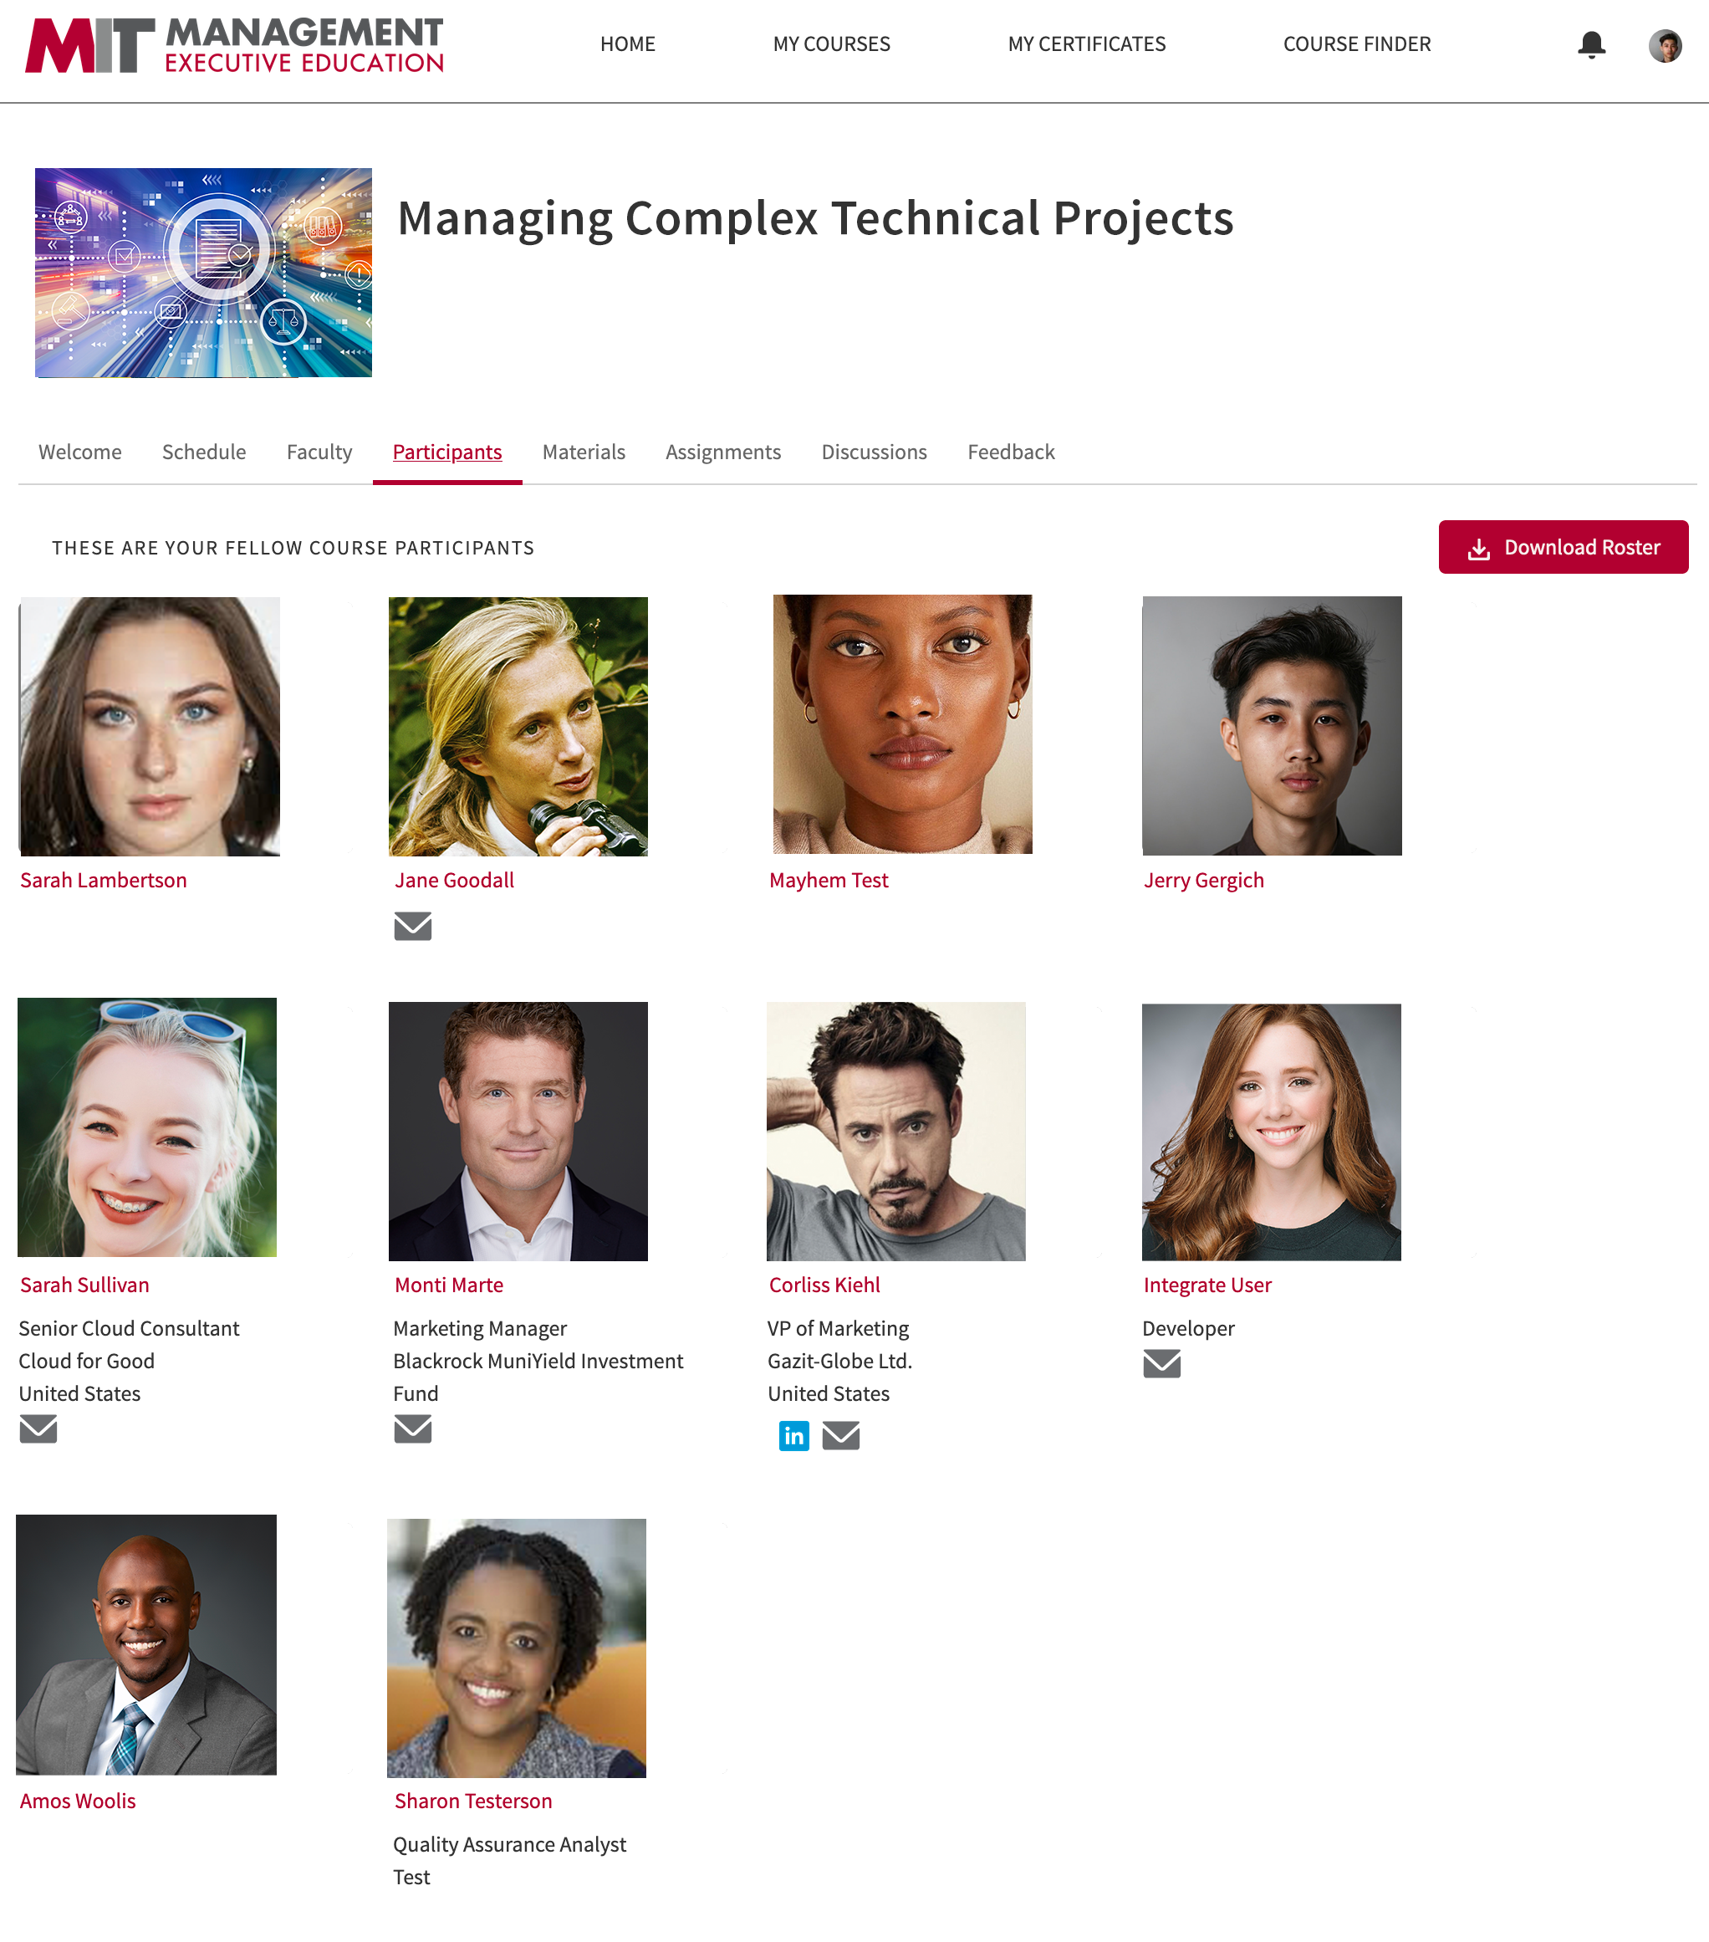
Notes:
When a participant click on the course site link, a new window opens with a course site that includes a welcome letters, schedule, faculty list, participants list, material page, assignment, discussion board, and feedback tab. All tabs can be turned on or off based on the course. Custom courses can be built with additional tabs as needed.

Slide 7
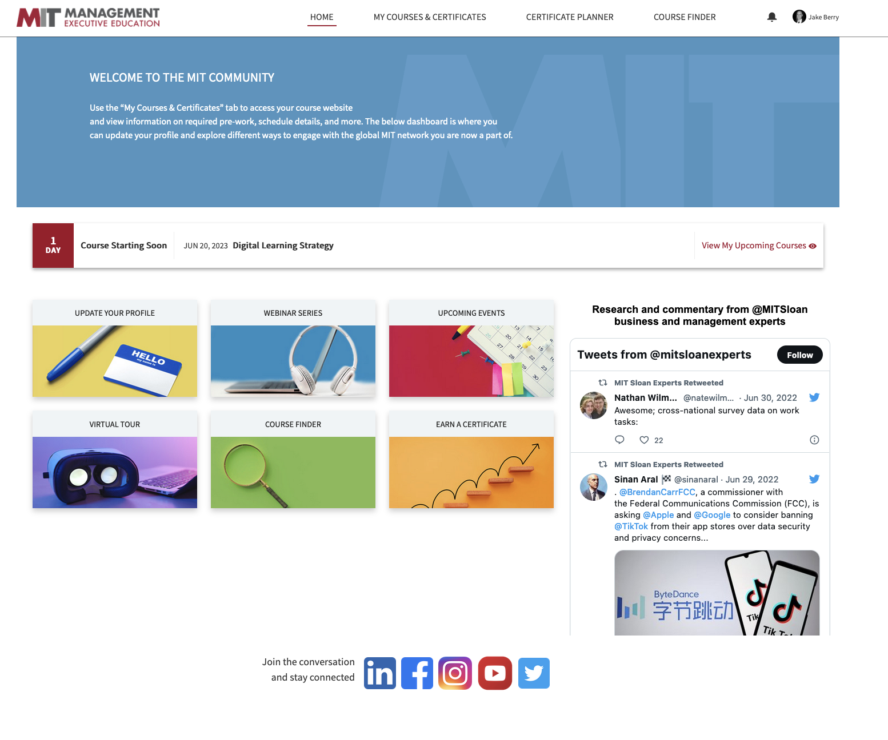
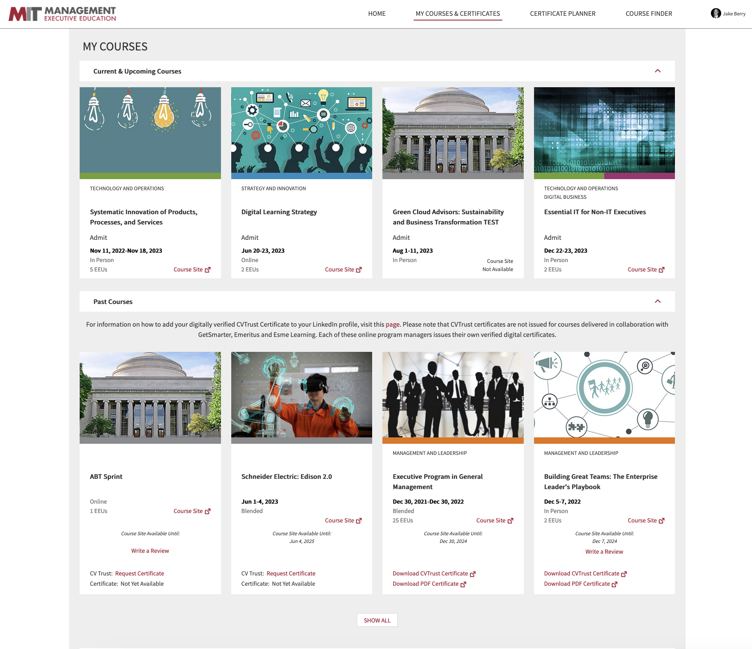
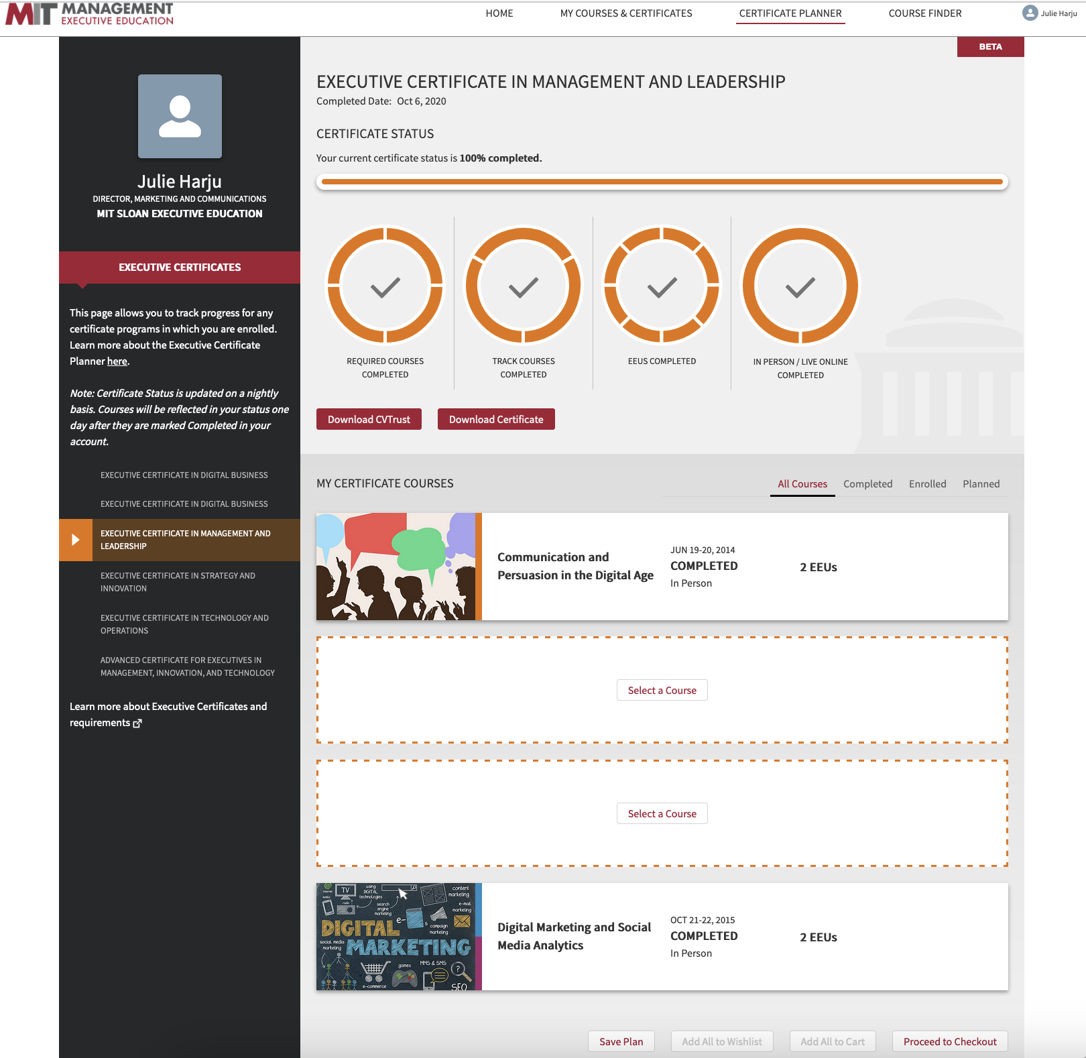

Slide 8
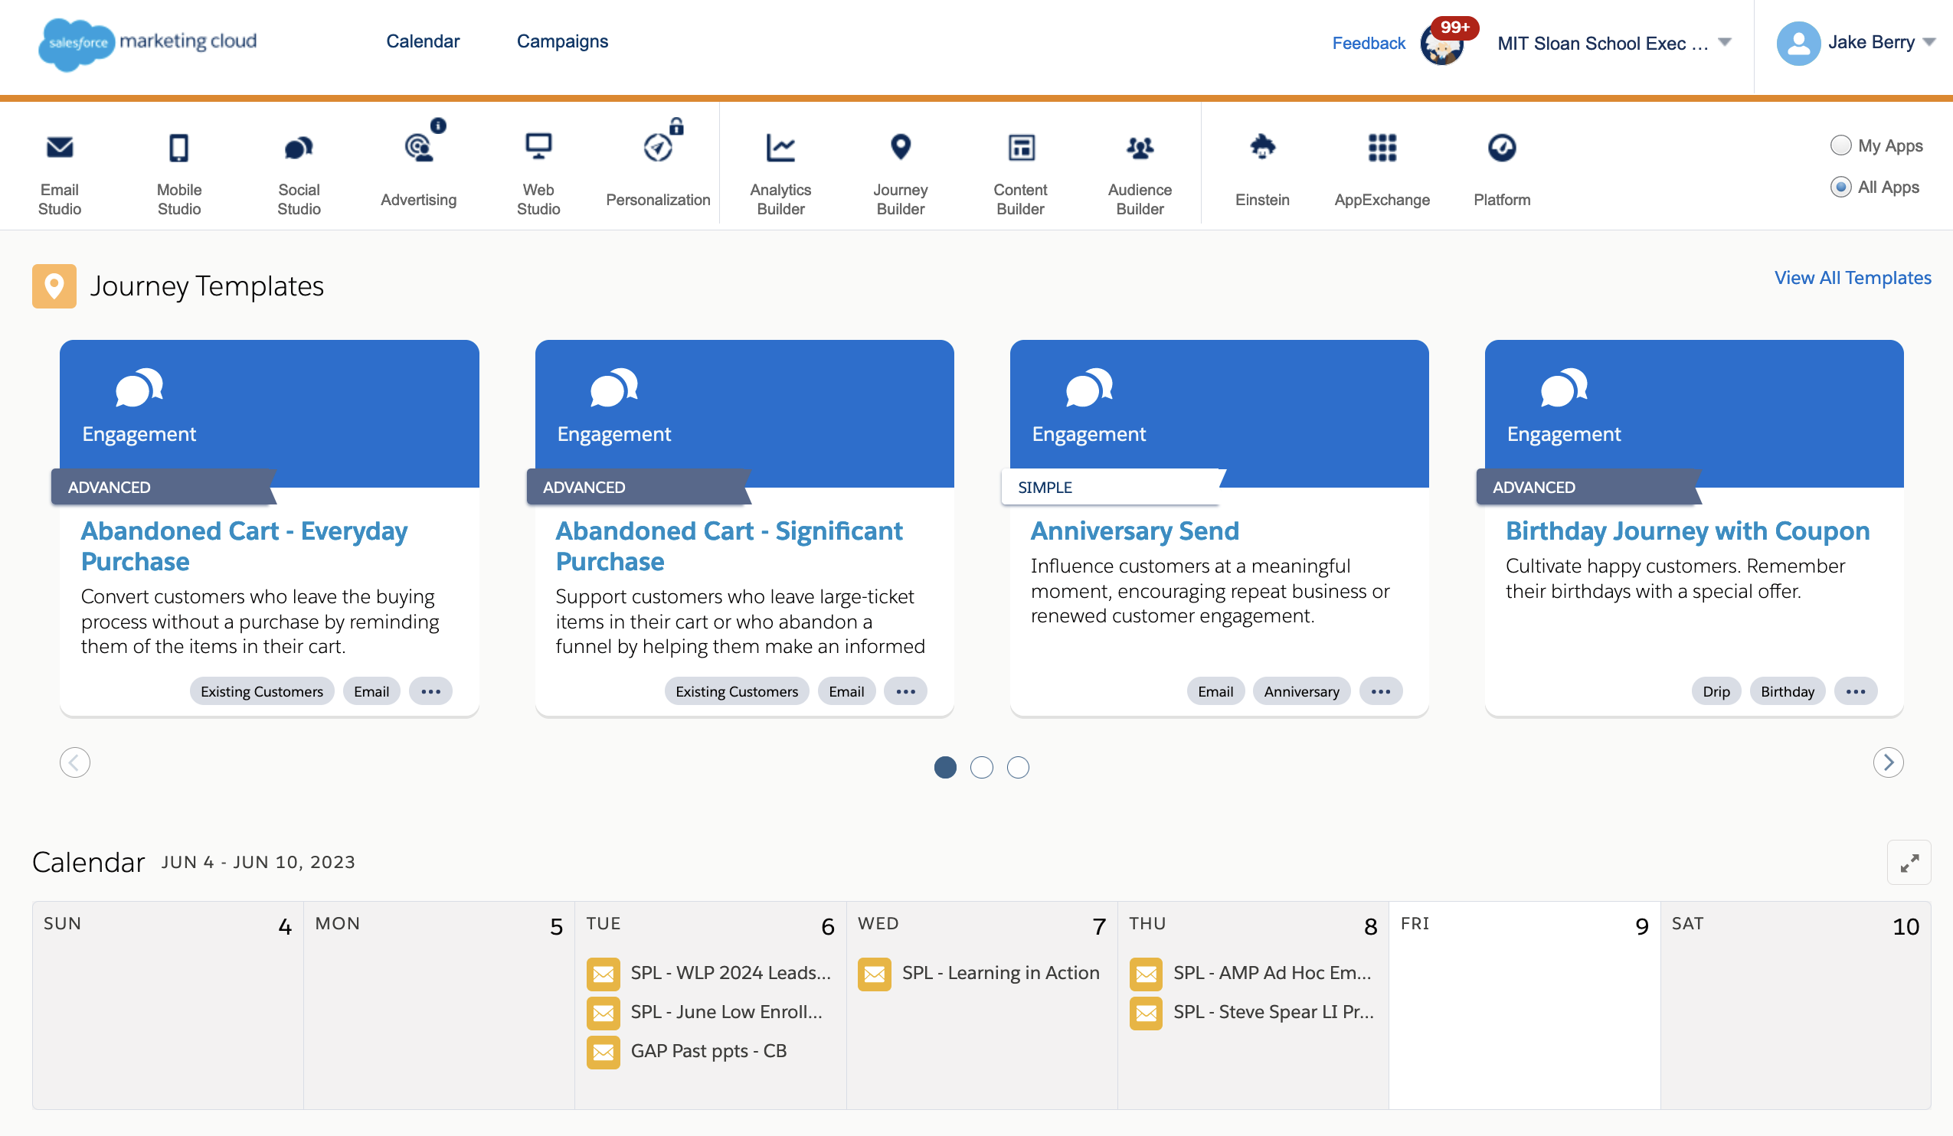
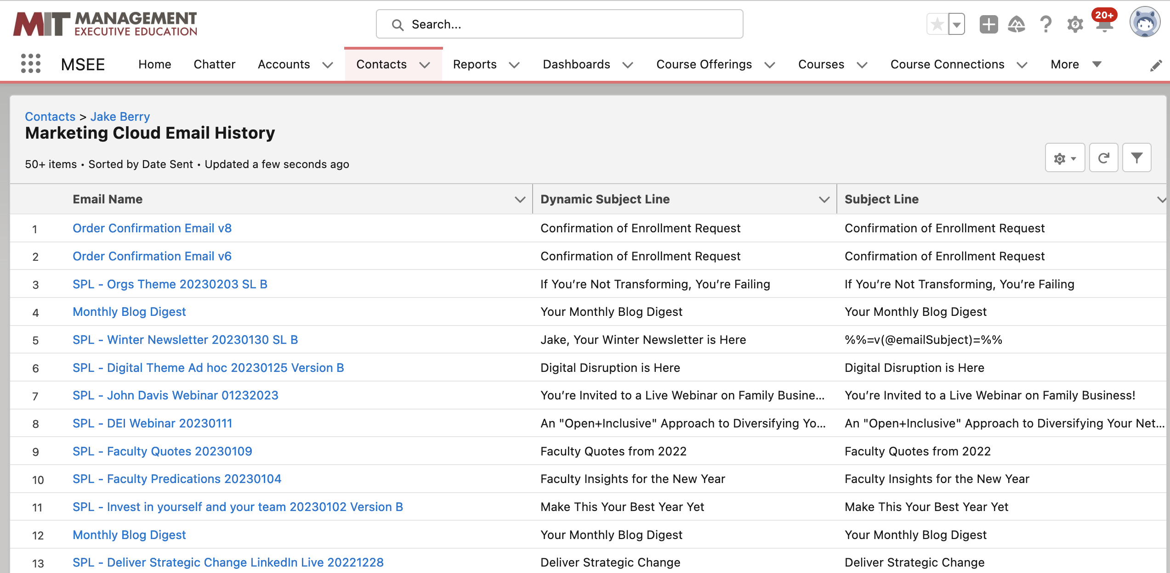
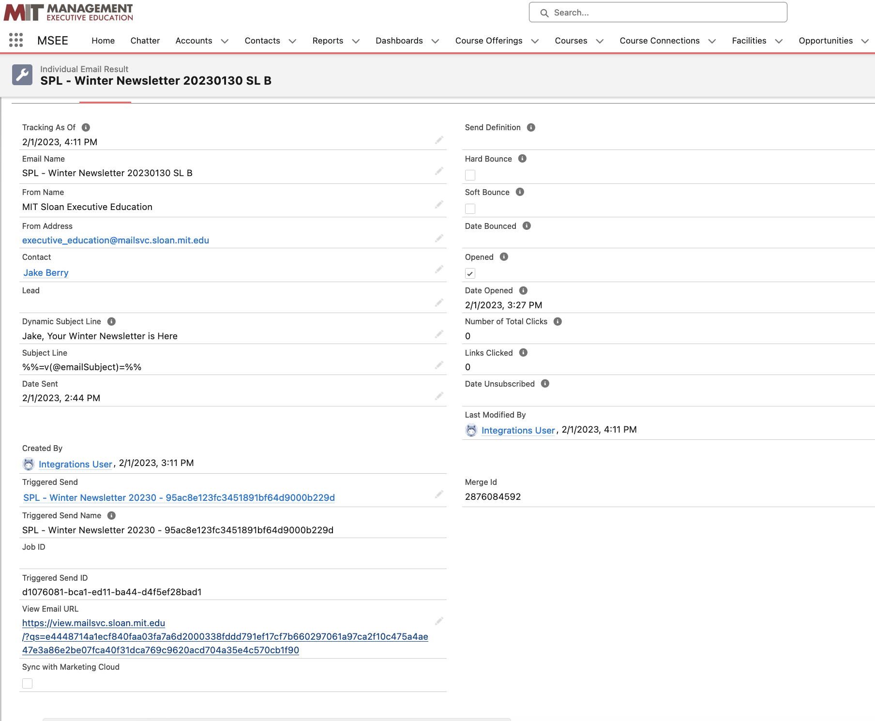
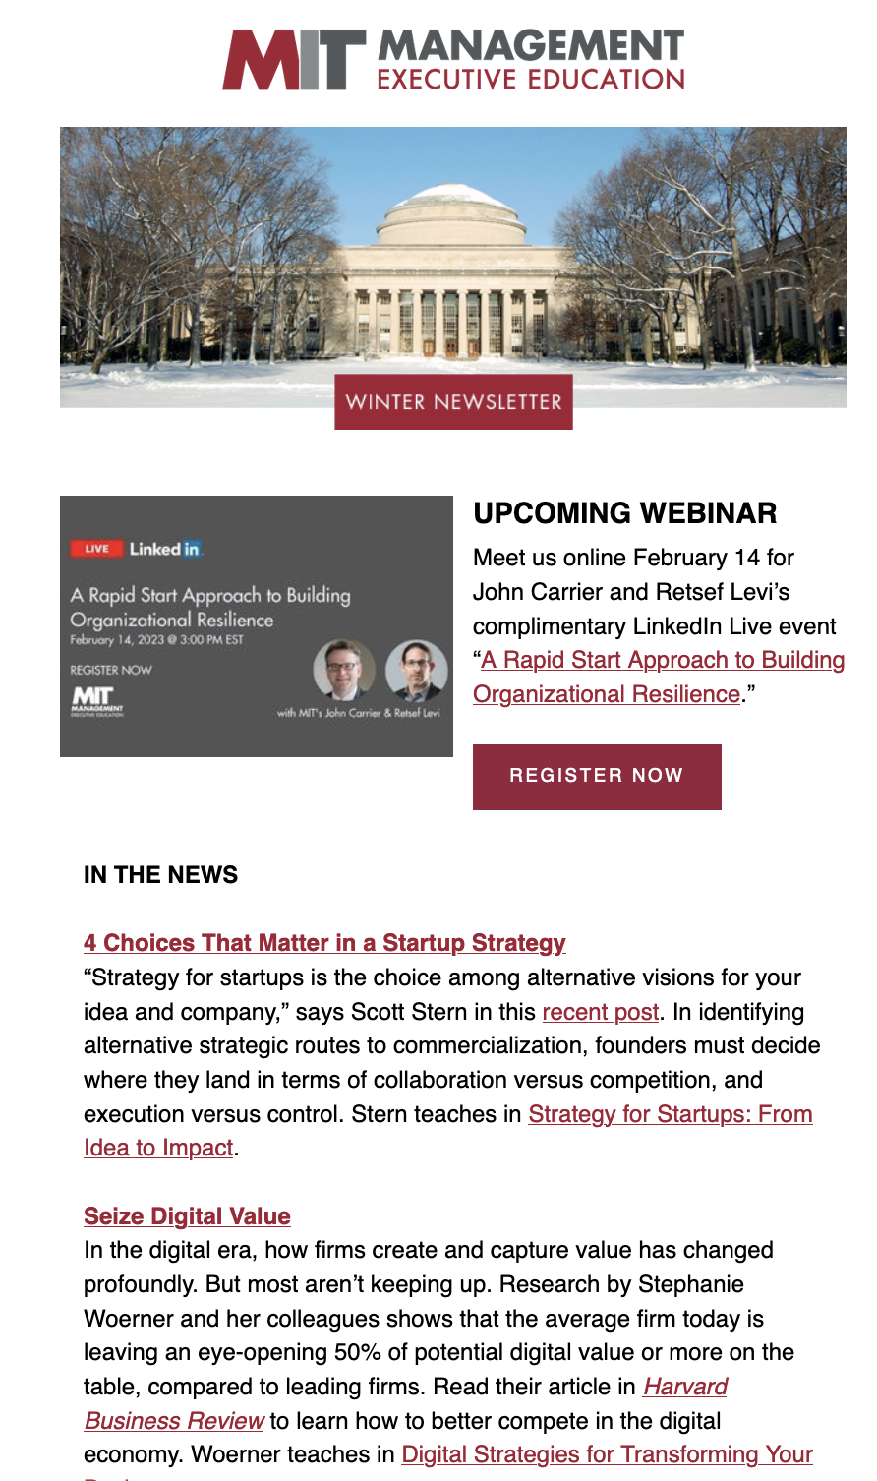

Slide 9
Sloan Person Database
One Source Of Truth Data Policy
Sloan Person Database (SPD)
MuleSoft
Salesforce
(SFDC)
Commerce Cloud
(SFCC)
Digital Experience
Sloan Data Warehouse
www.sloan.mit.edu

Slide 10
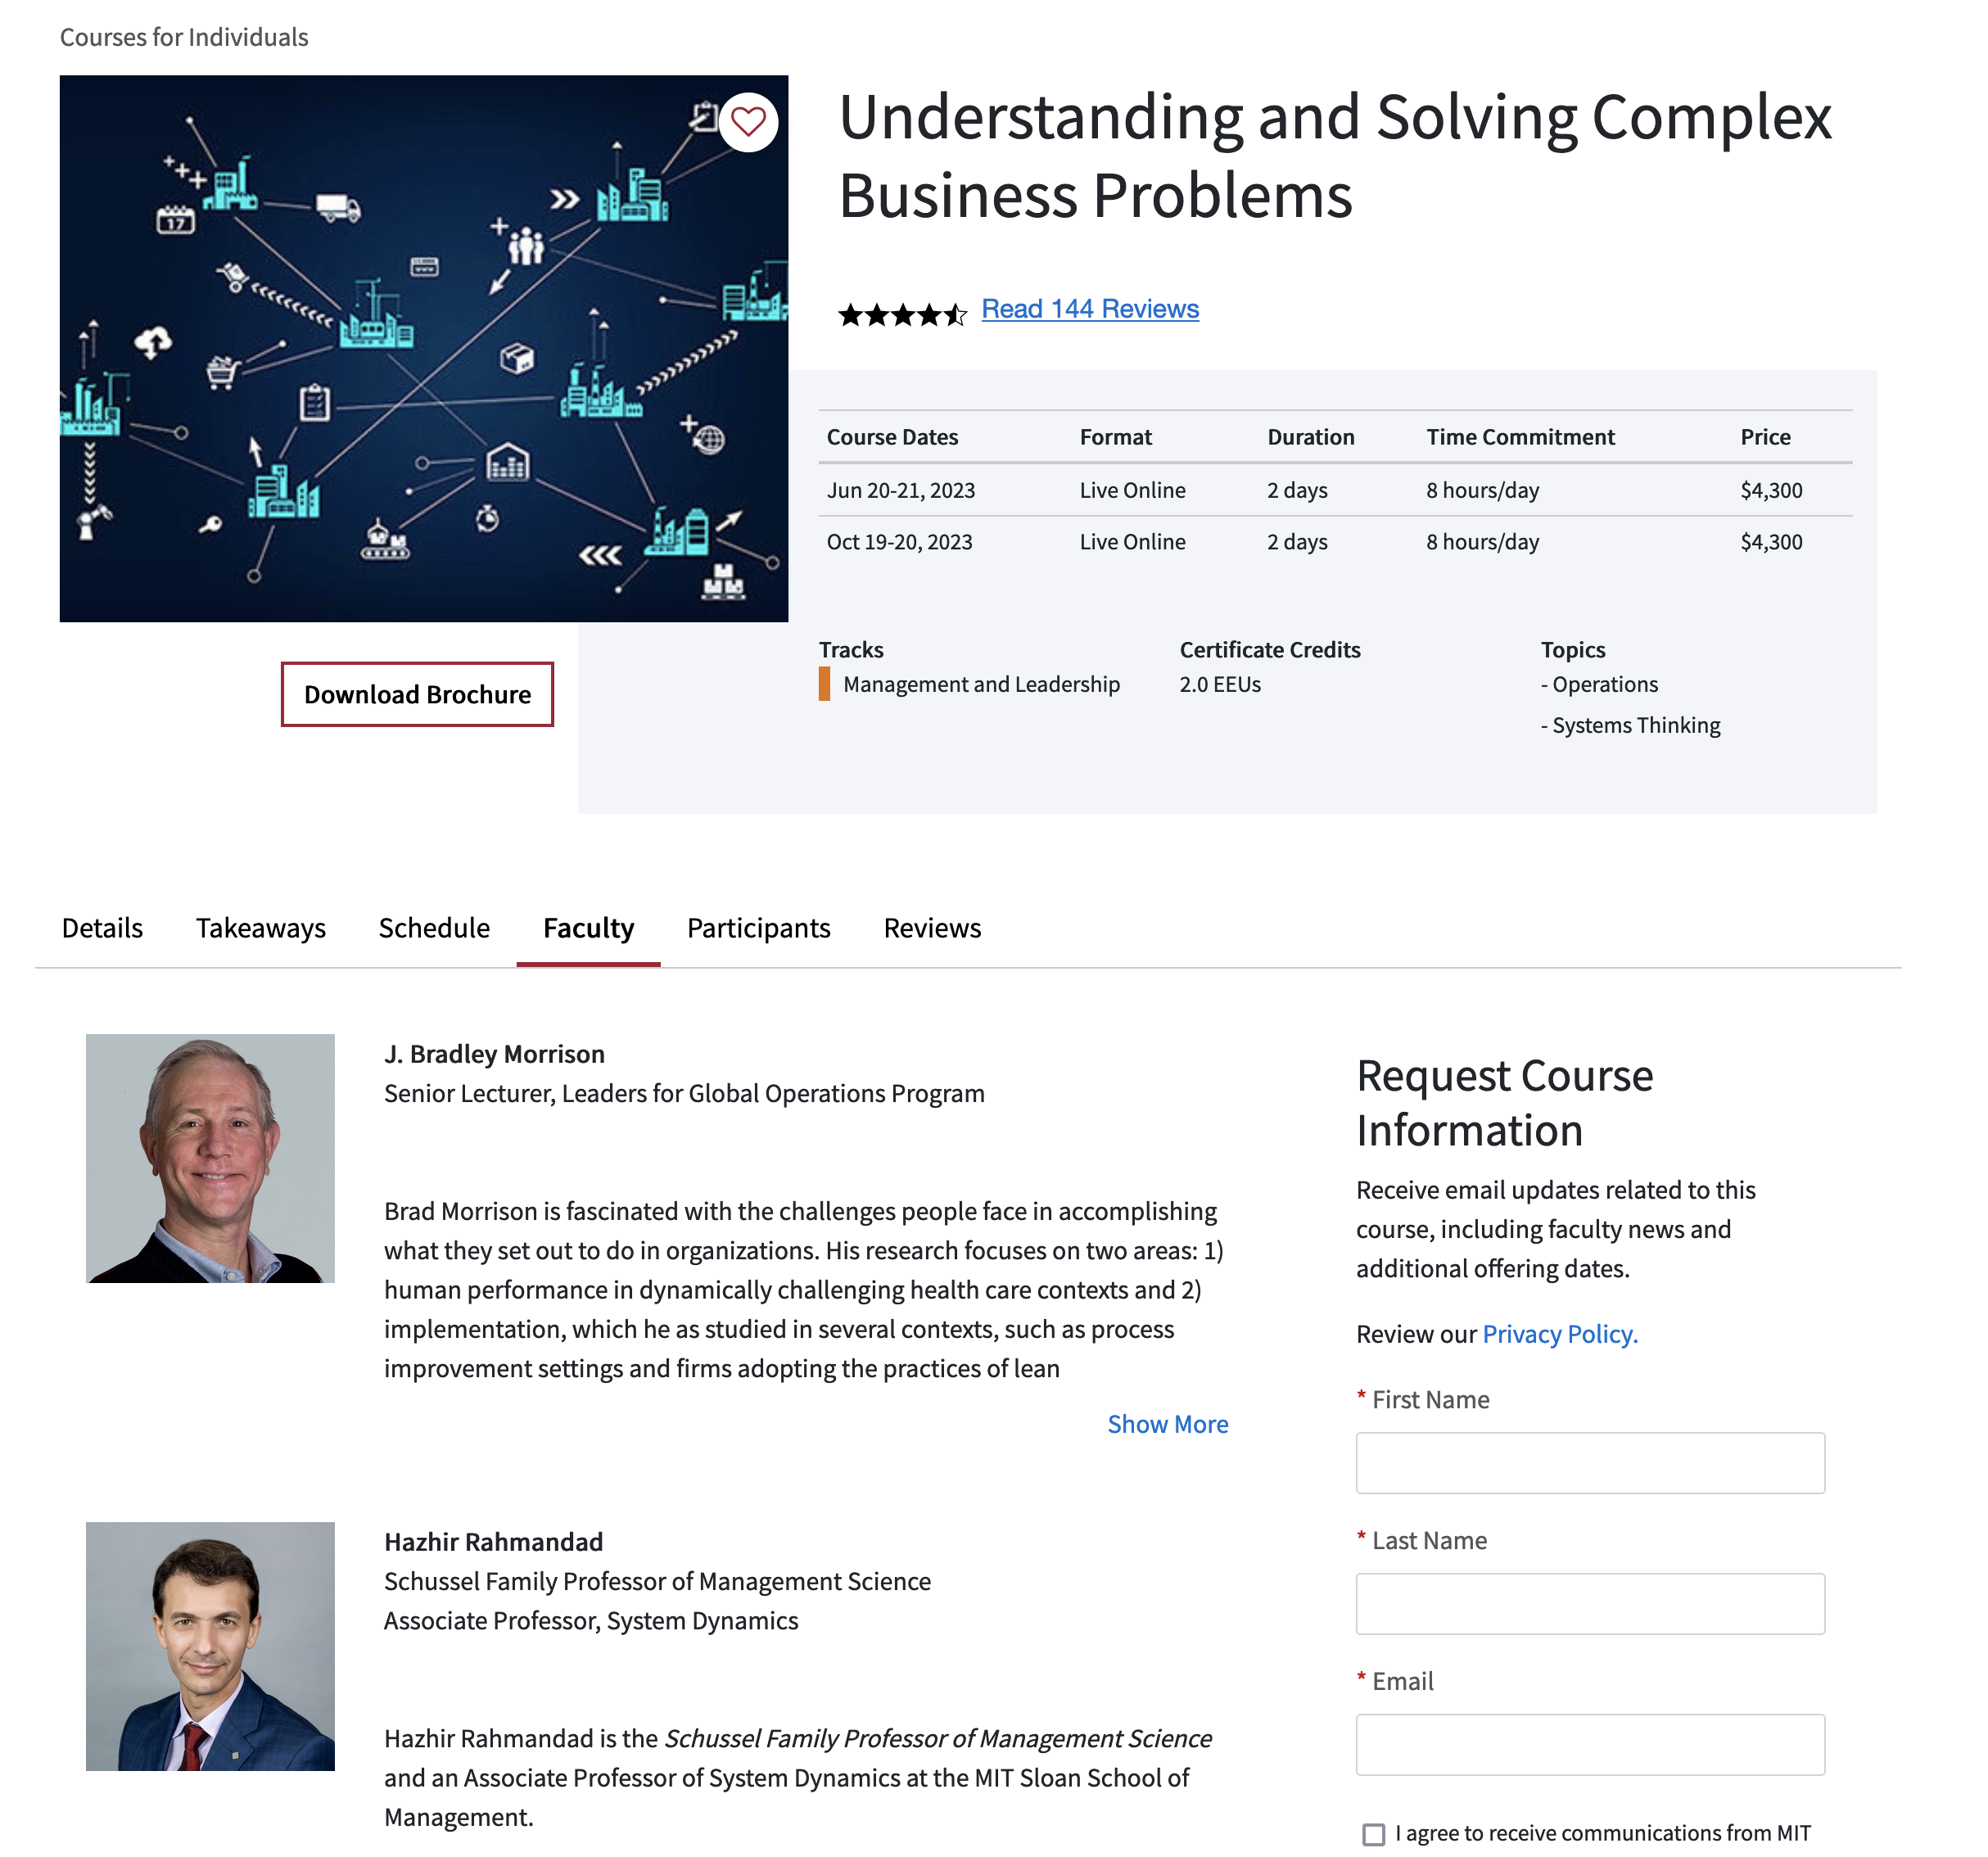
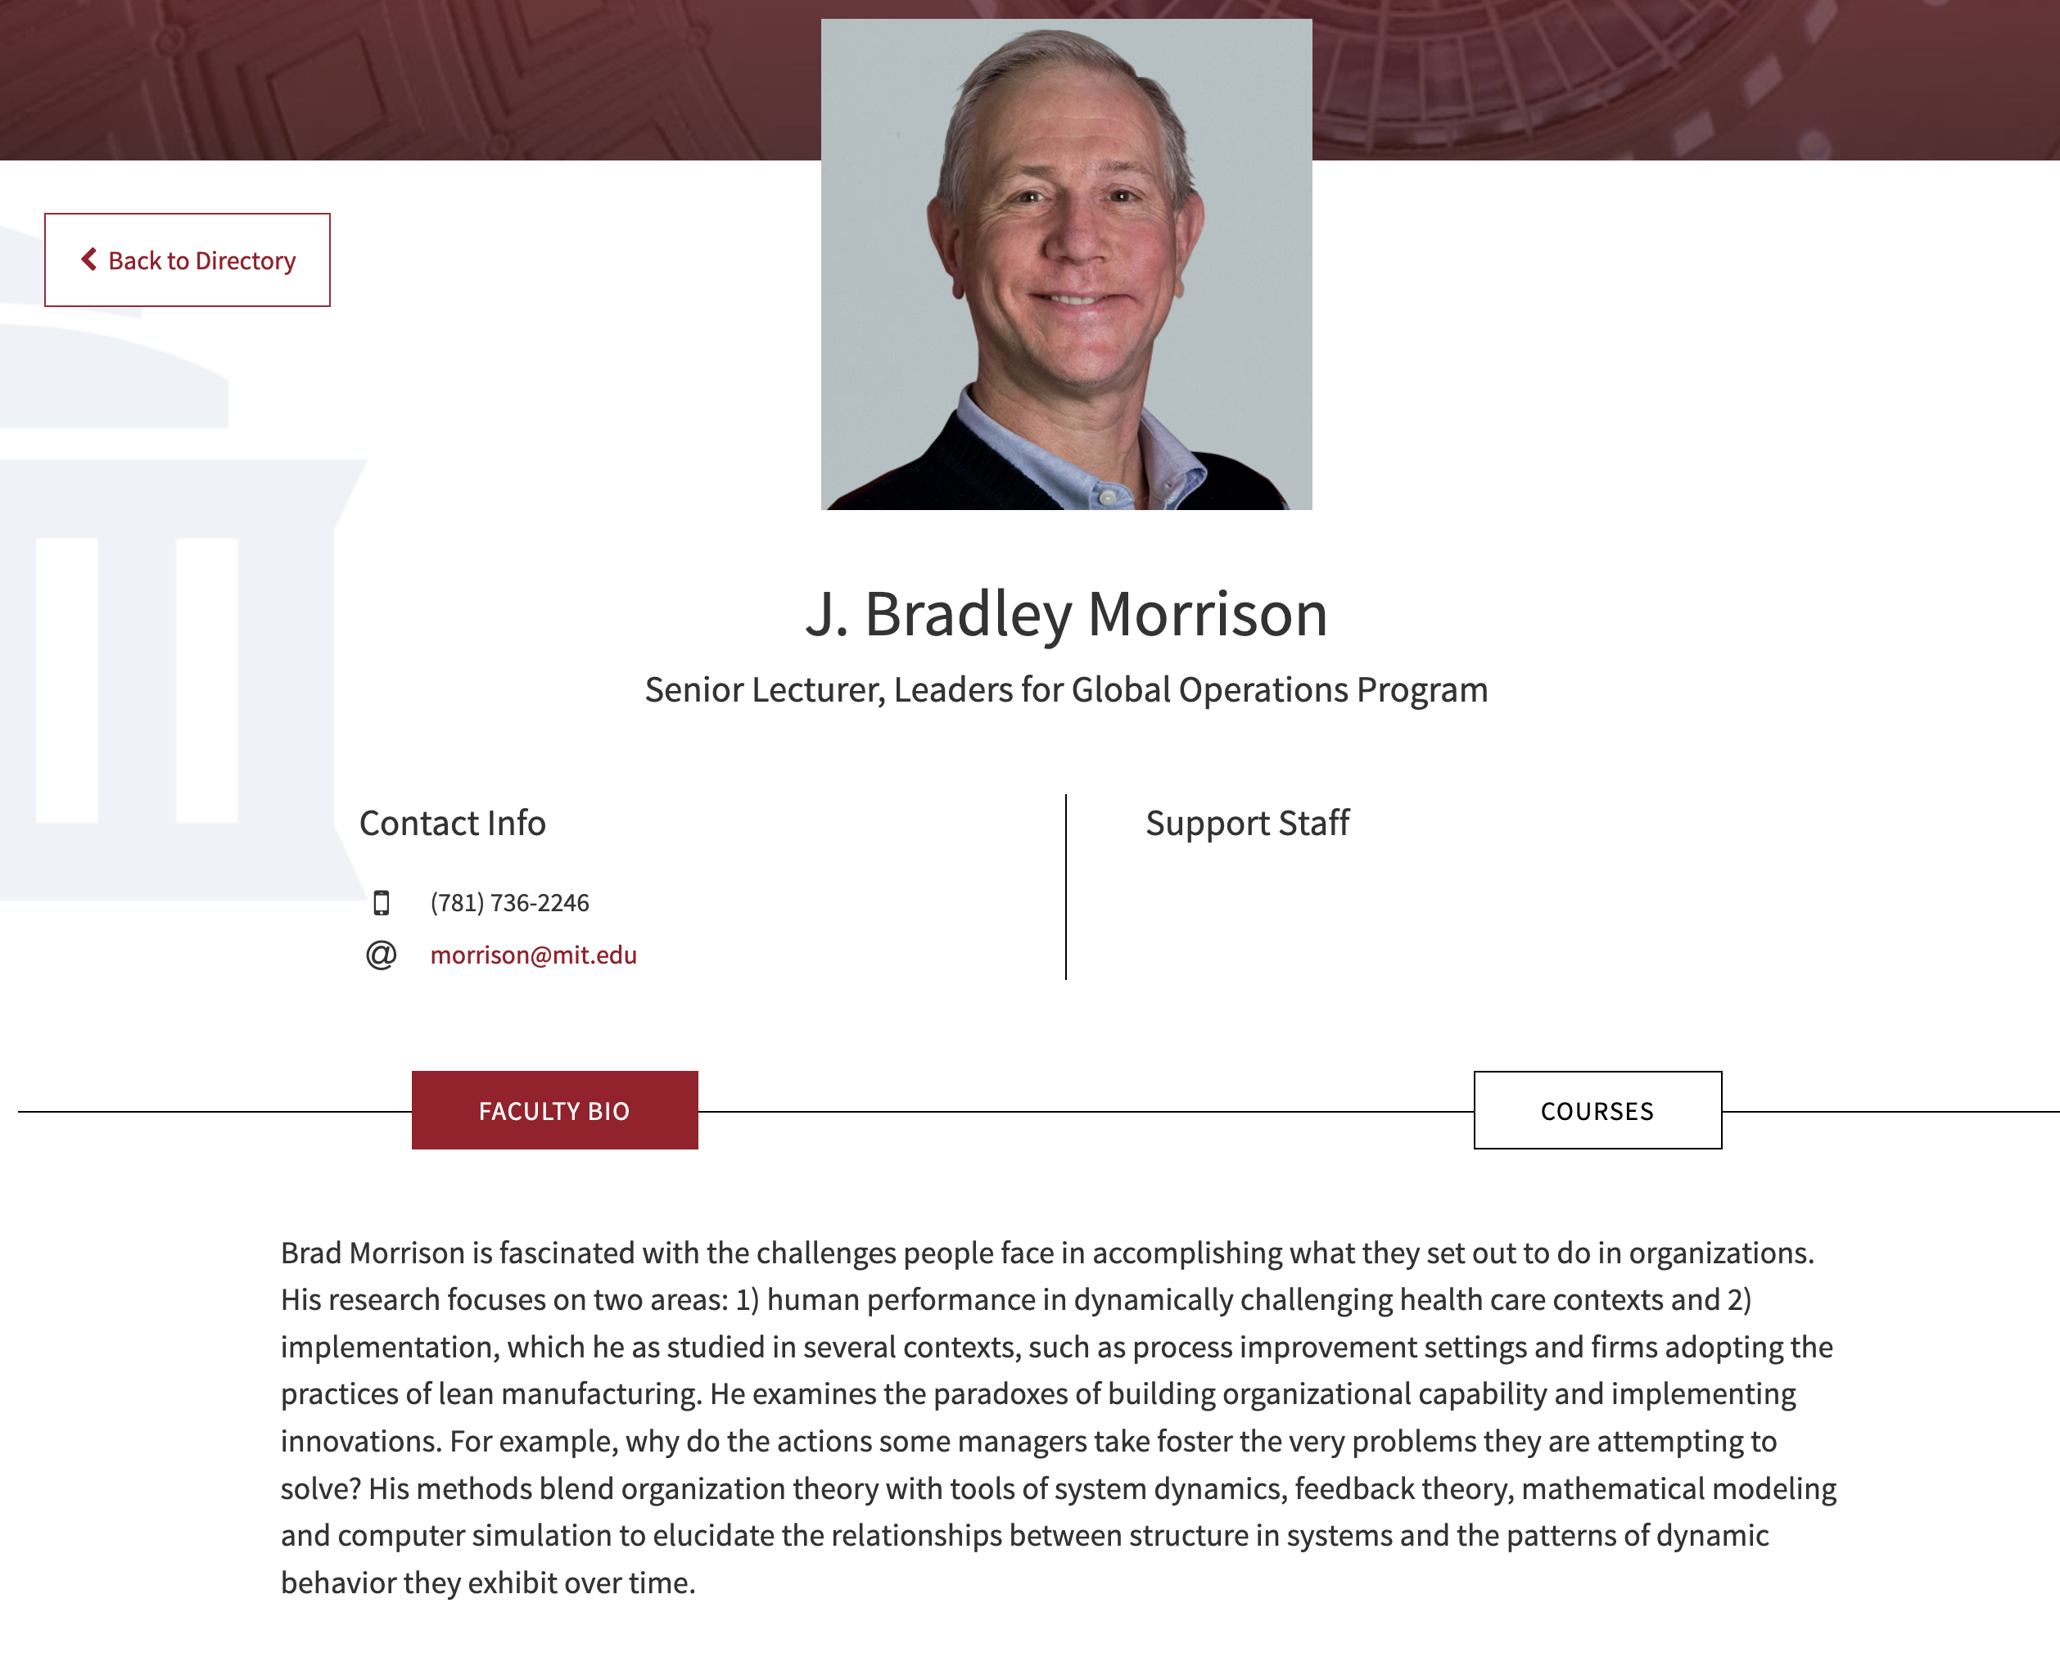
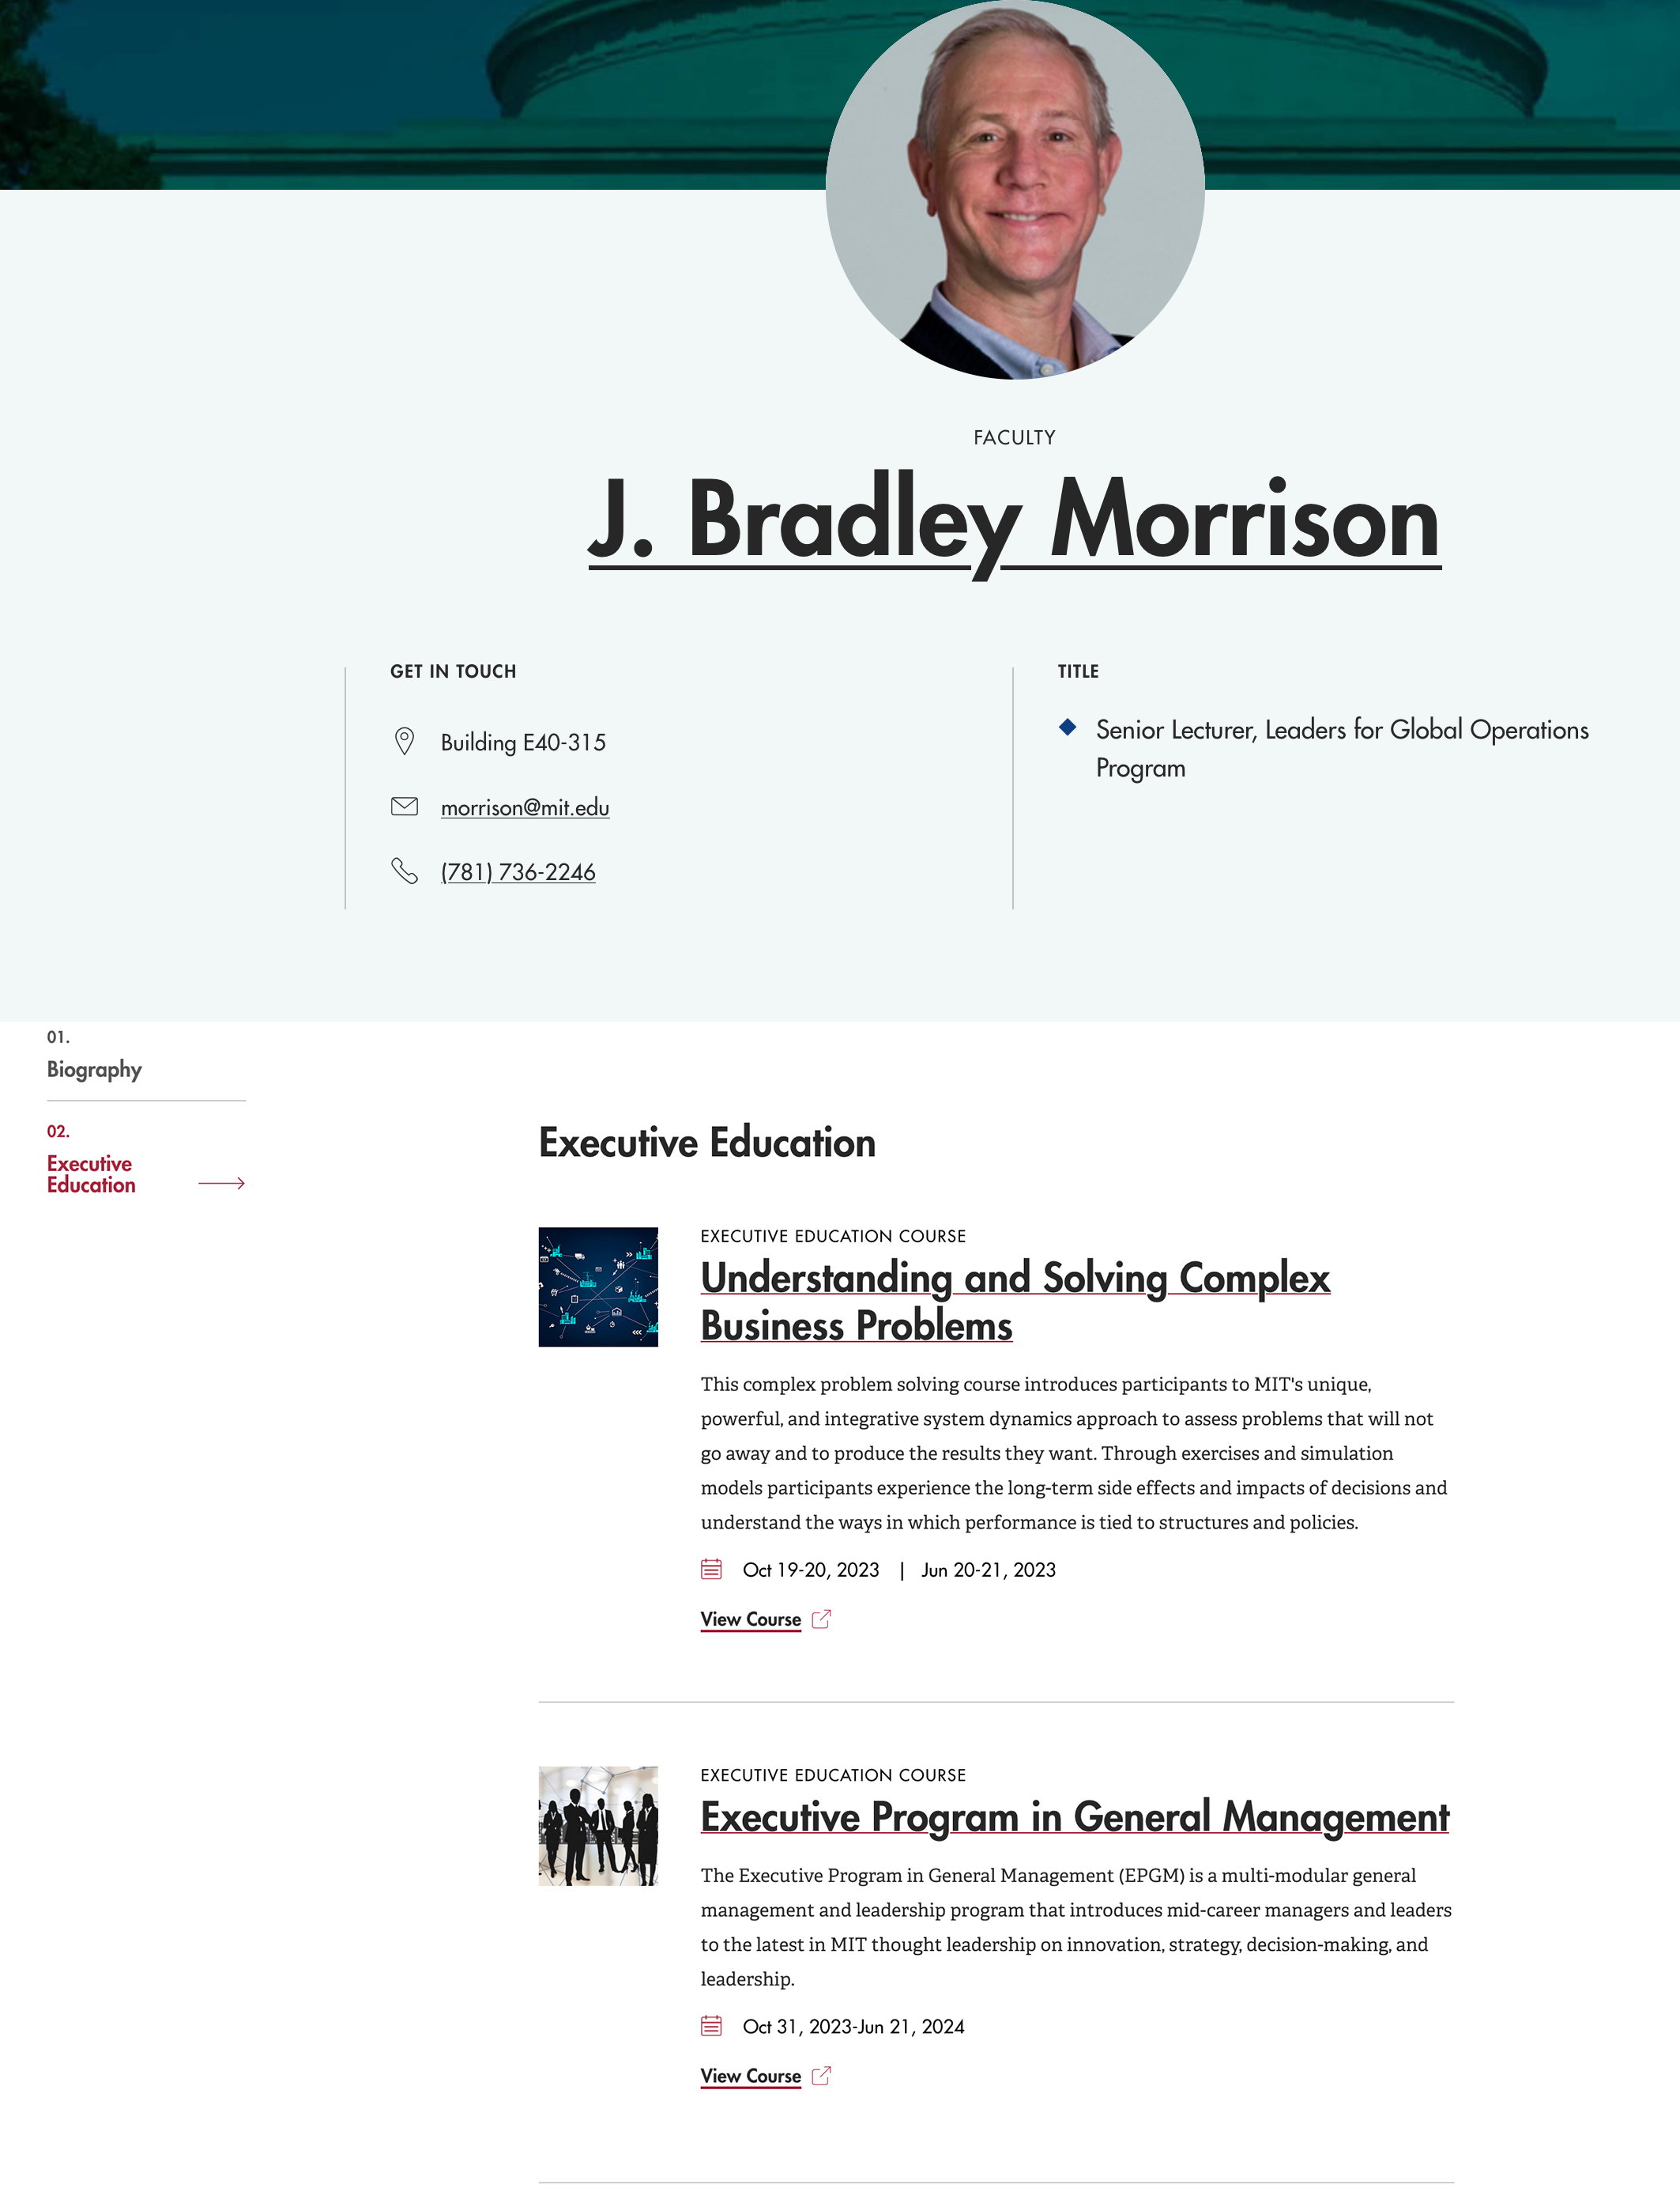
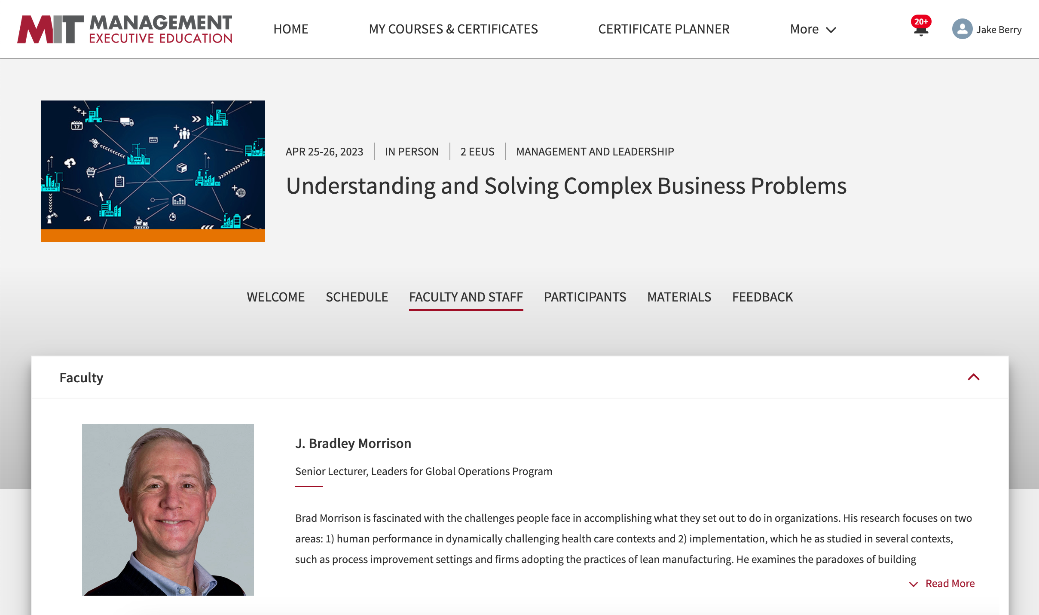

Slide 11
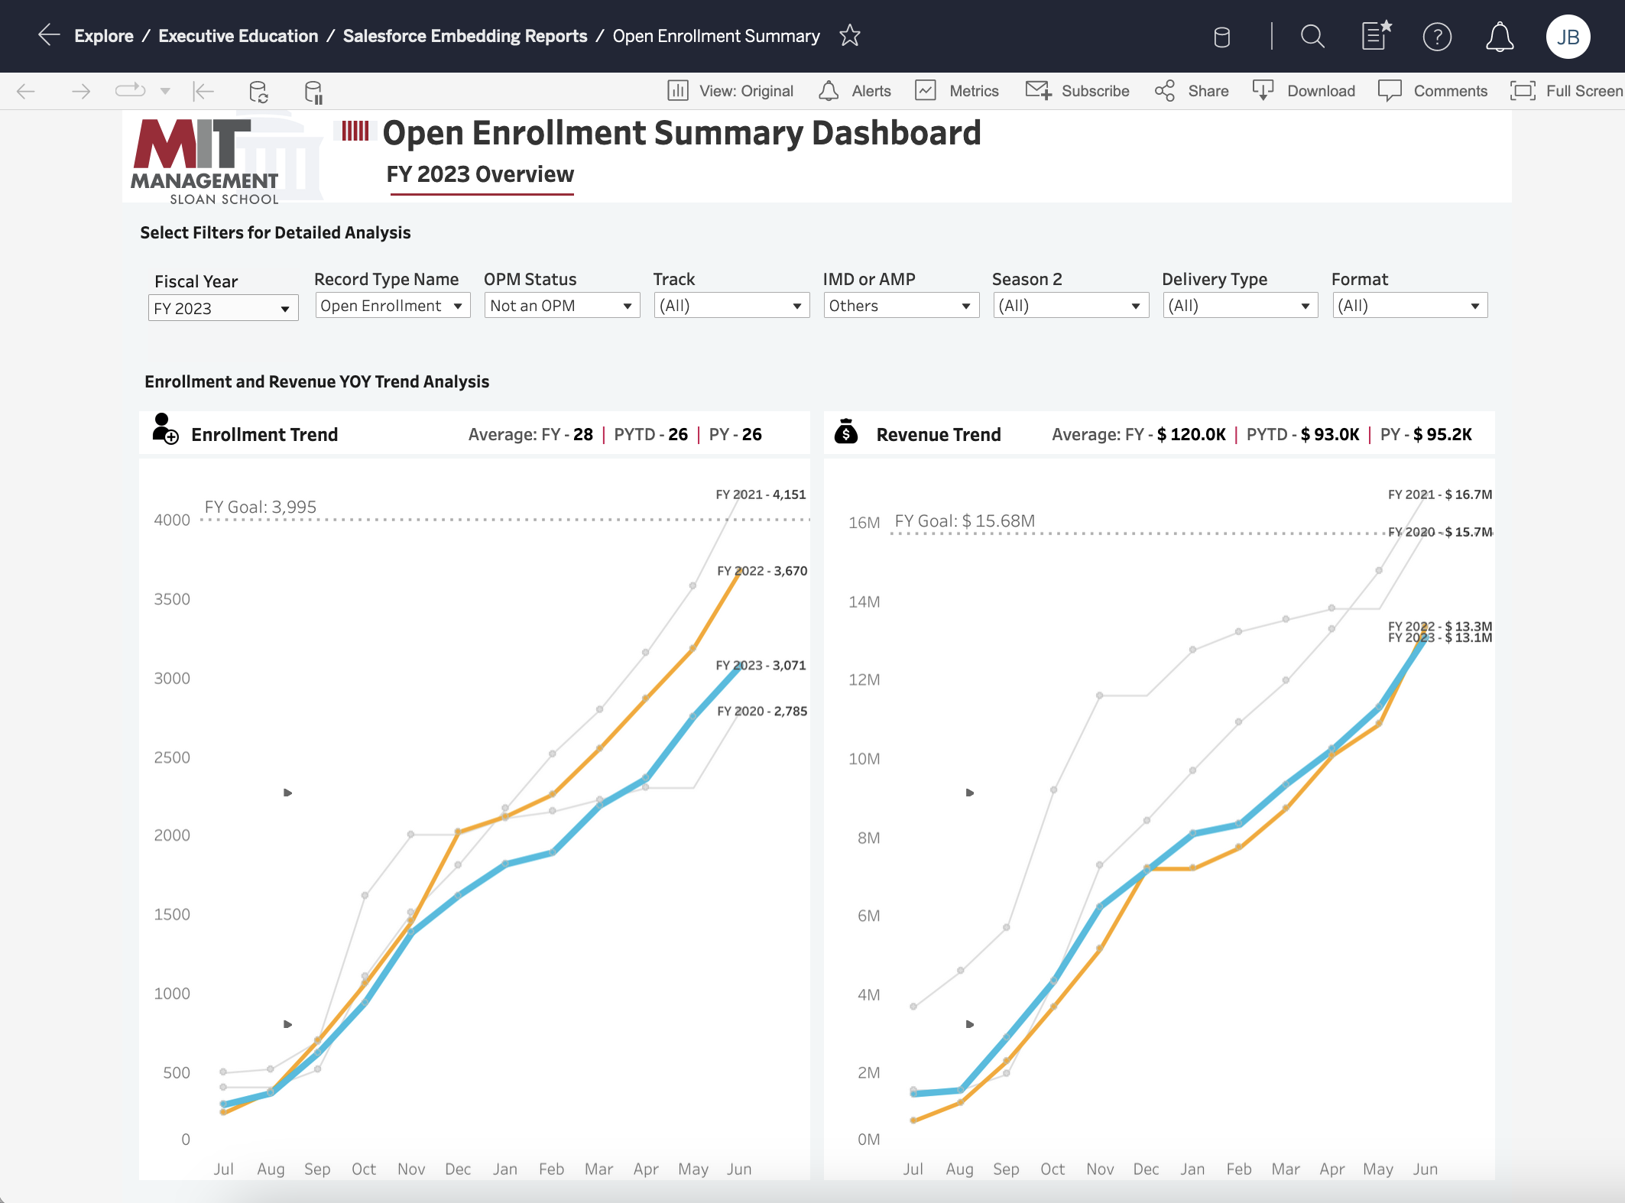
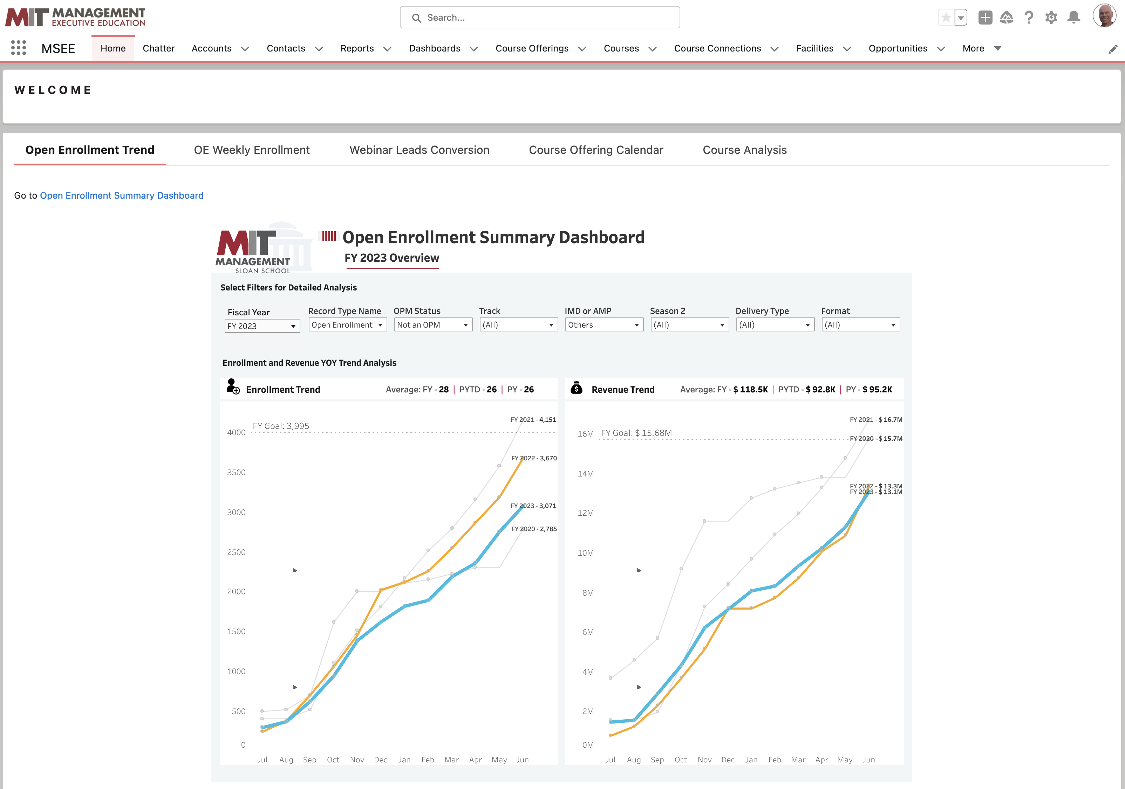

Slide 12
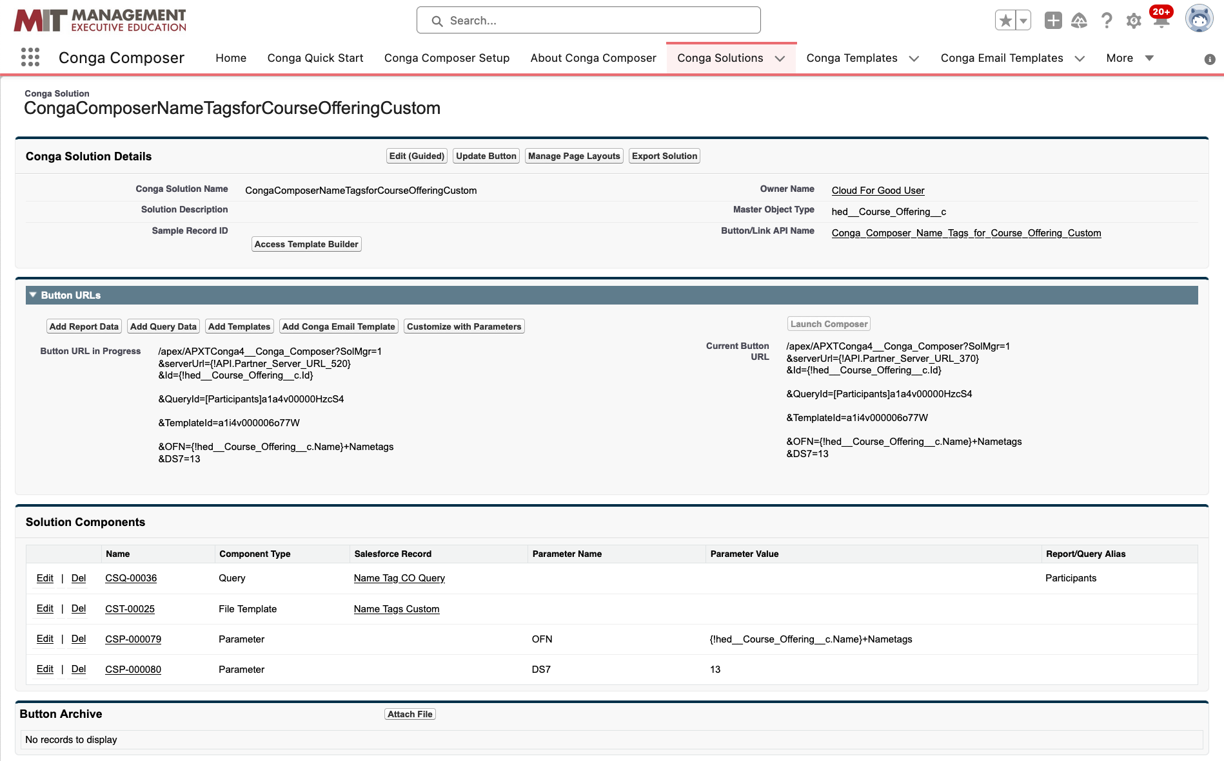
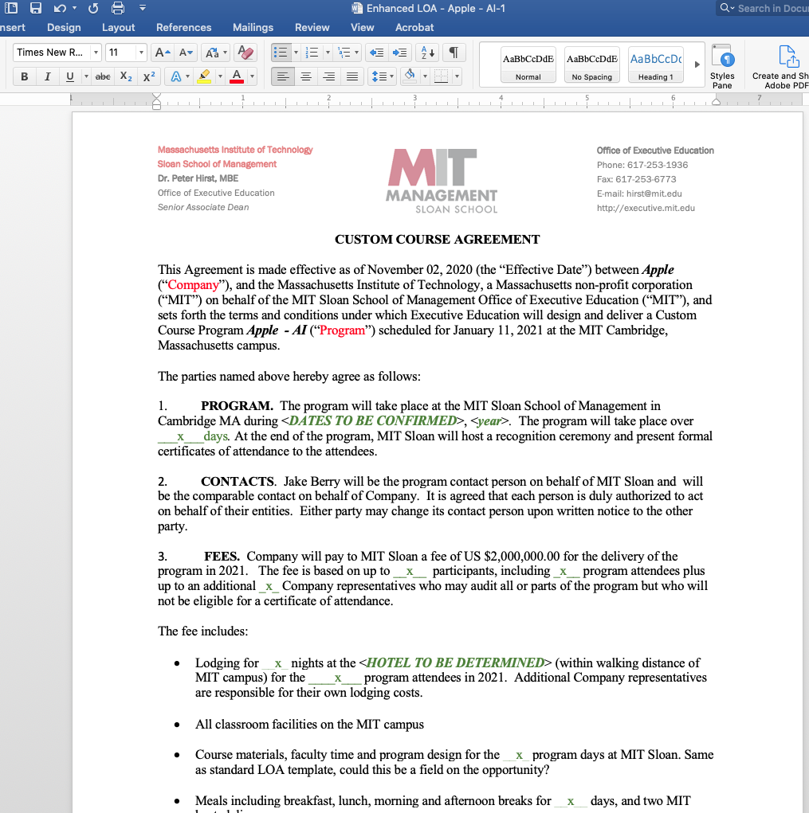
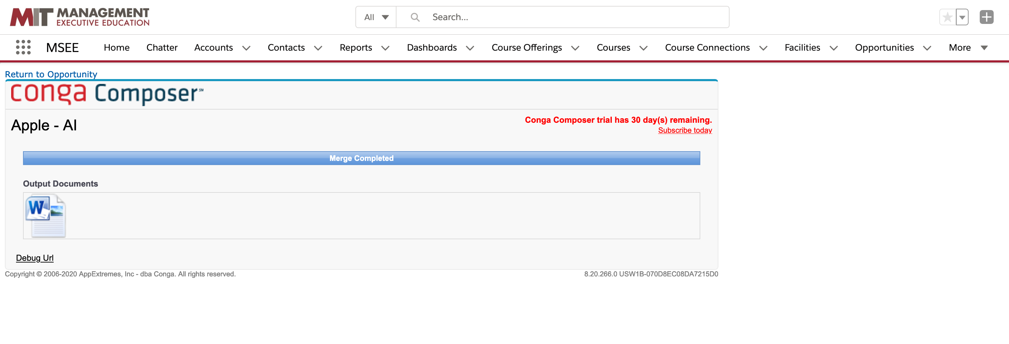
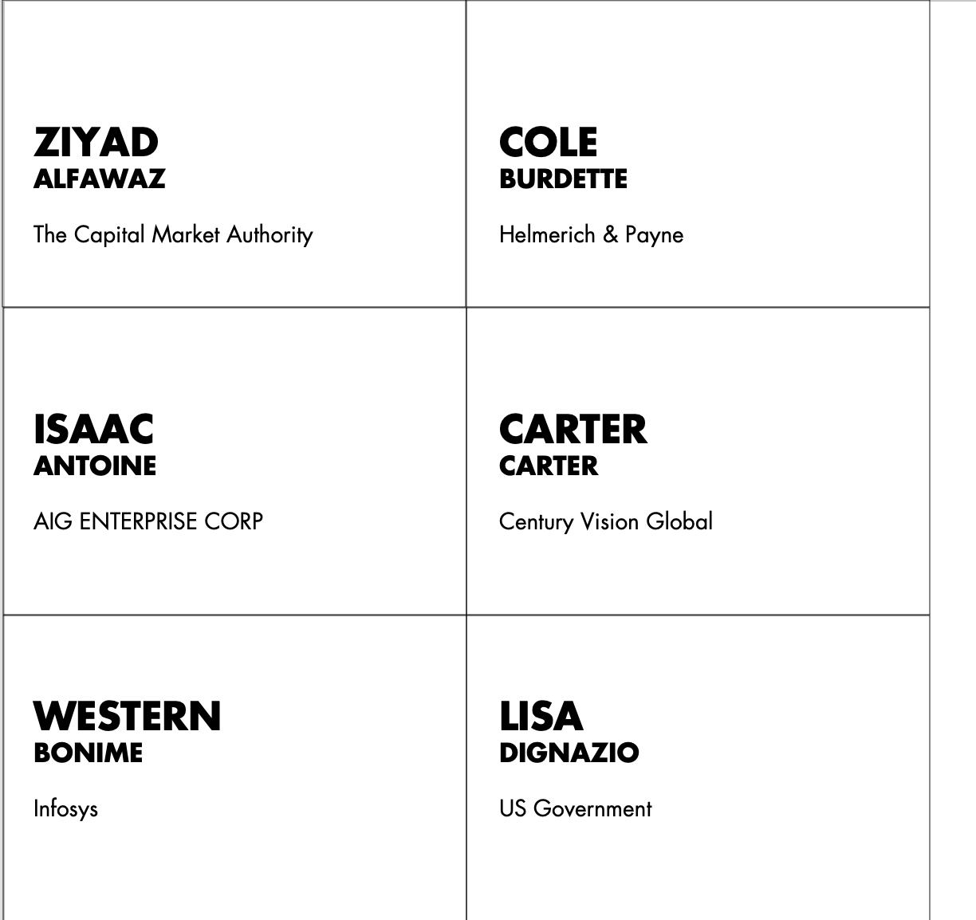
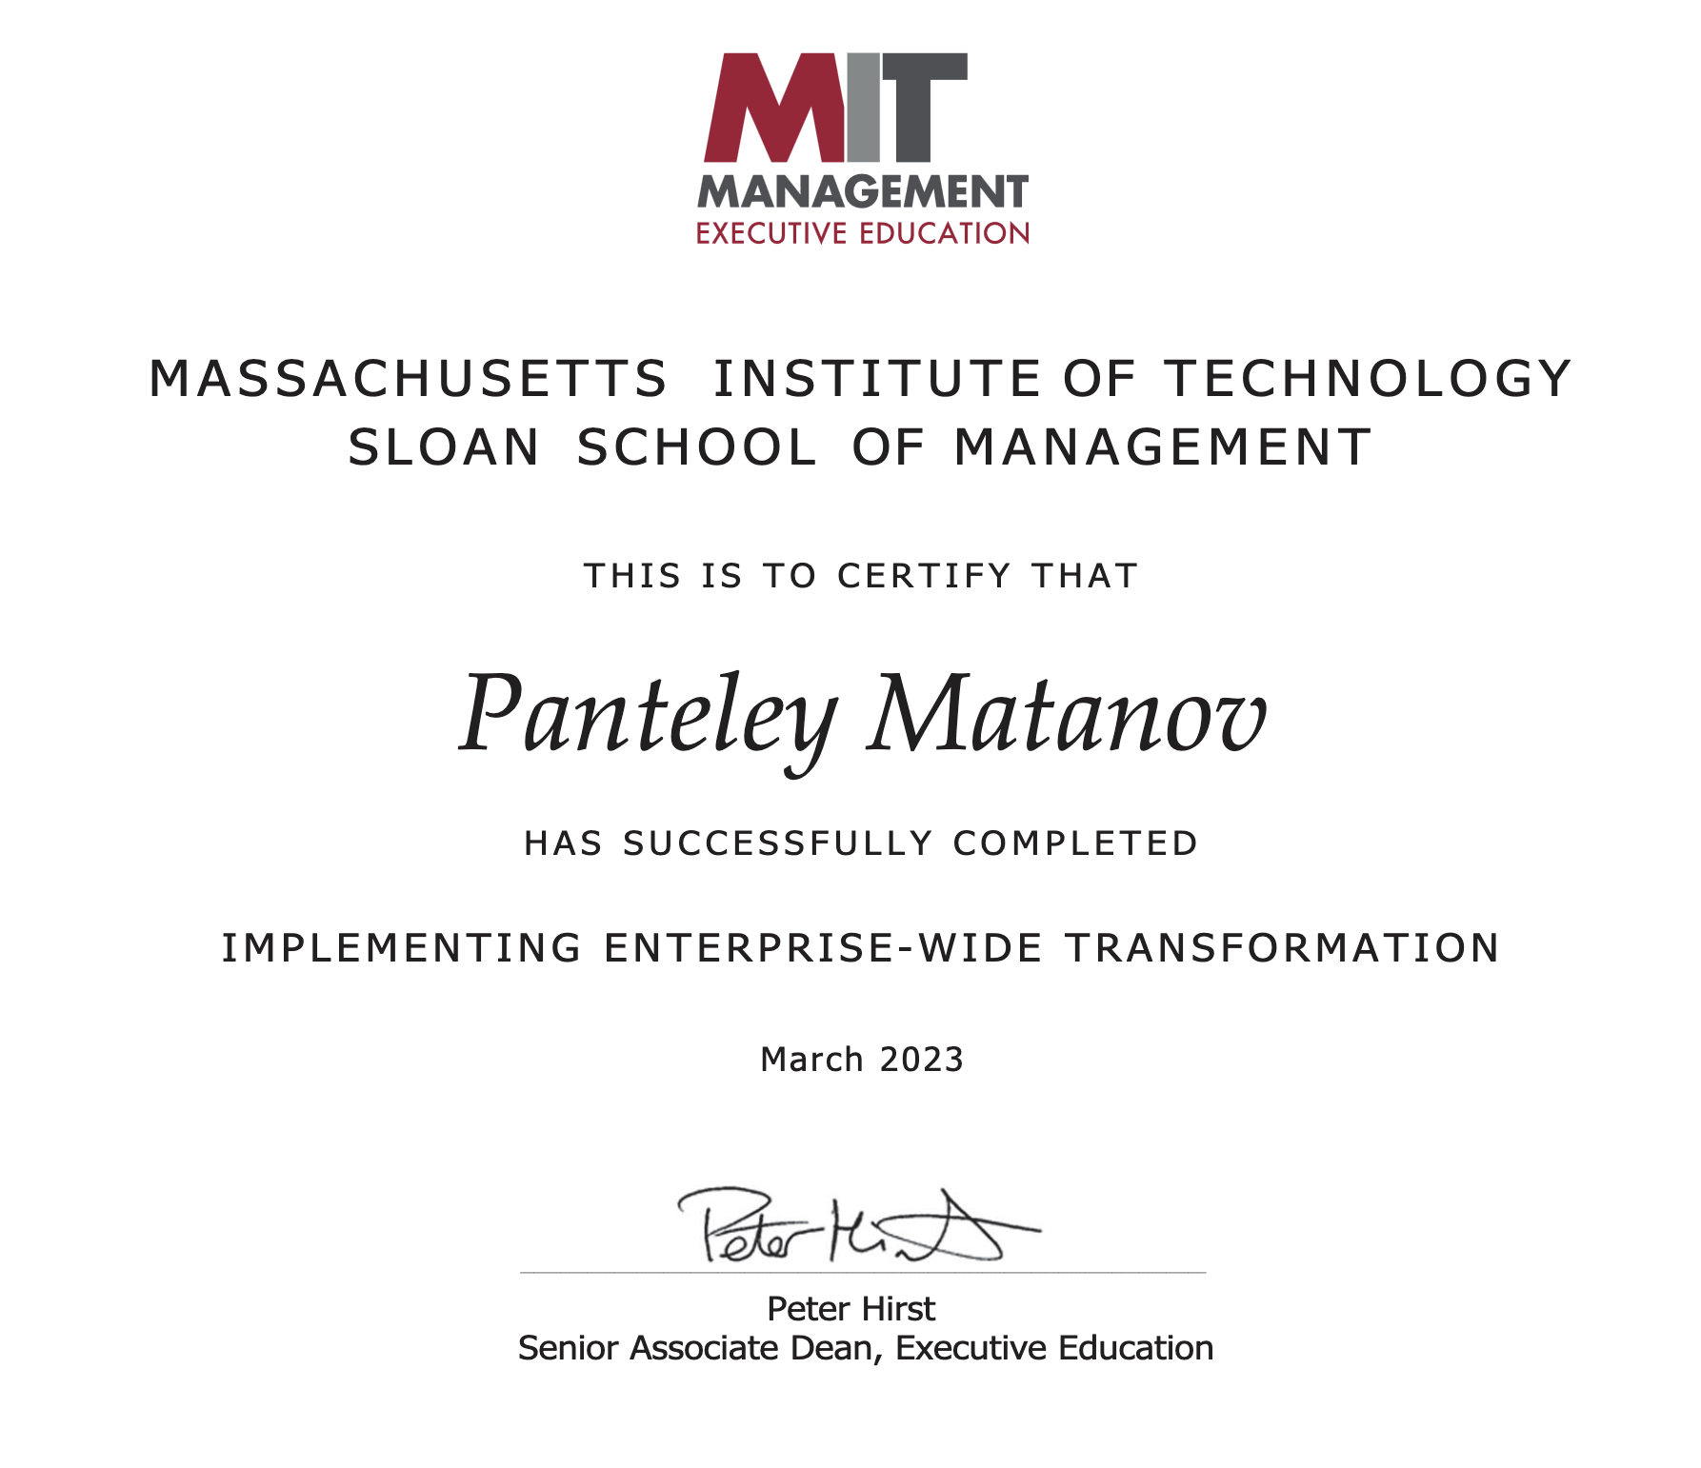

Slide 13
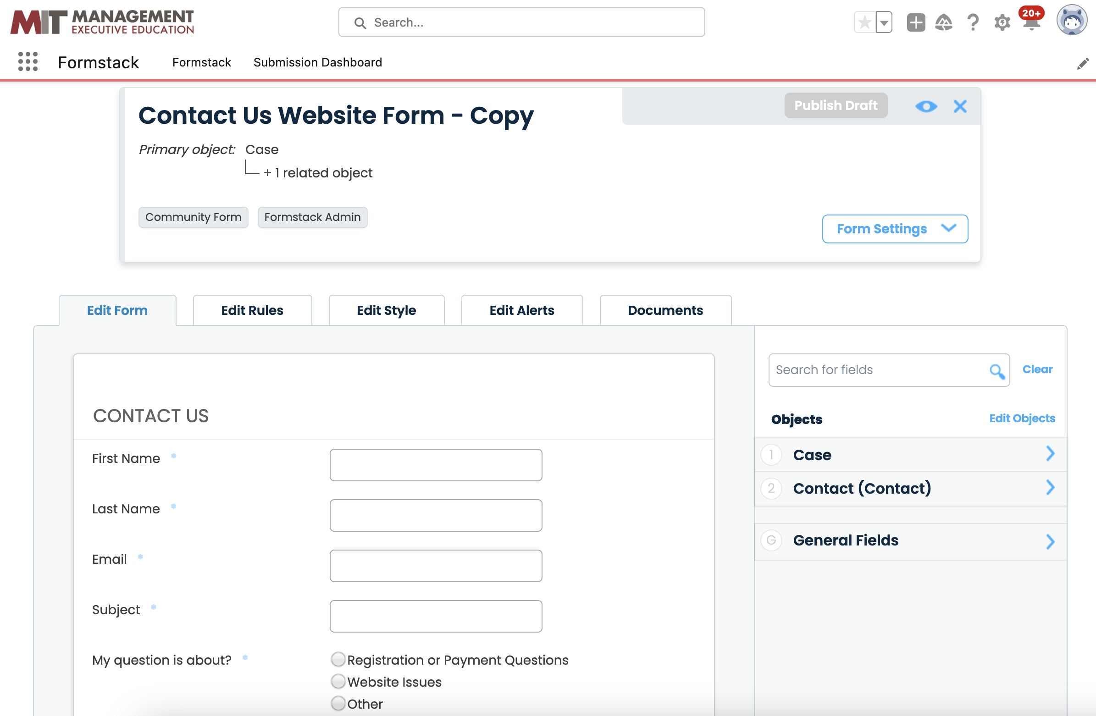
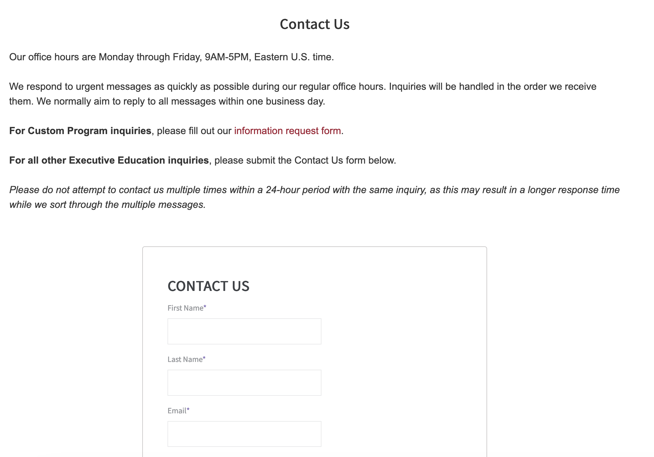

Slide 14
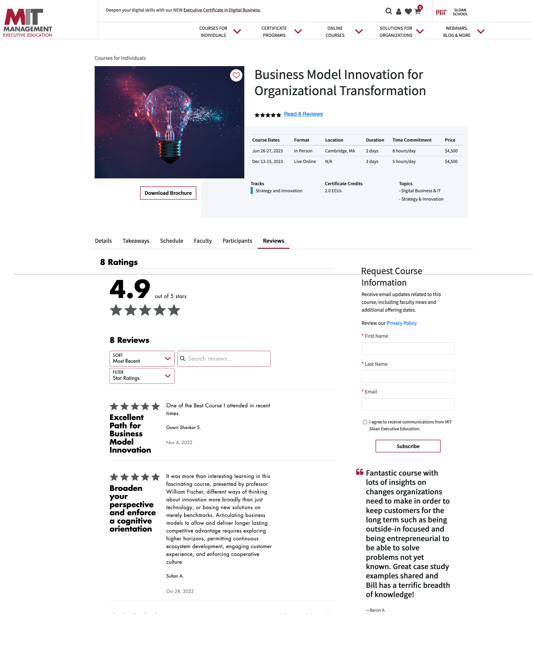
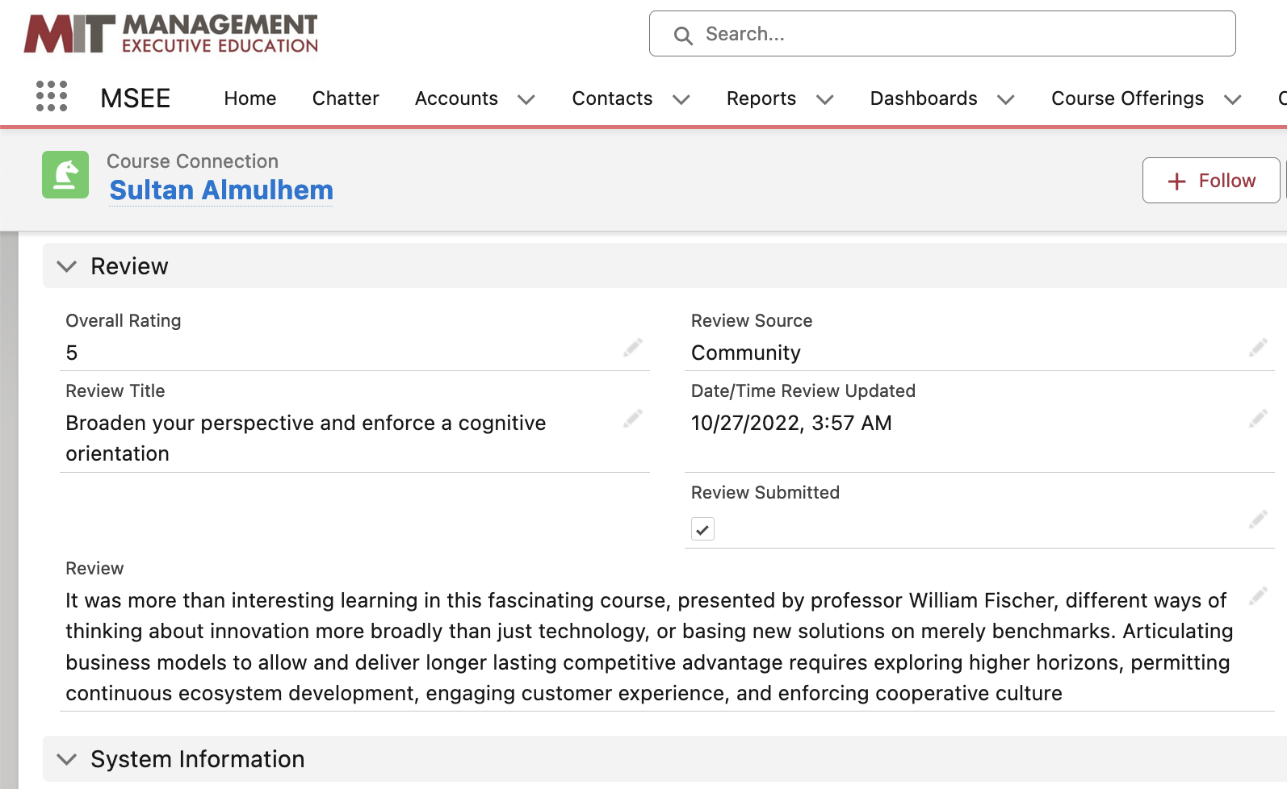

Slide 15
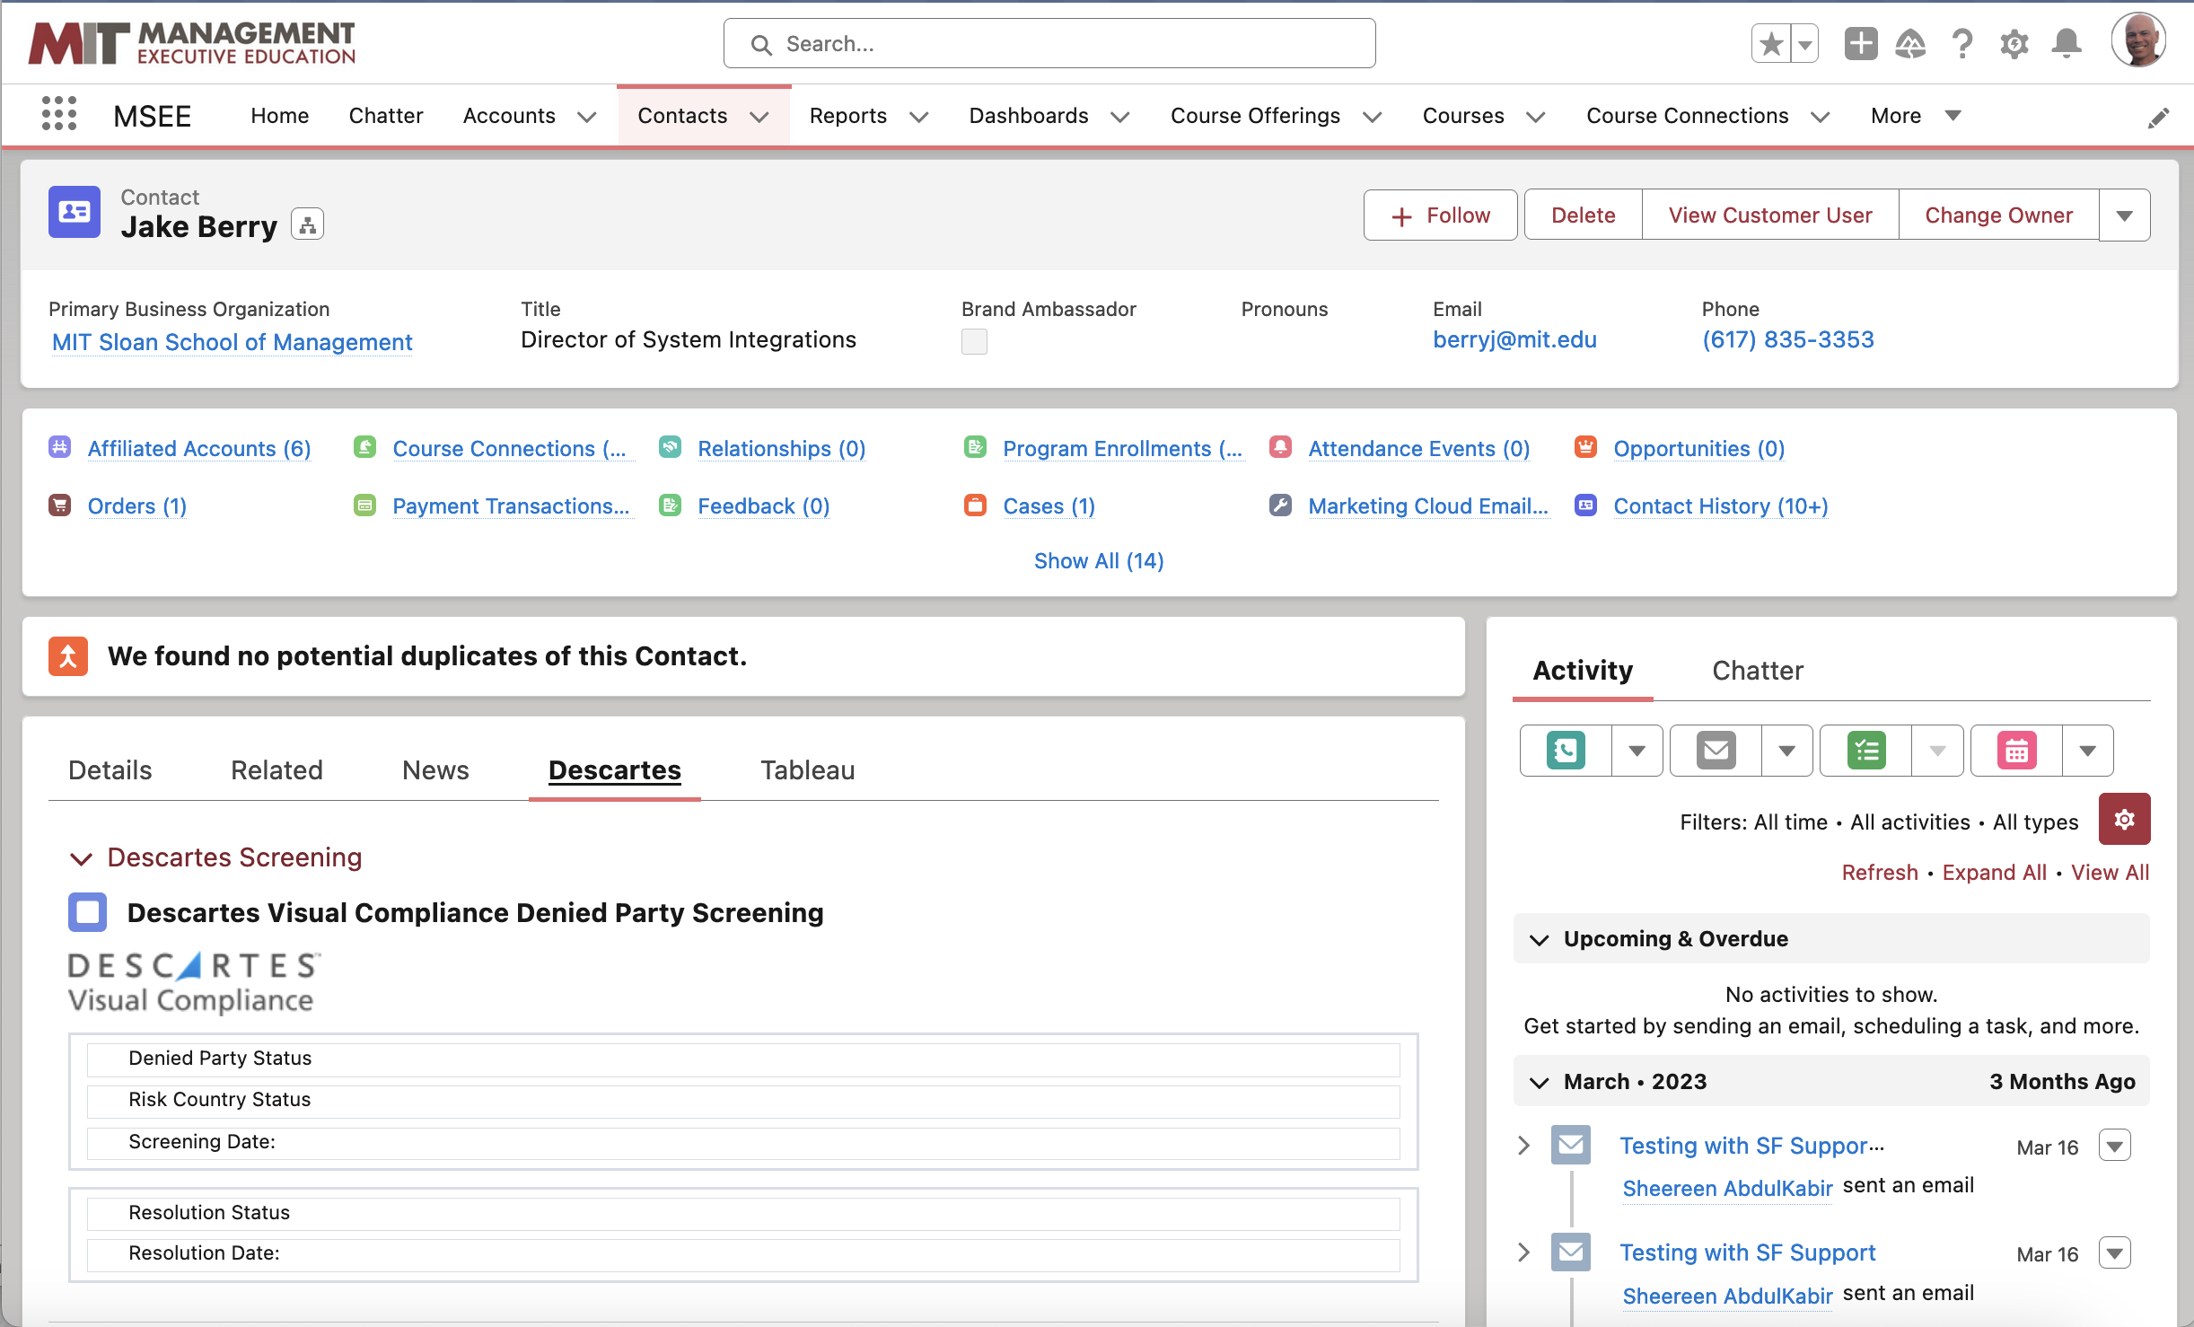

Slide 16
What does it take to keep the system running?
2 full-time Salesforce system admins (internal)
1 part-time technical project manager (contactor)
1 full-time Commerce Cloud developer (contactor off-shore)
1 full-time Salesforce developer (contactor off-shore)
1 Part-time (20 hours/week) Marketing Cloud developer (contactor off-shore)
1 Part-time (10 hours/week) MuleSoft developer (contactor off-shore)
1 Part-time (10 hours/week) Tableau developer (contactor off-shore)

Slide 17



Vendors we use

Slide 18
What You Should Know
Salesforce will say “Seamless Integration Between All Products”….It’s not even close to true.
Search, SEO and out of the box components in Experience Cloud have limited functionality. Plan on extensive customization.
MuleSoft just announced a new starter package this spring which provides a very cost effective option for individual business units.
Post launch will require significant support and the support staff should ideally be part of the implementation process.
The more you customize Salesforce, the more support staff you will need.
If it all possible, modify your business process, not the software

Slide 19
Thank You!
Feel free to reach out with any questions.
Jake Berry
Software Implementation and Integration Consultant
berryj@mit.edu
www.linkedin.com/in/jakeberry

