Slide 1


Slide 2
Why Process Street
Monitoring
As tasks are completed, the process moves onto the next step automatically
We have full audit and reporting around current and completed workflows
Notifications and handoffs are automated through Process Street
Entire processes are managed and run through Process Street
Integrations with SharePoint, DocuSign, Slack, and other applications
Users can check their Process Street Inbox to see what’s assigned to them and due dates
Automation
Integration

Slide 3
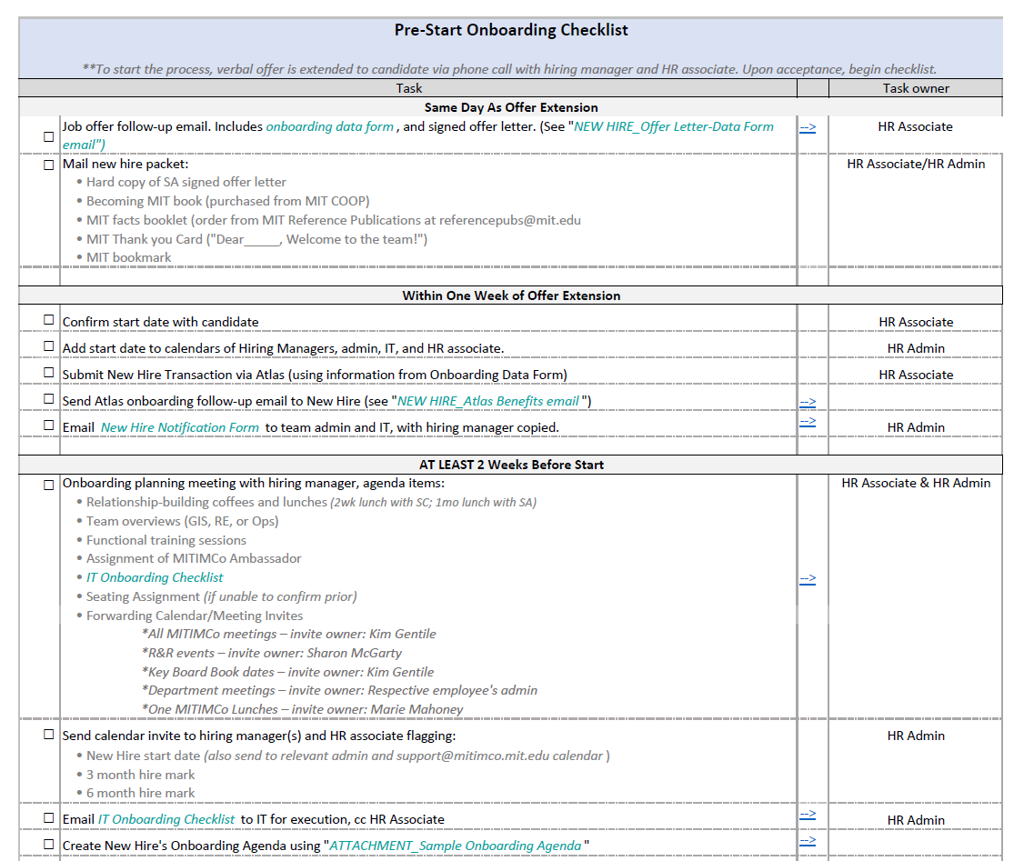
HR onboarding and offboarding
  The old system
    Not very dynamic
    Not collaborative
    Little to no systems integration

Slide 4
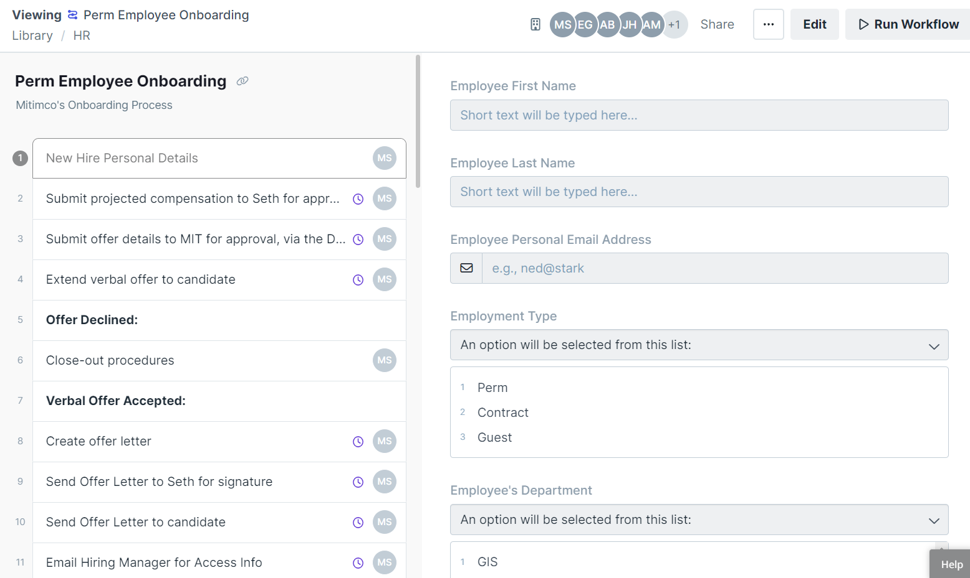
HR onboarding and offboarding
  The new system with Process Street

Slide 5
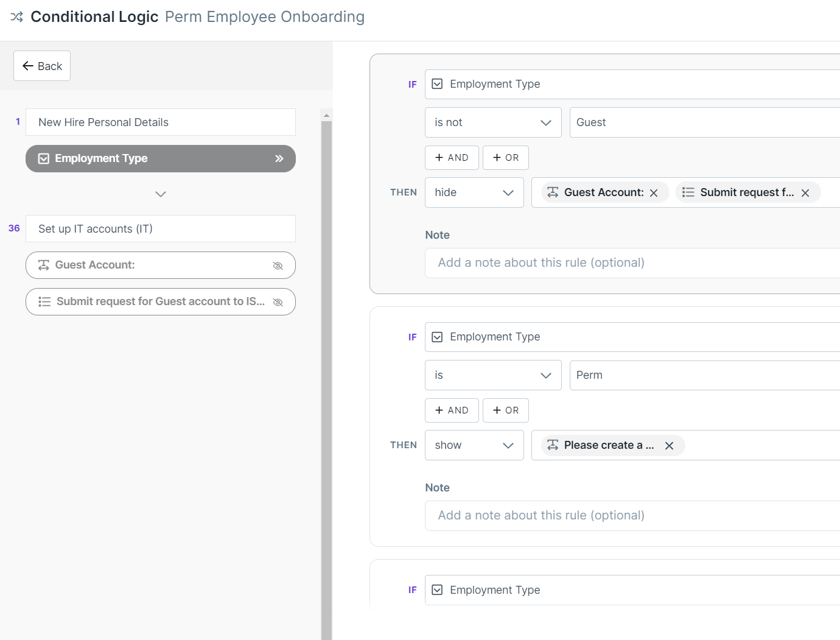
Benefits
    Conditional formatting (ex: staff vs temp vs transfer)
    Data capture and feeding
    Template emails
    Fast editing to update the process

Slide 6
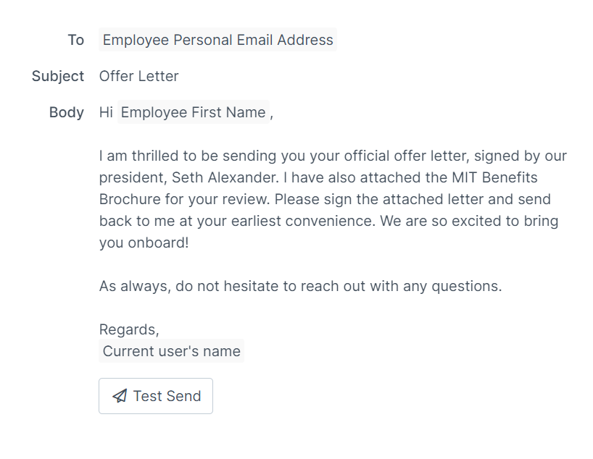
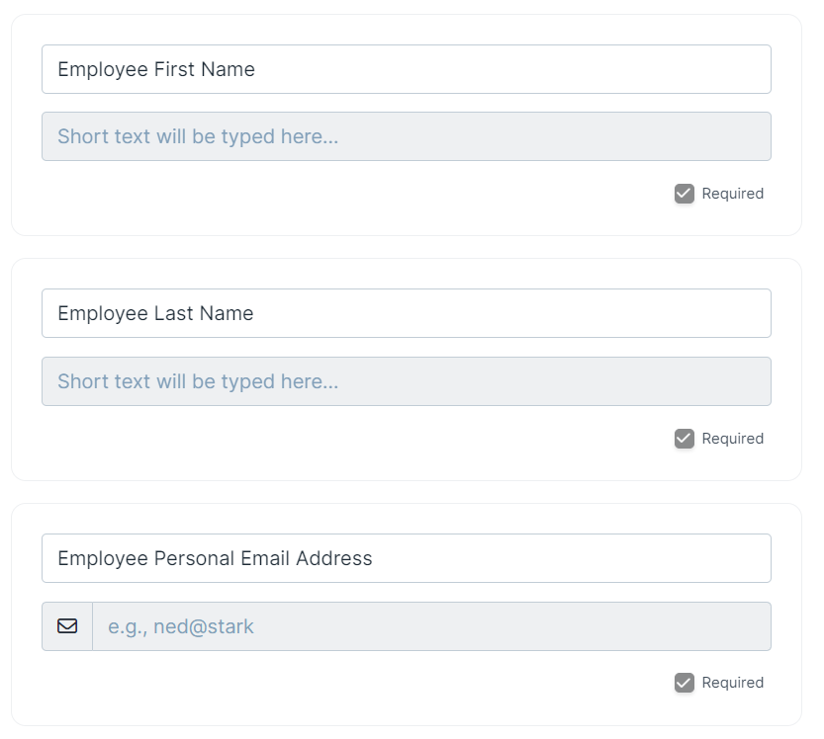
Benefits
    Conditional formatting (ex: staff vs temp vs transfer)
    Data capture and feeding
    Template emails
    Fast editing to update the process

Slide 7
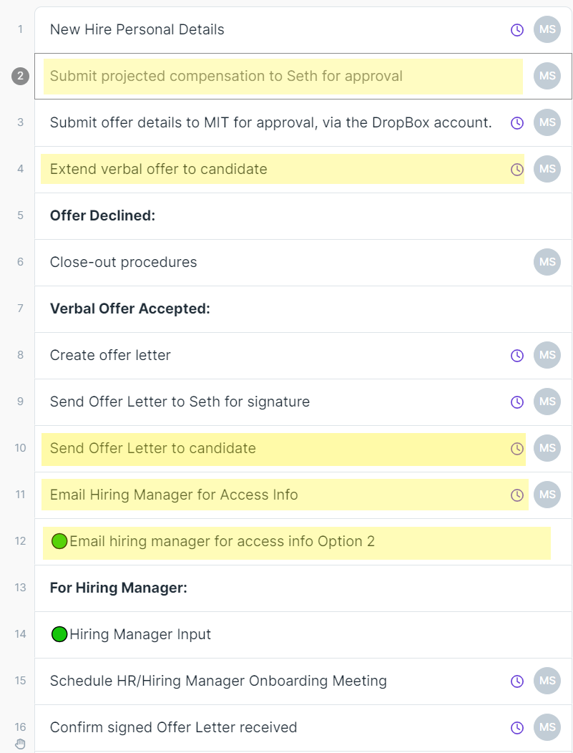
Benefits
    Conditional formatting (ex: staff vs temp vs transfer)
    Data capture and feeding
    Template emails
    Fast editing to update the process

Slide 8
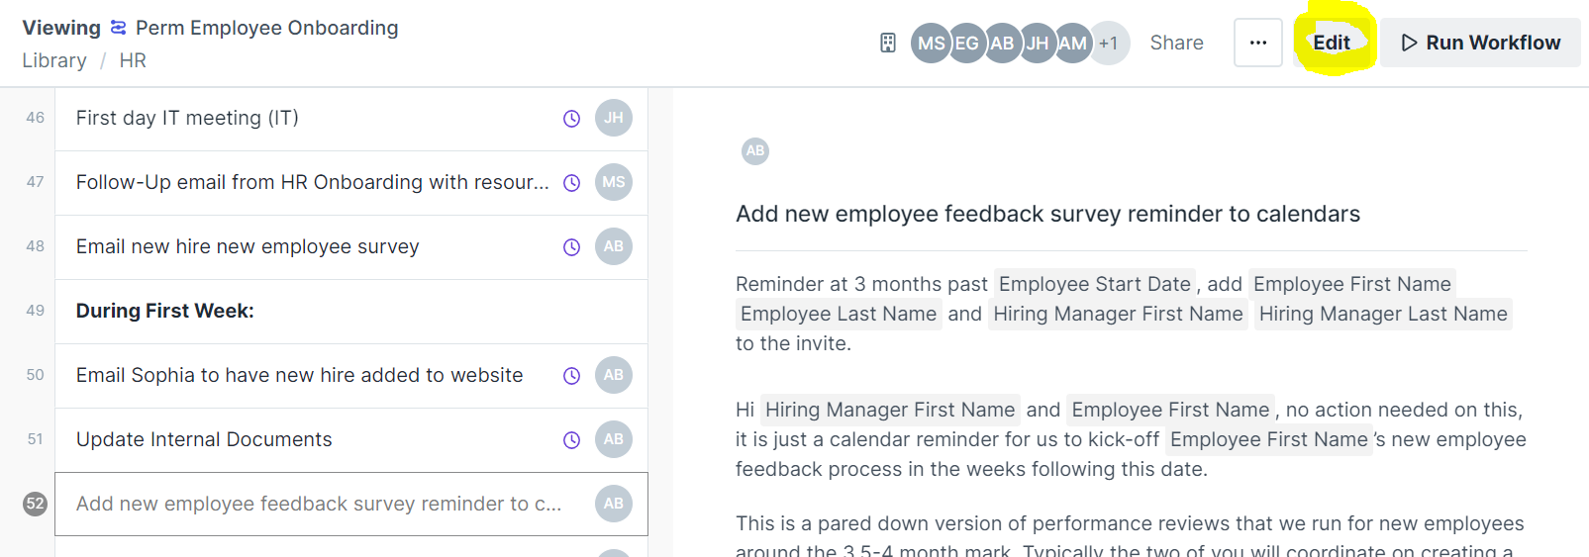
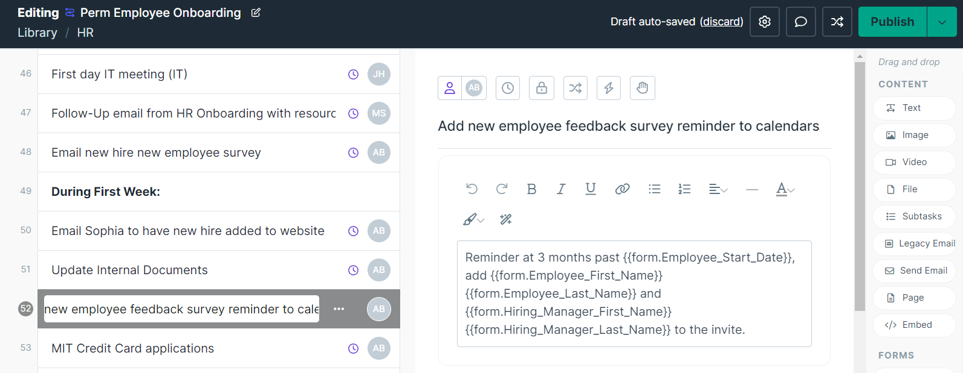
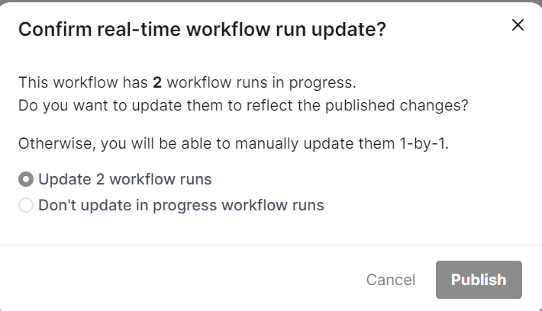
Benefits
    Conditional formatting (ex: staff vs temp vs transfer)
    Data capture and feeding
    Template emails
    Fast editing to update the process

Slide 9
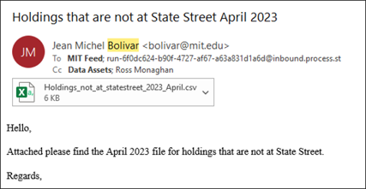
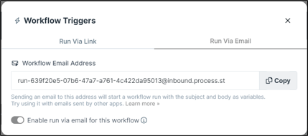
Data Reporting
    Email Triggers
    Due Dates
    Stop Tasks
    Automated Email Sends

Slide 10
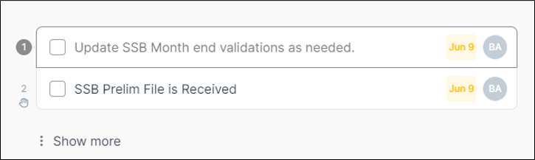
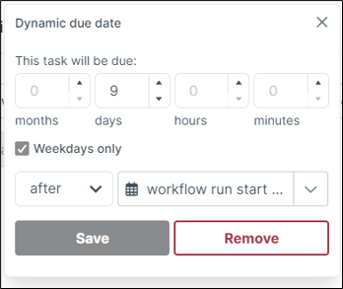
Data Reporting
    Email Triggers
    Due Dates
    Stop Tasks
    Automated Email Sends

Slide 11
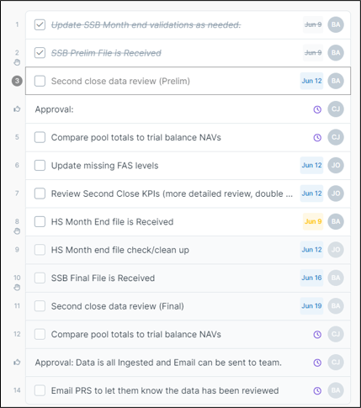
Data Reporting
    Email Triggers
    Due Dates
    Stop Tasks
    Automated Email Sends

Slide 12
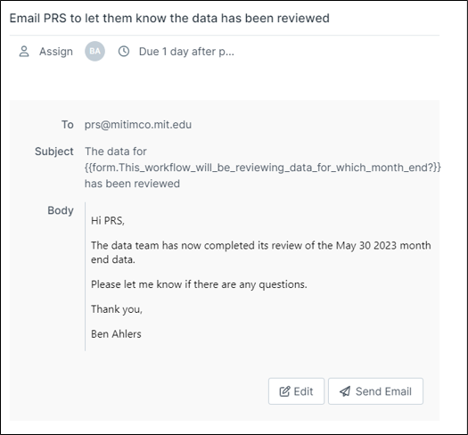
Data Reporting
    Email Triggers
    Due Dates
    Stop Tasks
    Automated Email Sends

Slide 13
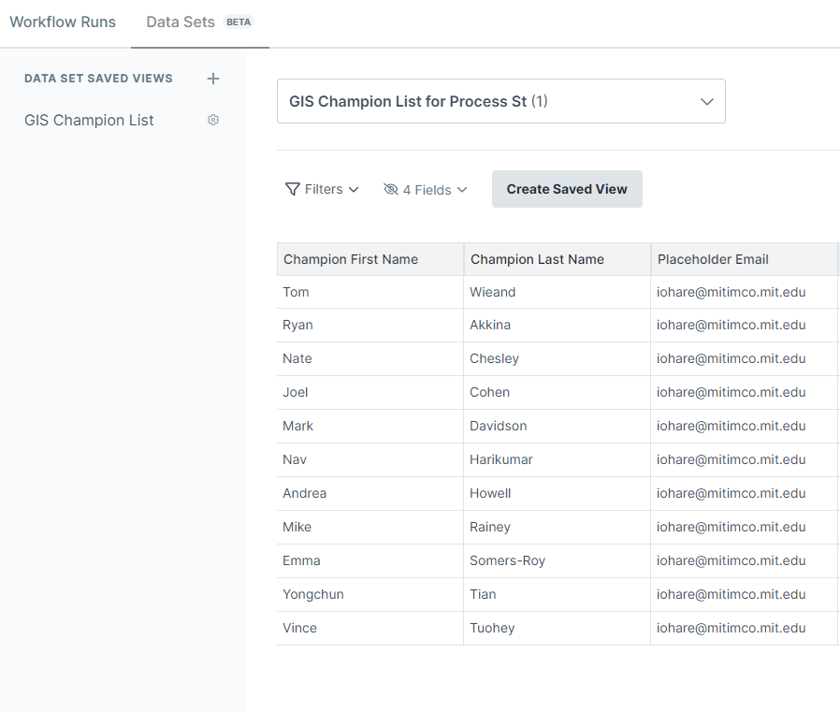
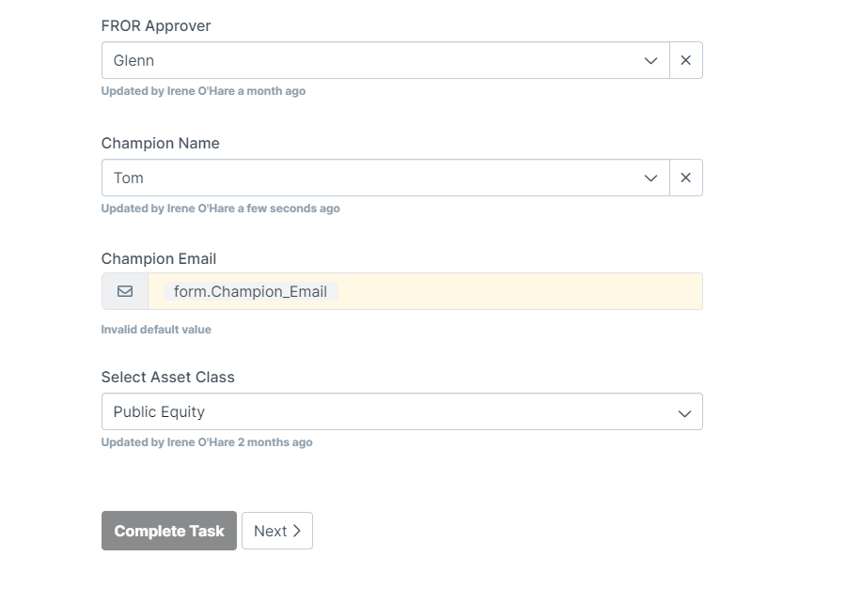
Investment Due Diligence
    Data Sets
    DocuSign Integration
    Slack Integration

Slide 14
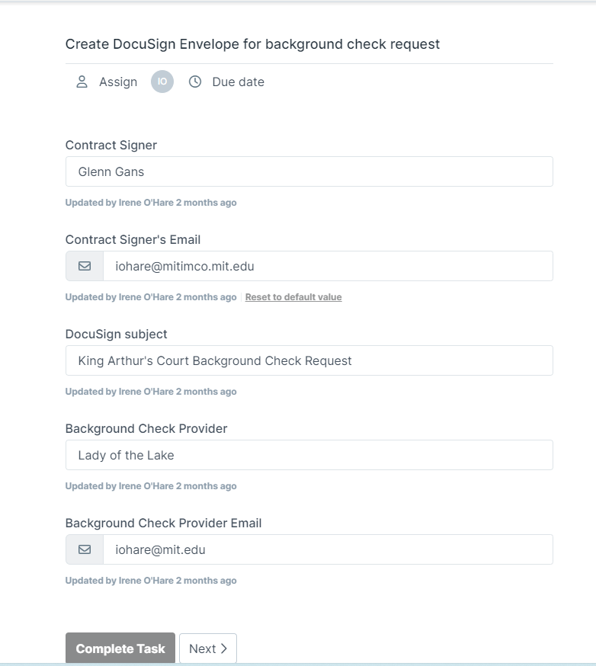
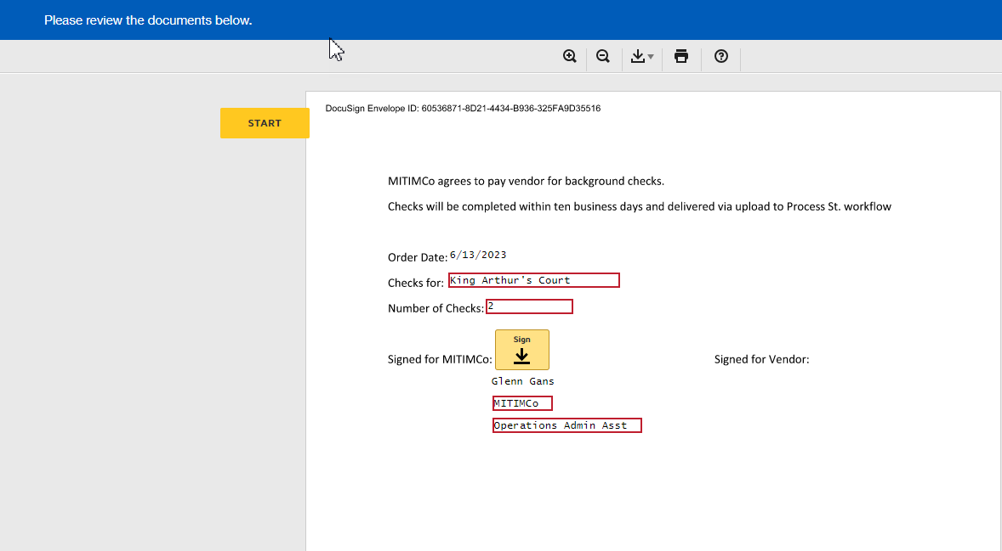
Investment Due Diligence
    Data Sets
    DocuSign Integration
    Slack Integration

Slide 15
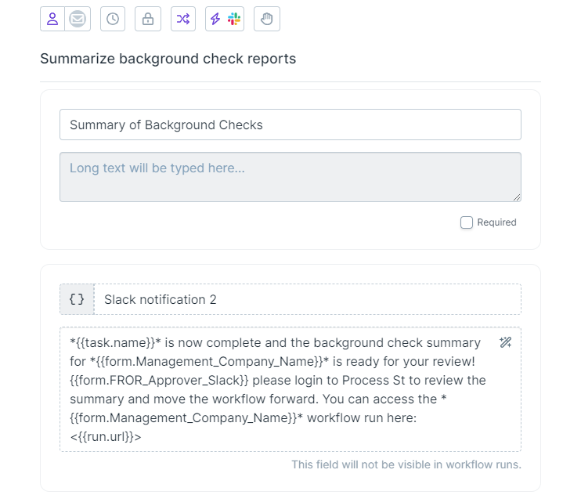
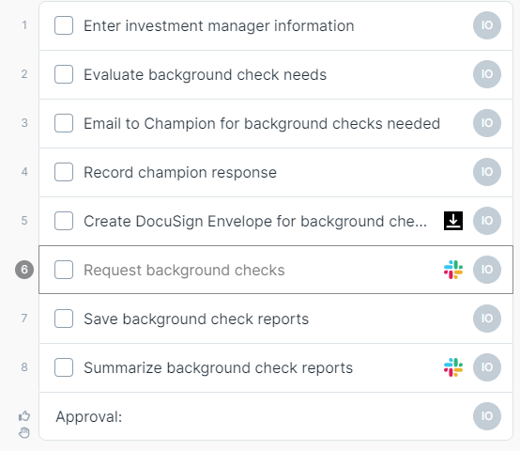
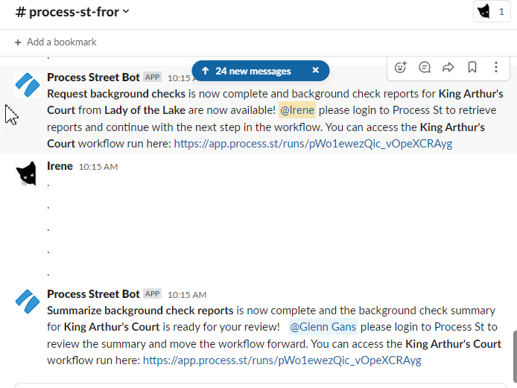
Investment Due Diligence
    Data Sets
    DocuSign Integration
    Slack Integration

Slide 16
Automation with PowerAutomate + API
Kick Off Lease Abstract Process
Prepare Lease Abstract
Review and Comment on Lease Abstract
Revise Lease Abstract
Approve Lease Abstract
Complete Post-Approval Tasks
Lease Abstract Administrator
Abstractor/Property Manager
Reviewer(s) who initially rejected
If they continue to have additional comments, this step loops back to the Abstractor
Notifies Abstractor/Property Manager that there are comments
Reviews comments and updates lease abstract
Review and approve

Slide 17
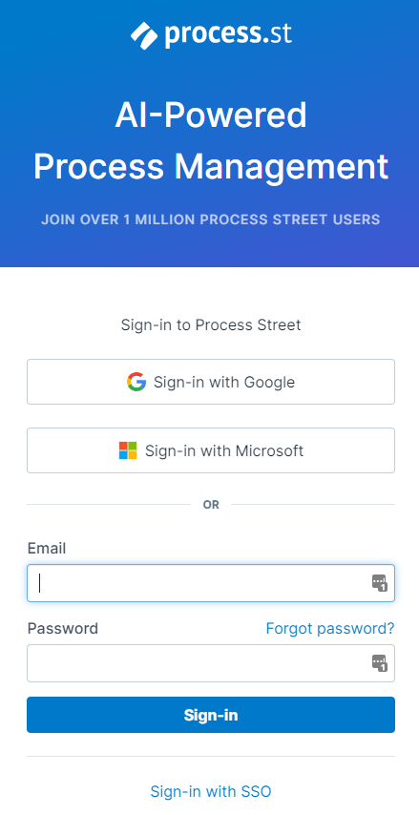
Permissions
    SSO vs username/password
    Groups, and members vs guests
    Permission levels
External users
MITIMCo users

Slide 18
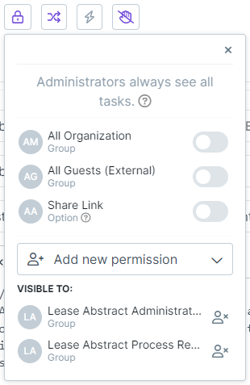
Permissions
    SSO vs username/password
    Groups, and members vs guests
    Permission levels

Slide 19
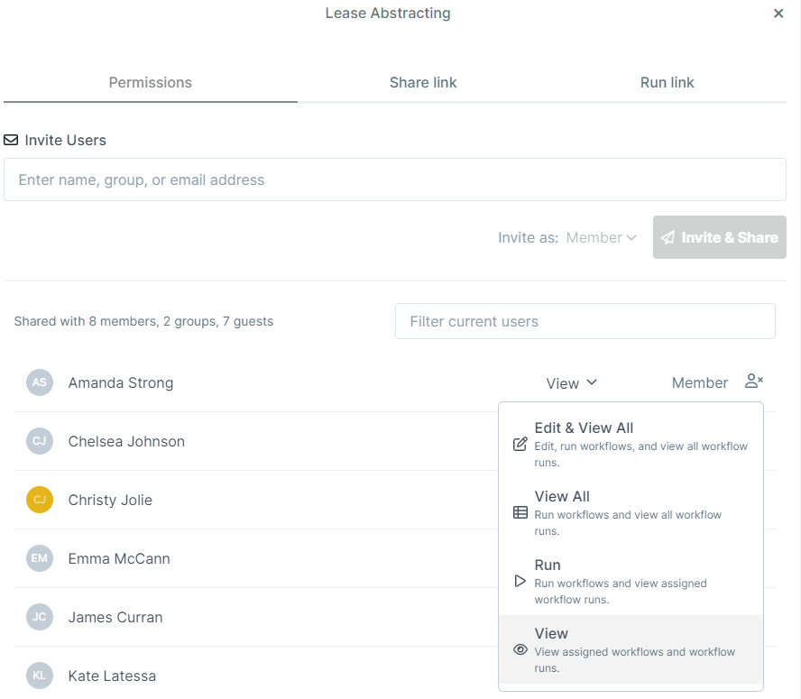
Permissions
    SSO vs username/password
    Groups, and members vs guests
    Permission levels

Slide 20
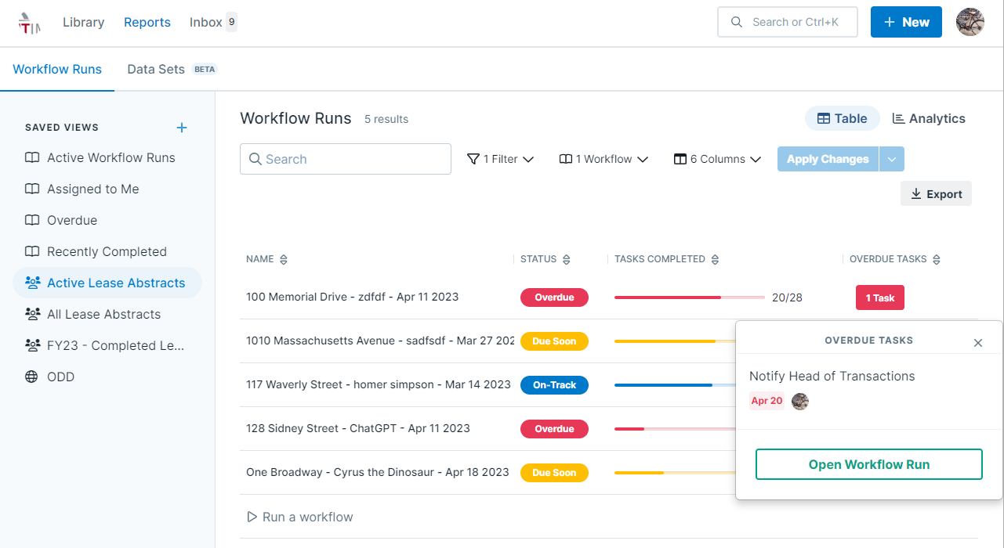
Reporting
    Summary tables
    Click-through to detail
    Exports

Slide 21
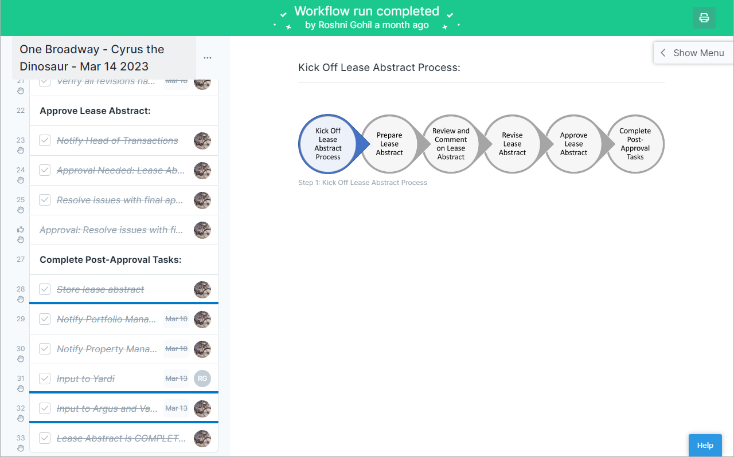
Reporting
    Summary tables
    Click-through to detail
    Exports

Slide 22
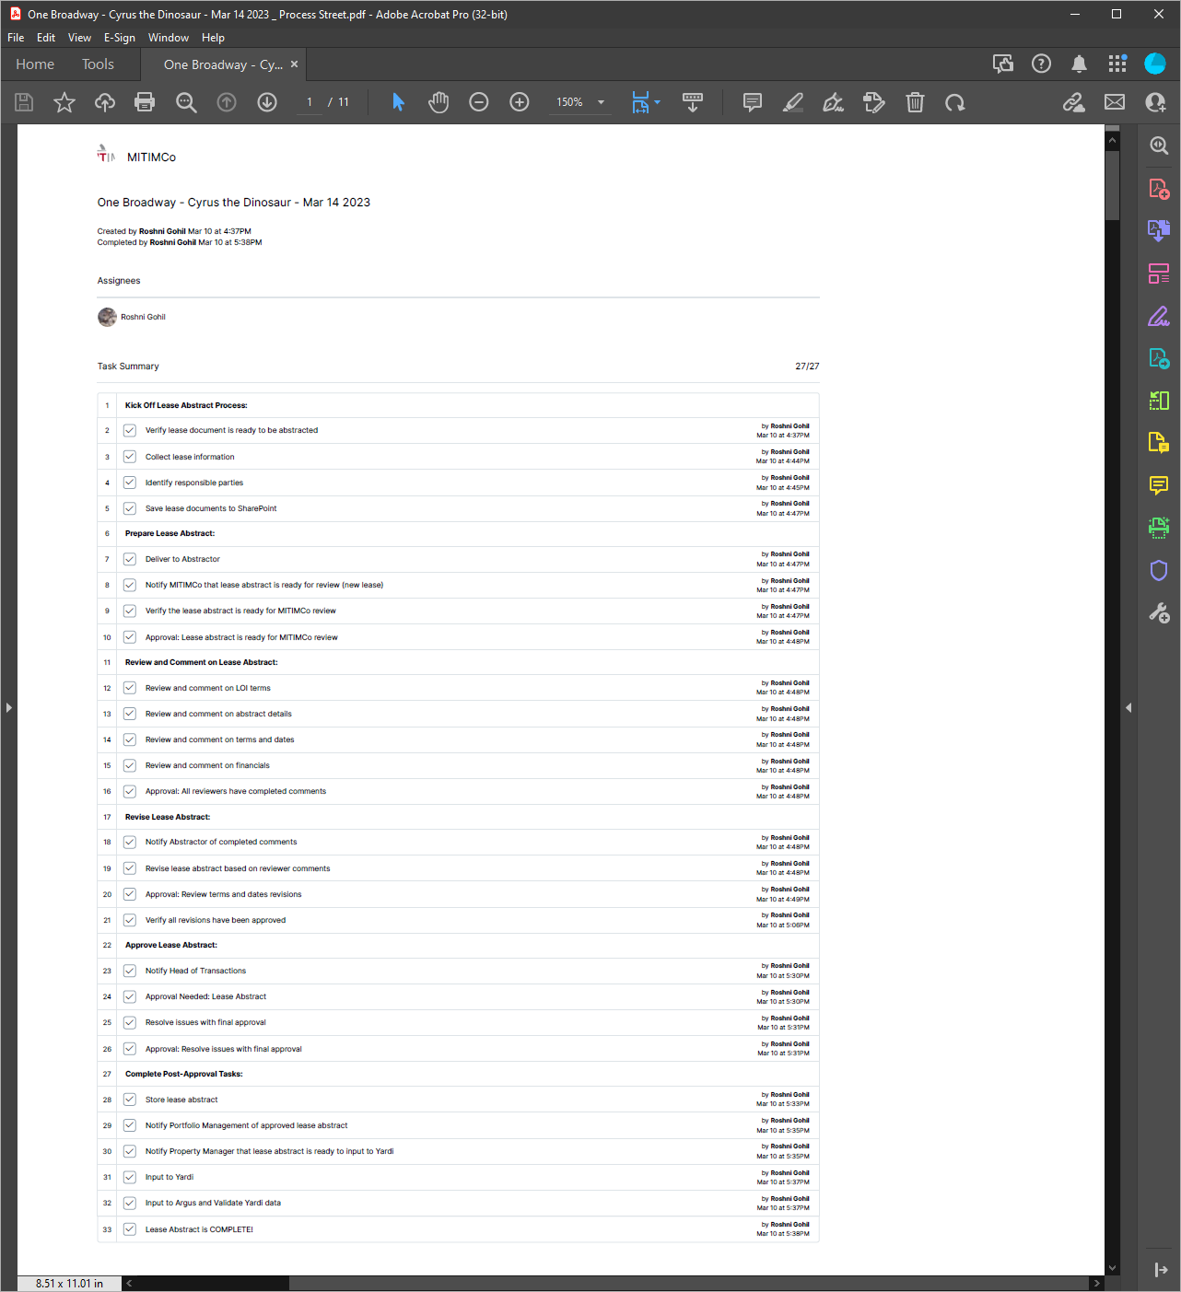
Reporting
    Summary tables
    Click-through to detail
    Exports

Slide 23
What are YOU using to manage workflows?
Monitoring
As tasks are completed, the process moves onto the next step automatically
We have full audit and reporting around current and completed workflows
Notifications and handoffs are automated through Process Street
Entire processes are managed and run through Process Street
Integrations with SharePoint, DocuSign, Slack, and other applications
Users can check their Process Street Inbox to see what’s assigned to them and due dates
Automation
Integration

Slide 24
Want a demo? Have questions?
Contact Blake Bailey: blake@process.st

