Slide 1

End user computing it-partners 2023
Timothy Yager
tyager@mit.edu

Slide 2


Agenda
Year in review
Statistics
macOS automated updates with Nudge
Microsoft Intune and Autopilot
Android device management
Workshops
Questions

Slide 3


Year in review
Citrix cloud migration
Jamf cloud migration
Prey Anti-Theft rollout
Sophos Central migration
CrowdStrike full rollout
Third party patching full rollout

Slide 4
instant fixes
Fixed CrashPlan rename from Code42 for full disk access on Macs
Installed updated Citrix Workspace when the application broke on all Macs
Fixed Win 11 WSUS targeting
GPO to fix Outlook Autodiscover
Fixed “New Outlook” by reverting to ”Old Outlook”

Slide 5
Statistics - Windows
2019
2023
Windows 7 - 333
Windows 10 - 2342
Windows 11 - 0
Windows 7 - 17
Windows 10 - 2355
Windows 11 - 903

Slide 6
Statistics - MECM
2019
2023
Device Collections - 50
Computers - 2334
BitLocker % encrypted - 55%
3rd party patching - 65%
Device Collections - 76
Computers - 3384
BitLocker % encrypted - 77%
3rd party patching - 98%

Slide 7
Statistics - macs
2019
2023
Office 2011 - 612
Office 2016 - 2964
Office 2019 - 558
FileVault Encrypted - 67%
Sites using automated third-party patching - 35%
Office 2011 - 34
Office 2016 - 151
Office 2019/2021 - 4304
FileVault Encrypted - 83%
Sites using automated third-party patching - 98%

Slide 8
Statistics - jamf
2019
2023
Jamf Sites - 50
Computers - 3155
Mobile devices - 574
Policies - 1998
Smart groups - 1175
Jamf Sites - 87
Computers - 4571
Mobile devices - 5620
Policies - 2046
Smart groups -1372

Slide 9



Automated macOS upgrades via Nudge

Slide 10
os upgrade concerns
End users don’t patch their machines
IT techs don’t have the time to update each machine individually for each patch
Any device not on the latest patch is generally considered insecure
Apple provides no effective way of automating updates

Slide 11
macOS breakdown
macOS 10.11 | 4
macOS 10.12 | 12
macOS 10.13 | 45
macOS 10.14 | 17
macOS 10.15 | 472
macOS 11 | 727
macOS 12 | 1585
macOS 13 | 1703

Slide 12

why this matters
12% of devices run a fully non supported OS
  These devices are no longer supported by Sophos, CrowdStrike, CrashPlan, etc.
28% will drop out of support when Sonoma is released in a few months
73% are not on macOS 13

Slide 13
Solution
Organizations are using 3rd party tools, notably Nudge
Nudge uses a launch agent to pop up a window urging the user to upgrade
They can then either defer or launch system preferences and upgrade themselves
No IT technician work required other than communications
Non-destructive, no forced reboots or logouts

Slide 14
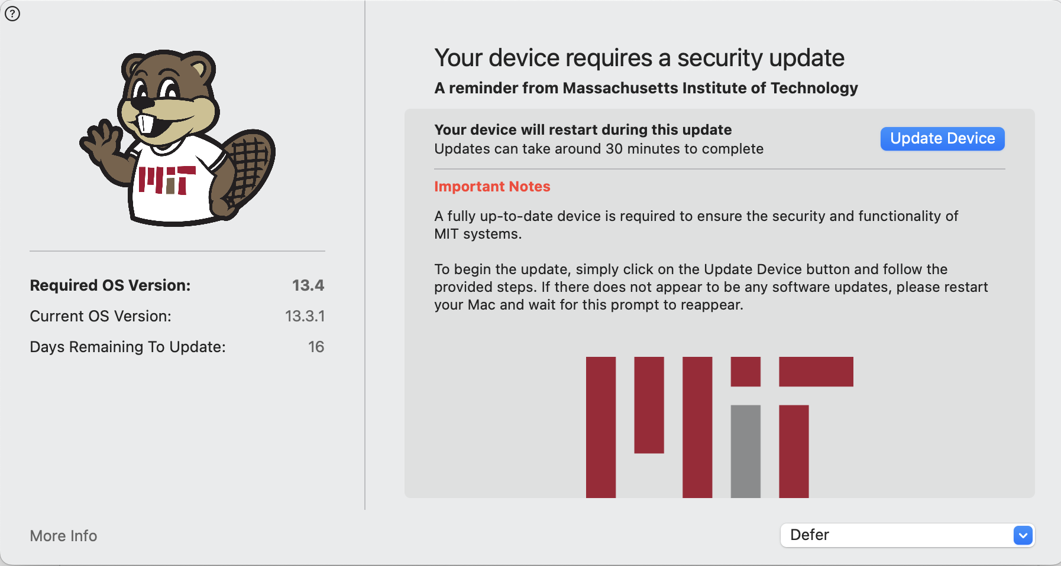

Slide 15
success stories
Technology Review has this enabled in production
  Day 0 - 5% on 13.4
  Day 2 - 50% on 13.4
  Day 14 (deadline) – 94% of devices on 13.4, completing all devices that could upgrade
Stanford University – 20,000 devices running Nudge, 6 total tickets and all asking if this was a legitimate popup
Other universities – Princeton, Cornell, UT-Austin, all reporting great success
  General feedback – first upgrade is a learning curve, all future upgrades were simple

Slide 16
rollout
Timeframe
  This is coming in July / August to DLCs
  Finalizing timeline and communications later this week
  Anyone wishing to opt in immediately please let me know
We will be incrementing this for all minor patches after vetting, this is not a one-time upgrade
macOS 11 and higher only. Anything lower we will apply a config profile that enables automatic updates with Apple’s built in notifications
Goal is to have all capable devices upgraded prior to Sonoma release

Slide 17

Microsoft Autopilot and intune

Slide 18
Definitions according to AI
ChatGPT
  Microsoft Intune: The Jedi Master of Device Control and Security, Keeping Chaos at Bay in the Digital Galaxy
  Microsoft Autopilot: The Magical Wizard that Transforms Clunky Computers into Sparkling Unicorns of Productivity
Google Bard
  Microsoft Intune is the cloud-based, end-to-end mobile management solution that helps you achieve peak device velocity and security.
  Microsoft Autopilot is the zero-touch, cloud-powered, self-driving IT solution that helps you achieve peak device velocity and security without lifting a finger.

Slide 19
Definitions according to AI
What would ChatGPT say that Bard would say?
  Microsoft Intune: The Wizardly Enforcer of Device Domination, Taming Tech Tornadoes with a Snap of Its Fingers!
What would Bard say that ChatGPT would say?
  Microsoft Intune is the game-changing, state-of-the-art, next-gen mobile management solution that will revolutionize the way you manage your devices.

Slide 20

actual Definitions
Intune is cloud based MECM with new and / or different functionality
Autopilot is DEP for Windows

Slide 21
How does it work?
Device hash sent to EUC team (gotten via script), we enroll into Autopilot
End user turns on device, connects to wi-fi, authenticates via Touchstone
Device then binds to Azure AD, installs Intune, installs MECM, then installs software and configurations
Device is applied a scope tag that only your DLC has access to
No IT-Technician work required, a true Zero Touch model

Slide 22
past to present
On-prem model
Cloud model
Lite Touch
Active Directory binding
MECM device management
Group policy
ADUC
MBAM key escrow
Autopilot
Azure Active Directory binding
Intune and MECM co-management
Configuration profiles
Scope tags
Intune key escrow

Slide 23
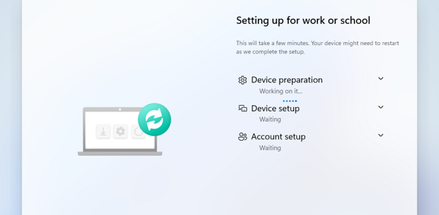

Slide 24

end user experience
End user advantages
  No pre-logon VPN!
  Automated integrations for Office / OneDrive / Teams
  No KMS activation required
  Almost no VPN needed
  End users won’t really notice any difference once logged in
End user disadvantages
  Device authentication training (especially if using Windows Hello)
  Mapped drives / Kerberos auth training

Slide 25
IT technician experience
IT technician advantages
  Zero Touch imaging! Zero Touch reimaging! (user just needs to reset device)
  BitLocker keys in one easy to reach cloud console
  Direct access to limited MDM commands
  Greater / more up to date customizations via config profiles

Slide 26
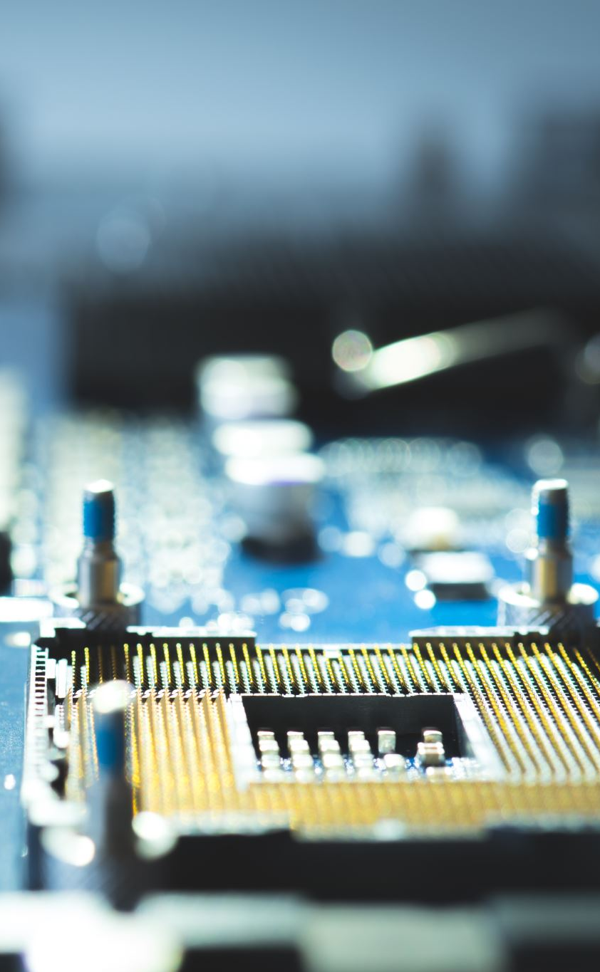
IT technician experience
Concerns
  Getting hashes requires running a script, unlike DEP where you can just send a serial number
  Devices must be unenrolled from Autopilot when offboarded!!
  RBAC for Intune is very different and TBD
  No device collections or queries in Intune, it’s all user based – this is a major paradigm shift
    If you support multiple DLCs this gets even trickier

Slide 27
Security paradigm change
No opt-outs – this is the modern security model meeting best practices
No Windows 10, all devices will upgrade to latest specified Windows 11 feature release
BitLocker encryption required for all devices
LAPS required for all devices
  Local Administrator Password Solution – auto rotates local admin account pw
3rd party patching required for all devices
WuFB replaces WSUS

Slide 28
rollout
We will be ready to pilot Autopilot and Intune starting July
Anyone who wants to be part of early adoption please email me directly
  The main concern we are still working through is RBAC, any early adopters have to understand we might remove or add already granted privileges
No hard start date, but once we feel all configurations are ready to go DLCs can be onboarded at any time
This will not be a requirement any time soon, but eventually domain join will be sunsetted permanently

Slide 29
android device management via Microsoft intune

Slide 30

android device management
Manage device lifecycle including:
  Enrollment
  Inventory
  Software distribution
  Settings
  Security management
  MDM commands
  Offboarding

Slide 31
android device management
For MIT tagged devices
More limited than iOS management, but very similar
Ideal for cheaper kiosks and classroom signage but can support phone fleets
Requirements
  Lenovo and Samsung only
  Android 12 and above only
Available today – email euc-help@mit.edu to get started.

Slide 32
summer workshops
Intune / Autopilot
Jamf Advanced
Android – on-demand training during onboarding

Slide 33




timeframe
Immediately - Android Intune
July - Nudge rollout
July / August - early adoption Autopilot / Intune
Workshops - TBD, summertime

Slide 34

Questions?
Email euc-help@mit.edu to sign up for these services or ask questions.

