Slide 1
Data Warehouse:
Tools to access data
IT Partners – 06/20/2023

Slide 2
DW: Tools Agenda
Getting Data out of the Warehouse
IS&T Enterprise Reporting Solutions
  Cognos
  Tableau
Other Applications
  Excel
  SQL*Developer
  Quickbase / FileMaker
What’s up with Brio Query?

Slide 3
Getting Data Out of the Warehouse
There are several ways to access the data in the warehouse:
IS&T Enterprise Reporting Solutions
  Cognos - Management Reporting
  Tableau - Visualization
Other DB Applications / Scheduled Extracts / Extract to other Applications*
  SQL Plus
  Excel
  Quickbase, FileMaker, Whatever you please
Ad-hoc Querying
  SQL*Developer
  What’s up with Brio Query?
* Note:
Once data is extracted from the warehouse, the extractor is responsible for keeping it secure!!!

Slide 4
IS&T Enterprise Reporting Solutions
Cognos
IBM Cognos Business Intelligence is a web-based integrated business intelligence suite by IBM. It provides a toolset for reporting, analytics, scorecarding, and monitoring of events and metrics.
Use Cognos to:
  Run standard reports, created by IS&T for use by the MIT Community (available on the MIT Cognos home page and through Atlas)
  Modify standards reports to meet your specific needs
  Create your own reports
Tableau
Tableau is a visual analytics platform transforming the way companies use data to solve problems—empowering people and organizations to make the most of their data.
Use Tableau to:
  Create Dashboards
  Query data

Slide 5

Cognos
Who uses it?
  Anyone with a Kerberos Account and Warehouse Account
Where can I access it?
  Production
  Test
How do I navigate?
  Demo Locating a report
Can I break anything?
  No
Ways To Access
  Cognos
  Atlas
  Email

Slide 6



Cognos
Production: reports.mit.edu
Test: reports-test.mit.edu
Share and Consume
Report Studio
Query Studio
Foundation Layer
Framework Manager
Combine, Shape, and Clean Data
Data Warehouse

Slide 7

Cognos
Demonstration
Report Studio
  reports.mit.edu
Atlas
  atlas.mit.edu

Slide 8

Cognos Resources/Community
IS&T
  Site help – warehouse@mit.edu
  Reporting help – reporting-help@mit.edu
  KB – http://kb.mit.edu/confluence/display/istcontrib/Cognos+Landing+Page
MIT Cognos User
  Starting up soon

Slide 9


Tableau
ist.mit.edu/tableau
Share and Consume
Tableau Server
Tableau Reader*
Tableau Public*
Explore, Analyze, and Build
Tableau Desktop
Tableau Server (web editing)
Combine, Shape, and Clean Data
Tableau Prep*
Tableau Desktop

Slide 10
Tableau – Share and Consume
Tableau Server tableau.mit.edu
How most users are going to access Tableau workbooks that Tableau Desktop users have published
  Available via browser (all devices) and Tableau Mobile app (phone/tablet)
  Embed on other websites (ir.mit.edu/diversity-dashboard)
Enables users to interact
  See, filter, sort, hover for detail, etc., visualizations/dashboards
  Share filtered/sorted dashboards using Custom Views
  Use web edit to:
    build new workbooks with published data sources
    make changes to or create new versions of existing reports
Security
  Access controls based on Moira groups
  You can control whether users have access to granular data (e.g., HR data at the individual level) vs aggregated data (non-identifiable aggregate displayed in published report)

Slide 11
Tableau – Share and Consume
Tableau Reader
Not recommended in most cases
  Offline access but requires program to be downloaded
  Data is packaged with the workbook, so there’s effectively no security:
    If a user has a Tableau Desktop license, they can get to the most granular level
    And they can share that data with ANYONE
  Manual sharing – if you make changes, you have to share the updated version with everyone you sent the original workbook

Slide 12
Tableau – Share and Consume
Tableau Public public.tableau.com
Like Tableau Server in that it’s online
But it’s open to the world
Can limit ability to download workbook or data, if connected to MIT Tableau Desktop license
Takeaways:
  Generally, avoid using it for anything MIT-related unless your dashboard uses publicly available data (i.e., almost nothing from the MIT Data Warehouse)
  Contains lots of examples to use for inspiration and learning

Slide 13
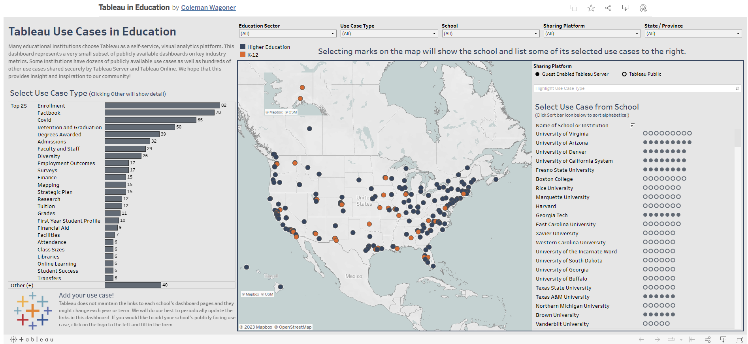
Tableau – Share and Consume
Tableau Public public.tableau.com
public.tableau.com/views/TableauinEducation/TableauUseCasesinEducation

Slide 14
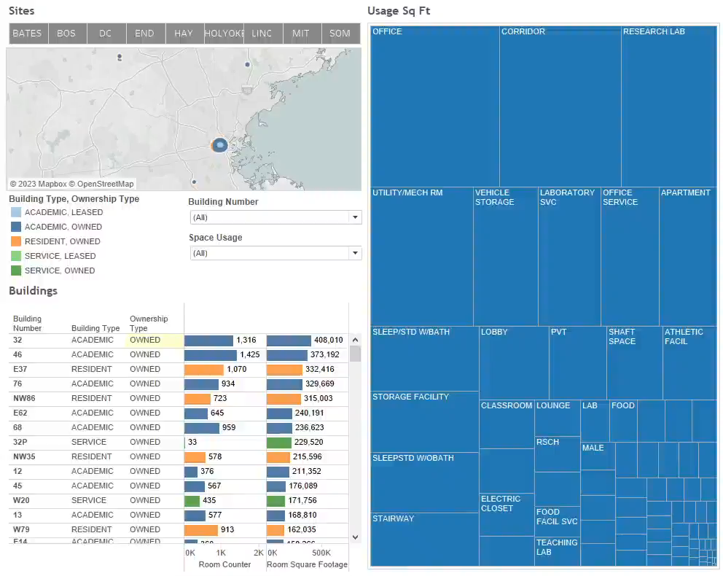
Tableau – Explore, Analyze, and Build
Tableau Desktop + Tableau Server (Web Editing)
Build charts, tables, and dashboards
Add filters, parameters, sets, dynamic tooltips, and other interactivity

Slide 15
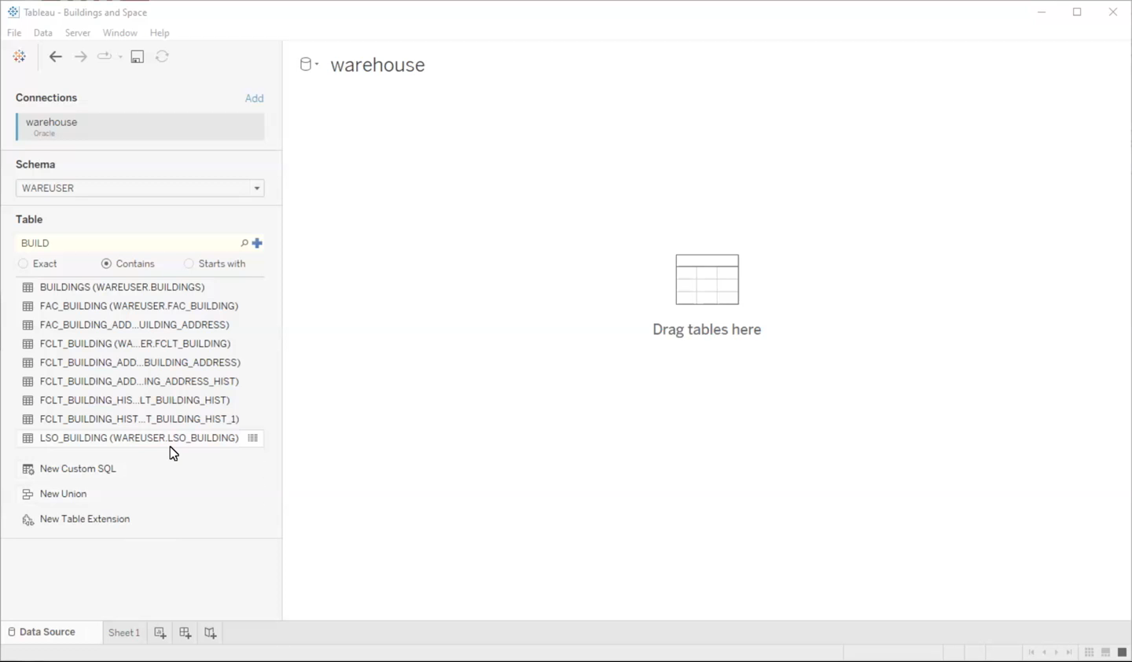
Tableau – Combine, Shape, and Clean Data
Tableau Desktop
Join or union data
Combine DW data with other sources (Excel/CSV/text files, spatial data, other databases, etc.)
Create calculations to aggregate, group, and more
Publish data sources to Tableau Server for others to use in building dashboards

Slide 16
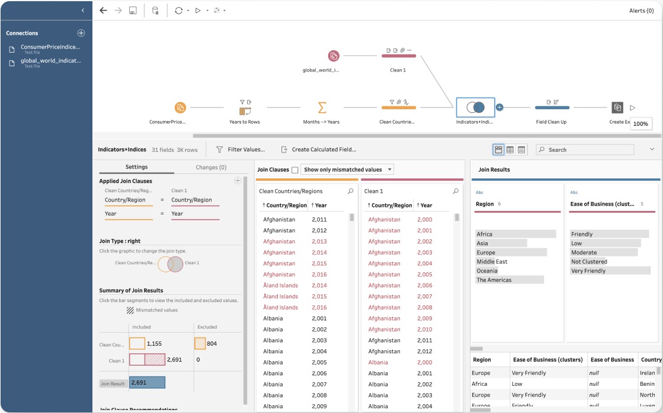
Tableau – Combine, Shape, and Clean Data
Tableau Prep
IS&T does not offer Tableau Prep licenses, but the Software Asset Management Team (software-distribution@mit.edu) can help DLCs procure licenses
Prep is fine for a one-time data clean-up project, but if your data refreshes, you will need to open it in Prep again to pull in new data, or find a workaround (e.g., Python scripts) to apply the cleaning process on data used on Tableau Server

Slide 17
Tableau Resources/Community
MIT Tableau Community
  MIT Tableau User Group (MIT TUG)
  tinyurl.com/MITTUGHome
  MIT Tableau Slack
  mit-tableau.slack.com
Tableau User Groups (usergroups.tableau.com) and related spaces
  Massachusetts Higher Education Tableau User Group (MUG)
  tinyurl.com/subscribemug
  Higher Education Tableau User Group (HETUG)
  tinyurl.com/subscribeHETUG
  Higher Education Tableau Slack
  higher-ed-tableau.slack.com
  Join with .edu email: tinyurl.com/JoinHETableauSlack
  Boston Tableau User Group
  tinyurl.com/BostonTUG
#DataFam, Tableau Public, and so much more

Slide 18
Other Applications
Any application that can connect to a database can be used to connect to the Data Warehouse
Examples:
  Excel
  SQL*Developer
  Quickbase / FileMaker
What’s up with Brio Query? Next slide…

Slide 19
What’s up with BrioQuery (Brio)?
    Brio
    Reporting
    Is
    Obsolete

Slide 20

What’s up with BrioQuery (Brio)?
IS&T Recommends that if you’re not using it today - don’t start (Parent company (Oracle) no longer supports this technology)
If you are using it, and love it, carry on. We won’t stop you – but as technology upgrades are done it is possible that you may find that some day it does stop working
There are MANY Brio queries in existence at MIT – if you want to reproduce one in a supported technology, we recommend you email reporting-help@mit.edu
Alternatives:
  Tableau
  Cognos
  SQL
  Excel/PowerQuery

Slide 21
How do I get help?
Help with data in the warehouse – warehouse@mit.edu
Looking for specific data but don’t know where it is
Data you’re looking at looks odd
One-on-One session with team member (or Group sessions)
Access to data – warehouse@mit.edu
Need access to objects you can’t see
Help connecting to the warehouse – warehouse@mit.edu
Help with ODBC or similar connections
Help setting up a system account
Help with a report (Cognos / Tableau) – reporting-help@mit.edu
Existing reports or help creating new
One-on-One session with team member (or Group sessions)
User Group sessions will be starting up again this summer

Slide 22
Questions?

