Slide 1
Data Warehouse
Real Life Examples
IT Partners – 06/20/2023

Slide 2
Real Life Examples - Agenda
Quickbase People App – Lisa Robinson, Chemical Engineering
Data Integration within QuickBase – Tyler Brezler, VPF

Slide 3

Quickbase People App
LISA ROBINSON
Business Systems Analyst
Department of Chemical Engineering
Started at MIT in 2000
Joined ChemE in 2022
Help Desk Team Lead > Software Developer > Manager, Release Engineering

Slide 4

Quickbase People App
Designed and built by Materials Science and Engineering (DMSE)
Centers around Faculty Research Groups
Chemical Engineering added some additional Data Warehouse imports

Slide 5
What is Quickbase?
Cloud database with user-friendly web interface
Create and display reports
Easily create forms so that users can populate data
Import from external data sources
Automations and workflow
Similar to Microsoft Access and FileMaker, accessed via web browser

Slide 6
Sharing Quickbase Apps
Manage departmental HR and Finance processes
Department of Materials Science Engineering (DMSE) – thought leaders in Quickbase app creation

Slide 7
Quickbase People App
Principal Investigator Research Group
  Faculty Member
  Administrative Assistant
  Financial Administrator
  EHS Representative
  Sponsored Staff
  Grad Students
  Undergrad Students

Slide 8
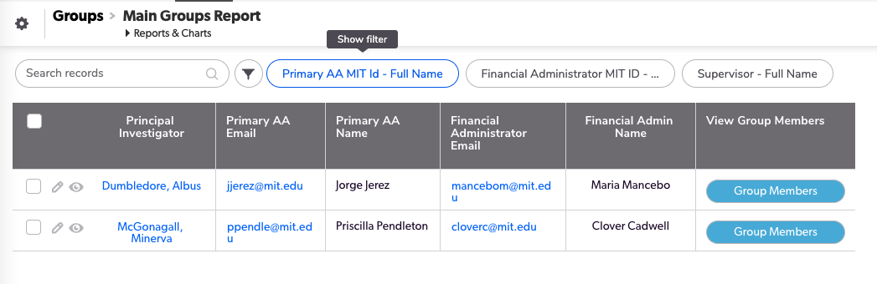
Quickbase People App

Slide 9

Data Hunting
How can I find the sponsored research staff, Undergrads and Grad Students in Professor Dumbledore’s research group?

Slide 10
Data Hunting
How can I track the salary and benefit costs for the sponsored staff and grad students in Professor Dumbledore’s research group?

Slide 11

Data Hunting
In SAP Financials, find Professor Dumbledore’s accounts
In SAP HR, find the postdocs and research staff appointed on those accounts
On the eDACCA, find the salary and benefit transactions for those staff

Slide 12
Data Hunting
In MITSIS, find the grad students for whom Professor Dumbledore is the advisor
In Graduate Appointment Portal, find the appointments for those grad students

Slide 13

Data Warehouse
What if all of the data were available in one place?
What if it were organized so that I could easily connect the data, using Account Number and MIT ID?

Slide 14
Data Warehouse >> Quickbase
Nightly feed from Data Warehouse to Quickbase
Python app runs on AWS, queries Data Warehouse and pushes to Quickbase
Developed by School of Science Dean’s Office
Nightly import of SAP Finance, SAP HR, eDACCA, MITSIS and GAP data

Slide 15
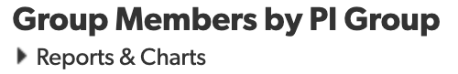
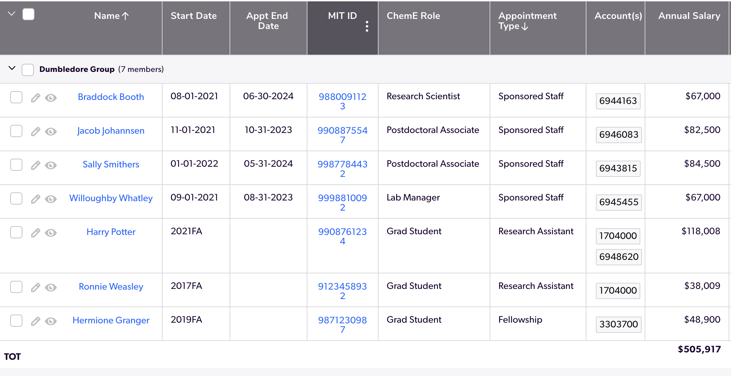
Quickbase People App

Slide 16

Quickbase Data Integration
Tyler Brezler
Data Engineer
Office of the Vice President for Finance
Started at MIT in 2002
Joined Chemistry in 2003
Administrative Assistant > Financial Officer

Slide 17

Dude, Where’s My Data?
SAP
Kuali Coeus
Atlas
Roles
Buy2Pay
Cognos
Excel
???

Slide 18
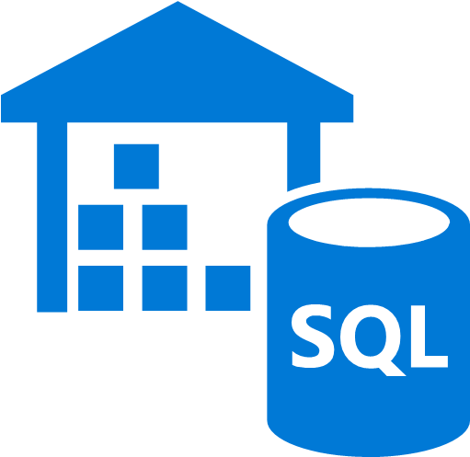
All Your Data in One Place
The MIT Data Warehouse contains the majority of MIT administrative data
If you know SQL (Structured Query Language), you’re all set
If you don’t know SQL, you need software that will write SQL for you, but there will be limitations

Slide 19

Unlocking the Warehouse
Cognos
  Learning curve
  Some limitations regarding accessing/connecting data
  Web-based
  Reports are shareable
Tableau
  Learning curve
  Direct access to warehouse data
  Great for charts & graphs
BrioQuery
  No longer officially supported
  Windows only
  Technically still works

Slide 20

Or You Can Learn SQL!
Tons of free learning opportunities online
Gives you ultimate access to the data you need
Incorporate into the tools you currently use
Power up your business skills

Slide 21

Integrating Your Data
Excel
Filemaker
Quickbase
Tableau
Salesforce
Etc.

Slide 22

Data Integration Journey in Chemistry
Data Integration Journey in Chemistry
Started with canned reports in Cognos
Learned how to design custom Cognos reports
Warehouse data manually imported into Quickbase
Quickbase is used to assemble disparate data sources
Data is accessible interdepartmentally

Slide 23

What Is Quickbase?
Low code / no code, cloud-based relational database platform
Intuitive and easy to learn
Import existing data or enter your own
You can connect directly to the DW, but with limitations
Limited licensing through MIT

Slide 24

Data Integration Within Quickbase

Slide 25
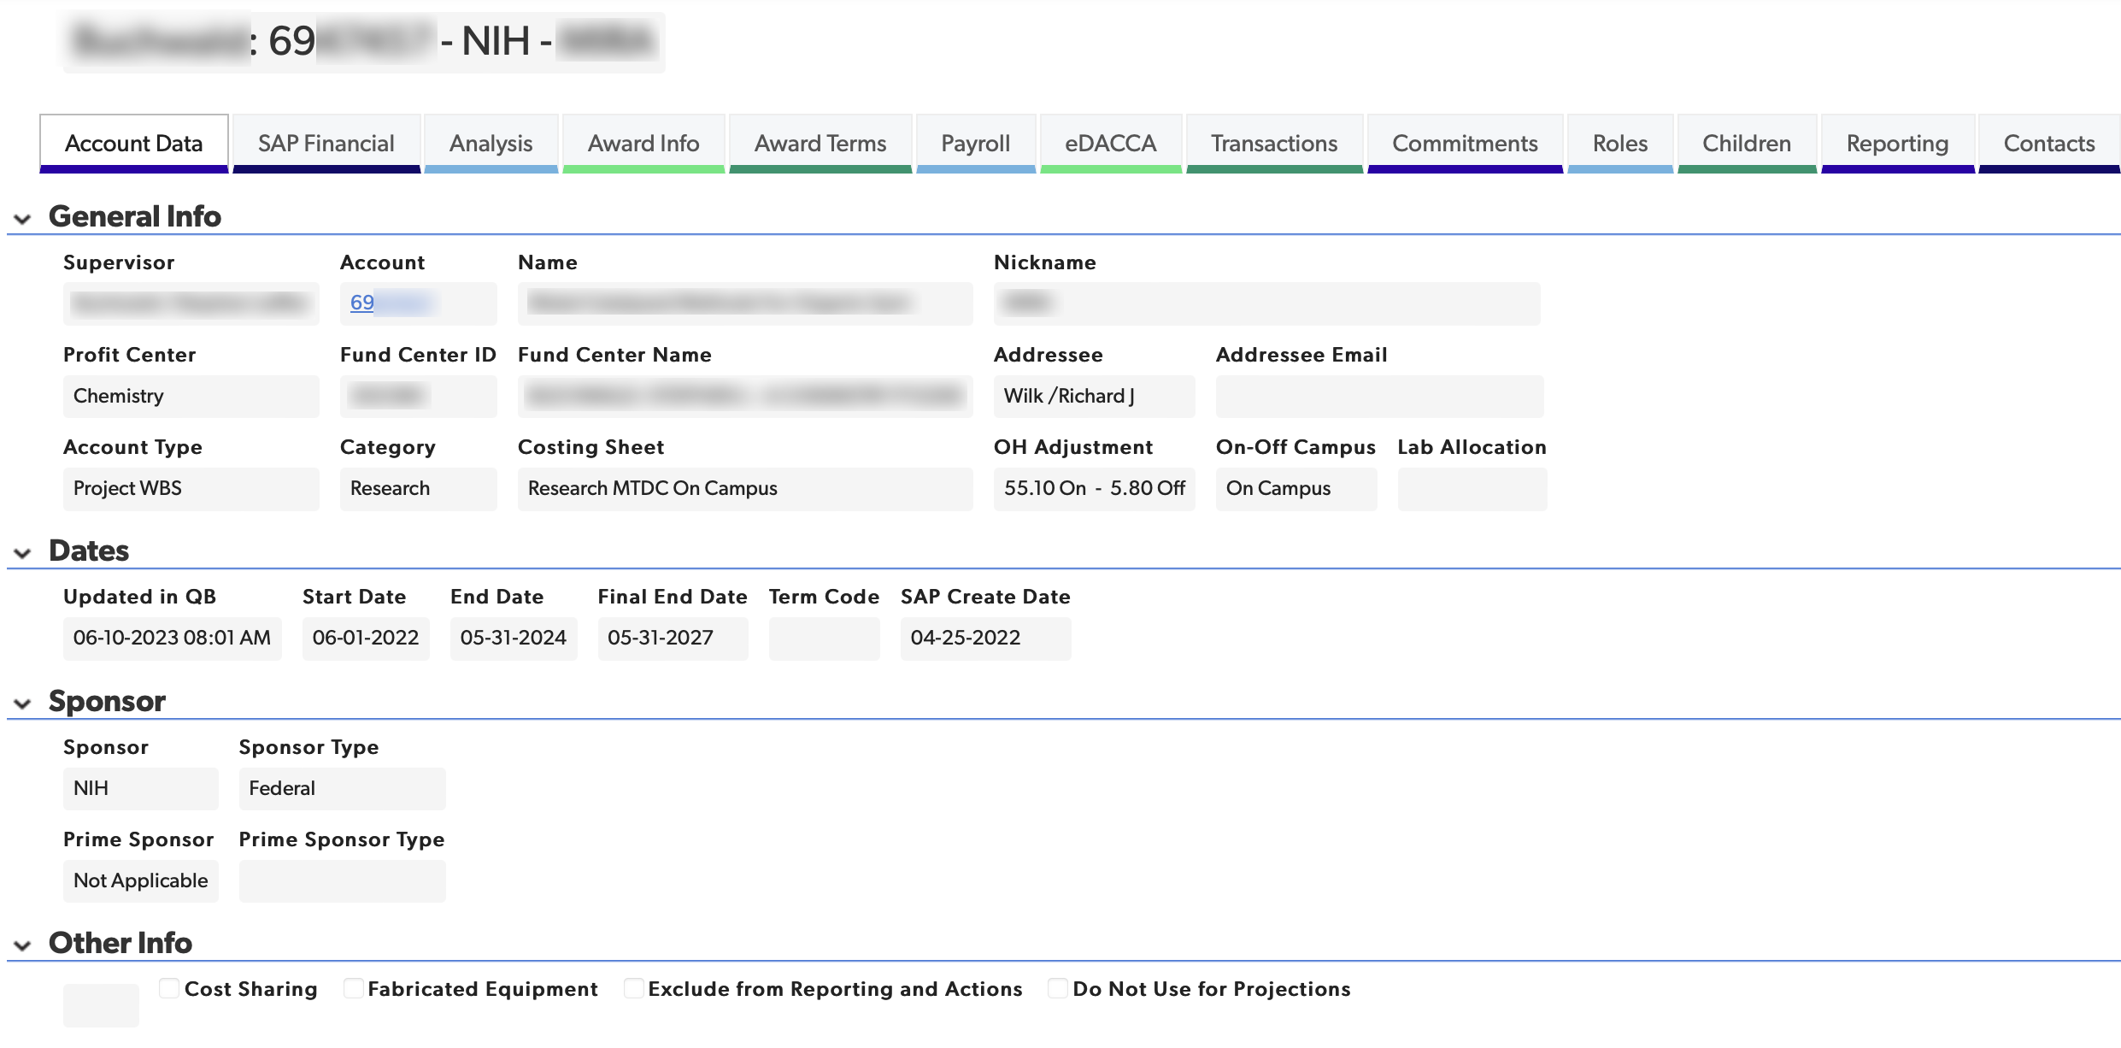
All Account Details On One Screen

Slide 26
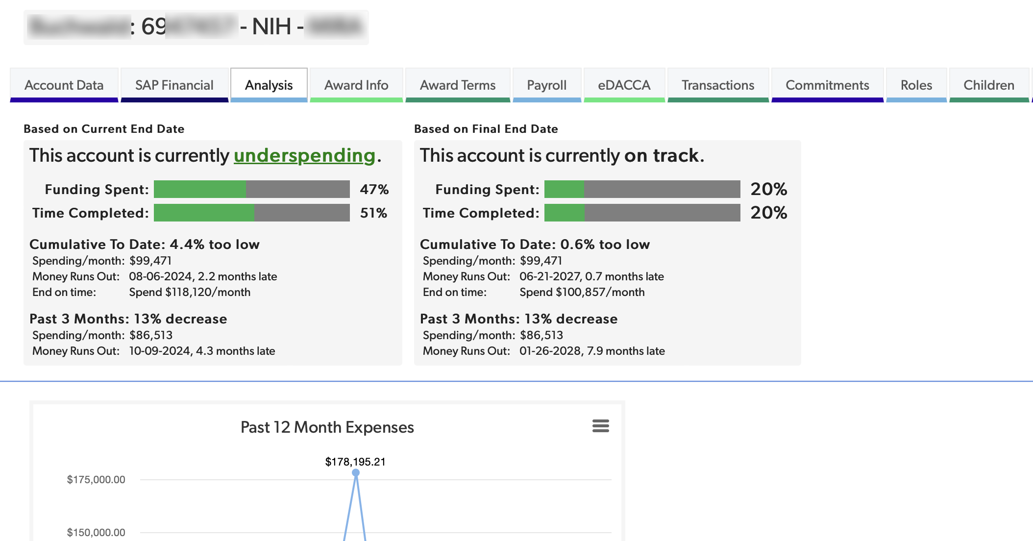
Build Your Own Custom Data Analysis

Slide 27
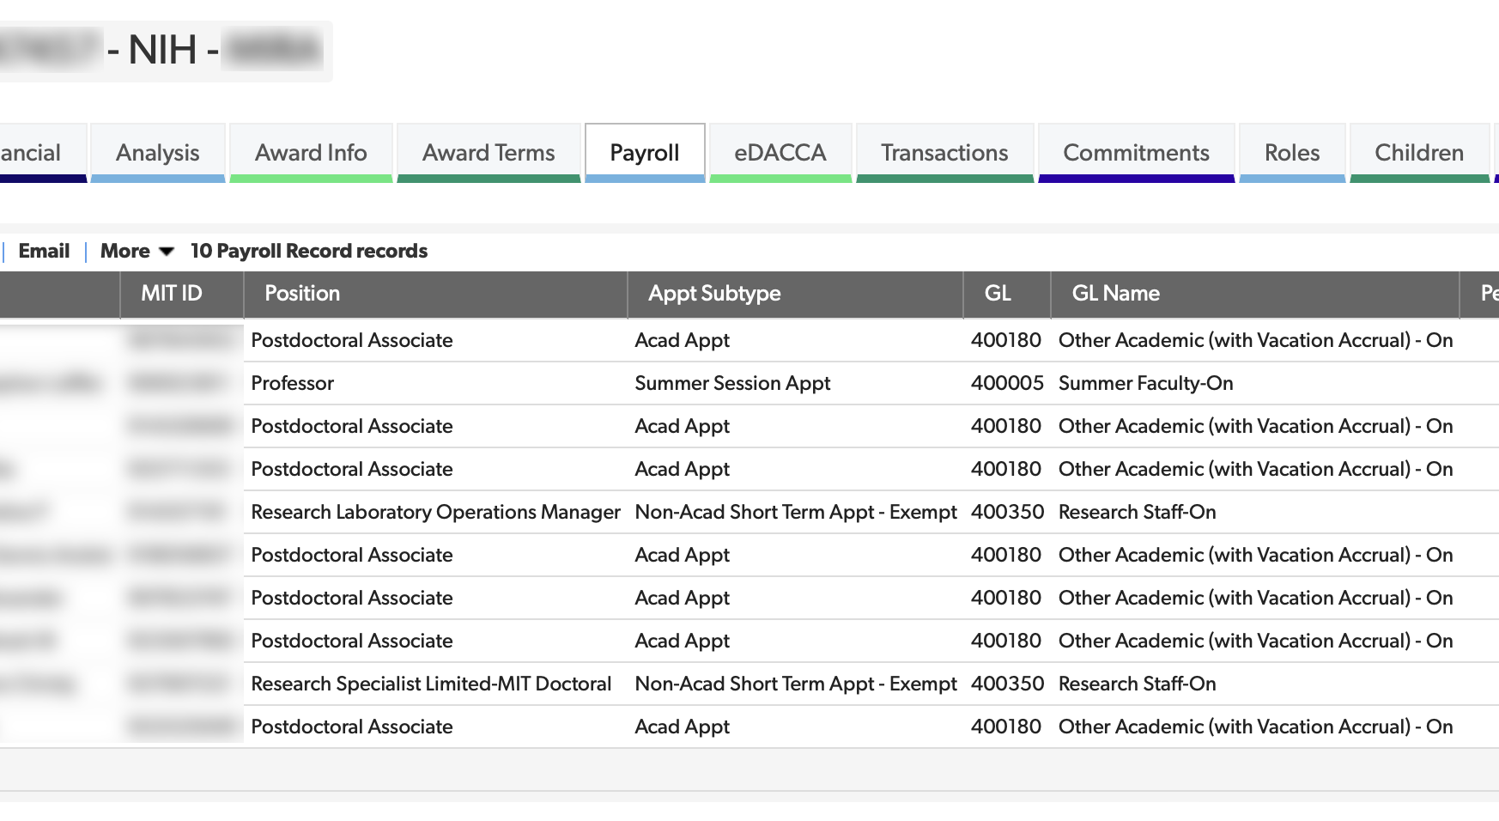
Summarize Records However You Want

Slide 28
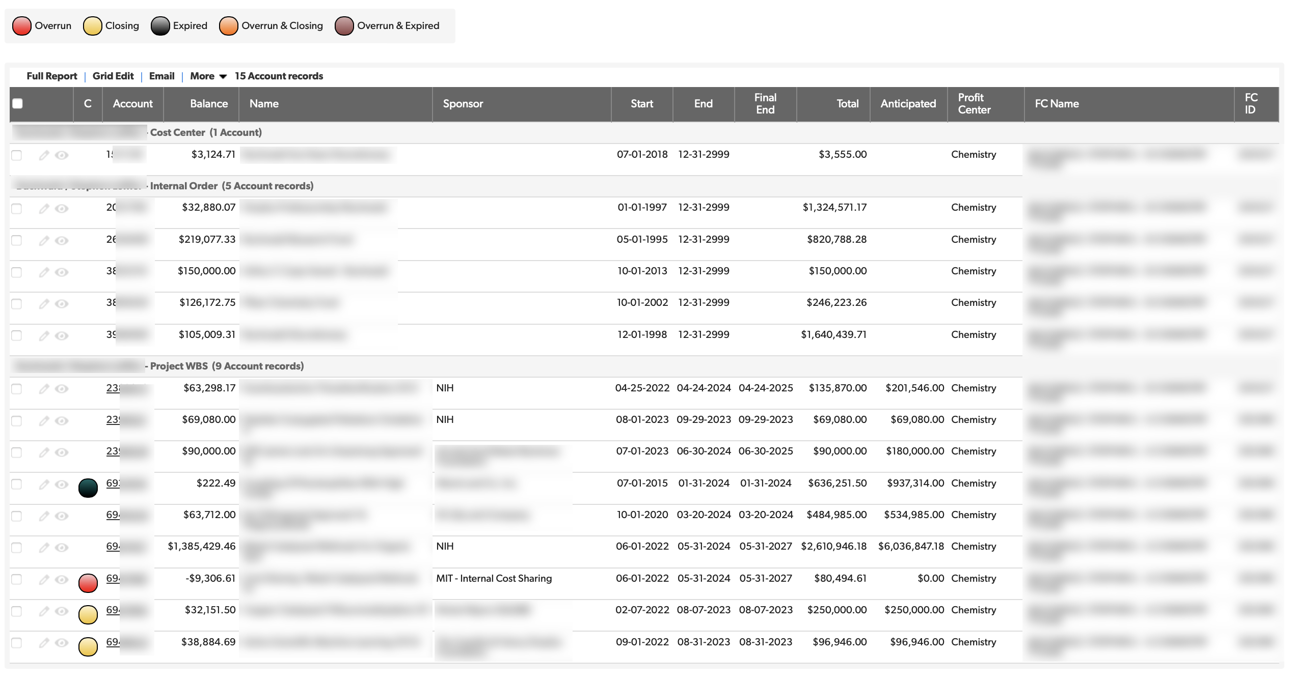
Summarize Across Supervisor or Profit Center

Slide 29

Get Notifications When Data Changes
MIT systems do not send alerts when important data changes
  Account overruns
  Personnel changes
  Billing updates
  Unallowable expenses
Quickbase and other tools can send you the necessary notifications

Slide 30
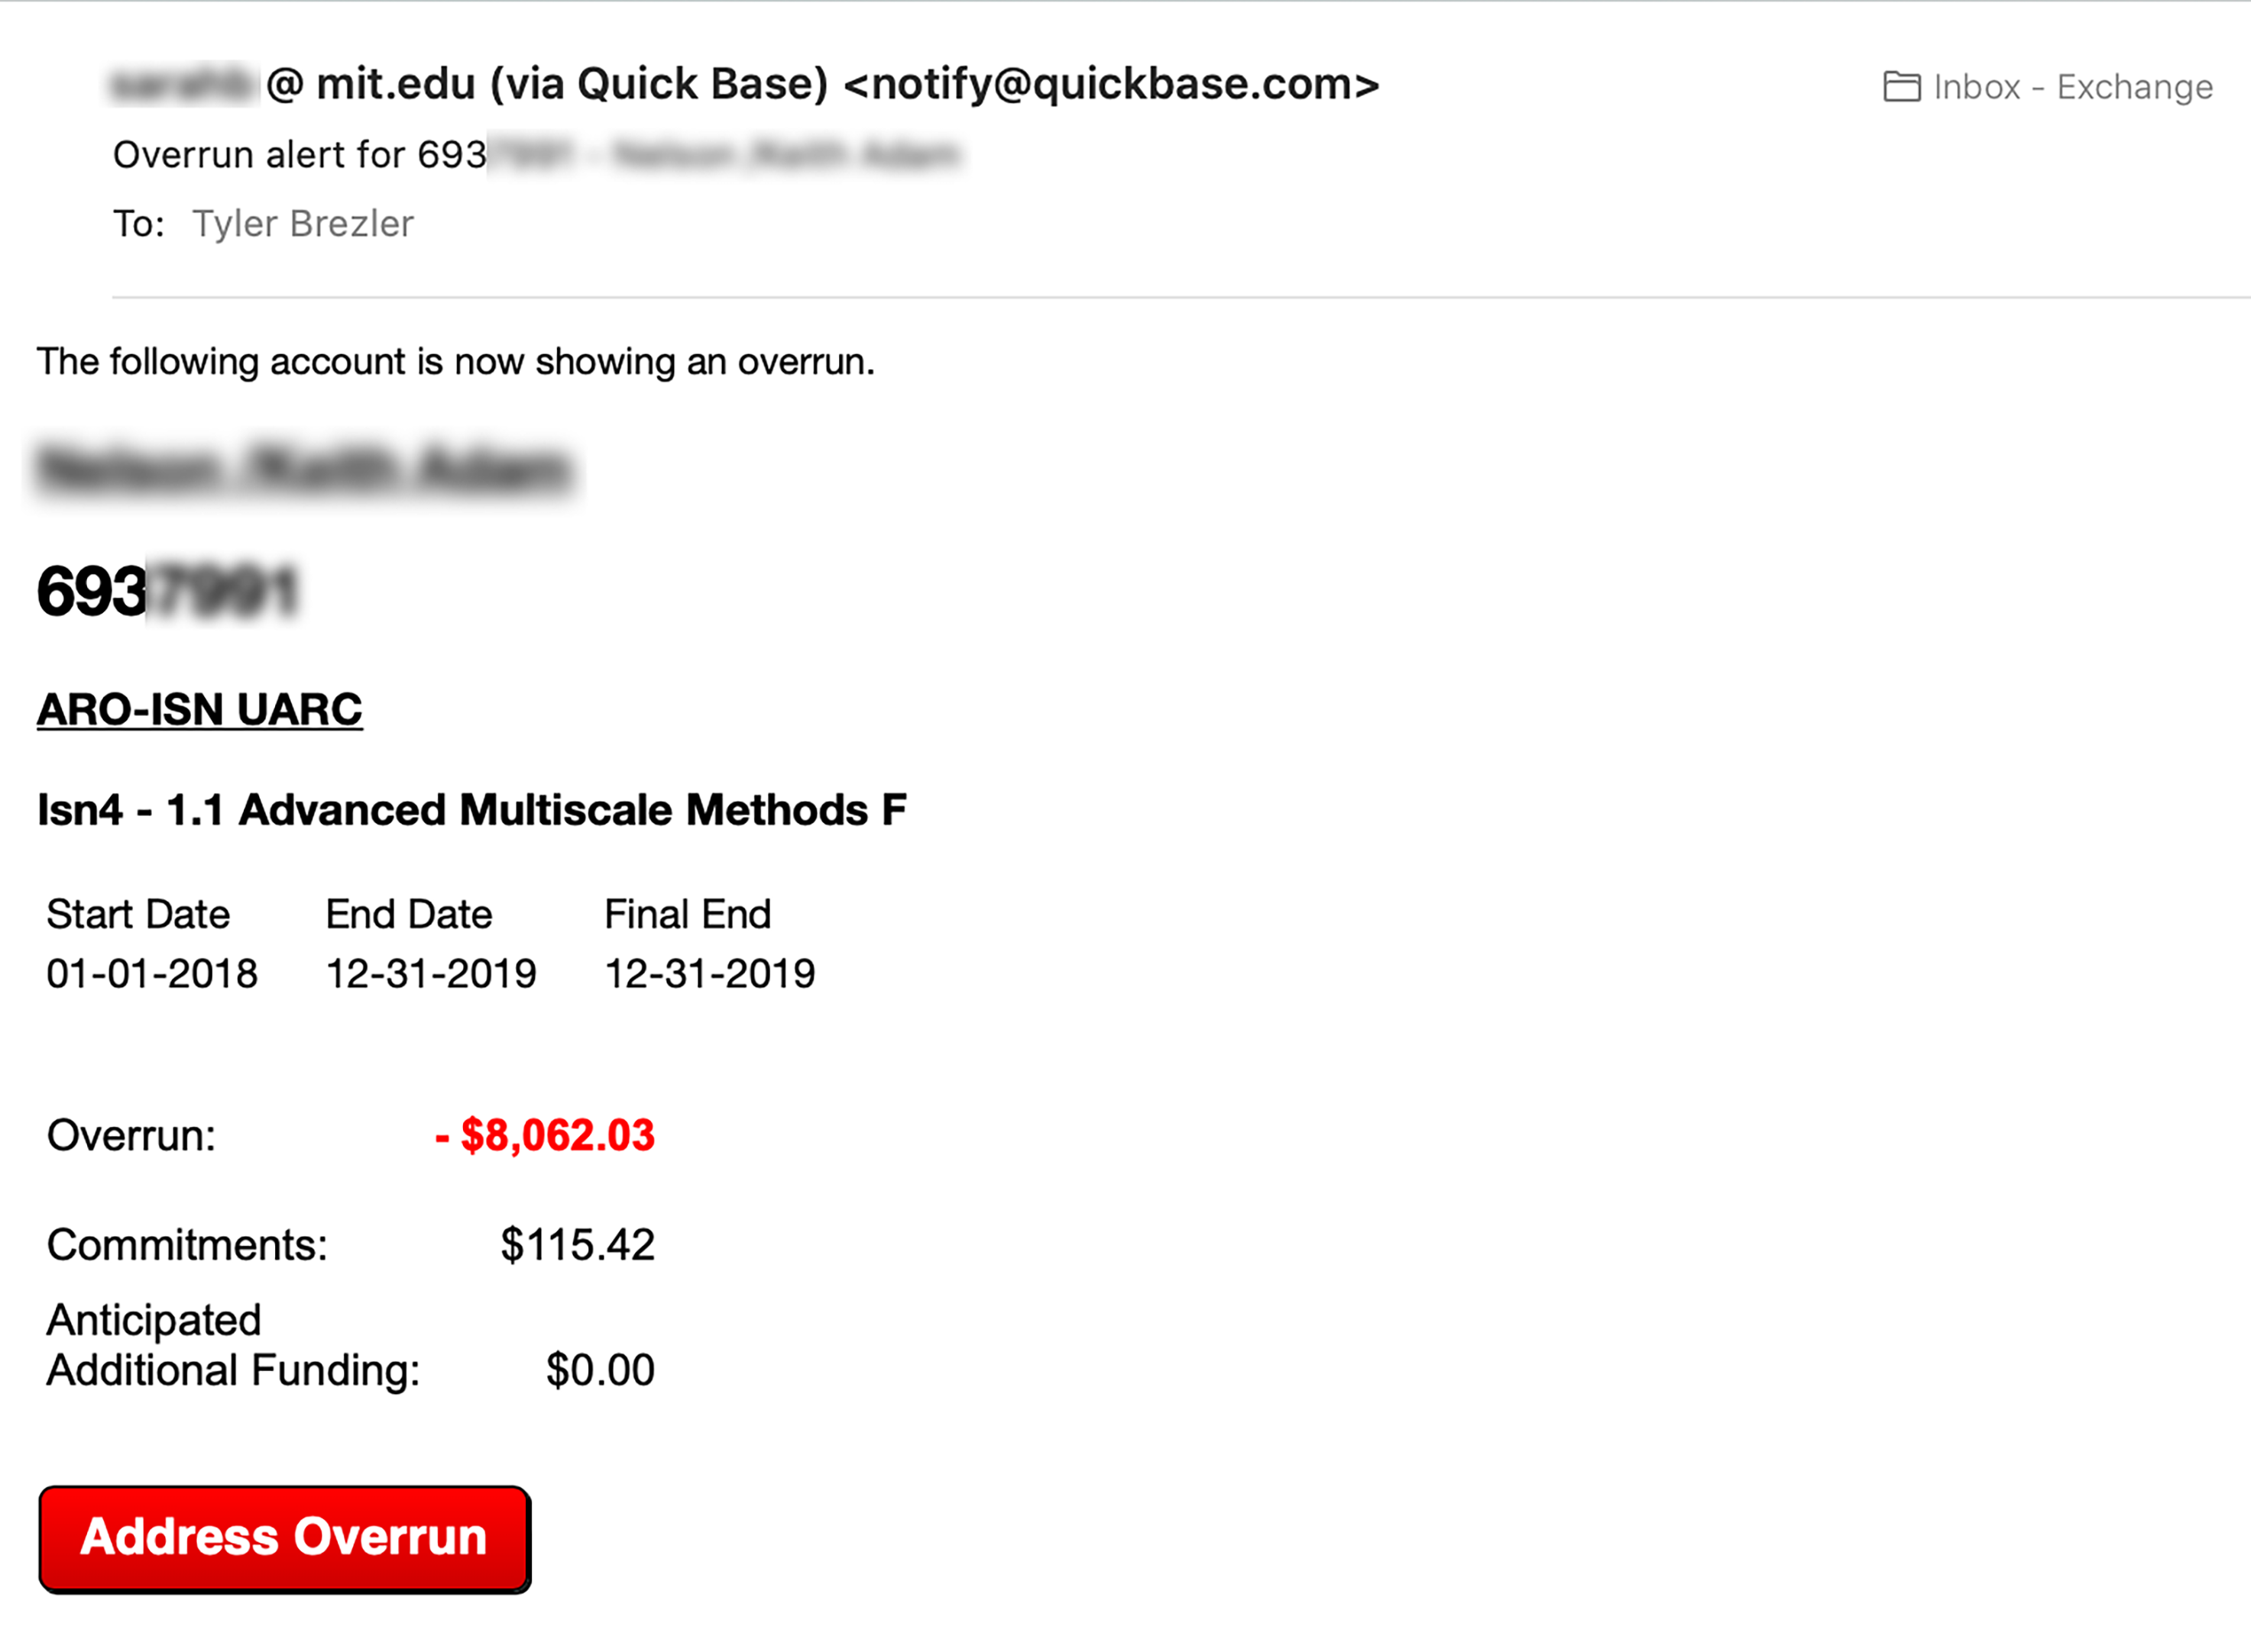
Account Overrun Notification

Slide 31

Administrative Process Solutions
Administrative Process Solutions
Accounting
  Projections
  Billing
  Overruns
  Closing / Closeouts
Auditing
  FRC
  Travel
  Unallowable expenses
Personnel
  Suspense
  Late changes
  Grad student appointments
Research Administration
  Proposal tracking
  Current and pending
  Cost sharing

Slide 32

Evolution of Data Integration Process
Manual import of Cognos reports
Automated import of Cognos reports
Automated import of SQL queries via Pentaho using computer on campus
Automated import of SQL via Pentaho using computer on Amazon Web Services
Automated import of SQL via Python using AWS

Slide 33

Key Takeaways
Lots of ways to access DW
  Cognos
  Brio
  SQL
  Python
Integrate with your data
  Excel
  Filemaker
  Quickbase
Learning resources available
  IS&T
  LinkedIn Learning
  Mimo
Make your life easier
  Reduce manual data lookup
  Share data with coworkers (responsibly!!)
  Automate and save time

Slide 34

Conversations We Need to Be Having
MIT is lacking data professionals and analysts who can manage data and business intelligence solutions Institute-wide
Administrative, financial, and IT support personnel should NOT be expected to be data experts
There are tools and resources available RIGHT NOW that can increase automation and reduce the workload for admins – SIGNFICANTLY!
MIT needs to invest in the right personnel to implement and administer these solutions
Why do we keep kicking the can down the road? We can fix this TODAY!

Slide 35
Questions?

