Slide 1


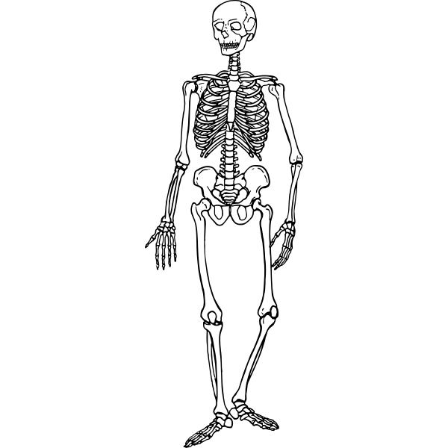



MIT Tableau User Group
(MIT TUG)
Tip or Trick or Treat
October 25, 2022
Join the conversation on Slack
mit-tableau.slack.com
Yes, we are recording the session
The recording will be sent out and posted on Slack
Notes:
Laura
Post in chat:
MIT TUG wiki, aka where all the links are: https://wikis.mit.edu/confluence/display/MITTUG
Join us on Slack: https://mit-tableau.slack.com
What’s your favorite fall/Halloween treat?

Slide 2
Agenda
What is the MIT TUG?
Tip or Trick or Treat
December MIT TUG Meeting
Chat! (including Tableau AMA)

Slide 3
What is the MIT TUG?
A community of Tableau users, and those who want to use or are thinking about using Tableau, across MIT
Open to anyone
Any MIT department
All skills levels: none to novice to Jedi
Those who use Tableau only, and those who use Tableau with other data tools
Users of any Tableau product (Desktop, Prep, Server, Online, DataDev)

Slide 4
How It Works
Virtual meetings every other month
Community-informed topics
Presentations (informal or formal) specific to Tableau at MIT
Opportunities to meet other Tableau users at MIT
MIT Tableau Slack: mit-tableau.slack.com
Join the email list: mailman.mit.edu/mailman/listinfo/mit_tableau_user_group
Notes:
Post in chat:
MIT TUG wiki, aka where all the links are: https://wikis.mit.edu/confluence/display/MITTUG
Join us on Slack: https://mit-tableau.slack.com

Slide 5
Participate How You Like
Be active
present, share, ask and/or answer questions
Lurk
watch, listen, learn
Anything in between
If you want to present and/or have a topic you want to see, contact the leads
#ask-mit-tug-leads on Slack
mit-tableau-user-group-admin@mit.edu

Slide 6
Tip or Trick or Treat
Guides and shape visibility on scatterplots - Jen Lesar (SFS)
Tooltips Cool Tricks, part 3: dynamic viz in tooltips - Laura Urciuoli (Resource Development)
Where the heck is this field used?! - Laura Urciuoli (Resource Development)
Parameters and hierarchies - Quan Nghiem (Resource Development)
Parameters for color mapping and aliases - Henry Hannon (Sloan)
Custom and accessible(!!) color palettes - Christine Malinowski (MIT Libraries)
Show/hide containers - Roshni Gohil (MITIMCo)
Notes:
Jen

Slide 7
Tip or Trick or Treat
Guides and shape visibility on scatterplots - Jen Lesar (SFS)
Tooltips Cool Tricks, part 3: dynamic viz in tooltips - Laura Urciuoli (Resource Development)
Where the heck is this field used?! - Laura Urciuoli (Resource Development)
Parameters and hierarchies - Quan Nghiem (Resource Development)
Parameters for color mapping and aliases - Henry Hannon (Sloan)
Custom and accessible(!!) color palettes - Christine Malinowski (MIT Libraries)
Show/hide containers - Roshni Gohil (MITIMCo)
Notes:
Jen

Slide 8
Tip or Trick or Treat
Guides and shape visibility on scatterplots - Jen Lesar (SFS)
Tooltips Cool Tricks, part 3: dynamic viz in tooltips - Laura Urciuoli (Resource Development)
Where the heck is this field used?! - Laura Urciuoli (Resource Development)
Parameters and hierarchies - Quan Nghiem (Resource Development)
Parameters for color mapping and aliases - Henry Hannon (Sloan)
Custom and accessible(!!) color palettes - Christine Malinowski (MIT Libraries)
Show/hide containers - Roshni Gohil (MITIMCo)
Notes:
Jen

Slide 9
Tooltips Cool Tricks III:
Dynamic Viz in Tooltips
I want different sheets for different categories!

Slide 10
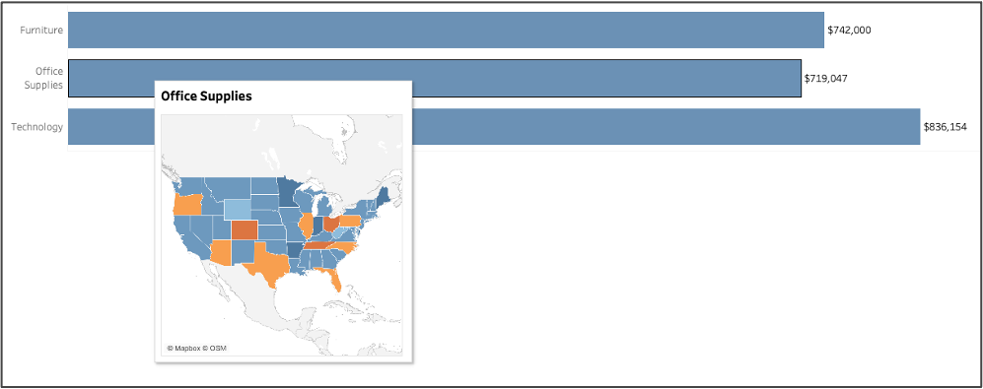
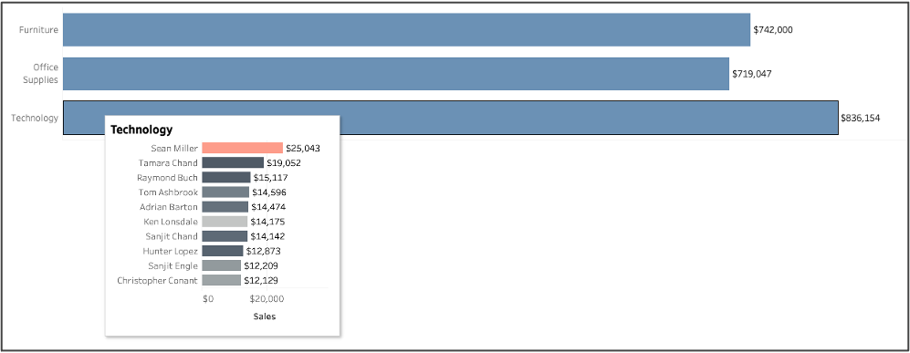
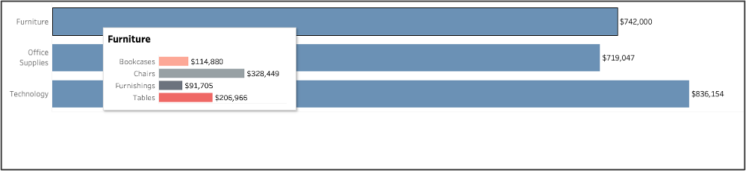
Dynamic Viz in Tooltips
You have different categories and want different vizes for each.
This requires some formatting of data to group things by category.
Using a calculated field and viz in tooltips to make

Slide 11
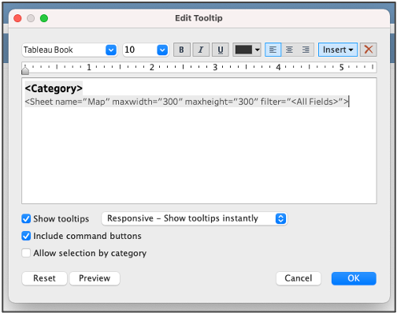
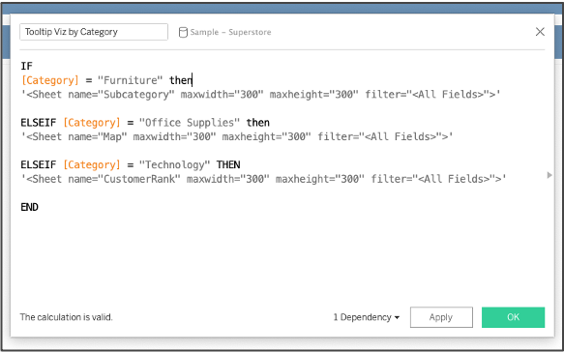
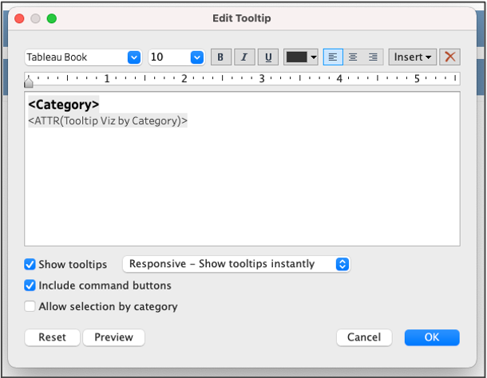
Dynamic Viz in Tooltips
1. Insert a Viz in tooltip
2. Copy the code and create a calculated field
3. Put that field as an ATTR in the tooltip
4. Repeat steps 1 and 2 in the same calculated field for each viz!
1
2
3

Slide 12
Tip or Trick or Treat
Guides and shape visibility on scatterplots - Jen Lesar (SFS)
Tooltips Cool Tricks, part 3: dynamic viz in tooltips - Laura Urciuoli (Resource Development)
Where the heck is this field used?! - Laura Urciuoli (Resource Development)
Parameters and hierarchies - Quan Nghiem (Resource Development)
Parameters for color mapping and aliases - Henry Hannon (Sloan)
Custom and accessible(!!) color palettes - Christine Malinowski (MIT Libraries)
Show/hide containers - Roshni Gohil (MITIMCo)
Notes:
Laura

Slide 13
Find that Field!
Removing field from data source
But where is it used?
Can’t just remove it! (Errors galore!)

Slide 14
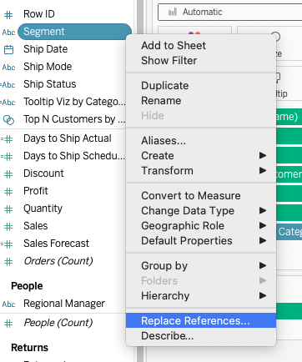
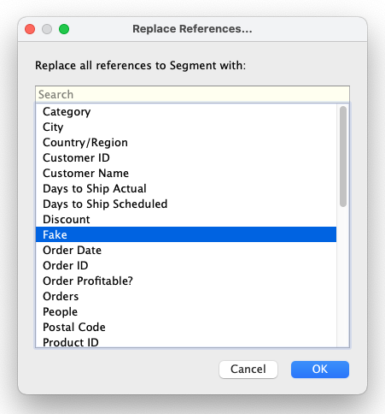
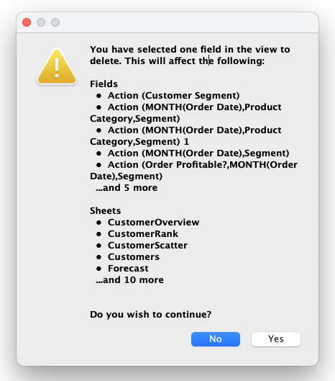
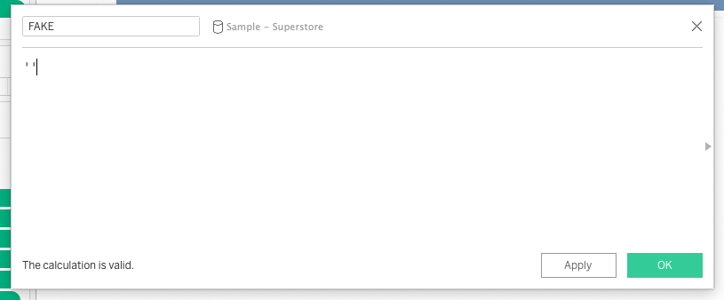
Find that Field!
Make a fake field
Replace References using fake field
Delete fake field!
If field isn’t being used, nothing will happen!
  If field is being used you’ll get an error!

Slide 15
Tip or Trick or Treat
Guides and shape visibility on scatterplots - Jen Lesar (SFS)
Tooltips Cool Tricks, part 3: dynamic viz in tooltips - Laura Urciuoli (Resource Development)
Where the heck is this field used?! - Laura Urciuoli (Resource Development)
Parameters and hierarchies - Quan Nghiem (Resource Development)
Parameters for color mapping and aliases - Henry Hannon (Sloan)
Custom and accessible(!!) color palettes - Christine Malinowski (MIT Libraries)
Show/hide containers - Roshni Gohil (MITIMCo)
Notes:
Laura

Slide 16
Tip or Trick or Treat
Guides and shape visibility on scatterplots - Jen Lesar (SFS)
Tooltips Cool Tricks, part 3: dynamic viz in tooltips - Laura Urciuoli (Resource Development)
Where the heck is this field used?! - Laura Urciuoli (Resource Development)
Parameters and hierarchies - Quan Nghiem (Resource Development)
Parameters for color mapping and aliases - Henry Hannon (Sloan)
Custom and accessible(!!) color palettes - Christine Malinowski (MIT Libraries)
Show/hide containers - Roshni Gohil (MITIMCo)
Notes:
Quan

Slide 17
Tip or Trick or Treat
Guides and shape visibility on scatterplots - Jen Lesar (SFS)
Tooltips Cool Tricks, part 3: dynamic viz in tooltips - Laura Urciuoli (Resource Development)
Where the heck is this field used?! - Laura Urciuoli (Resource Development)
Parameters and hierarchies - Quan Nghiem (Resource Development)
Parameters for color mapping and aliases - Henry Hannon (Sloan)
Custom and accessible(!!) color palettes - Christine Malinowski (MIT Libraries)
Show/hide containers - Roshni Gohil (MITIMCo)
Notes:
Quan

Slide 18
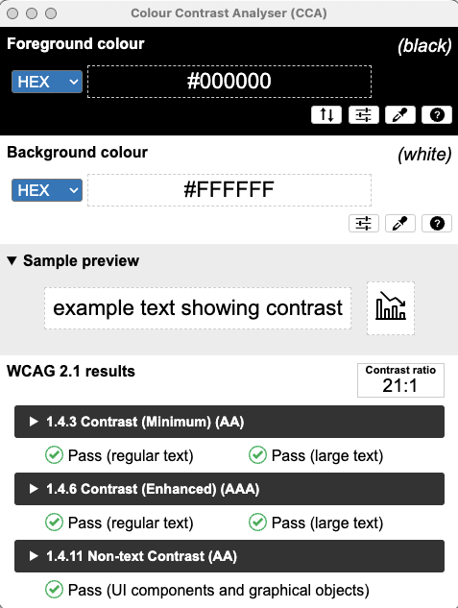
Create custom color palettes
Determine the hexadecimal values or RGB format for your desired palette colors.
Don’t forget color accessibility considerations. Utilize color accessibility tools to test for color blindness and color contrast issues.
ColorBrewer2
Coblis – Color Blindness Simulator
Colour Contrast Analyser (CCA)
Coolors (color palette generator)

Slide 19
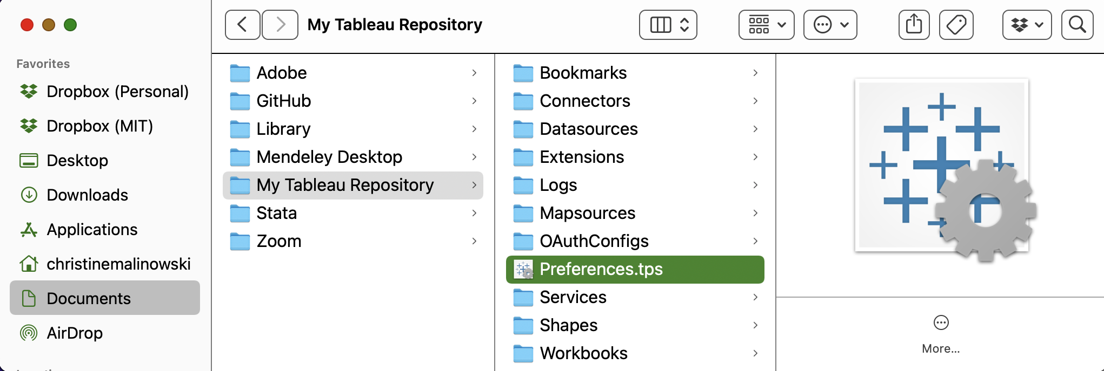
Create custom color palettes
Find your preferences.tps file in your “My Tableau Repository” folder and open it with a text editor (e.g., Notepad, TextEdit)

Slide 20
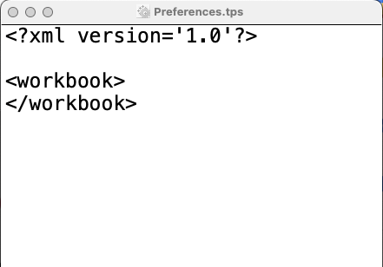
Create custom color palettes
Edit the Preferences.tps file to add your desired palette(s).
<? xml version='1.0'?>
<workbook>
<preferences>
<color-palette name="MIT colors" type="regular">
<color>#A31F34</color>
<color>#8A8B8C</color>
<color>#C2C0BF</color>
</color-palette>
</preferences>
</workbook>

Slide 21
Create custom color palettes
You can create the following types of color palettes
Categorical <color-palette name="CAT" type="regular">
Sequential <color-palette name="SEQ" type="ordered-sequential">
Diverging <color-palette name="DIV" type="ordered-diverging">
More information on setting up these different palettes on this Tableau page.

Slide 22
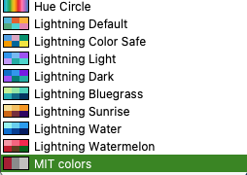
Create custom color palettes
Save the Preferences.tps file and restart Tableau Desktop. Your palettes will now be available.

Slide 23
Tip or Trick or Treat
Guides and shape visibility on scatterplots - Jen Lesar (SFS)
Tooltips Cool Tricks, part 3: dynamic viz in tooltips - Laura Urciuoli (Resource Development)
Where the heck is this field used?! - Laura Urciuoli (Resource Development)
Parameters and hierarchies - Quan Nghiem (Resource Development)
Parameters for color mapping and aliases - Henry Hannon (Sloan)
Custom and accessible(!!) color palettes - Christine Malinowski (MIT Libraries)
Show/hide containers - Roshni Gohil (MITIMCo)
Notes:
Christine

Slide 24
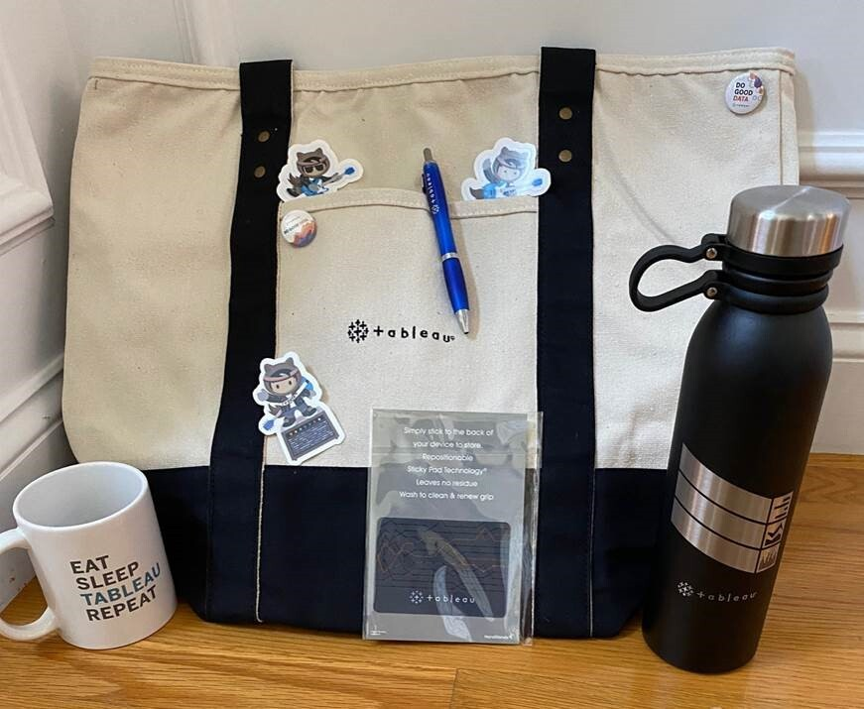
Anyone else want to share a tip?
Feel free to unmute and share your screen
Or if you’d like to share in the future, let us know
Notes:
Roshni

Slide 25
December MIT TUG Meeting
We’re looking for presenters and topics
Want to present? Want to see something?
Contact us:
Join the Chat w/ MIT TUG leads breakout room
Slack us at #ask-mit-tug-leads
Email us at mit-tableau-user-group-admin@mit.edu
More info: https://wikis.mit.edu/confluence/display/MITTUG/
Notes:
Roshni

Slide 26
Important Links
MIT TUG
Wiki
wikis.mit.edu/confluence/display/MITTUG/
Slack
mit-tableau.slack.com
Join the email list
mailman.mit.edu/mailman/listinfo/mit_tableau_user_group
Contact MIT TUG co-leads
  #ask-mit-tug-leads on Slack
  mit-tableau-user-group-admin@mit.edu
Other Higher Ed Tableau Resources
Higher Ed TUG (HETUG)
usergroups.tableau.com/HigherEducation
Slack
higher-ed-tableau.slack.com
Community Group
community.tableau.com/s/group/0F94T000000gQYoSAM/higher-education
Notes:
Post in chat:
MIT TUG wiki, aka where all the links are: https://wikis.mit.edu/confluence/display/MITTUG
Join us on Slack: https://mit-tableau.slack.com
Higher Ed TUG (HETUG): usergroups.tableau.com/HigherEducation
Slack: higher-ed-tableau.slack.com

Slide 27
Stick around to chat
Breakout rooms:
AMA with Jeremy and Denise (Tableau)
Chat with MIT TUG leads
Other topics?
Notes:
Roshni

