Slide 1

e-Builder
MOU & Stage 1 - MPBE
Bob Brosseau
e-Builder Trainer
e-Builder Training| May 2017

Slide 2
MOU and Stage 1 Budget
Automatically started at the conclusion of the CRSP Screening Process. The PM does not typically have to launch the MOU and Stage 1 Budget Process.
PM should see the process in their court when they assume management of the project.

Slide 3
Process Output
Three key functions of the MOU Process
Provides draft content about the project for the MOU to the Provost office that is used to create the draft MOU.
Provide a mechanism for project team members so that they to review the draft MOU and provide comments to the Provost office used to create the final, printable MOU that is distributed by the Provost office.
After the MOU is approved, provides a mechanism for the PM to create the Stage 1 Estimate and to gain approvals to move the project forward.
Starts the 3.01 Milestone Project Estimate. It appears in the Project Manager’s court for completion.

Slide 4
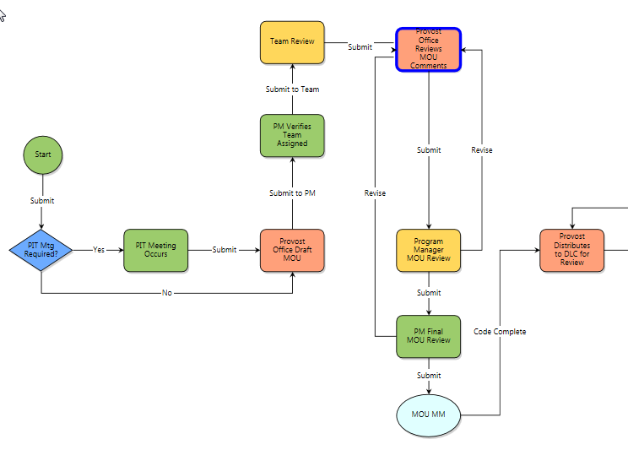
Creating the MOU
This sequence of process steps produces the MOU, which the Provost distributes to the DLC.
The Provost office is the primary actor creating the MOU.
Use the process as designed. Information being used for the MOU can be edited and reviewed on the process page.
Do not print and distribute the MOU document before the MOU MM step has completed.
After 3 Days in the Team Review step the PM gets a notification.
After 7 days in Team Review the eB Admin receives a notification to move the process out of Team Review and forward to the Provost Office.
Enter the appropriate topical text into the process text boxes. Putting information under the wrong heading will cause rework for the MOU to print properly.

Slide 5
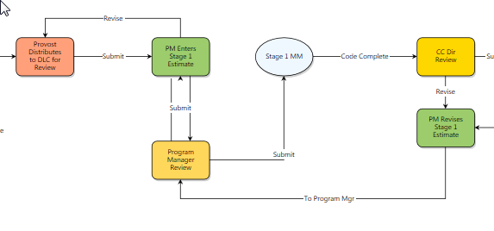
Stage 1 – Process Step Sequence

Slide 6
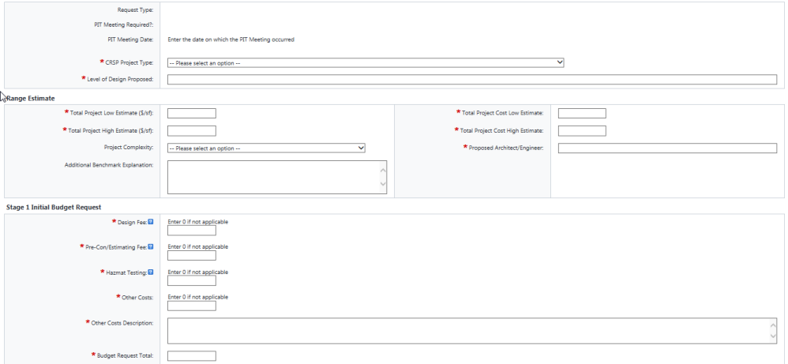
Stage 1 Fields Completed by PM

Slide 7
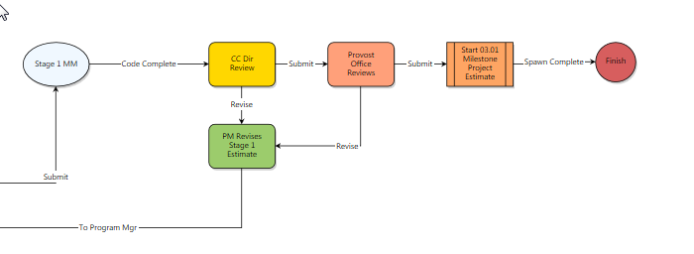

Start 3.01 MPEB Process
Following Provost Office Review the MPEB Process is Started and will appear in the initiator’s (PM’s) court.

Slide 8
Processes:
Helpful Skills to Know
Filtering to view a process
Using Submit and Revise steps (revise allows for a reviewer to request a correction or ask questions)
Comments – making and requesting
Attaching documents to processes
Print merge template (Current View and Merge Templates)
Show History, Current Actors, Workflow Diagram

Slide 9
MOU Stage 1
Known Issue(s) – May 2017
The merge template will not accurately reproduce font and or font size for text generated from rich text boxes. This is a known issue in e-Builder with an unknown resolution date.
The work around is to download the document and edit in in Word. Upload the final version after editing.

