Slide 1
MIT Tableau User Group
(MIT TUG)
July 12, 2022
Join the conversation on Slack
mit-tableau.slack.com
Yes, we are recording the session
The recording will be sent out and posted on Slack

Slide 2
Agenda
What is the MIT TUG
Tableau Resources
Tooltip Cool Tricks
Summer Projects Chat

Slide 3
What is the MIT TUG?
A community of Tableau users, and those who want to use or are thinking about using Tableau, across MIT
Open to anyone
Any MIT department
All skills levels: none to novice to Jedi
Those who use Tableau only, and those who use Tableau with other data tools
Users of any Tableau product (Desktop, Prep, Server, Online, DataDev)

Slide 4
How It Works
Virtual meetings every other month
Community-informed topics
Presentations (informal or formal) specific to Tableau at MIT
Opportunities to meet other Tableau users at MIT
MIT Tableau Slack: mit-tableau.slack.com
Join the email list: mailman.mit.edu/mailman/listinfo/mit_tableau_user_group

Slide 5
Participate How You Like
Be active
present, share, ask and/or answer questions
Lurk
watch, listen, learn
Anything in between
If you want to present and/or have a topic you want to see, contact the leads
#ask-mit-tug-leads on Slack
mit-tableau-user-group-admin@mit.edu

Slide 6
Tableau Resources
Tableau Whitepapers - Roshni
  Visual Analysis Best Practices
  Designing Efficient Workbooks
Visual Vocabulary - Quan
Flerlage Twins - Christine
Sir Viz-a-Lot - Laura
HETUG Slack/Meetings - Jen

Slide 7

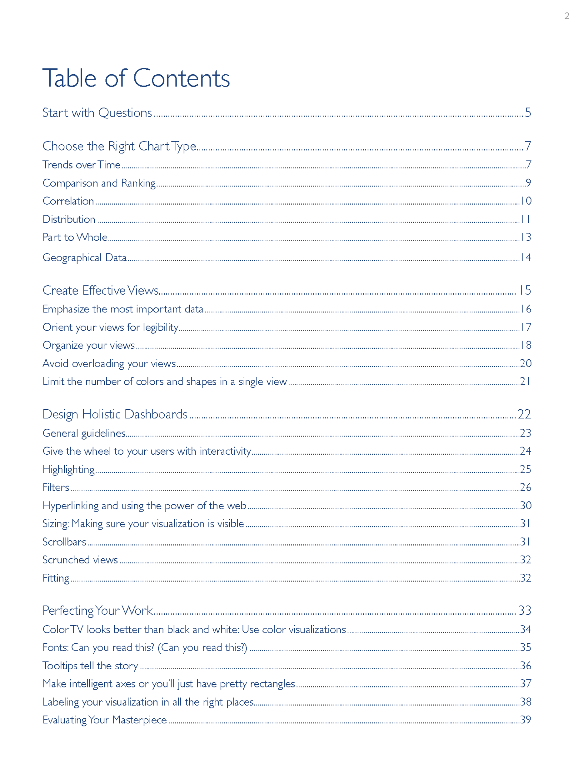

Slide 8
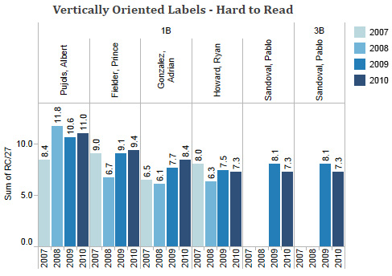
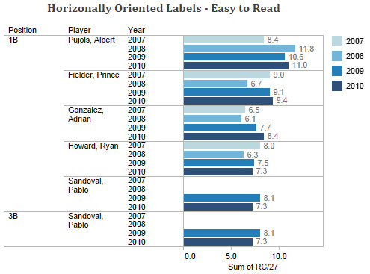

Slide 9
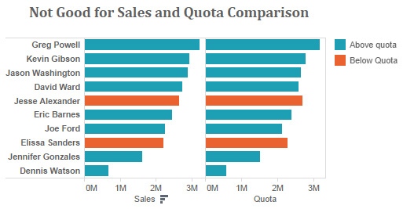
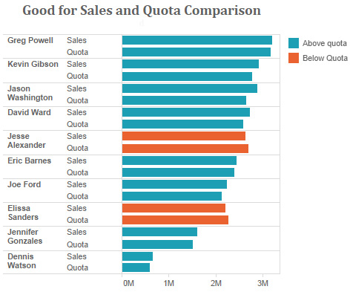
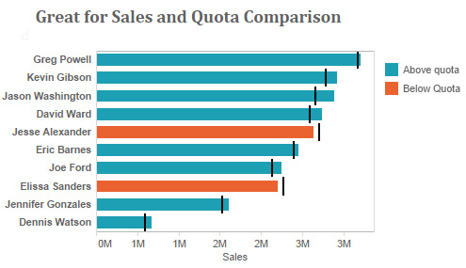

Slide 10
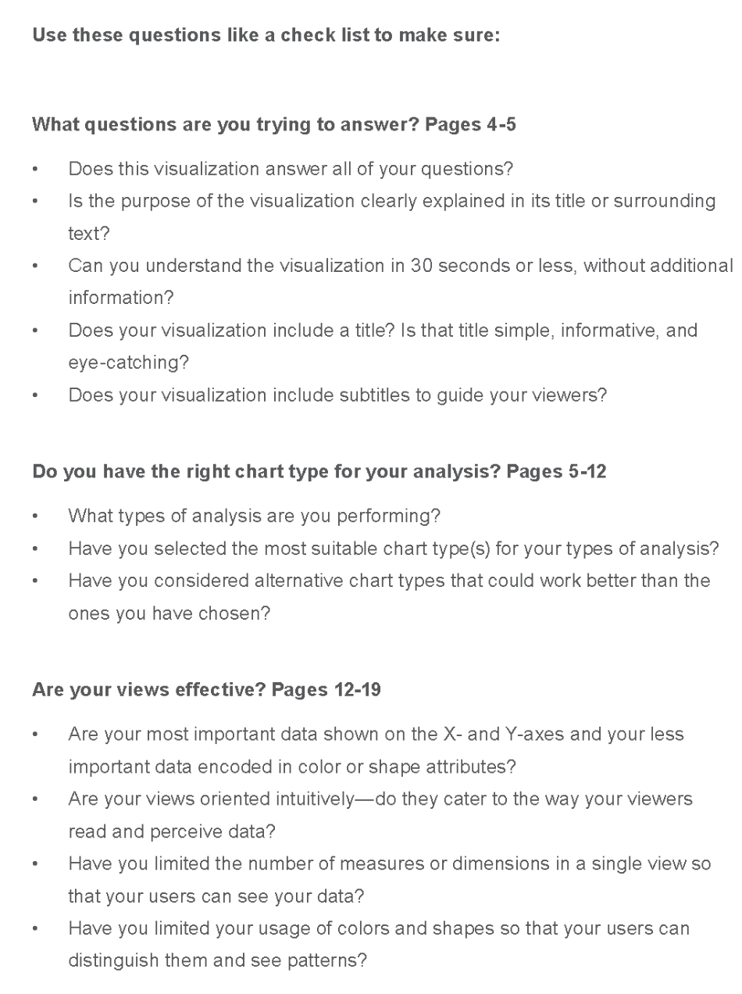
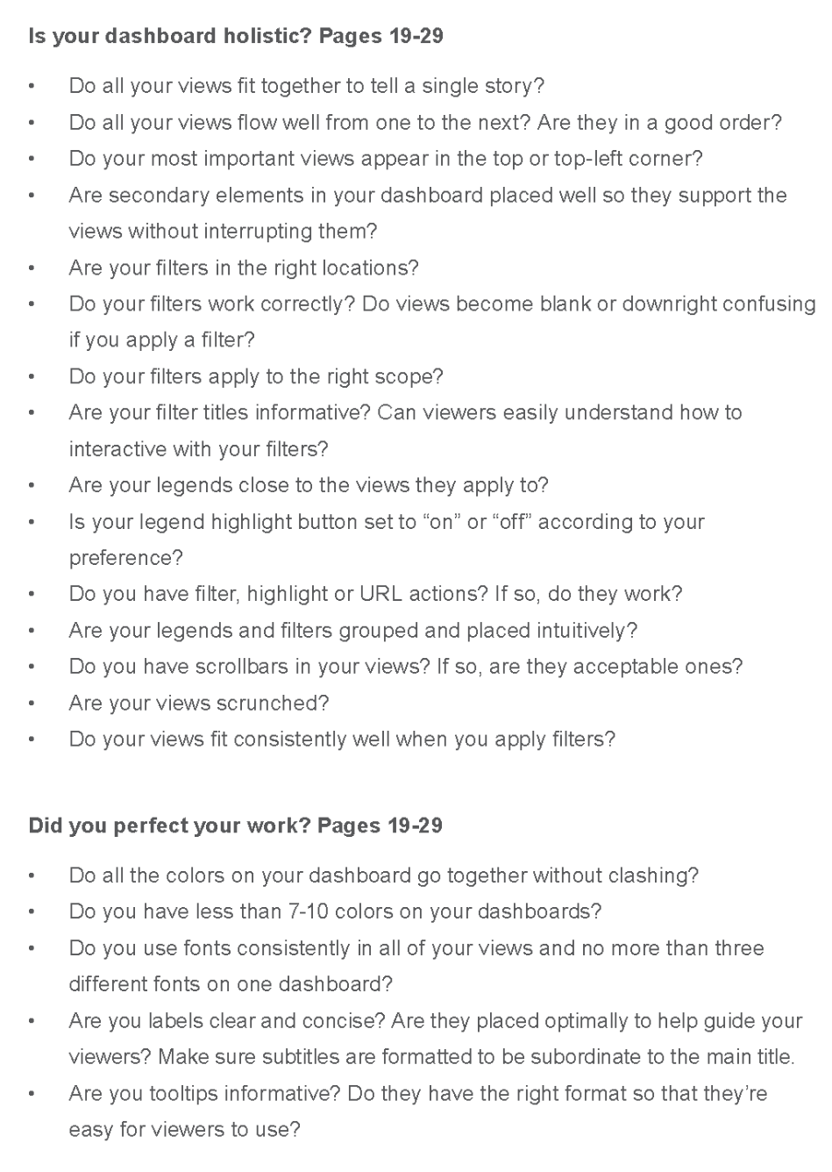

Slide 11

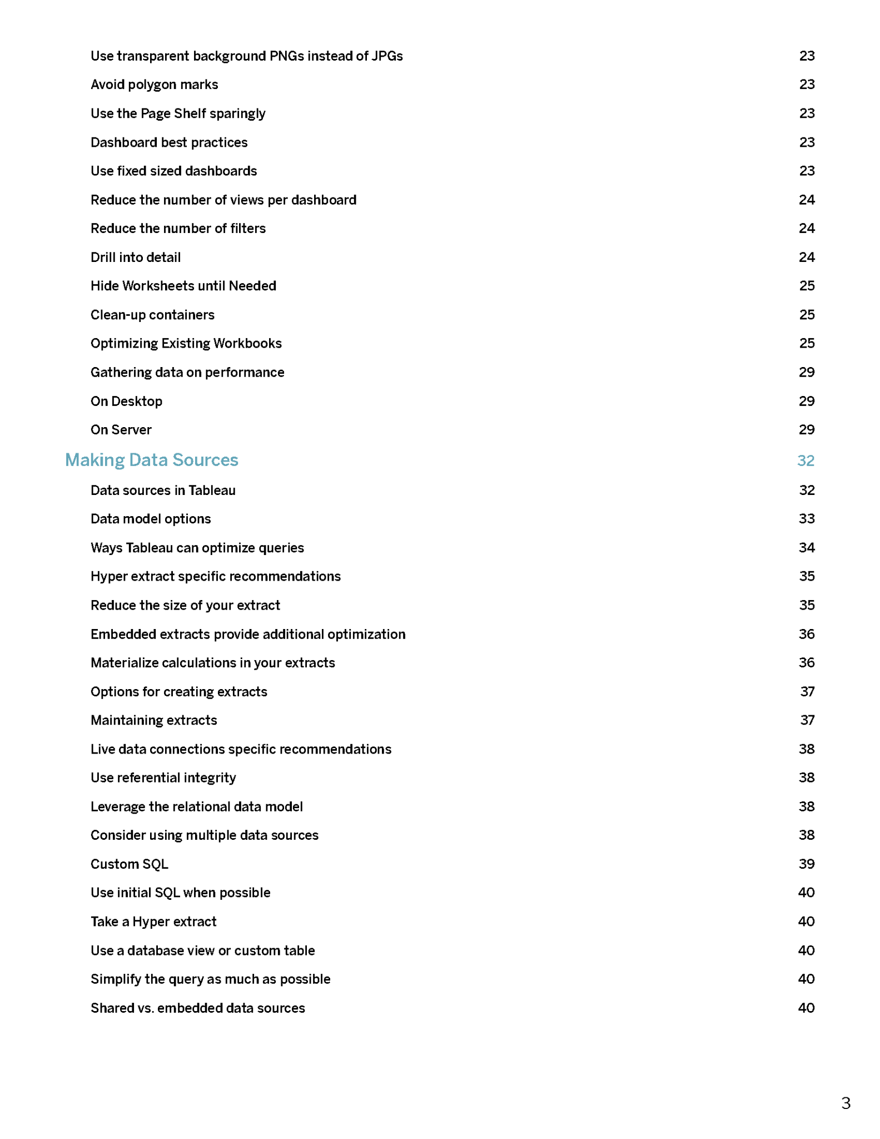
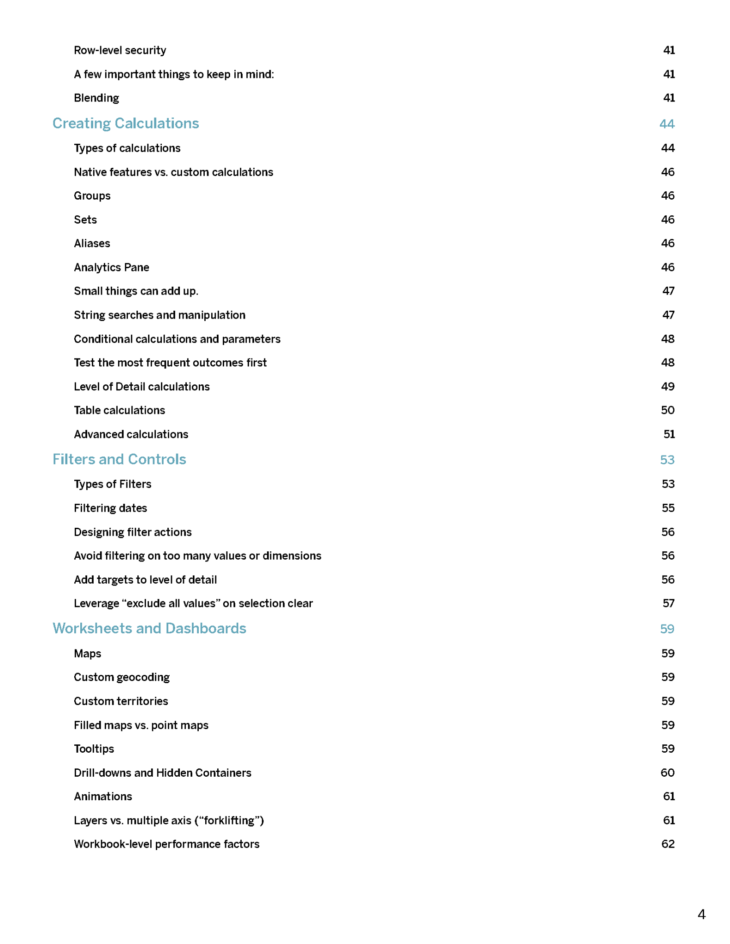
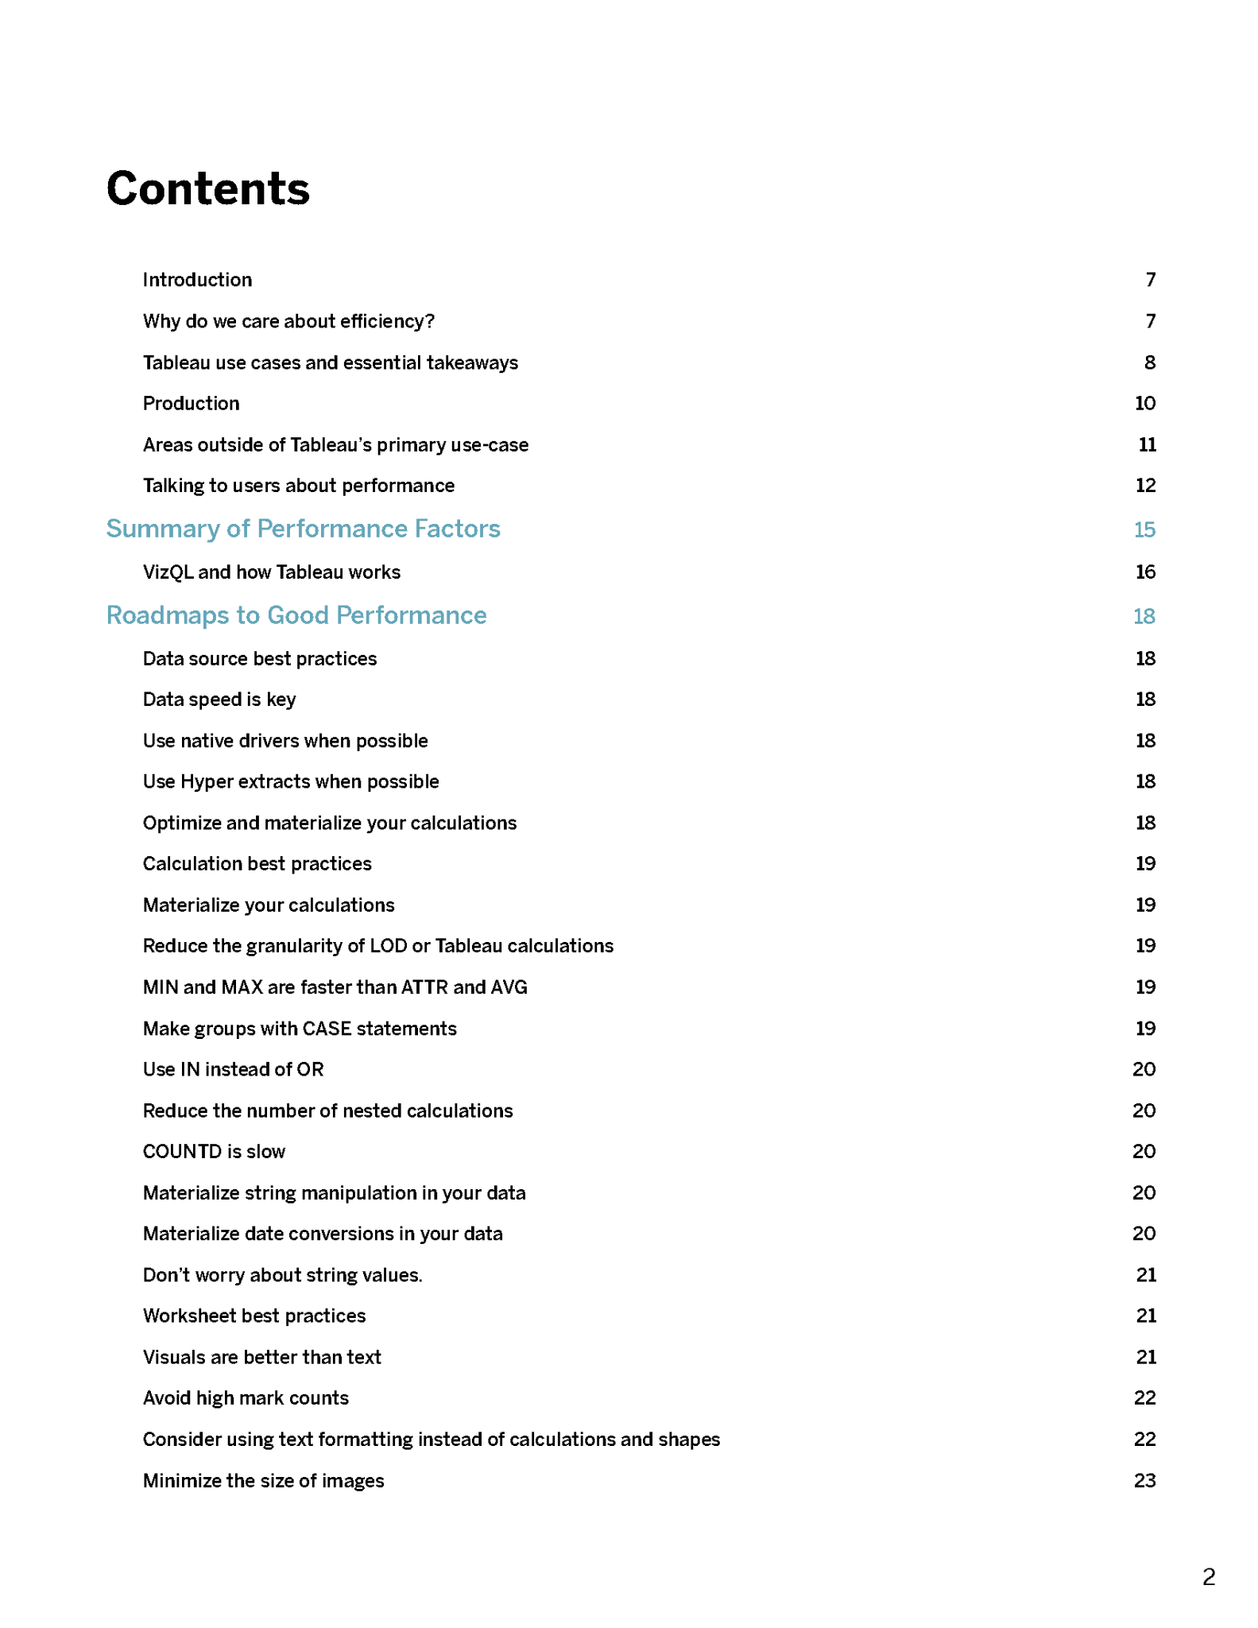
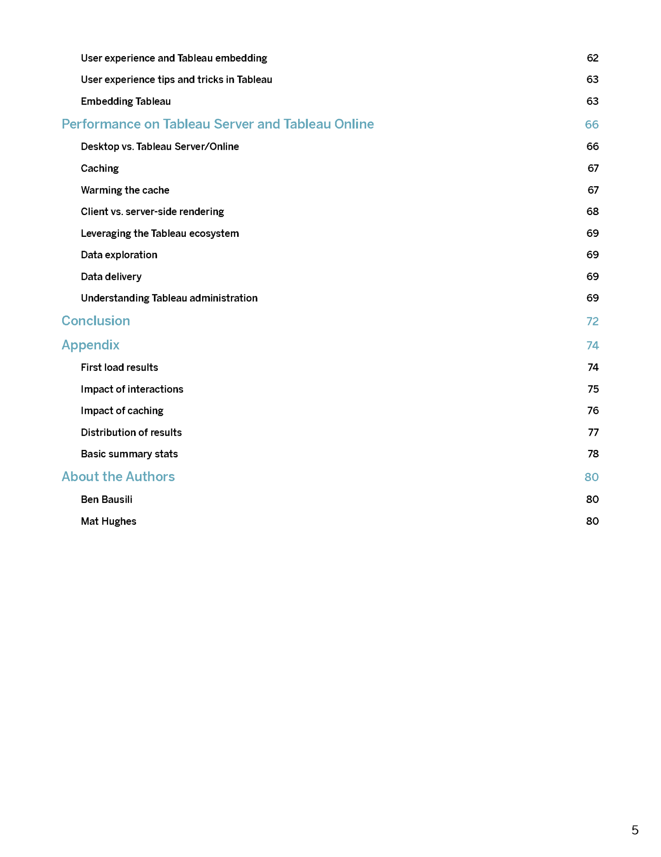
80+ PAGES

Slide 12
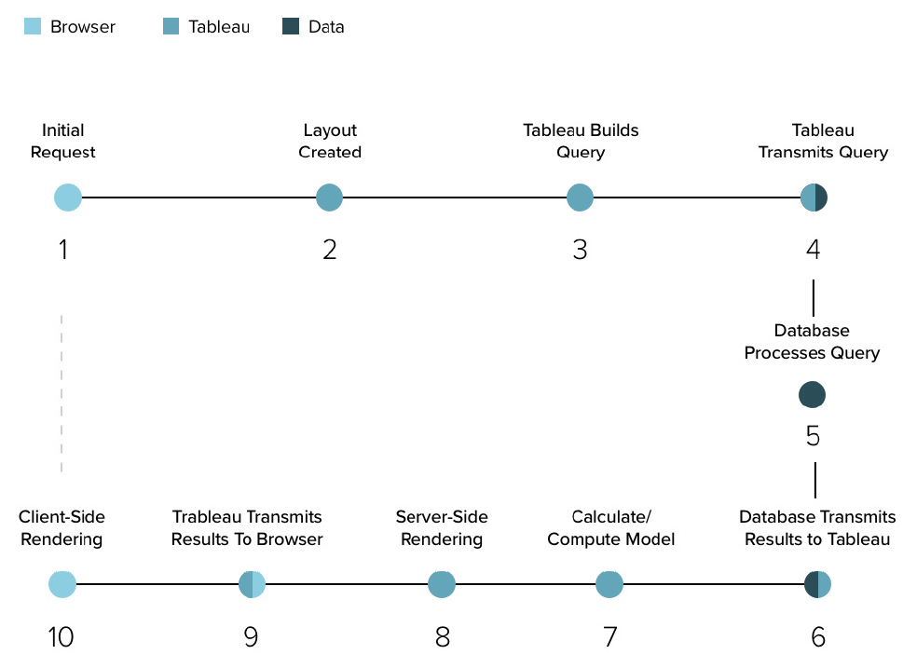

Slide 13
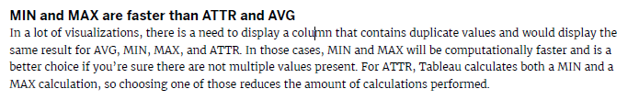
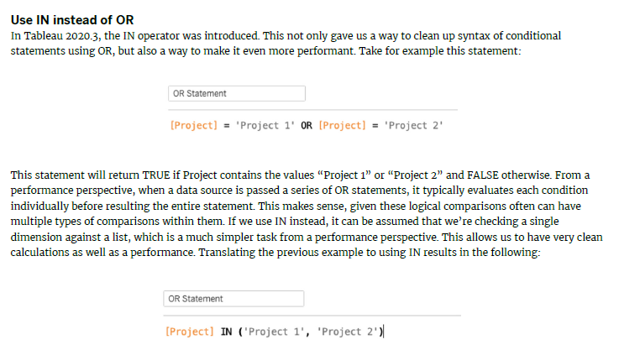

Slide 14
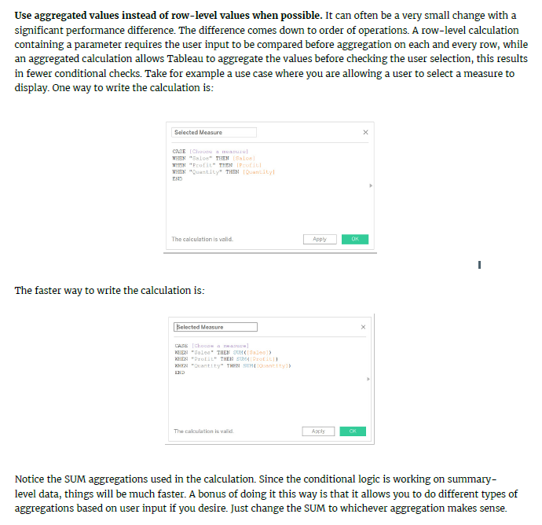

Slide 15
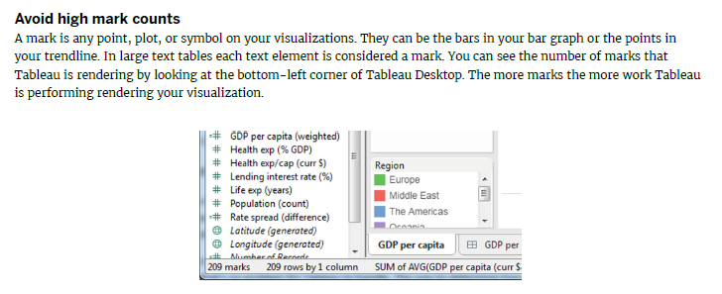

Slide 16
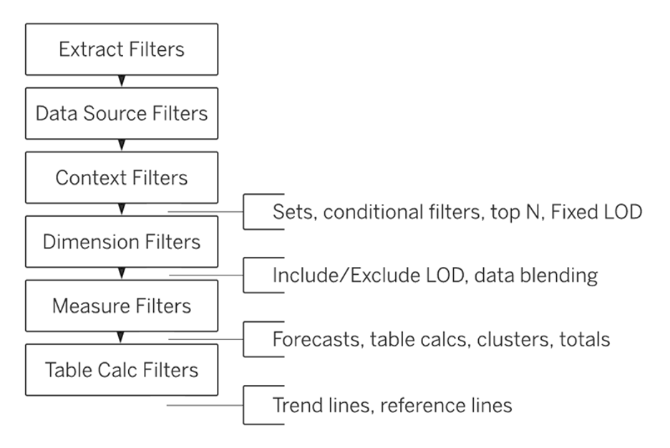

Slide 17
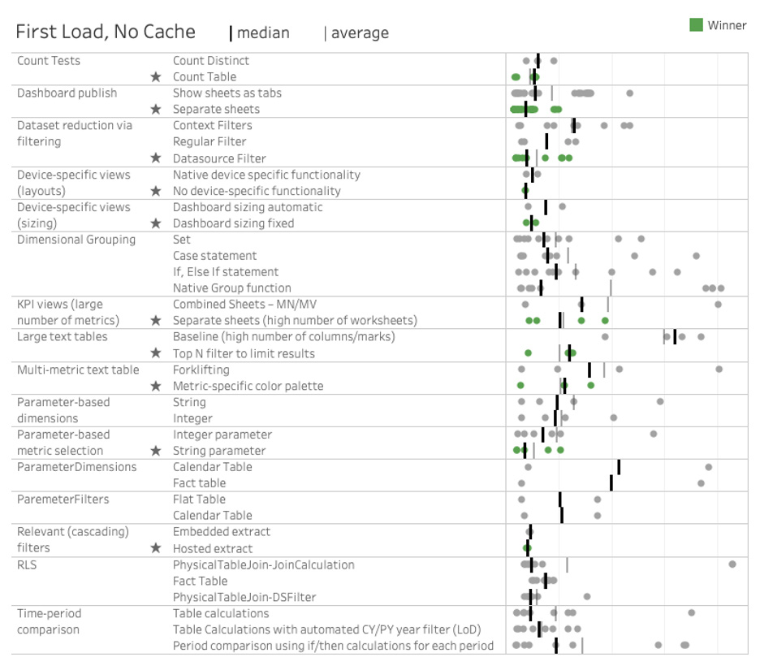

Slide 18
Tableau Resources
Tableau Whitepapers - Roshni
  Visual Analysis Best Practices
  Designing Efficient Workbooks
Visual Vocabulary - Quan
Flerlage Twins - Christine
Sir Viz-a-Lot - Laura
HETUG Slack/Meetings - Jen

Slide 19

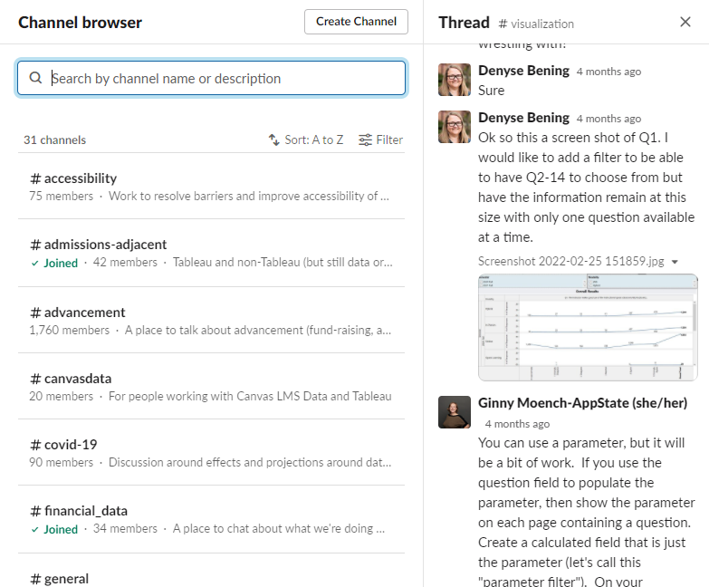
HETUG Slack/Meetings
Slack/Meetings
  higher-ed-tableau.slack.com
  usergroups.tableau.com/HigherEducation
Monthly meetings
31 channels (as of June 2022)
Lots of Q & very quick A
Ken Flerlage, Ginny Moench, Roshni Gohil and other Tableau Ed superstars

Slide 20
Do YOU have any resources you’d like to share?
The resources we shared (AND MORE!) are on the MIT TUG wiki:
wikis.mit.edu/confluence/x/gQeuCg

Slide 21


Tooltips
Cool Tricks

Slide 22
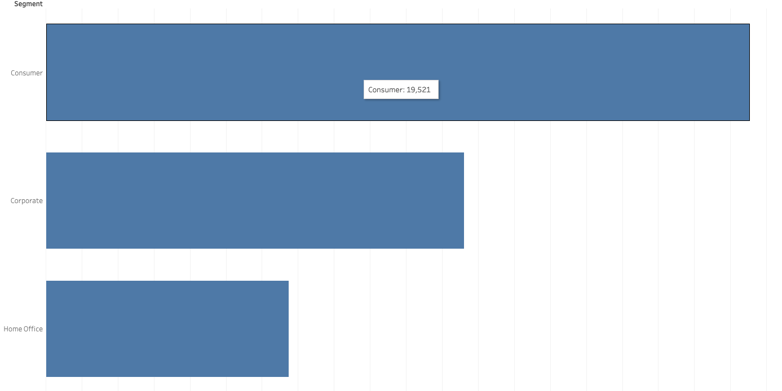
Refresher: What are Tooltips?
Tooltips are the info box that appears when hovering over a viz object

Slide 23
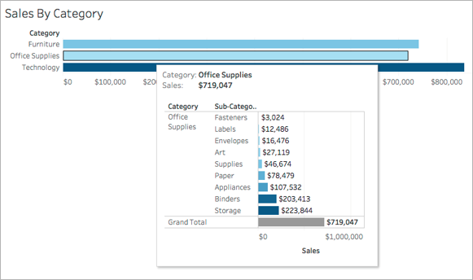
Viz IN tooltips
You can insert a sheet into a tooltip!

Slide 24
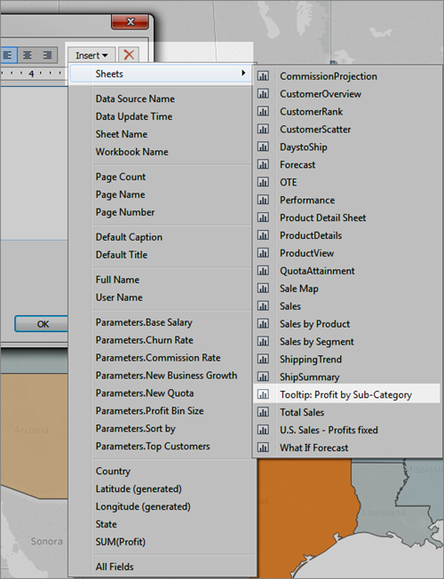
Viz IN tooltips: How to
First you’ll create a tooltip
Select insert on the top right, there’s an option for sheets
Select the sheet you want to show up
By default it will filter on all fields

Slide 25
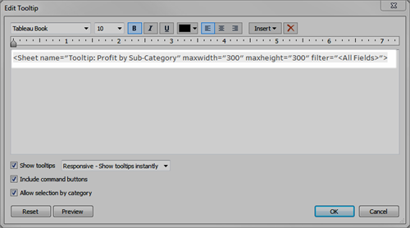
Viz IN tooltips: Troubleshooting
Viz might be too big, you will need to resize your tooltip
Might want to change the filters
Use the code to edit

Slide 26
Time to get more complicated…
TUNE IN NEXT TIME FOR…
DYNAMIC VIZ IN TOOLTIPS!
Where we can change the tooltip depending on what you’re hovering over!
Photos from: https://help.tableau.com/current/pro/desktop/en-us/viz_in_tooltip.htm

Slide 27


Tentative TUG Timeline
Tableau Tuesday Tappy H(t)our
August or September
Slack polls: when and where?
Tableau Tip or Trick or Treat
October
Have a tip or trick to share?

Slide 28
Important Links
MIT TUG
Wiki
wikis.mit.edu/confluence/display/MITTUG/
Slack
mit-tableau.slack.com
Join the email list
mailman.mit.edu/mailman/listinfo/mit_tableau_user_group
Contact MIT TUG co-leads
  #ask-mit-tug-leads on Slack
  mit-tableau-user-group-admin@mit.edu
Other Higher Ed Tableau Resources
Higher Ed TUG (HETUG)
usergroups.tableau.com/HigherEducation
Slack
higher-ed-tableau.slack.com
Community Group
community.tableau.com/s/group/0F94T000000gQYoSAM/higher-education

Slide 29
Stick around to chat
Want to present? Want to see something?
Contact us:
Slack us at #ask-mit-tug-leads
Email the MIT TUG co-leads at mit-tableau-user-group-admin@mit.edu

