Slide 1
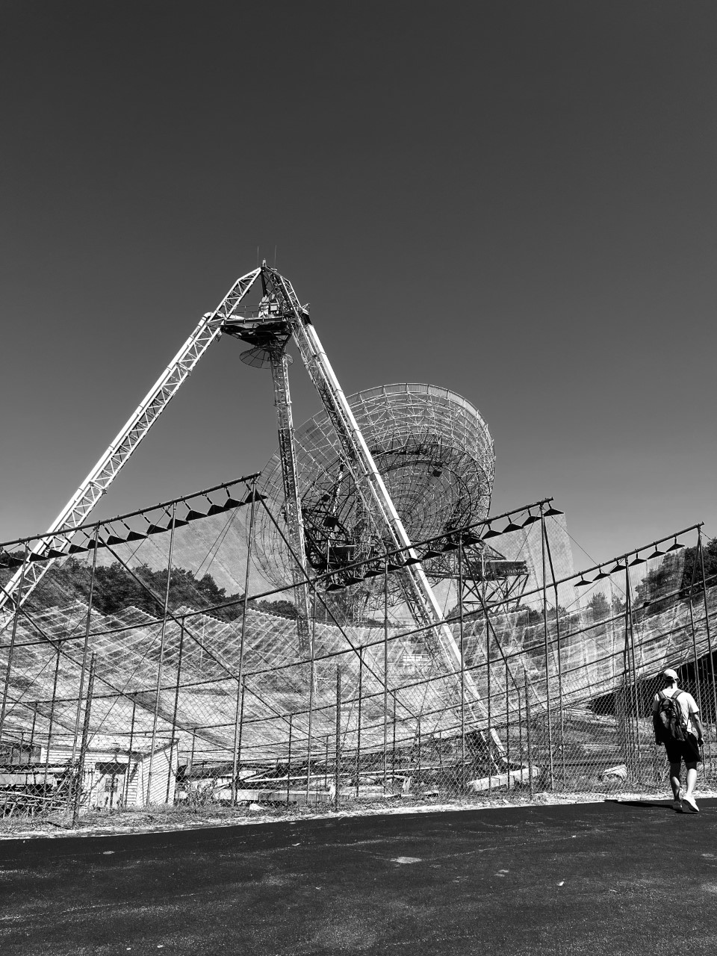
ISR Summer School 2022
Investigating the Impact of Increased Solar Activity on the Mid and High-latitude Ionosphere
Wei Zhang, Lujain Almarhabi,Rachel Boedicker, Rachel Conway,

Slide 2
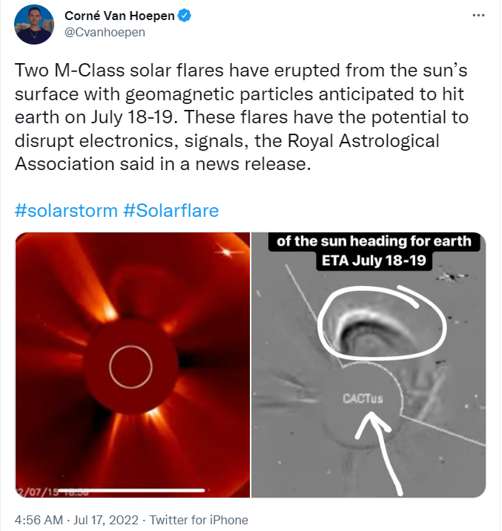
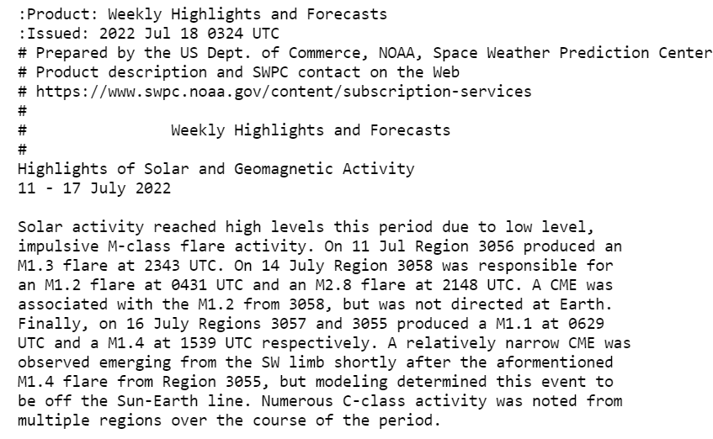
Motivation
Strong solar activity in the days leading up to July 18
Forecasted kp index of 3 from 6-8pm July 18th
1

Slide 3
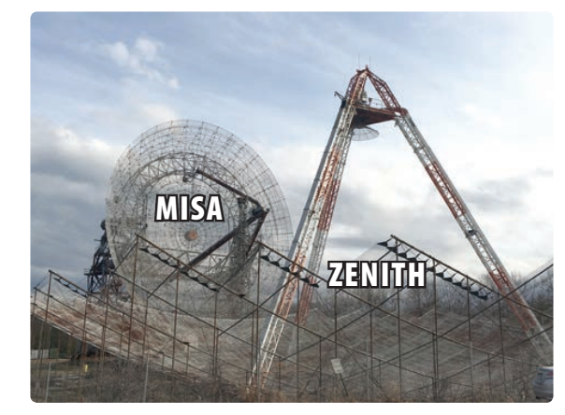
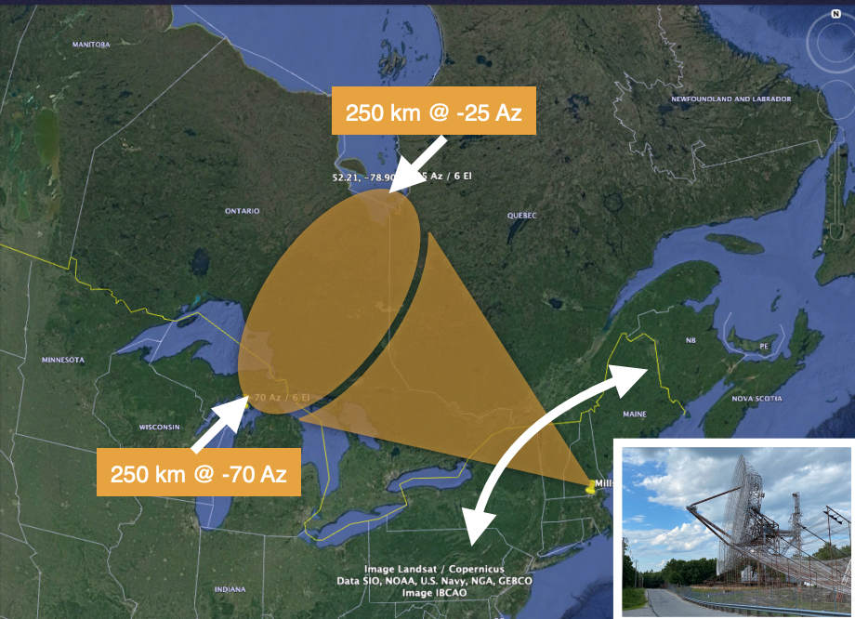
Experiment Design
Experiment Type C
Timeslot: 18 - 20 LT (22-24)UT
MISA
  Limited radar coverage in latitude and longitude (6 deg elevation, and -25 to -75 deg Azimuth)
ZENITH
  68m fixed antenna system creates zenith profiles at end of each scan
Millstone Hill ISR Summer school 2022
2

Slide 4
Scientific Objectives
Attempt to observe Subauroral Polarization Streams (SAPS)
Attempt to observe effects of elevated geomagnetic index
Attempt to observe Storm Enhanced Density (SED)
3

Slide 5
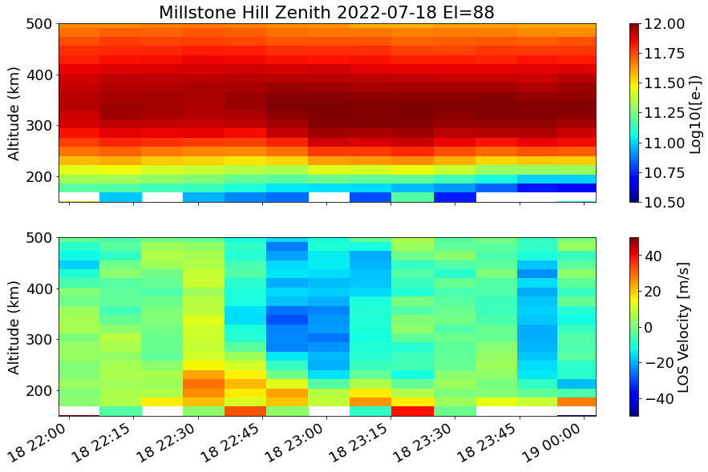
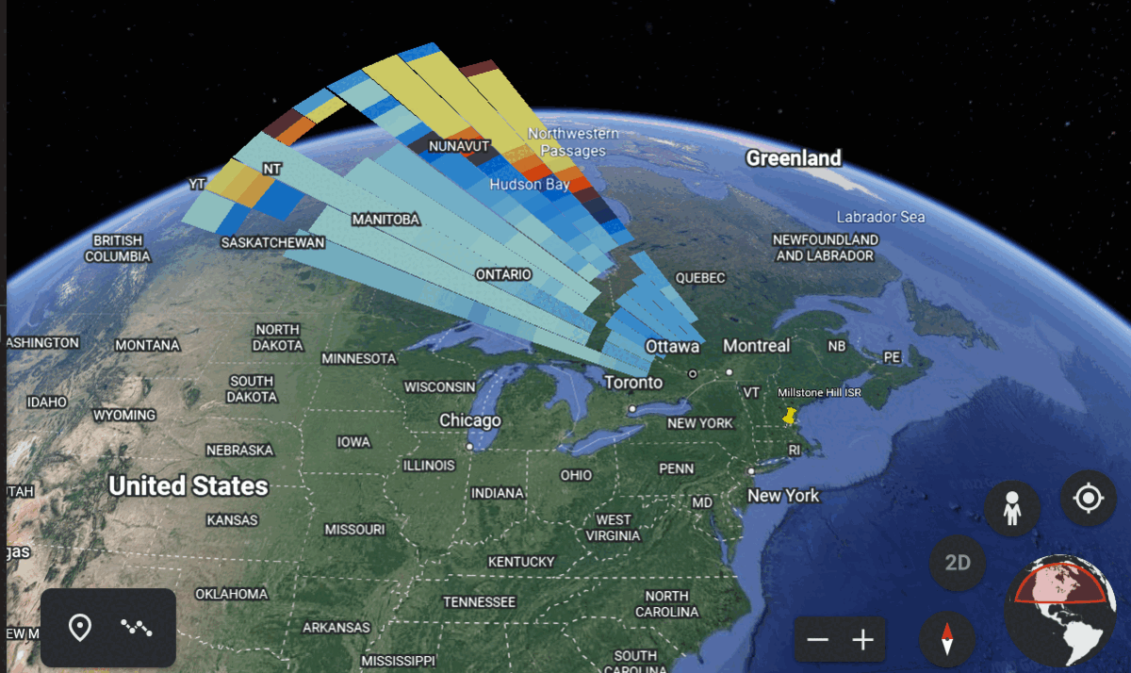
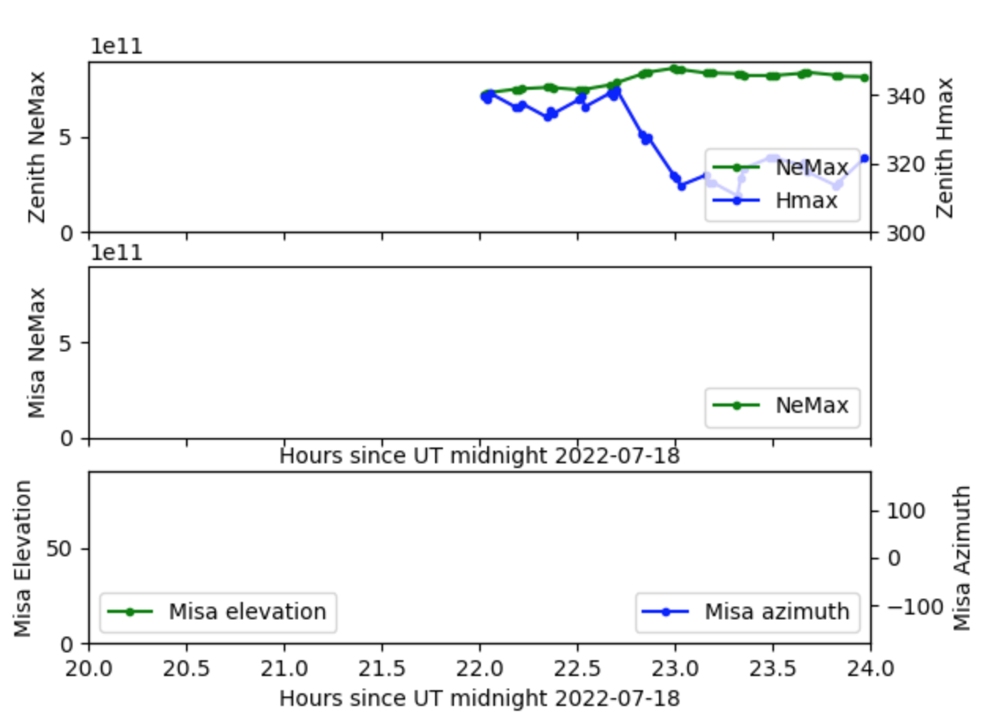
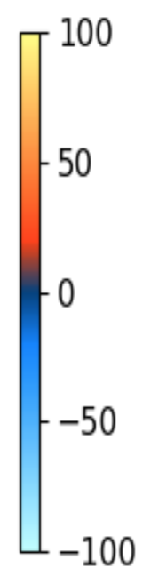
Overview MISA SCAN and zenith data
Line-of-Sight Velocity
For our timespan:
no evident density fluctuations;
Plasma move downward around UT =23, consistent with the maximum Ne altitude
4

Slide 6
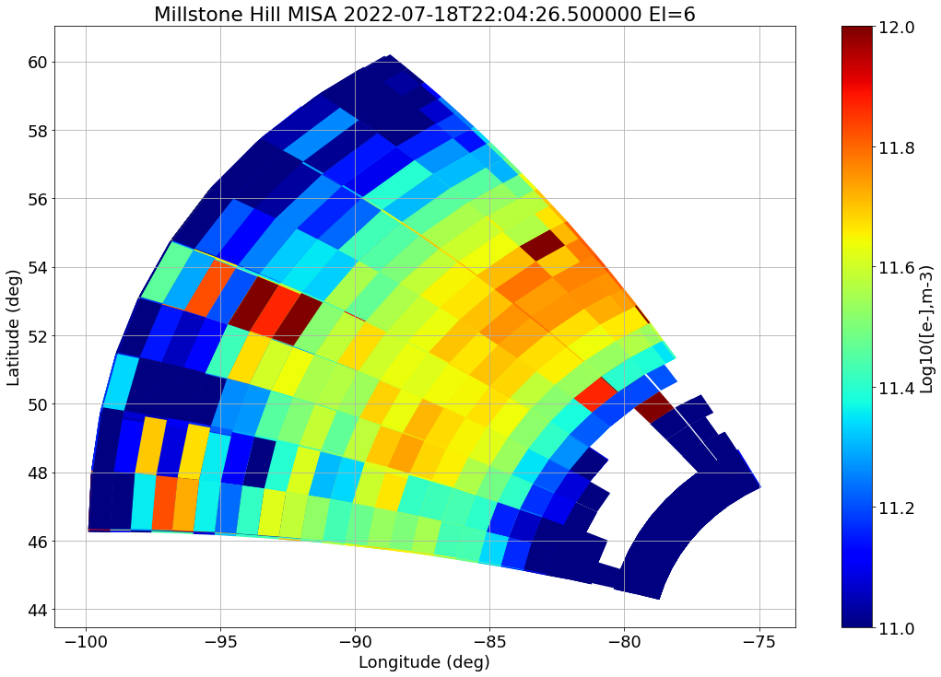
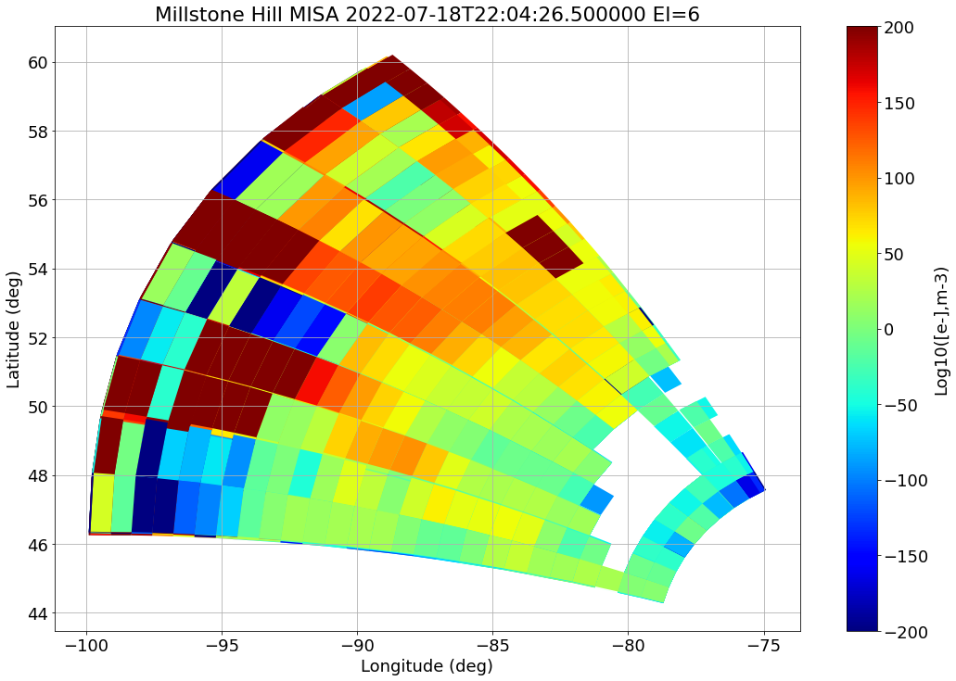
MISA SCAN
Density scanning
Velocity scanning
Longitude range: [75 W, 100 W]
Latitude range: [44.5 N, 62.5 N]
High Density at central region, F2 region
LOS velocity is general positive, moving away from radar, indicating the west convection moving component.
5
Notes:
MISA Scan Plot using Erickson script from GitHub
Electron Density and

Slide 7
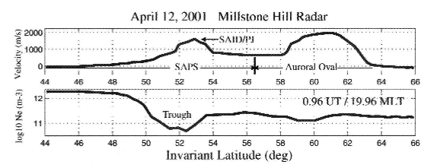
Sub-Auroral Polarization Streams (SAPS)
Westward plasma flows driven by enhanced poleward electric fields in the the subauroral ionosphere region.
Why study SAPS?
  Structuring
  GPS Scintillation
When observed?
  Dawn-midnight
  Winter
  Active geomagnetic periods
6
Notes:
Subauroral polarization streams are regions in the sub-auroral ionosphere with lower plasma density and large westward flow driven by a poleward electric field.
Density irregularities have been observed in the SAPS region and therefore they are of great interest due to negative impact of the density irregularities on radio signals causing phase and amplitude fluctuations.

Slide 8
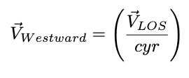
Sub-Auroral Polarization Streams (SAPS)
Measuring the westward velocity
Assumption
  Magnetically westward flow
7
Notes:
Assumption:
All of the flow is magnetically westward so using a projection angle to convert line-of-sight velocity into magnetically westward flow

Slide 9
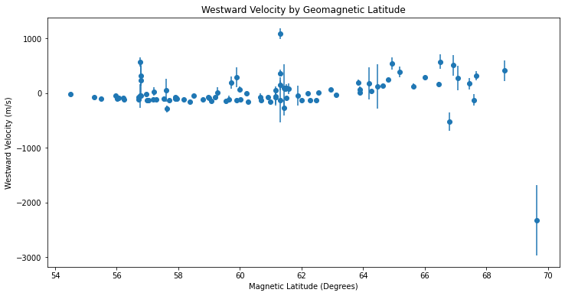
Sub-Auroral Polarization Streams (SAPS)
Millstone Hill Westward velocities at (17:00 MLT)
8
Notes:
Assumption:
All of the flow is magnetically westward so using a projection angle to convert line-of-sight velocity into magnetically westward flow
Results:
-SAPS: Observed Westward velocities were below the threshold of those typically/usually are associated with SAPS (200 m/s)
-Density and east-west velocity at F peak, selected MLT.

Slide 10
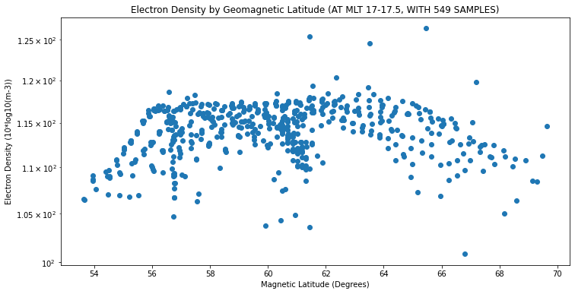
Sub-Auroral Polarization Streams (SAPS)
Millstone Hill densities at (17:00 MLT)
9
Notes:
Assumption:
All of the flow is magnetically westward so using a projection angle to convert line-of-sight velocity into magnetically westward flow

Slide 11
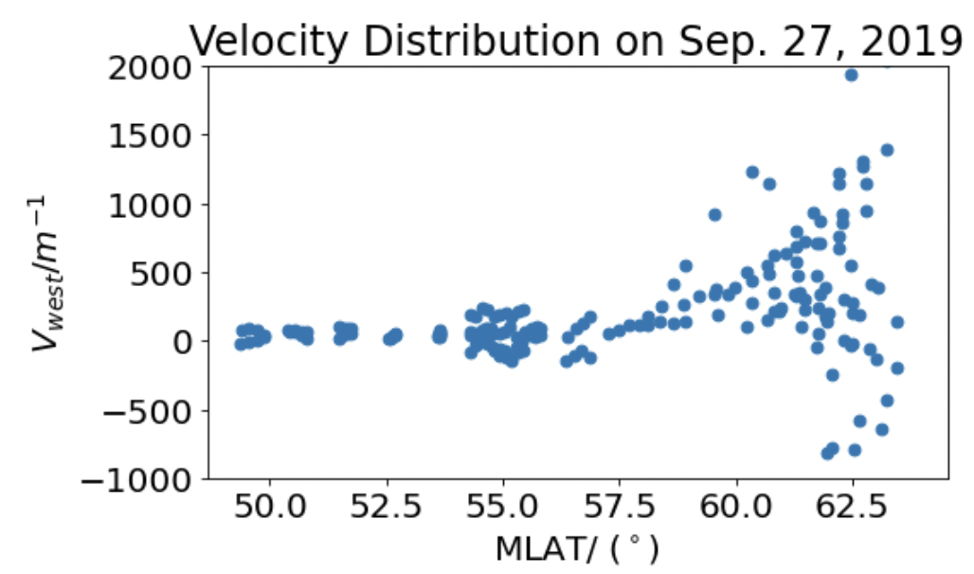
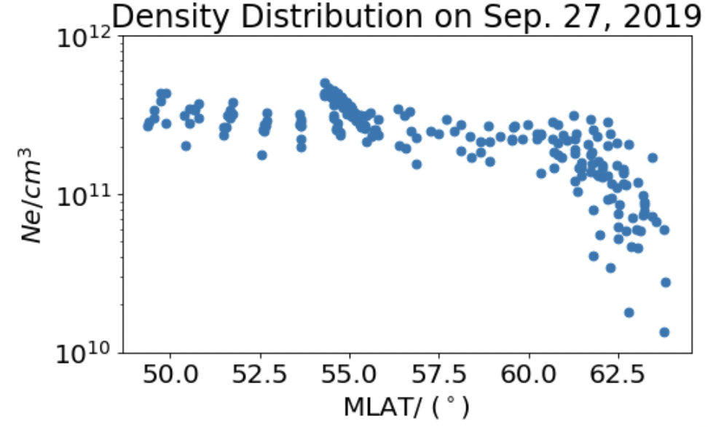
Comparison to Historical Data
Millstone Hill Data July-18-22
Millstone Hill Data Sep-27-19
[Ercha et al., 2021]
10
Notes:
-Density drops and westward velocity increases for SAPS event at MLat ~ [60, 62.5], where the SAPS happens [Ercha et al., 2021]
- RHS: at certain altitude where the F peak is where the LHS is at
- RHS: Data at same time (21-24 UT): A minor but geo-effective storm at deep solar minimum produced

Slide 12
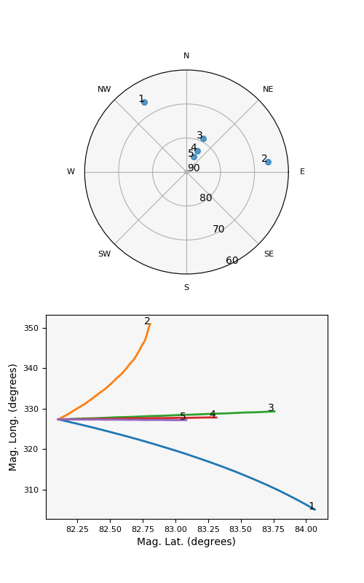
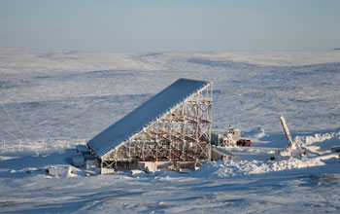
High-latitude: Observations from RISRN
Beam 1 (NW) : azimuth -31, elevation 65
Beam 2 (E): azimuth 83, elevation 65
11

Slide 13
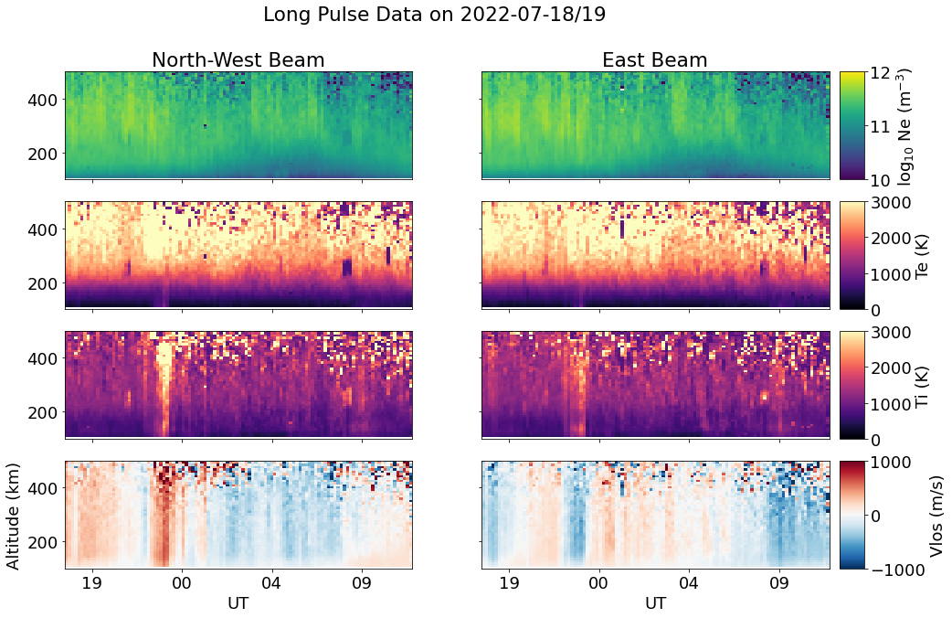
High-latitude: Observations from RISRN
Strong ion temperature enhancement during our two hour observation window. Elevated temperatures align with strong line of sight velocities.
12

Slide 14
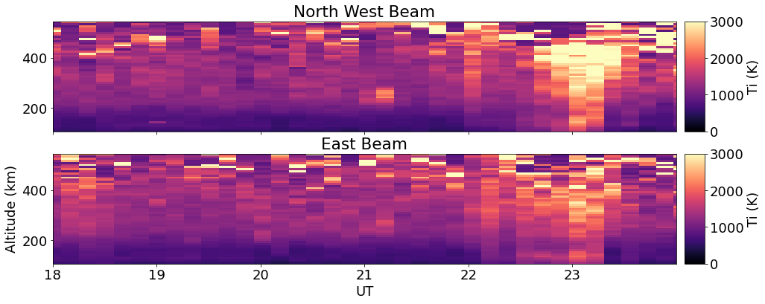
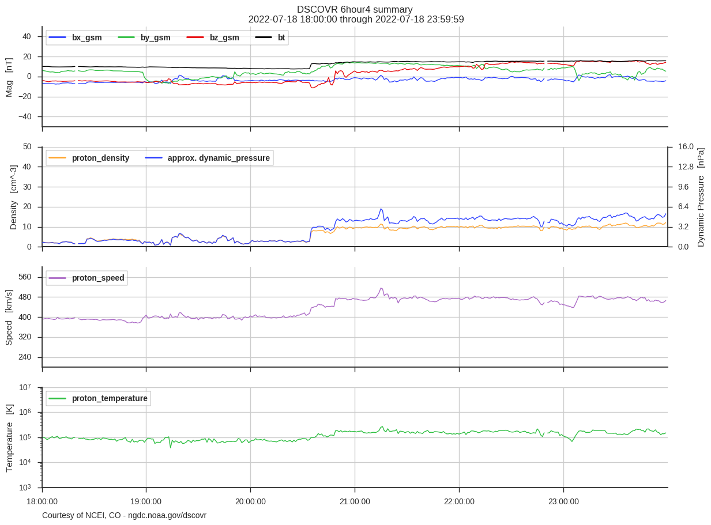
Bz ~= +15nT
Compare ion temperature enhancements to the IMF measurements made by DSCOVR. Strong Bz component
13

Slide 15
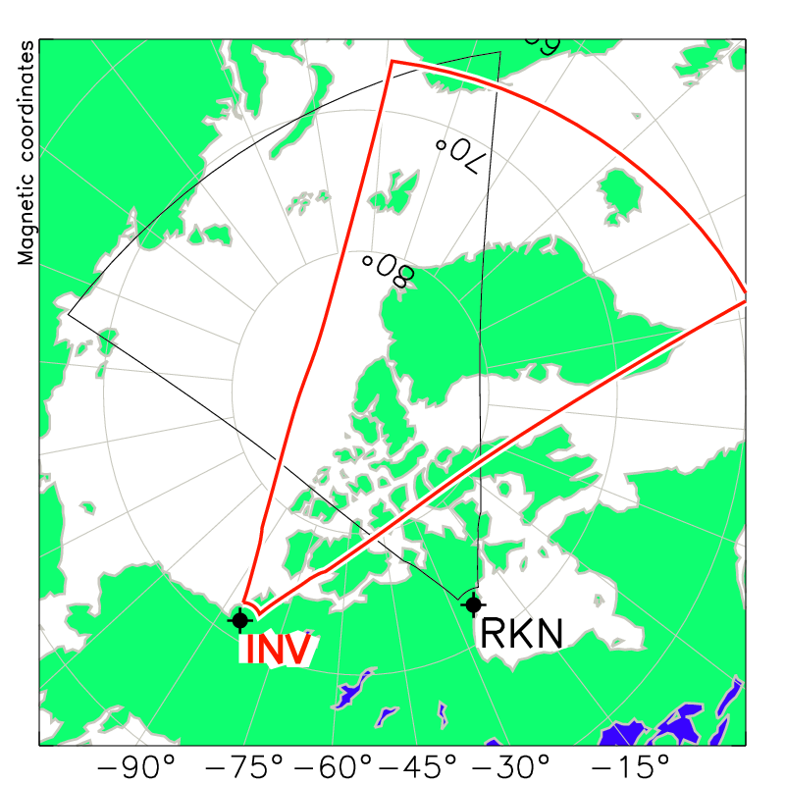
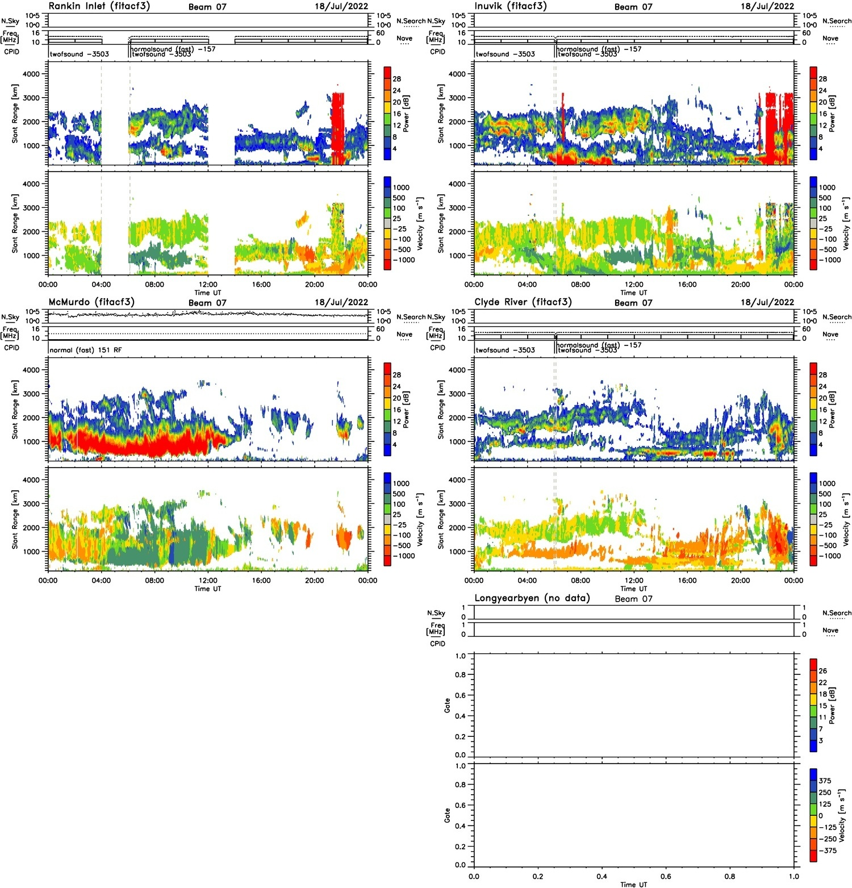
INV (Inuvik)
RKN (Rankin Inlet)
SuperDARN
strong , localized velocities
RISR
SuperDARN radars also measure velocity enhancements over Resolute Bay.
14

Slide 16
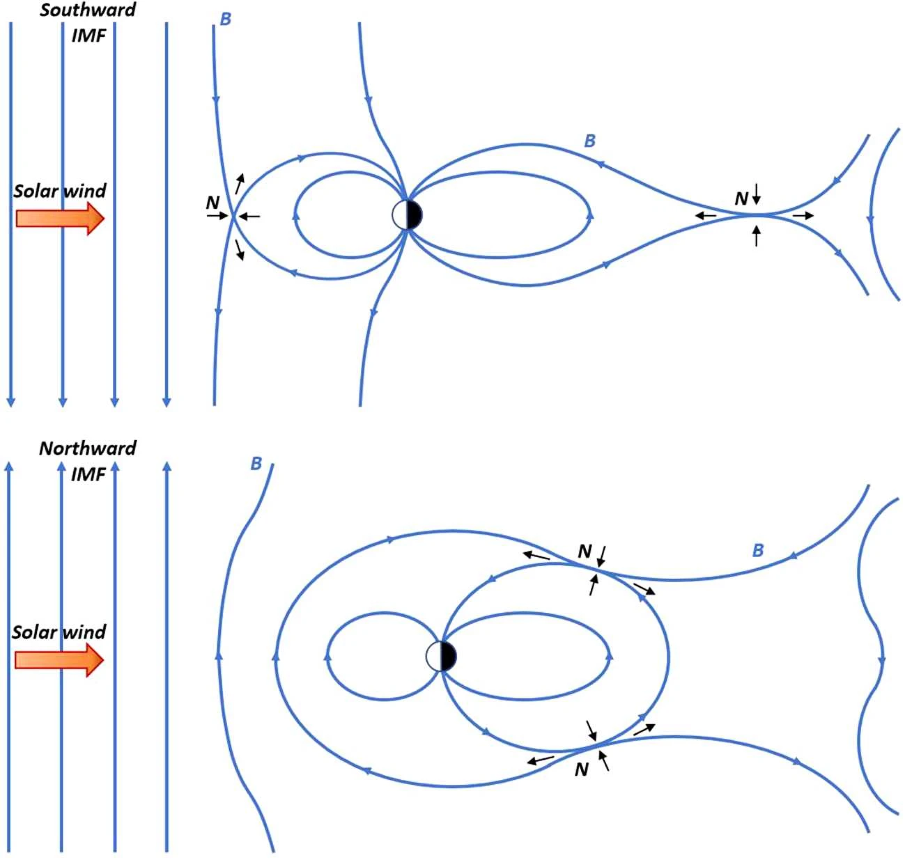
What’s happening?
Positive Bz (northward magnetic field) leads to reconnection near the magnetic lobes
  Changes convection pattern!
By remains low
Strong flow channels —> leads to localized Joule heating
15
Trattner, K.J., Petrinec, S.M. & Fuselier, S.A. (2021)

Slide 17
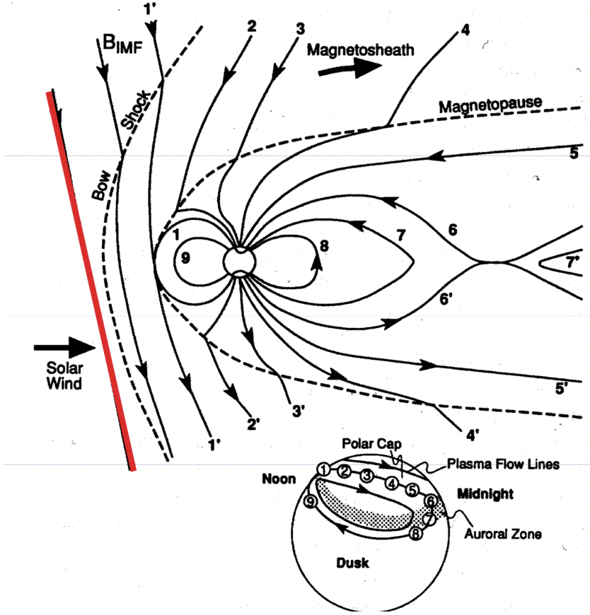
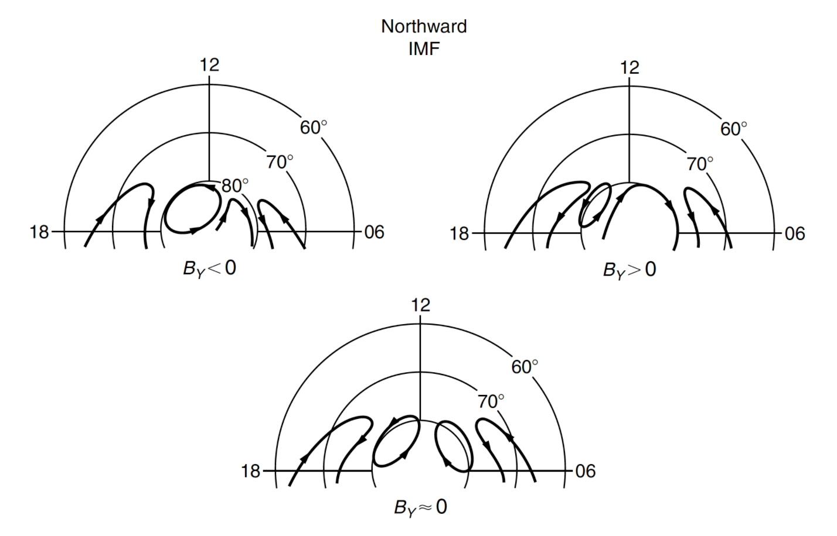
Convection pattern
[Heelis et al. 1986]
[Hughes, 1995]
IMF Bz < 0: two-cell convection
IMF Bz > 0: four-cell convection
16

Slide 18
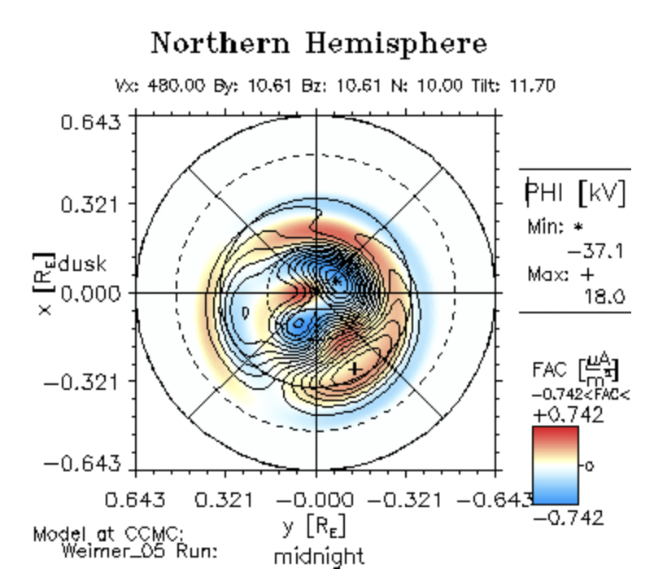
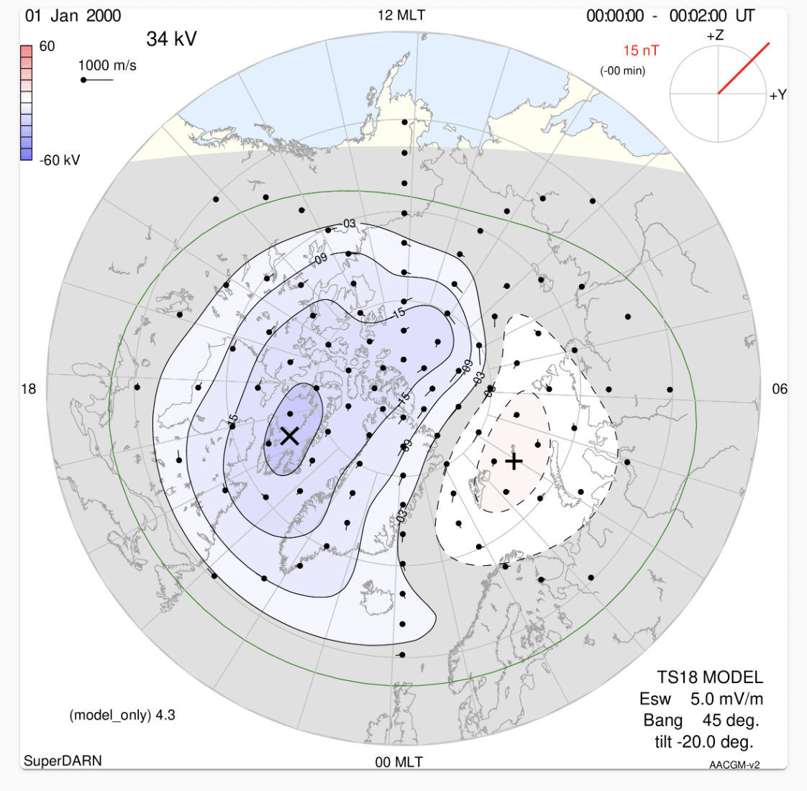
Convection pattern simulation (from web)
Four-cell convection, substantial FAC —> Joule heating
SuperDARN simulation also supports northward IMF but not evident four-cell convection, velocity not high
17
Notes:
Right: superDARN
Left: ???

Slide 19
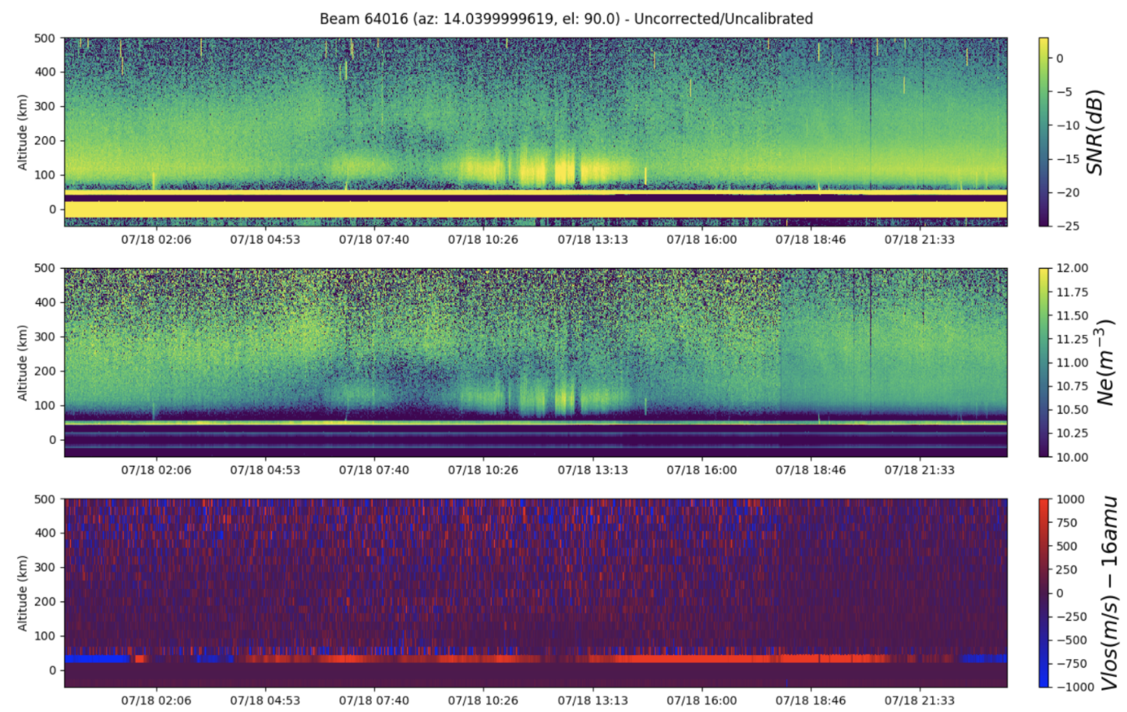
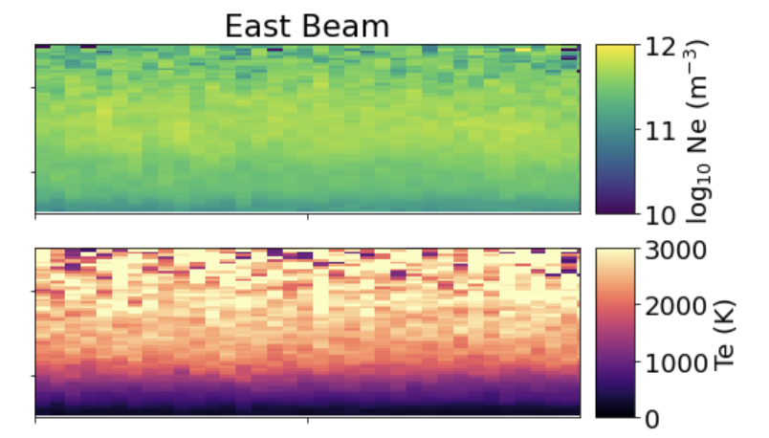
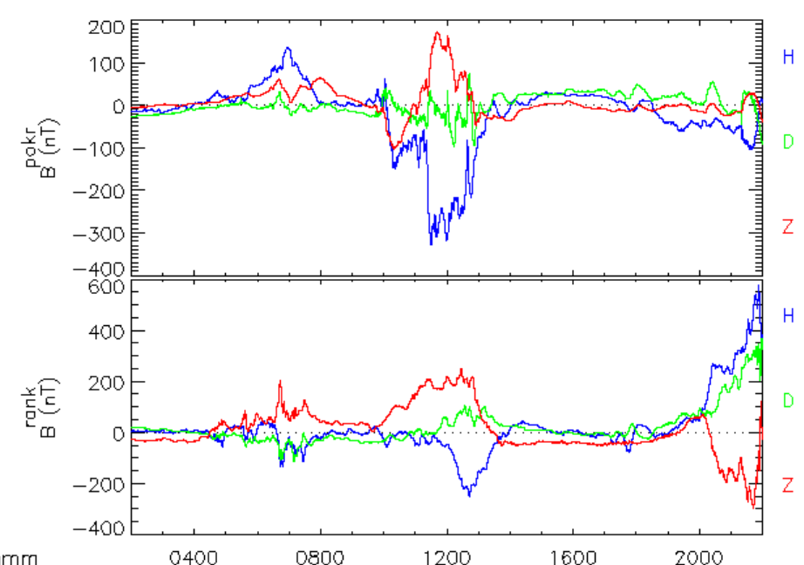
PFISR observation
SNR
Ne
Vlos
Our timespan: quite
But if we see a little earlier:
E region enhancement during 10-14 UT
F region density reduce
Bg oscillation shows ionosphere conductivity enhancement: particle precipitation
Reason:
Aurora arc combined with soft energy particle precipitation (maybe protons),
Ground magnetometer
18

Slide 20
Summary
Quiet pre-sunset conditions at mid-latitudes in summer;
Observed Westward velocities were below the threshold of typical SAPS (200 m/s) (i.e. SAPS are NOT observed) due to lack of “ideal” SAPS conditions.
Northward IMF leads to four-cell convection and strong, localized ion temperature enhancements with little Ne change in the high latitude region.
19
Notes:
What’s the spas conditions

Slide 21
References
Lamarche, L. J., Varney, R. H., & Reimer, A. S. (2021). Ion heating in the polar cap under northwards IMF Bz. Journal of Geophysical Research: Space Physics, 126, e2021JA029155. https:// doi.org/10.1029/2021JA029155
Trattner, K.J., Petrinec, S.M. & Fuselier, S.A. The Location of Magnetic Reconnection at Earth’s Magnetopause. Space Sci Rev 217, 41 (2021). https://doi.org/10.1007/s11214-021-00817-8
Aa E, Zhang S R, Erickson P J, et al. Salient midlatitude ionosphere‐thermosphere disturbances associated with SAPS during a minor but geo‐effective storm at deep solar minimum[J]. Journal of Geophysical Research: Space Physics, 2021, 126(7): e2021JA029509.
Heelis R A, Reiff P H, Winningham J D, et al. Ionospheric convection signatures observed by DE 2 during northward interplanetary magnetic field[J]. Journal of Geophysical Research: Space Physics, 1986, 91(A5): 5817-5830.
Hughes W J. The magnetopause, magnetotail, and magnetic reconnection[J]. Introduction to space physics, 1995: 227-287.

Slide 22
Questions?

Slide 23
Papers
https://agupubs.onlinelibrary.wiley.com/doi/full/10.1029/2002JA009409 (Figure 1; an example of SAPS)
A Statistical Study of the Subauroral Polarization Stream Over North American Sector Using the Millstone Hill Incoherent Scatter Radar 1979–2019 Measurements - Aa - 2020 - Journal of Geophysical Research: Space Physics - Wiley Online Library ( Figure 3, dusk line)
Storm Enhanced Densities measured by millstone hill isr (quiet and active density vs altitude plots https://agupubs.onlinelibrary.wiley.com/doi/full/10.1002/2015JA021832
Madrigal:
http://millstonehill.haystack.mit.edu/static/experiments/2022/mlh/18jul22/summary_Nel.html

Slide 24
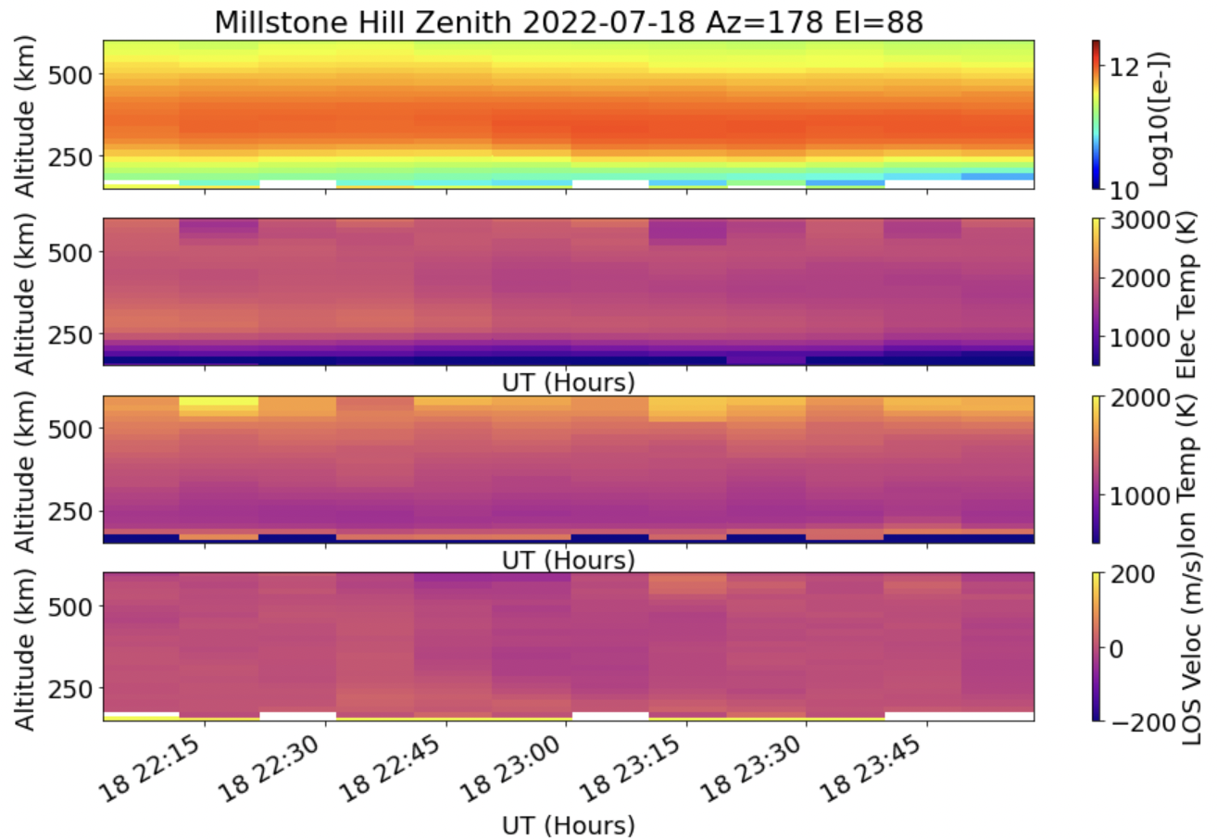

Slide 25
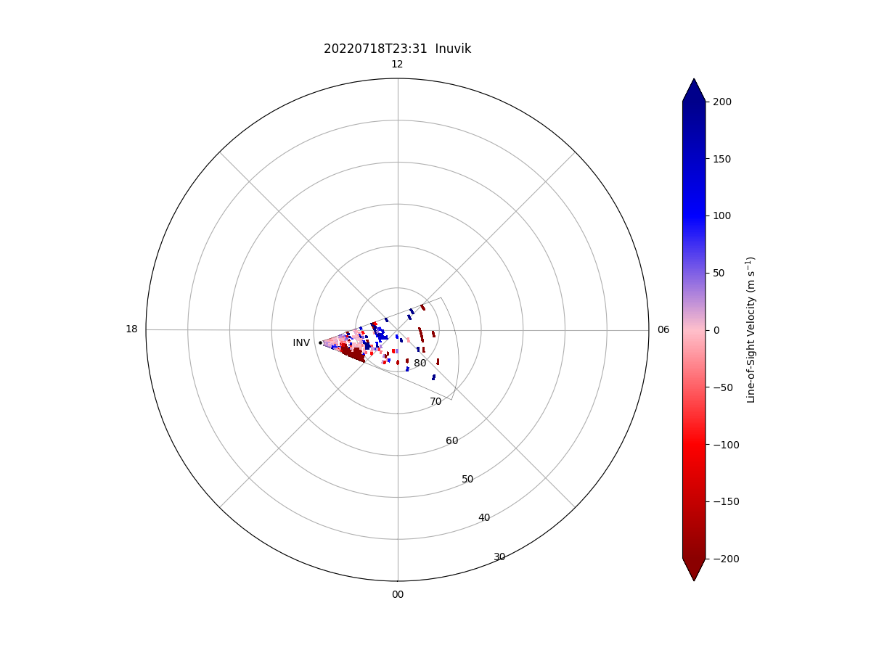
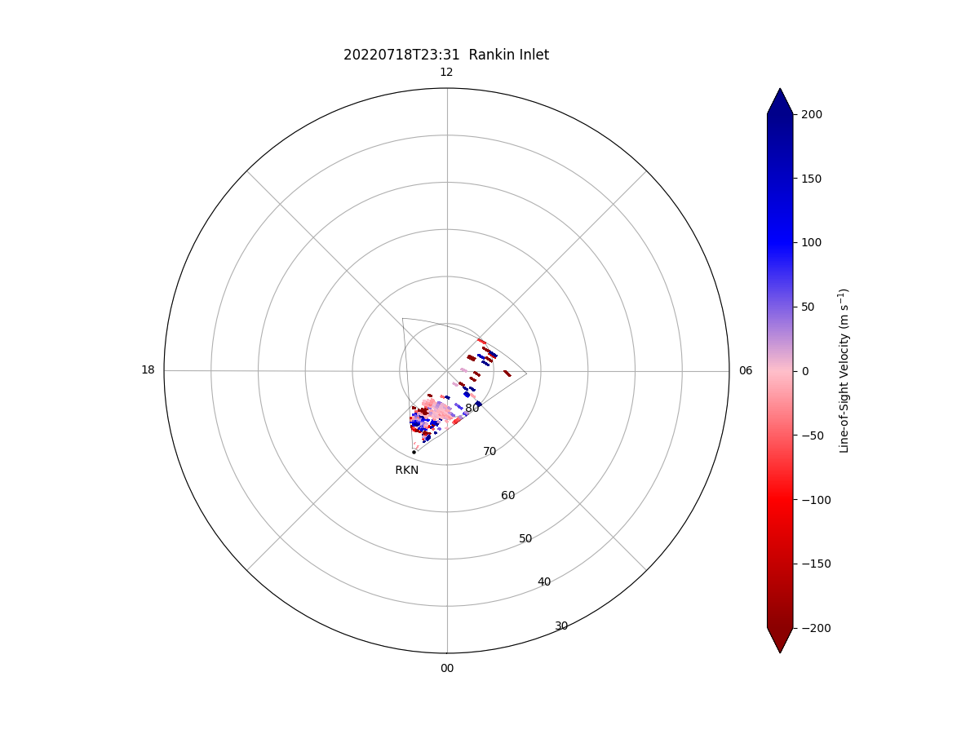

Slide 26
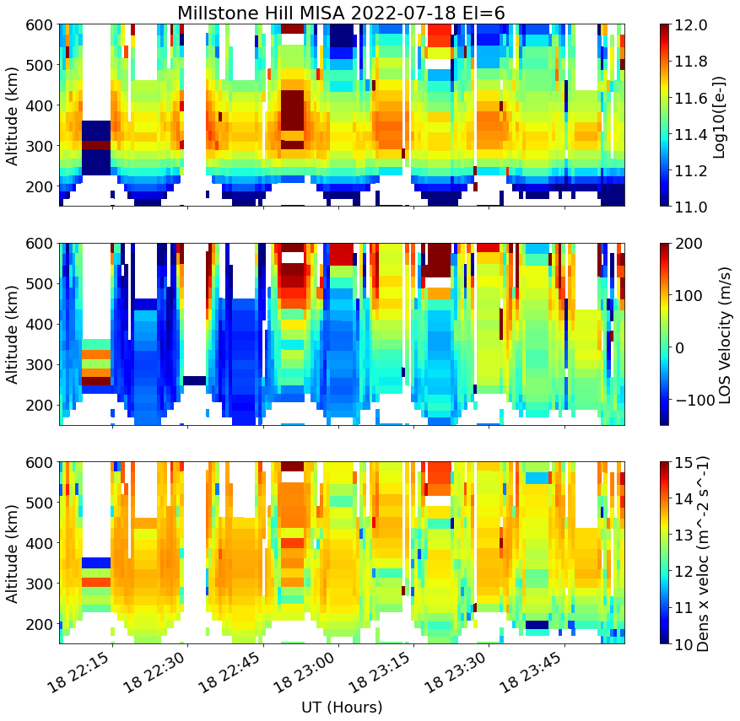
MISA DATA
Notes:
MISA scan data using Erickson

Slide 27
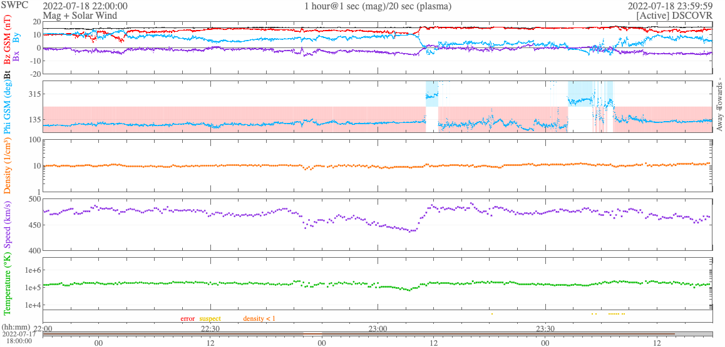
IMF

Slide 28
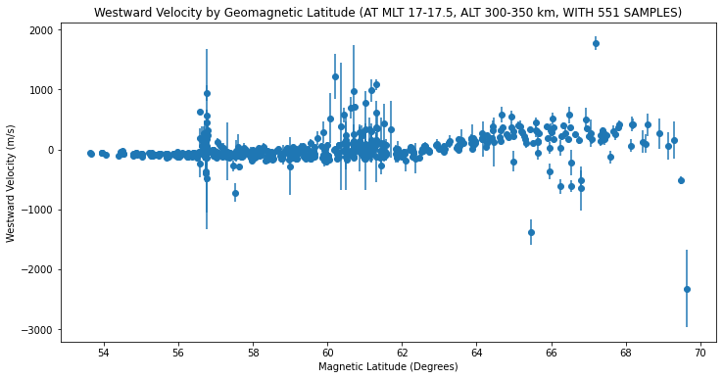
Notes:
At a specific altitude?

Slide 29
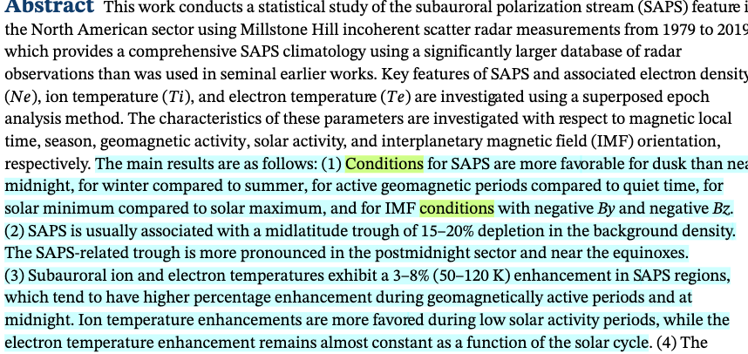
Notes:
SAPS “ideal” or favorable conditions from :A Statistical Study of the Subauroral Polarization Stream
Over North American Sector Using the Millstone Hill Incoherent Scatter Radar 1979–2019 Measurements.

