Slide 1





Sunrise Data Analysis
ISR School 2022
Brenna Royersmith^{*1}, Veronica Romanek^{*2}, Arthur Brock^{*3}, Yanlin Li^{*4}
^{*1}University of Colorado Boulder, ^{*2}The University of Scranton, ^{*3}Embry-Riddle Aeronautical University, ^{*4}Penn State University

Slide 2
Introduction and Motivation
Experiment setup and pulse scheme
  Rapid Regional:
    Time: 0400 - 0600 LT (Group 2), 2200 - 2400 LT (Group 5, the day before)
    Pointing: Zenith [Vertical poiointing] and MISA [fixed:Azimuth -45º/ Elevation 45º]
    Pulse: Uncoded/Coded
    IPP: 8.91ms
    TX Power: 1.45MW
    Range resolution: 17.9 km [Uncoded], 4.5 km [Coded]
  Default:
    Time: 0100 - 0400 LT, 1000-1600 LT
    Pulse: Uncoded
Motivation
  Obtain the ionosphere measurements during the sunrise

Slide 3
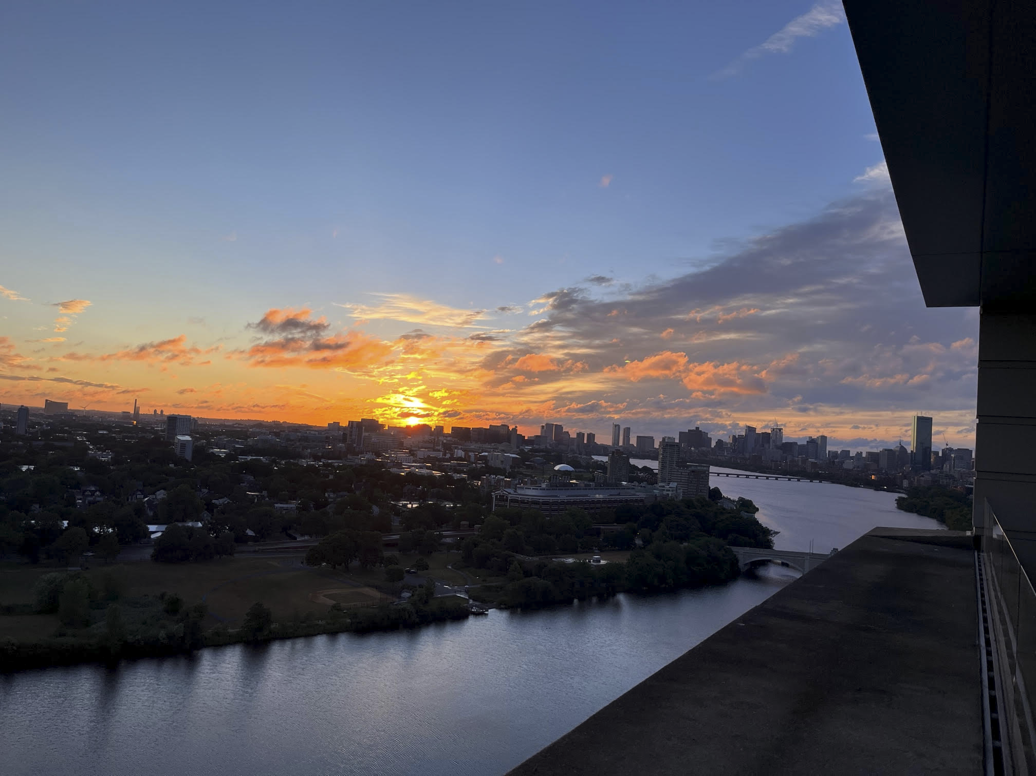
Introduction and Motivation
Outline:
  Electron density visualization
    Full data plots
    Meteor head echo examples
    Error ratios
  Particle velocity
    Visualization (ion and doppler velocities)
    Statistical distributions
  Ionosonde analysis
    What information we can read from it
    Loss and production rates
  TIDs
    Detections in electron density and correlation
    Multiple detections -> approximate phase velocity
  Summary and questions
Photo credit: Anthea Coster

Slide 4
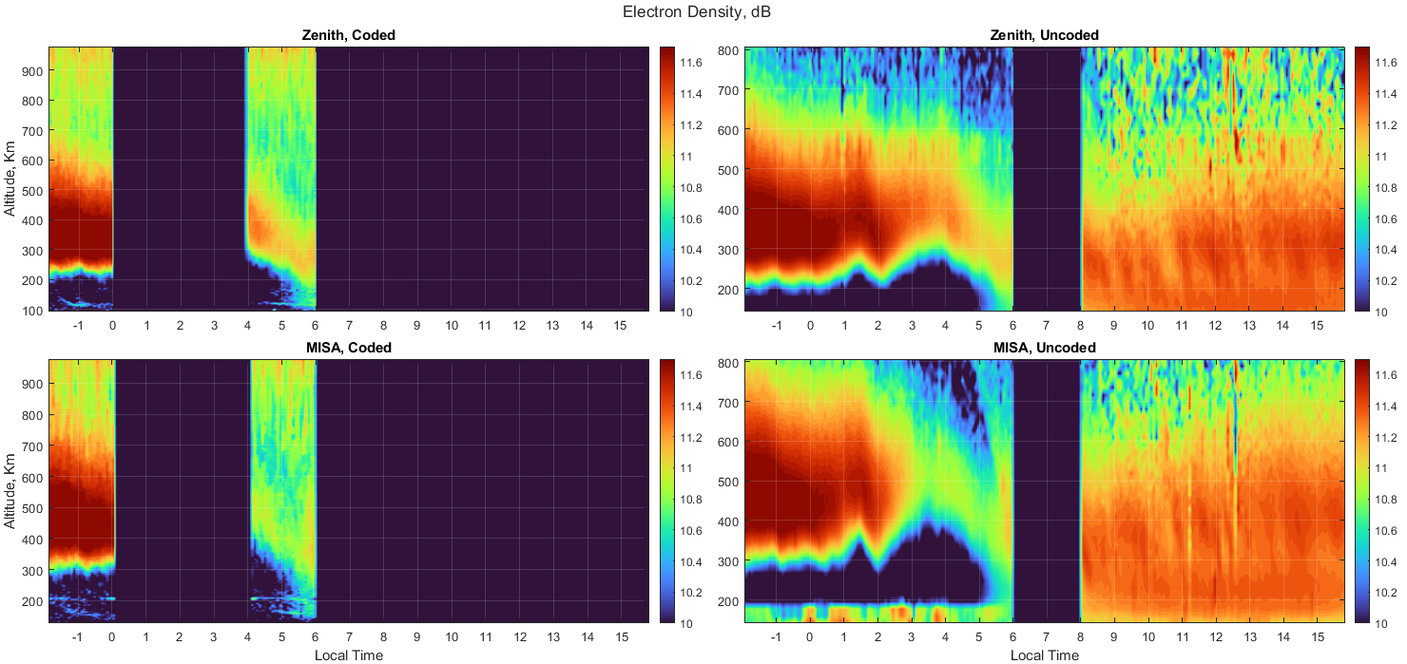
Electron Density

Slide 5
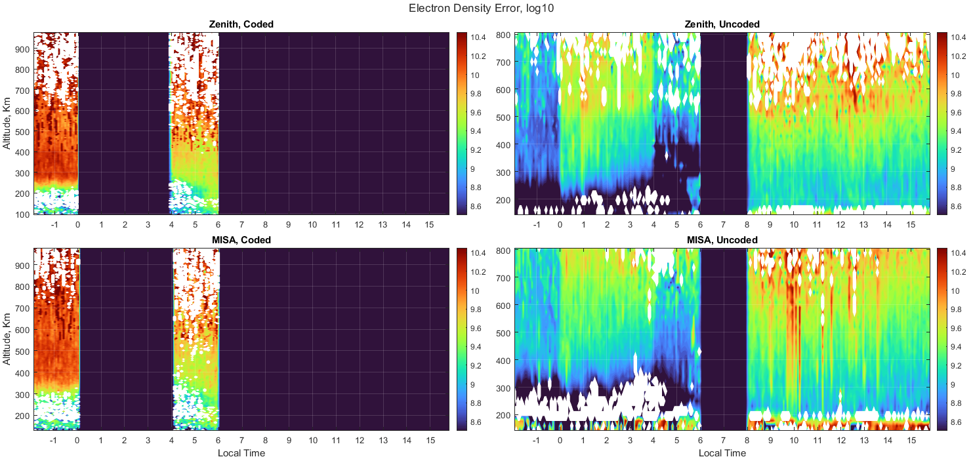
Electron Density Error

Slide 6
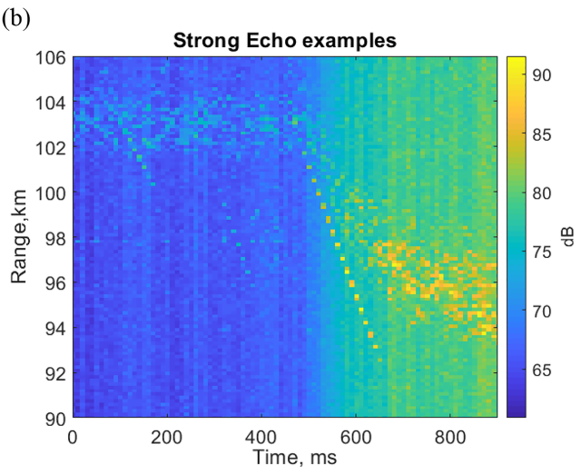
Meteor Head Echoes
Jicamarca Radio Observatory radar RTI
Meteor head echoes
Meteor head echoes with trail
Equatorial Electrojet (EEJ)
Li et al., 2020

Slide 7
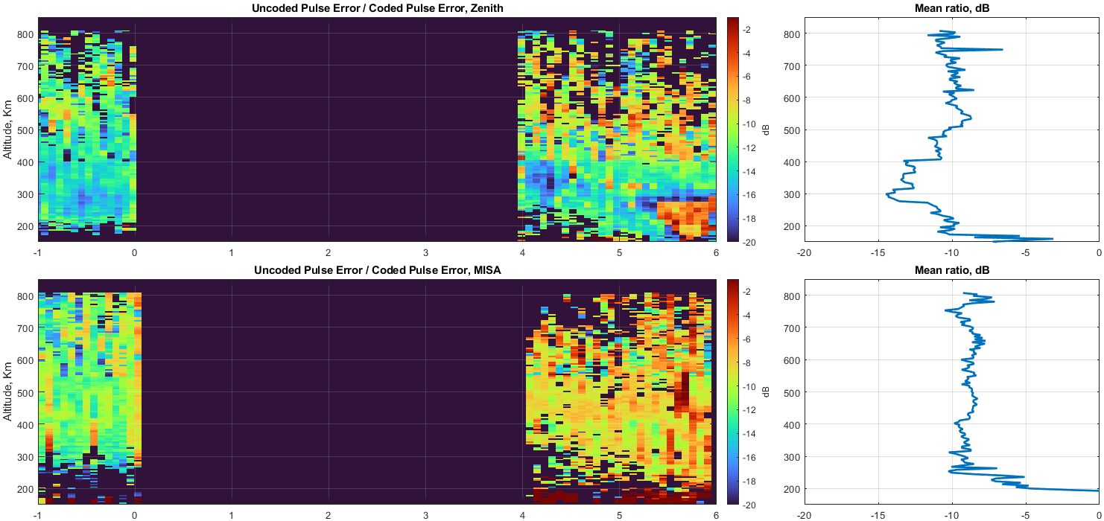
Error ratio (Uncoded/Coded)

Slide 8
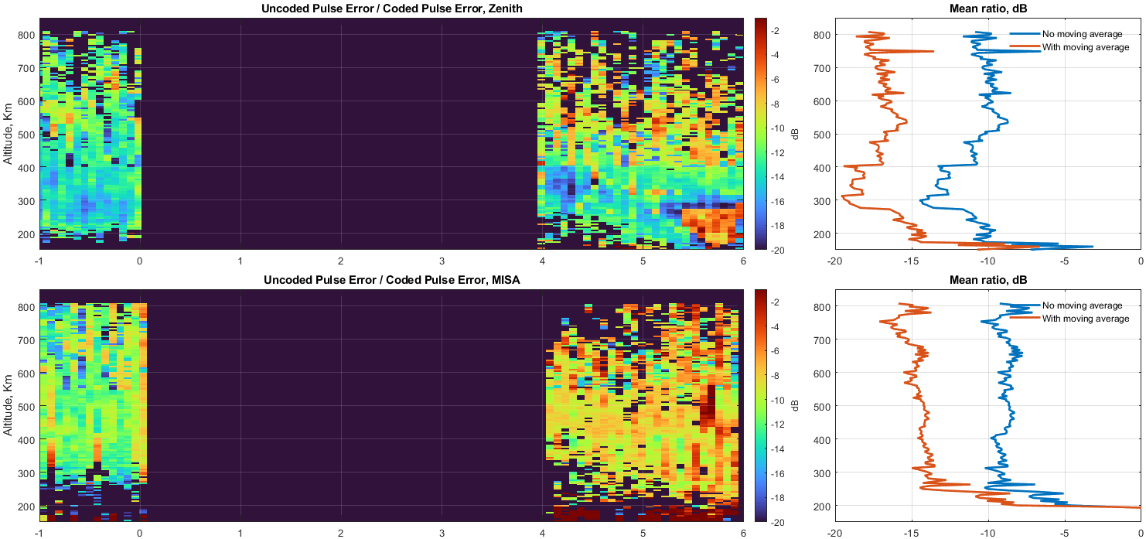
Error ratio (Uncoded/Coded)

Slide 9
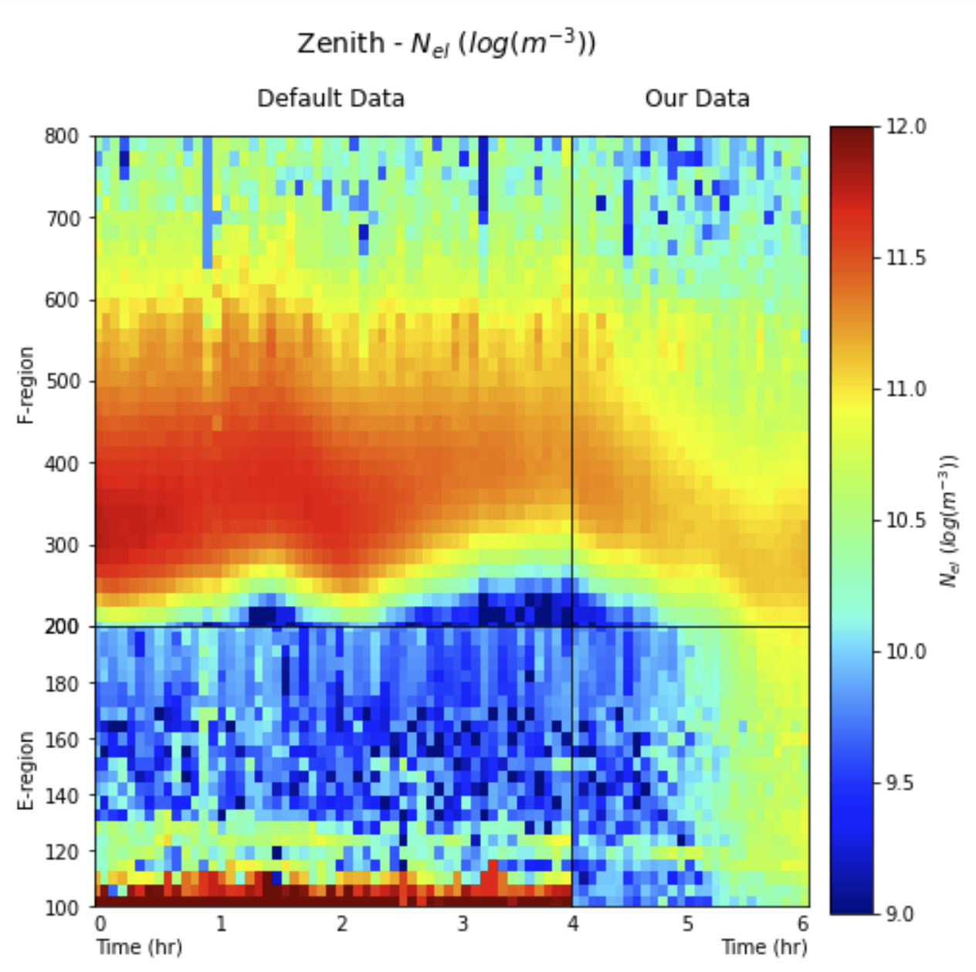
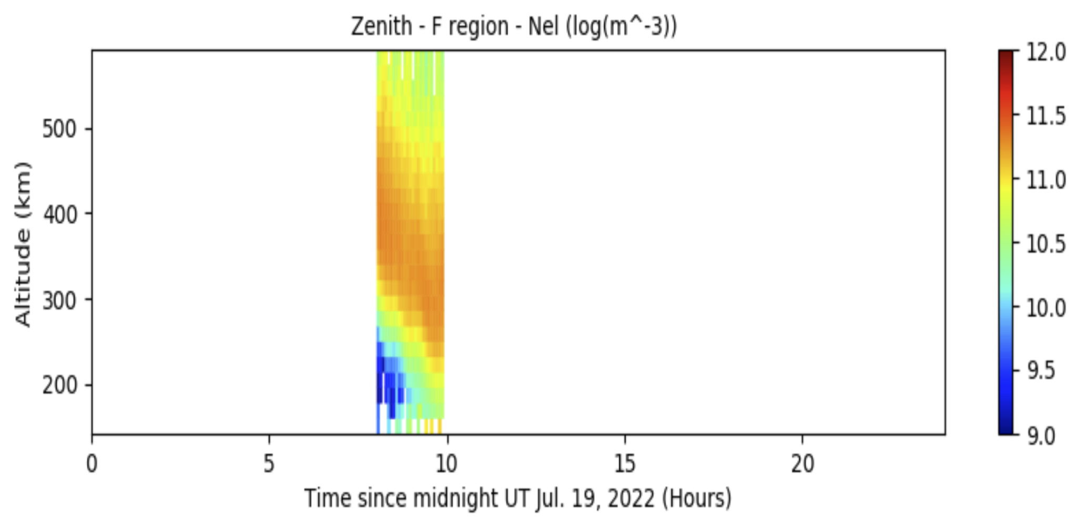
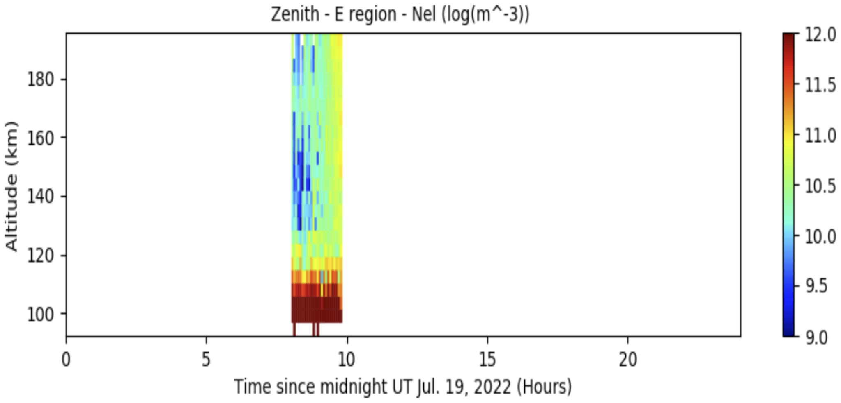
Ne Visualization (Zenith)
+
+
Prior Default Data

Slide 10
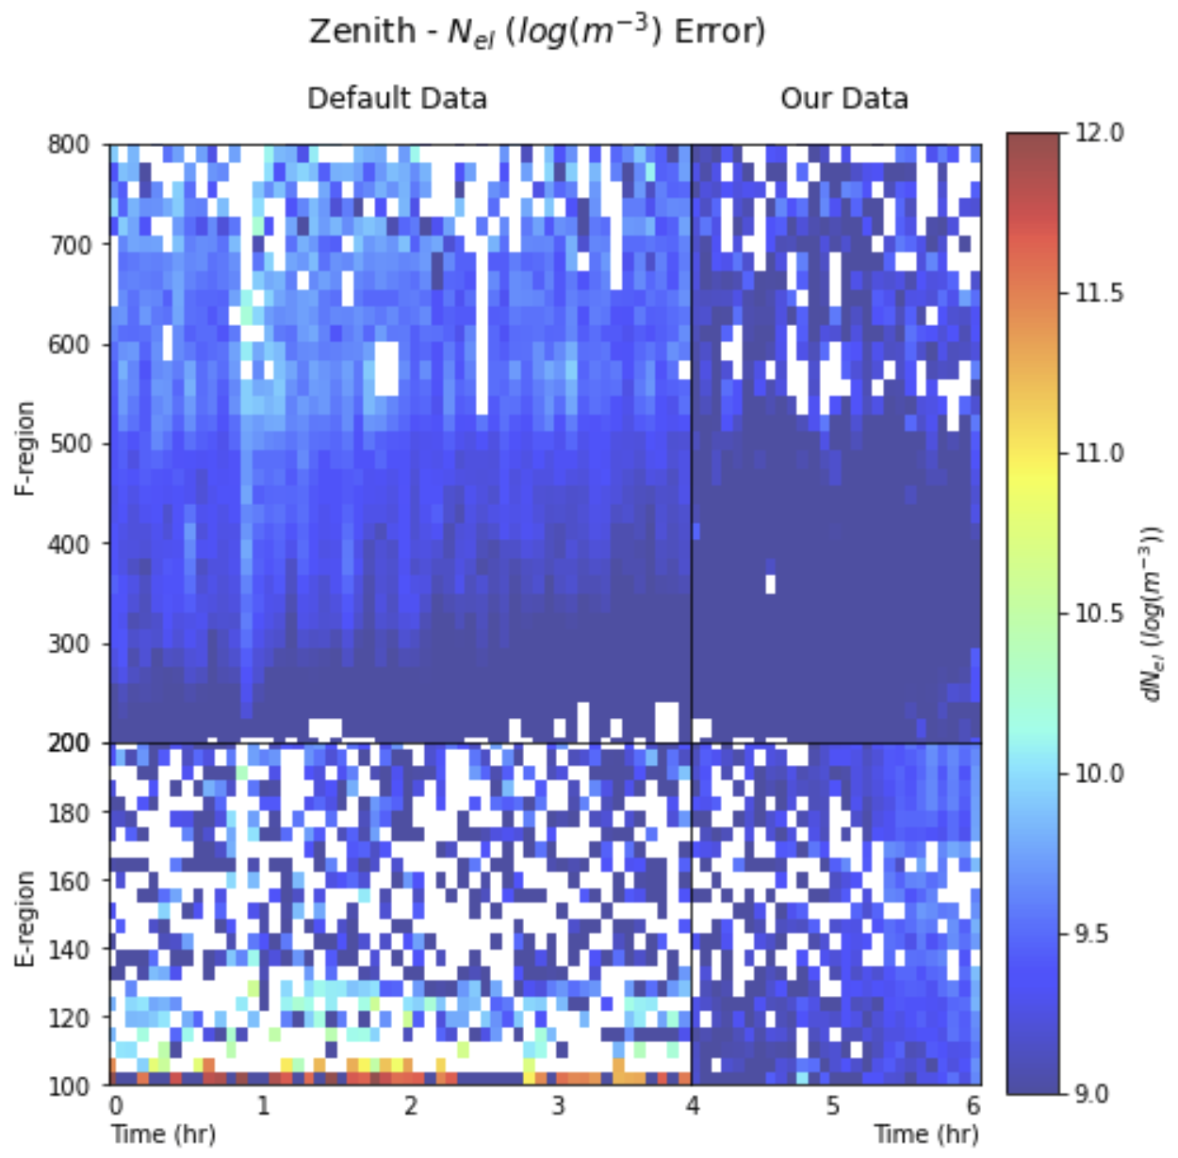
Ne Visualization (Zenith)

Slide 11
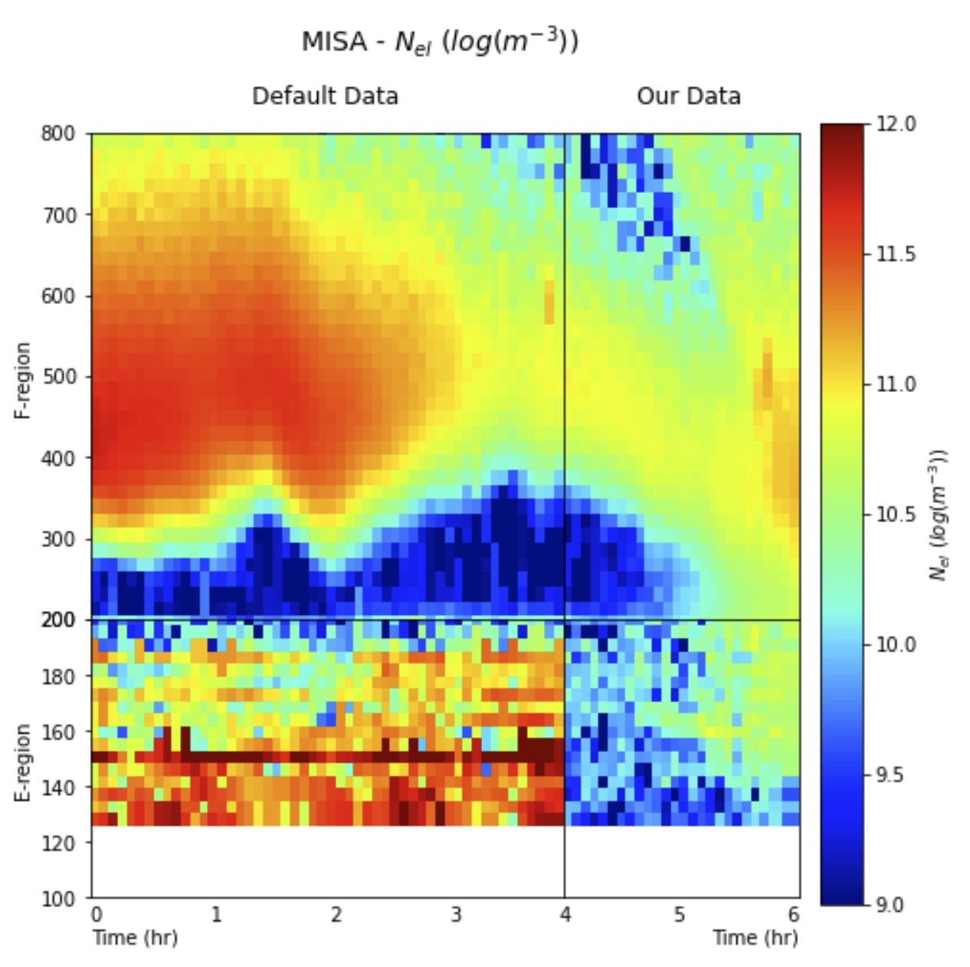
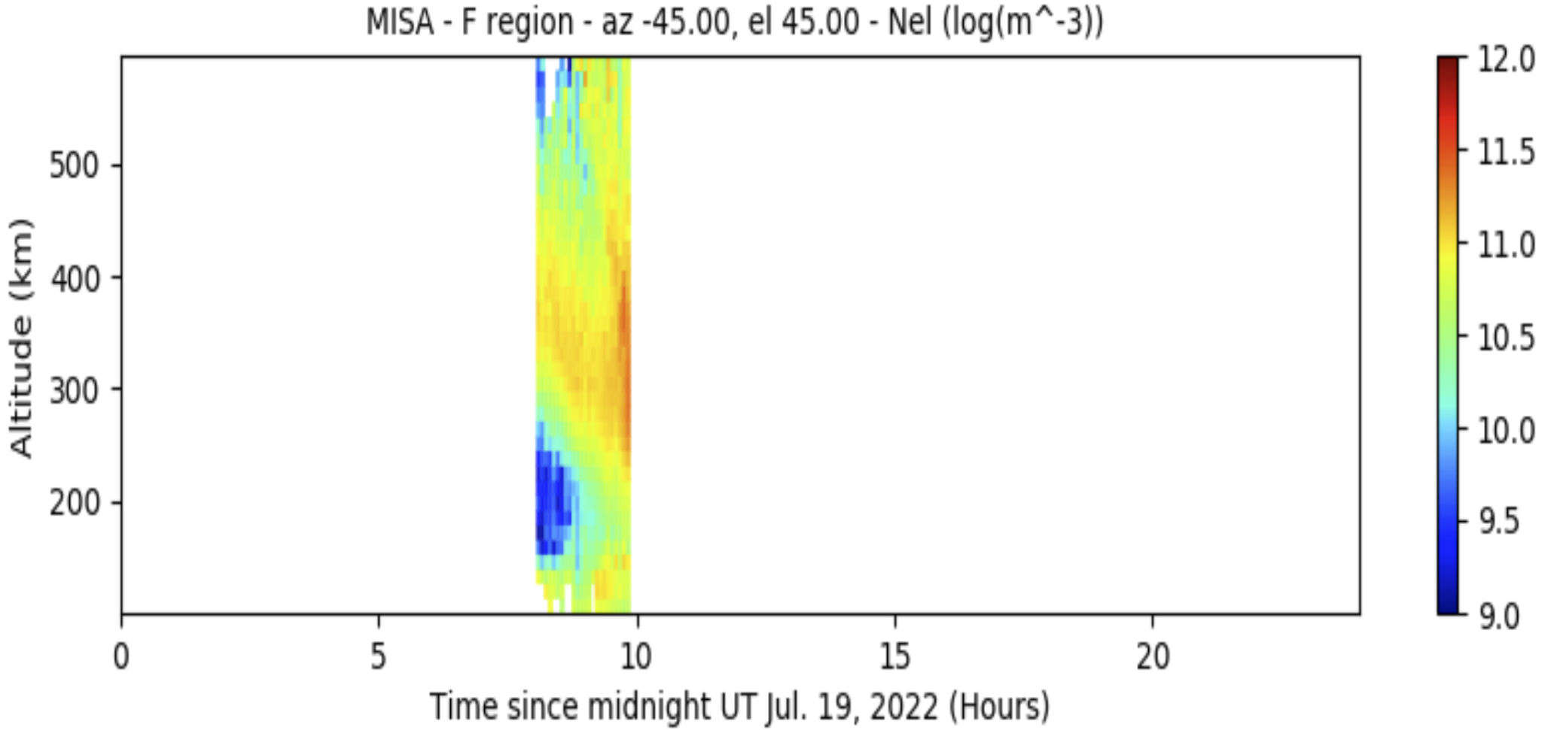
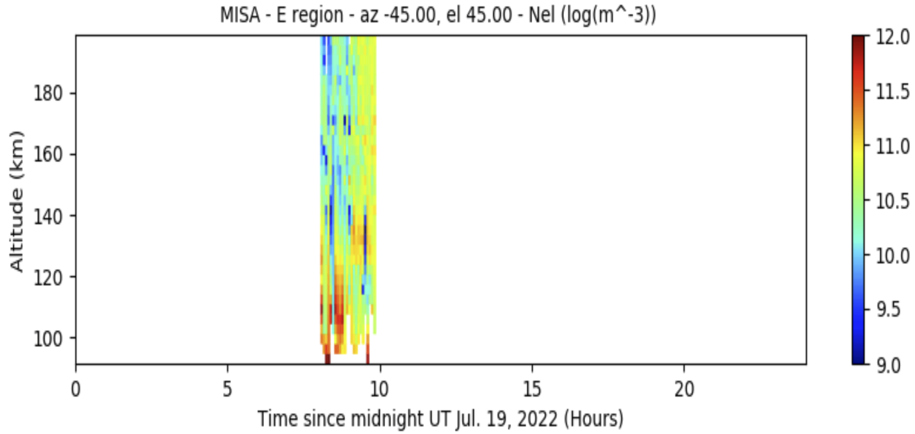
Ne Visualization (MISA)
+
+
Prior Default Data

Slide 12
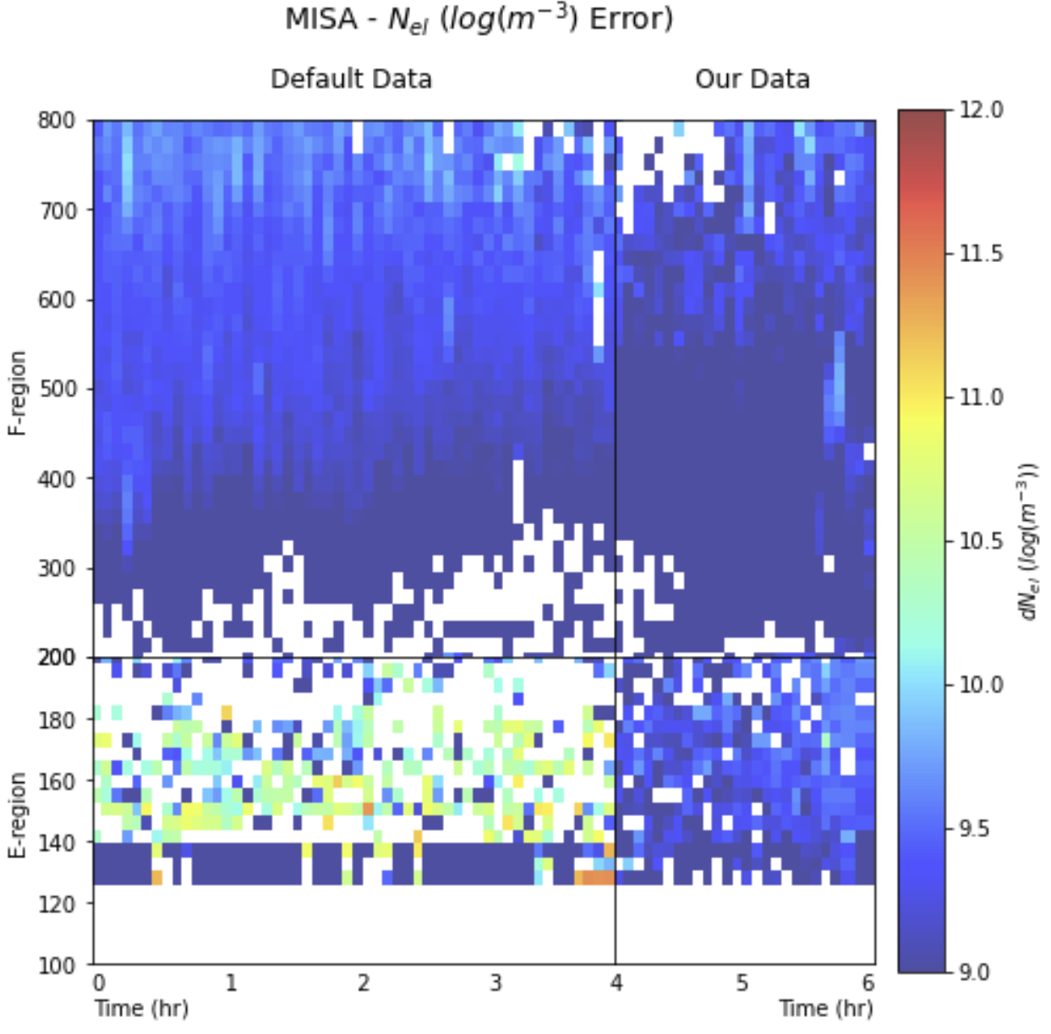
Ne Visualization (MISA)

Slide 13
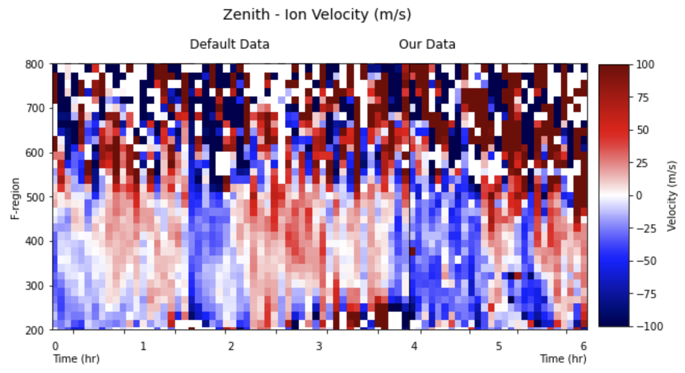
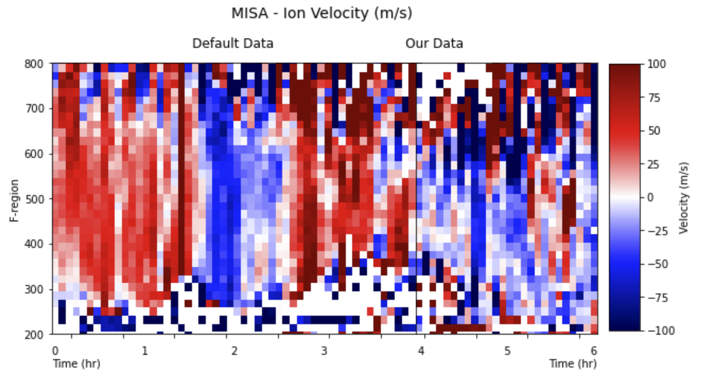
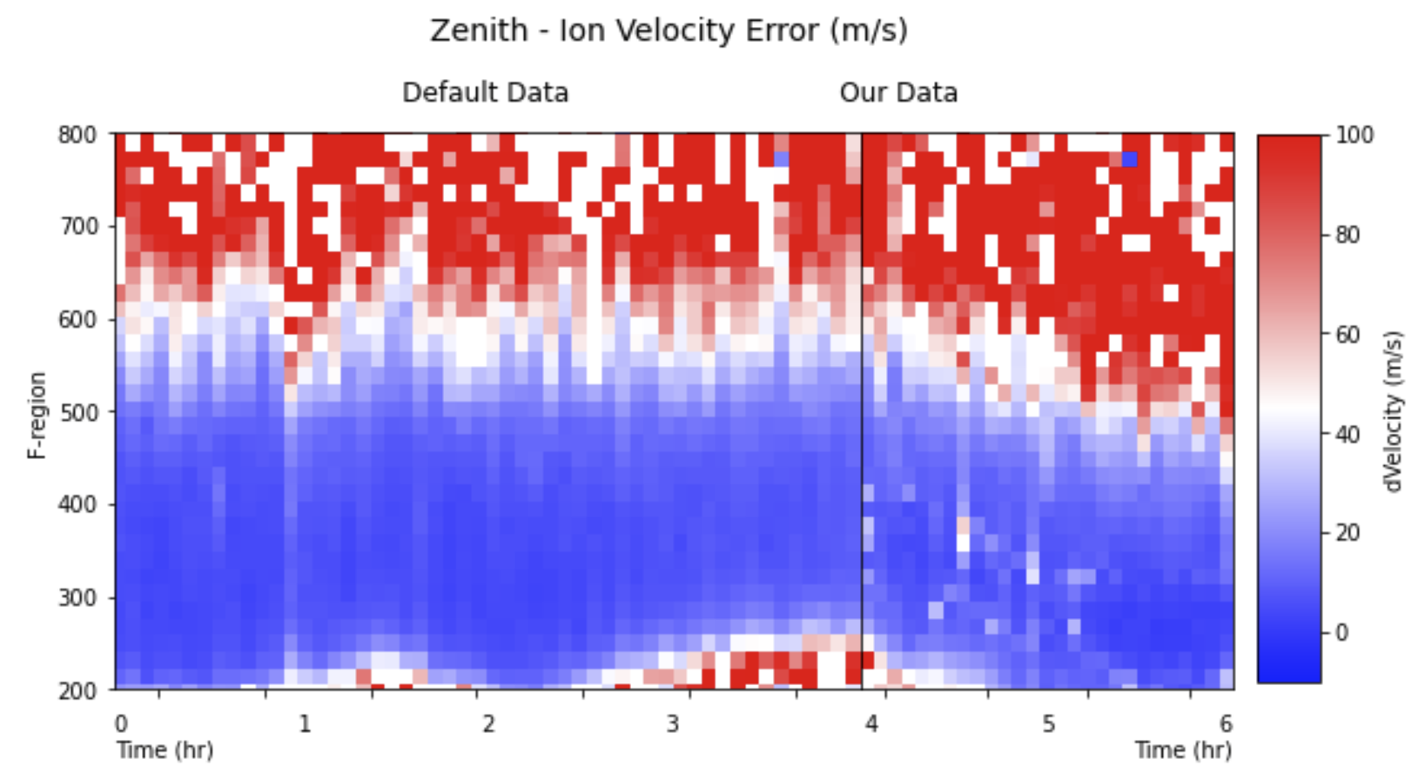
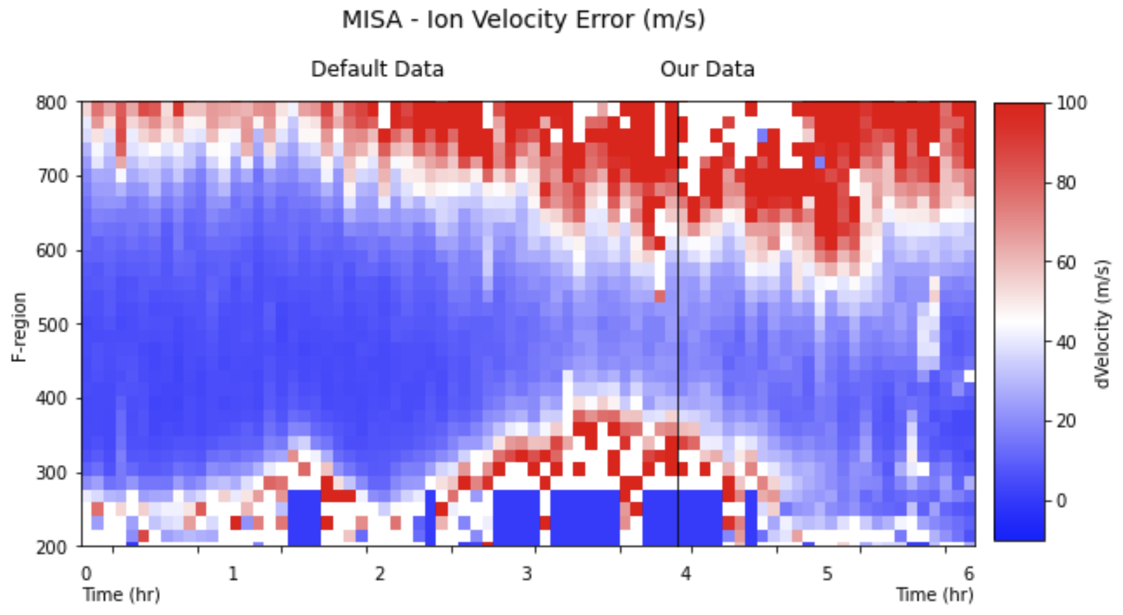
Particle Velocity

Slide 14
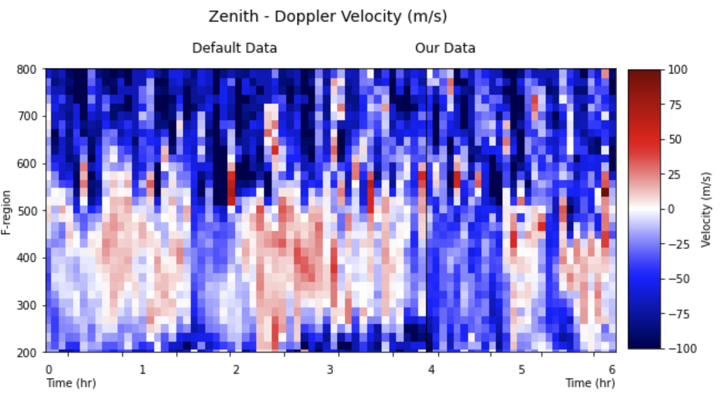
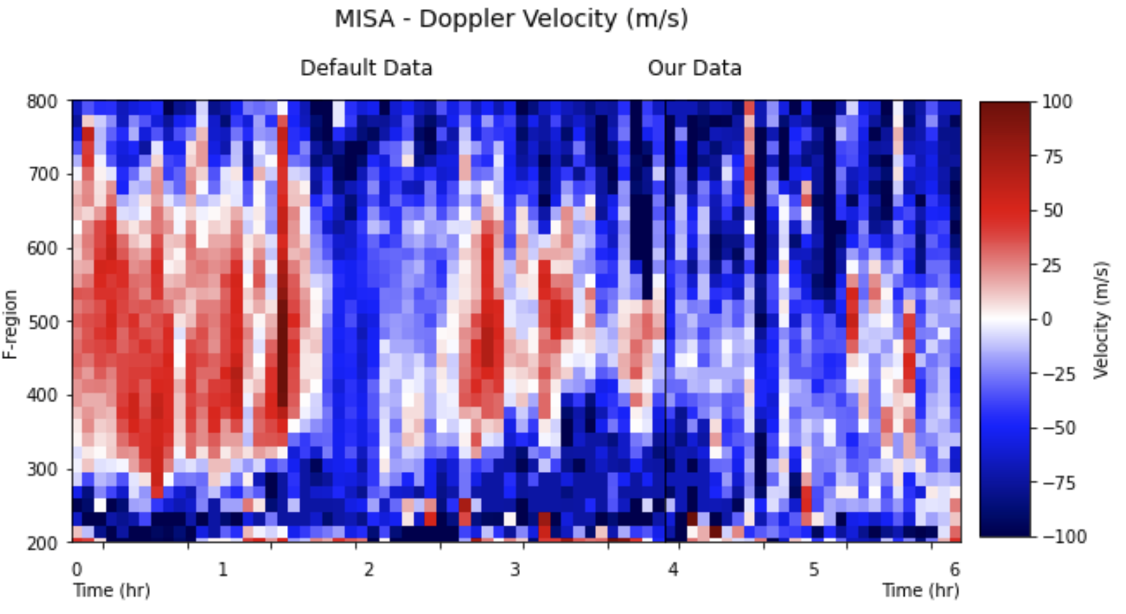
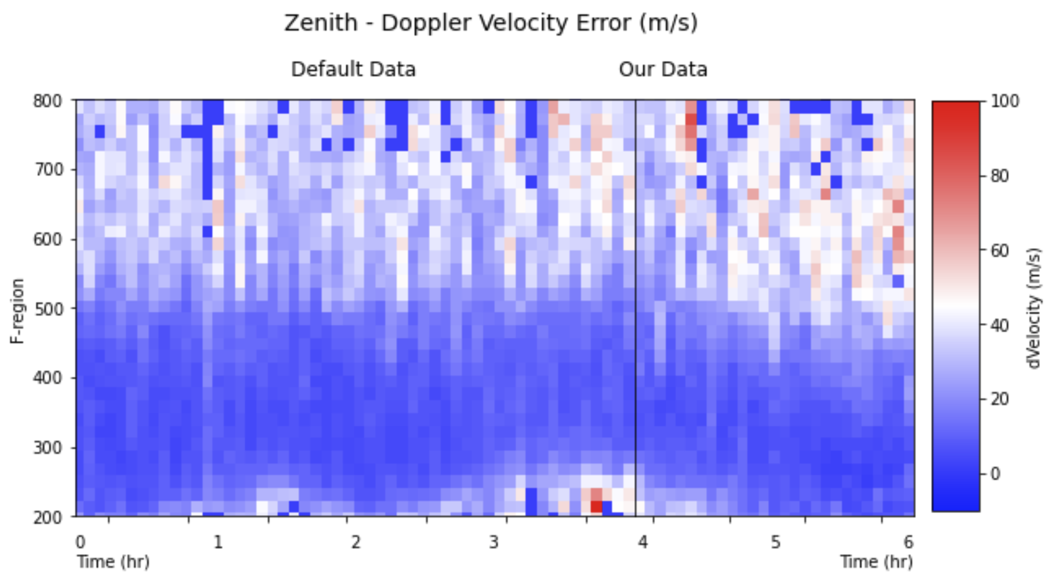
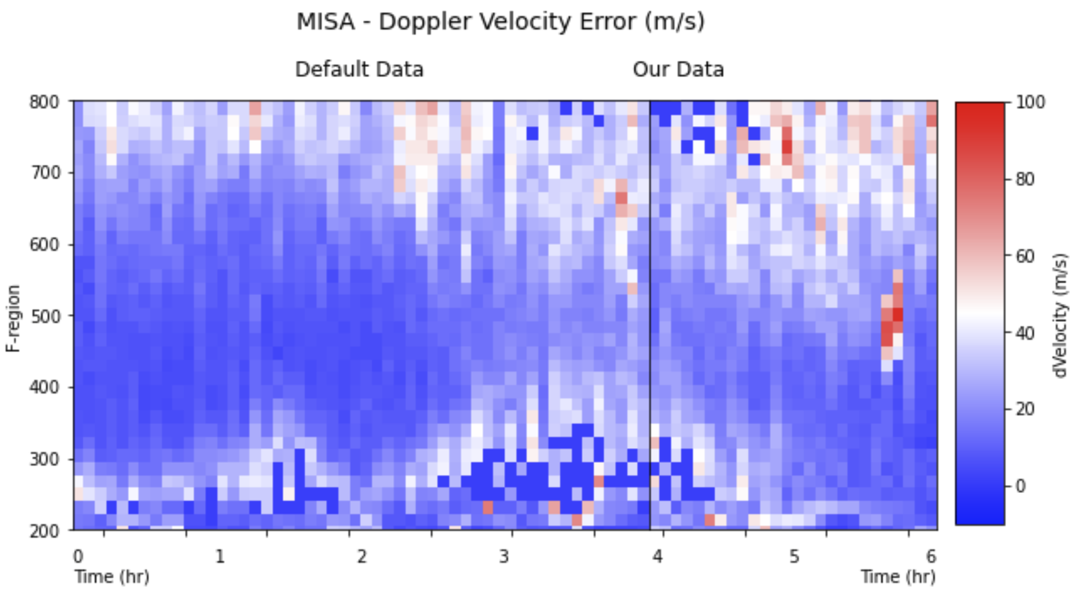
Doppler Velocity

Slide 15
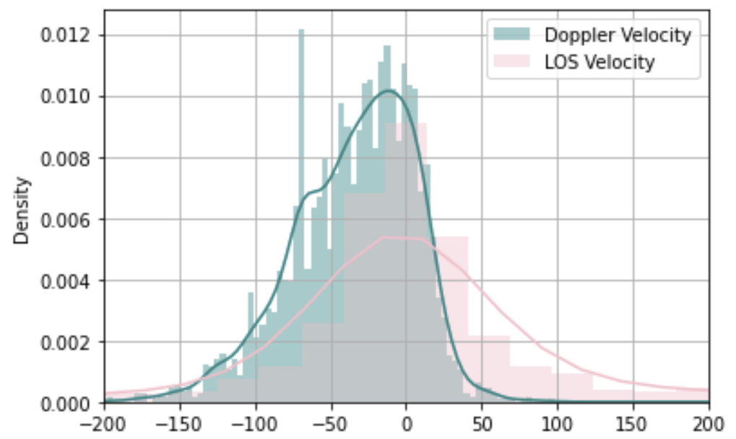
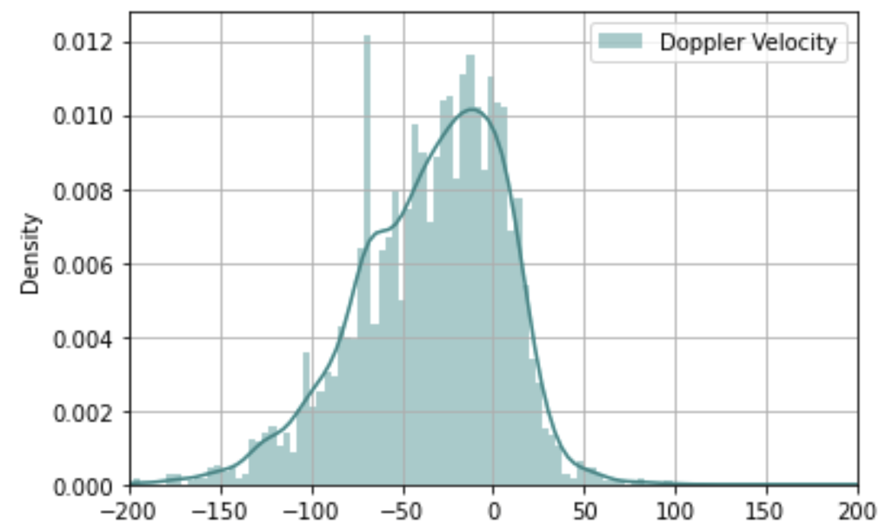
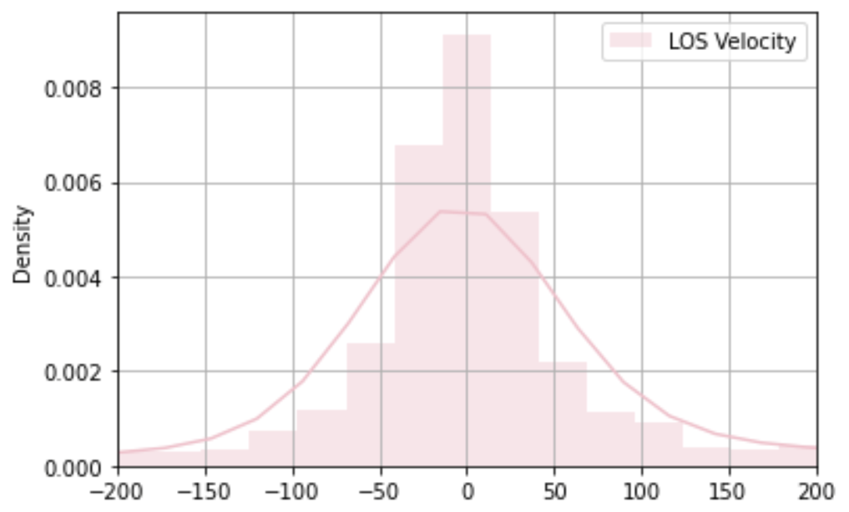
Particle Velocity (zenith)

Slide 16
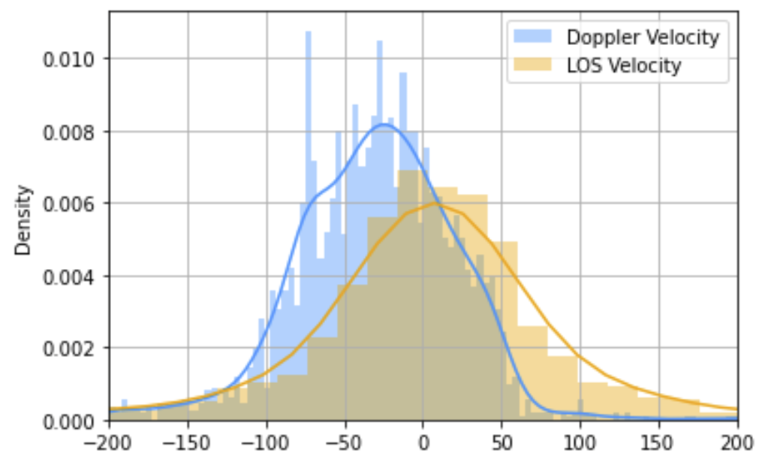
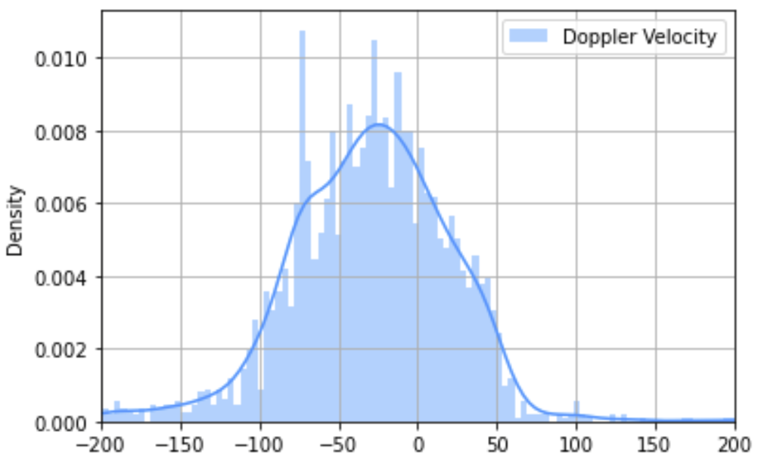
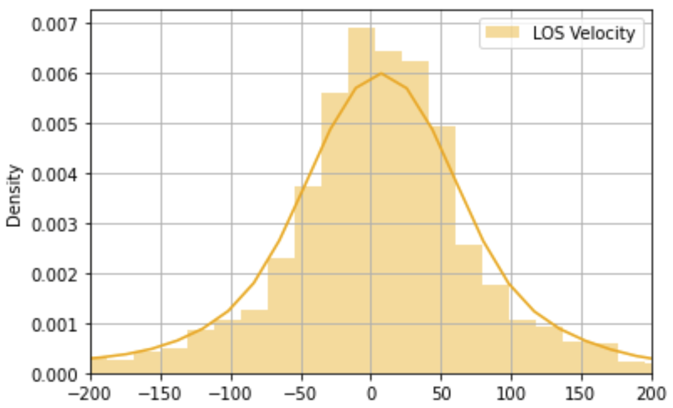
Particle Velocity (MISA)

Slide 17
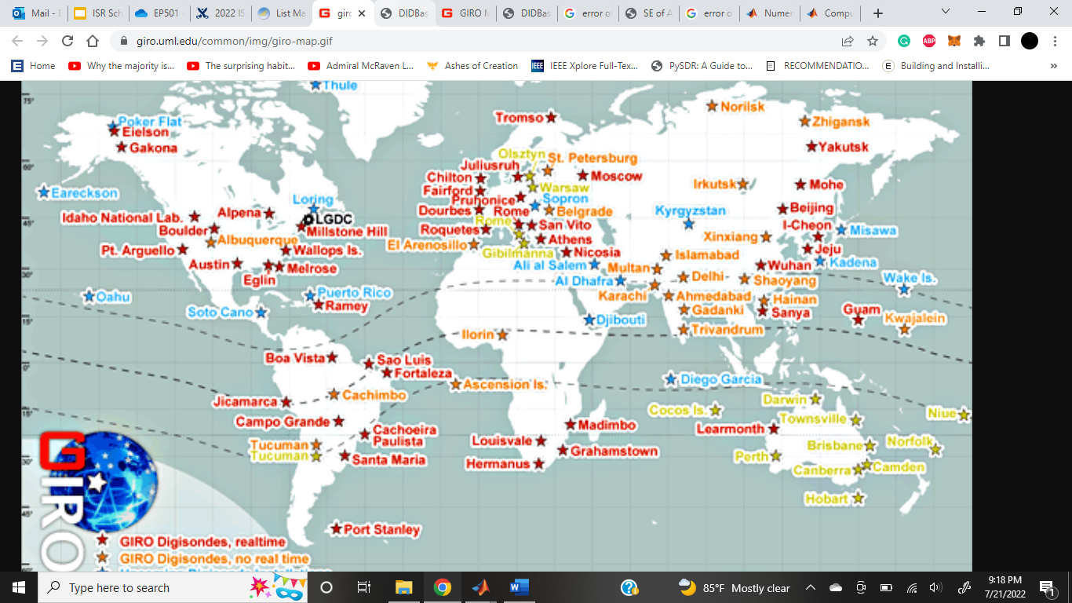
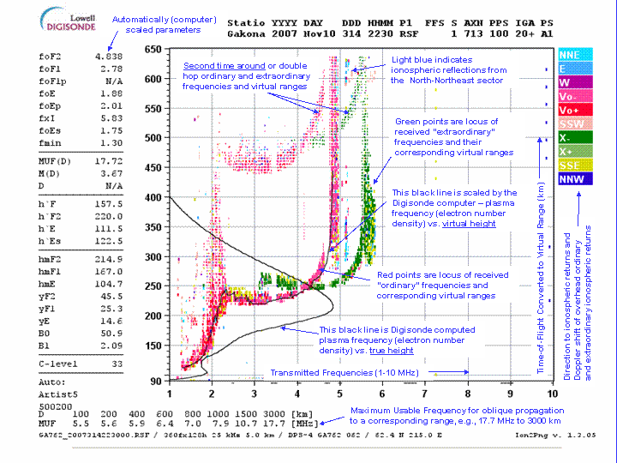
Ionosonde Information

Slide 18
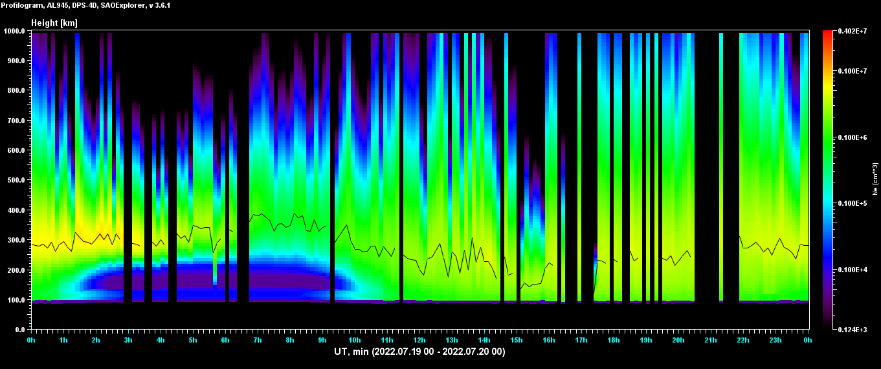
Ionosonde Information

Slide 19
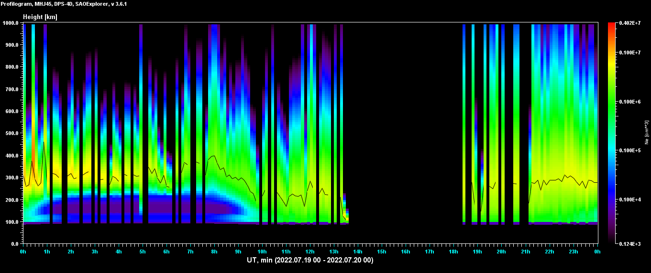
Ionosonde Information

Slide 20
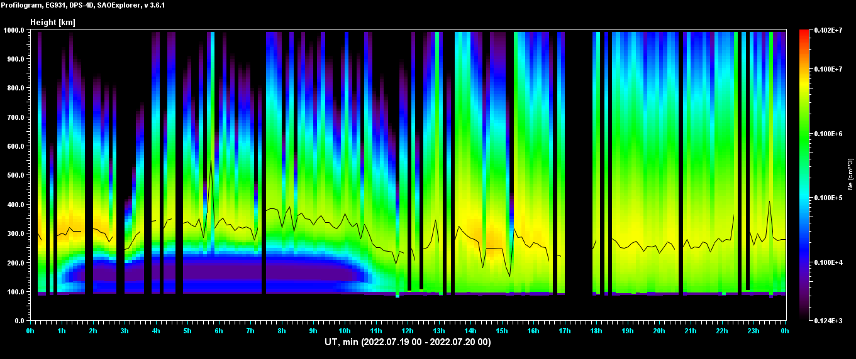
Ionosonde Information

Slide 21
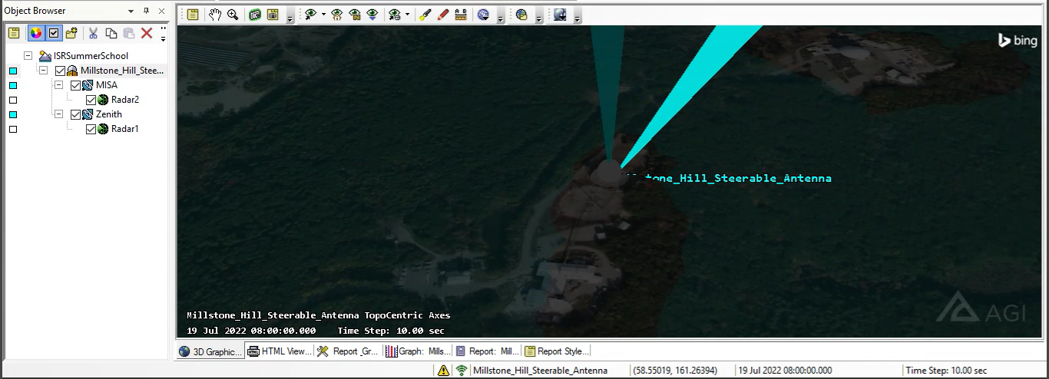
Scenario Configuration

Slide 22
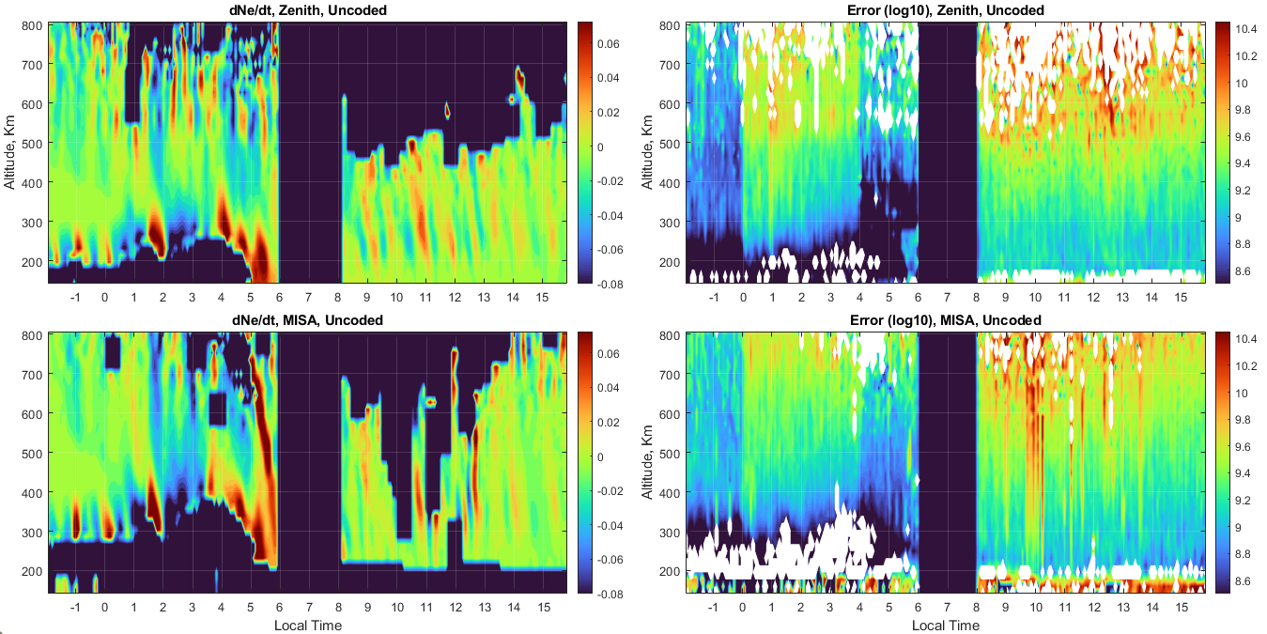
Loss and Production Rates
Dpdt = G - R

Slide 23
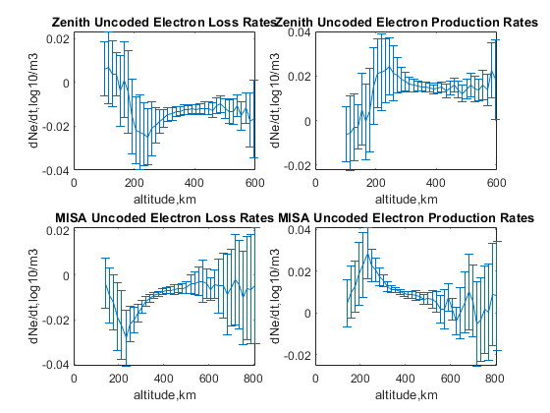
Loss and Production Rates
Dp/dt = G - R

Slide 24
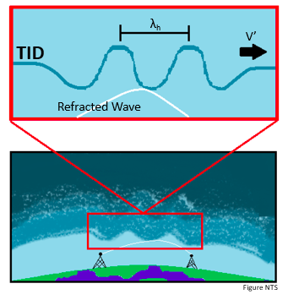
Traveling Ionospheric Disturbances
Space weather effect
Generated by propagating gravity waves or geomagnetic activity
^ disturb the electron density in the ionosphere
TID = moving wavelike irregularity of charged particles in a planet’s atmosphere
Impact HF communications, GPS systems, anything else dependent on the ionosphere to work properly

Slide 25
Traveling Ionospheric Disturbances
Ways to detect them:
Ionosondes
GNSS Systems
HF Doppler Systems
Incoherent Scatter Radars (ISRs)

Slide 26
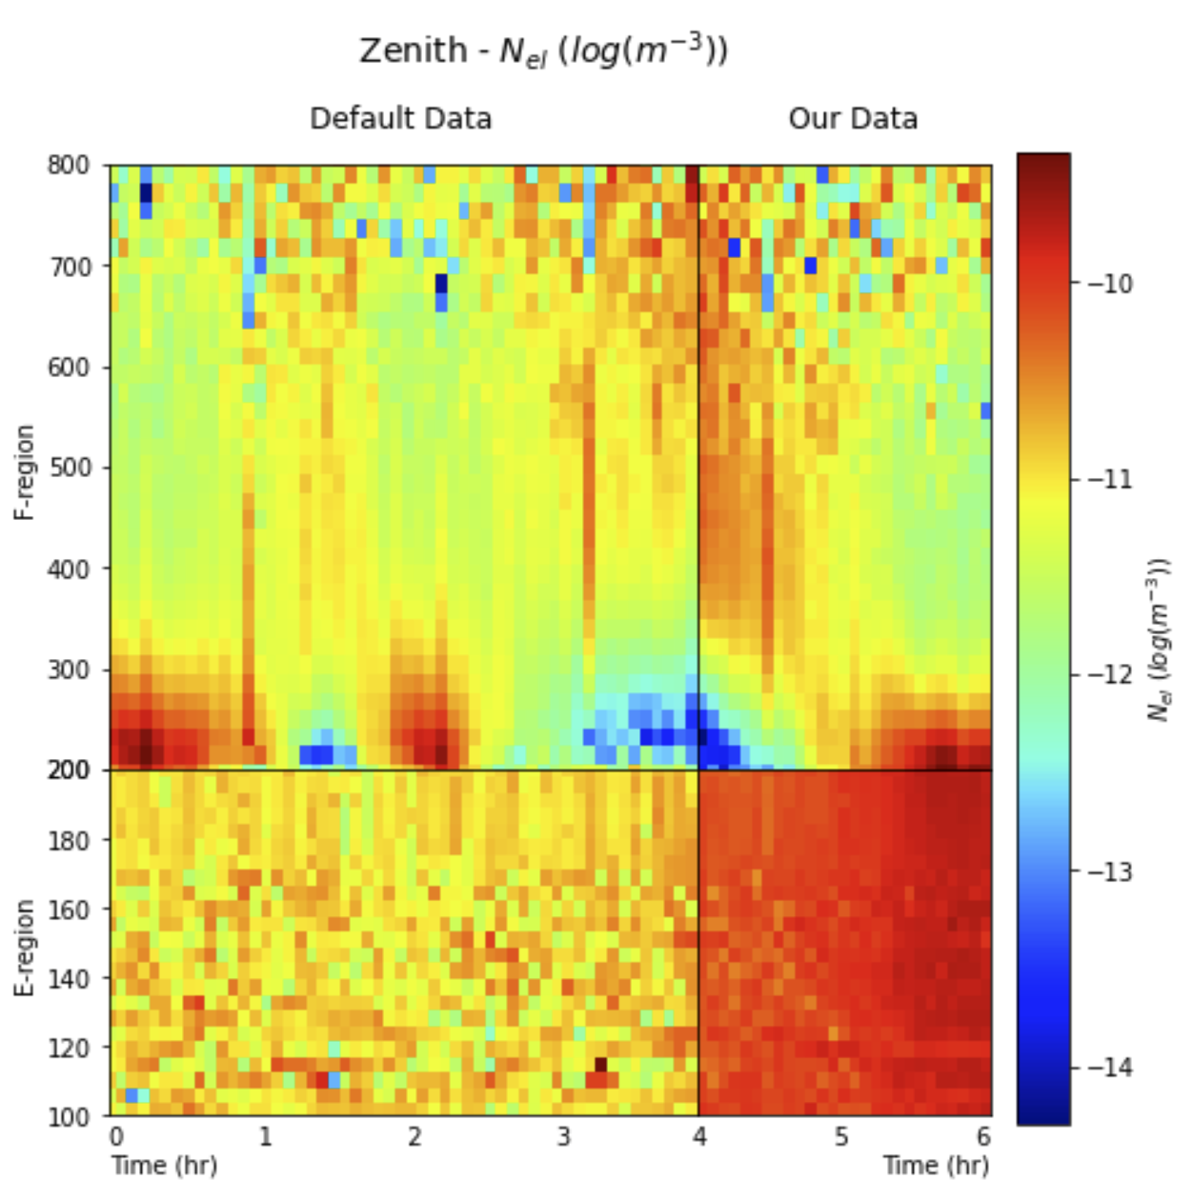
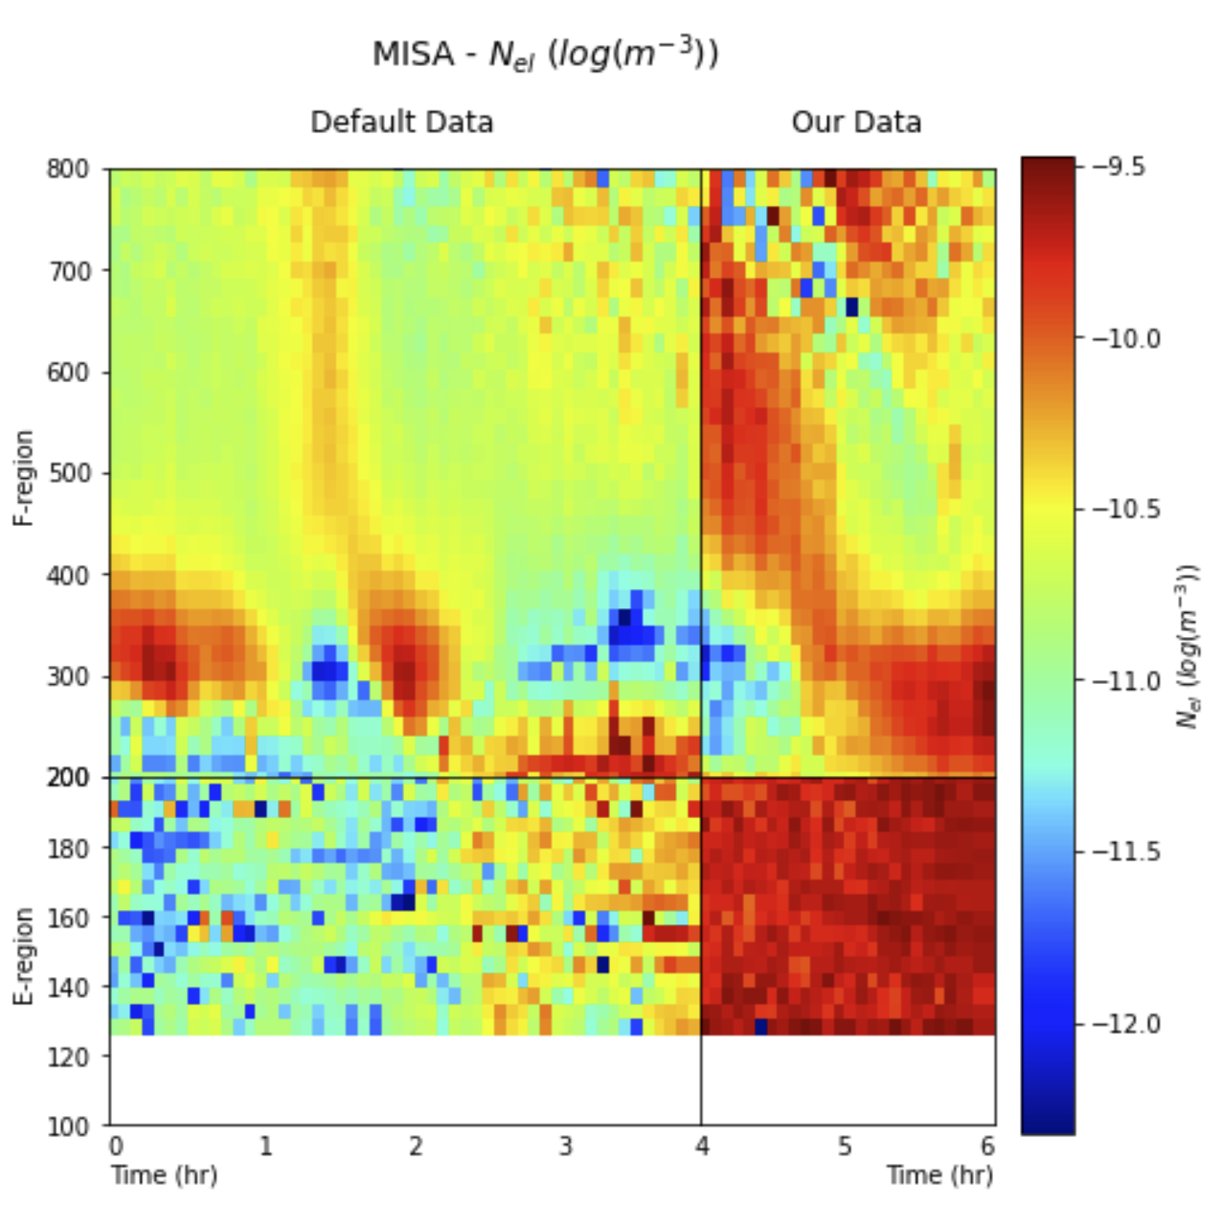
Visualization of TIDs
These plots are electron density with a rolling average subtracted from the background
Can more easily see fluctuations in electron density around 200 km altitude which indicate a TID

Slide 27
Method for TID Detection
Data: Default Rapid Regional and our Rapid Regional
  (00:00 EST - 6:00 EST) or (04:00 UTC - 10:00 UTC)
Electron density at one altitude (350km) for each time value
Resample and interpolate the data into 1 second bins
Cross-correlate the resampled data

Slide 28
Method for TID Detection

Slide 29
Method for TID Detection

Slide 30
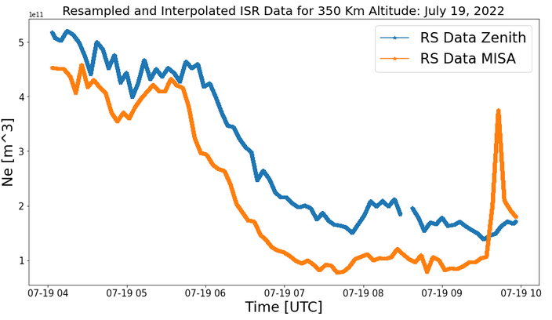
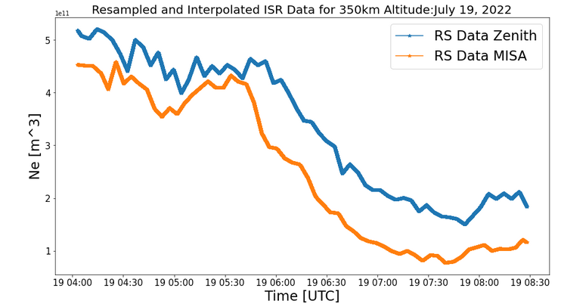
Method for TID Detection

Slide 31
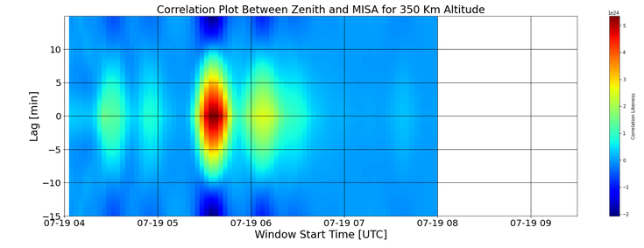
Cross Correlation Results
The data suggests several TIDs inclduing ones around 5:30 UTC (1:30 EST) and 6:00 UTC (2:00 EST)

Slide 32
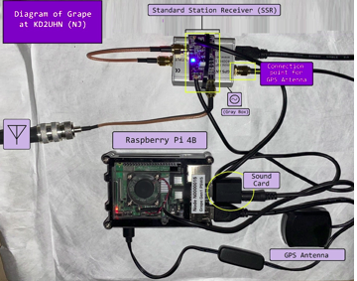
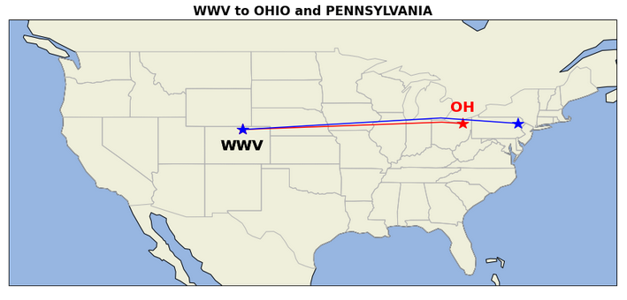
Comparison TID
Grape Personal Space Weather Station
Designed by HamSCI
Small multi-instrument
Can be used to make ground-based observations of the space environment
PA

Slide 33
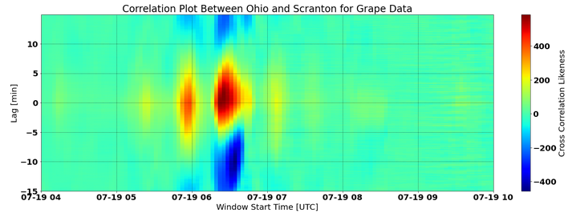
Comparison TID
Data suggests a number of TIDs including ones around 6:00UTC (2:00 EST) and 6:30 UTC (2:30 EST)
(+) lag = Scranton saw it first

Slide 34
Potential Analysis of TIDs
A
B
Notice the similar structures:
Possibility 1:
  A and C are the same TID
  B and D are the same TID
Possibility 2:
  A and D are the same TID
Possibility 3:
  They are different TIDs
C
D

Slide 35
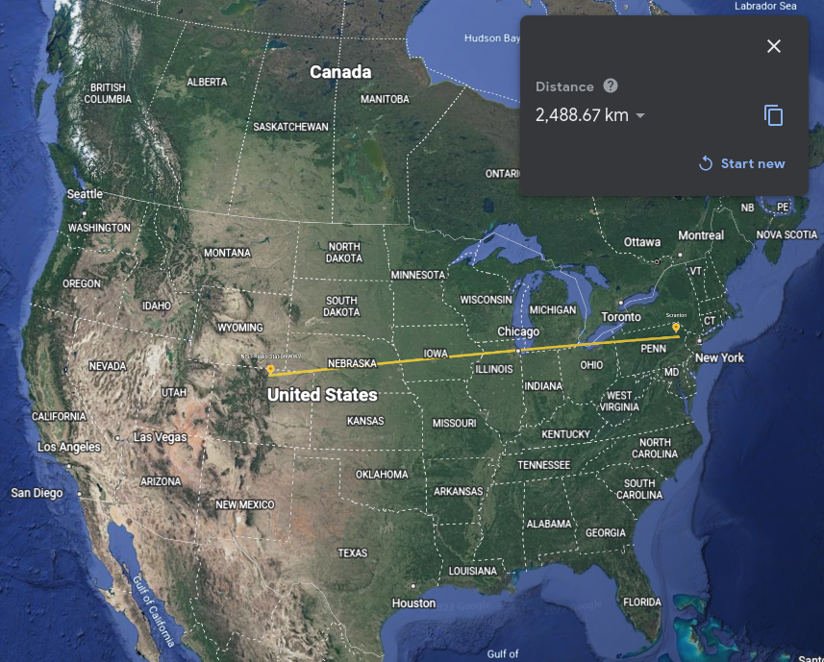
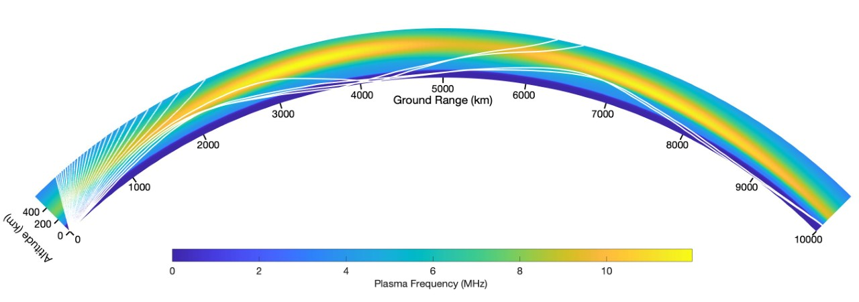
Reason for picking 350km altitude

Slide 36
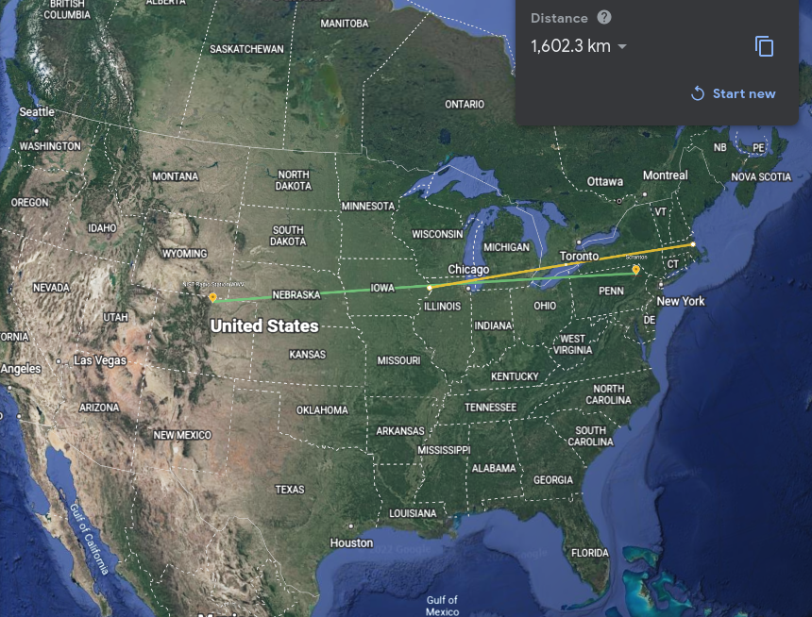
Potential Phase Velocity of TID
2
Estimating: Possibility A
  1,600 km between refraction point and ISR locations
  About 30 minute time window between detection of TIDs
  1,600,000m/1,800sec = 888.889m/sec in the general Westward direction
Estimating: Possibility B
  1,600 km between refraction point and ISR locations
  About 1 hour time window
  1,600,000m/3600sec = 444m/sec in the general Westward direction
A
B
C
D

Slide 37
Summary
Electron density visualization
  The activities associated with sunrise
  The find structures during the daytime
  Less error by uncoded pulse but worse range resolution
Particle velocity
  Activity through night, but spikes at sunrise abruptly
  Doppler velocity implies most particles moving towards us (downward as ionosphere heats)
  Low errors overall
Ionosonde analysis
  Confirms observations in electron density data, improves confidence
TIDs
  Disturbance seen in electron density, especially with background subtracted
  TID measured at two different stations
  Calculation of velocity and height of refraction of signal

Slide 38
Acknowledgements and References
*NSF Support for ISF
*Boston University
*MIT Haystack
*HamSCI’s Grape Network
*PHaRLAP (and Danielle)
*UCF
*SRI
*Staff

Slide 39
Questions?

Slide 40
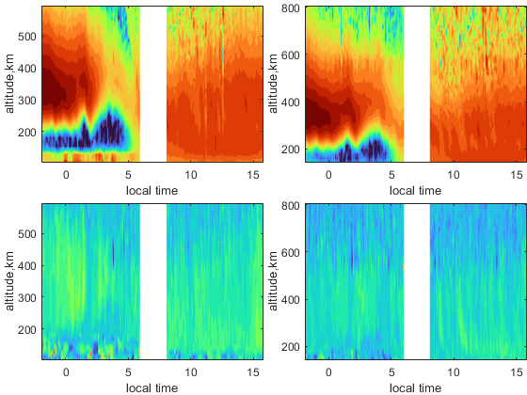
Appendix

