Slide 1
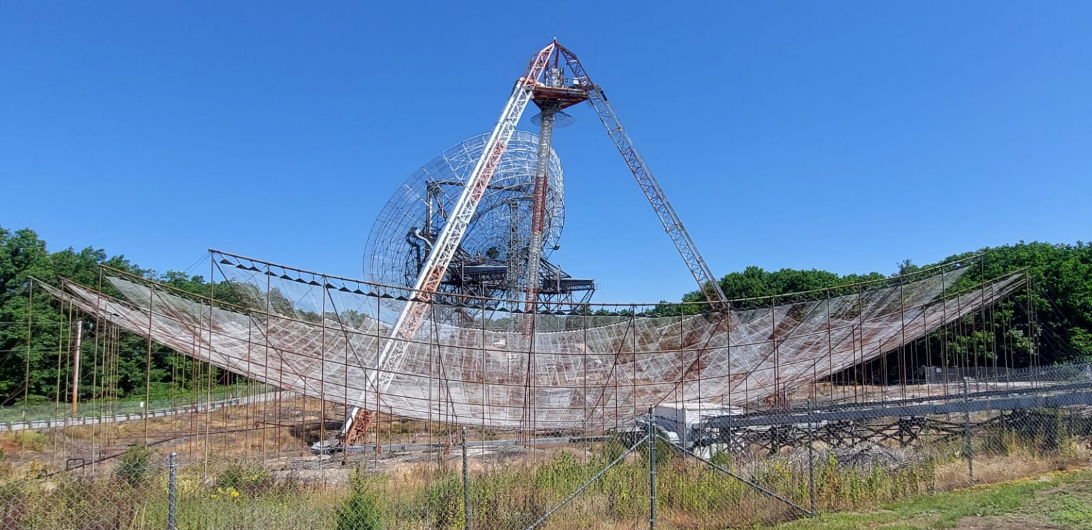
Mid latitudes effects from a geomagnetic storm striking the ISR2022 summer school
Group 1

Slide 2
OVERVIEW
Motivations for the project
Instruments and Methodology
Previous Geomagnetic Activity
Observations
  PFISR
  RISR
  Millstone Hill
Machine learning results
Conclusions

Slide 3
MOTIVATIONS
07/18/2022 various Space weather centers released news of a solar flare that would be visible in our area
These events offer unique opportunities to understand physical phenomena in the Sun-Earth environment
Solar events (CMEs, flares) may trigger severe events on Earth
Due to these motivations we chose to run experiment A: Rapid Regional
  Experiment cycle time = ~4.5 minutes
  Primarily focused on the E and F regions
  Time Slot: 6:00am - 8:00am EST (10:00 - 12:00 UTC)

Slide 4
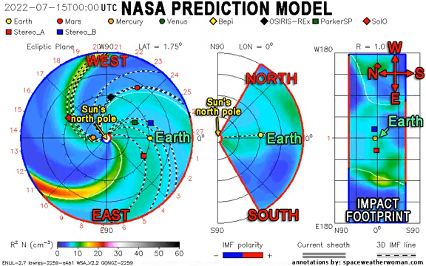
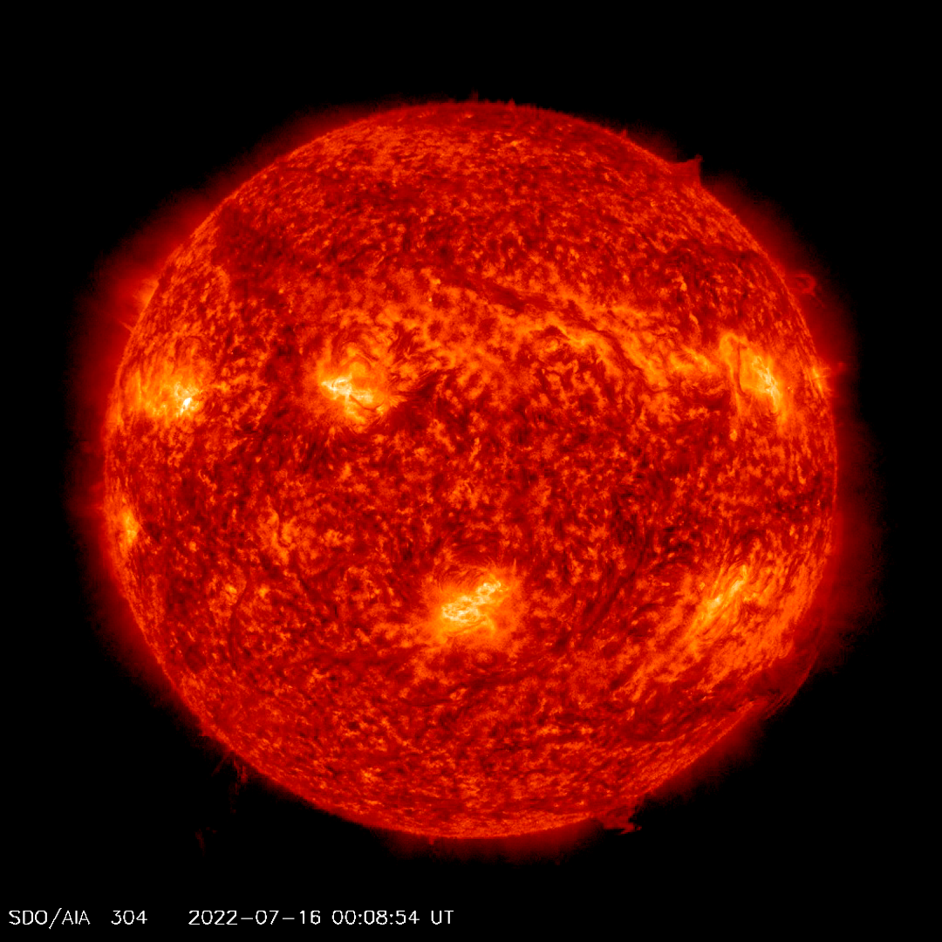
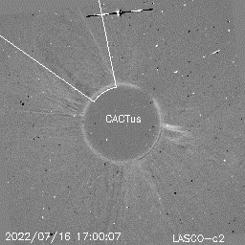
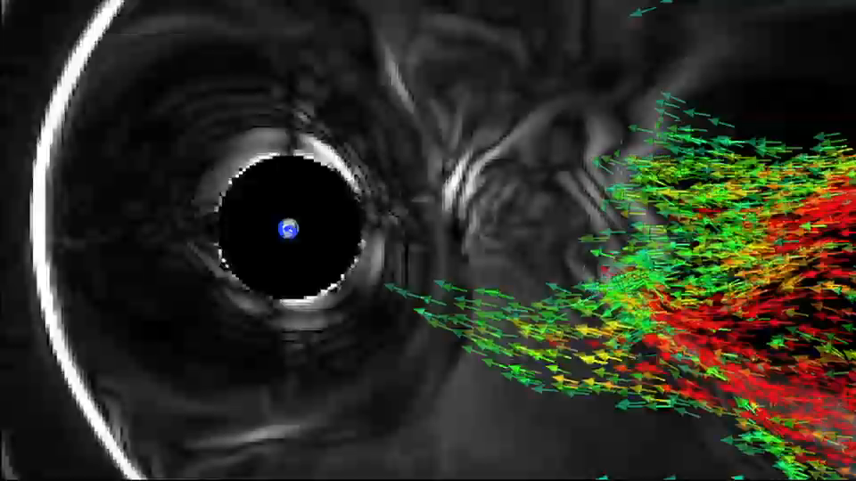

Slide 5
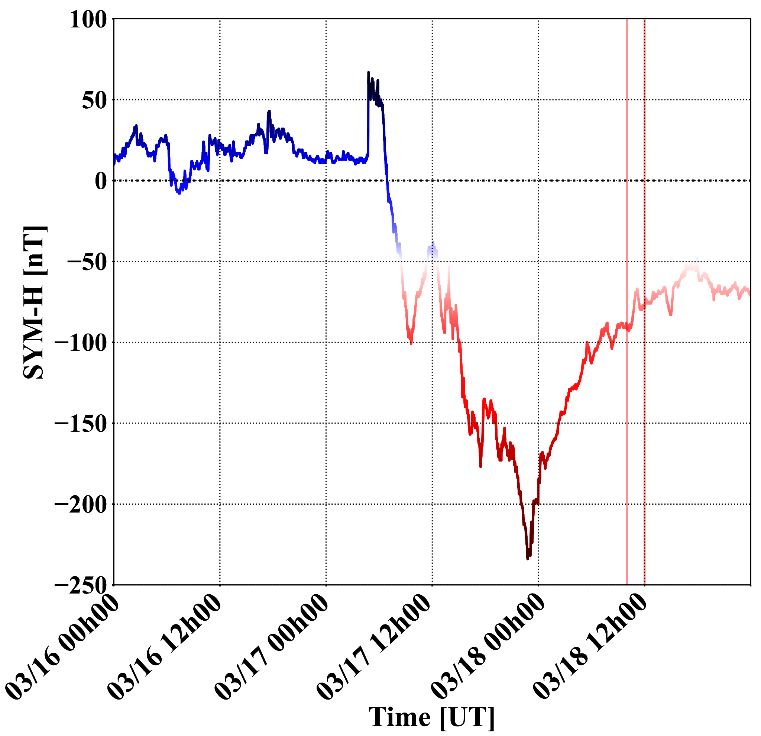
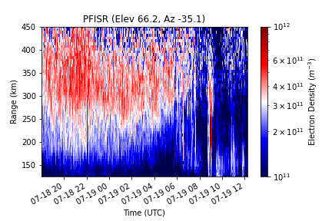
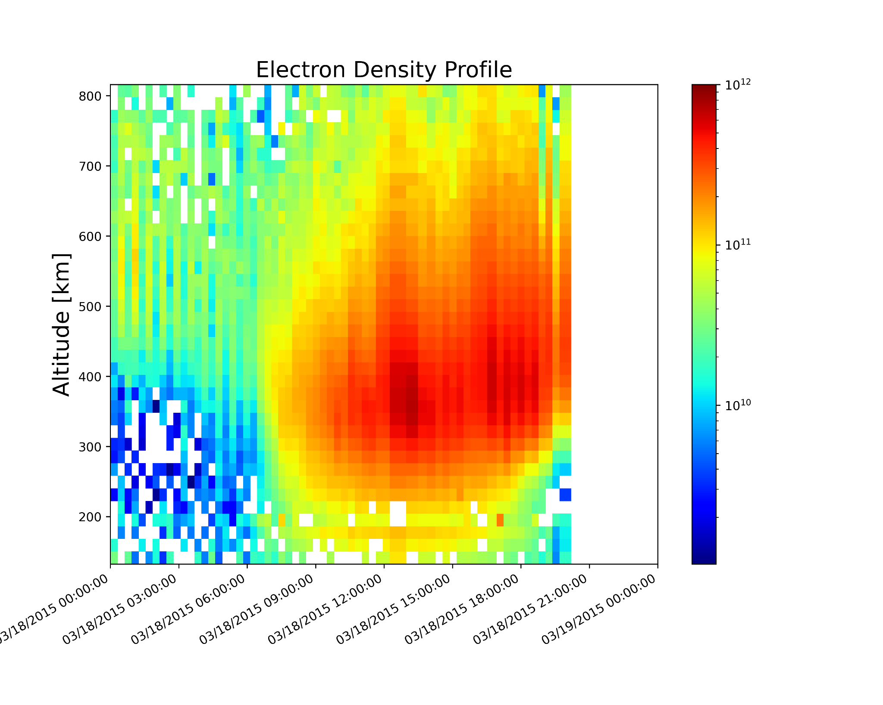
INSTRUMENTS AND METHODS
Geomagnetic indices
RISR/PIFSR data
(auroral events)
Millstone Hill
Zenith and MISA (mid-latitude)

Slide 6
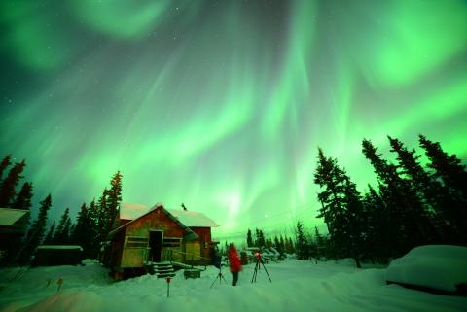
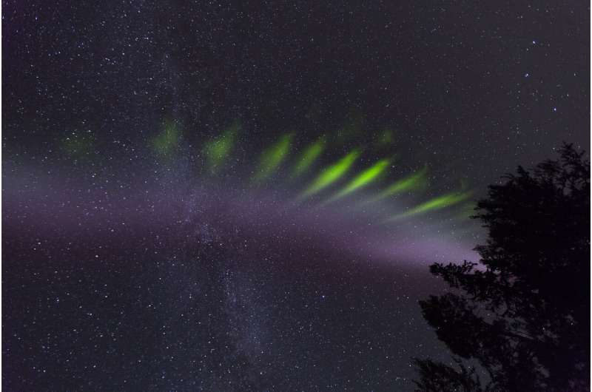
Geomagnetic Activity
Right: https://phys.org/news/2019-11-steve-picket.html
Left: https://www.pfrr.alaska.edu/content/aurora-over-venetie

Slide 7
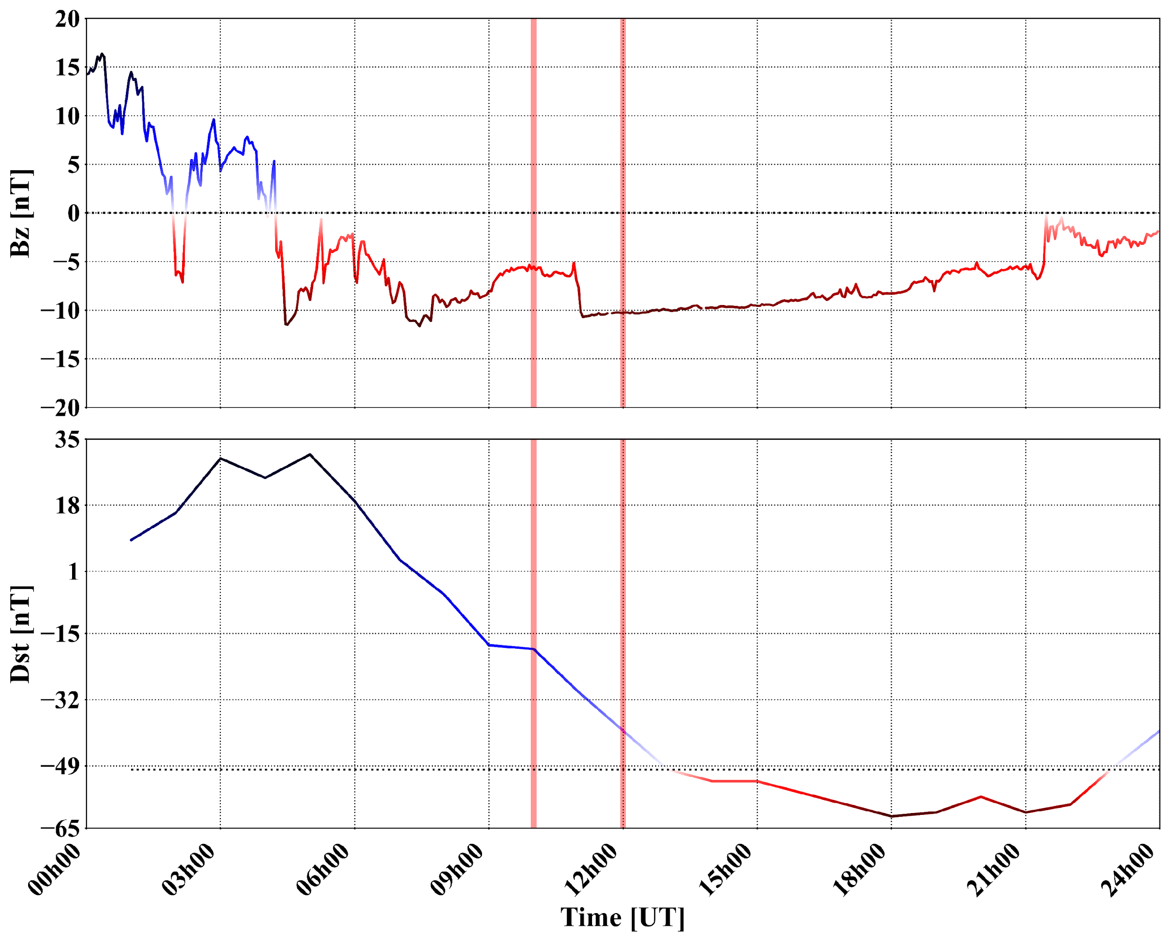
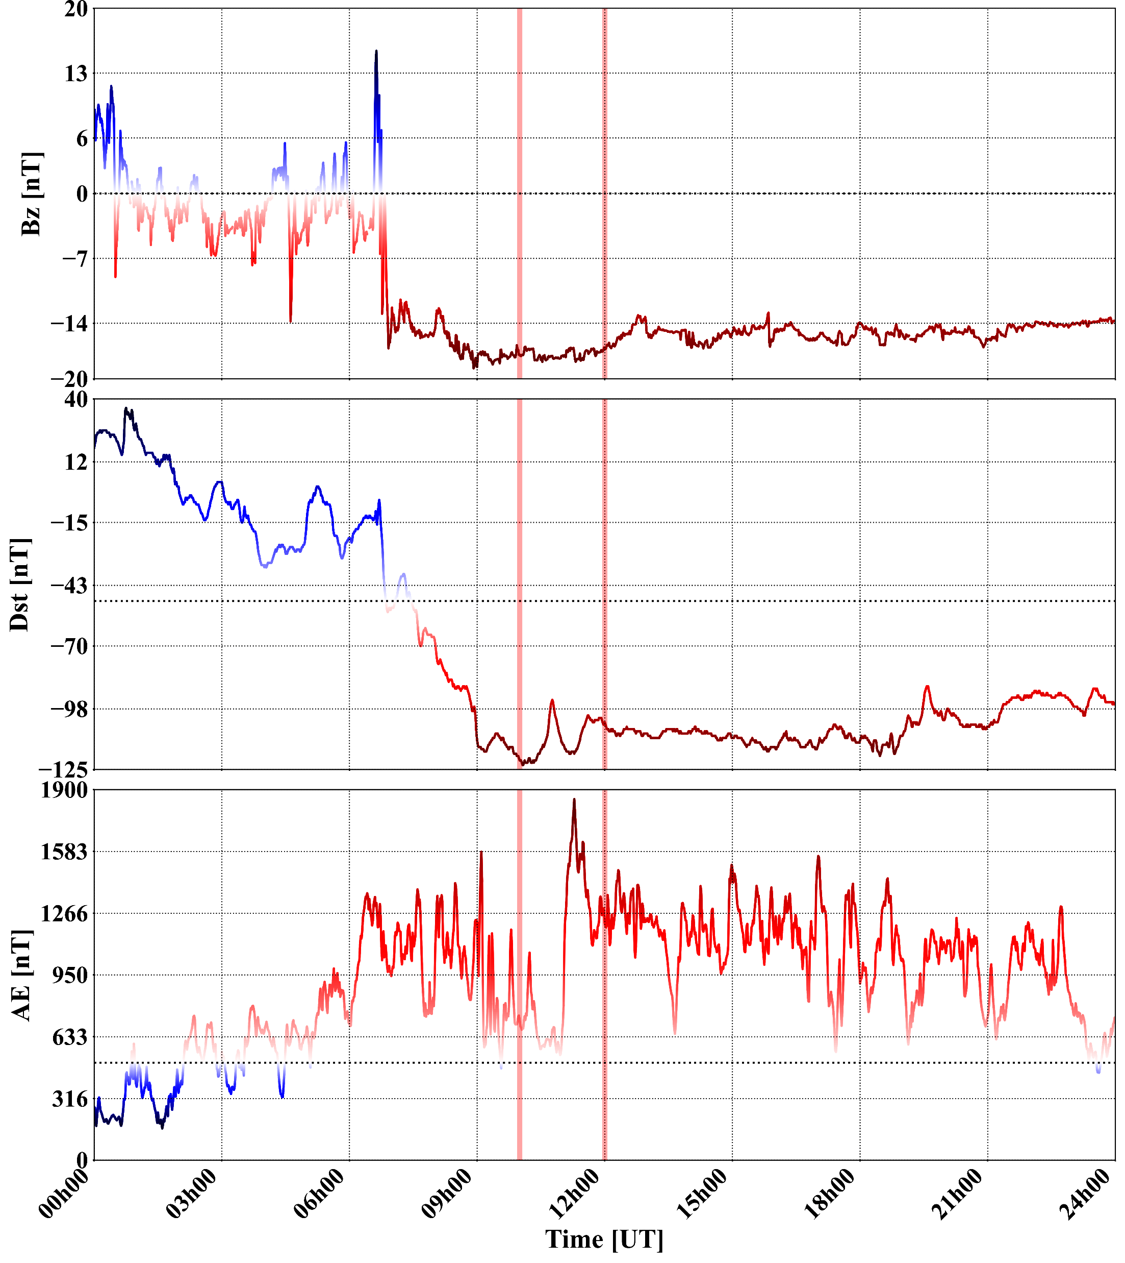
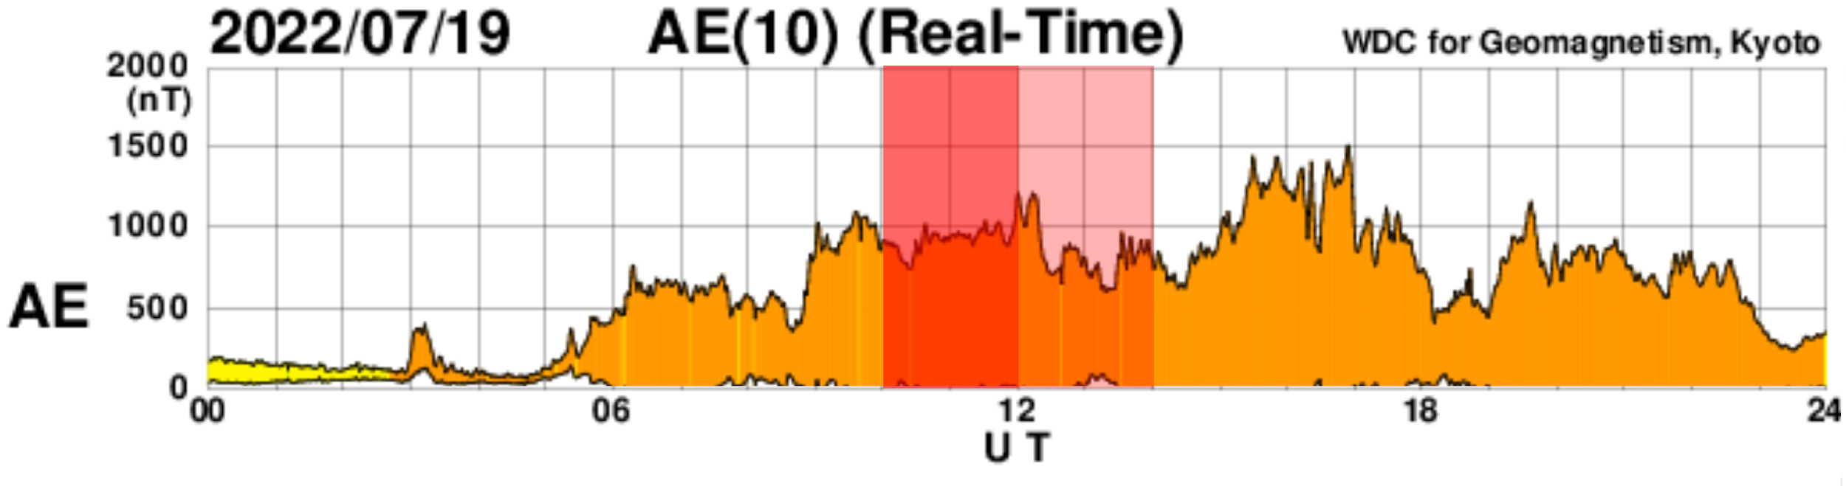
July 19, 2022
July 15, 2012

Slide 8
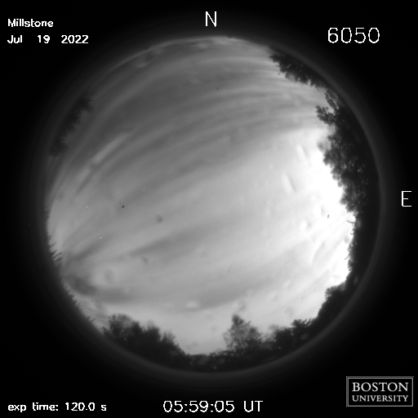
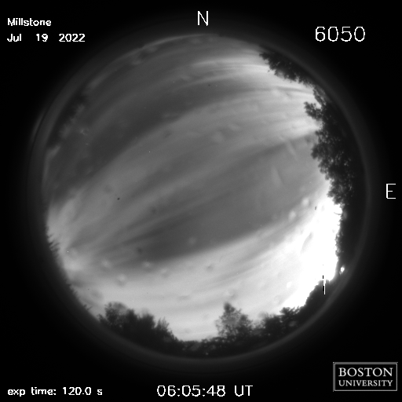
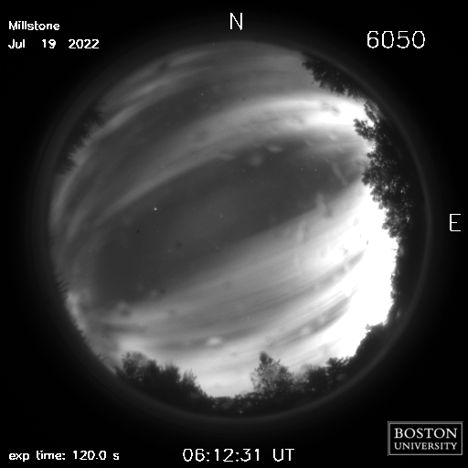
Already something there?

Slide 9
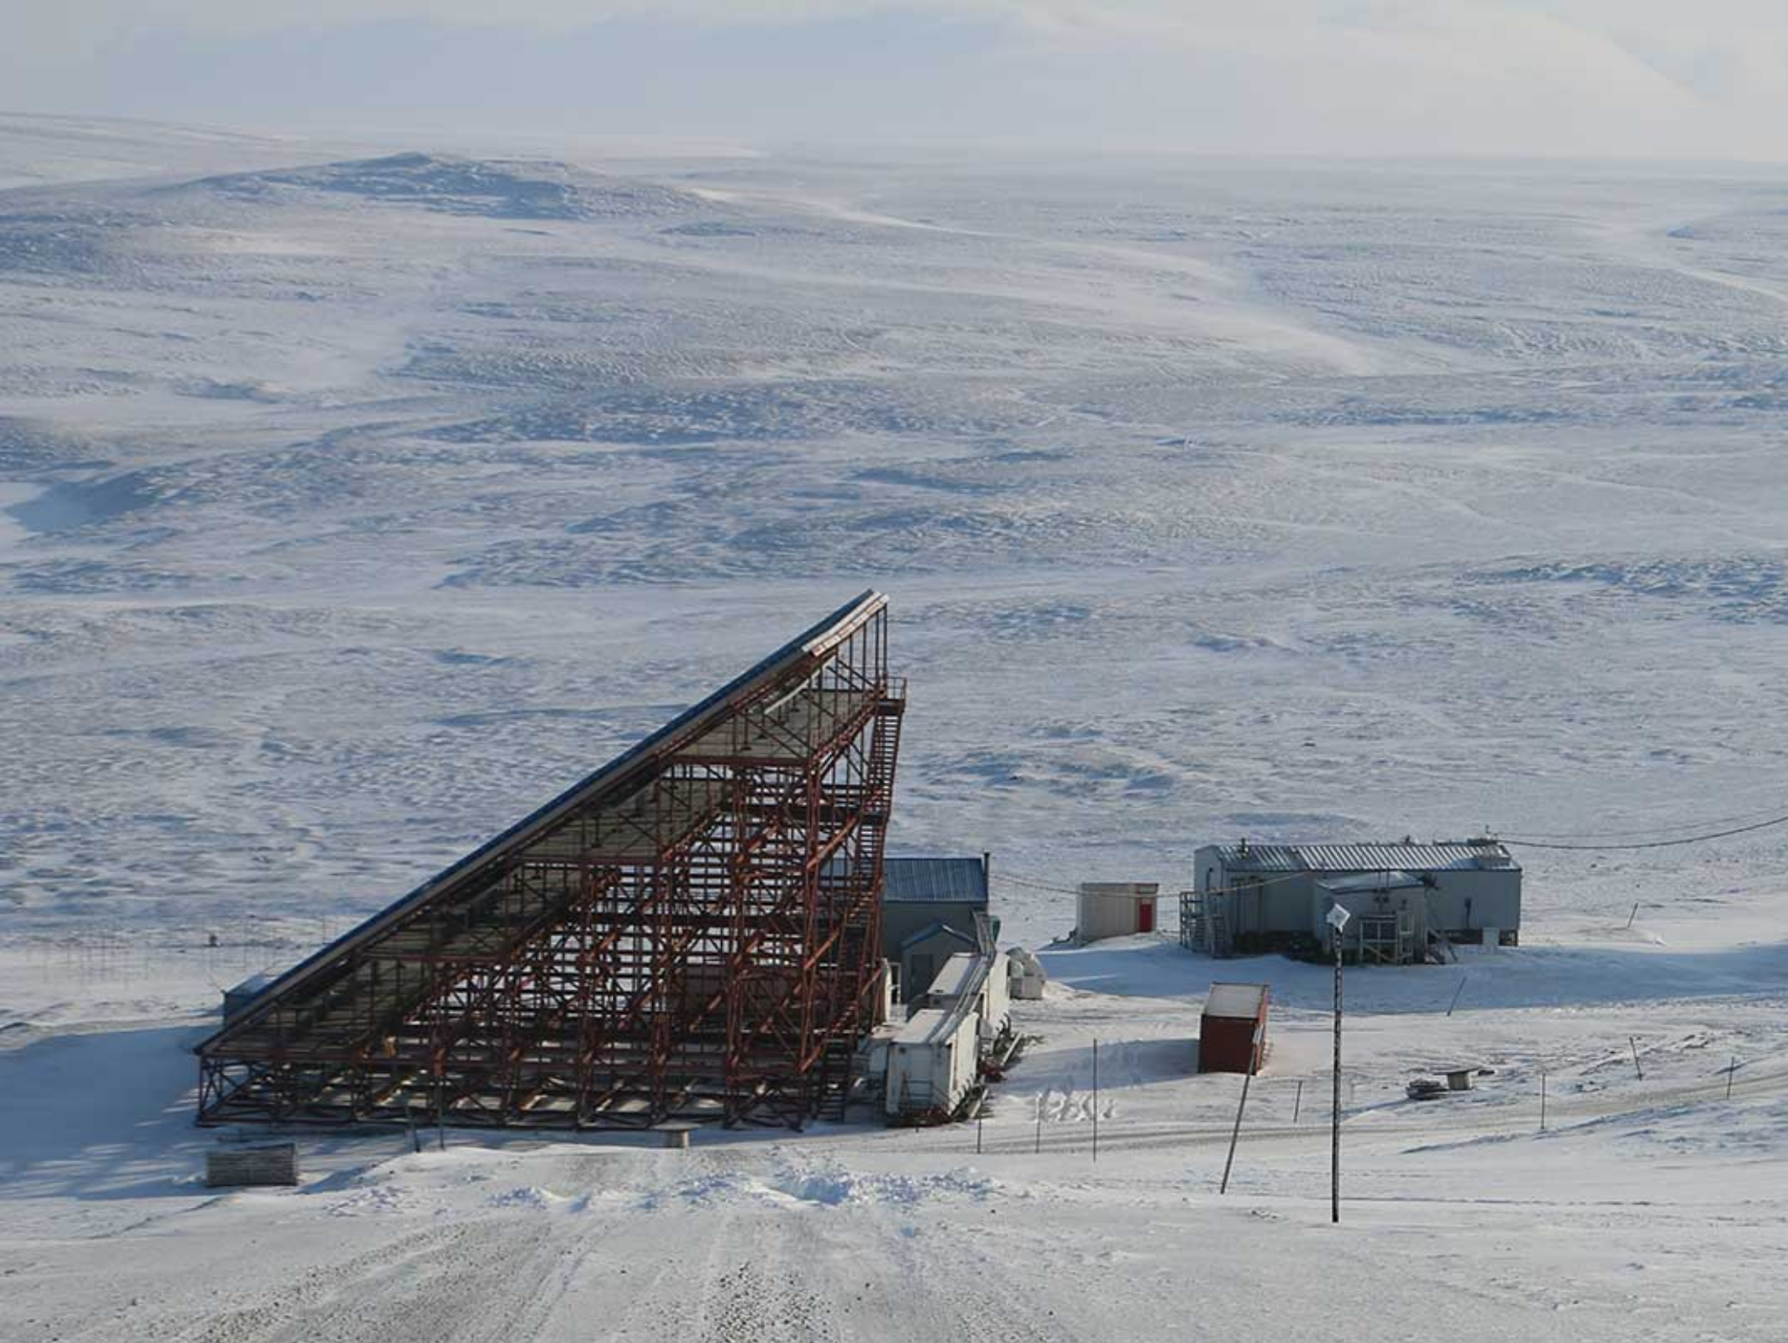
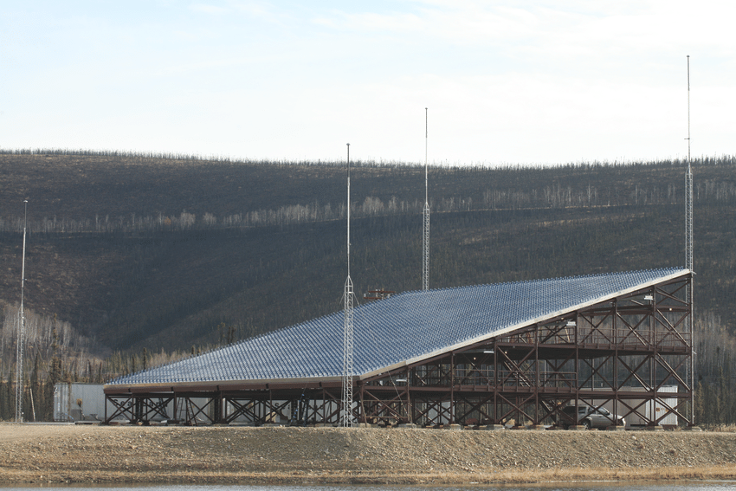
RISR and PFISR

Slide 10
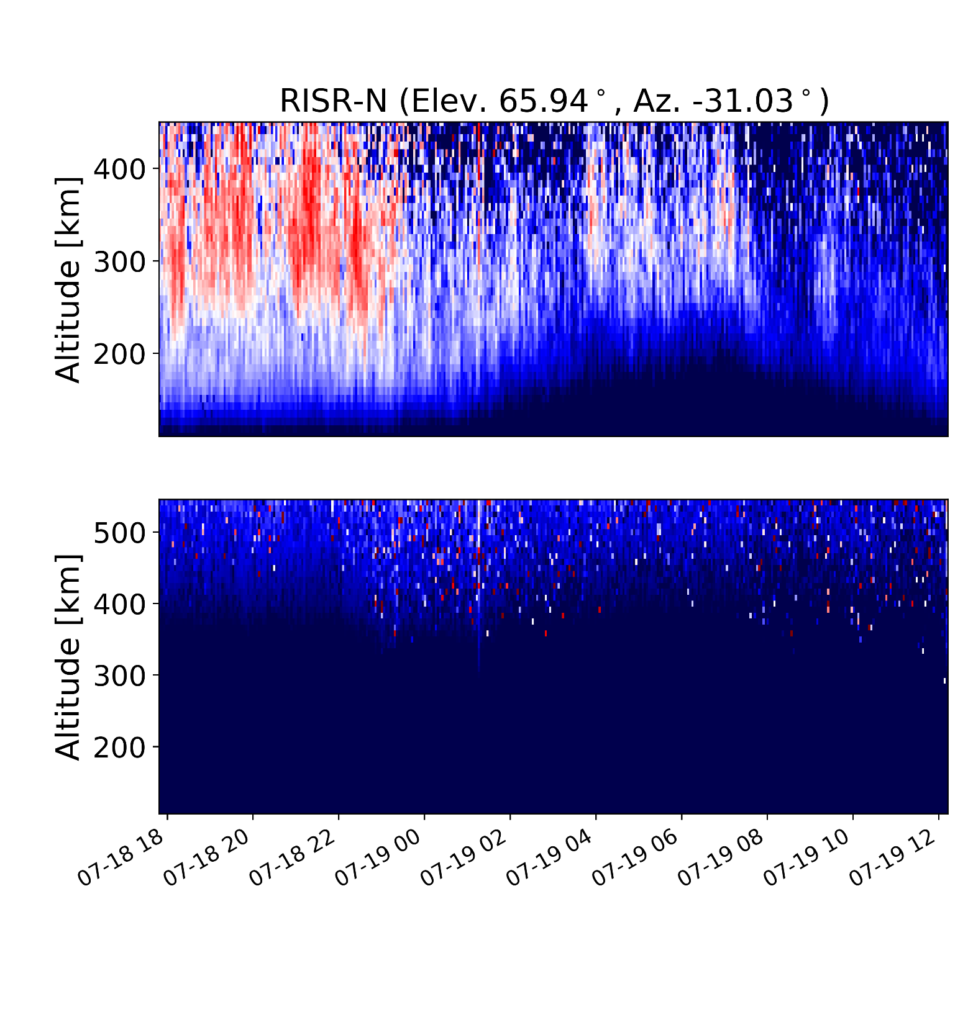
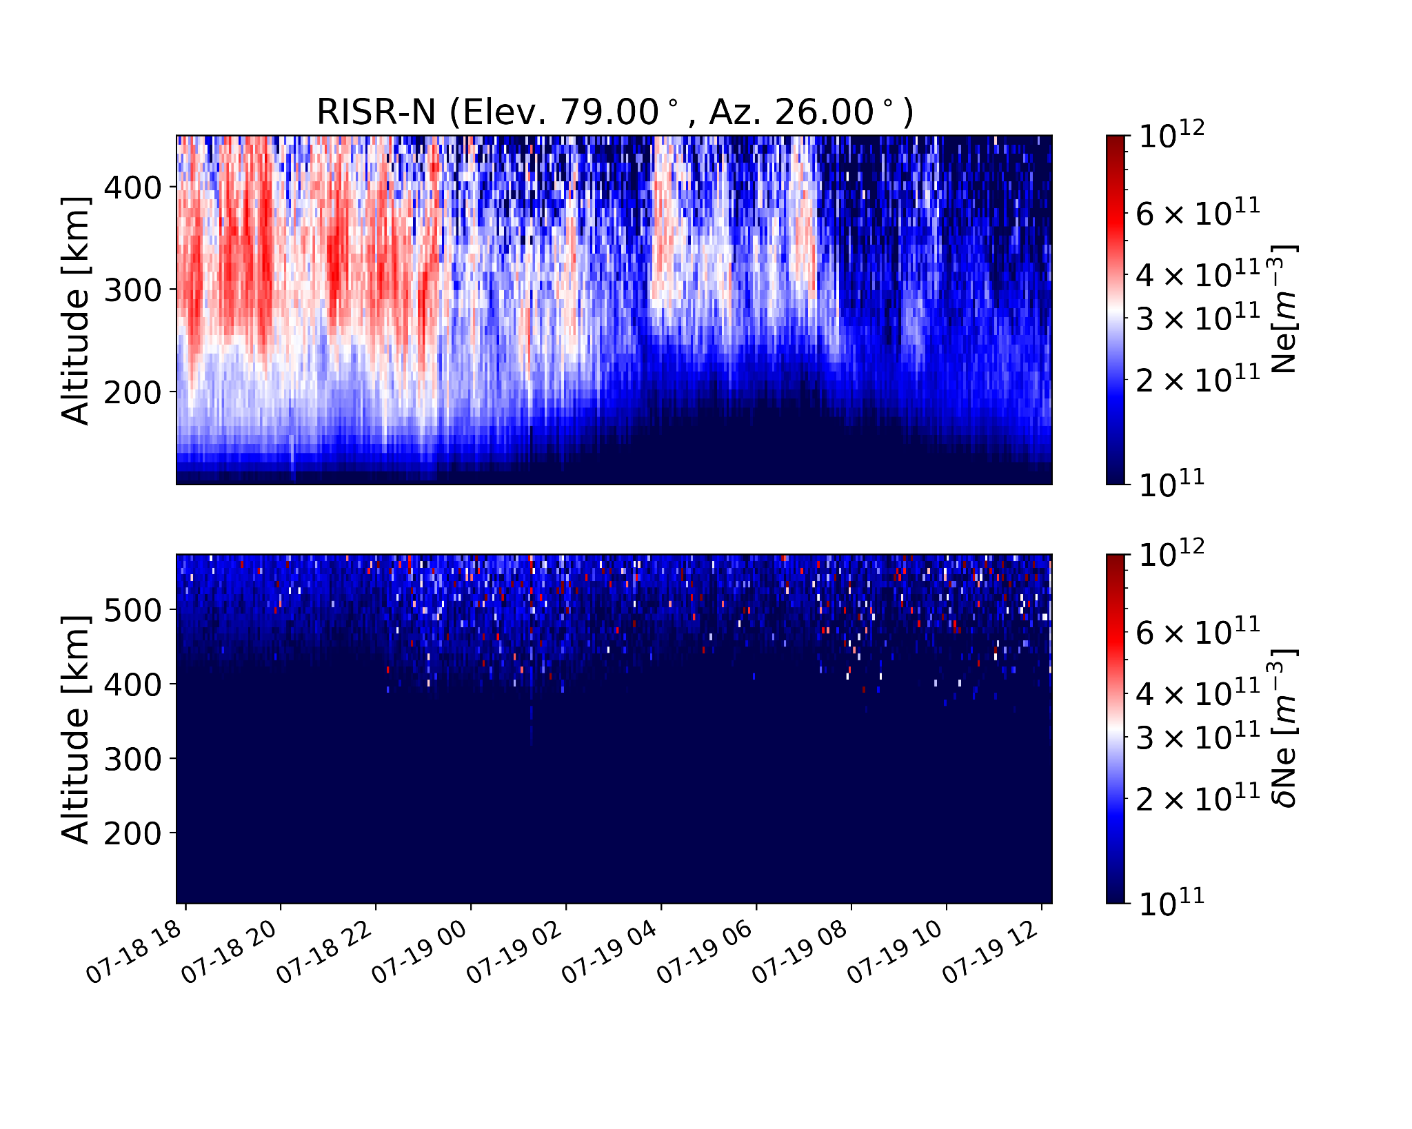
RISR-N Observations

Slide 11
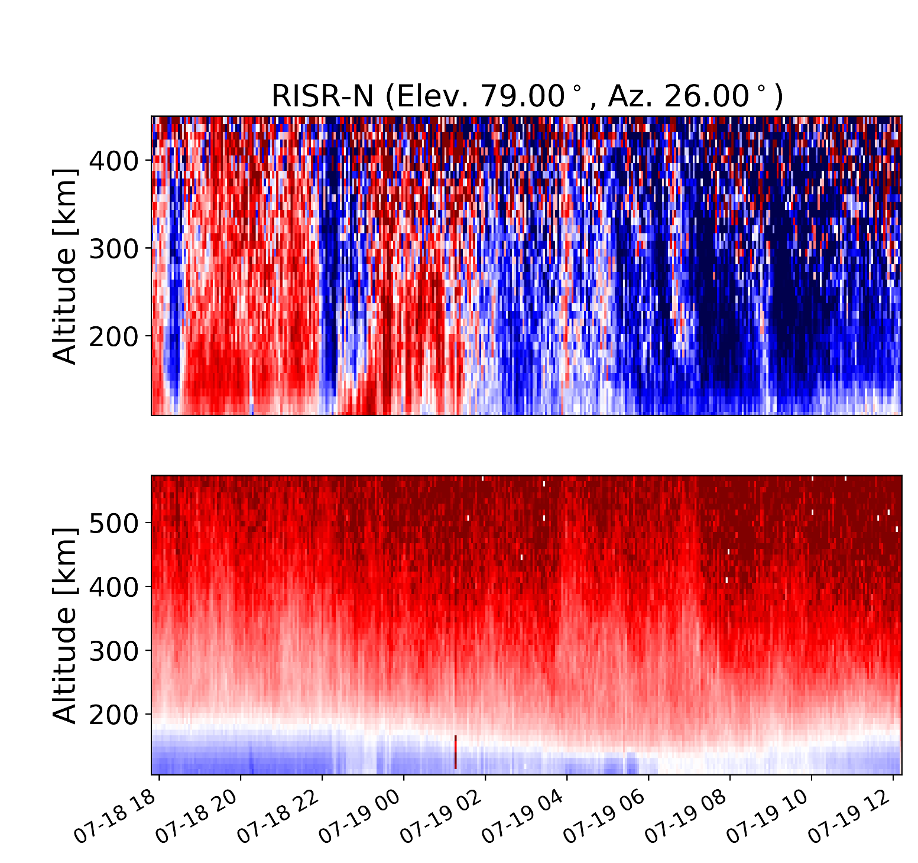
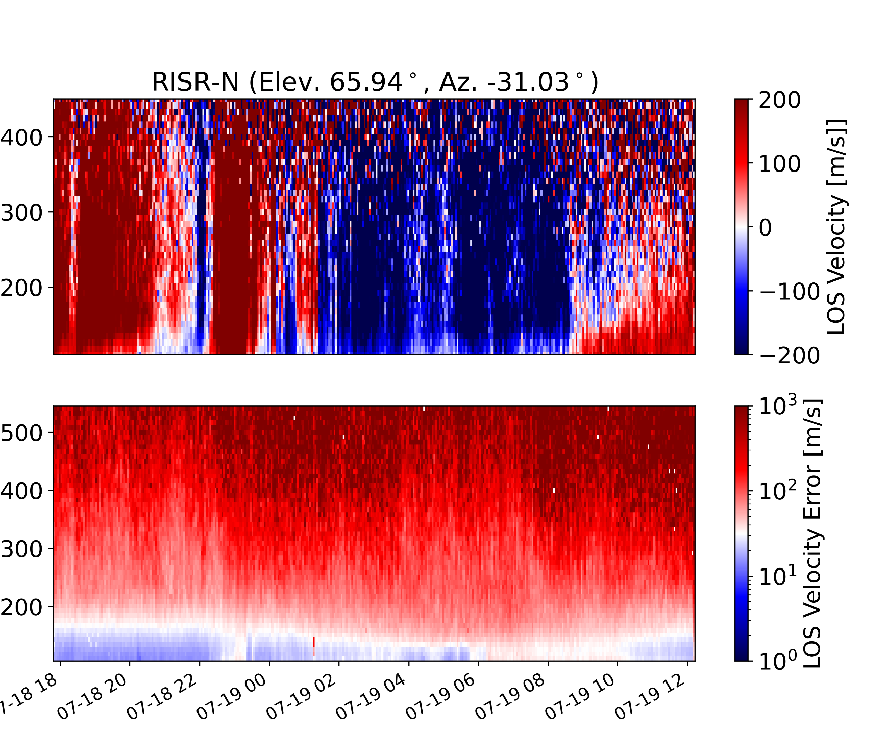
RISR-N Observations

Slide 12
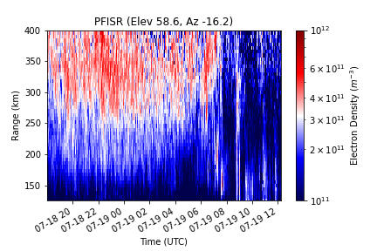
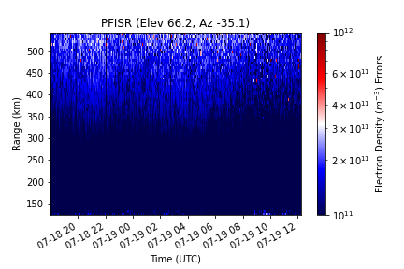
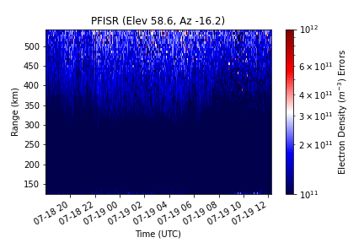
PFISR Observations
Notes:
We know activity was happening earlier in the night and can see the effects it had on certain parameters such as electron density, line of sight velocity and ion temperature

Slide 13
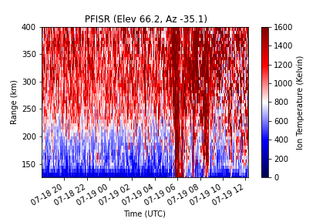
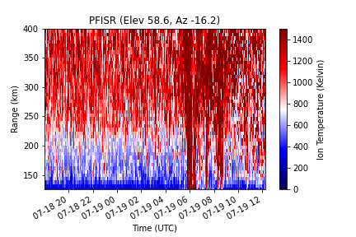
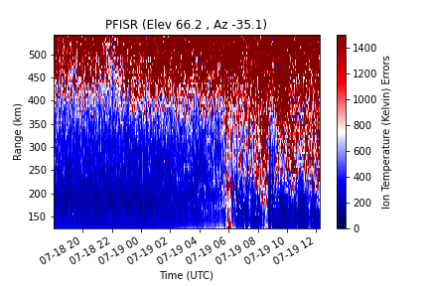
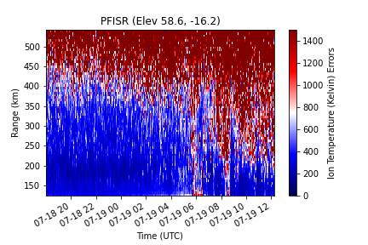
PFISR Observations

Slide 14
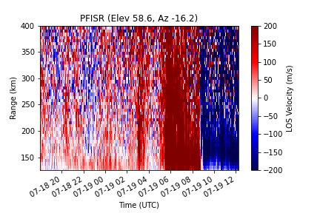
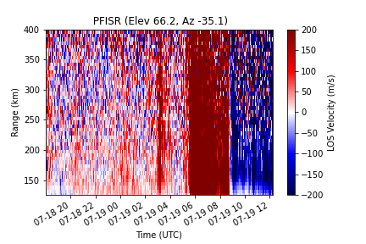
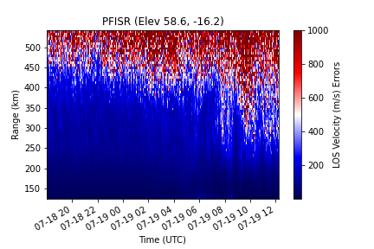
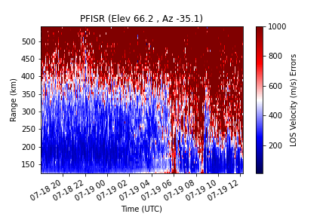
PFISR Observations

Slide 15
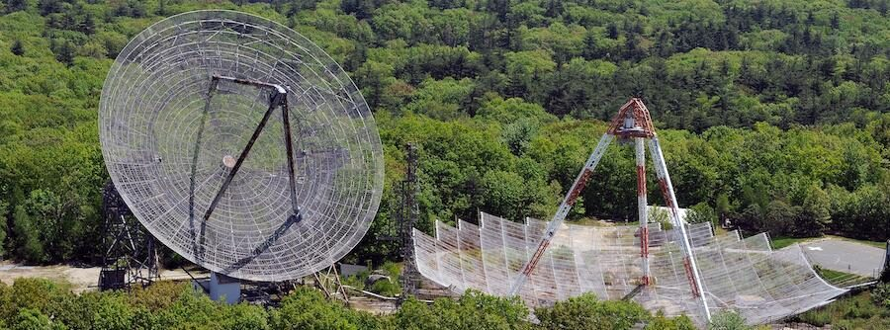
Millstone Hill

Slide 16
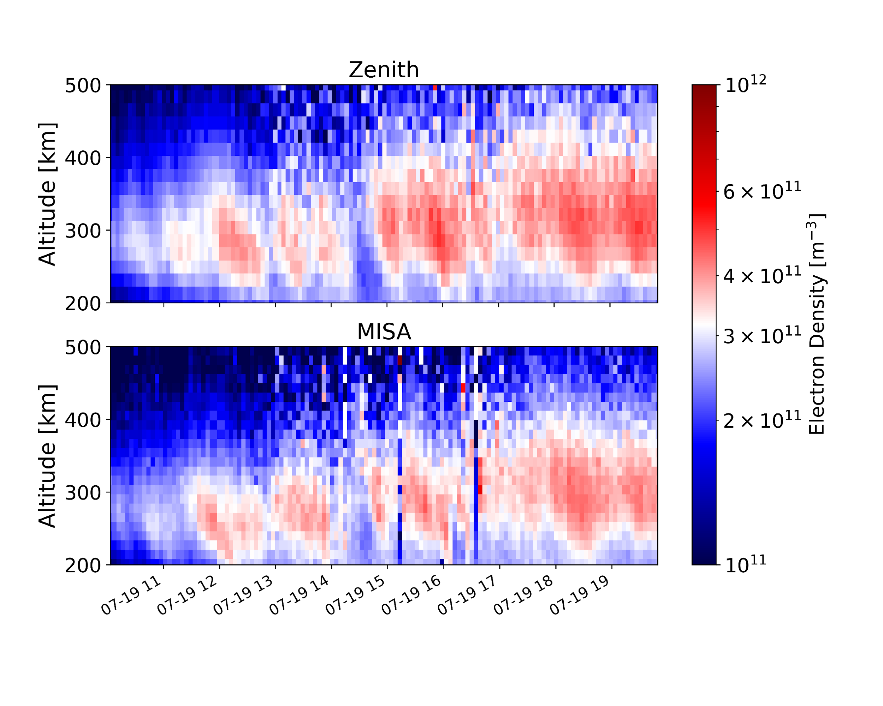
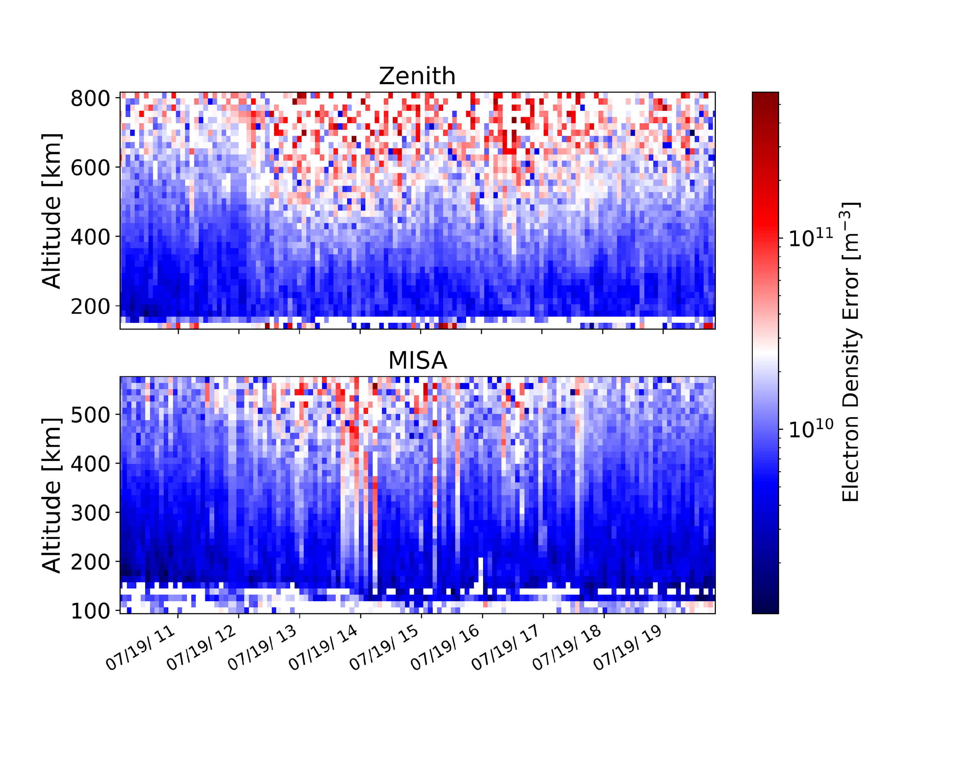
Millstone Hill Observations

Slide 17
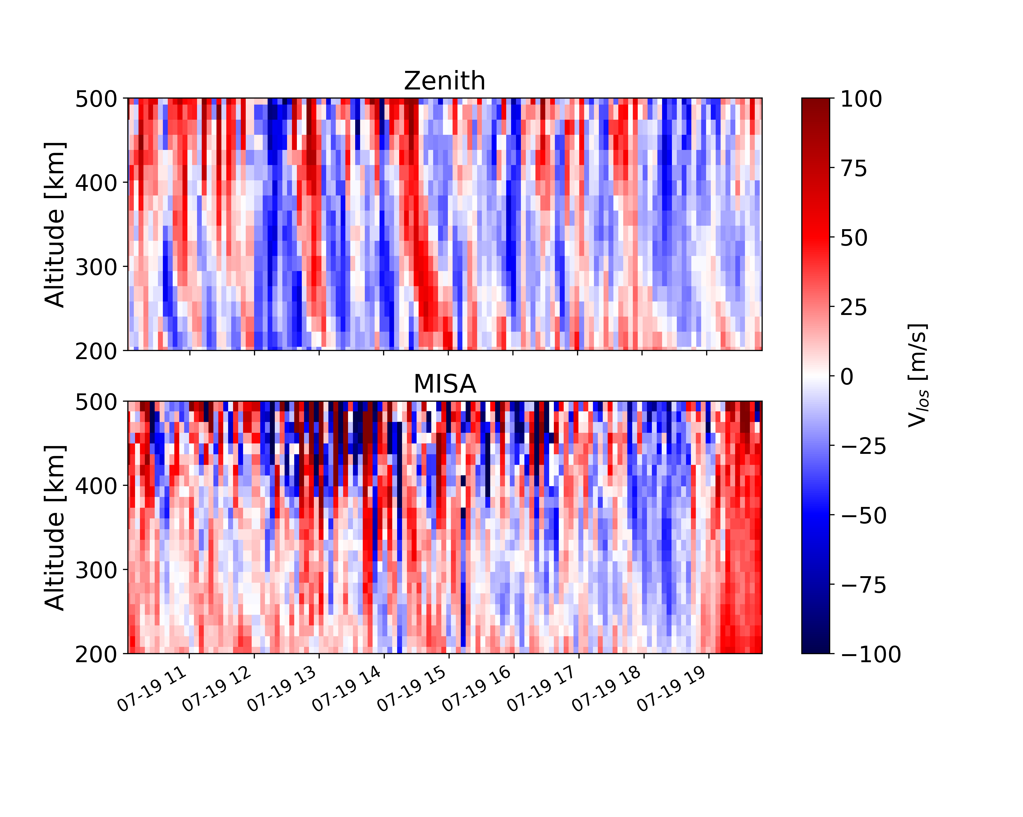
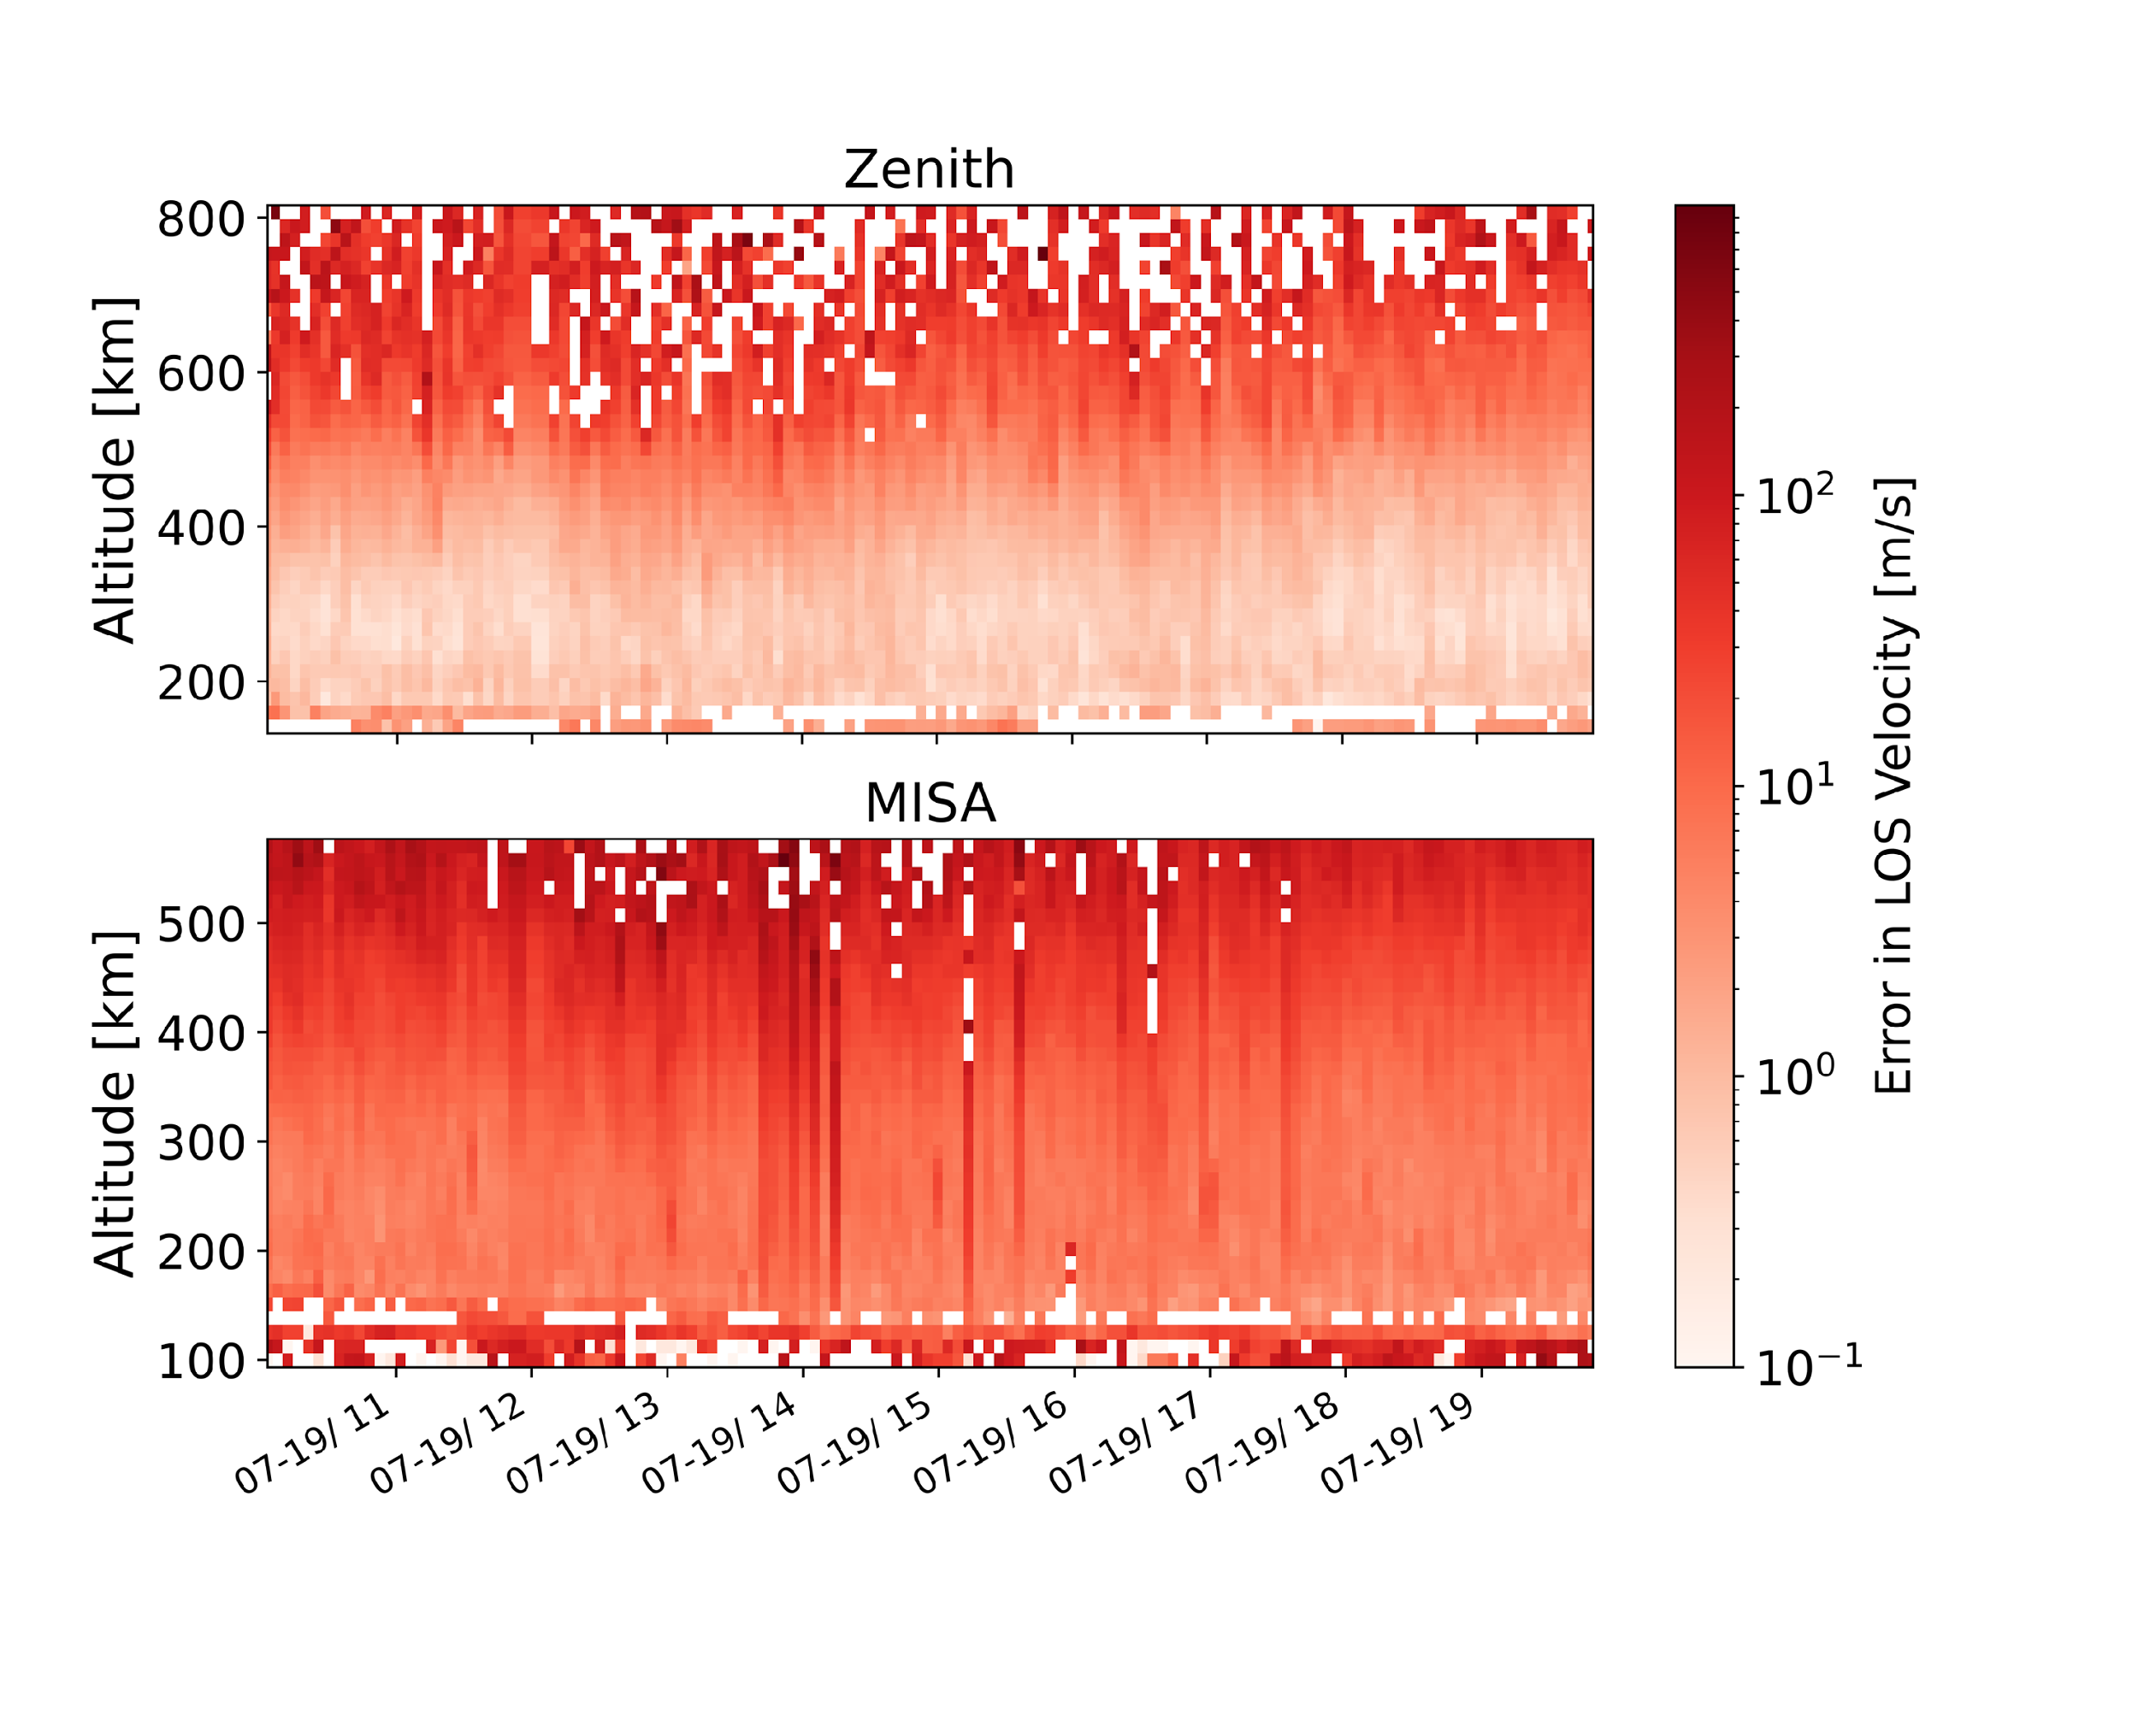
Millstone Hill Observations

Slide 18
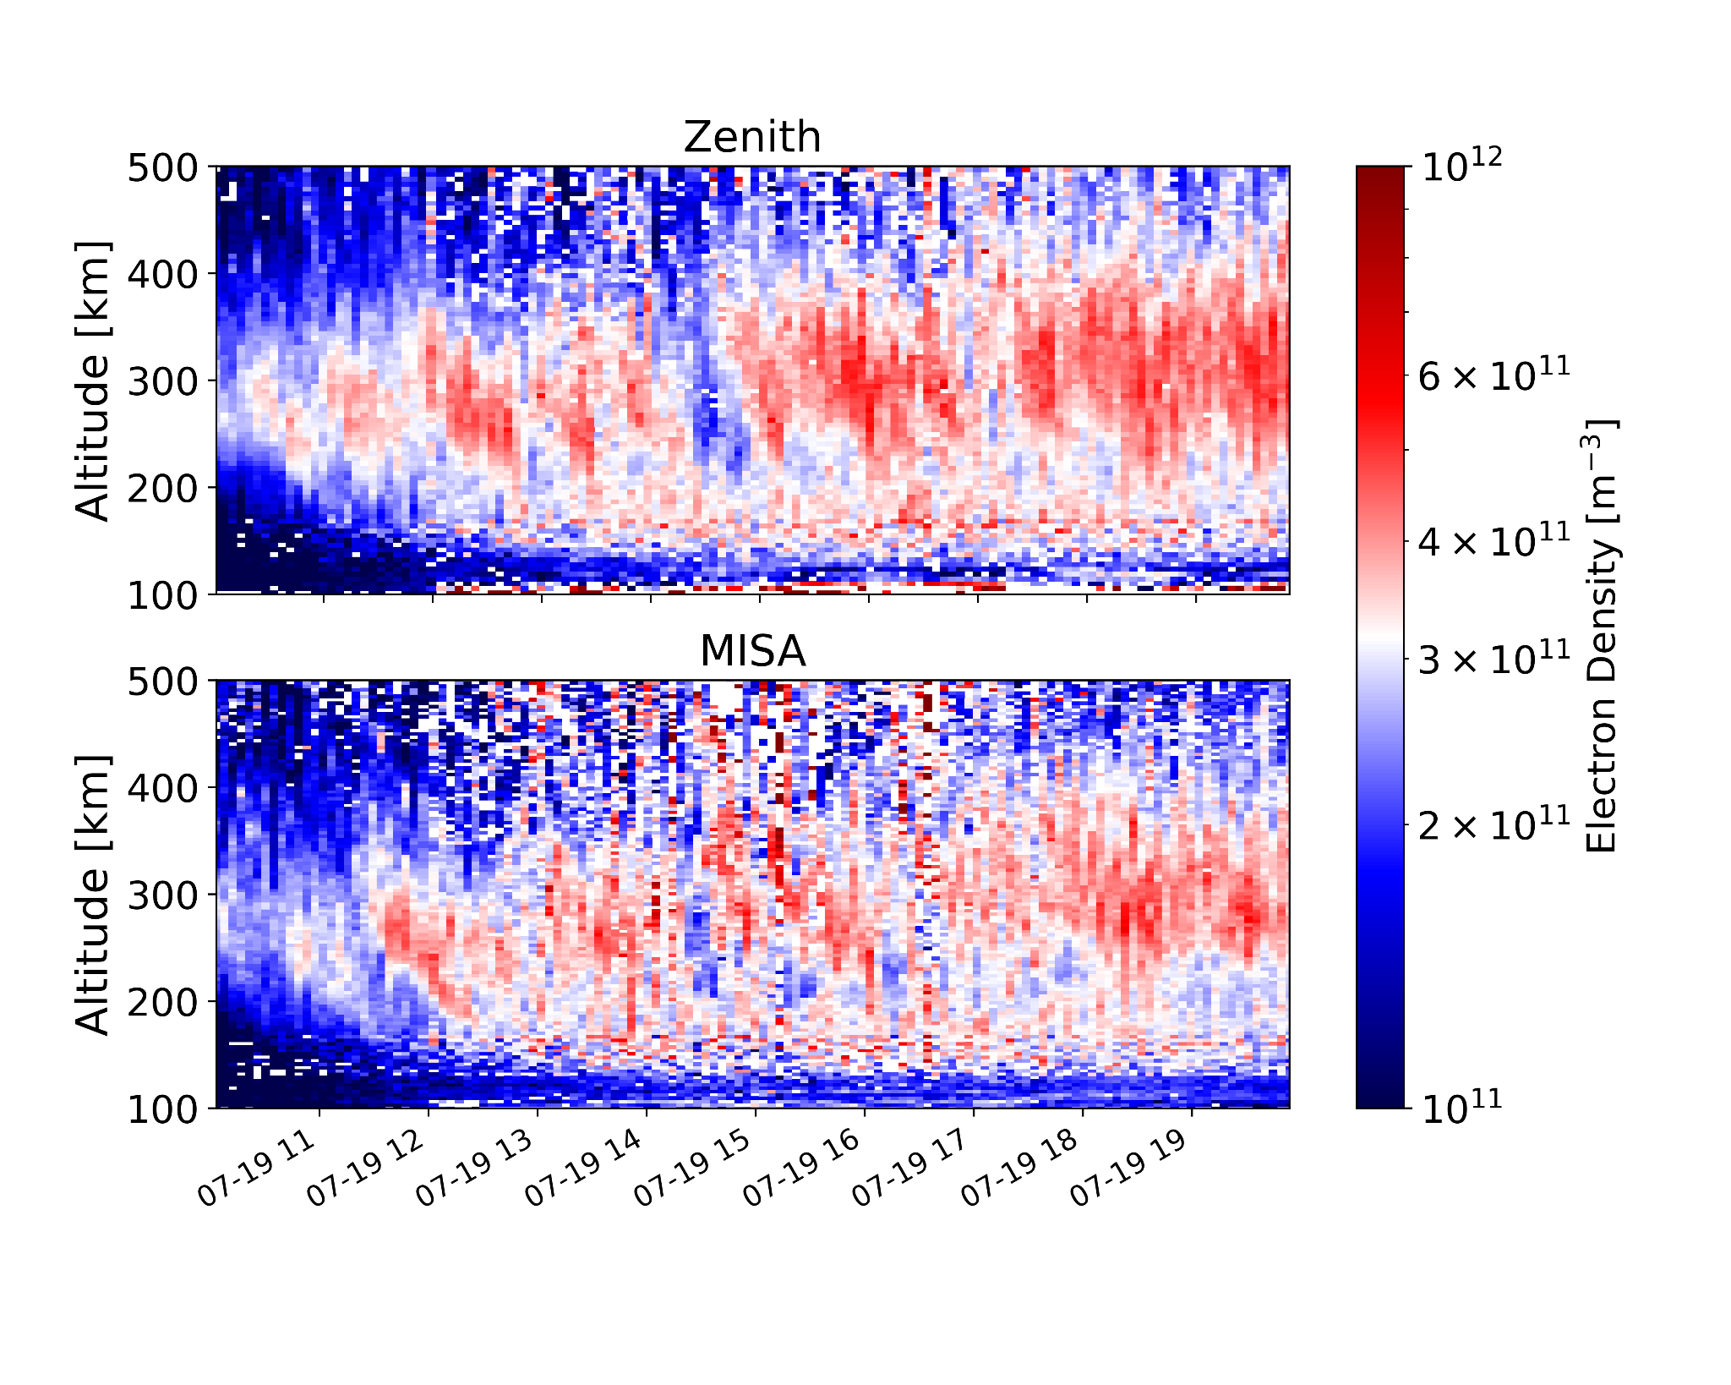
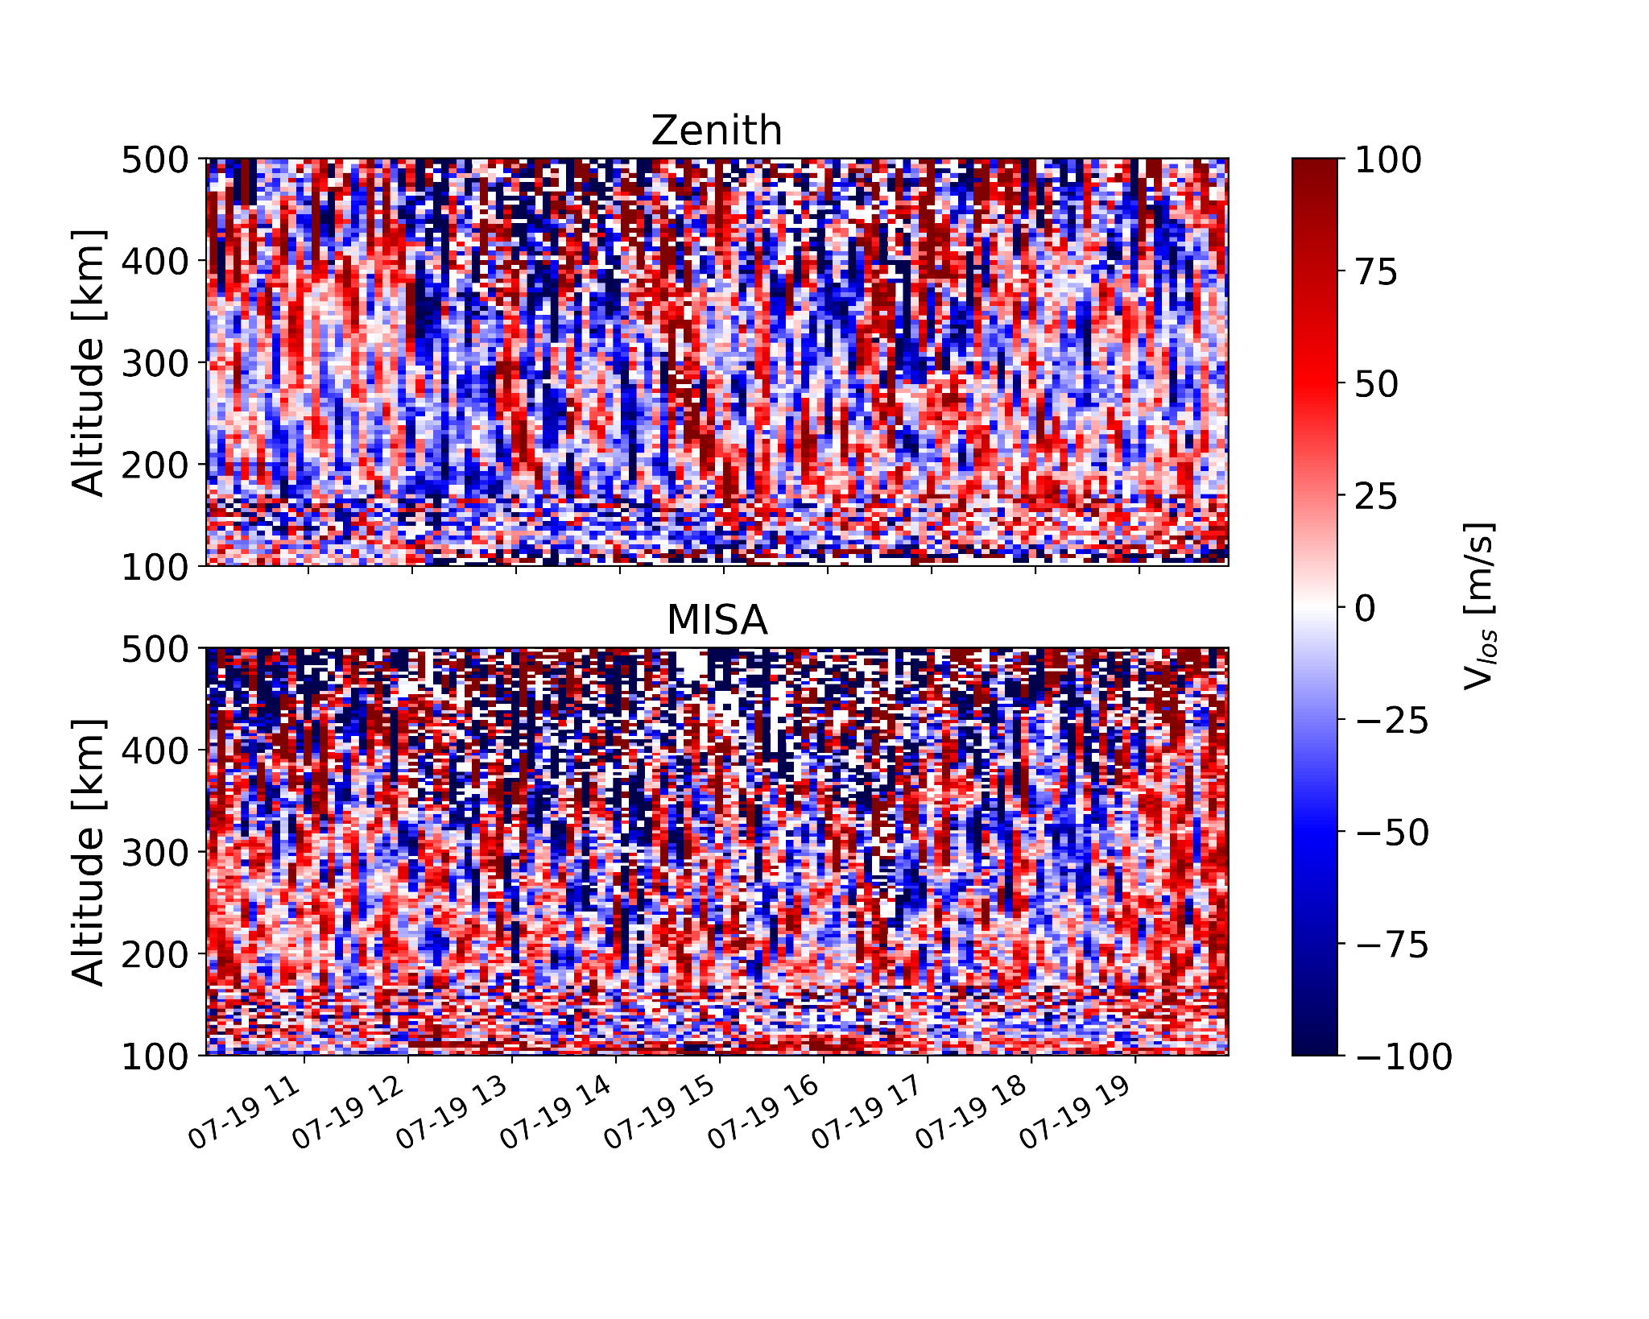
Millstone Hill Observations

Slide 19
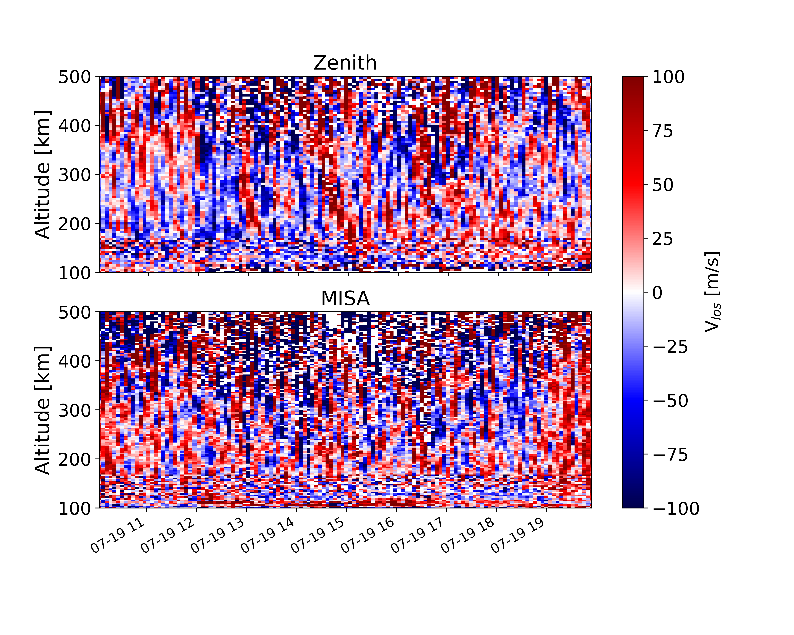
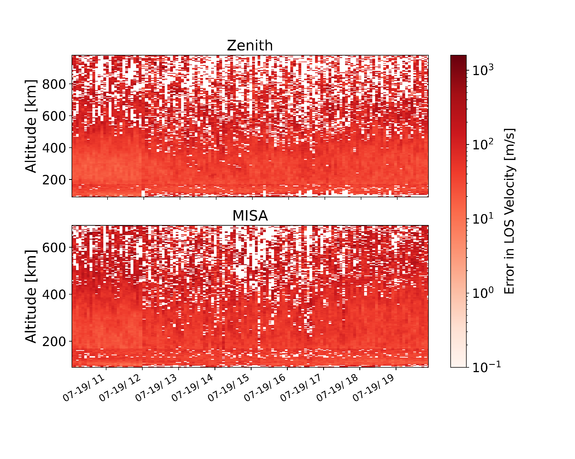
Millstone Hill Observations

Slide 20
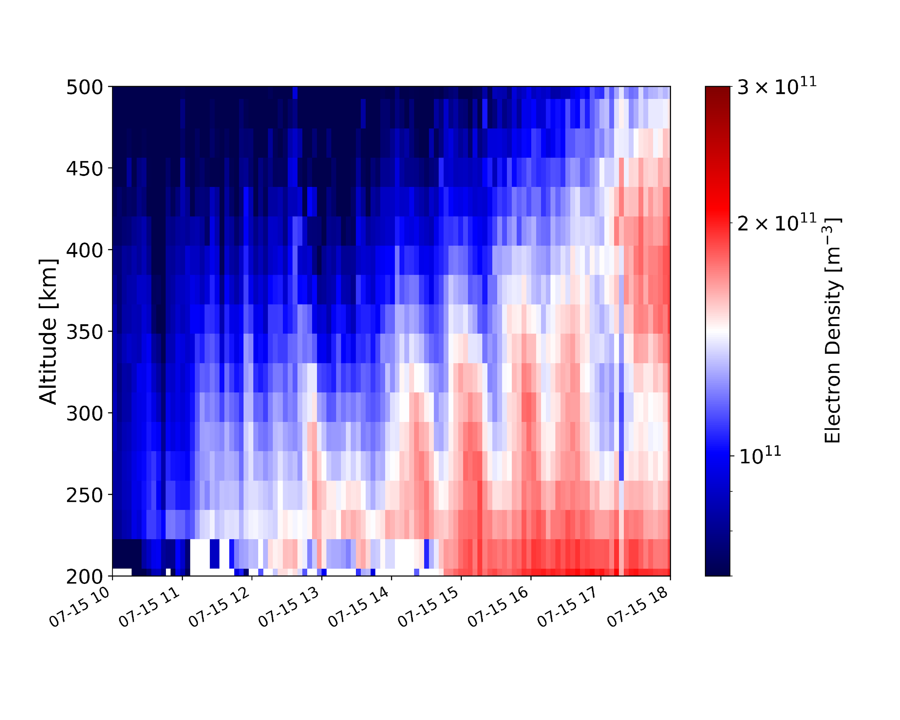
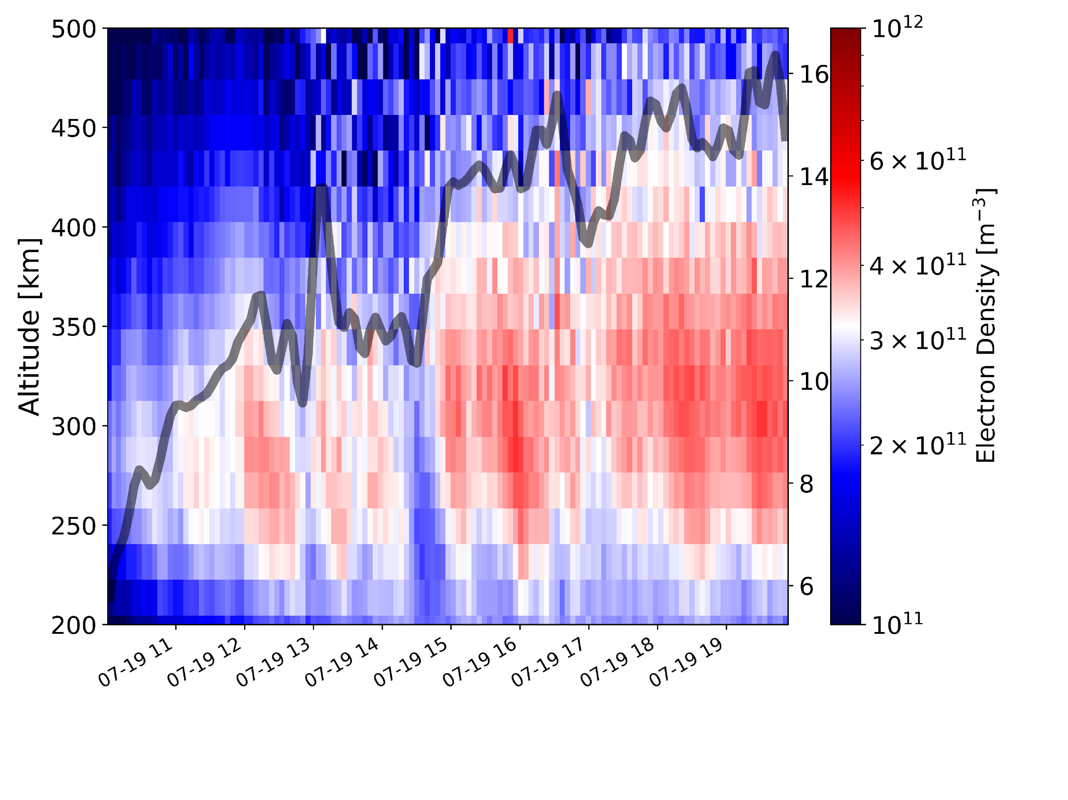
Millstone Hill MSTIDs observations
July 19, 2022
July 15, 2012

Slide 21
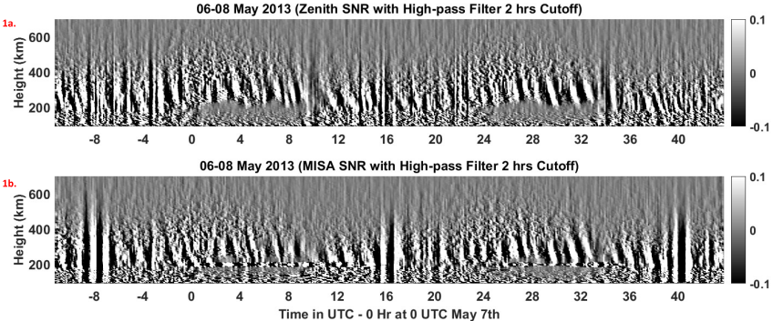
Millstone Hill - MSTID structures
Source: Disnmore et al. 2021

Slide 22
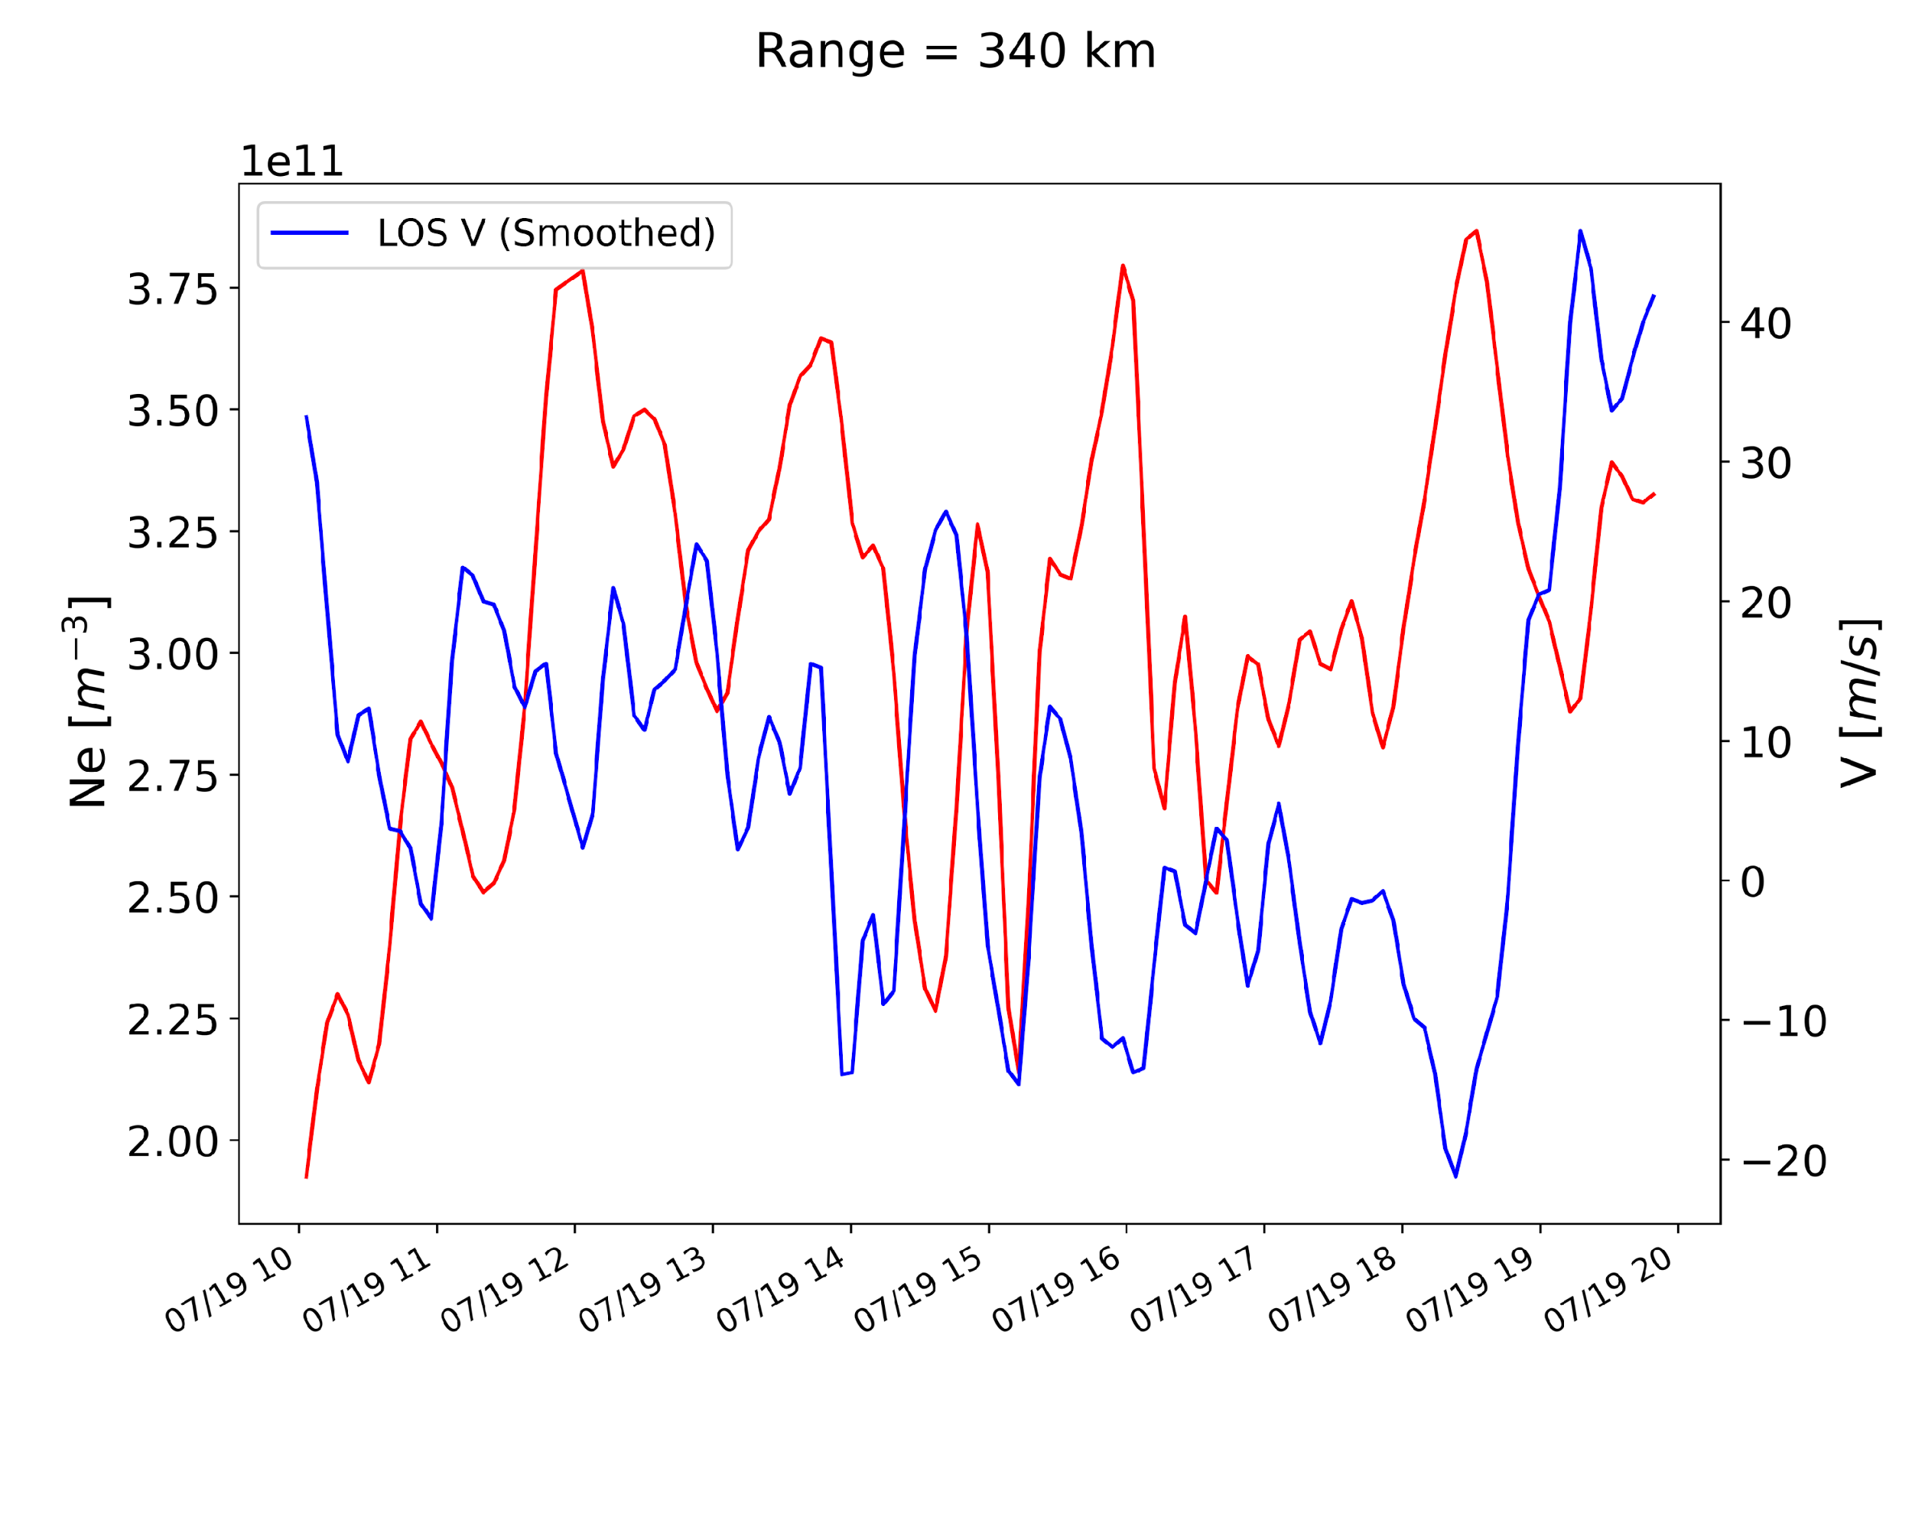
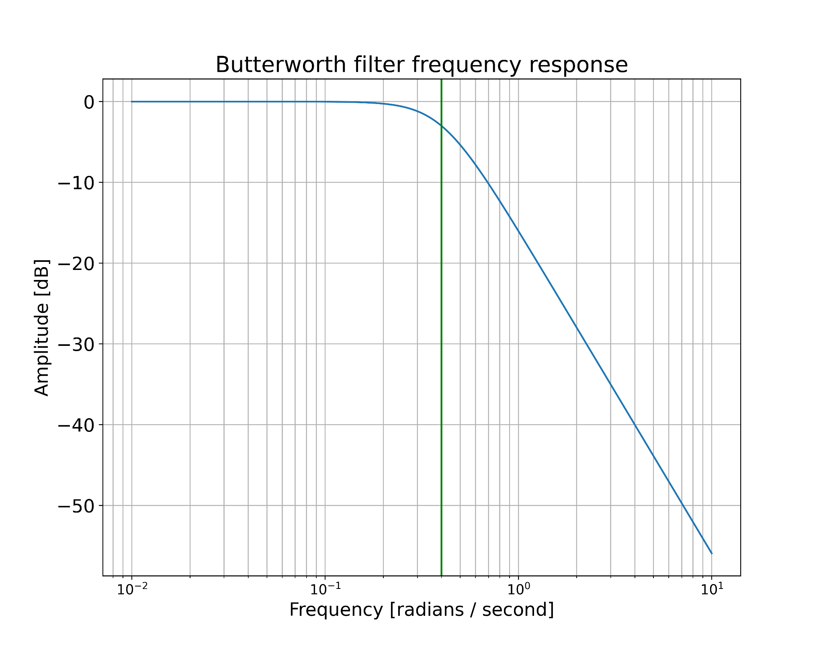

MSTID Period

Slide 23
MACHINE LEARNING RESULTS
(feat. GN5)

Slide 24
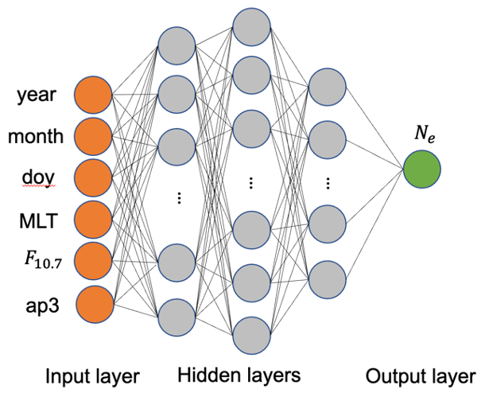

Deep Neural Network
Credit of real time F10.7 and Ap3 data.
Matzka, J., Stolle, C., Yamazaki, Y., Bronkalla, O. and Morschhauser, A., 2021. The geomagnetic Kp index
# and derived indices of geomagnetic activity. Space Weather, https://doi.org/10.1029/2020SW002641
ML applications related are artificial neural network (ANN) and deep neural network (DNN).
The number of hidden layers distinguishes between ANN and DNN.
The real time F10.7 and Ap3 indices are from Helmholtz Centre, Potsdam.

Slide 25
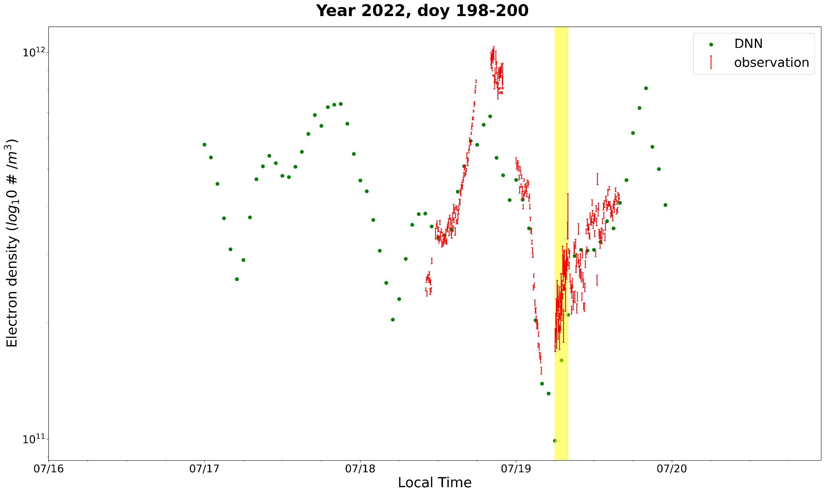
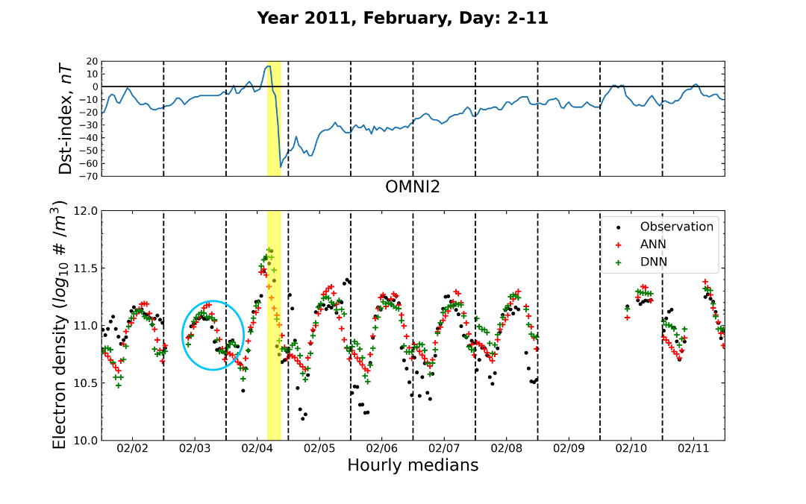
Deep Neural Network
Yellow region highlights our assigned time slot of interest.
Red dots with error bars are the observed electron densities from zenith antenna.
Green dots are the DNN results (hourly).
The day-to-day diurnal pattern shares the agreement between observation and model results.
Geomagnetic quiet time leads to better agreement between observations and model results (right plot) compared to the geomagnetic disturbed period.

Slide 26
Conclusions
According to our results, the solar event caused steep changes in the polar region, followed by well defined wave patterns over mid-latitudes
Abrupt flow reversal observed at PFISR
Period ~ 31 min
        Likely MSTID
        DNN captured steep variations in electron density even with sparse inputs

Slide 27





Acknowledgements
ISR Summer School Instructors
University of Central Florida
Boston University
MIT Haystack Observatory
SRI International
NSF
Sarah and Anna Jo

Slide 28


Bonus Slide!

