Slide 1
MIT Tableau User Group
(MIT TUG)
October 26, 2021
Join the conversation on Slack
mit-tableau.slack.com
Yes, we are recording the session
The recording will be sent out and posted on Slack

Slide 2
What is the MIT TUG?
A community of Tableau users, and those who want to use or are thinking about using Tableau, across MIT
Open to anyone
Any MIT department
All skills levels: none to novice to Jedi
Those who use Tableau only, and those who use Tableau with other data tools
Users of any Tableau product (Desktop, Prep, Server, Online, DataDev)

Slide 3


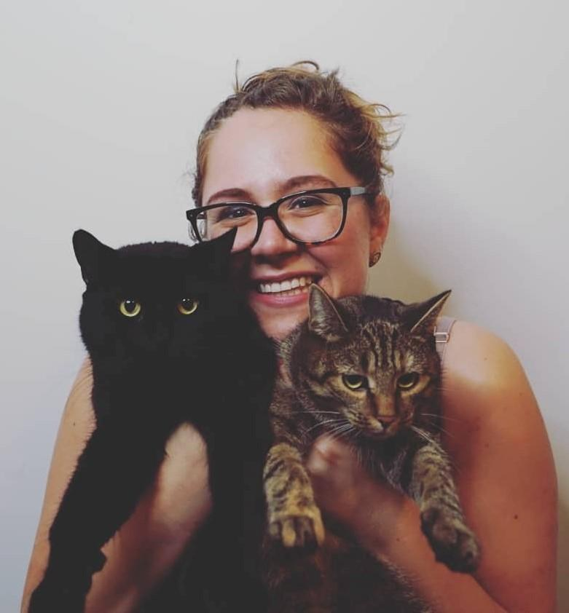


Meet the MIT TUG leads
Christine
Malinowski
Jen
Lesar
Laura
Urciuoli
Quan
Nghiem
Roshni
Gohil
Research Data Librarian
MIT Libraries
Sr Data Analyst
Student Financial Services
Data Analyst II
MIT Alumni Association
Director, Reporting & Analytics
Resource Development
Data Analyst III
Resource Development

Slide 4
How It Works
Virtual meetings every other month
Community-informed topics
Presentations (informal or formal) specific to Tableau at MIT
Opportunities to meet other Tableau users at MIT
MIT Tableau Slack: mit-tableau.slack.com
Check out the poll in #_general
Join the email list: mailman.mit.edu/mailman/listinfo/mit_tableau_user_group

Slide 5
Participate How You Like
Be active
present, share, ask and/or answer questions
Lurk
watch, listen, learn
Anything in between
If you want to present and/or have a topic you want to see, contact the leads
#ask-mit-tug-leads on Slack
mit-tableau-user-group-admin@mit.edu

Slide 6
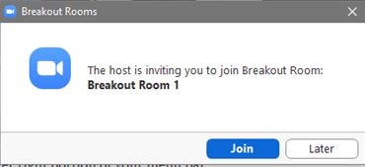
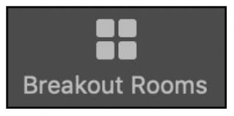
Meet Fellow MIT TUG Members
How this will work
2 rounds of networking
We’ll randomly assign everyone into breakout rooms for 12-15 minutes
Take turns answering a question
We’ll meet back here between each round and switch rooms
Joining a breakout room
You’ll see a pop-up to join a Breakout Room button pop up. Click Join.
If you choose Later, click the Breakout Rooms button in meeting controls to join.

Slide 7
Meet Fellow MIT TUG Members
Here are a few starter questions (or come up with your own)
Tell us about yourself. Who are you? What department are you in?
How long have you been using Tableau?
Share your favorite Tableau horror/success story.
What type of data do you work with, and how do you use Tableau at work?
What’s your favorite Tableau feature?
How did you learn Tableau?
What do you want to learn more about?
What do you wish you had known about Tableau when you first started?
If you could make Tableau do one thing that it doesn’t do now, what would that be?

Slide 8
Tableau Conference Nov. 9-11
It’s free!
It’s virtual!
Things to keep in mind
Treat it like an actual conference (block your calendar)
Reruns in other markets/timezones
Recordings after the conference
Don’t forget the commercials!
Musical guest: Beck
♪ Two turn-Tableaus and a microphone ♪
Register at tableau.com/conference

Slide 9
Tableau Conference Nov. 9-11
Main Stage at 12pm (Eastern) daily
Tuesday: Keynote
What’s coming up in Tableau from Tableau’s President and CEO, Mark Nelson, and Chief Product Officer, Francois Ajenstat, plus special guests
Wednesday: Iron Viz
3 challengers build a viz in 20 minutes on the same data set. Who will win?
Thursday: Devs on Stage
What cool things is the Tableau developer team working on

Slide 10
Tableau Conference Nov. 9-11
Sessions (aka “episodes”)
Some how-to, some info, some strategy
  Tableau Speed Tips
  Tableau Secrets
  Advocate for Data Literacy
  Education track: tableau.com/events/conference/education
Multiple simultaneous “live” channels
  They’re recorded
  Reruns in other markets (if you want to stay up late/wake up early)
Additional on-demand sessions in the month after the conference

Slide 11
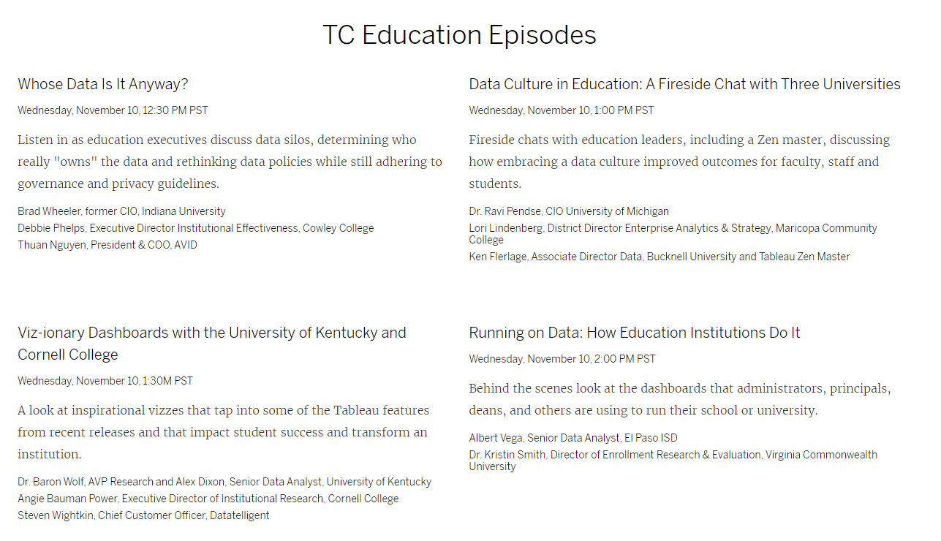
Tableau Conference Nov. 9-11
Sessions (aka “episodes”)
Some how-to, some info, some strategy
  Tableau Speed Tips
  Tableau Secrets
  Advocate for Data Literacy
  Education track: tableau.com/events/conference/education
Multiple simultaneous “live” channels
  They’re recorded
  Reruns in other markets (if you want to stay up late/wake up early)
Additional on-demand sessions in the month after the conference

Slide 12
Tableau Conference Nov. 9-11
Interact!
Higher Ed Meetup
11/10 at 10:45am
Includes breakout sessions
tableau.com/events/conference/education
Tableau Doctor
Connect one-to-one with a Tableau expert to solve technical challenges, review deployments, and more
20 minutes or 45 minutes
Photo booth
tc21.virtualbooth.co
TC21 Slack
tc-21.slack.com
Braindates!
Informal conversations on any topic
Meet up with small groups (one-on-one or up to 6 people)
New “fishbowl” option (20 people)
tc21.braindate.com

Slide 13
Tableau Conference Nov. 9-11
What is MIT TUG doing?
MIT Tableau Slack channel: #tc21
What are you watching?
What are you learning?
Coffee break on Nov. 10, 10am
Recap day 1
Strategize days 2 and 3
Zoom link will be in #tc21 Slack and sent to email list
Dec. 1 MIT TUG meeting
Highlights from recorded sessions
Send us your faves

Slide 14
Important Links
MIT TUG
Register for the next meeting (Dec. 1st)
calendar.mit.edu/event/mit_tug_dec_2021
Wiki
wikis.mit.edu/confluence/display/MITTUG/
Slack
mit-tableau.slack.com
Join the email list
mailman.mit.edu/mailman/listinfo/mit_tableau_user_group
Contact MIT TUG co-leads
  #ask-mit-tug-leads on Slack
  mit-tableau-user-group-admin@mit.edu
Other Higher Ed Tableau Resources
Higher Ed TUG (HETUG)
usergroups.tableau.com/HigherEducation
Slack
higher-ed-tableau.slack.com
Community Group
community.tableau.com/s/group/0F94T000000gQYoSAM/higher-education

