Slide 1
MIT Tableau User Group
(MIT TUG)
December 1, 2021
Join the conversation on Slack
mit-tableau.slack.com
Yes, we are recording the session
The recording will be sent out and posted on Slack

Slide 2
What is the MIT TUG?
A community of Tableau users, and those who want to use or are thinking about using Tableau, across MIT
Open to anyone
Any MIT department
All skills levels: none to novice to Jedi
Those who use Tableau only, and those who use Tableau with other data tools
Users of any Tableau product (Desktop, Prep, Server, Online, DataDev)

Slide 3
How It Works
Virtual meetings every other month
Community-informed topics
Presentations (informal or formal) specific to Tableau at MIT
Opportunities to meet other Tableau users at MIT
MIT Tableau Slack: mit-tableau.slack.com
Join the email list: mailman.mit.edu/mailman/listinfo/mit_tableau_user_group

Slide 4
Participate How You Like
Be active
present, share, ask and/or answer questions
Lurk
watch, listen, learn
Anything in between
If you want to present and/or have a topic you want to see, contact the leads
#ask-mit-tug-leads on Slack
mit-tableau-user-group-admin@mit.edu

Slide 5
Tableau Conference 2021 #TC21
What was it?
What did we learn?
What are we looking forward to watching?

Slide 6
TC21 Recordings
tableau.com/conference
Education
tableau.com/events/conference/2021/education
New to Tableau
tableau.com/events/conference/2021/new-to-tableau
New in Tableau
tableau.com/events/conference/2021/new-in-tableau
Tableau Community
tableau.com/events/conference/2021/tableau-community

Slide 7
Fun Stuff
Data Music
tableau.com/events/conference/2021/fun
Data for the Win, Episode 1: Allyson Felix and Jessica Long
tableau.com/events/tc/2021/data-win-episode-1-allyson-felix-and-jessica-long
Data for the Win, Episode 2: Tom Daley
tableau.com/events/tc/2021/data-win-episode-2-tom-daley
Special Performance by Beck
tableau.com/events/tc/2021/special-musical-performance-beck

Slide 8
Recommendations
New to Tableau
  Know Your Audience: Designing Dashboards with the End User in Mind
  tableau.com/events/tc/2021/know-your-audience-designing-dashboards-end-user-mind
  The Performant-First Approach to Designing Efficient Workbooks
  tableau.com/events/tc/2021/performant-first-approach-designing-efficient-workbooks
Building Better Dashboards
  Make It Better: Tips for Better Dashboard Design
  tableau.com/events/tc/2021/make-it-better-tips-better-dashboard-design
  Inclusive Design: Making Dashboards Engaging, Informative, and Accessible
  tableau.com/events/tc/2021/inclusive-design-making-dashboards-engaging-informative-and-accessible
Tips & Tricks
  Tableau Speed Tips: Shortcuts and Tricks for All Skill Levels
  tableau.com/events/tc/2021/tableau-speed-tips-shortcuts-and-tricks-all-skill-levels
  Trucos Rápidos de Tableau ¡en Español! (subtitled in English)
  tableau.com/events/tc/2021/trucos-rapidos-de-tableau-en-espanol-subtitled-english

Slide 9
Know Your Audience:
Designing Dashboards with the End User in Mind
Three main themes of dashboards “not working”
Limited data available and low data integrity
Miscommunication between developer and user
Low user adoption
Limited Data
Checking your data throughout the development process
Bring your user in to possibly help you check your data!
Miscommunication
Make sure you know what your user wants to answer and how they want to answer it
Where does the user currently go, and how do we get them to go here
Successful dashboard should get the point across and allow for follow-up action
Simple and intuitive!
Needs vs “nice-to-haves”

Slide 10
The Performant-First Approach to Designing Efficient Workbooks
Rationale for designing with performance in mind
Goal is to get user adoption
Users have different tolerance levels for performance
Performance factors
Environmental factors and design considerations
Tableau dashboard developers have limited ability to affect former, but can affect latter
Factors that Tableau dashboard developers can influence
Data: data size, model considerations, drivers, hyper extracts
Calculations: data source calculations, granularity, alternative functions, grouping
Visuals, controls, layout: limit dashboard objects, cascading layouts, visuals, images
User experience considerations: wayfinding, reduce clicks, embed Tableau

Slide 11
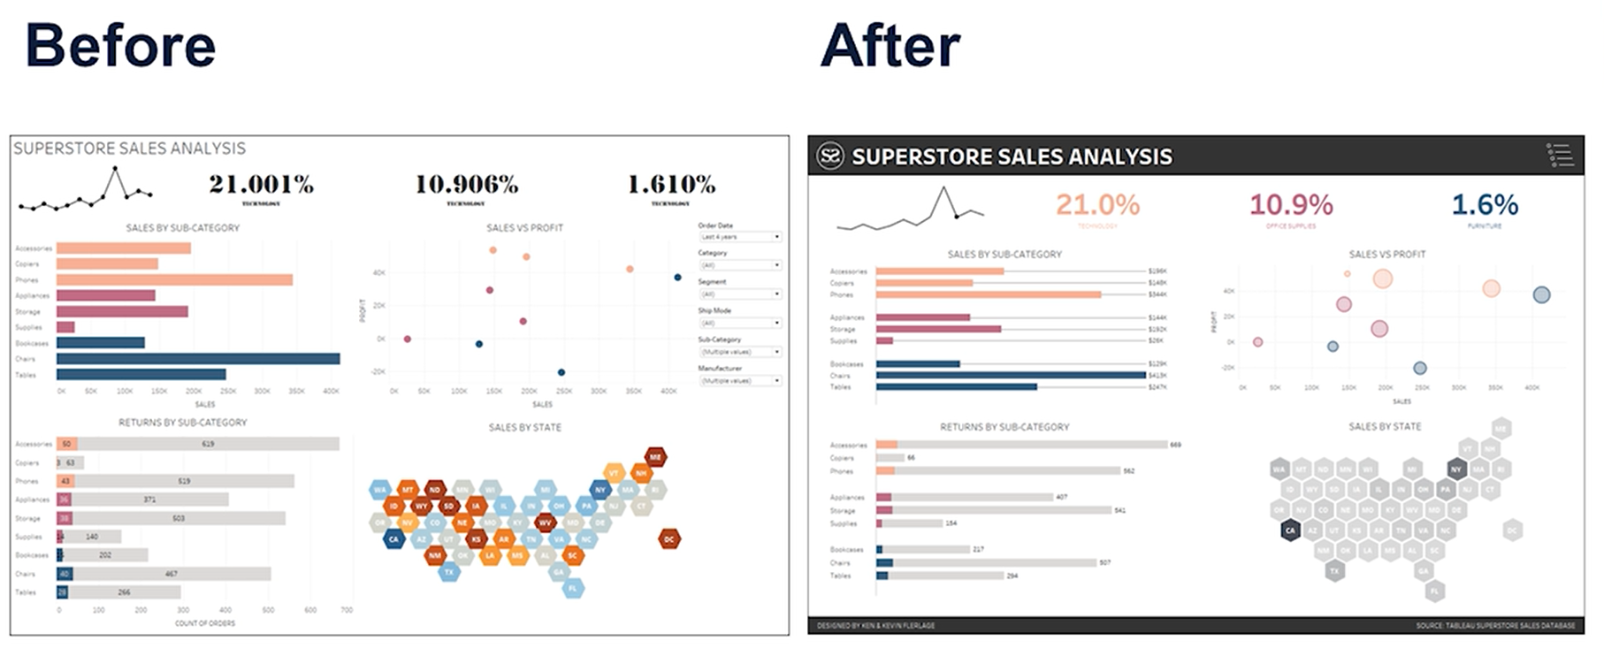
Make It Better:
Tips for Better Dashboard Design

Slide 12
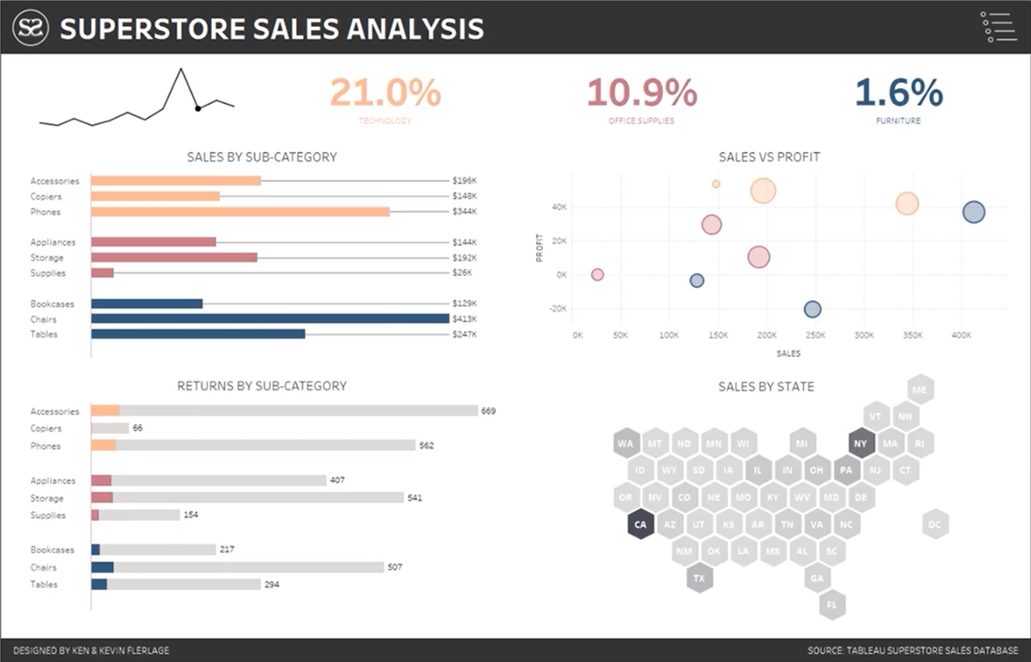

Slide 13
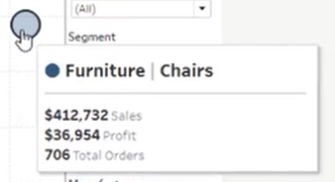
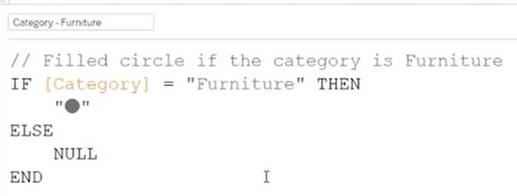
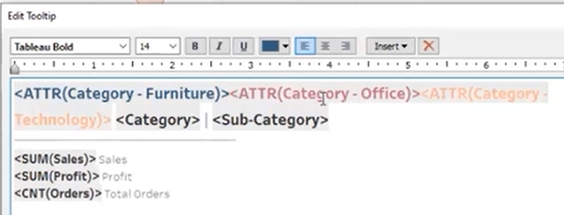
Make It Better:
Tips for Better Dashboard Design

Slide 14
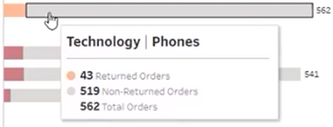
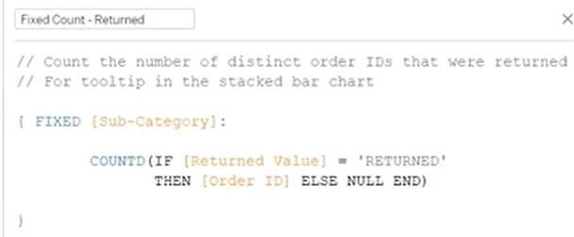
Make It Better:
Tips for Better Dashboard Design

Slide 15
Inclusive Design:
Making Dashboards Engaging, Informative, and Accessible
Recording: link (also in previous recommendations slide)
PDF of slides: bit.ly/tc21inclusive
We don't all have the same experience. When you solve for one, you extend to many.
Apply inclusive design principles, like:
Be consistent with your conventions (headings, color, layout)
Use accessible typefaces (ex: Arial vs. Verdana)
Provide choice (multiple ways to complete a task, alternate ways of presenting data)
Prioritize content (don’t try to cram in all your data stories into one dashboard)
This (25 mins) talk included:
Tableau Dashboard Case Study with walkthrough of issues and a detailed before/after
Considerations list and how to solve for each

Slide 16
Speed Tips/Trucos Rápidos
DASHBOARDS
Maintain dashboard layout while adding sheets
Switch between dark/light modes in dashboard
Show and hide your tiled or floating containers (2021.2 on)
How to truly duplicate a dashboard
Filter footers (dashboard breadcrumb trail)
Layout (using hierarchy/controls)
MAPS
How to use Mark Layers (buffer)
Map layers

Slide 17
Speed Tips/Trucos Rápidos (cont.)
NAVIGATING/TOOLS
Copy & paste fields
*Copy & paste data (from Excel or partial data source - creates new "Clipboard" database)
Fields search (2020.3 on)
How to use relationships with target data
Pivots (e.g., for columns by date)
Replacing references (similar data sources with different fields)
Dashboard in tooltip

Slide 18
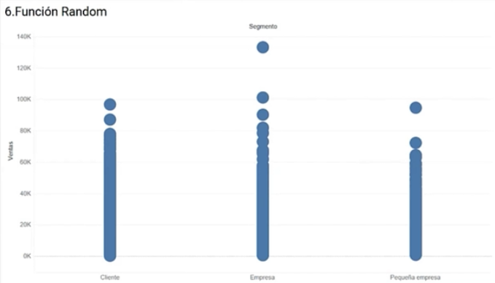
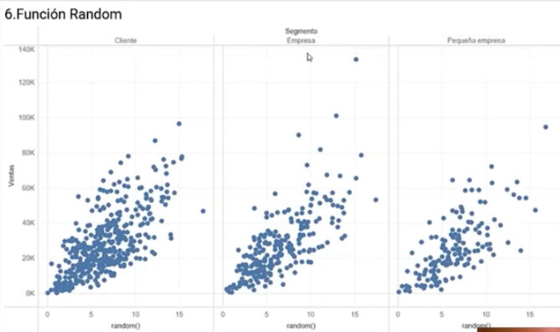
Speed Tips/Trucos Rápidos (cont.)
APPEARANCES
Zoom axis via parameter
*Formatting numbers
*Custom formats (e.g., emojis) (+ve; -ve; 0)
Creating space between bars
Adding a dot at the end of a line
Retain formatting of field (replacing calc in pill)
Multiple color marks
*Random function (to spread out overlapping values)
Names on bars
*Totals on stacked bars (ref line by cell, total, value)
Formatting workbooks
Highlight action to deselect
Emoji alerts

Slide 19
Speed Tips/Trucos Rápidos (cont.)
CALCULATIONS/FUNCTIONS
Dummy measures
KPIs (dashboard look within a sheet)
Maintaining table calculations while filtering dimensions
How the Set Actions Combinations work together
Creating a dynamic date parameter
Creating dates (parsing, formatting)
Extend date ranks (predictive table calcs)
Max year parameter (last avail date in data source)
*Arrays in functions (e.g, setting -ves to 0; histogram that groups long tail into single final column)
Ranked parameters (w/add'l functionality for dates from 2020.4 on)
*Parameter from a list (copy/paste from Excel)
Tooltip filter (e.g., viz in tooltip filtered for region)
Nested sorting with table calcs

Slide 20
What do you recommend?
Unmute or share in chat
Conference sessions
Future MIT TUG topics

Slide 21
Important Links
MIT TUG
Next meeting: Feb. 16
calendar.mit.edu/event/mit_tug_feb_2022
Wiki
wikis.mit.edu/confluence/display/MITTUG/
Slack
mit-tableau.slack.com
Join the email list
mailman.mit.edu/mailman/listinfo/mit_tableau_user_group
Contact MIT TUG co-leads
  #ask-mit-tug-leads on Slack
  mit-tableau-user-group-admin@mit.edu
Other Higher Ed Tableau Resources
Higher Ed TUG (HETUG)
usergroups.tableau.com/HigherEducation
Slack
higher-ed-tableau.slack.com
Community Group
community.tableau.com/s/group/0F94T000000gQYoSAM/higher-education

Slide 22
Stick around to chat
Want to present? Want to see something?
Contact us:
Slack us at #ask-mit-tug-leads
Email the MIT TUG co-leads at mit-tableau-user-group-admin@mit.edu

