Slide 1
MIT Tableau User Group
(MIT TUG)
May 10, 2022
Join the conversation on Slack
mit-tableau.slack.com
Yes, we are recording the session
The recording will be sent out and posted on Slack

Slide 2
Agenda
What is the MIT TUG
Tableau Upgrade
Tooltip Cool Tricks
Tableau Conference 2022 (#TC22)
Tableau AMA (Ask Me Anything)

Slide 3
What is the MIT TUG?
A community of Tableau users, and those who want to use or are thinking about using Tableau, across MIT
Open to anyone
Any MIT department
All skills levels: none to novice to Jedi
Those who use Tableau only, and those who use Tableau with other data tools
Users of any Tableau product (Desktop, Prep, Server, Online, DataDev)

Slide 4
How It Works
Virtual meetings every other month
Community-informed topics
Presentations (informal or formal) specific to Tableau at MIT
Opportunities to meet other Tableau users at MIT
MIT Tableau Slack: mit-tableau.slack.com
Join the email list: mailman.mit.edu/mailman/listinfo/mit_tableau_user_group

Slide 5
Participate How You Like
Be active
present, share, ask and/or answer questions
Lurk
watch, listen, learn
Anything in between
If you want to present and/or have a topic you want to see, contact the leads
#ask-mit-tug-leads on Slack
mit-tableau-user-group-admin@mit.edu

Slide 6
Tableau Upgrade to v2021.4
Through 2021, Tableau released quarterly upgrades
IS&T upgrades MIT’s Tableau Server 1-2 times a year
  Usually to the previous (stable) version
We’re moving from v2021.1 to v2021.4 (v2022.1 was released in late March)

Slide 7
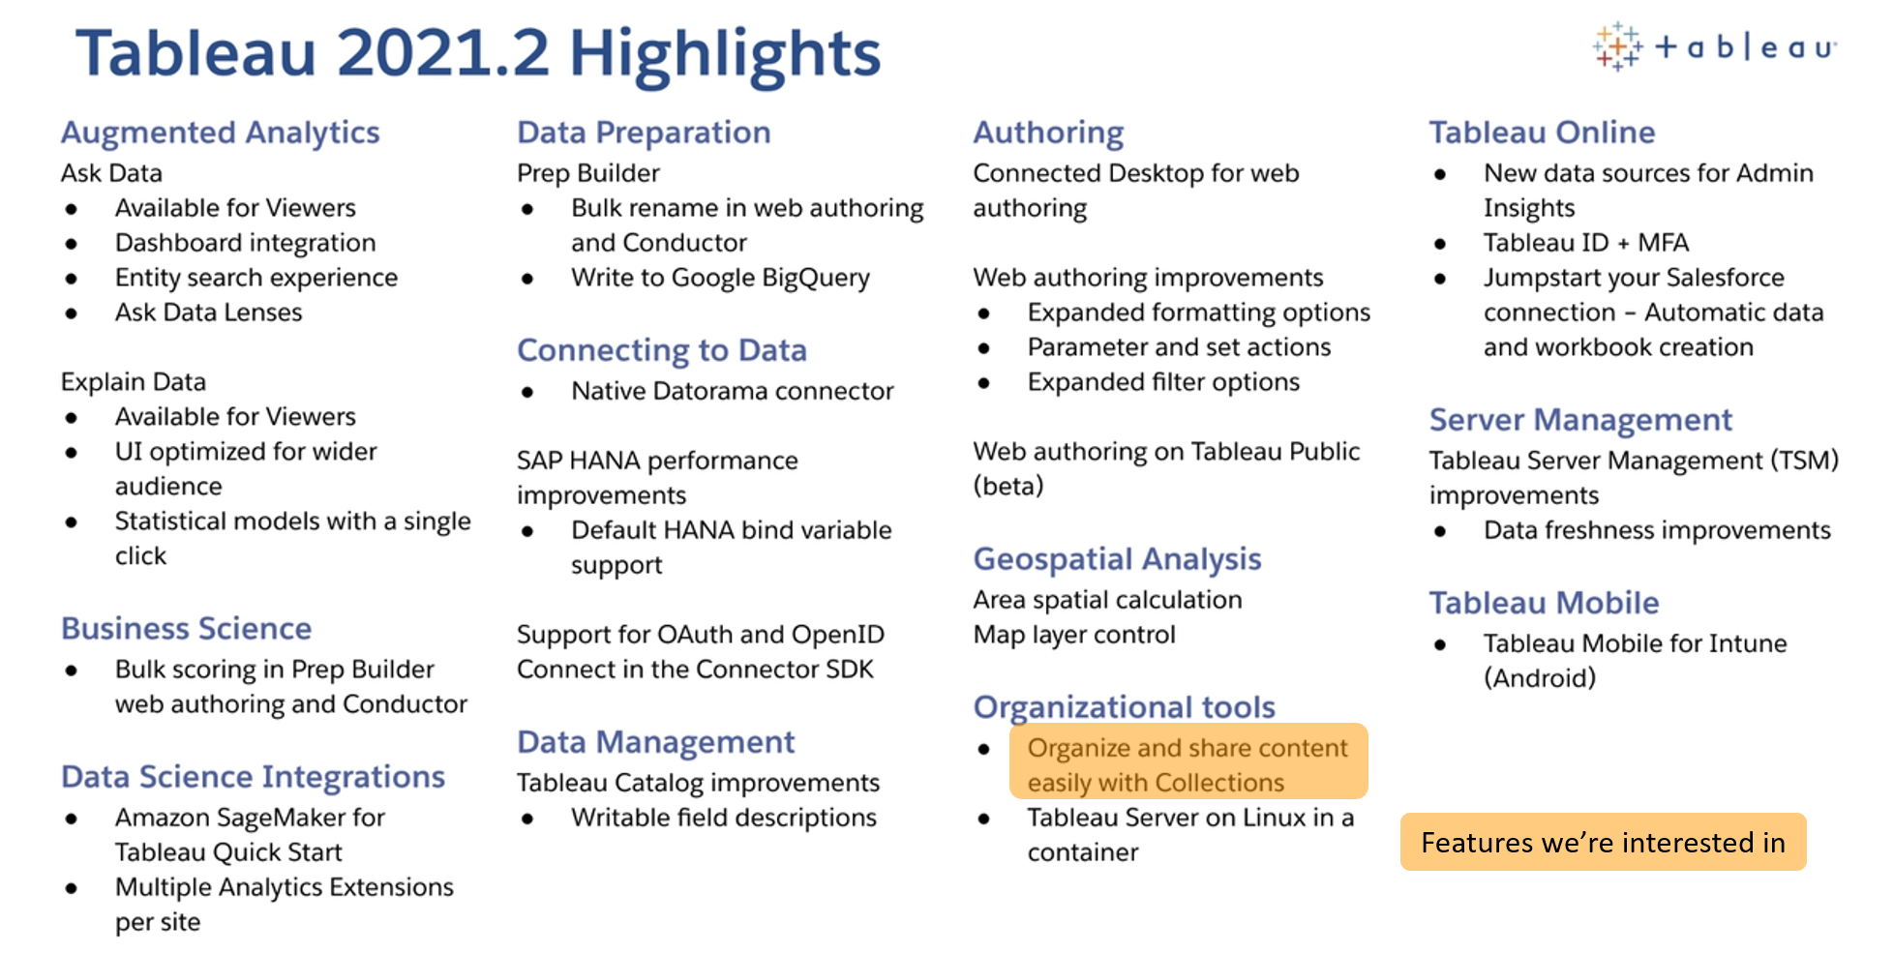
https://www.tableau.com/2021-2-features

Slide 8
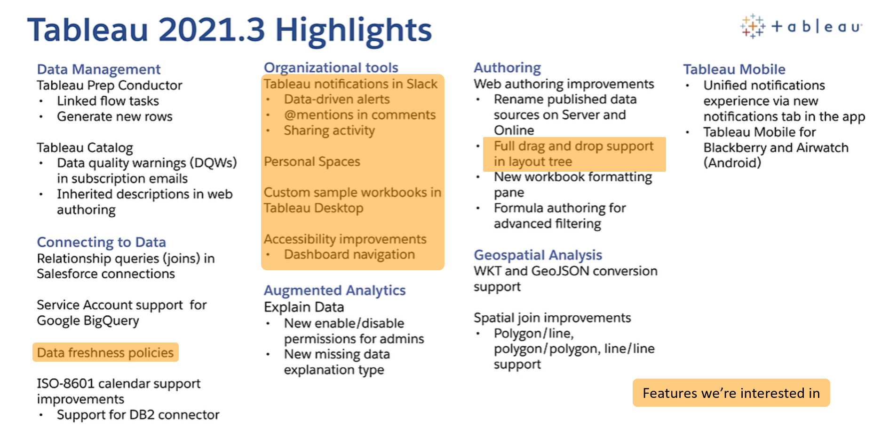
https://www.tableau.com/2021-3-features

Slide 9
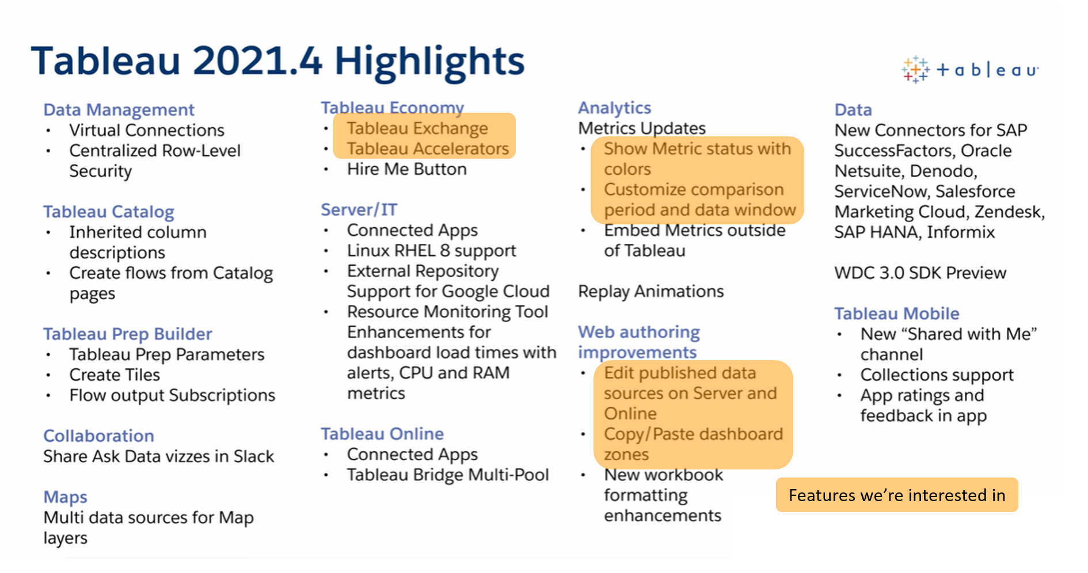
https://www.tableau.com/2021-4-features

Slide 10
New and Updated Server Features

Slide 11
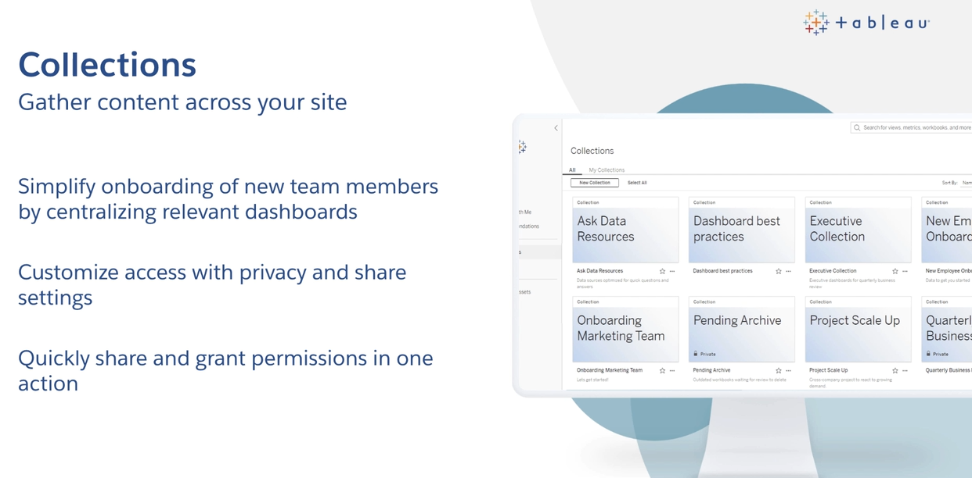
Organize content across a site into topic- or role-centric collections
https://www.tableau.com/2021-2-features#item-81388
Notes:
With projects, or folders, a workbook, metric, or other content type can only go in one project. That’s it.
With collections, these objects can go in multiple places (like proposal types in proposal type categories).
That means you can create collections around different roles–an “Admin” collection, an “Executive” collection–and have some of the content overlap.
You can create team-based collections, collections for onboarding different types of users, and more.
Permissions are also customizable in collections, which means more flexibility than projects currently provide.

Slide 12
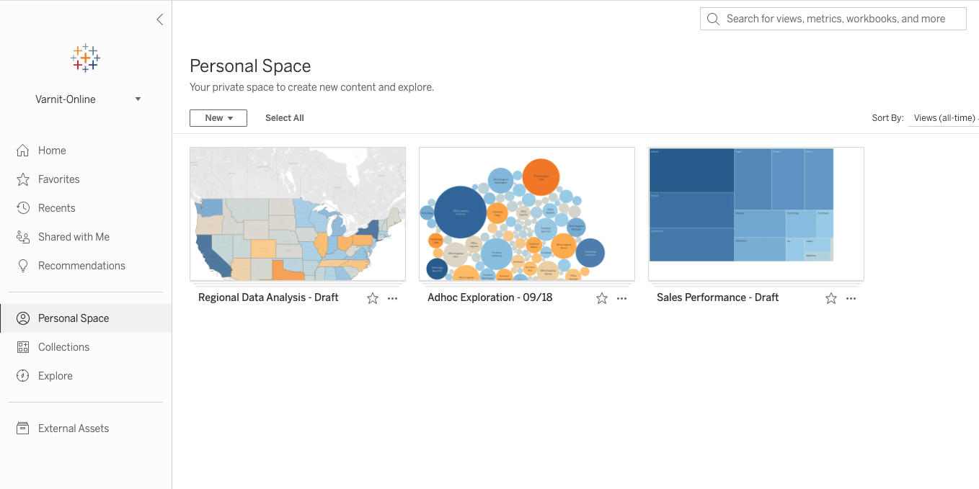
Personal Space to “save content before it’s ready to be shared with others”
https://www.tableau.com/2021-3-features#item-83963

Slide 13
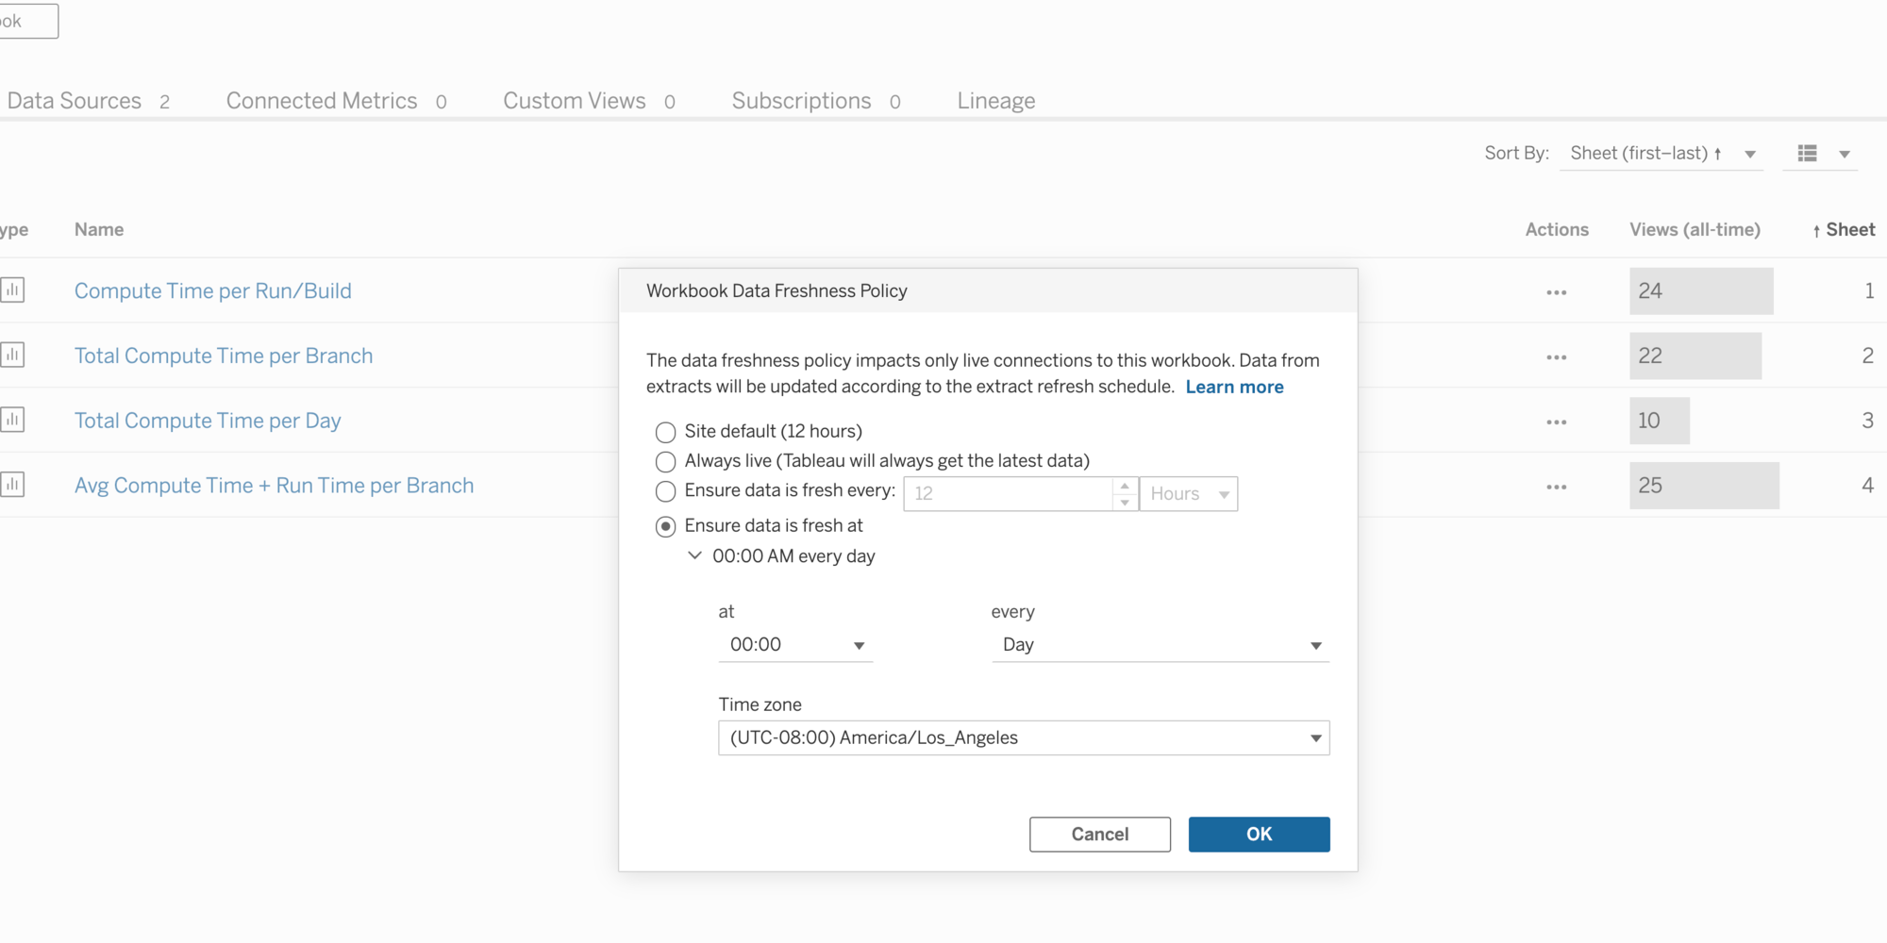
Set data freshness policy for live connections
https://www.tableau.com/2021-3-features#item-83270

Slide 14
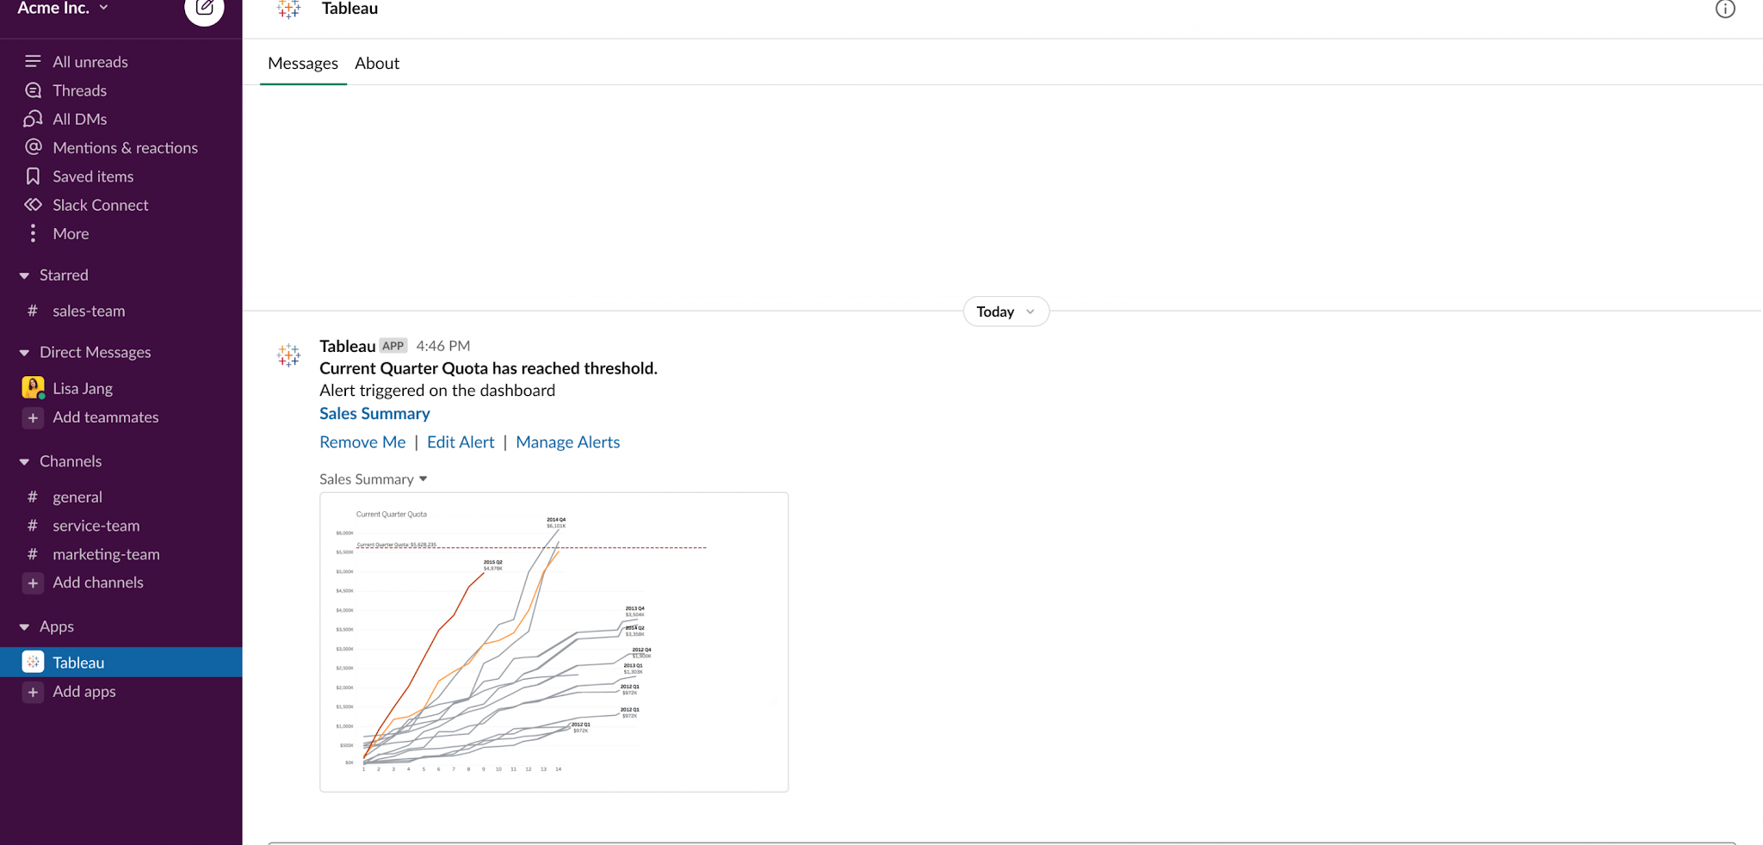
Get Tableau notifications (e.g., alerts and comments) directly in Slack!
https://www.tableau.com/2021-3-features#item-83774
Notes:
Did you know Tableau has a commenting feature that lets you email people about a dashboard, a chart, or a specific value in a workbook? And that you can set up alerts to watch certain measures and notify you when a number goes above or below a threshold?
Those communication features have gotten a major upgrade with Slack integration. (Salesforce, the company that bought Tableau a few years ago, also bought Slack. Coincidence?)
What Slack integration means is that you can now set up your site to send alerts, comments, and other notifications directly to Slack and have conversations about (and with) a viz directly in Slack. Cool, right?

Slide 15
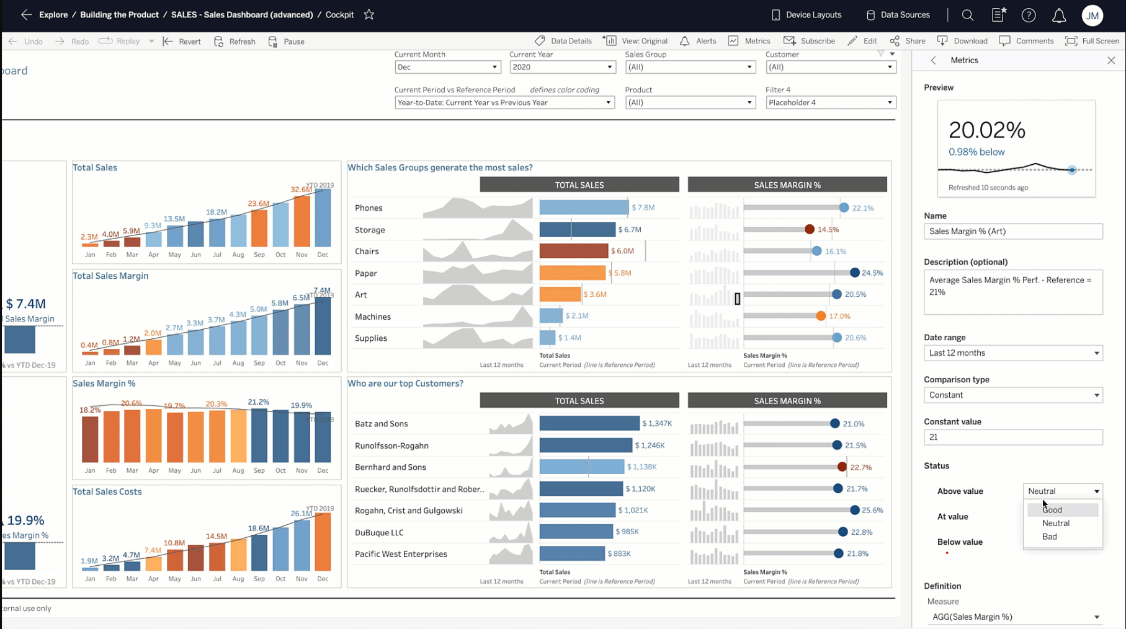
Metrics improvements
https://www.tableau.com/2021-4-features#item-86382
Notes:
Metrics came to Tableau a couple years ago as a way to look at specific KPIs at a glance. Now metrics have a few new features to make them more useful, including the ability to set color indicators for status changes, change your comparison period (e.g., last 12 months only, last quarter only, etc.)..

Slide 16
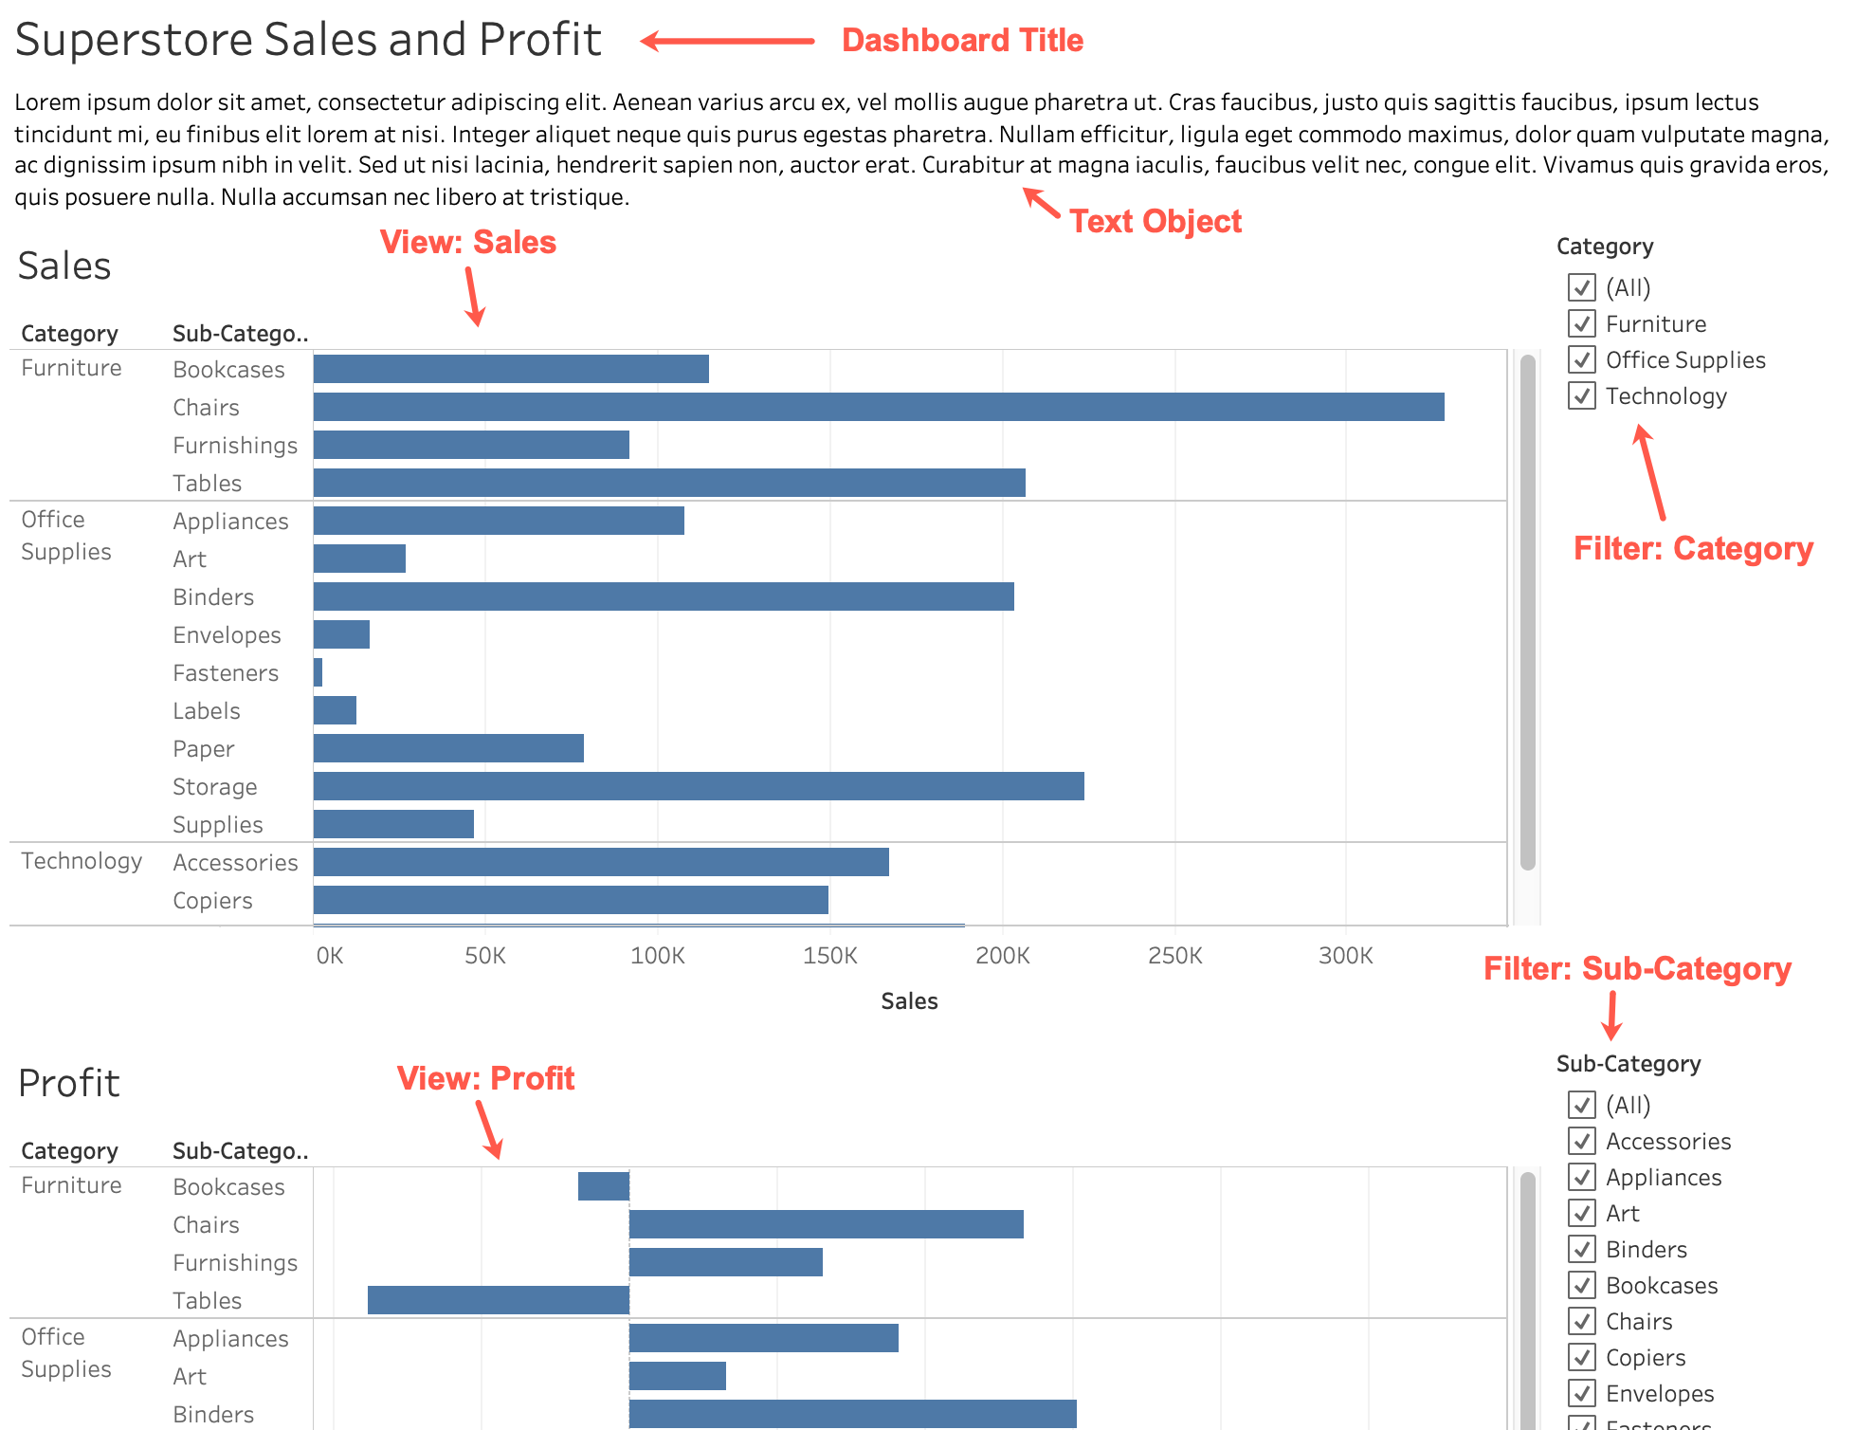
Old dashboard tab order was based on the order in which you added objects to the dashboard
New dashboard tab order
Dashboard Title
Text Object
View: Sales
Filter: Category
View: Profit
Filter: Sub-Category
Improved keyboard navigation, including tab (focus) order improvements
https://community.tableau.com/s/news/a0A4T0000020qJLUAY/new-dashboard-focus-order-behavior-in-tableau-20213
Notes:
While most of the server improvements are flashy, there are some accessibility features that fly under the …screen reader.
First, focus order. When you use a keyboard to navigate web pages, you use the Tab key to move from one field or control to the next. On a web page, it’s usually left to right, top to bottom.
In the past, the tab or focus order in Tableau depended on the order in which you added an object to the dashboard. So if you added the Profit chart at the bottom of this screenshot first, and then added the Sales sheet afterwards, using the Tab key would take you from the dashboard title to the Profit chart, then to the filter(s) for that chart, and then to the Sales chart and its filters. Basically, it was far from intuitive and you’d sometimes be very surprised at where you landed. For someone using a screenreader, a Tableau dashboard could be downright impossible to use.
Now, tab order follows standard web conventions: left to right, top to bottom.
What if you have a workbook whose focus order is all messed up? Open the workbook, and duplicate the dashboard. That new, duplicated dashboard will follow “standard” focus order. Delete the old dashboard, rename the new dashboard so that the tab name matches the deleted one, and then republish. In just a couple minutes, you’ve made your workbook much easier to use for people who like to or NEED to navigate using a keyboard or screenreader.

Slide 17
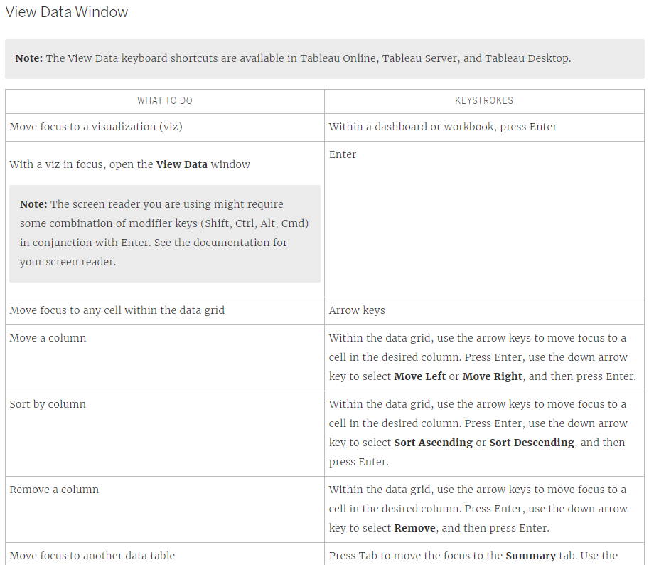
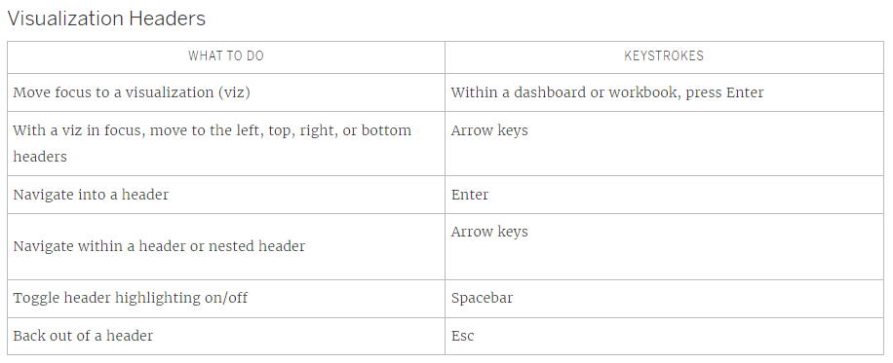
Improved keyboard/screen reader accessibility, including “walking headers”
https://help.tableau.com/current/pro/desktop/en-us/access_keyboard_navigation.htm
Notes:
The other set of improvements are around how you navigate a single chart or table. You can now use arrow keys, enter, and escape to “walk” the headers of a chart. While these changes may seem small, they are a huge step forward in making Tableau more accessible.

Slide 18
Creating/Authoring Workbooks

Slide 19
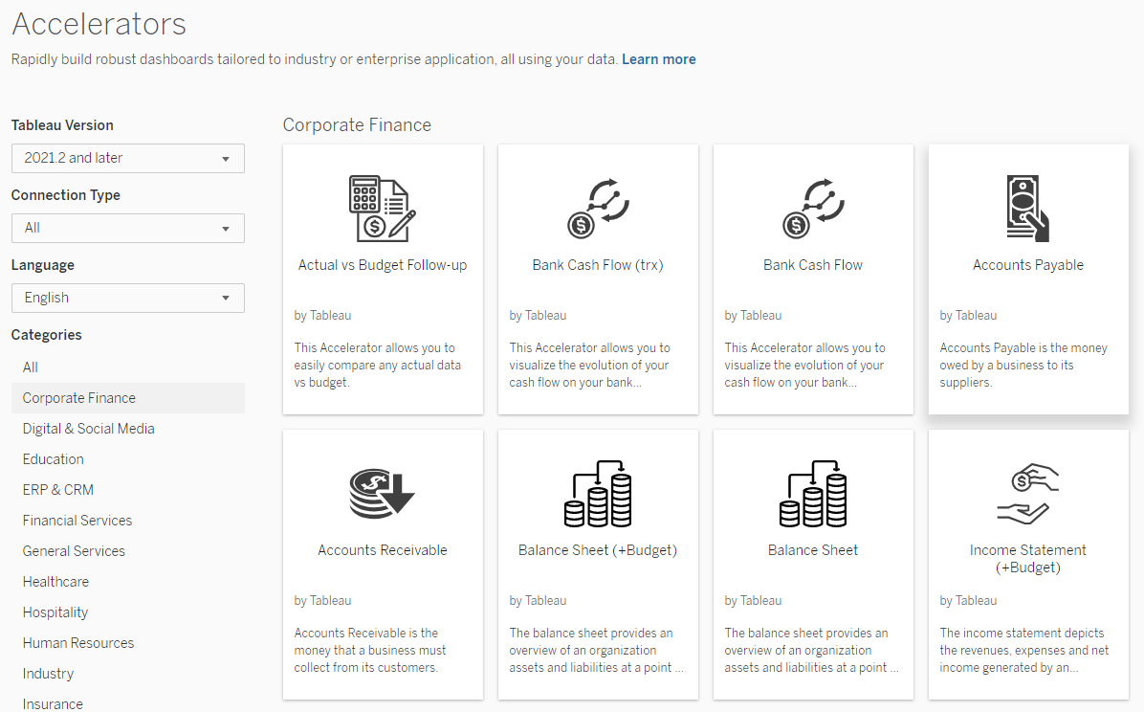
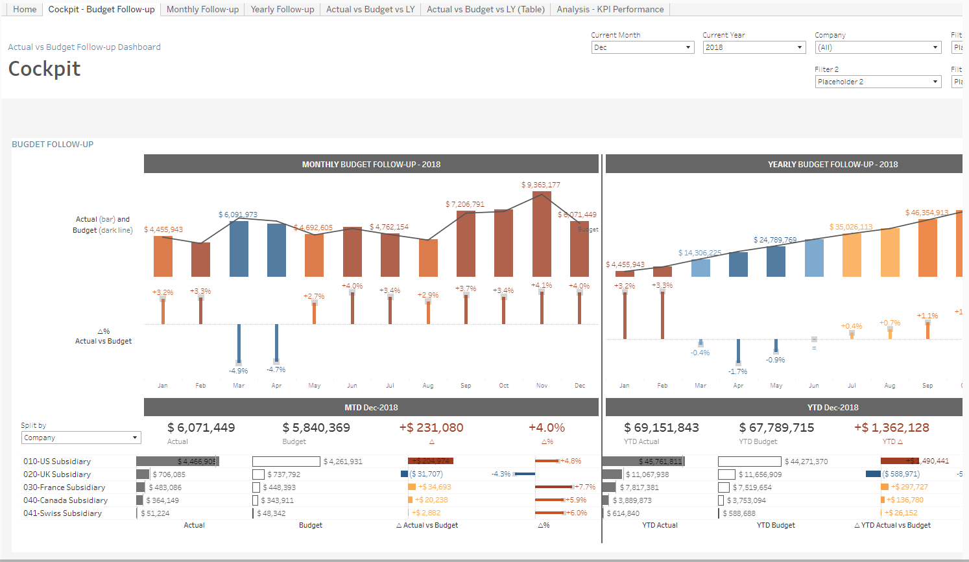
Tableau Exchange for Accelerators (a.k.a. dashboard starters) and more
https://exchange.tableau.com/
Let’s check it out!
Notes:
It’s really easy to create a table in Tableau. But have you ever been charged with creating a dashboard to show X and then just spun your wheels trying to figure out what to highlight, how to show certain data, what comparisons to show, what should be KPIs or BANs (big ass numbers)? Tableau has created a bunch of “accelerators,” basically dashboard starters, in a number of topics–from enrollment to financials to HR. These accelerators and other tools are available to download, many for free, in the Tableau Exchange.
Let’s take a look at the Tableau Exchange, https://exchange.tableau.com.
Dashboard extensions let you bring web applications into Tableau. There are extensions to write back to a database, to create different types of charts, to add natural language captions to your dashboards and more. Fun fact: you can build your own extensions, and the file extension is .trex, as in tableau plus extension plus an R because dinosaur :)
Connectors let you connect to different databases and applications that aren’t natively supported by Tableau–like SAP Success factors, and Oracle NetSuite, and more. You can also build your own connectors. They’re in .taco files. And it is Tuesday…
Finally, the real reason we’re looking at the Exchange, the Accelerators. Accelerators are the newest addition what Tableau calls the Tableau Economy.
Let’s go ahead and look at available accelerators. We can scroll through the list, but it’s really long. They are tagged by topic – education, financial services, HR, IT, there’s some fundraising ones in there, too.
Let’s click on Corporate Finance to see some common ones that folks who deal with financials might find useful. The first couple are built by Slalom, a Tableau Partner. Others are created by Tableau. There is a filter to look at just Tableau and Salesforce, and limit to free dashboard starters.
One thing I know AOs and FOs care about is budget vs actuals–what do we have to spend and what have we spent. Let’s look at the Actual vs Budget Follow-up. This page tells us about what questions the dashboard can answer, what KPIs are highlighted in the dashboard, what fields it picks up from the data source. There’s a working version of the workbook embedded at the bottom.
There are a couple ways to use these accelerators.
First you can just interact with the embedded dashboard and see what’s in it. Switch tabs, apply filters, etc., and use the dashboard as inspiration. If you’ve ever looked at Tableau Public’s Viz of the Day gallery, you’ve probably seen people promote what I somewhat derisively call data art. It’s pretty to look at, but often hard to use and if you’re thinking of applying to our work at MIT? Get real. These dashboards are on the other end of the spectrum. They’re useful visualization inspiration, and are workhorses that can be applied across a variety of departments and industries.
It doesn’t stop with inspiration. You can actually download the workbook and swap out the built-in data source with your own data–whether in a spreadsheet, a database, or something else. This is why I call these dashboard starters. They’re basically full-fledged, working templates that you can put YOUR data into. You may need to tweak things here or there, but it may be much easier than starting from scratch.

Slide 20
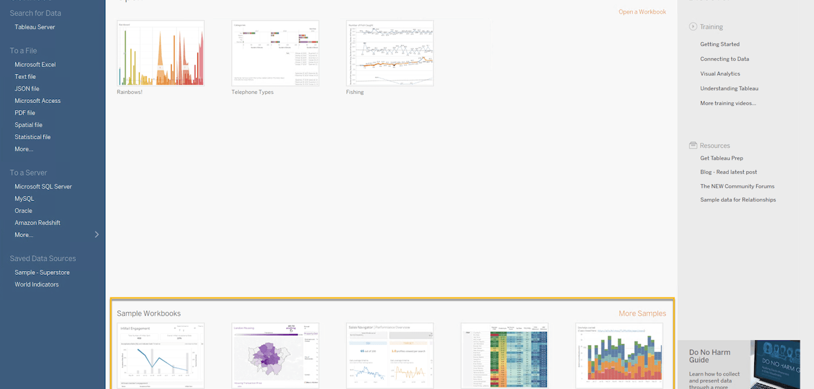
Forget Superstore! Share custom sample workbooks in Desktop
https://www.tableau.com/2021-3-features#item-83227
Notes:
Another cool addition is the ability to create your own sample workbooks. Everyone has probably seen Superstore, but quick show of hands–how many of you actually deal with the type of data that’s in Superstore–sales, orders, customers? Probably not many.
One thing that people in the Higher Ed space have been complaining about for a while is that we want to be able to create workbooks with more relevant data. And after the upgrade, that will be possible. I could see some enterprising Tableau developer at MIT creating sample workbooks around MIT financials, HR data, and so on.

Slide 21
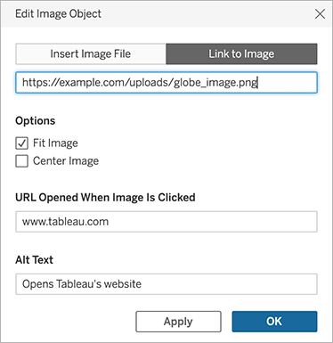
Display web-based images in dashboards to improve load times for large images and embed GIFs
https://help.tableau.com/current/pro/desktop/en-us/whatsnew_previous_versions_desktop_webauthor.htm#Display
Notes:
One of the cool things about Tableau is that you can embed images–logos, background images, and that sort of thing. What happens if your department does some rebranding and changes the logo or colors or whatever. Well then you have to go through every workbook and change the logo. That’s a pain.
Now you can point to web-based images so that all workbooks that use image X are using actual same image X on your webserver instead of copies of that file embedded in the workbook.
In addition to making workbooks easier to maintain, using web-based images can also improve the performance of your workbook, especially when you’re using large/high-resolution images. They’ll be loaded more quickly when they’re hosted on the web vs downloaded from the server on each tab.
One of the coolest aspects of linking to web-based images is that you can include GIFs. I could see recording mini how-to videos, converting them to GIFs, and using them as embedded end-user help.

Slide 22
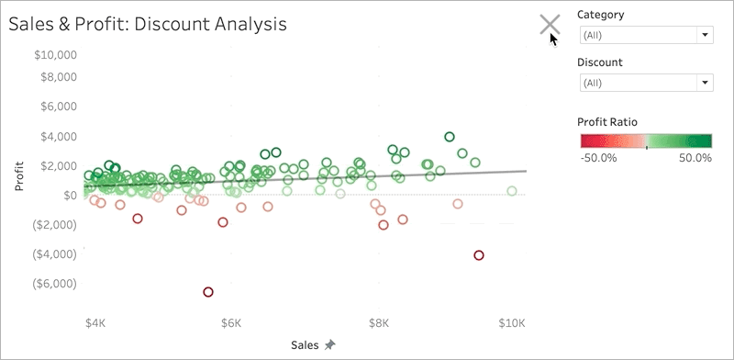
Create Show/Hide buttons for any dashboard object (not just floating layout containers)
https://help.tableau.com/current/pro/desktop/en-us/whatsnew_previous_versions_desktop_webauthor.htm#Create2
Notes:
Speaking of animated GIFs, check this out!
One of the features I was most excited about last upgrade was Show/Hide buttons for floating layout containers. In practice, they were a bit of a mixed bag, because floating containers, by definition, float on top of the dashboard, so when you show them, you’re covering actual dashboard content, and as you interact with content in the floating layout container, you may need to hide it again to see whatever’s underneath it. They can actually create a usability issue for users.
Well show/hide buttons got an upgrade–now you can use them with ANY dashboard object, not just floating ones. What I’m most excited about here is that now you’re not forced to cover the dashboard in order show a hidden container. Instead, as in this GIF, you can actually shrink the dashboard content down to fit the once-hidden object. That seems like a game changer for me, though I imagine it may also be a mixed bag in practice (especially if it means you’re now squishing the data viz into a smaller area). (Recommendation: test with your actual users to see if this feature makes things better or worse.)

Slide 23
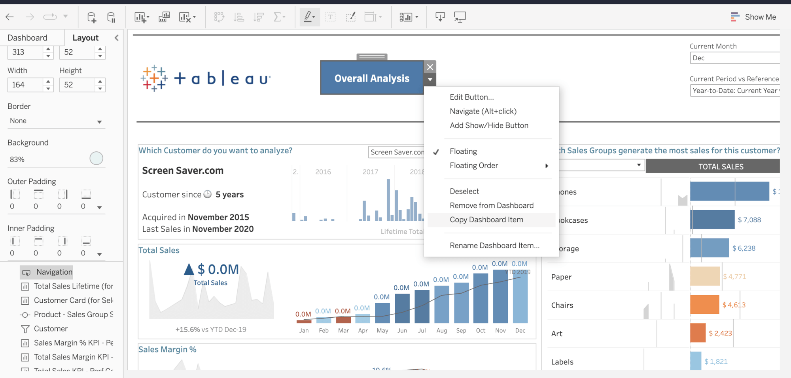
Copy and paste dashboard elements (e.g., images, text boxes, etc.)
https://www.tableau.com/2021-4-features#item-86344
Notes:
Last upgrade, I was most excited about that Show/Hide button. This time around, copy and paste dashboard elements are in my top three. How many times have you wanted to have two (almost) identical buttons or container that you’ve specified color or padding or whatever formatting for, but had to spent multiple minutes fussing recreating the object and fussing with formatting to get them to match. No more! Now you can copy and paste dashboard items.
However, I’m going to add some caveats to this feature:
In order to paste, you have to use CTRL or CMD+V. The object is pasted as a floating object, so you may still have to do some fussing with the item hierarchy and layout containers to the newly-pasted object where you want it.
You can copy across dashboards, so if you want an image or a blank object or a button, to be formatted similarly across dashboards, you can.
You can’t copy and paste EVERYTHING.
A worksheet can only appear on a dashboard once, so copying and pasting it onto the same dashboard isn’t possible.
The same is true for layout containers that contain worksheets or a dashboard title object. No copy/paste.
What about layout containers that only contain blank objects, text objects, buttons, and/or other non-worksheet elements? Those you CAN copy and paste.
That’s why this feature is in my top three, but not at the top of the list.

Slide 24
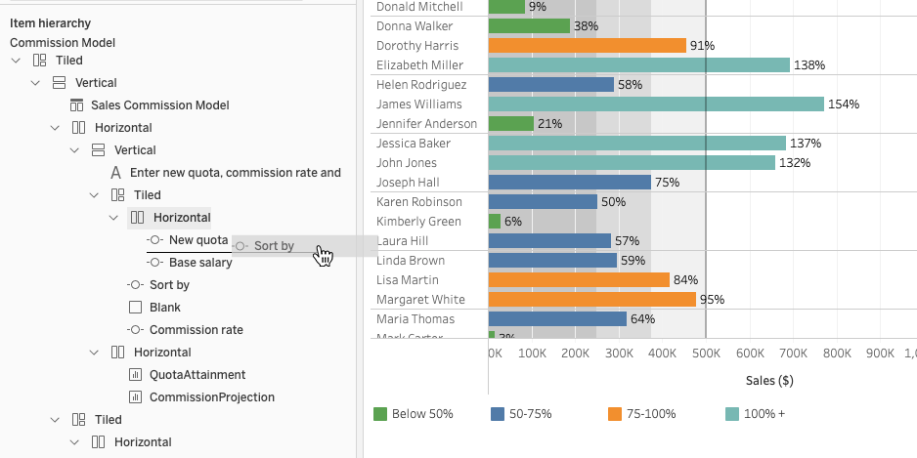
Drag and drop elements in the item hierarchy (Web Authoring only)
https://www.tableau.com/2021-3-features#item-85275
Notes:
This another top three for me, but with another big ol’ caveat.
If I were to ask many seasoned Tableau developers what they find the most annoying in Tableau. One of the most common answers is probably going to be rearranging content in dashboards–dealing with containers and that sort of thing.
Well, there’s an ever-so-slight improvement that comes with our upgrade–the ability to drag and drop elements in the item hierarchy. Now instead of selecting an object and having to click and drag IN THE DASHBOARD and cross your fingers that you let go of the mouse in just the right spot, you can use the nifty hierarchy on the left side of the screen to click and drag and drop it right where you want it in the hierarchy. This is a HUGE improvement in dealing with dashboards.
That big ol’ caveat I mentioned? It’s only available in Web Authoring, not in Tableau Desktop. For those of you using Web Authoring, you’re all set. For those of you who prefer Tableau Desktop, could this be the feature that makes you switch?
A couple of side notes
Web Authoring has come a VERY LONG WAY since MIT first got Tableau. And with every upgrade, Web Authoring is getting closer and closer to functioning like Tableau Desktop, though this is probably the first substantial feature I’ve noticed that was introduced on the Web instead of Desktop.
If you are thinking of making the switch to Web Authoring, one of the other features that’s part of this upgrade is that you can more seamlessly switch from Web Authoring directly into Tableau Desktop–the “Connected Desktop” feature in v2021.2. There are also other improvements to Web Authoring that we haven’t covered. If there is someone out there who does use Web Authoring a lot or has switched from Desktop to Web Authoring, we’d love to have you come share your experience with us at a future MIT TUG meeting.

Slide 25
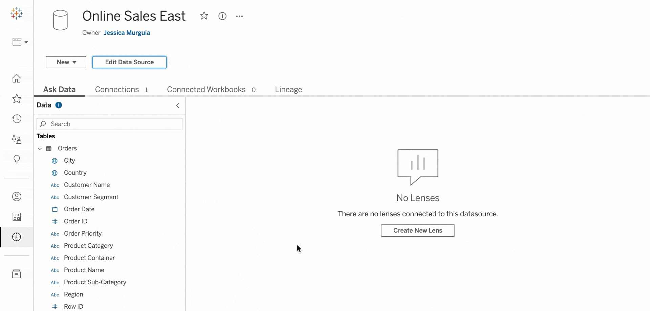
Edit published data sources on Tableau Server
https://www.tableau.com/2021-4-features#item-86341
Notes:
The final “building” feature is around published data sources, and it’s sort of the data canvas counterpart of Web Authoring. In the past, if you published a data source and then wanted to make a change–whether that change was renaming the data source, updating a column name, adding or removing a column, or joining or relating a new table–all of that had to be done by downloading the data source, and opening it in Tableau Desktop, and crossing your fingers and toes that you wouldn’t break it. (Or so I’ve been told.)
Now, you can edit published data sources on the web–everything from simple renaming to joining or relating tables, and just about everything in between. Again, this is an example of making the web interface as fully-featured as Tableau Desktop.

Slide 26
What are you most excited about?
Post it in the chat!
Notes:
So that was it for the highlights (so many) for our upcoming upgrade.
What are you most excited about? Post it in the chat!

Slide 27
Tableau Upgrades v2022.1 and beyond
Starting in 2022, Tableau is releasing upgrades twice a year (spring v202X.1 and fall v202X.3)
MIT will continue to upgrade 1-2 times a year
  Timing depends on IS&T priorities and user interest
  Want something? Say something reporting-help@mit.edu
Notes:
Before we leave the topic of the upgrade, we want to talk about what’s NOT in the upgrade. We’re upgrading to v2021.4, but back in March, Tableau actually released v2022.1. As we mentioned before, MIT will always be at least a major version behind. That’s nothing new.
What’s changing in the future, though, is Tableau’s release timing. They’re switching from updates 4 times a year to twice a year. IS&T is still planning to upgrade once or twice a year, depending on their priorities and what MIT’s Tableau community needs. One key factor is that community need. There’s lots of cool features in the newest version of Tableau that we won’t be getting until summer or fall at the very earliest, or even as far out as a year or more from now if IS&T doesn’t know we’d like the features.
To take a line from the MBTA, want something? Say something. If there are features that you see in new releases, let IS&T know by contacting reporting-help@mit.edu. Let them know what the feature is, what version it’s in, and how it’ll help you do your job better. That’s the best way for us as a community to advocate for timely upgrades.

Slide 28
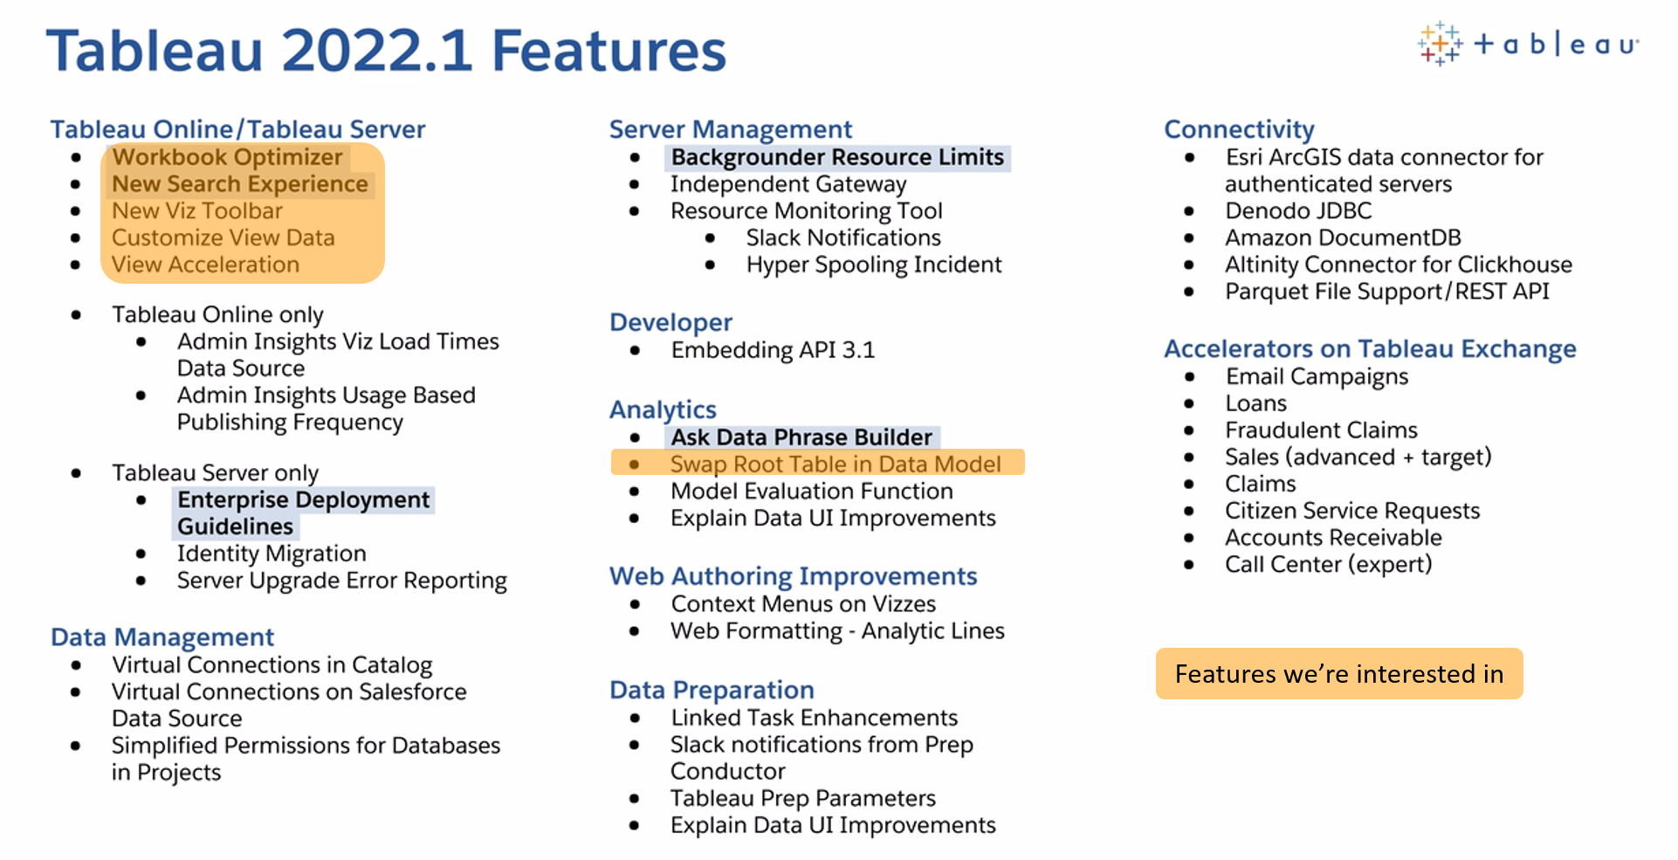
https://www.tableau.com/2022-1-features
Notes:
So what are some of those coming attractions that won’t make it to theaters near us until a second or third run?
Here’s a list of the highlights. We’re going to look at some of these in detail.

Slide 29
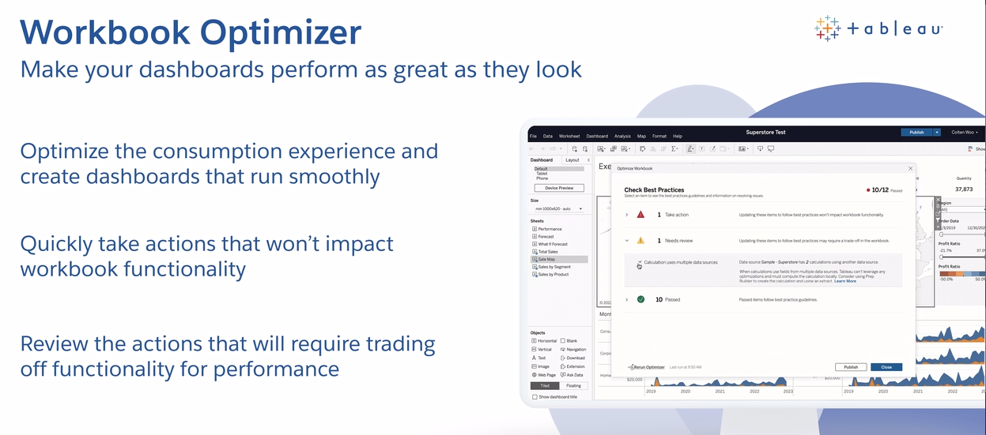
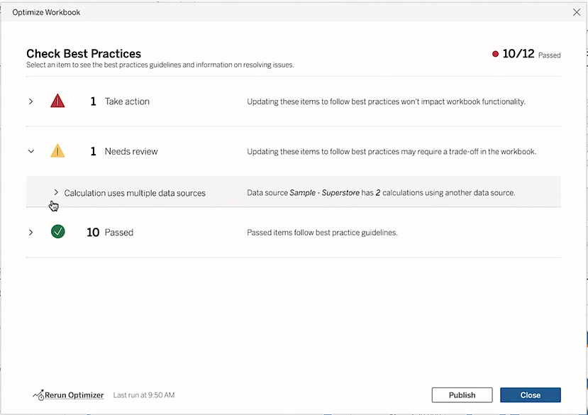
Workbook Optimizer
https://www.tableau.com/products/new-features#item-89136
Notes:
This is my top item in v2022.1. The Workbook Optimizer.
Tableau performance is complicated. There are lots of small and big changes you can make to make your dashboards load faster, make interactions work better, and even have extracts refresh more quickly. Unfortunately, there are a lot of factors. Last Fall, Tableau and InterWorks published an 80+ page revision of their Efficient Dashboards whitepaper. Yeah, 80+ pages.
How the heck are you supposed to keep all 80 pages of tips, tricks, and other random details in mind every time you build or publish a dashboard? Well, the Workbook Optimizer actually does it for you. It analyzes your workbook and identifies changes you can make to improve the performance of your dashboard. You can scroll through them, and decide what to change and what to ignore, and after making changes, re-run it to see if your changes introduced new or different issues.
I’m super-excited about this feature…for when it eventually becomes available to us…

Slide 30
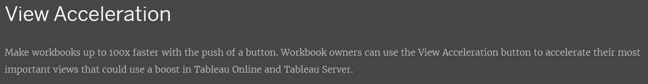
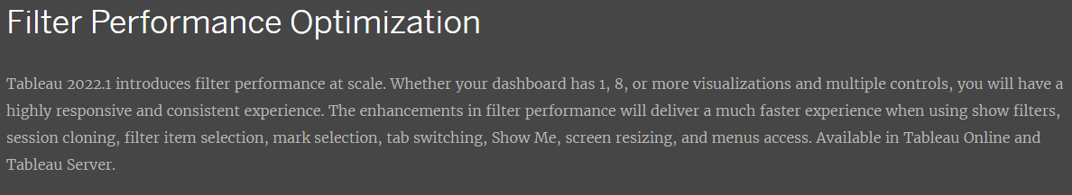
Performance updates
https://www.tableau.com/products/new-features#item-89151 and https://www.tableau.com/products/new-features#item-89158
Notes:
Talking about performance, every new version of Tableau is pretty much guaranteed to have some sort of performance improvement.
V2022.1 has a couple:
View Acceleration lets you prioritize certain views in a workbook so they always take precedence over others.
There are also updates to how filters perform. I know I’m not the only one who has ever added 10 or more filters to a dashboard. (Our users need to be able to slice and dice!) What happens with those filters? Things slow down. While the improvements in v2022.1 won’t fix all your filter problems (best practice exist for a reason–remember, there’s that 80+ page whitepaper on dashboard performance), they should help make filters and other interactivity work at least a little bit better.

Slide 31
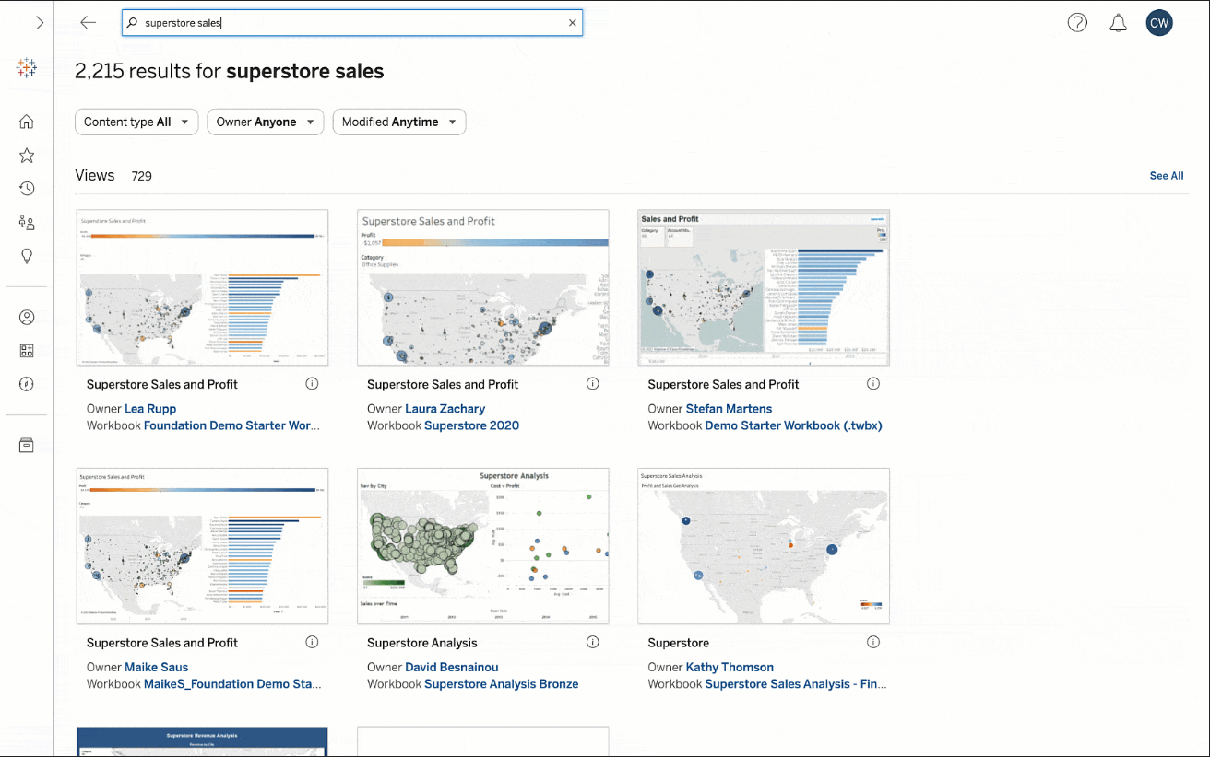
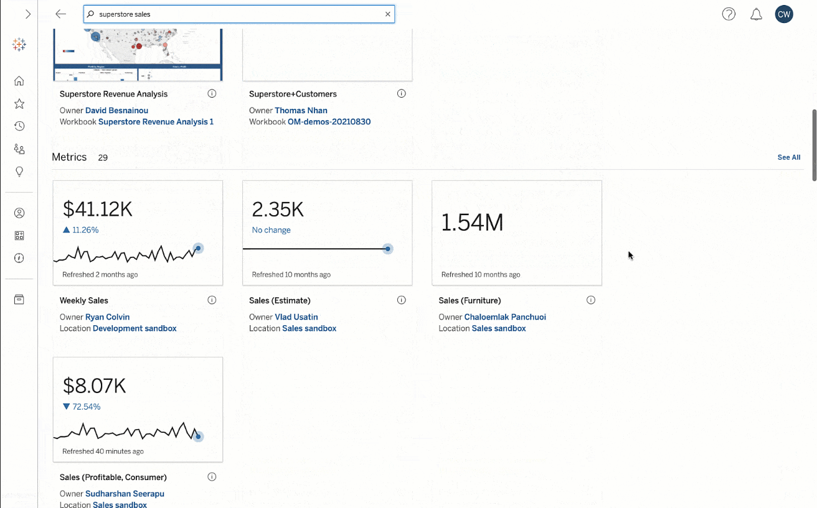
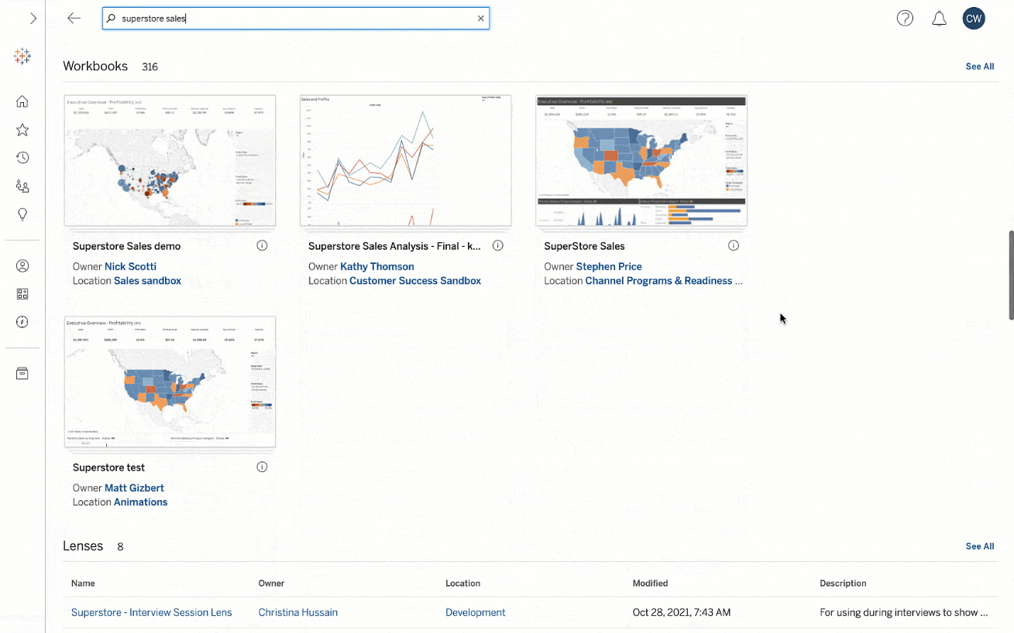
New Search Experience
https://www.tableau.com/products/new-features#item-89157
Notes:
There are number of improvements to the Tableau Server interface as well. My guess is that these elements were designed to make using Tableau on mobile devices easier, but the end result, I think, is an improvement for those of us using laptops and big monitors, too.
These changes include a better search interface that lets you scroll through results across different content types (views, dashboards, metrics) rather than click on tabs for each content type.

Slide 32
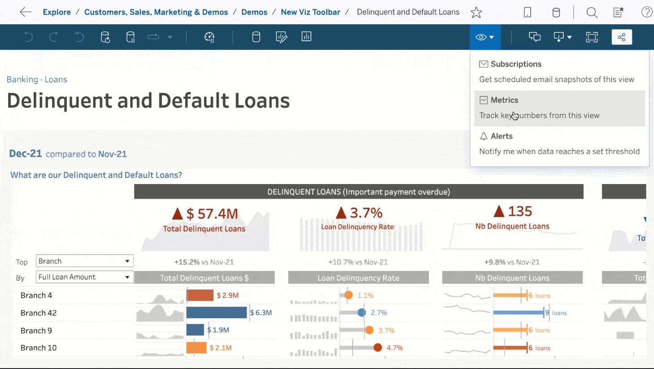
New
Old
New Viz Toolbar
https://www.tableau.com/products/new-features#item-89154
Notes:
And a new viz toolbar that has easier-to-click buttons (compared to the narrow strip of buttons/words in the old version)

Slide 33
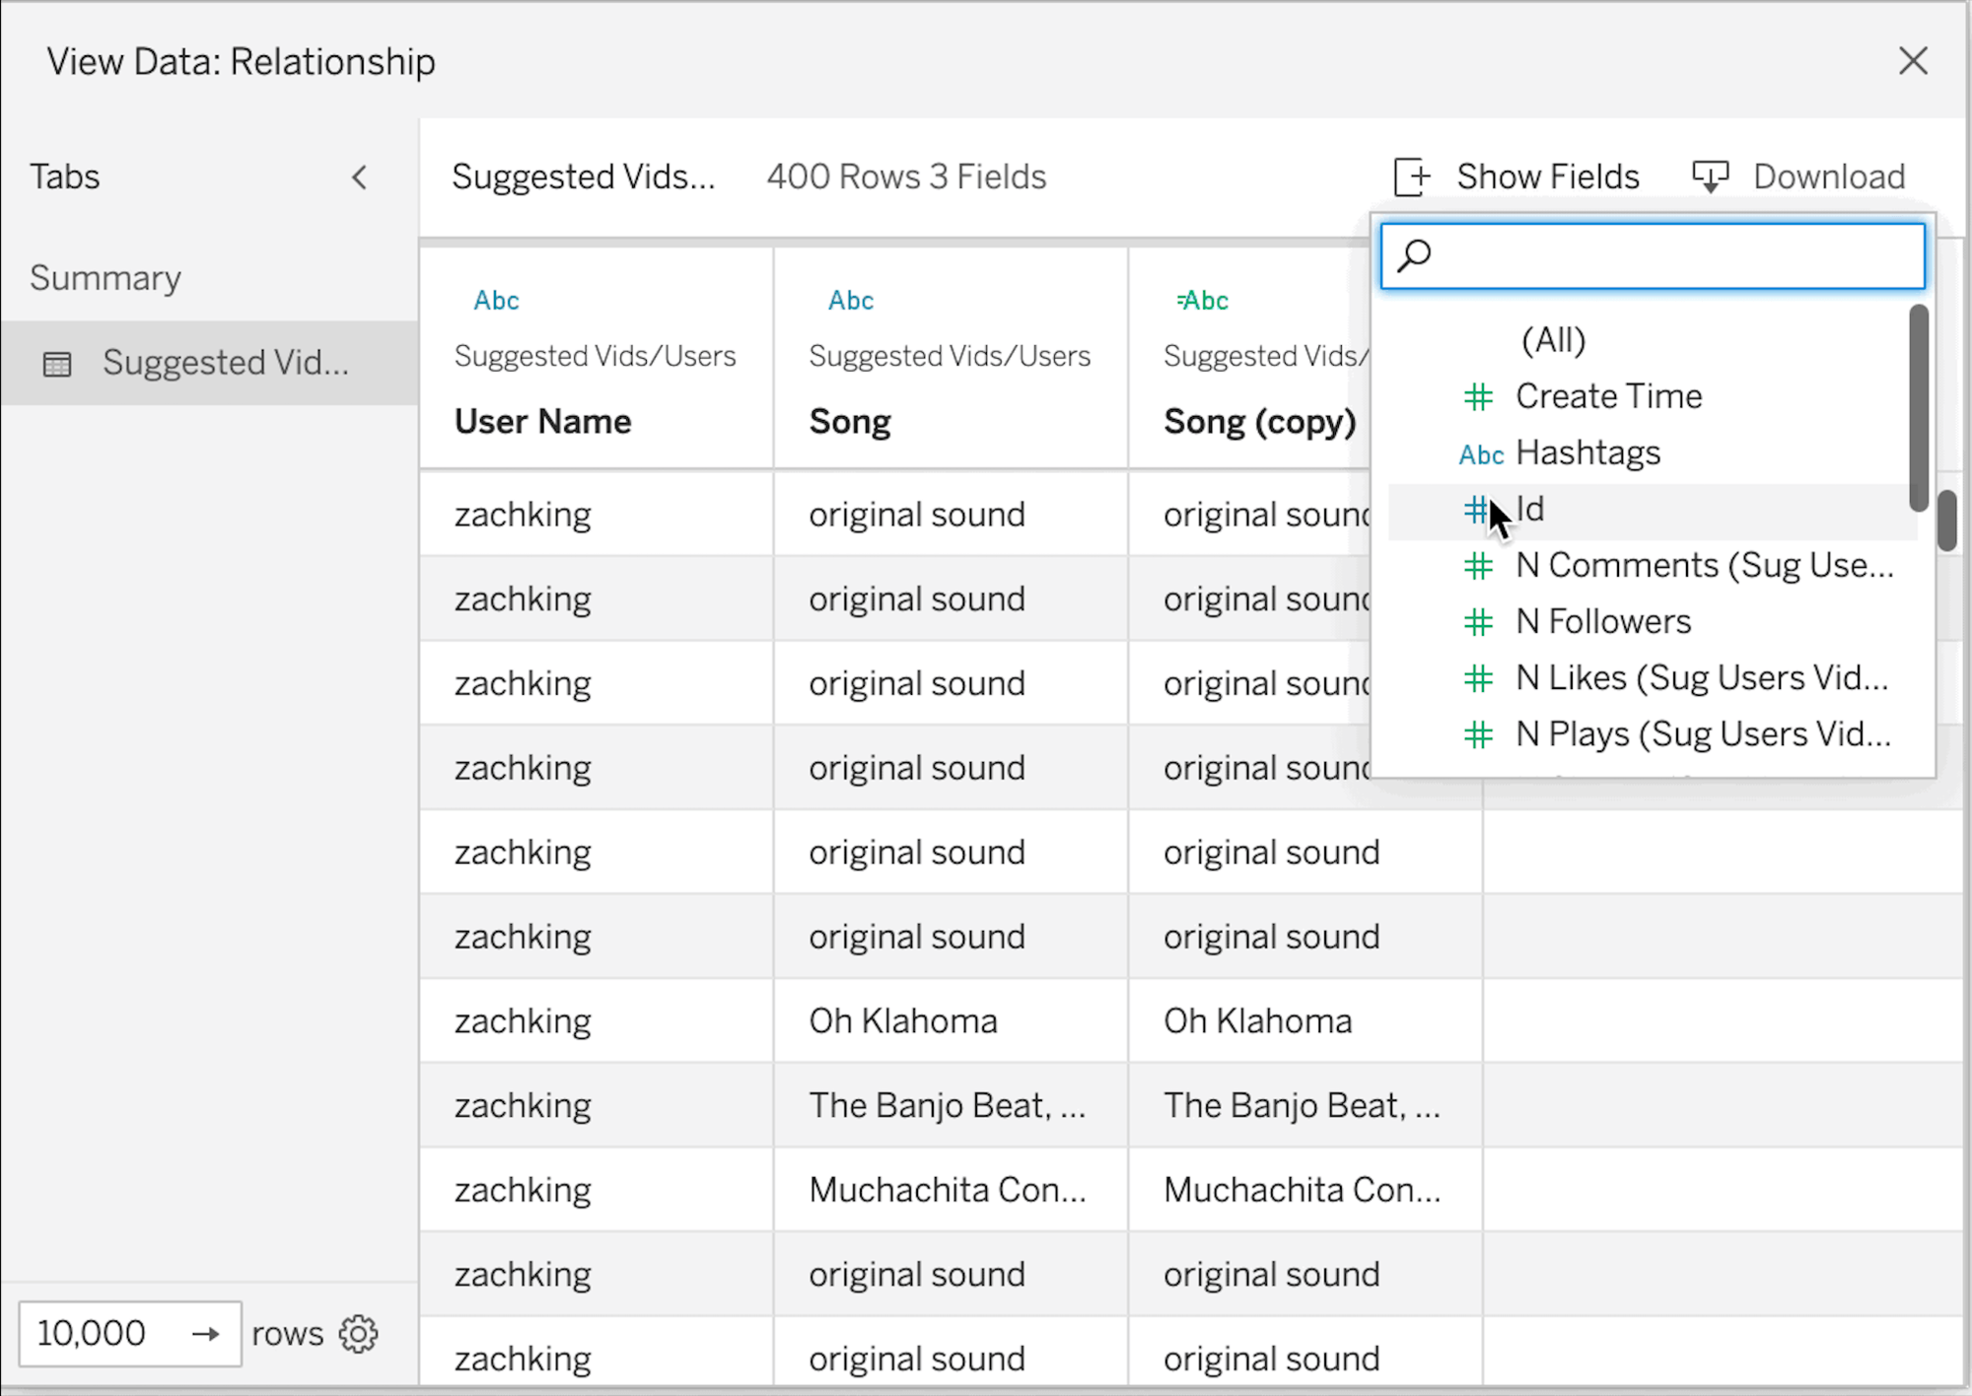
Customize View Data
https://www.tableau.com/products/new-features#item-89137
Notes:
One of my pet peeves in Tableau is full data. It’s great that we can provide downloads because people want their spreadsheets. But how many times has someone asked you to reorder the columns in their CSV export? Or how many times have you been forced to use some random calculation just to make Tableau display a chart just so, and then had users ask about (or ask you to remove) that random formatting-related element in the export?
Well in v2022.1, you have control over what shows up when you View Data.

Slide 34
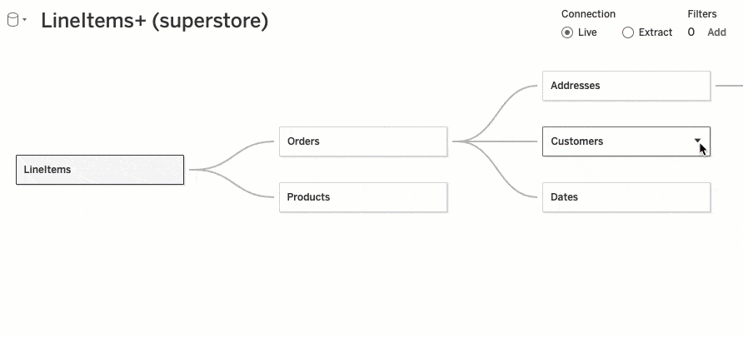
Swap with Root Table
https://www.tableau.com/products/new-features#item-89146
Notes:
When you’re creating a data source, have you ever gotten your tables joined or related just right…only to realize that you really needed that last table to be the first one in the canvas? Need to move it? Good luck–best case, you’ll have to update every relationship or join, or worst case, you may have to start over from scratch. Either way, it’s a pain.
Well, in v2022.1, you can actually do that rearrangement from the right-click menu. The relationships adjust automatically and and you don’t have to re-add all the tables.

Slide 35
What’s next?
v2021.4 is coming soon to the Tableau prod server
For v2022.1 and beyond
Want something? Say something reporting-help@mit.edu
Notes:
That’s it for the upgrade.
v2021.4 is coming soon–unless there are major issues in testing, expect it before the end of the FY (hopefully sooner)
For new features after that, if there’s something new you’re interested in using: Want something? Say something. Contact IS&T at reporting-help@mit.edu
And now, didja know it’s Tuesday? And that we’re talking Tableau. And Tableau Tuesday should have tips and tricks. Today, we have tips and tricks on tooltips, you could say we’ve got Tableau Tuesday tooltip tips and tricks, with MIT’s talented Tableau trailblazer, Laura Urciouli.
Laura, take it away!

Slide 36

Tooltips
Cool Tricks

Slide 37
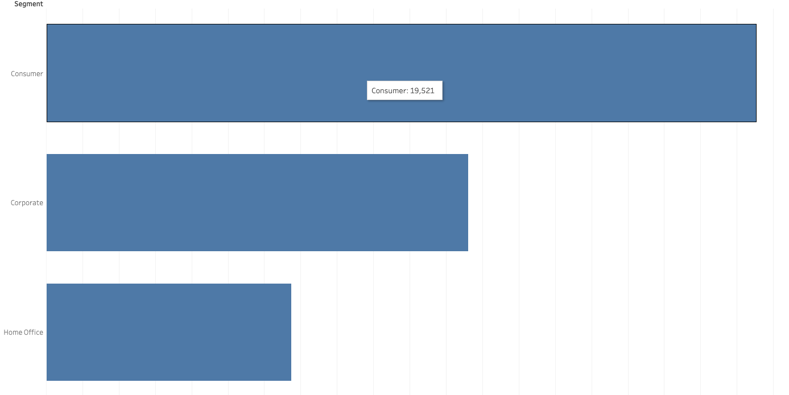
What are Tooltips?
Tooltips are the info box that appears when hovering over a viz object

Slide 38
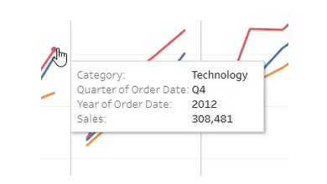
Tooltips can help you…
Show the actual values
Notes:
https://www.artofvisualization.com/blog/7-golden-rules-of-tableau-tooltips

Slide 39
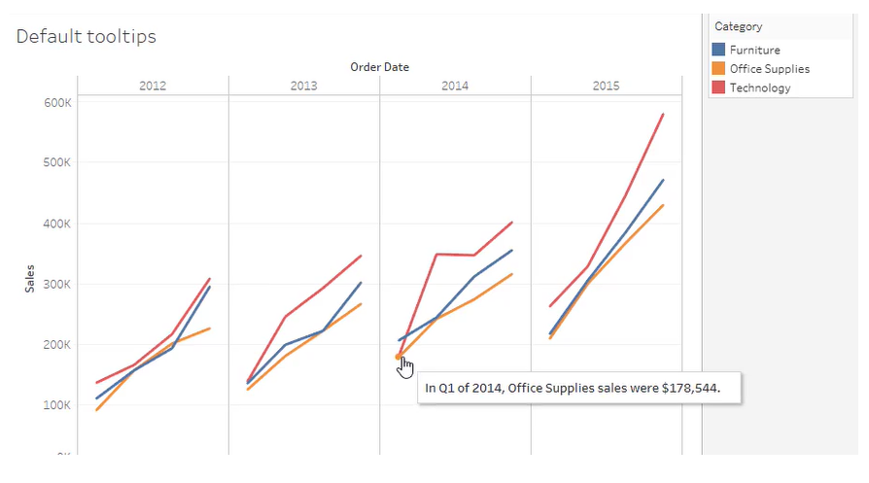
Tooltips can help you…
Explain your data

Slide 40
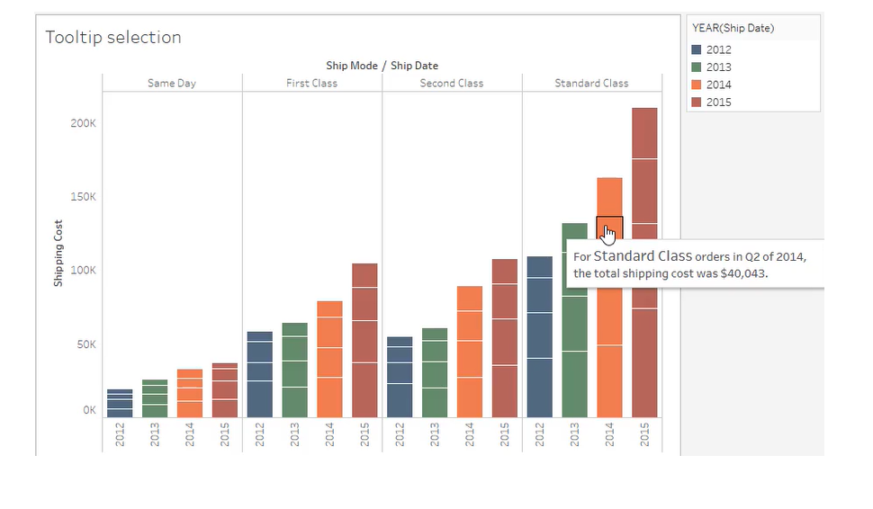
Tooltips can help you…
Further break up your data

Slide 41
Tooltips can help you…
SO MUCH MORE!!!
TUNE IN NEXT TIME FOR…
Examples are from:
https://www.artofvisualization.com/blog/7-golden-rules-of-tableau-tooltips
Viz in Tooltips

Slide 42

Notes:
May 17-19, 2022
Virtual and In-Person
Registration is now open
tableau.com/conference
LEARN | CONNECT | GROW | INSPIRE
#Data22
Virtual Broadcast - FREE:
● 2 Full Days
● 100,000 + data lovers.
● 3 time zones with hours of content/ breakout sessions
on data insights,trends, and Tableau best practices
● Tableau Doctor
● Slack
Live In Person in Las Vegas:
● 2.5 Days
● 5,000 data lovers
● 4 Keynotes
● 1 Iron Viz
● Hands-on-Training
● Breakout sessions
● Tableau Doctor
● Networking
● Executive Experience
● Press/Analyst programming

Slide 43
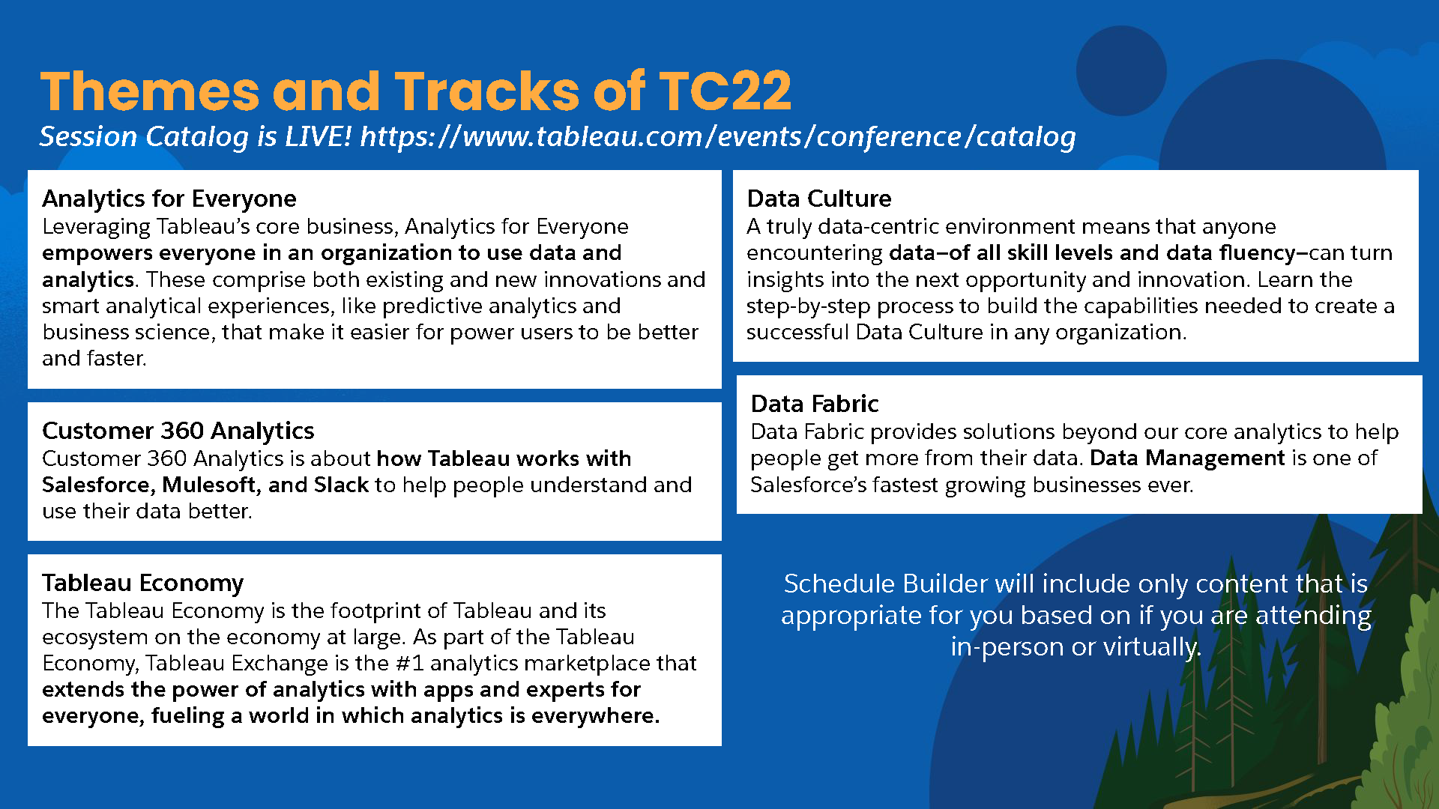
Notes:
Themes and Tracks of TC22
Session Catalog is LIVE! https://www.tableau.com/events/conference/catalog
Analytics for Everyone
Leveraging Tableau’s core business, Analytics for Everyone
empowers everyone in an organization to use data and
analytics. These comprise both existing and new innovations and
smart analytical experiences, like predictive analytics and
business science, that make it easier for power users to be better
and faster.
Customer 360 Analytics
Customer 360 Analytics is about how Tableau works with
Salesforce, Mulesoft, and Slack to help people understand and
use their data better.
Data Fabric
Data Fabric provides solutions beyond our core analytics to help
people get more from their data. Data Management is one of
Salesforce’s fastest growing businesses ever.
Data Culture
A truly data-centric environment means that anyone
encountering data—of all skill levels and data fluency—can turn
insights into the next opportunity and innovation. Learn the
step-by-step process to build the capabilities needed to create a
successful Data Culture in any organization.
Tableau Economy
The Tableau Economy is the footprint of Tableau and its
ecosystem on the economy at large. As part of the Tableau
Economy, Tableau Exchange is the #1 analytics marketplace that
extends the power of analytics with apps and experts for
everyone, fueling a world in which analytics is everywhere.
Schedule Builder will include only content that is
appropriate for you based on if you are attending
in-person or virtually.

Slide 44
Keynotes & Iron Viz
Keynotes
  Opening: …hear about the data opportunity ahead and new innovations that are shaping how the world sees, understands, and acts on data. Featuring a special edition of Devs on Stage!
  The Promise of Data: …Learn how data has become instrumental in empowering people and communities to have their issues seen and understood, and to shape new solutions.
  Thought Leader: featuring Hannah Fry, a Professor of Mathematics of Cities at the Centre for Advanced Spatial Analysis at UCL.
Iron Viz
  Three finalists take the stage to compete for bragging rights (and $10,000 cash) in the world's largest data visualization competition. Watch, learn, and cheer with other Data Rockstars around the globe.

Slide 45

Notes:
Hybrid
Slack
IN-PERSON AND VIRTUAL CHANNELS
Viz Gallery
VIRTUAL + DATA VILLAGE GALLERY
Live Streams & Broadcasts
-DATA + WOMEN
-DATA + DIVERSITY
-COMMUNITY CHATS
-ROVING REPORTERS

Slide 46

EST
2:00PM - 2:30PM
4:00PM - 4:30PM
4:30PM - 5:00PM
5:00PM - 5:30PM
Notes:
Learn
Virtual Day 1 (May 17)
2-2:30pm EST
Back 2 Viz Basics
Speaker: Eric Balash
Recommended by MIT TUG Leads
Data+Diversity: Fireside chat with Chad E. Foster and Jackie Yeaney
Speakers: Chad E. Foster, Jackie Yeaney
4-4:30pm EST
Tableau Speed Tips (Beginner)
Speakers: Annabelle Rincon, Heidi Kalbe
Recommended by MIT TUG Leads
Data+Women: Bridging the Gender Gap with Kyla Guru
Speaker: Kyla Guru
4:30-5pm
Bring the Wow Factor with Tableau Public Portfolios
Speakers: Autumn Battani, Priyanka Dobhal
5-5:30pm
Con o sin chimichurri? Strike the Right with Balance Design and Cognitive Load
Speakers: Diego Parker, Pablo Gomez

Slide 47
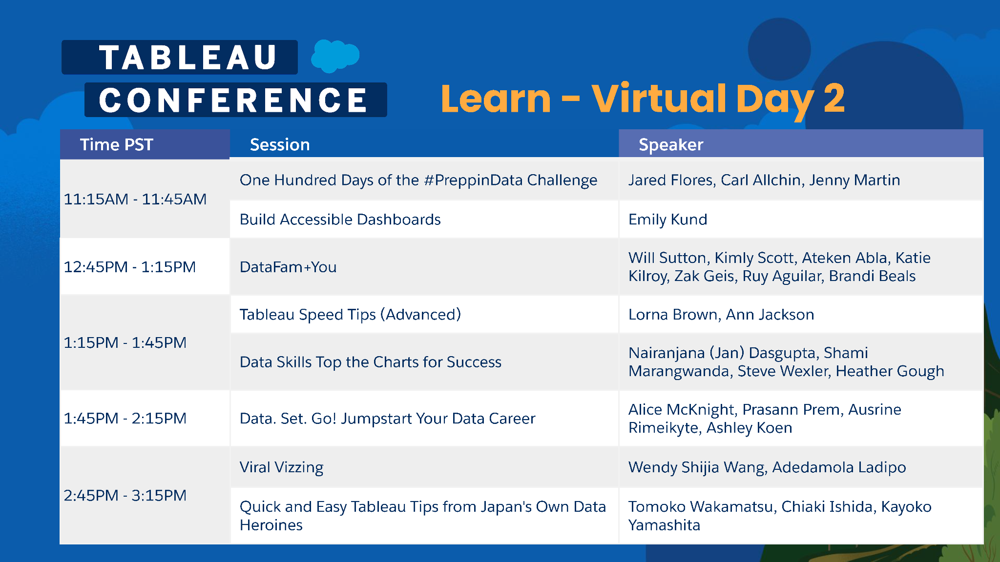
Also check out
3:15PM - 3:45PM Lovelytics Five Step Guide To Building Efficient Dashboards
3:45PM - 4:15PM From Data to Dashboard: Key Features for Analytical Success
EST
2:15PM - 2:45PM
3:45PM - 4:15PM
4:15PM - 4:45PM
4:45PM - 5:15PM
5:45PM - 6:15PM
Notes:
Learn
Virtual Day 2 (May 18)
2:15-2:45pm EST
One Hundred Days of the #PreppinData Challenge
Speakers: Jared Flores, Carl Allchin, Jenny Martin
Build Accessible Dashboards
Speaker: Emily Kund
Recommended by MIT TUG Leads
3:15-3:45pm EST
Lovelytics Five Step Guide To Building Efficient Dashboards
Speakers: Chantilly Jaggernauth, Agata Ketterick, Sekou Tyler
Recommended by MIT TUG Leads
3:45-4:15pm
DataFam+You
Speakers: Will Sutton, Kimly Scott, Ateken Abla, Katie Kilroy, Zak Geis, Ruy Aguilar, Brandi Beals
From Data to Dashboard: Key Features for Analytical Success
Speakers: Aaron Frein
Recommended by MIT TUG Leads
4:15-4:45pm
Tableau Speed Tips (Advanced)
Speakers: Lorna Brown, Ann Jackson
Recommended by MIT TUG Leads
Data Skills Top the Charts for Success
Speakers: Nairanjana (Jan) Dasgupta, Shami Marangwanda, Steve Wexler, Heather Gough
4:45-5:15pm
Data. Set. Go! Jumpstart Your Data Career
Speakers: Alice McKnight, Prasann Prem, Ausrine Rimeikyte, Ashley Koen
5:45-6:15pm
Viral Vizzing
Speakers: Wendy Shijia Wang, Adedamola Ladipo
Quick and Easy Tableau Tips from Japan's Own Data Heroines
Speakers: Tomoko Wakamatsu, Chiaki Ishida, Kayoko Yamashita

Slide 48

Notes:
Connect
Virtual networking using Remo
https://usergroups.tableau.com/tc22remohangouts

Slide 49
Tableau AMA (Ask Me Anything)
We’ve got some special guests from Tableau!
Jeremy Weatherall
Principal Solution Engineer
Denise Youngberg
Account Executive, Education
(MIT’s Account Exec)

Slide 50
Important Links
MIT TUG
Next meeting: TBD
Wiki
wikis.mit.edu/confluence/display/MITTUG/
Slack
mit-tableau.slack.com
Join the email list
mailman.mit.edu/mailman/listinfo/mit_tableau_user_group
Contact MIT TUG co-leads
  #ask-mit-tug-leads on Slack
  mit-tableau-user-group-admin@mit.edu
Other Higher Ed Tableau Resources
Higher Ed TUG (HETUG)
usergroups.tableau.com/HigherEducation
Slack
higher-ed-tableau.slack.com
Community Group
community.tableau.com/s/group/0F94T000000gQYoSAM/higher-education

Slide 51
Stick around to chat
Want to present? Want to see something?
Contact us:
Slack us at #ask-mit-tug-leads
Email the MIT TUG co-leads at mit-tableau-user-group-admin@mit.edu

