Slide 1
MIT Touchstone
SAIS briefing
June 20, 2008

Slide 2
Who?
Bob Basch
Vijay Konda
Arnis Kletnieks
Laura Watts
Joanna Proulx
Brian Knoll
Paul Hill

Slide 3
Why?
Support situations where x.509 certificates are not practical
Federated web authentication
Web SSO
Provide a clear integration strategy to MIT web developers
Ability to adopt new technologies

Slide 4
How?
MIT – a federation of (at least) two
  People with a Kerberos account and the ability to obtain a certificate
  External collaborators – know by an email address

Slide 5
What?
Shibboleth
IdP
Shib-HA
LDAP
SP
InCommon
WAYF
Stanford WebAuth
  Username and password
  X.509
  http-spnego
CAMS
  Account management application
  Authentication server
    Email address and password
    http-spnego (x-realm)
    OpenID

Slide 6
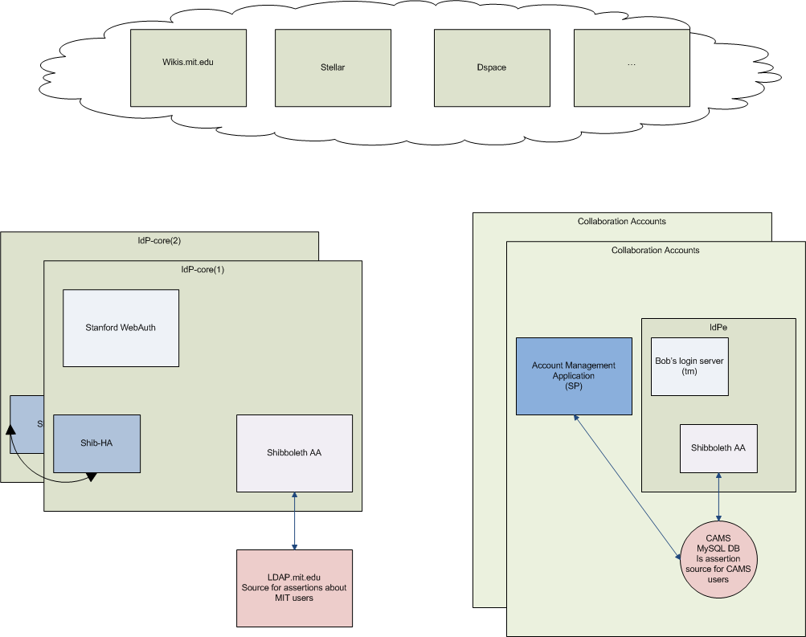

Slide 7
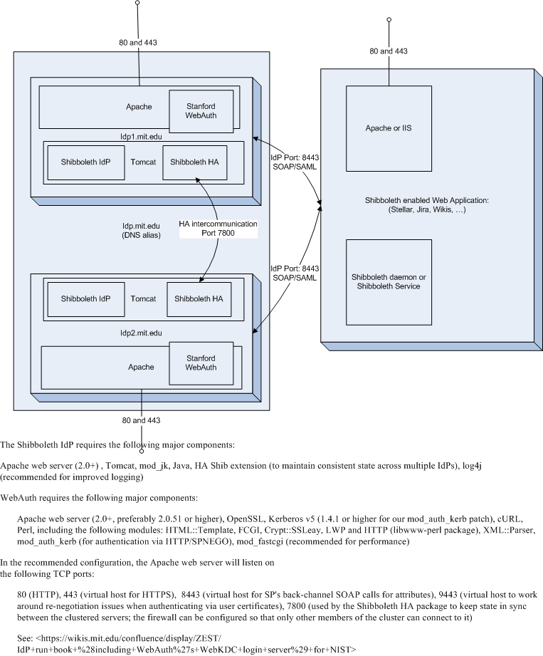

Slide 8
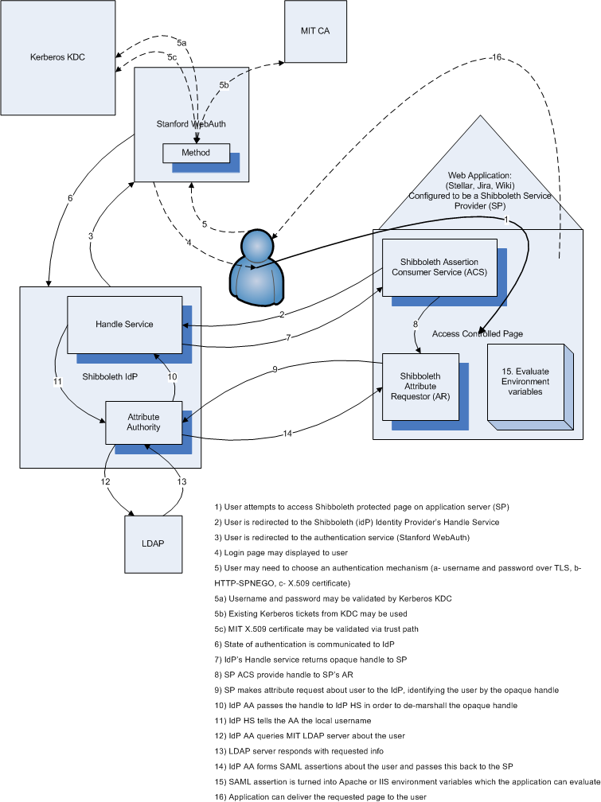

Slide 9
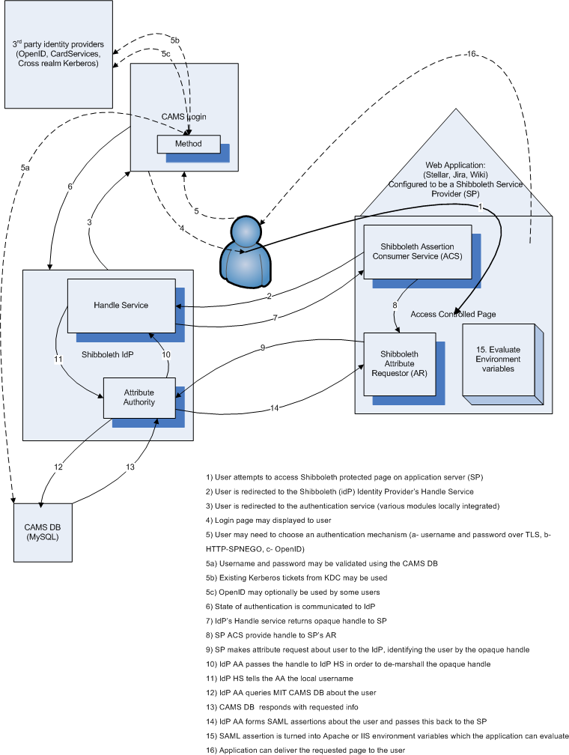

Slide 10
A SAML Assertion
<Response xmlns="urn:oasis:names:tc:SAML:1.0:protocol" InResponseTo="_0a189e60e90898256cfb267f4e9166e5" IssueInstant="2008-05-06T18:10:02.569Z" MajorVersion="1" MinorVersion="1" ResponseID="_aacbbada3fe6ff28a28f7180c7e511ef" xmlns:saml="urn:oasis:names:tc:SAML:1.0:assertion" xmlns:samlp="urn:oasis:names:tc:SAML:1.0:protocol" xmlns:xsd="http://www.w3.org/2001/XMLSchema" xmlns:xsi="http://www.w3.org/2001/XMLSchema-instance">
<Status>
<StatusCode Value="samlp:Success"/>
</Status>
<Assertion xmlns="urn:oasis:names:tc:SAML:1.0:assertion" AssertionID="_001a35010c27af0867ff2c9fda6b6397" IssueInstant="2008-05-06T18:10:02.569Z" Issuer="https://idp.foonalagoona.mit.edu/shibboleth" MajorVersion="1" MinorVersion="1">
<Conditions NotBefore="2008-05-06T18:10:02.569Z" NotOnOrAfter="2008-05-06T18:40:02.569Z">
<AudienceRestrictionCondition>
<Audience>
https://posteverything.mit.edu/shibboleth
</Audience>
<Audience>
https://isda-shib-test.mit.edu
</Audience>
</AudienceRestrictionCondition>
</Conditions>
<AttributeStatement>
<Subject>
<NameIdentifier Format="urn:mace:shibboleth:1.0:nameIdentifier" NameQualifier="https://idp.foonalagoona.mit.edu/shibboleth">
_9c6b3a718cc609ccb55286bc18b17ad7
</NameIdentifier>
</Subject>
<Attribute AttributeName="urn:mace:dir:attribute-def:eduPersonNickname" AttributeNamespace="urn:mace:shibboleth:1.0:attributeNamespace:uri">
<AttributeValue>
Paul B Hill
</AttributeValue>
</Attribute>
<Attribute AttributeName="urn:mace:dir:attribute-def:eduPersonScopedAffiliation" AttributeNamespace="urn:mace:shibboleth:1.0:attributeNamespace:uri">
<AttributeValue Scope="mit.edu">
staff
</AttributeValue>
</Attribute>
<Attribute AttributeName="urn:mace:dir:attribute-def:eduPersonAffiliation" AttributeNamespace="urn:mace:shibboleth:1.0:attributeNamespace:uri">
<AttributeValue>
staff
</AttributeValue>
</Attribute>

Slide 11
SAML Assertion (2)
<Attribute AttributeName="urn:mace:dir:attribute-def:ou" AttributeNamespace="urn:mace:shibboleth:1.0:attributeNamespace:uri">
<AttributeValue>
Information Services &amp; Technology
</AttributeValue>
</Attribute>
<Attribute AttributeName="urn:mace:dir:attribute-def:givenName" AttributeNamespace="urn:mace:shibboleth:1.0:attributeNamespace:uri">
<AttributeValue>
Paul B
</AttributeValue>
</Attribute>
<Attribute AttributeName="urn:mace:dir:attribute-def:mail" AttributeNamespace="urn:mace:shibboleth:1.0:attributeNamespace:uri">
<AttributeValue>
pbh@mit.edu
</AttributeValue>
</Attribute>
<Attribute AttributeName="urn:mace:dir:attribute-def:eduPersonPrimaryAffiliation" AttributeNamespace="urn:mace:shibboleth:1.0:attributeNamespace:uri">
<AttributeValue>
staff
</AttributeValue>
</Attribute>
<Attribute AttributeName="urn:mace:dir:attribute-def:telephoneNumber" AttributeNamespace="urn:mace:shibboleth:1.0:attributeNamespace:uri">
<AttributeValue>
617-253-0124
</AttributeValue>
</Attribute>
<Attribute AttributeName="urn:mace:dir:attribute-def:cn" AttributeNamespace="urn:mace:shibboleth:1.0:attributeNamespace:uri">
<AttributeValue>
Paul B Hill
</AttributeValue>
</Attribute>
<Attribute AttributeName="urn:mace:dir:attribute-def:sn" AttributeNamespace="urn:mace:shibboleth:1.0:attributeNamespace:uri">
<AttributeValue>
Hill
</AttributeValue>
</Attribute>
<Attribute AttributeName="urn:mace:dir:attribute-def:eduPersonPrincipalName" AttributeNamespace="urn:mace:shibboleth:1.0:attributeNamespace:uri">
<AttributeValue Scope="mit.edu">
pbh
</AttributeValue>
</Attribute>
</AttributeStatement>
</Assertion>
</Response>

Slide 12
When?
Stellar, Jira, and Wikis started last fall
CAMS portion – July 2008 (service readiness)
Developer outreach October 2008
Libraries: Dspace, Document Delivery, GeoWeb, EZ Proxy – working with them.
SDLS – dependent on
NIST Citrix farm – in development

Slide 13
Future?
Shibboleth and Liberty convergence
Shibboleth and ADFS interoperability
InCommon – coming fast – 86 members including MIT
http://www.incommonfederation.org/participants/

Slide 14
Supported platforms
IIS 6.0
Apache 2.0.x and later
  Linux (RHEL preferred)
  Solaris 10.x
  MacOS 10.3 and higher tested at other sites
Apache 1.3.x has been done elsewhere

Slide 15
Shibboleth and SAP
Rumors that a site in France has succeeded integrating with SAP ERP
K.U.Leuven has also done this work (http://atmire.com/lirias.php)

Slide 16
How to typically integrate
.htaccess directives available on Apache
Shibboleth configuration files
HTTP headers and CGI environment variables

Slide 17
Apache htaccess
If we simply want users (from the Federation) to be authenticated:
    AuthType shibboleth
    ShibRequireSession On
    Require valid-user
Note this doesn’t say where they are from or who they are.

Slide 18
Apache htaccess continued
What if we want to require that the user have an MIT account?
      AuthType shibboleth
      ShibRequireSession On
      ShibRequireAll On
      Require ShibIdentityProvider https://idp.mit.edu/shibboleth

Slide 19
Example of using Shibboleth configuration
Shibboleth.xml
...
<Host name="sp.example.org">
<Path name="secure" authType="shibboleth" requireSession="true">
<AccessControl>
<AND>
<Rule require="affiliation">student</Rule>
<OR>
<Rule require="homeOrganization">ethz.ch</Rule>
<Rule require="homeOrganization">unizh.ch</Rule>
</OR>
<NOT>
<Rule require="homeOrganization">vho-switchaai.ch</Rule>
</NOT>
</AND>
</AccessControl>
</Path>
</Host>
...

Slide 20
Some of the environment variables
HTTP_REMOTE_USER HTTP_SHIB_APPLICATION_ID default
HTTP_SHIB_AUTHENTICATION_METHOD urn:oasis:names:tc:SAML:1.0:am:unspecified
HTTP_SHIB_EP_AFFILIATION staff@mit.edu
HTTP_SHIB_EP_ENTITLEMENT
HTTP_SHIB_EP_NICKNAME Paul B Hill
HTTP_SHIB_EP_PRIMARYAFFILIATION staff
HTTP_SHIB_EP_PRIMARYORGUNITDN
HTTP_SHIB_EP_UNSCOPEDAFFILIATION staff
HTTP_SHIB_IDENTITY_PROVIDER https://idp.foonalagoona.mit.edu/shibboleth
HTTP_SHIB_INETORGPERSON_GIVENNAME Paul B
HTTP_SHIB_INETORGPERSON_MAIL pbh@mit.edu
HTTP_SHIB_ORGPERSON_ORGUNIT Information Services & Technology
HTTP_SHIB_ORIGIN_SITE https://idp.foonalagoona.mit.edu/shibboleth
HTTP_SHIB_PERSON_COMMONNAME Paul B Hill
HTTP_SHIB_PERSON_DESCRIPTION
HTTP_SHIB_PERSON_SURNAME Hill
HTTP_SHIB_PERSON_TELEPHONENUMBER 617-253-0124
HTTP_SHIB_TARGETEDID REMOTE_USER pbh@mit.edu

