Slide 1
MIT Identity Services
January 2010

Slide 2
Scope
Identity services and the management of identities extends to people, hosts, services, applications, and executing processes
This presentation will primarily focus on the identity services as they relate to people

Slide 3
Why are Identity Services important?
Provisioning - Establishes standard processes for obtaining and maintaining an MIT identity
Authentication - Enable a ‘real world’ person to prove who he, or she, is to internal and external digital assets and resources
Authorization - Ensures the distinction between registering for an MIT identity and assigning privileges to that identity
Compliance - Addresses some of MIT’s key privacy and legislative obligations
Personalization - Enables MIT to personalize and manage the user experience
Branding - Binds outstanding individuals to the MIT name, which in turn extends the brand recognition
Services - Assists in maintaining and evolving a consistent information security infrastructure for access to MIT systems and data

Slide 4
Landscape
People collaborate with others across traditional organizational boundaries
Experiments may have teams that include members from dozens of organizations
Data and other materials may be scattered across dozens of sites, organizations, or countries

Slide 5
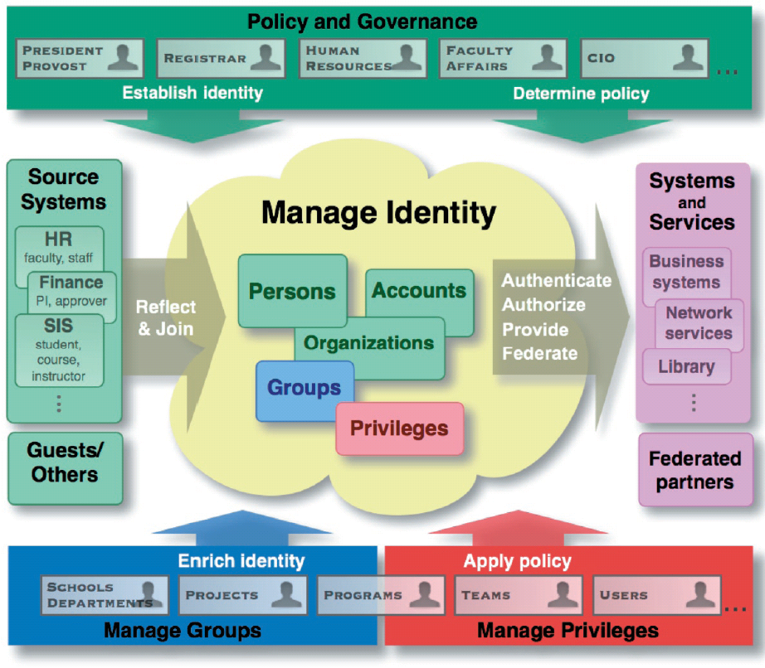
Generic Components

Slide 6
Main Topics
Provisioning
Authentication
Authorization
Data and Directory Services

Slide 7
Sidebar: terminology and jargon
Moira
MIT ID DB
Kerberos
Regular Account
Special, aka sponsored, Account
SoR
X.509 Certificates
  User
  Server
LDAP
Federation
InCommon Federation
Shibboleth
IdP
SP
SAML
Collaboration Accounts
Touchstone
Roles
perMIT

Slide 8
Sidebar: What is Moira?
Moira is a meta-directory dating from 1988, originally developed for Project Athena
  Namespace management and reservation
  User account registration and management
  List and group management
  Network/subnet management
  Host/Machine management
  Athena cluster management
  AFS and NFS file system management
  Win.mit.edu container management

Slide 9
Sidebar: MIT ID DB and service
The MIT ID DB provides authorized lookup and assignment of MIT ID numbers
In 1994 MIT decided to eliminate the use of SSNs as a primary identifier across institute systems
MIT ID DB is SoR for SSNs
MIT ID DB does not report SSNs
Ideally a person should only need one MIT ID number in their lifetime
Even applicants are assigned ID numbers, prior to acceptance

Slide 10
Sidebar: Kerberos
A computer network authentication protocol, originally developed at MIT
Defines the MIT user namespace (e.g. mtsmith@mit.edu)
The Kerberos protocol is generally used by native clients or thick clients, not web applications
Kerberos authenticator lasts approximately a day
Used in conjunction with MIT ID number to obtain MIT X.509 User Certificate

Slide 11
Sidebar: accounts
MIT Regular
MIT Special, aka sponsored
employees (including faculty and staff as identified by MIT HR)
registered students (as determined by the Registrar)
members of the Corporation
Members of certain Corporation or Alumni Association committees.
People not entitled through MIT affiliation to a Regular Account but who are otherwise affiliated with the Institute through activities sponsored by a current MIT faculty or staff member
Collaboration Accounts
Outside of the MIT namespace
Anyone in the world can obtain on via self-registration

Slide 12
Sidebar: Systems of Record (SoR)
The SOR is the system that has the official master copy. Many systems have copies of data that was collected elsewhere.
is responsible for all aspects of the integrity and maintenance of this information.
Many systems are an SoR for only a small subset of the data that they contain
The Data Warehouse is not an SoR

Slide 13
Sidebar: X.509 Certificates
An X.509 certificate is an electronic document which uses digital signatures to bind together a public key with an identity
A certificate authority (CA) issues X.509 certificates
The MIT CA issues certs for MIT users, servers, and applications
We also use the Equifax CA to issue some server certificates
Certificates are generally used for web authentication. They are rarely used for native application authentication.

Slide 14
Sidebar: LDAP
An industry standard protocol for querying and updating directory services
Not a SoR for any MIT data
Fed by Moira and the Data Warehouse
Applications and systems use this as an integration tool to access names, group memberships, and other information.

Slide 15
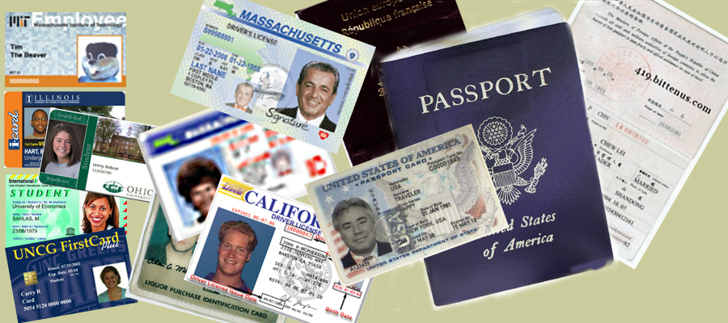
Sidebar:
Federation
an association of organizations that use a common set of attributes, practices and policies to exchange information about their users and resources in order to enable collaborations and transactions
each organization continues to manage its own identities, but is capable of securely sharing and accepting identities and credentials from other organizations
Participants may use different technologies with different security approaches and still integrate their businesses without substantial custom integration.

Slide 16
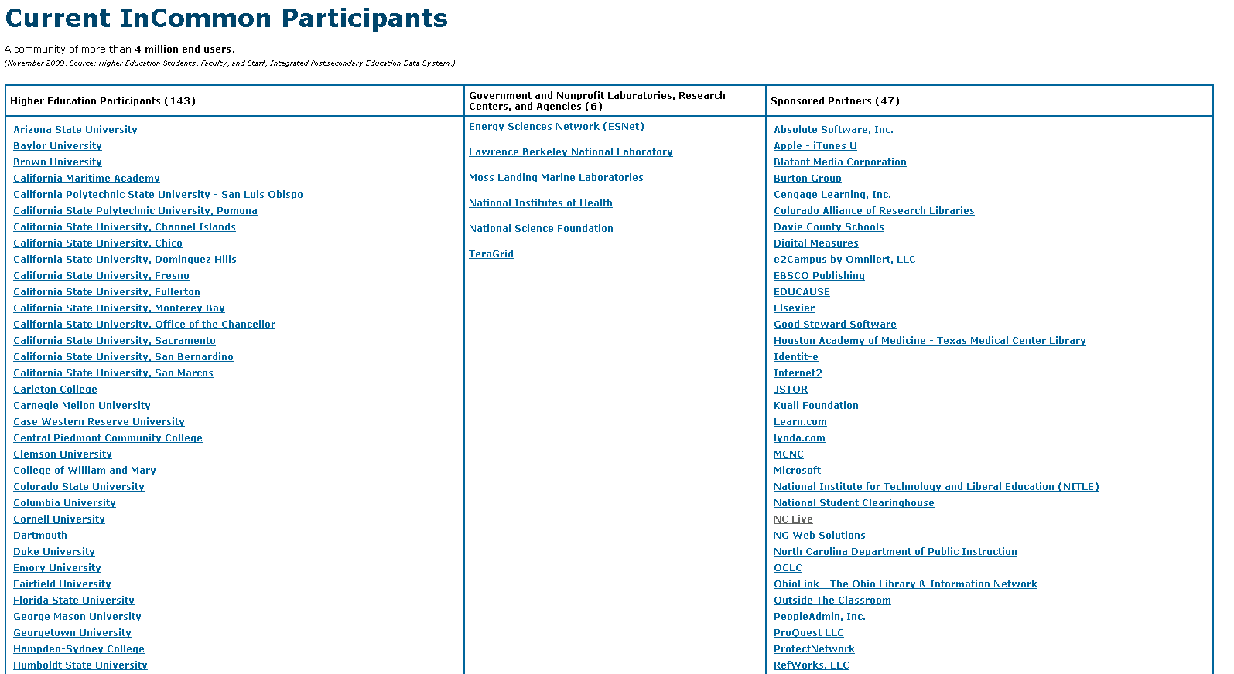

Slide 17
Sidebar: IdP
Identity Provider
  Mediates the user’s initial authentication
  Supplies information about the user to the participating applications
  Arbitrates what information about a user will be disclosed to a particular application

Slide 18
Sidebar: SP
Service Provider, aka Relying Party
This is the component that resides on the enabled application server
Consumes the information about the user provided by the IdP
Marshalls the disclosed information so that an application can access it
Grants or denies access to protected content

Slide 19
Sidebar: SAML
Security Assertion Markup Language
Standard for exchanging authentication data between an IdP and an SP
SAML is a product of the OASIS Security Services Technical Committee
Used by Shibboleth and many other systems

Slide 20
Sidebar: Shibboleth
Shibboleth is a web centric authentication product
Is a product of Internet2
Supports federated authentication
Uses SAML
Interoperates with Microsoft’s ADFS and Liberty Alliance compliant systems
Includes the IdP and SP components

Slide 21
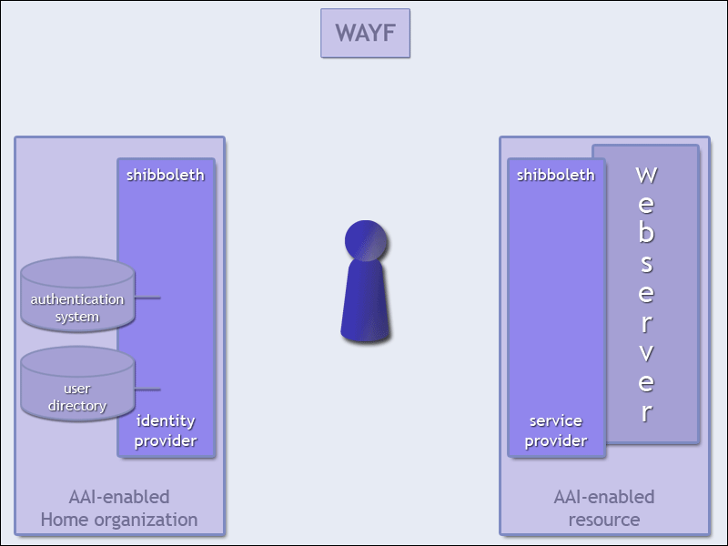
Sidebar: Shibboleth

Slide 22
Sidebar: Collaboration Accounts
Outside of the MIT namespace
Anyone in the world can obtain on via self-registration
Used specifically for Touchstone/Shibboleth enabled web applications
Created so that applications don’t have to create their own local account management system
Alumni plans to migrate to this system

Slide 23
Sidebar:
Touchstone
Wikis Stellar EzProxy ILLiad Barton Seminar XXI HR TeraGrid Dreamspace CAMS
InCommon IdPs
IDP.mit.edu
Kerberos KDC
IDP.TouchstoneNetwork.Net
Shibboleth AA
MIT CA
Moira
Shibboleth AA
LDAP
Data Warehouse
CAMS DB

Slide 24
Sidebar: Roles
A privilege management system developed at MIT
in use at MIT for well over a decade
Supports
  Inheritance
  Explicitly granted privileges
  Privileges defined as the result of evaluating enterprise data
Includes a master department hierarchy system
Accessible via:
  a SOAP based web service
  Flat files
  Exporting data to LDAP groups

Slide 25
Sidebar: Roles
In use by over 30 applications, including:
  Financials, payroll, student system, admissions, registrar, telephony, libraries, graduate aide, HR, environmental health and safety, data warehouse, MIT ID system, help desk, master department hierarchy, accounts management
6258 people have the ability to grant privileges (10/2/2009)
  Institutional size is roughly 23,000
  Only 601 can grant privileges if you exclude 5637 people who have the GRANT flag turned on for their privileges in the Telephony and Network category (for maintaining VoIP preferences).
Growing interest from a number of business areas:
  Physical security / door access / parking
  Backup system
  Certificate authority
  Travel / reservations

Slide 26
Sidebar: perMIT
perMIT is the next generation of Roles
Roles is limited to MIT Kerberos accounts
perMIT will allow us to manage privileges of users that authenticate via other IdPs as well
Add strong data typing to Qualifier subtypes
  The logic of some existing stored procedures is based on knowledge of MIT data formats, instead of data typing. This will go away.
Expand the audit trails
High Availability
Make it available to other sites

Slide 27

Who is the MIT Community?

Slide 28
Provisioning
Identification is the process used to determine that the person is who they claim to be.
Registration is the process whereby users are given electronic credentials, ensuring that they are coupled with the correct electronic identity information. ⁽¹⁾

Slide 29
Provisioning: Key identifiers
Let’s first focus on Staff, Students, applicants, and Special Accounts:
MIT ID Number
  Input: Full Name, Day of Birth, optionally SSN
  Output: MIT ID Number ⁽²⁾
Kerberos principal name
  User chooses name and password
  Used as the basis for most other online credentials at MIT

Slide 30
Provisioning: entry points
Human Resources
  MIT ID number, and ability to register for account
Registrar / Admissions
  MIT ID number, and ability to register for account
IS&T Athena Accounts
  MIT ID number, and ability to register for account
MIT ID Card Office
  MIT ID number, Library Patron ID number, and issuing of MIT ID Card

Slide 31
Provisioning: Open Issues
Areas where we would like to initiate projects:
  Level of Assurance
  Data Quality of MIT ID number
  New privacy concerns
  Pylon: expose active federation users to our authorization management systems
  Username restrictions
  Improve management of special accounts
  Kerberos non-null instances

Slide 32
Level of Assurance (LOA) ₍₁₎
Create an application which builds the evidence to associate a Kerberos principal with a specific MIT ID Card holder.
  When a person picks up an MIT ID Card, have the person authenticate at a workstation in the Card Office.

Slide 33
Improve data quality and reduce the number of times a person is assigned multiple MIT ID numbers ₍₂₎
A new interface to the MIT ID database has been created which helps people performing data entry determine if a small typing mistake has been made. E.g. show if a newly entered SSN differs by 1 or 2 characters, while the full name matches.
Athena Accounts is using this.
Other systems are not yet using the new interfaces.
Issuing multiple MIT ID numbers to the same person will be reduced by making the change to existing systems.

Slide 34
Privacy concern introduced by Google Apps, OpenID, and Federation ₍₃₎
MIT usernames are being used by external systems such as Google Apps. If a DLC converts a username to a mail list, it possible for someone on the mail list to gain control of the Google App, and the data within.
Educate people to use contact lists, not usernames, as the customer contact point for DLC business.

Slide 35
expose active federation users to our authorization management systems ₍₄₎
Create an application to facilitate the registration of active federation users with our authorization management services.
  Pylon is intended to be a gateway application that will facilitate the registration of collaborators from the InCommon Federation with the MIT LDAP service and perMIT, so that application administrators may easily administer the external user's access to various application resources.
  A person with an account from a IdP participating in the InCommon Federation would visit, or be redirected to, the Pylon application, which would require Shibboleth authentication. This would be done only the first time the user has accessed a participating application, such as Wikis, Stellar, or Seminar XXI.

Slide 36
Username restrictions
Some systems impose length restrictions on usernames (only 8 characters)
Create an inventory of these systems and target them for maintenance as appropriate
Example: Roles, the perMIT work will address this issue

Slide 37
  Improve management of special accounts
Lack of external email address for holders of sponsored accounts
Add new fields to Moira
Modify sponsorship form
Summer of 2010

Slide 38
Kerberos non-null instances
Lack of central reporting for Kerberos non-null instances (root, extra, admin, …)
This data only resides in Kerberos KDC today
Some references are visible in Moira and other system
Should be reflected into the Data Warehouse for reporting
Will improve authorization management

Slide 39
Provisioning
More details about provisioning can be found starting at slide number 83

Slide 40
Authentication
the process of validating the credentials presented in a particular security context.
Authentication should not imply access to resources, which is done with the Authorization step.

Slide 41
Authentication: Services and Credentials
MIT Card Office
  MIT ID Card
  Prox cards for door access
MIT Libraries
  Library Patron Cards (sold to external community)
IS&T
  Small number of Secure ID Tokens
  Small number of prox cards
IS&T
  Kerberos
  MIT Certificate Authority
  Equifax Certificate Authority
  X.509 certificates
  MIT Touchstone / Shibboleth
  SAML (Security Assertion Markup Language) , part of Touchstone
  RADIUS
  MAC addresses

Slide 42
Authentication: Kerberos
Defines the MIT user namespace
Used in conjunction with MIT ID number to obtain MIT X.509 User Certificate
The Kerberos protocol is generally used by native clients or thick clients, not web applications
Kerberos authenticator lasts approximately a day

Slide 43
Authentication: Kerberos protocol used with
Athena login
Win.mit.edu login
SAP Native GUI
Some Jabber clients
Some email clients
AFS (file system) access
Zephyr instant messaging
Some LDAP authentication
Active Directory
Some CIFS/SMB (file system) access
DLC Sharepoint usage
Oracle SNC
Moira, native clients
Some SSH clients
Some telnet and ftp clients
PowerBuilder client access to MIT Roles
C API interface to MIT ID system
Optional mechanism for initial authentication to MIT IdP
MITSIS native client
COEUS thick client

Slide 44
Authentication: X.509 (soft) User Certificates
Namespace is derived from the Kerberos name space
Kerberos username and password and MIT ID number is used to obtain a user certificate
Certificates tend to last approximately a year
MIT does not currently operate a certificate revocation service ⁽⁵⁾
Used primarily for web authentication
Not all devices support certificates

Slide 45
Authentication: Server Certificates
Each web server that accepts user certificates, or indeed supports TLS/SSL must have a server certificate
MIT CA is used in most cases
Third party certificates used in a small numer of cases (Equifax) cost money

Slide 46
Authentication: Application Certificates
Used to secure SOAP based web services
Used for server-to-server authentication

Slide 47
Authentication: local accounts
Many systems are written without consideration of an existing authentication infrastructure and hence implement their own local account management.
There are likely hundreds of systems on campus doing this, including some IS&T systems.
IS&T provides limited consulting services to integrate 3rd party software with our authentication infrastructure.

Slide 48
Authentication: Radius
RADIUS is yet another widely adopted authentication and authorization service
Used with:
  MIT Data Warehouse
  MIT Network Access (wired and wireless)
  MIT Tether (PPP dial-in access)
  iPass (to be phased out)
Sometimes used as a way to integrate with Kerberos

Slide 49
Authentication: Touchstone / Shibboleth
Primarily for web applications
SSO
Supports federation
Supports multiple initial authentication mechanisms: Kerberos, X.509, password
Passwords are never exposed to the application servers

Slide 50
Authentication: Touchstone/Shibboleth applications
Stellar
Wikis
MIT Libraries:
  Barton catalog
  Interlibrary Borrowing (ILLiad)
  EzProxy
IS&T web site
Seminar XXI
Teragrid
Microsoft Dreamspark
Internet2 wiki
HR Drupal site
Roles Web UI
Jira
Maven

Slide 51
Authentication: Touchstone interest
Alumni (~100,000 accounts)
Koch Institute
Industrial Liaison Program
Other library systems
Other DCAD systems
Other HR systems

Slide 52
Authentication: Touchstone in progress
Transition to Shibboleth 2.x
  Core IdP
  CAMS IdP
  Customer SPs (pleading and consulting)
Phase out Stanford WebAuth
Improve SP registration process
Targeted ID support
U-Approve evaluation

Slide 53
Authentication: Open Issues
Areas where we would like to initiate projects:
  In progress the Touchstone 2.0 project
  LOA issue – see provisioning issues
  CRL – Certificate Revocation
  Lack of self-service creation of application certificates
  Data Velocity issues
  Grow the usage of Touchstone
  TouchstoneNetwork.net InCommon membership
  The international experience
  OpenID

Slide 54
CRL ₍₅₎
MIT uses X.509 certificates extensively and has been doing so since 1996.
MIT does not operate a certificate revocation list (CRL) service.
NIST is working to create a production CRL service.
Touchstone has been working with them on testing and looking at deployment issues

Slide 55
Issuing Server and Application Certificates
Currently this is a manual process involving NIST
We desire a self-service automated process, with the authorization managed by perMIT
Jeff Schiller of NIST has done some design work in this area

Slide 56
Data velocity
  Lack of realtime updates to krb_person table in Data Warehouse and Roles/perMIT
Currently an overnight batch process
Can lead to 3 business days before some tasks can be performed

Slide 57
Grow the usage of Touchstone
  Many IS&T applications wed to certificates, not Touchstone
Identify the IS&T applications that are using certificates AND creating local accounts
Determine budget required to update the identified applications

Slide 58
  TouchstoneNetwork.net InCommon membership
The CAMS portion of Touchstone is not currently a member of InCommon
If we add it to InCommon this will add value to Alumni’s and ILP’s transition to Touchstone
It also makes Touchstone more desirable to researchers involved with multi-university projects

Slide 59
The International Experience
Faculty have suggested that all Touchstone pages need to support multiple languages
Faculty are involved with international projects
This aligns with part of MIT mission statement
We need to budget for this

Slide 60
OpenID
Should MIT become and OpenID provider as well as a Shibboleth provider?
Privacy concerns similar to Google Apps
What happens to a student when their MIT account goes away?

Slide 61
Authorization
is the process of controlling, based on business rules, an individual’s access to resources.

Slide 62
Authorization services
Moira lists
  LDAP groups
Roles / perMIT

Slide 63
Authorization: Moira lists
Can be used as mail list and access control lists
  AFS file system
  NFS file system
  WIN.mit.edu AD security descriptors
  LDAP groups
  DLC applications
Can contain:
  MIT users, arbitrary Kerberos principals, external email addresses, Moira lists, machines

Slide 64
Authorizations: Moira lists
Any MIT user can create a list and populate it
A list is a simply a collection of identifiers
A list has no privilege management semantics
A list does not necessarily indicate what data is being protected, or exposed
  w92all, wiki-groups, sparklerusers
Lists do not have a full audit history

Slide 65










Authorization: perMIT’s model
WHO
WHAT or ACTION
WHERE
(in Hierarchy)
MIT
Admin
Finance
HR
Provost
Eng
CS
Physics
EE
Math
English
IT
Payroll
ISDA
OIS
Network
OPS
Discrete
calculus
Phys Plant
Electrical
Buildings
W92
W91
Nuclear
Steam
MIT
Admin
Finance
HR
Provost
Eng
CS
Physics
EE
Math
English
IT
Payroll
ISDA
OIS
Network
OPS
Discrete
calculus
Phys Plant
Electrical
Buildings
W92
W91
Nuclear
Steam
Related to Category
(or Application)

Slide 66
Authorization: perMIT’s model
ASPEC = subject + function + qualifier (aka scope)
  Joe
    Can Access Oxford English Dictionary Online
  Jane
    Can Download MS Office 2007
  John
    Can Modify Voice Mail Forwarding 6172589850
  Jim
    Can Create Functions in category HR
  Juan
    Can spend and commit on cost object Q678543
  Attila
    can approve on cost object Q678543

Slide 67
Authorization: perMIT’s model
ASPECs have starting and ending dates
  Attila
    can approve
    on cost object Q678543
    Starting on July 1st, 2007
    Ending on September 15, 2010

Slide 68
Authorization: perMIT’s model
A subject may also be a grantor of a function + qualifier pair
  Jane
    Can grant
      “Can Download + MS Office 2007”
    (To anyone )

Slide 69
Authorization: perMIT’s model
A function can have child functions (inheritance)
EHS Coordinator for a DLC
  Add or update Room Sets in Labs Database
  View information on Room Sets
  View room set info plus suppressed phone numbers
  View EHS Training Reports
  View all inspection data for Room Sets under a DLC
  Maintain inspection data for Room Sets under a DLC

Slide 70
Authorization: perMIT’s model
Qualifiers are organized into hierarchies (inheritance)
+--10000000 MIT-All
+--10000001 Provost Area
| +--10000005 Architecture & Planning Area
| | +--10000267 School of Architecture & Planning (030000)
| | +--10000270 Architecture (031000)
| | +--10000272 Center for Real Estate (033000)
| | +--10000273 Urban Studies & Planning (035000)
| | +--10000275 Program in Media Arts and Sciences (036000)
| | +--10000276 Center for Advanced Visual Studies (038000)
| | +--10000277 Media Laboratory (039000)
| | +--10002536 The Aga Khan Program (031500)
| | +--10002537 Architecture & Planning - Depart Heads (030100)
| | +--10002583 Design Laboratory (030010)
| | +--10003158 Legatum Center for Dev Entrepreneurship (030020)
| +--10000006 Associate Provost for the Arts
| | +--10000604 Museum (401811)
| | +--10000605 List Visual Arts Center (401812)
| | +--10000606 Office of the Arts (401813)

Slide 71
Authorization: perMIT’s deployment
MIT Roles has been in use since at least 1998
perMIT is the next generation
FY10 – perMIT and Roles will coexist, Roles will act as the master
March 2010 – perMIT available for download to other sites
April 2010 – some MIT applications will use perMIT as the Policy Decision Point
FY11 – perMIT and Roles will continue to coexist, perMIT will act as the master
  three applications have an Oracle SQL dependency

Slide 72
Authorization: upcoming features
Broaden the allowable values of SUBJECTS in an ASPEC
  Federated users, Servers / machines, Applications / processes
Add strong data typing to Qualifier subtypes
  The logic of some existing stored procedures is based on knowledge of MIT data formats, instead of data typing. This will go away.
Expand the audit trails
High Availability
Packaging for external distribution
  Sample data sets

Slide 73
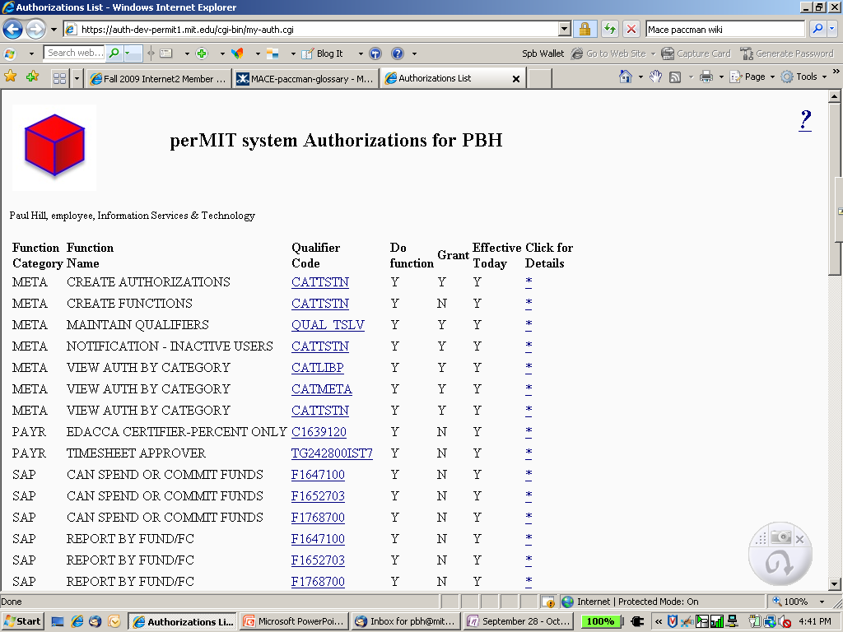

Slide 74
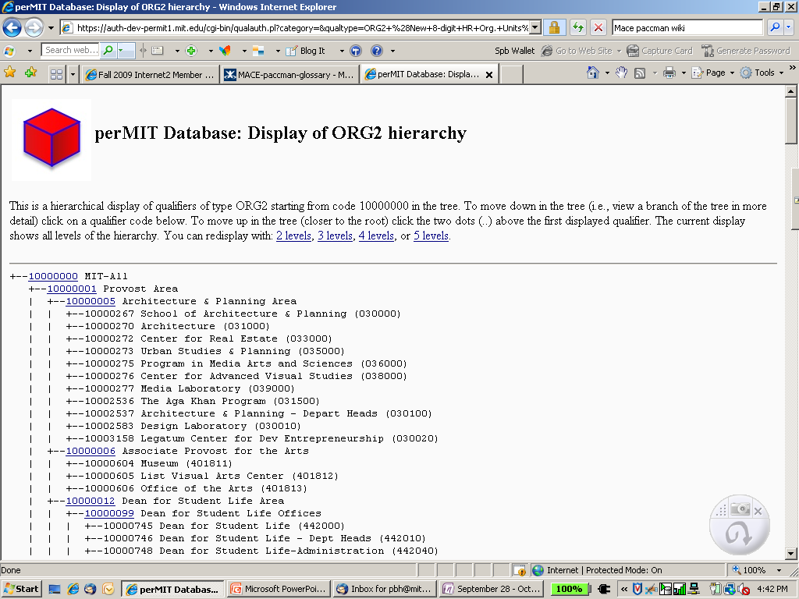

Slide 75
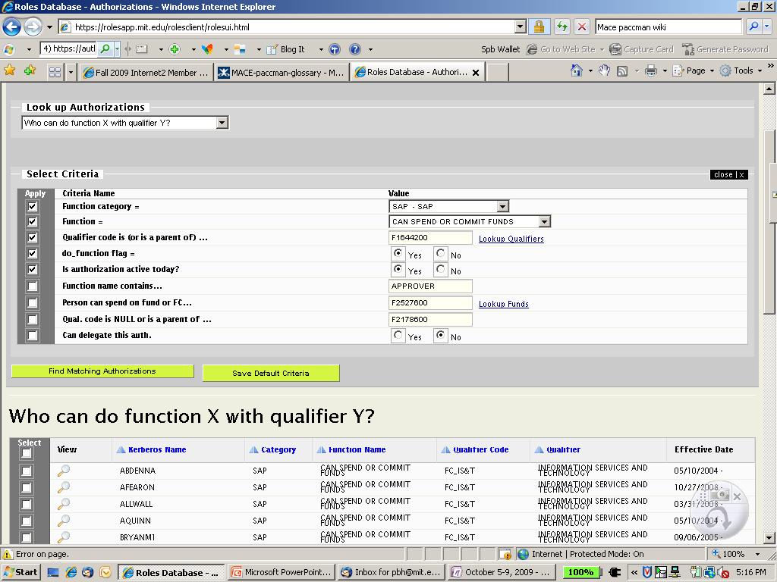

Slide 76
Authorization: attributes
SAML can also contain authorization data
E.g. is the person a student, staff, or affiliate
Could release group membership but this becomes a huge privacy concern
Could release application specific perMIT information with development effort

Slide 77
Authorization: local
Too many applications implement their own local authorization management
Security concern: too many dangling privileges when a person changes jobs
Lack of consistent auditing

Slide 78
More details about authorization
Can be found starting at slide 94

Slide 79
Data and Directory Services
How we expose aspects of identification, registration, authentication, and authorization information to applications and systems

Slide 80
Data and Directory Services
Data Warehouse
SAML assertions via IdPs: MIT and otherwise
(meta) Directories:
  (Moira)
  Hesiod
  LDAP
  Active Directory
    WIN.mit.edu
    Exchange.mit.edu
  NIST OID
  SAIS OID
  CSO
  DLC systems

Slide 81
Apples to Oranges
Types of MIT ID Cards
LDAP categories
  Student
  Employee
  Affiliate
  Spouse/Partner
  DLC Sponsored
  Retiree
  Other and special
  Alumni
Student
Staff
Affiliate
Moira classes
Staff
G
GuestYY
YYYY
Faculty
Notice neither card office nor LDAP have a category of “faculty”

Slide 82
Data Services: Open Issues
Desire better reporting to users, of the self-service data that we have about user (host and DHCP registrations, list memberships, authorizations, …)
One stop viewing and updates for the user
Useful to Accounts and Security teams
Need to scope project and make proposal

Slide 83
End

Slide 84
Provisioning Details
83

Slide 85
Provisioning: Systems of Record
MITID Database
  Entry points must first create an MIT ID Number
Moira
  Fed from Data Warehouse, but becomes the SoR for Kerberos Account Registration
Kerberos
  SoR for username and password
  Chosen username is fed back into Moira, which then feeds it back to the Data Warehouse (KRB_PERSON) table

Slide 86
Provisioning: Systems of Record and entry points
SAP/HR
  Employees (receiving benefits, not contractors)
Registrar/MITSIS
  Students
Moira
  Affiliates (including contractors)
Card Services
  Affiliates, spouses and partners, DLC sponsored, …

Slide 87
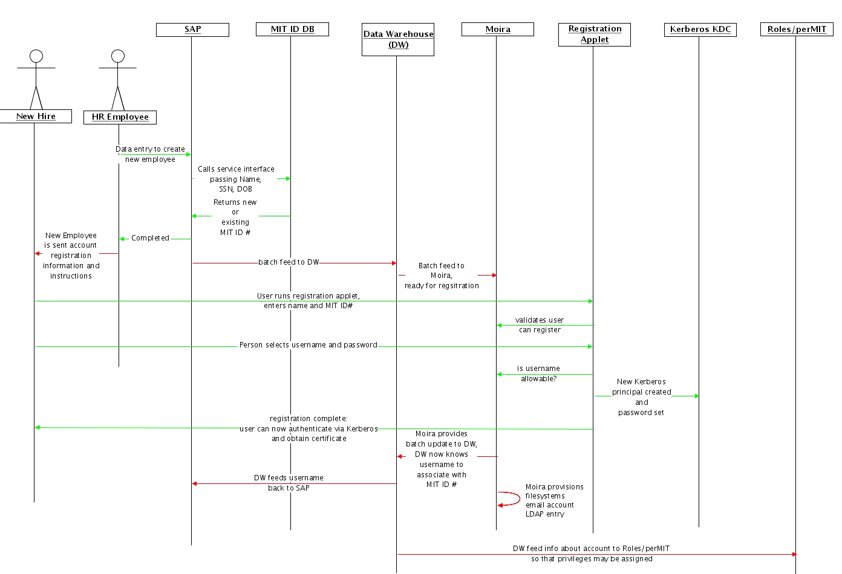
Provisioning: example, employee

Slide 88
Provisioning: Special Accounts
Any employee (provisioned by HR) may sponsor an account for someone that doesn’t come through the normal processes
  Contractors, temporary employees, voucher employees, visiting scholars, visiting faculty, VIPs, friends of the institute, collaborators, …
  It is important that systems be designed so that successful authentication != authorization

Slide 89
Provisioning: lifetime
MIT ID Numbers by design are never recycled
Ideally a person should only need one MIT ID number during their lifetime ⁽²⁾
Kerberos principal names were originally intended to be recycled, and were for many years.
At this time Kerberos principal names are not recycled. ⁽³⁾

Slide 90
Provisioning: non-Kerberos accounts
When dealing with systems that support federated authentication, or distributed authentication, there is a registration aspect of provisioning which is bound to the authorization process.
External users that are actively using MIT applications should appear in our central authorization management systems. ⁽⁴⁾

Slide 91
Provisioning: Collaboration Accounts
All (self registered) Collaboration Accounts are propagated into Moira and LDAP and MAY appear on Moira and LDAP lists and groups.
At this time, Collaboration Accounts, cannot be represented in Roles/perMIT authorizations. This will change as perMIT reaches production status.

Slide 92
Provisioning: Accounts from federation partners
Accounts from federation partners do not automatically appear in Moira or LDAP. ⁽⁴⁾
This presents some usability issues for some applications.

Slide 93
Authorization
94
Further details

Slide 94
Authorization: perMIT’s model
Each function is associated with a particular type of qualifier
The function “Initiate a Termination Request”
  Can have a qualifier of ORG Unit (e.g. Department of Athletics, Community Programs)
  Cannot have a qualifier of Payroll Deduction Type (e.g. Day Care Deductions)

Slide 95
Authorization: perMIT’s model
Functions have an attribute which determine to which category they may be applied
Example of Functions within category “Telephony and Network”
  Administer phone preferences by network ID
  Can administer telephones authorized by phone no.
  Network Administration
  Telephone administration
The functions above fall within category “Telephony”, not “Student Financial Systems”. Thus, users or applications that are limited to granting or viewing ASPECs within the “Student Financial Systems” category would not have access to the above functions.

Slide 96
Authorization: perMIT’s model
More than one qualifier type can exist within a category
Functions within category “Telephony and Network”
  Administer phone preferences by network ID
    Applicable qualifier type = Network IDs
  Can administer telephones authorized by phone no.
    Applicable qualifier type = MIT Phone numbers
  Network Administration
    Applicable qualifier type = COST OBJECT
  Telephone administration
    Applicable qualifier type = COST OBJECT

Slide 97
Authorization: perMIT’s model
Rules / Implied privileges
Added after over a decade of deployment
Institutional Data from a variety of systems of record
+
Simple set of rules
=
ASPECs for a large number of users
Access to library resources
Door access controls

Slide 98
Authorization: perMIT’s model
Master department hierarchy
  Is conceptually independent of perMIT
  Is bundled with perMIT
  Is used by perMIT, and other systems
used for is creating a master hierarchy whose objects can then be linked to the department-like objects in the various stovepipe hierarchies
  Lets you relate or link one vertical view with another
    HR org, Academic units, profit centers, spending groups, …

