Slide 1

Content and Collaboration Services
ISDA ALL-Hands, September 24th, 2009

Slide 2
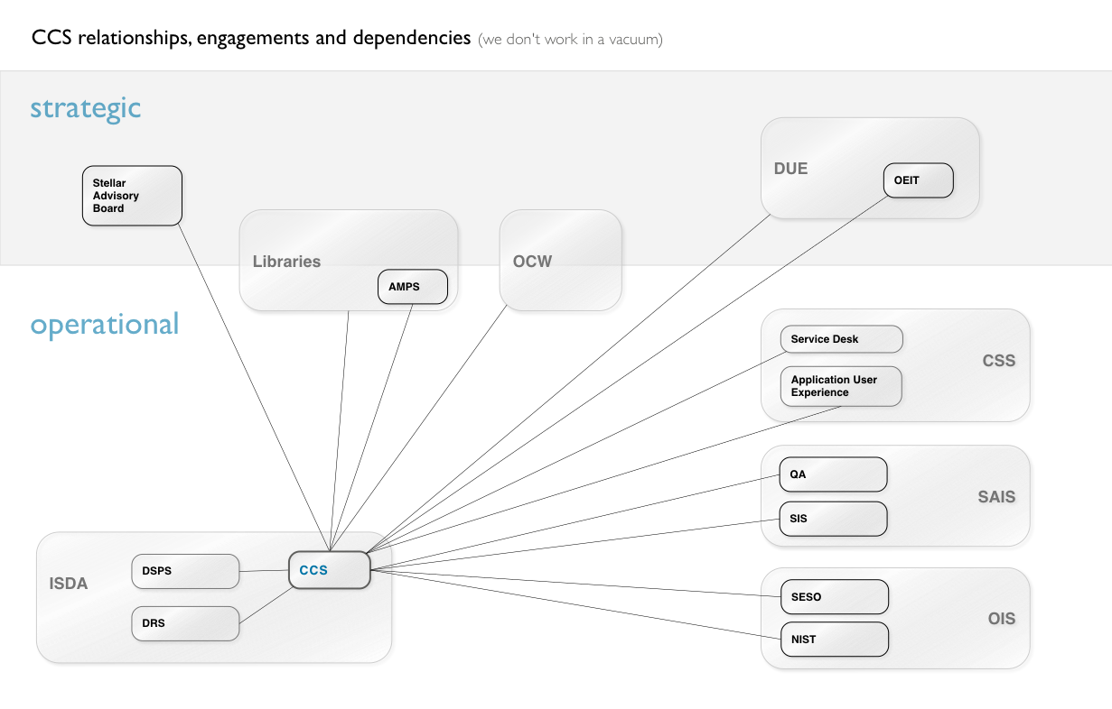
Notes:
Strategic:
Stellar Advisory Board
drawn from wide MIT community
Academic Department representation includes Math, Physics, and ....?
Departmental and Administrative representation includes Sloan, Libraries, Registrar, DUE and OEIT
Student interests are represented by presence of Graduate and Undergraduate Student Council Presidents
DUE and OEIT partner with us as LMS advisors and as liaisons to the Faculty
Our relationship with the Libraries includes a Stellar service dependency on the AMPS video services for SMA sites, eReserves data for Stellar and OTI collaboration along with involvement in the DOS project and participation in the Stellar Advisory Board
OCW is a long-standing partner WRT content from Stellar courses as well as the DOS project
Operational:
Service Desk
RT, support for Stellar & Wikis
Application User Experience – newly-formed
usability, accessibility, training
we have our Support Braintrust meeting with these two entities
QA – mostly testing enablement for PE usage of the Gradebook, which is very specific
SIS – online grade submission project, weekly knowledge-sharing with UI team, HASS project updates to the Stellar Course Guide
SESO – server ops, hardware support for LMS and wikis, first responders
NIST – LDAP
DSPS
- Touchstone
- AMIT application management for wikis
- DRS – Data Warehouse, MITBI project, Roles UI

Slide 3
CCS Roadmap: FY 2009
Stellar 2.2 release
Stellar 2.2.1 release
Thalia community release
Stellar Dev Docs, user guide
Stellar NG proofs-of-concept
Mobile features & interface
Wikis 2nd tier support rollout
DOS CMS selection/scalability
Notes:
Stellar 2.2.1
CAMS sign-on
Gradebook adopted by Course 8 and 18
Thalia (out of pilot)
NG – candidate recommendation; presentation to ACCORD, ISDA and SAB
Mobile 1.0 and 2.0 released over Q4

Slide 4
CCS Roadmap: FY 2010 1
Wikis 3 upgrade & support rollout
Stellar & Wikis full Touchstone sign-on
DOS faculty portal wireframes
MITBI RAFT UX design & development
Native iPhone app for Mobile
Stellar NG decision
Gradebook out of pilot
Stellar automation
Wikis upgrades/plugins
MITAA site relaunch
Q2-3 2010
Q1 2010
Notes:
SAB - Stellar Advisory Board
Wikis 3.0.1 upgrade then 3.1 if warranted.

Slide 5

CCS Roadmap: FY 2010 2
Q3 2010

Slide 6
CCS Work
Services
Projects
Stellar
Stellar NG
MIT Wikis
Thalia
MITBI RAFT
MITAA Website
DOS
MIT Mobile

Slide 7
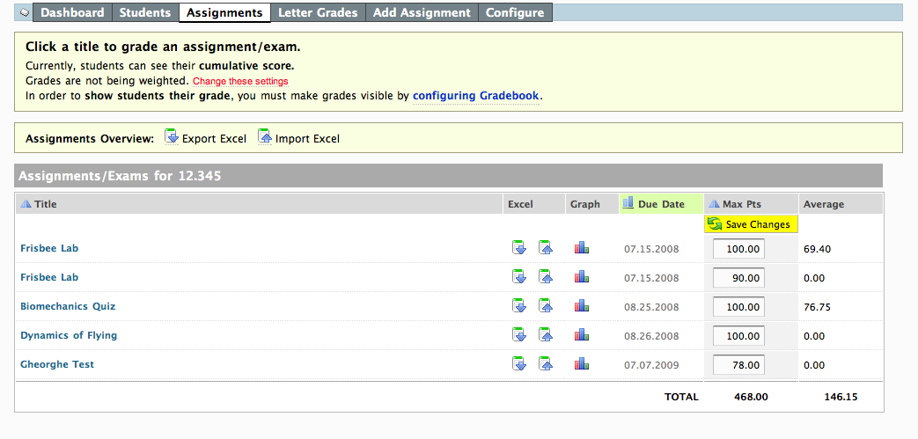
Stellar Gradebook
One of the most feature-rich gradebooks available
Well-integrated with MIT infrastructure
Export/import features allow interoperability with Registrar and WTW
Notes:
Loosely based on Sakai 2 gradebook, but greatly improved. Additional features, graphing, role-based configuration.
MITSIS, PE reg. On horizon: Online grading.
Export/import features: MIT IDS and section data now included in export spreadsheet. Match students directly to IDS and to sections.

Slide 8
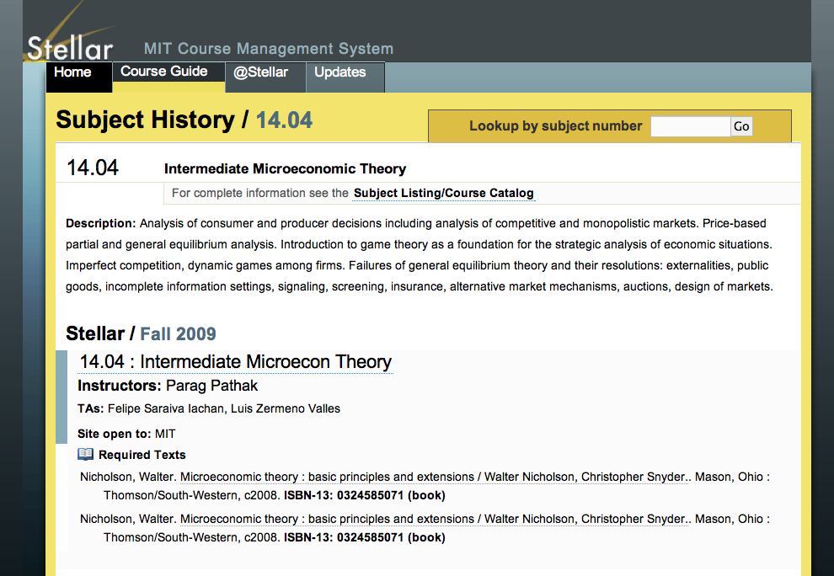
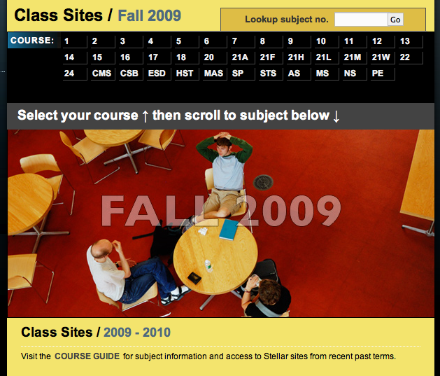
Stellar Course Guide
Online Textbook Information (OTI) availability expanded
HASS requirement information coming up
Integration with new OCW CMS
Notes:
Information regarding humanities requirements to be added to courseguide

Slide 9
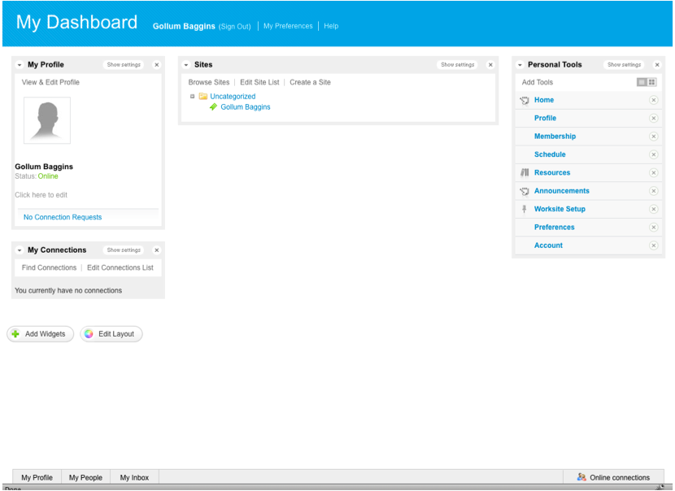
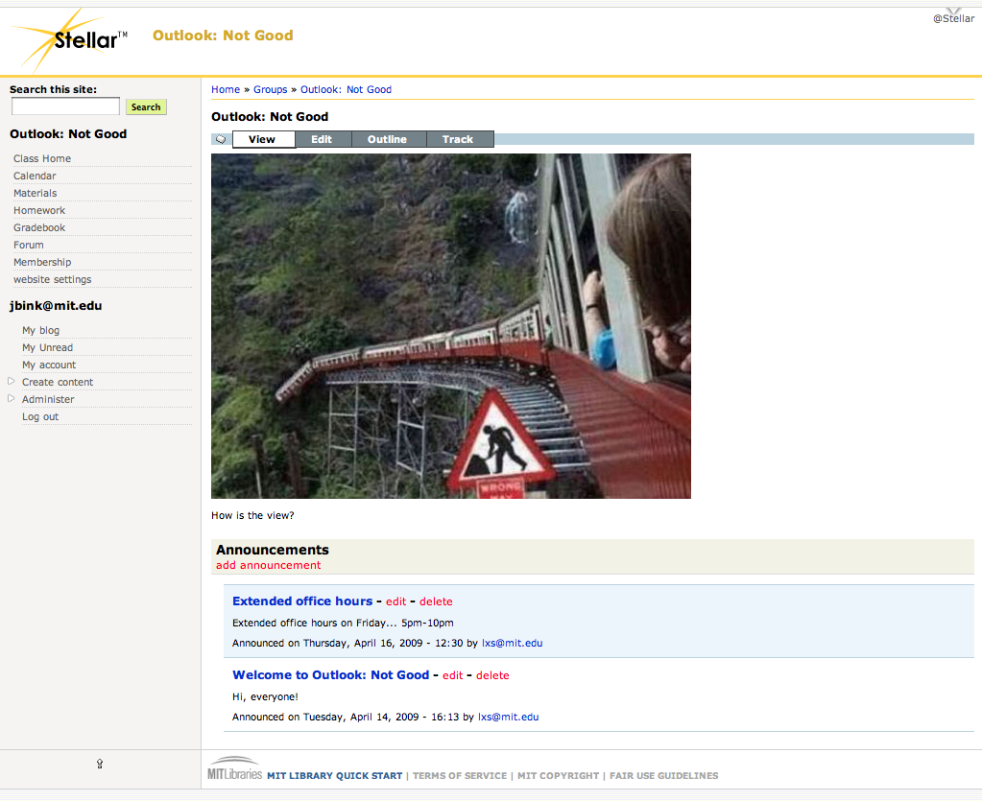
Stellar Next Generation
Done * Candidates, use cases, proofs of concept, recommendation
In progress * Socialization, stakeholder decision
Coming up * Prototypes, user adoption testing
Notes:
At left – Sakai 3 Dashboard portal page
At right – Drupal 6 proof of concept for Stellar test site

Slide 10
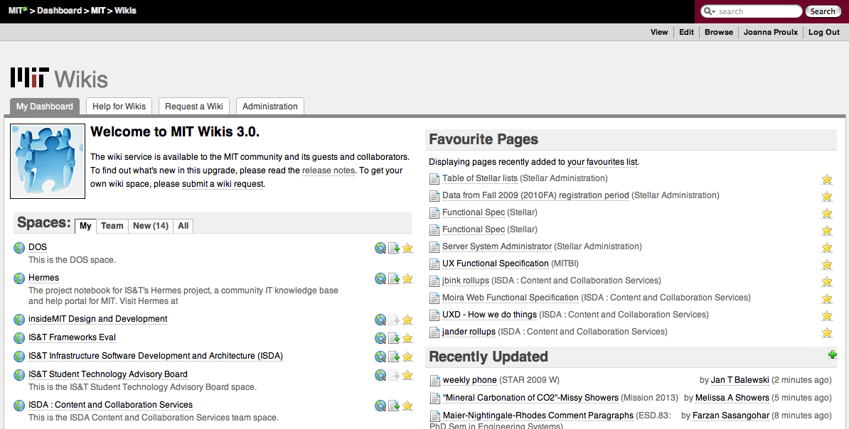
MIT Wikis
Done * 3.0 upgrade, new support plan, user documentation
In progress * FAQ, user testing, plugin rollout
Coming up * 3.0.1, service enhancements, 3.1 roadmap
Notes:
Documentation, support and theme design
Online documentation and video help
Second tier support
MIT theme
Outreach and usability testing for Confluence 3.0
Issues with attachments

Slide 11
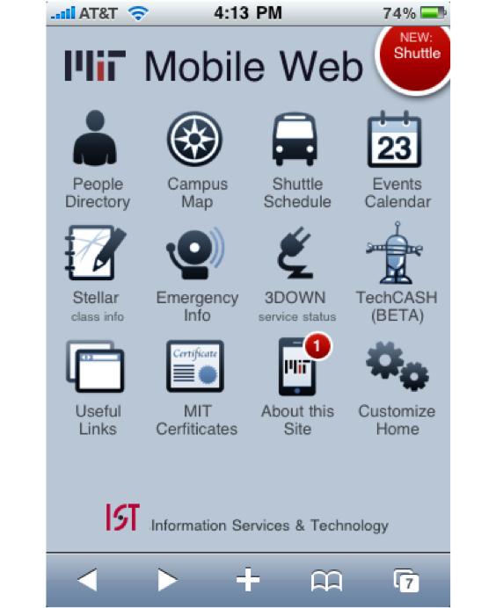
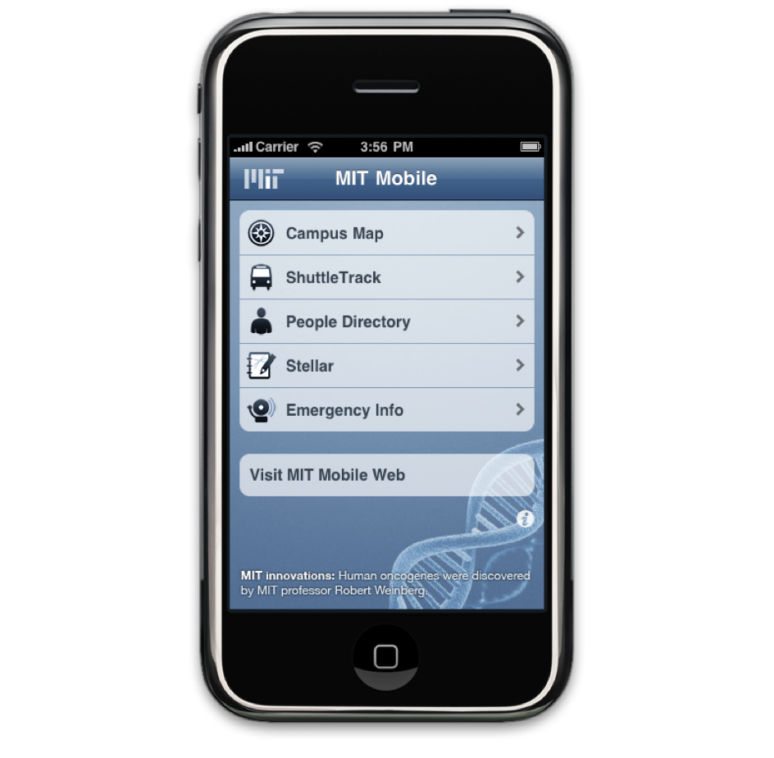
MIT Mobile
m.mit.edu
iPhone app
Notes:
Overview: User Interface and Design work on MIT Mobile website
Numerous functionality and interface enhancements
New module added (TechCash)
Existing modules have been enhanced (Campus Map, Shuttle Track)
Homepage is now customizable
Native iPhone application in-progress: free download and access an enhanced set of MIT services.

Slide 12
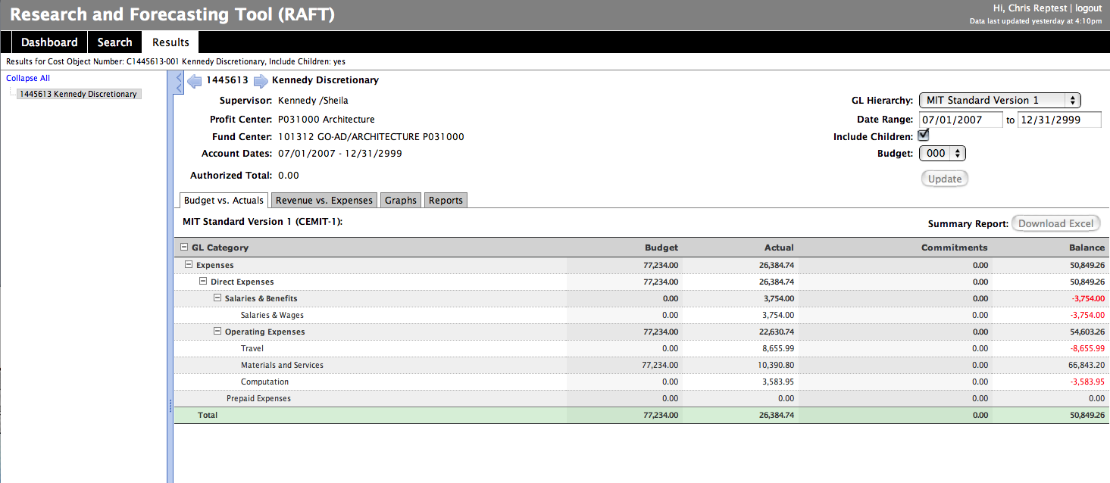
MITBI RAFT
Done * UX workflow design & implementation, usability, QA
In progress * Documentation, user testing, sprint 1 development
Coming up * Graphing features
Notes:
Building of the Reporting And Forecasting Tool (RAFT)
Provides financial officers a snapshot of their accounts.
Tracks funding and spending
Decreases likelihood for under spending
User-friendly web interface

Slide 13
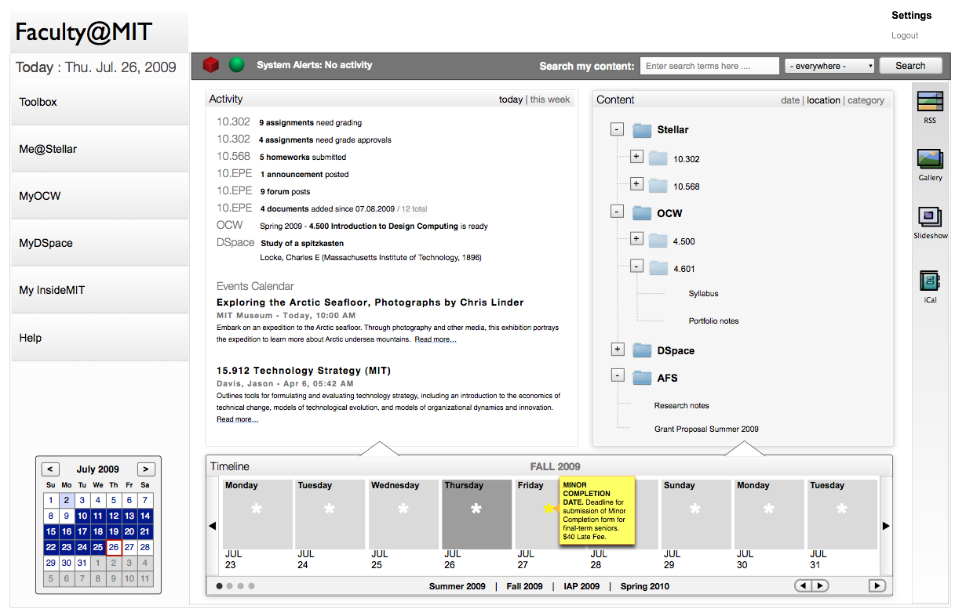
DOS
Done * Meta-portal wireframes, CMS selection
In progress * Student meta-portal
Coming up * Stellar integration, documentation
Notes:
Overview: Evaluation of CMS solutions for OCW; wireframes for DOS Meta-portal
Research and evaluation of Drupal and Plone content management systems
Meta-portal design aimed to facilitate accessing of content, files and information, regardless of the systems of storage
Done * for Drupal 6 & Plone 3
In progress * Iteration 3 of Faculty meta-portal, Student meta-portal?
Coming up * APIs, Prototype Wireframes; Usability Testing, Documentation, Training
Allows faculty to interact with their content across MIT and across time

Slide 14
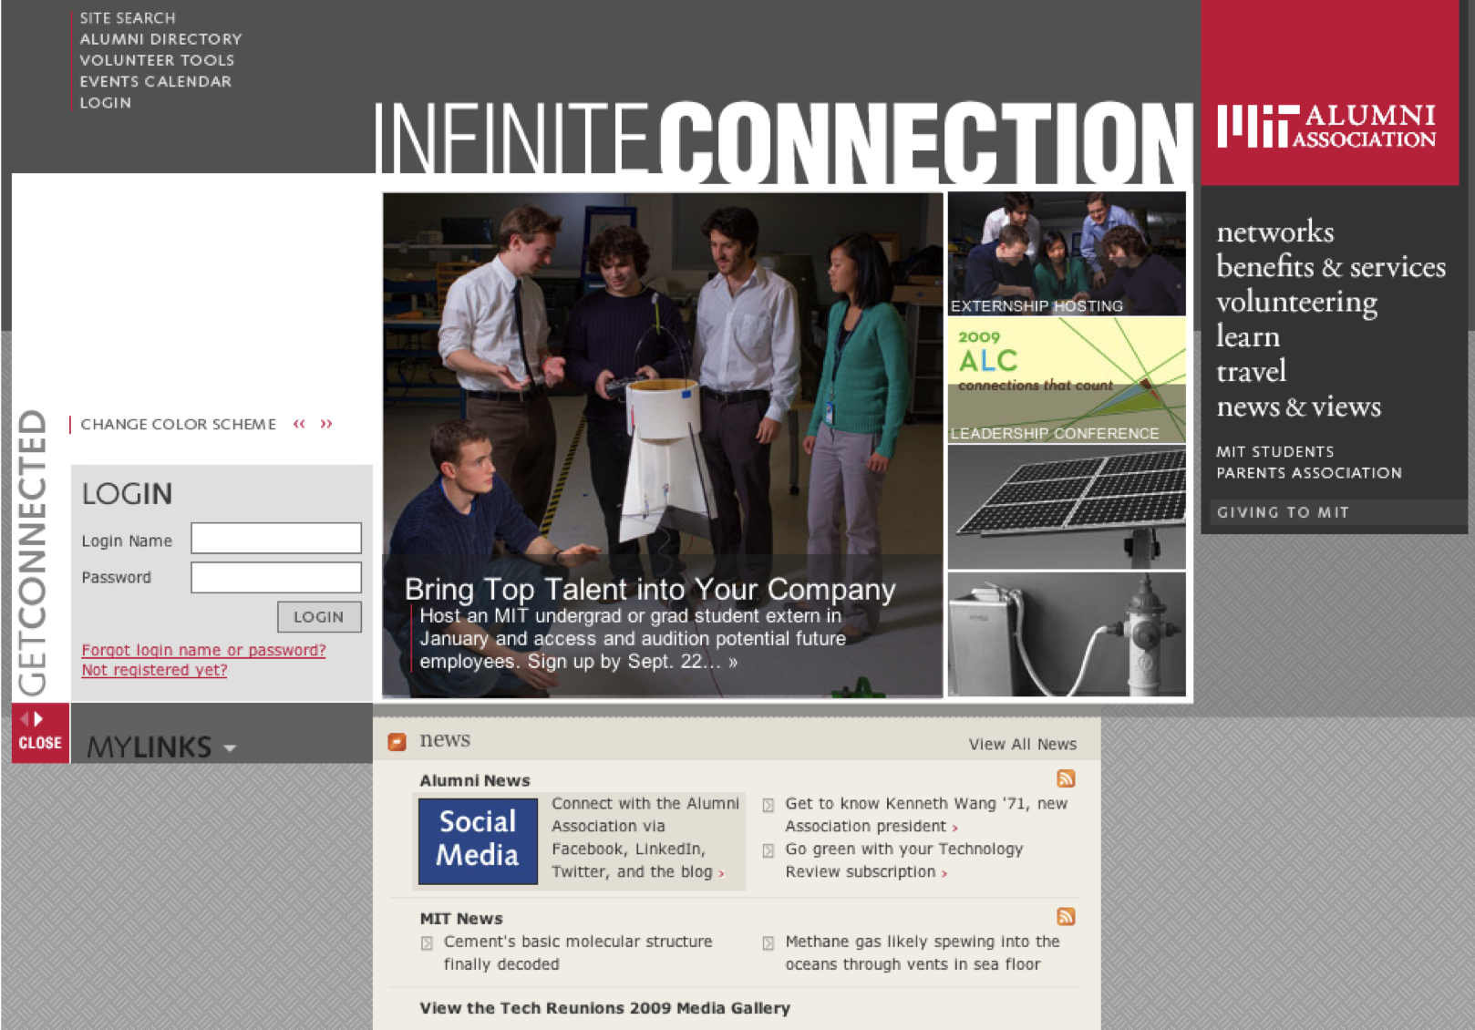
MITAA
Migration of MITAA from proprietary CMS to Drupal
Full site relaunch in Q3 2010
Savings of $100K in annual licensing fees
Notes:
Feature-rich web tools encourage alumni engagement
Content editing features cooperate with existing publishing process (i.e., removes editorial speed bumps)
Savings of $100K in annual licensing fees
Overview: Migration of MIT Alumni Association website from a proprietary CMS to Drupal

Slide 15
CCS People
Derek Jaeger
Architecture, Integration & Development
  (Ajay Bhandari)
  Joe Calzaretta
  Robin Colodzin
  Qing Dong
  Janet Riley-Bowker
Interface Development & User Experience
  (Joanna Proulx)
  Justin Anderson
  Alexis Ellwood
  Laura Watts
Outreach & Support
  (Jeanne Chiang)
  Carlyn Jorgensen
  Devin Stronge

Slide 16
Thank you
isda-ccs@mit.edu

