Slide 1
2.98 Team 49ers
2980-49ers@mit.edu

Slide 2
Team Intros.

Slide 3
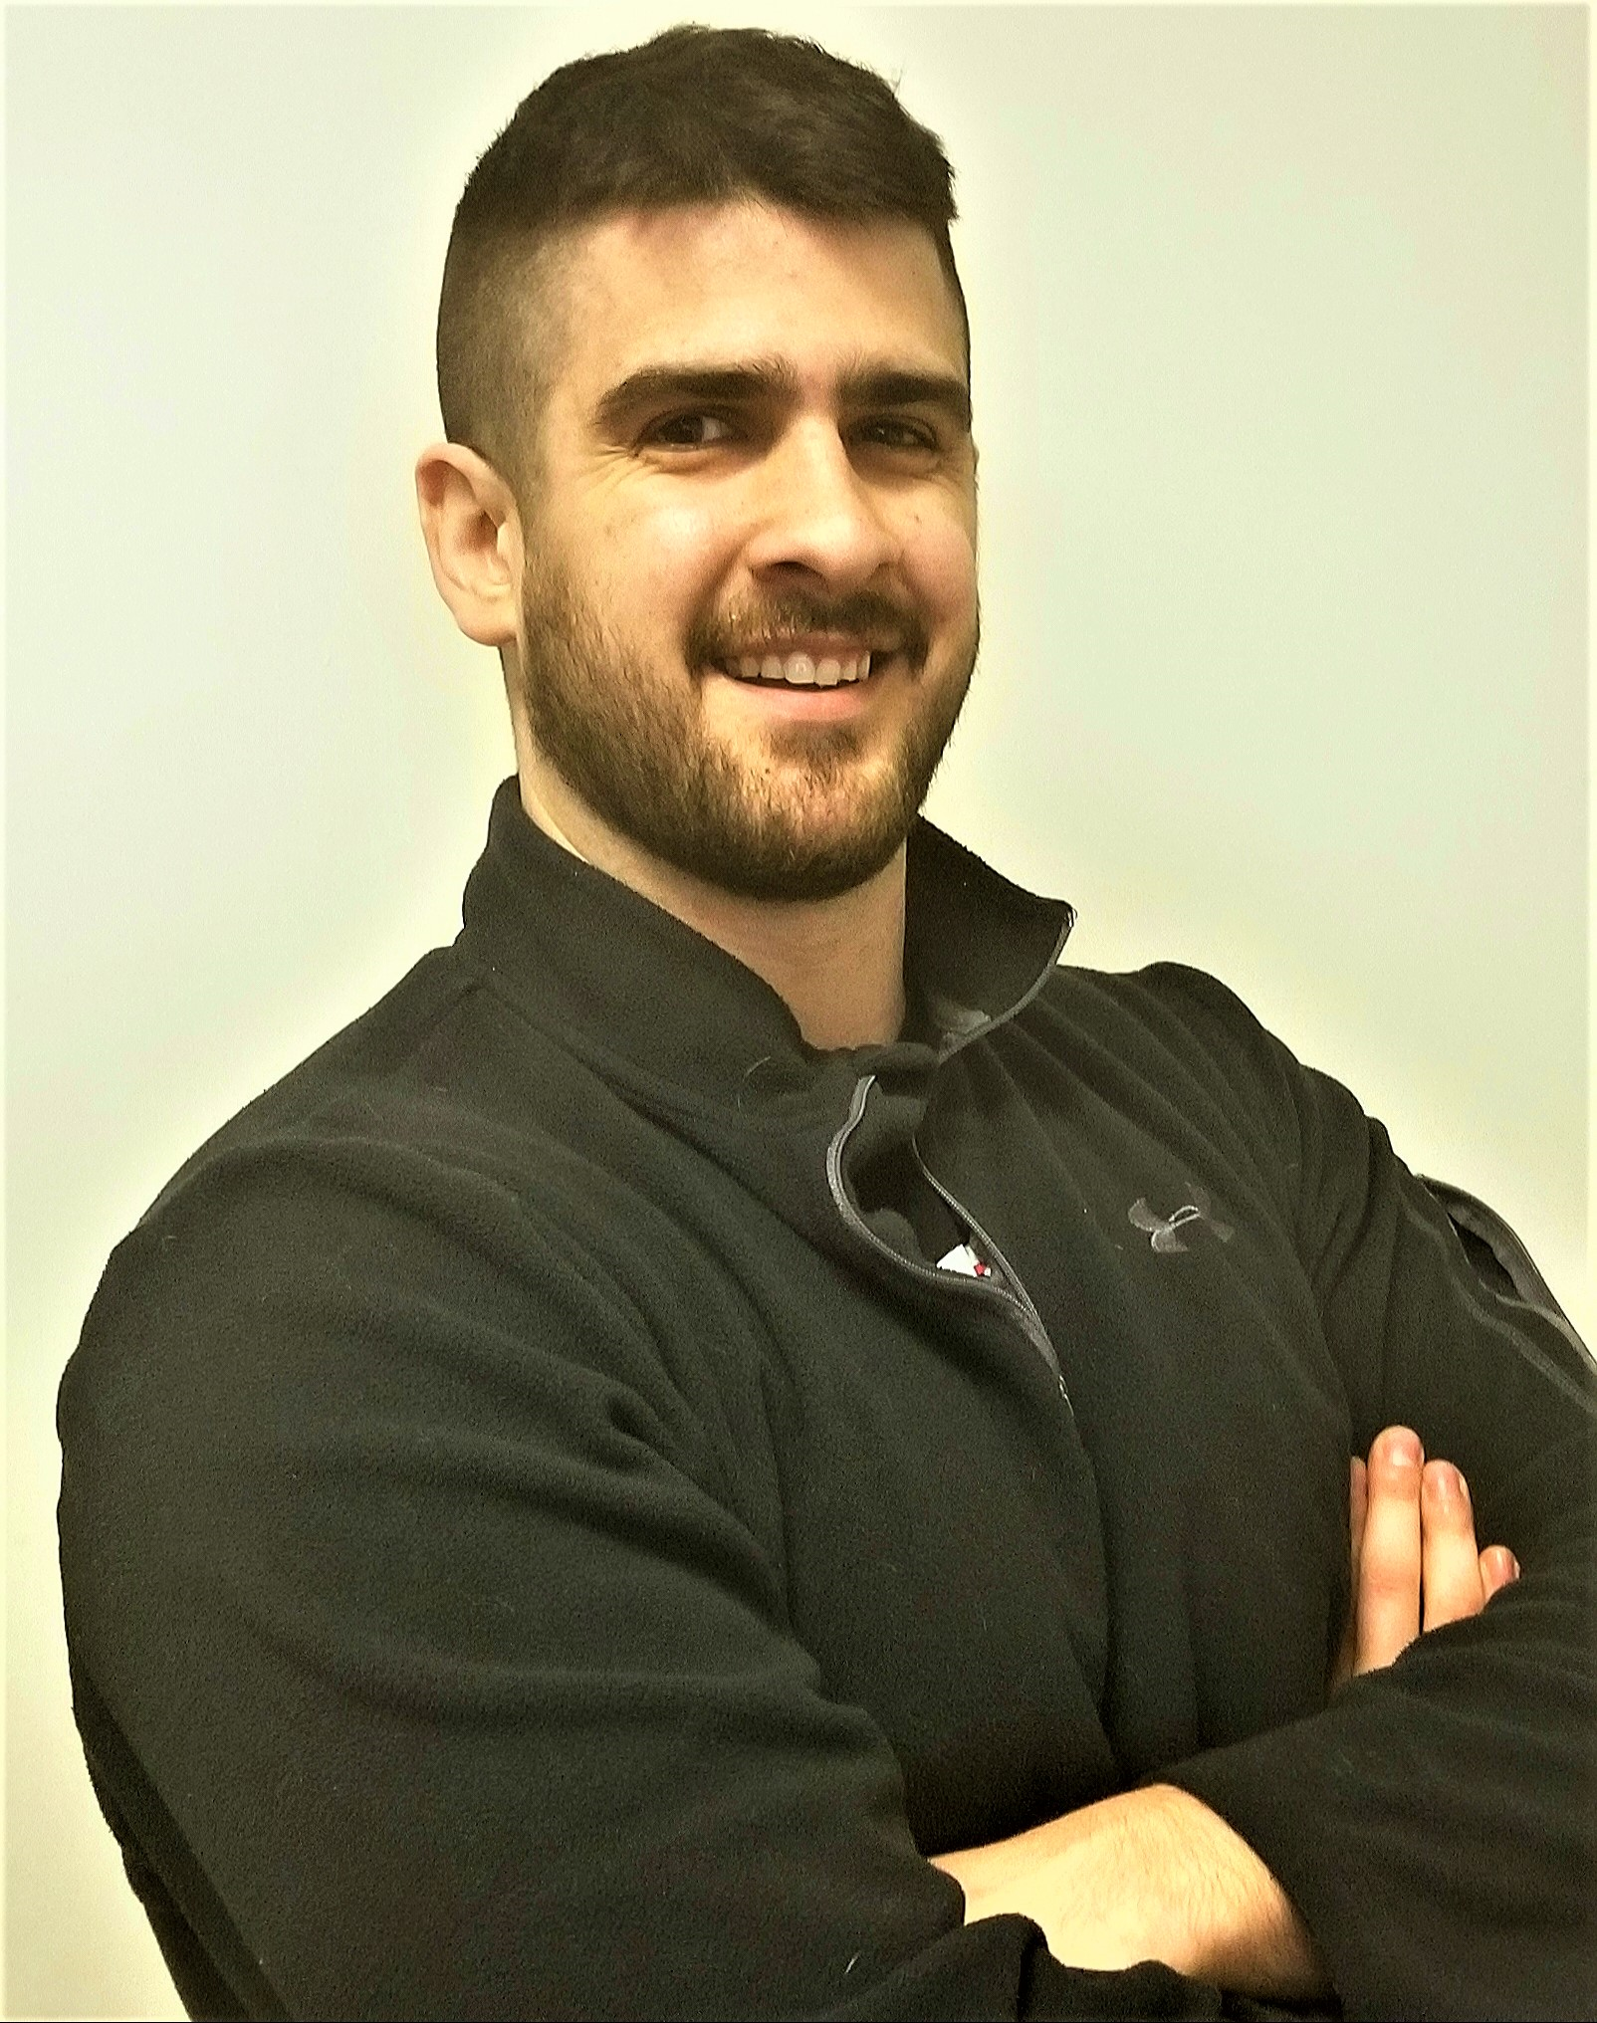
Tom Abitante
Hometown: Berkeley Heights, NJ, USA
Education:
  BS Astronautical Engineering, US Naval Academy ‘12
  PhD Student (3rd Year), Harvard-MIT Health Sciences & Technology
Previous Work Experience:
  2012-17: US Marine Corps
  2016-17: HIIT, CrossFit Trainer
Skills: Musculoskeletal, Spaceflight, and Exercise Physiology; Experimental Design.
Sports Interests: Powerlifting, CrossFit. NFL (Giants), and NHL (Devils)
abitante@mit.edu

Slide 4
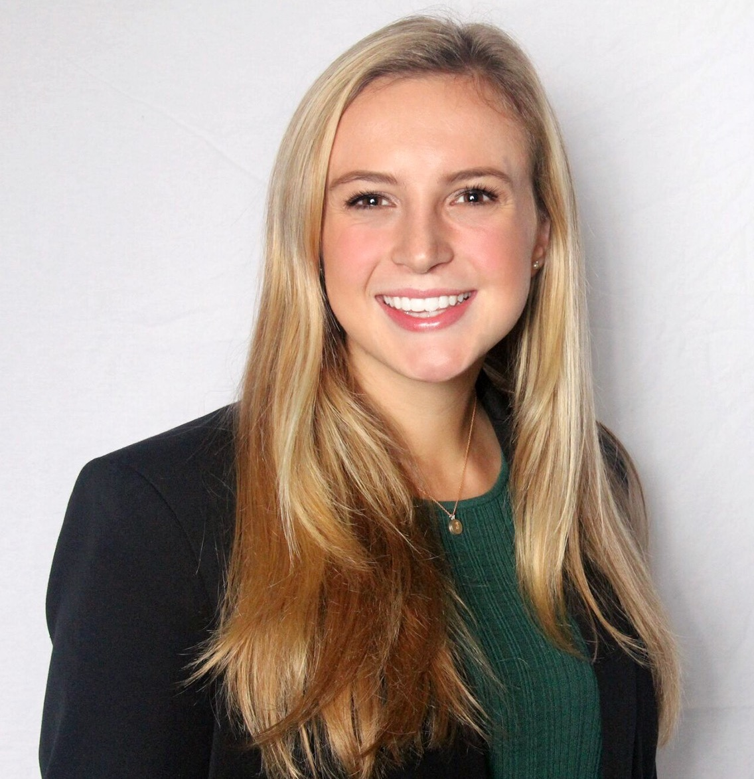
Amanda Garofalo
Hometown: Fairfield, NJ, USA
Education: BS Mechanical Engineering & Minor Computer Science MIT ‘21
Previous Work Experience:
  2019 (3 mo) Facebook Product Design Intern
  2018 (3 mo) Ultimate Software Software Development Intern
  2018 (6 mo) MIT Tata Center Undergraduate Researcher
Skills: Mechanical design & testing, CAD, fabrication/prototyping, experimental design, python, electronics
Sports Interests: Field Hockey (MIT Varsity), basketball, softball
agarofal@mit.edu

Slide 5
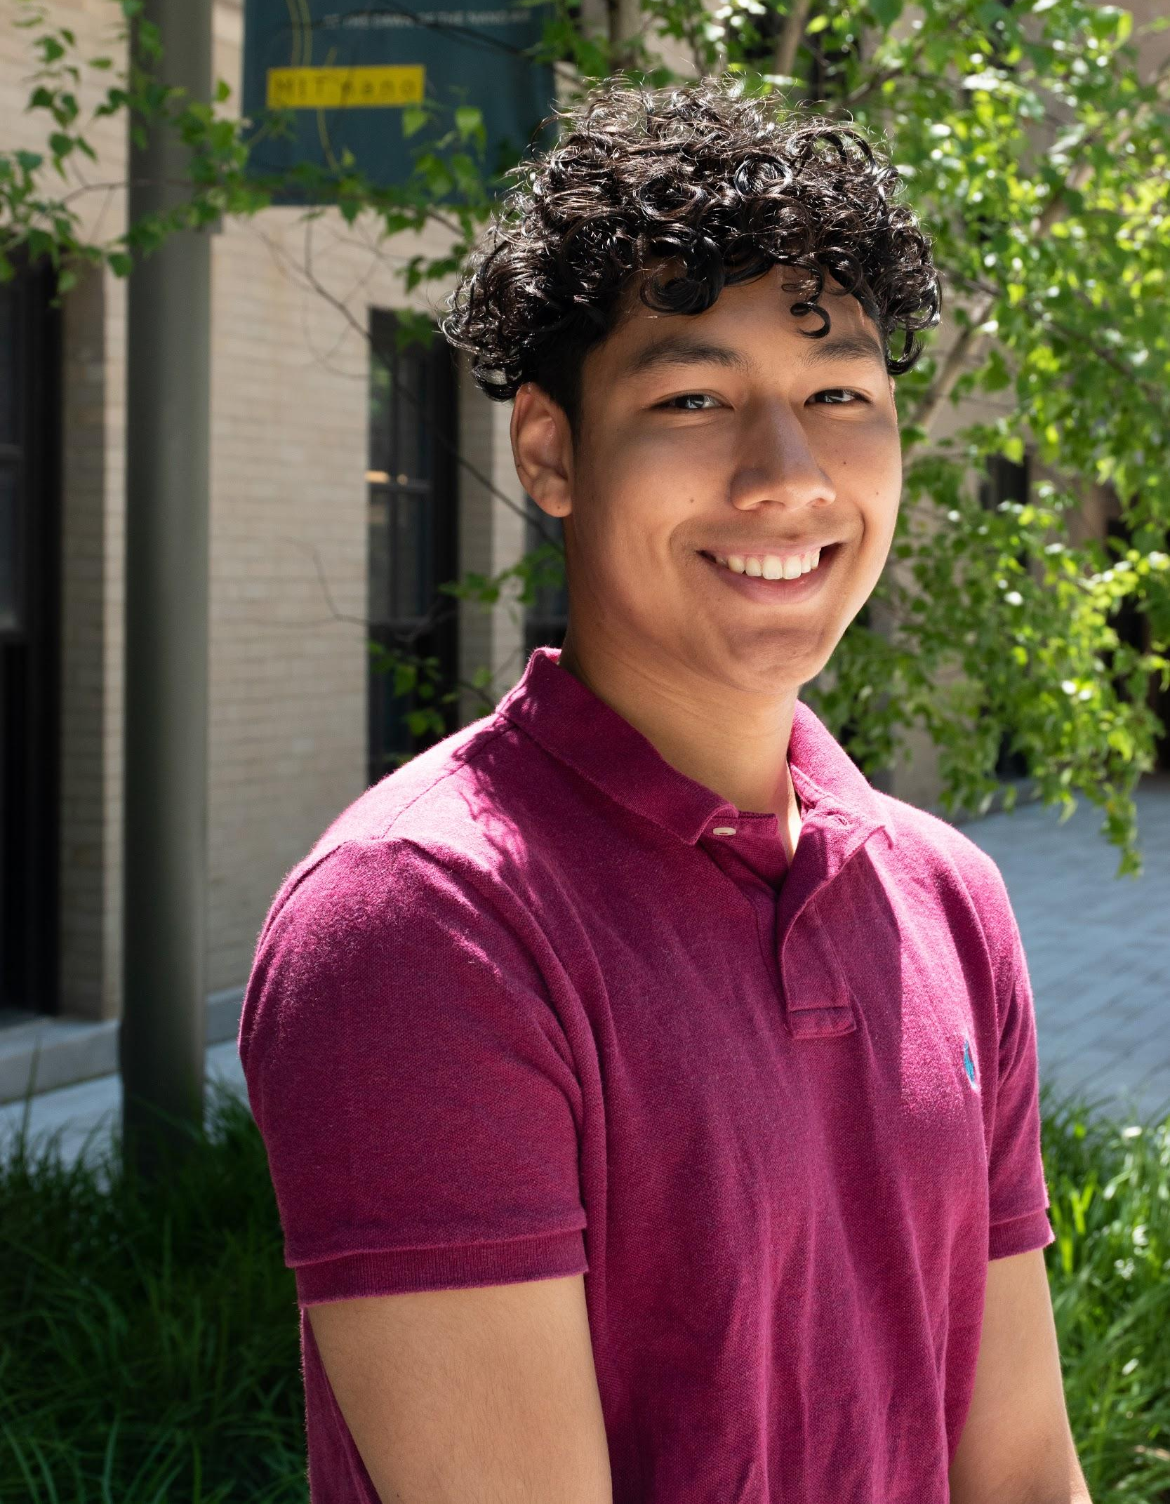
Brendt Stephens
Hometown: Troy, MI, USA
Education: BS Mechanical Engineering MIT ‘22
Previous Work Experience:
  Research in the MIT Rohsenow Kendall Heat Transfer Lab with the NanoEngineering Group
Skills: Mechanical design & rapid prototyping, CAD, MATLAB, Python, Sustainability Analysis, Manufacturing, Spanish
Sports Interests: Basketball (Varsity High School and Collegiate), Track and Field (4x400 and Long Jump)
bdsteph@mit.edu

Slide 6

Lisa Yan
Hometown: Seattle, WA, USA
Education: BS Mechanical Engineering and Business Management MIT 22’
Previous Work Experience:
  2020 (1 mo) MoneyLion Inc. Product Management Intern
  2019 (3 mo) TinyBop Inc. Product Design Intern
  2019 (6 mo) MIT Media Lab Undergraduate Researcher
Skills: Mechanical Design, Adobe Creative Suite, Graphic Design, Project Management, Strategy and Communications, Chinese
Sports Interest: boxing, cycling (spin), weightlifting, personal training, health and wellness
lisayan@mit.edu

Slide 7
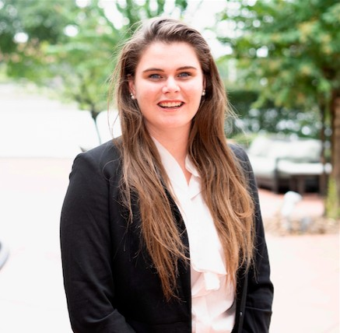

Rachel O’Grady
Hometown: Sarasota, Fl, USA
Education: BS Mechanical Engineering & Minor Management MIT ‘20
Previous Work Experience:
  2019 (3 mo) Schlumberger drilling and measurements field engineering intern
  2018 (3 mo) African Leadership University engineering intern and robotics program coordinator
  2017 (3 mo) MIT Sea grant undergraduate researcher
Skills: Mechanical design & testing, CAD, fabrication/prototyping, manufacturing, data analysis
Sports Interests: Swimming, hiking, water polo, SCUBA diving, cycling, whitewater kayaking
rachelo@mit.edu

Slide 8
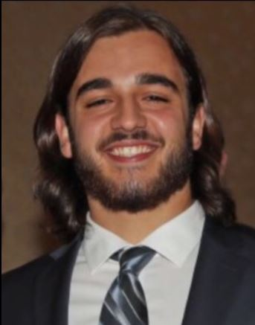
Samuel Gozelski
Hometown: East Northport, NY, USA
Education: BS Mechanical Engineering concentrated in Biomechanical Product Design ‘22
Previous Work Experience:
  2019 (3 mo) Ferrantello Group data collection and topographical mapping intern
  2019 (4 mo) MIT Mechatronics Lab Undergraduate Researcher
  2017-2018 (9 mo) Viscoelastic Properties Research
Skills: Mechanical Design & Testing, CAD, Prototyping & Fabrication, Materials
Sports Interests: Defensive Lineman for MIT’s Football Team, Strength and Conditioning, Health and Wellness
gozelski@mit.edu

Slide 9
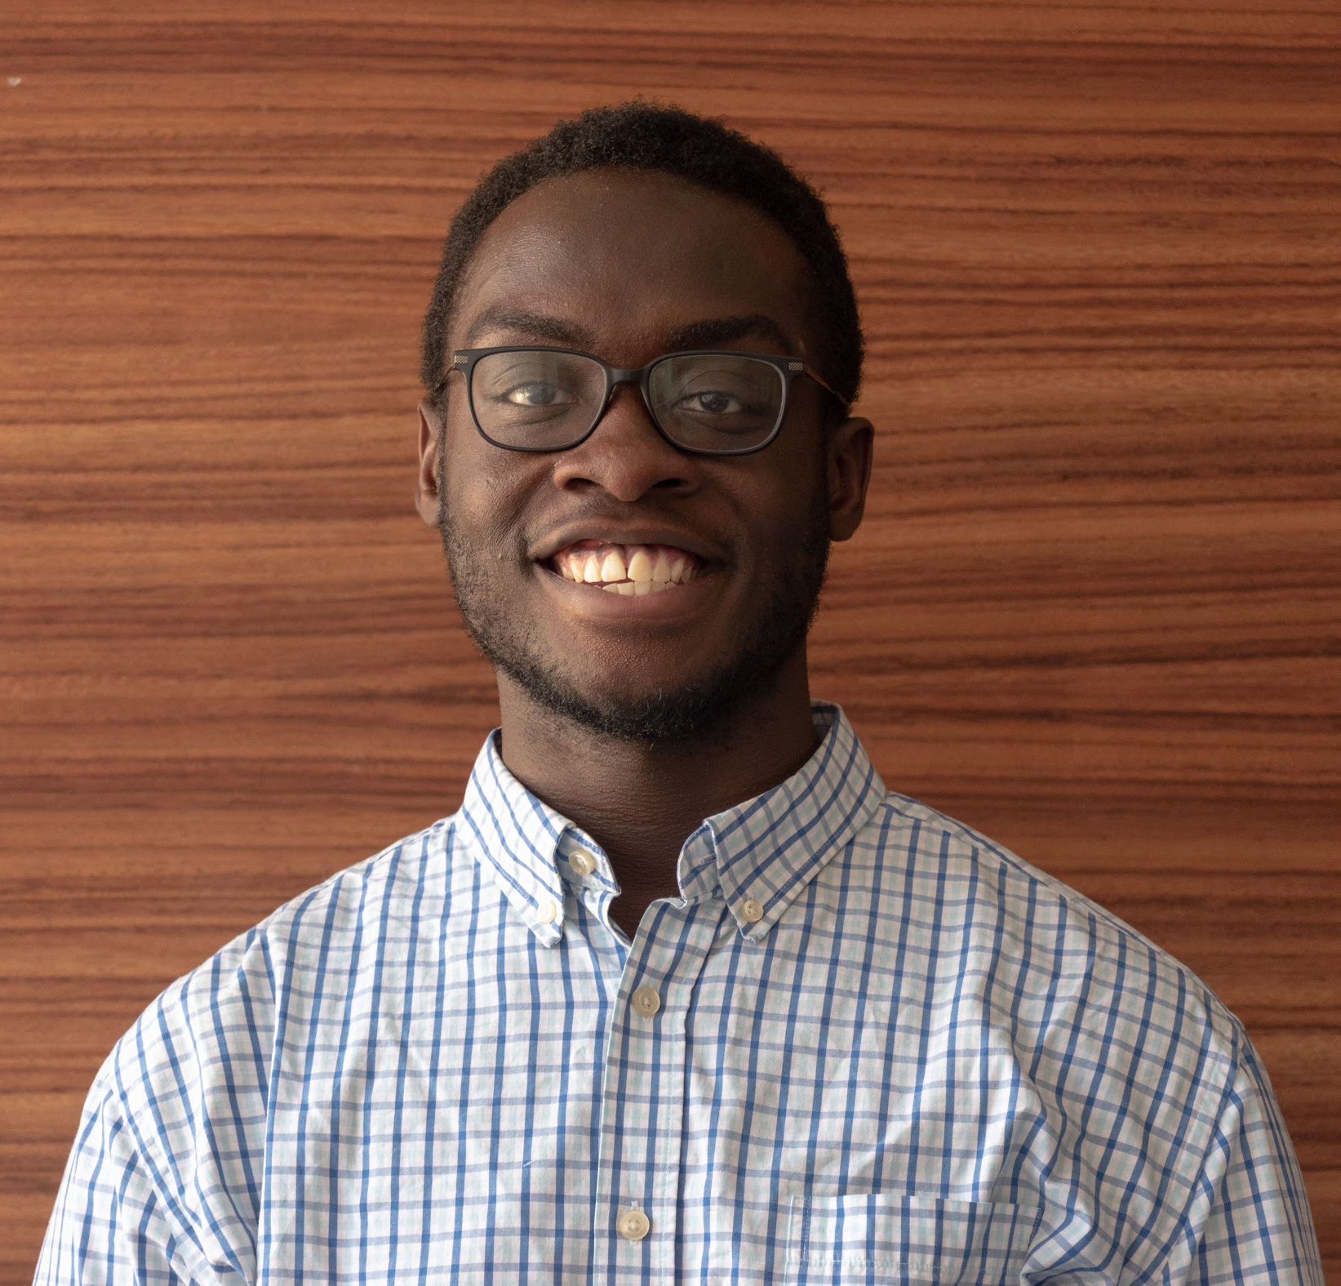
Jonathan Sampson
Hometown: Houston, TX, USA
Education: BS Mechanical Engineering, Minor Energy Studies MIT ‘20
Previous Work Experience:
  2019 (1 yr) MIT Sloan Automotive Lab: Undergrad Research Associate
  2018 (4 mo) NextEra Energy: Power Generation Division Intern
  2018 (6 mo) MIT Lab Energy Assessment Center: Undergrad Researcher
Skills: Mechanical Design, Physical Analysis, Rapid Prototyping, Product Integration, Data Analysis
Sports Interests: Ice hockey (MIT Men’s Club Team), football, soccer, basketball
sampsonj@mit.edu

Slide 10
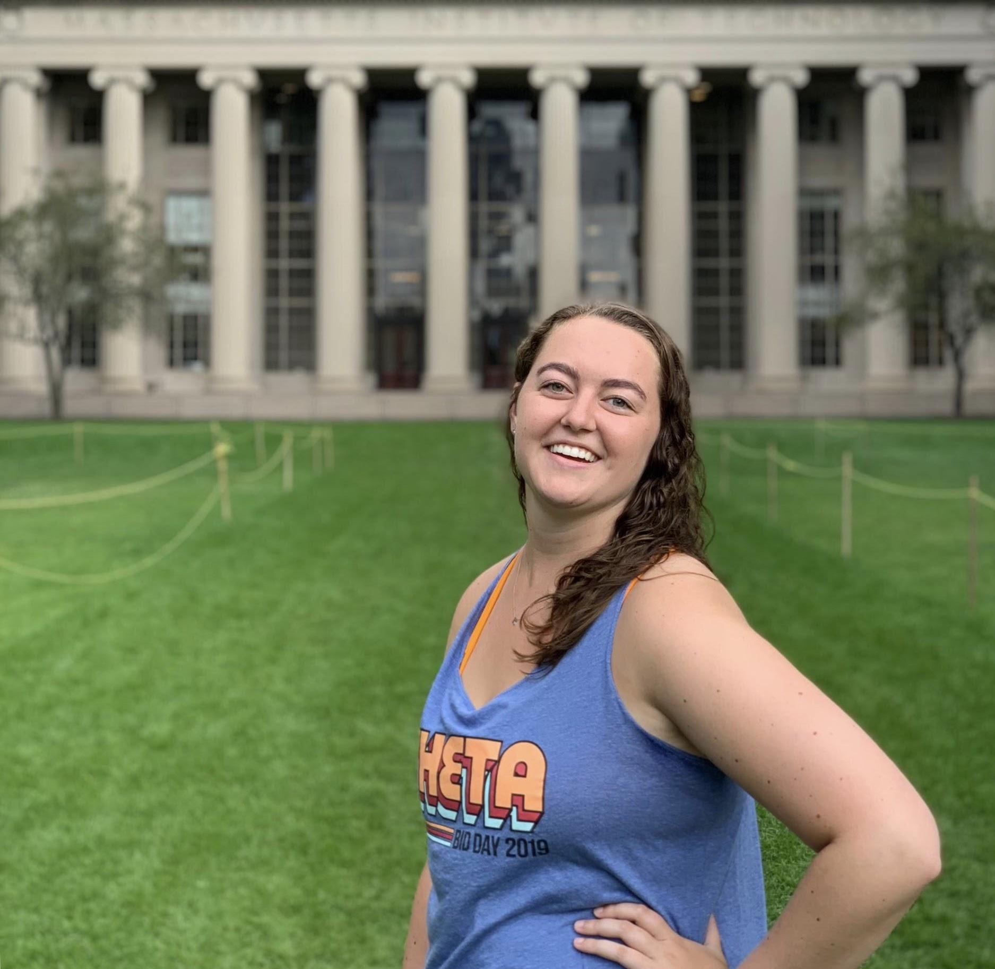
Riley Ennis
Hometown: Riverside, CT, USA
Education: BS Mechanical Engineering MIT ‘20
Previous Work Experience:
  2019 (3 mo) Transenterix Mechanical Engineering Intern: Developed software and hardware for the Senhance Robotic Surgical System
  2018 (3 mo) Morphic Therapeutic: Purified and crystallized protein as a member of the structural biology team
  2017 (9 mo) MIT Center for Gynepathology Research Undergraduate Researcher
Skills: Mechanical design & testing, CAD, fabrication/prototyping, manufacturing, rapid prototyping
Sports Interests: Swimming (MIT Varsity 2016-17)
rileyjo@mit.edu

Slide 11
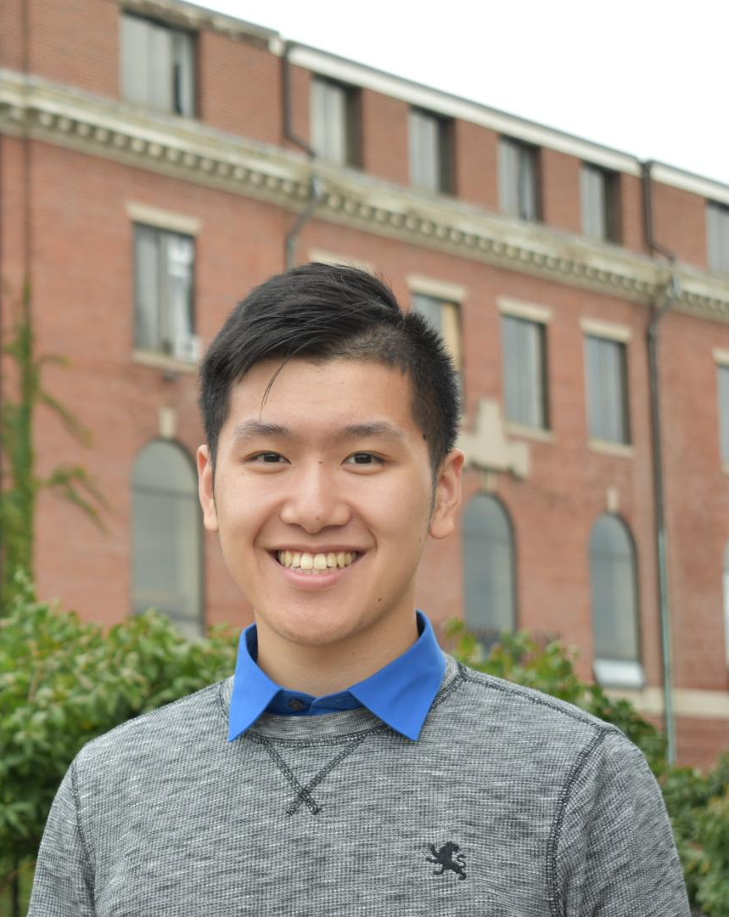
Johnny Fung
Hometown: Chicago, IL, USA
Education: BS Mechanical Engineering ‘20
Previous Work Experience:
  2019 (to present) MIT Research Laboratory of Electronics: Investigating fiber electronics for auscultation
  2018 (3 mo) Olsen Research Group: Optimizing methods to recycle used rubber tires
Skills: Mechanical design, CAD, rapid fabrication/prototyping, material science, manufacturing
Sports Interests: Basketball, volleyball, weightlifting
jfung@mit.edu

Slide 12
Our Timeline
March 19th Progress Report Presentations
May 12th Final Presentations
Key dates

