Slide 1

Islanders Sports Tech
Team Introduction
Understanding fan engagement via Twitter
islanderssportstech@mit.edu

Slide 2
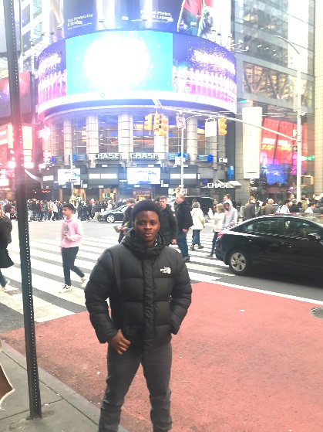
ADEDAYO ADERIBOLE
Team Member
Hometown: Lagos, Nigeria
Education: BS Electronic & Electrical Engineering OAU ’13
MS Electrical Power Engineering KU ’17
Previous Work Experience:
  2015 - 2018 (3 yrs) Masdar Institute Energy Systems lab : Power Systems Stability Analysis and Control
  2018 - 2020 (18 mo) Research Lab of Electronics (RLE), MIT : Circuit Design, Embedded System Design and Communictions.
Skills: Circuit Design, Embedded Systems Design, Signal Processing, Machine Learning and Data Analysis
Sports Interests: Football, Tennis, Basketball, American Football, Formula One.
Contact Information: adedayo@mit.edu

Slide 3
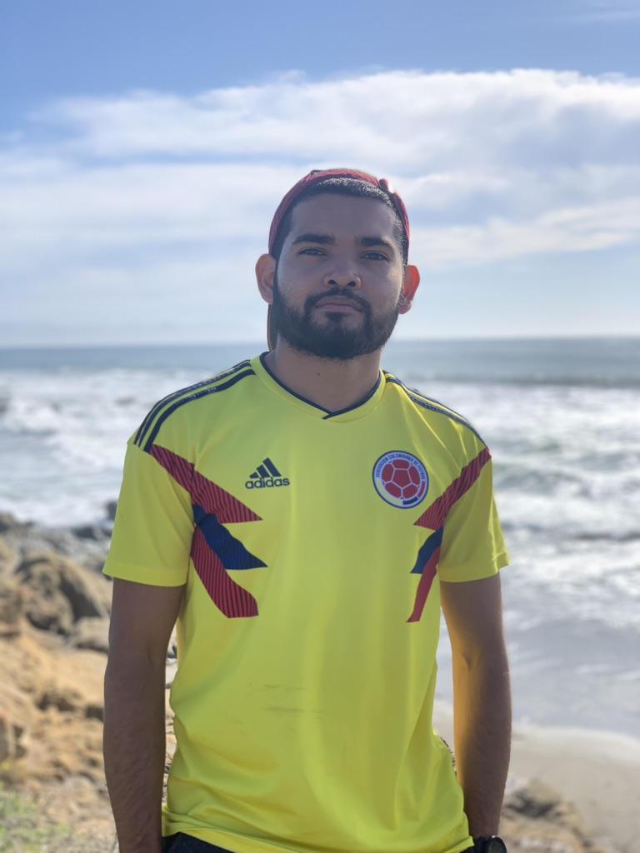
Mateo Correa
Team Member
Self Photo
Hometown: Pereira, Colombia
Education: Pursuing Bachelors of Science in Mechanical Engineering
Previous Work Experience:
  2019 (3 mo) BMW Manufacturing Company: machine learning analysis to characterize assembly patterns
  2018 (3 mo) Northrop Grumman Aerospace Systems: testing of James Webb Space Telescope and 3D space printers
  2017 (3 mo) Google Inc: optimization of data validation techniques to decrease server load
  2016-2017 (9 mo) MIT Distributed Robotics Laboratory:
Skills: Python, R, SQL, Swift, MATLAB, Solidworks, Fusion360, Mills, Lathes, Laser Cutter, 3D Printer, Power Tools
Sports Interests: Football, Basketball, Soccer, Statistics Analysis
Contact Information: mateoc@mit.edu

Slide 4
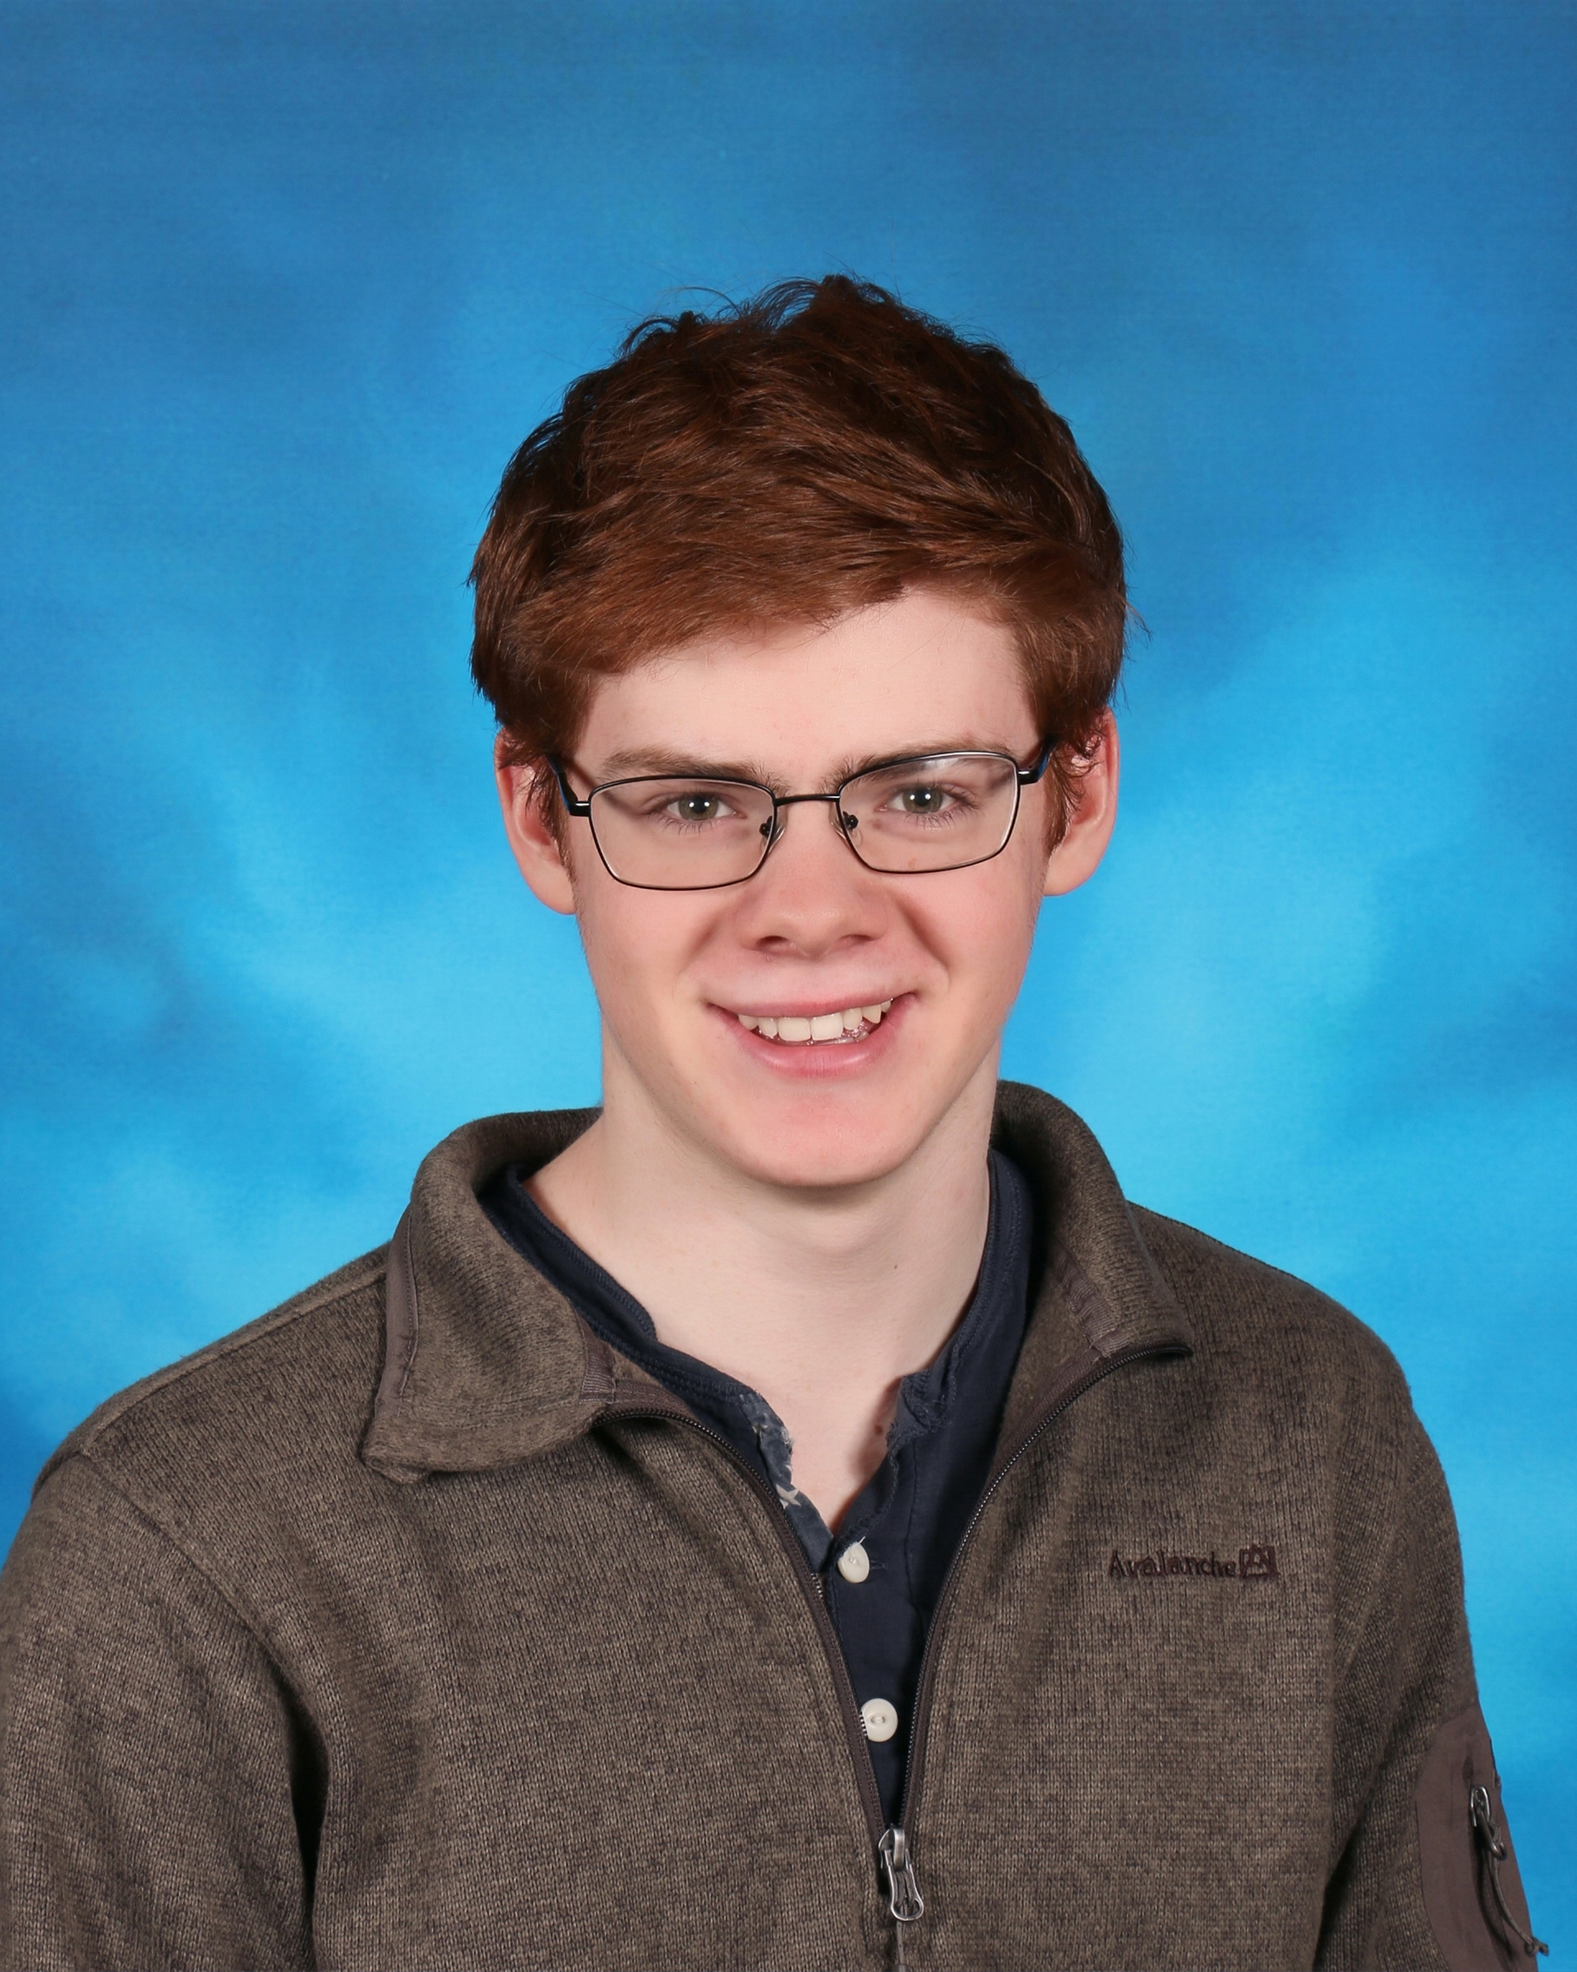
Henry Martin
Team Member
Hometown: Brooklyn, NY
Education: BS in Business Analytics ‘21
Previous Work Experience:
  2018 (3 mo) – Research Assistant for Entrepreneurship, Innovation, Startups and the Law
  2018 (6 mo) – Undergraduate Researcher for Professor John Akula
  2019 ( 3 mo) – Intern at Sigma Ratings
Skills: R, Python, Excel
Sports Interests: Squash , Basketball, Baseball, Football, Hockey
Contact Information: hemartin@mit.edu

Slide 5
Kevin Ma
Team Member
Self Photo
Hometown: Rockville, Maryland
Education: MIT Sloan School of Management - MBA 2021
Princeton University – B.A., Economics 2014
Previous Work Experience:
  2014 – 2016 : Financial Analyst, Yext
  2016 – 2017 : Senior Business Analyst, Plated
  2017 – 2019 – Corporate Strategy Senior Manager, Yext
Skills: Python (Pandas/Numpy), MySQL/PostgreSQL, Tableau, Looker
Sports Interests: Football, Basketball, Table Tennis
Contact Information: kevinsma@mit.edu

Slide 6
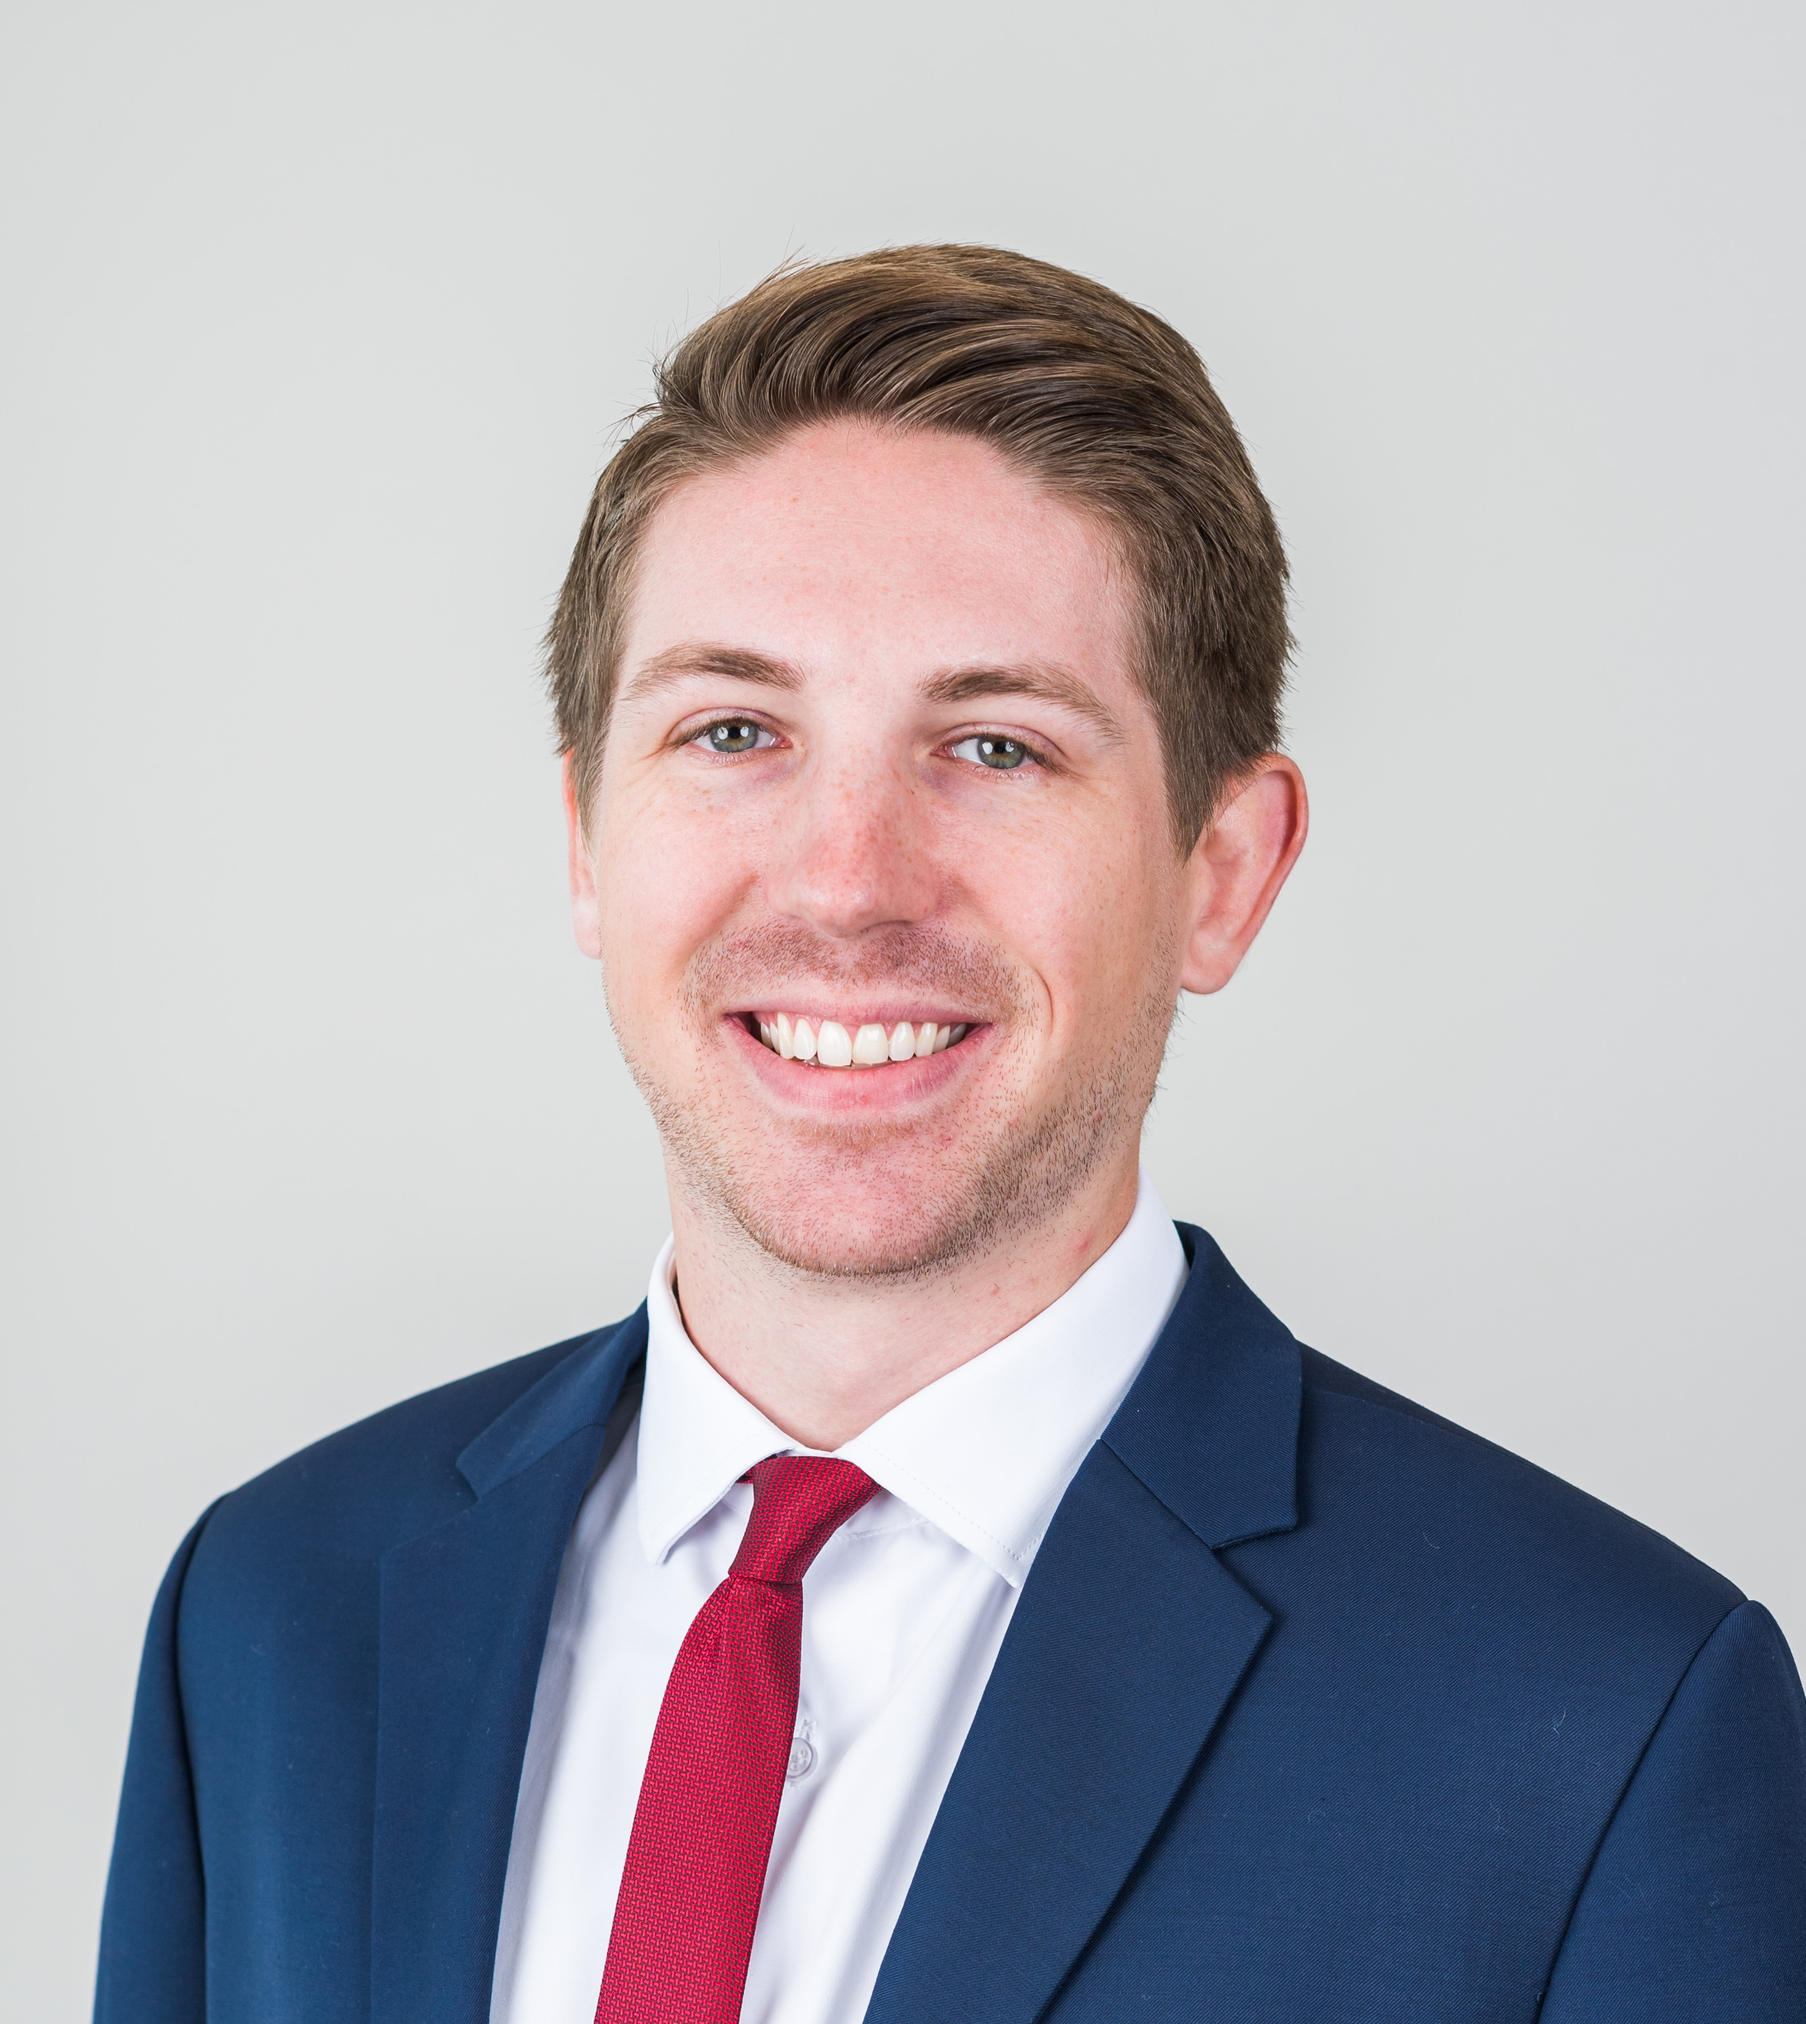
Jack Behrens
Team Lead
Hometown: Woodbury, Minnesota
Education: MIT Sloan School of Management - MBA 2020
University of Minnesota Carlson School of Management – B.S., Finance & Management Information Systems 2014
Previous Work Experience:
  2014 – 2016 : FP&A Analyst, 3M Consumer Business Group
  2016 – 2018 : Business Finance Analyst, 3M Home Care Division
Skills: Excel modeling/data analysis, PowerPoint, Minimal R and SQL
Sports Interests: Huge basketball fan (Timberwolves, UofMN Gophers) and recreational player, Football (Vikings, Gophers)… big drop-off… hockey (Wild, Gophers), baseball (Twins)
Contact Information: jackbehr@mit.edu

