Slide 1
First Technical Deliverable
Henry Martin
2.980
February 20th

Slide 2
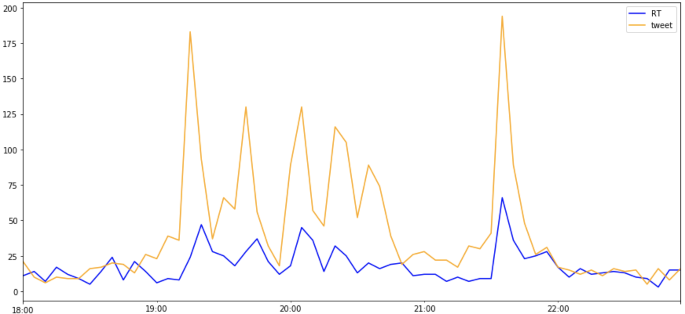
Twitter Activity During Feb 10 game vs Washington
1st Goal
Isles Win !!
2nd Goal
3rd Goal
# of Tweets
4th Goal
5th Goal
Time

Slide 3
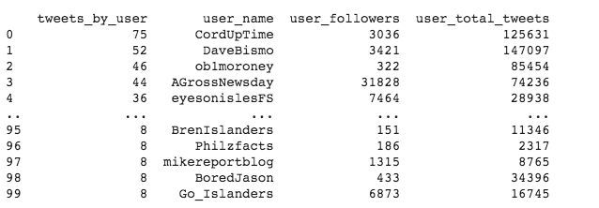
Top 100 people tweeting about the Islanders on February 10th

Slide 4
Insights from Graph + Data
We can use data from game day to analyze user activity
Have user data that can give insights into fan information + patterns
Graph created by taking data from Feb. 10 game and overlaying events in real time (goals, end of game) to see overlap and how game play affects the twitter activity
Data has some inaccuracies, mostly in misuse of the hashtags creating unrelated content, but mostly strong data thus far

Slide 5
Going Forward
Getting more information on users, including possible clustering/ identifying a type of user ( fan, journalist, fan site/blog) and identifying those users that tweet frequently about the islanders
Use game day data from multiple games as the season progresses to talk about trends in win vs loss, home vs away and see the possible differences in twitter activity
Look at more/ different hashtags relating to the islanders (#lgi,#nyi…) and look at followers of some players on the team to see how followers match up

