Slide 1
MLB - Automatic Strike Detection
Team Introductions
Predicting changes in offensive statistics if every ball/strike call were perfect
mlb2020@mit.edu

Slide 2
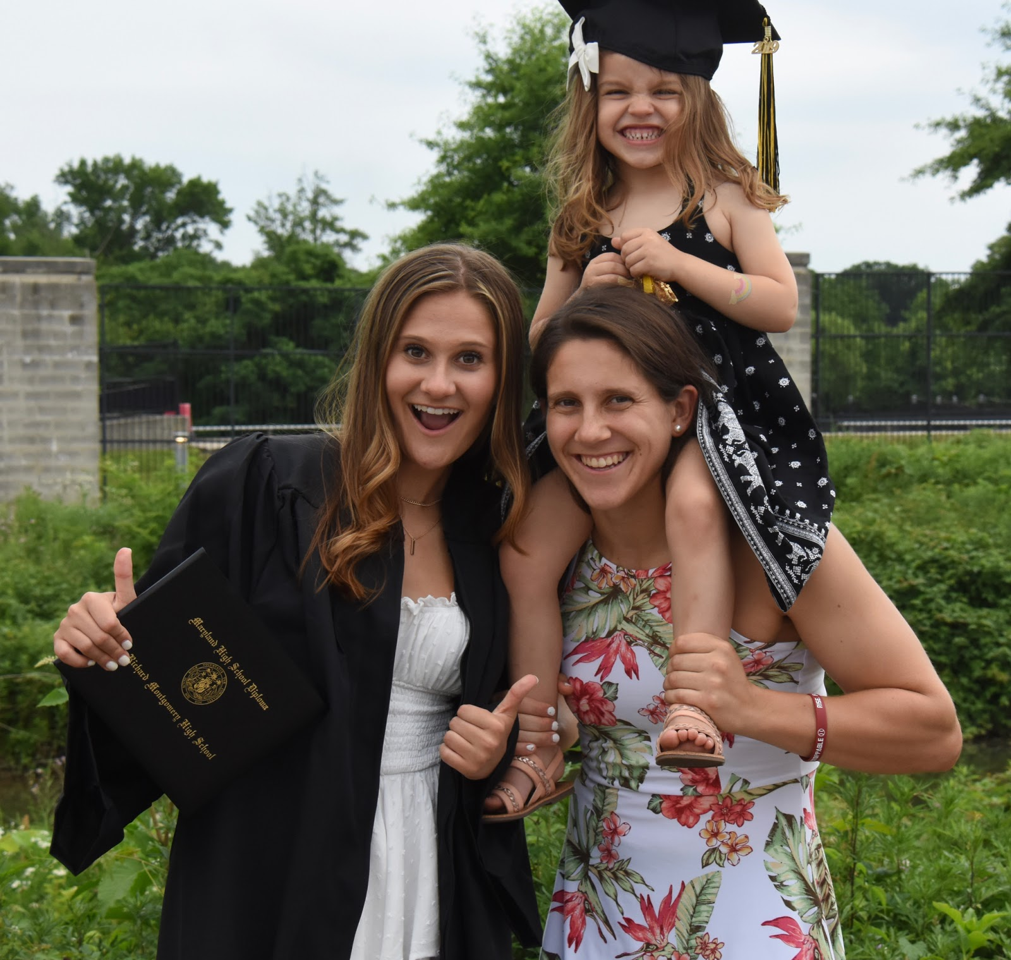
DEVON GOETZ
Team Lead
Hometown: Rockville, MD
Education: Mechanical Eng. and Brain & Cog. Sci. // senior!
Previous Work Experience:
  2017 Draper
  2018 Diamond Kinetics
  2019 Liva Nova
Skills: Project management, communications, product design, CAD, MATLAB, Python, juggling (sort of)
Sports Interests: I play field hockey and softball for MIT, but I grew up playing and watching all kinds of different sports!
Contact Information: dkgoetz@mit.edu // 240-994-4623

Slide 3
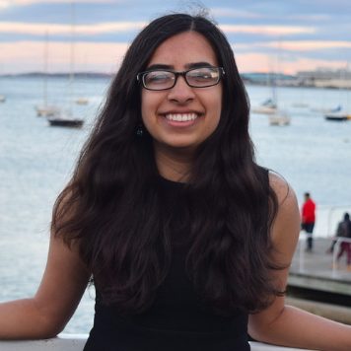
SIMRAN PABLA
Team Member
Hometown: San Jose, CA
Education: Computer Science // Senior
Previous Work Experience:
  2019 Boeing
  2019 Oliver Wyman Labs
  2018 Dataguise
Skills: Python/ML Frameworks (PyTorch, Keras), NLP, Project Management
Sports Interests: Love watching basketball and tennis.
Contact Information: simmyp@mit.edu // (408)888-4990

Slide 4
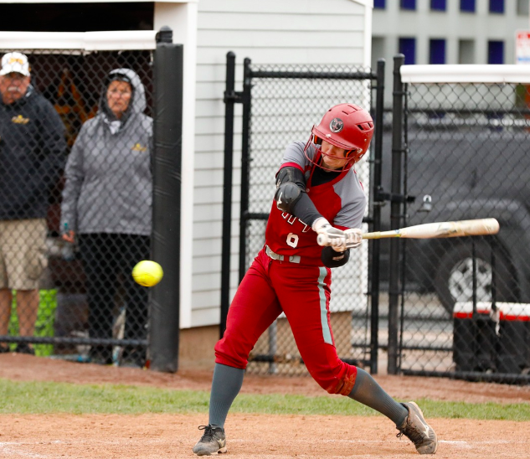
CLAIRE WICHMAN
Team Member
Hometown: Omaha, NE
Education: Mechanical Engineering // Sophomore
Previous Work Experience:
  2019 Engineering Systems Inc.
Skills: Python, MATLAB, CAD
Sports Interests: I play softball at MIT, but I enjoy watching baseball, college football, college basketball, and golf.
Contact Information: cwichman@mit.edu // 402-953-7104

Slide 5
ZACK KOPSTEIN
Communications Lead
Hometown: Tiburon, CA
Education: Mechanical Engineering // Senior
Previous Work Experience:
  2017 (3 mo) OpenROV
  2018 (9 mo) MIT Aerospace Controls Laboratory
  2019 (1 yr) MIT Ideation Laboratory
  2019 (3 mo) Boeing
Skills: Product design, rapid prototyping, CAD, manufacturing, project management, Python
Sports Interests: I play baseball at MIT, but also love to watch hockey, football, and basketball
Contact Information: kopstein@mit.edu // (415) 404-0685

Slide 6
Enrique Montas
Technical Lead
Hometown:
Education:
Previous Work Experience:
Skills:
Sports Interests:
Contact Information:

