Slide 1
MLB - Automatic Strike Detection
Introduction
Predicting changes in offensive statistics if every ball/strike call were perfect
mlb2020@mit.edu

Slide 2
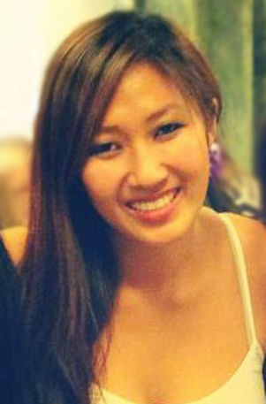
JODY FU
Team Lead
EXAMPLE
Hometown: San Francisco, CA, USA
Education: BS Mechanical Engineering & Minor Materials MIT ‘15
Previous Work Experience:
  2014 (1 yr) MIT Media Lab Fluid Interfaces: utilize surfaces to communicate through heat
  2015 (1 yr) Sistine Solar: invent method and process to create aesthetic solar panels
  2015 (3 mo) Samsung Think Tank Team: conceptualize to prototype new VR product
  2016 (8 mo) Apple Watch Product Design: design & manufacture at scale new watch accessory
  2016 (4 mo) Adidas Futures Team: execute simulation, mechanical testing, materials analysis, new manufacturing methods for next generation athletic footwear.
Skills: Mechanical design & testing, CAD, fabrication/prototyping, FEA, materials, manufacturing, data analysis
Sports Interests: Volleyball (Junior Olympics qualifier, 2007, 2008), basketball, badminton, soccer, swimming
Contact Information: jody@mit.edu

Slide 3
ZACK KOPSTEIN
Communications Lead
Hometown: Tiburon, CA
Education: BS Mechanical Engineering MIT ‘20
Previous Work Experience:
  2017 (3 mo) OpenROV: designed and prototyped underwater robot camera attachment
  2018 (9 mo) MIT Aerospace Controls Laboratory: led structural hardware redesign for autonomous mobility device
  2019 (1 yr) MIT Ideation Laboratory: designed robotic interactive light switch to encourage sustainable behaviors
  2019 (3 mo) Boeing: created new parts and assemblies for use in future military aircraft
Skills: Product design, rapid prototyping, CAD, manufacturing, project management, Python
Sports Interests: MIT varsity baseball, soccer, basketball, hockey
Contact Information: kopstein@mit.edu

Slide 4
[NAME]
[Role on team]
Self Photo
Hometown:
Education:
Previous Work Experience:
  [insert here]
  [insert here]
  [insert here]
  [insert here]
Skills:
Sports Interests:
Contact Information:

