Slide 1
Vice President For Finance department
By Wendy Daudier

Slide 2
About me
CRLS c’18
Rising sophomore at Fitchburg State University
Studying nursing
First year doing this program

Slide 3
What I do in my department?
Apply payments to customer accounts in Coupa
Make sure to add the right payment to avoid overpay or underpay
Pick up mails in the morning
Organize mails so they can be ready to be scan
Enter the 10 digits PO # through SAP so they can be sent to another department

Slide 4
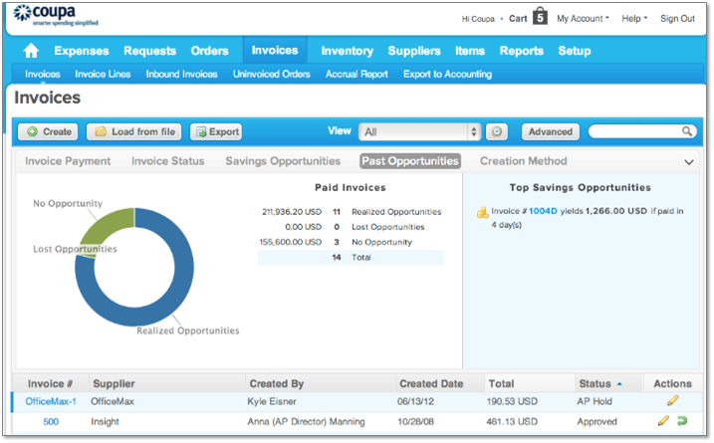

What exactly is Coupa?
global technology platform for Business Spend Management

Slide 5

My Experience Overall
Likes: Working as a team although I have my own office but If I get confused or don’t know what to do, there’s always people to ask.
Dislikes: It gets boring doing the same thing daily.

